Slide 1
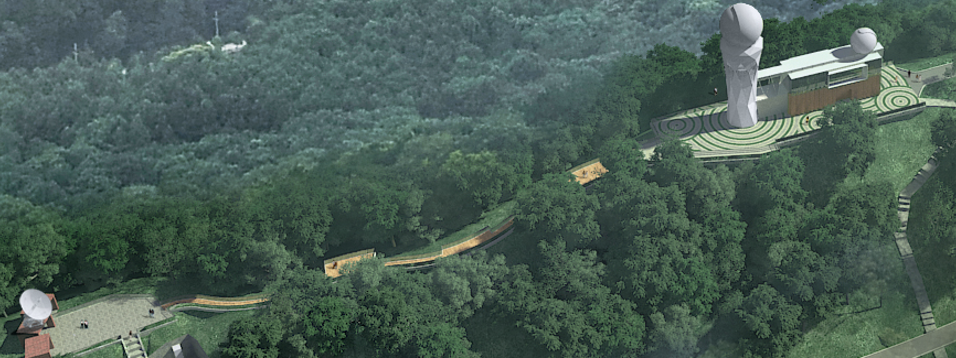
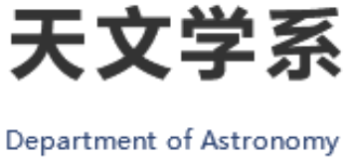
Crab 脉冲星glitch恢复机制
张倩
合作者：郑小平 教授

Slide 2
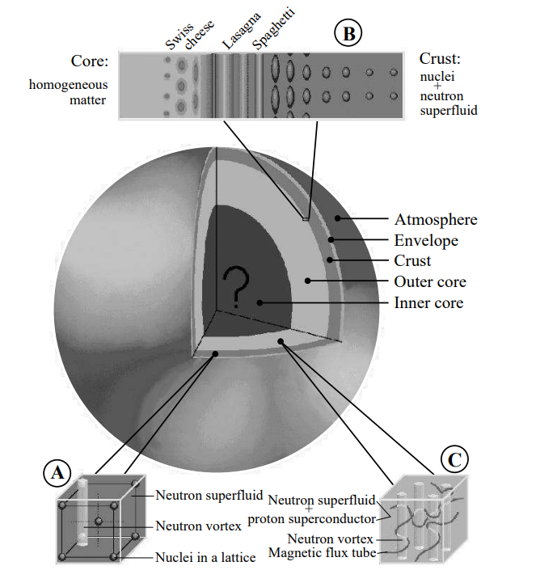
Vortex creep theory
In the inner crust of a neutron star, the lattice formed by neutron-rich nuclei is conducive to the vortex pinning on it.
The neutron star's rotation slows down under the action of external torque, and the pinned vortexes cannot move outward, so the angular velocity of the superfluid cannot be slowed down, resulting in the angular velocity $Ω_{s}$ of the superfluid being higher than that of the crust $Ω_{c}$ .
When the lag$ω$= $Ω_{s}$- $Ω_{c}$is greater than the critical lag $ω_{cr}$, the vortex wire is unpinned, the angular momentum is transferred from the superfluid to the normal component, and the normal part of the star rotates rapidly, and glitch phenomenon is observed.
Page et al. 2006
Alpar et al. 1984

Slide 3
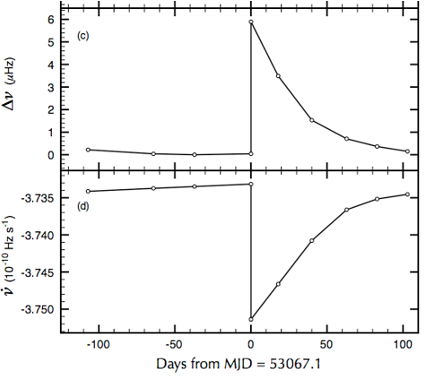
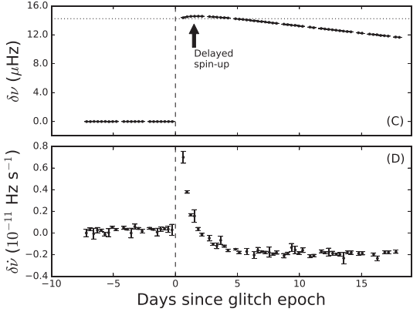
The largest Crab glitch on 2017 November
Espinoza et al. 2011
Shaw et al. 2018

Slide 4
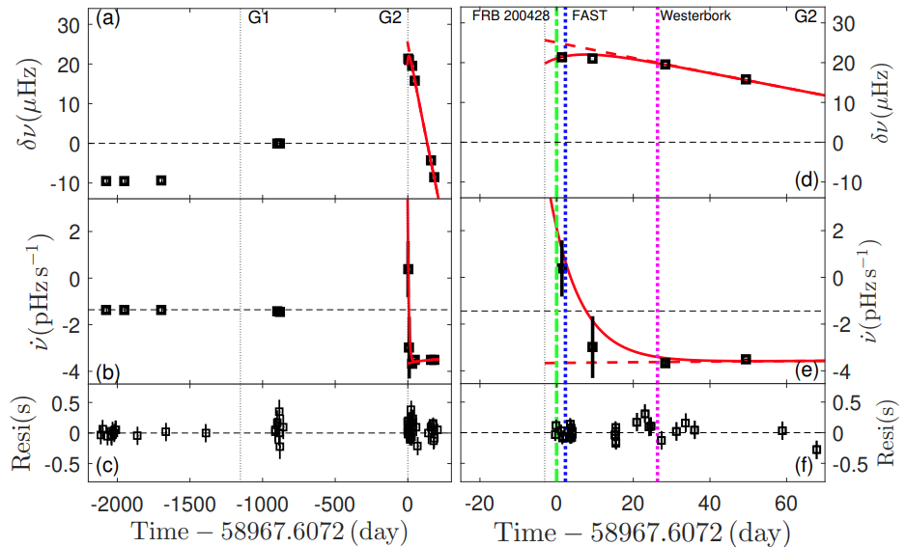
The spin evolution of SGR J1935+2154
Ge et al report a giant glitch from SGR J1935+2154, which occurred approximately 3.1±2.5 day before FRB 200428, with ∆ν = 19.8±1.4 µHz and ∆ $\dot{ν}$= 6.3±1.1 $pHz/s$ .
∆ν = 19.8±1.4 µHz
∆ $\dot{ν}$= 6.3±1.1 $pHz/s$
$$τ_{d}=8 days$$
Ge et al. 2022

Slide 5
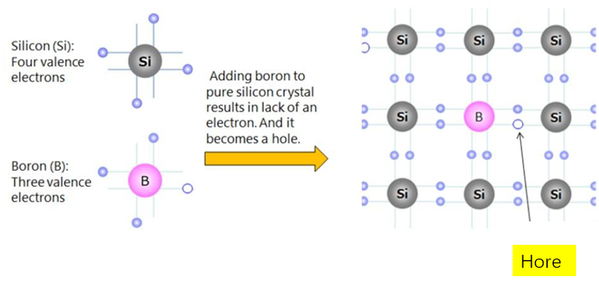
Copper pair breaking effect
When glitch occurs, it may induce a chemical deviation that cause a break in the net cooper pair, resulting in a partial superfluid transformation of the outer core into normal matter and transfers angular momentum and moment of inertia to normal matter.

Slide 6
Copper pair breaking effect
The equations of motion of superfluid components
$$\frac{∂Ω_{s}}{∂t}=−\frac{knv_{r}}{r}=−\left[2Ω_{s}\left(r\right)+r\frac{∂Ω_{s}}{∂r}\right]\left(\frac{ν_{r}}{r}\right)$$
$$υ_{r}\left(r,t\right)=υ_{0}exp\left\{−\frac{E_{p}}{kT}\left[\frac{ω_{cr}−ω}{ω_{cr}}\right]\right\} \left(Alpar 1984\right)$$
The equation of motion of the “normal” component
$$\frac{d\left(I_{c}Ω_{c}\right)}{dt}=N_{e}+N_{i}$$
$$N_{i}=−I_{p}{\dot{Ω}}_{s}^{\left(1\right)}−\frac{d\left({δI}_{s}Ω_{s}^{\left(2\right)}\right)}{dt}$$
$N_{e} ：$the external torque；
$N_{i}$： the sum of internal torques；

Slide 7
Copper pair breaking effect
The system is in steady state when all superfluid regions share the external torque in proportion to their moments of inertia, so that the crust and the superfluid decelerate at the same rate:
$$\frac{∂Ω_{s}}{∂t}={\dot{Ω}}_{c}=\frac{N}{I}≡{\dot{Ω}}_{∞} \left(5\right)$$
$$υ_{∞}=\frac{{\left|\dot{Ω}\right|}_{∞}r}{nk} \left(6\right)$$
$$I=I_{c}^{0}+I_{p}+∆I$$

Slide 8
Copper pair breaking effect
$Ω_{c}^{\left(2\right)}\left(t\right)=Ω_{c,∞}\left(t\right)+{δΩ}_{c}^{\left(2\right)}(t)$ (7)
$Ω^{\left(2\right)}\left(r,t\right)=Ω_{c,∞}\left(t\right)+ω_{∞}\left(r,t\right)−{δΩ}^{\left(2\right)}(r,t)$ (8)
$ω^{\left(2\right)}\left(r,t\right)=ω_{∞}\left(r,t\right)−{δω}^{\left(2\right)}(r,t)$ (9)
${δω}^{\left(2\right)}(r,t)={δΩ}_{c}^{\left(2\right)}(r,t)+{δΩ}^{\left(2\right)}(t)$ (10)
$$υ_{r}\left(r,t\right)=υ_{0}exp\left\{−\frac{E_{p}}{kT}\left[\frac{ω_{cr}−ω_{∞}\left(r,t\right)+δω(r,t)}{ω_{cr}}\right]\right\}$$
$$=υ_{∞}exp\left[−\frac{E_{p}}{kT}\frac{δω(r,t)}{ω_{cr}}\right]$$

Slide 9
Copper pair breaking effect
$δ{\dot{Ω}}_{c}=$ $\frac{{\dot{I}}_{c,0}e^{−\frac{t}{τ_{d}}}}{I_{c}}\left(Ω_{s0}−Ω_{c0}\right)+\frac{{{\dot{I}}_{c,0}τ}_{d}\left({1−e}^{−t/τ_{d}}\right)}{I_{c}}\left|{\dot{Ω}}_{∞}\right|\left\{1−\frac{1}{1+{\left\{e^{{t_{0}^{′}}/{τ_{2}}}−1\right\}e}^{−\frac{t}{τ_{2}}}}\right\}−\frac{∆I}{I_{c}}\left|{\dot{Ω}}_{∞}\right|$ $−\left|{\dot{Ω}}_{∞}\right|\frac{I_{p}}{I_{c}}\left\{1−\frac{1}{1+\left\{e^{{t0}/{τ_{1}}}−1\right\}e^{{−t}/{τ_{1}}}}\right\}$
考虑copper pair breaking
标准vortex creep
(Alpar2019)

Slide 10
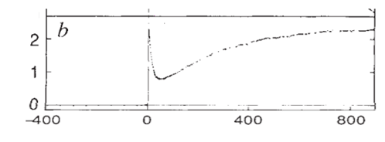
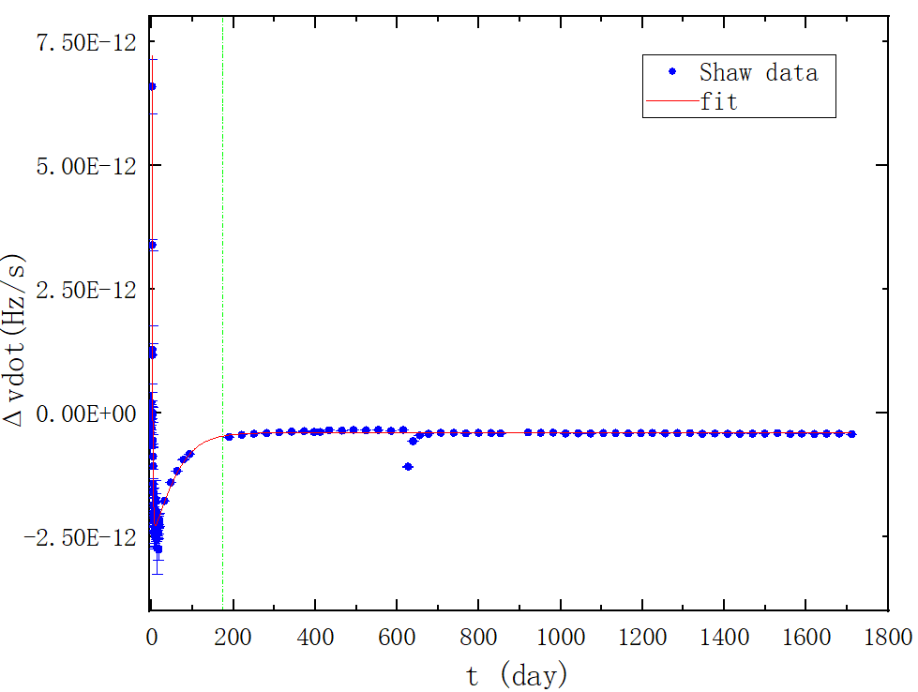
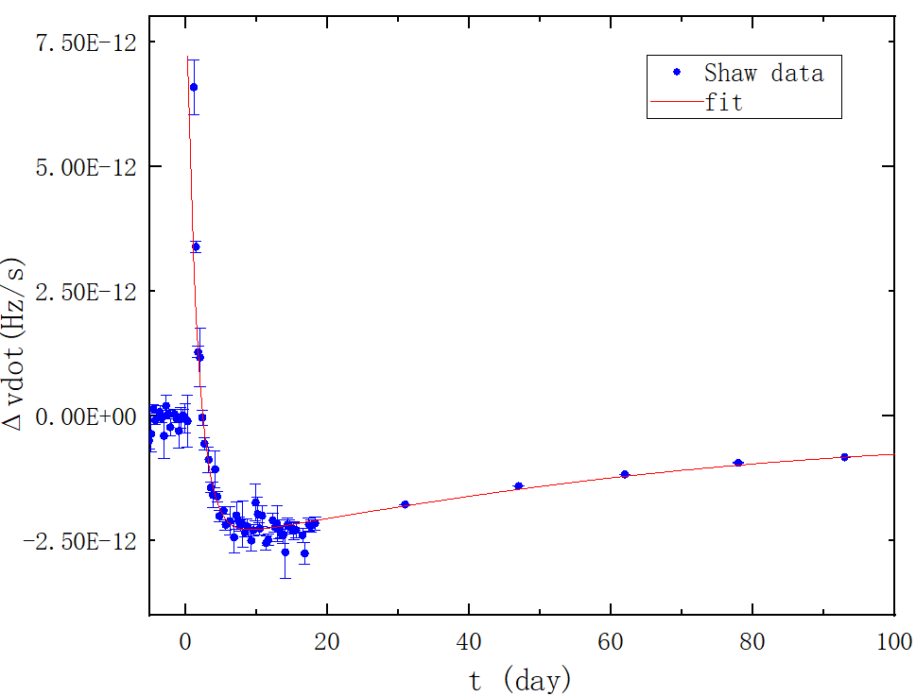
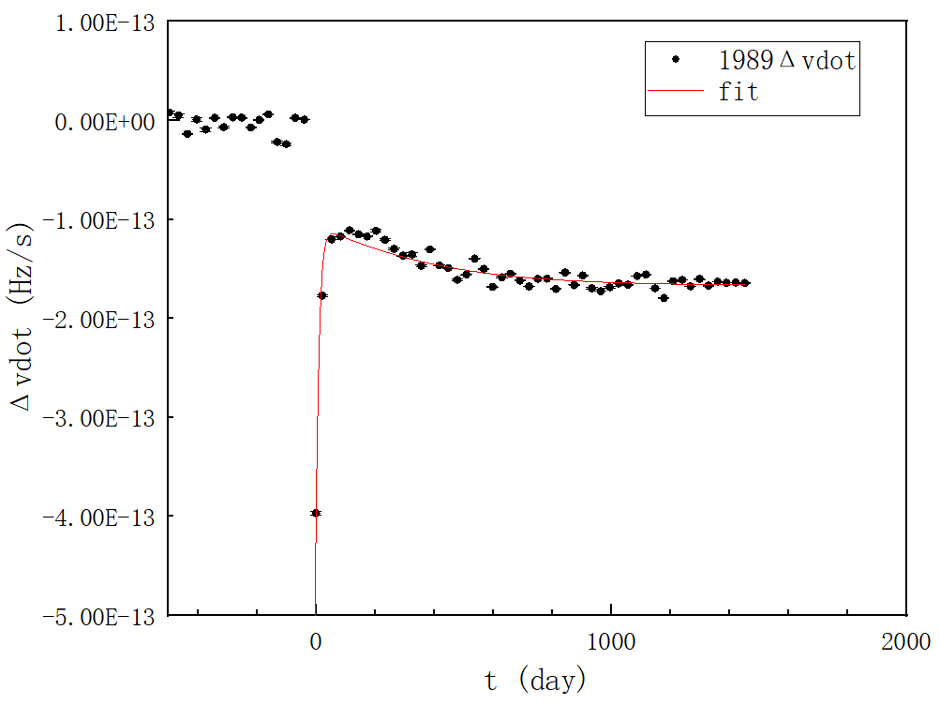
Crab 脉冲星post-glitch拟合
Glitch 1989, Lyne et al. 1992

Slide 11
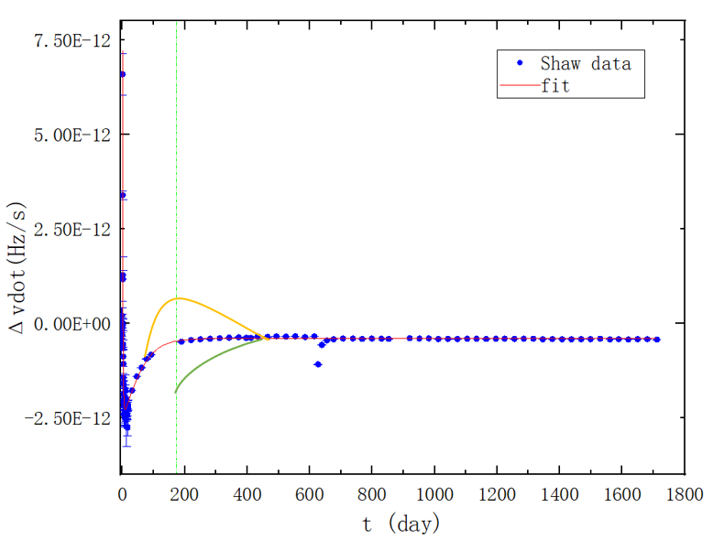
Crab 脉冲星post-glitch拟合

Slide 12
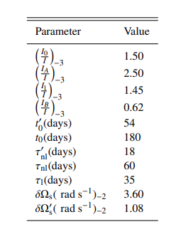
Crab 脉冲星post-glitch拟合
The largest Crab glitch
观测值：
$${∆Ω}_{obs}={8.9×10}^{−5}$$
$${∆Ω}_{d,obs}={6.7×10}^{−6}$$
$$\frac{I_{p}}{I}×\left(t_{0}×\left|{\dot{Ω}}_{∞}\right|\right)={6.74×10}^{−5}$$
$$\frac{∆I}{I}×\left(Ω_{s0}−Ω_{c0}\right)=9.9×{10}^{−6}$$
Alpar et al. 2019

Slide 13
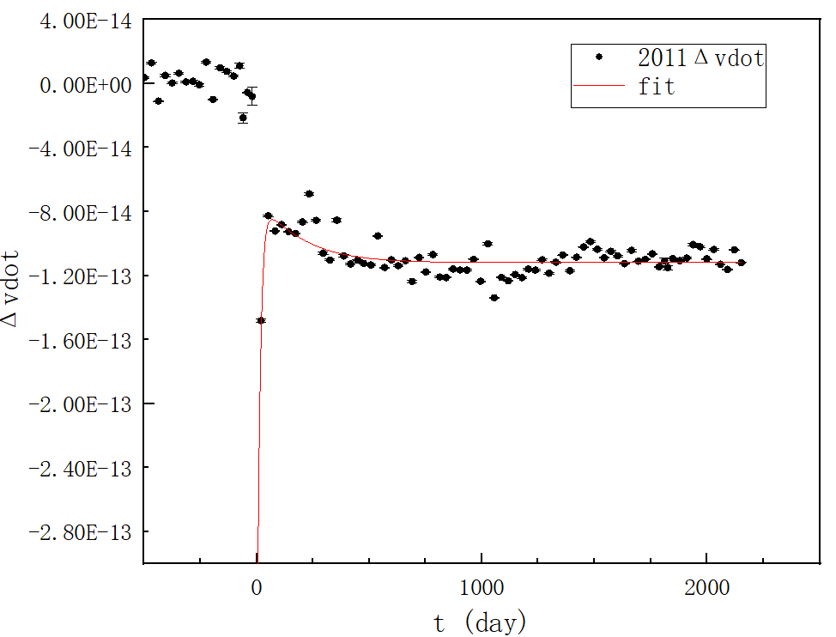
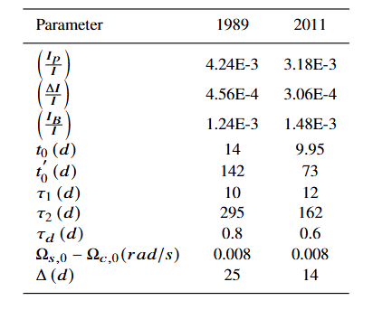
Crab 脉冲星post-glitch拟合

Slide 14
summary
Inside the Crab pulsar, the destruction of the Cooper pair is possible.
Our extended model can uniformly explain delayed spin-up process, frequency first derivative decay to a fixed value and permanent shifts in spin down rate (${Δ\dot{υ}}_{p}$).
The permanent shifts in spin down rate (${Δ\dot{υ}}_{p}$) does not come from the external torque.
Thanks ！

