Slide 1
Single-pulse Study of Newly Discovered CRAFTS Pulsars
Xinjiang Astronomical Observatory, CAS (XAO)
Speaker: Rukiye Rejep
2026.07.05

Slide 2
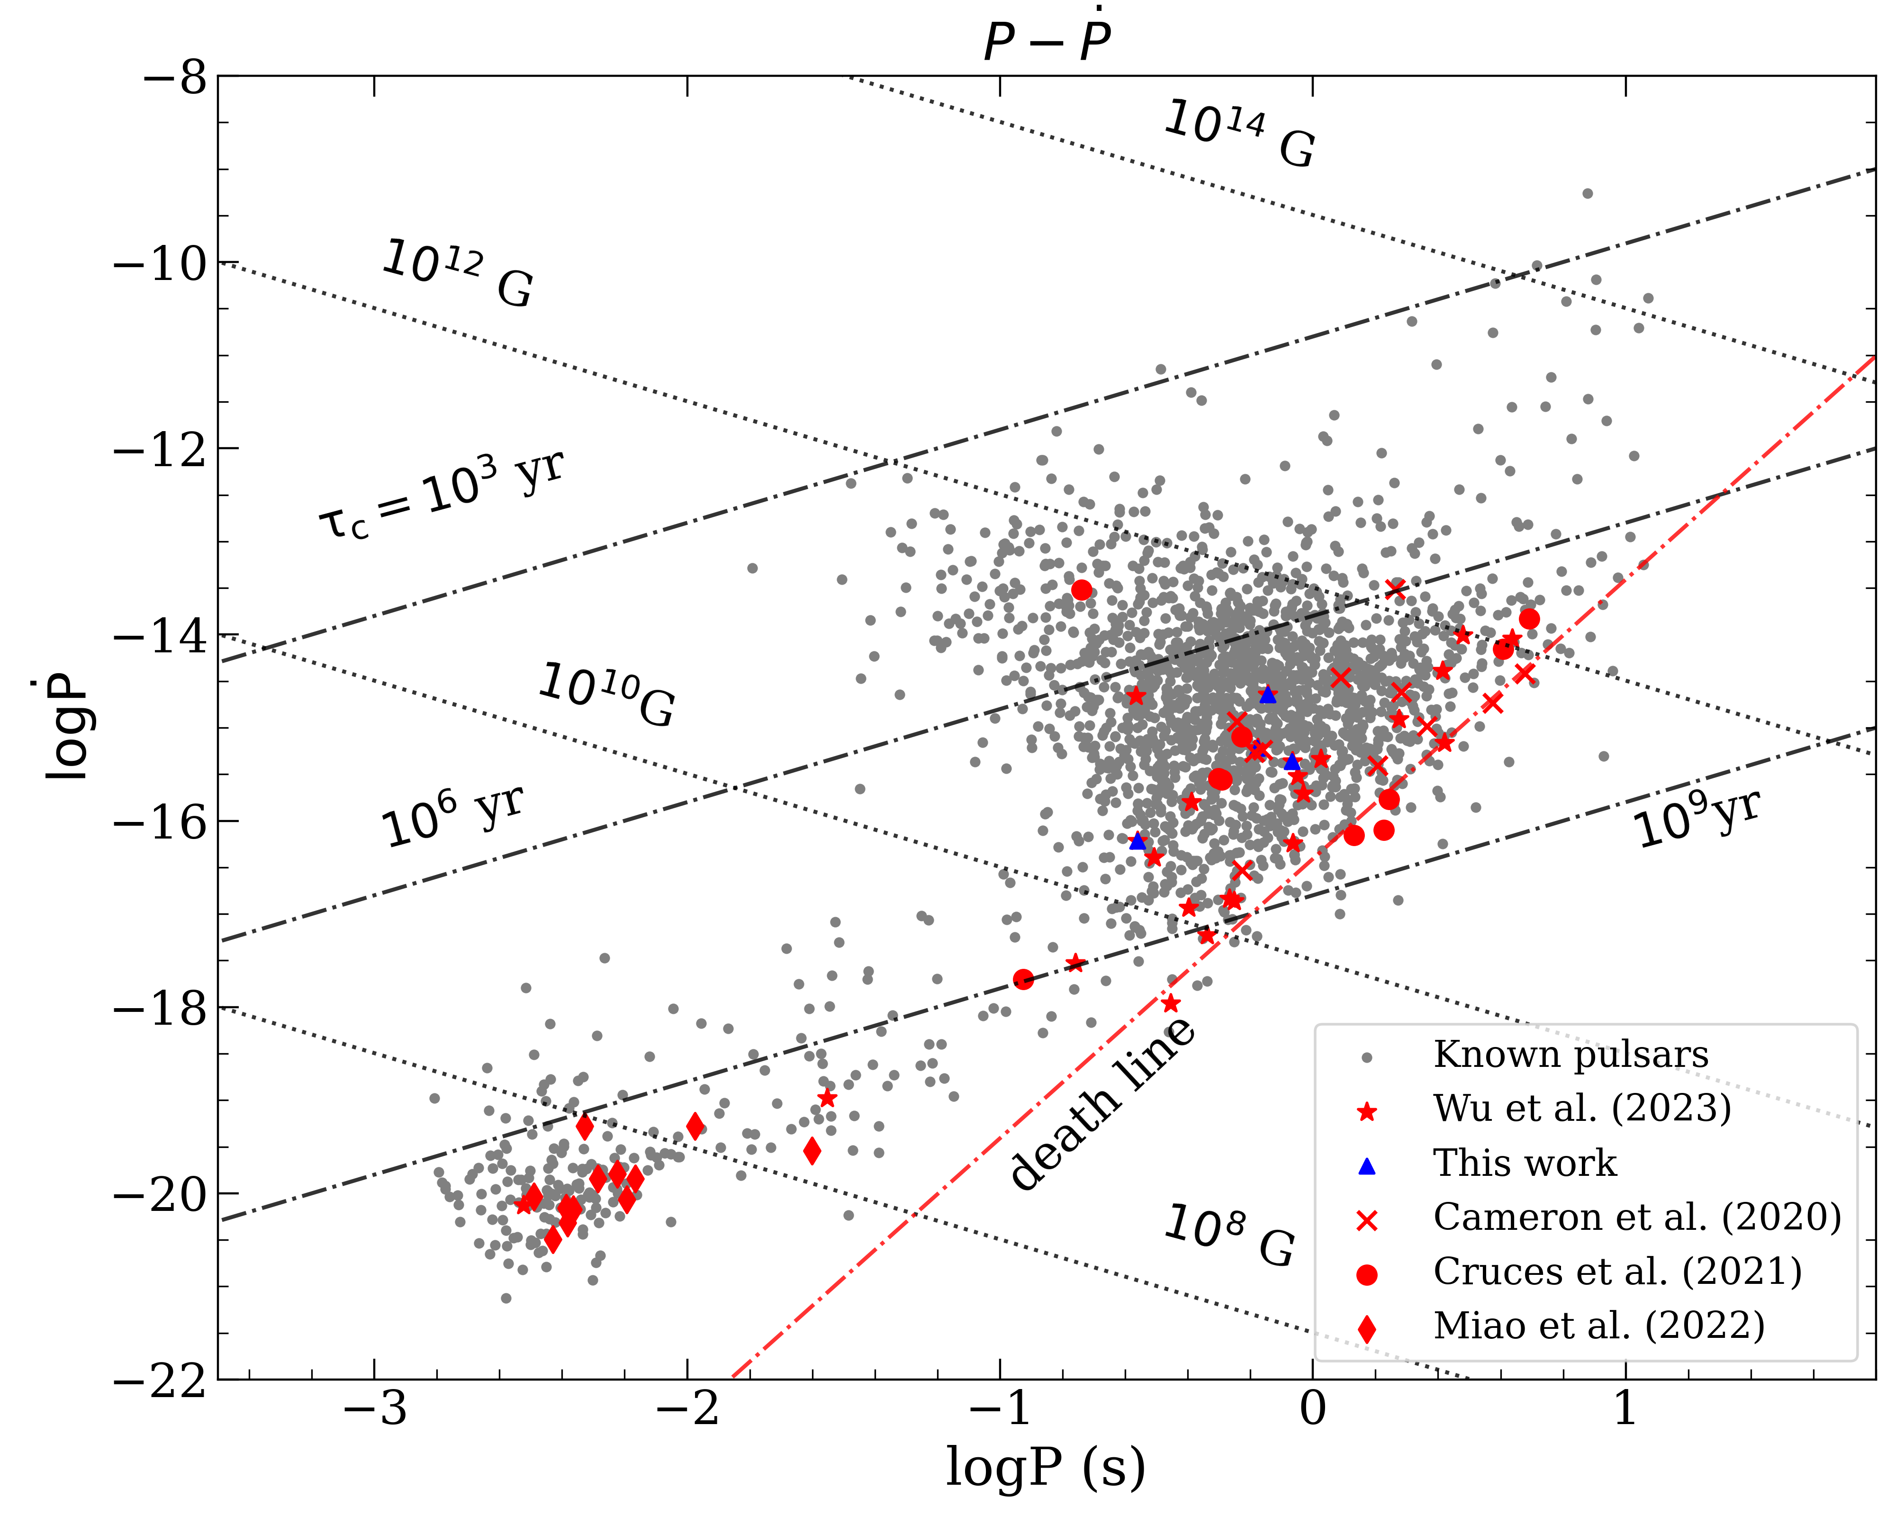
FAST CRAFTS
Timing: 19C69, 19C106, 19C112,
19C118, 19C119, 19C123
Single-pulse: 19C84, 19C19, 19C63,
19C83, 19C112
Pulsar | ZD06 timing | FAST
19C84 | 15→75 min | 2→40 min
19C19 | 9→38min | _
19C61 | 7→38min | _
19C83 | 4→17min | 1→20 min
19C112 | _ | 2→2.8 hour

Slide 3
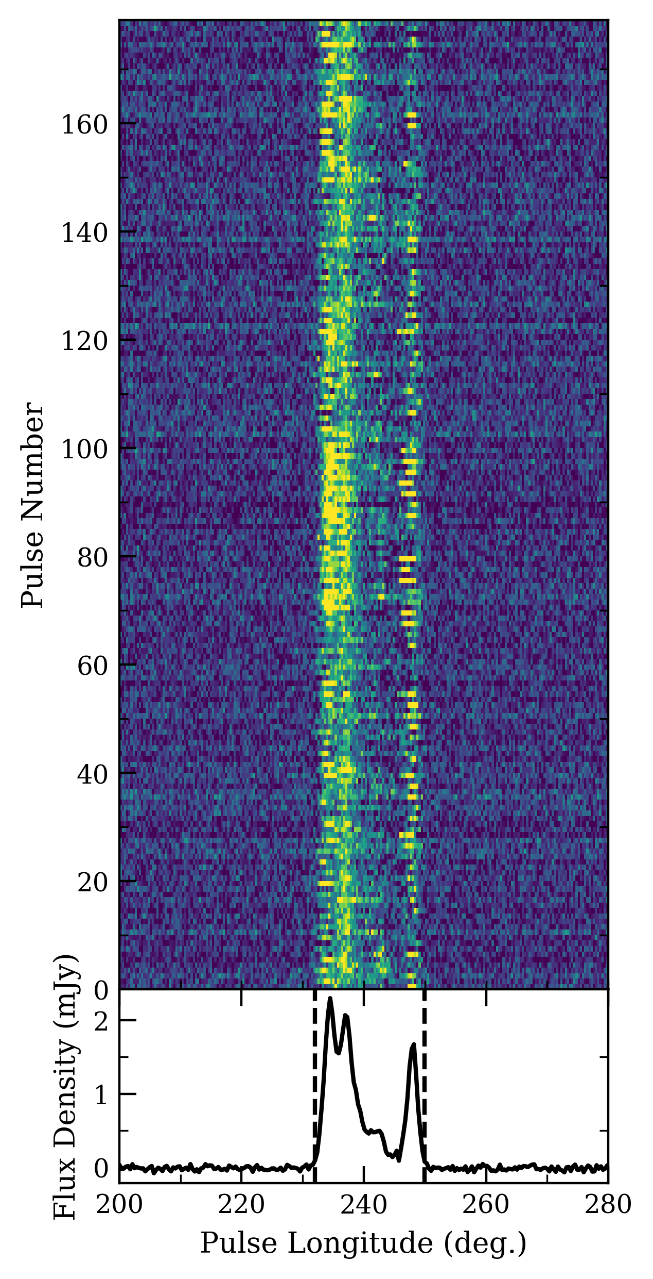
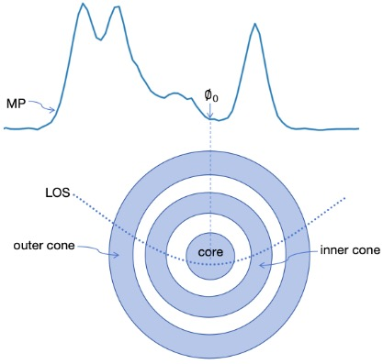
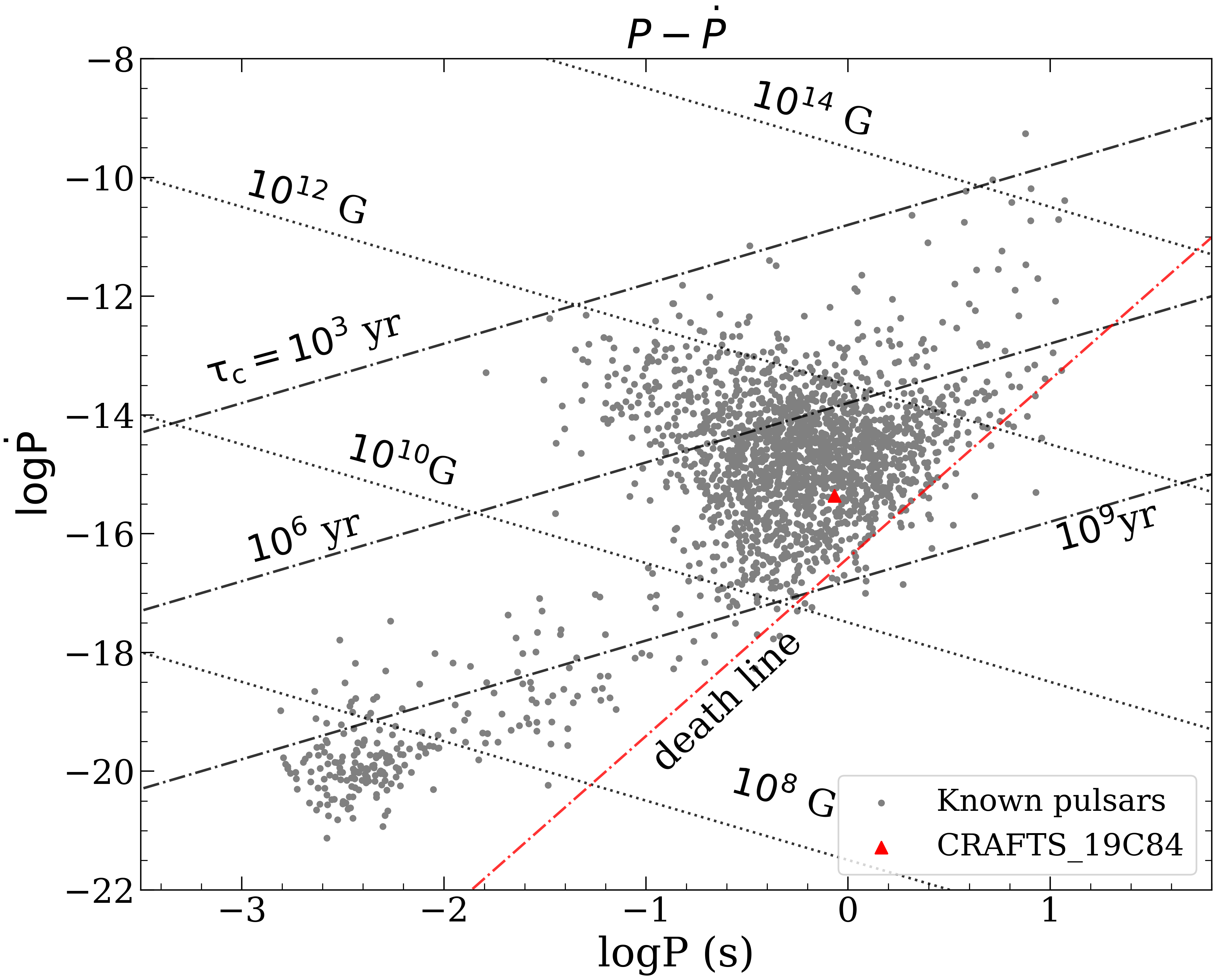
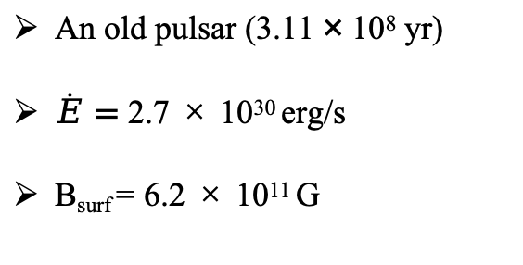
PSR J1239+0326 (19C84)
Pulsar | Pulse Period (s) | DM (pc cm-3) | Frequency (MHz) | Num. of SP | Obs. Length (mins)
PSR J1239+0326 (19C84) | 0.858 | 34.3 | 1250 | 4277 | 75
An old pulsar (3.11 × 10⁸ yr)
$\dot{E}=$ 2.7 × 10³⁰ erg/s
B_{surf} = 6.2 × 10¹¹ G
2D emission region

Slide 4
PSR J1239+0326 (19C84)
PSR J1239+0326 has four components emitted from a double cone-core emission geometry;
We estimated the inclination angle between the magnetic and the rotational axes to be 10◦;
Outer-cone components display ‘even–odd’ subpulse modulation with quasi-periodicity around 2P
subpulse modulation;
Published in ApJ.

Slide 5
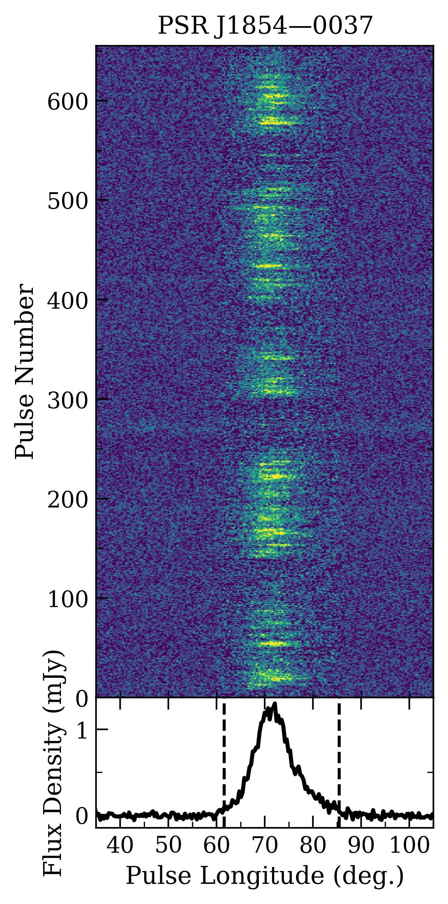
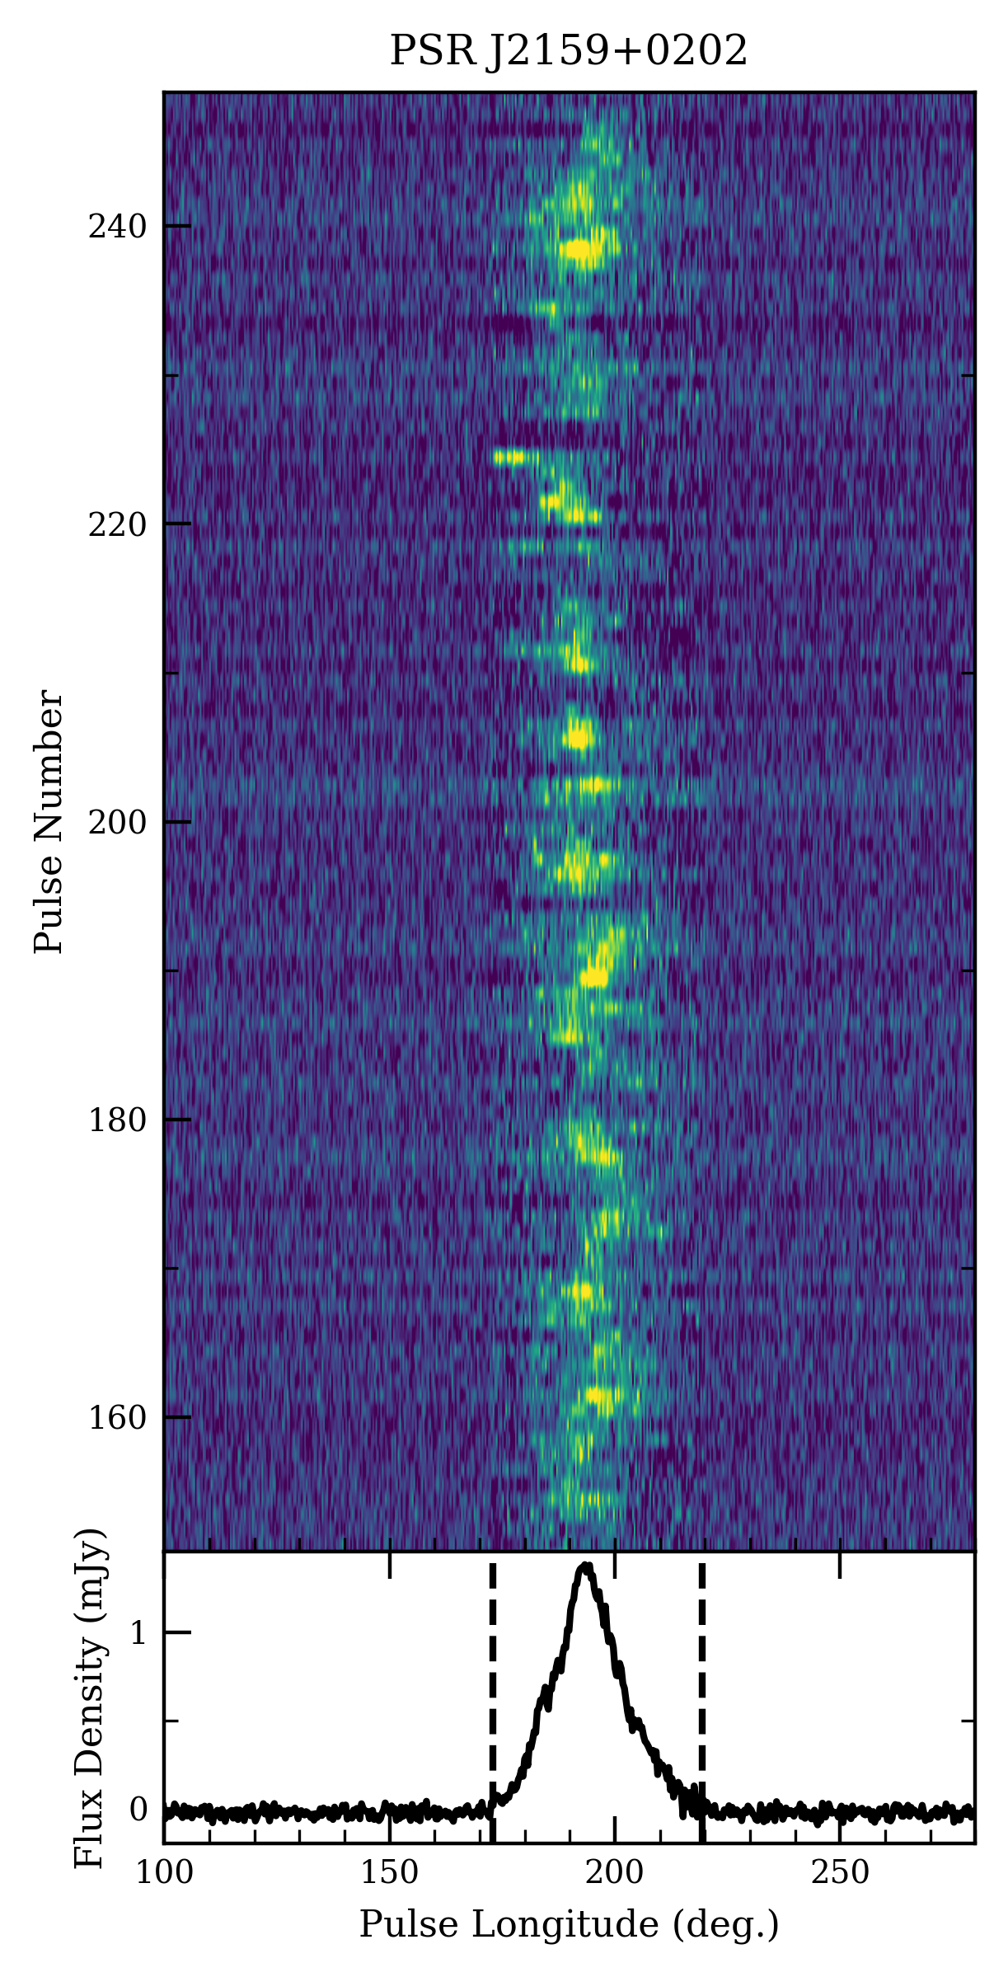
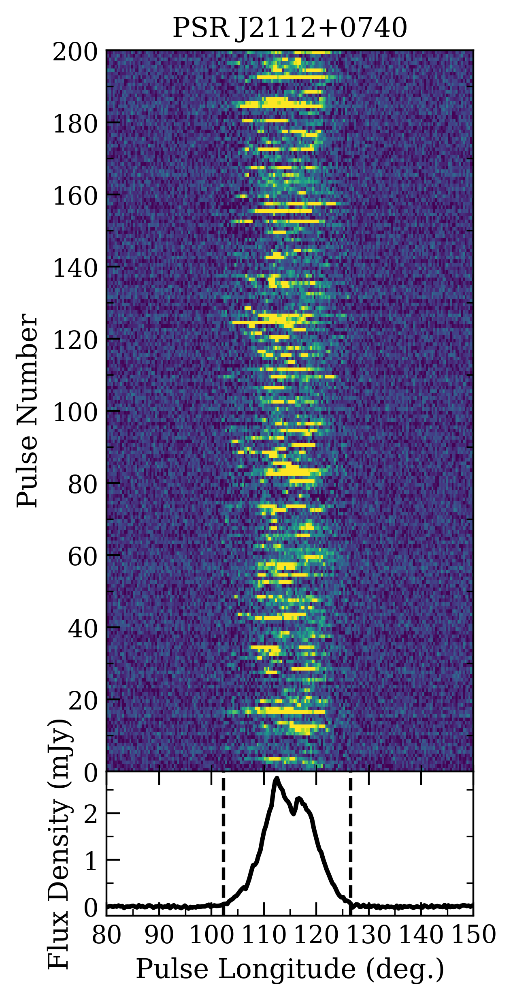
② Three CRAFTS Pulsars
Pulsar | Pulse Period (s) | DM (pc cm-3) | Frequency (MHz) | Num. of SP | Obs. Length (mins)
PSR J1854-0036 (19C61) | 0.717 | 491.2 | 1250 | 2950 | 38
PSR J2159+0202 (19C83) | 0.665 | 35 | 1250 | 1400 | 17
PSR J2112+0740 (19C19) | 0.275 | 24.9 | 1250 | 7989 | 38

Slide 6
This study conducts a comprehensive single-pulse analysis of three FAST-CRAFTS discovered pulsars: PSRs J1854–0036, J2159+0202, J2112+0740;
PSR J1854–0036 shows quasi-periodic nulling (31% fraction, 127.4P period) with weak null emission, pointing to magnetospheric state switching or geometric changes;
PSR J2159+0202 exhibits complex subpulse drift reversals and intensity modulations (7.0±0.2P to 10.9±0.1P), indicating aliasing effects;
PSR J2112+0740 has burst-like emission (no nulling/drifting), possibly linked to stochastic pair production or plasma instabilities.
Published in ApJ.

Slide 7
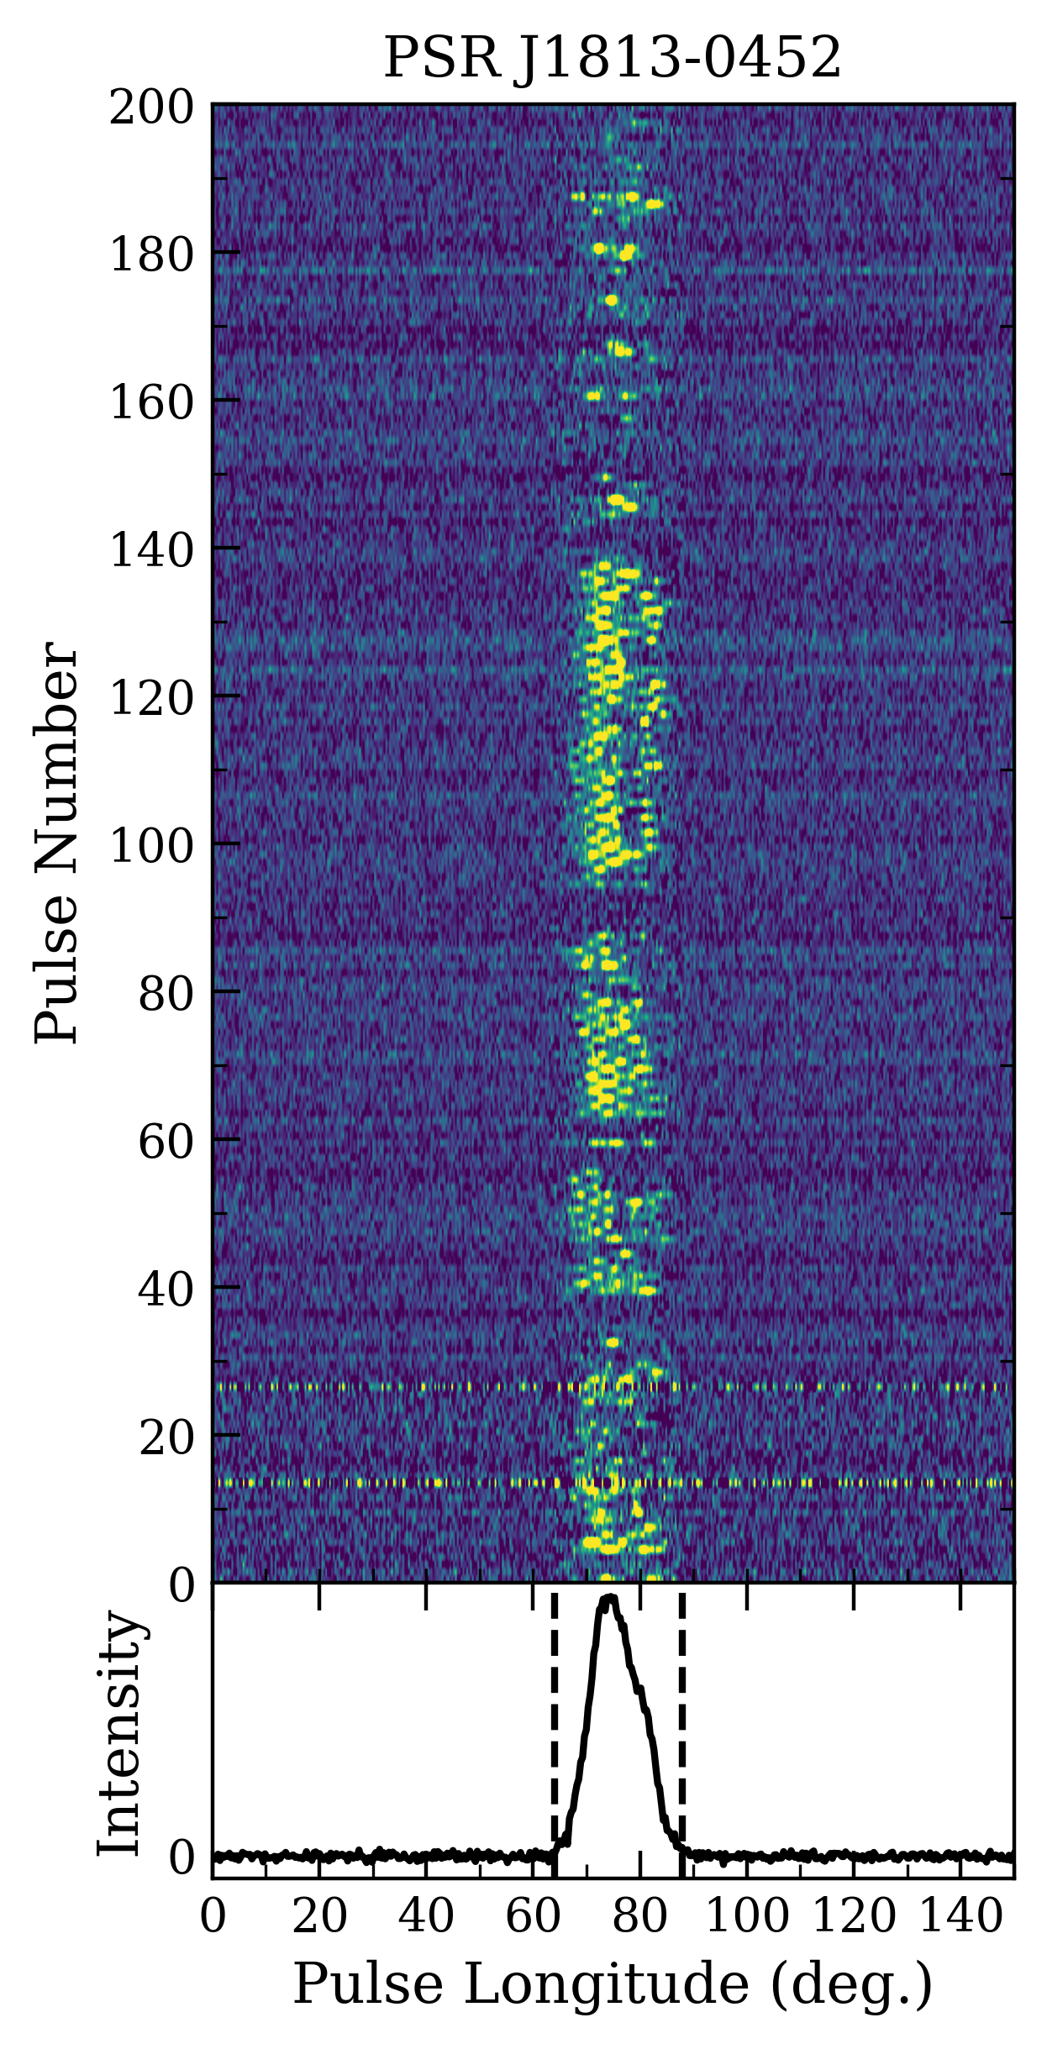
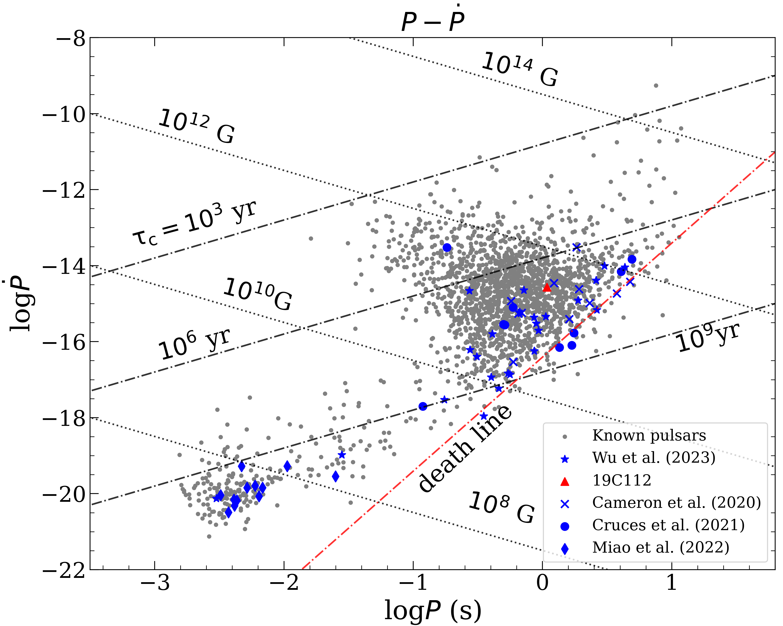
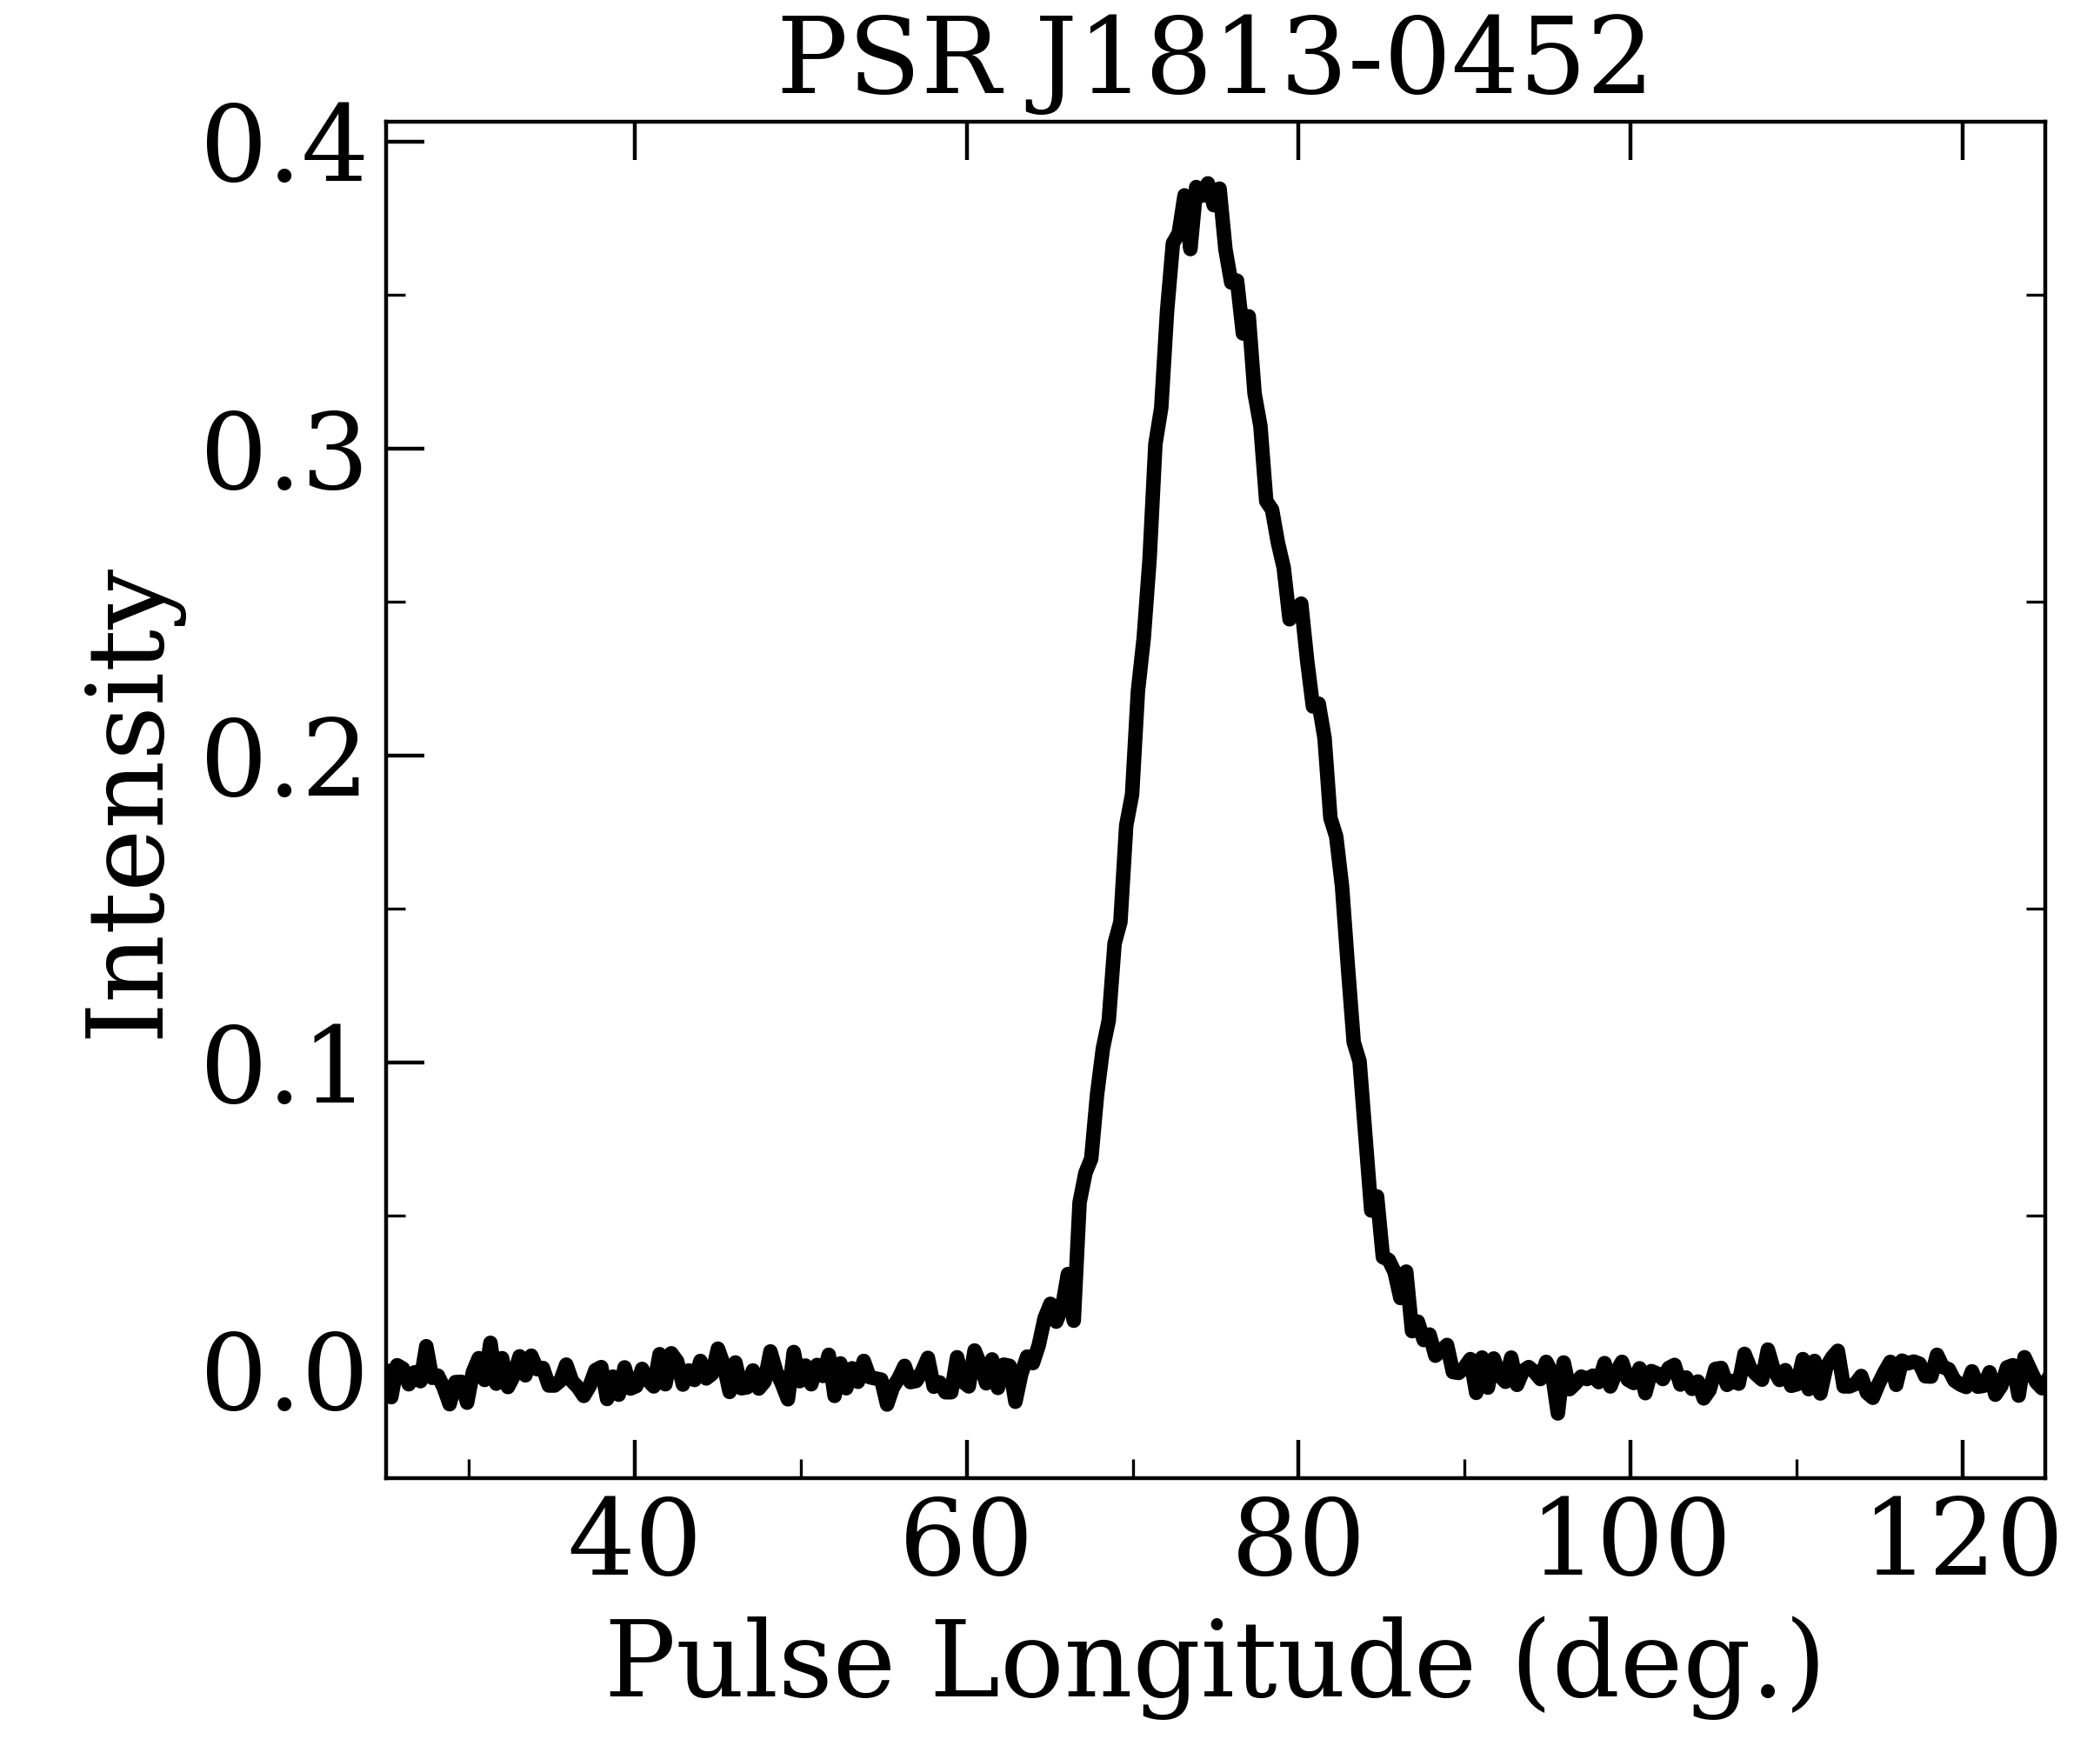
③ PSR J1813-0452 (19C112) 单脉冲研究
研究成果
RESEARCH PAPERS
Pulsar | Pulse Period (s) | DM (pc cm-3) | Frequency (MHz) | Num. of SP | Obs. Length (mins)
19C112 | 1.083 | 122.5 | 1250 | 9998 | 185

Slide 8
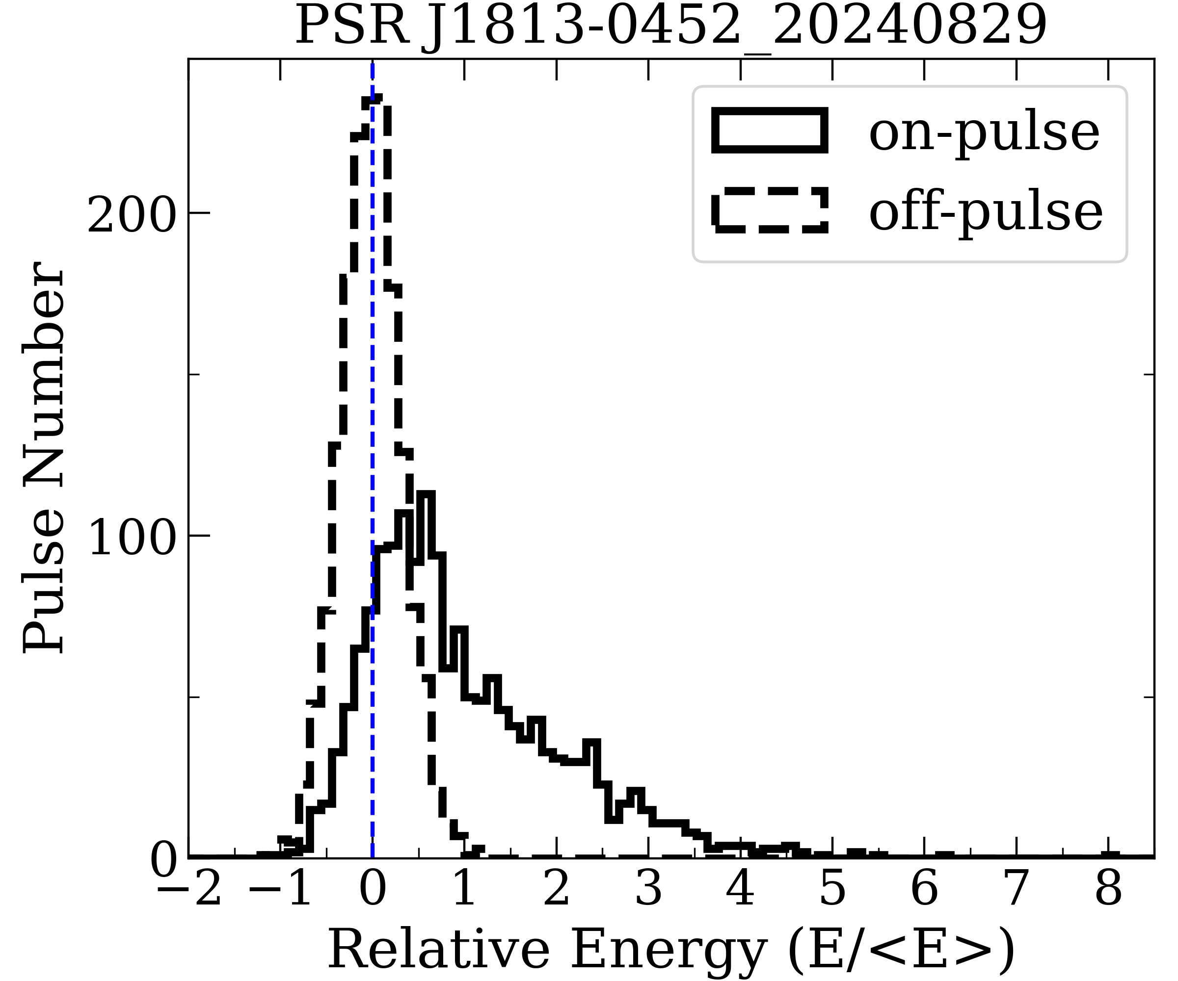
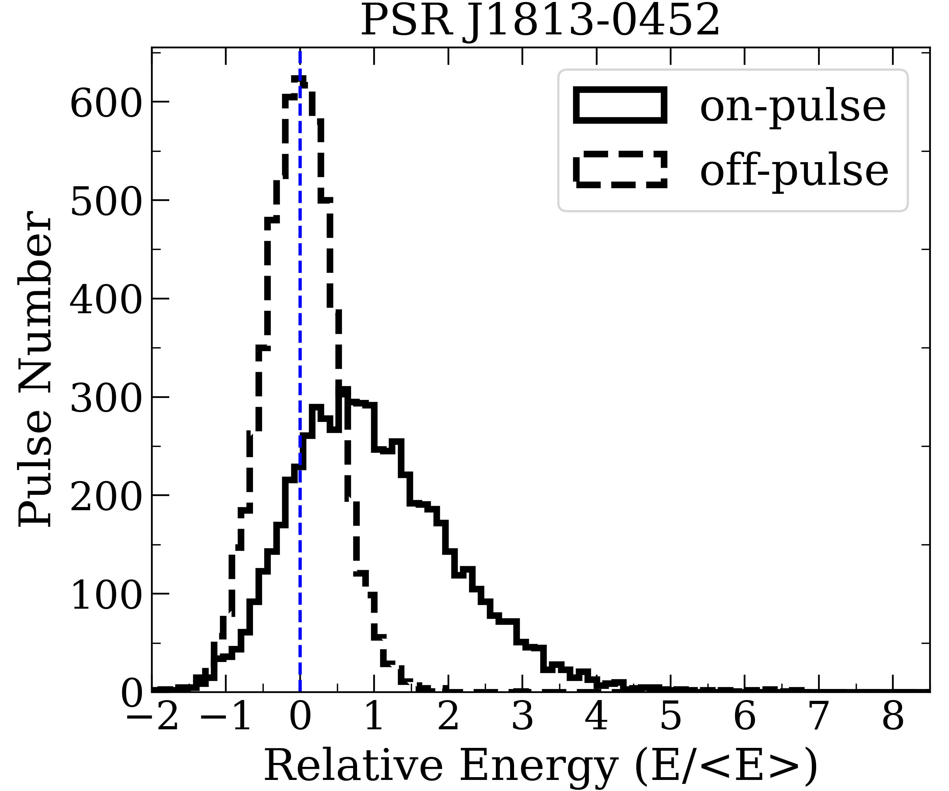
On/Off Pulse Energy Distribution
研究成果
RESEARCH PAPERS

Slide 9
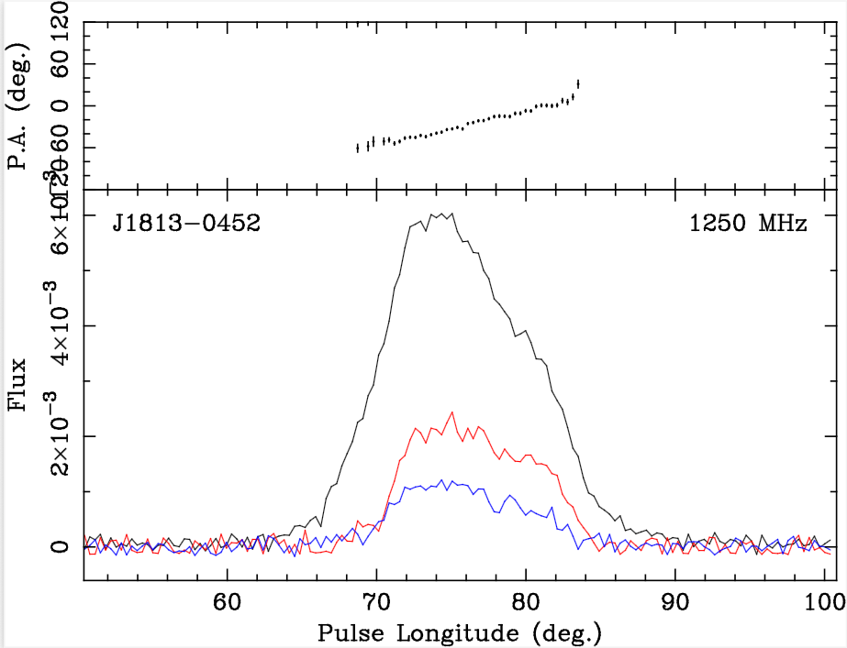
Polarization Position Angle
研究成果
RESEARCH PAPERS

Slide 10
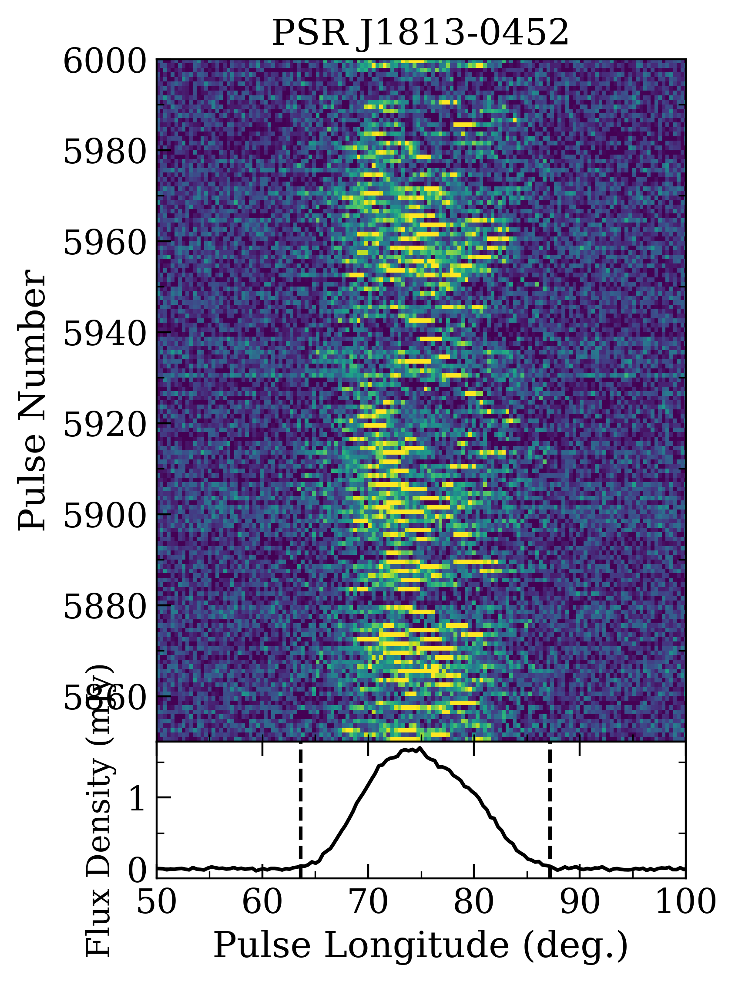
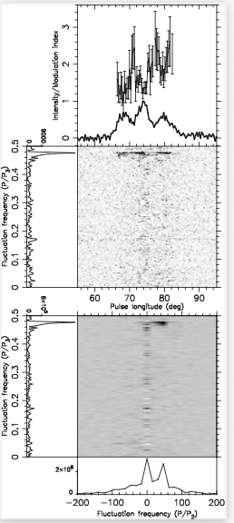
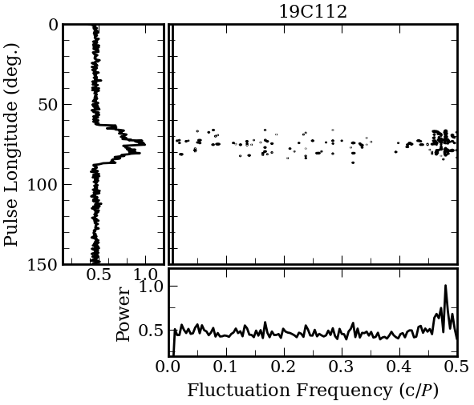
Unusual Drifting
研究成果
RESEARCH PAPERS
PSRSALSA
PAPS

Slide 11
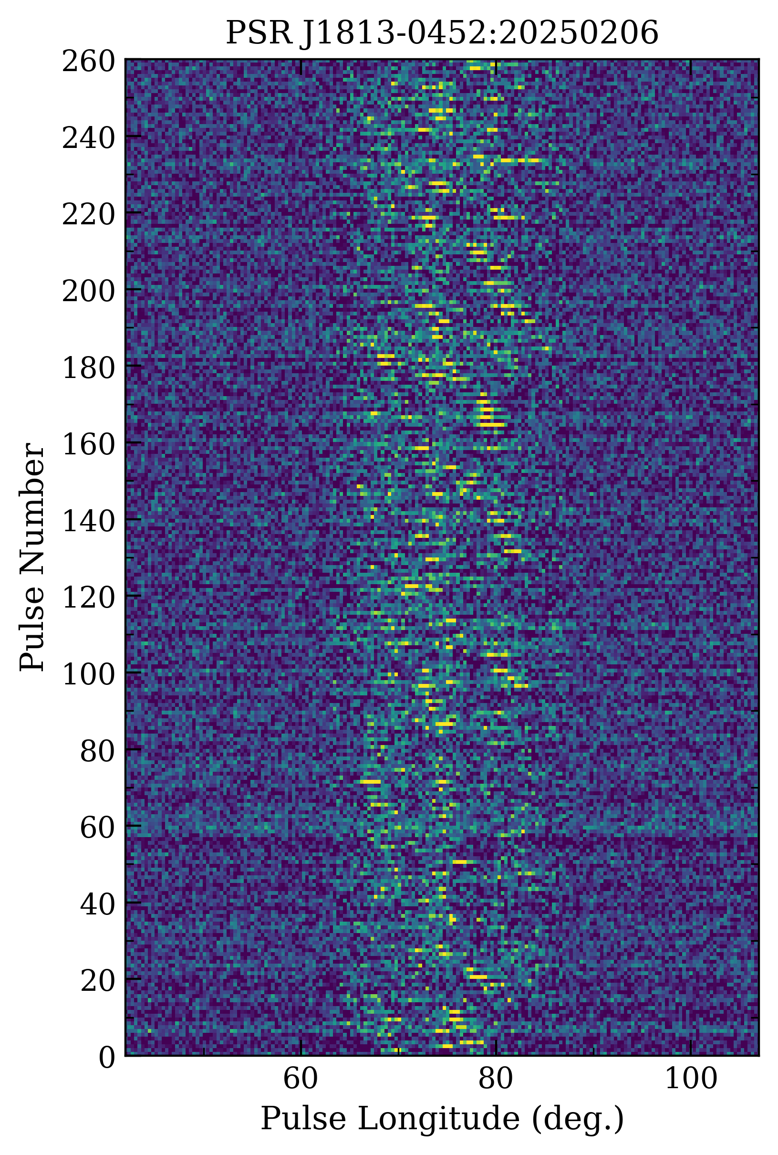
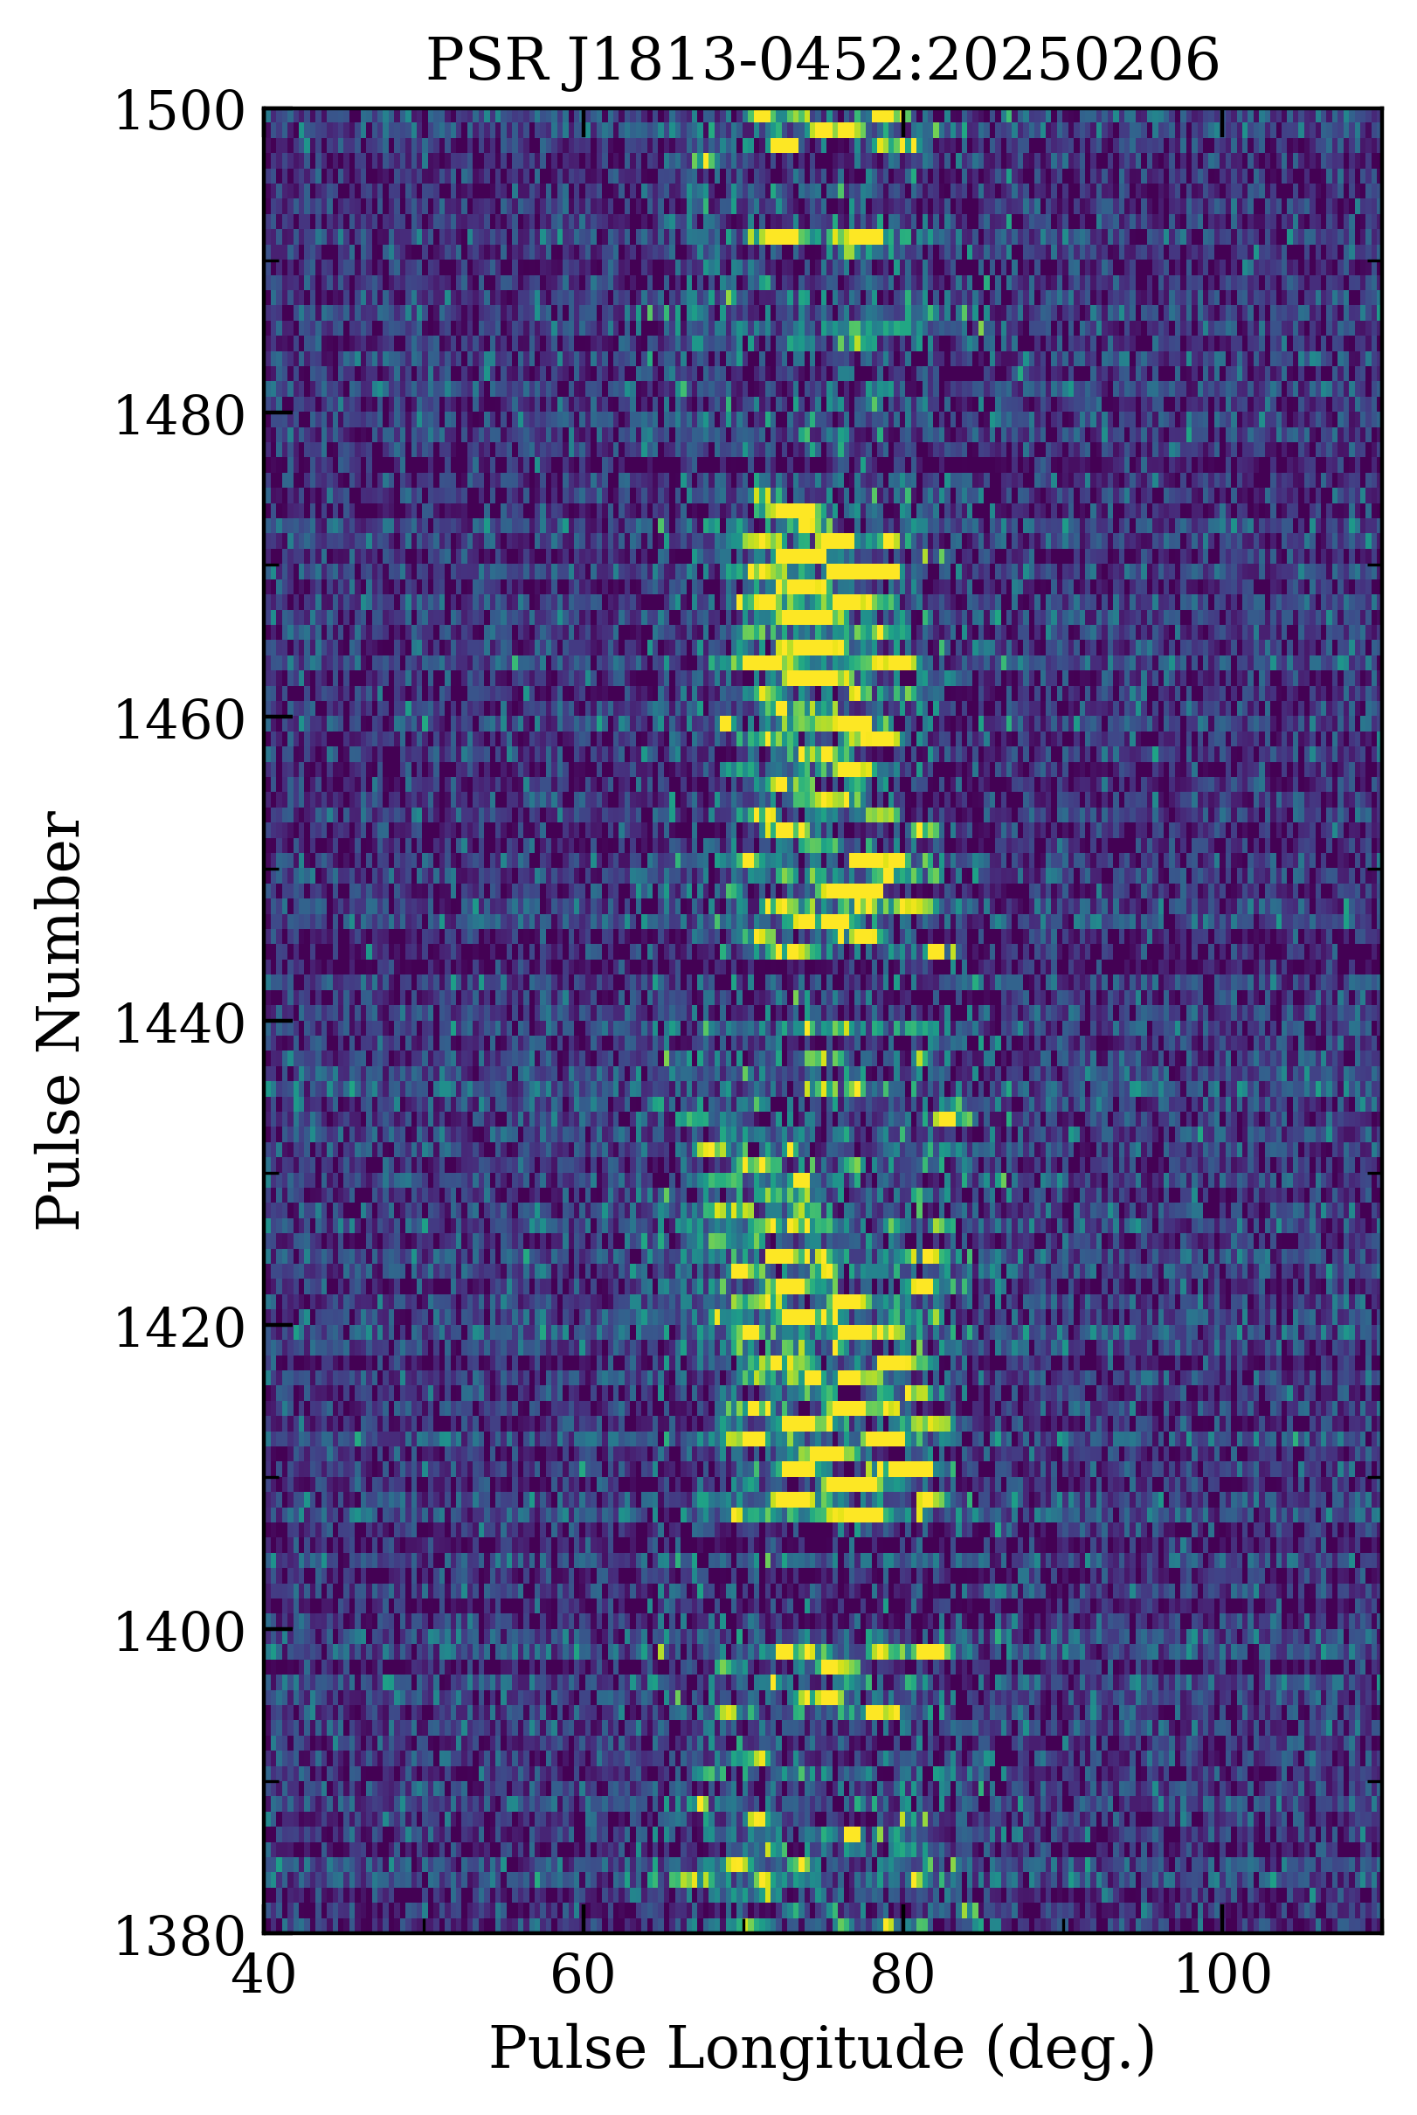
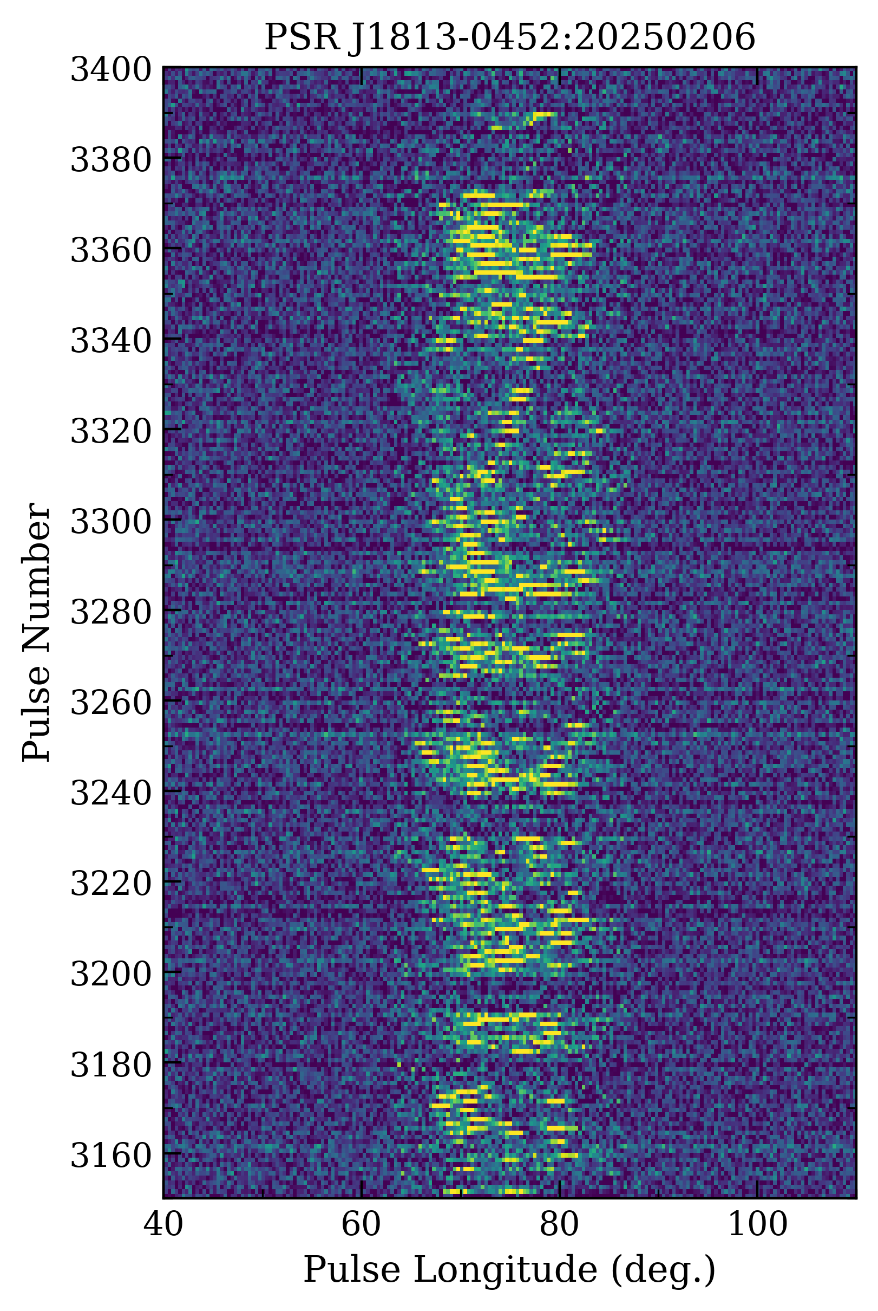
0-260:
P₃=2.1P
P₂=-9.8deg
1405-1475:
P₃= 2.3P P₃= 2.8P
P₂= -12.8deg P₂= 12.7deg
P₃= 33.5P
3200-3370:
P₃= 2.2P
P₂=-8.6deg

Slide 12
谢谢！

