Slide 1



Refining planetary ephemeris with multi-frequency multi-calibrator VLBI astrometry of millisecond pulsars
5 July 2026 @ FPS15
Hao Ding (丁浩)
Email: hdingastro@hotmail.com
Background Image Credit: SKAO

Slide 2
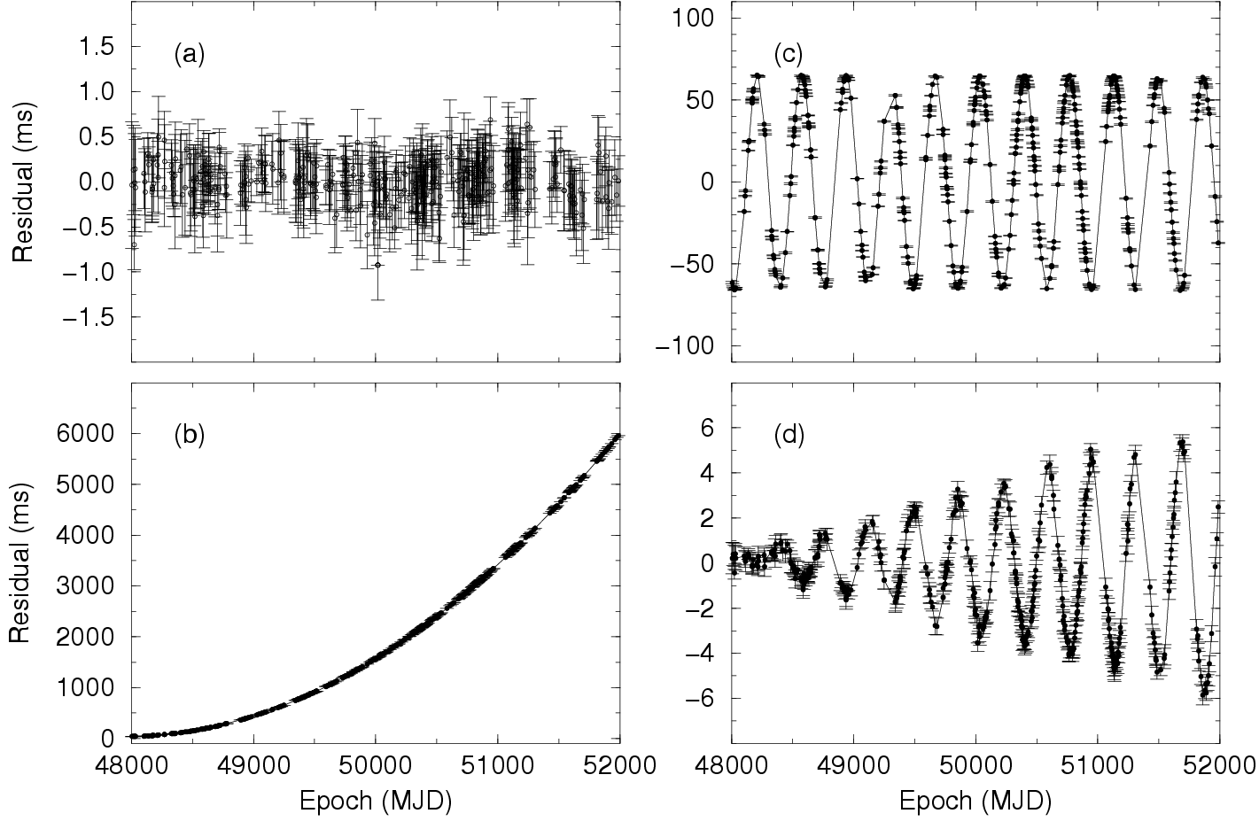
Timing of millisecond pulsars (MSPs)
(a) “good” timing fit
(b) error in spin decay
(c) error in reference position
(d) error in proper motion
Credit: Lorimer and Kramer, 2005

Slide 3

Two distinct reference systems
Pulsar
Dynamic celestial reference system
  Based on planetary ephemerides
  May have residual systematic offset from the kinematic celestial reference system
Kinematic celestial reference system
  Established with remote AGNs quasi-static (with zero parallax) on the sky
  e.g., ICRF and Radio Fundamental Catalogue, GCRF
Sun
$$∆t$$
Earth
SSB

Slide 4
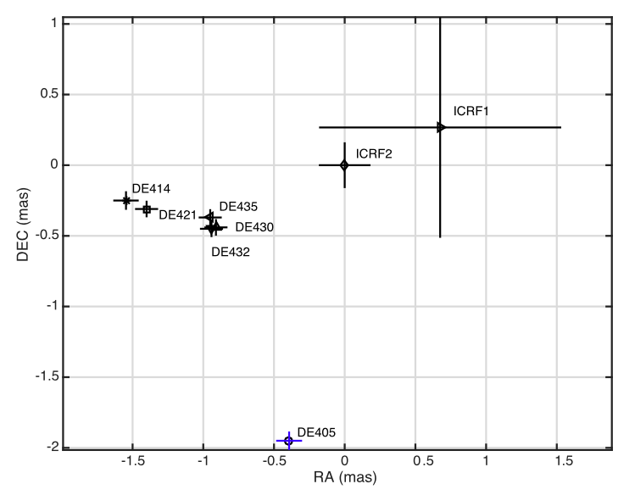
Dependence of timing positions on planetary ephemerides
PSR J0437-4715
Credit: Wang et al. 2017, MNRAS

Slide 5
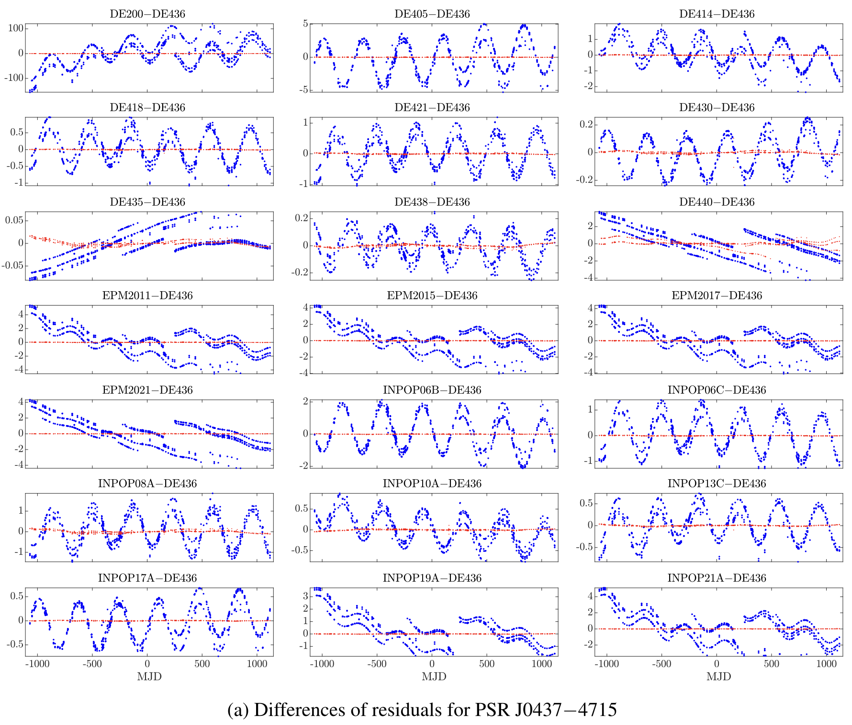
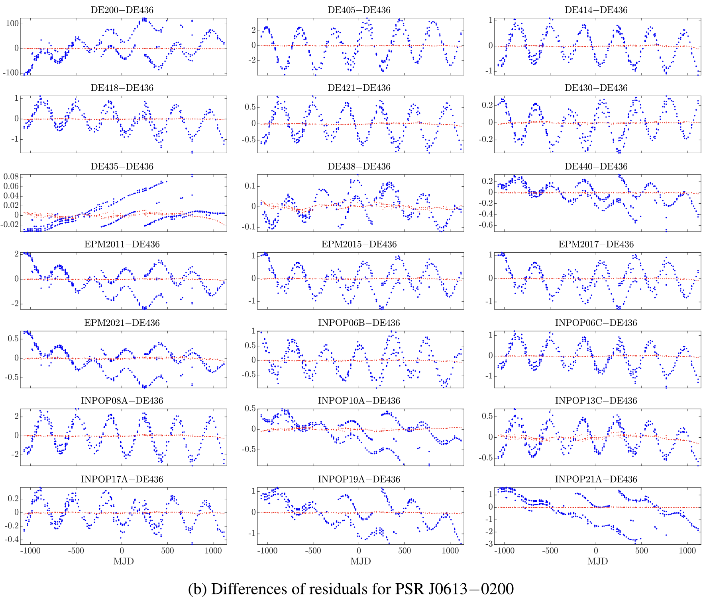
Differences in timing residuals based on different PEs; Dai, Han, and Wang, RAA, 2024

Slide 6
Probing planetary ephemerides with VLBI

Slide 7
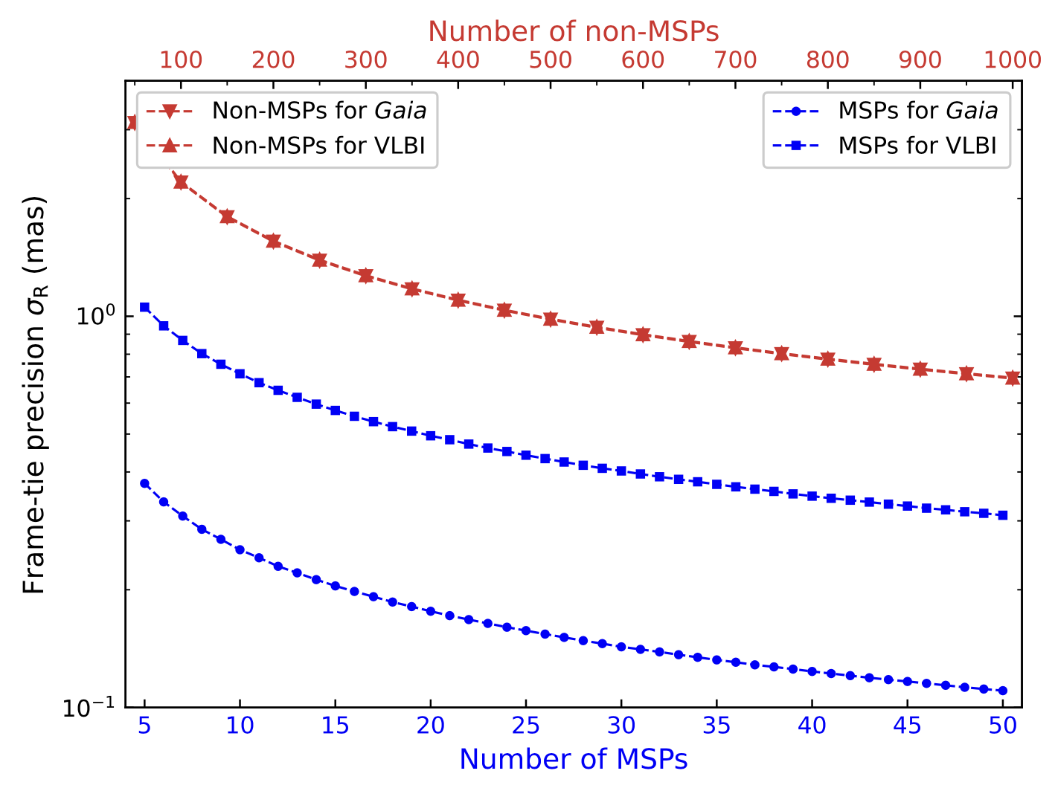
Connecting dynamic and kinematic frames
The frame tie transformation needs to be performed to the ~100 µas level
MSPs serve as the key to building the frame tie
  ~8 Gaia MSPs with ~0.3-mas-precision positions
  ~25 MSPs with ~1-mas-precision VLBI positions → ~100 MSPs with ?-mas-precision positions
Image Credit: Liu et al. 2023, A&A

Slide 8
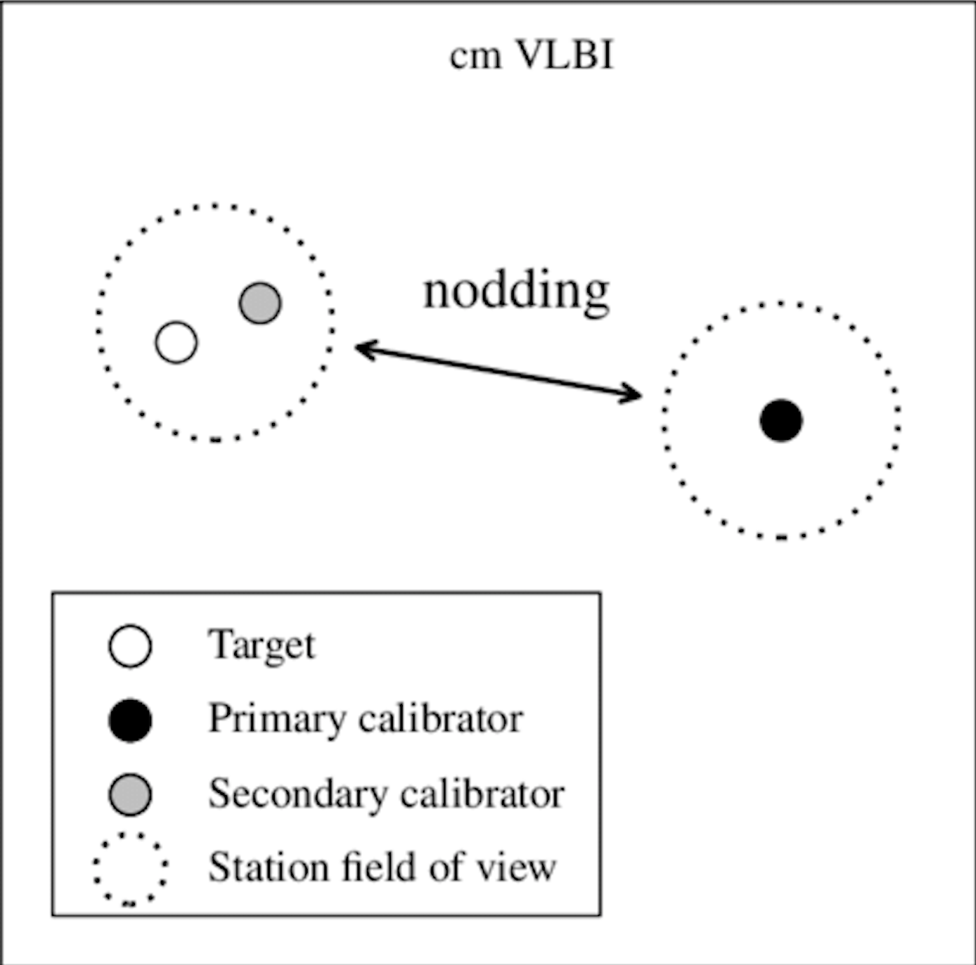
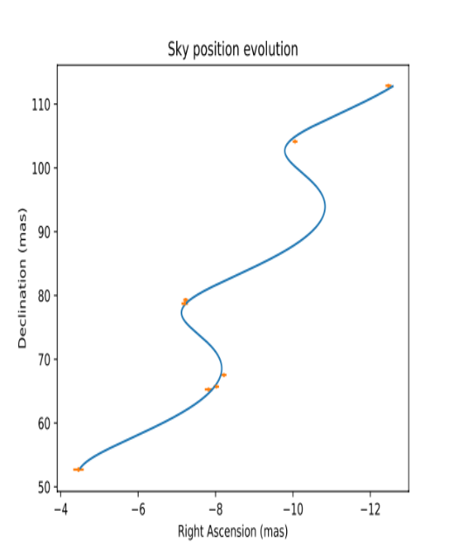
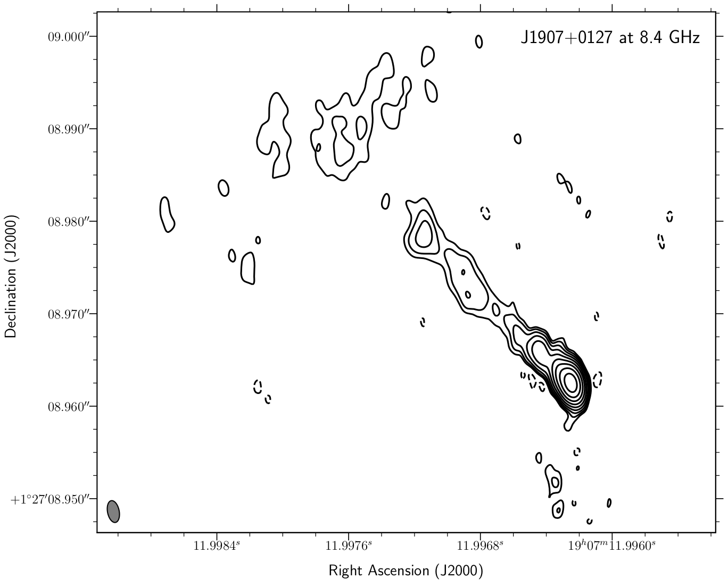
The bottleneck — the absolute VLBI positions
an MSP
Quasar, localized in the International
Celestial Reference Frame (ICRF)
reference position (relative),
proper motion and parallax

Slide 9
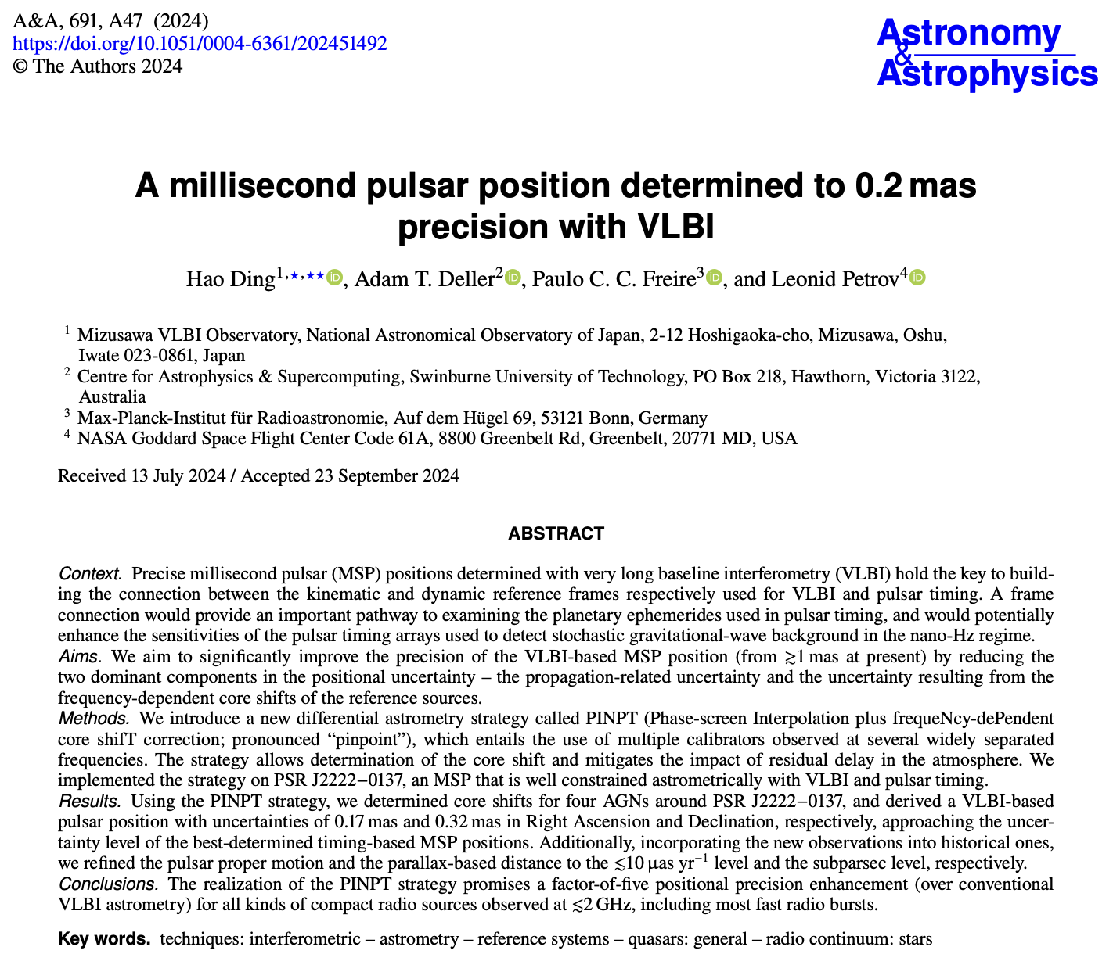
Pathways to precise absolute positions
The absolute position error budget
  dominated by the unknown frequency-dependent core shift at the 1mas level
  propagation-related errors
PINPT (Phase-screen interpolation plus frequency-dependent core shift correction) strategy
  Removing propagation-related errors to the first order using 2D interpolation
  Determining frequency-dependent core (e.g. Voitsik et al. 2018)

Slide 10
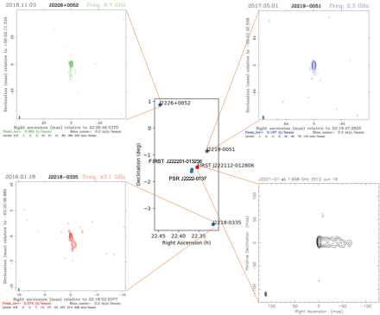

Example PINPT calibrator plan
Image Credit: NRAO

Slide 11
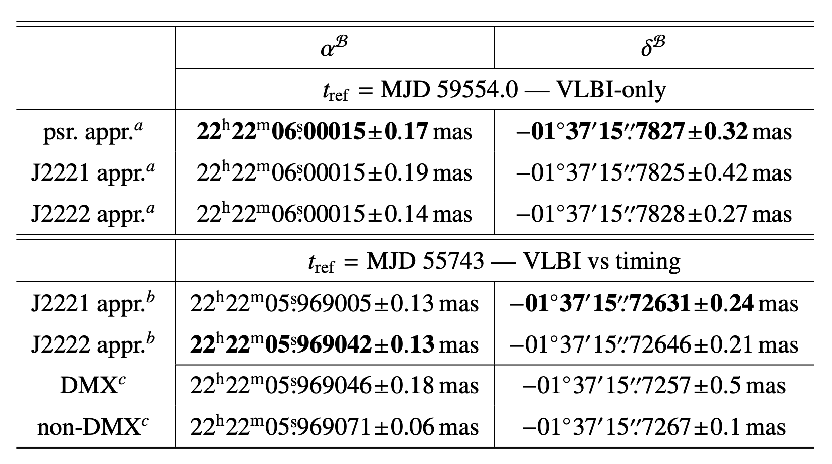
A millisecond pulsar position determined to 0.2 mas with VLBI
Position of PSR J2222-0137 (Ding et al. A&A, 2024)
~50 MSPs with ~0.3mas absolute position precision →100µas
Image Credit: Liu et al. 2023, A&A

Slide 12
Summary
PINPT astrometry of MSPs can
    Connect kinematic and dynamic reference systems
    Improve models of pulsar timing
~21+40 MSPs with ~0.2mas absolute position precision will refine the connection between dynamic and kinematic reference systems to the <100µas level

