Slide 1

The Interplay of Symmetry Energy Uncertainties, Nonlinear σ-δ Coupling, and Dark Matter in Neutron Star Macroscopic Properties
Reporter: Zhaohui Feng (冯朝辉)
Collaborator: Xiaoxuan Zhai(翟筱萱)
Supervisor: Defu Hou(侯德富)
Institute of Particle Physics and Key Laboratory of Quark and Lepton Physics (MOS), Central China Normal University

Slide 2
Outline
Background
Theoretical Framework
Results
Summary

Slide 3
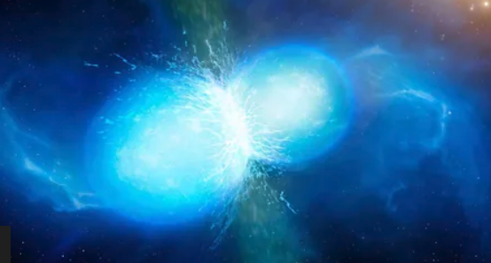
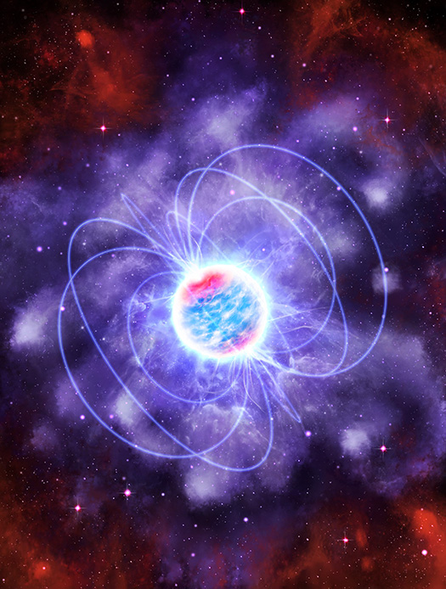
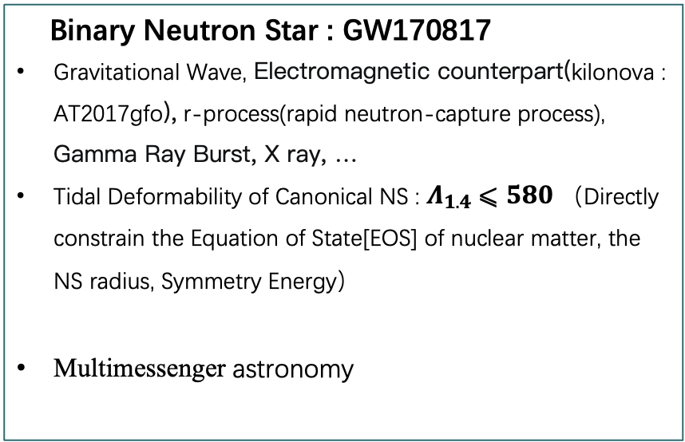
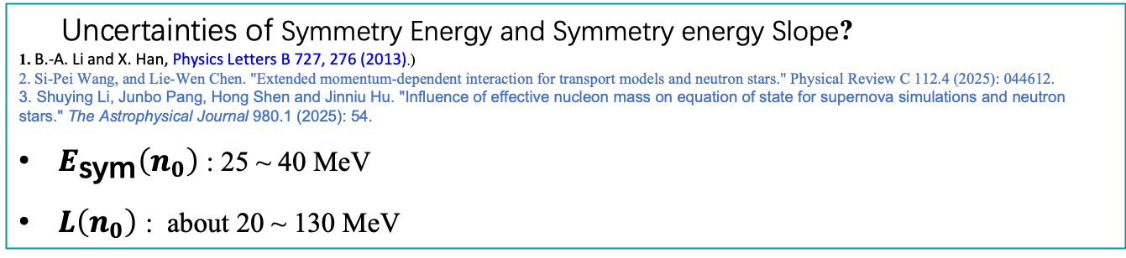
Background
(Abbott, Benjamin P., et al. "GW170817: Measurements of neutron star radii and equation of state." Physical review letters 121.16 (2018): 161101 )
Binary Neutron Star : GW170817
Gravitational Wave, Electromagnetic counterpart(kilonova : AT2017gfo), r-process(rapid neutron-capture process), Gamma Ray Burst, X ray, …
Tidal Deformability of Canonical NS : $Λ_{1.4}⩽580$ （Directly constrain the Equation of State[EOS] of nuclear matter, the NS radius, Symmetry Energy）
Multimessenger astronomy
Uncertainties of Symmetry Energy and Symmetry energy Slope?
1. B.-A. Li and X. Han, Physics Letters B 727, 276 (2013).)
2. Si-Pei Wang, and Lie-Wen Chen. "Extended momentum-dependent interaction for transport models and neutron stars." Physical Review C 112.4 (2025): 044612.
3. Shuying Li, Junbo Pang, Hong Shen and Jinniu Hu. "Influence of effective nucleon mass on equation of state for supernova simulations and neutron stars." The Astrophysical Journal 980.1 (2025): 54.
$E_{\text{sym}}\left(n_{0}\right)$ : 25 ~ 40 MeV
$L\left(n_{0}\right)$ : about 20 ~ 130 MeV
Have important impacts on NS EOS

Slide 4
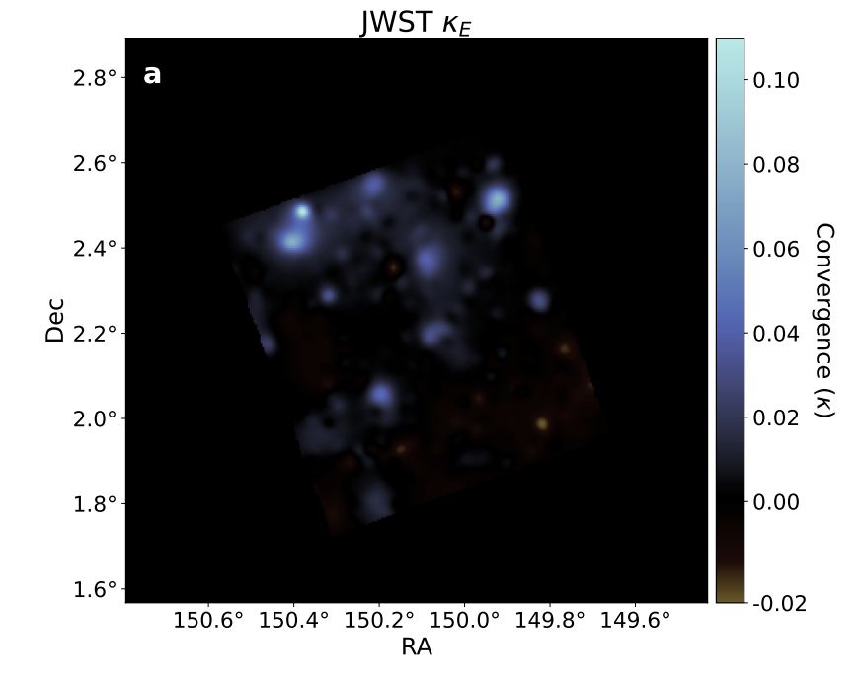
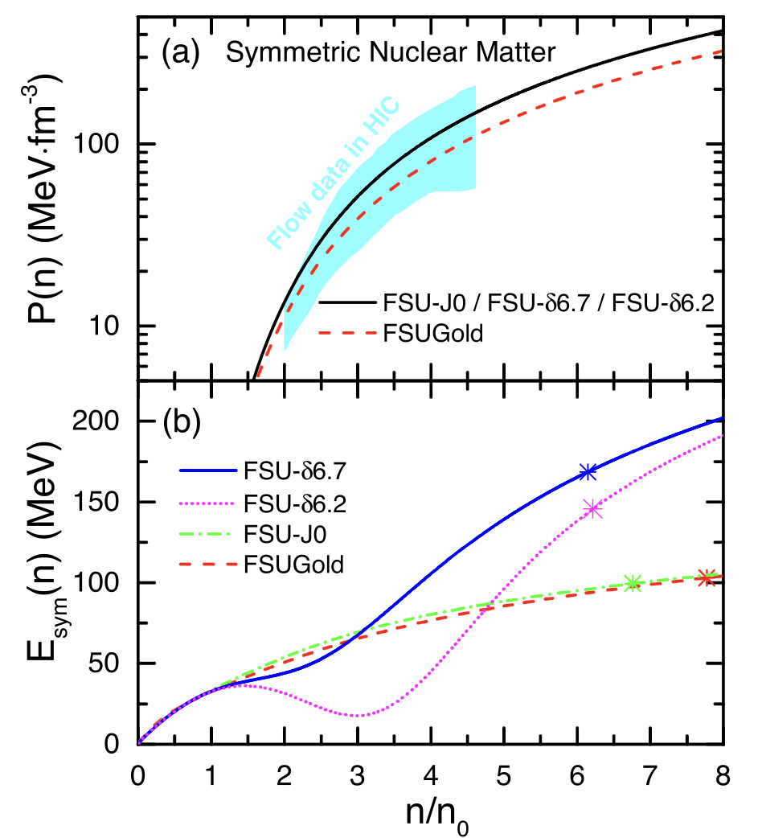
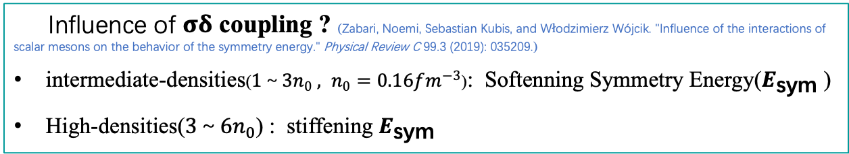
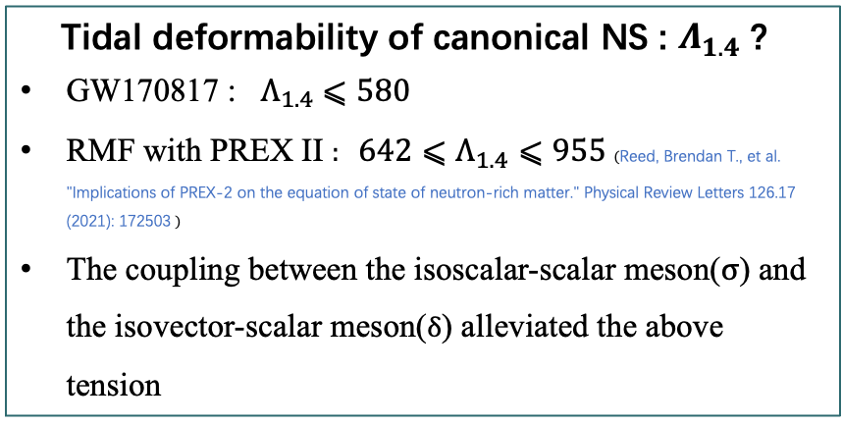
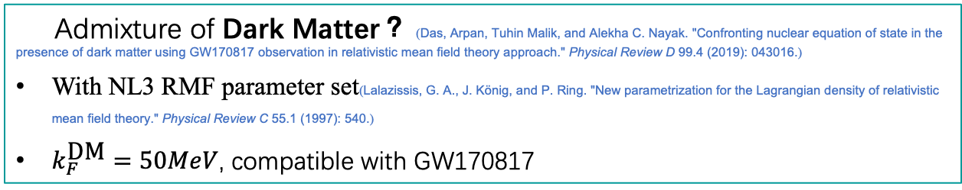
Background
Fan Li, Bao-Jun Cai, Ying Zhou, Wei-Zhou Jiang, and Lie-Wen Chen ."Effects of isoscalar-and isovector-scalar meson mixing on neutron star structure." The Astrophysical Journal 929.2 (2022): 183
Tidal deformability of canonical NS : $Λ_{1.4}$ ?
GW170817 : $Λ_{1.4}⩽580$
RMF with PREX II : $642⩽Λ_{1.4}⩽955$ (Reed, Brendan T., et al. "Implications of PREX-2 on the equation of state of neutron-rich matter." Physical Review Letters 126.17 (2021): 172503 )
The coupling between the isoscalar-scalar meson($σ$) and the isovector-scalar meson($δ$) alleviated the above tension
Scognamiglio, Diana, et al. "An ultra-high-resolution map of (dark) matter." Nature Astronomy (2026): 1-10.
Li, Fan, et al.
Influence of $σδ$ coupling ? (Zabari, Noemi, Sebastian Kubis, and Włodzimierz Wójcik. "Influence of the interactions of scalar mesons on the behavior of the symmetry energy." Physical Review C 99.3 (2019): 035209.)
intermediate-densities($1～3n_{0} , n_{0}=0.16fm^{−3}$): Softenning Symmetry Energy($E_{\text{sym}}$ )
High-densities($3～6n_{0}$) : stiffening $E_{\text{sym}}$
Admixture of Dark Matter？ (Das, Arpan, Tuhin Malik, and Alekha C. Nayak. "Confronting nuclear equation of state in the presence of dark matter using GW170817 observation in relativistic mean field theory approach." Physical Review D 99.4 (2019): 043016.)
With NL3 RMF parameter set(Lalazissis, G. A., J. König, and P. Ring. "New parametrization for the Lagrangian density of relativistic mean field theory." Physical Review C 55.1 (1997): 540.)
$k_{F}^{\text{DM}}=50MeV$, compatible with GW170817

Slide 5
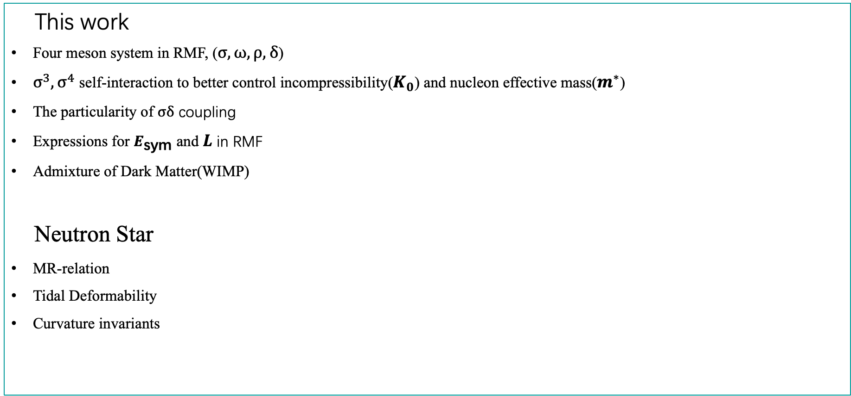
Background
This work
Four meson system in RMF, ($σ, ω, ρ,δ$)
$σ^{3},σ^{4}$ self-interaction to better control incompressibility($K_{0}$) and nucleon effective mass($m^{∗}$)
The particularity of $σδ$ coupling
Expressions for $E_{\text{sym}}$ and $L$ in RMF
Admixture of Dark Matter(WIMP)
Neutron Star
MR-relation
Tidal Deformability
Curvature invariants

Slide 6

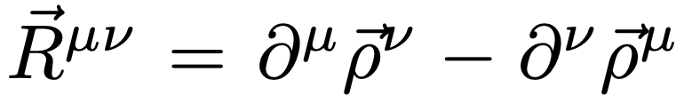



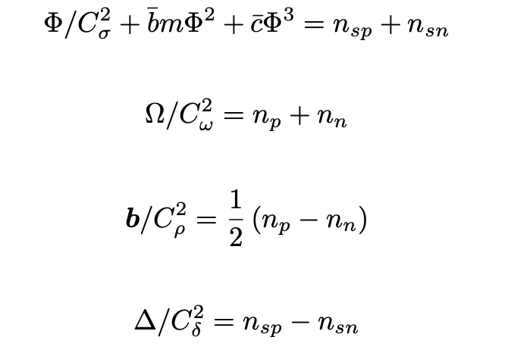
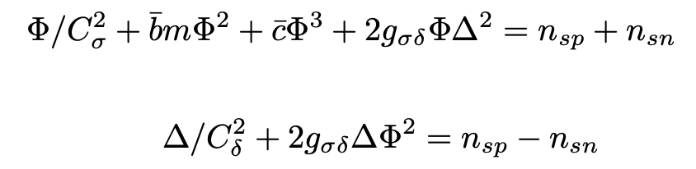

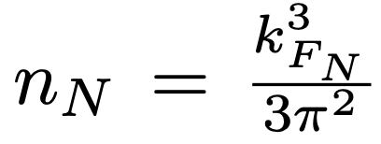
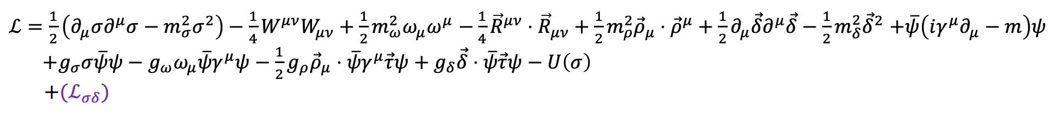
RMF
Lagrangian
field strength tensor:
$ℒ=\frac{1}{2}\left(∂_{μ}σ∂^{μ}σ−m_{σ}^{2}σ^{2}\right)−\frac{1}{4}W^{μν}W_{μν}+\frac{1}{2}m_{ω}^{2}ω_{μ}ω^{μ}$ $−\frac{1}{4}{\vec{R}}^{μν}⋅{\vec{R}}_{μν}+\frac{1}{2}m_{ρ}^{2}{\vec{ρ}}_{μ}⋅{\vec{ρ}}^{μ}+\frac{1}{2}∂_{μ}\vec{δ}∂^{μ}\vec{δ}−\frac{1}{2}m_{δ}^{2}{\vec{δ}}^{2}$ $+\overline{ψ}\left(iγ^{μ}∂_{μ}−m\right)ψ$
${+g}_{σ}σ\overline{ψ}ψ−g_{ω}ω_{μ}\overline{ψ}γ^{μ}ψ−\frac{1}{2}g_{ρ}{\vec{ρ}}_{μ}⋅\overline{ψ}γ^{μ}\vec{τ}ψ+g_{δ}\vec{δ}⋅\overline{ψ}\vec{τ}ψ−U\left(σ\right)$
$+(ℒ_{σδ})$
Kubis, S., and Marek Kutschera. "Nuclear matter in relativistic mean field theory with isovector scalar meson." Physics Letters B 399.3-4 (1997): 191-195.
for simplicity of calculations
with
The Field Equation of Mesons
with
Scalar density(N=n,p)
Vector density

Slide 7
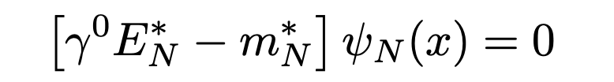
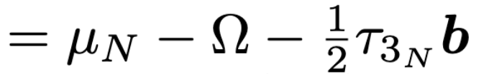


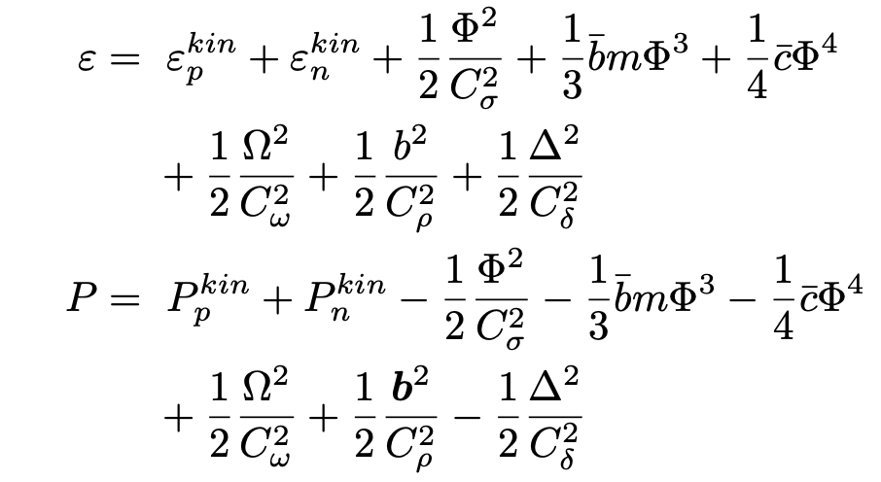
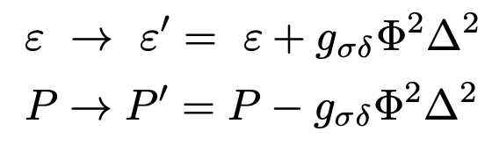
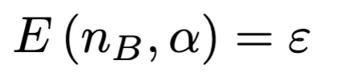
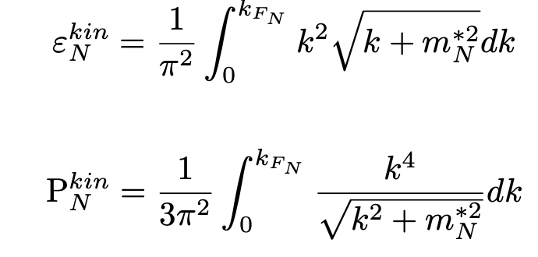
RMF
The Field Equation of Nucleons
Nucleon chemical potential
Nucleon effective mass
Equation of States
with
kinetic contributions

Slide 8
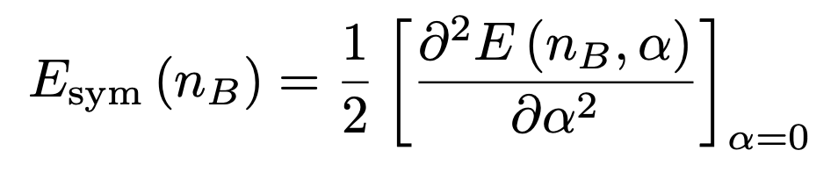
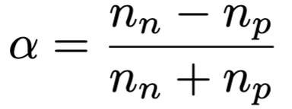

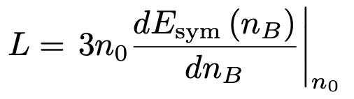
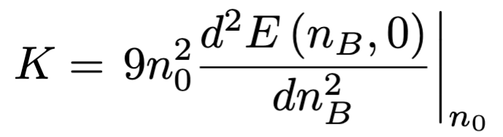

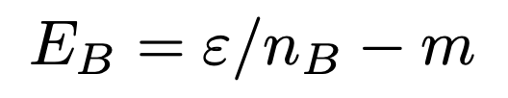

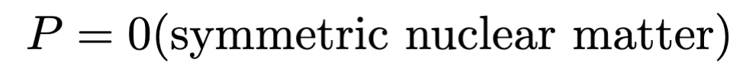


Bulk Properties of Nuclear Matter
Definition
Symmetry energy :
Slope :
Incompressibility :
Bind energy :
Saturation density :
Effective mass :
Determination of Isoscalar parameter
With Bayesian Inference

Slide 9
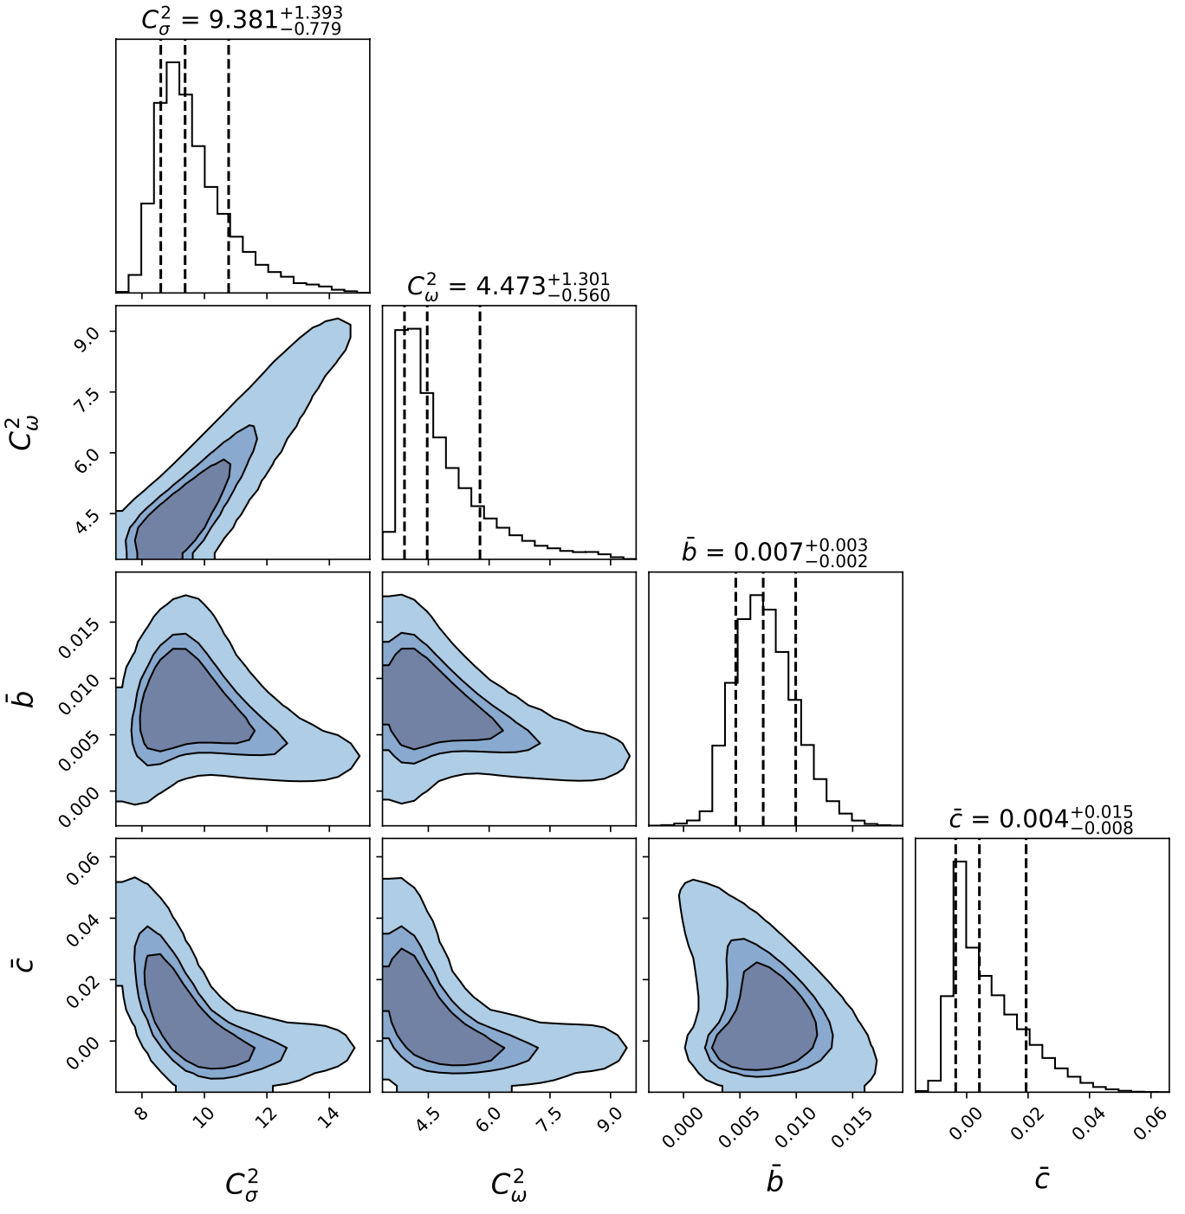

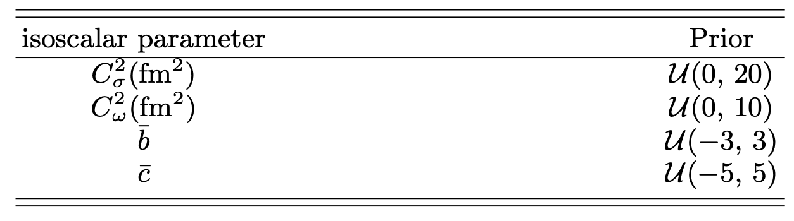
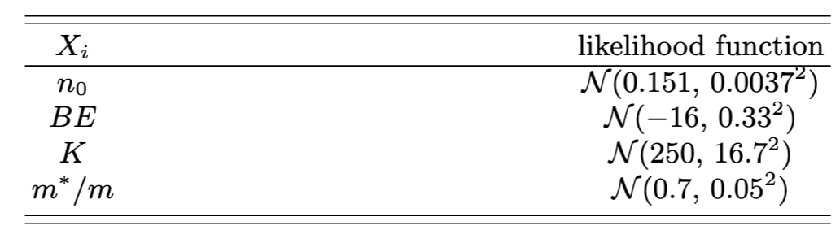
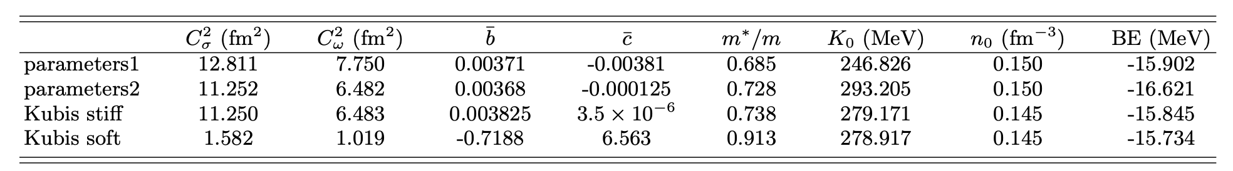
Bayesian Inference
posterior
prior
Likelihood function
Posterior probability distribution
Bayes' theorem
Prior settings
Package: emcee (https://emcee.readthedocs.io/en/stable/ )
Foreman-Mackey, Daniel, et al. "emcee: the MCMC hammer." Publications of the Astronomical Society of the Pacific 125.925 (2013): 306-312.
Likelihood function
S. Kubis and M. Kutschera, Physics Letters B 399, 191.

Slide 10
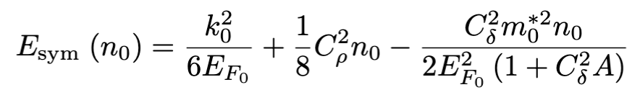
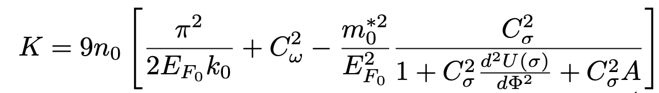
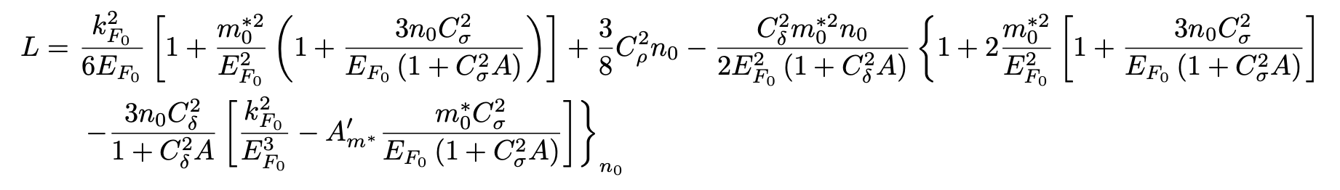
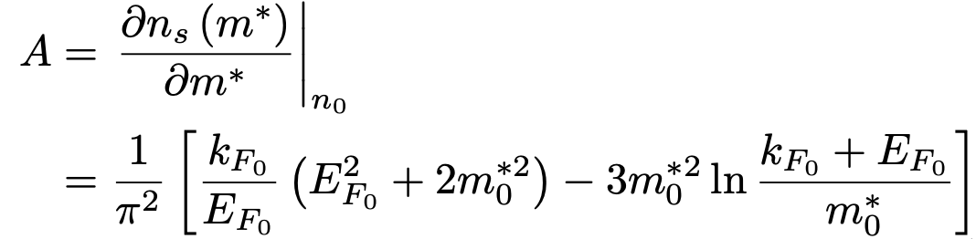
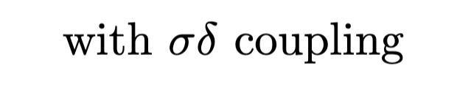
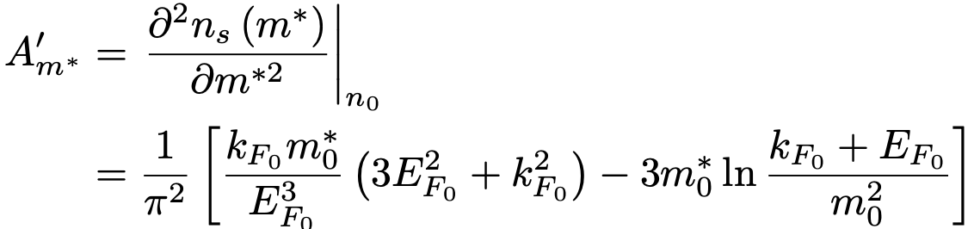
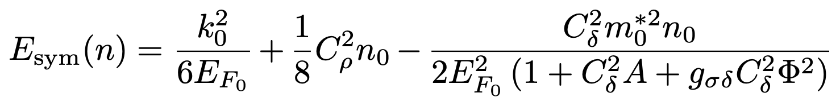
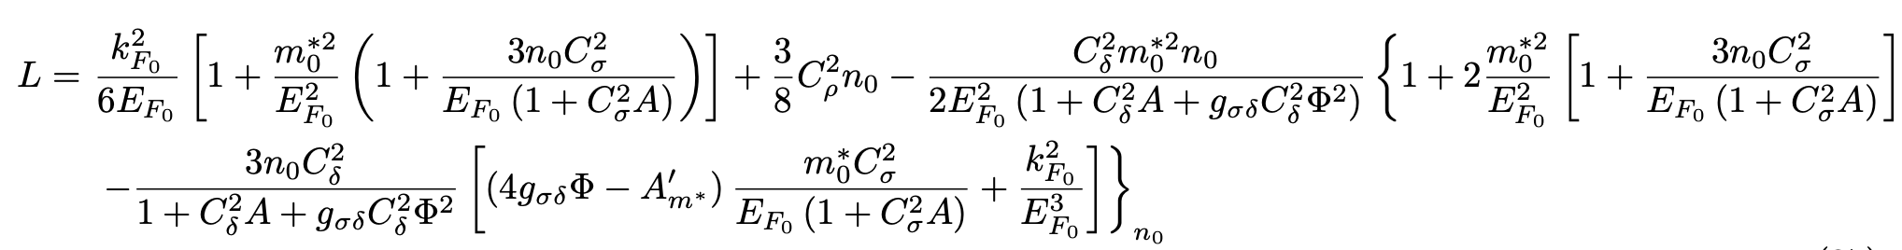
Expressions

Slide 11
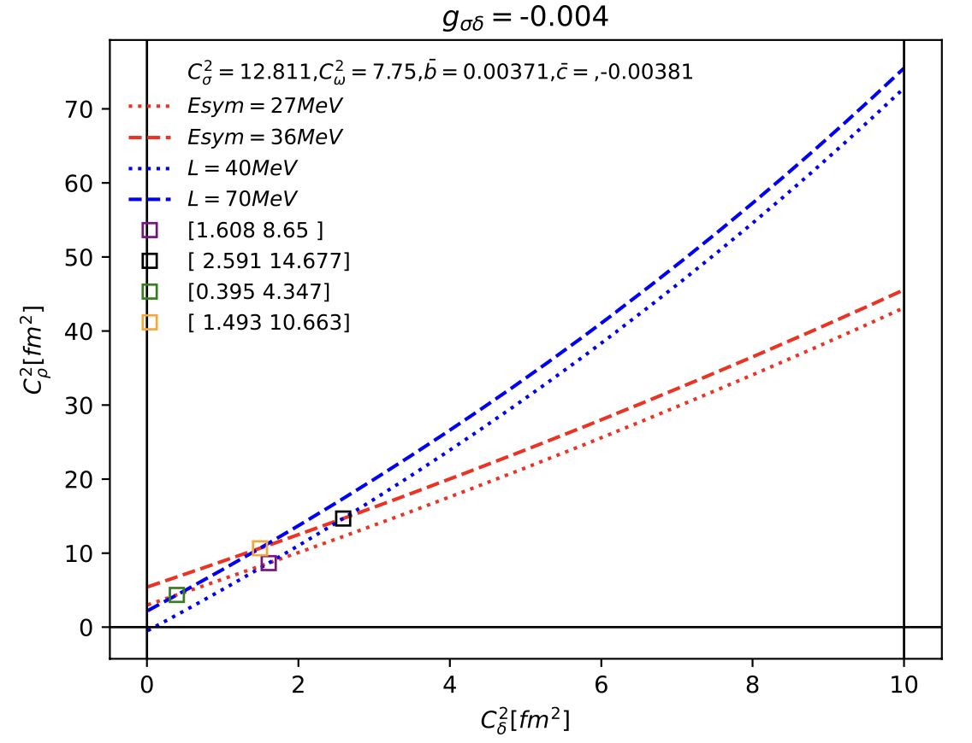
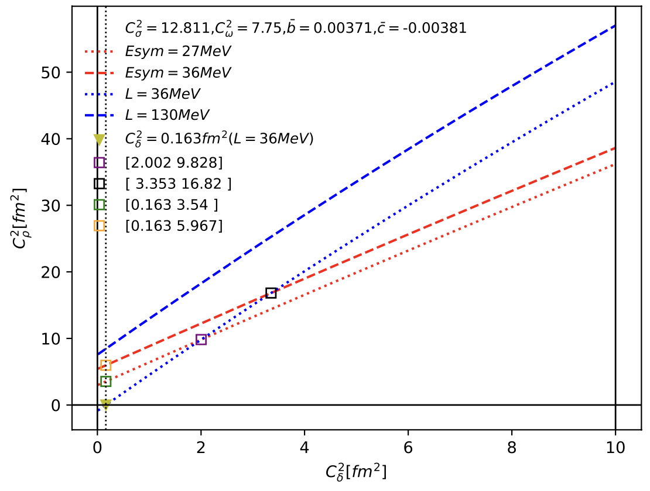
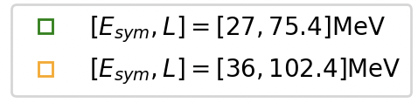
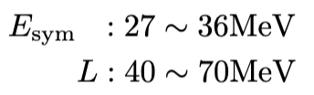

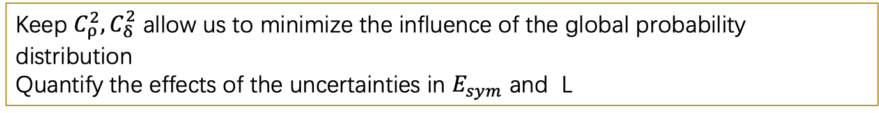
Range of isovector parameters
Ensuring the same range of variation
Upper bound of L should smaller than 75MeV
Keep $C_{ρ}^{2},C_{δ}^{2}$ allow us to minimize the influence of the global probability distribution
Quantify the effects of the uncertainties in $E_{sym}$ and L

Slide 12
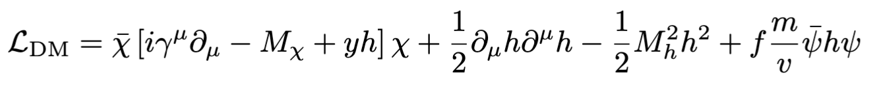
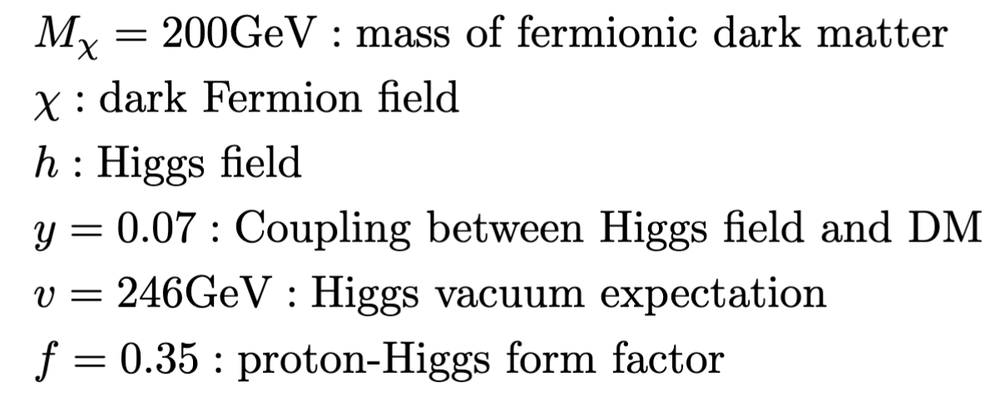

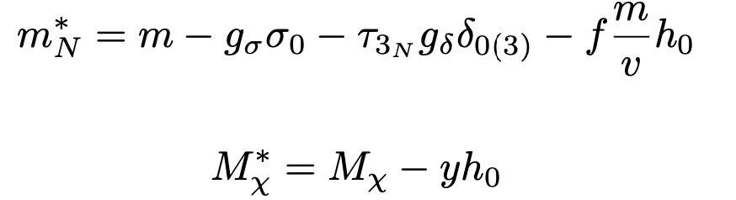
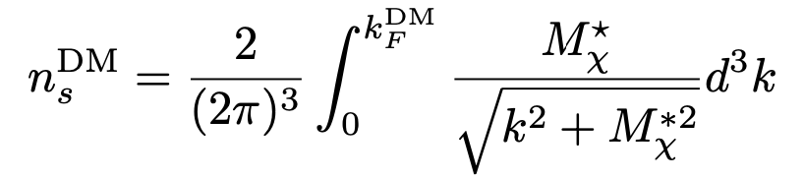
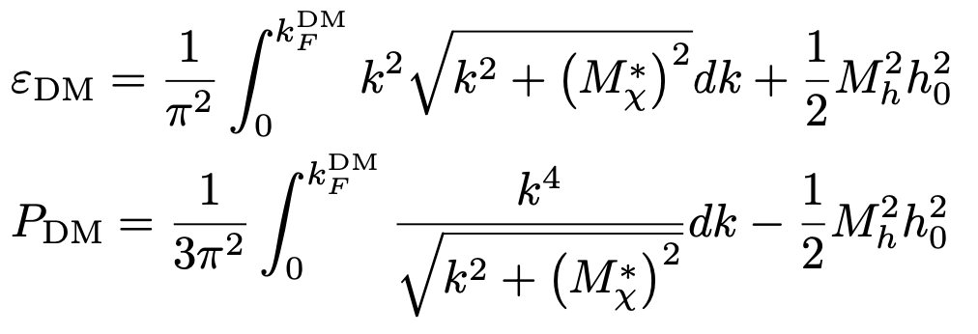
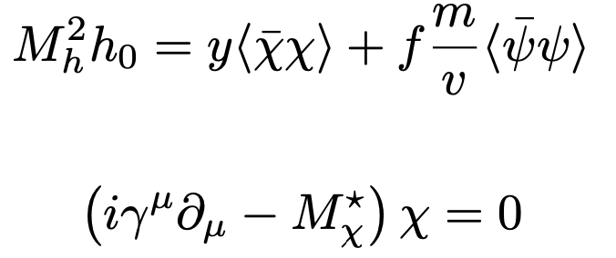
Dark Matter
Lagrangian(Panotopoulos, Grigorios, and Ilídio Lopes. "Dark matter effect on realistic equation of state in neutron stars." Physical Review D 96.8 (2017): 083004.)
G. Panotopoulos and I. Lopes, Physical Review D 96, 083004 (2017).
B. Murakami and J. D. Wells, Physical Review D 64, 015001 (2001).
J. M. Cline, P. Scott, K. Kainulainen, and C. Weniger, Physical Review D—Particles, Fields, Gravitation, and Cosmology 88, 055025 (2013).
H. C. Das, A. Kumar, B. Kumar, S. K. Biswal, T. Nakatsukasa, A. Li, and S. Patra, Monthly Notices of the Royal Astronomical Society 495, 4893 (2020).
The total Lagrangian:
Effective mass
Scalar density
The field equation:
EOS

Slide 13



Curvature invariants
K.Y.Ek ̧si,C.Gu ̈ng ̈or,andM.M.Tu ̈rkog ̆lu,Physical Review D 89, 063003 (2014)
Vanish in the vacuum
Can be used as the surface curvature

Slide 14
















TOV equation, Tidal Deformability
M-R-$Λ$ relation
Curvature-R relation
Input NS P , $ε$
Boundary condition
: radius of star surface

Slide 15







Results—Symmetry Energy
Fan Li, Bao-Jun Cai, Ying Zhou, Wei-Zhou Jiang, and Lie-Wen Chen ."Effects of isoscalar-and isovector-scalar meson mixing on neutron star structure." The Astrophysical Journal 929.2 (2022): 183
With $L_{n_{0}}$ $=50MeV$ fixed
With ${\left(E_{\text{sym}}\right)}_{n_{0}}=30MeV$
Conclusions:
smaller ${\left(E_{\text{sym}}\right)}_{n_{0}}$ , stiffer $E_{\text{sym}}\left(n_{B}\right)$
$g_{σδ}=−0.004$ : soften $E_{\text{sym}}\left(n_{B}\right)$
Conclusions:
larger $L_{n_{0}}$ , softer $E_{\text{sym}}\left(n_{B}\right)$
$g_{σδ}=−0.004$ : soften $E_{\text{sym}}\left(n_{B}\right)$
Not a fixed conclusion. Depend on the isoscalar parameter

Slide 16





M-R relation
Effects of DM on EOS : Soften
Das, Arpan, Tuhin Malik, and Alekha C. Nayak. "Confronting nuclear equation of state in the presence of dark matter using GW170817 observation in relativistic mean field theory approach." Physical Review D 99.4 (2019): 043016.
$C_{S}^{2} ?$

Slide 17




Effects of 𝜎−𝛿 coupling
With Dark Matter:
R: smaller
$Λ$: smaller
M: smaller
EOS softening
With 𝜎−𝛿 coupling:
R: smaller than ''no coupling''
$Λ$: smaller than ''no coupling''
M: larger？(abnormal phenomenon)
𝜎−𝛿 coupling's trend of the MR Curve is opposite to that of dark matter softening EOS
𝜎−𝛿 coupling seems like stiffening
Actually: softening

Slide 18












EOS abnormally softening
softening
softening
$L_{n_{0}}$=40
$L_{n_{0}}$=40
The expectation of EOS softening: M, R, $Λ$ all become smaller
Shaded region:
${\left(E_{\text{sym}}\right)}_{n_{0}}$fixed at 36 MeV
$L_{n_{0}}$ ： from Right to Left
40 to 70 MeV
No coupling : M , R , $Λ$
$k_{F}^{DM}=50MeV:$ M , R , $Λ$
Increasing M with decreasing R and $Λ$
Abnormally softening behavior similar with 𝜎−𝛿 coupling
larger $L_{n_{0}}$ , softer $E_{\text{sym}}$

Slide 19


Tidal deformability for Canonical NS
Das et al. "Confronting nuclear equation of state in the presence of dark matter using GW170817 observation in relativistic mean field theory approach." Physical Review D 99.4 (2019): 043016.
Satisfy GW170817
Radius variation average 0.44km 0.296km 0.437km 0.356km / 0.166km
Tidal variation average 299.628 186.483 294.897 169.128 / 30.060
Same calculations as before
Soften：effects of 𝜎−𝛿 coupling and $k_{F}^{DM}=30MeV$ are comparable
Hardly to determine whether radius(or tidal deformability) is more relevant to $E_{\text{sym}}\left(n_{0}\right)$ or $L_{n_{0}}$

Slide 20








Curvature
Canonical NS with
inner crust
Conclusions :
The softer EOS , the lager curvature and compactness
outer crust
core
This confirms the correctness of 𝜎−𝛿 coupling softening the NS EOS with $g_{σδ}=−0.004$
In vacuum : $\frac{4\sqrt{3}GM}{r^{3}c^{2}}$
Common trajectory
Also explain the surface curvature of NS lager than the Sun :
Only related to the mass source

Slide 21




curvature
$E_{\text{sym}}\left(n_{B}>n_{0}\right)$ softening
$E_{\text{sym}}\left(n_{B}>n_{0}\right)$ stiffening
Consistent with the previous conclusion :
The softer $E_{\text{sym}}$ , the larger curvature quantities

Slide 22

Summary
The analytical expressions of $E_{\text{sym}}\left(n_{B}\right)$ , $K_{0}$ , $L(n_{B})$ in two cases were derived
A set of parameters for effectively reducing the $K_{0}$ from 280 to 246 MeV was obtained
With $g_{σδ}=−0.004$, 𝜎−𝛿 coupling abnormally softening EOS, make both R and $Λ$ decrease while M increases
Similar abnormal behavior occur with $k_{F}^{DM}=50MeV$ at $E_{\text{sym}}=36$ MeV
Behavior of symmetry energy around $n_{0}$ depend on the isoscalar parameter rather than isovector parameter
NS curvature is strongly correlated with the stiffness of $E_{\text{sym}}$, with softer $E_{\text{sym}}$ corresponding to larger surface curvatures

Slide 23







Anomalous Behavior
$L_{n_{0}}$ larger, R larger， $Λ$ smaller
Difference: the behavior of $E_{\text{sym}}$ around $n_{0}$ is opposite to
this work
With Larger $L_{n_{0}}$ , $E_{\text{sym}}$ stiffer
Our result: larger $L_{n_{0}}$ , $E_{\text{sym}}$ softer
Zhu, Zhen-Yu, En-Ping Zhou, and Ang Li. "Neutron star equation of state from the quark level in light of GW170817." The Astrophysical Journal 862.2 (2018): 98.

Slide 24




Anomalous Behavior
Possible explanation : Very likely depend on the behavior of $E_{\text{sym}}$ around $n_{0}$
The Canonical NS: central density ～ 2$n_{0}$
In progress
EOS of core: from 0.5$n_{0}$ to around 2$n_{0}$
Our calculations : avoid this region
EOS of core: from $n_{0}$ to around 2$n_{0}$
include a large fraction of the stiffness crossing region
Zhu, Zhen-Yu, En-Ping Zhou, and Ang Li. "Neutron star equation of state from the quark level in light of GW170817." The Astrophysical Journal 862.2 (2018): 98.
Their explanation：may be relevant to the core EOSs with different L matched to the same inner crust EOS of Negele & Vautherin (NV EOS: inner crust)
also exhibit a crossing in the vicinity of $n_{0}$

Slide 25
Thanks

Slide 26






EOS construction for NS
RMF nuclear matter : core
Other method : Fortin, M., et al. "Neutron star radii and crusts: Uncertainties and unified equations of state." Physical Review C 94.3 (2016): 035804
Also need for crust
outer crust : BPS EOS (G. Baym, C. Pethick, and P. Sutherland, Astrophysical Journal, vol. 170, p. 299 170, 299 (1971). )
inner crust : polytropic
matching region : $0.5n_{0}\sim n_{0}$
A, B : undetermined coefficient
chemical equilibrium and charge neutrality
lepton contribution

Slide 27









appendix
HVH theorem:
N. M. Hugenholtz and L. Van Hove, Physica 24, 363 (1958).
softening
energy per nucleon equals to the Fermi energy
Without out coupling
Can be used to simplify the calculation at $n_{0}$ of the incompressibility
W.-C. Chen and J. Piekarewicz, Physical Review C 90, 044305 (2014).
Accord with effect of softening
Canonical NS: $ε_{c}$ , R , $Λ$
Central density

Slide 28















The intrinsic behavior of Symmetry Energy
Intrinsic? : It means that the behavior around $n_{0}$ of the stiffness of $E_{\text{sym}}$ already determined by the isoscalar parameters
$$k_{0}$$
Symmetric nuclear matter
With given $n_{B}$
$$σ$$
$m_{0}^{∗}$, $E_{F_{0}}$, $A\left(k_{0},m_{0}^{∗}\right)$
With already known isoscalar parameters to solve the values of $σ$ field
这里不同斜率取值下对称能软硬顺序的变化就是所描述的intrinsic行为
Take $E_{\text{sym}}\left(n_{0}\right)$ fixed as an example
Determine $E_{\text{sym}}\left(n_{B}\right)$?
intrinsic behavior !!!
相当于$C_{ρ}^{2},C_{δ}^{2}$是多项式的常数项， $m_{0}^{∗}$, $E_{F_{0}}$, $A\left(k_{0},m_{0}^{∗}\right)$相当于$x^{2},x^{3},x^{4}$… 这些决定函数曲线行为的元素
$L_{n_{0}}=40$MeV
$L_{n_{0}}=50$MeV
$L_{n_{0}}=60$MeV
$L_{n_{0}}=70$MeV
Along this direction , the sequence of the stiffness for $E_{\text{sym}}$
$$L_{n_{0}}$$
Four sets $C_{ρ}^{2},C_{δ}^{2}$
Our results：soften
Results in Zhu, Zhen-Yu, En-Ping Zhou, and Ang Li : stiffen
Conclusion：the intrinsic behavior of $E_{\text{sym}}$ is merely highlighted by isovector parameters. The sequence of softening–stiffening behavior itself is essentially independent of isovector parameters.

Slide 29





materials in [Fan Li, Bao-Jun Cai, Ying Zhou, Wei-Zhou Jiang, and Lie-Wen Chen ."Effects of isoscalar-and isovector-scalar meson mixing on neutron star structure." The Astrophysical Journal 929.2 (2022): 183]

