Slide 1


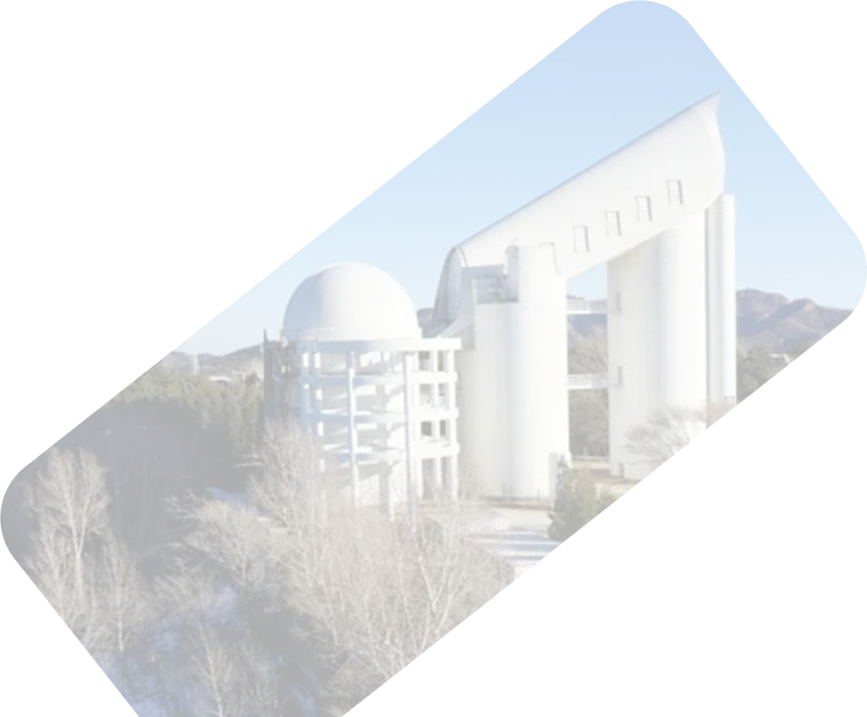

Random Polarization Angle Behavior across Bursts of Reapting FRBs
Xiao-Hui Liu
Collaborators: Xue-Lei Chen and FAST FRB Key Science Project
National Astronomical Observatories, CAS
e-mail: liuxh@bao.ac.cn
FPS15

Slide 2
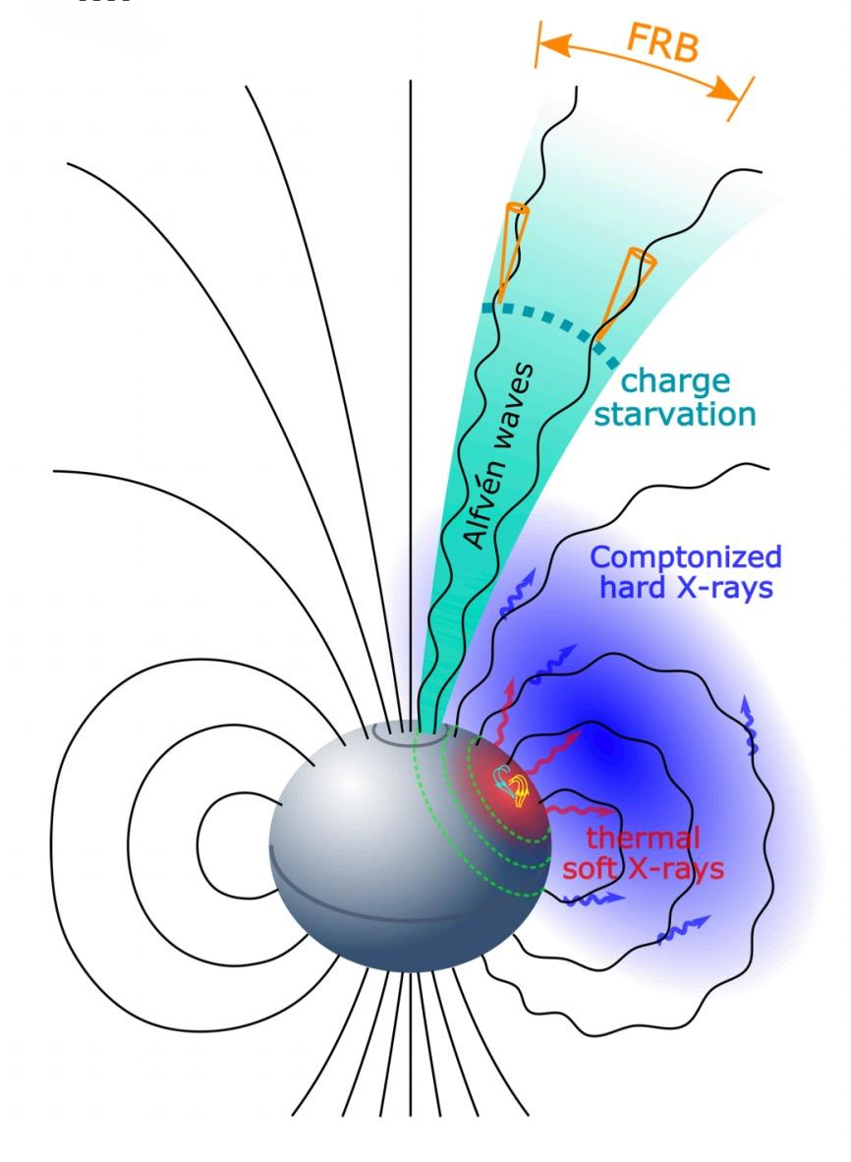
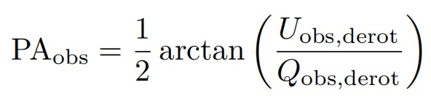
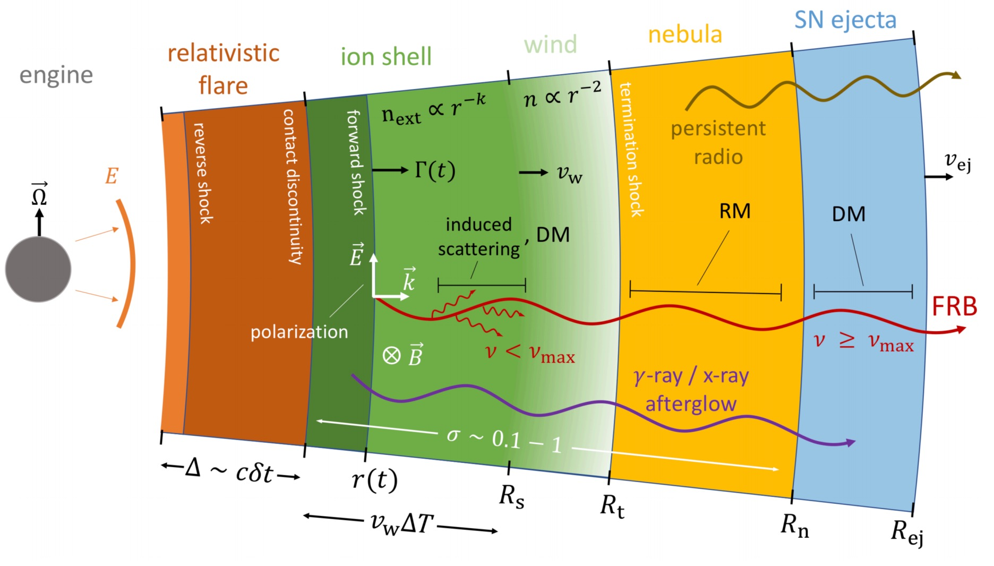
FRB Mechanisms
PA:
FRB models:
1) Magnetospheric models
1. geometry 2. distortion => diverse PA
2) Relativistic shock models
1. ordered magnetic field => constant PA
pulsar-like model (up) and GRB-like model (left)
Zhang 2020a

Slide 3
FRB Mechanisms
PA:
FRB models:
1) Magnetospheric models
1. geometry 2. distortion => diverse PA
2) Relativistic shock models
1. ordered magnetic field => constant PA
pulsar-like model (up) and GRB-like model (left)
Zhang 2020a

Slide 4
FRB Mechanisms
PA:
FRB models:
1) Magnetospheric models
1. geometry 2. distortion => diverse PA
2) Relativistic shock models
1. ordered magnetic field => constant PA
pulsar-like model (up) and GRB-like model (left)
Zhang 2020a

Slide 5
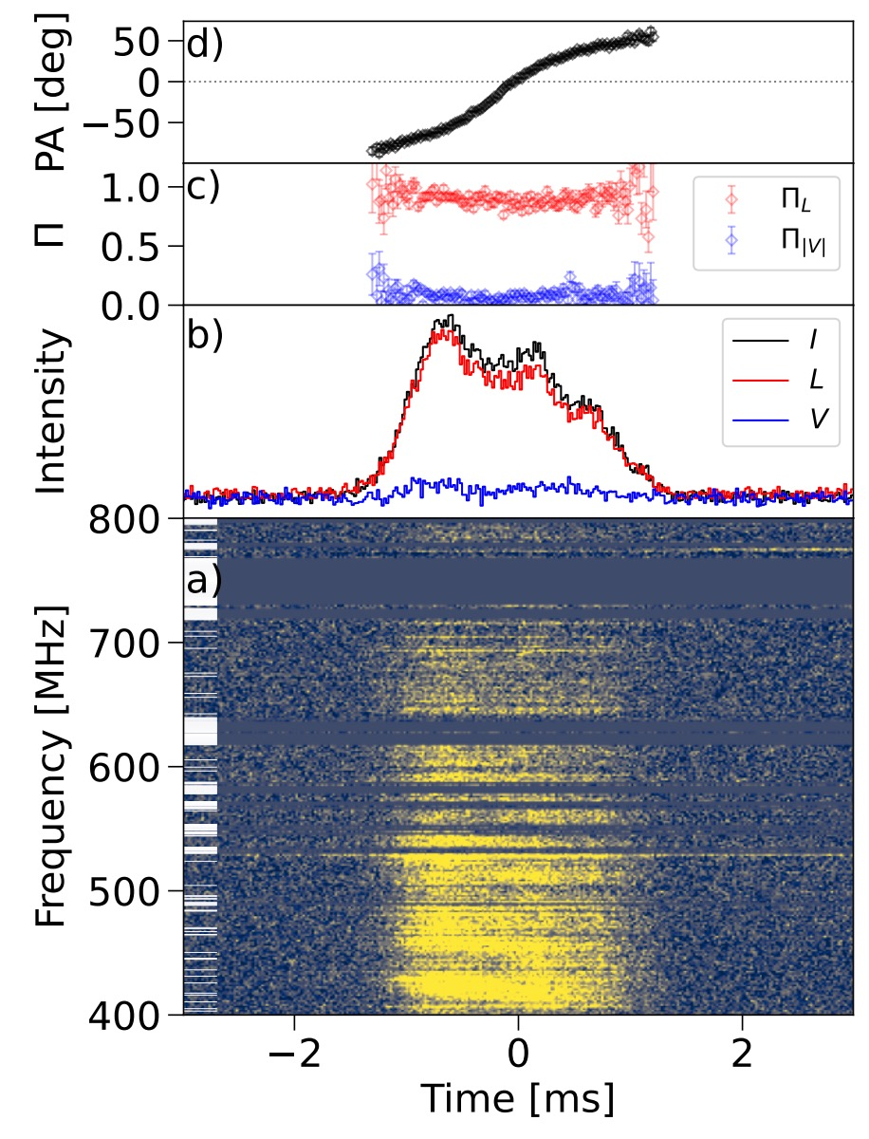
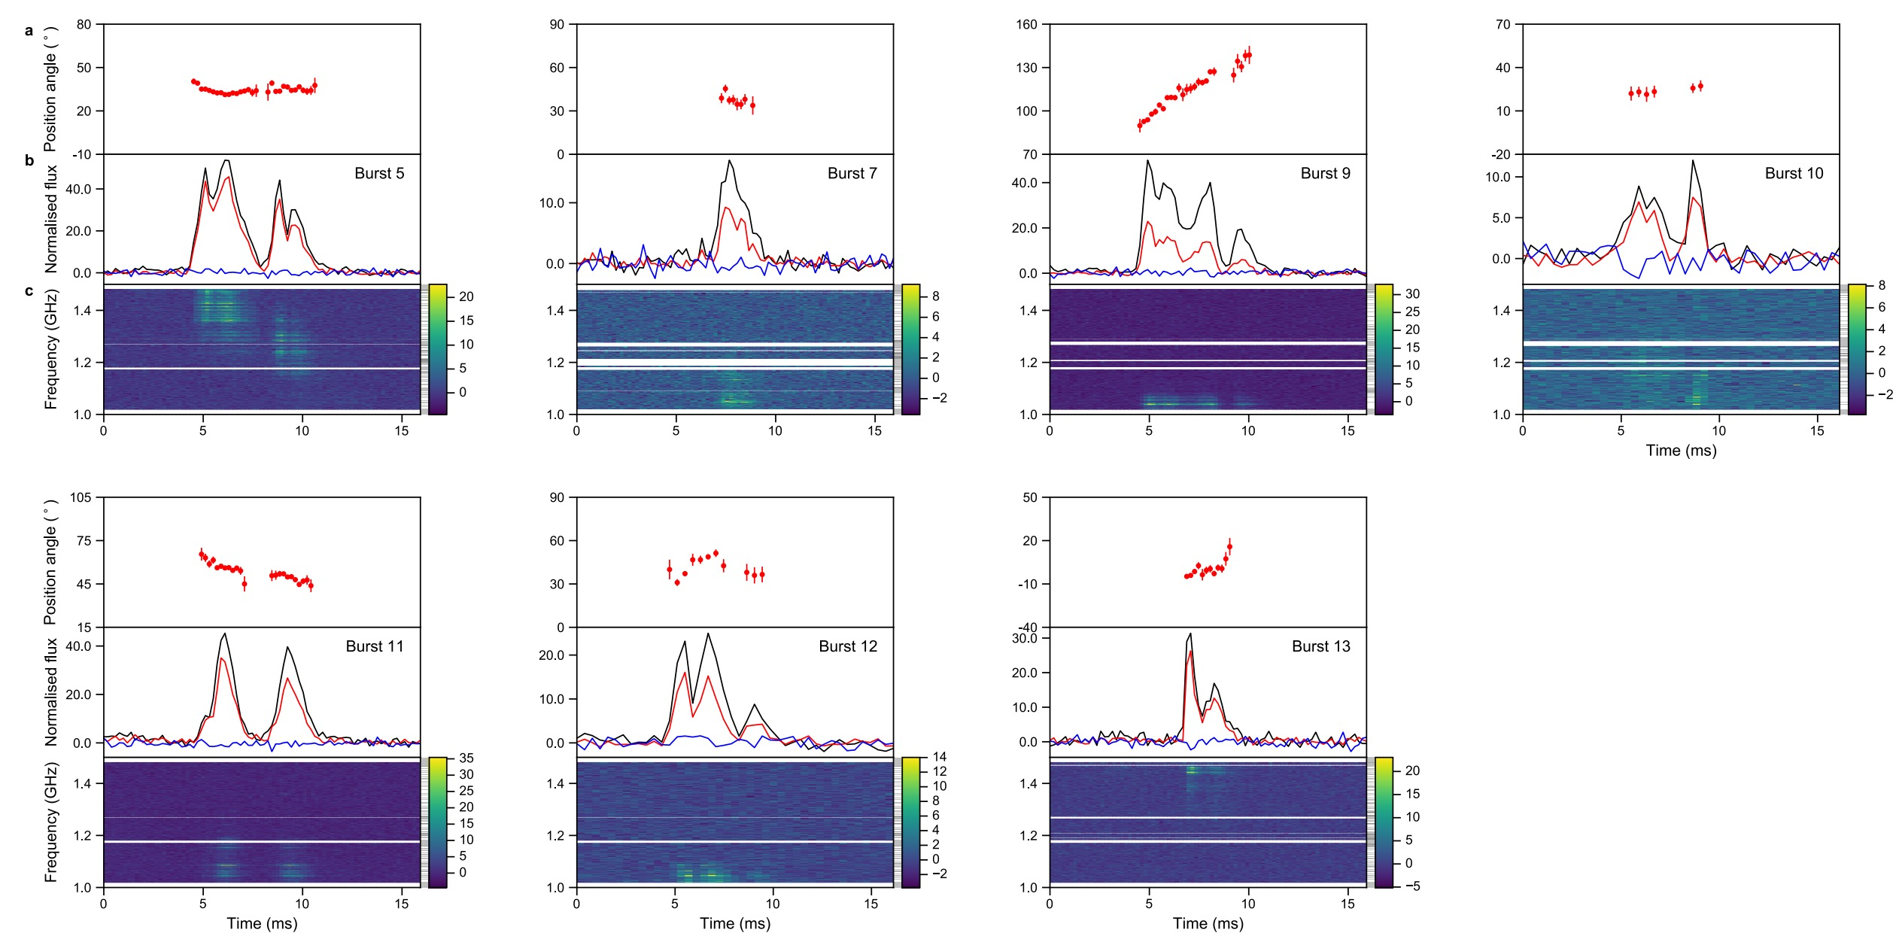
Diverse PA
FRB 20221022A
Mckinven et al. 2025
FRB 20180301A
Luo et al. 2020
Magnetospheric origins
1. geometry
2. distortion
This is a one-off FRB.
Further test on repeater sample is needed

Slide 6
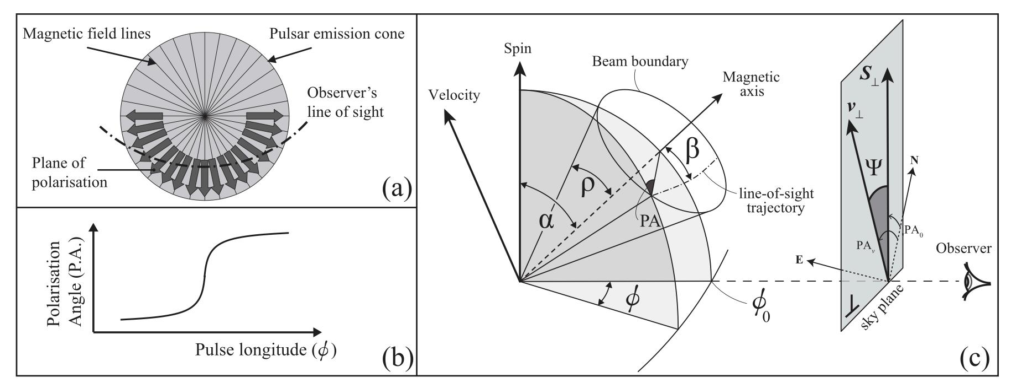

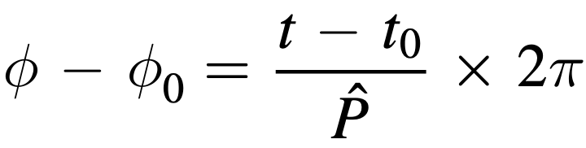
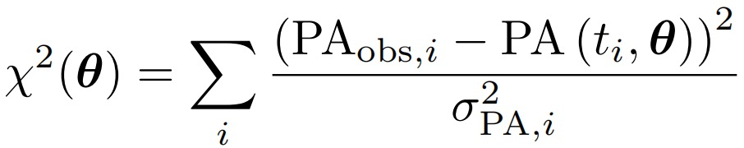
Rotating Vector Model (RVM)
Radhakrishnan, V. & Cooke, D. J. 1969
effective parameters:
spin period
inclination angle
impact angle
reference phase and PA
opening angle
A. Noutsos et al. 2012

Slide 7
duty cycle is too large?
2+21+12+11=46
Notes:
show 46 RVM-like curves -> special cases (large duty circle)

Slide 8
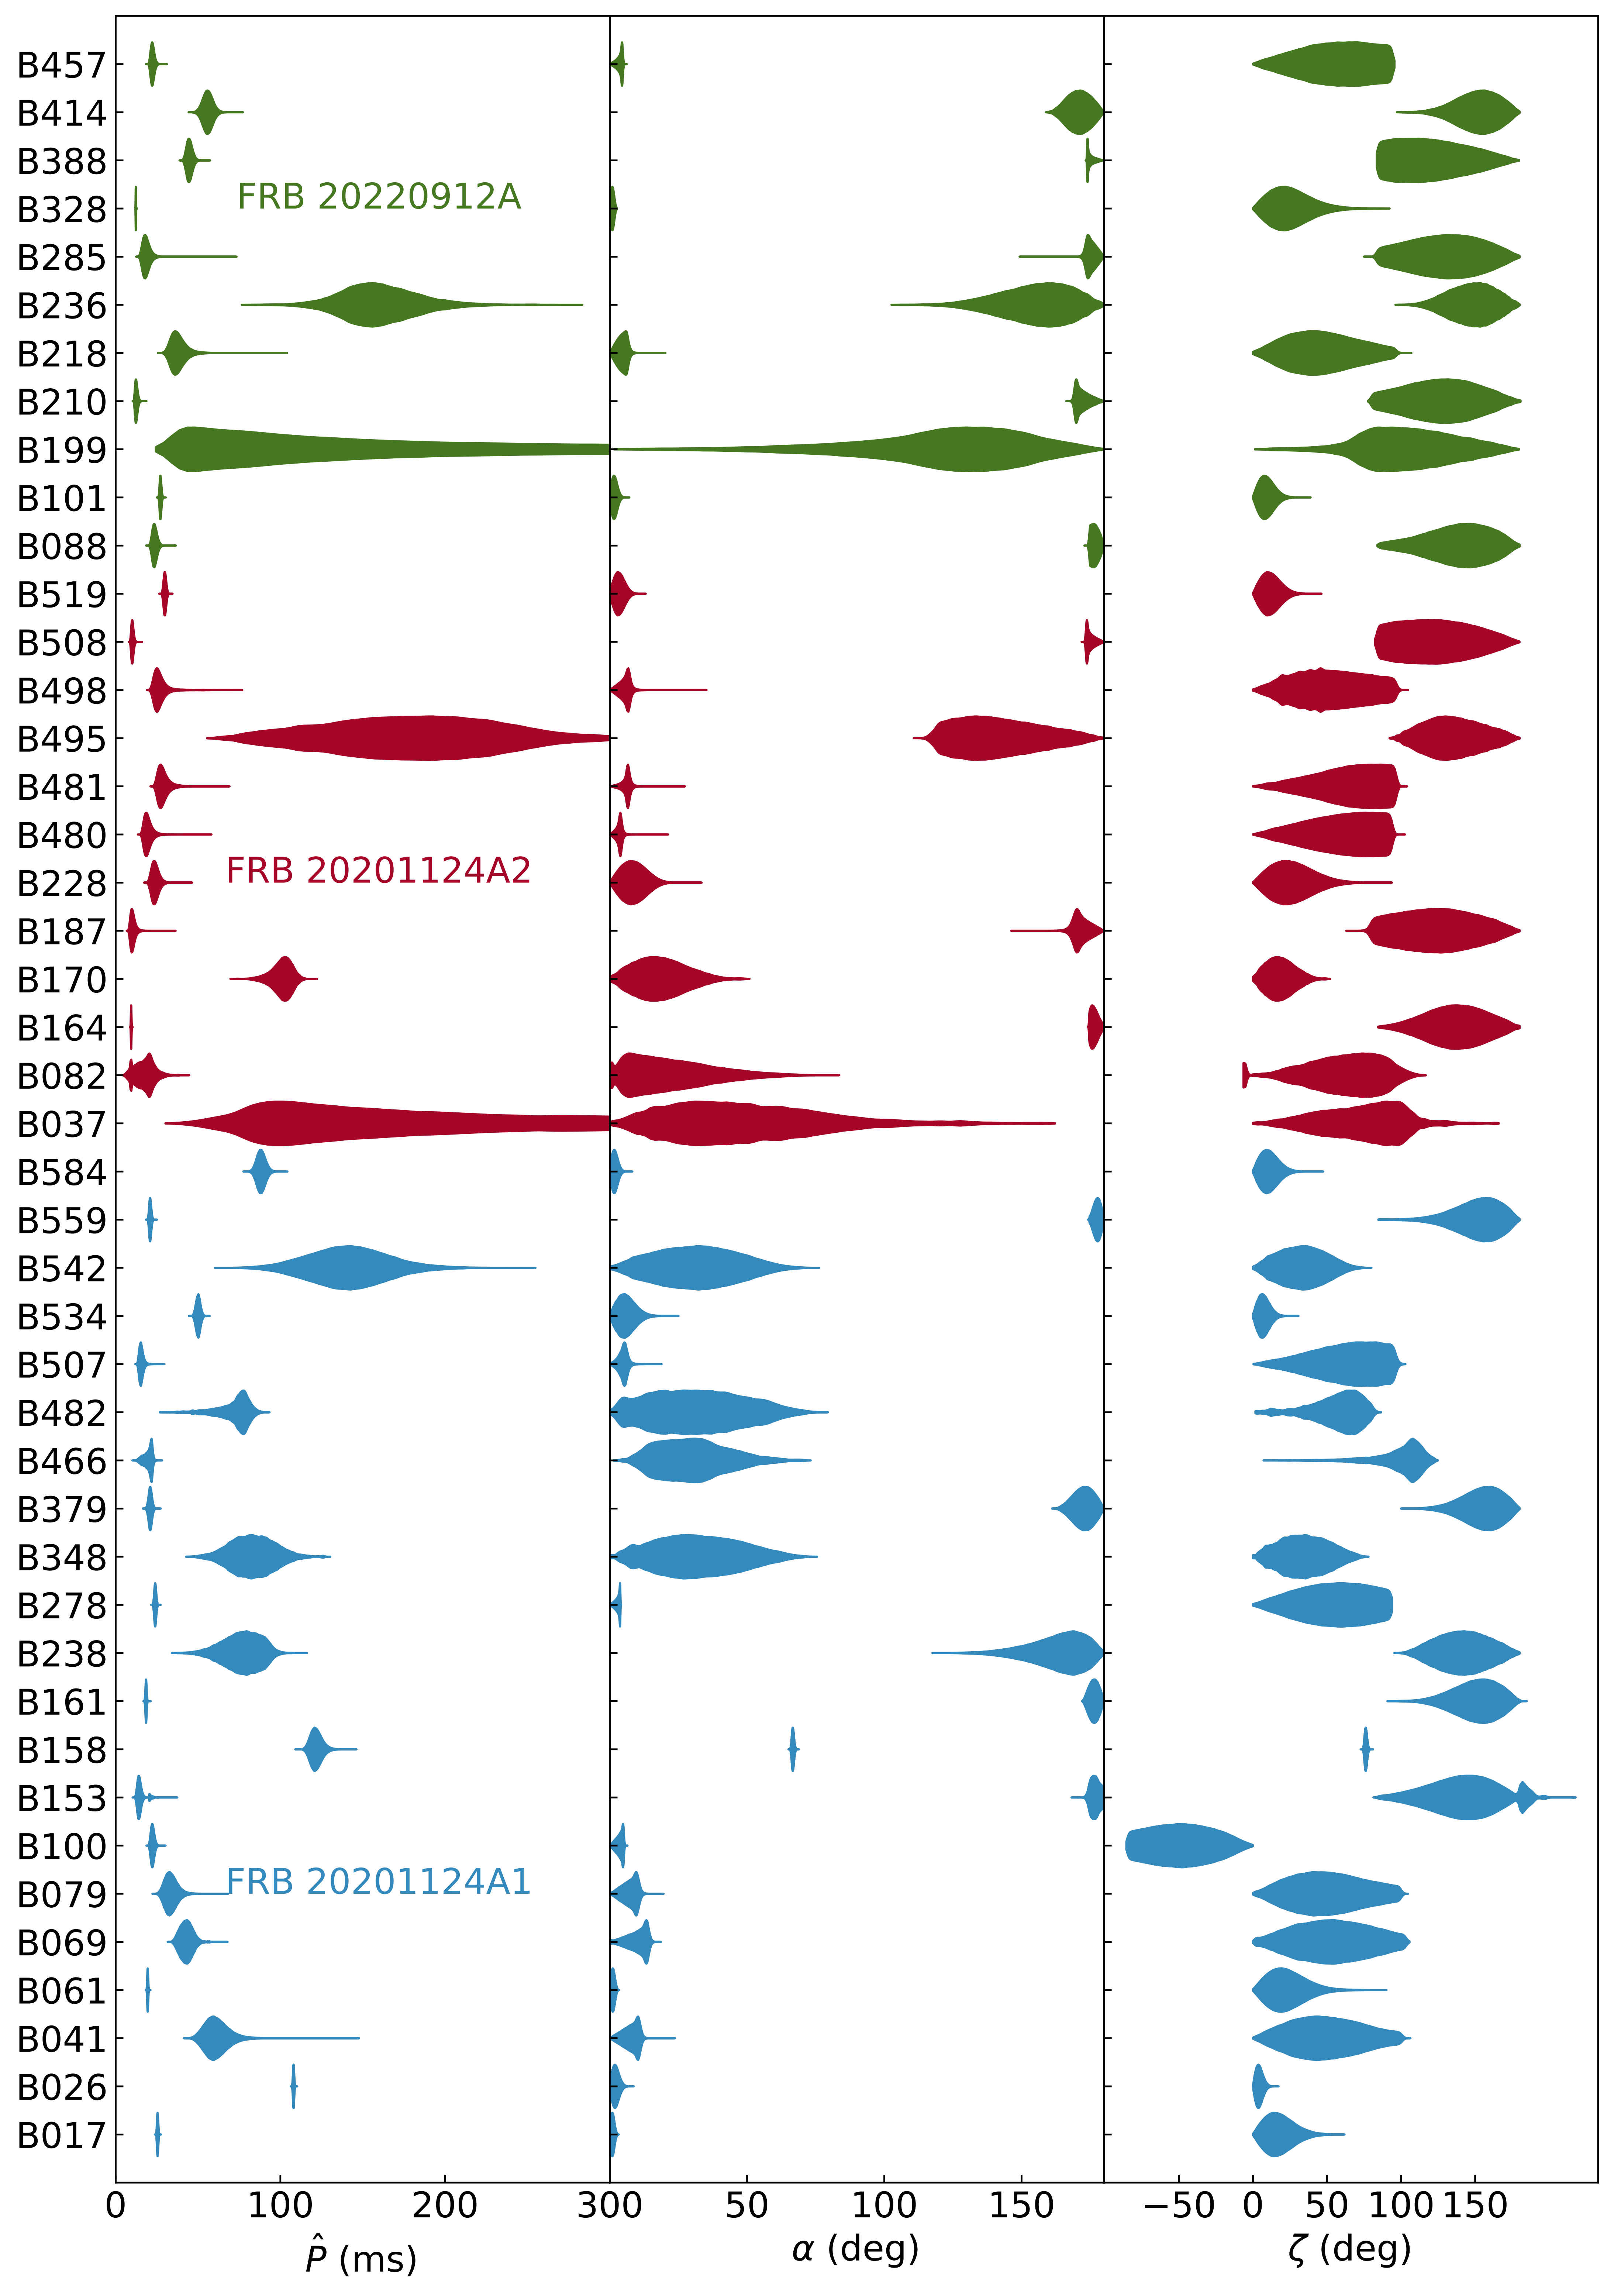
Origion of PA Variations
inconsistent periods and viewing angle:
magnetosphere is not stable and could be dynamically evolving
How the RVM-like cases show up?
1) emission may from random phase (Zhu et al. 2023)
2) low emission height (Cao et al. 2025)
3) the ram pressure of FRB ejecta and the radiation pressure of radio and X-ray emission (Ioka et al. 2020)
4) straighten the field lines (Qu et al.)
5) magnetic configuration
-> a dynamically evolving magnetosphere

Slide 9
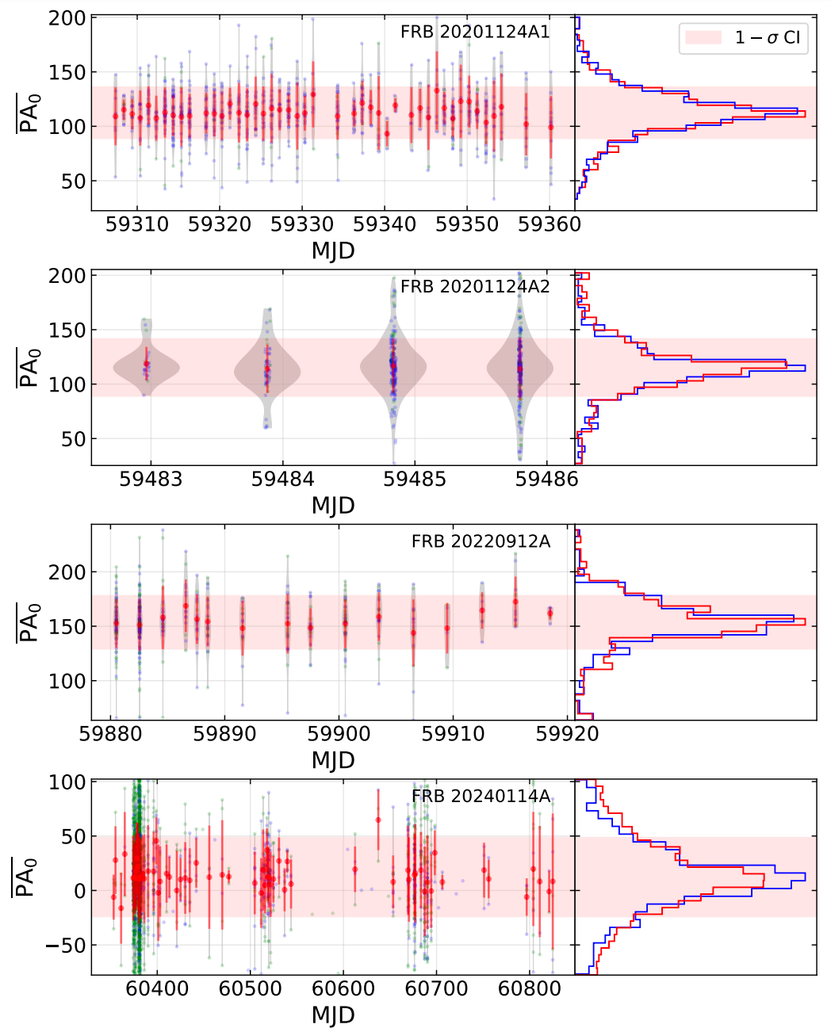
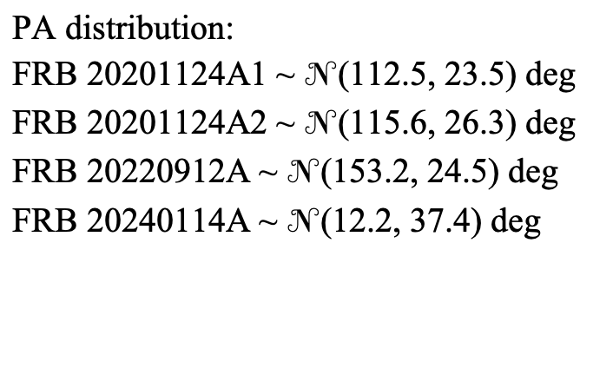
PA Behavior
PA properties:
1. burst-to-burst variation
2. stable Gaussian-like PA statistics
PA distribution:
FRB 20201124A1 ~ $𝒩$(112.5, 23.5) deg
FRB 20201124A2 ~ $𝒩$(115.6, 26.3) deg
FRB 20220912A ~ $𝒩$(153.2, 24.5) deg
FRB 20240114A ~ $𝒩$(12.2, 37.4) deg
FRB 20240114A observed by Parkes (Uttarkar et al. 2026) and Nancy (Manaswini et al. 2026)
GMRT FRB 20180916B => Stable magnetosphere?
(Bethapudi et al. 2025)

Slide 10
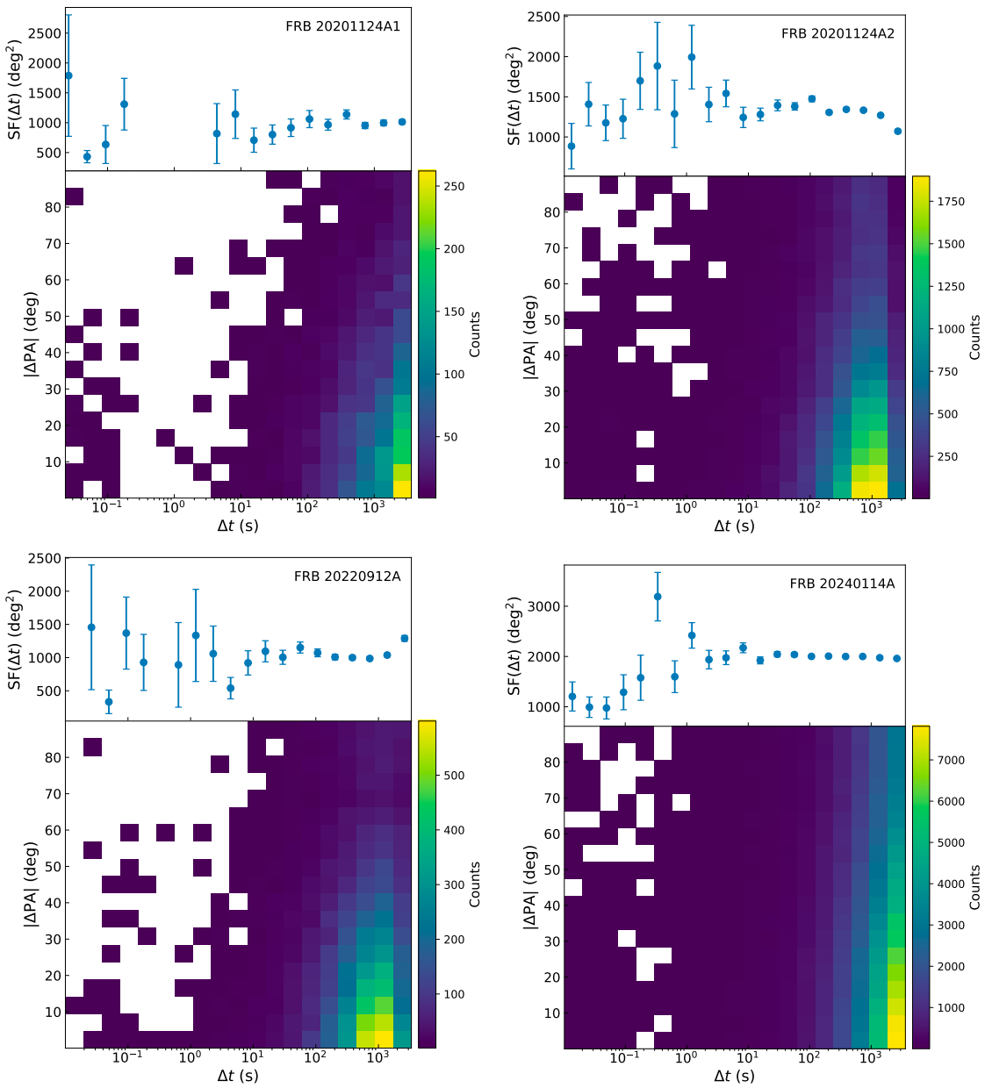

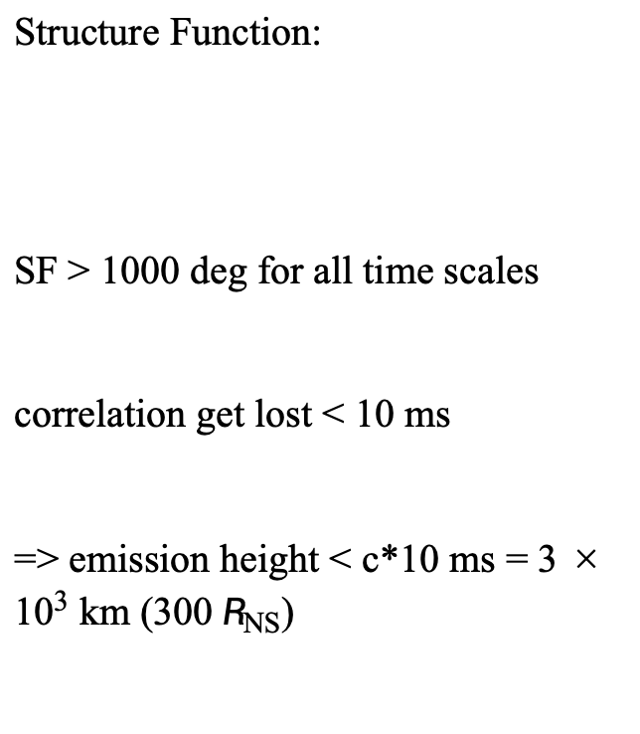
PA Behavior
Structure Function:
SF > 1000 deg for all time scales
correlation get lost < 10 ms
=> emission height < c*10 ms = $3×{10}^{3}$ km (300 $R_{NS}$)

Slide 11
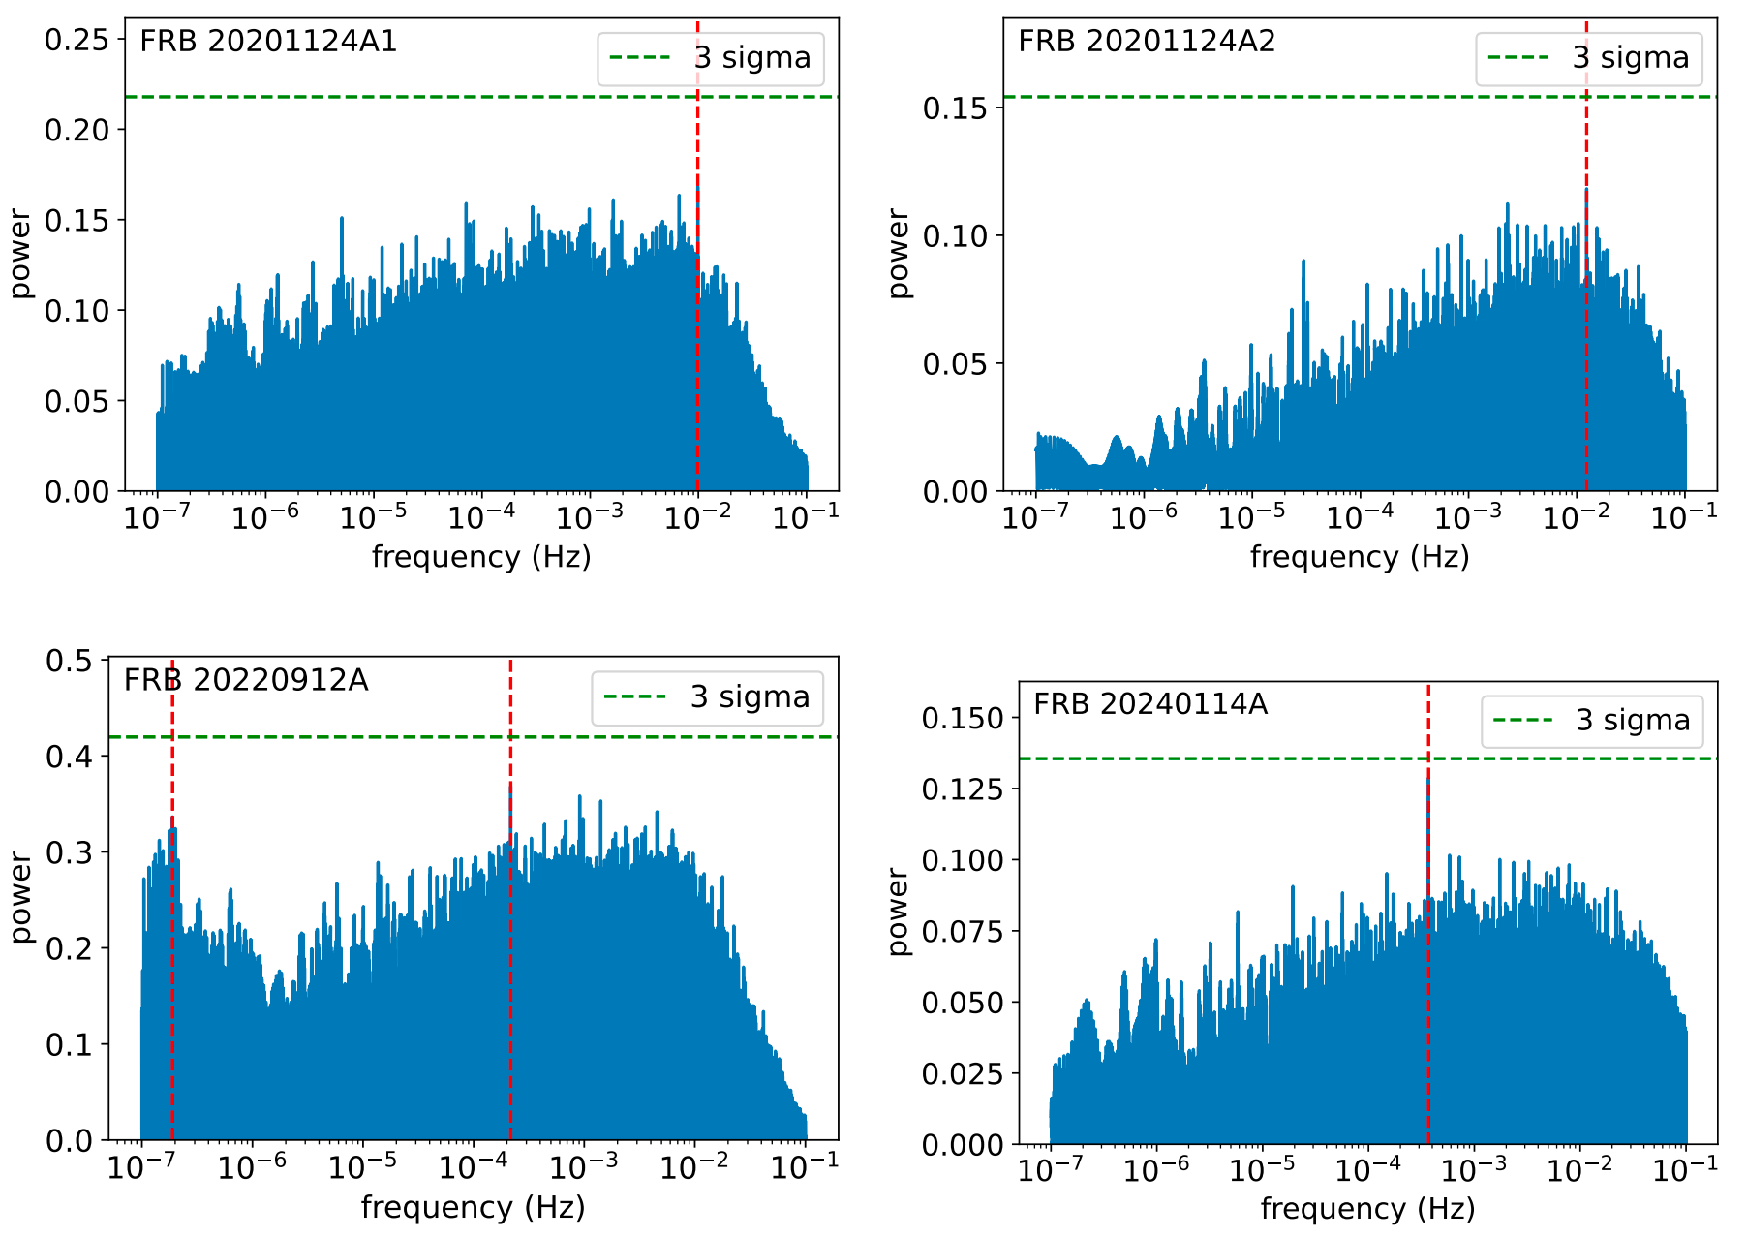
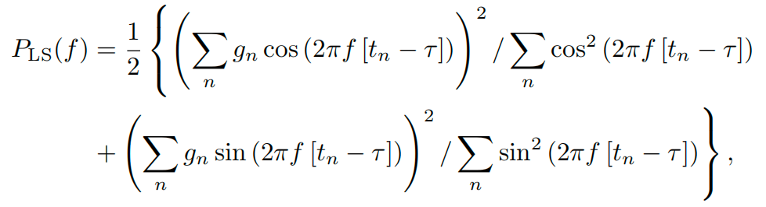
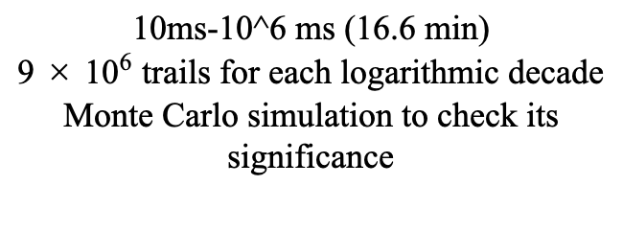
Period Search
Lomb-Scargle Periodogram (LSP)
Rajwade & Karastergiou 2025
10ms-10^6 ms (16.6 min)
$9×{10}^{6}$ trails for each logarithmic decade
Monte Carlo simulation to check its significance
No 3-sigma Candidates

Slide 12
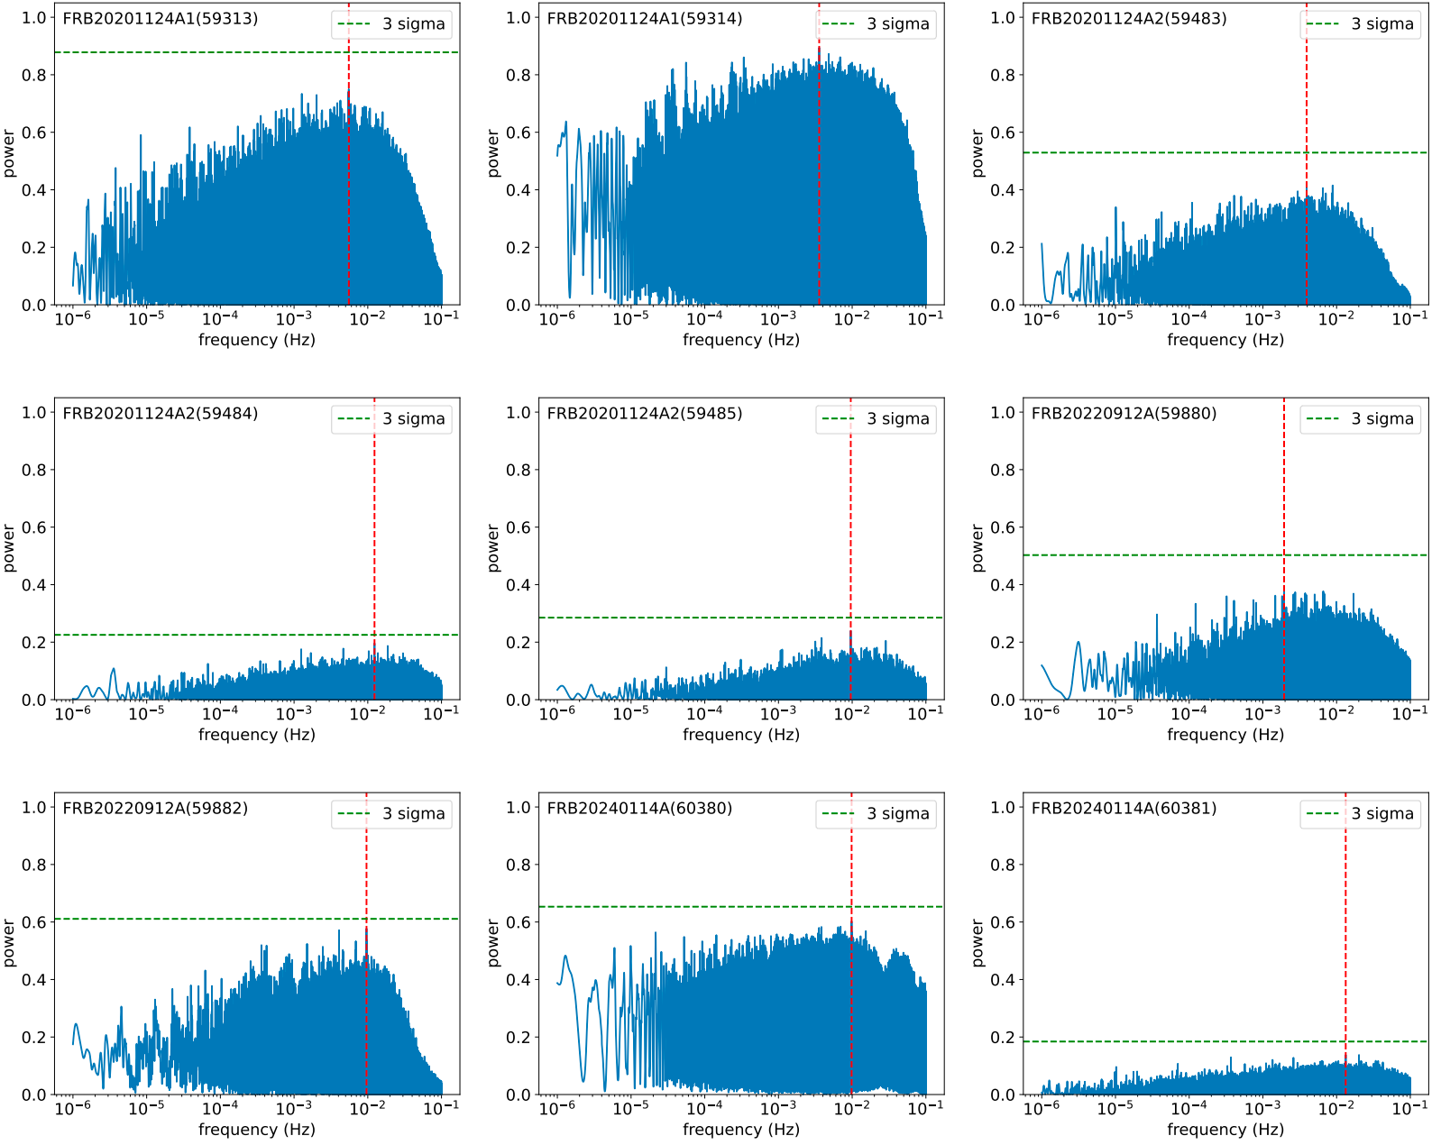
Period Search
The peak frequencies are weak (< 3-sigma) and inconsistent across different observing days and the full dataset.
No Global Periodic Signal

Slide 13
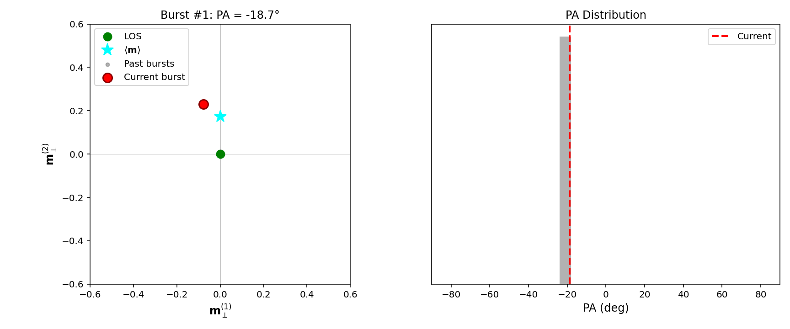
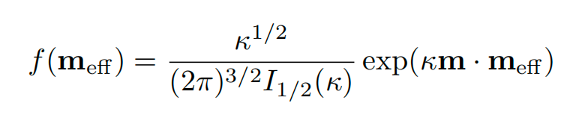

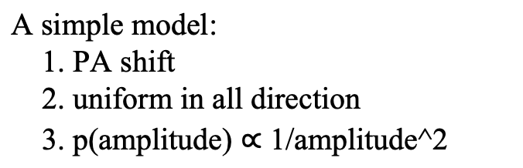
Dynamically Evolving Magnetosphere
short long
intra-burst PA swing Gaussian-like PA distribution
3-D von Mises-Fisher distribution
A simple model:
1. PA shift
2. uniform in all direction
3. p(amplitude) $∝$ 1/amplitude^2

Slide 14
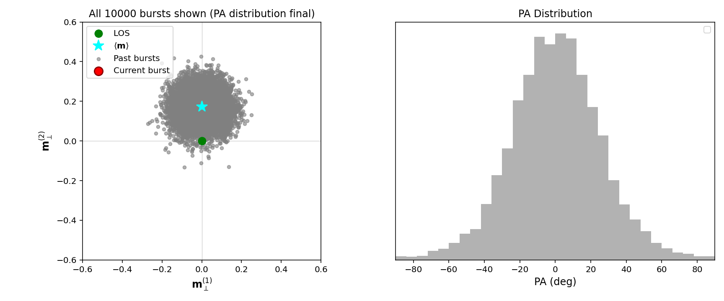
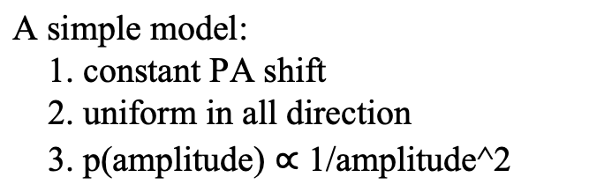
Dynamically Evolving Magnetosphere
A simple model:
1. constant PA shift
2. uniform in all direction
3. p(amplitude) $∝$ 1/amplitude^2
3-D von Mises-Fisher distribution

Slide 15
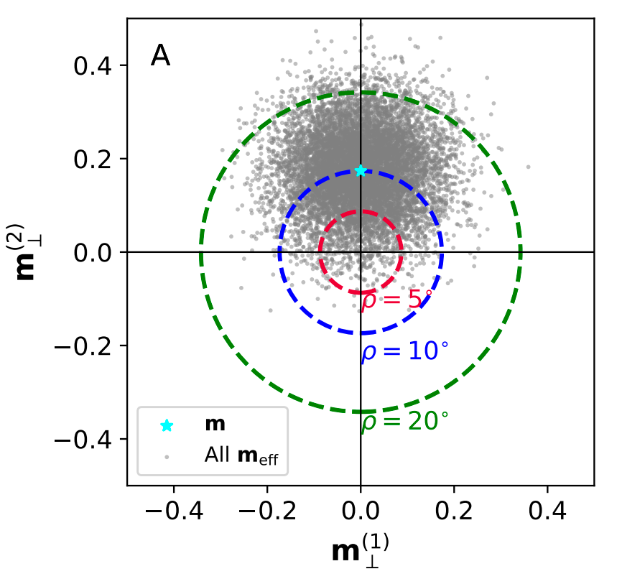
Dynamically Evolving Magnetosphere
3-D von Mises-Fisher distribution
+RVM = dynamic RVM!

Slide 16
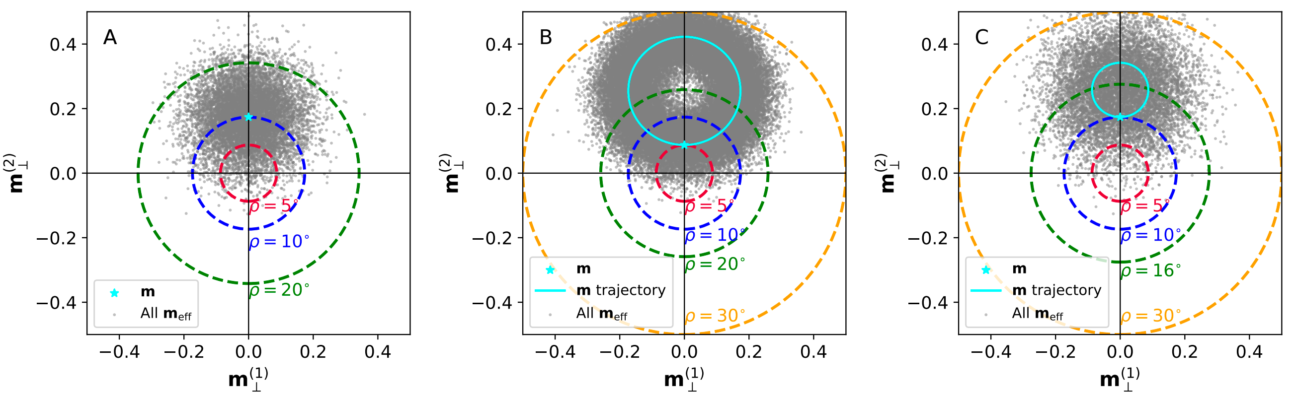
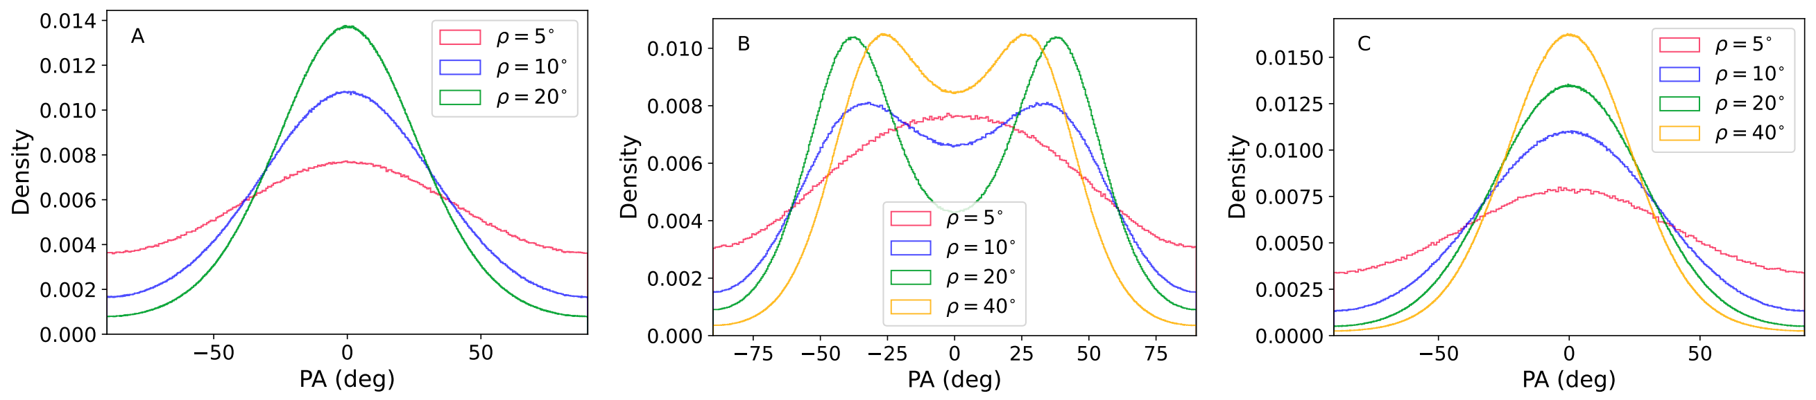



Dynamically Evolving Magnetosphere

Slide 17
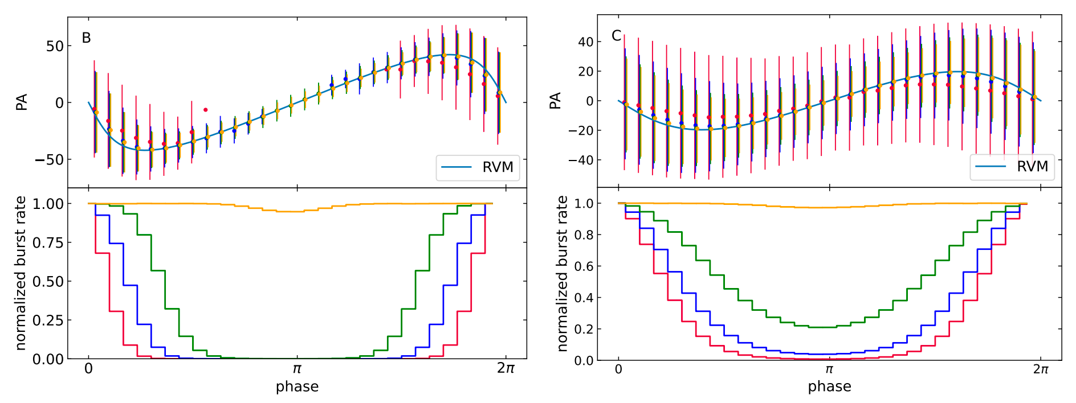
Dynamically Evolving Magnetosphere
The mean PA shows RVM-like phase evolution, sometimes the burst rate is modulated periodically.
We found no time-dependent trend in PA distribution.

Slide 18
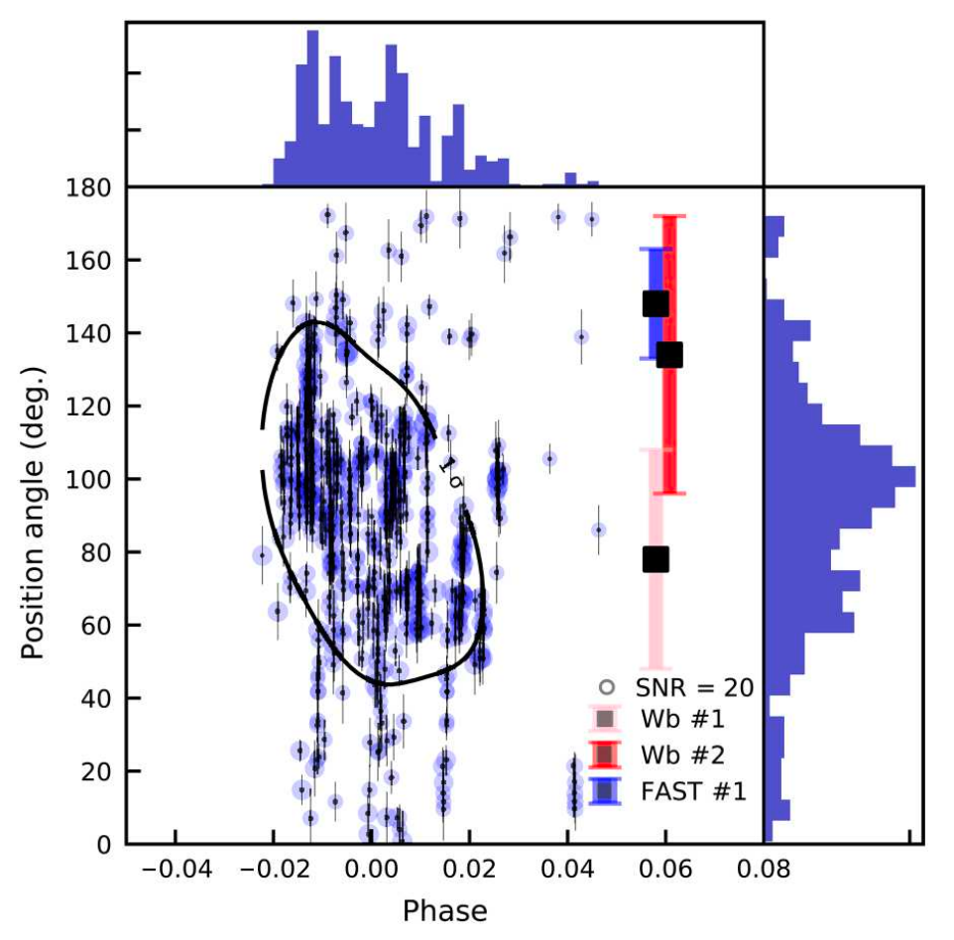
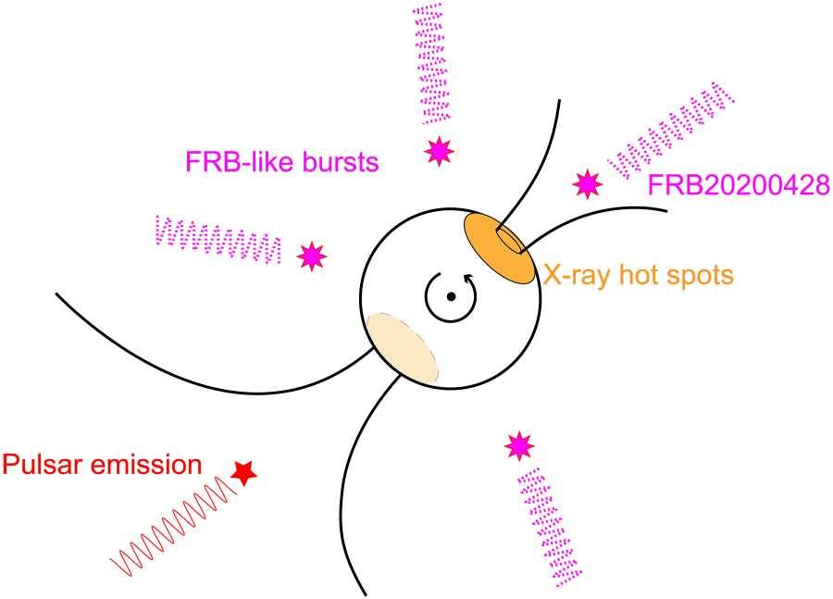
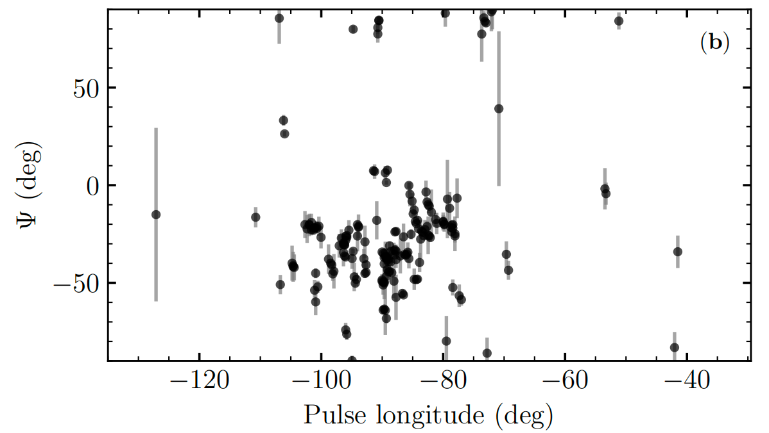
Discussion
SGR 1935+2154
Similarity with magnetars
Zhu et al. 2023
1E 1547-5408
Random locations?
No fixed phase and random PA distribution can be explained by the random wandering of the magnetic axis within a confined region
Lower et al. 2026
Zhu et al. 2023
a dynamically evolving magnetosphere

Slide 19
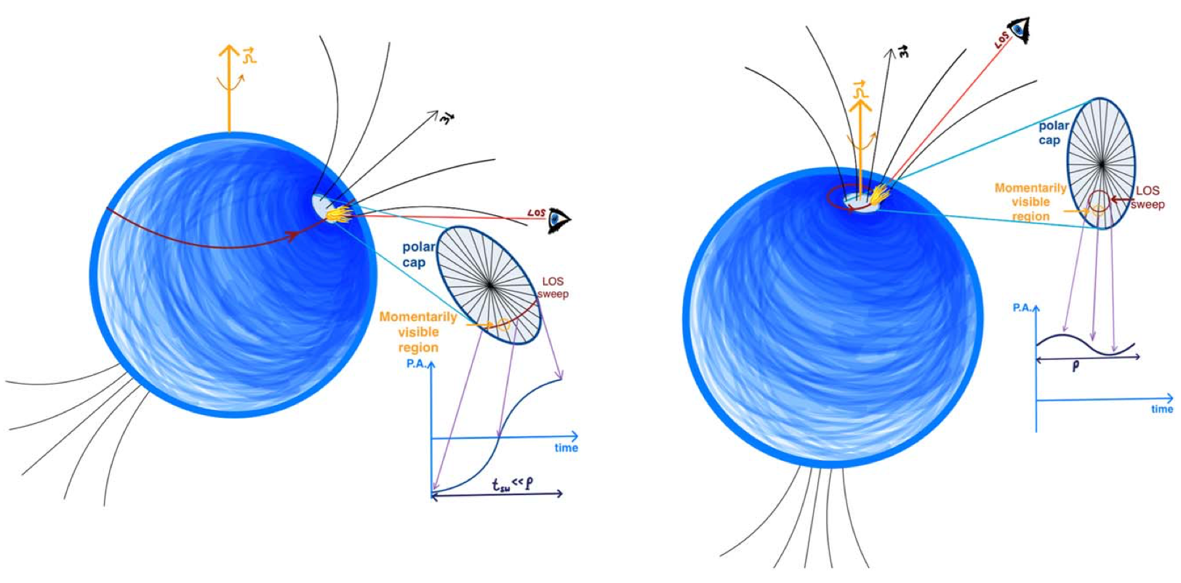
Discussion
One-off FRBs vs Repeating FRBs => misaligned and aligned geometries
Beniamini & Kumar 2025
The dynamically evolving magnetosphere can relieve this problem. For most viewing geometries, bursts can be detected only once or extremely infrequently. When line of sight is aligned with the mean magnetic axis, they can detect bursts frequenctly.

Slide 20
Conclusion
1. We identified 46 RVM-like PA curves, while the inferred parameters are inconsistent. This indicates that FRBs likely originate from the dynamically evolving magnetosphere.
2. The burst-to-burst PAs are randomly distributed, show no detectable periodicity, and can be naturally explained by the geometric projection effects of a dynamically evolving magnetosphere.
(Liu et al. 2025, ApJ; Liu et al. 2026, ApJ)
arxiv:2504.00391; 2605:00372
Thank you!

Slide 21
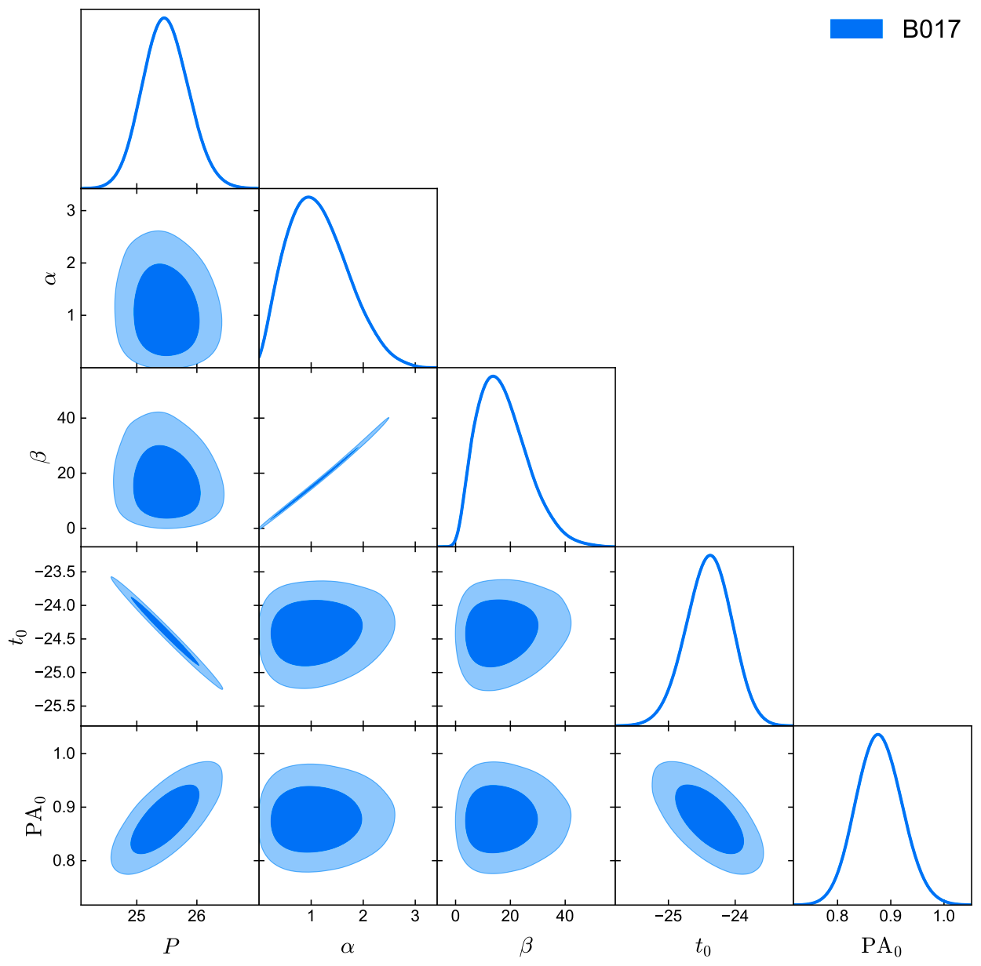
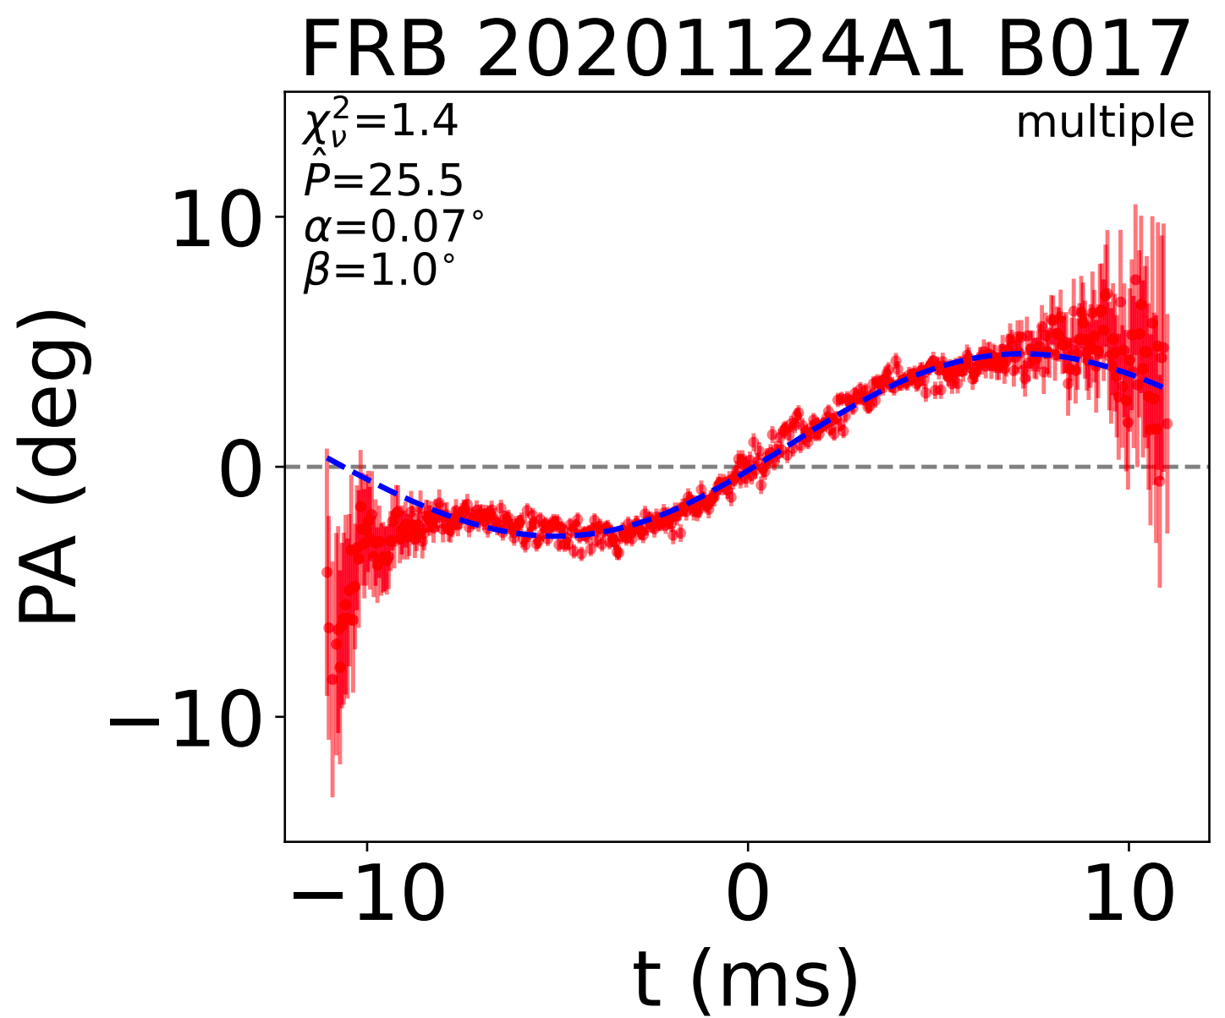
Q1: Parameter Degeneracy
Some PA curves can cover an entire cycle!

Slide 22
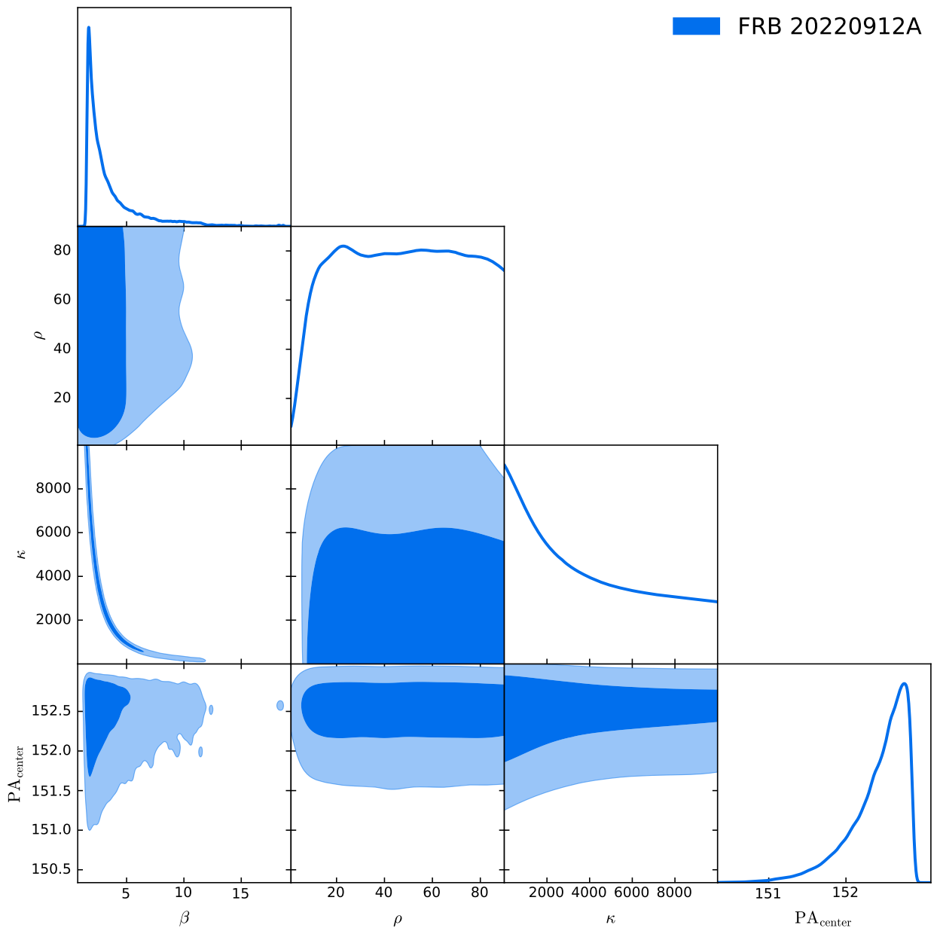
Q2: Fit PA distribution with Model A
The concentration parameter and beta are highly degenerated!
Decreasing κ and increasing β produce the same effect of broadening the distribution.

