Slide 1
Fast/Future Pulsar Symposium 15
Distinct Modes of Pulsar Glitch Activity
Revealed by the Waiting-Time-Amplitude Morphology
Wen-Tong Liu(刘文通)
Xinjiang Astronomical Observatory
Suoervisor: Xia Zhou
Collaborators: Wei-Hua Wang, Fei-Fei Kou
2026.7.3
Notes:
EN:
- Today I will present our work on pulsar glitch activity.
- The key idea is to classify glitches using the joint morphology of waiting time and amplitude.
- Main result: 349 glitches from 22 pulsars reveal two reproducible modes: Compact and Extended.
中文：
- 今天我汇报我们关于脉冲星 glitch 活动模式的工作。
- 核心思路是不用单独的振幅分类，而是看等待时间和振幅的二维形态。
- 主要结果是：22 颗脉冲星的 349 次 glitch 显示出 Compact 和 Extended 两种模式。

Slide 2
Why Move Beyond Vela-like and Crab-like?
Glitches are sudden spin-up events that probe angular-momentum exchange inside neutron stars.
The traditional labels capture useful intuition but do not define reproducible quantitative boundaries.
Amplitude alone is incomplete: recurrence time carries information about the pre-glitch reservoir.
Goal: classify sources in the joint plane of backward waiting time and fractional glitch amplitude.
Question: are glitching pulsars organized into distinct activity modes, or only a continuum?
Notes:
EN:
- Glitches are sudden spin-up events and probe angular-momentum transfer inside neutron stars.
- Traditional labels, such as Vela-like and Crab-like, are useful but qualitative.
- We want a reproducible, data-driven boundary.
- The central question is whether glitch activity forms distinct modes in the waiting-time-amplitude plane.
中文：
- Glitch 是脉冲星突然自转加快的事件，可以探测中子星内部角动量转移。
- 传统的 Vela-like 和 Crab-like 分类有直观意义，但边界不够定量。
- 我们希望建立一个可复现、数据驱动的分类标准。
- 核心问题是：在等待时间-振幅平面上，glitch 活动是否存在不同模式。

Slide 3
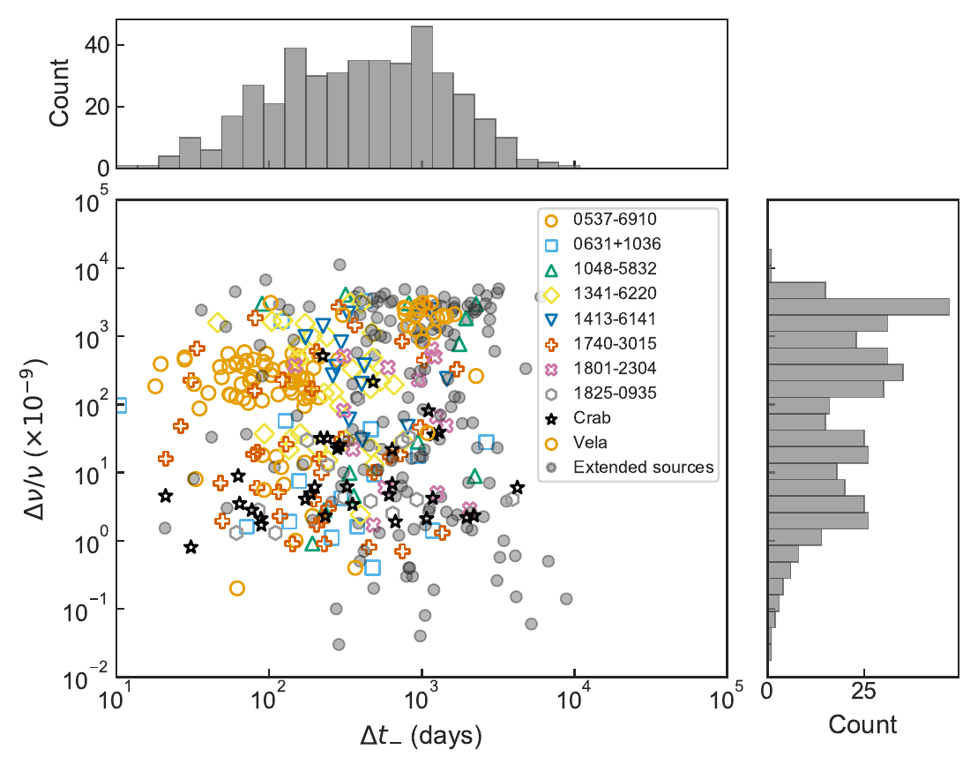
Data Set: The Waiting-Time-Amplitude Plane
Catalog: Jodrell Bank + ATNF, with recent literature updates through March 2026.
Cleaned sample: 349 glitches from 22 pulsars after duplicate, missing-amplitude, and coverage-gap filtering.
Selection threshold: retained sources have at least 6 recorded glitches.
Dynamic range: Delta t- spans days to >4000 d; Delta nu / nu spans about 10^-9 to 10^-6.
Notes:
EN:
- We combine the Jodrell Bank and ATNF glitch catalogues, plus recent literature updates.
- The final cleaned sample contains 349 glitches from 22 pulsars.
- We use backward waiting time, Delta t-, because it traces the pre-glitch accumulation stage.
- The data span several orders of magnitude in both waiting time and fractional amplitude.
中文：
- 数据来自 Jodrell Bank 和 ATNF glitch 星表，并加入近期文献更新。
- 清洗后样本包括 22 颗脉冲星、349 次 glitch。
- 我们使用 backward waiting time，也就是前一次 glitch 到本次 glitch 的间隔，因为它对应事件前的积累过程。
- 数据在等待时间和相对振幅上都覆盖了几个数量级。

Slide 4
Method: Turn Sparse Events into Morphology
Per-source events
Delta t- and Delta nu / nu
2D KDE
smooth occupancy field
68% HDR
defines the core
Descriptors
area, anisotropy, tails
Ward
clustering
Feature vector for each pulsar: log A_HDR, log AR, and f_out.
A_HDR measures the size of the high-density core.
AR measures elongation of the occupancy pattern.
f_out measures the fraction of events outside the 68% HDR core.
Notes:
EN:
- For each pulsar, we estimate a two-dimensional KDE in the Delta t- versus Delta nu / nu plane.
- We extract the 68 percent highest-density region, or HDR, as the activity core.
- Three descriptors summarize the morphology: HDR area, anisotropy ratio, and out-of-HDR fraction.
- These descriptors are then used for hierarchical clustering.
中文：
- 对每颗脉冲星，在 Delta t- 和 Delta nu / nu 平面上做二维 KDE。
- 提取包含 68% 概率质量的最高密度区域，也就是 HDR，作为活动核心。
- 用三个量描述形态：HDR 面积、各向异性比值、以及 HDR 外事件比例。
- 最后用这些形态参数做层次聚类。

Slide 5
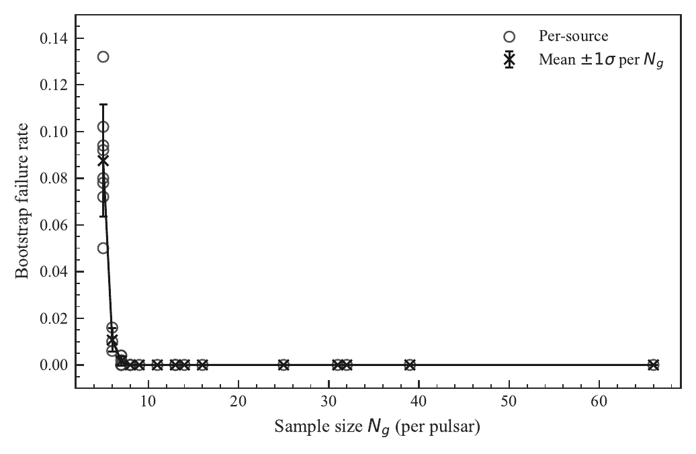
Why Require at Least Six Glitches?
Bootstrap resampling tests whether KDE-HDR reconstruction is stable for each source.
The failure rate drops sharply from N_g = 5 to N_g = 6.
This supports the adopted threshold and limits the influence of poorly constrained density fields.
Notes:
EN:
- Sparse glitch records can make KDE reconstruction unstable.
- Bootstrap tests show that the failure rate drops clearly at N_g = 6.
- This motivates the threshold of at least six recorded glitches.
- The point is to keep enough sources while avoiding unreliable density maps.
中文：
- 如果单颗脉冲星记录的 glitch 太少，KDE 形态会不稳定。
- Bootstrap 测试显示，失败率在 N_g = 6 处明显下降。
- 因此我们采用至少 6 次 glitch 的阈值。
- 这样可以在保留样本数量和保证形态可靠性之间取得平衡。

Slide 6
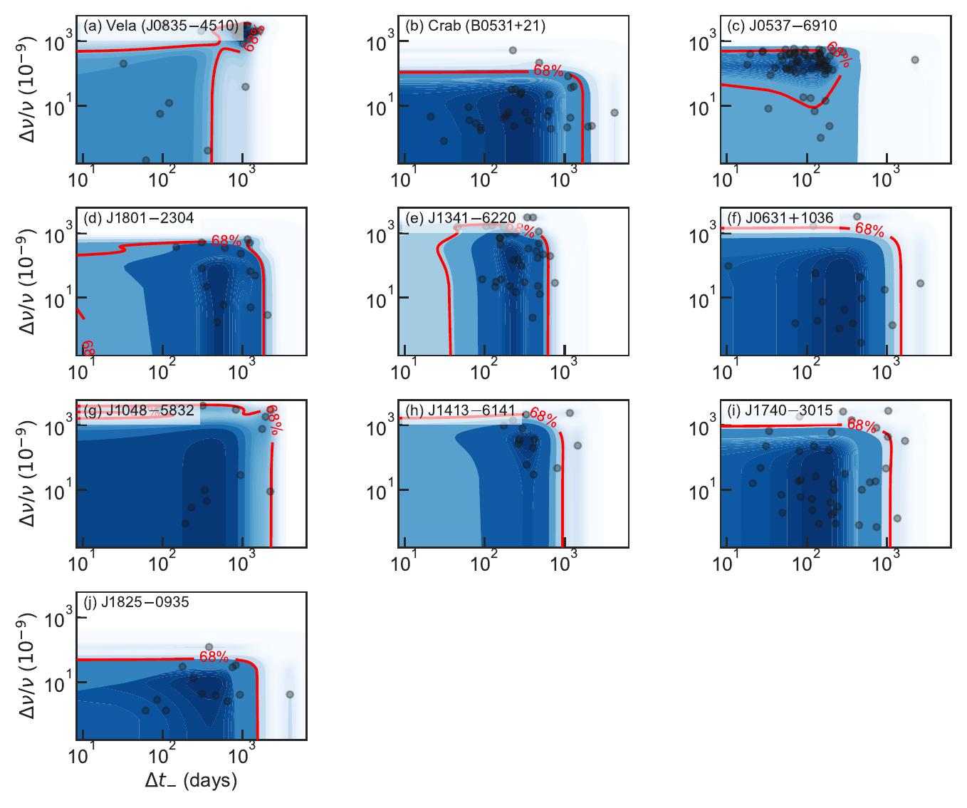
Per-Source KDE Maps Show Real Morphological Diversity
Crab: a tightly confined core at small amplitudes and short-to-moderate waiting times.
Vela: a broad, structured ridge at large amplitudes with secondary occupancy.
J0537-6910: an elongated field with multiple peaks and high peripheral occupancy.
The relevant signal is geometry, not only the one-dimensional glitch-size distribution.
Notes:
EN:
- The KDE maps show that individual pulsars occupy the plane differently.
- Crab has a compact core at small amplitudes.
- Vela has a broader and more structured distribution.
- J0537-6910 is elongated and shows strong peripheral occupancy.
- So the key signal is the geometry of the two-dimensional distribution.
中文：
- KDE 图显示，不同脉冲星在二维平面上的占据形态明显不同。
- Crab 的核心很紧凑，振幅较小。
- Vela 的分布更宽，并且有更复杂的结构。
- J0537-6910 的分布被拉长，并且外围事件较多。
- 因此真正有信息的是二维分布的几何形态，而不只是 glitch 振幅。

Slide 7
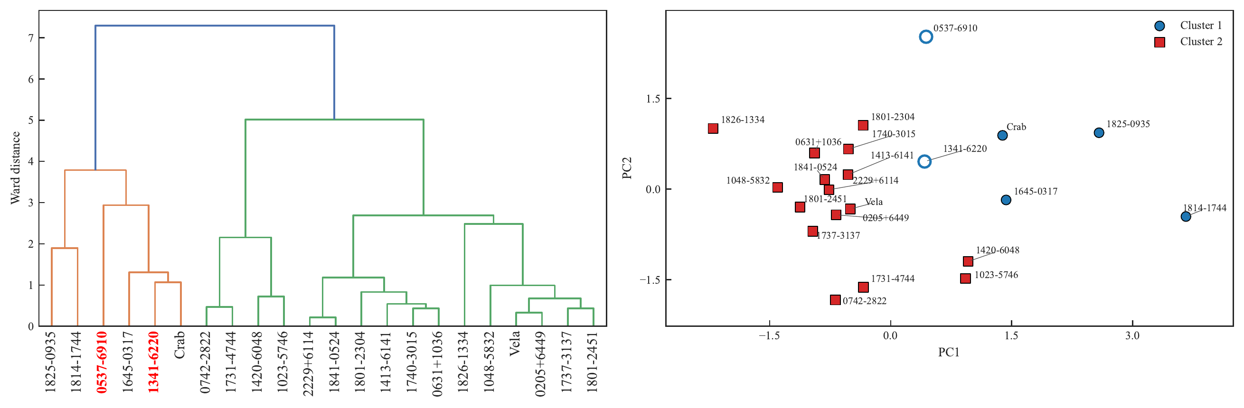
Population Result: Compact and Extended Classes
Hierarchical clustering reveals a primary two-class split in KDE-HDR feature space.
Compact class: smaller HDR areas, higher anisotropy, and limited peripheral excursions.
Extended class: broader, more isotropic distributions with stronger low-density tails.
Two prolific sources, J0537-6910 and J1341-6220, sit in intermediate Complex positions.
PCA context: PC1 explains 72.4% of the variance and traces overall occupancy extent; PC2 adds 19.1% and captures shape variation.
Notes:
EN:
- Hierarchical clustering gives a primary split into two classes.
- Compact sources have small HDR areas, higher anisotropy, and limited tails.
- Extended sources have broader, more isotropic distributions and stronger tails.
- J0537-6910 and J1341-6220 are marked as Complex because they lie between the two modes.
中文：
- 层次聚类给出了一个主要的二分类结构。
- Compact 类的 HDR 面积较小，各向异性较高，外围事件较少。
- Extended 类分布更宽、更接近各向同性，并且低密度尾部更明显。
- J0537-6910 和 J1341-6220 位于两类之间，因此标记为 Complex。

Slide 8
Robustness and Physical Drivers
Classification stability
Most sources retain their baseline class in more than 85% of bootstrap realizations.
Feature ablation changes labels mainly for low-stability sources.
The baseline split is exactly recovered for q = 0.50 or 0.68 with moderate bandwidths.
Physical association
Logistic regression gives in-sample AUC = 0.88.
Leave-one-out AUC_CV = 0.59, so coefficients are trends, not hard boundaries.
The dominant predictor is mean backward waiting time, with coefficient 1.531.
Notes:
EN:
- The two-class structure is stable under bootstrap resampling for most sources.
- Feature-ablation tests show that the result is not controlled by one single descriptor.
- Logistic regression links the morphology to physical parameters.
- The strongest predictor is the mean backward waiting time.
- The in-sample AUC is high, but cross-validation is modest, so we interpret coefficients cautiously.
中文：
- 对多数源来说，二分类结果在 bootstrap 重采样下是稳定的。
- 去掉单个特征后的测试说明，这个结果不是由某一个形态参数单独决定的。
- Logistic regression 进一步把形态分类和物理参数联系起来。
- 最强的预测因子是平均 backward waiting time。
- 训练集 AUC 较高，但交叉验证结果有限，因此系数主要表示重要性排序，而不是精确边界。

Slide 9
Physical Interpretation
Compact mode
Near-complete reservoir depletion in each cycle.
Waiting time and amplitude are coherently coupled.
Occupancy appears as a concentrated core or elongated ridge.
Extended mode
Partial, avalanche-like releases tap only part of the reservoir.
Sizes and intervals become broader and less tightly coupled.
Observed short-term glitch activity G can underestimate true superfluid participation.
Notes:
EN:
- Compact morphology suggests coherent, nearly complete depletion of the angular-momentum reservoir.
- In this case, waiting time and glitch amplitude remain tightly coupled.
- Extended morphology is more consistent with partial, avalanche-like releases.
- Then the observed glitch activity may underestimate the total superfluid reservoir.
中文：
- Compact 形态可以理解为角动量库被较为一致、接近完全地释放。
- 这种情况下，等待时间和 glitch 振幅耦合更紧密。
- Extended 形态更像是部分释放、雪崩式触发的结果。
- 因此观测到的 glitch activity 可能低估真实参与的超流储备。

Slide 10
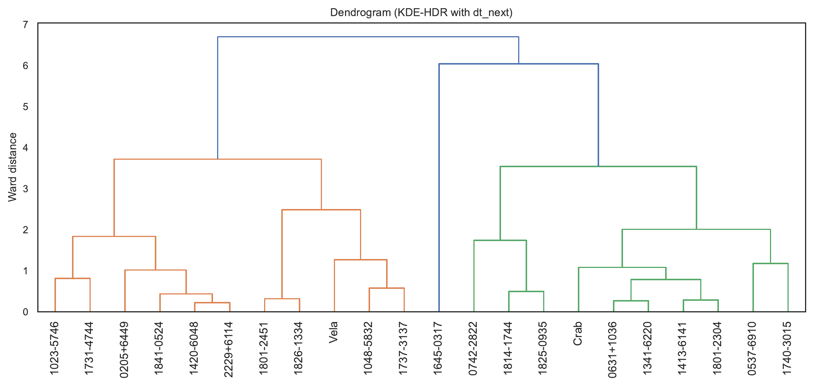
Why the Backward Waiting Time Matters
Delta t- conditions each glitch on the pre-event state of the reservoir.
Repeating the pipeline with forward waiting time still gives two classes, but the separation is weaker.
Forward intervals are more exposed to post-glitch recovery and stochastic triggering.
This supports Delta t- as the primary variable for reservoir accumulation.
Notes:
EN:
- We also repeated the analysis with forward waiting time.
- A two-class structure still appears, but it is less stable.
- This makes sense because forward waiting time is affected by post-glitch recovery and later triggering.
- Backward waiting time is more directly connected to pre-glitch reservoir accumulation.
中文：
- 我们也用 forward waiting time 重复了同样分析。
- 仍然可以看到二分类结构，但稳定性更弱。
- 这是合理的，因为 forward waiting time 会受到 glitch 后恢复和后续触发过程的影响。
- 相比之下，backward waiting time 更直接反映 glitch 前的储备积累。

Slide 11
Conclusions
A reproducible KDE-HDR framework quantifies glitch morphology in the Delta t_- versus Delta nu / nu plane.
The cleaned sample of 349 glitches from 22 pulsars separates into Compact and Extended modes.
Mean backward waiting time is the strongest physical predictor of class membership.
Compact morphology is consistent with coherent, near-complete depletion; Extended morphology points to partial avalanche-like releases.
Morphological class should be considered when using glitch activity to infer the angular-momentum reservoir.
Thank you
Notes:
EN:
- We propose a KDE-HDR framework for classifying pulsar glitch morphology.
- The method turns sparse event records into reproducible geometric descriptors.
- The sample separates into Compact and Extended modes.
- Mean backward waiting time is the most important physical predictor.
- This morphology should be considered when using glitches to infer neutron-star interiors.
中文：
- 我们提出了基于 KDE-HDR 的脉冲星 glitch 形态分类方法。
- 这个方法把稀疏事件记录转化为可复现的几何参数。
- 样本显示出 Compact 和 Extended 两种模式。
- 平均 backward waiting time 是最重要的物理预测因子。
- 用 glitch 约束中子星内部结构时，应当考虑这种形态分类。

