Slide 1




Interpreting the Asymmetric Morphology of
Geminga and Monogem Halos Measured by HAWC
Sizhe Wu¹, ChaoMing Li^{1,2}, Ruoyu Liu¹,
¹School of Astronomy and Space Science, Nanjing University
²Deutsches Elektronen Synchrotron (DESY)
221840235@smail.nju.edu.cn
2026.07.04

Slide 2
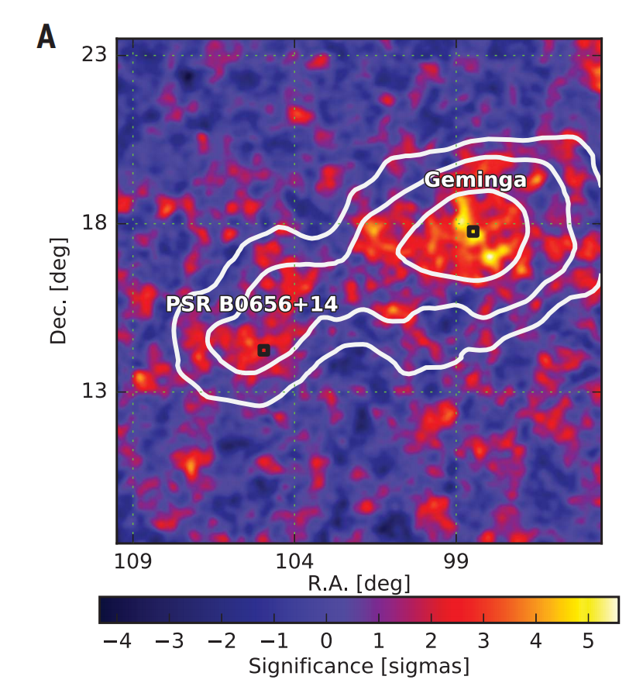
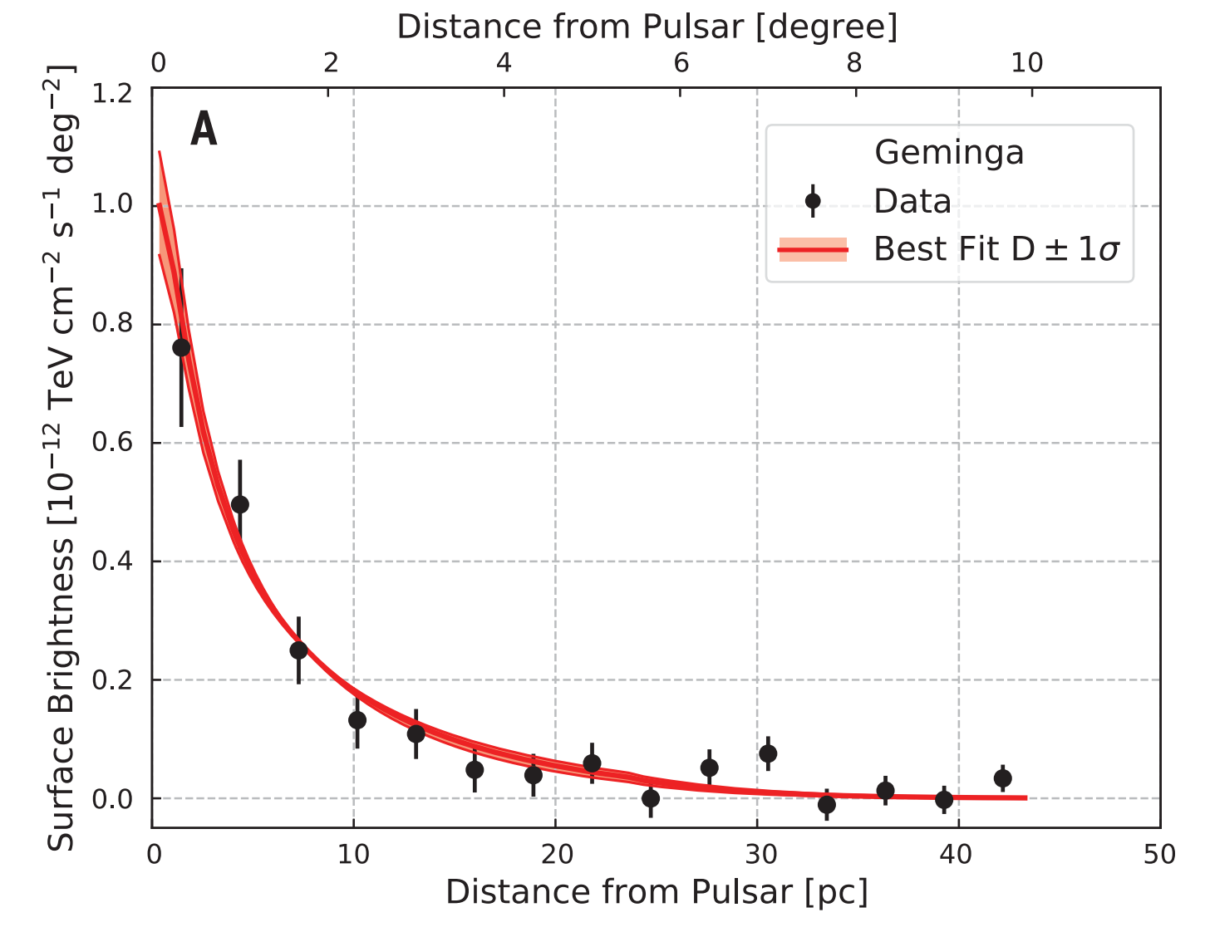
Introduction - What is Pulsar Halo?
In 2017, HAWC detected diffuse TeV gamma-ray emission around Geminga and Monogem pulsars, extending for at least ∼20 pc, which are termed pulsar halos.
Abeysekara et al. (2017)
Science
01

Slide 3
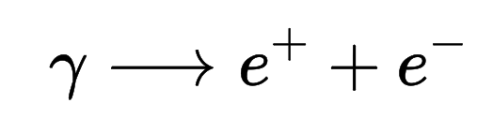
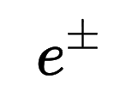
Introduction - What is Pulsar Halo?
(With B field)
In PWNe
Fermi acceleration
TeV
B-field
photon field (e.g. CMB)
Synchrotron radiation
(X-Ray)
Inverse Compton Scattering
(TeV gamma-ray)
02

Slide 4
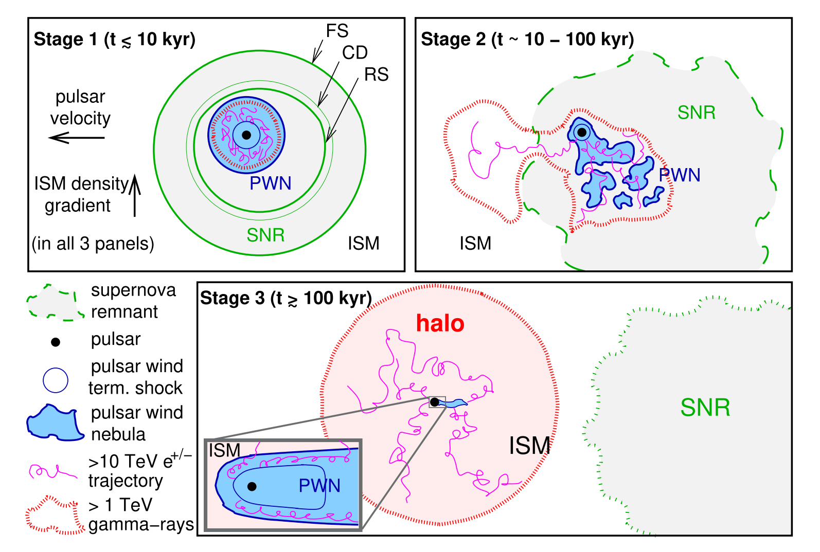
Introduction - What is Pulsar Halo?
Pulsar halos evolve from PWNe
G. Giacinti et al.,
Astron. Astrophys. 636, A113
03

Slide 5
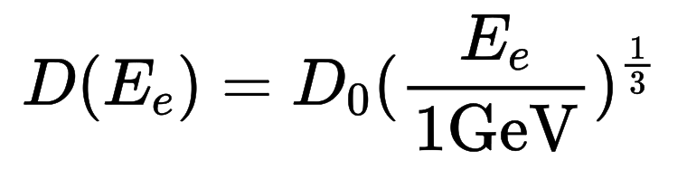
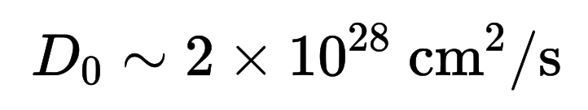
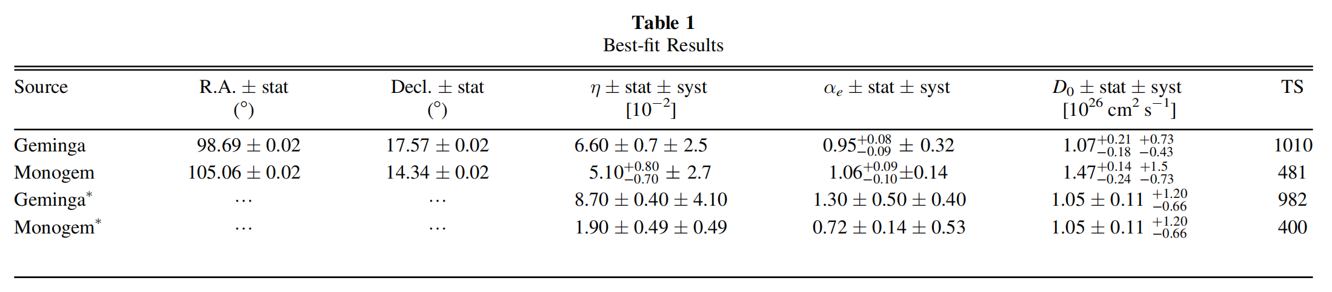
Introduction - Slow Diffusion Coefficient in Pulsar Halo
Typical diffusion coefficient of cosmic rays in the galaxy:
请输入标题
Tens to hundreds of times smaller than expected!
Albert et al. (2024) PRD
04

Slide 6
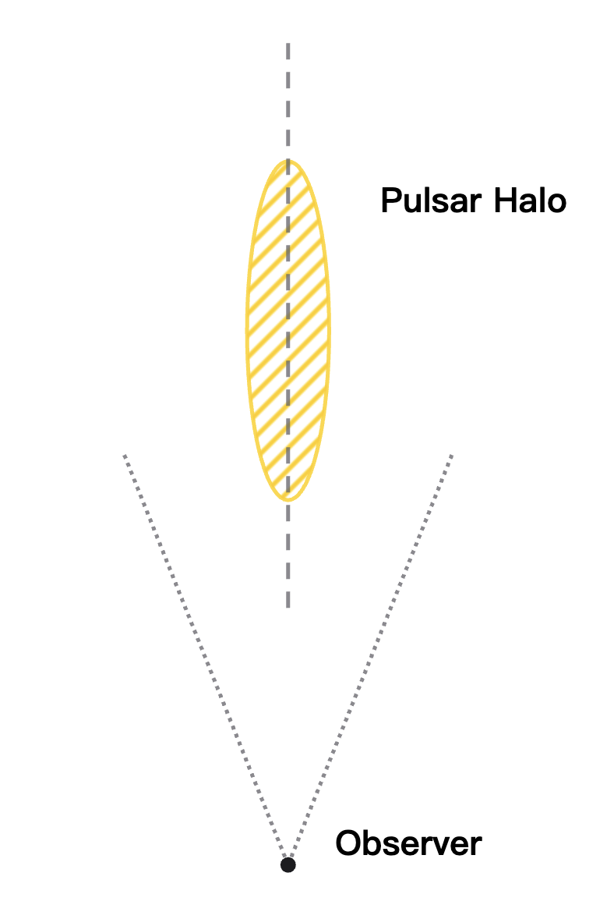

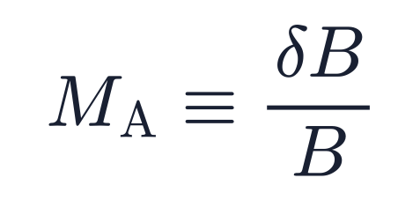
Introduction - Anisotropic Diffision Model
Within a single coherent magnetic domain, electron diffusion proceeds more slowly in the direction perpendicular to the mean magnetic field.
请输入标题
In the anisotropic diffision model, pulsar halos exhibit an elongated elliptical morphology.
Anisotropic diffision model can explain the suppressed diffusion and predict the asymmetric shape of pulsar halo in observation.
05

Slide 7
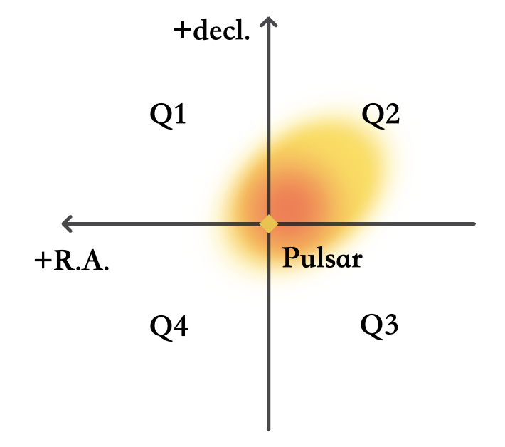
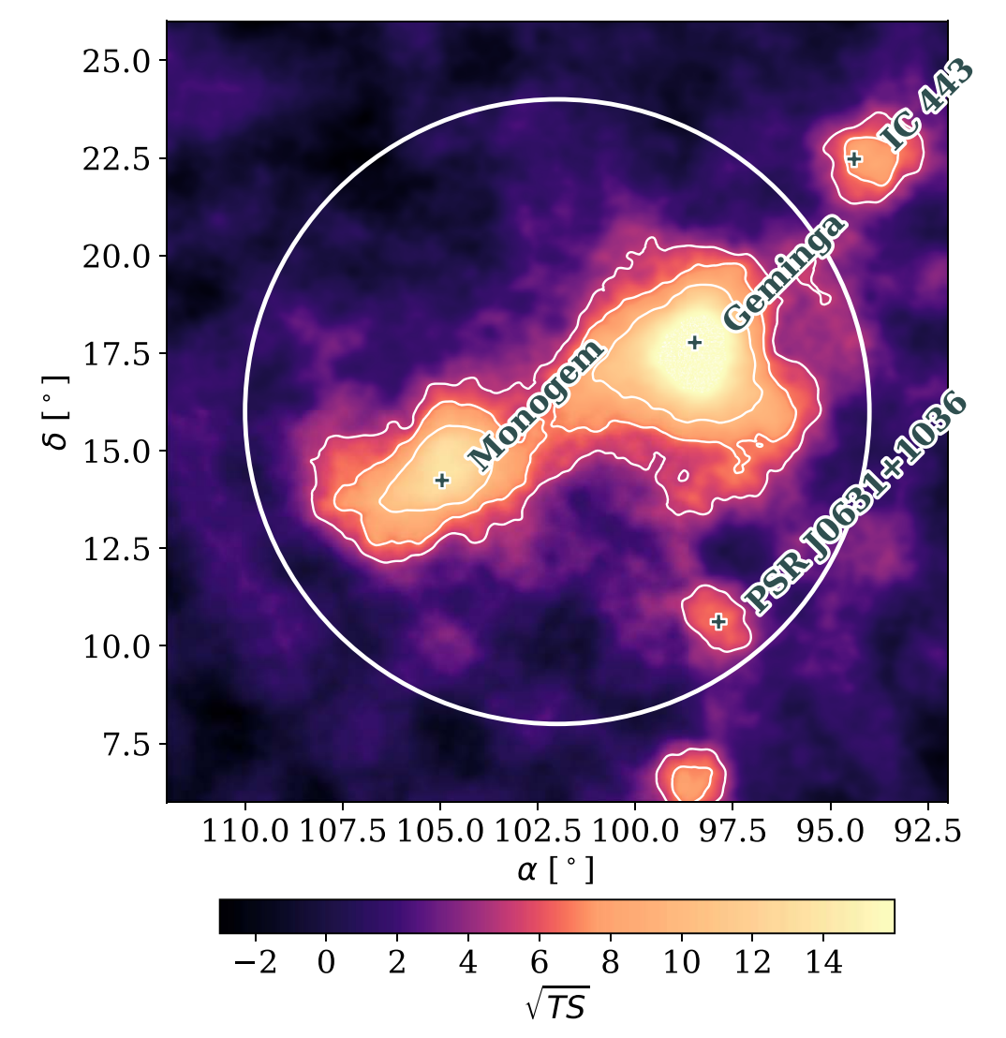
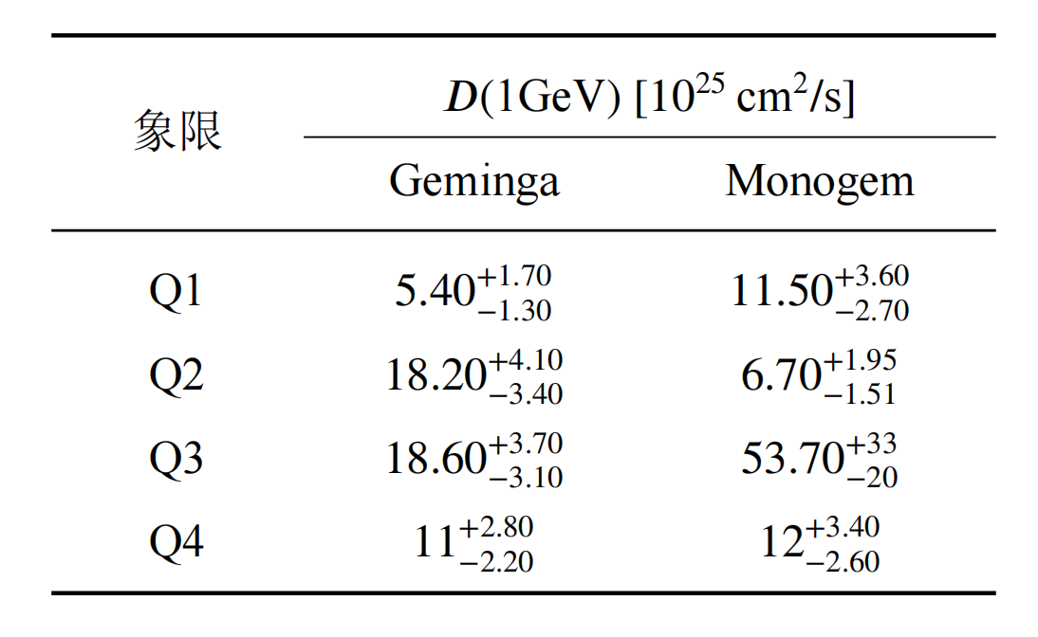
Introduction - Asymmetric Morphology Detection
请输入标题
Albert et al. (2024) PRD
06

Slide 8
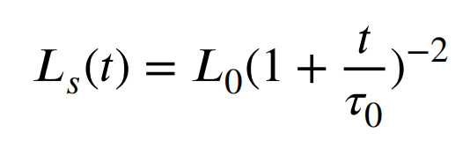
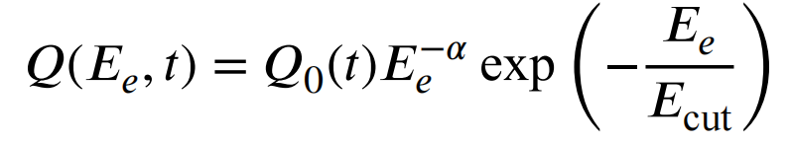
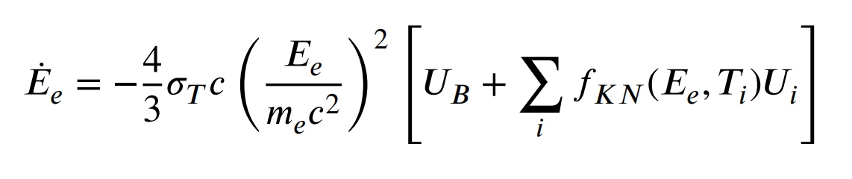
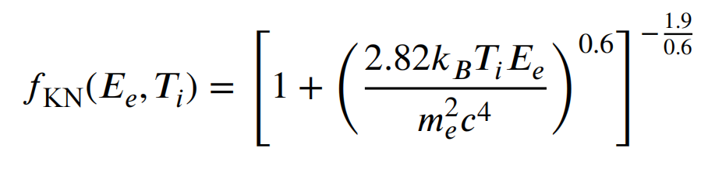
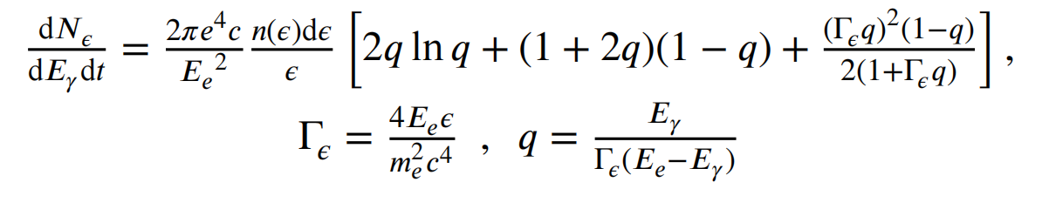
Method - Anisotropic diffusion model
Electron injection:
Energy loss & ICS spectrum:
请输入标题
07

Slide 9
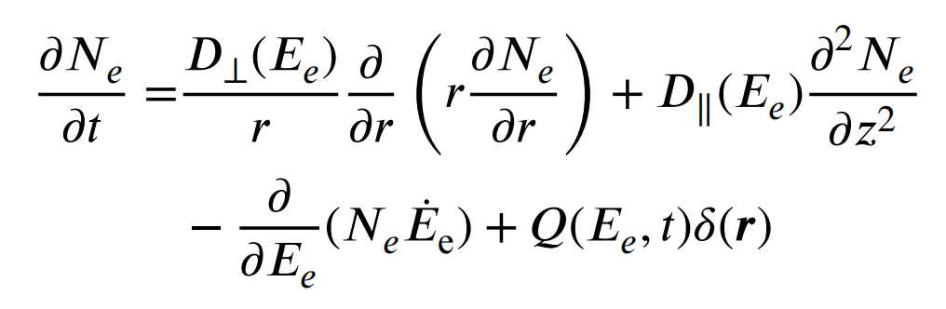
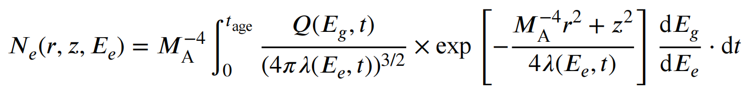
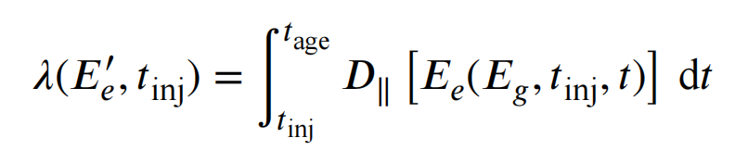
Method - Anisotropic diffusion model
Anisotropic diffusion:
请输入标题
08

Slide 10
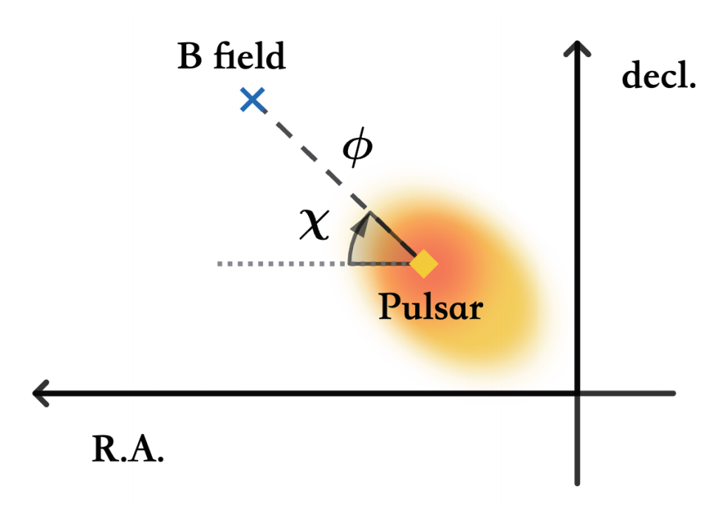
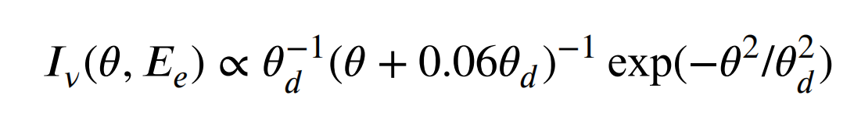
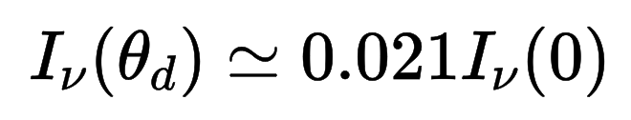
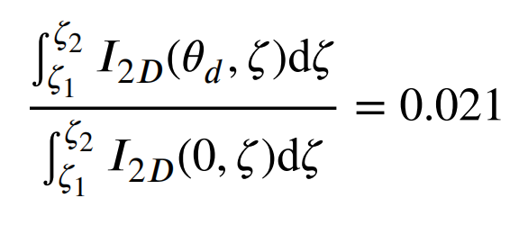
Method - Coordinate System & Characteristic Diffusion Angle
In isotropic model, the characteristic diffusion angle θ_{d} can be written as:
请输入标题
In anisotropic model, we define θ_{d} as:
09

Slide 11
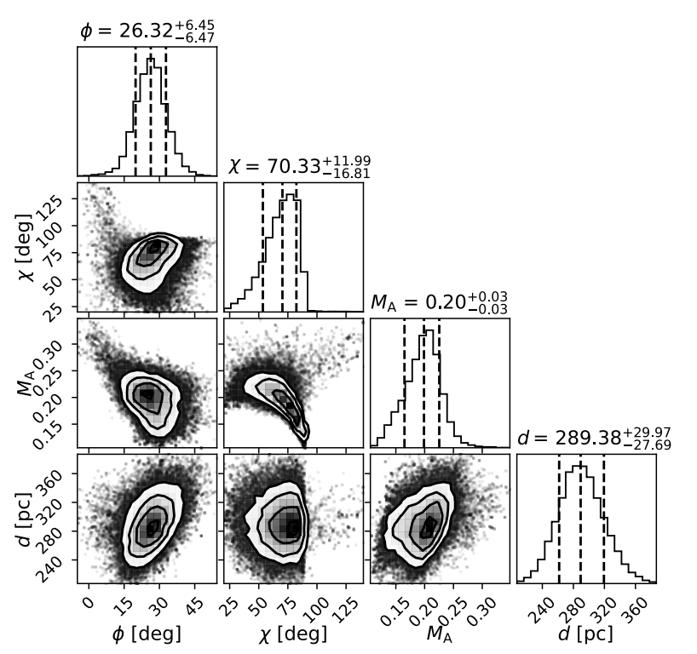
Method - MCMC fitting
Free parameters:
Φ: the angle between Line of sight and the mean
direction of magnetic field
χ : azimuthal angle of magnetic field
M_{A}: Alfvénic Mach number
d : distance of pulsar (with Gauss prior distribution)
Limited integration radius: r_{max}
10

Slide 12
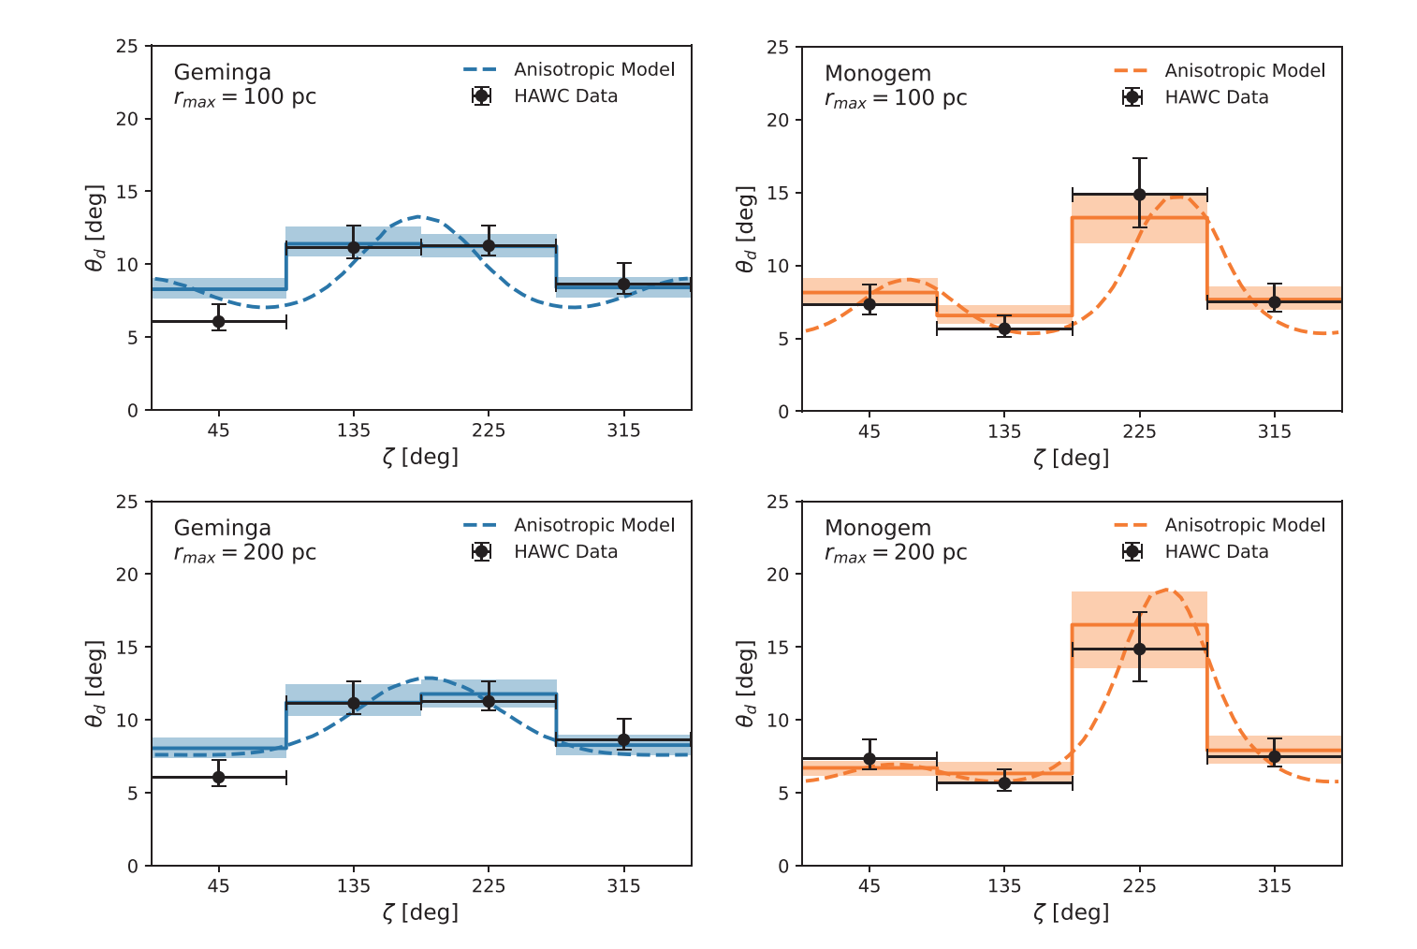
Result - Morphology fitting
11

Slide 13
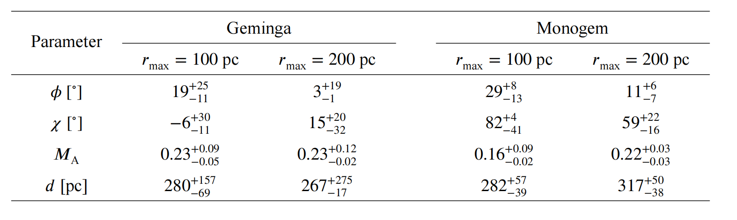
Result - Parameters Distribution
Φ is significantly greater than previous estimation (~5 deg).
M_{A} ~ 0.2, consistent with the results of the radio polarization method.
12

Slide 14
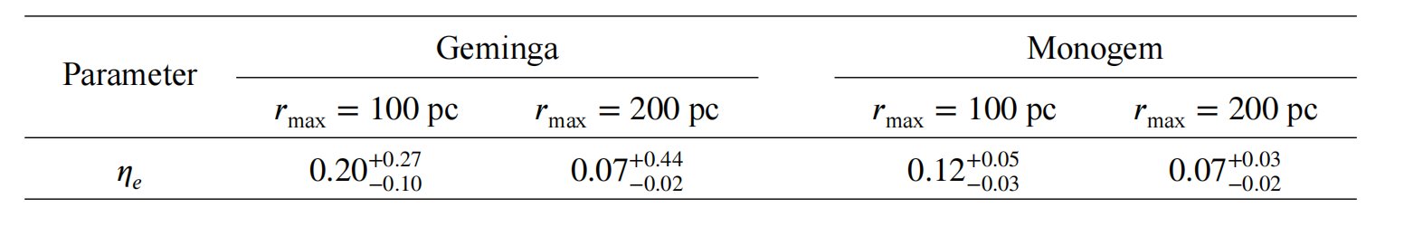
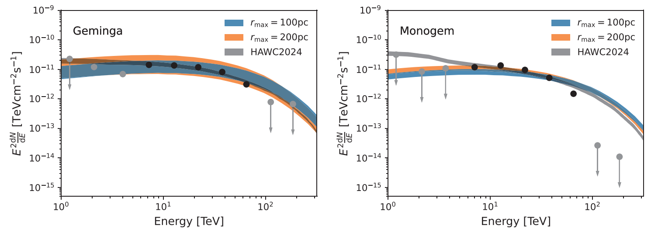
Result - Electron injection efficiency & Gamma-ray Spectrum
13

Slide 15
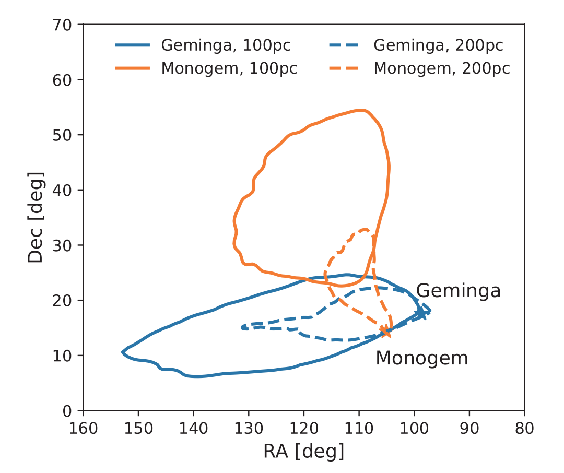
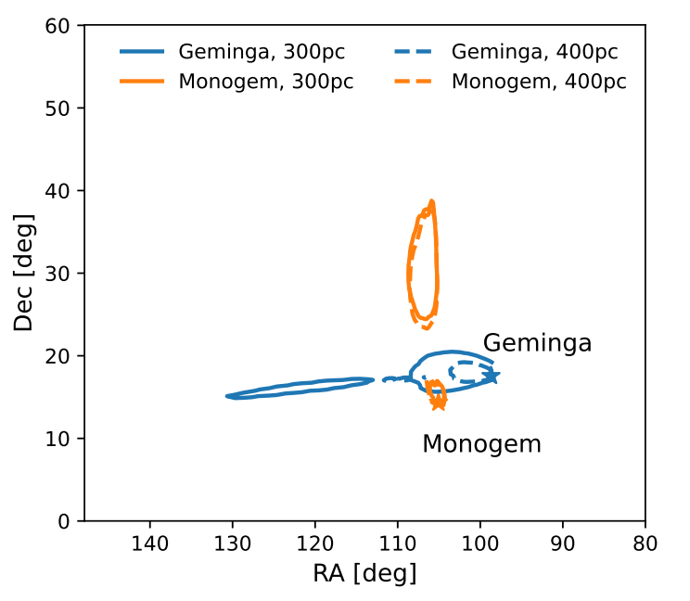
Discussion - Magnetic Coherence Length
the two pulsars are spatially proximate, separated by ∼100 pc. Consequently, their emission regions significantly overlap.
14

Slide 16
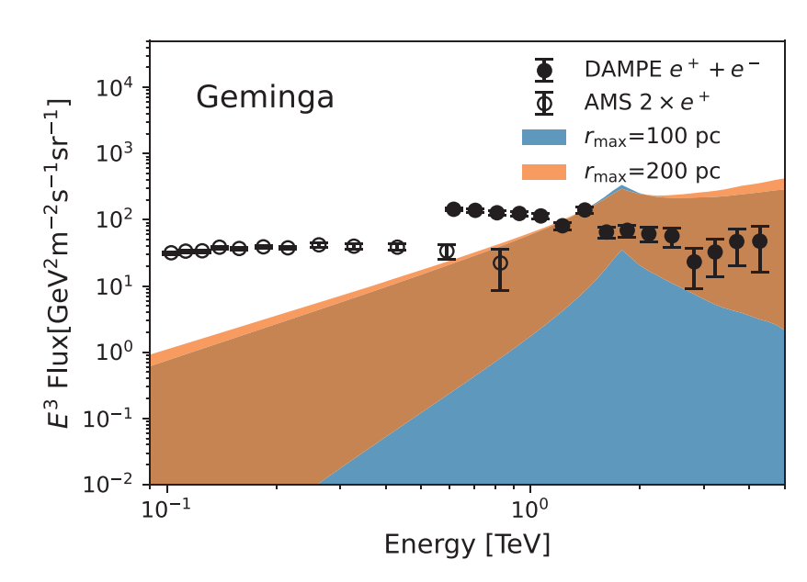
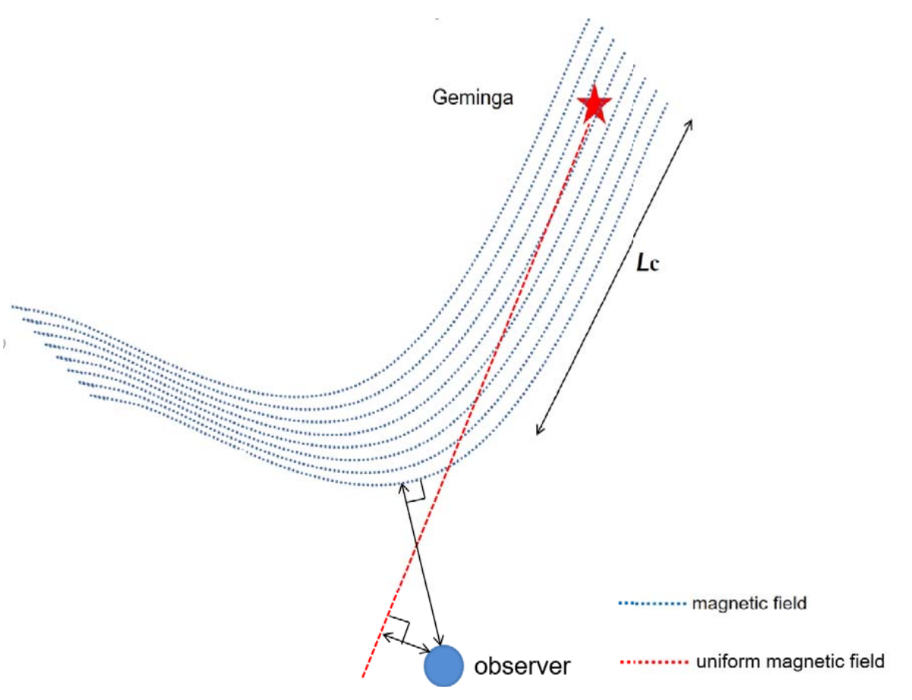
Discussion - Contribution to Local Electron/Positron Spectrum
the electron/positron in Geminga and Monogem halo may diffuse to Earth, the local electron/positron spectrum measured by DAMPE and AMS-02 can constrain our model.
Xia et al. (2025)
ApJ
15

Slide 17

Summary
The anisotropic diffusion model can account for the asymmetric morphologies of the Geminga and Monogem halos observed by HAWC, which remains consistent with the constraints on the electron injection efficiency and the local electron spectrum.
Pulsar halo morphology may serve as a novel tool to probe the properties of interstellar magnetic turbulence.
Through a joint analysis of the magnetic field directions inferred from the halos, the magnetic coherence length is estimated to be Lc ~ 100pc.
Thanks for listening !
16

Slide 18

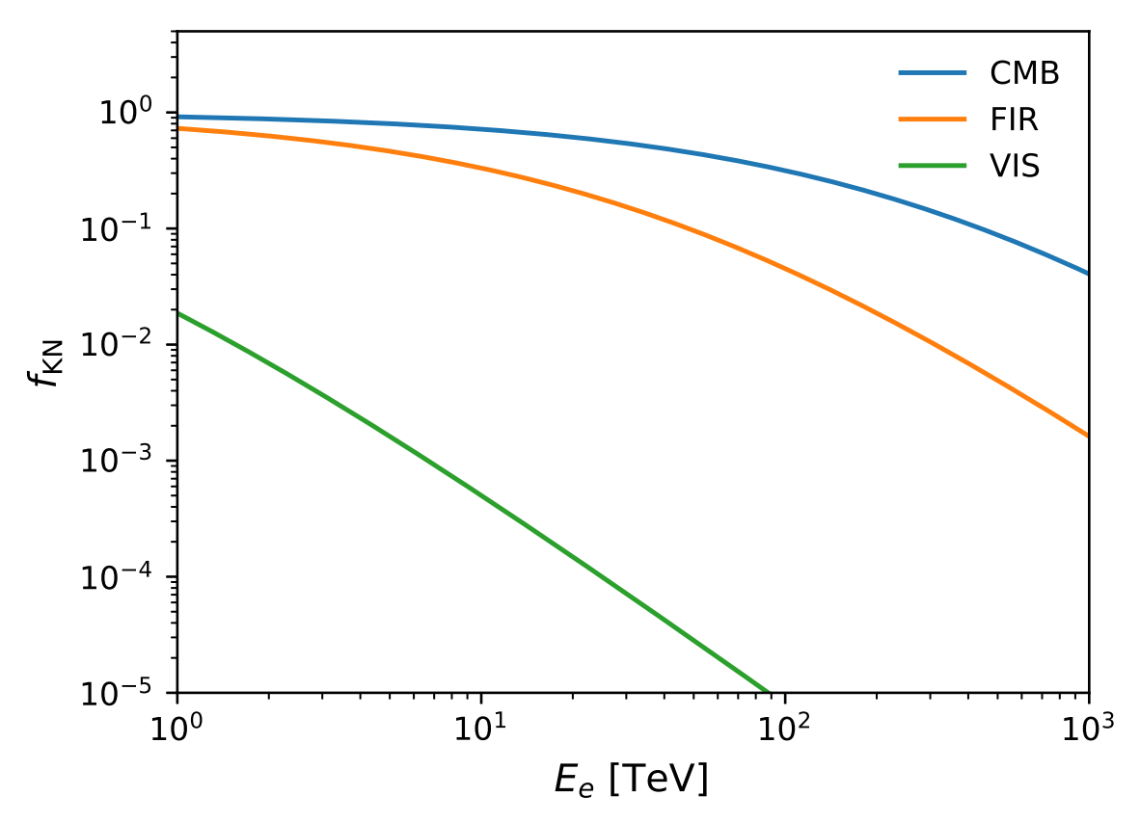
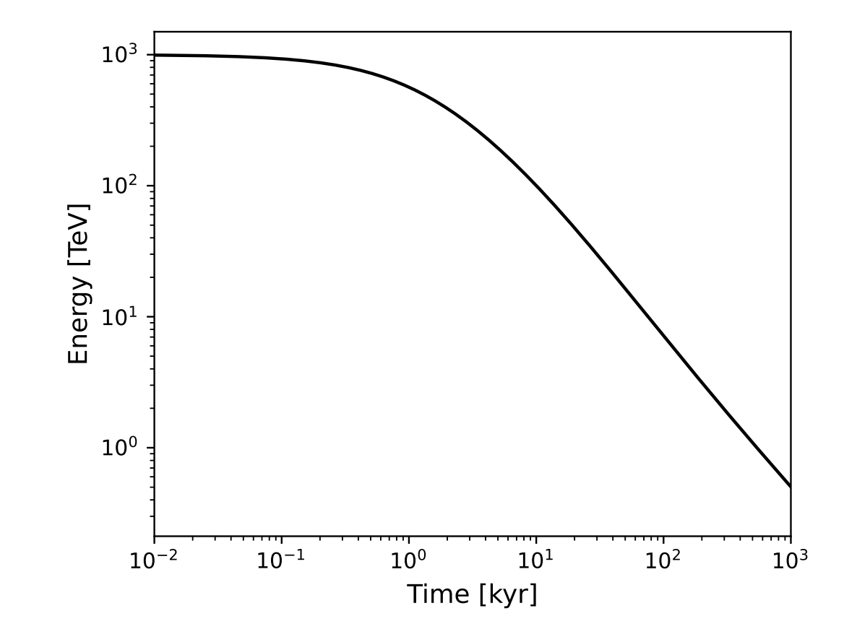
Back up

Slide 19

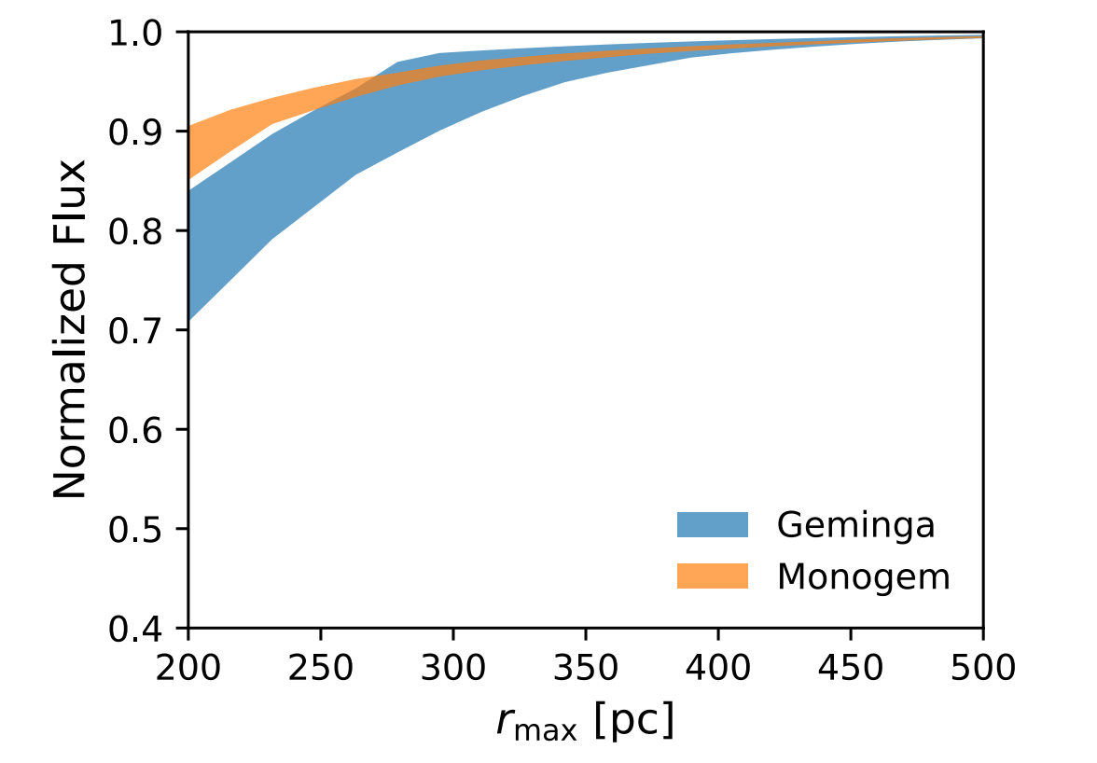
Back up

