Slide 1



Gravitational Gertsenshtein–Zel'dovich Mechanism for the Association between GW190425 and FRB 20190425A
Speaker: Shaoqin Wu
Collaborators: Jing-Rui Zhang, Rong-Gen Cai, Bing Zhang and Yun-Long Zhang
Guiyang, China 2026.7.4

Slide 2
Content
1. Background: Association between GW190425 and FRB 20190425A.
2. Our work: Associating GW190425 and FRB 20190425A using GZ and ICS.
  2.1. GZ Effect: Conversion of GWs to EM waves.
  2.2. Inverse Compton Scattering.
    Boosting the EM waves from kHz to GHz.
    Scattering of charged particles.
3. Conclusions and discussions.

Slide 3
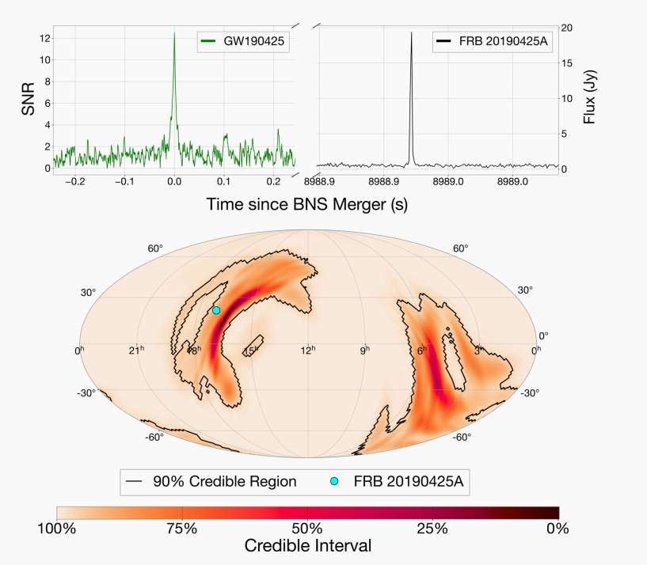
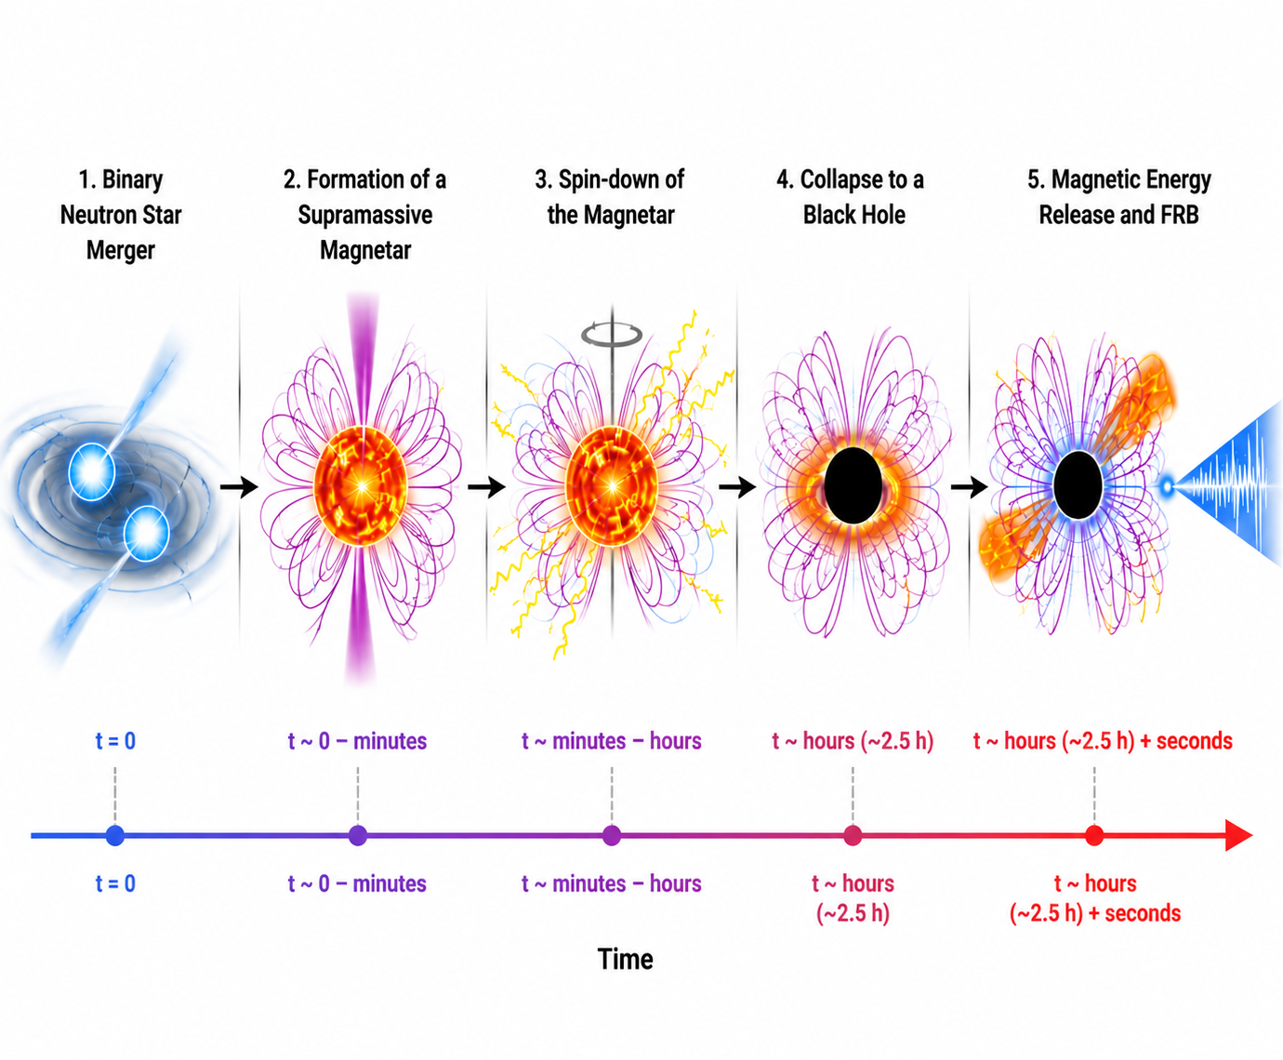
1. Background
A. Moroianu et al. , Nature Astron. 7, 579 (2023).
GPT-5.5
A. Moroianu et al. , Nature Astron. 7, 579 (2023).

Slide 4
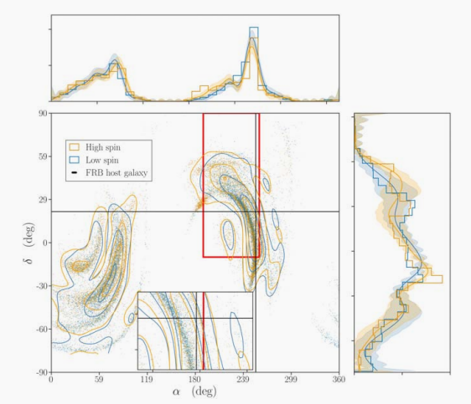
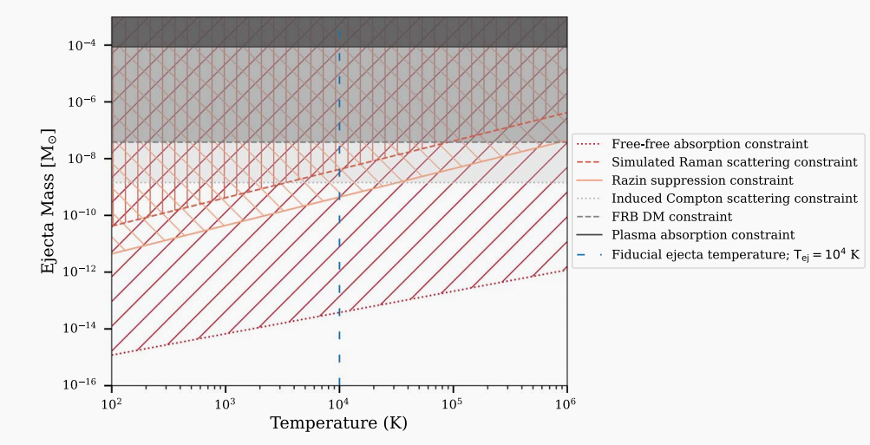
1. Background
M. Hernandez, et al.. 2024, Astrophys. J. Lett., 971, L5,
M. Bhardwaj et al. , Astrophys. J., 977(1):122, 2024.

Slide 5
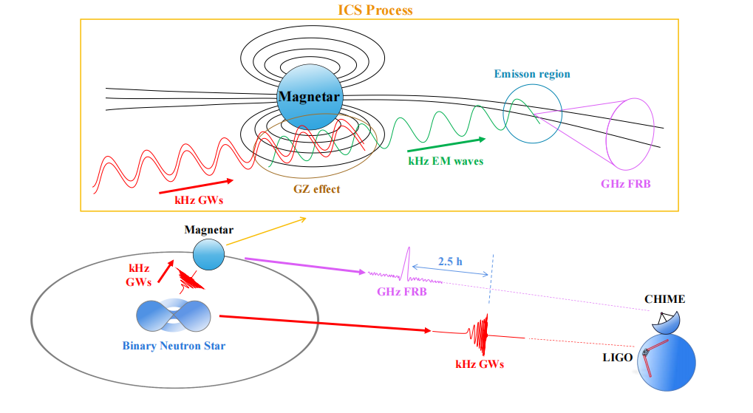
1. Background
S.-Q. Wu, J.-R. Zhang, R.-G. Cai, B. Zhang, and Y.-L. Zhang, Gravitational Gertsenshtein-Zeldovich mechanism for the Association between GW190425 and FRB 20190425A, (2026).

Slide 6
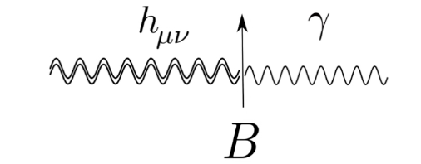


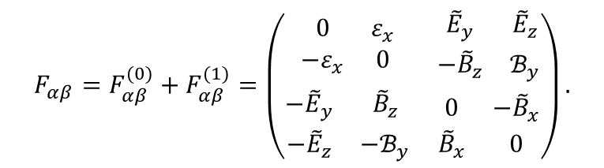
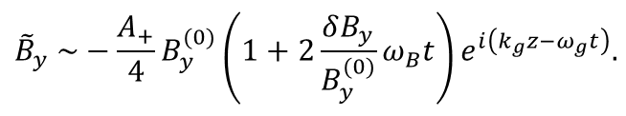
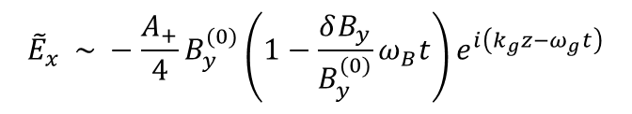
2.1. The GZ effect
Gertsenshtein–Zel’dovich effect indicates that GWs can be converted to EM waves under strong magnetic field.
One can regard the GWs as the plane waves which across the y-direction magnetic field. The EM tensors can be written, accordingly:
$$F_{αβ}=F_{αβ}^{(0)}+F_{αβ}^{(1)}=\left(\begin{matrix}\begin{matrix}0 & ε_{x} \\ {−ε}_{x} & 0\end{matrix} & \begin{matrix}{\tilde{E}}_{y} & {\tilde{E}}_{z} \\ {−\tilde{B}}_{z} & ℬ_{y}\end{matrix} \\ \begin{matrix}−{\tilde{E}}_{y} & {\tilde{B}}_{z} \\ {−\tilde{E}}_{z} & {−ℬ}_{y}\end{matrix} & \begin{matrix}0 & {−\tilde{B}}_{x} \\ {\tilde{B}}_{x} & 0\end{matrix}\end{matrix}\right).$$
One can obtain the wave equations by solving the Maxwell equations：
$$\frac{1}{c^{2}}\frac{∂^{2}{\tilde{E}}_{x}}{∂t^{2}}−∂_{z}^{2}{\tilde{E}}_{x}=−{\tilde{f}}_{E}(z’, t’)$$
$$\frac{1}{c^{2}}\frac{∂^{2}{\tilde{B}}_{y}}{∂t^{2}}−∂_{z}^{2}{\tilde{B}}_{y}=−{\tilde{f}}_{B}(z’, t’).$$
One can obtain the induced Electric field and Magnetic field：
$${\tilde{E}}_{x} \sim −\frac{A_{+}}{4}B_{y}^{(0)}\left(1−\frac{δB_{y}}{B_{y}^{(0)}}ω_{B}t\right)e^{i\left(k_{g}z−ω_{g}t\right)}$$
$${\tilde{B}}_{y} \sim −\frac{A_{+}}{4}B_{y}^{(0)}\left(1+2\frac{δB_{y}}{B_{y}^{(0)}}ω_{B}t\right)e^{i\left(k_{g}z−ω_{g}t\right)}.$$
M. E. Gertsenshtein, Soviet Physics JETP 14, 84 (1962).
Y. B. Zel’dovich, Soviet Physics JETP 38, 652 (1974).

Slide 7
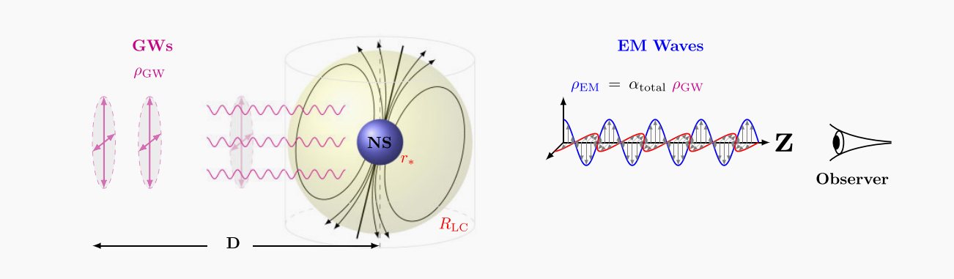
2.1. The GZ effect
In the presence of a strong magnetic field, GWs and EM waves can be converted to each other through the GZ effect. Recent studies suggest that a fraction of FRB may originate from high-frequency GWs via this mechanism.
A. Kushwaha, et al. , Mon. Not. Roy. Astron. Soc. 527, 4378 (2023).

Slide 8
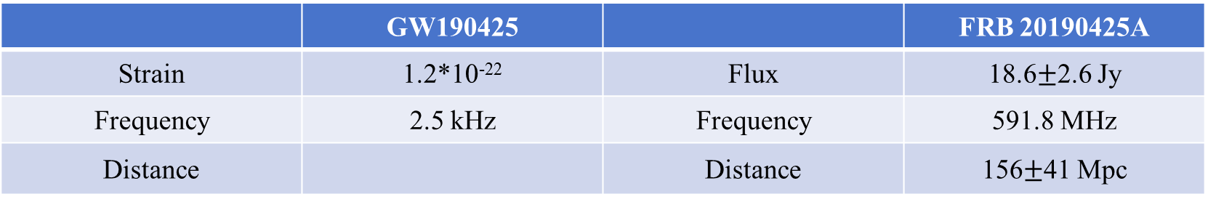

2. The GZ effect
The conversion factor from GWs to EM waves ：
$$α≡\frac{ρ_{EM}}{ρ_{GW}}=\frac{GB_{0}^{2}}{4c^{2}ω_{0}^{2}r_{g}^{6}}\left(1+ξ^{2}ω_{B}^{2}t^{2}\right)=\frac{GB_{0}^{2}}{4c^{2}ω_{0}^{2}r_{g}^{6}}η≈4.4×{10}^{−8}{\left(\frac{B_{0}}{6.1×{10}^{15} G}\right)}^{2}{\left(\frac{ω_{0}}{2.5 kHz}\right)}^{−2}{\left(\frac{r_{g}}{2}\right)}^{−6}η$$
The energy density of the converted EM waves ：
$$ρ_{EM}=αρ_{GW}=\frac{B_{0}^{2}{\left|h_{0}\right|}^{2}}{64π}\frac{η}{r_{g}^{6}}≈1.3×{10}^{8} erg/{cm}^{3}{\left(\frac{D}{18 AU}\right)}^{−2}{\left(\frac{B_{0}}{6.1×{10}^{15} G}\right)}^{2}{\left(\frac{r_{g}}{2}\right)}^{−6}η$$
Issue
 | GW190425 |  | FRB 20190425A
Strain | 1.2*10⁻²² | Flux | 18.6$±$2.6 Jy
Frequency | 2.5 kHz | Frequency | 591.8 MHz
Distance |  | Distance | 156$±$41 Mpc
159$_{−72}^{+69}$ Mpc
B. P. Abbott et al. (LIGO Scientific, Virgo), Astrophys. J. Lett. 892, L3 (2020).
M. Amiri et al. (CHIME/FRB), Astrophys. J. Supp. 257, 59 (2021).

Slide 9
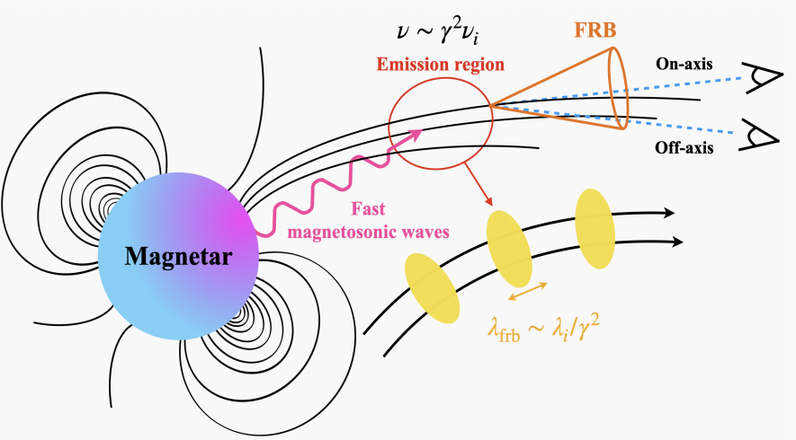
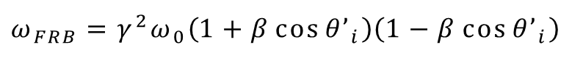

2.2. Inverse Compton Scattering
The frequency of EM waves is boosted by ICS：
$$ω_{FRB}=γ^{2}ω_{0}\left(1+β\cos{{θ’}_{i}}\right)\left(1−β\cos{{θ’}_{i}}\right)$$
$$≈591.8 MHz{\left(\frac{γ}{486.5}\right)}^{2}\left(\frac{ω_{0}}{2.5 kHz}\right)$$
Y. Qu and B. Zhang, Astrophys. J. 972,124 (2024).

Slide 10
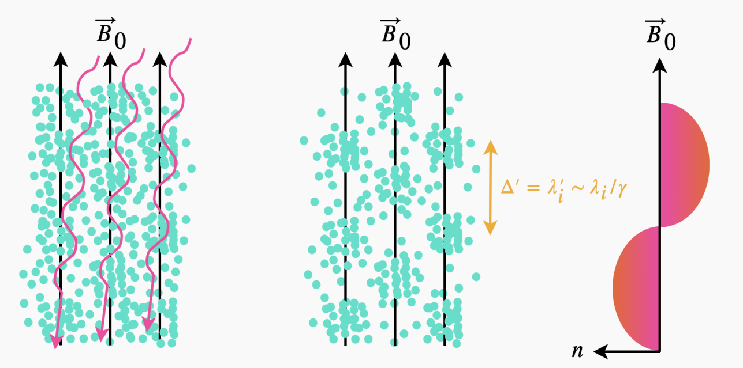


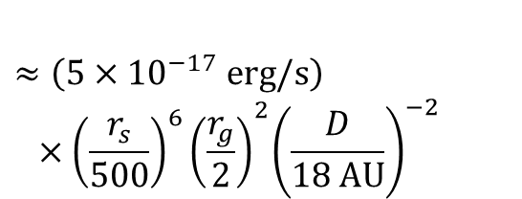

2.2. Inverse Compton Scattering
The scattering cross section in a strong magnetic field :
$$σ_{X}=\frac{σ_{T}}{2}\left(1−β\cos{θ_{i}}\right)\left[\frac{{ω’}_{0}^{2}}{{\left({ω’}_{0}+ω_{c}\right)}^{2}}+\frac{{ω’}_{0}^{2}}{{\left({ω’}_{0}−ω_{c}\right)}^{2}}\right]$$
$$≈\left(5.3×{10}^{−41} {cm}^{2}\right){\left(\frac{r_{s}}{500}\right)}^{6}{\left(\frac{B_{0}}{6.1×{10}^{15} G}\right)}^{−2}$$
The ICS emission power of a single particle:
$$P_{ICS}=γ^{2}σ\left(X\right)cρ_{EM}$$
$$≈\left(5×{10}^{−17} erg/s\right)$$
$${ ×{\left(\frac{r_{s}}{500}\right)}^{6}\left(\frac{r_{g}}{2}\right)}^{2}{\left(\frac{D}{18 AU}\right)}^{−2}$$
Y. Qu and B. Zhang, Astrophys. J. 972,124 (2024).

Slide 11
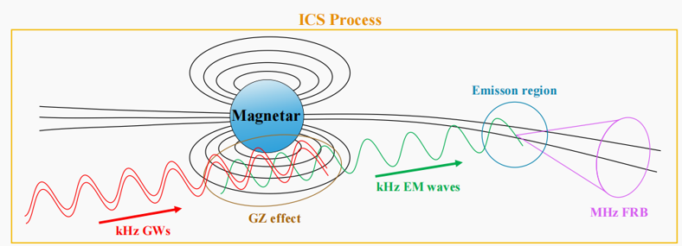


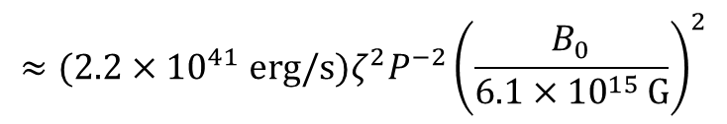



2.2. Inverse Compton Scattering
The total luminosity via ICS:
The flux density via our model:
$$L_{ICS}≅γ^{4}N_{e,b}^{2}N_{e}^{2}P_{ICS}$$
$$S=\frac{L_{ICS}}{4πd^{2}∆ν}$$
$$≈(2.2×{10}^{41} erg/s)ζ^{2}P^{−2}{\left(\frac{B_{0}}{6.1×{10}^{15 }G}\right)}^{2}$$
$$≈\left(19 Jy\right){\left(\frac{d}{156 Mpc}\right)}^{−2}$$
$${{×\left(\frac{D}{18 AU}\right)}^{−2}\left(\frac{r_{g}}{2}\right)}^{−6}{\left(\frac{r_{s}}{500}\right)}^{−2}{\left(\frac{T}{1 s}\right)}^{−2}ζ^{2}$$
$${×\left(\frac{∆ν}{400 Mpc}\right)}^{−1}\left(\frac{L_{ICS}}{2.2×{10}^{41} erg/s}\right)$$

Slide 12
3. Conclusions and discussions
GWs and FRB differ by 2.5 hours -- the BNS and the magnetar are 18 AU apart.
kHz GWs and kHz EM waves -- GZ effect.
kHz EM waves and GHz EM waves -- Inverse Compton scattering.
S.-Q. Wu, J.-R. Zhang, R.-G. Cai, B. Zhang, and Y.-L. Zhang, Gravitational Gertsenshtein-Zeldovich mechanism for the Association between GW190425 and FRB 20190425A, (2026).

Slide 13
3. Conclusions and discussions
A rare fraction of FRBs may be associated with GWs --BNS mergers and BBH mergers.
The FRB delays from the GWs by a timescale determined by the distance between the GW source and the magnetar.
The event rate density of these FRBs is very small --likelihood of the existence of a magnetar in the vicinity of the GW sources.
S.-Q. Wu, J.-R. Zhang, R.-G. Cai, B. Zhang, and Y.-L. Zhang, Gravitational Gertsenshtein-Zeldovich mechanism for the Association between GW190425 and FRB 20190425A, (2026).

Slide 14
Summary
1. Background: Association between GW190425 and FRB 20190425A.
2. Our work: Associating GW190425 and FRB 20190425A using GZ and ICS.
  2.1. GZ Effect: Conversion of GWs to EM waves.
  2.2. Inverse Compton Scattering.
    Boosting the EM waves from kHz to GHz.
    Scattering of a single charged particle.
3. Conclusions and discussions.
Thank you for listening!

