Slide 1
Magnetized Coulomb crystals in neutron star crusts
第十五届全国脉冲星研讨会
(FPS15), July 2–6, 2026
arXiv: 2606.24355
Xia, Cheng-Jun (夏铖君)
Center for Gravitation and Cosmology,
Yangzhou University
Collaborators: Toshiki Maruyama, Nobutoshi Yasutake, Toshitaka Tatsumi
@ 贵阳

Slide 2
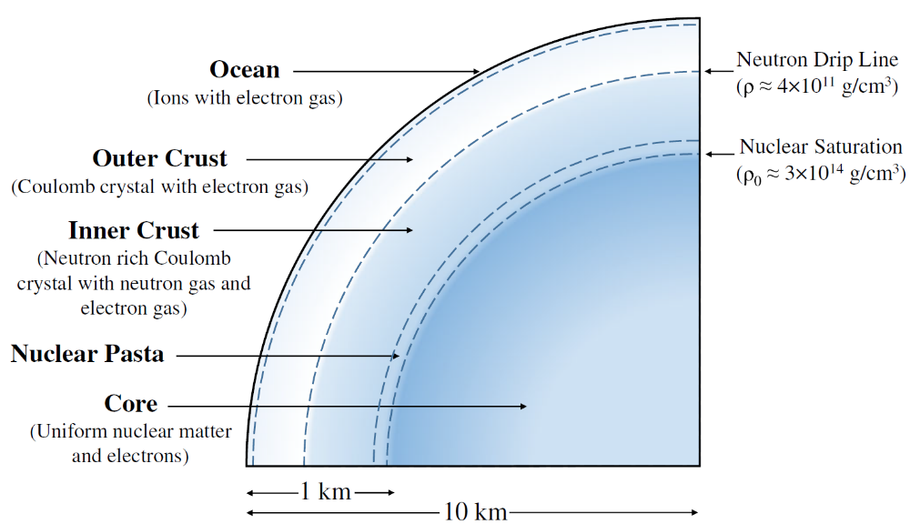
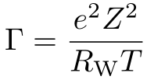

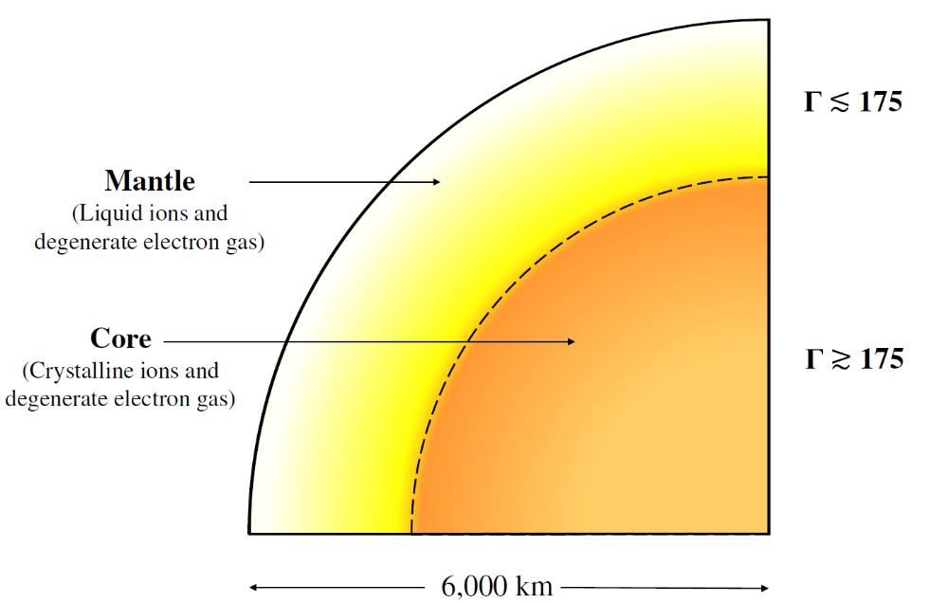
Compact star structures
Cross section of a neutron star
Cross section of a cooling white dwarf star
Caplan_Horowitz2017_RMP89-041002
Notes:
Coulomb parameter Γ describe the ratio of a typical Coulomb energy to the thermal energy
(1) 中子星大气是一层薄薄的等离子体，主要成分是氢和氦，对于无吸积的冷暗中子星，该层厚度大约为几毫米到十厘米不等。大气层虽然很薄，但却影响热辐射的光谱。
(2) 中子星海洋是覆盖在固体外壳层上的一层液体，主要成分是由离子和自由电子组成的等离子体。
(3) 外壳层被定义为从大气层底部到中子滴密度的固态区域，厚度约为几百米
(4) 内壳层由富中子化原子核、自由中子、电子和少量质子组成，主要由非相对论性自由中子和相对论性简并电子提供压强，它从中子滴密度一直延展到0.5倍核饱和密度附近。

Slide 3

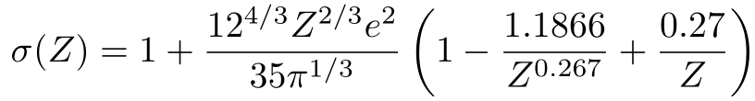
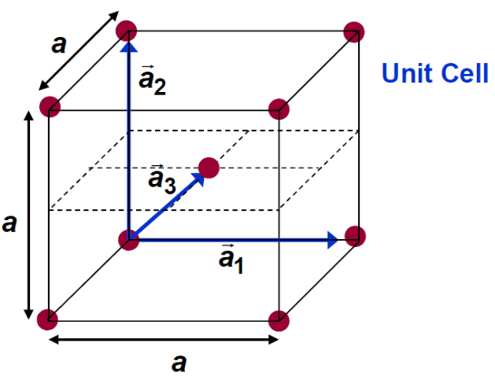

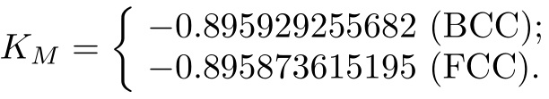
Coulomb crystals
Γ<<1: Coulomb interactions are insignificant and ions behave like an ideal noninteracting gas;
Γ ≈ 1: Coulomb interactions become important, where ions undergo short-range correlations and behaving like a liquid;
Γ > 175: ions will eventually freeze and form a crystallized structure.
Energy density of cold Coulomb crystals (BPS model):
Madelung constants [Baiko et al.2001_PRE64-057402]:

Slide 4
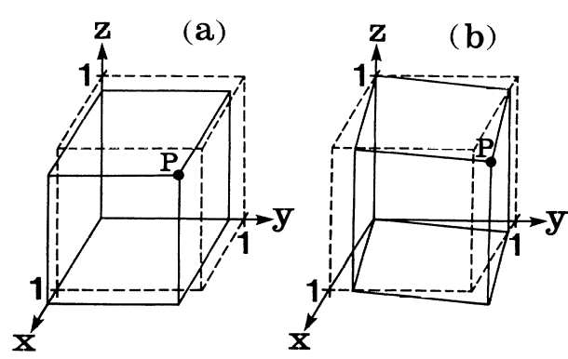



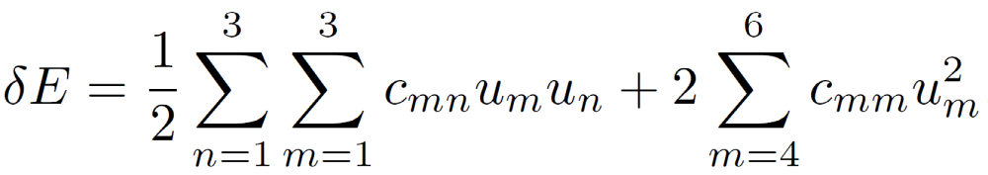
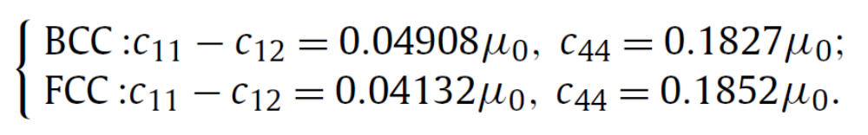
Elastic properties
The displacement gradient u_{ij} moves a droplet at position r to r'
Single crystal:
The variation of energy density due to deformation
Assuming point nuclei embedded in a uniform electron background, a Monte Carlo simulation predicts [Ogata_Ichimaru1990_PRA42-4867]
BCC and FCC lattices with cubic symmetry:
c₁₁ = c₂₂ = c₃₃, c₁₂ = c₂₁ = c₁₃ = c₃₁ = c₂₃ = c₃₂, c₄₄ = c₅₅ = c₆₆.

Slide 5
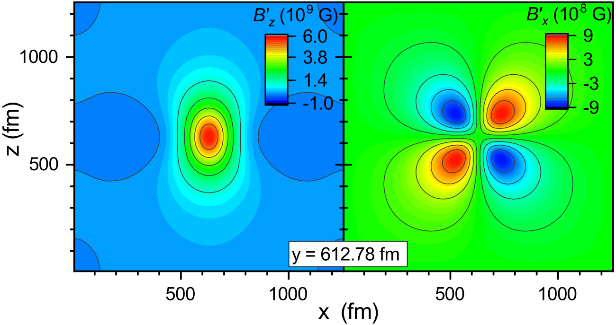
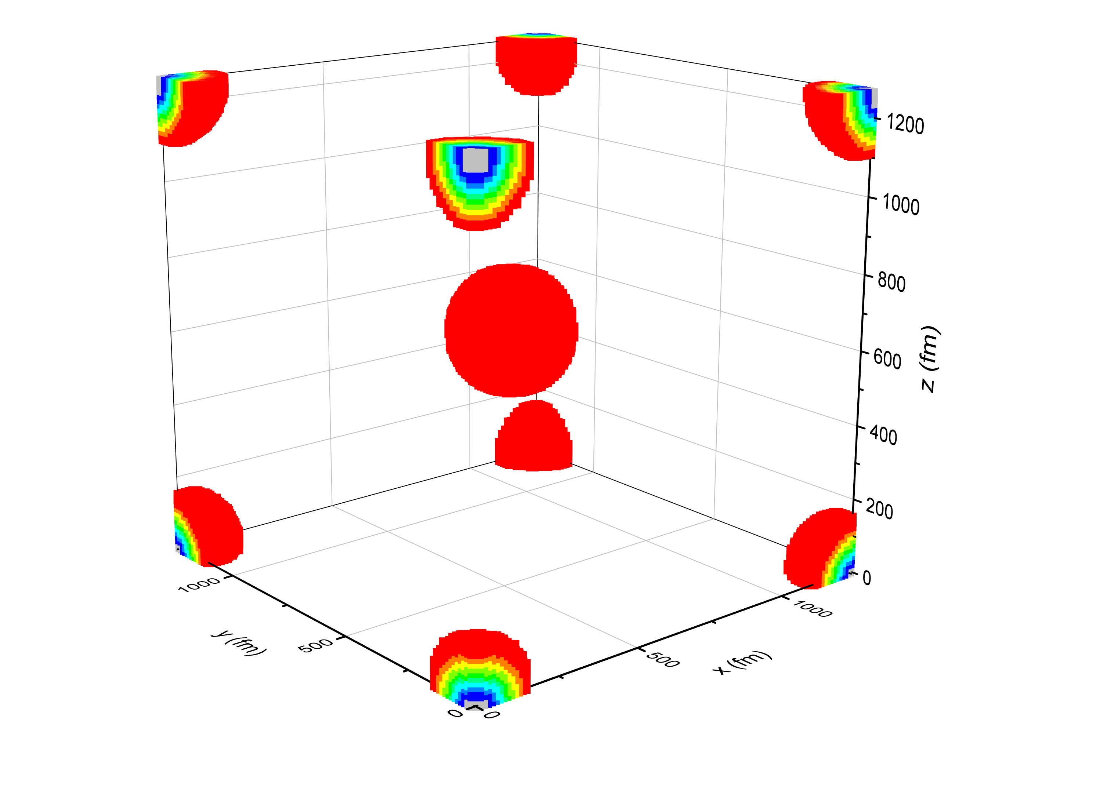
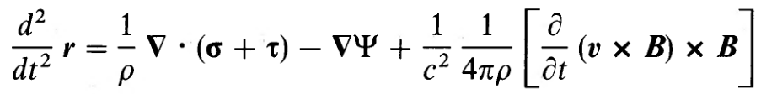

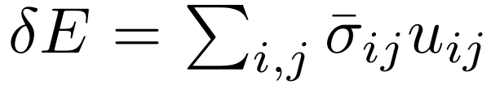
Motivation
There exists strong magnetic fields inside neutron stars, e.g., magnetars (reaching 10¹⁴⁻¹⁵ G on the surface and ~10¹⁸ G inside).
Note:
B₀ = 5×10¹⁵ G
[Cardall_Prakash_Lattimer2001_ApJ554-322]
Momentum conservation equation [Carroll et al.1986_ApJ305-767]:
For a stationary system without gravity, this is reduced into
Magnetization
Impact of nonuniform magnetic fields
-
The stress tensor σ_{ij} is related to the variation of energy density with respect to a (deformed) Coulomb crystal

Slide 6
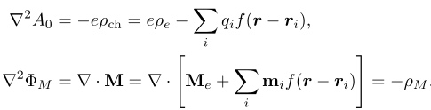

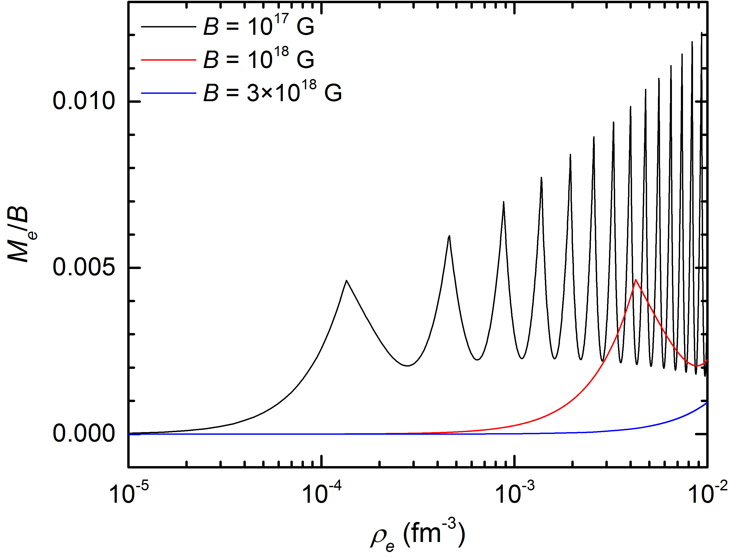

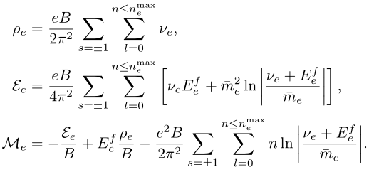
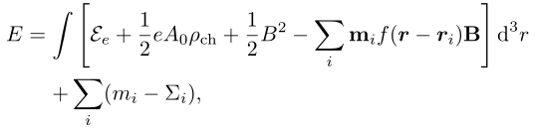
Method
Thomas-Fermi approximation
Considering the variation of the magnetic field
Solved in a periodic three-dimensional cell
Electromagnetic fields are obtained with
effective magnetic charge density
f(r) represents the distrubution of the nucleus
Source currents:
Total energy:
larmor radius: l ~ m_{e}c/(eB)~λ_{e}B_{q}/B (B_{q} ≡ m_{e}²/e = 4.414×10¹³ G)
Notes:
lambda_e = 2426 fm

Slide 7

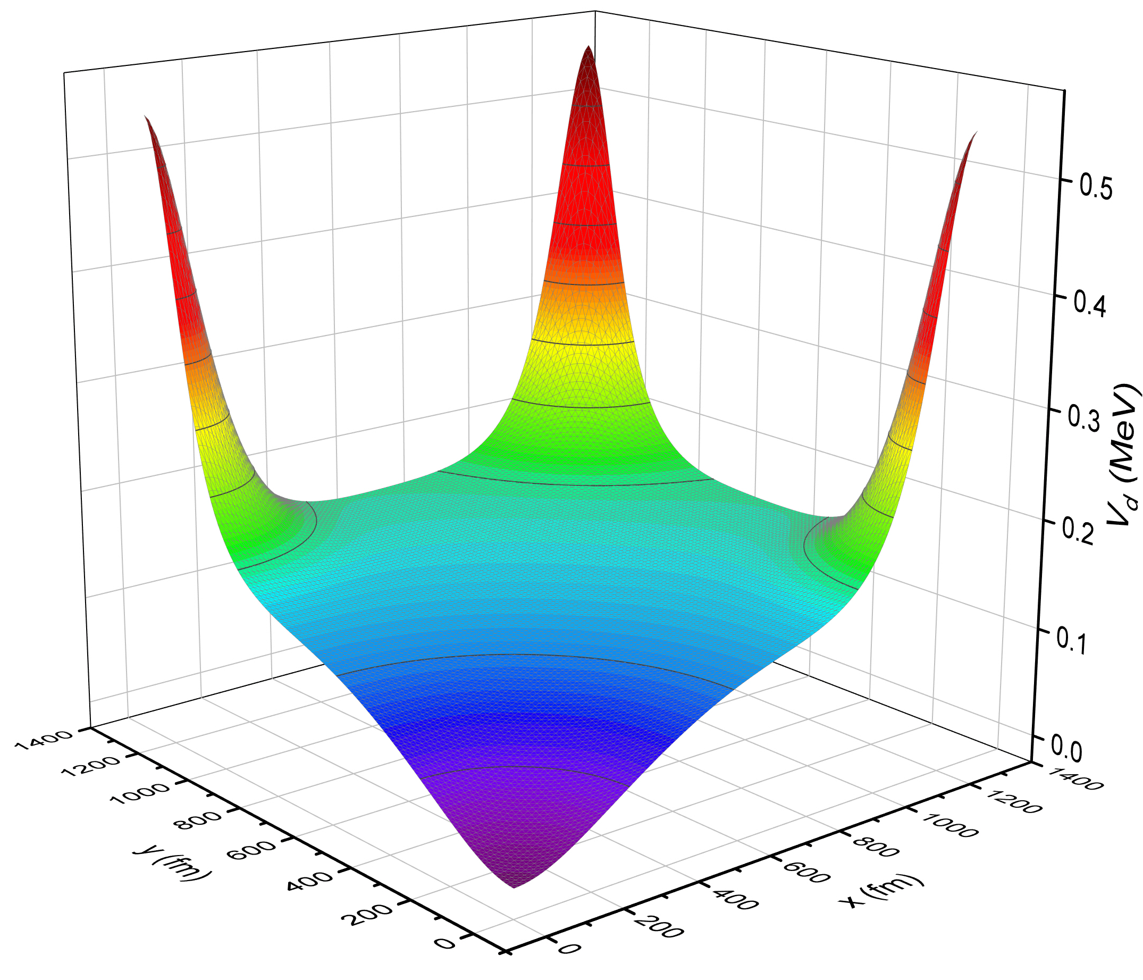
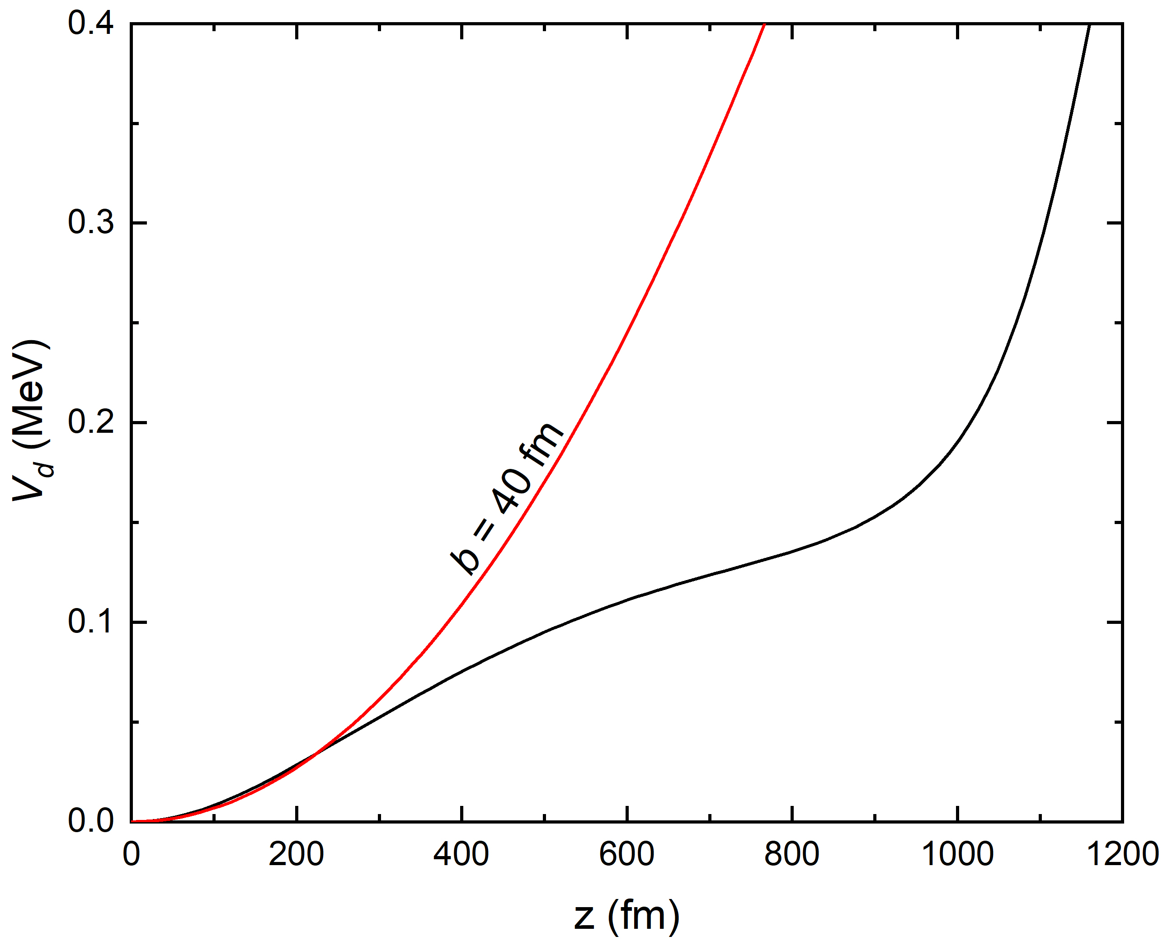
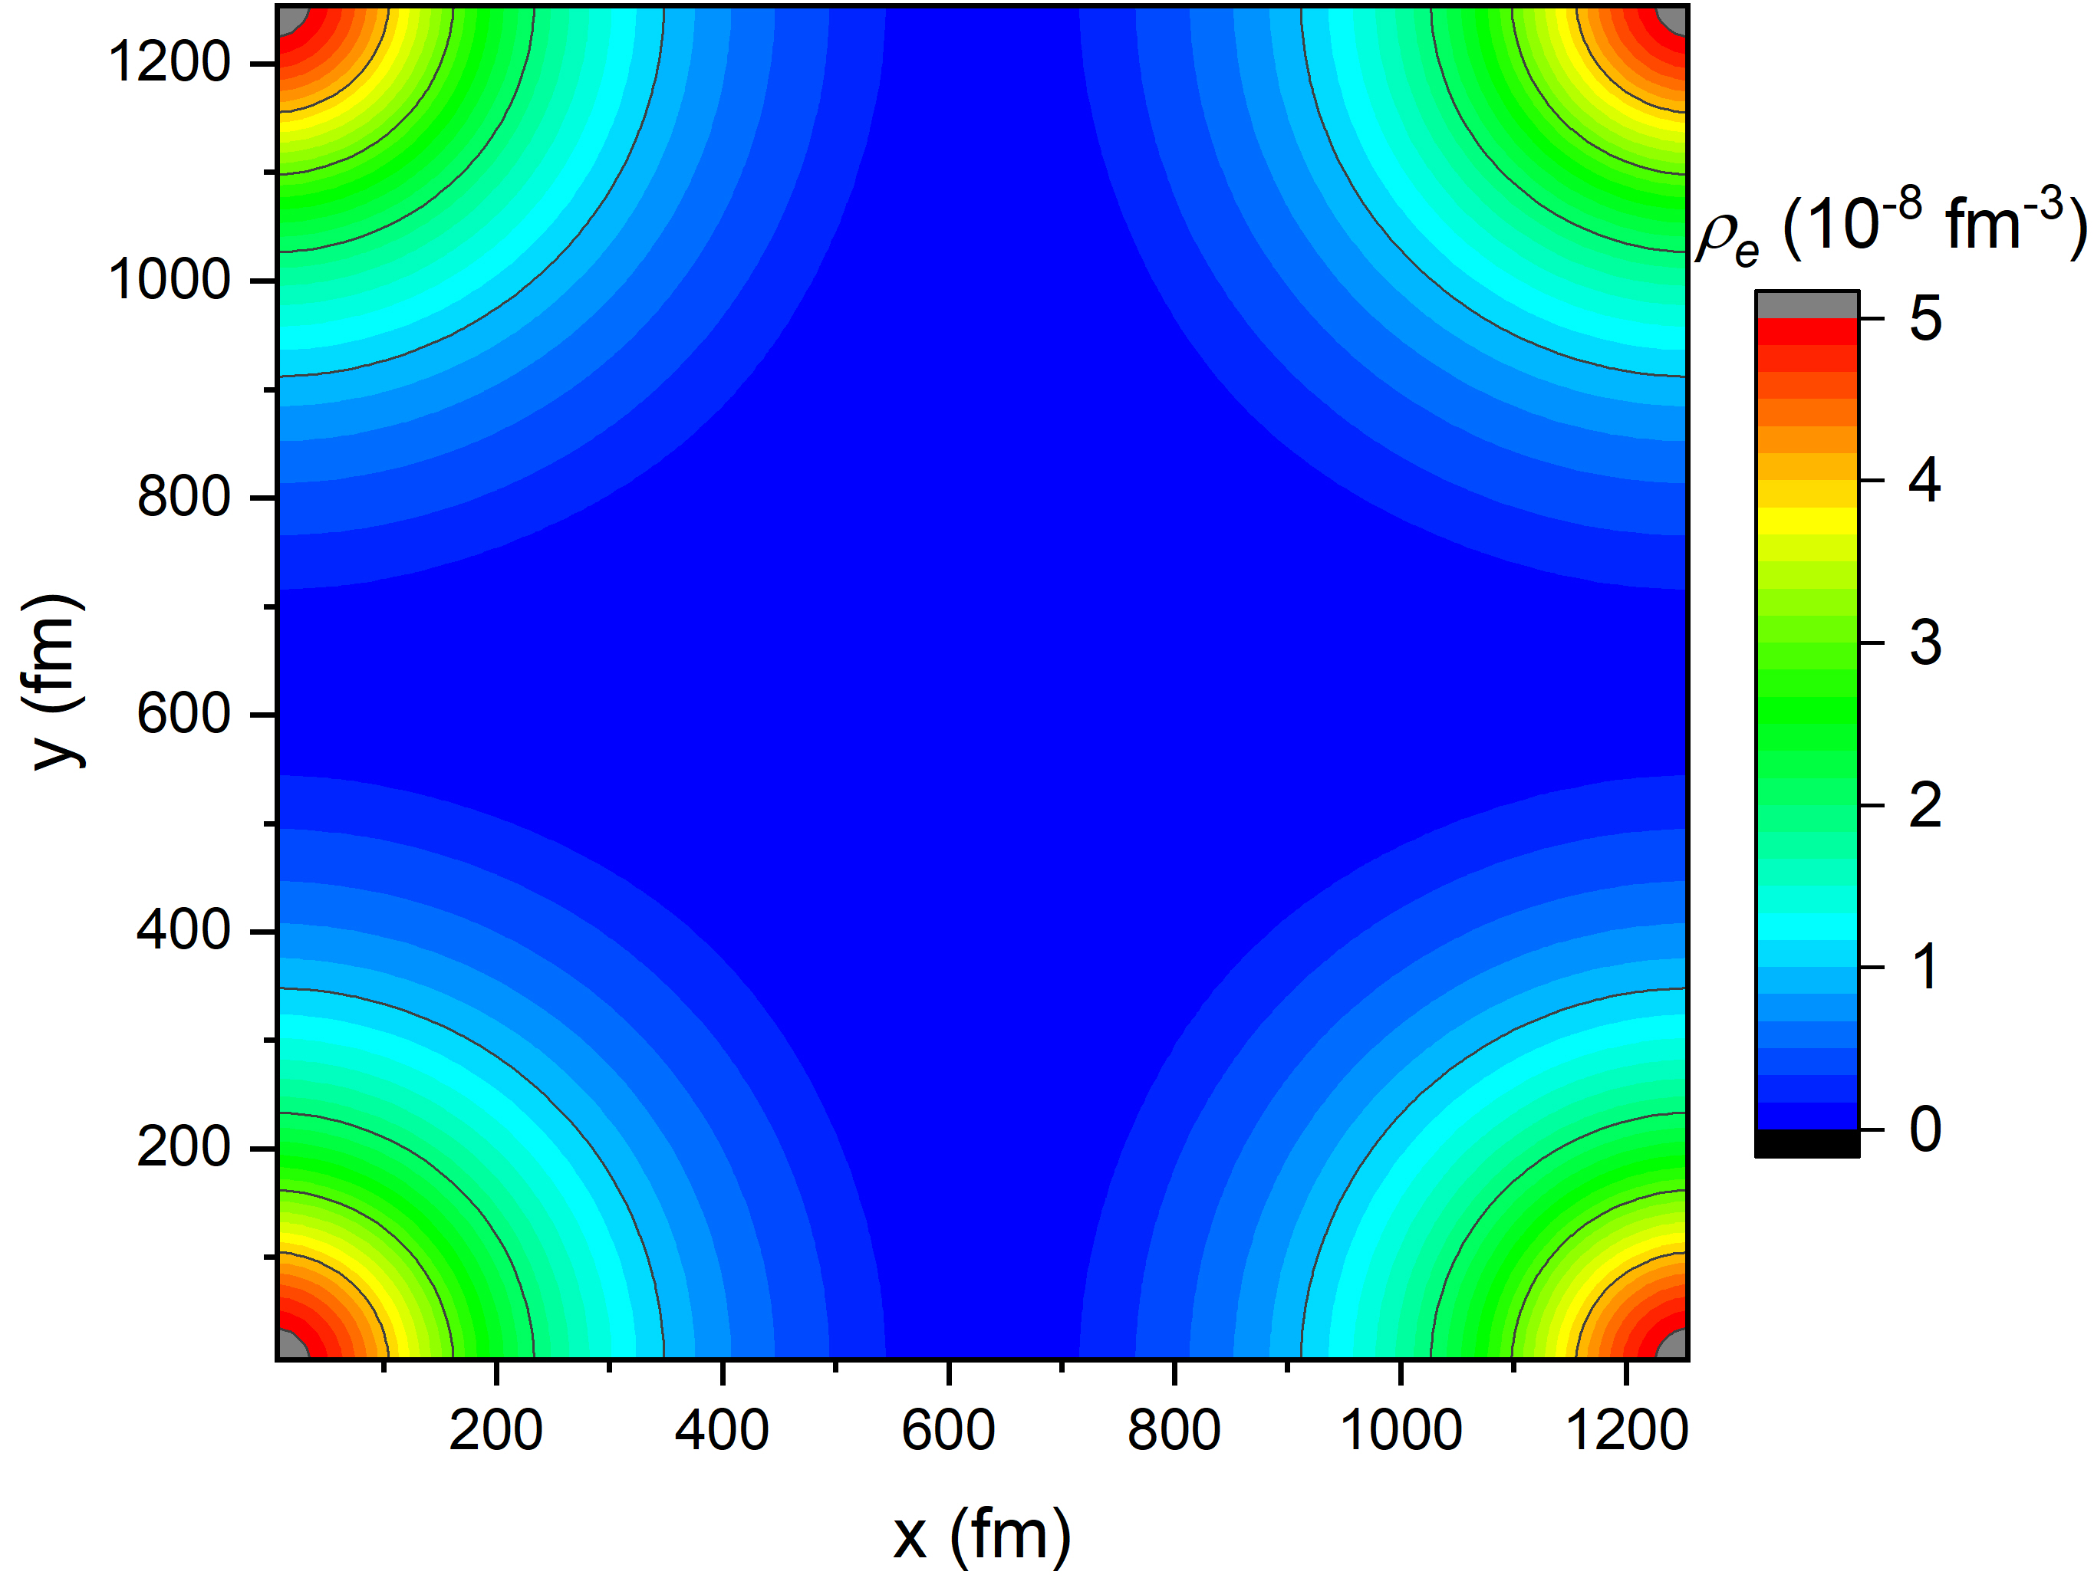
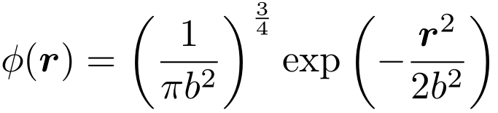


Gaussian wave function for nuclei
b = 100 fm
x = y = 0
Gaussian wave function for nuclei is adopted, i.e.,
y = 0
y = 0
E = 3ω₀/2
For ¹²C:
ω₀ = 3.486 MeV/(b/fm)²
Notes:
1 eV=11605 K

Slide 8
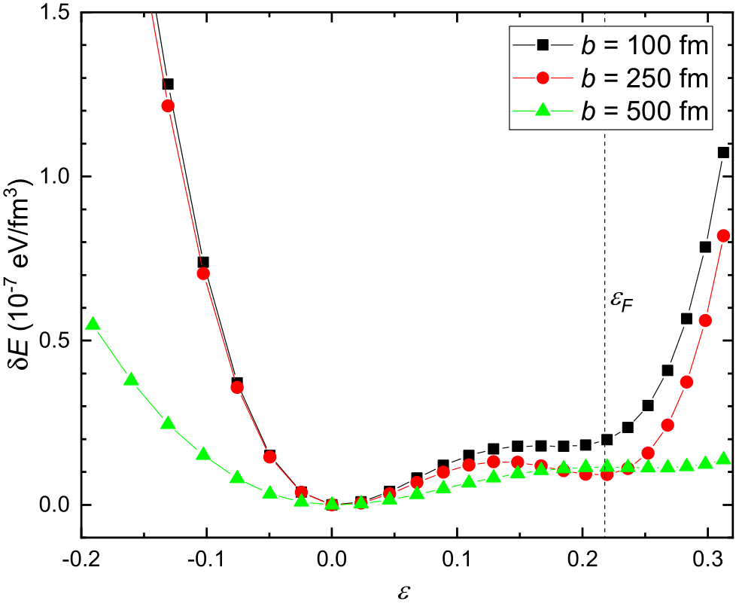
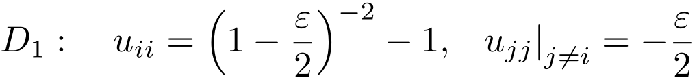
Elastic properties
¹²C,
B_{z0} = 10¹⁵ G,
n_{d} = 10⁻⁹ fm⁻³
b (fm) | c₁₁-c₁₂ (μ₀)
100 | 0.06475
250 | 0.06052
500 | 0.01669

Slide 9
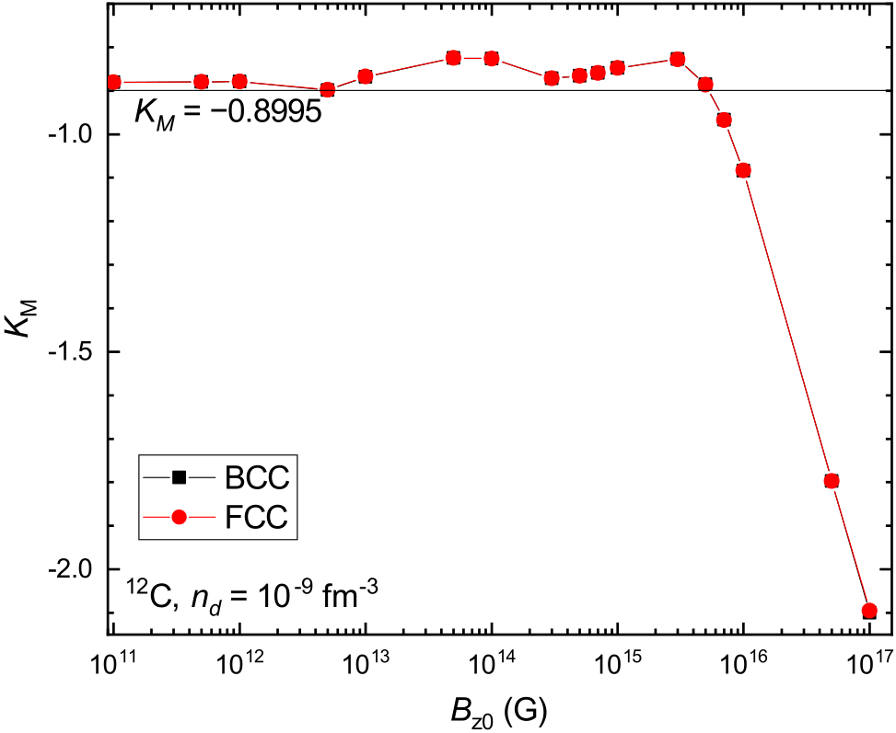
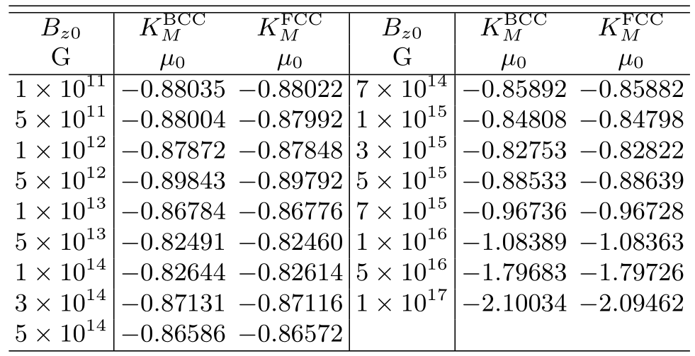
Madelung constant
Energy density of cold white dwarf matter (BPS model):
Baiko et al.2001_PRE64-057402:

Slide 10
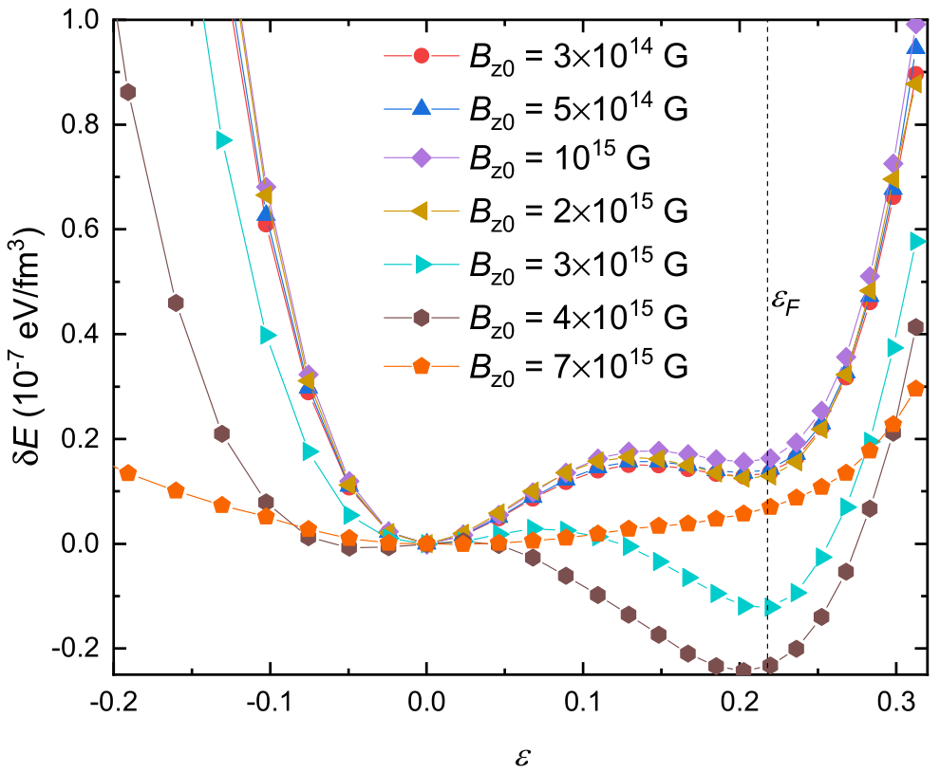
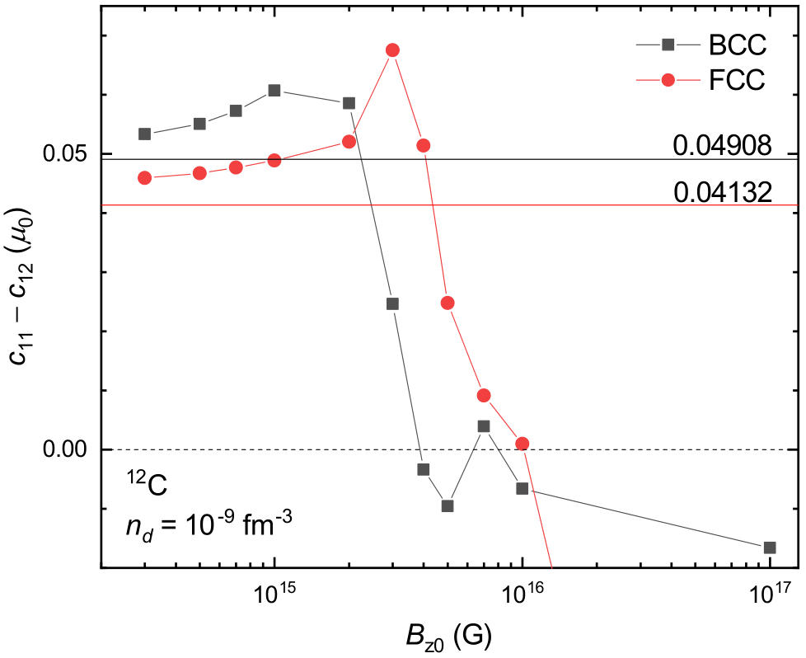
Elastic properties
¹²C,
n_{d} = 10⁻⁹ fm⁻³

Slide 11
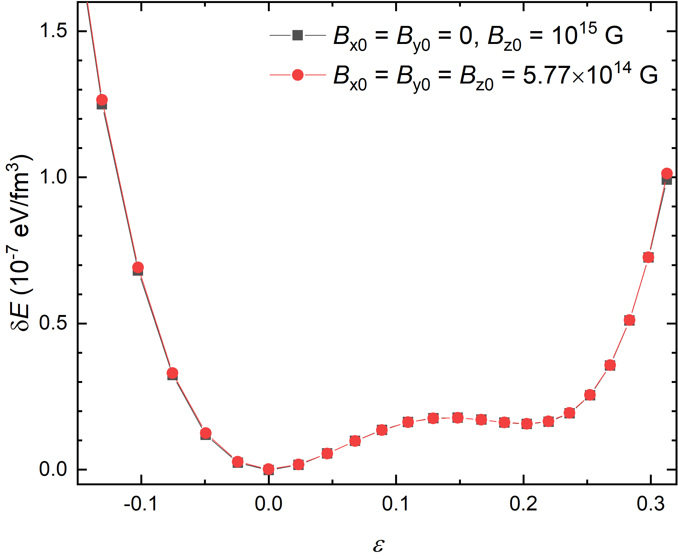
Elastic properties
¹²C, BCC,
n_{d} = 10⁻⁹ fm⁻³

Slide 12
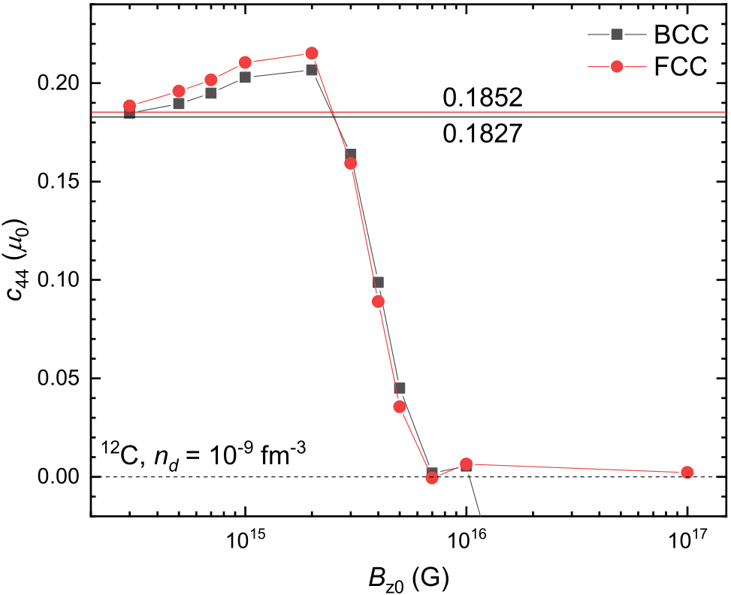
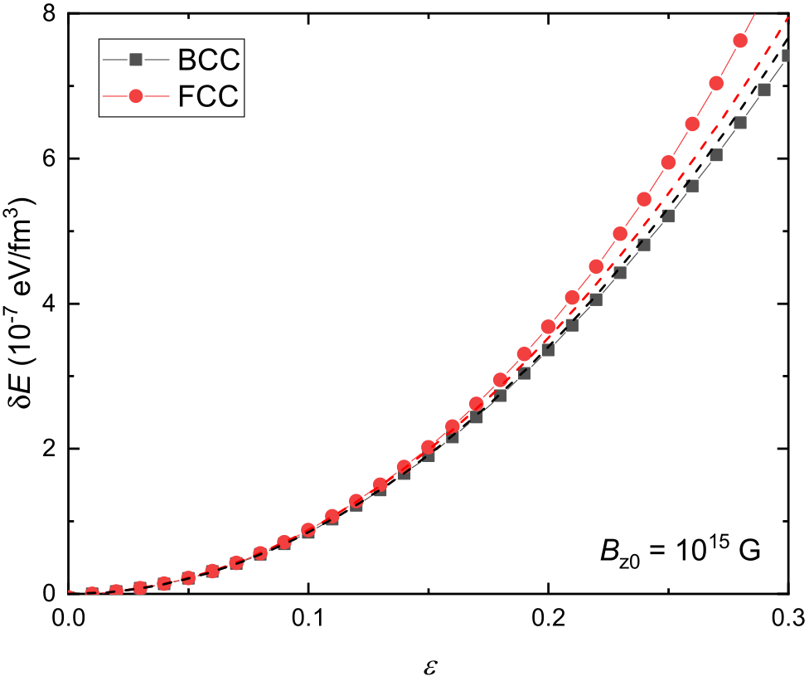

Elastic properties
¹²C,
n_{d} = 10⁻⁹ fm⁻³

Slide 13
Summary
We investigated the properties of magnetized Coulomb crystals in neutron star crusts. It was found that:
The Madelung constants of the Coulomb crystal (in unit of µ₀) fluctuate with external magnetic field at B_{z0} ≤ 3×10¹⁵ G. At higher field strengths, they decrease with B_{z0}.
The BCC lattice is slightly more stable than that of FCC at B_{z0} ≤ 3×10¹⁵ G, while the FCC lattice may become more stable at larger B_{z0}.
The (zero-point) ion vibrations reduces the elastic constants.
The properties of Coulomb crystals are insensitive to the direction of external magnetic field with B₀ =10¹⁵ G.
The elastic constants c₁₁ − c₁₂ and c₄₄ (in unit of µ₀) increase with B_{z0} at 3×10¹⁴ G < B_{z0} < 2×10¹⁵ G and decrease to vanishing values at larger B_{z0}, i.e., lattice structure becomes unstable.
Thank you!!!

Slide 14
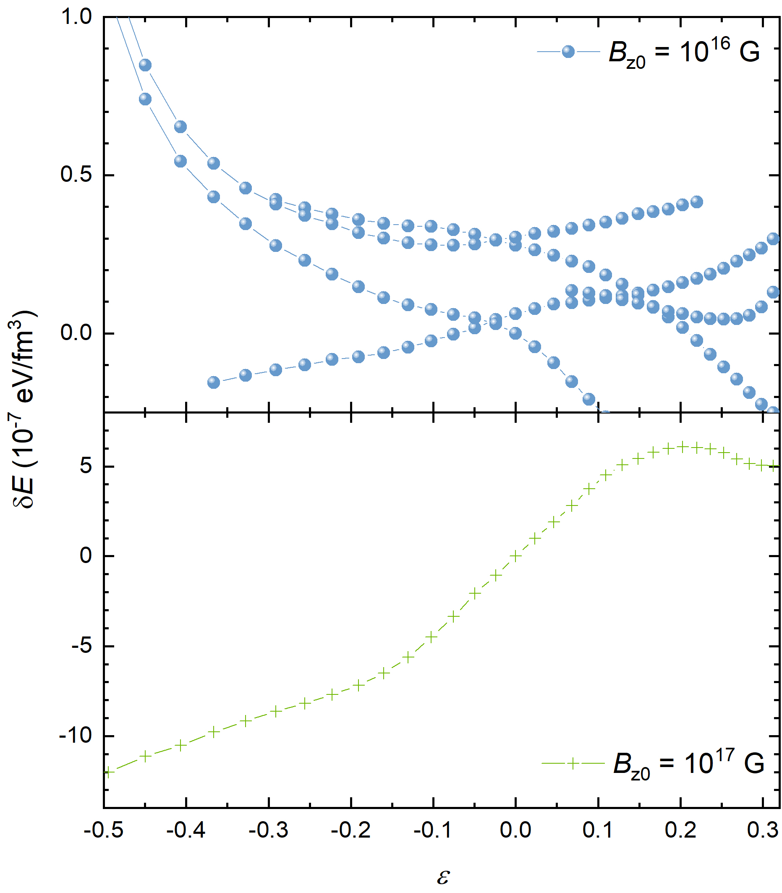
Elastic properties
Amorphous state?
¹²C, BCC,
n_{d} = 10⁻⁹ fm⁻³

Slide 15
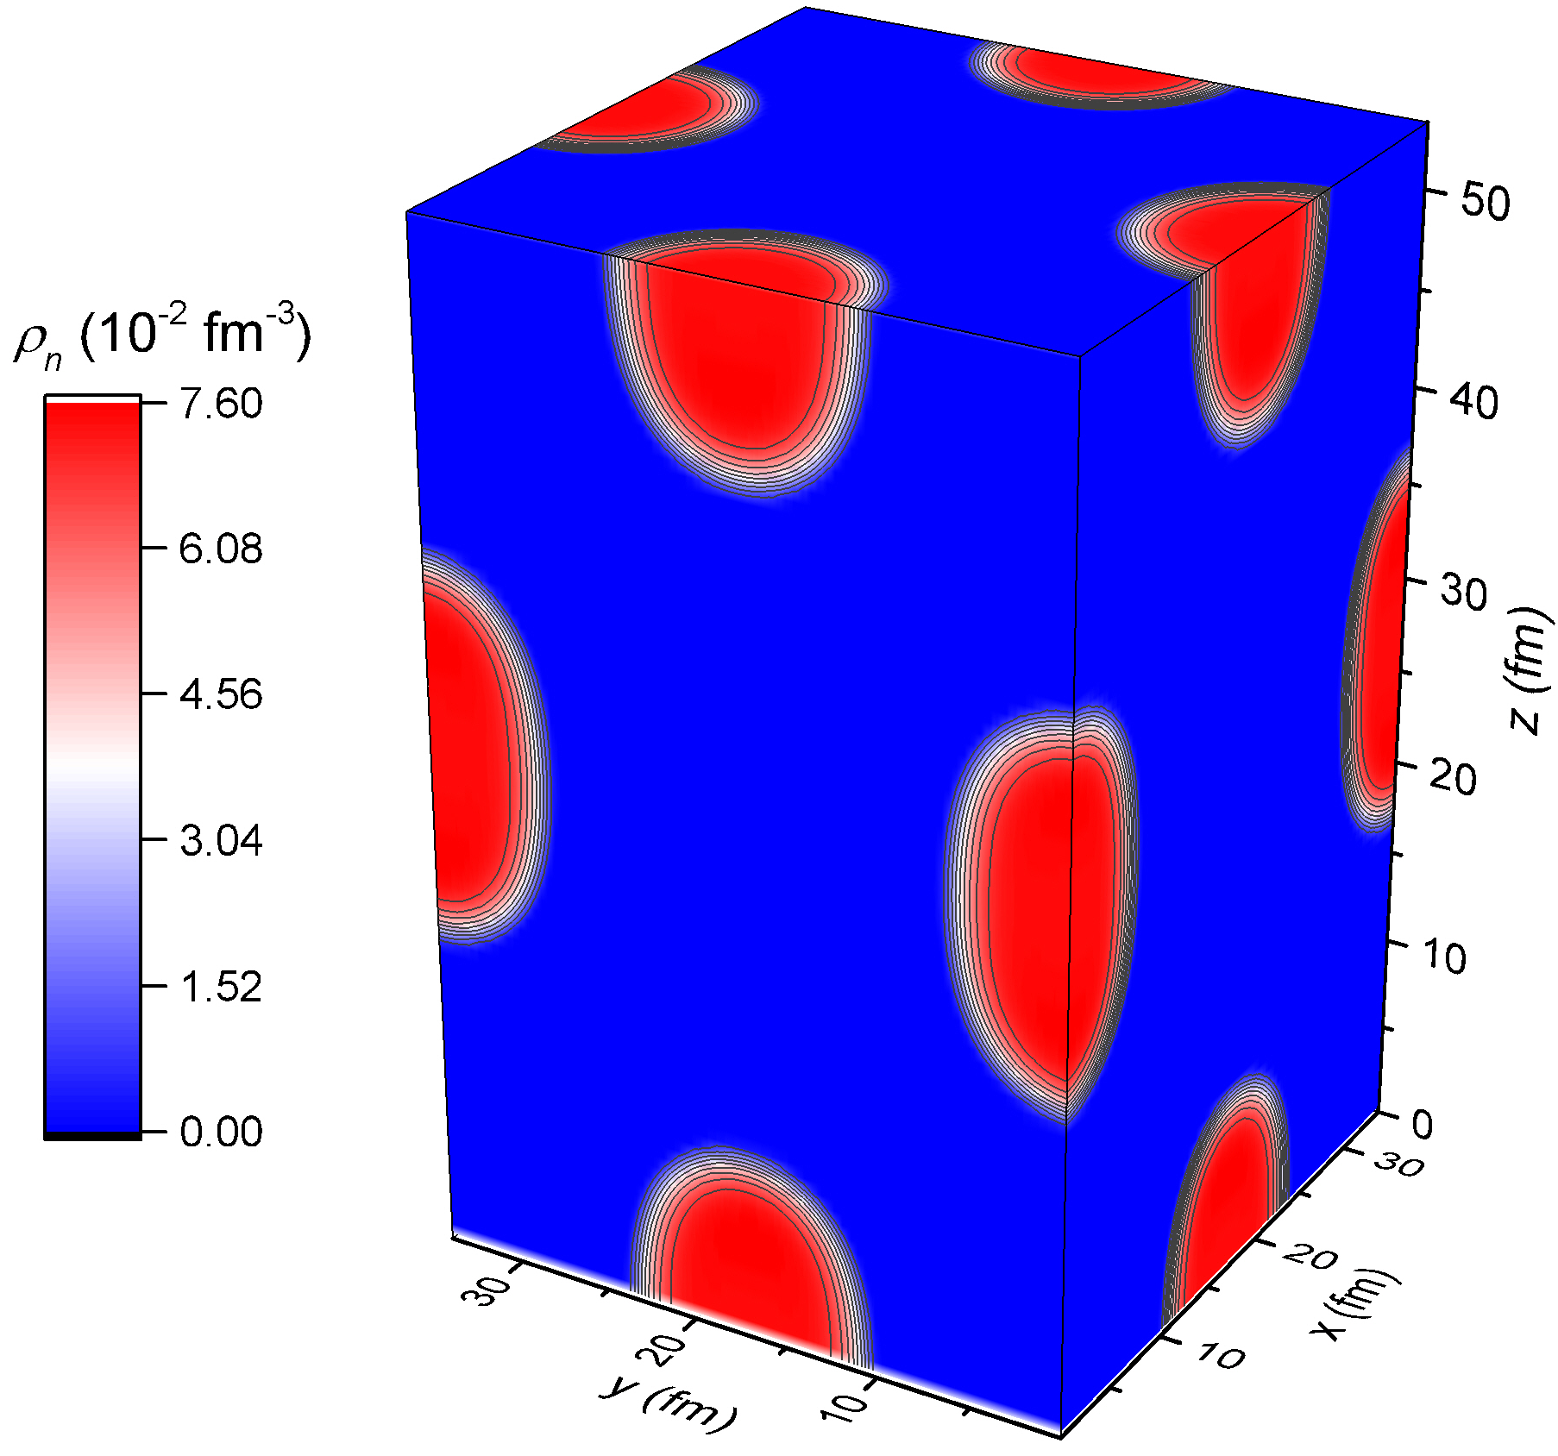
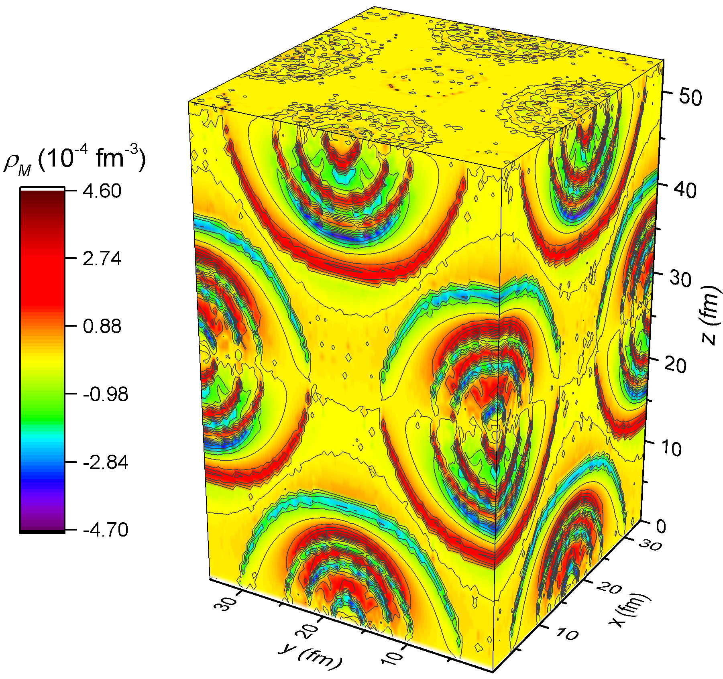
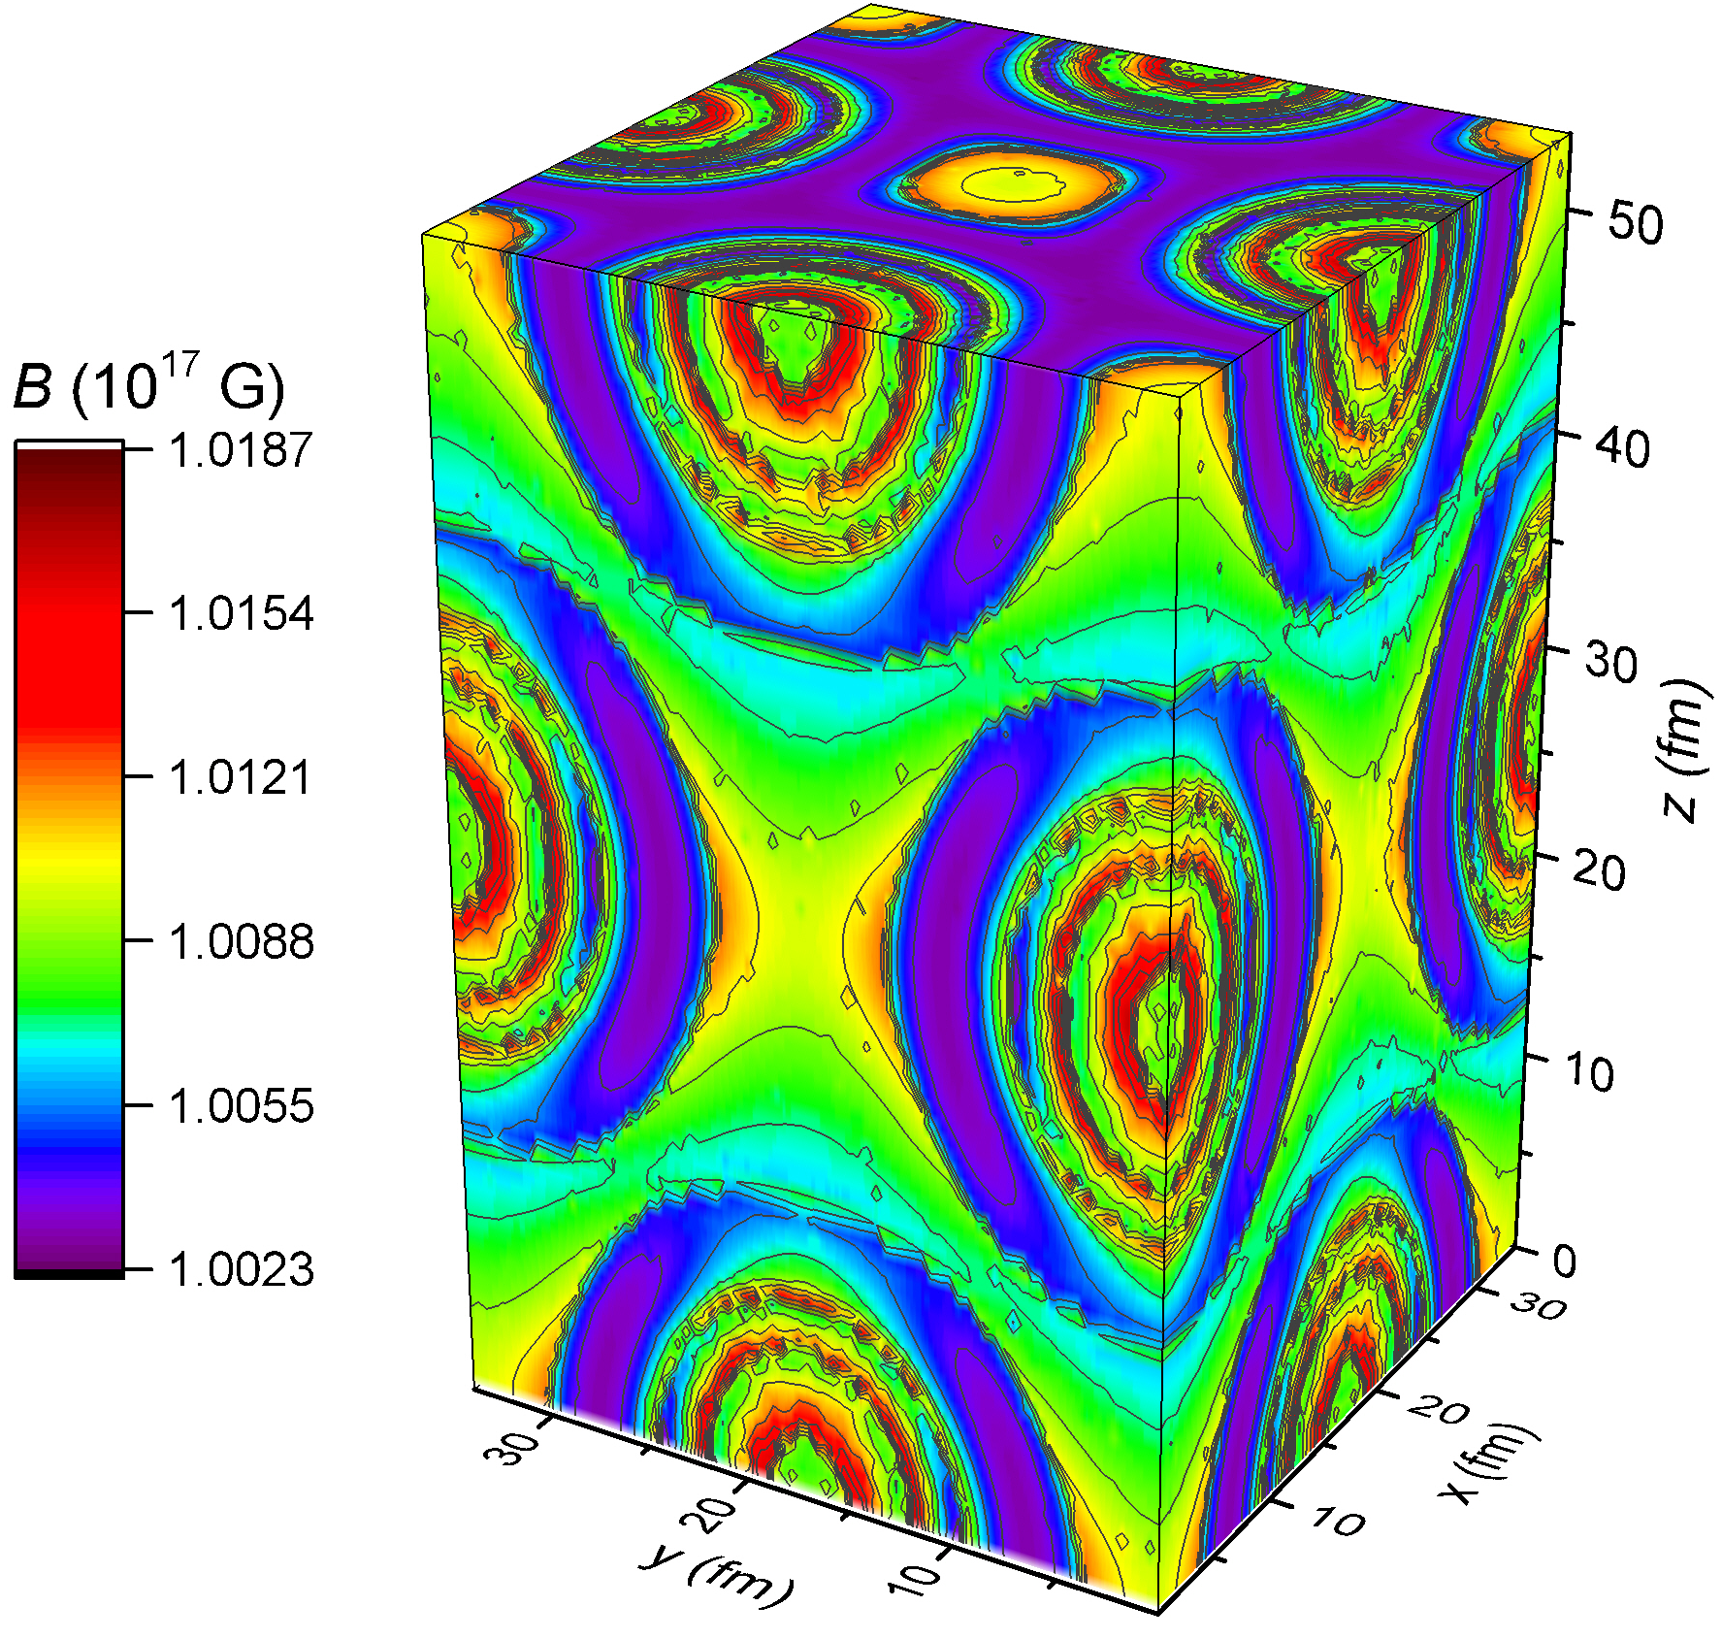
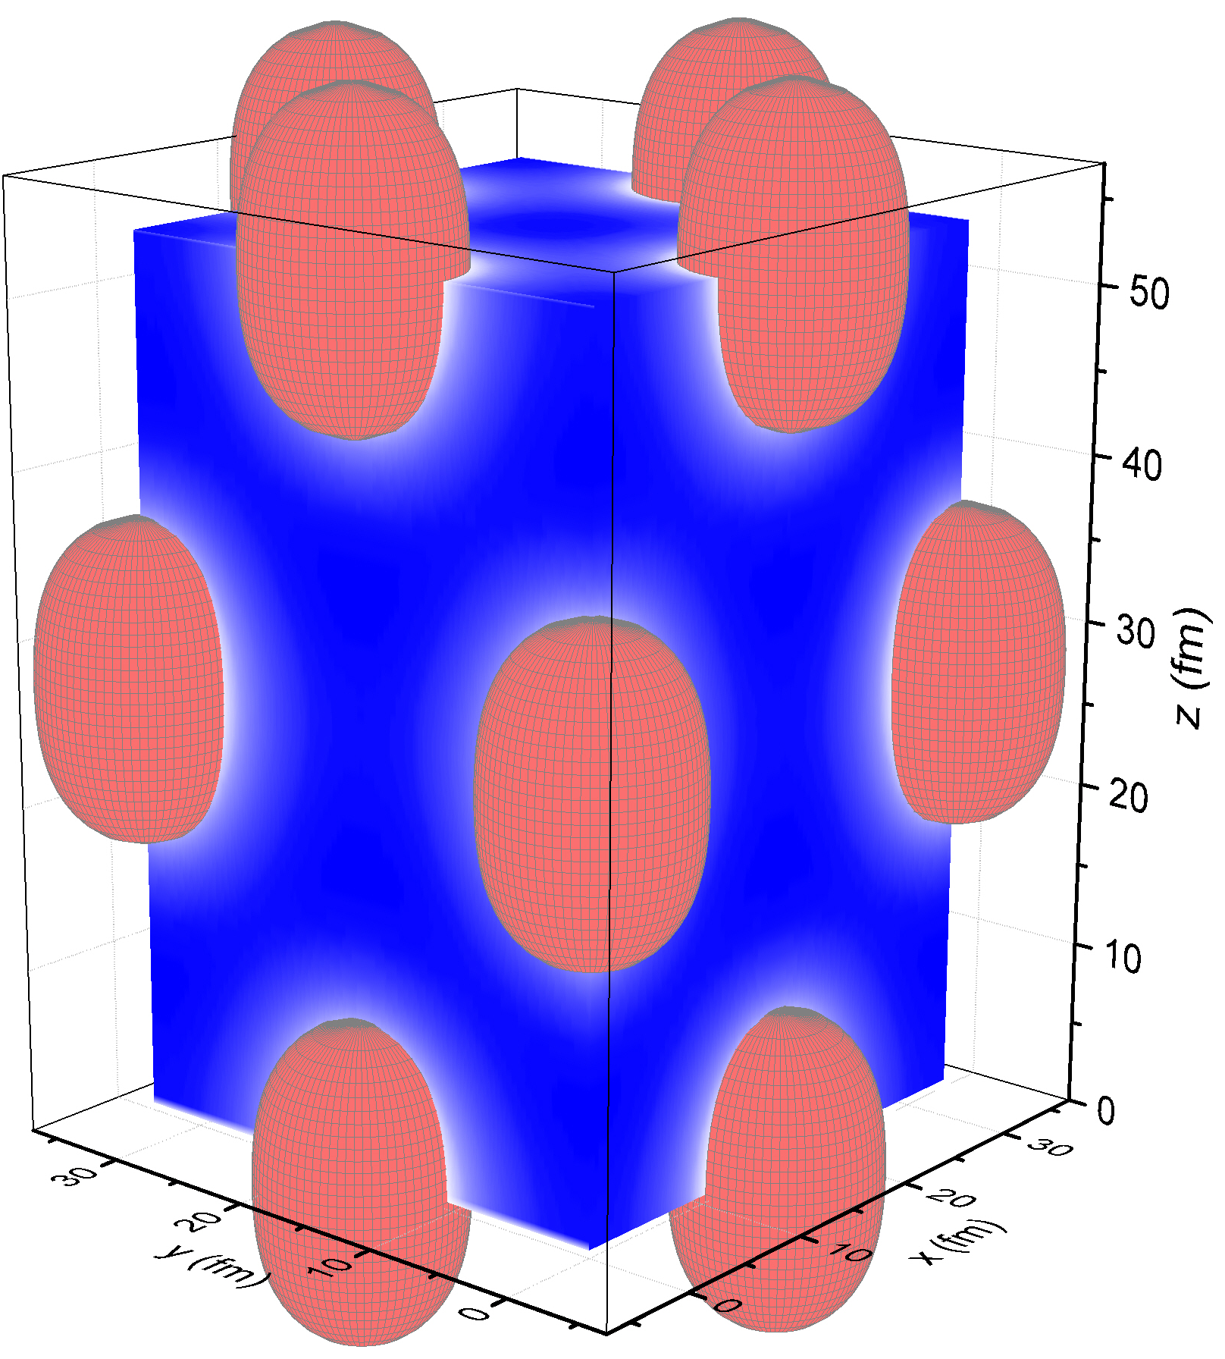
3D calculation at ρ = 0.014 fm⁻³, Y_{p}= 0.5, and B₀ = 10¹⁷ G

Slide 16
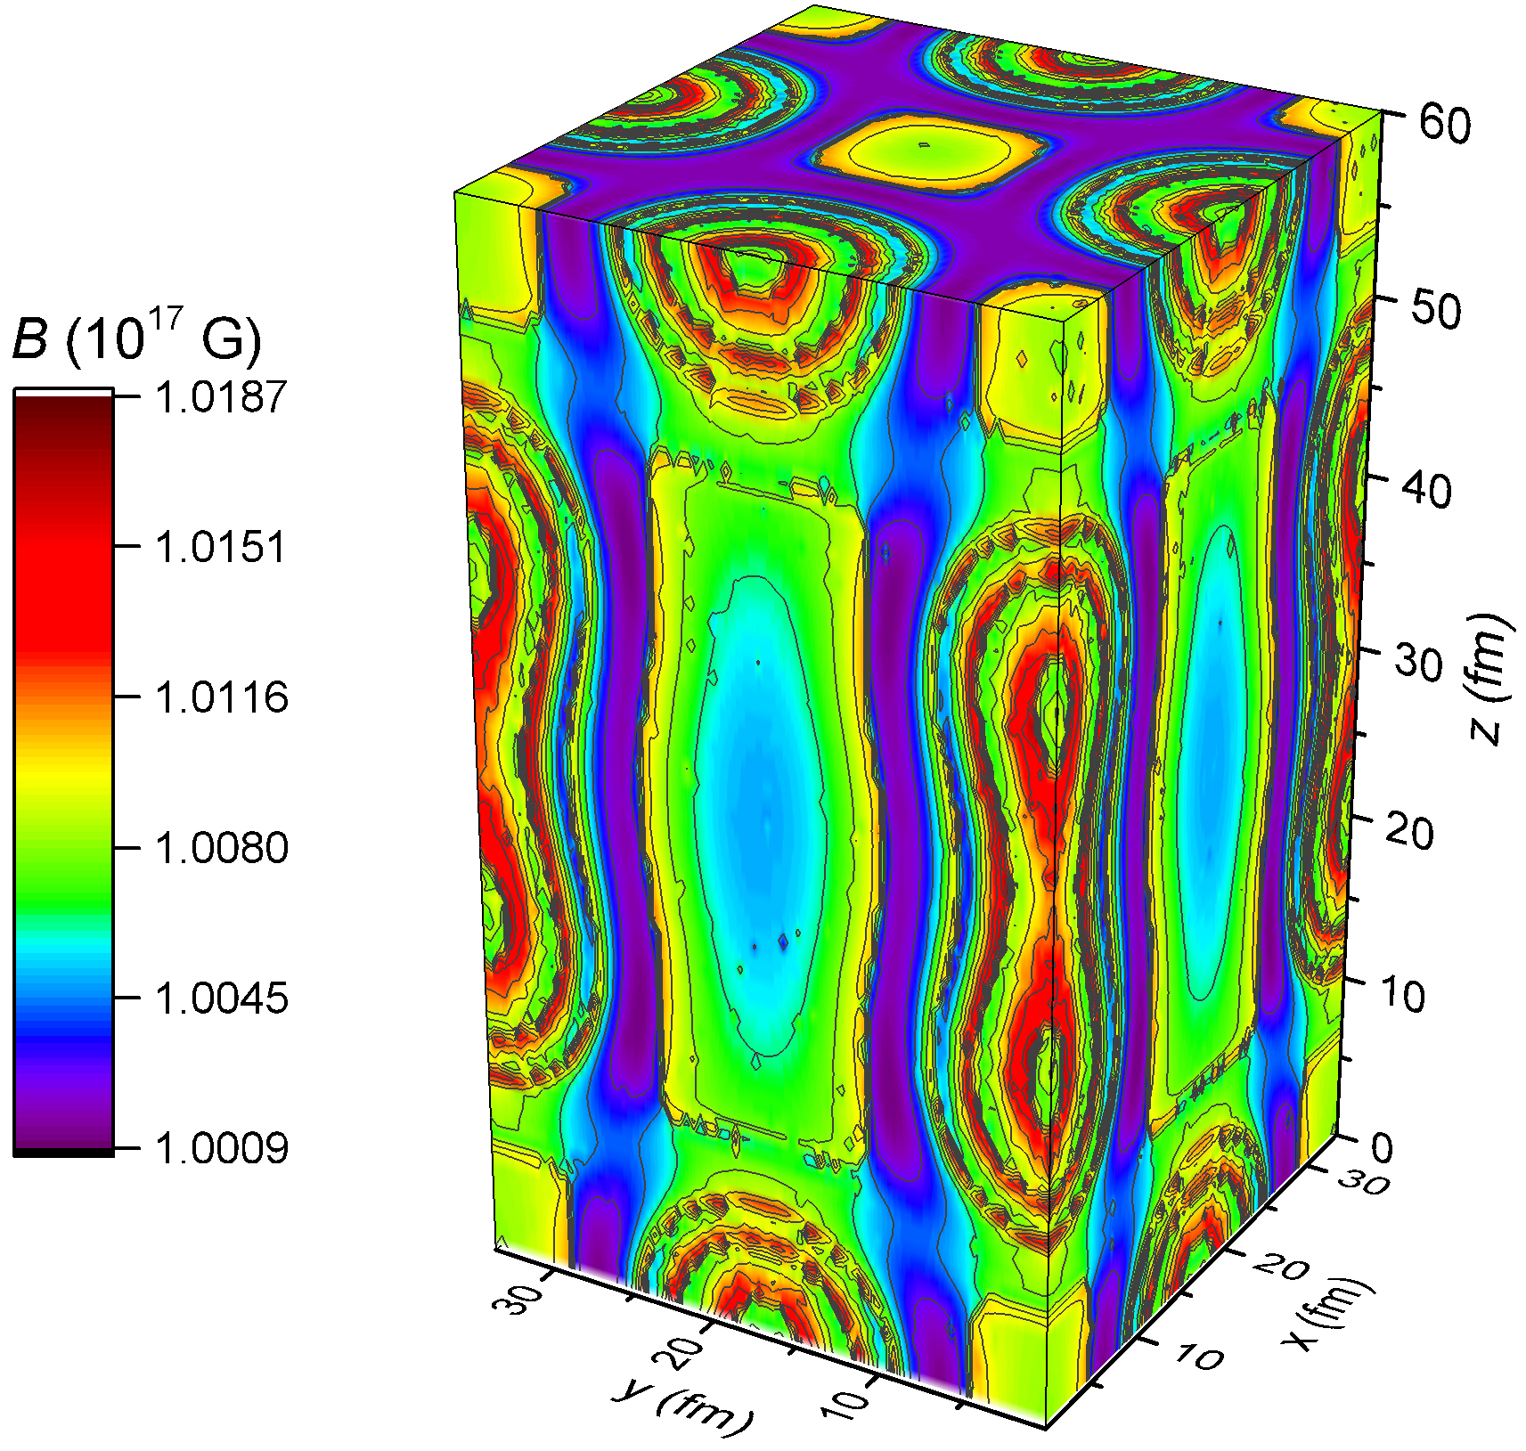
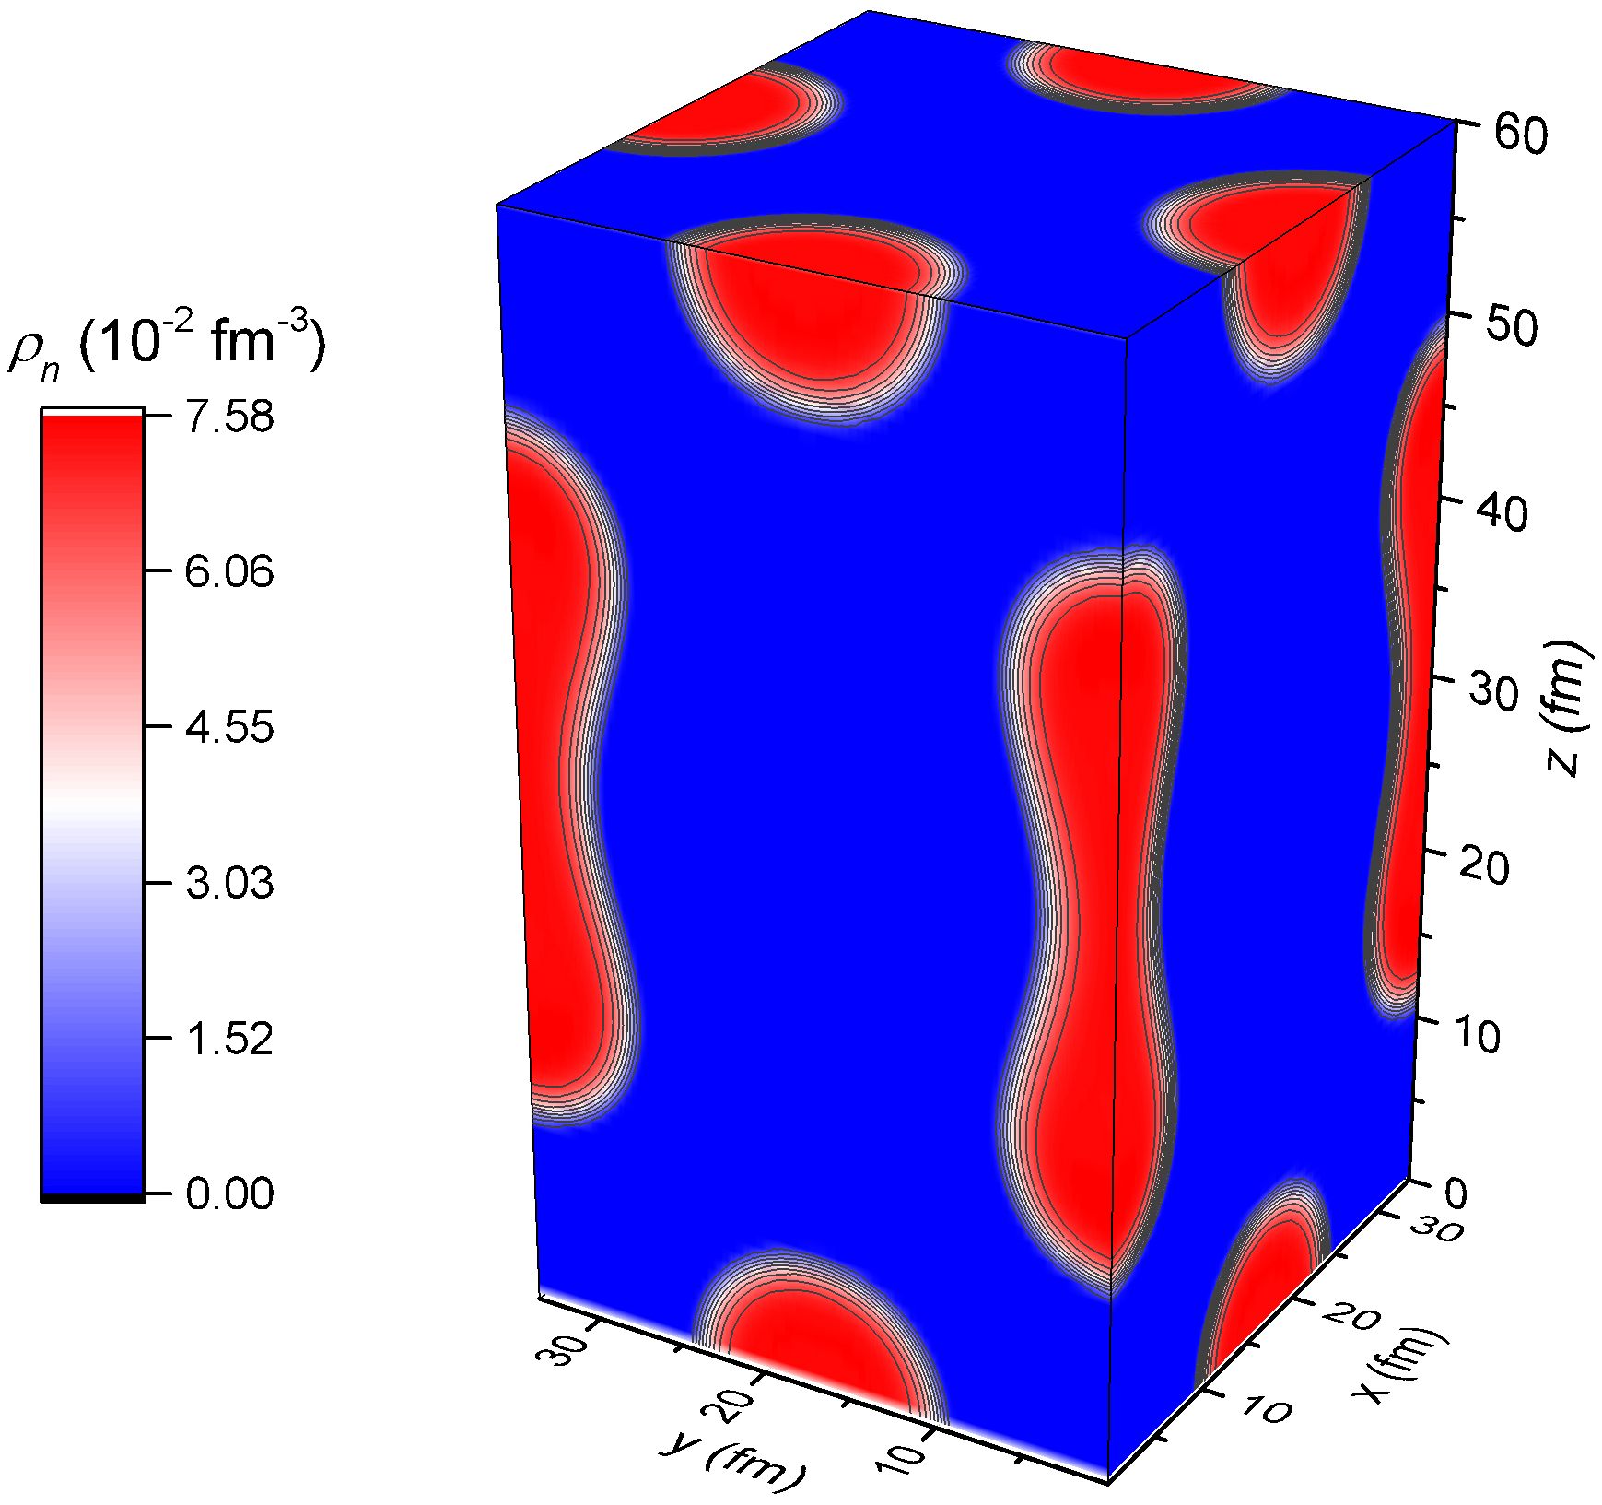
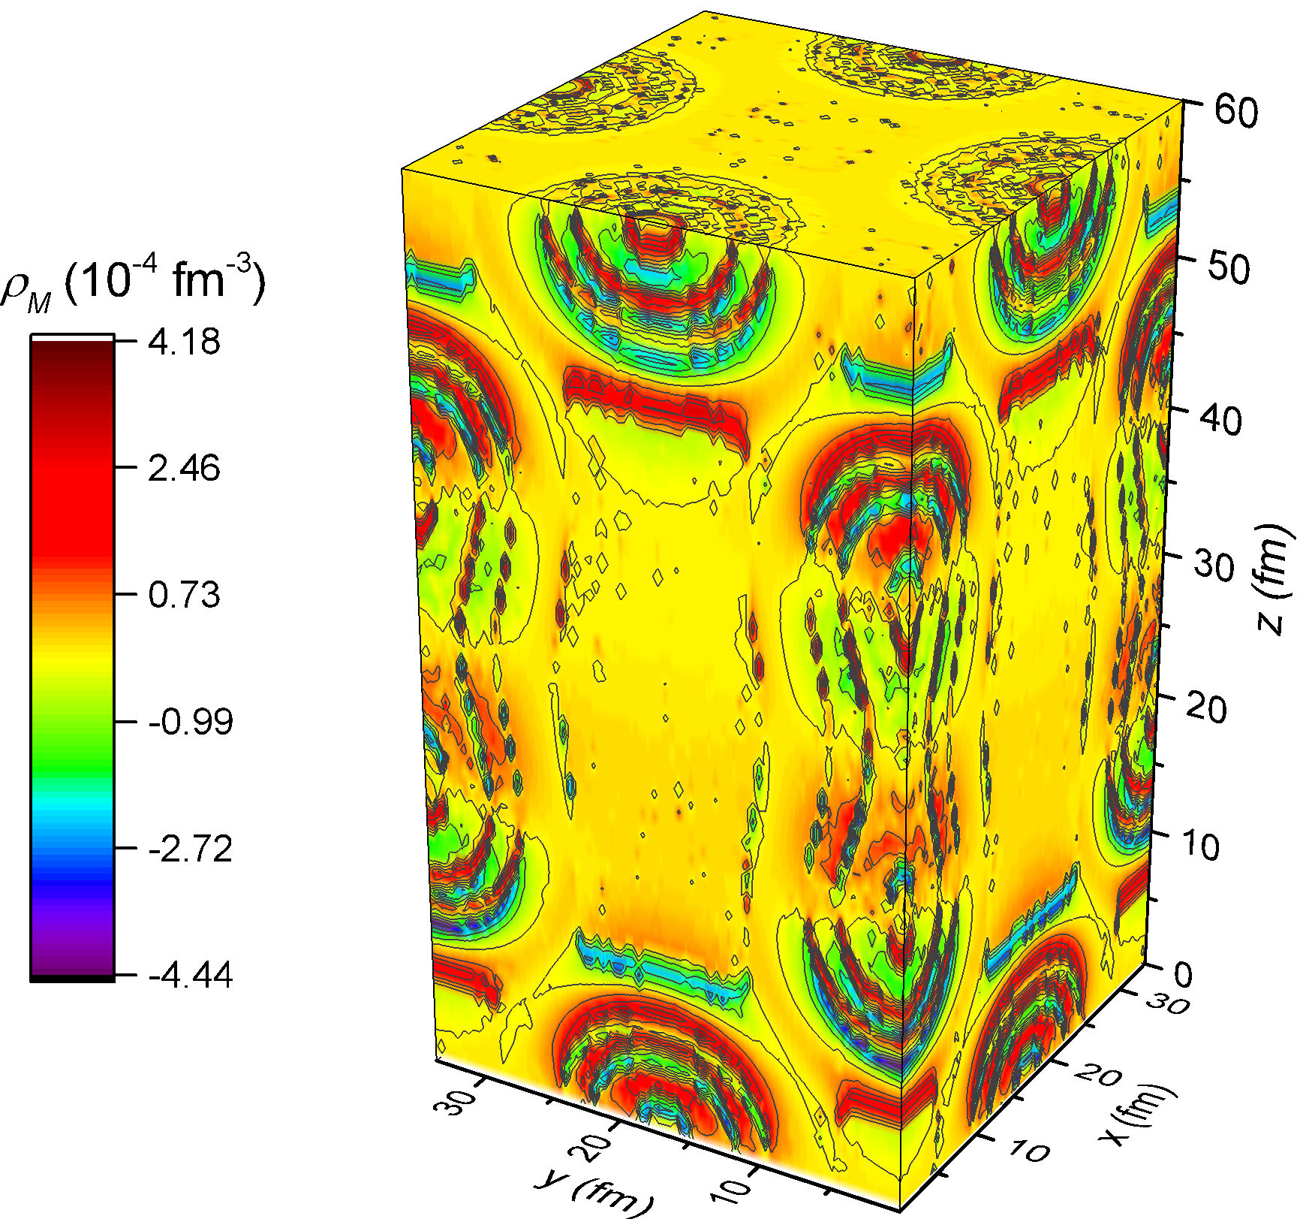
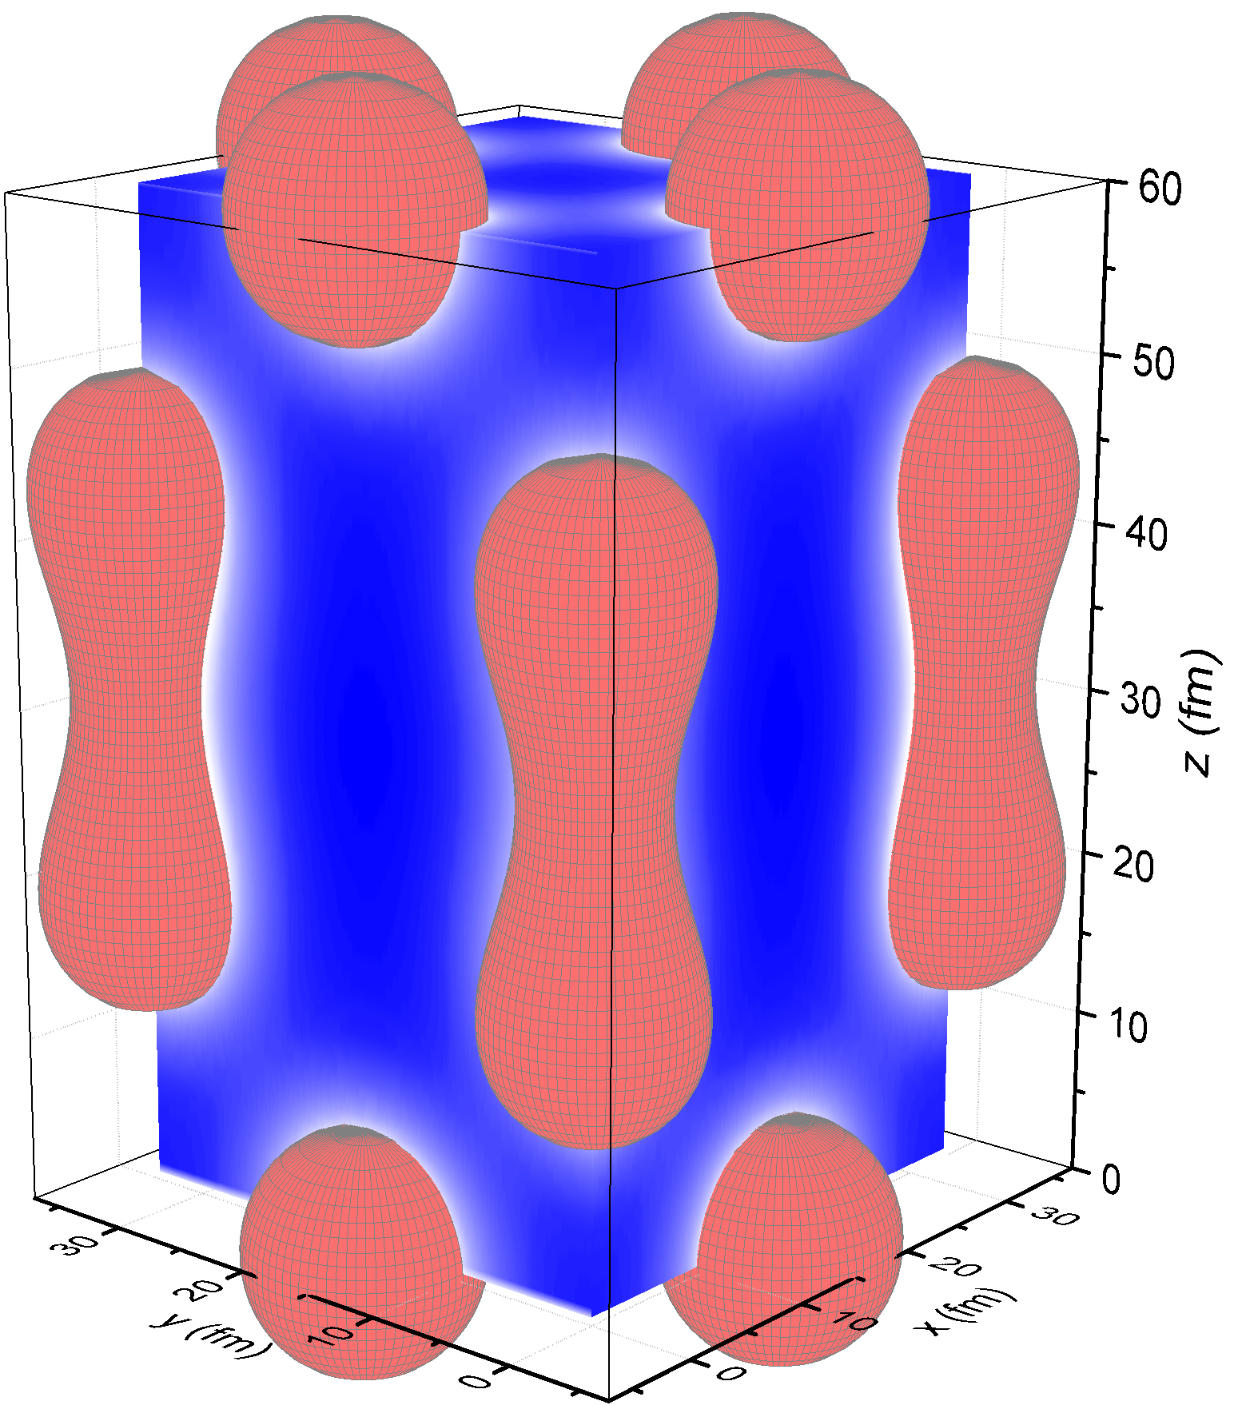
3D calculation at ρ = 0.018 fm⁻³, Y_{p}= 0.5, and B₀ = 10¹⁷ G

Slide 17
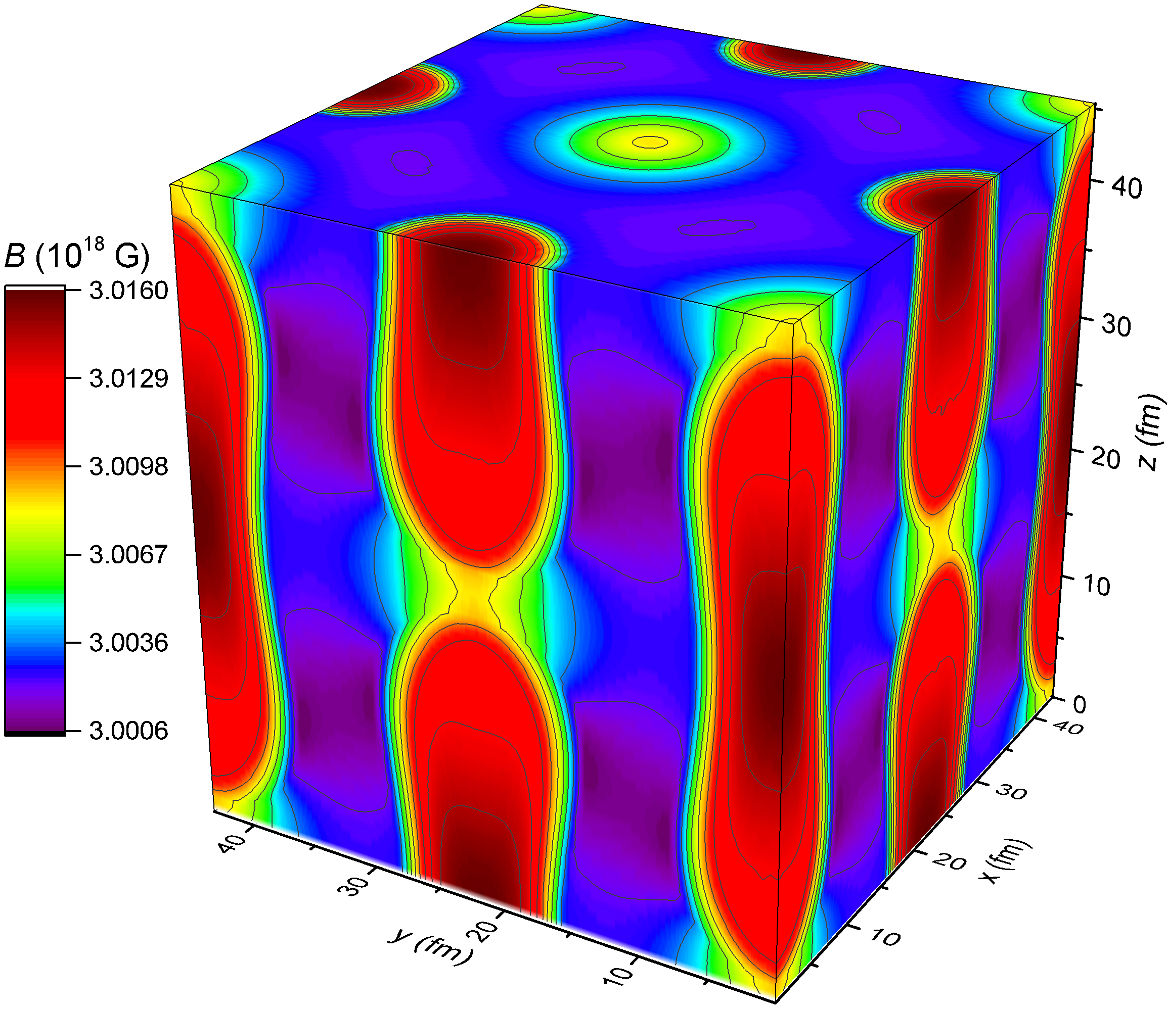
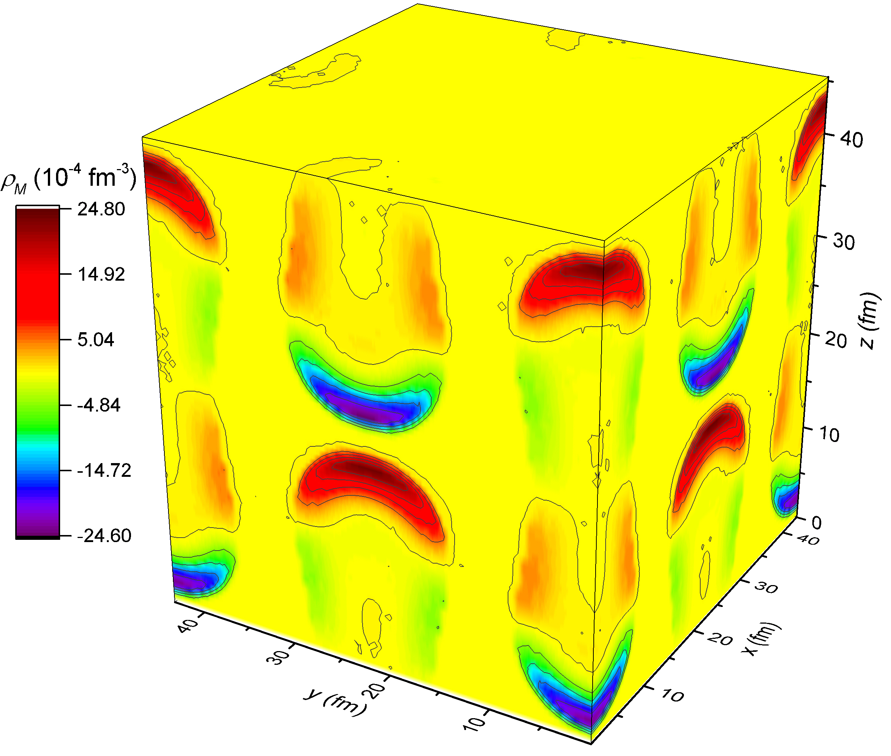
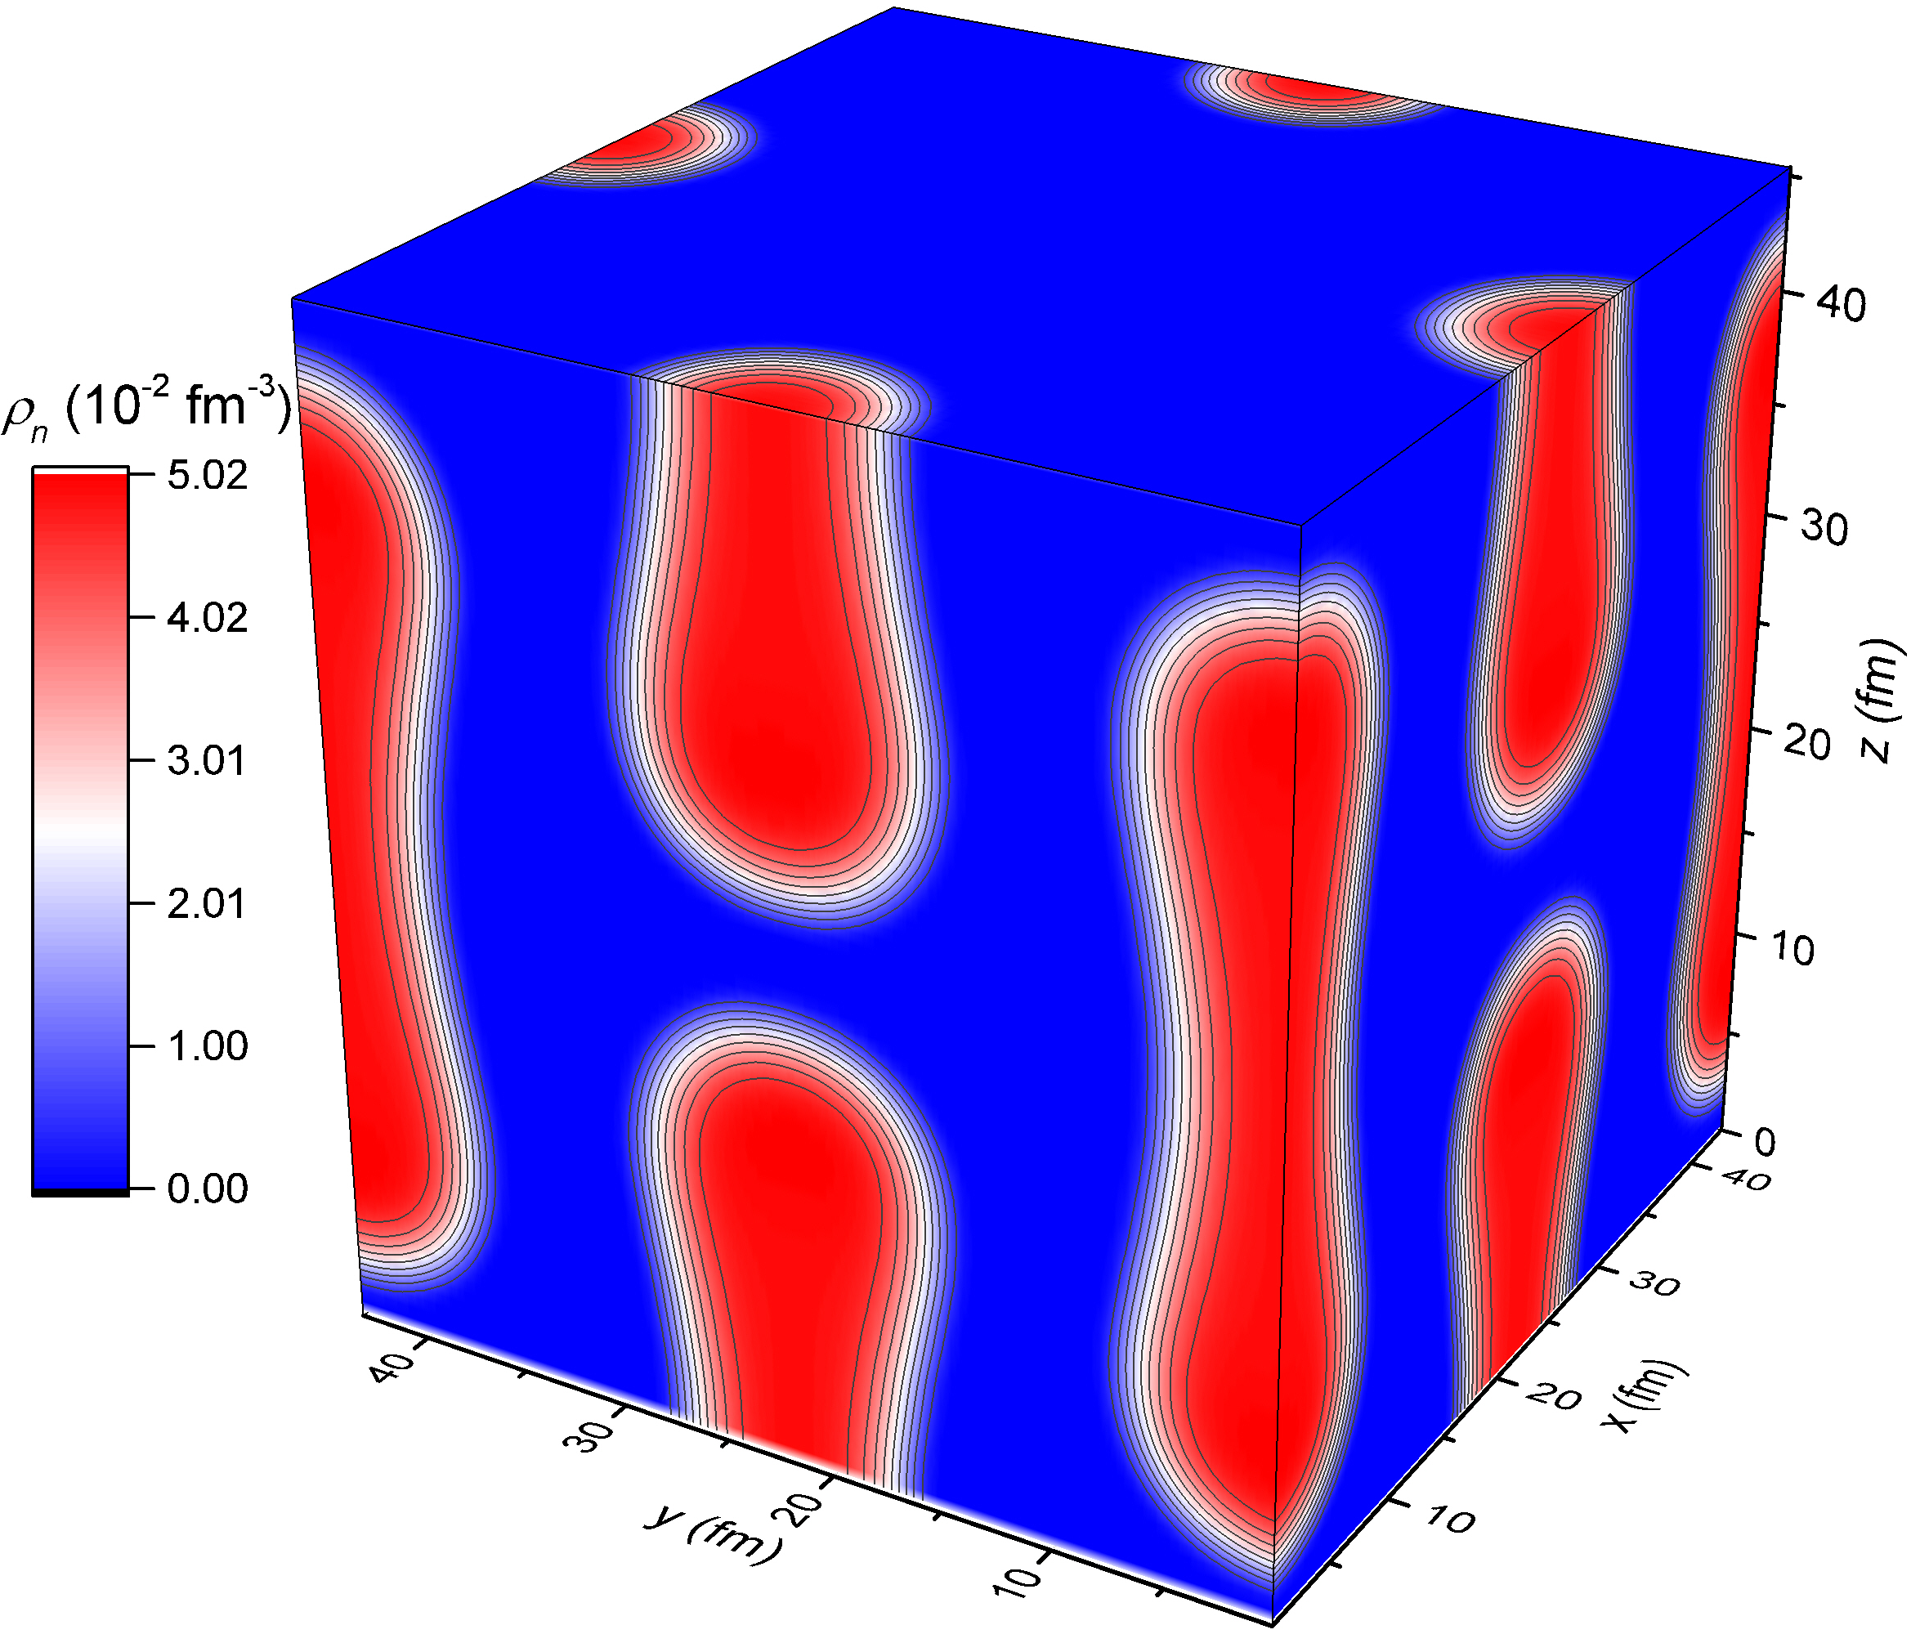
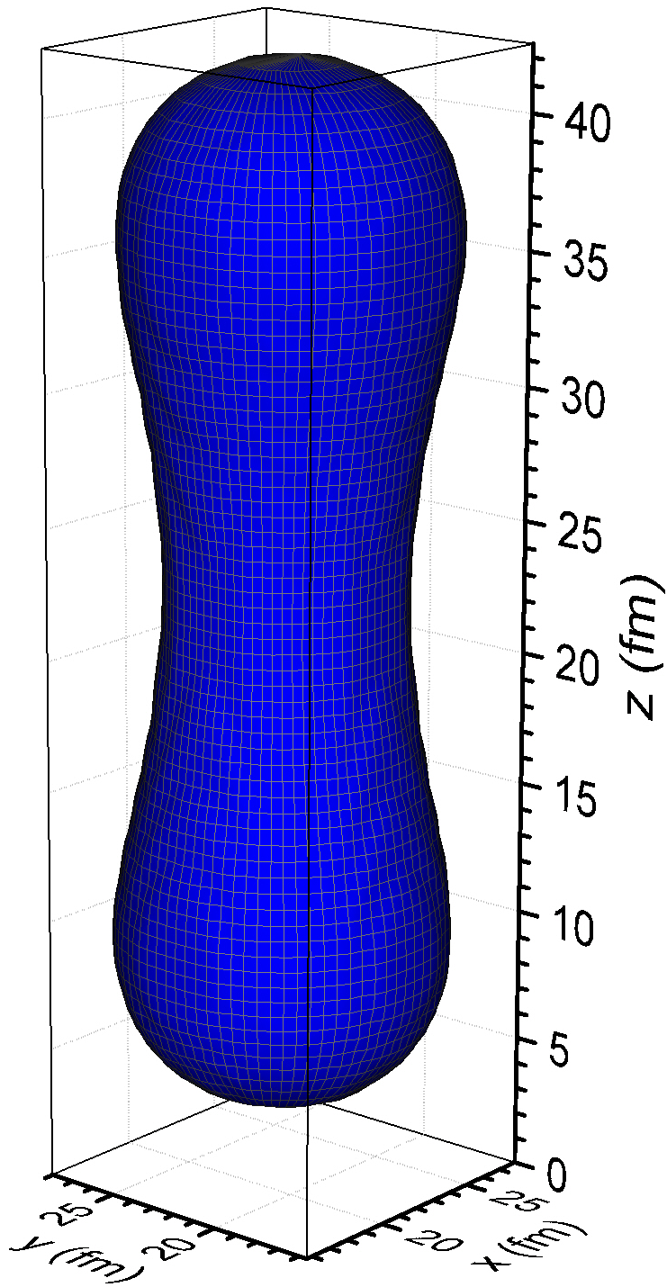
3D calculation at ρ = 0.016 fm⁻³, Y_{p}= 0.5, and B₀ = 3×10¹⁸ G

Slide 18
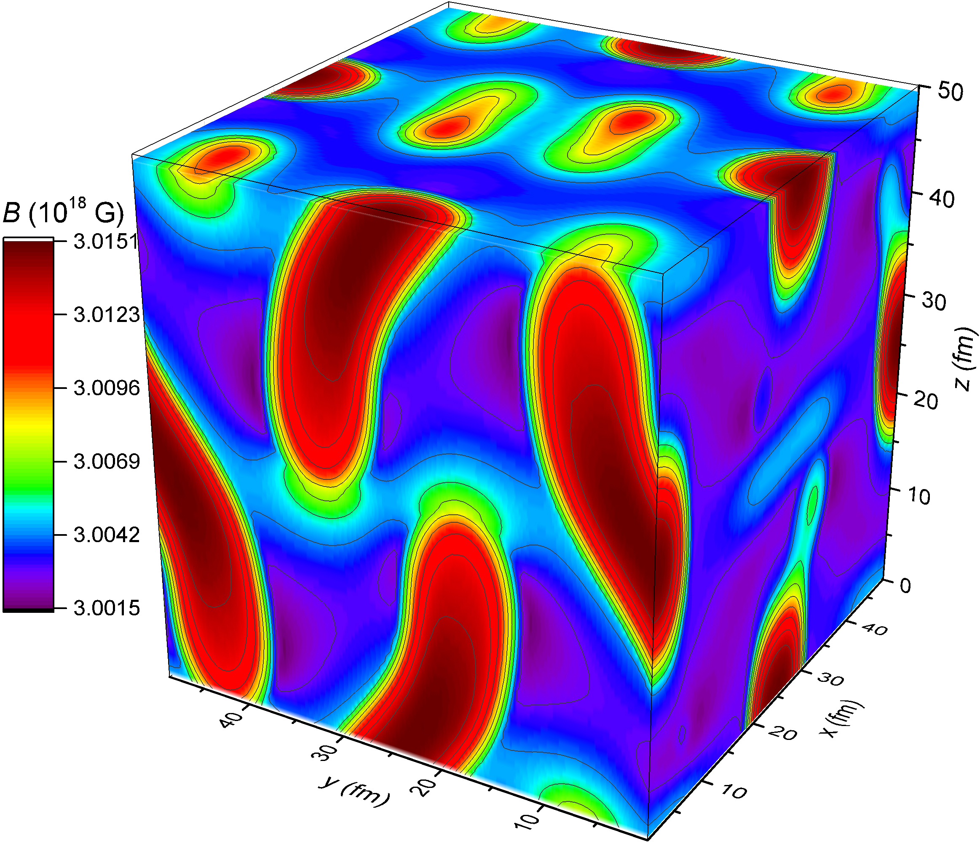
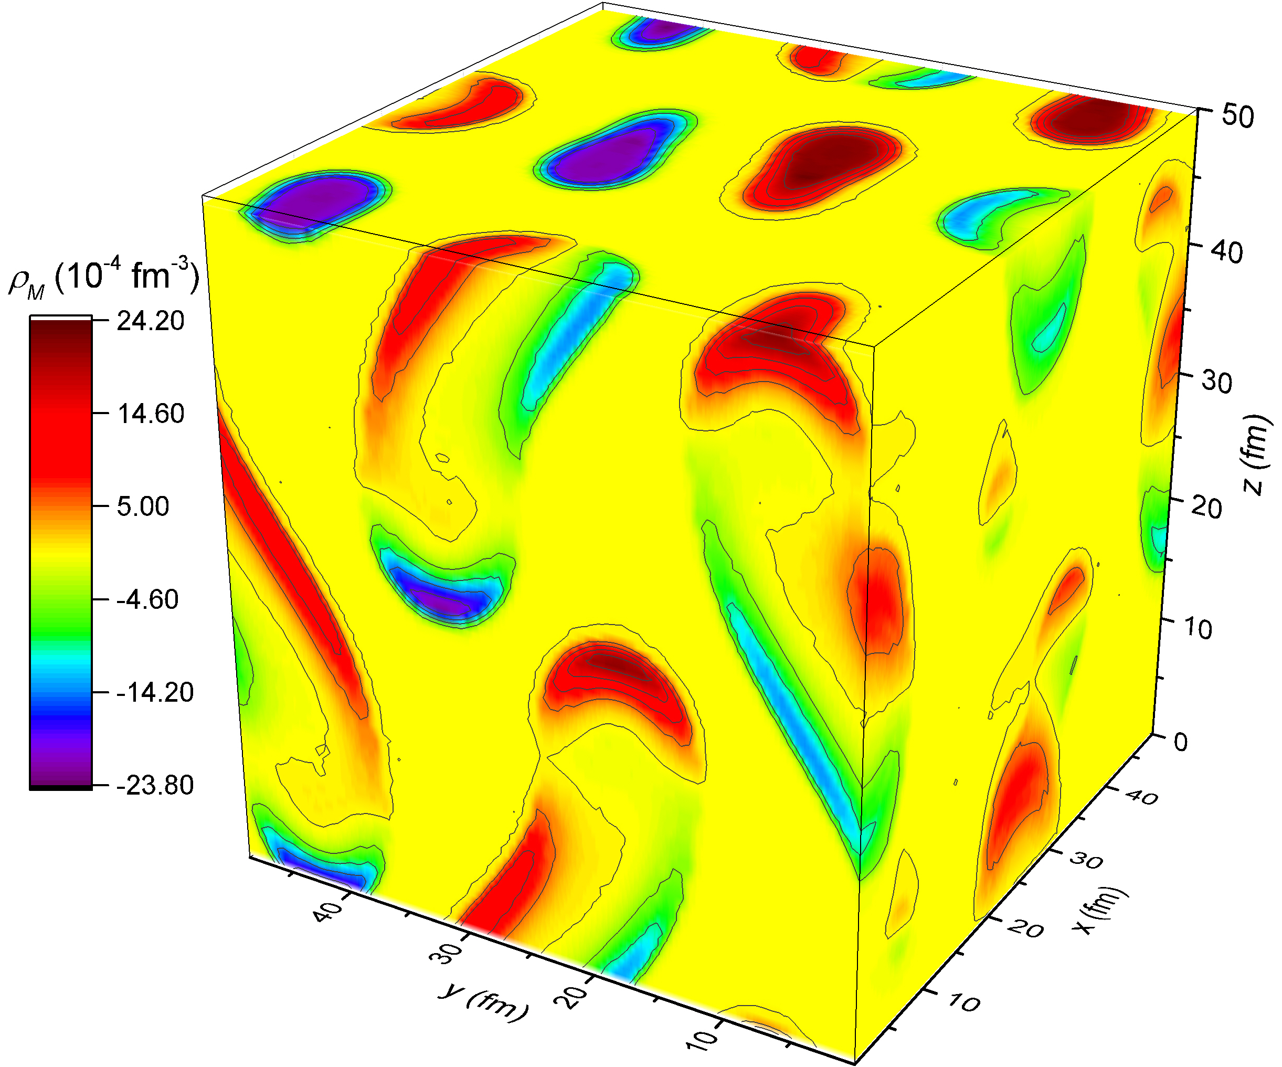
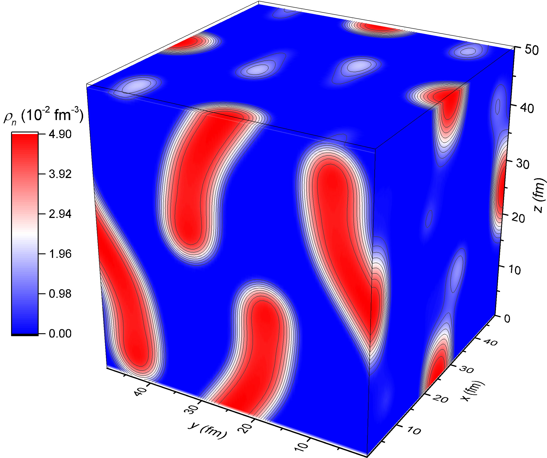
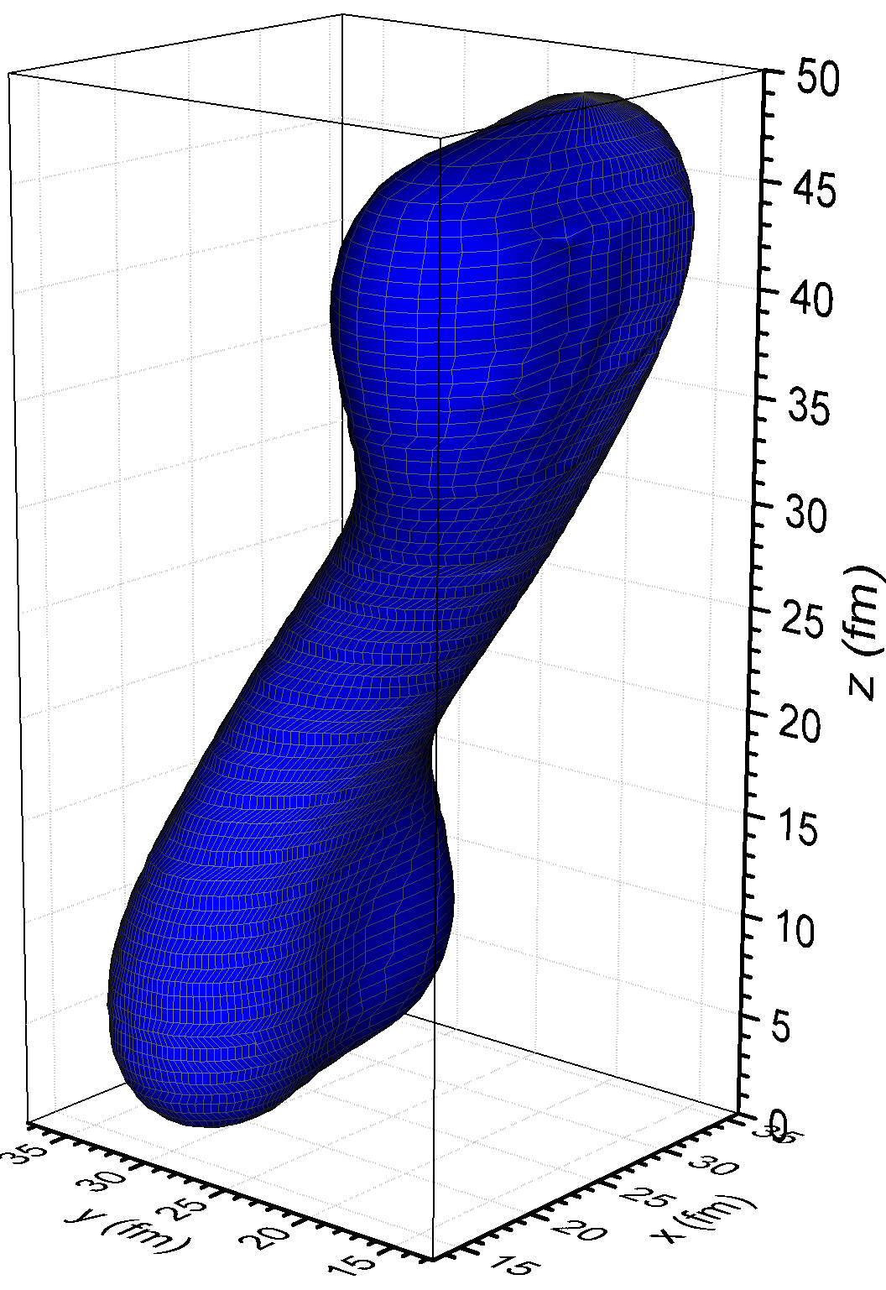
3D calculation at ρ = 0.02 fm⁻³, Y_{p}= 0.5, and B₀ = 3×10¹⁸ G

Slide 19
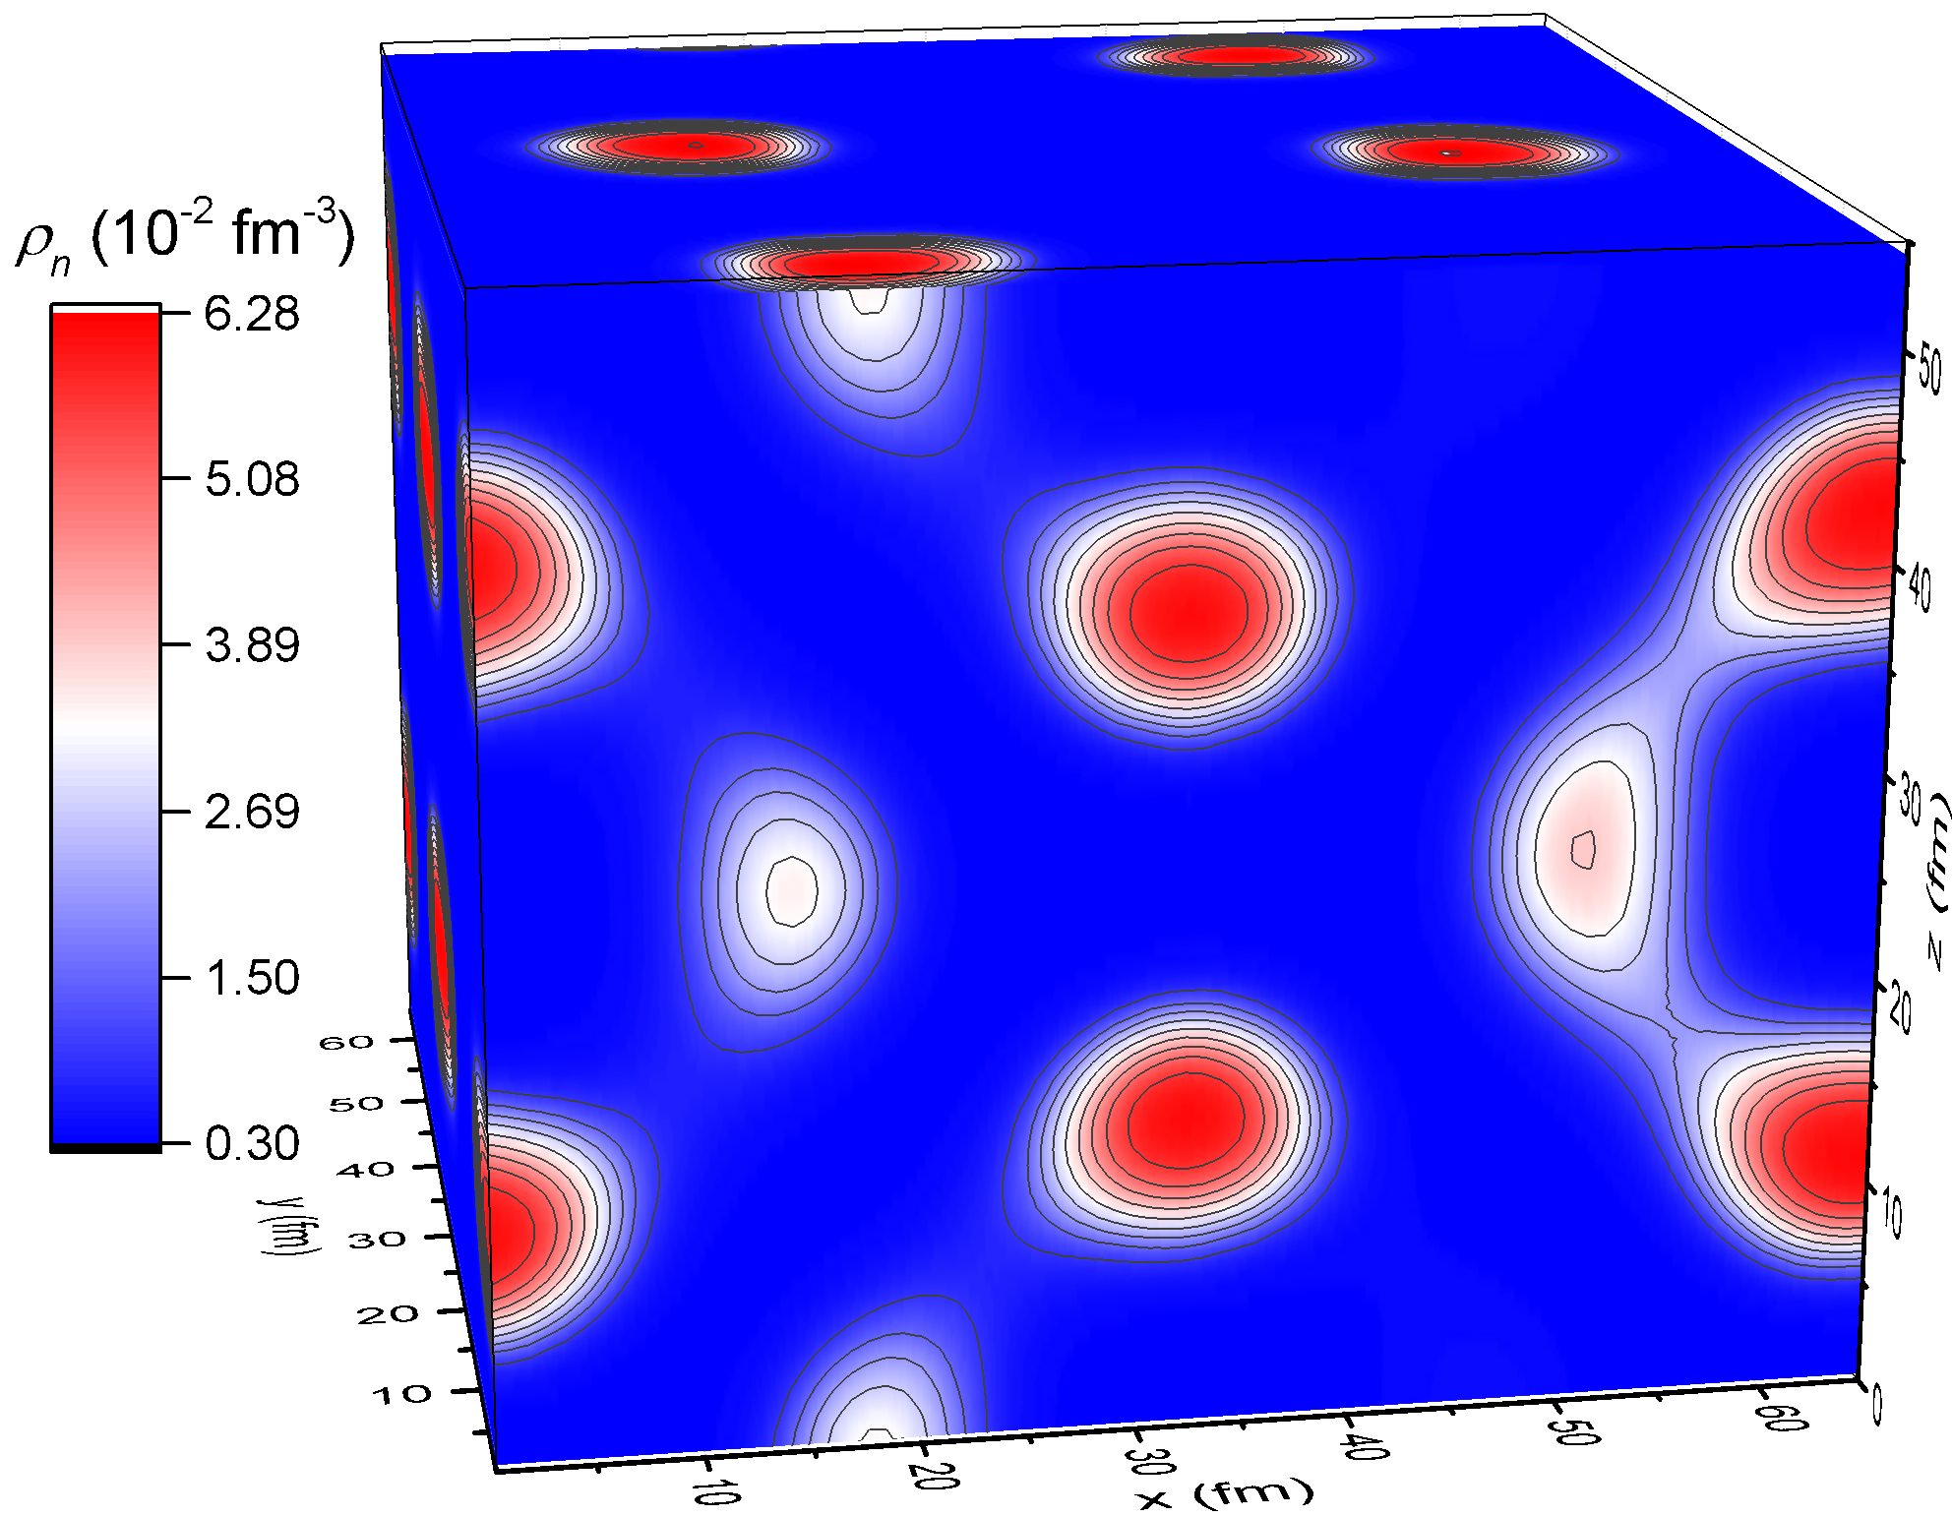
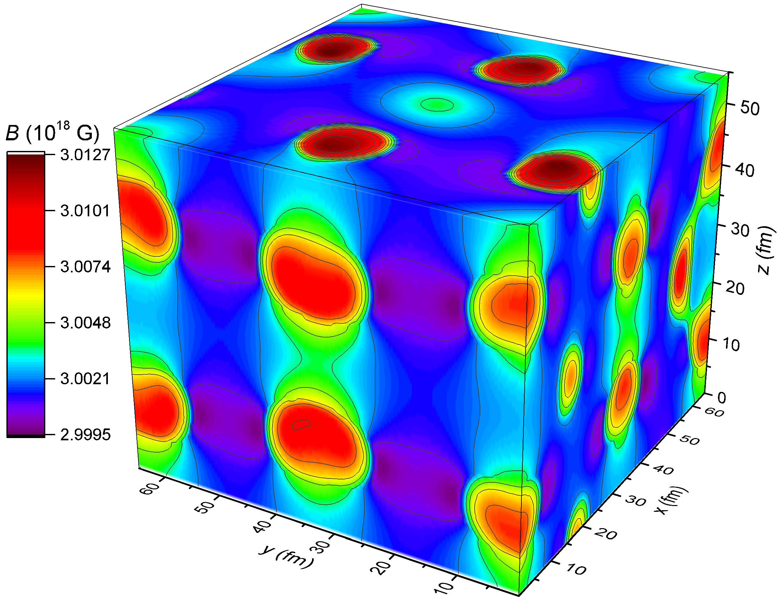
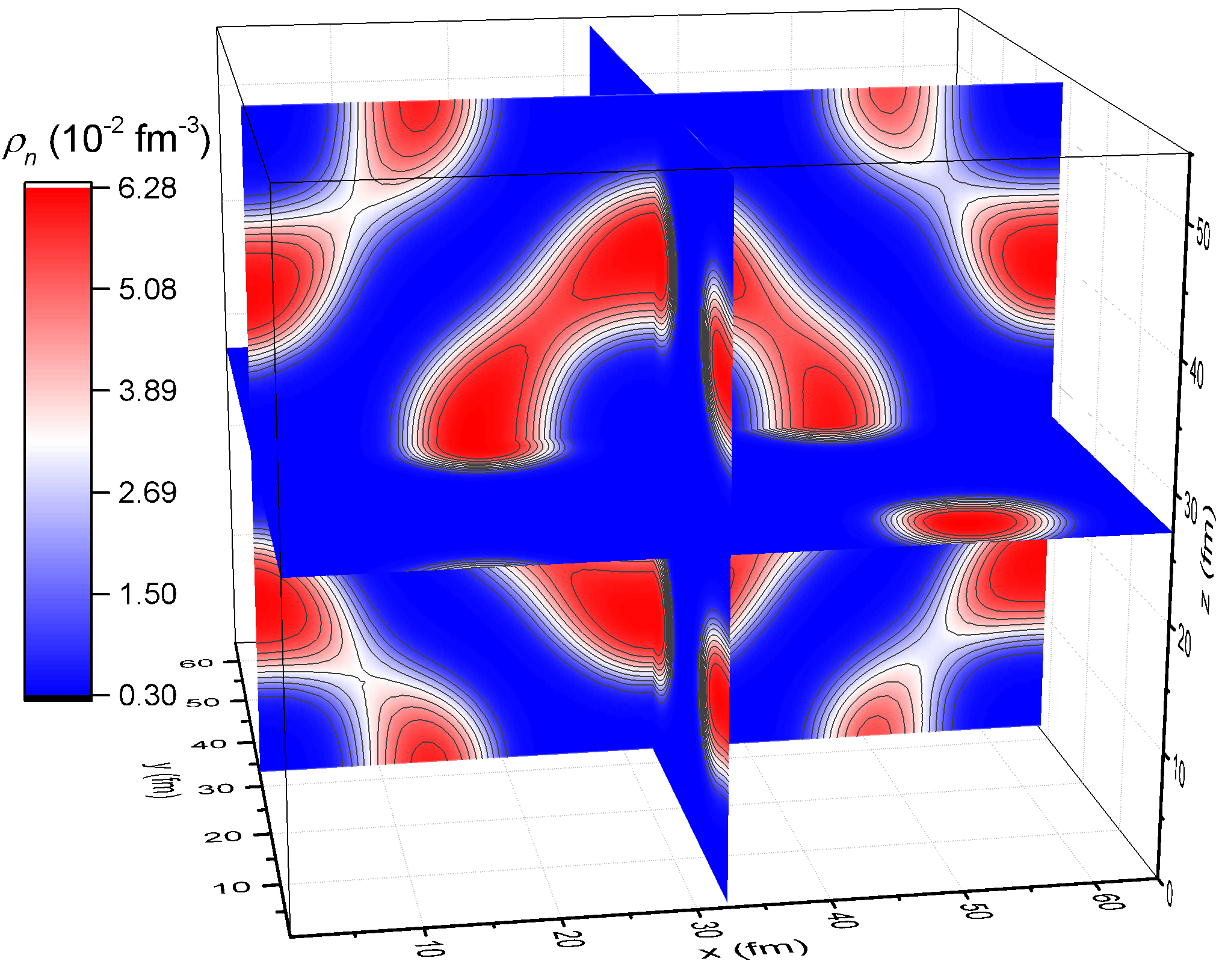


3D calculation at ρ = 0.016 fm⁻³, Y_{p}= 0.3, and B₀ = 3×10¹⁸ G

Slide 20



Magnetized Nuclear pasta

