Slide 1



单脉冲搜索和在 FAST 漂移扫描数据中的脉冲星发现
张亦弛 国家天文台
合作者：潘之辰，钱磊，张光远，
张欣雨，王路尧，Ralph Eatough
2026.07.4
Notes:
Wang et al. M13?
M3A?

Slide 2
研究背景
方法：单脉冲搜索
补充 FFT 周期搜索对长周期、nulling 脉冲星和RRATs等盲区
短驻留时间下长周期脉冲星可能只看到一两个脉冲，通过单脉冲搜索能把这些“入口信号”发现，从而后续定位、跟踪、验证新的候选体
单脉冲搜索时间快，适用于快速处理巡天数据
FAST 极高灵敏度和 19 波束的漂移扫描积累了大规模巡天数据

Slide 3
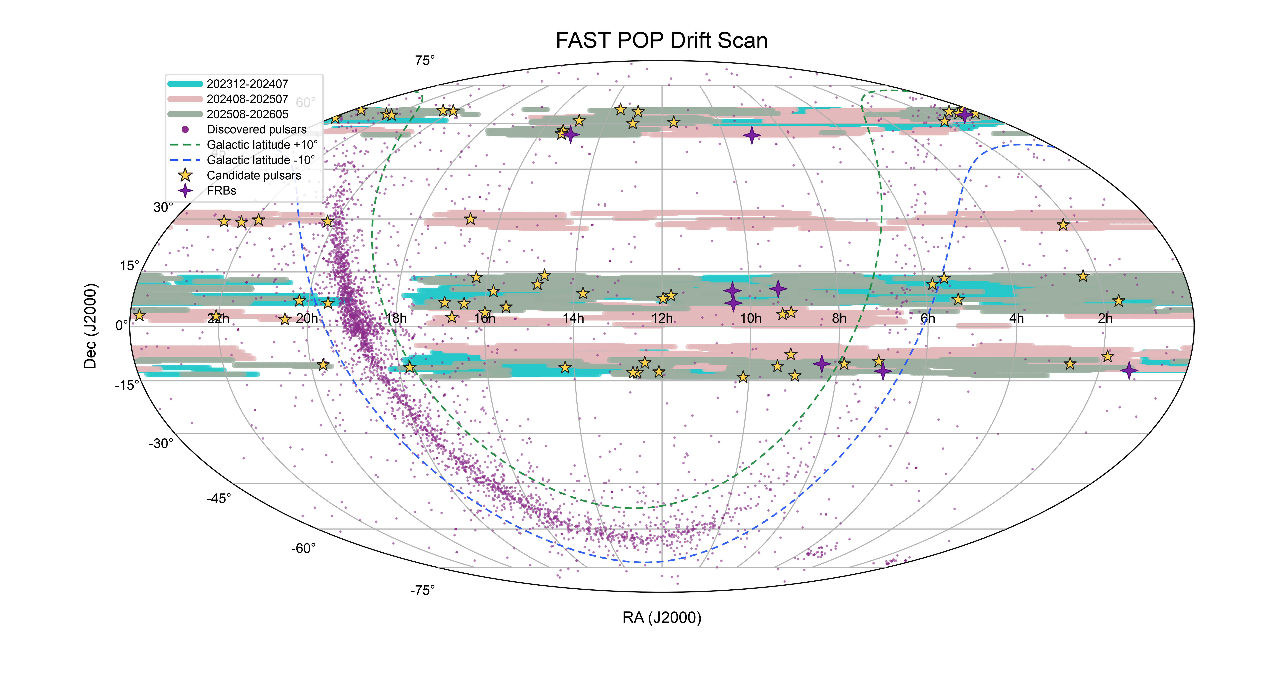
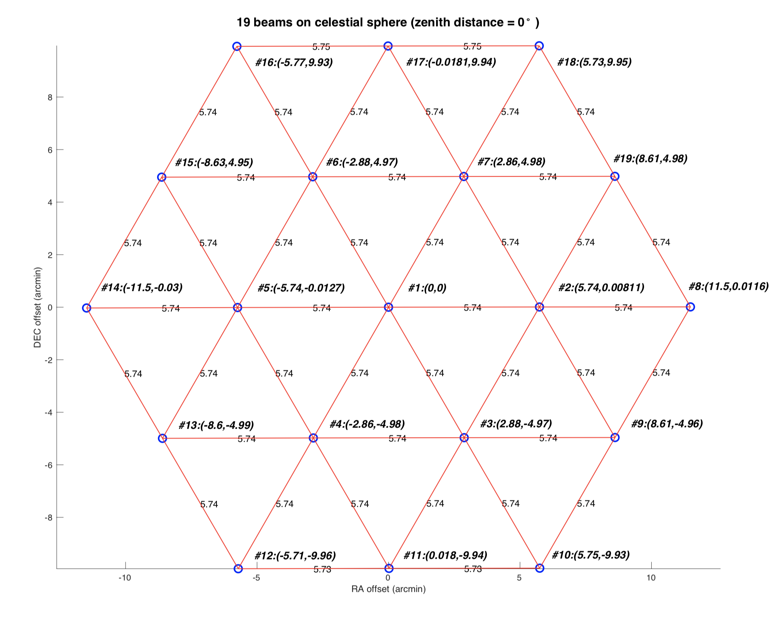
FAST Piggyback Observation of Pulsars (POP)
FAST高灵敏度优势，19 波束漂移扫描的高效巡天能力
漂移扫描模式：带角度保位漂移(DecDriftWithAngle)
19-beam L-band receiver (1.05-1.45 GHz), dual linear polarizations, 1024 channels, 196.608 µs sampling.
目前已发现63颗新脉冲星候选体和9个FRB
巡天项目详见钱磊报告
Sun Jinghai & Yang Qingliang，
FAST 19 beams

Slide 4
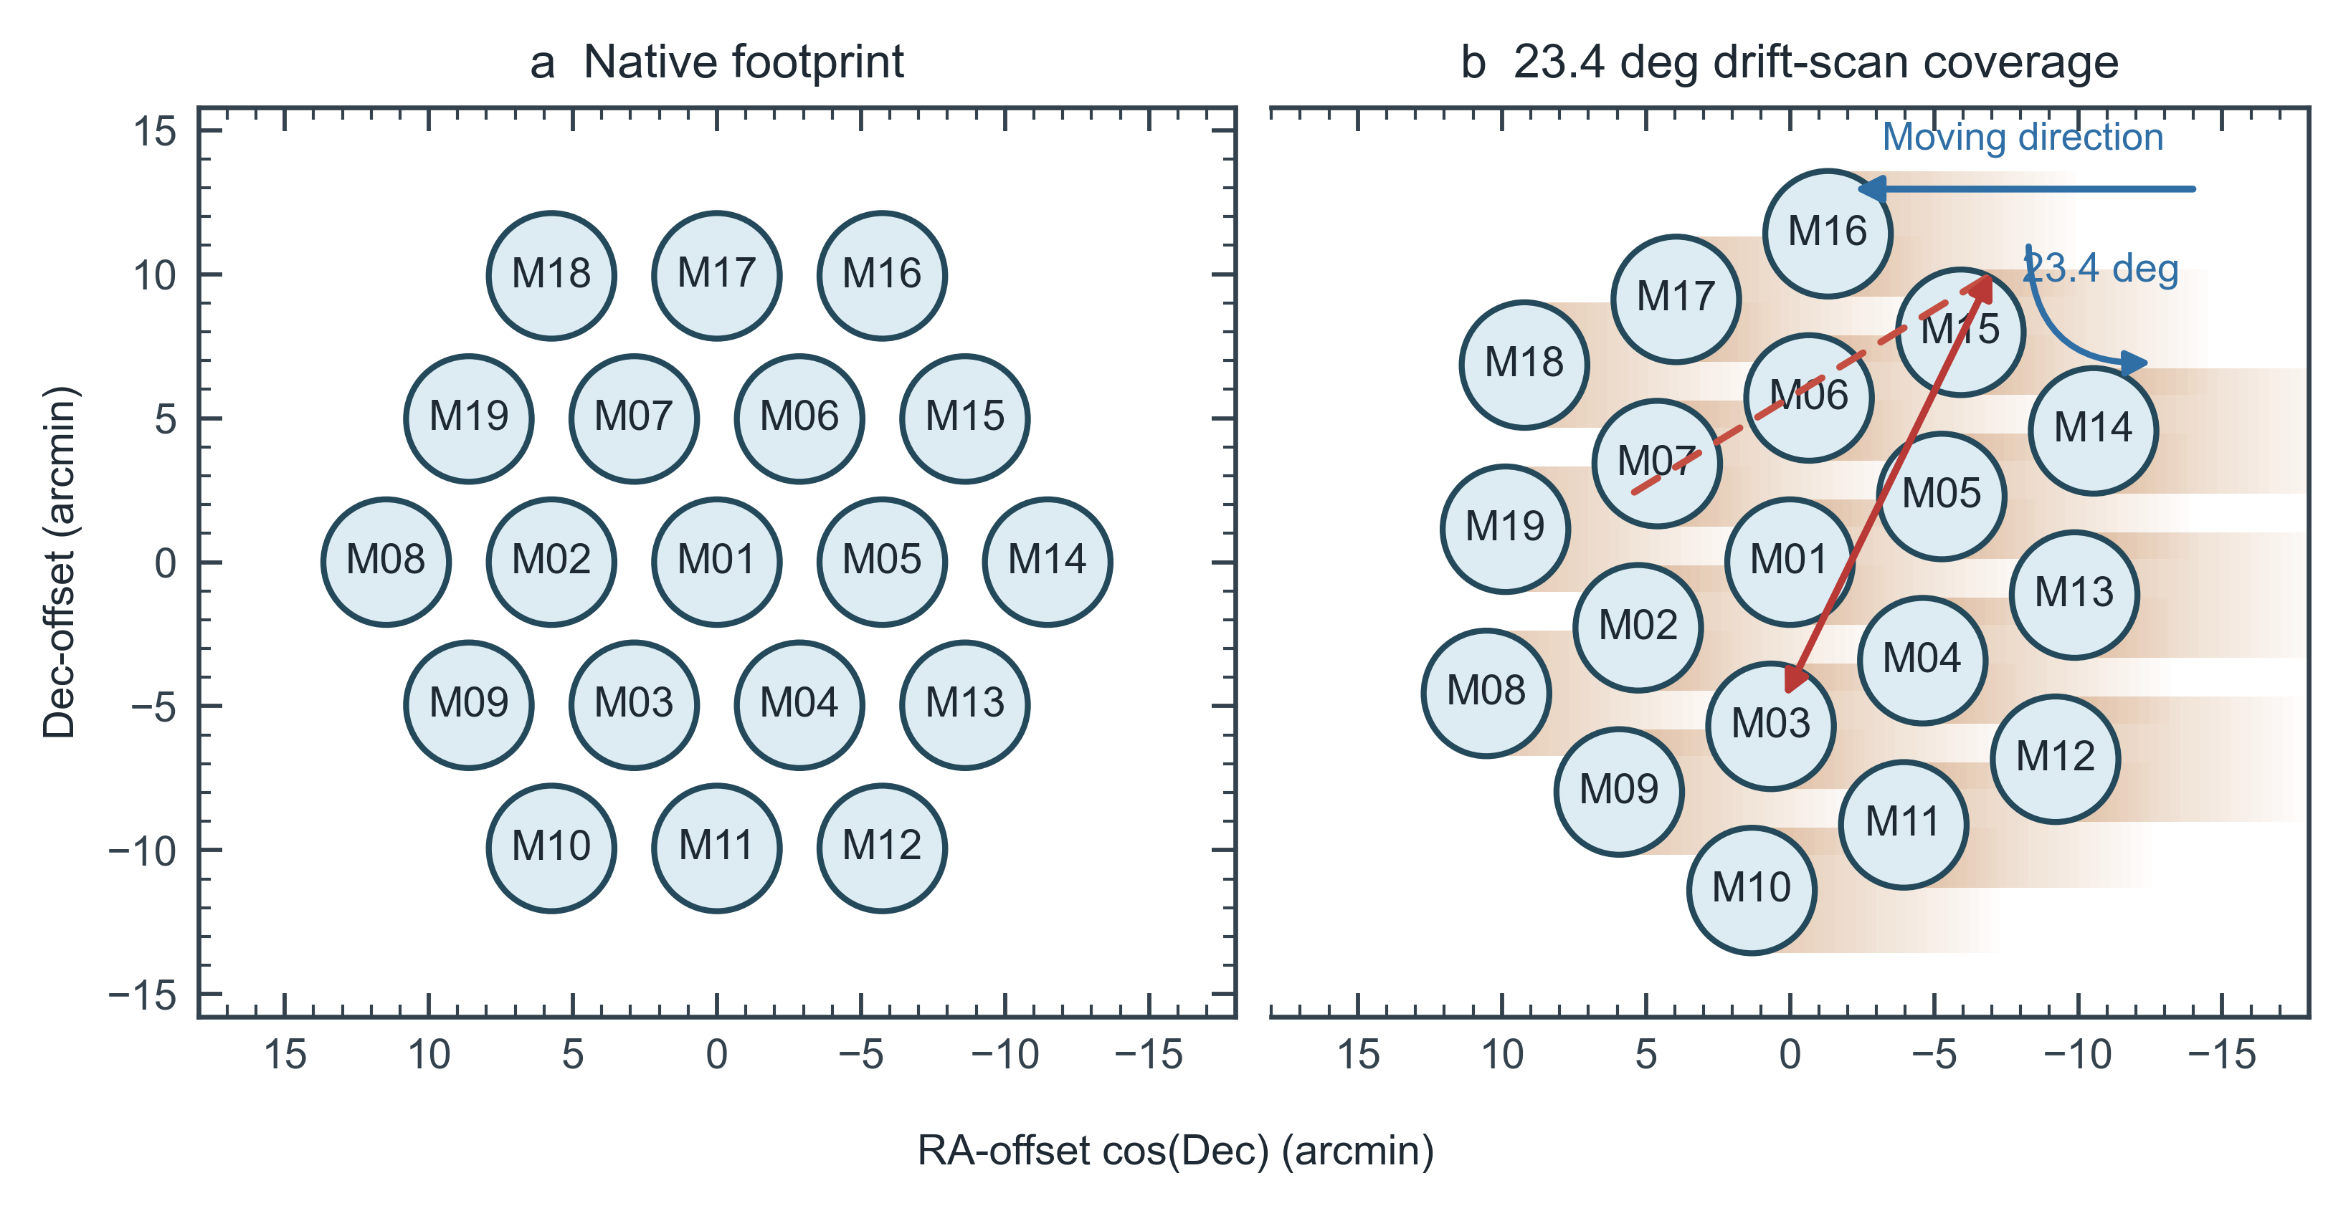
FAST 19波束 漂移扫描
Peng Jiang et al. 2019
As a function of frequency HPBW ∼ 2.9′− 3.4′
drift-scan crossing time ∼ 12s − 14s

Slide 5
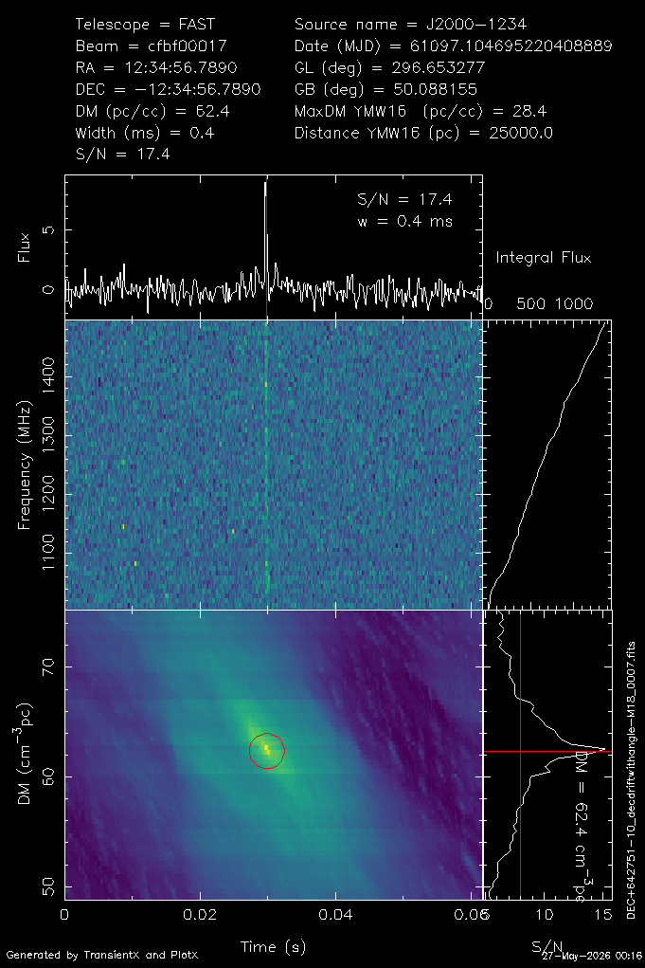
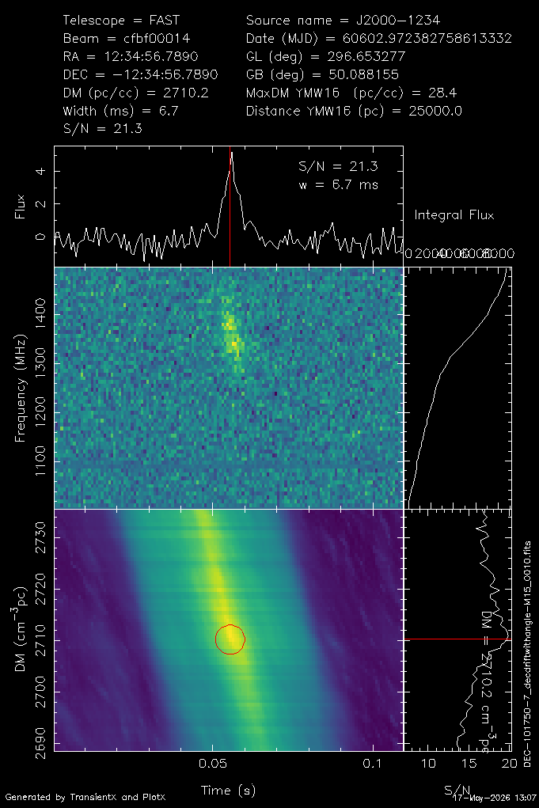
单脉冲搜索流程
https://github.com/ypmen/TransientX
TransientX (Yunpeng Men et al. 2024)
• normalisation and RFI mitigation
• sub-band dedispersion
• boxcar matched filtering
• DBSCAN：合并同一脉冲的重复候选
• replot candidate plot
搜索参数：
DM : 10-5000 pc cm^-3
pulse width : 0.2-100 ms
S/N >= 8.0
DC039 plot
DFC007 plot
FAST PSRFITS
transientx_fil
replot_fil
图像筛选
定位与跟踪
FFT/FFA验证
Sources: Men & Barr 2024, TransientX; Mickaliger et al. 2018; Ransom 2011, PRESTO.

Slide 6
Processing time
cpu cores : 192/node RAM GiB : 1515.53 GiB/node nodes : 6 cpu并行
all observation duration
2398.88 h
Observation / Processing
all processing time
7.12
336.83 h
Processing time is 14.0%
of the observation duration
Project | Observation h | Exposure (deg2 h) | 候选体图像 数量 | DM≧500 候选体数量 | processing time t (h) | t (d)
202312-202407 | 763.19 | 39.450 | 1,077,073 | 11,608 | 107 | 4.47
202408-202507 | 948.50 | 48.760 | 3,805,057 | 28,831 | 133 | 5.55
202508-202605 | 687.19 | 35.522 | 2,502,848 | 34,270 | 96 | 4.02
ALL | 2,398.88 | 123.732 | 7,384,978 | 74,709 | 336 | 14.03

Slide 7
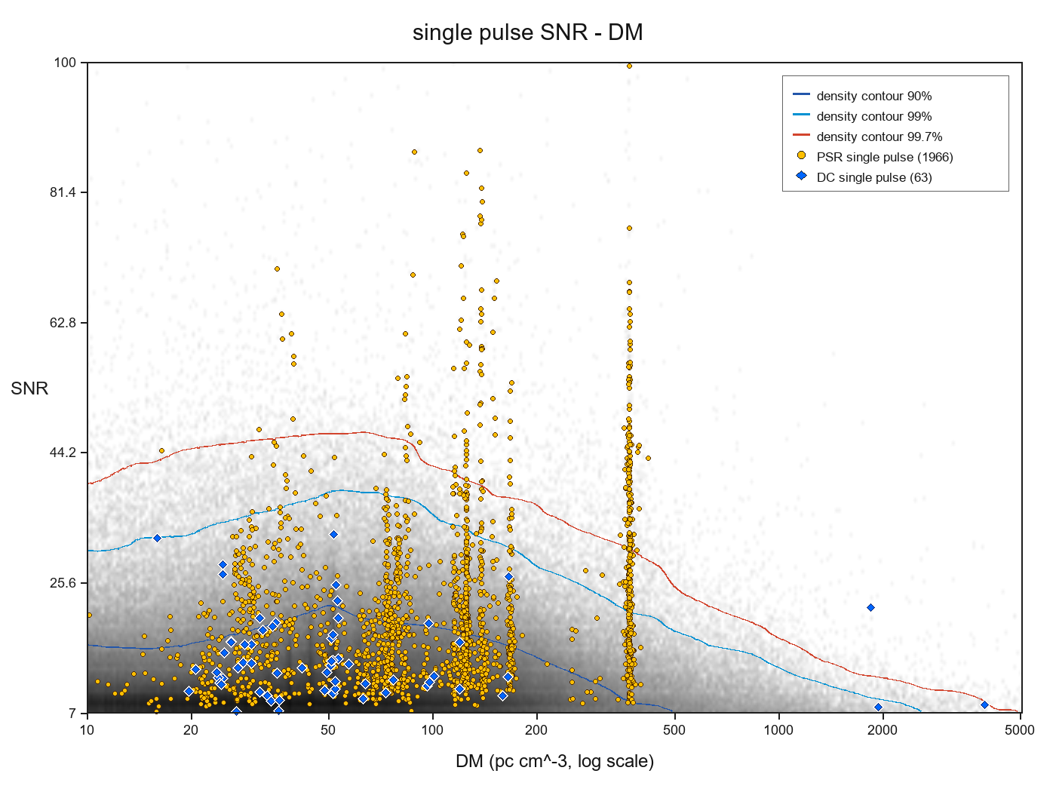
All plots : 7,384,978
Prioritize clean high-DM events DM > 500 pc cm^-3, ~1% plots
Reviewed candidates from high to low S/N
Manual selection for the training set
For repeated single pulses, checked :
whether pulse intervals match the beam-crossing time
whether DMs are consistent
how many beams detected the signal
202312-202407 single pluse DM-SNR

Slide 8
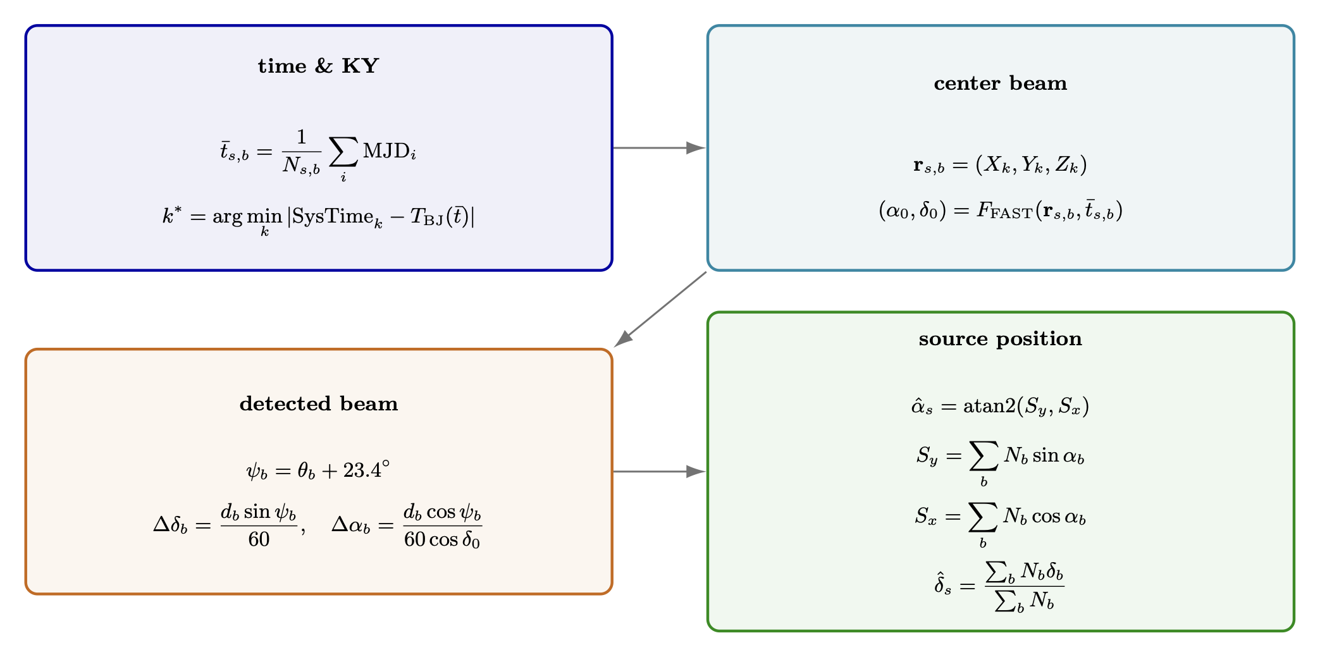
定位方法
脉冲发生时间+馈源姿态+天球投影
Sun Jinghai & Yang Qingliang，
FAST 19 beams
Notes:
这一页用 LaTeX 公式总结 DC 定位：按源和波束从单脉冲文件名提取平均 MJD；在 KY 文件中匹配最接近时刻的馈源舱 XYZ；投影得到 M01；按 23.4° 波束几何修正到发现束；最后按各波束单脉冲数对 RA/Dec 做加权平均。

Slide 9
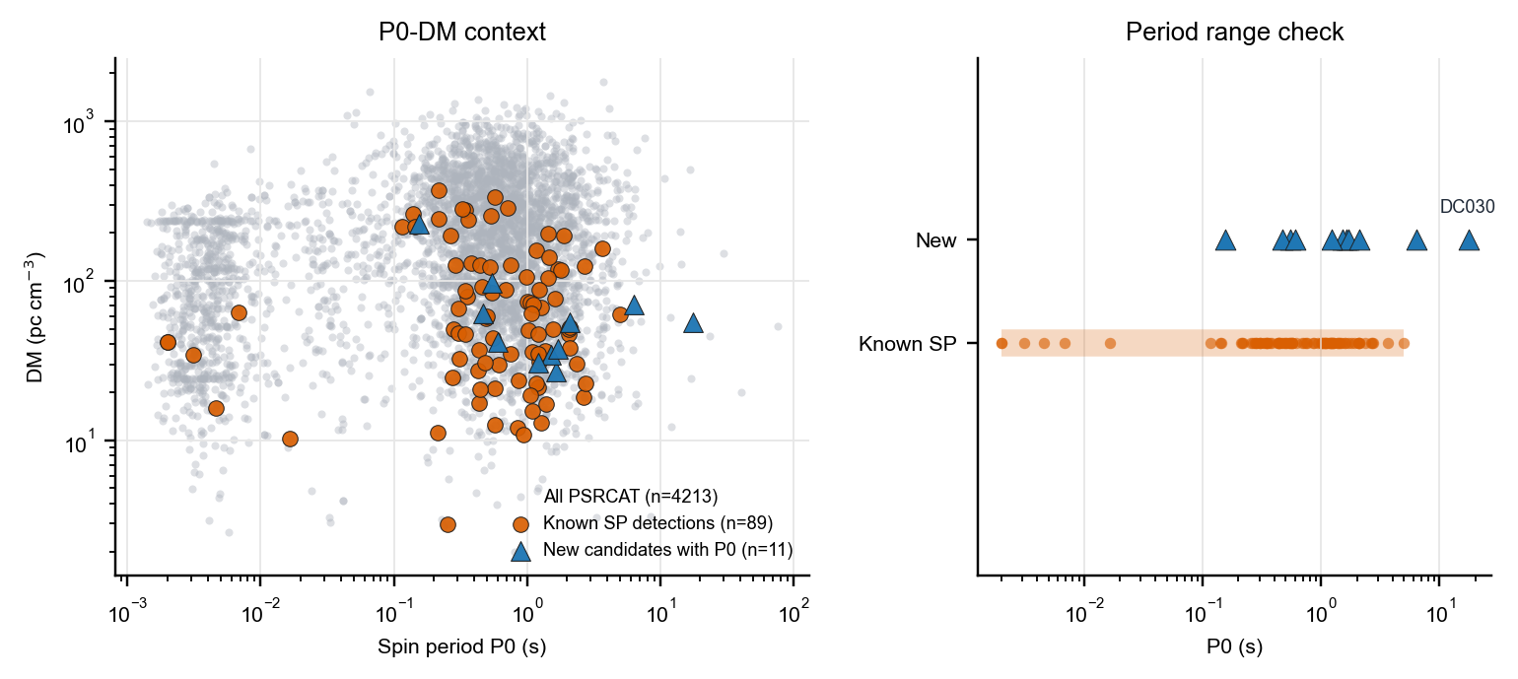
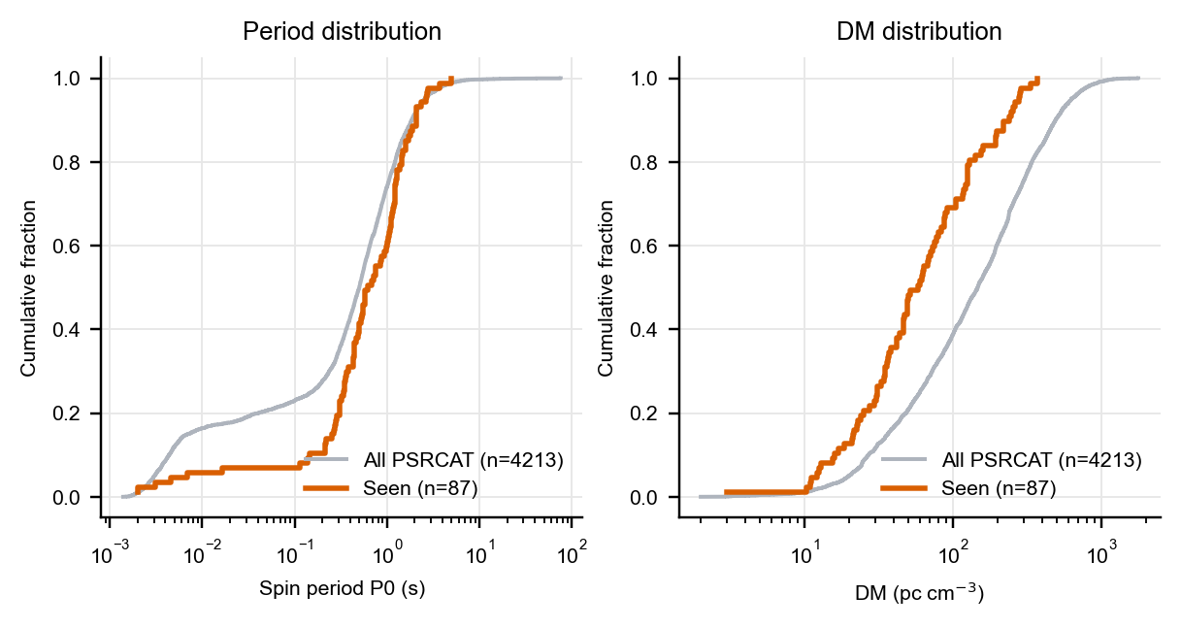
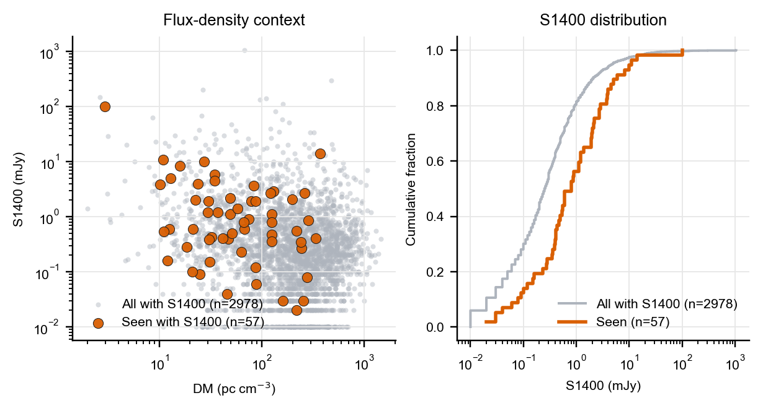
The long-period of the PSRs
FAST drift-scan candidates compared with PSRCAT and known single-pulse pulsars
Known SP P0 range
0.00199-5.01 s
Longest new P0
DC030, 17.494 s
单脉冲搜索探测到89颗已知脉冲星，共发现63颗脉冲星候选体，已验证17颗新脉冲星，FAST持续验证中...
Known-pulsar parameter distribution
Notes:
Known group includes the 87 previously matched known pulsars plus the user-specified known DC sources. The updated source table gives DC020 P0 = 9.92040 s, making it the longest measured new candidate. Cumulative fraction means the fraction of sources at or below the x-axis value; shifts between curves show parameter-selection bias.

Slide 10
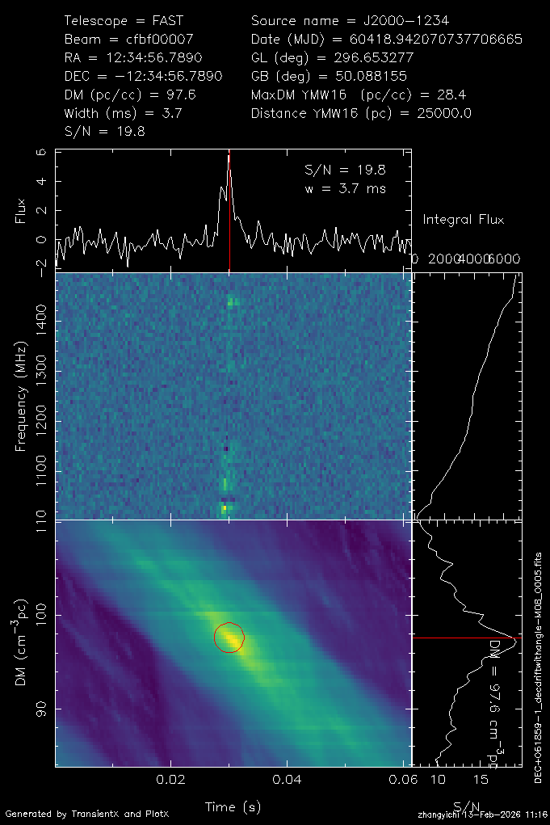
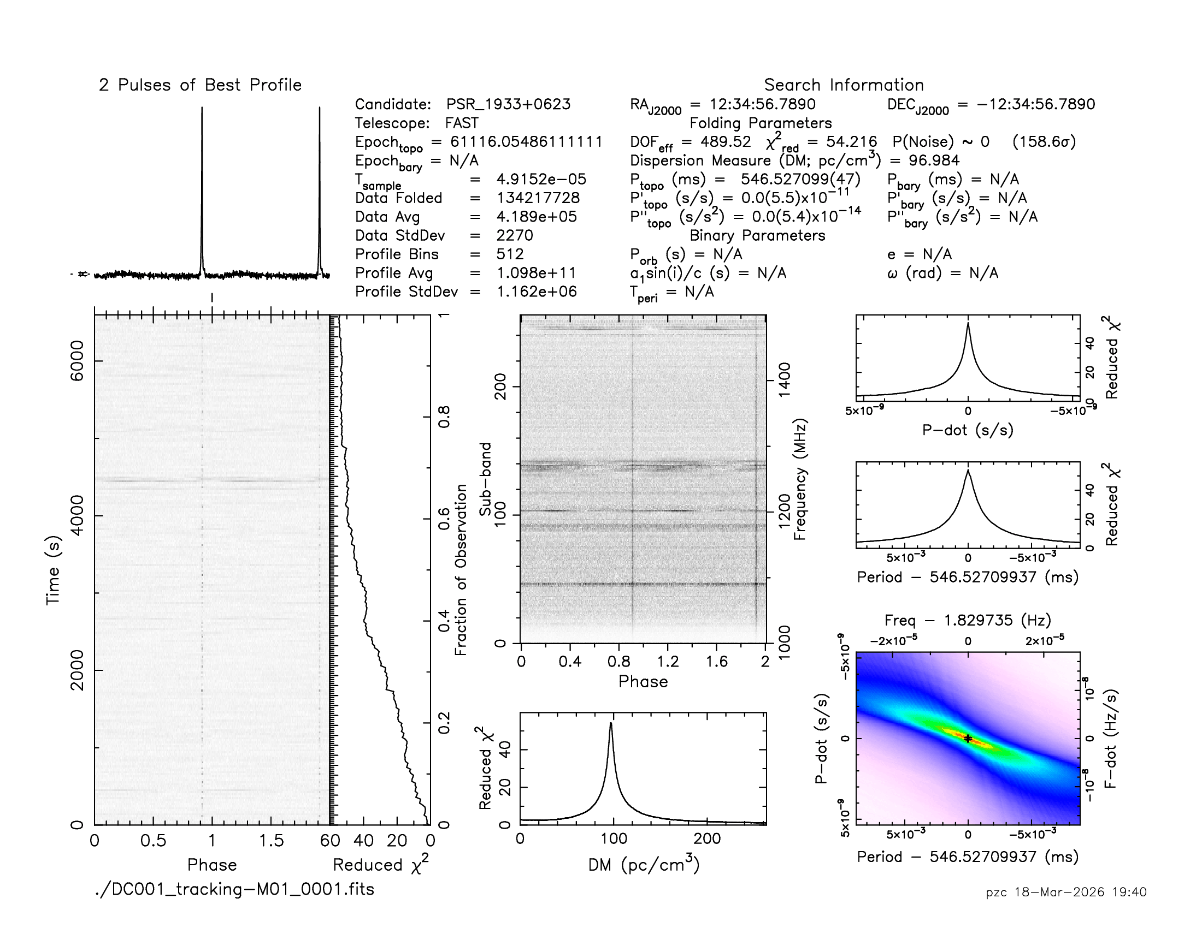
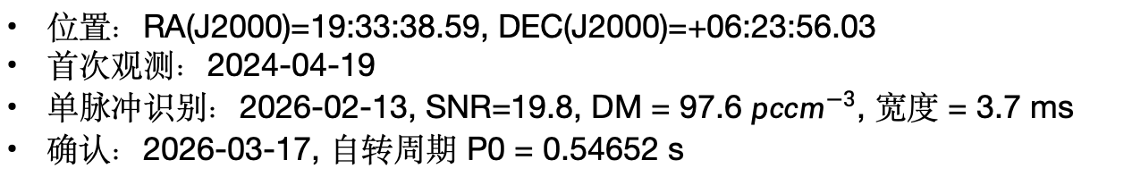
DC001 (J1933+0623)
位置：RA(J2000)=19:33:38.59, DEC(J2000)=+06:23:56.03
首次观测：2024-04-19
单脉冲识别：2026-02-13, SNR=19.8, DM = 97.6 $pc{cm}^{−3}$, 宽度 = 3.7 ms
确认：2026-03-17, 自转周期 P0 = 0.54652 s

Slide 11
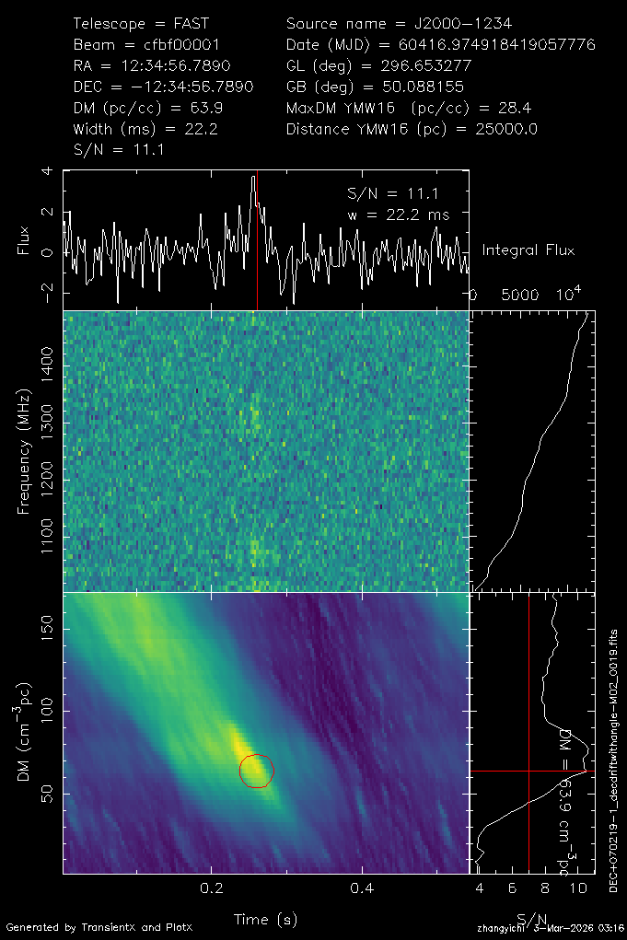
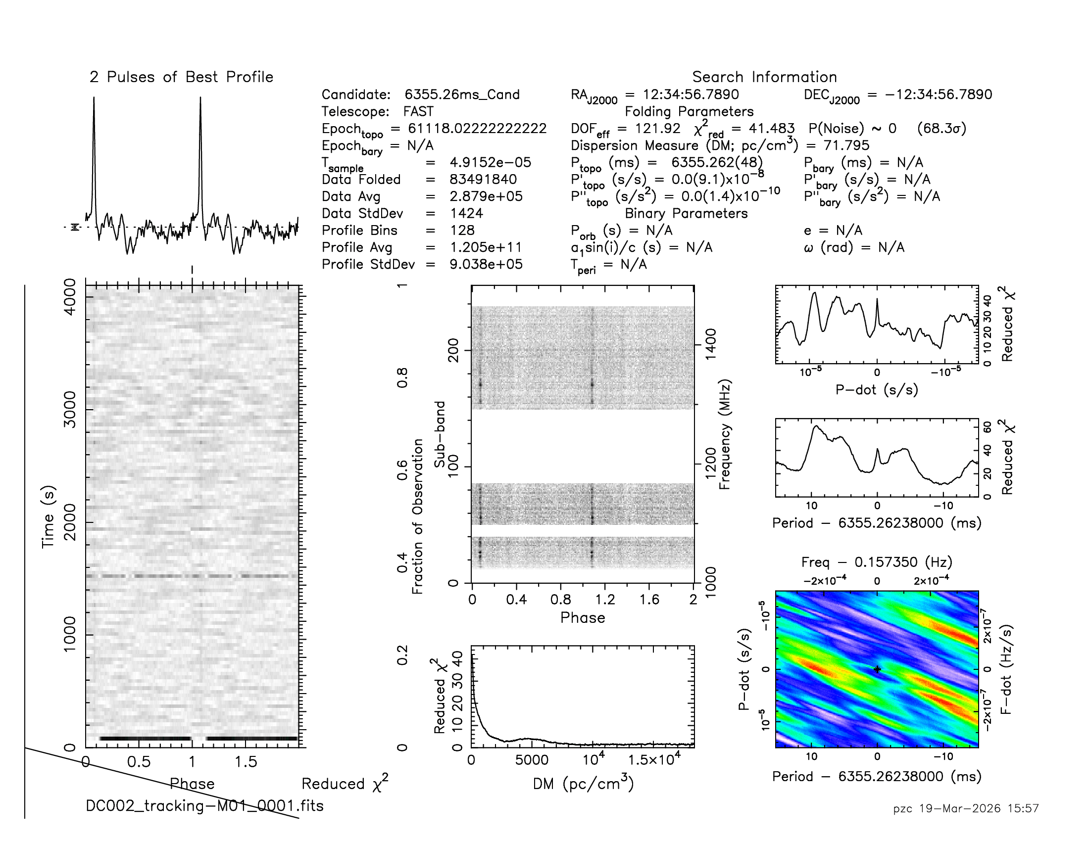
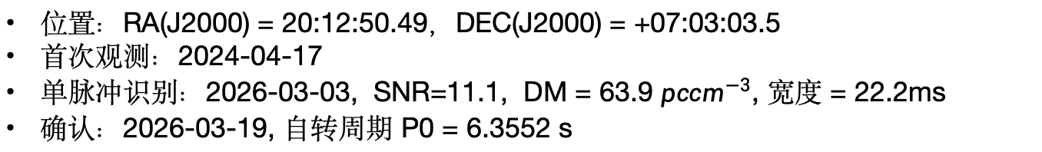
DC002 (J2012+0703)
位置：RA(J2000) = 20:12:50.49，DEC(J2000) = +07:03:03.5
首次观测：2024-04-17
单脉冲识别：2026-03-03, SNR=11.1, DM = 63.9 $pc{cm}^{−3}$, 宽度 = 22.2ms
确认：2026-03-19, 自转周期 P0 = 6.3552 s

Slide 12
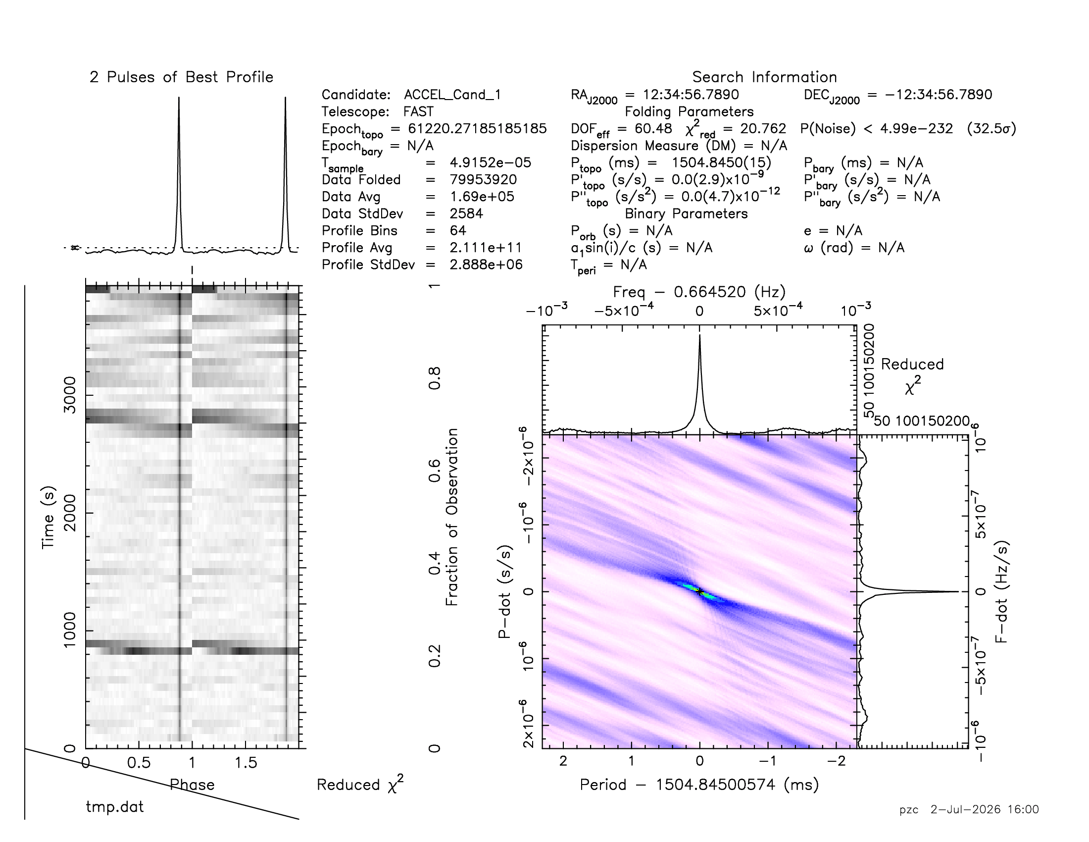
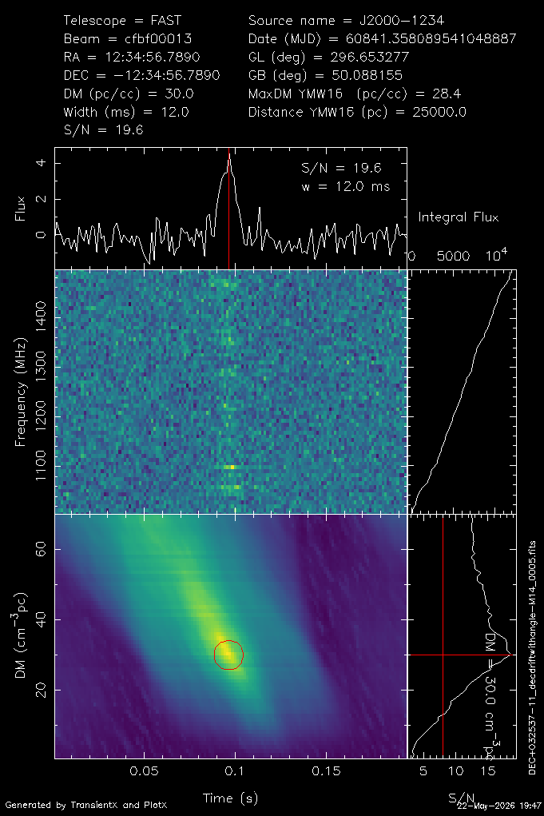
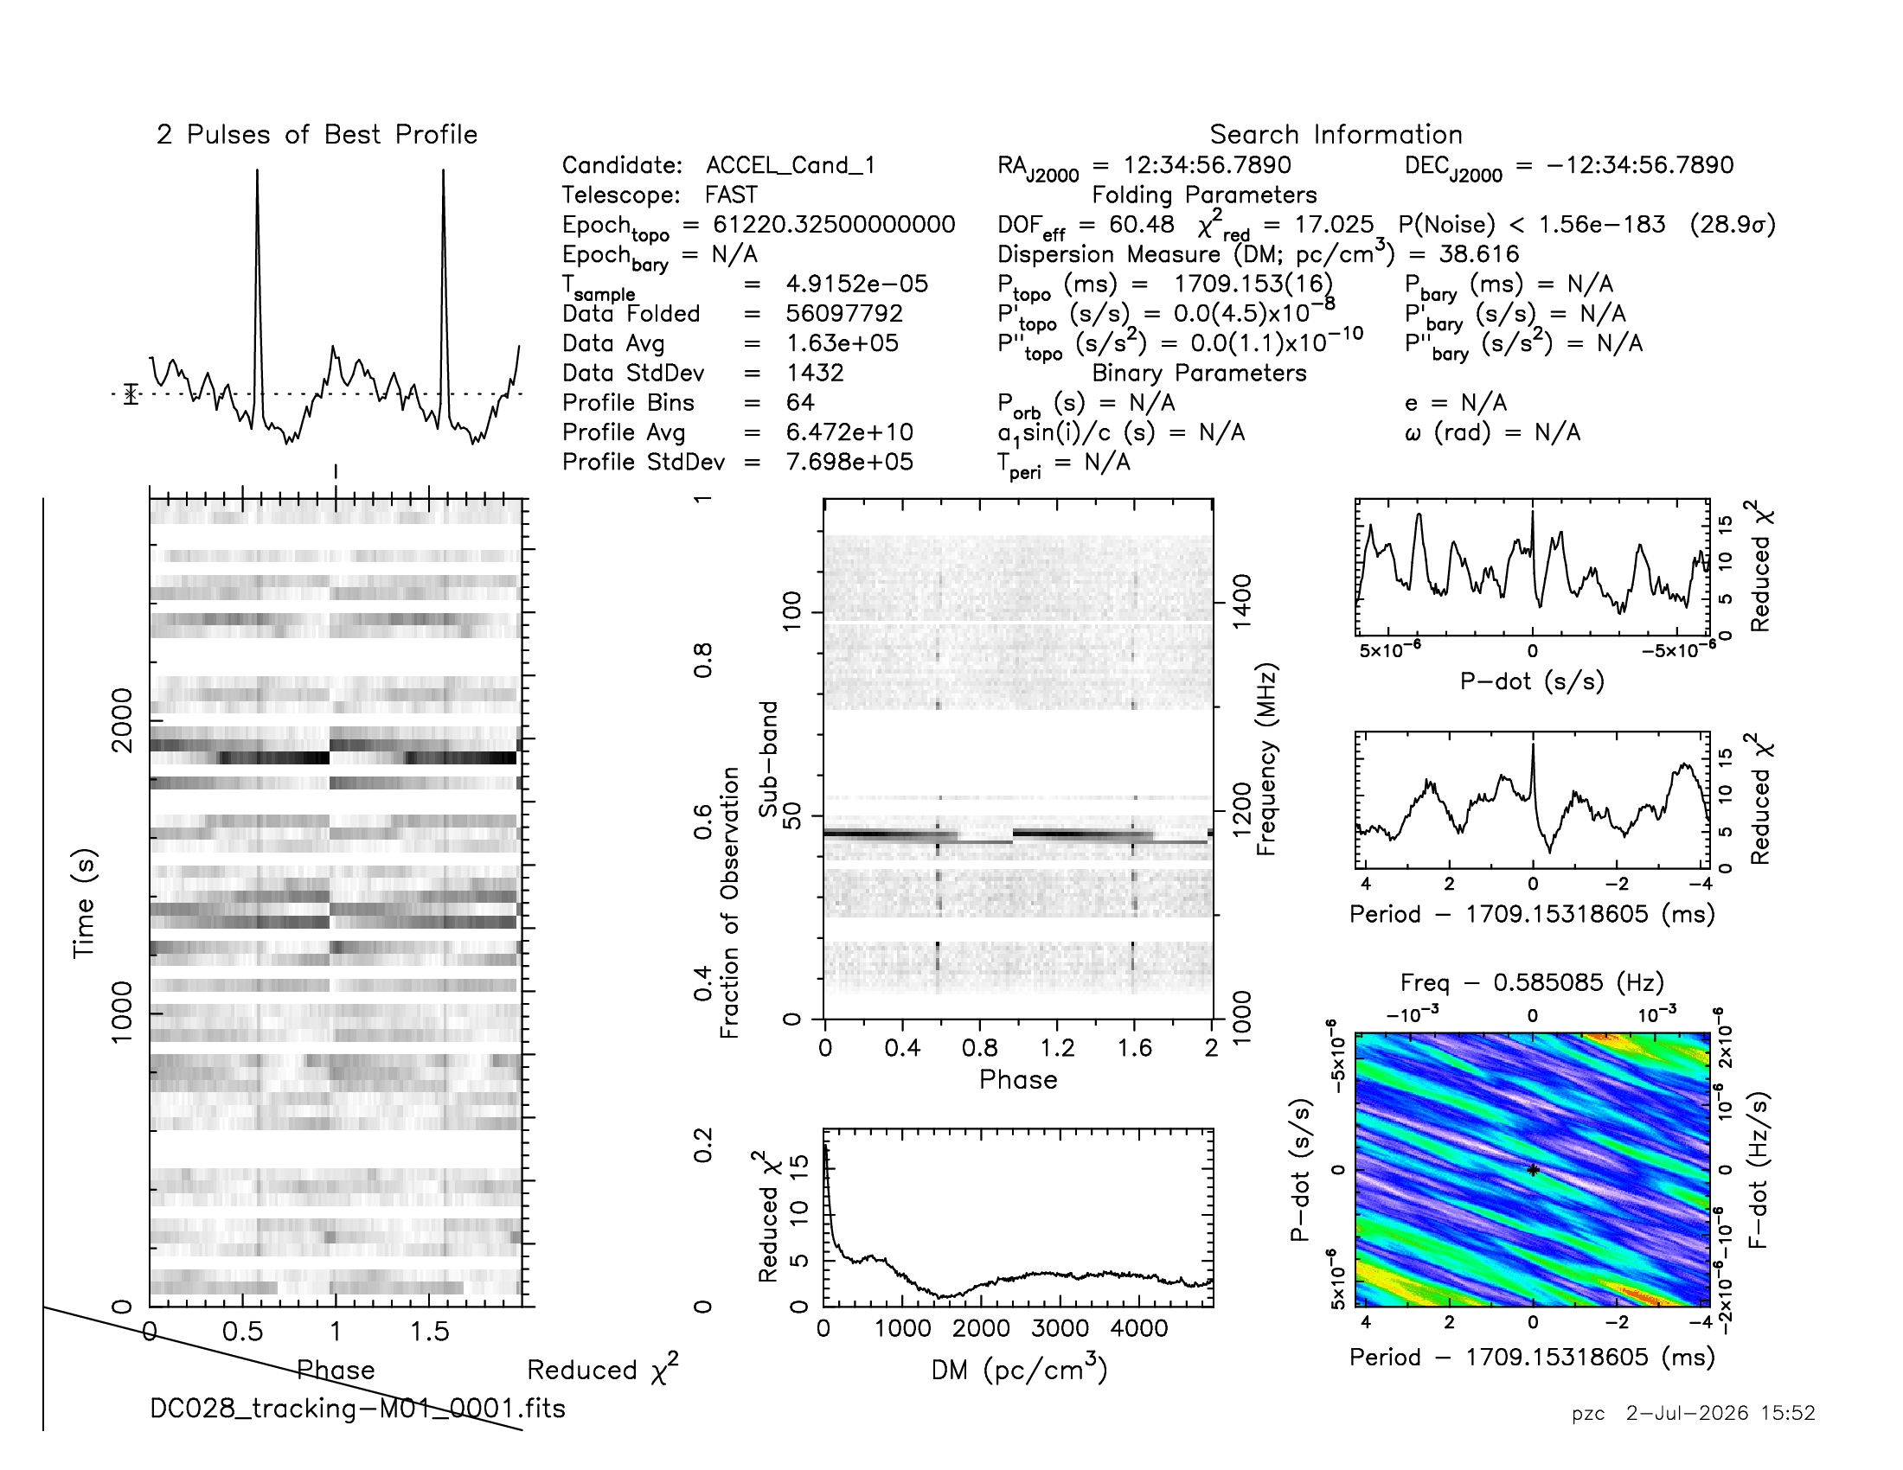
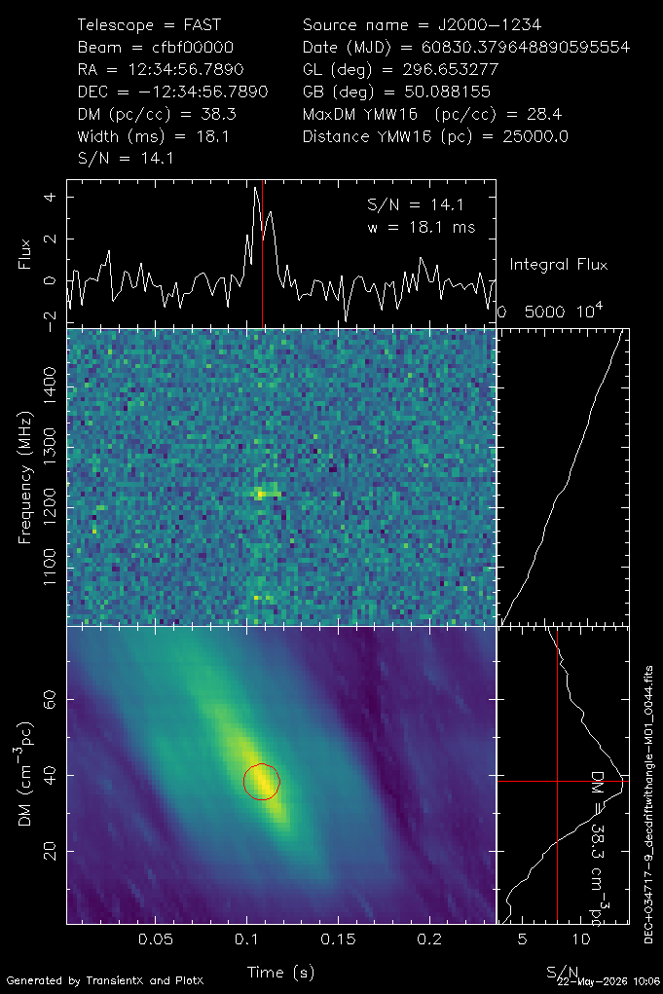
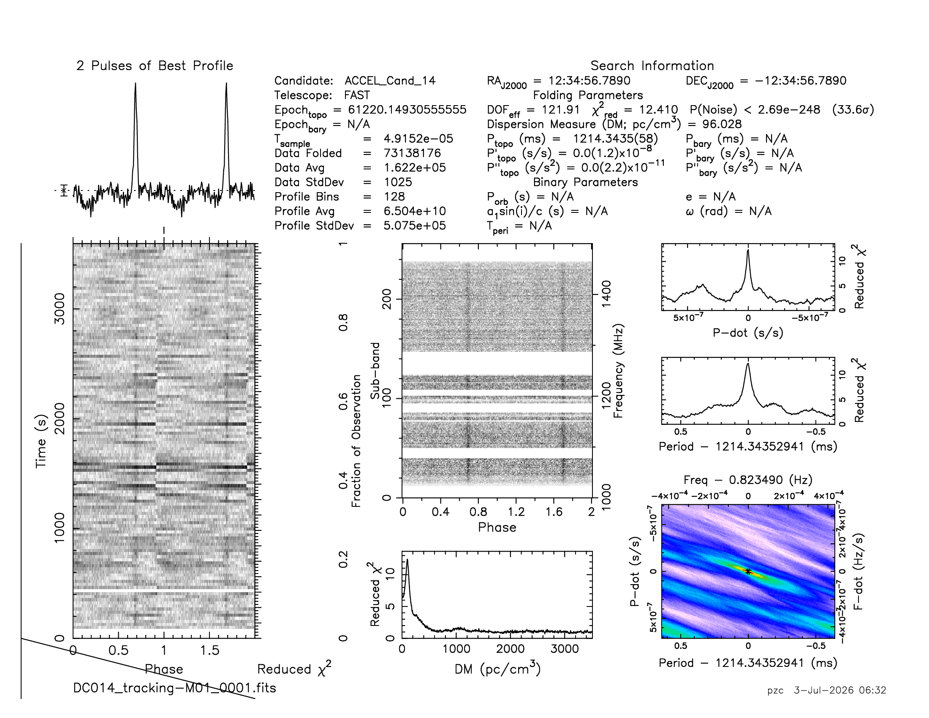
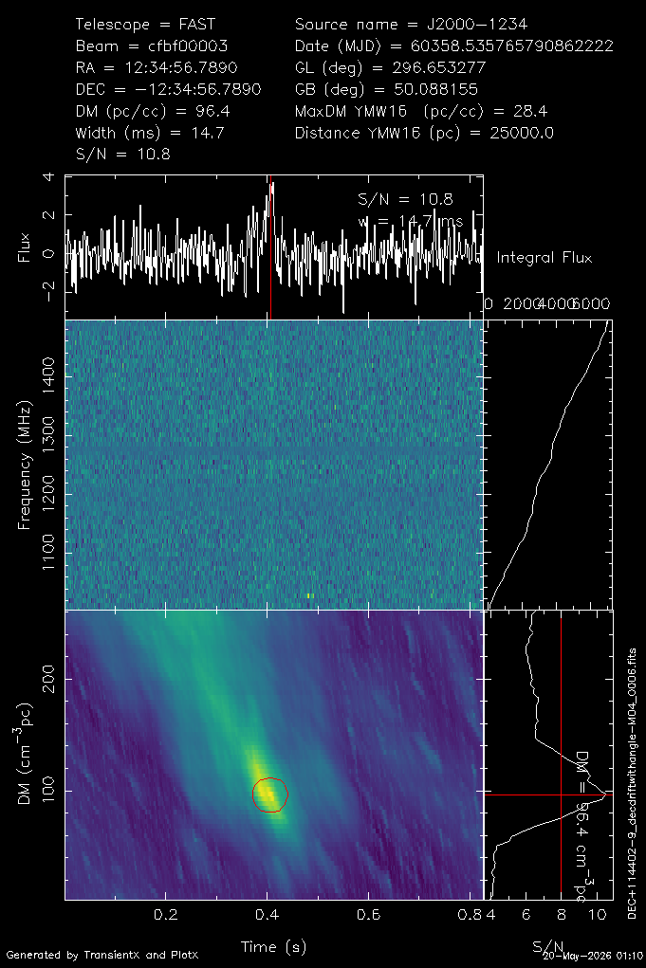
DC | Date | DM cm^-3 pc | P0 (s) | RA Dec (J2000) | Nsp
DC027 | 2025-06-06 | 34.2 | 1.5048 | 09:16:37.6 +03:20:40.1 | 1
 | 2025-06-15 | 32.84 |  |  | 15
DC028 | 2025-06-01 | 37.5 | 1.7091 | 09:05:05.5 +03:48:54.2 | 5
 | 2025-06-04 | 37.98 |  |  | 11
DC014 | 2024-02-18 | 98.75 | 1.2143 | 05:49:29.7 +11:38:34.7 | 2
DC027
DC028
DC014

Slide 13
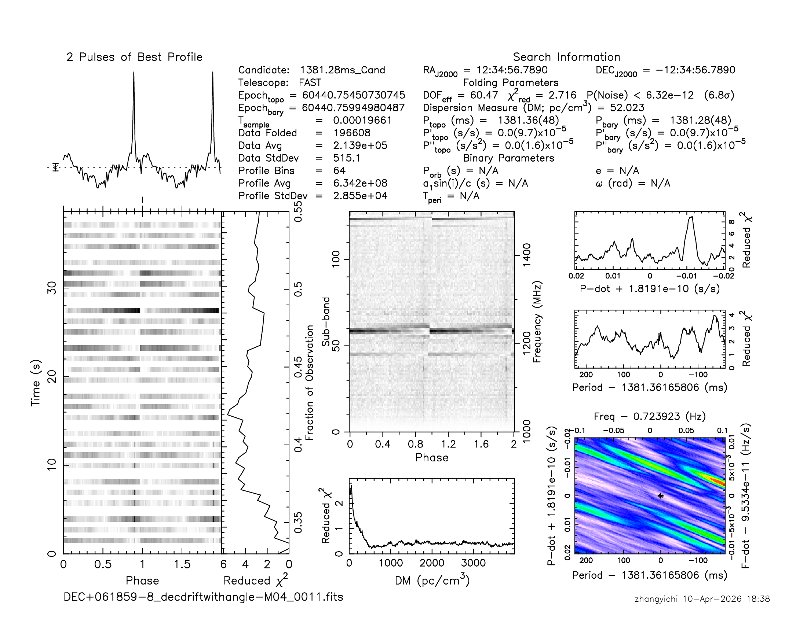
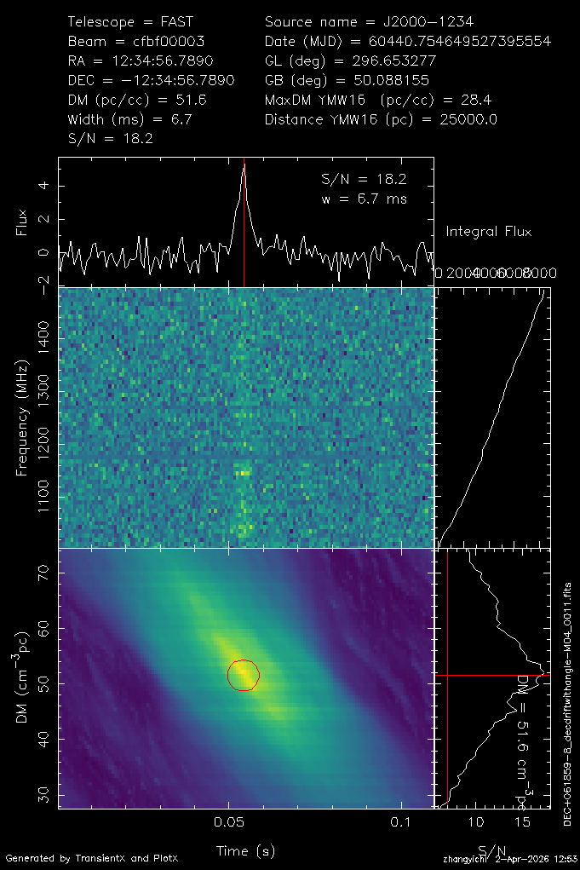
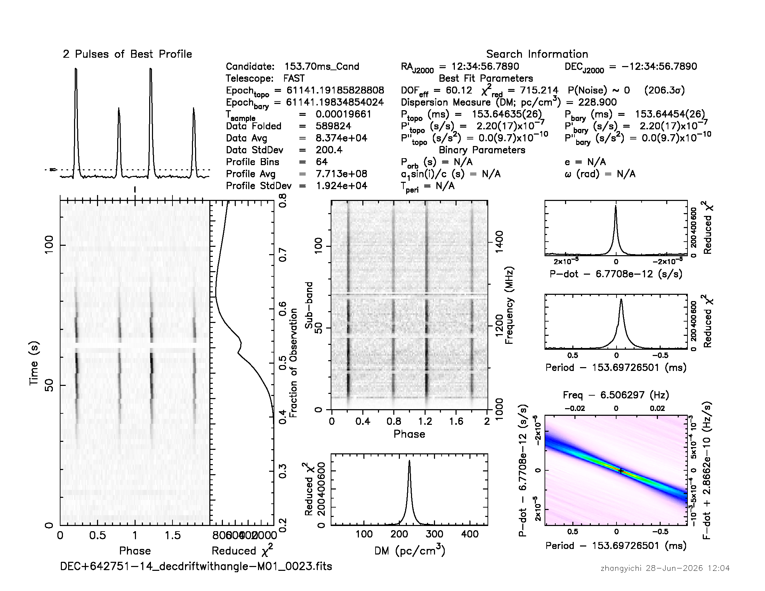
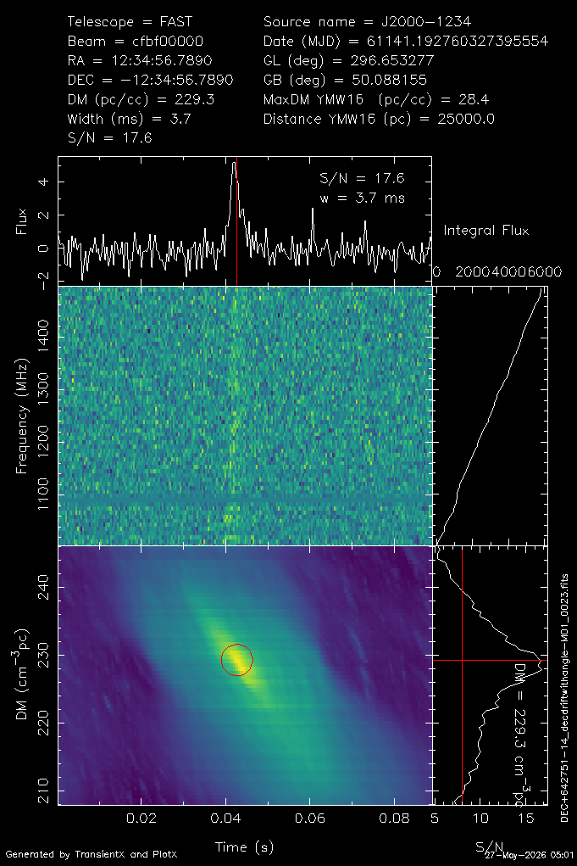
DC007
DC | Date | RA | Dec | DM (cm^-3 pc) | P0(s) | Nsp
DC042 | 26-04-07/ 26-04-11 | 01:00:47.2 | +64:26:38.86 | 228.7 | 0.154 | 2099
DC070 | 26-03-17/ 26-04-01 | 12:04:27.9 | -12:33:44.08 | 30.7 | 1.215 | 67
DC045 | 26-03-05/ 26-03-20 | 00:50:14.9 | +63:44:05.36 | 38.6 | -- | 38
DC039 | 26-02-26/ 26-03-14 | 20:02:07.5 | +64:39:33.98 | 62.5 | 0.469 | 32
DC041 | 25-09-21/ 25-09-30 | 12:54:57.7 | +64:22:32.06 | 39.3 | -- | 24
DC028 | 25-06-01/ 25-06-04 | 09:05:05.5 | +03:48:54.23 | 37.7 | 1.709 | 16
DC027 | 25-06-06 /25-06-15 | 09:16:37.6 | +03:20:40.11 | 33.5 | 1.505 | 16
DC038 | 26-02-22/ 26-03-24 | 23:40:30.3 | +64:59:56.04 | 68.9 | -- | 13
DC007 | 24-05-10/ 25-09-22 | 16:28:54.2 | +06:14:15.56 | 52.5 | 1.381 | 12
DC064 | 25-09-22/ 25-10-25 | 16:55:12.2 | +06:31:46.65 | 54.8 | -- | 5
DC044 | 26-03-05/ 26-03-20 | 00:10:18.2 | +63:49:34.95 | 139.1 | -- | 4
DC042
Notes:
讲法建议：
1. 这一页保留原来的 DC007 和 DC042 展示，右侧新增的是 SourceName>1 的多源检测候选。
2. 多源检测说明同一个候选在多个漂移源轨迹中被看到，比单次偶然触发更有后续确认价值。
3. 表格只保留日期、秒级坐标、DM、P0 和单脉冲数；P0 为空时用 -- 表示还需要 timing confirmation。
4. 日期来自 replot PNG 文件名中的 MJD，已换算为 UTC 日期。

Slide 14
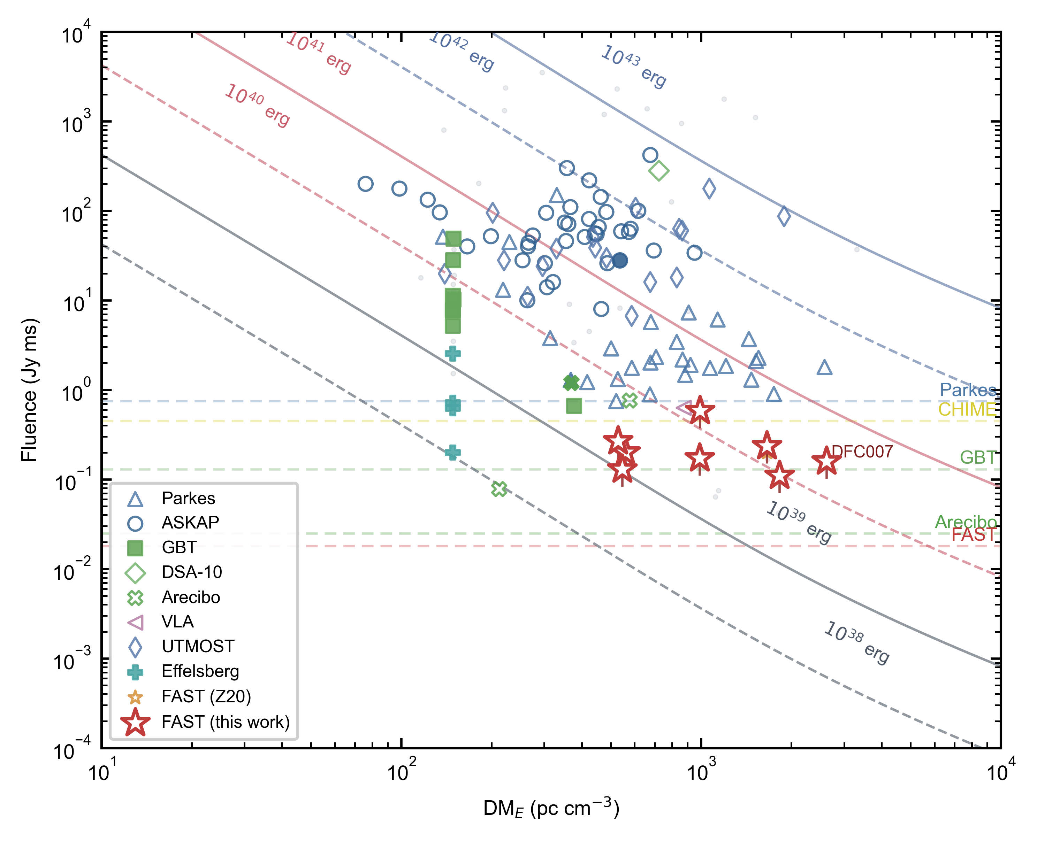
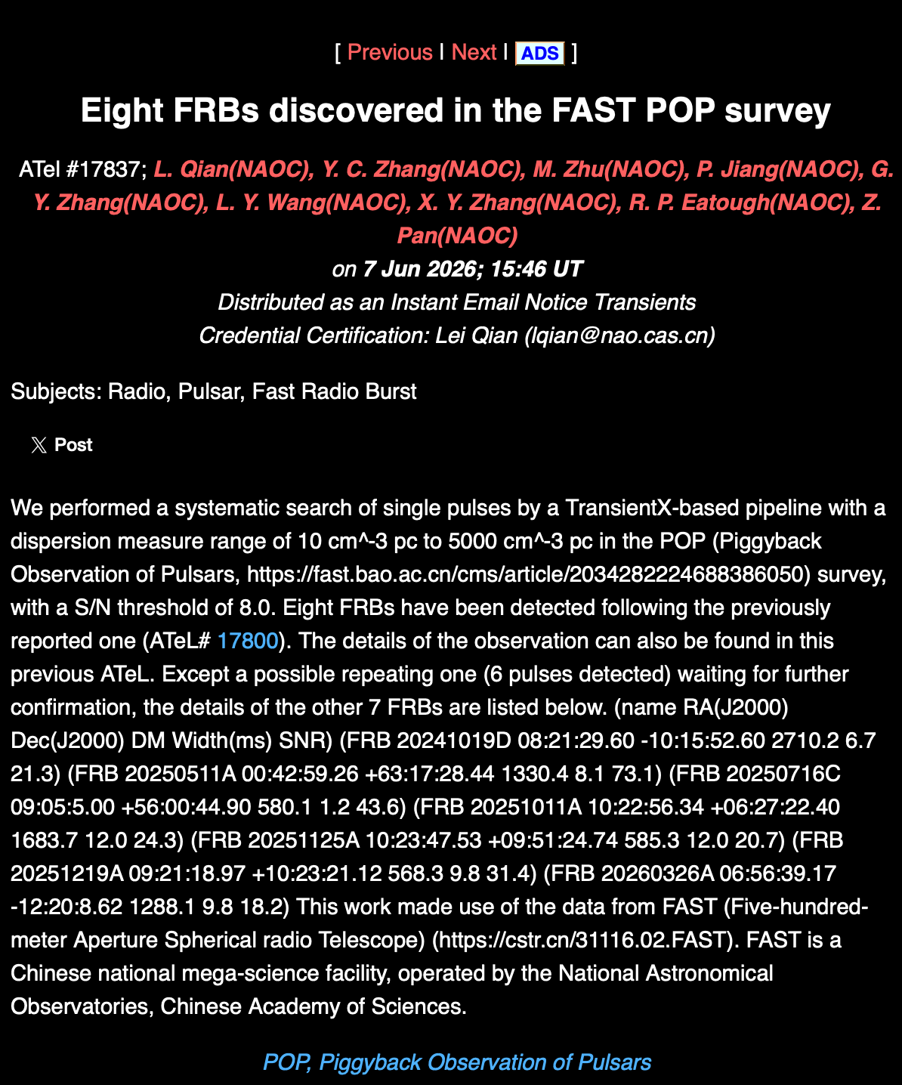
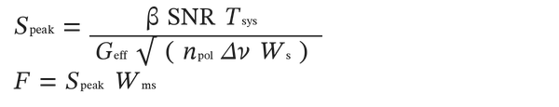
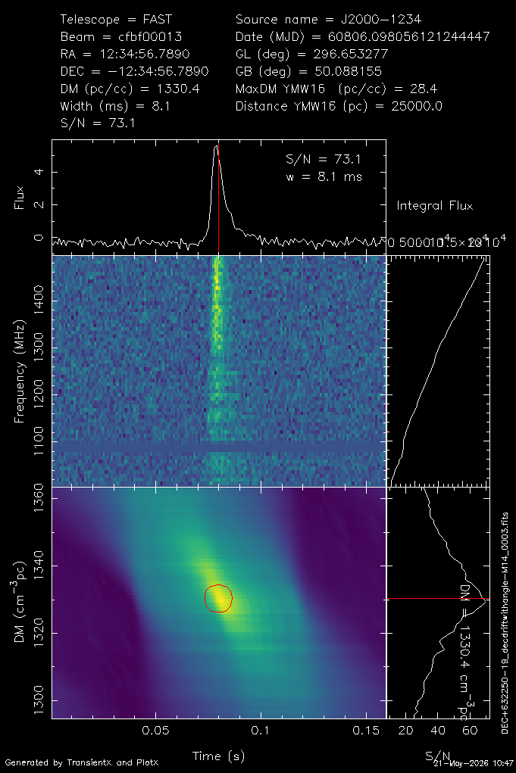
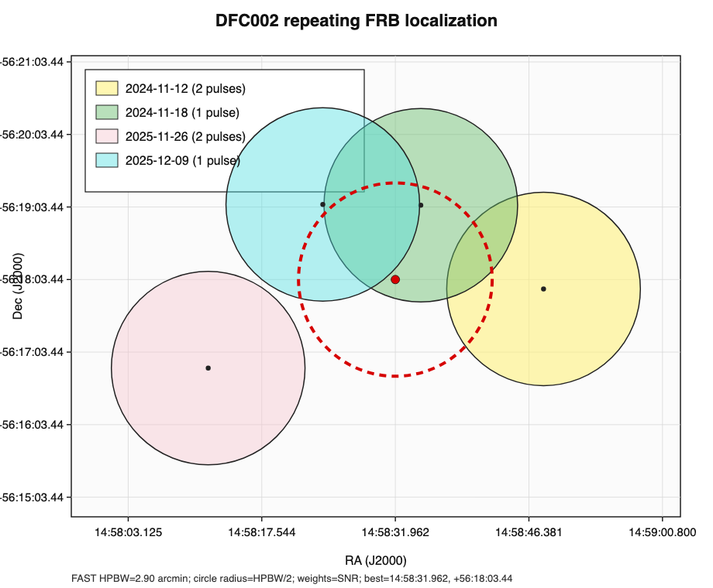
The discovery of FRBs in the POP
事件率估计
R = 1.28 x 10^5 sky^-1 day^-1
68% Poisson: 9.64 x 10^4 - 1.69 x 10^5
above 0.072 Jy ms
共发现9个FRB，17个Burst，其中DFC002已确认是Repeating FRB
ID | Name | Date | Burst_N | RA | Dec | SNR | W(ms) | DM | YMW16_DM
DFC001 | FRB 20240519A | 2024-5-19 | 1 | 01:19:06.76 | -12:07:35.5 | 22.0 | 3.7 | 1846.7 | 20.5
DFC002 | FRB 20241112A | 2024-11-12 | 3 | 14:58:47.96 | +56:17:55.66 | 28.3 | 3.7 | 1009.4 | 25.3
 |  |  |  |  |  | 8.4 | 8.4 | 1012.8
 |  |  |  |  |  | 14.8 | 6.7 | 1020.8
 |  | 2024-11-18 | 2 | 14:58:34.71 | +56:19:4.86 | 22.2 | 5.5 | 1012.4
 |  |  |  |  |  | 8.7 | 14.7 | 1023.9
 |  | 2025-11-26 | 2 | 14:58:11.76 | +56:16:50.20 | 11.5 | 6.7 | 1014.5
 |  |  |  |  |  | 18.4 | 6.7 | 1018.8
 |  | 2025-12-9 | 1 | 14:58:24.131 | +56:19:5.56 | 18.7 | 3.7 | 1017.2
DFC003 | FRB 20260326A | 2026-3-26 | 1 | 06:56:39.17 | -12:20:8.62 | 18.2 | 9.8 | 1288.1 | 299.6
DFC004 | FRB 20251011A | 2025-10-11 | 1 | 10:22:56.34 | +06:27:22.40 | 24.3 | 12.0 | 1683.7 | 26.3
DFC005 | FRB 20251125A | 2025-11-26 | 1 | 10:23:47.53 | +09:51:24.74 | 20.7 | 12.0 | 585.3 | 25.4
DFC006 | FRB 20251219A | 2025-12-20 | 1 | 09:21:18.97 | +10:23:21.12 | 31.4 | 9.8 | 568.3 | 39.2
DFC007 | FRB 20241019D | 2024-10-20 | 1 | 08:21:29.60 | -10:15:52.60 | 21.3 | 6.7 | 2710.2 | 90.7
DFC008 | FRB 20250716C | 2025-7-16 | 1 | 09:05:5.00 | +56:00:44.90 | 43.6 | 1.2 | 580.1 | 33.5
DFC009 | FRB 20250511A | 2025-5-11 | 1 | 00:42:59.26 | +63:17:28.44 | 73.1 | 8.1 | 1330.4 | 337.4
Zhang et al. 2026
DFC009
SNR 73.1
DM 1330.4
Notes:
第 15 页整合事件率、Fig. 3、fluence 公式和 POP 表。LaTeX source: $S_{\rm peak}=\frac{\beta\,{\rm SNR}\,T_{\rm sys}}{G_{\rm eff}\sqrt{n_{\rm pol}\Delta\nu W_s}}$; $F=S_{\rm peak}W_{\rm ms}$. POP 表已合并 DFC002 重复 burst 的公共字段。

Slide 15
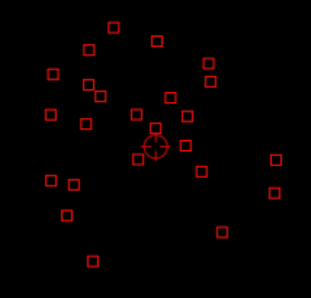
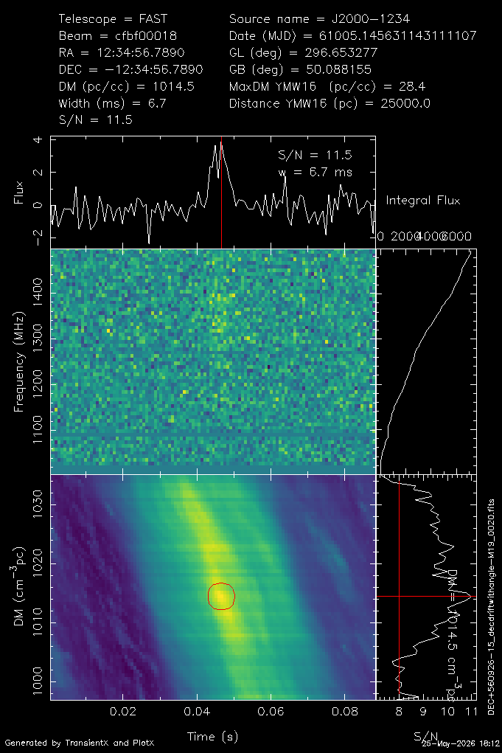
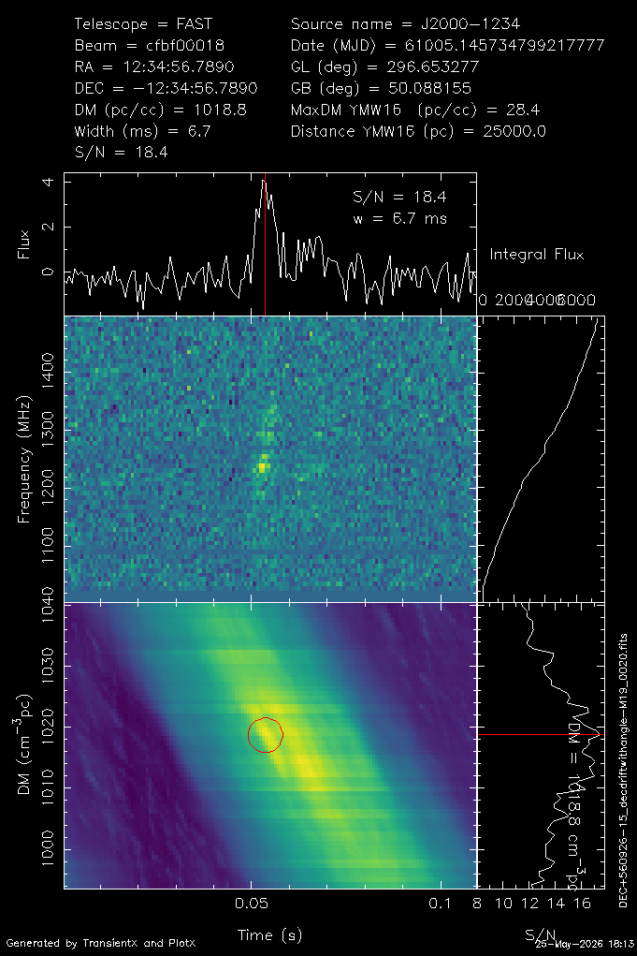
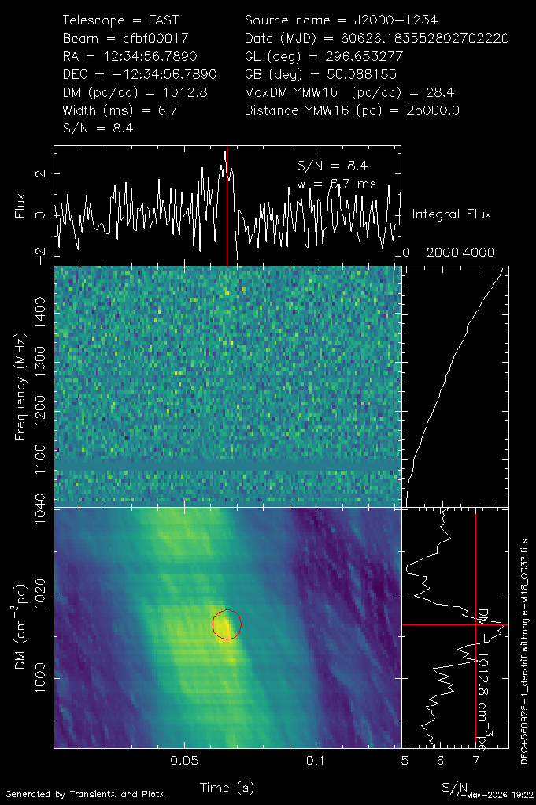
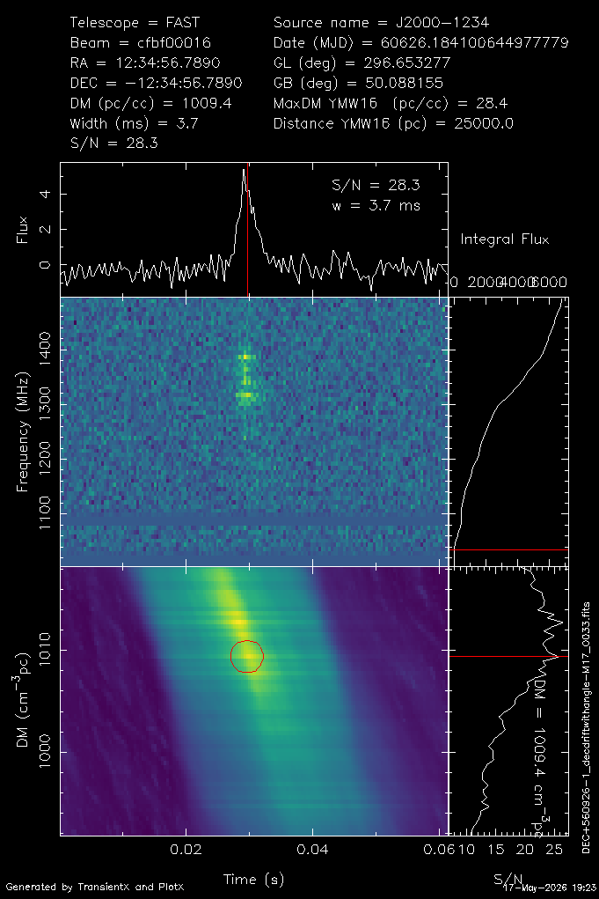
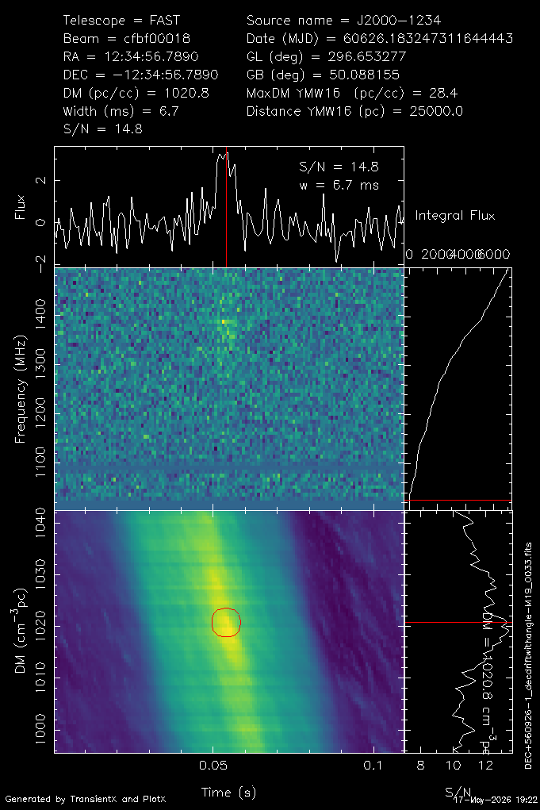
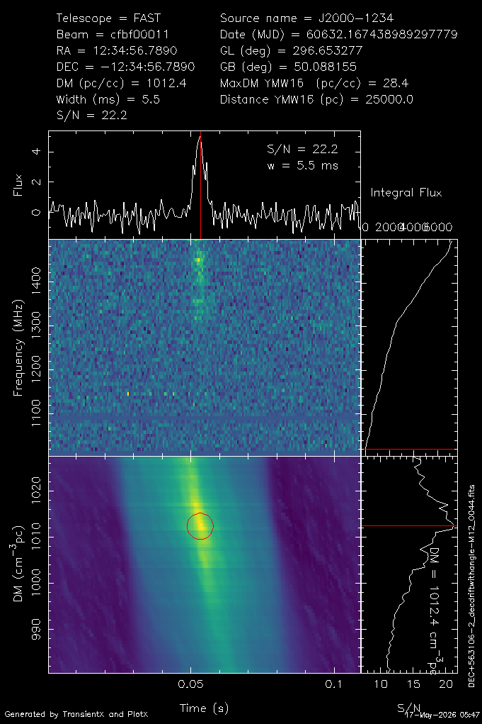
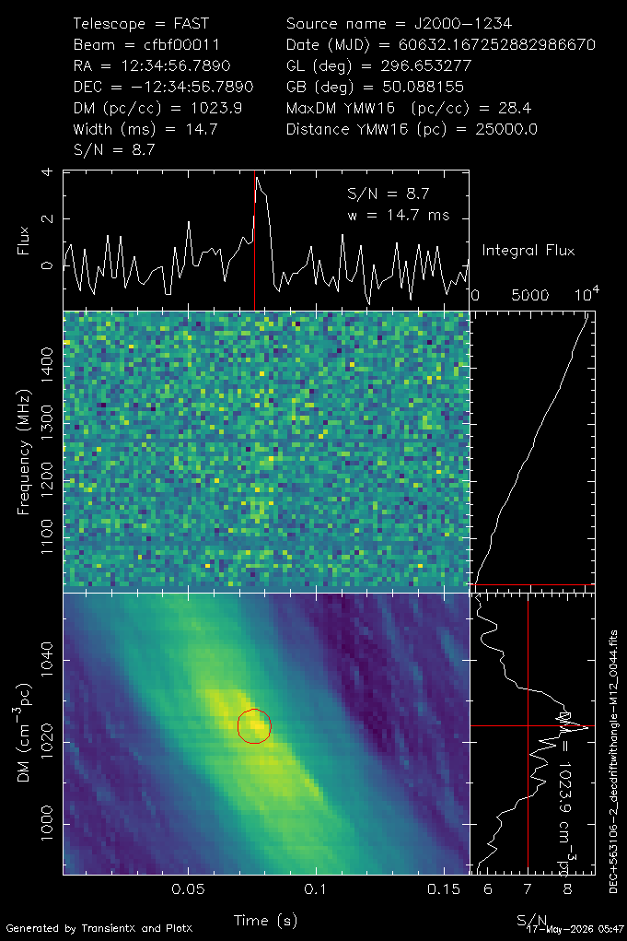
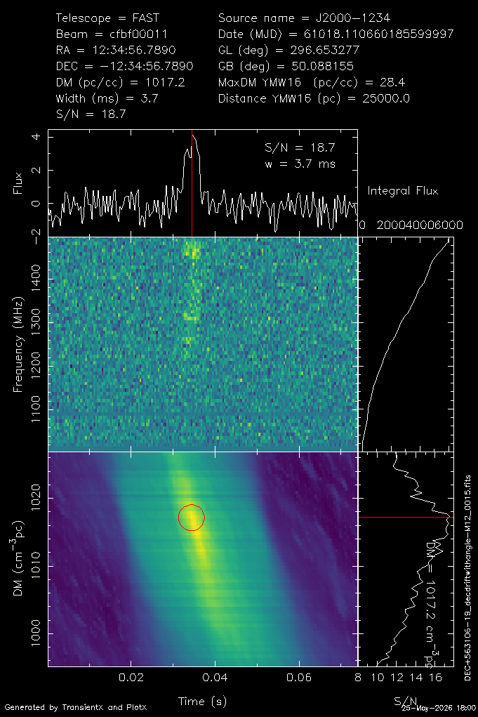
DFC002 | FRB 20241112A | DM : 1015±8 pc cm^-3
Burst_Date (UTC+8) | Burst_Count | Burst_MJD | SNR | Width (ms) | DM (pc cm^-3)
2024-11-12 | 3 | 60626.1841006450 | 28.3 | 3.7 | 1009.4
 |  | 60626.183552802 | 8.4 | 8.4 | 1012.8
 |  | 60626.1832473116 | 14.8 | 6.7 | 1020.8
2024-11-18 | 2 | 60632.1674389893 | 22.2 | 5.5 | 1012.4
 |  | 60632.167252882 | 8.7 | 14.7 | 1023.9
2025-11-26 | 2 | 61005.1456311431 | 11.5 | 6.7 | 1014.5
 |  | 61005.1457347992 | 18.4 | 6.7 | 1018.8
2025-12-9 | 1 | 61018.1106601856 | 18.7 | 3.7 | 1017.2
2025-11-26
8次Burst，横跨一年。计划FAST核心阵观测定位
2024-11-12
2024-11-18
2025-12-9

Slide 16
总结及后续研究
短驻留时间下长周期脉冲星可能只看到一两个脉冲，通过单脉冲搜索能把这些“入口信号”发现，从而后补齐其它方法的搜索盲区
单脉冲搜索仍是 FRB 发现中最通用、最标准的方法
单脉冲搜索时间快，适用于快速处理巡天数据
验证剩下的脉冲星候选体
长期观测和研究DFC002 Repeating FRB
已验证脉冲星的偏振定标、timing等研究 (Ralph Eatough & Guangyuan Zhang & Zhichen Pan)
DC001 & DC039 窄脉冲研究 (Guangyuan Zhang & Yilin Xu)
FFT方法搜索毫秒脉冲星、脉冲双星(Luyao Wang)
FFA方法搜索中长周期脉冲星(Xinyu Zhang)

Slide 17
Thank You!
张亦弛 潘之辰 钱磊
国家天文台
2026.07.04

