Slide 1

Evidence for a Delayed Progenitor Population for CHIME non-repeating Fast Radio Bursts using a Self-Consistent Forward and Backward Inference Framework
Zi-Liang Zhang (张子良) &
Bing Zhang (张冰)
The Hong Kong Institute for Astronomy & Astrophysics (HKIAA)

Slide 2
Outline
Background of FRBs & Motivation of this work
Methods
1. Backward (from observation to intrinsic distribution)
weighted Lynden–Bell method (include selection effect)
2. Independent test, whether the redshift and energy distribution are independent
3. Forward population synthesis (compare prediction with observation)
Monte Carlo mock sample + DM-z uncertainty + selection function
Summary

Slide 3
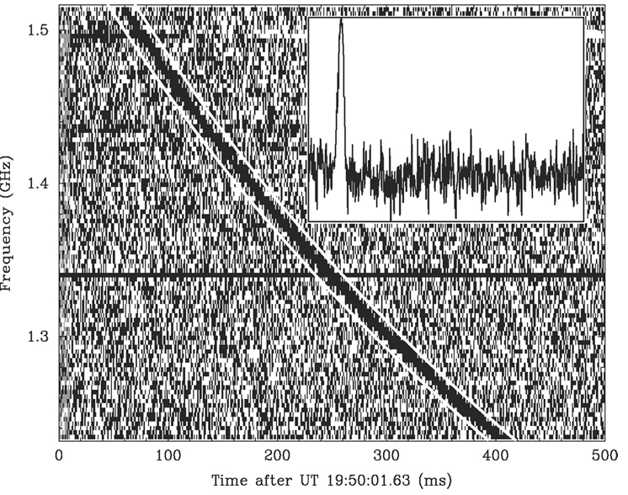
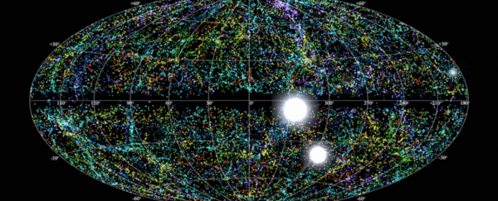
FRB characteristics
Fast Radio Burst
ms
GHz
Jy ms
Duration, wavelength, intensity
High Dispersion Measure (DM)
FRB 20010724
(NRAO Outreach/Vimeo)
Lorimer+(2007)

Slide 4
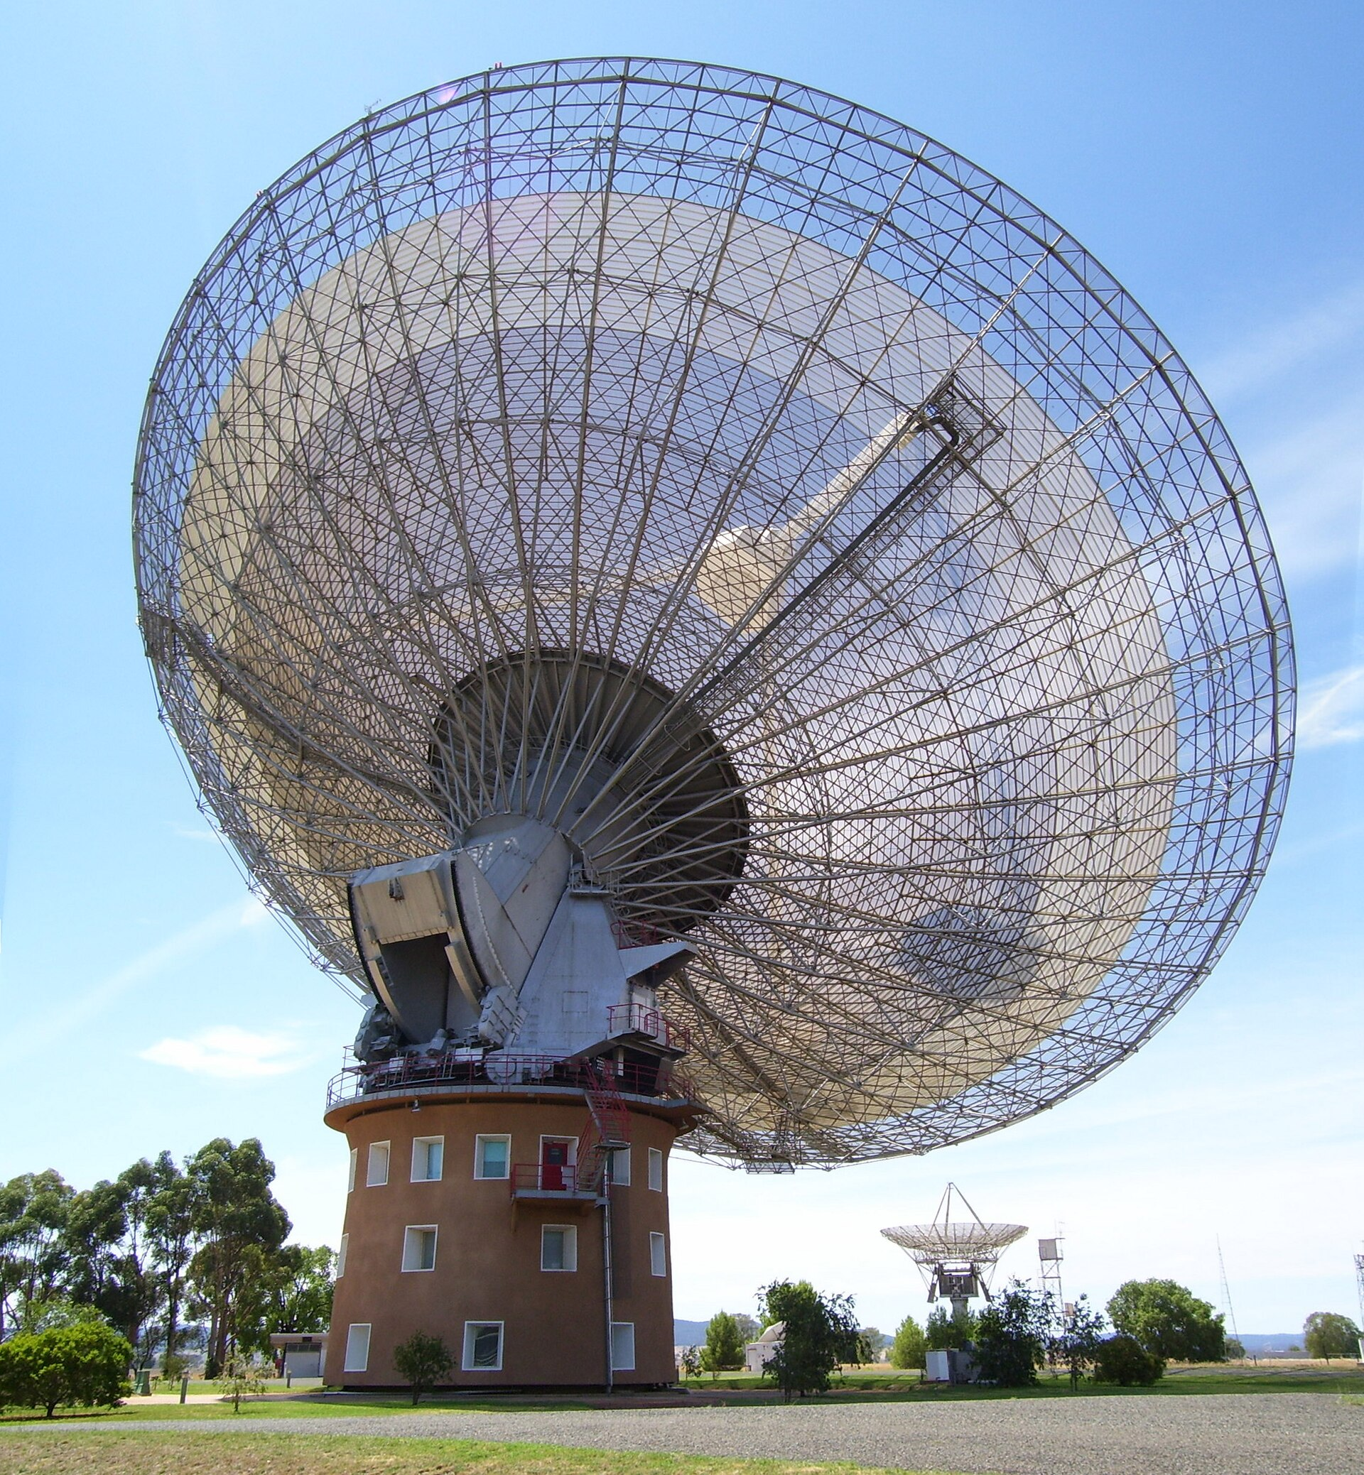
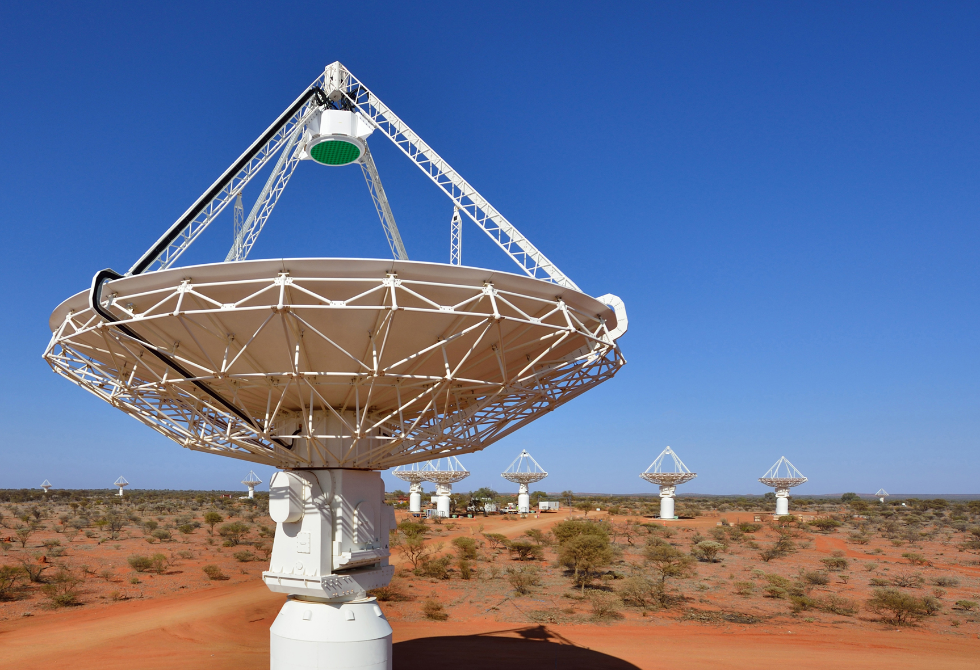
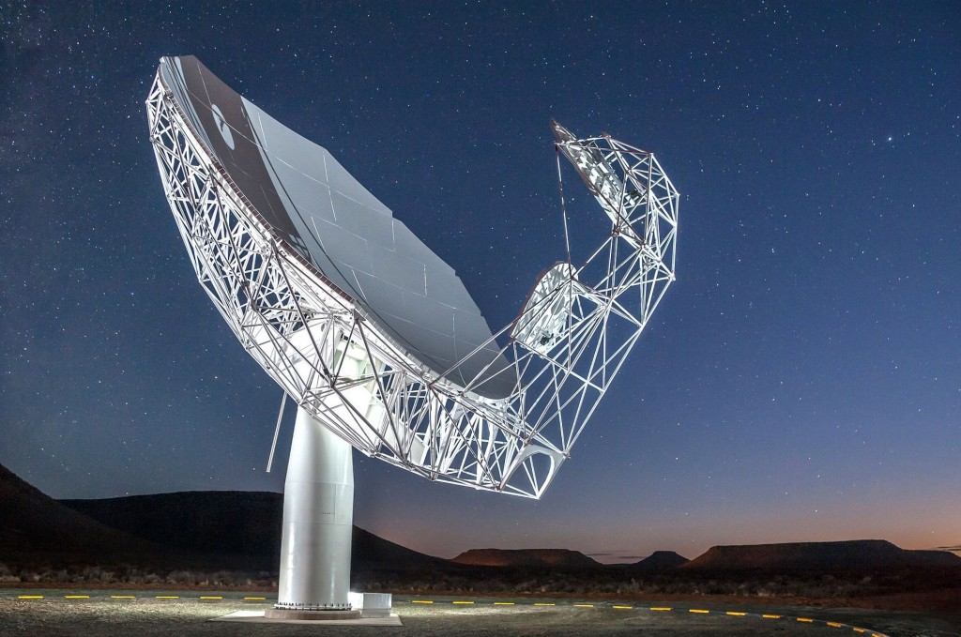
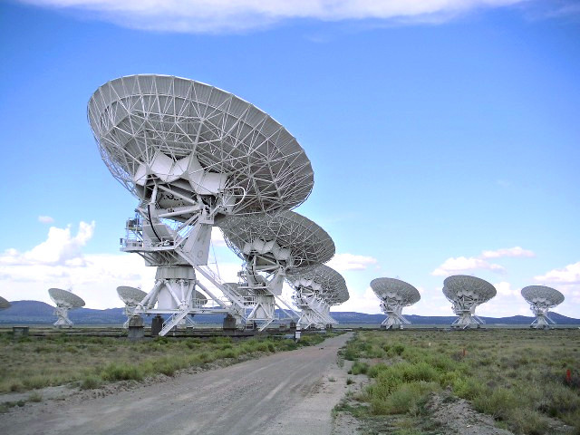
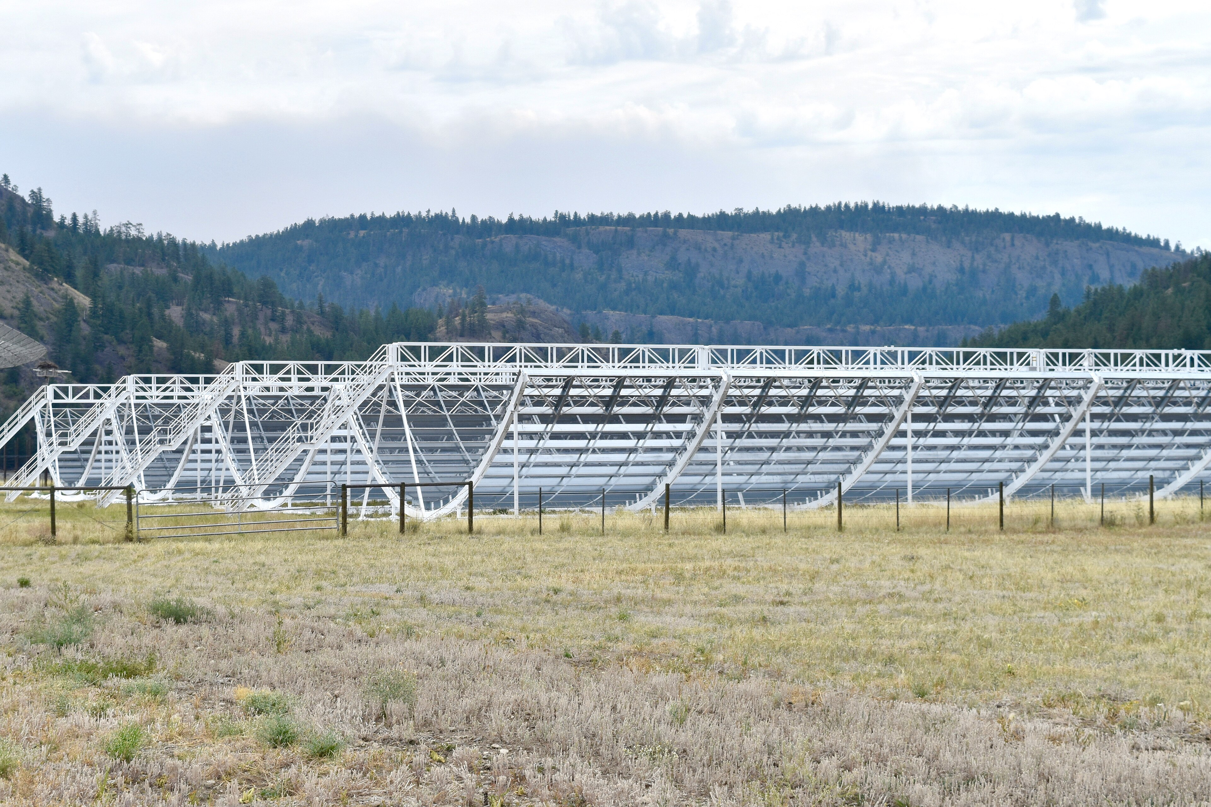
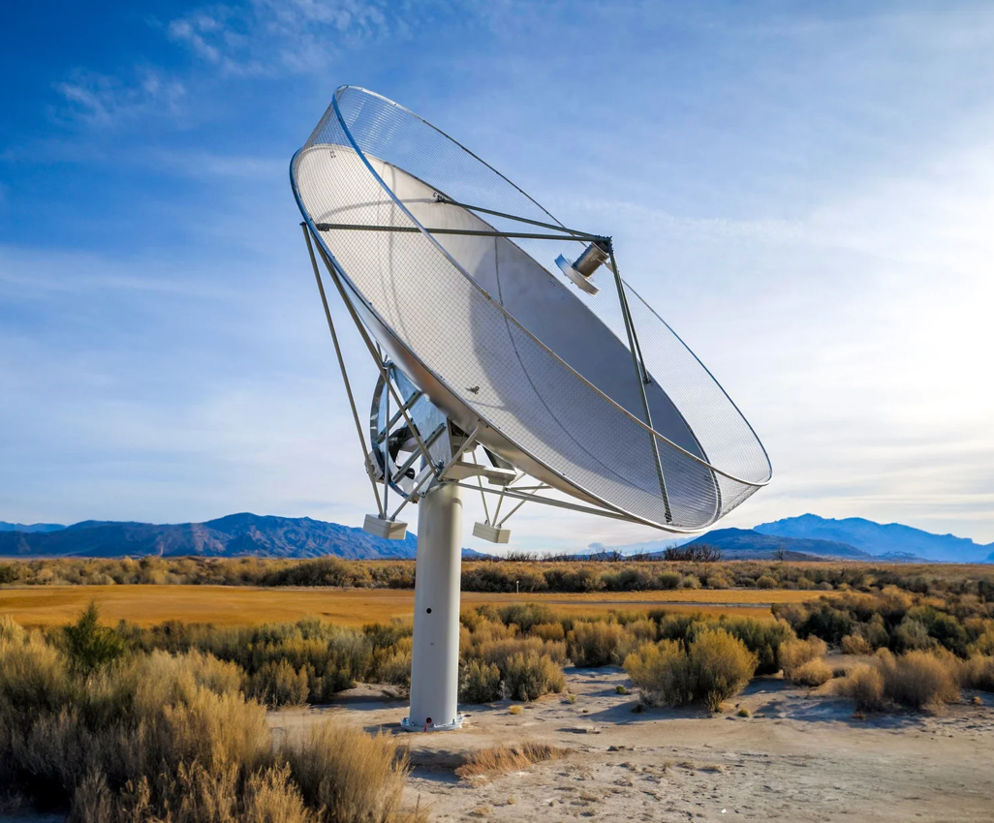
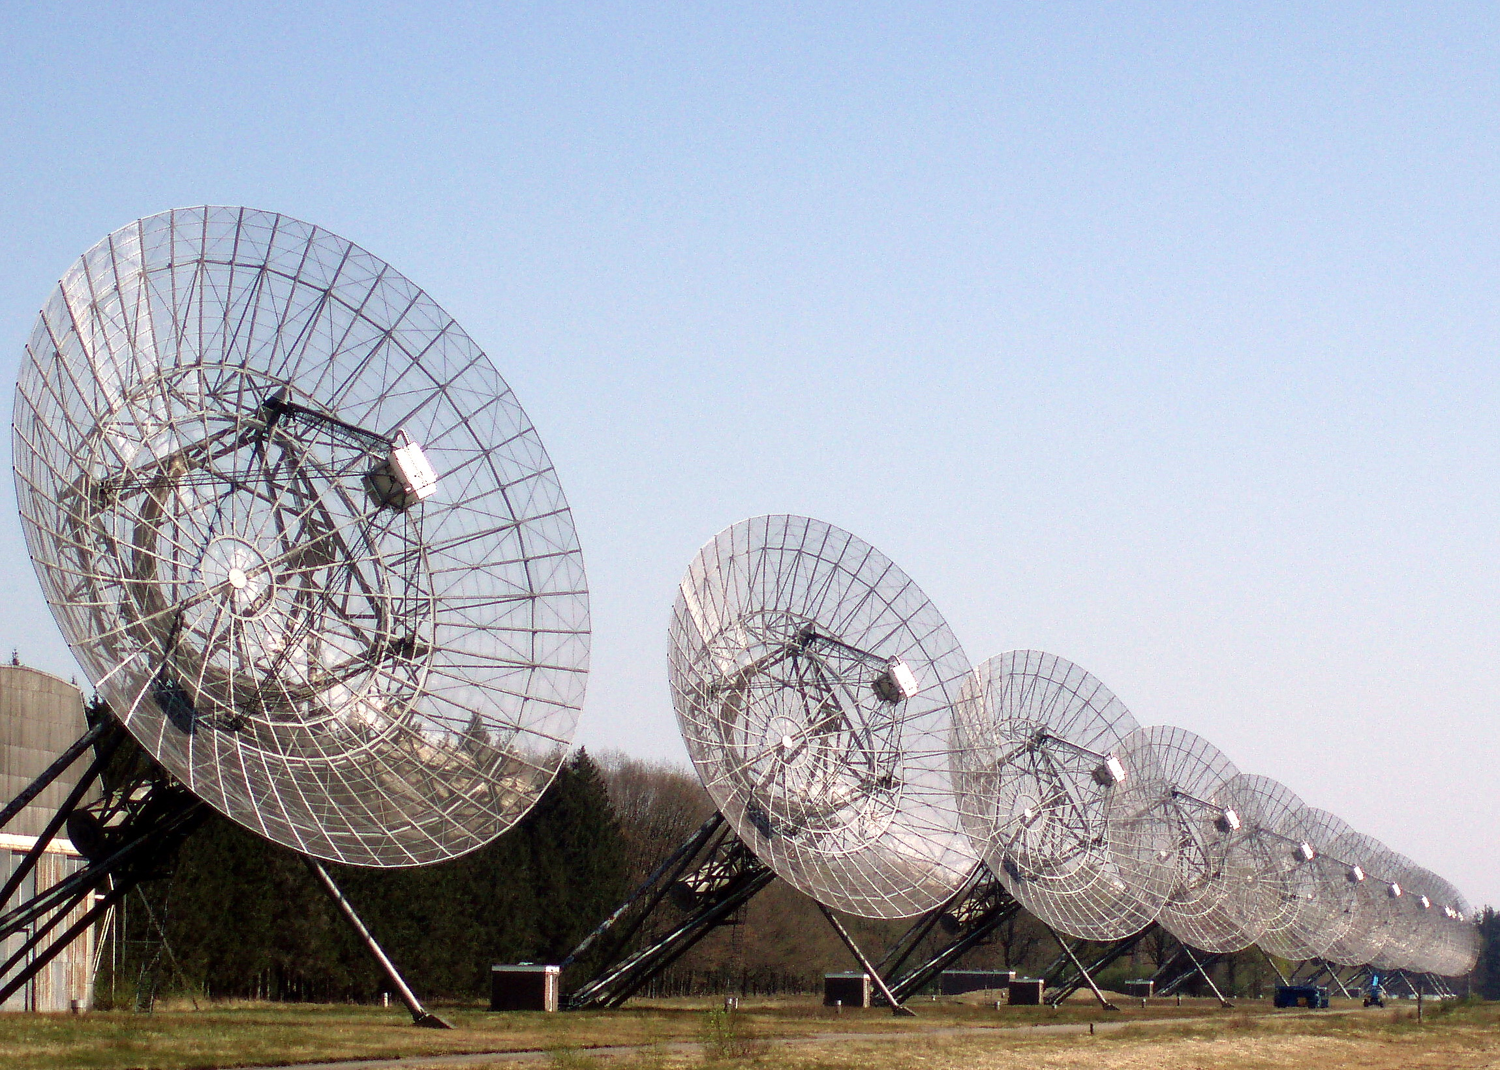
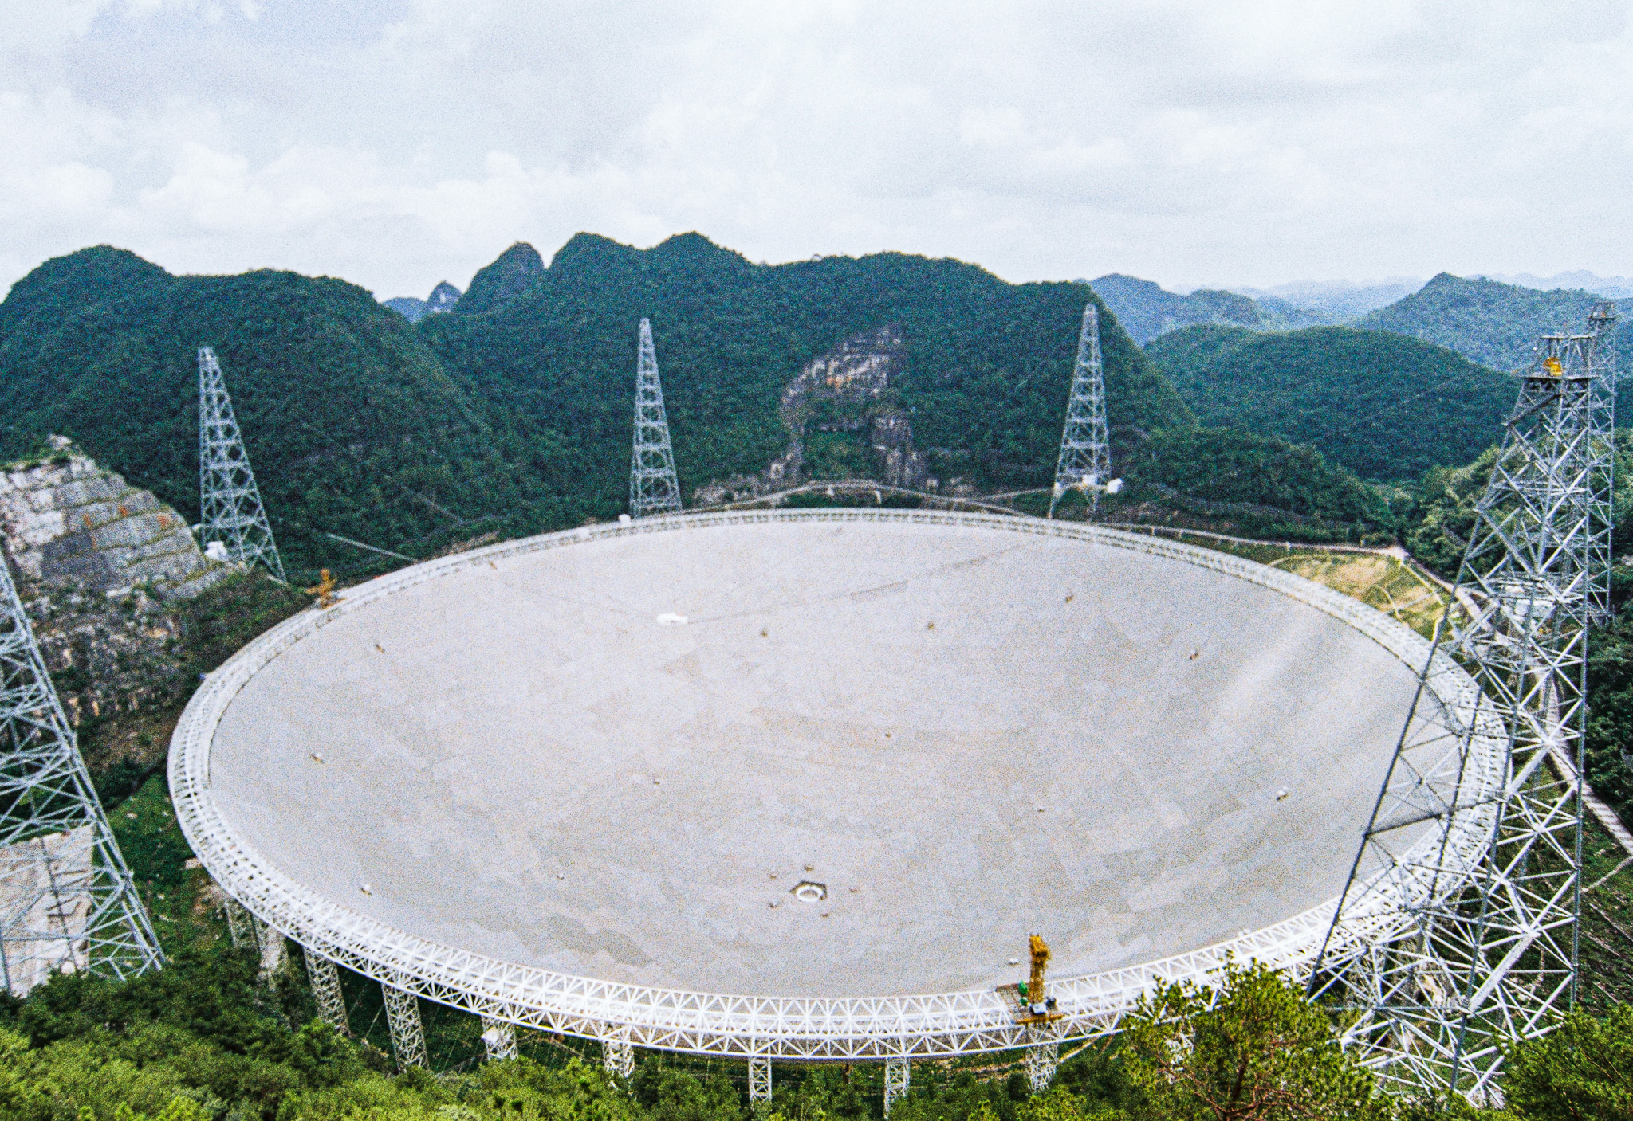
FRB source overview
Thanks to Parkes(Murriyang), ASKAP, Meerkat, CHIME, VLA, EVN, DSA, FAST,…
Over 4k+sources, 10k+pulses, ~100 localized host galaxy (with redshift)

Slide 5
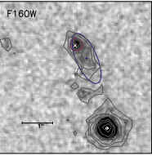
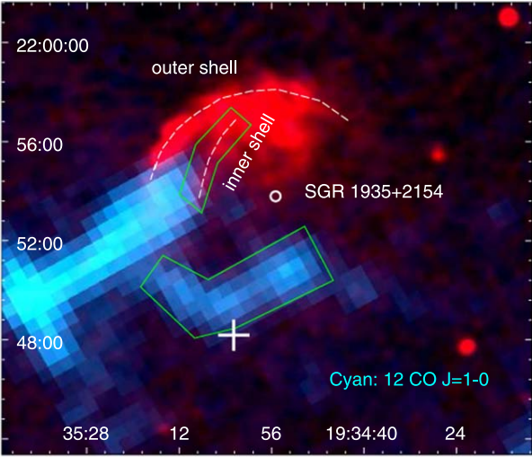
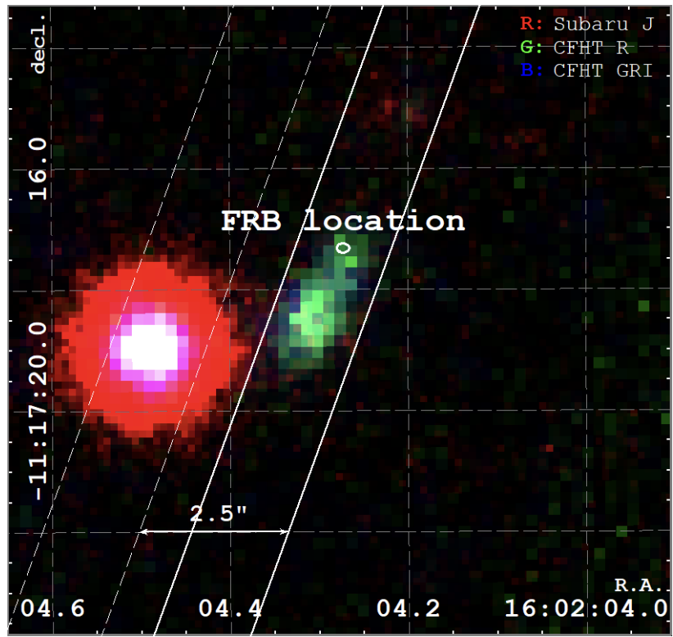
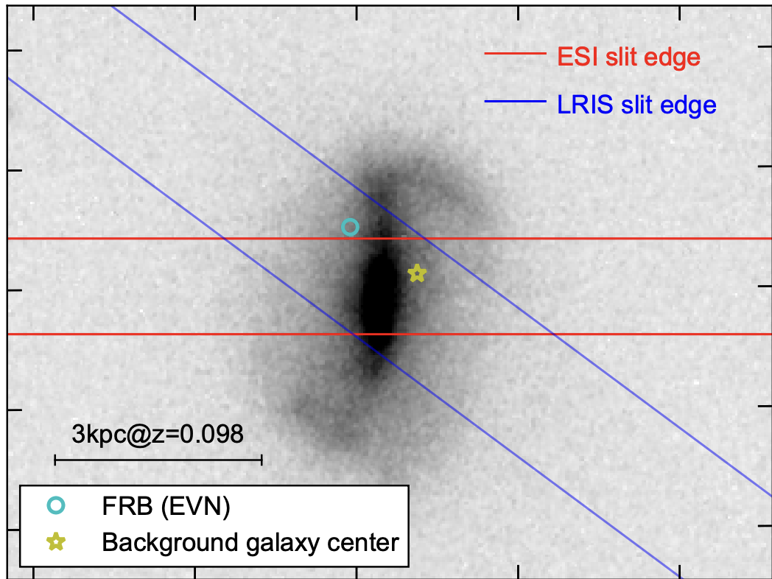
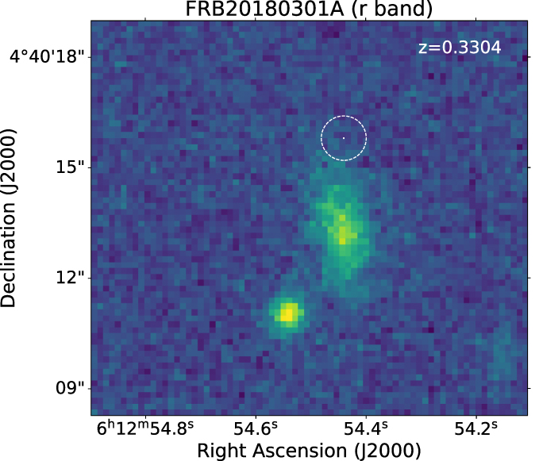
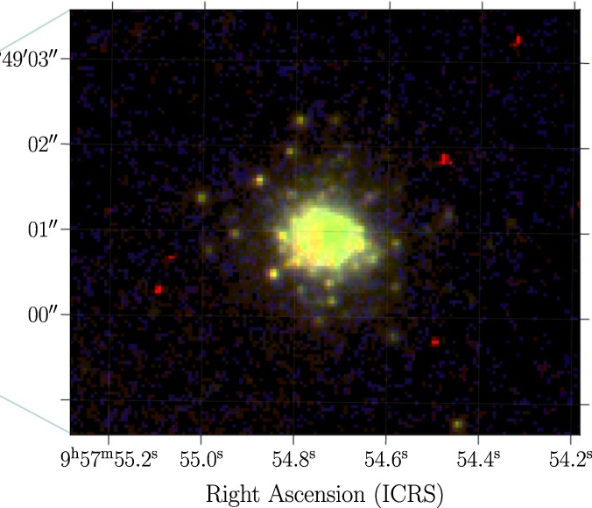
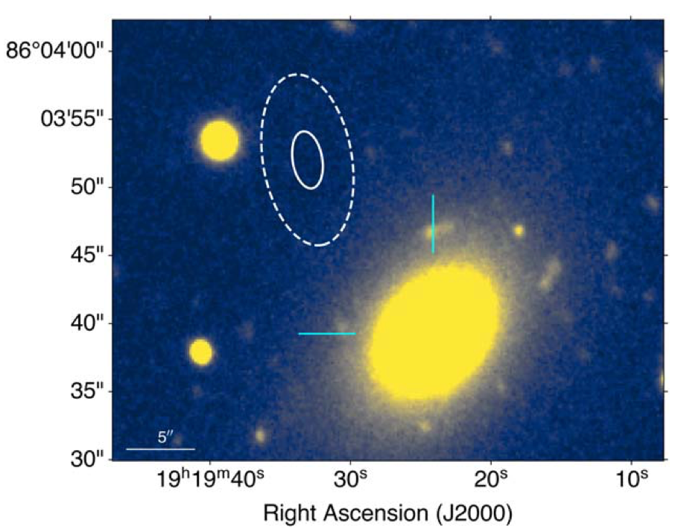
Various host galaxy type
However, localized events are precious and from different telescope/survey, highly heterogeneous
Thanks to CHIME, uniform dataset ~400 FRBs Catlog1 enable population studies (e.g., Zhang+2022, Shin+2023, Zhang+2023, Wang+2024, Chen+2024, Gupta+2024, Zhang+2025,…). Now, CHIME catlog2 include ~3k sources
Dwarf
SNR
Dwarf
Barred
Bassa +(2017)
Zhou+(2020)
Chen+(2025)
Xu+(2022)
Globular Cluster
Outskirt of elliptical galaxy
Outskirt
Bhandari+(2022)
Dage+(2023)
Shah+(2025)

Slide 6
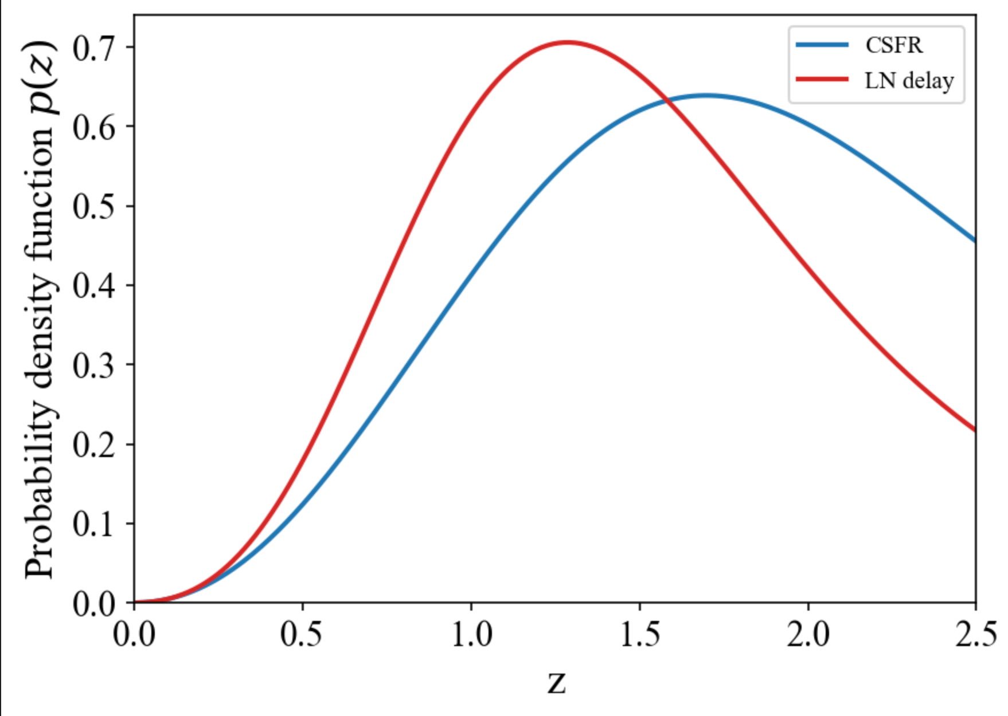
Why transient’s redshift distribution important?
Delayed, compact binary merger, SN Ia, accretion induced collapse,…
Lifetime of 10 $M_{⊙}$ star ~ 30 Myr
Delay time of compact stars merger~Gyr
Massive star, Core-Collapse SN, Long GRB (type II),…
delay

Slide 7
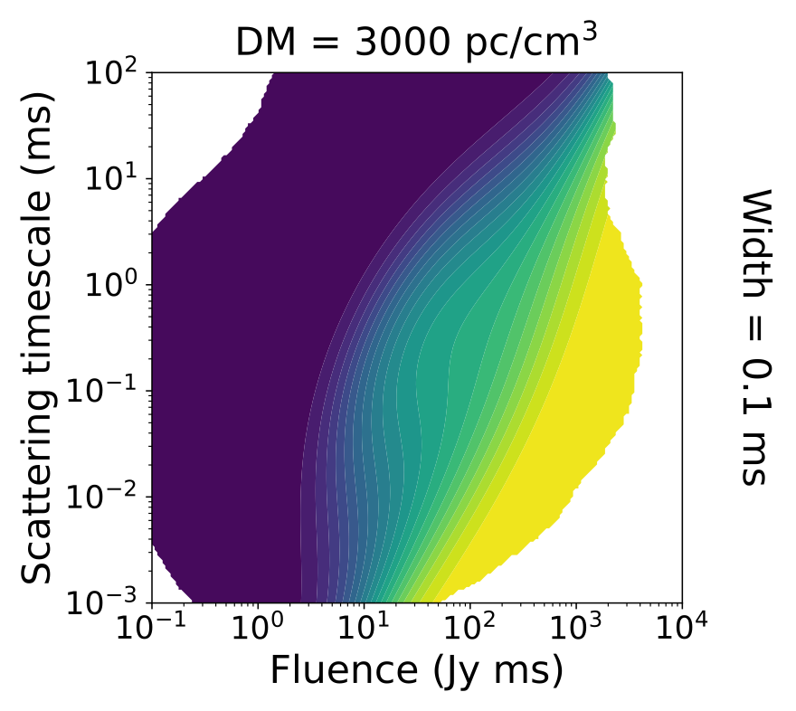
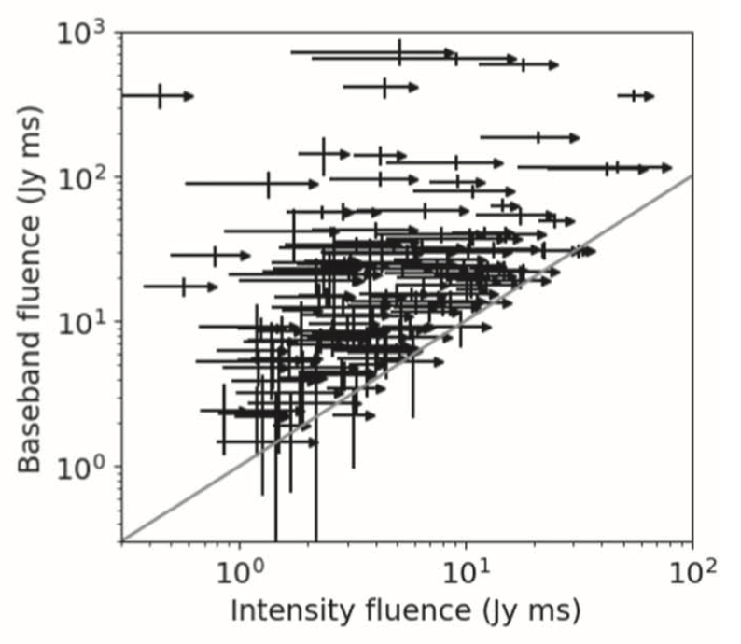
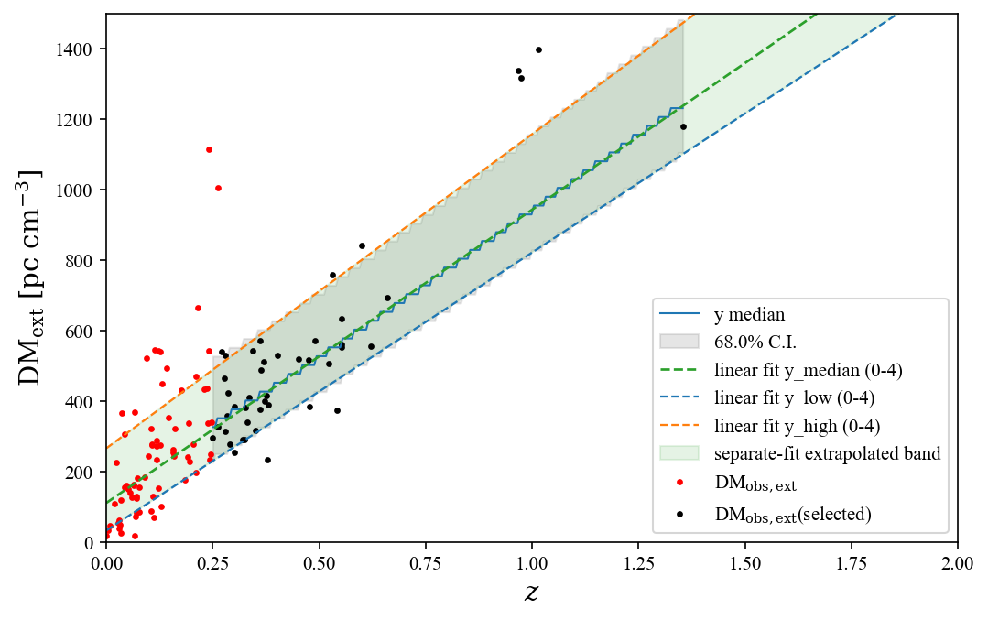
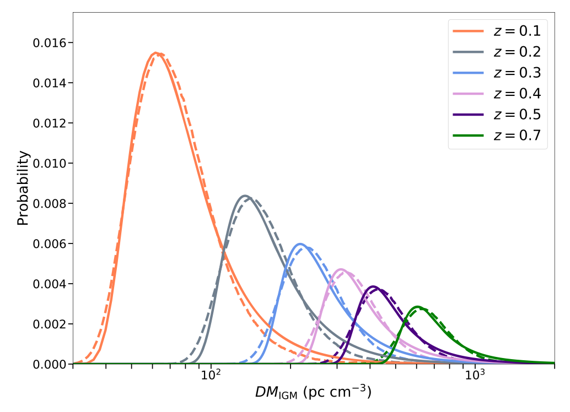
Difficulties
1. Selection Bias
2. Lower limit fluence
Kyle McGregor+(2026)
Amiri+(2024)
Zhu-Ge+(2026)
3. DM-z uncertainty
Zhang+(2021)

Slide 8
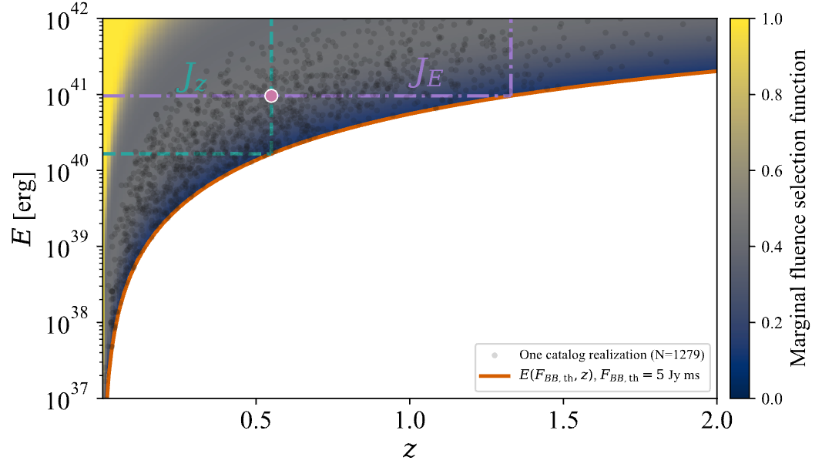
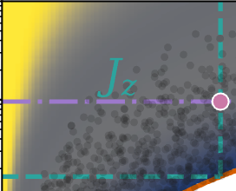
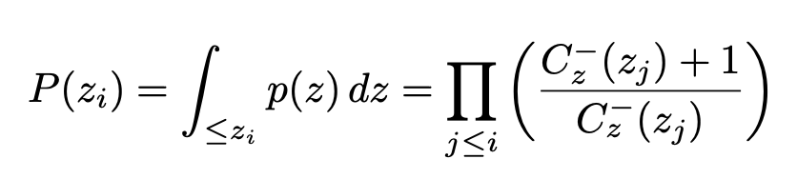

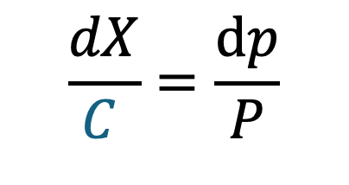
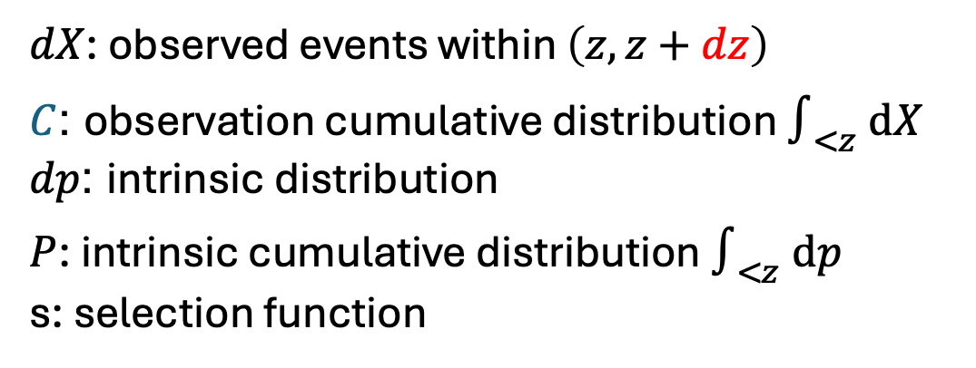
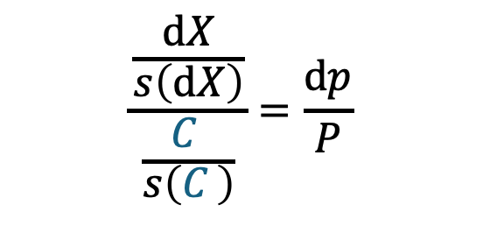

Backward Lynden–Bell method
With fuzzy selection effect s:
$$\frac{\frac{ⅆX}{s\left(ⅆX\right)}}{\frac{C }{s\left(C \right)}}=\frac{ⅆp}{P}$$
$$C$$
$$dz$$
$dX$: observed events within $\left(z,z+dz\right)$
$C$: observation cumulative distribution $∫_{<z}^{}⁢ⅆX$
$dp$: intrinsic distribution
$P$: intrinsic cumulative distribution $∫_{<z}^{}⁢ⅆp$
s: selection function
Without fuzzy selection effect s:
$$\frac{dX}{C }=\frac{ⅆp}{P}$$
Lynden-Bell (1971), Zhang+, in prep.

Slide 9
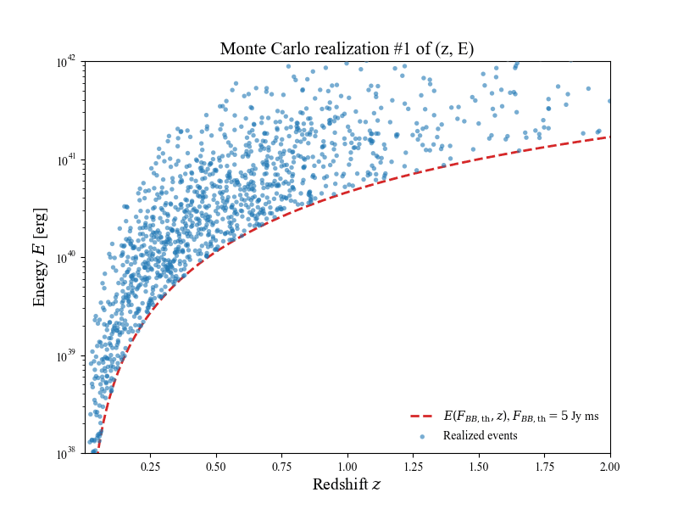
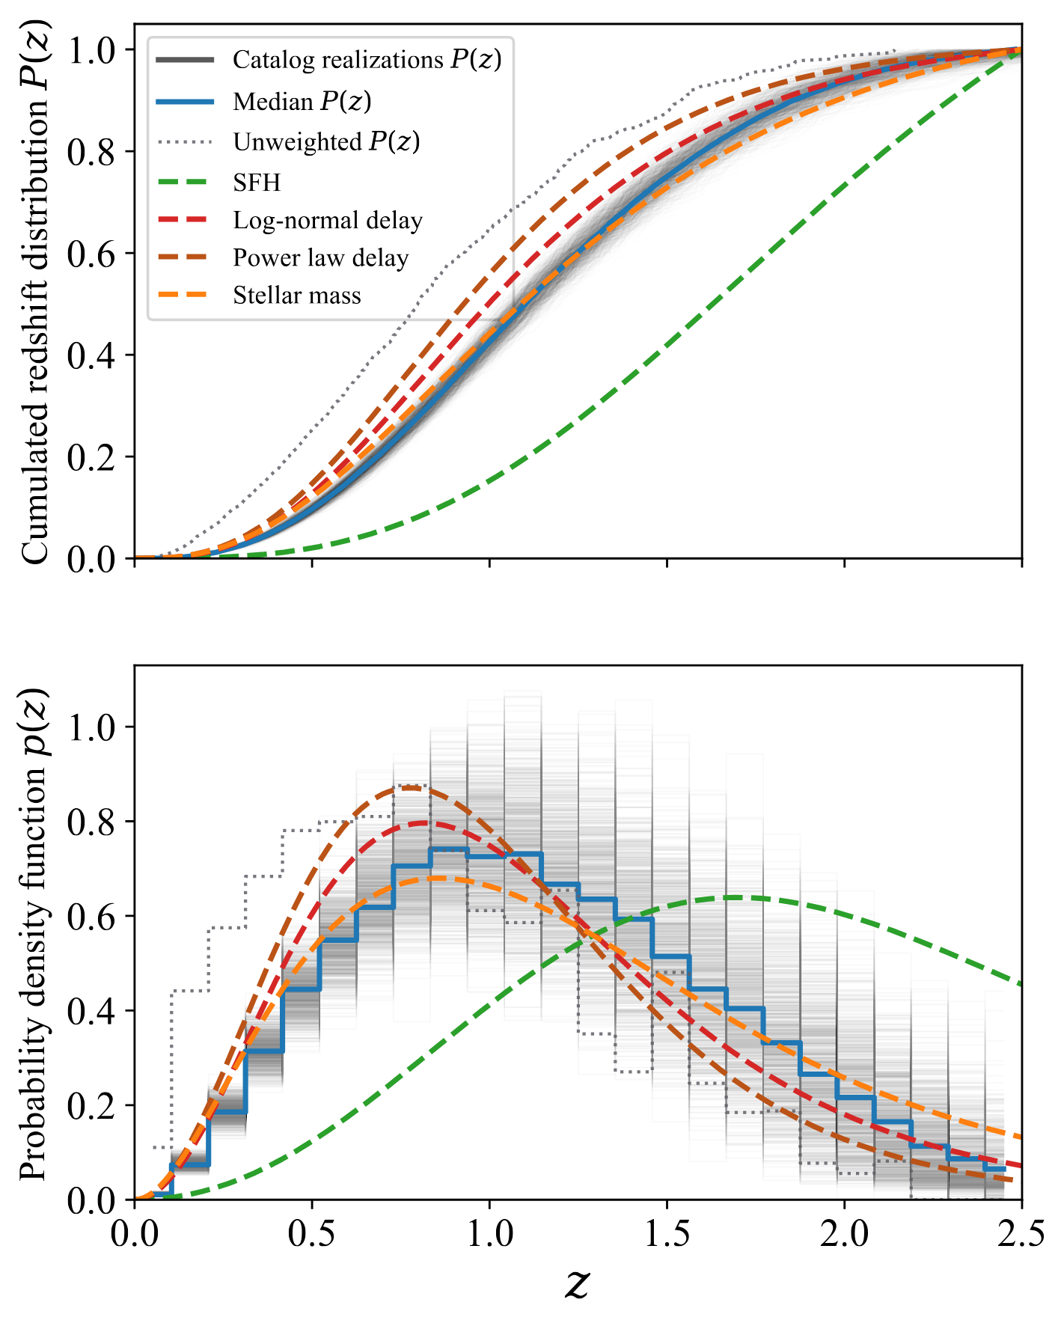
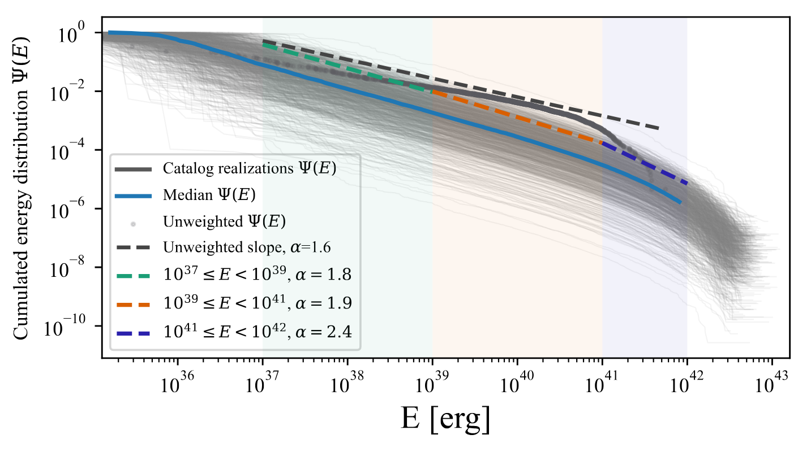
Intrinsic redshift and energy distribution
Zhang+, in prep.

Slide 10
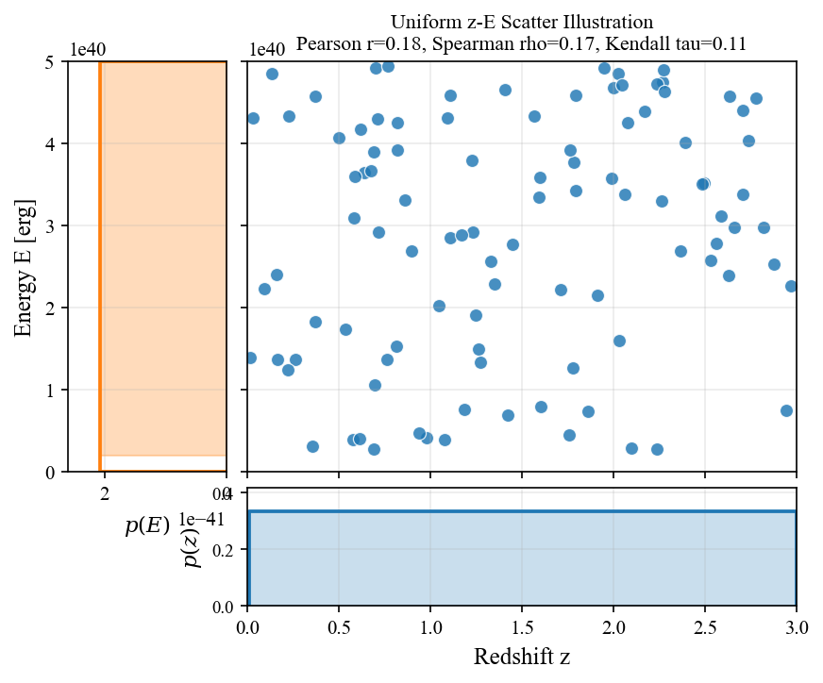
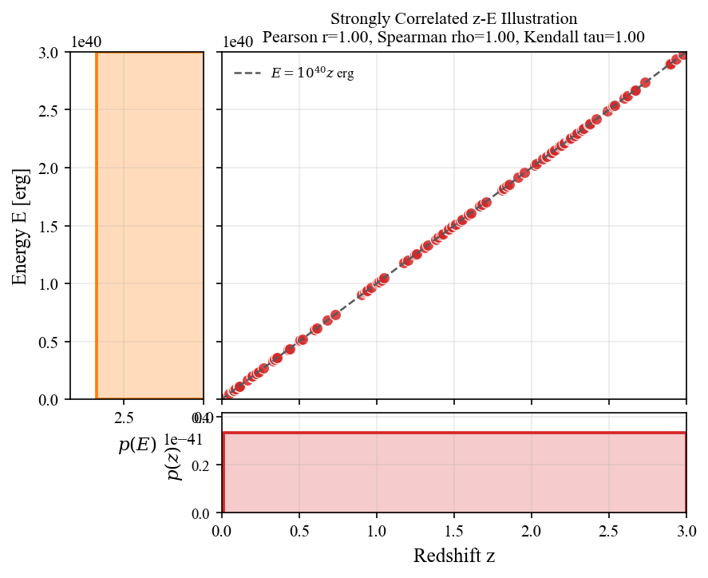
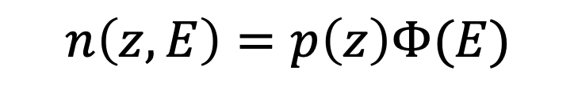
Dependence of redshift distribution and energy function
Independence:
$$n\left(z,E\right)=p\left(z\right)Φ(E)$$
Zhang+, in prep.

Slide 11
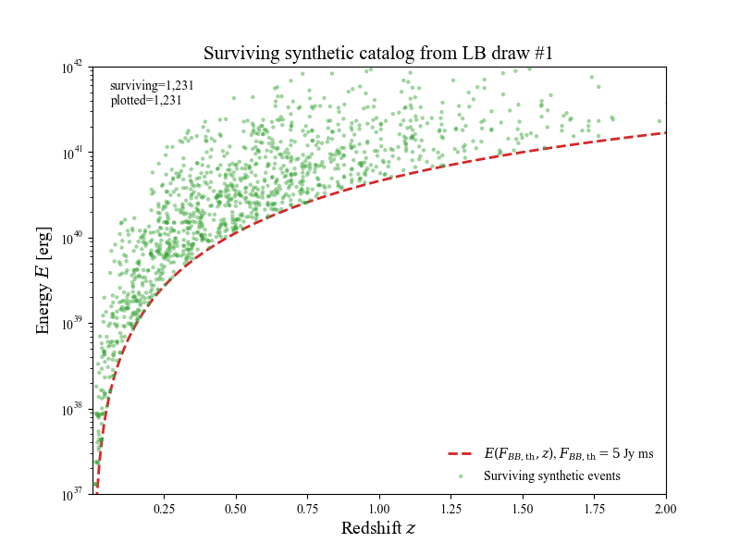
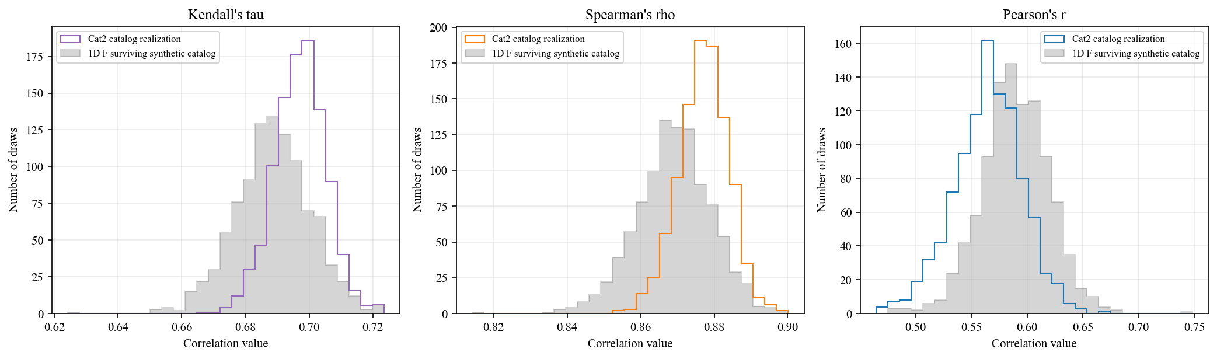
Dependence of redshift distribution and energy function
Simulation
Observation

Slide 12
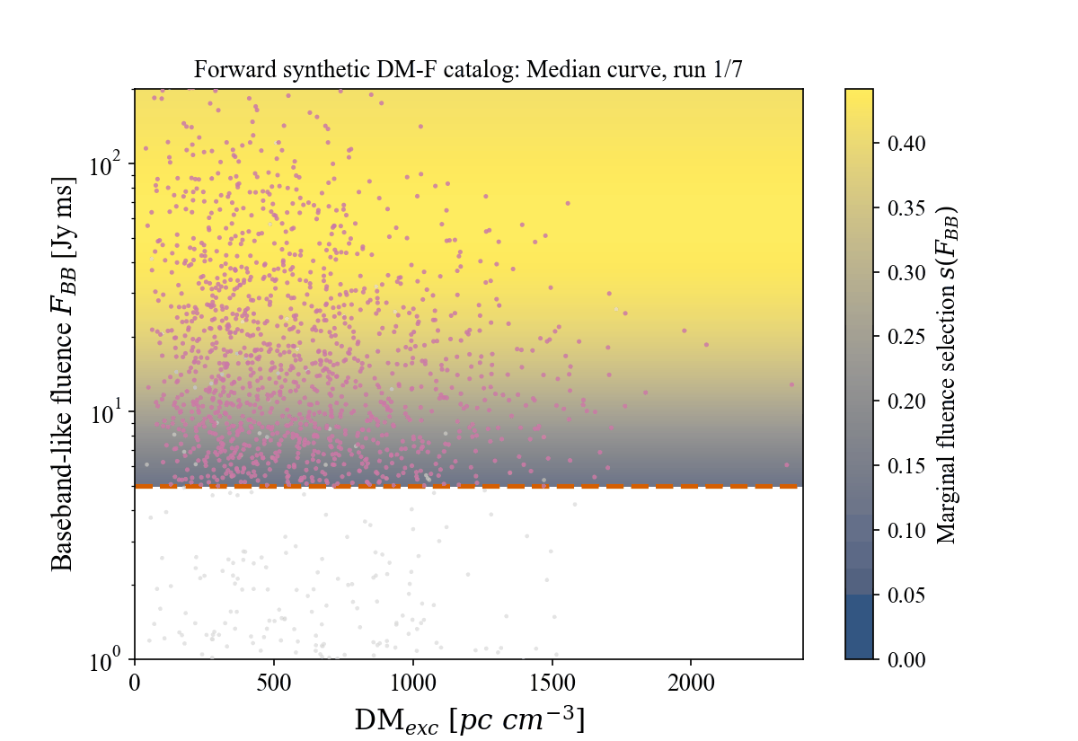
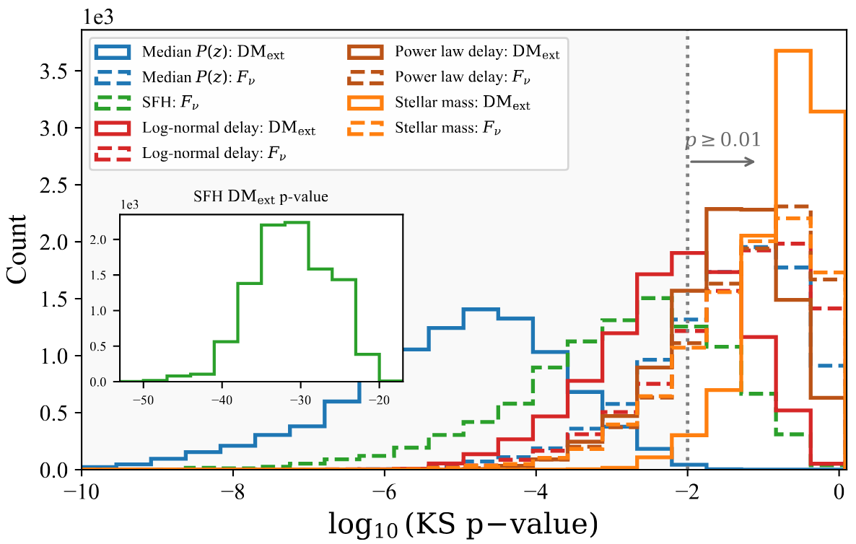
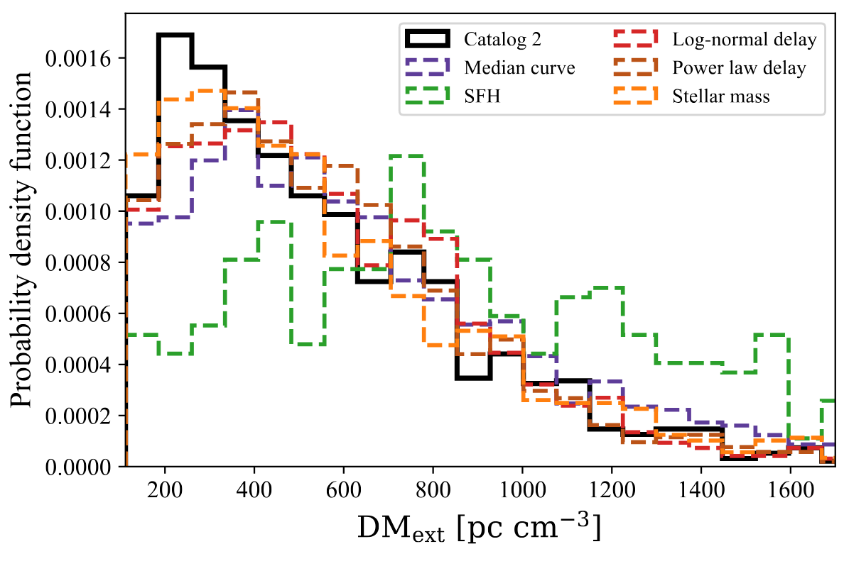
Forward population synthesis
Including the DM-z probability
Cosmic star formation history model can not pass KS test in 10000 times simulation
Zhang+, in prep.

Slide 13
Summary
1. Refine the backward Lynden–Bell method to include selection effects and consider the physical fluence and DM-z probability
2. Forward Monte Carlo population synthesis + DM-z uncertainty + selection effect
Two independent way disfavor cosmic star formation history model
No statistical evidence for dependence of redshift distribution and energy function

Slide 14
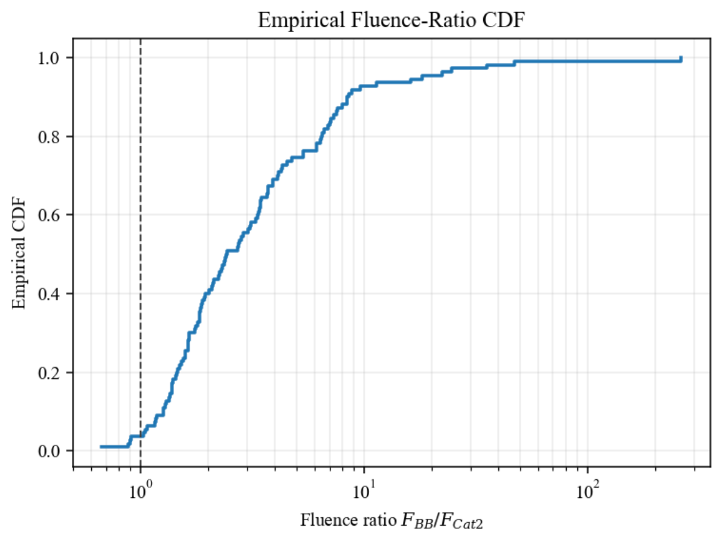
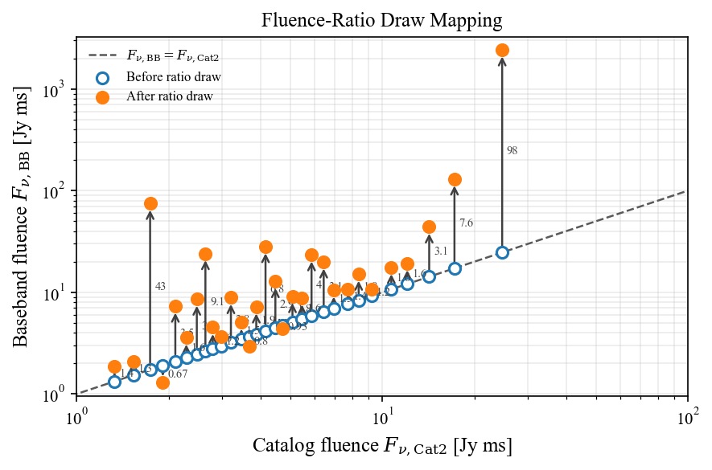
FRB

Slide 15
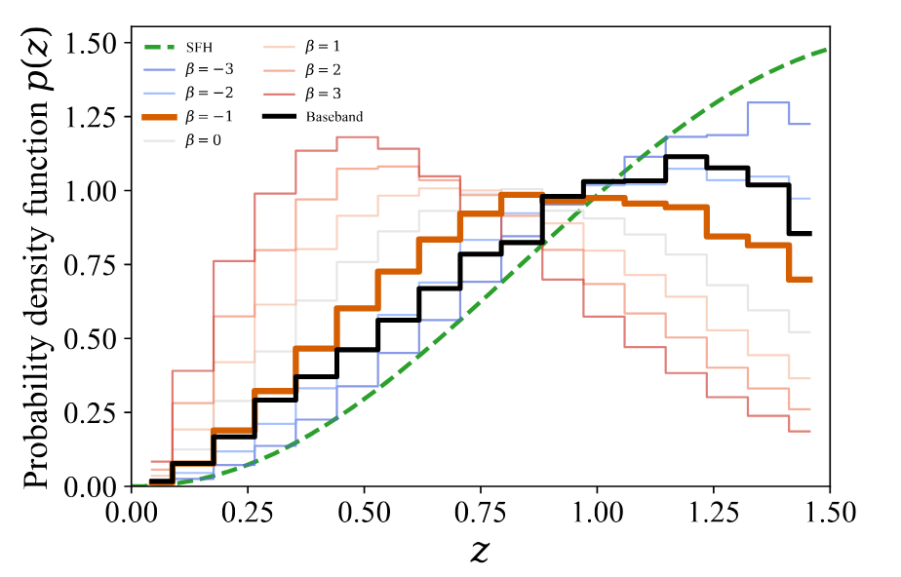
FRB

Slide 16
FRB

Slide 17
FRB

