Slide 1

Natal Kick Constraints from a Joint Population Synthesis Fit to Two Pulsar Age Samples
（submitted to ApJ, under review...）
Yifan Zhang
Advisor & Collaborator: Ruoyu Liu (NJU), Kai Yan (NJU), Pei Wang (NAOC)

Slide 2
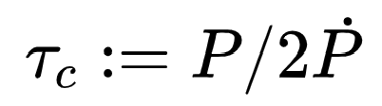
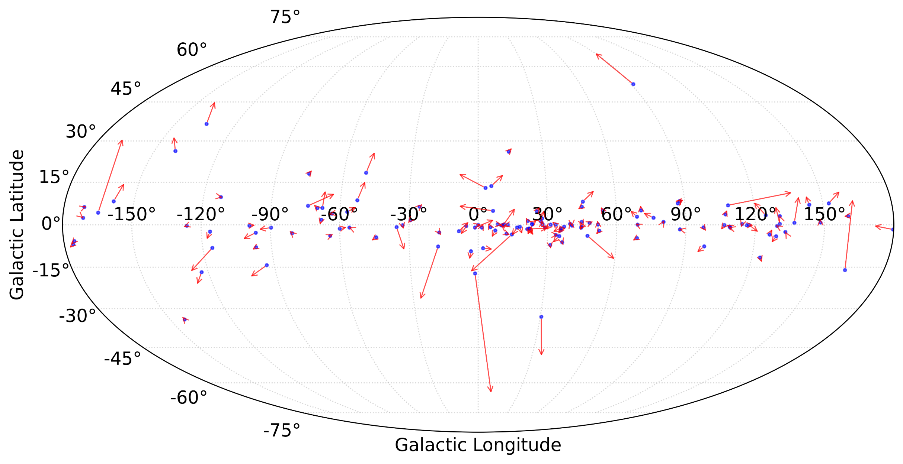
Proper Motion of Galactic Pulsars
<4 Myr
unit: mas/yr
from ATNF catalog

Slide 3
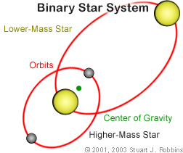
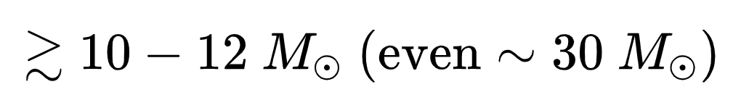
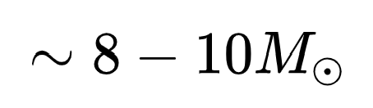
What contributes to the Proper Motion of a pulsar ?
Neutron Star (NS) formation
Core Collapse Supernovae, CCSNe
ZAMS mass:
David Arnett et al. (2011)
Electron Capture Supernovae, ECSNe
ZAMS mass: （super-AGB stars）
B. Mu:ller et al. (2019)
OB star progenitors reside in binary systems
H. Sana et al. (2012)
We assume NSs are born and later evolve
as single stars !
velocity of ~100 km/s may in principle come from binary breakup in a supernova (without kick)
D. Lai (2003)

Slide 4
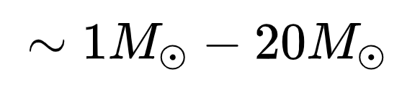
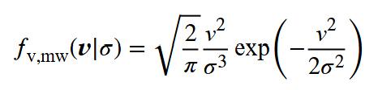

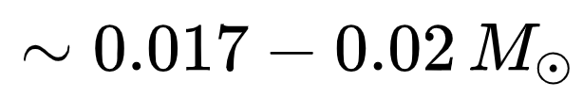
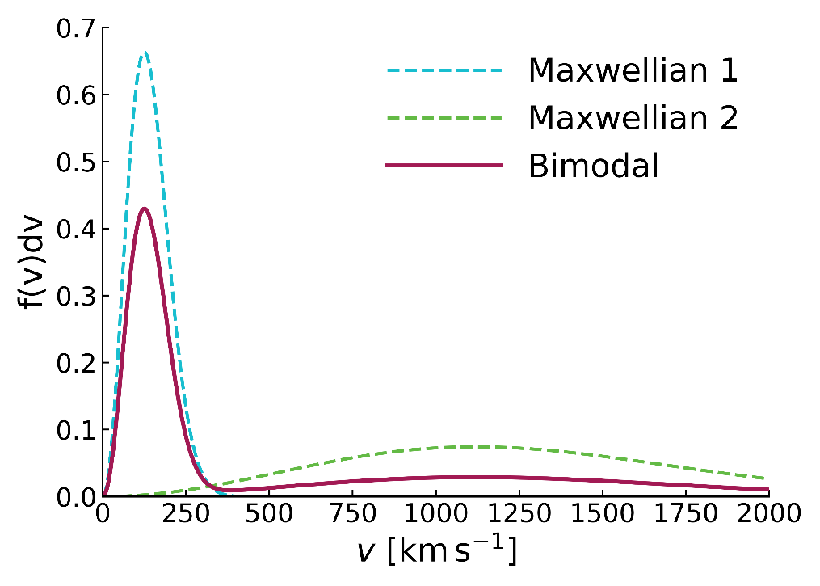
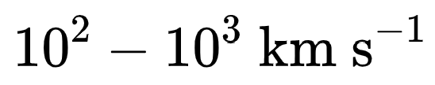
What contributes to the Proper Motion of a pulsar ?
Neutron Star (NS) formation
What is Kick Velocity?
How is it distributed & its physical interpretation
Core Collapse Supernovae, CCSNe
Electron Capture Supernovae, ECSNe
ejecta mass:
ejecta mass:
asymmetric
ejection of
matter
during SNe
explosion
results in
recoil kick
possible Kick Mechanisms
（1）Hydrodynamically Driven
（2）Neutrino-Magnetic Field Driven
（3）Electromagnetically Driven
(electromagnetic rocket effect)
（4）new physics?
J. Nordhaus et al. (2010); G. Lambiase (2005); I. Kondratyev(2024); D. Meyer(2025); Y. Farzan(2005); D. Lai (2003)

Slide 5
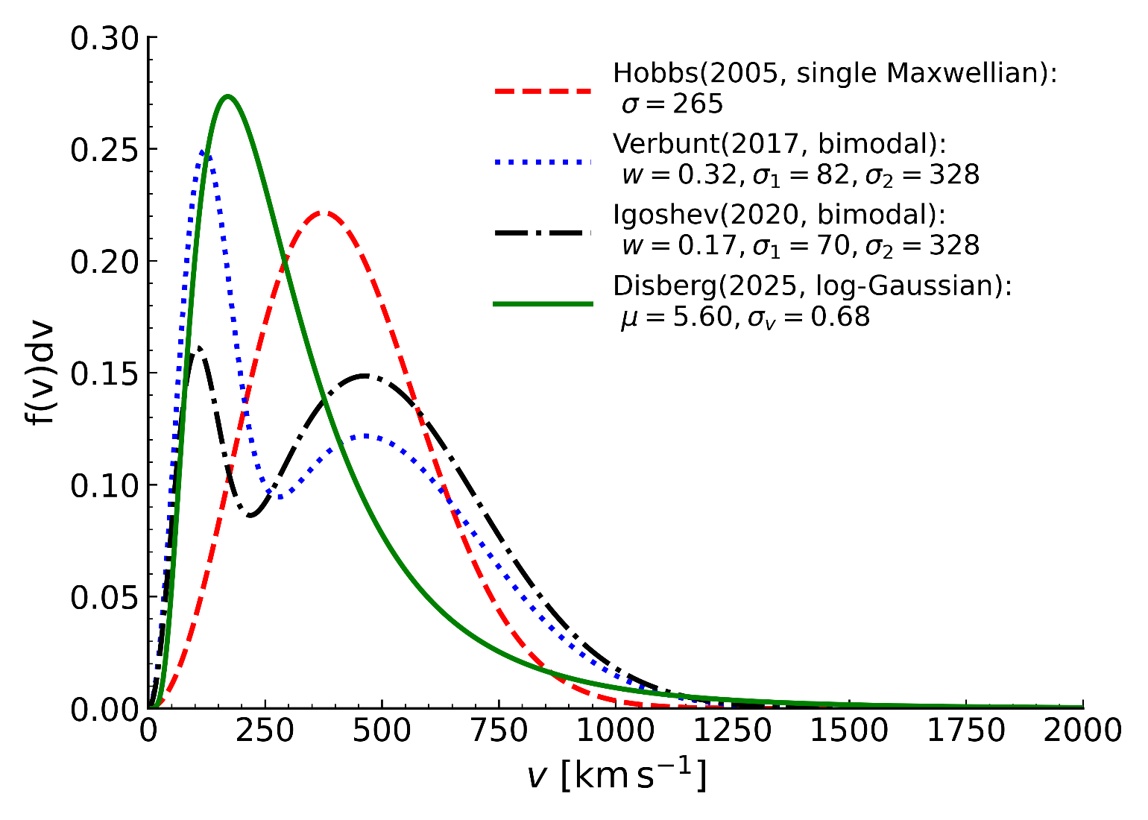
Literature Review (approach 1)
Use observed velocity distribution of young pulsars as a trace for kick velocity
Premise: kick velocity does not change significantly during the time period defined as “young”
How to define
YOUNG pulsars?
characteristic age <3Myr
?
Hobbs, et al. (2005) "A statistical study of 233 pulsar proper motions." red
Verbunt, et al. (2017) "The observed velocity distribution of young pulsars." blue
Igoshev, et al. (2020) "The observed velocity distribution of young pulsars–II. Analysis of complete PSRπ." black
P. Disberg, et al. (2025) "The Kick Velocity Distribution of Isolated Neutron Stars" green

Slide 6
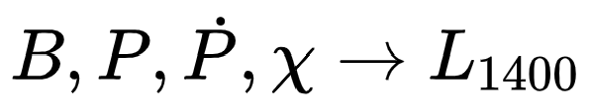
Literature Review (approach 2: population synthesis)
What is pulsar population synthesis?
1. constant birth rate
2. location in the Galaxy
birth location
kick velocity received at birth
orbit integration under MW potential
We model
Birth & Evolution
of NSs
detectability
3. intrinsic properties
(birth distribution and evolution functions)
spin period, P
dipolar magnetic field strength, B
inclination angle,

Slide 7
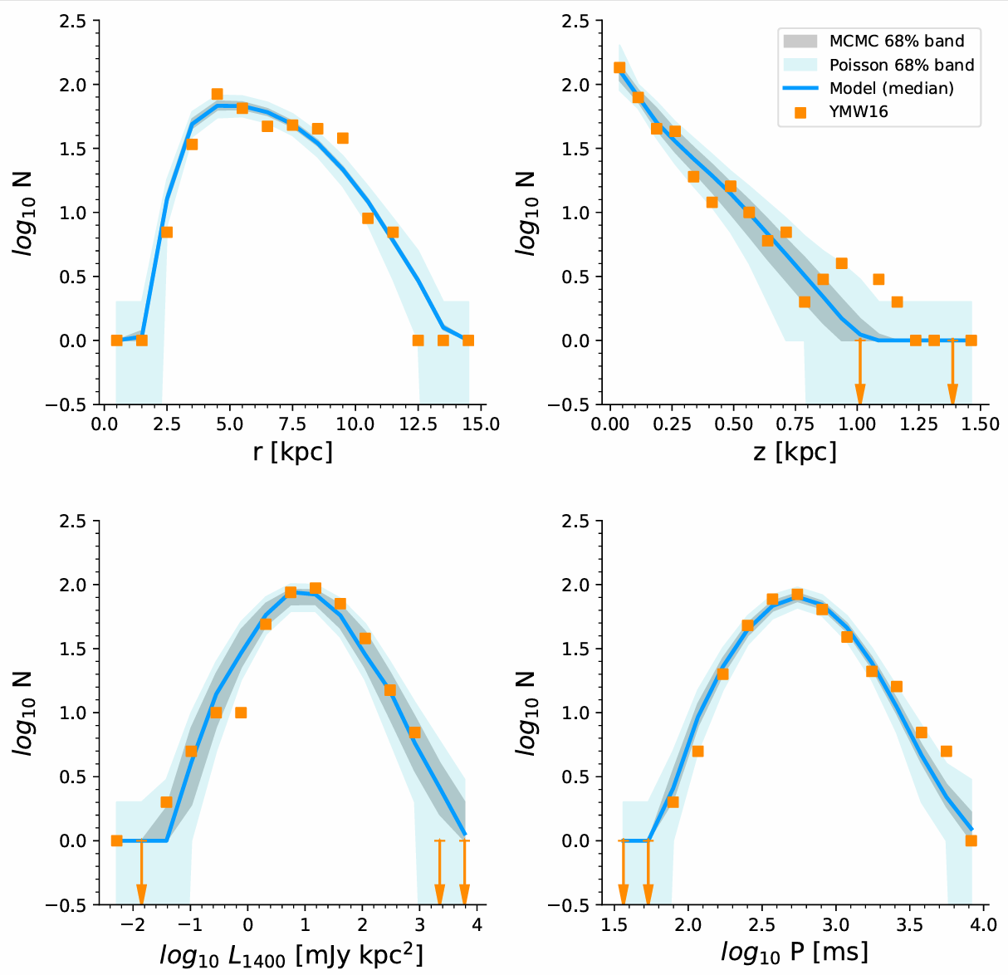

Birth & Evolution of NSs
constant birth rate
location in MW
intrinsic properties
1-4 Myr
detectability
Generates a set of synthetic samples
to compare with data (binned),
and further constrains
birth & evolution parameters
for example in this work, we compared
Galactocentric radius, r ,
Vertical distance from the Galactic plane, z ,
Spin period, P ,
Pseudo luminosity at 1400 MHz,

Slide 8
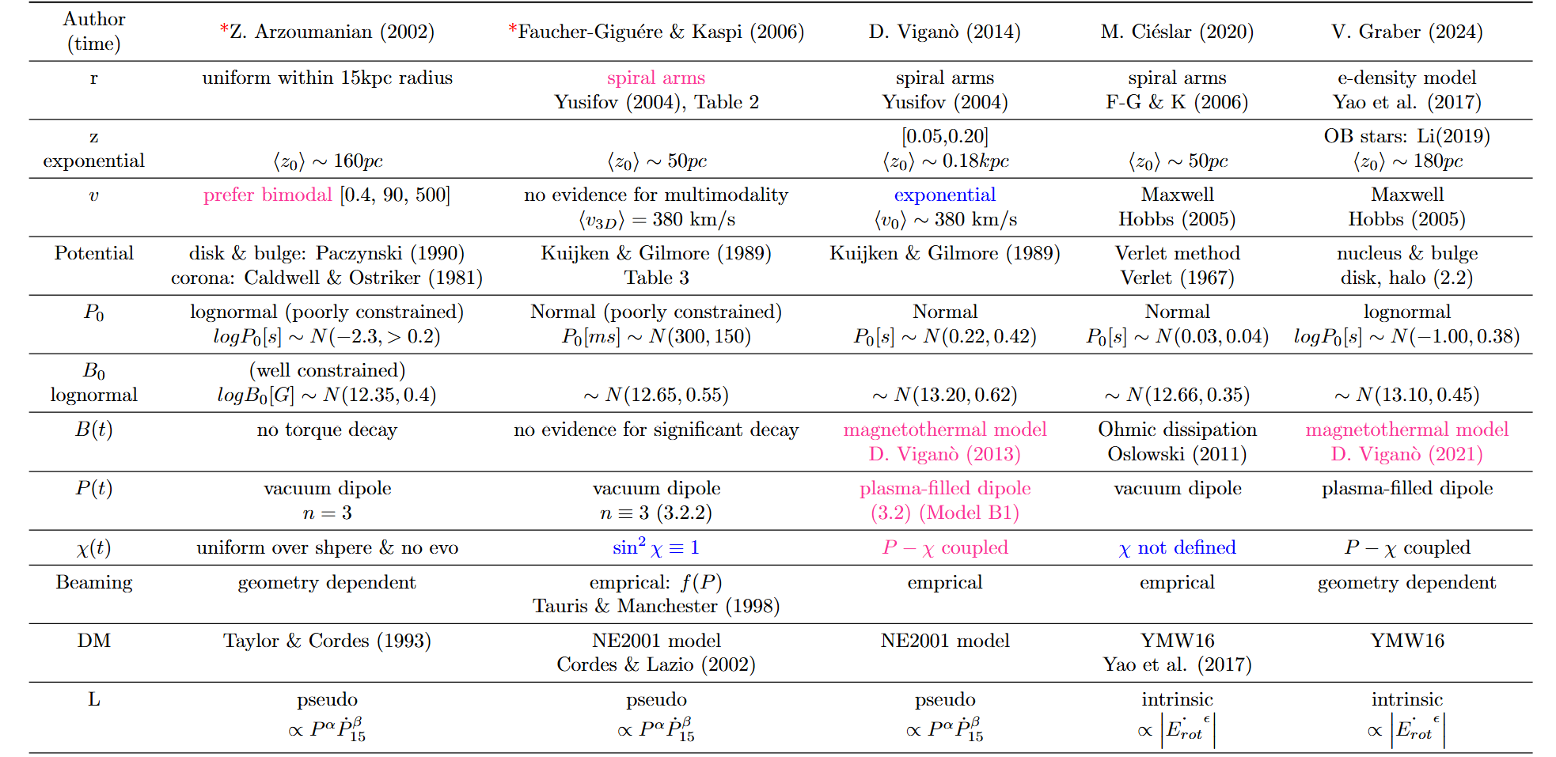
Literature Review (approach 2: population synthesis)

Slide 9

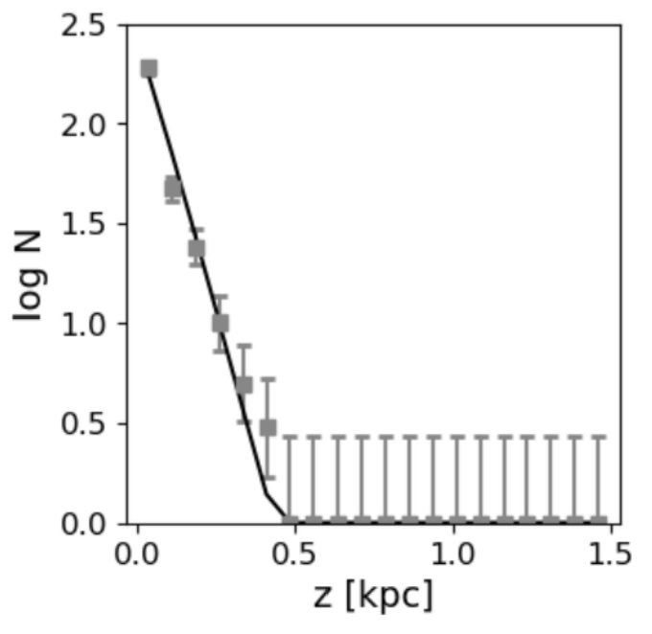
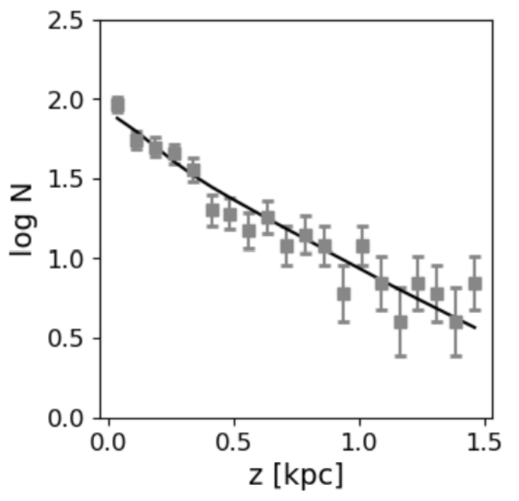
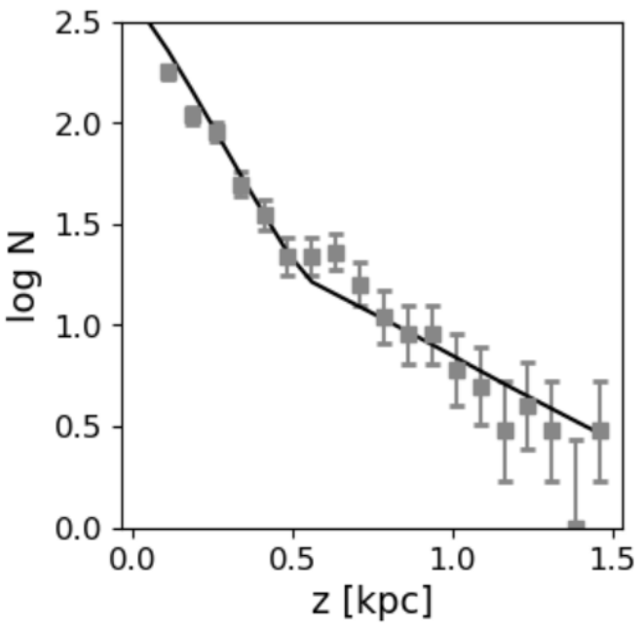
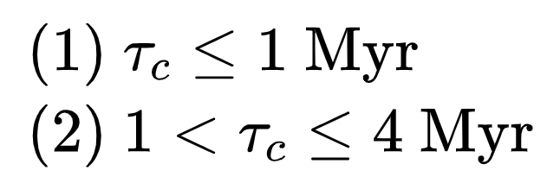
Evolution Model
kinematic
intrinsic
Birth Properties
Some are assumed
Some are treated as free parameter
Synthetic Samples
a Joint Fit to Two Pulsar Age Samples
< 0.5 Myr
5~30 Myr
Calculate
Selection Effects
&
Detectability
Constrain (MCMC method)
describes a self-consistent evolutionary path across time
Comparable Samples
Is this an effect of kick velocity? .
0.5~30 Myr
‘Dual-age’Sample Set

Slide 10
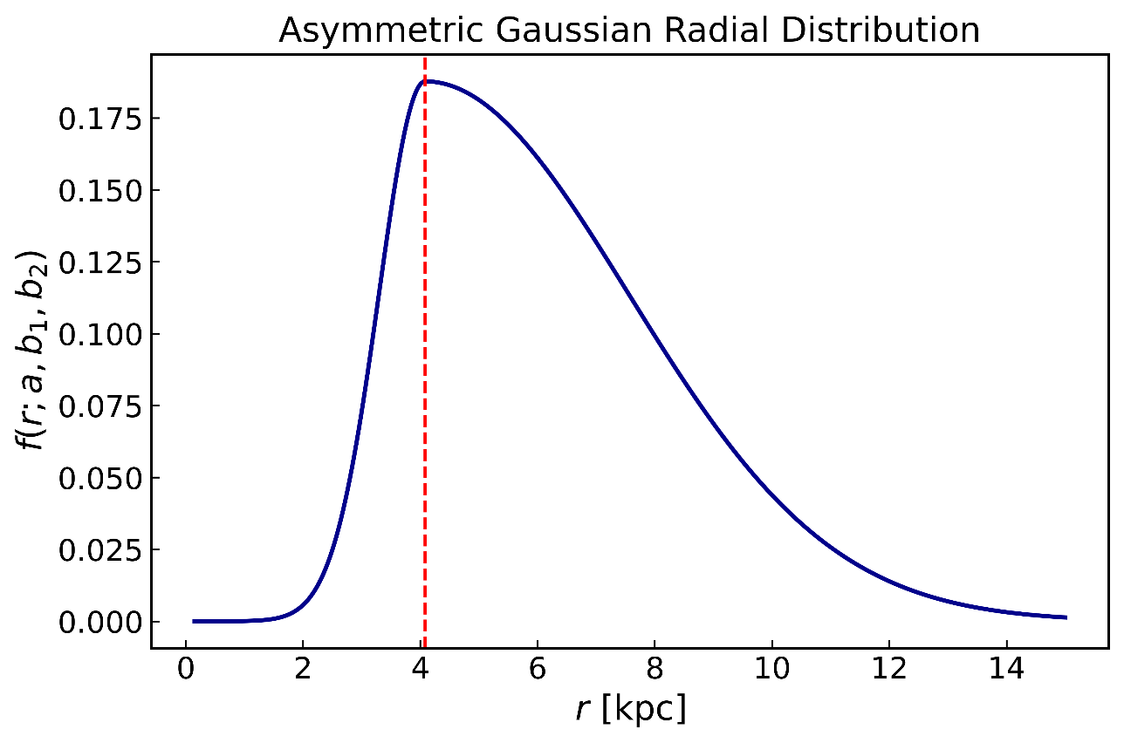
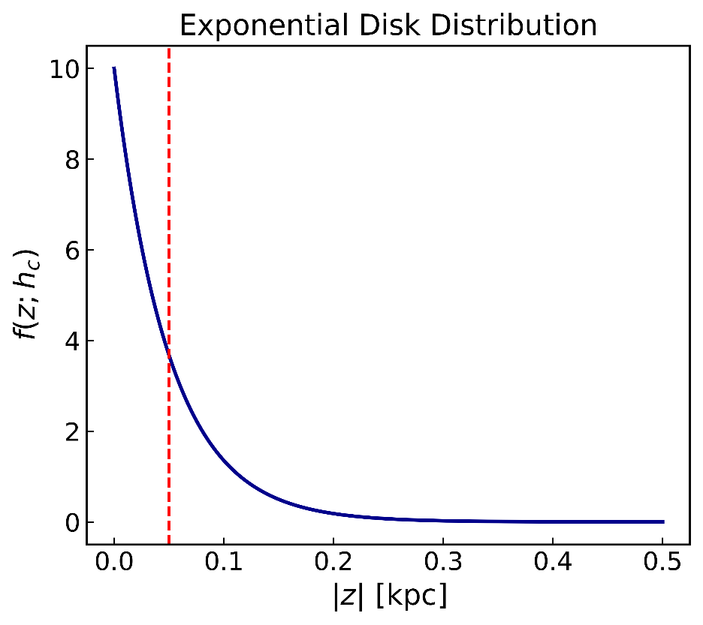
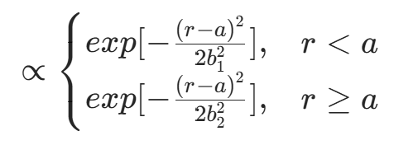

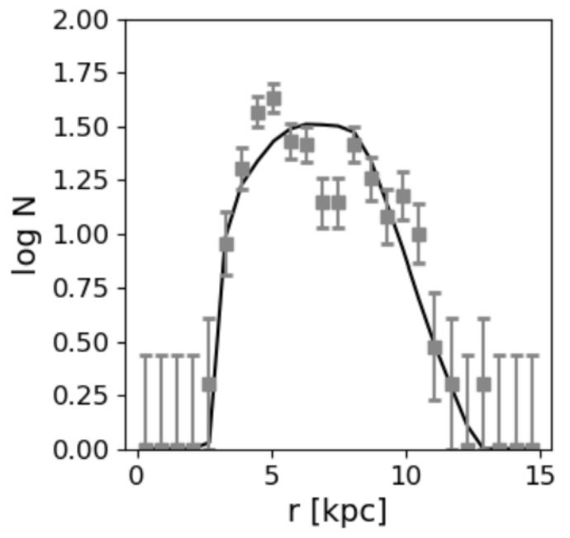
Birth & Evolution
f(z)
f(r)
a, b1, b2 are free parameter
hc is chosen to be consistent with massive star distribution
b2 = 3.5
L. Bronfman et al. (2000)
Sun & Han (2004)
b1 = 0.8
a = 4.08
hc = 0.05 kpc
< 0.5 Myr
< 0.5 Myr

Slide 11
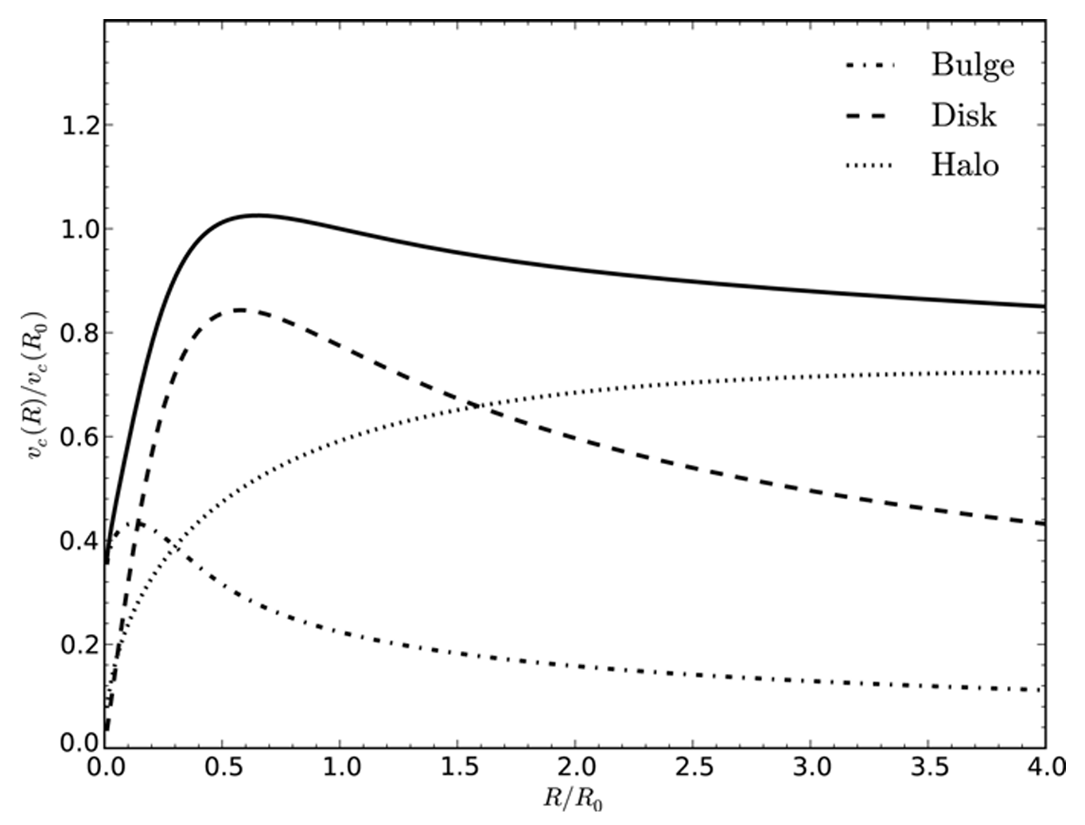
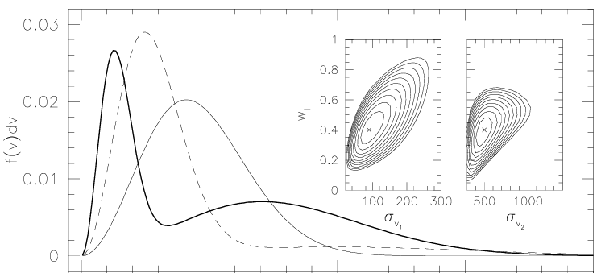
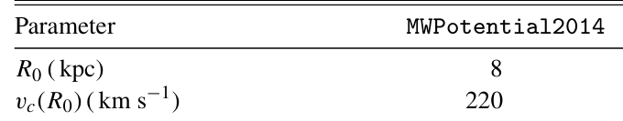

Birth & Evolution
Kick Velocity
MW potential & orbit integration
$$w, σ1, σ2$$
are free parameters
J. Bovy (2015)
Z. Arzoumanian et al. (2002)

Slide 12
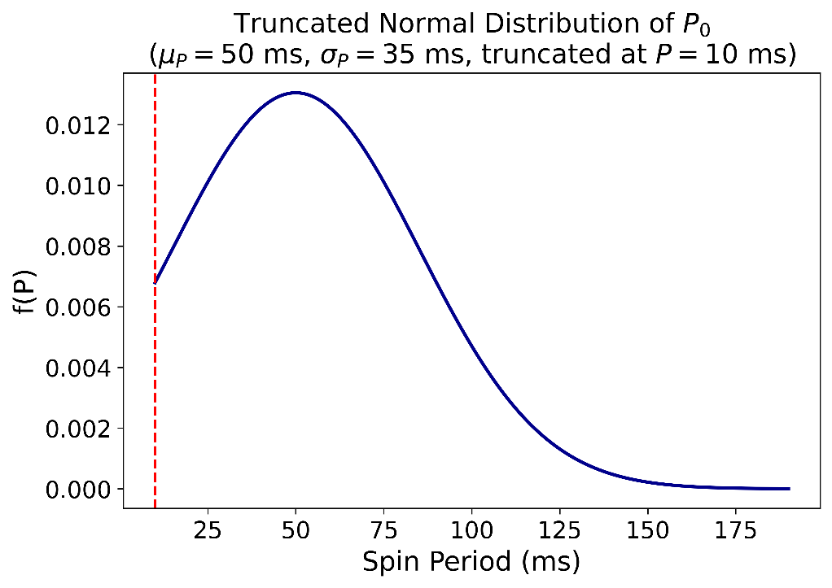
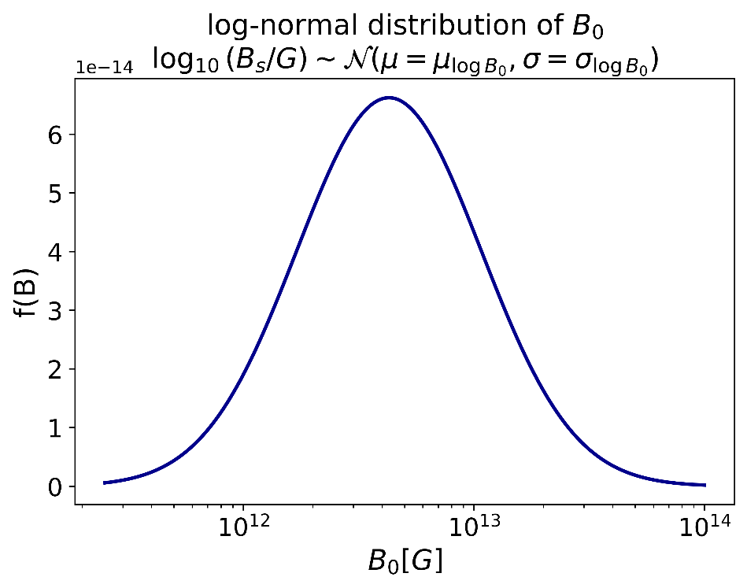
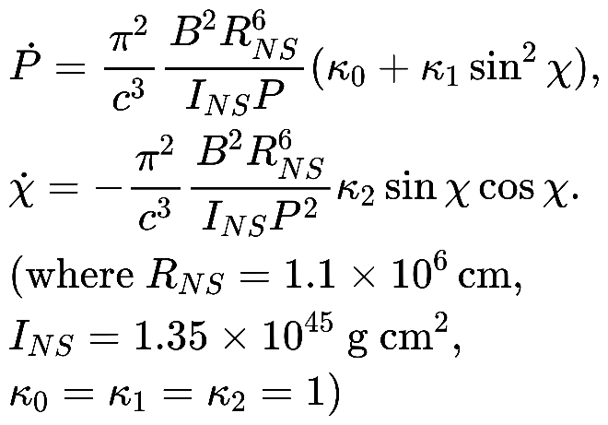

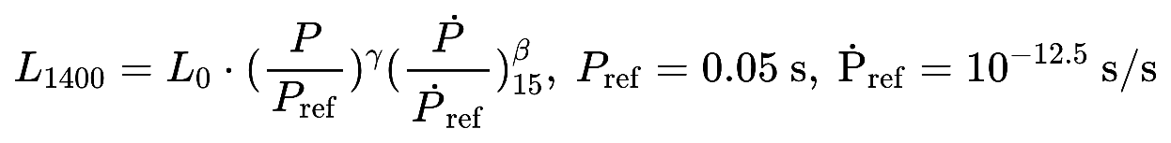




Birth & Evolution
Watters & Romani (2011)
$μ$_{logB0},
$σ$_{logB0}
are free parameters
pseudo-luminosity function definition:
( in the following discussion, we refer pseudo-luminosity as radio luminosity )
L0, $γ, β$are free parameter
A. Philippov (2014); M. Gullon (2014); M. Bagchi (2018)

Slide 13
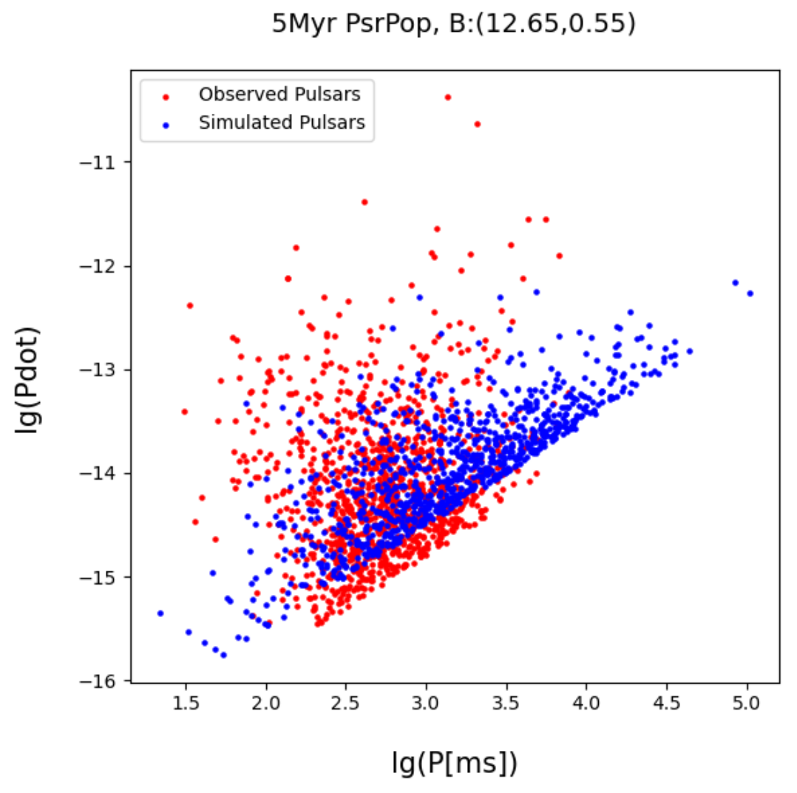
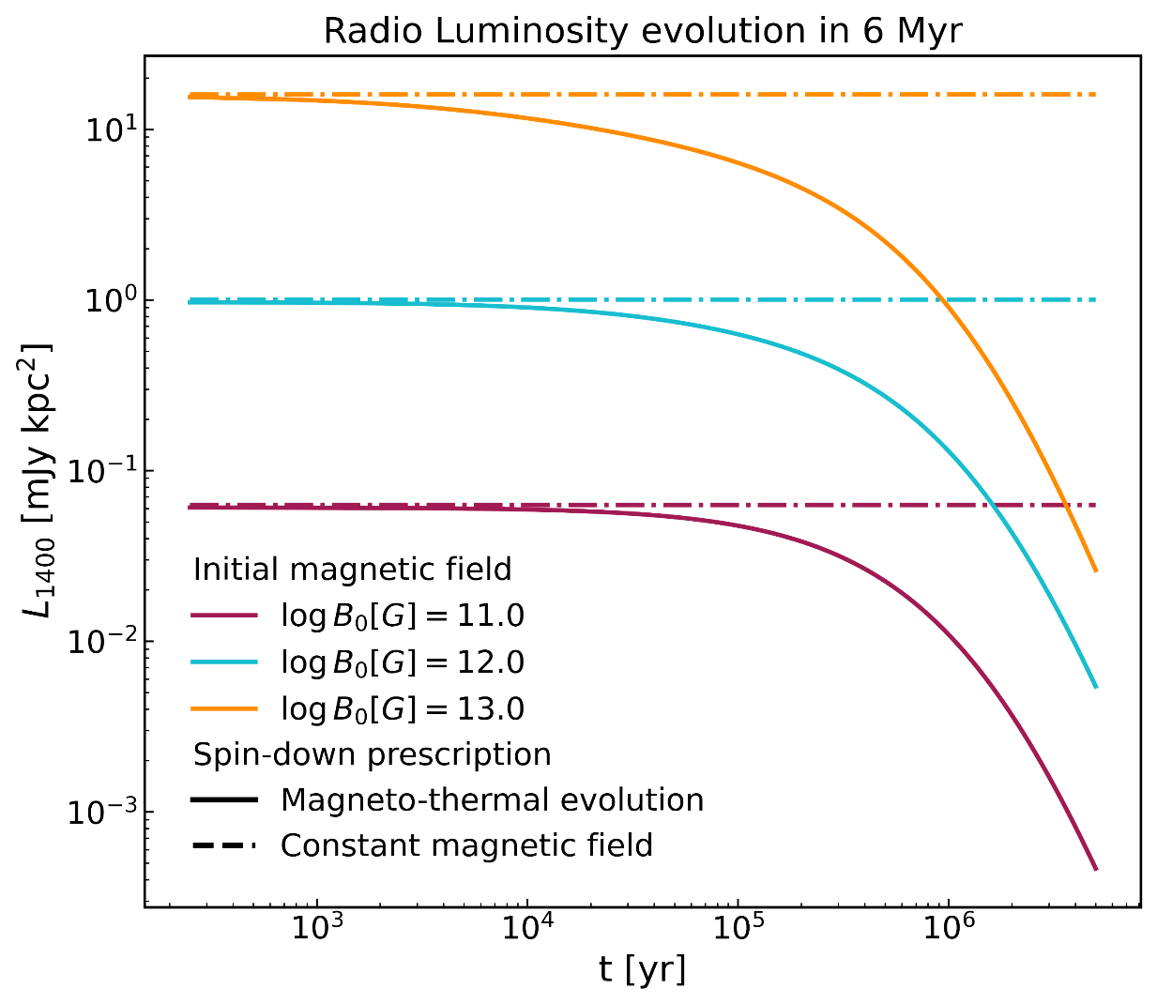
Magneto-Thermal Evolution is NECESSARY !
S. D. Bates & D. R. Lorimer et al. (2014)
D. Vigano (2023, 2024);V. Graber et al. (2024)
static magnetic field model disagrees with observed radio death line

Slide 14
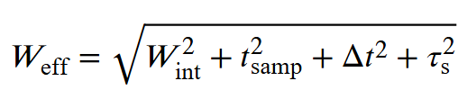
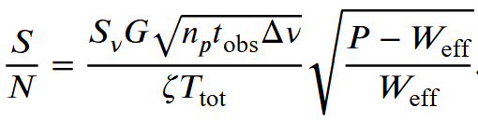
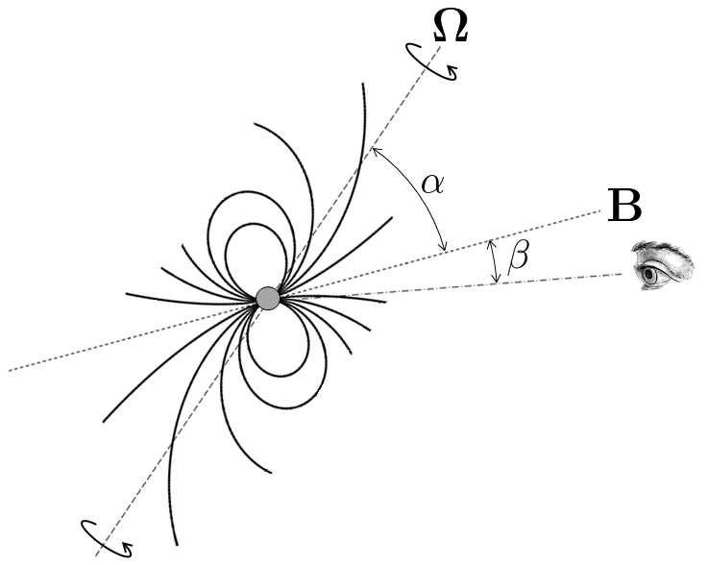

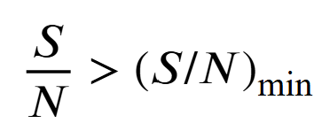
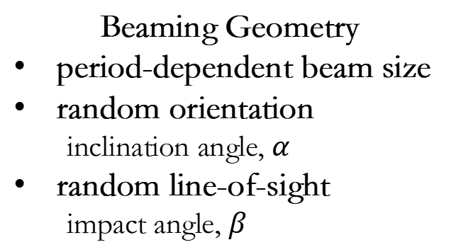
Selection Function
Assign pulsar properties
flat prior sampling
(r, z, P, Pdot)
DM model
compute propagation effects
Our main result uses YMW16 electron density model. J. Yao et al. (2017)
Coordinate Transformation
(x,y,z) → (l,b,d) → (RA, DEC)
Survey sensitivity calculation
compute S/N for each survey
Beaming Geometry
period-dependent beam size
random orientation
inclination angle, $α$
random line-of-sight
impact angle, $β$
Detected / Undetected
From Crispin Agar’s blog

Slide 15
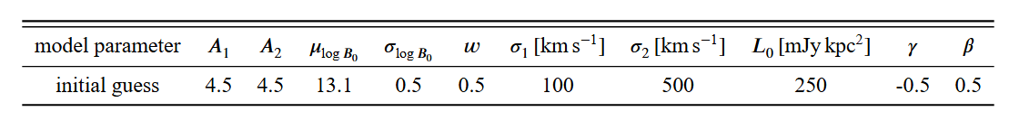


Bayesian Inference and MCMC Method
birth rate
Population Synthesis (Θ)
&
Selection Effects
→ Synthetic Observable Population
phase-space
binning
Poisson
Likelihood
Predicted Counts
n^{sim}(Θ)
Posterior Distribution
P(Θ|Data)

Slide 16
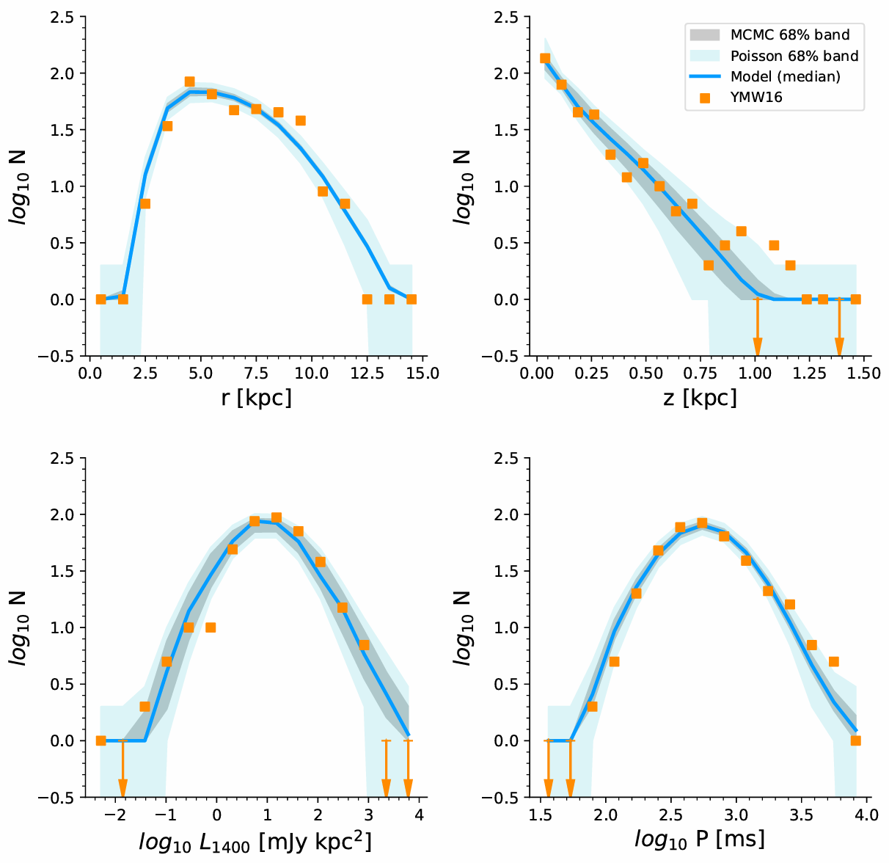
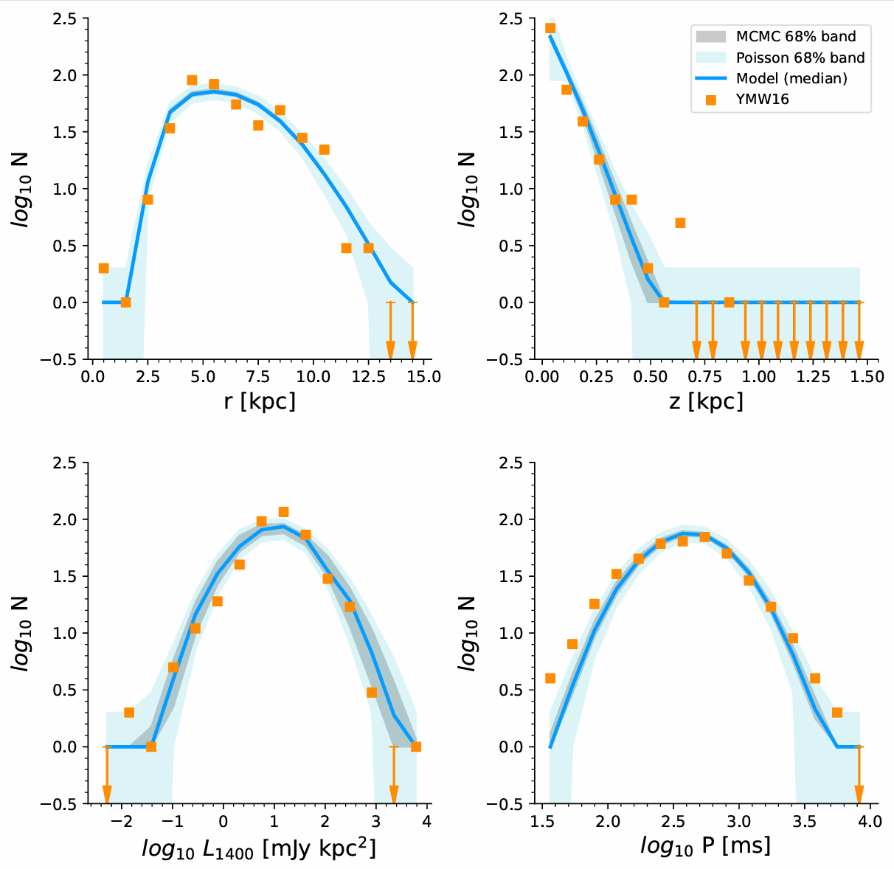
Model Outcome
< 1 Myr
1-4 Myr

Slide 17
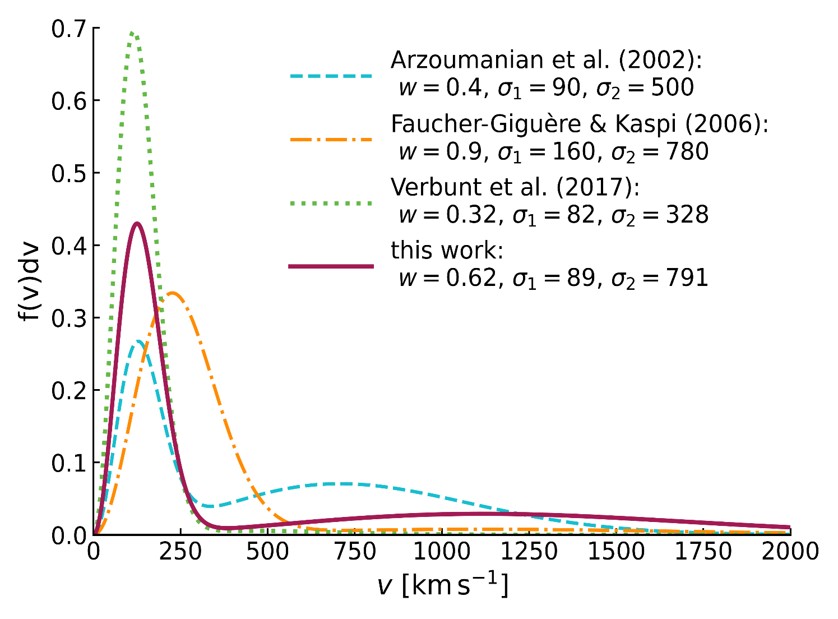
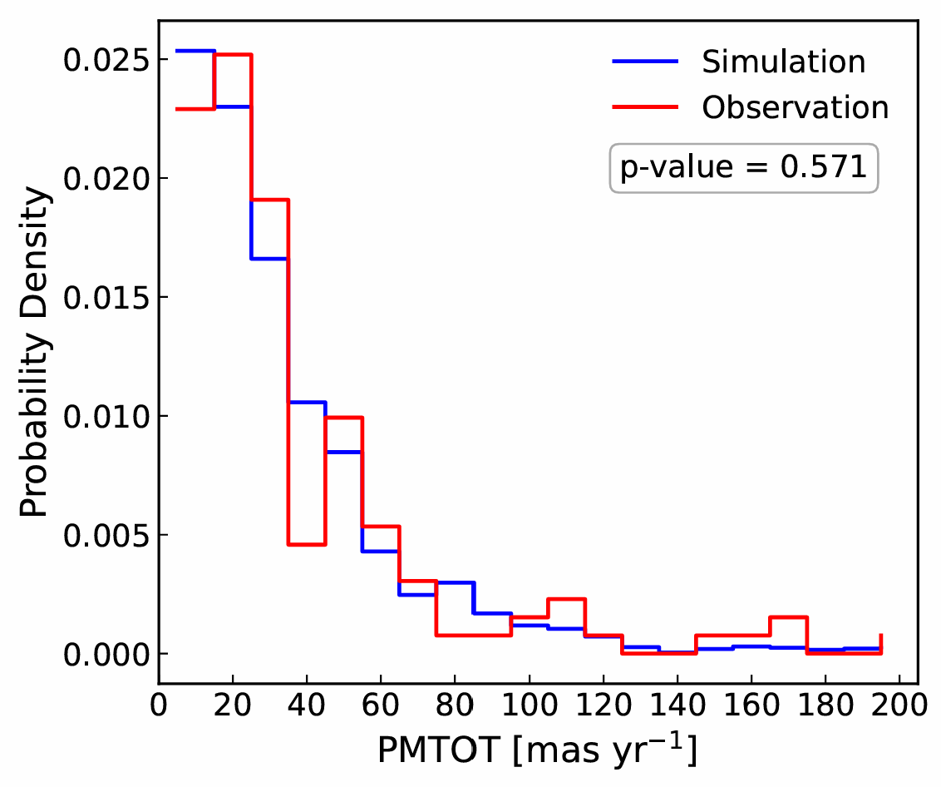
Main Result on Kick Velocity
?
Supports Multiple Supernovae Chanels!

Slide 18
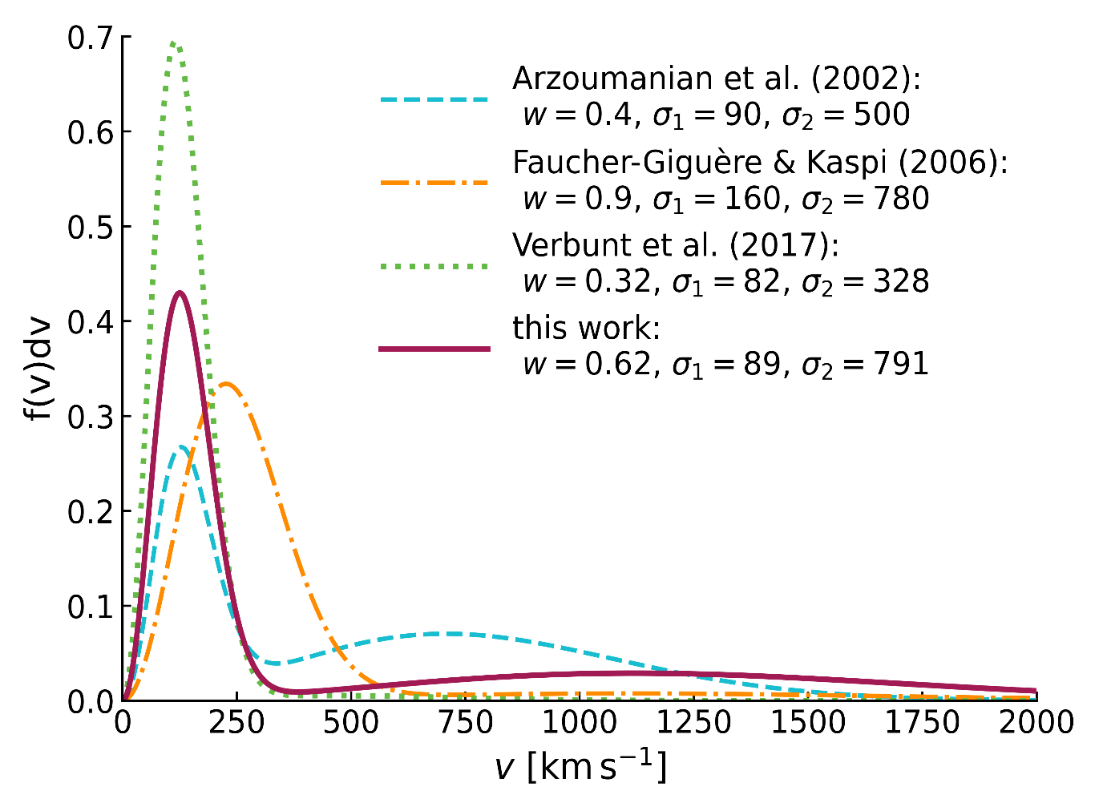
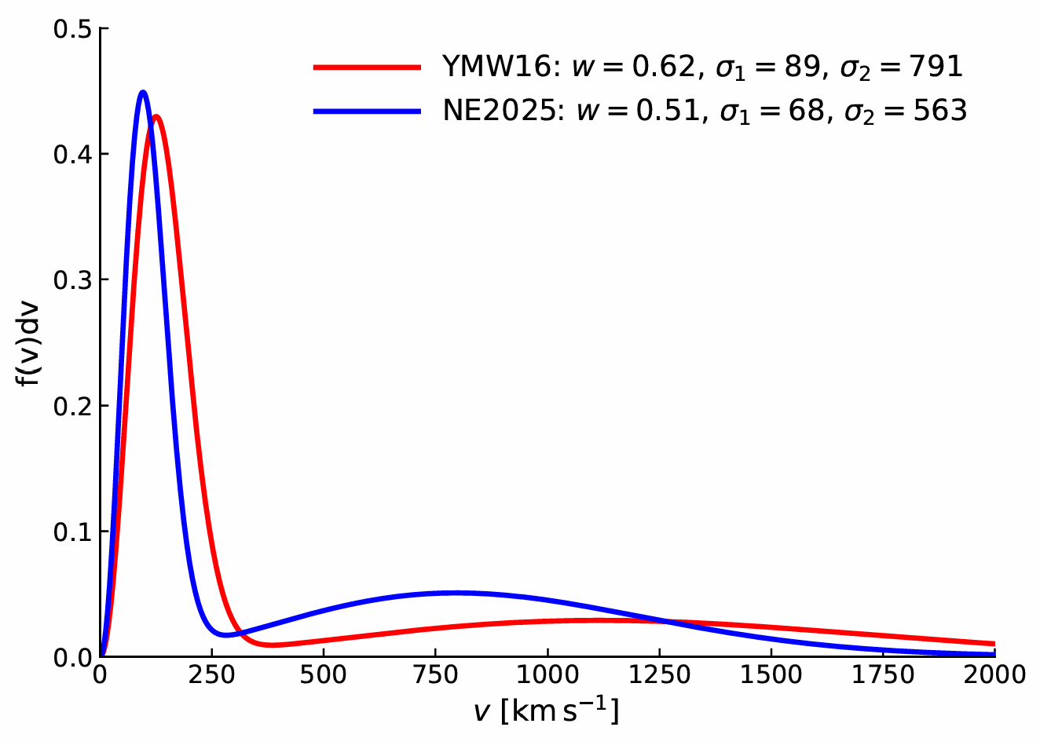
Main Result on Kick Velocity

Slide 19
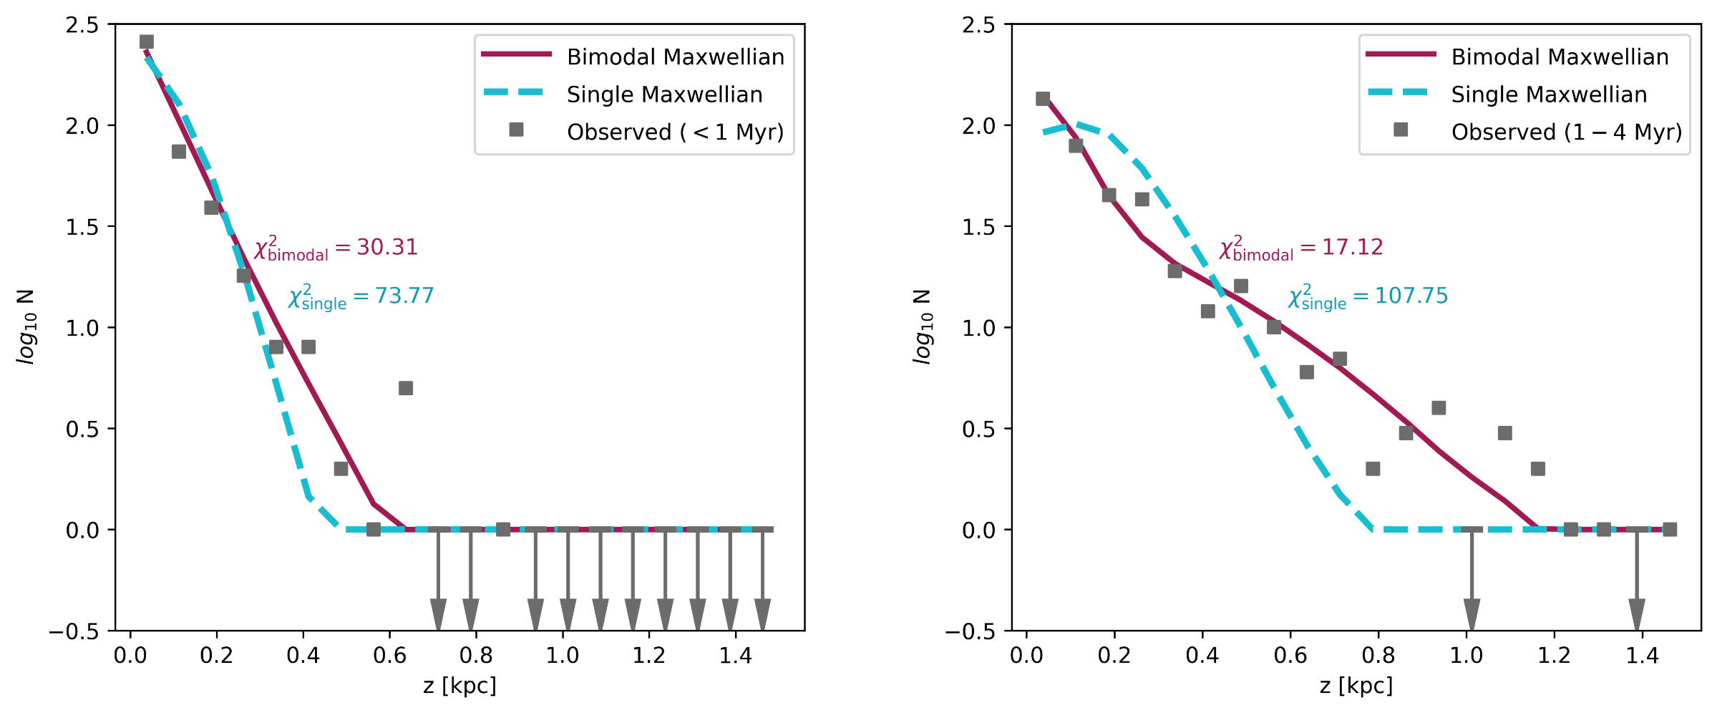
Single Maxwellian is NOT SUFFICIENT to describe observed pulsar population
< 1 Myr
1-4 Myr

Slide 20
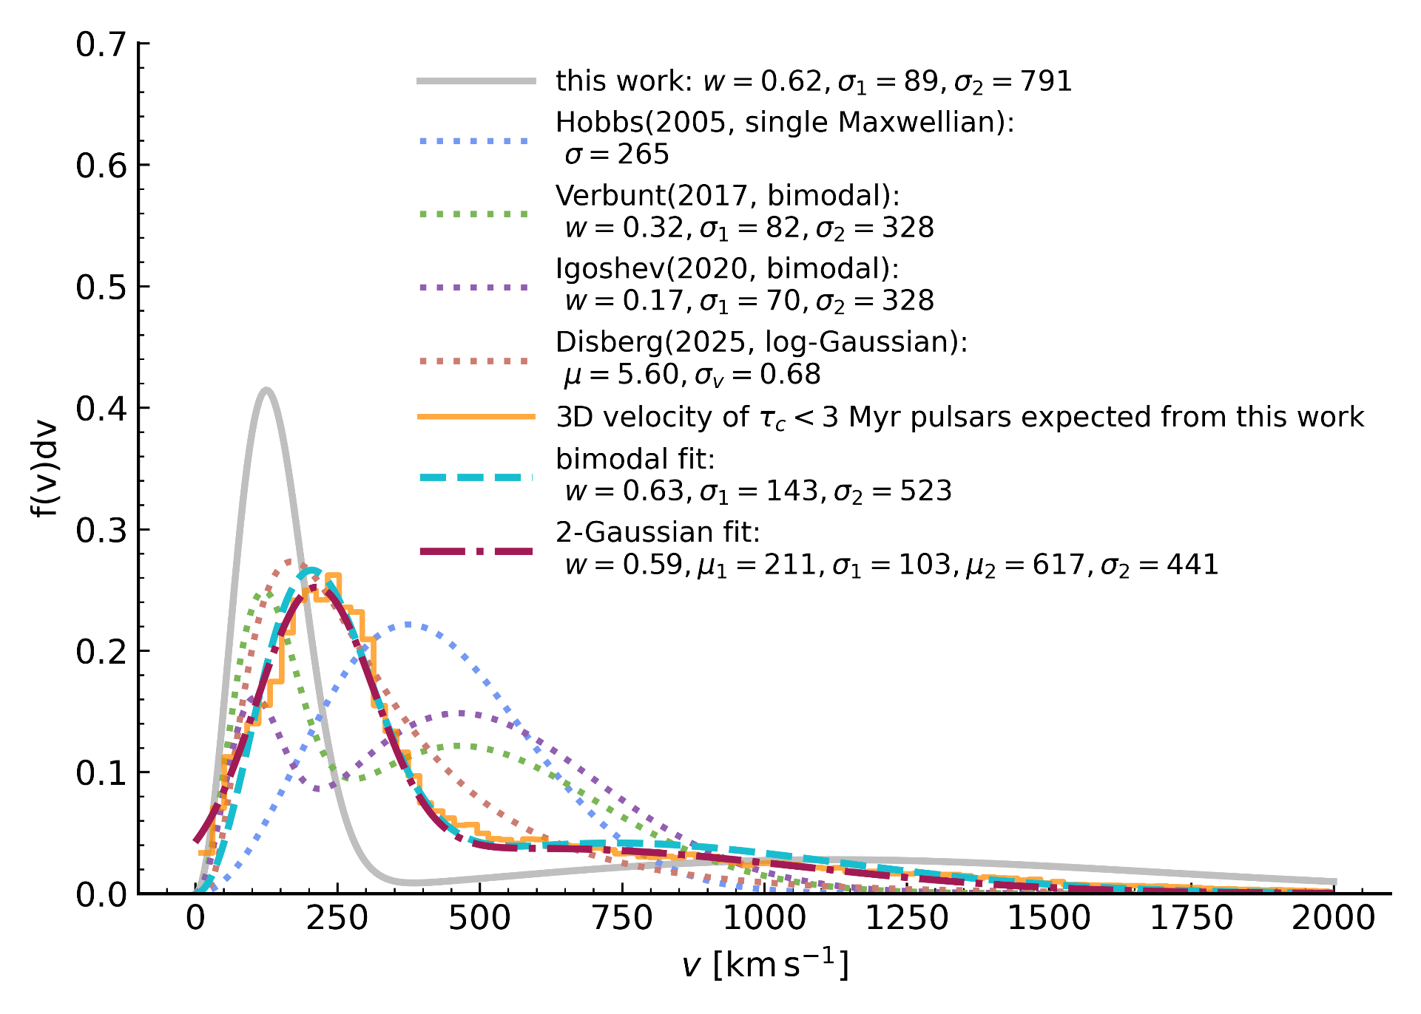
Velocity Alteration
by Galactic Potential

Slide 21
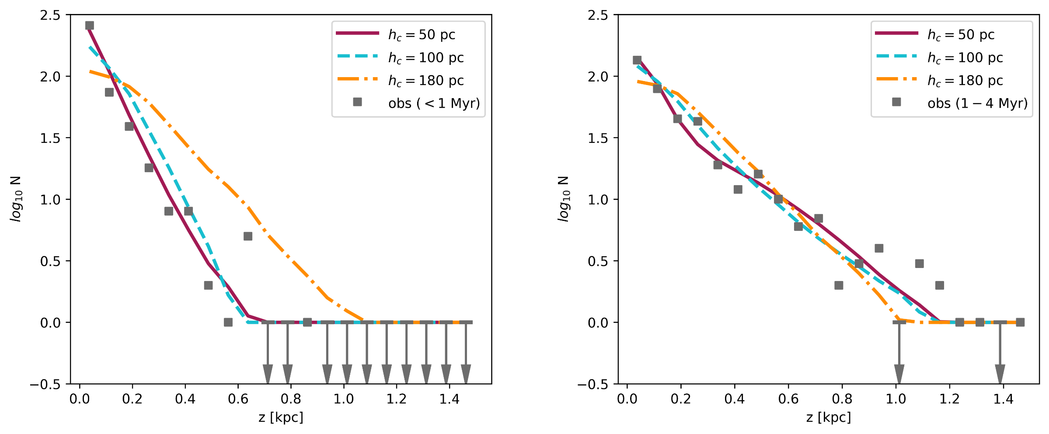
The Choice of Birth Scale Height
< 1 Myr
1-4 Myr

Slide 22
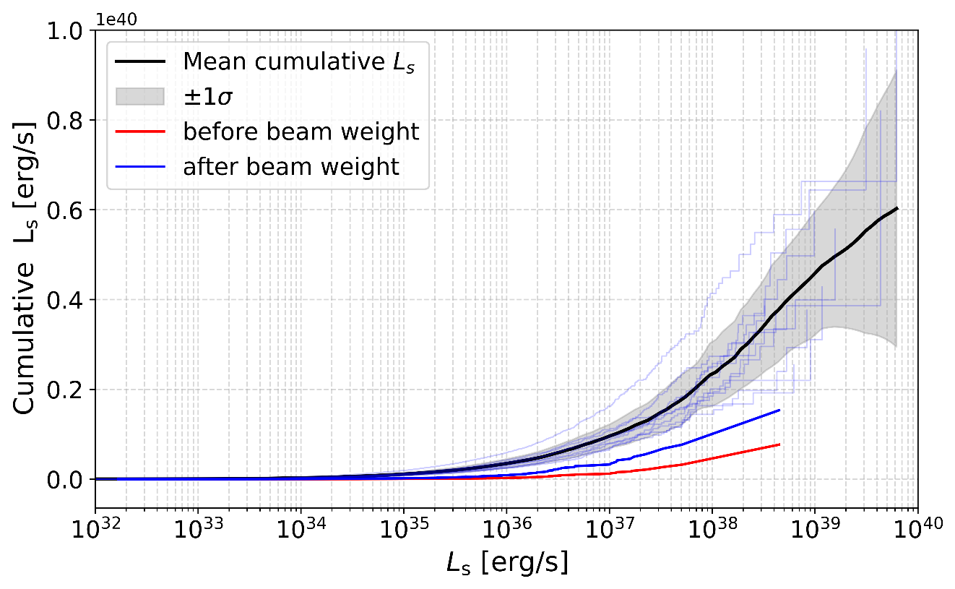
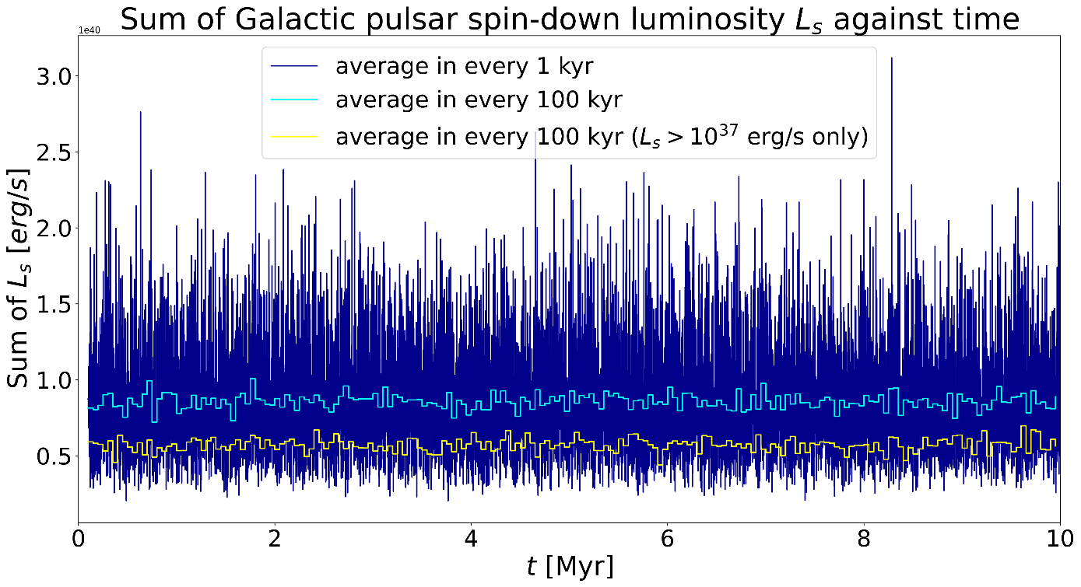
Implication for Galactic Diffuse Gamma-ray Emission
NS birth rate: ~0.75 per century

Slide 23
Thank you for your time!
Summary
natal kick velocity distribution is strongly bimodal
Magnetic field evolution regulates the observable lifetime of pulsar, thus crucial for obtaining synthetic samples which are consistent with the observed population of pulsars.
Galactic dynamics can produce statistically significant changes in velocity-related observables on timescales as short as a few million years.
Future improvements
We need to build a larger pulsar database with precise parallaxes and proper motions.
Jointly model the binary evolution and supernova processes.

Slide 24
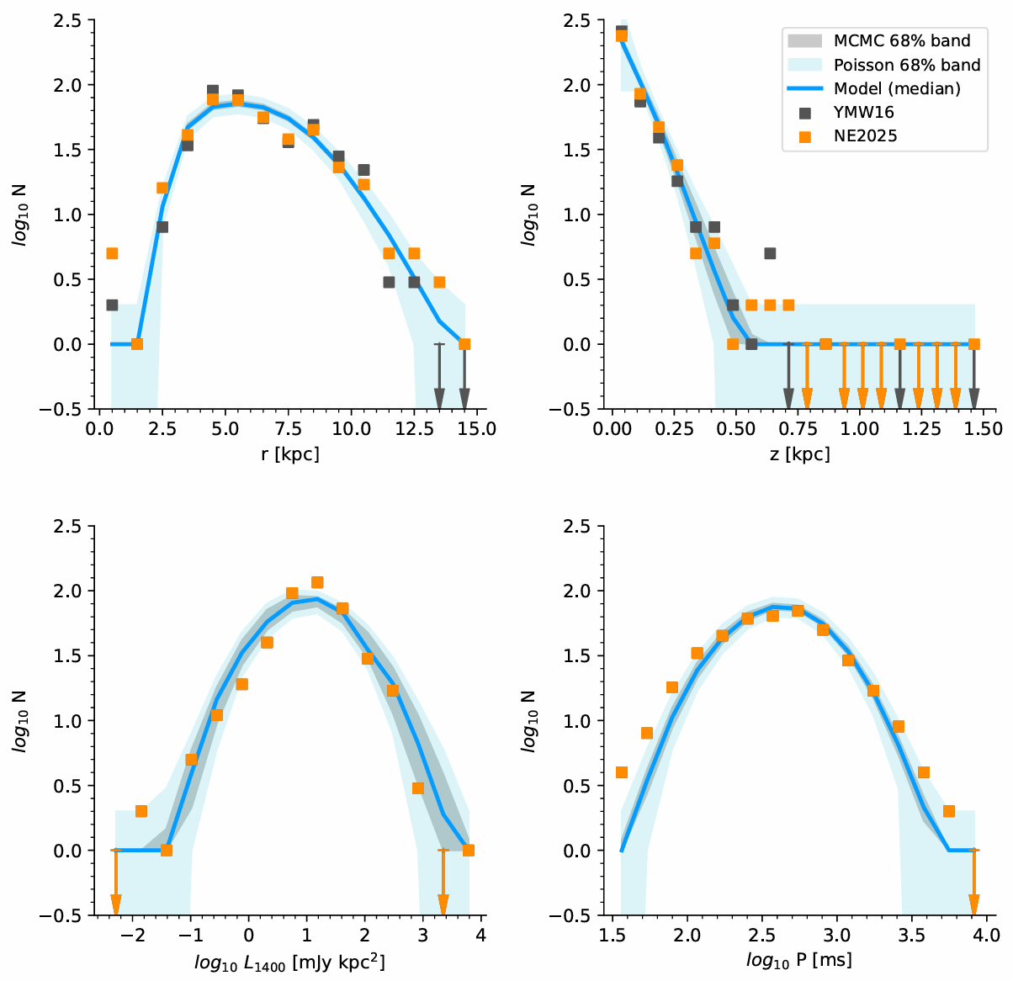
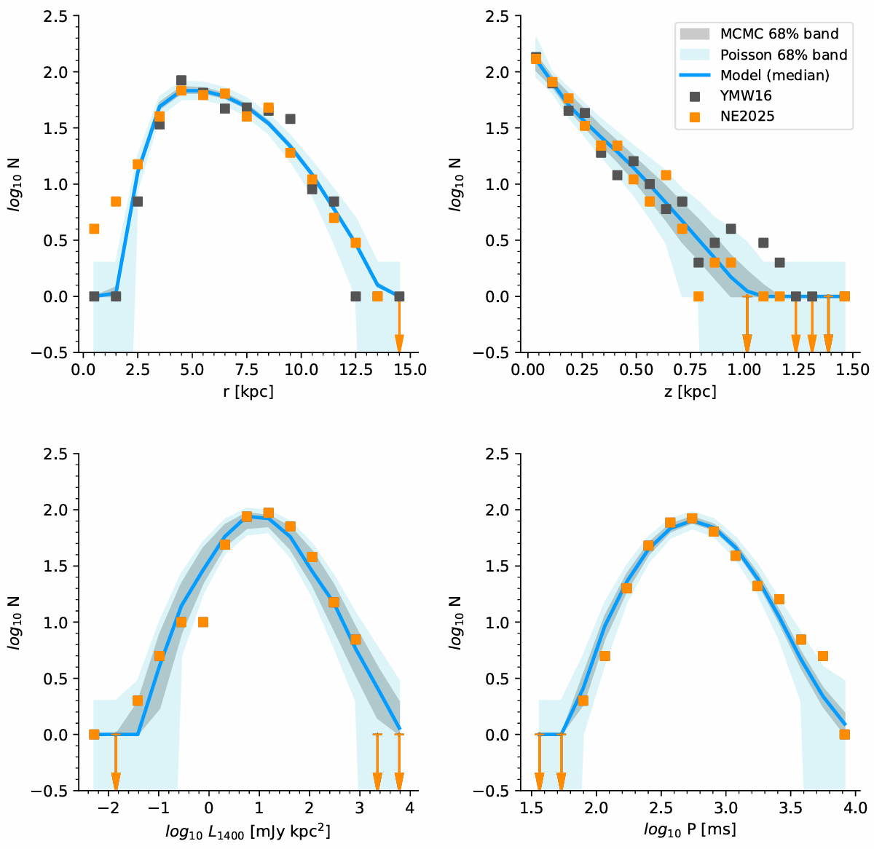
NE2025
< 1 Myr
1-4 Myr

Slide 25



Slide 26

What is Magneto-Thermal Evolution of NSs?
S. Ascenzi, D. Vigano et al. (2024)

Slide 27



定义比较量
S. Johnston (2017)

Slide 28

‘Dual-age’Sample Set
546
473

