Slide 1


PSR J1914+2636：Quasiperiodic Nulling and Bright-Pulse Emission from an Old Pulsar in the Death Valley
Speaker： 彭逸峰
Contrbutor: 党世军（Supervisor）、吴庆东、王维扬、王榆斌、
周祖荣、龚胤文、李威
Guizhou Normal University

Slide 2


CONTENT
1
Background
Observation and Data Processing
2
Results
3
Couclusion
4
Guizhou Normal University

Slide 3

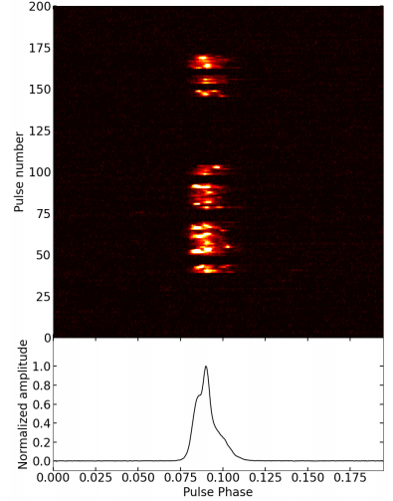
Background
What is pulse nulling？
Pulse nulling refers to the temporary cessation of a pulsar’s radio emission (Backer 1970).
Nulling Fraction(NF)：
The nulling fraction(NF) quantifies the proportion of time a pulsar spends in the null state, ranging from below 1% to over 95% among observed nulling pulsars (Konar & Deka 2019).
Quasiperiodicity：
The quasi-periodic switching behavior of pulsar radio emission between normal pulse states and null (emission-off) states.
PSR J1914+2636
Guizhou Normal University
Notes:
脉冲星的磁极会辐射出高度准直的电磁辐射束。
随着脉冲星的高速自转，这束辐射会像灯塔的光束一样扫过宇宙空间。当辐射束恰好扫过地球时，我们的射电望远镜就能接收到周期性的脉冲信号。

Slide 4
Background
：
Bright pulse
Question
Bright pulses are typically defined as individual pulses with peak flux densities exceeding roughly ten times the average pulse (Tuoheti et al. 2011).
What statistical distribution describes the peak flux density distribution of bright pulses?
Differences and connections with giant pulses:
Classical GPs have peak flux densities exceeding ∼30 times the mean and are extremely narrow, lasting from nanoseconds to microseconds (Staelin & Reifenstein III 1968; Tuoheti et al. 2011).
While bright pulses are generally broader and less extreme than classical GPs, they share the underlying characteristic of sporadic, high-intensity emission, representing a continuum between ordinary pulses and canonical GPs.
What distribution governs the waiting time between adjacent bright pulses?
Guizhou Normal University
Notes:
脉冲星的信号在到达地球的漫长旅途中，会穿过充满“湍流”的星际介质。这种介质会像透镜一样散射和衍射电磁波，导致我们接收到的信号强度发生快速变化，这就是星际闪烁。它就像宇宙中的涟漪，记录了信号沿途所经历的一切。
根据尺度不同，我们可以将其分为衍射闪烁和折射闪烁。衍射闪烁由小尺度的电子密度不规则引起，变化非常剧烈；而折射闪烁则由大尺度的不规则引起，变化相对平缓。

Slide 5
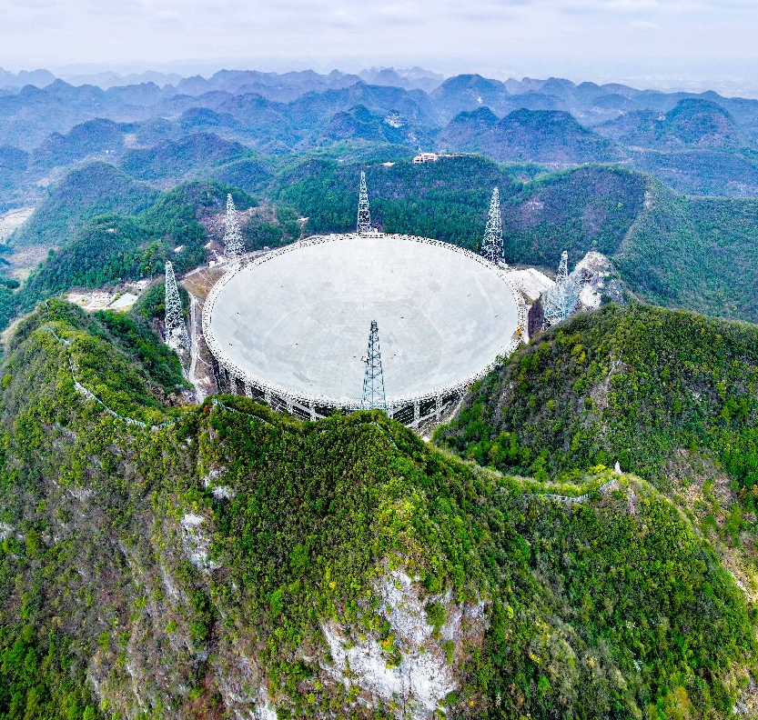
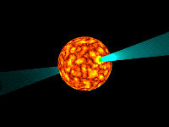
Observation and Data Processing
Observation Facilities ： Five-hundred-meter Aperture Spherical radio Telescope
Observation Epoch: MJD 60412
Total observing duration : 0.75 hr
Receiver: FAST 19-beam receiver
Observation frequency: 1.05 to 1.45 GHz
Time resolution: 49.512μs
Frequency channel: 4096
PSR J1914+2636 was discovered in the Commensal Radio Astronomy FAST Survey (Wu et al. 2023).
图片来源：中国科学院国家天文台
Guizhou Normal University
Notes:
我们研究的核心设备是被誉为“中国天眼”的FAST望远镜。作为世界最大单口径射电望远镜，FAST拥有无与伦比的超高灵敏度和高分辨率，这为我们开展高信噪比的闪烁研究提供了可能。本次观测我们使用了L波段接收器，在1.0到1.5GHz的频率范围内进行了高分辨率的数据采集。

Slide 6
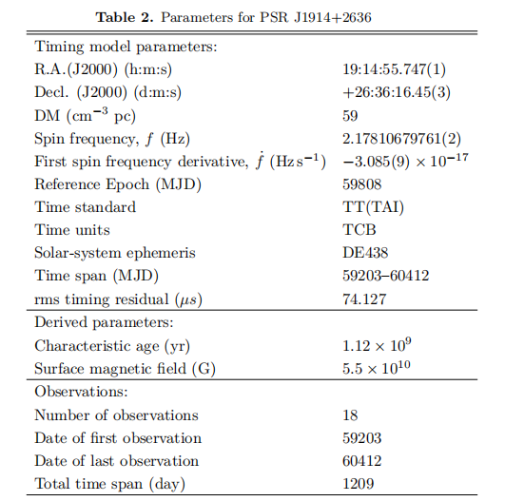
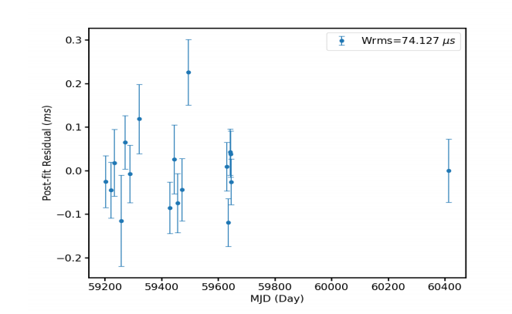
Observation and Data Processing
01
Flod Data with DSPSR
New timming solution
Remove RFI with PSRCHIVE
Calibrate polarization via PAC
Perform baseline correction
PAC
Parameters for PSR J1914+2636
Guizhou Normal University
Notes:
从原始数据到科学发现，我们经历了一个严谨的数据处理流程。这包括数据获取、初步处理、干扰去除、动态谱生成、参数提取等步骤。
其中最关键的一步是应用NuT变换，它能有效“锐化”二次谱中的闪烁弧，便于我们进行精确的曲率测量。
最后，通过高斯拟合，我们得到了每条闪烁弧的曲率值，这为后续的物理分析提供了坚实的数据基础。

Slide 7
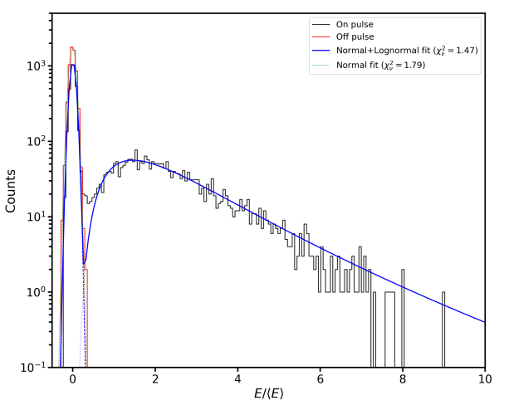
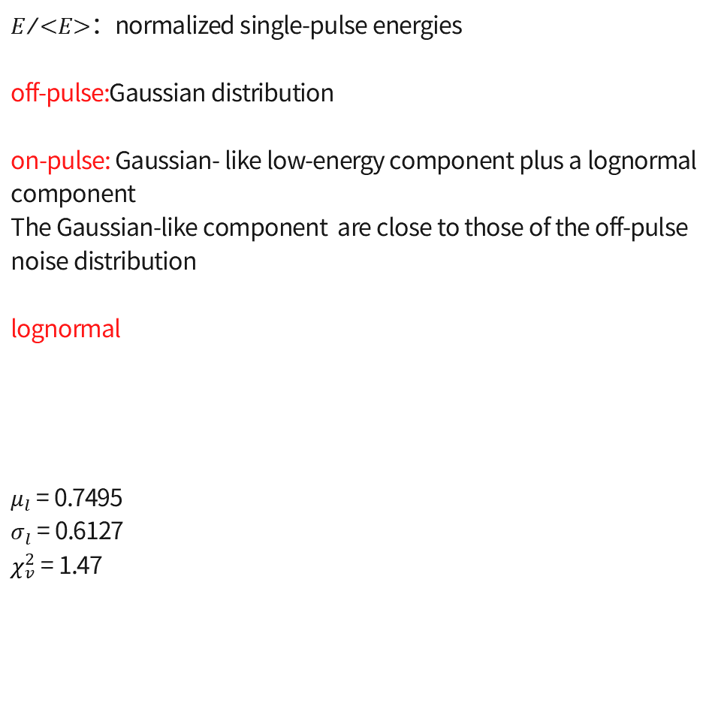
Results：
（1）Pulse energy distribution
$E/{<E>}$：normalized single-pulse energies
off-pulse:Gaussian distribution
on-pulse: Gaussian- like low-energy component plus a lognormal component
The Gaussian-like component are close to those of the off-pulse noise distribution
lognormal
$μ_{l}$ = 0.7495
$σ_{l}$ = 0.6127
$χ_{v}^{2}$ = 1.47
burst-state emission
The high-energy tail corresponds to sporadic bright pulses.
Guizhou Normal University

Slide 8
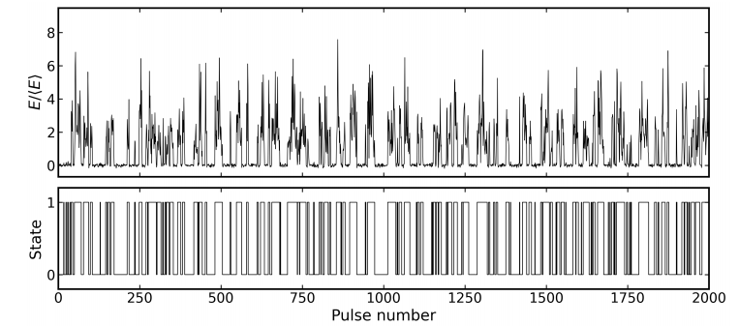
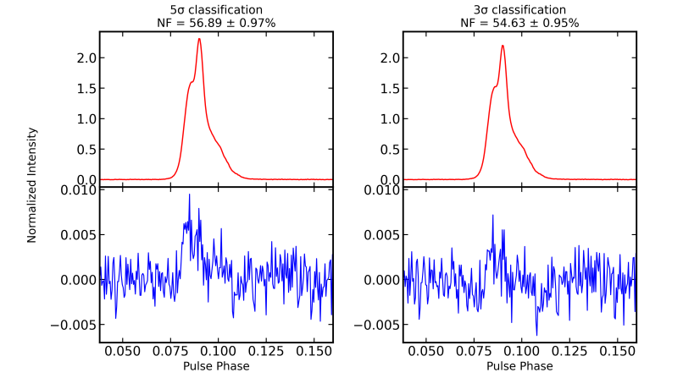


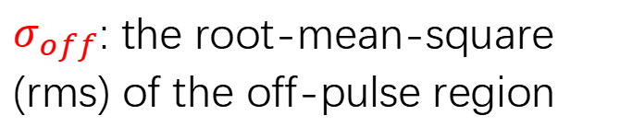


Results：
（2）weak residual emission
null = 0
burst = 1
$$σ_{ep}=\sqrt{n_{on}}σ_{off}$$
Bhattacharyya et al. (2010)
$n_{on}$: the number of bins in the on-pulse window
$σ_{off}$: the root-mean-square (rms) of the off-pulse region
NF = ${n_{p}}/n$
uncertainty$={\sqrt{n_{p}}}/n$
Wang et al. (2007)
• Both the 3σₑₚ and 5σₑₚ classifications reveal residual emission in null-state integrated profiles.
• This indicates that apparent nulls are more likely low-emission states rather than complete radio quenching.
• Such results disfavor the interpretation of full emission cessation, and the measured nulling fraction only represents an upper limit.
3σₑₚNF = 54.63 ± 0.95%.
Guizhou Normal University
Notes:
J0837+0610呈现一条轮廓清晰的主闪烁弧。J1136+1551：清晰呈现三条独立闪烁弧，有力证实了视线方向上多屏散射结构的存在。

Slide 9
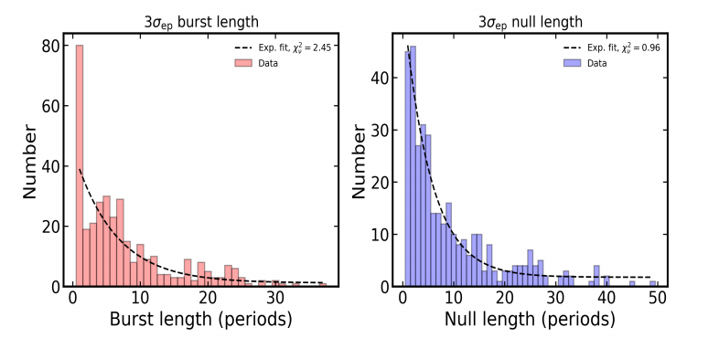
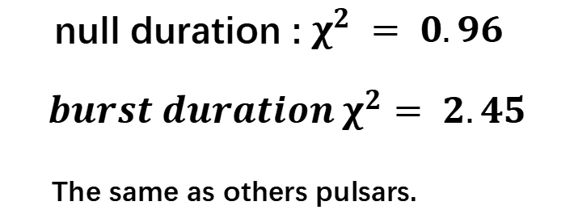
Results：
（3）the distributions of null and burst durations
exponential models
null duration : $χ^{2} = 0.96$
$$burst duration χ^{2}= 2.45$$
_{The same as others pulsars.}
Guizhou Normal University

Slide 10
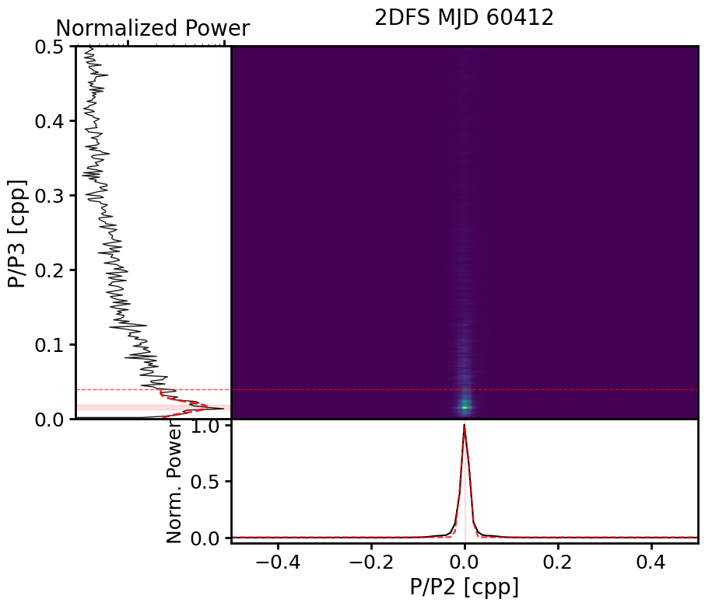
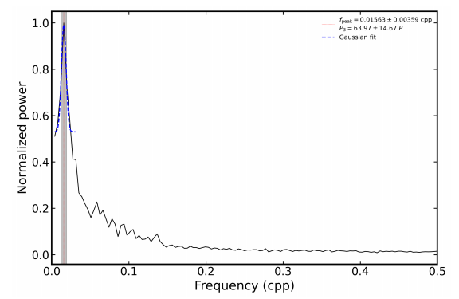
Results：
（4）Quasiperiodic nulling
Fourier transform on the 0-1 sequence
we identify a quasi-periodicity of approximately 63.57 ± 14.67P₀
vertical axis : P₀/P₃ = 63.29 ​± 10P₀​
horizontal axis : P₀/P₂
The Fourier analysis of the binary 0–1 state sequence and the 2DFS yield consistent modulation timescales.
Guizhou Normal University
Notes:
基于观测数据，我们首先计算了描述散射强度的闪烁带宽和闪烁时标。然后，利用测量到的闪烁弧曲率，我们计算出了各个散射屏到地球的距离。例如，J0837+0610的散射屏距离约为421秒差距，而J1136+1551的三个散射屏距离则分布在39到196秒差距之间。这些距离为我们后续的分析提供了关键数据。

Slide 11


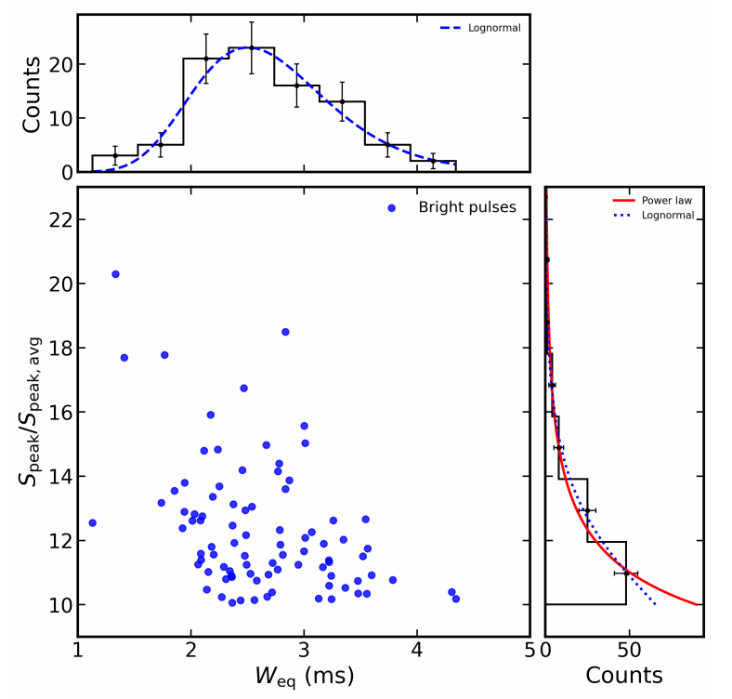
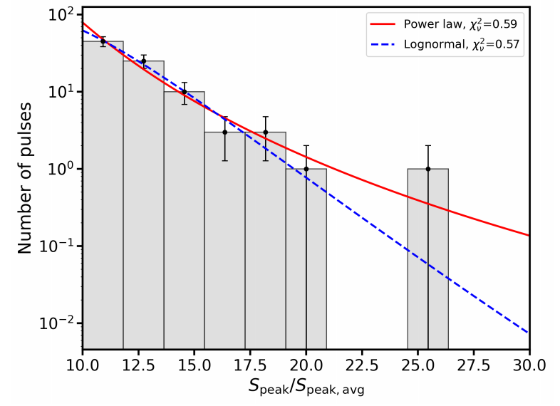
Results：
（5）Bright pulse
88 bright pulses
Tsys ≈ 20 K
G = 16 Jy/K
np = 2
tsamp = 49.512μs
∆f = 400 MHz
观测结果与Kolmogorov湍流谱理论相符，支持了散射过程的基本物理图像。
Power-law mode： Log-normal model：
χ2 ≈ 0.93 χ2 ≈ 0.90
AIC ≈ 8.65 AIC ≈ 9.62
BIC ≈ 8.54 BIC ≈ 9.46
Weq：the ratio between the pulse energy and the peak intensity（1,13-4,34ms）
χ2 ≈ 0.98 （Log-normal model）
A stronger peak corresponds to an overall narrower equivalent width.
Guizhou Normal University
Notes:
为了检验我们的观测结果是否符合理论预期，我们研究了闪烁弧曲率随频率的变化。理论预测曲率应与频率的平方成反比。
从右侧的图中可以看到，我们选取了几颗典型的脉冲星进行分析。所有的观测数据点都紧密地围绕在理论预测的 η 与 ν 的负二次方关系曲线附近。
例如，J0837+0610 的指数约为 -2.0，J1239+2453 约为 -1.9，都在误差允许的范围内完美契合理论模型。这一结果不仅验证了我们的观测数据的准确性，更有力地支持了我们在研究中所采用的 Kolmogorov 湍流散射物理图像。

Slide 12
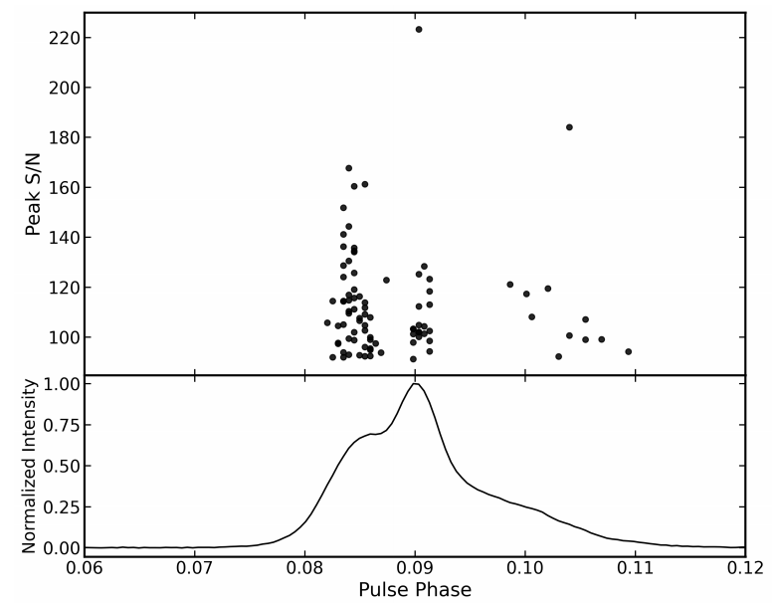
Results：
（6）The phase distribution of the 88 bright pulses
the leading component contains the largest number of bright pulses,
the trailing component contains the fewest number of bright pulses,
Unlike giant pulses, which are concentrated solely on the leading or trailing component.
Guizhou Normal University

Slide 13
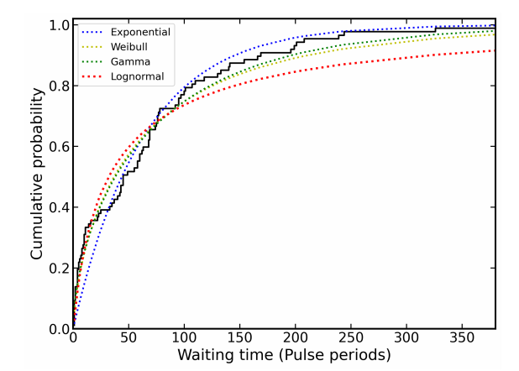
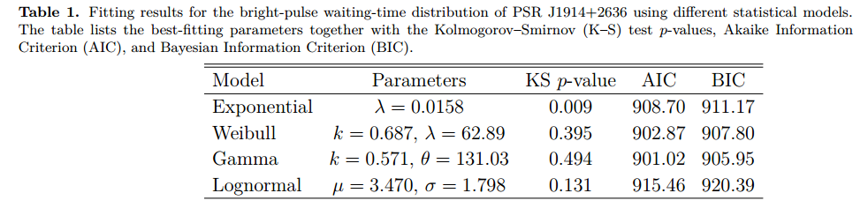
Results：
（7）The distribution of waiting time (∆t) between adjacent bright pulses
Exponential distribution provides the poorest fit
The gamma distribution yields the lowest (901.02) and BIC
(905.95), making it the most favored model
The log-normal fit is also acceptable with a K–S p-value of ~0.13, yet it yields larger AIC (915.46) and BIC (920.39).
图片来源：NASA
This indicates that the occurrence of bright pulses deviates from the Poisson process and exhibits clustering.
Guizhou Normal University

Slide 14
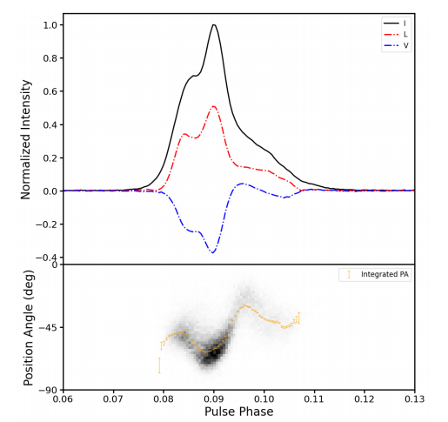
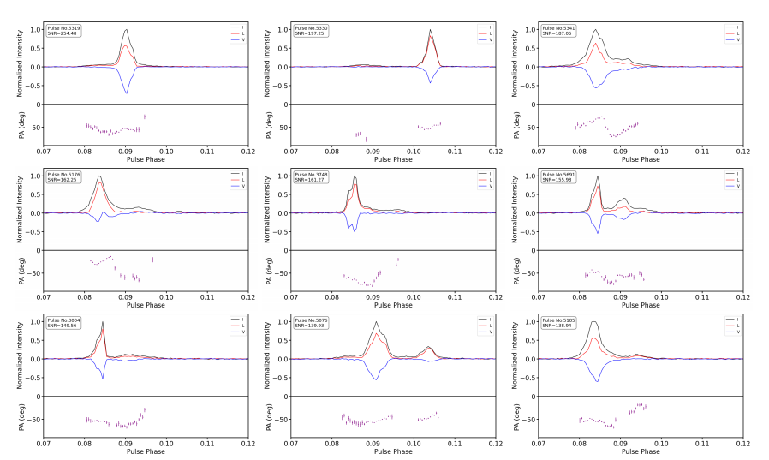
Results：
（8）Polarization Characteristics
⟨L ⟩/ ⟨I ⟩= 50.9%
⟨V ⟩/⟨I ⟩ and ⟨|V | ⟩/⟨I ⟩ are −37.5% and 37.5%
Guizhou Normal University

Slide 15
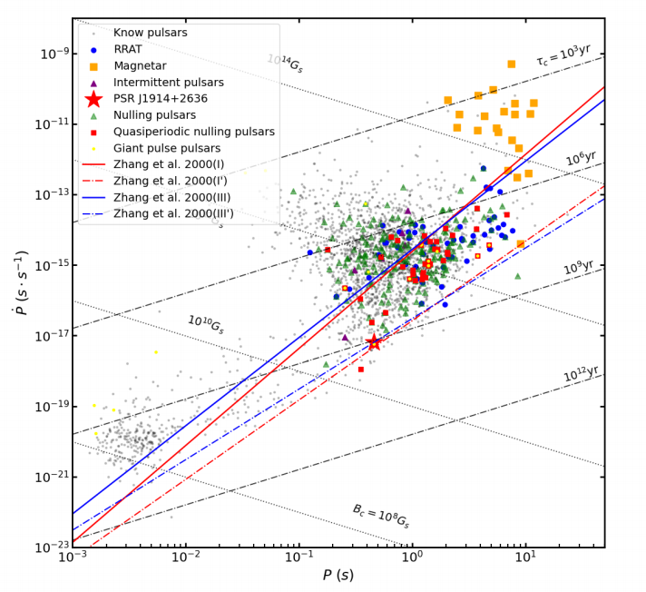
Results：
.
（9）Location of PSR J1914+2636 in the P − P Diagram
PSR J1914+2636 resides near the lower boundary of the death valley
pair production efficiency is low, which may trigger quasi-stable magnetospheric state transitions.
• Most known quasiperiodic nulling pulsars are located near or inside the pulsar death valley.
• PSR J1914+2636 exhibits quasiperiodic nulling, weak emission and clustered bright pulses simultaneously.
• This suggests that aged pulsars near the death valley can still produce intermittent rather than fully suppressed radio emission.
• The results provide observational constraints on the late-stage evolution of radio emission.
Guizhou Normal University

Slide 16
Summary and outlook：
Using FAST, we carried out observations of PSR J1914+2636 to study its quasiperiodic nulling and bright-pulse emission:
1.Nulling: Apparent nulls are better interpreted as low-emission states, at least for the present FAST observation. The quasiperiodic nulling (~63.57P₀) cannot be explained by the subpulse drift carousel model, and instead arises from quasi-stable magnetospheric state switching.
2. Bright pulses: They are not canonical giant pulses, but exhibit a high-intensity tail (power-law/log-normal) and clustered arrival pattern, sharing the same underlying mechanism of sporadic magnetospheric energy release.
3.P–Ṗ diagram: PSR J1914+2636 lies near the lower edge of the pulsar death valley. It is currently the oldest known pulsar with both quasiperiodic nulling and bright pulses, implying this phenomenology is associated with late-stage pulsar evolution near the death line.
Guizhou Normal University

Slide 17

THANKS!
email: pyf@gznu.edu.cn
phone：15350029009

