Slide 1

The FAST Stack Search: Discovery of Seven Faint Isolated Millisecond Pulsars in Globular Clusters
Speaker: Yinfeng Dai (BNU)
Advisor: Xingjiang Zhu (BNU)
Guiyang
2026.7.3

Slide 2
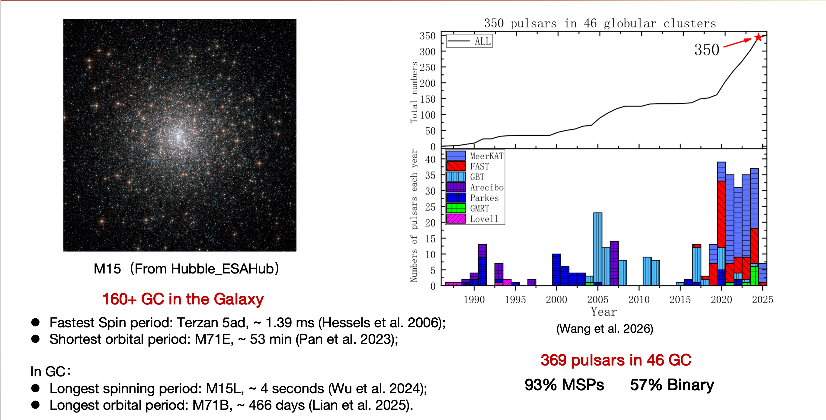
Globular Clusters Pulsar

Slide 3
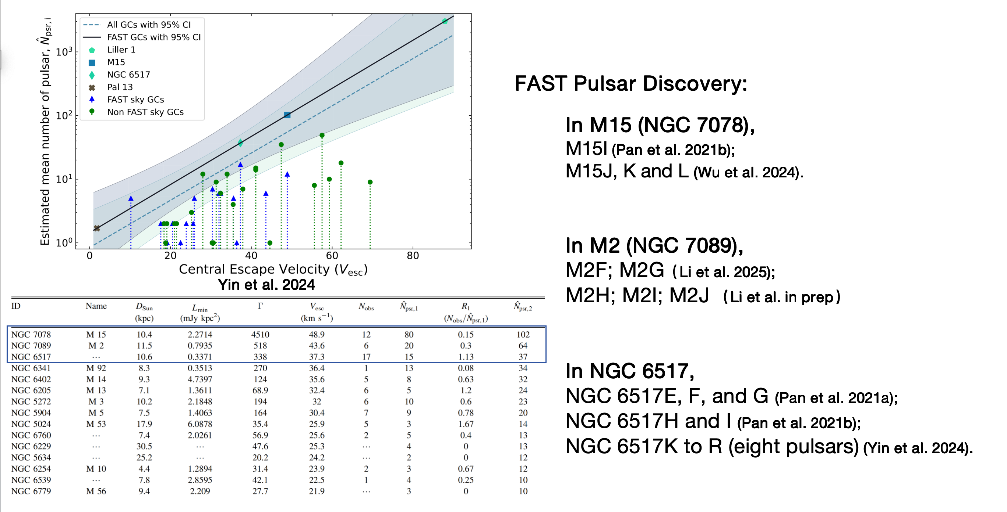
Globular Clusters Pulsar

Slide 4
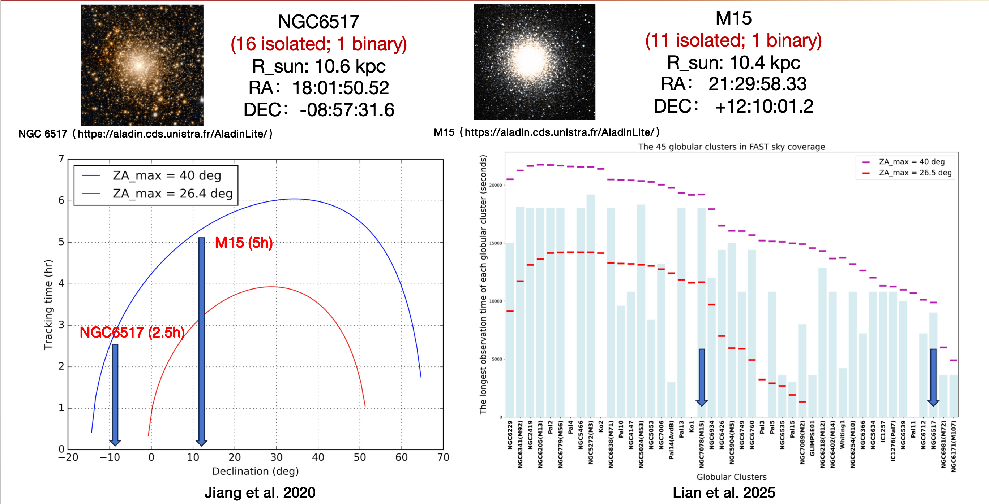
Globular Clusters Pulsar

Slide 5
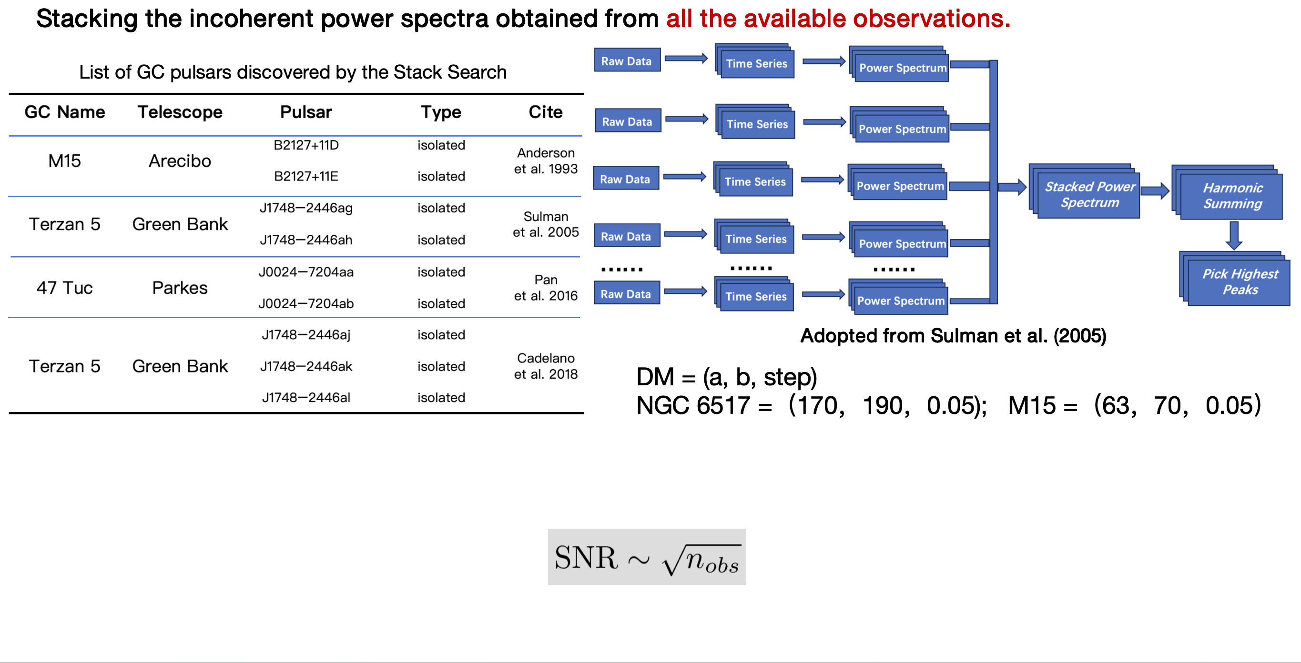
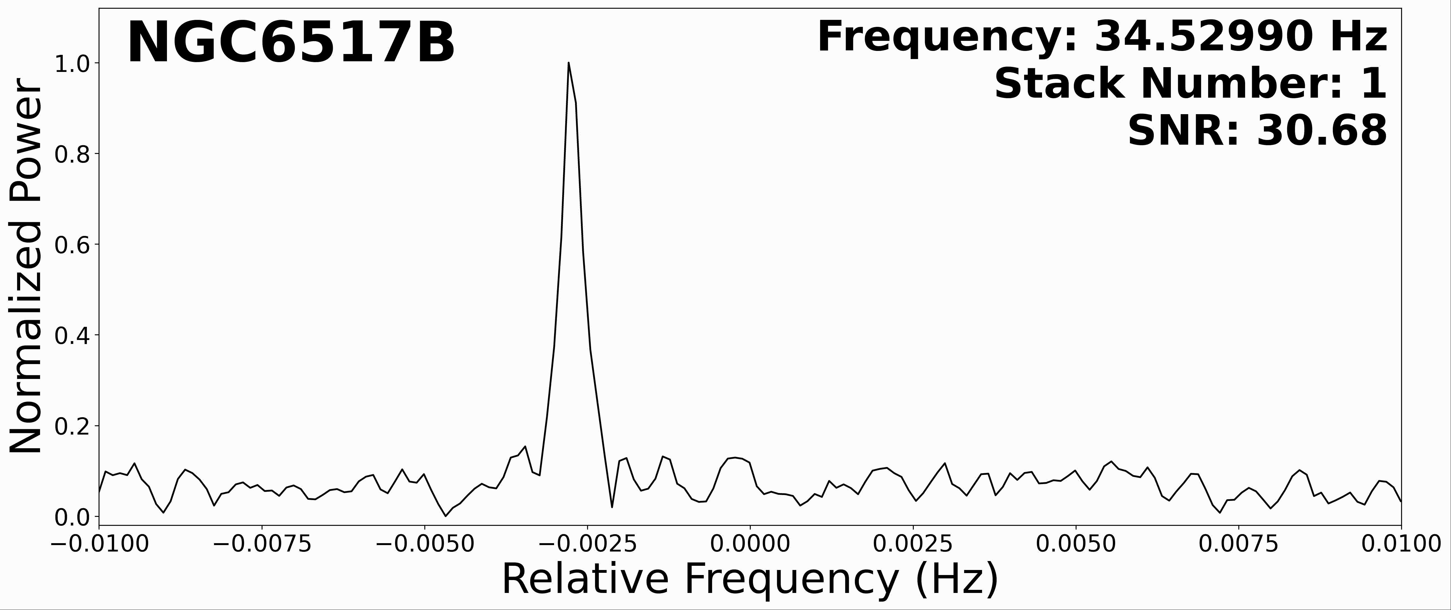
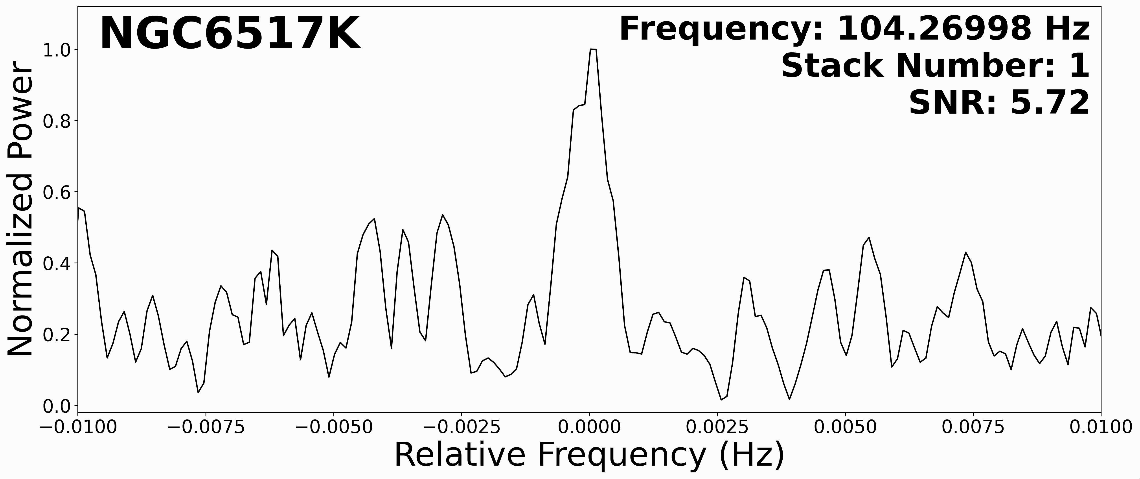
The Stack Search

Slide 6
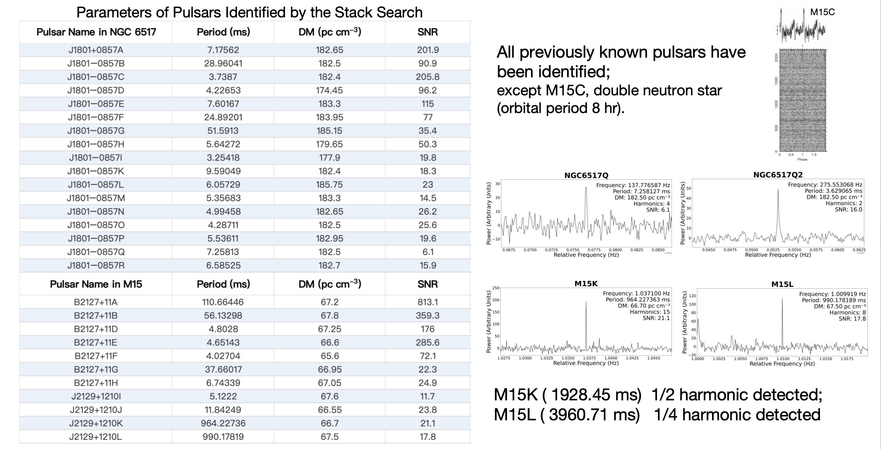
Know Pulsar
M15C

Slide 7
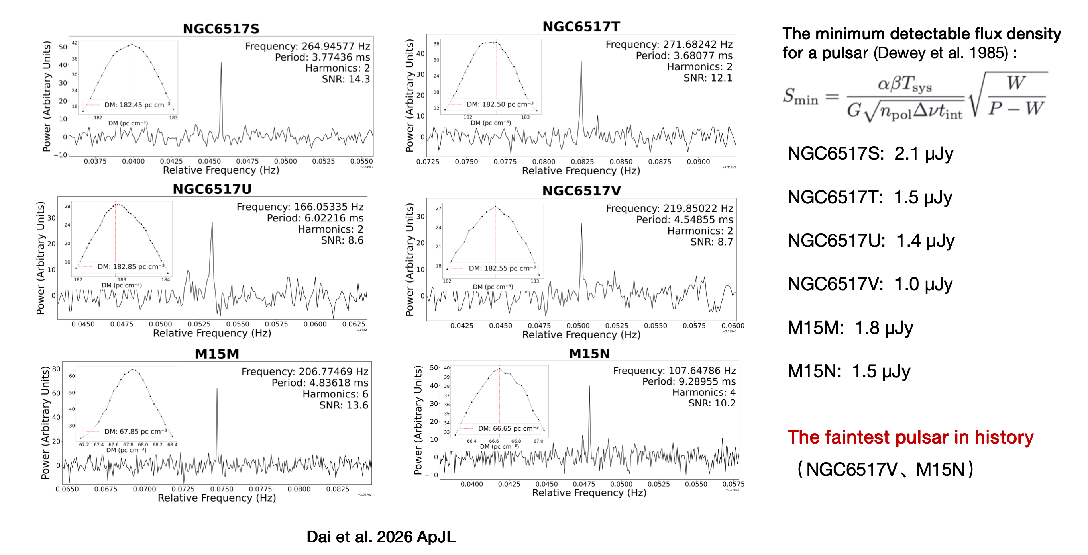
New Pulsar

Slide 8
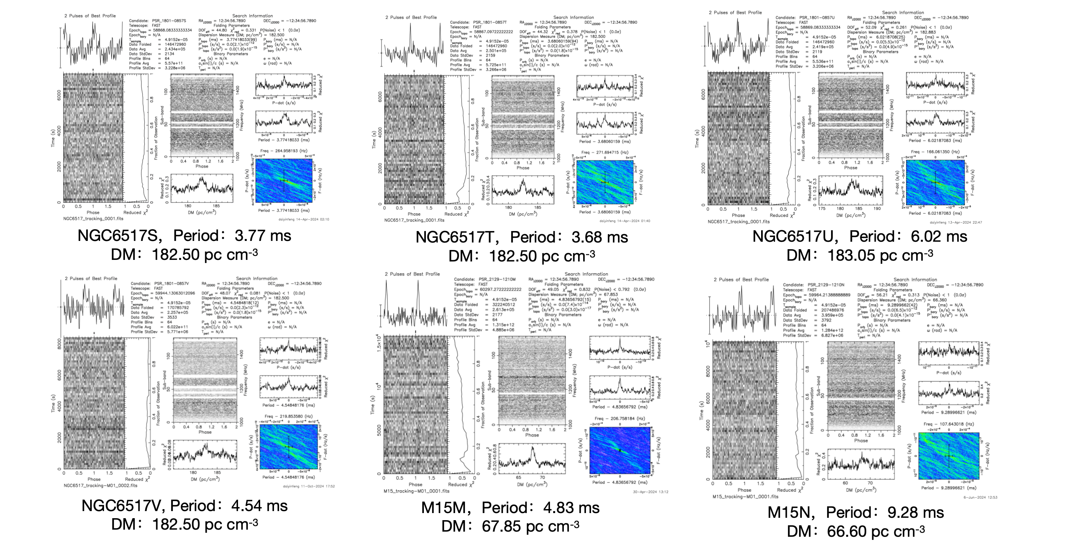
New Pulsar

Slide 9
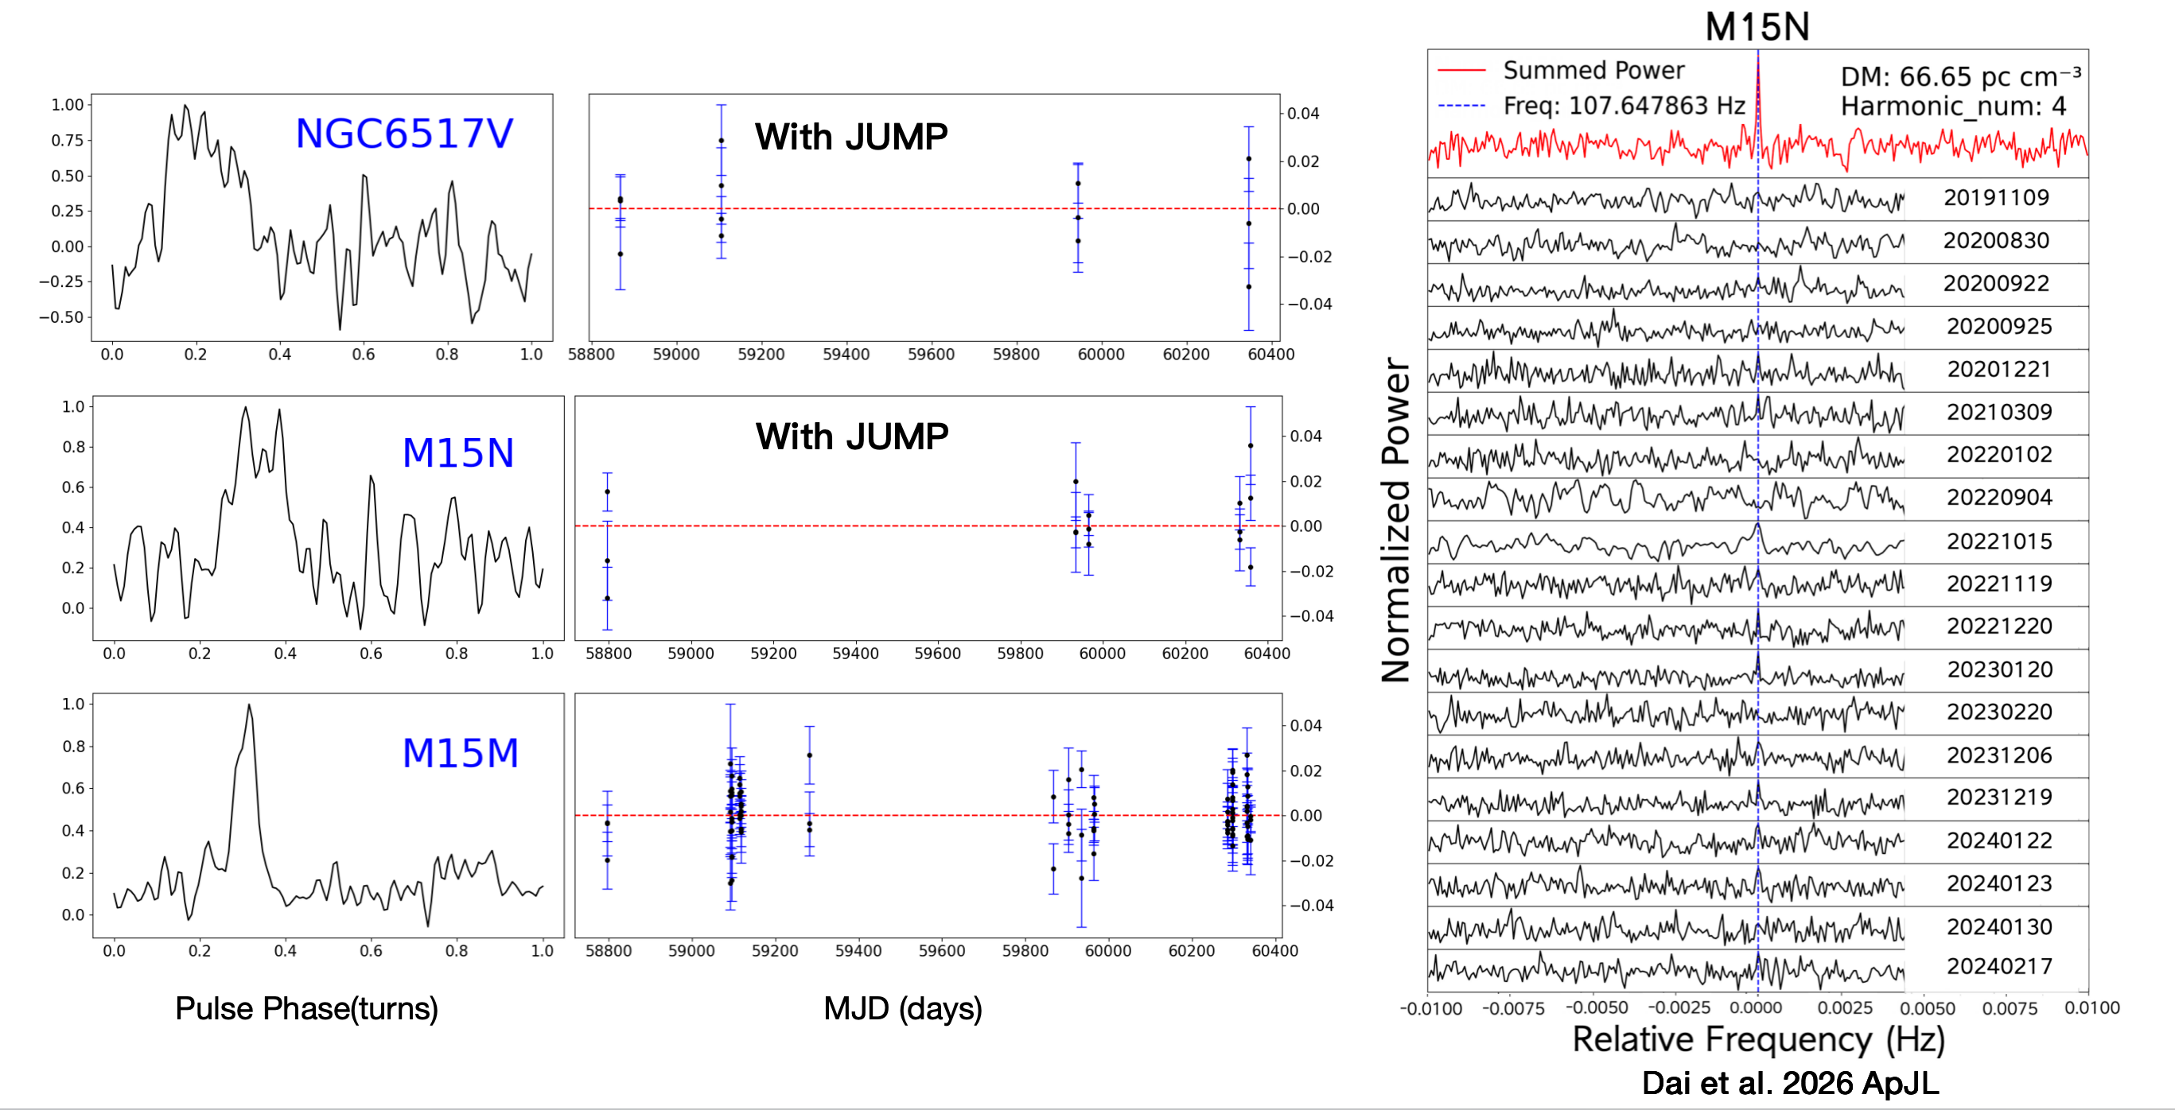
New Pulsar

Slide 10
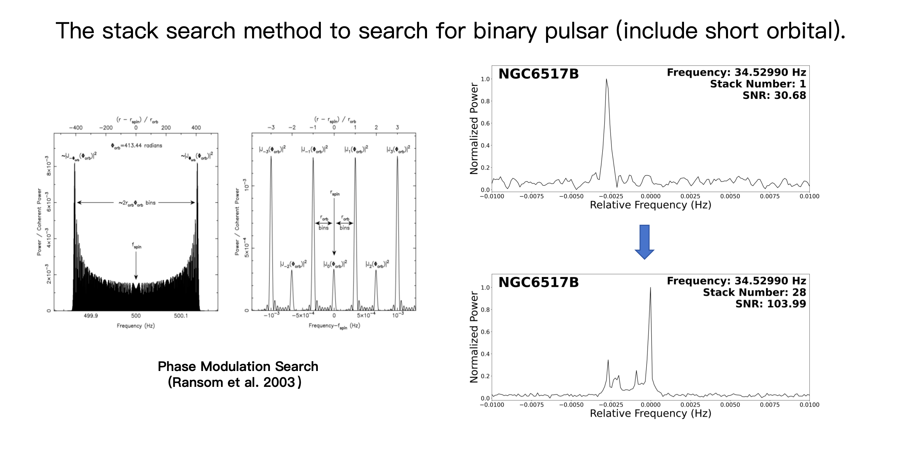
Binary Pulsar Search

Slide 11
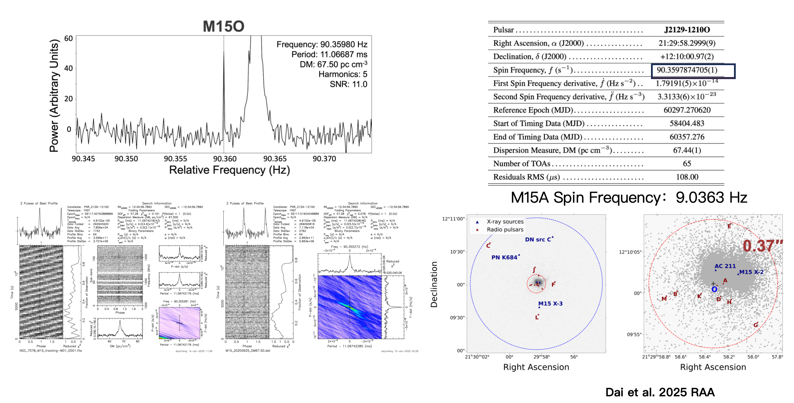
New Pulsar

Slide 12
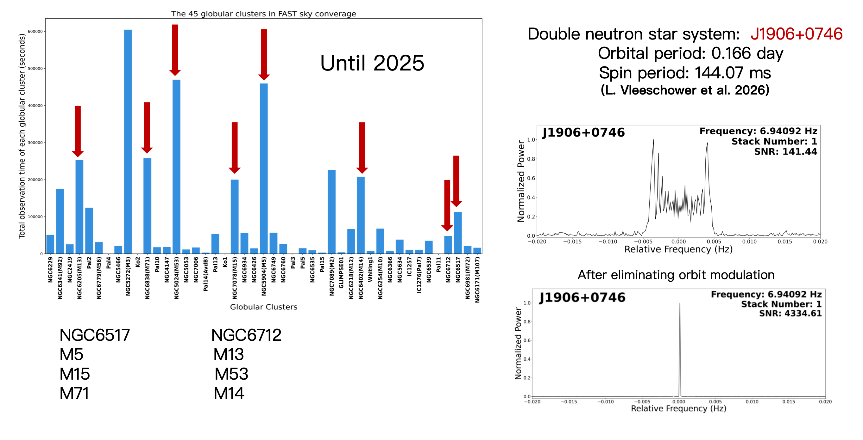
The Stack Search

Slide 13
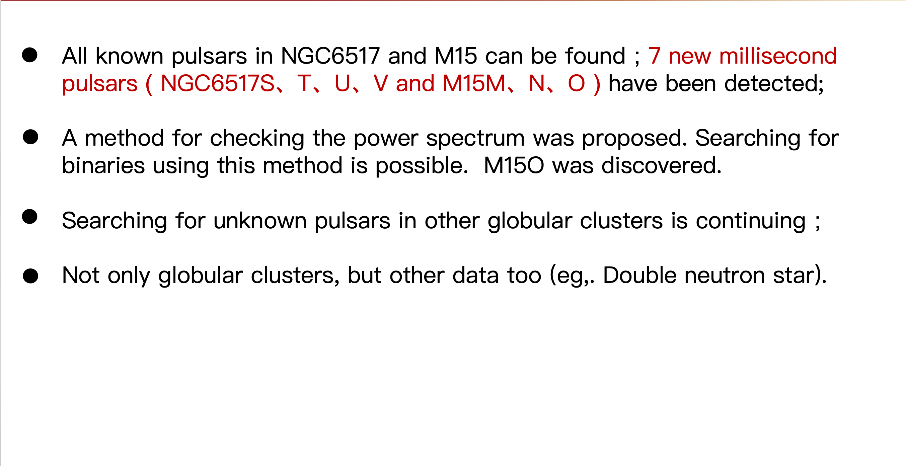
Summary

Slide 14
Thanks！
Email: yfeng.dai@foxmail.com

