Slide 1



Flux Variations of Fast Radio Bursts and Their Persistent Radio Sources: Evidence for a Shared Progenitor
Reporter: Li Xinming
Supervisor: Niu Chenhui
Guizhou 2026.7.3

Slide 2

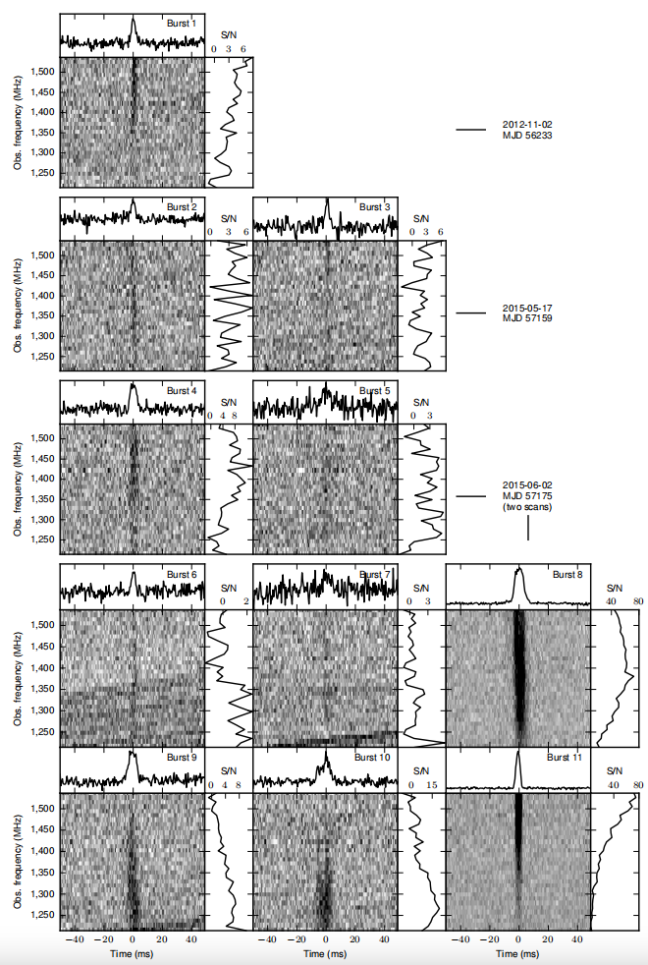
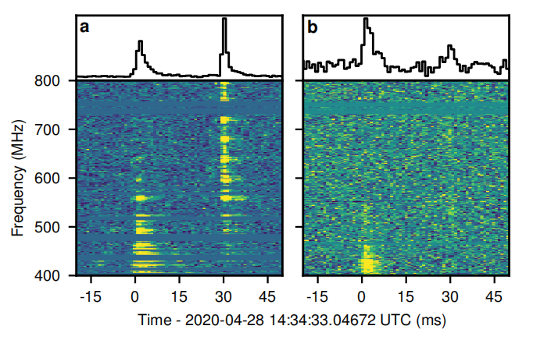
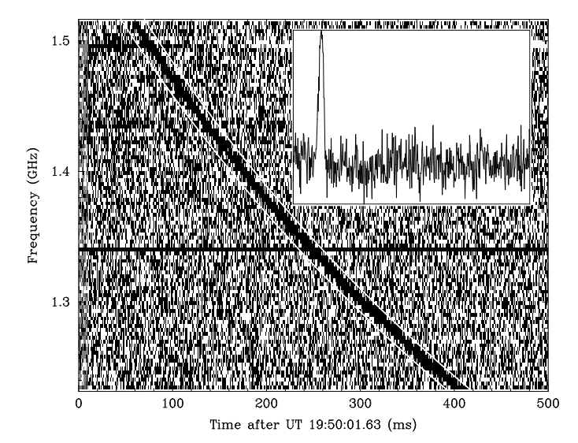
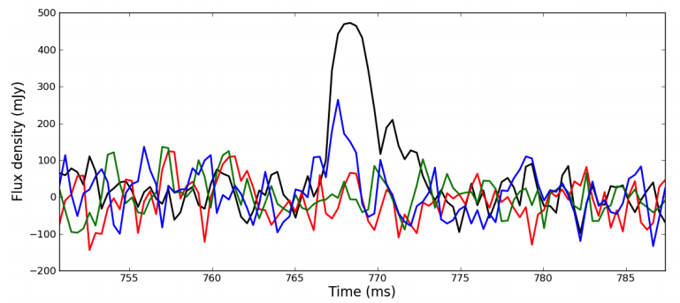
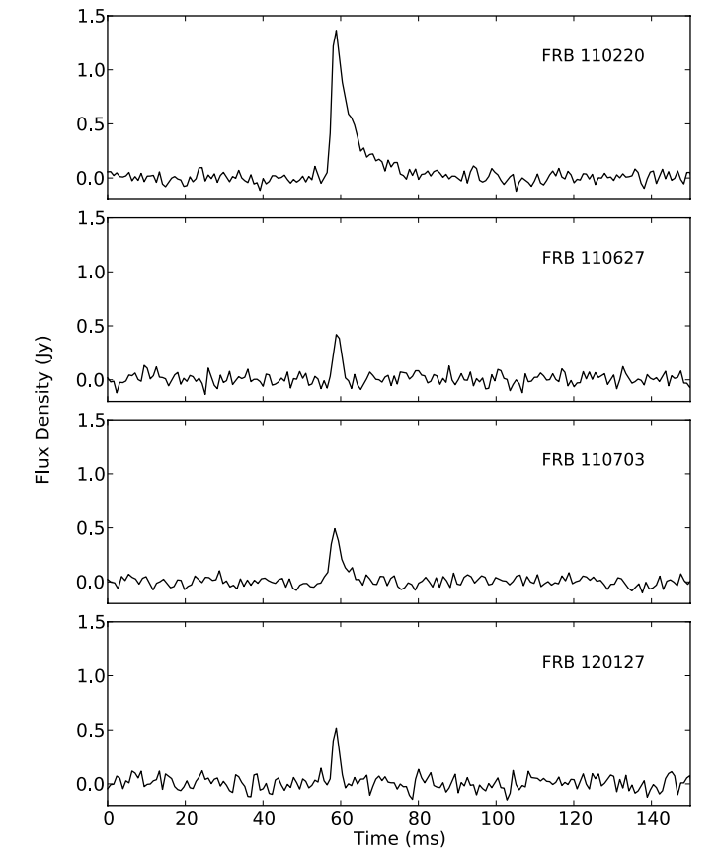
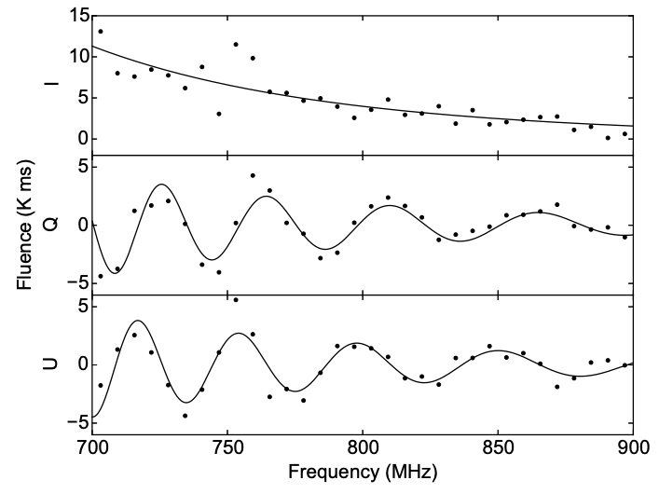
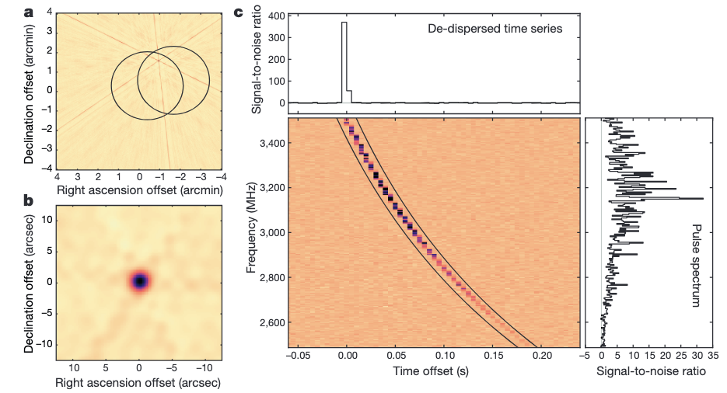
Background
The first repeater FRB20121102A
(Spitler et al. 2016)
First Galactic FRB and magnetar connection(SGR 1935+2154)
(CHIME/FRB & STARE2 2020)
Discovery
(Lorimer et al. 2007)
First real-time FRB detection and polarization measurement (FRB 140514)
(E. Petroff et al. 2014)
The first RM detection (FRB 110523)
(Kiyoshi Masui et al. 2015)
First localization and PRS (FRB20121102A)
(Chatterjee et al. 2017)
Naming of FRB
(D. Thornton et al. 2013)

Slide 3
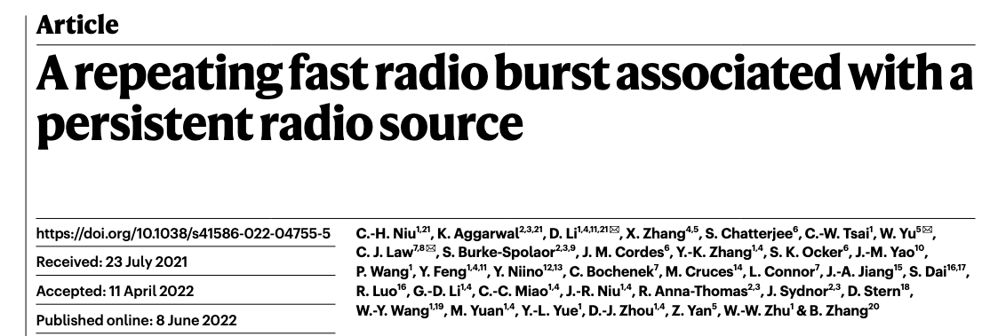
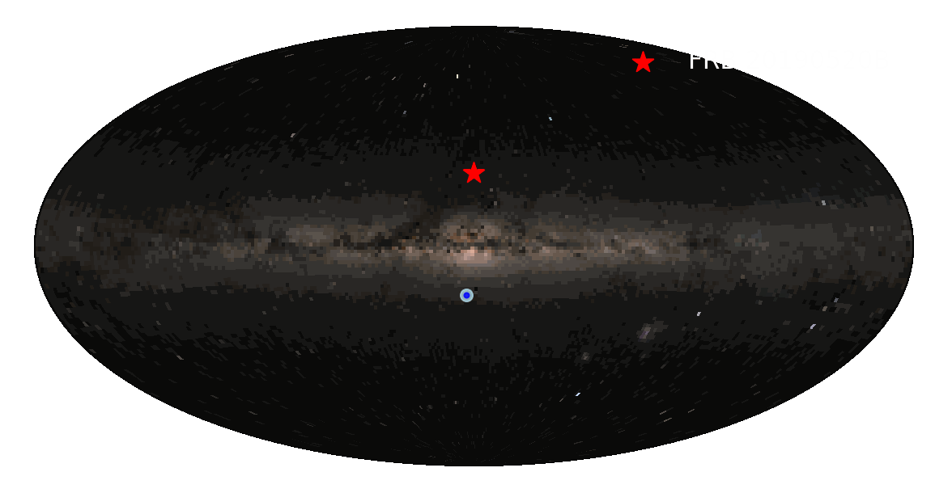
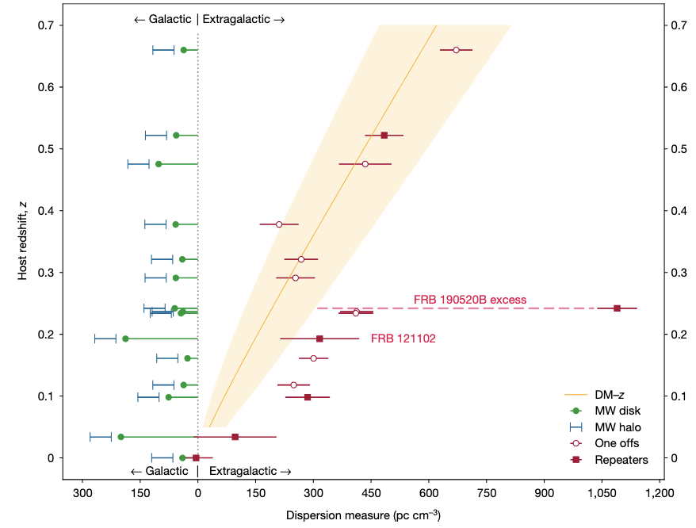
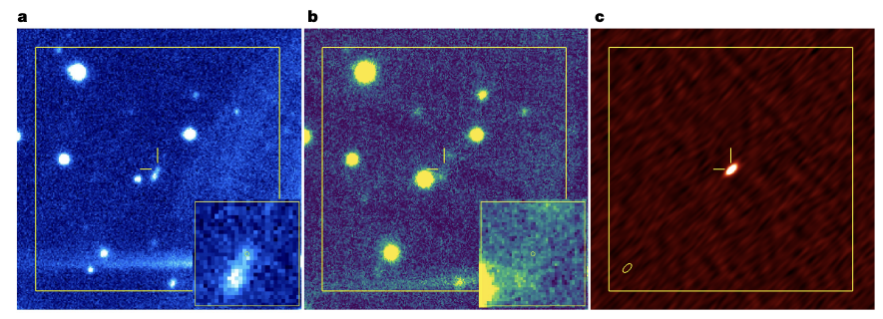
Background: Discovery of FRB 20190520B
Niu et al. (2022)
FAST/CRAFTS discovery in 2019
Active repeater: 75 bursts detected in 18.5 h follow-up
VLA localization: compact PRS at the FRB position
Dwarf host galaxy at z=0.241
Extremely large DM_{host}: ~ 903 pc cm⁻³
FRB 20190520B

Slide 4
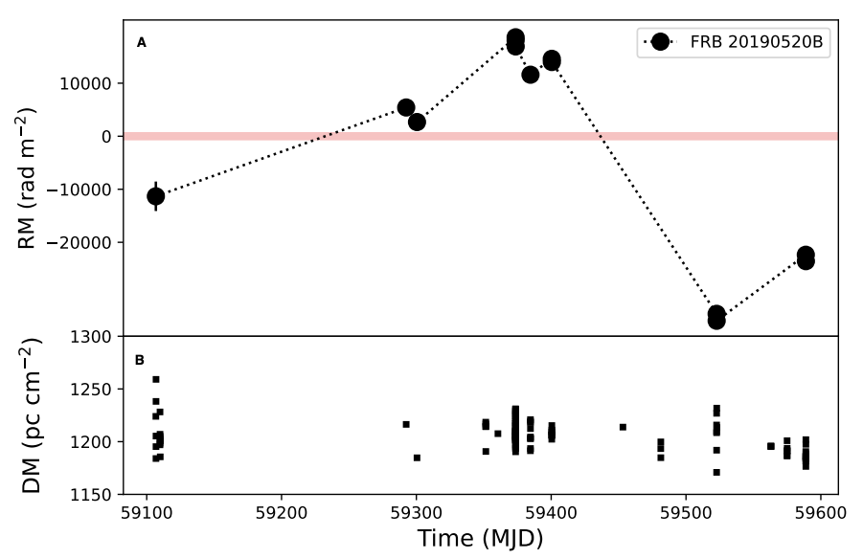
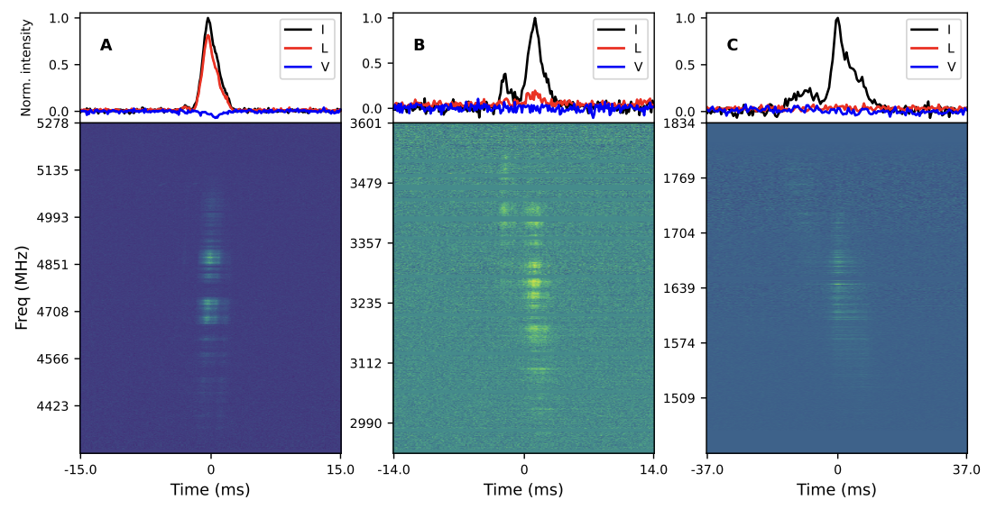
Background: Magnetic Field Reversal in FRB 20190520B
Anna-Thomas et al. (2023)
RM sign reversal:
RM changes from positive to negative values, indicating a reversal of the line-of-sight magnetic field.
Extreme RM variability:
RM varies on timescales from days to months, tracing a dynamic local magneto-ionic environment.
Frequency-dependent depolarization:
Low-frequency depolarization suggests turbulent plasma along the propagation path.

Slide 5
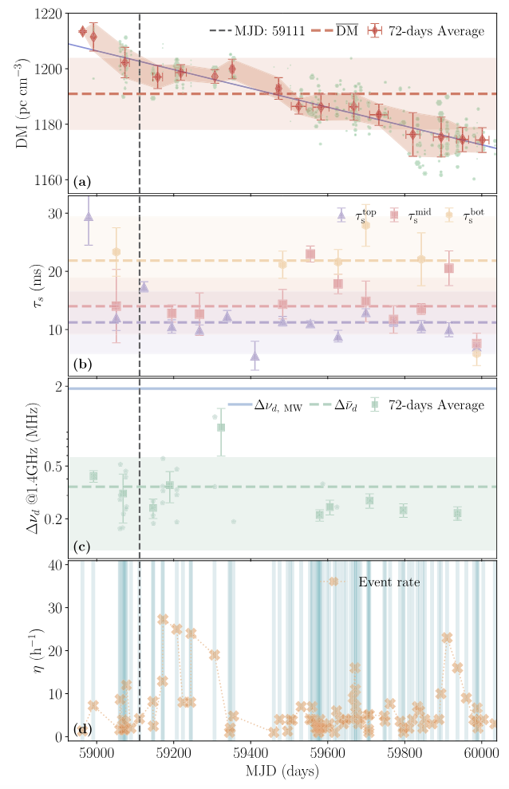
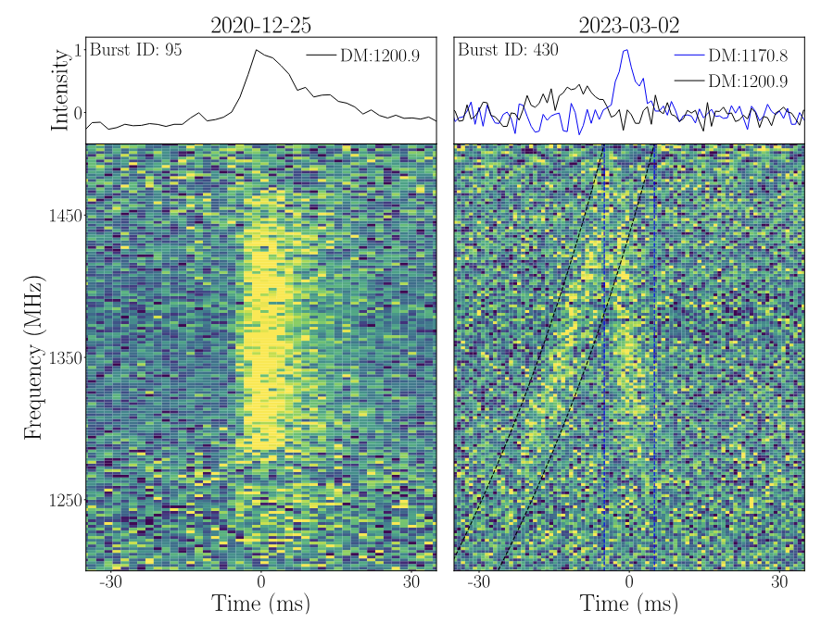
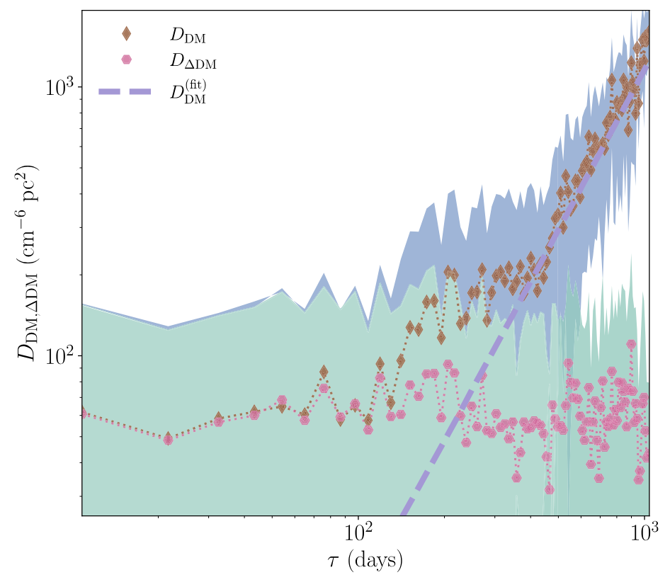
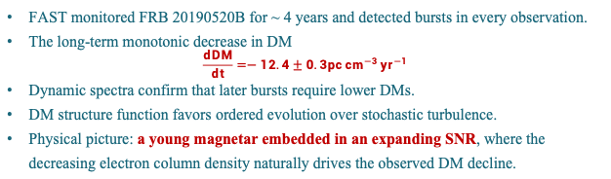
Background: DM Variations in FRB 20190520B
Niu et al. (2026)
FAST monitored FRB 20190520B for ~ 4 years and detected bursts in every observation.
The long-term monotonic decrease in DM
$$\frac{dDM}{dt}=−12.4±0.3pc {cm}^{−3 }{yr}^{−1}$$
Dynamic spectra confirm that later bursts require lower DMs.
DM structure function favors ordered evolution over stochastic turbulence.
Physical picture: a young magnetar embedded in an expanding SNR, where the decreasing electron column density naturally drives the observed DM decline.

Slide 6
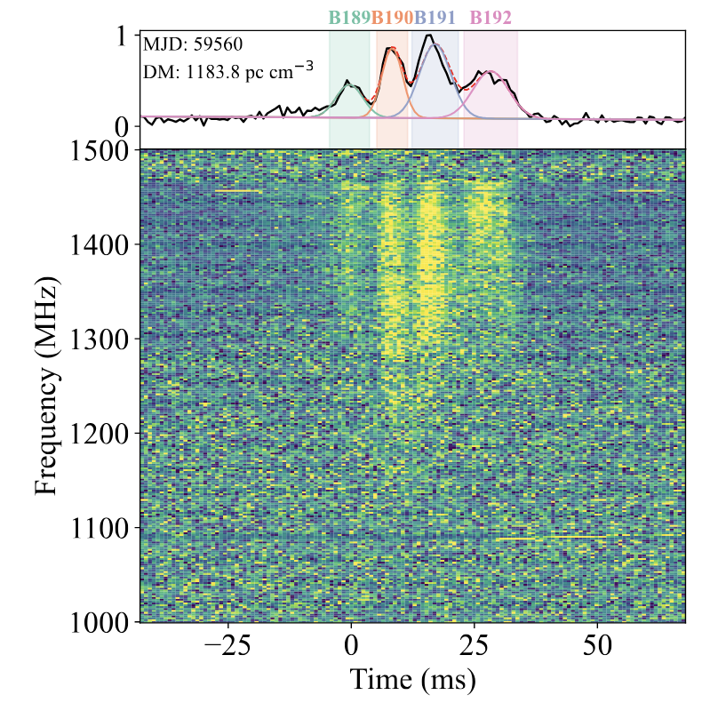
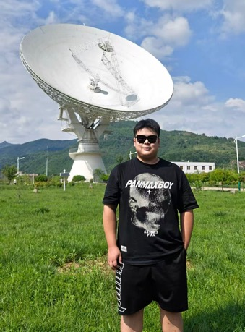
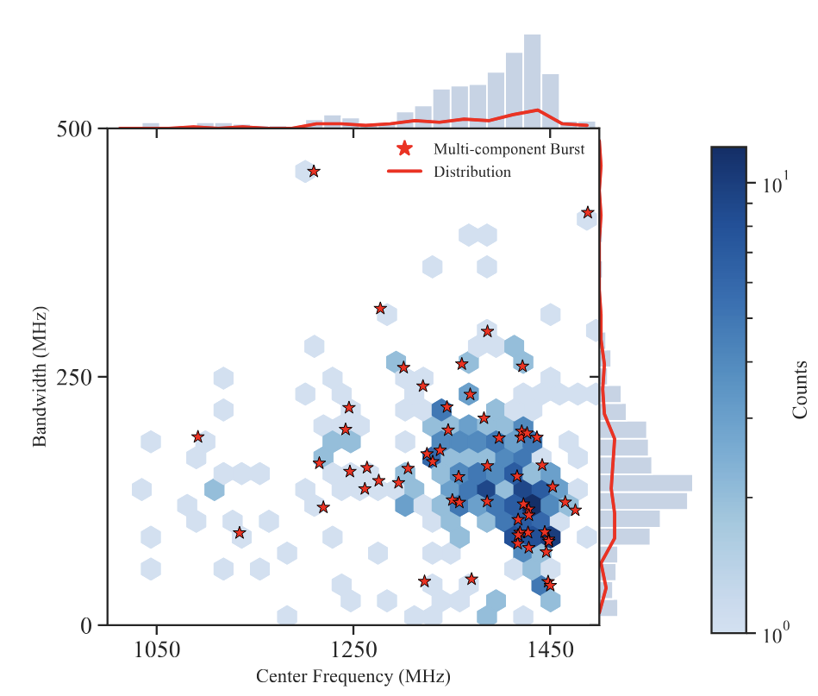
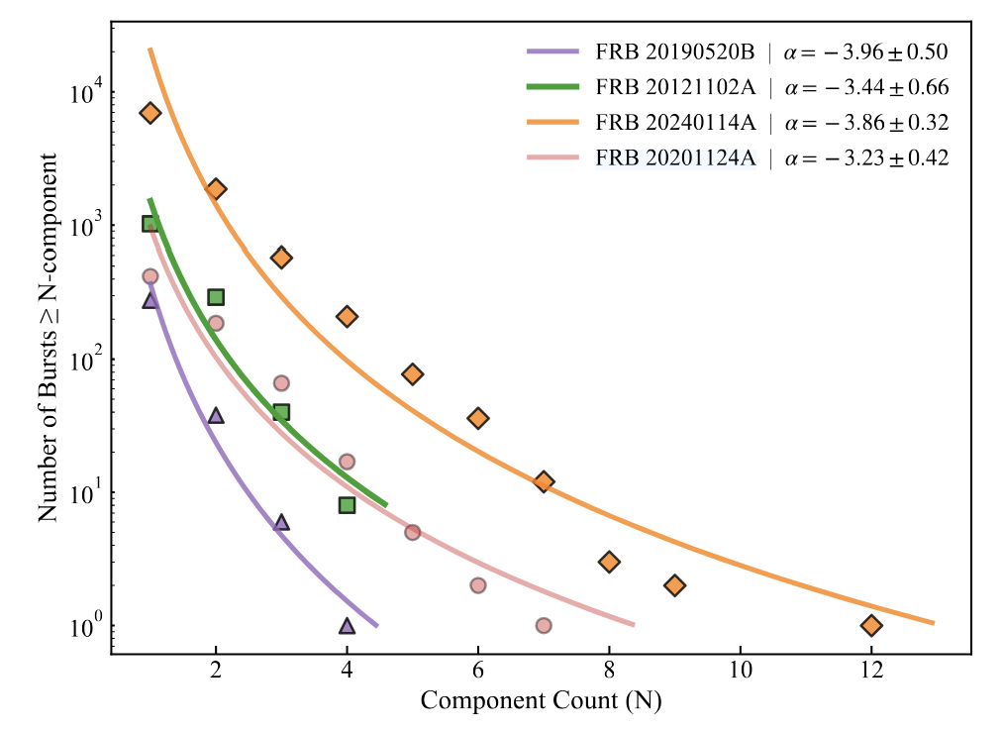
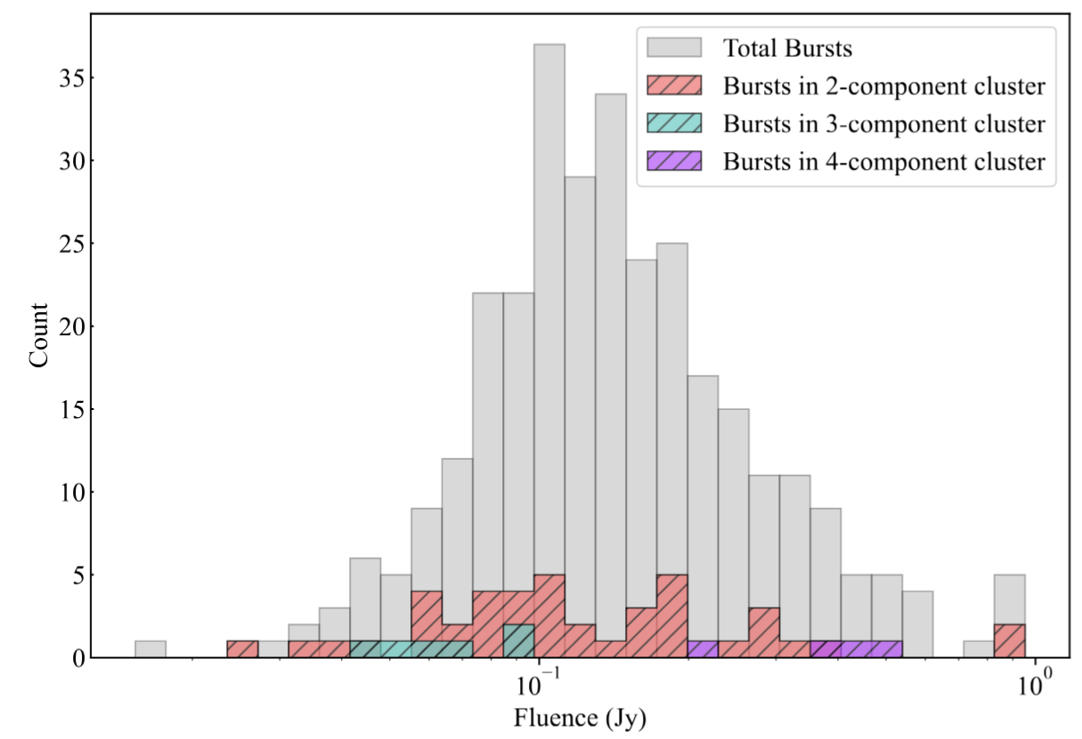
Background: Morphology of FRB 20190520B
zhang et al. (2026)
FRB 20190520B shows clear multi-component burst clusters.
The component-count distribution follows a power-law form.
Multi-component bursts occupy a similar frequency–bandwidth space as the full burst sample.
Component-count distributions follow a power law, suggesting an SOC-like process.

Slide 7
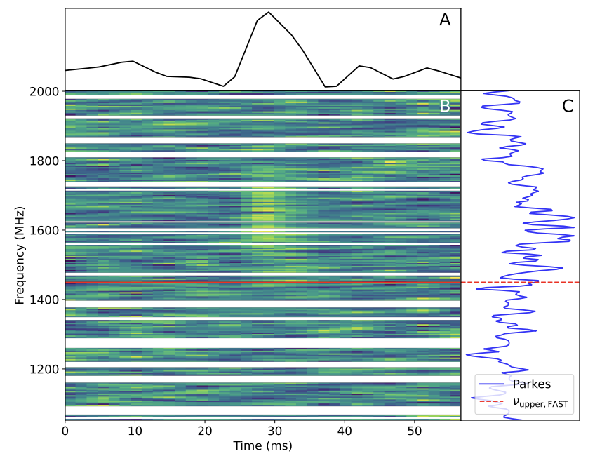
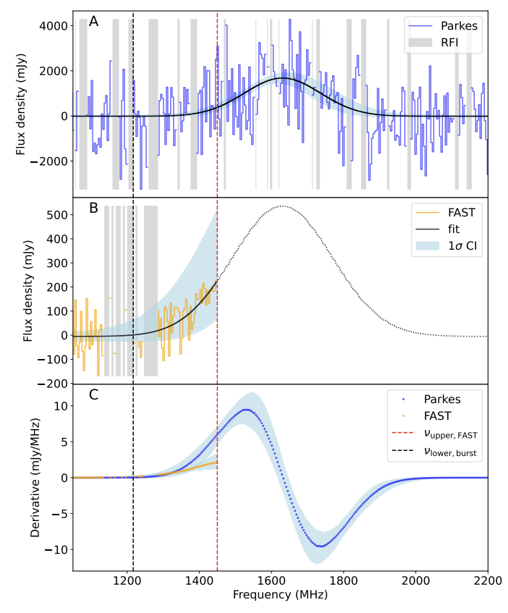

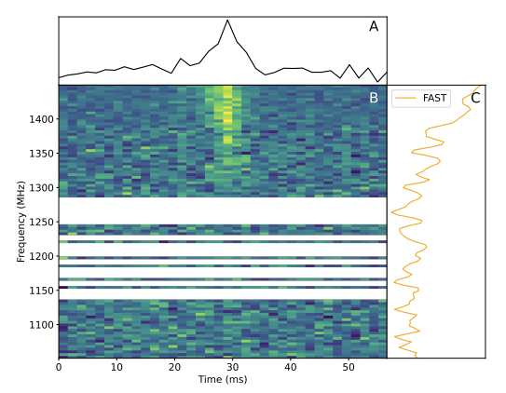
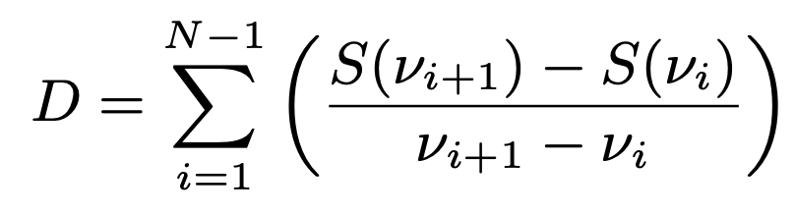
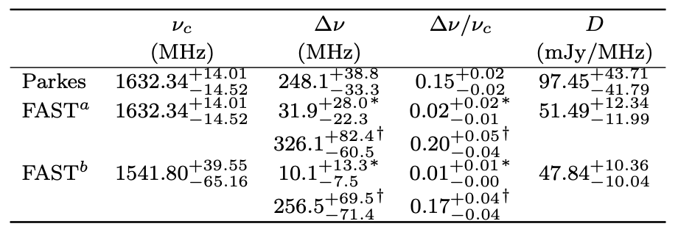
Background: Narrowband Emission of FRB 20190520B
Zhu et al. (2024)

Slide 8
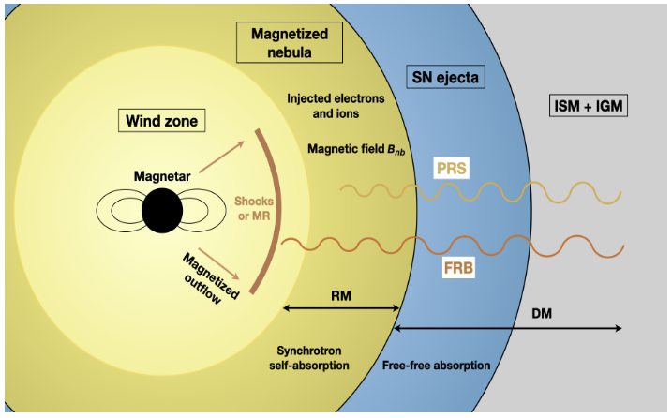
FRB - PRS System: model
Li et al. (2026)
https://doi.org/10.3847/1538-4357/ae69cb
Murase et al. 2016: predicted quasi-steady synchrotron emission from a young pulsar/magnetar wind nebula.
Kashiyama & Murase 2017: applied the young NS nebula scenario to the PRS of FRB 121102.
Metzger et al. 2017: linked FRB 121102 to millisecond magnetar birth, SLSNe, and long GRBs.
Margalit & Metzger 2018: modeled FRB 121102 as a flaring magnetar embedded in a magnetized wind nebula.
Yang & Dai 2019: proposed a magnetar-powered PWN origin without requiring SN ejecta.
......
Bhattacharya et al. 2024: extended the MWN model to multiple FRB–PRS systems.
Physical link ?
search for correlated variability between
PRS flux density and FRB burst-energy output

Slide 9
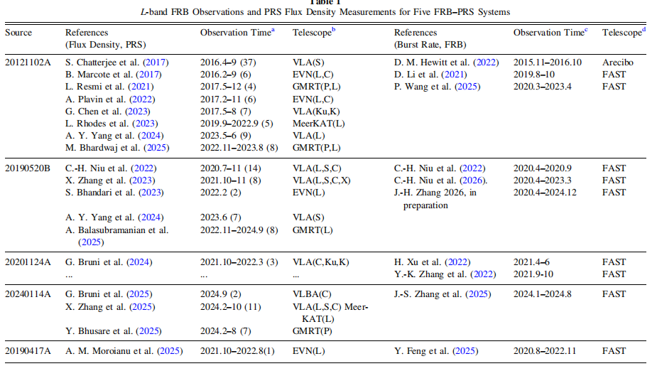
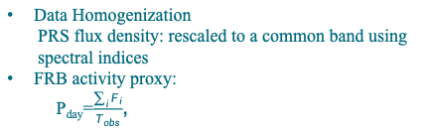
Data
Sample: five repeating FRB–PRS systems
FRB 20121102A, FRB 20190520B, FRB 20201124A, FRB 20240114A, and FRB 20190417A
PRS data:
multi-epoch flux-density measurements from VLA, EVN, GMRT, VLBA, and MeerKAT
FRB data:
FAST L-band burst samples during PRS monitoring periods
Problem
Sparse PRS monitoring at different radio bands
PRS flux and burst activity are not always measured on the same day
Data Processing
Data Homogenization
PRS flux density: rescaled to a common band using spectral indices
FRB activity proxy:
P_{day}=$\frac{\sum_{i}{F_{i}}}{T_{obs}}$,
F_{i} is the fluence of each burst
T_{obs} is the effective observing time.

Slide 10
Method
Correlation analysis
• Time-window pairing
Pair each PRS flux-density measurement with the window-averaged FRB Pday around the PRS observing epoch.
Quantify the correlation using Pearson and Spearman coefficients, with permutation tests to evaluate significance.
• ICCF analysis
Use the interpolated cross-correlation function to examine the correlation between unevenly sampled PRS and FRB time series. Estimate uncertainties using flux-randomization bootstrap resampling and evaluate significance with permutation tests.

Slide 11
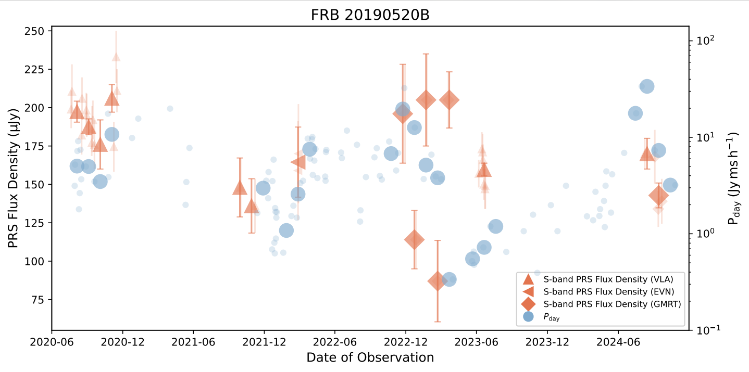
Result
Long-term Evolution of PRS Flux Density and Burst-activity Proxy in FRB 20190520B
2020 Jun–2022 Jun: Coordinated variability
PRS flux density and Pday show a positive
relationship during the relatively continuous
monitoring interval.
Around 2022 Dec: Unusual PRS fluctuations
GMRT observations show strong short-timescale
PRS flux variations, likely affected by local
environmental or propagation effects.
Later epochs: Sparse PRS sampling
Later PRS measurements are separated by large
temporal gaps, so they are not ideal for ICCF_x0002_
based correlation analysis.

Slide 12
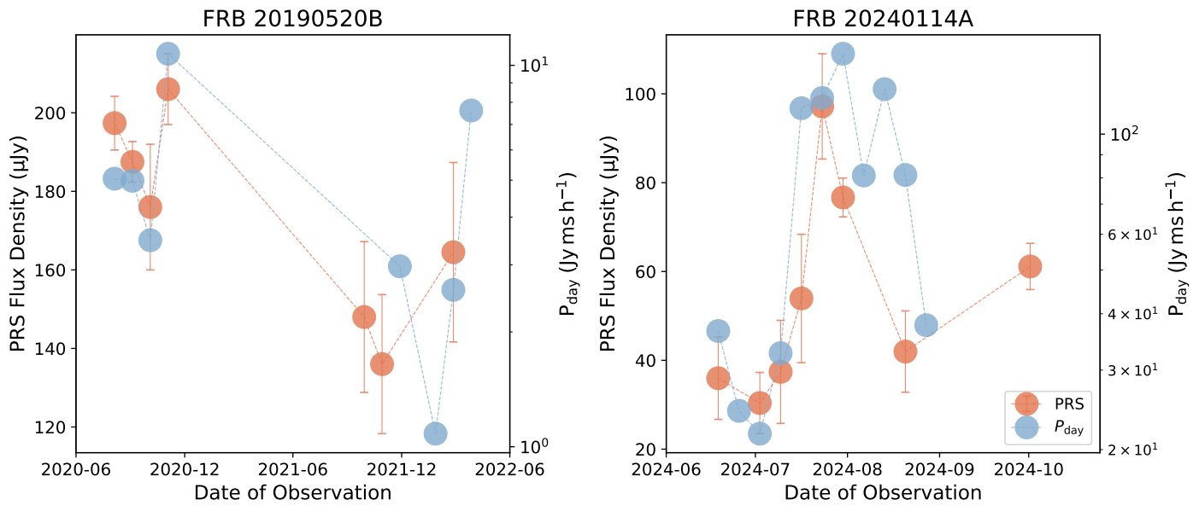
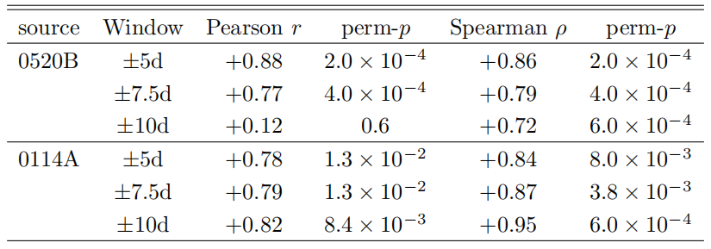
Result
Positive PRS–FRB Correlations in Two Active Repeaters
Both systems show a positive correlation between
PRS flux density and FRB activity, with detailed
correlation statistics presented below.
method 1

Slide 13
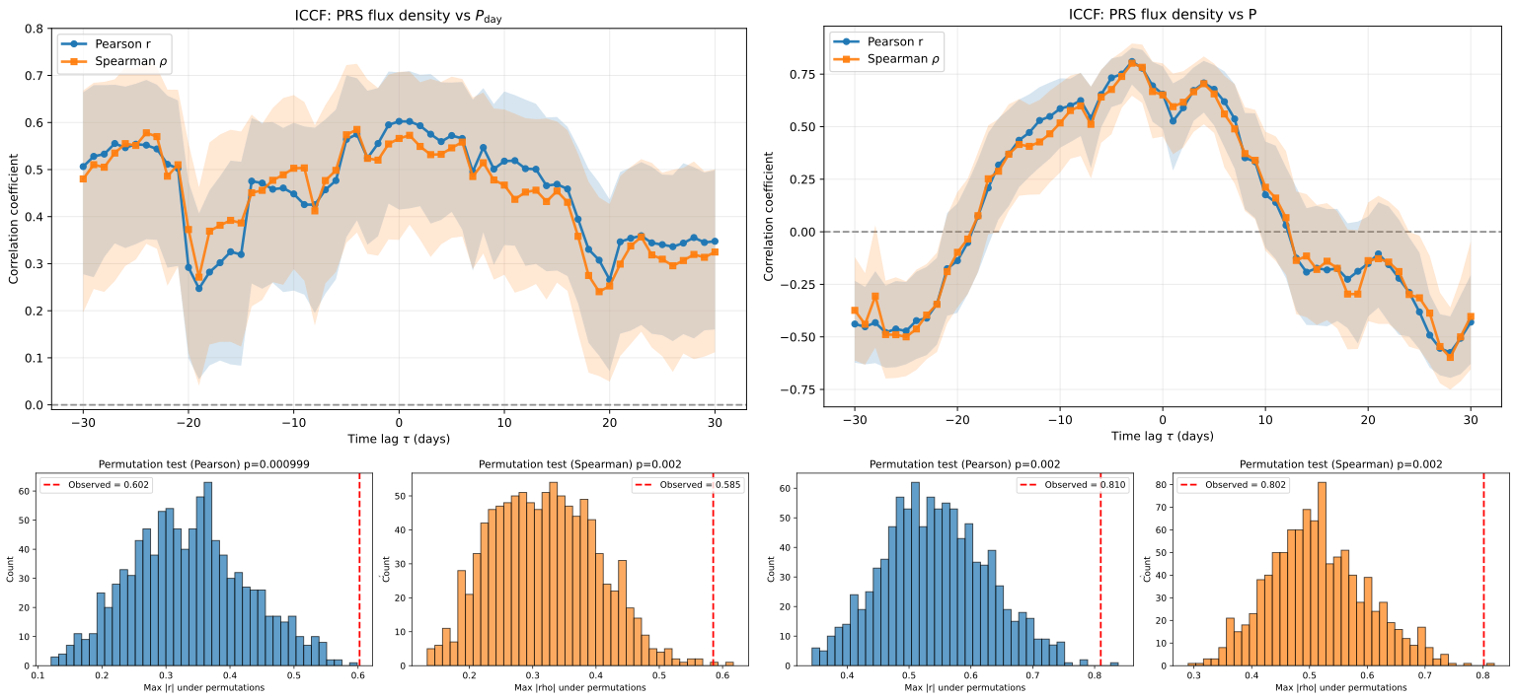
Result
Positive PRS–FRB Correlations in Two Active Repeaters
Both systems show a positive correlation between
PRS flux density and FRB activity, with detailed
correlation statistics presented below.
method 2

Slide 14
Discussion and Conclusion
Intrinsic PRS variability
The observed PRS modulation is lower than the expectation from refractive interstellar scintillation, suggesting that the PRS variability is not dominated by scintillation alone and likely contains an intrinsic component.
Shared energy reservoir
The positive PRS–FRB correlation on weekly-to-monthly timescales suggests that PRS emission and FRB burst activity may be powered by a common central-engine energy reservoir.
Magnetar wind nebula picture
In the magnetar-powered MWN scenario, the PRS is expected to gradually fade as the nebula expands and its energy density decreases. However, active FRB phases may temporarily enhance energy injection or particle acceleration, boosting nebular synchrotron emission and producing short-term PRS brightening on top of the long-term decline.

Slide 15
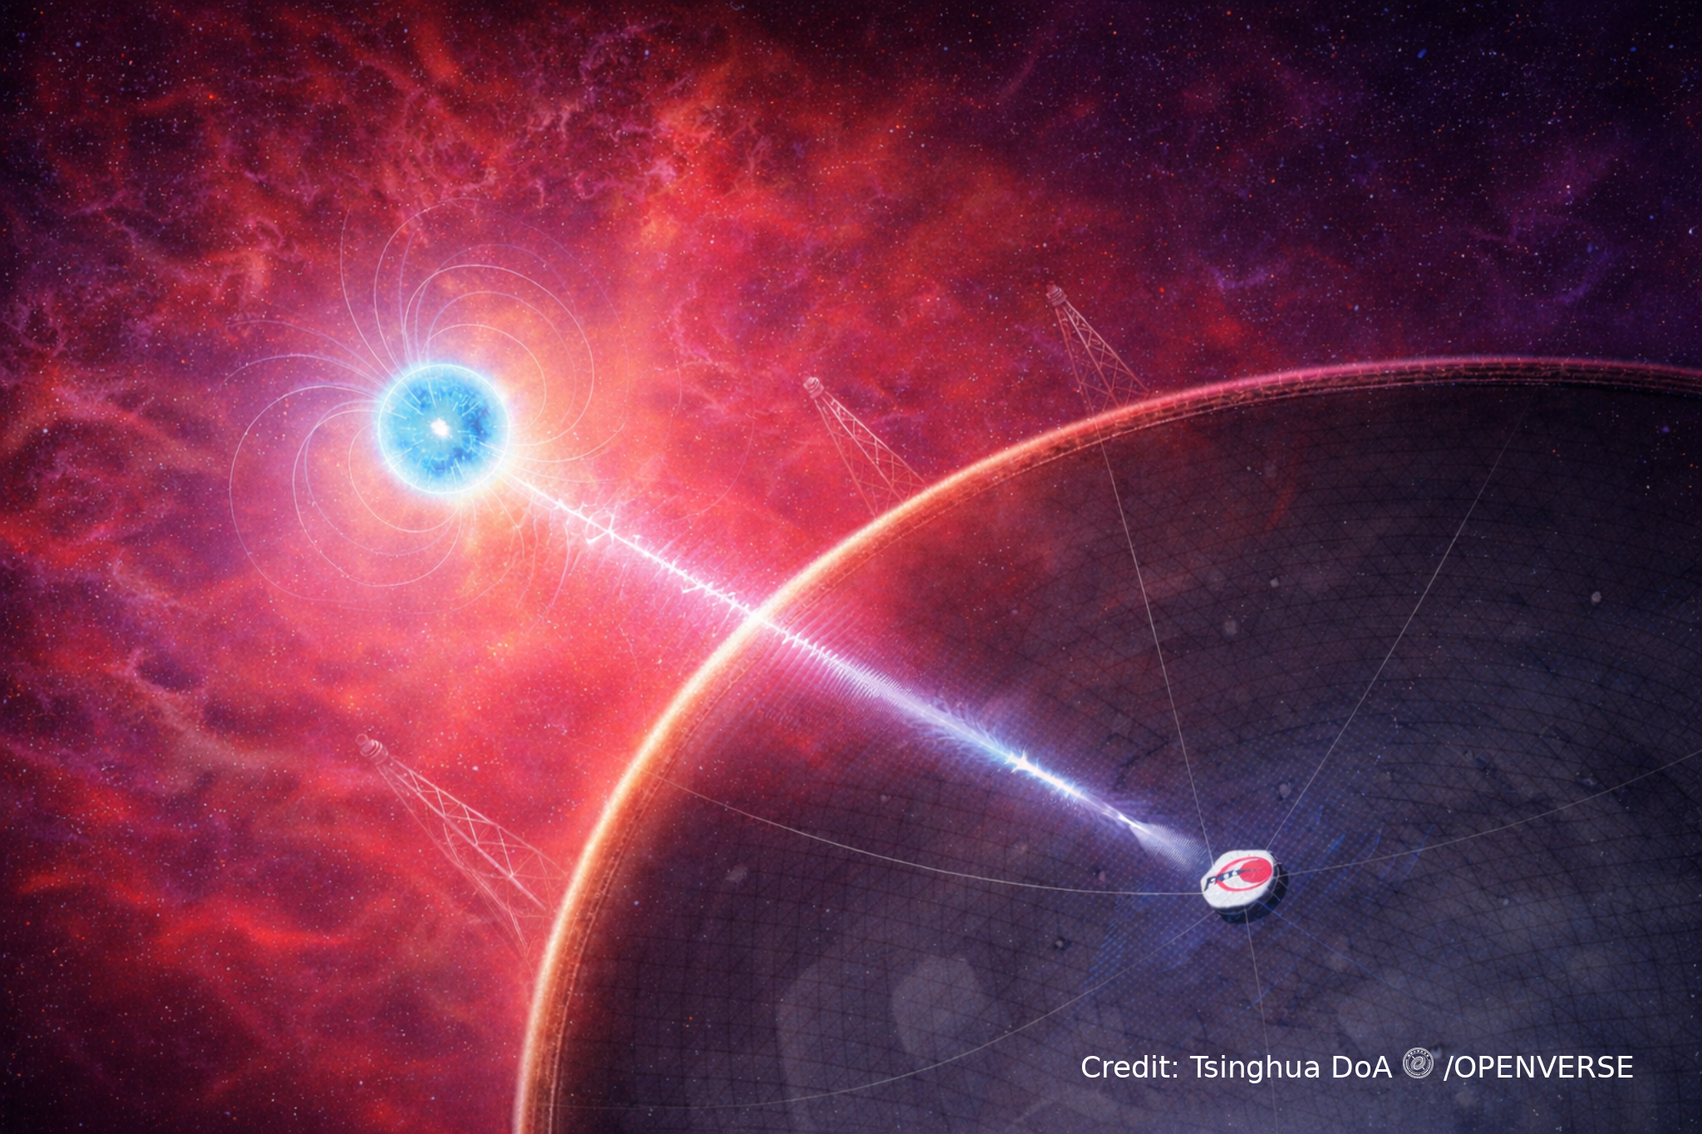
Summary
Characteristics of FRB 20190520B
Persistent activity
Compact PRS association
Dense local environment
Strongly magnetized plasma
Evolving source environment
Thanks ！！

