Slide 1
Probing the equation of state of pulsars with spin properties
来小禹
湖北第二师范学院 天文与高能物理研究所
第十五届全国脉冲星研讨会 @ 贵州师范大学
贵阳 2026.7.2-7.6

Slide 2
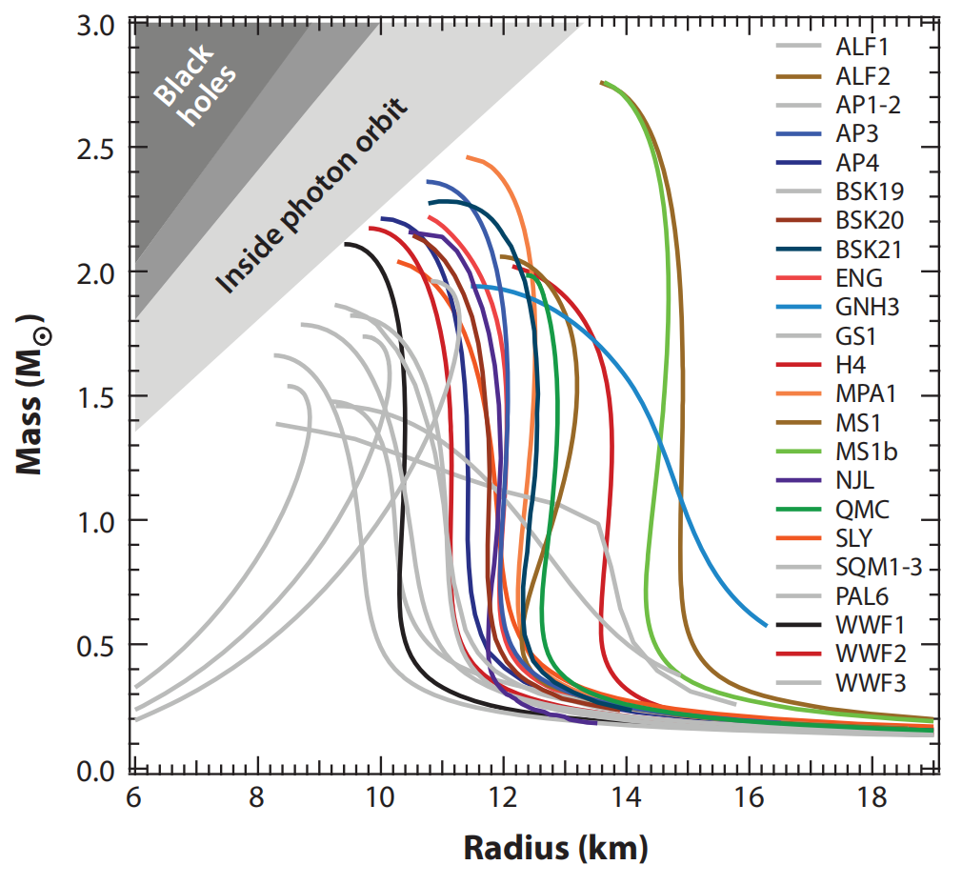
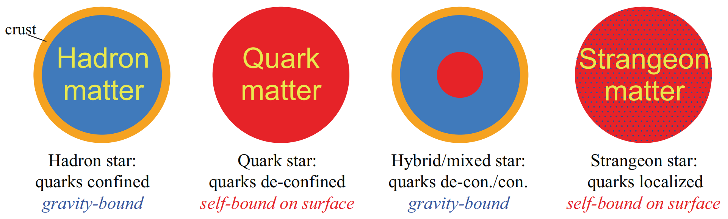
Nature of pulsars?
中子星 夸克星 混合星 奇子星
Neutron stars Quark stars Hybrid stars Strangeon Stars

Slide 3
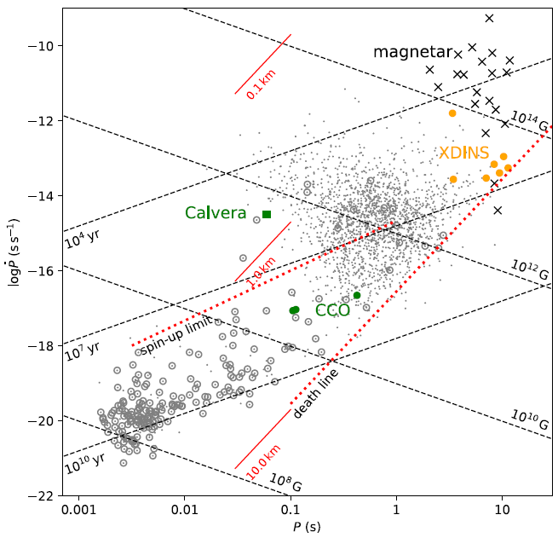
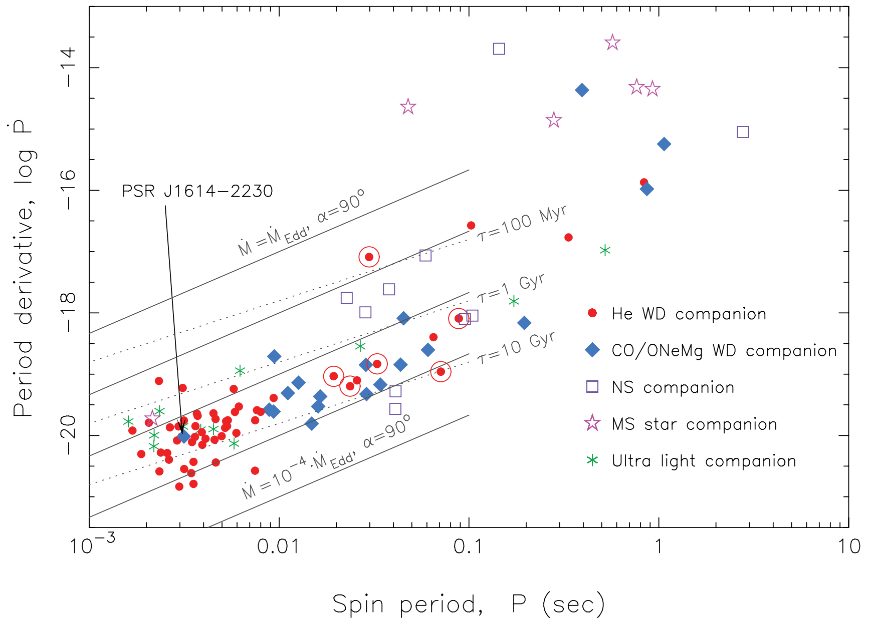
Millisecond pulsars
M ~ 1.4 M⊙, R ~ 10 km, I ~ 10⁴⁵ g cm² (M / M⊙)
(Li et al. 2018)
(Tauris et al. 2012)

Slide 4
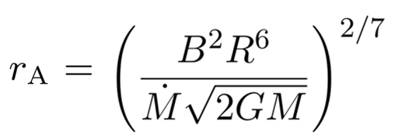
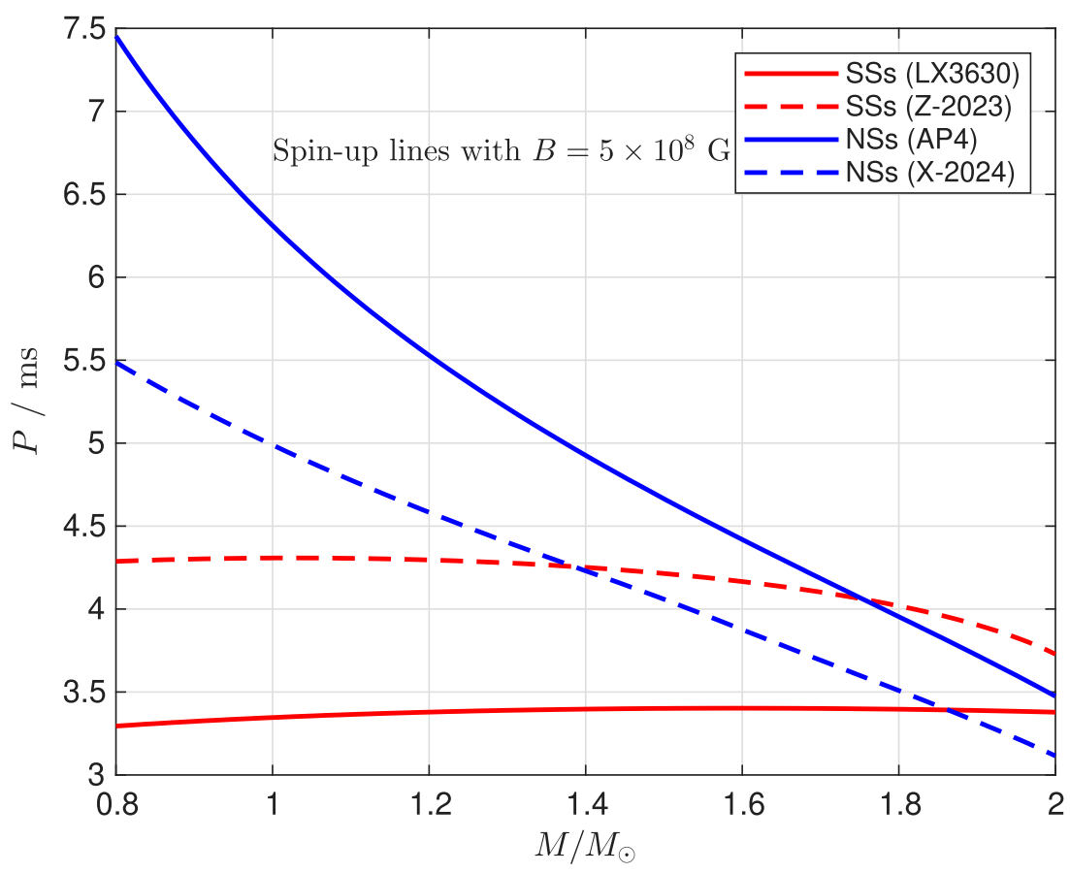

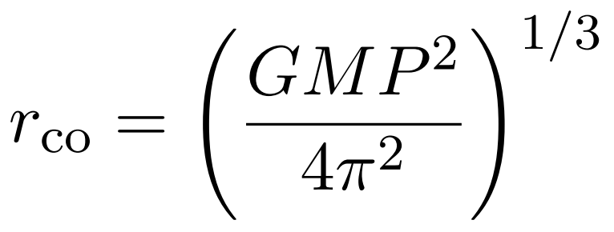



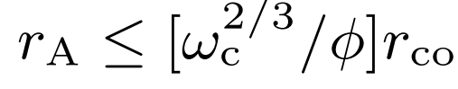



Spin-up condition
Zhong & Lai, MNRAS 544, 293 (2025)

Slide 5
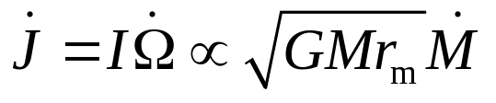

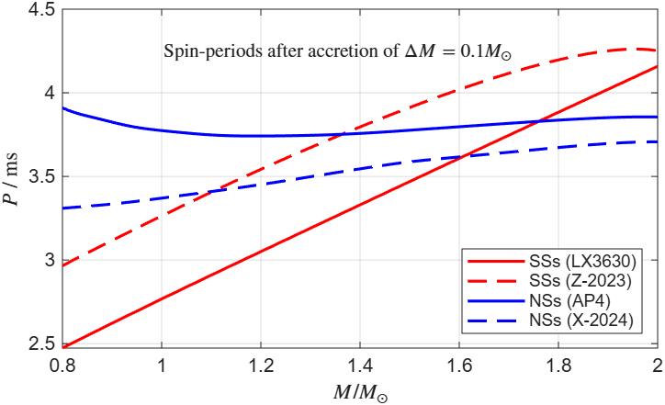
当 spin-up 条件满足时，吸积 ΔM 质量后能达到多小的周期？
(Zhang & Kojima 2006)
Zhong & Lai, MNRAS 544, 293 (2025)

Slide 6
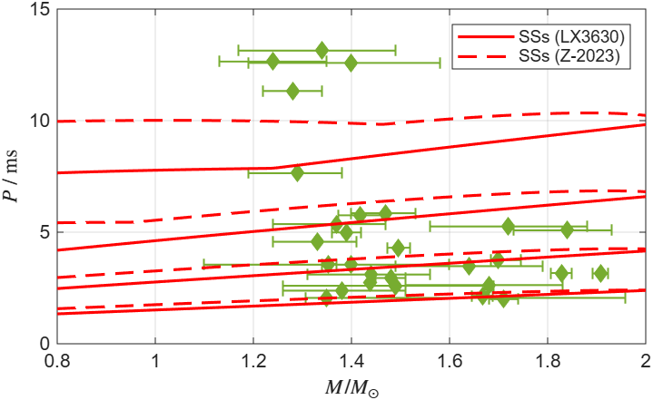
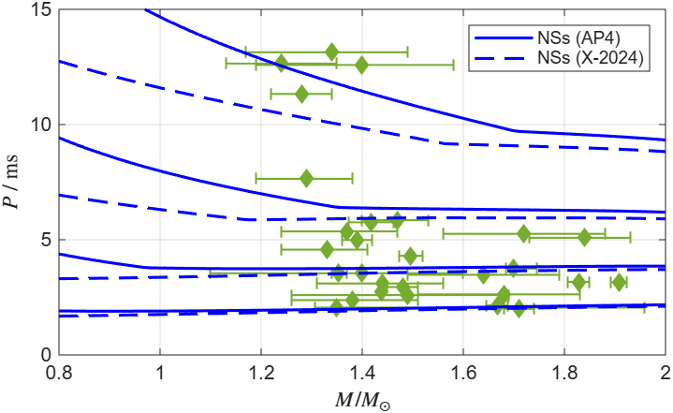
Comparison with observations
吸积质量 ΔM = 0.04 M，0.06 M，0.1 M，0.2 M .
在 ΔM < 0.1 M 且 M < 1.2 M⊙ 时，吸积相同 ΔM 后，奇异星能比中子星具有更小的周期. 这一区别更明显.
例如，如果对 ΔM 给出限制为 ΔM < 0.04 M ，那么 M < 1.2 M 的中子星无法加速到 P < 11 ms，但奇异星可以.
Data of spin periods and masses are from:
https://www.atnf.csiro.au/research/pulsar/psrcat/
https://www3.mpifr-bonn.mpg.de/staff/pfreire/NS_masses.html
Zhong & Lai, MNRAS 544, 293 (2025)

Slide 7
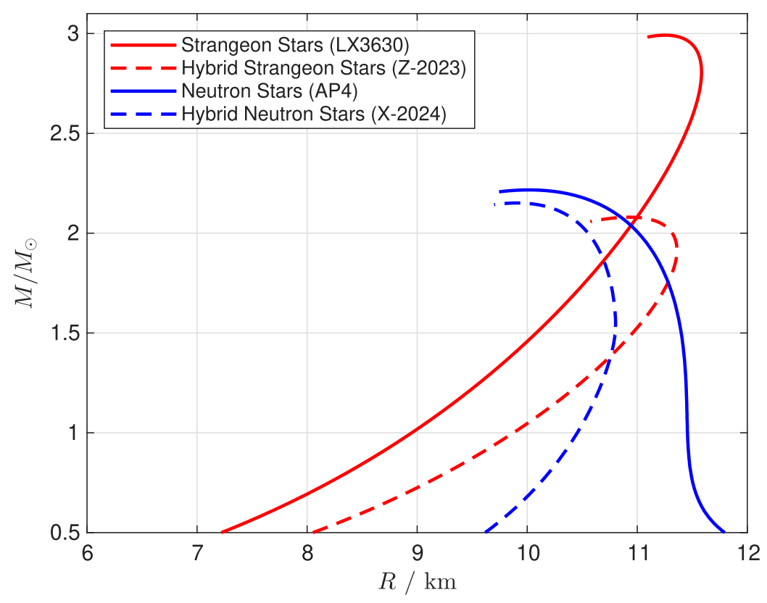
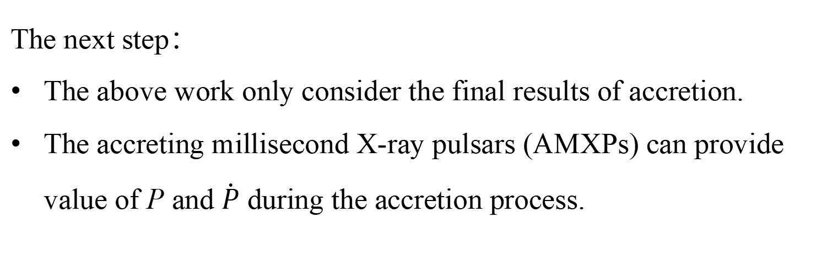
Therefore：
The structure of pulsars (M, R, I) will affect the recycle process and consequently affect the periods of MSPs.
To constrain the EoS models better, we need more low-mass MSPs and better constrains on the mass-transfer.
The next step：
The above work only consider the final results of accretion.
The accreting millisecond X-ray pulsars (AMXPs) can provide value of P and $\dot{P}$ during the accretion process.

Slide 8
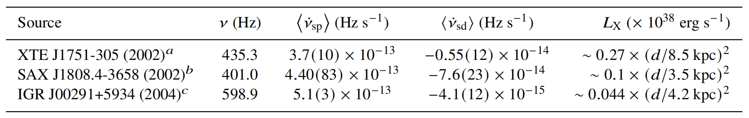
Glampedakis & Suvorov (2021)
a: Papitto et al. (2008); Riggio et al. (2011); Gierlinski & Poutanen (2005)
b: Burderi et al. (2006)
c: Patruno (2010); Papitto et al. (2011); Falanga et al. (2005)

Slide 9
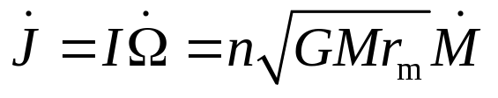
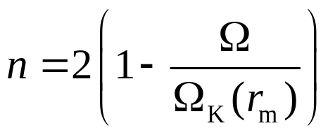


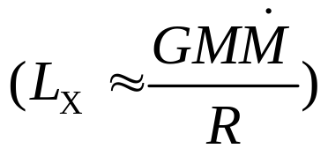

Spin-up by accretion
（1）
（2）Values of M、R、I derived under a given EoS
（3） and from observations
（4）L_{x} -->
We can plot the curves of M-B.
(Menou et al. 1999, Chatterjee et al. 2000)

Slide 10
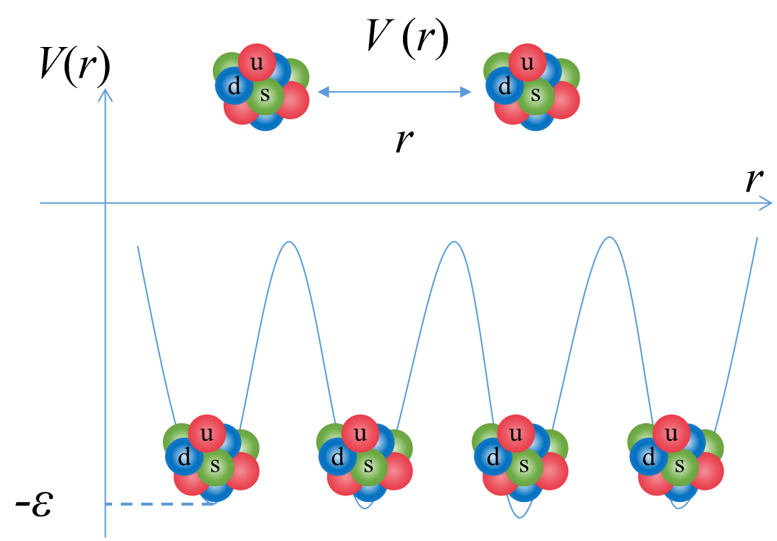
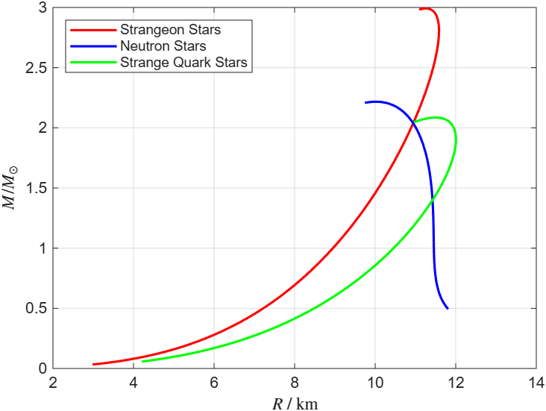
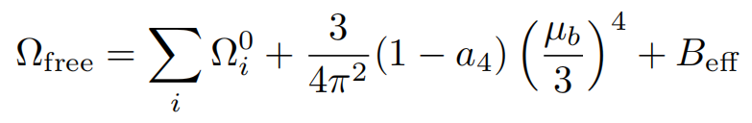

Strangeon Stars: LX n_{s} ε (Lai & Xu 2009)
  n_{s} : surface density, ε is the potential depth
  LX3630: n_{s} = 0.36 fm⁻³ , ε = 30 MeV
Neutron Stars: AP4 - {npeμ}
(Akmal, Pandharipande & Ravenhall, 1998)
Strange Quark Stars:
(Alcock et al. 1986, Haensel et al. 1986, Alford et al. 2005)

Slide 11
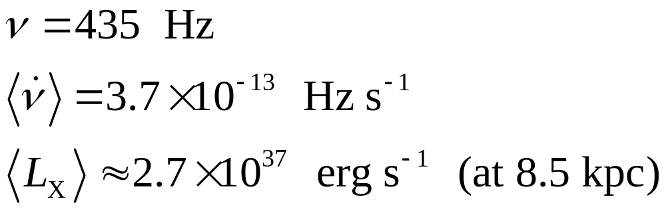
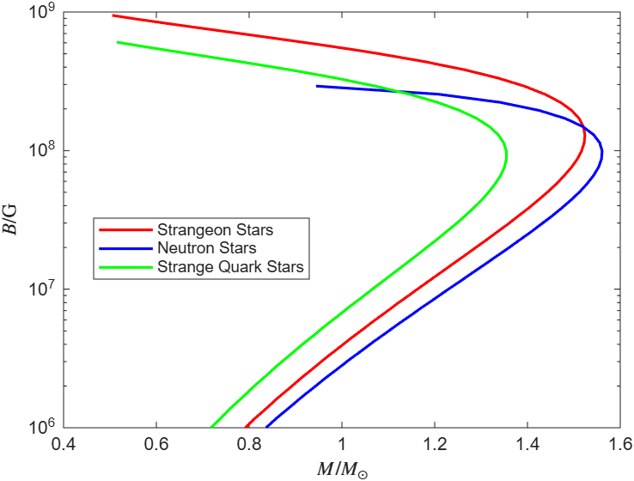
XTE J1751-305 (outburst in 2002)
Gierlinski & Poutanen (2005), Papitto et al. (2008)

Slide 12
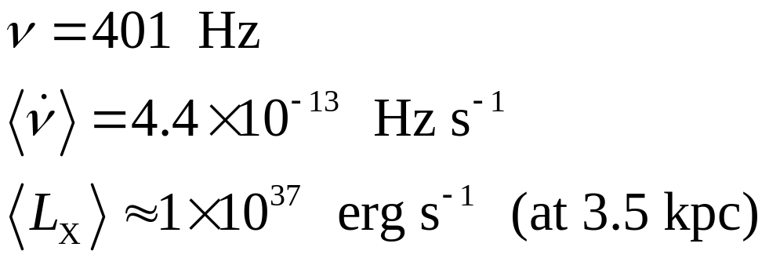
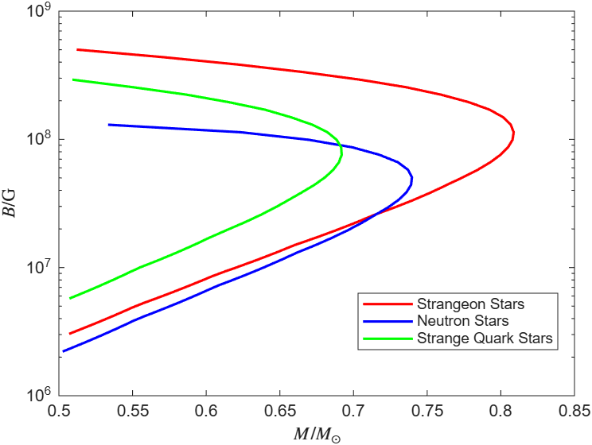
SAX J1808–3658 (outburst in 2002)
Burderi et al. (2006)

Slide 13
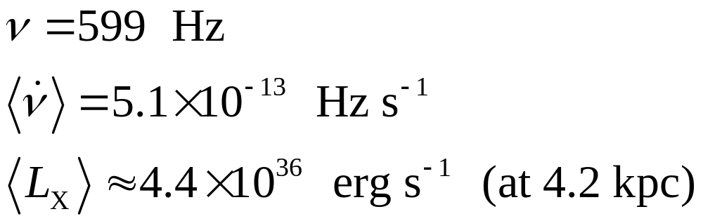
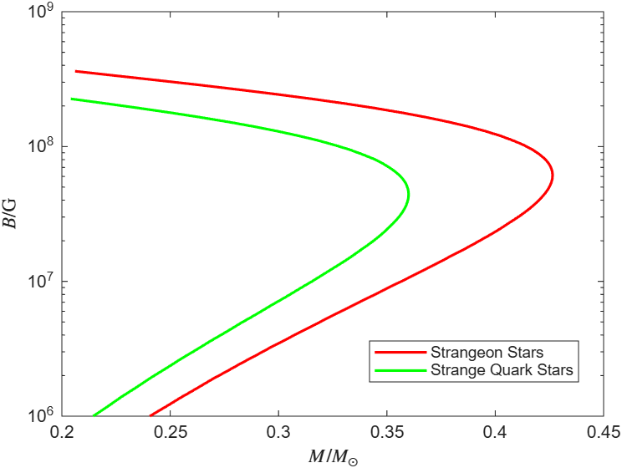
IGR J00291+5934 (outburst in 2004)
Falanga et al. (2005)
Patruno (2010)

Slide 14
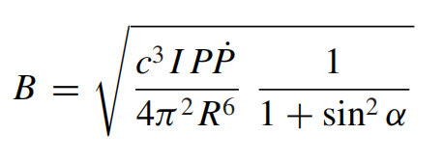
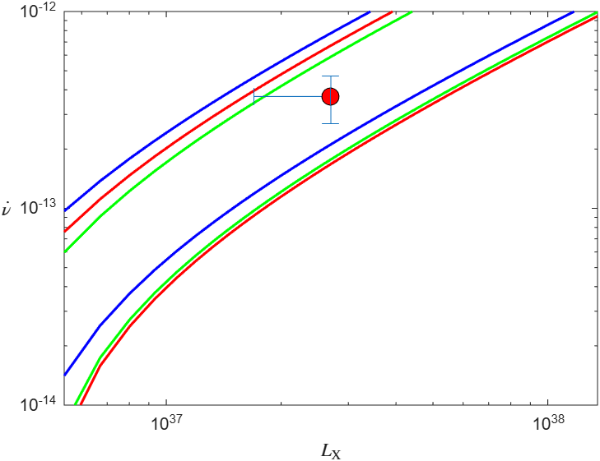
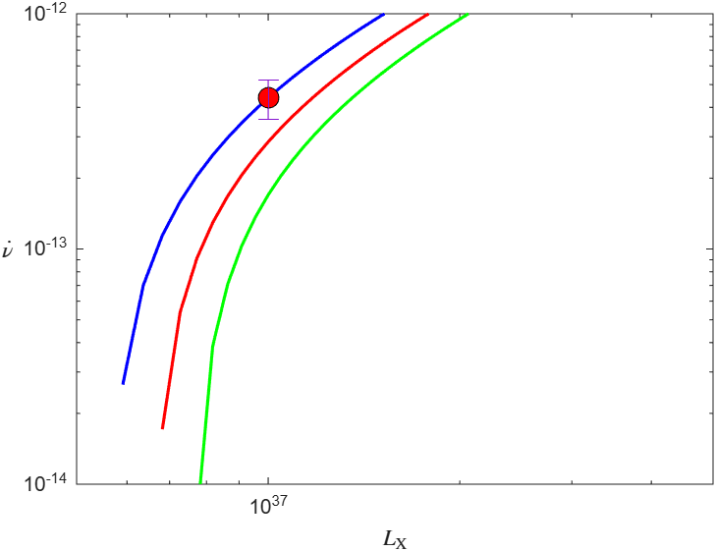
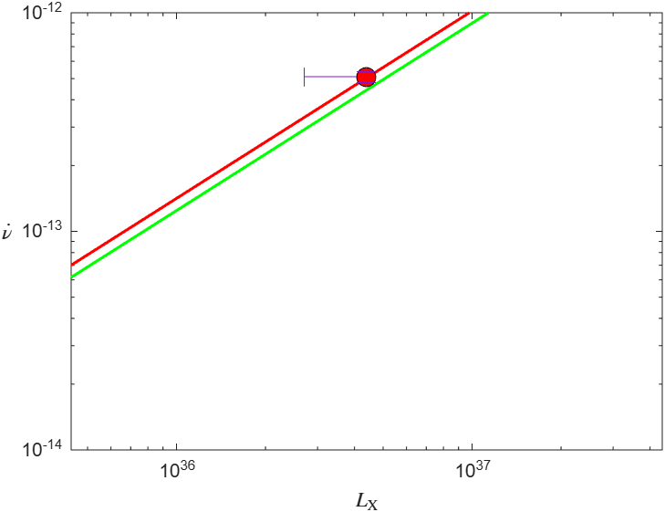
Spitkovsky (2006)
XTE J1751-305 (outburst in 2002)
SAX J1808–3658 (outburst in 2002)
IGR J00291+5934 (outburst in 2004)
M = 1 M
M = 0.5 M
M = 0.35 M
M = 2 M

Slide 15
Summary
The structure of pulsars (M, R, I) will affect the recycle process and consequently affect the periods of MSPs.
  More low-mass MSPs and better constrains on the mass-transfer are needed to constrain the EoS models better.
Can Accreting Millisecond X-ray Pulsars (AMXPs) test EoS?
  AMXPs with very low-mass ?

