Slide 1

Evidence of IMBH in GCs
Zhichen Pan (NAOC), Yujie Lian (MPIfR)
Lei Qian (NAOC), Shuo Cao (BNU)
Yu Pan (CQUPT), Bo Peng(SWUST), etc+++
2026.7.5
Notes:
Wang et al. M13?
M3A?

Slide 2
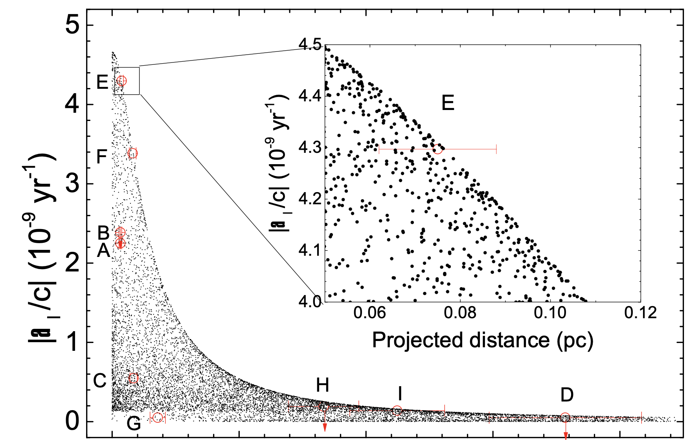
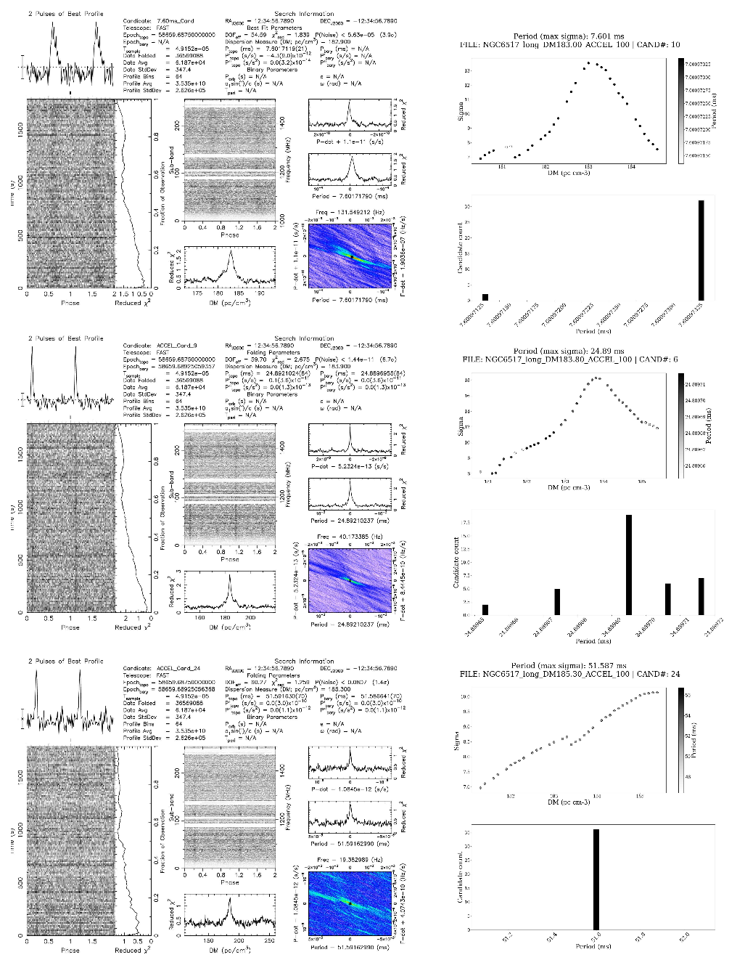
Discussion with Dr. Xie, Yi and His Paper (FPS11?)
Pan et al. 2021
15 PSR in NGC6517
9/15 timed
IMBH ~10⁵ Ms
Xie et al. 2023

Slide 3
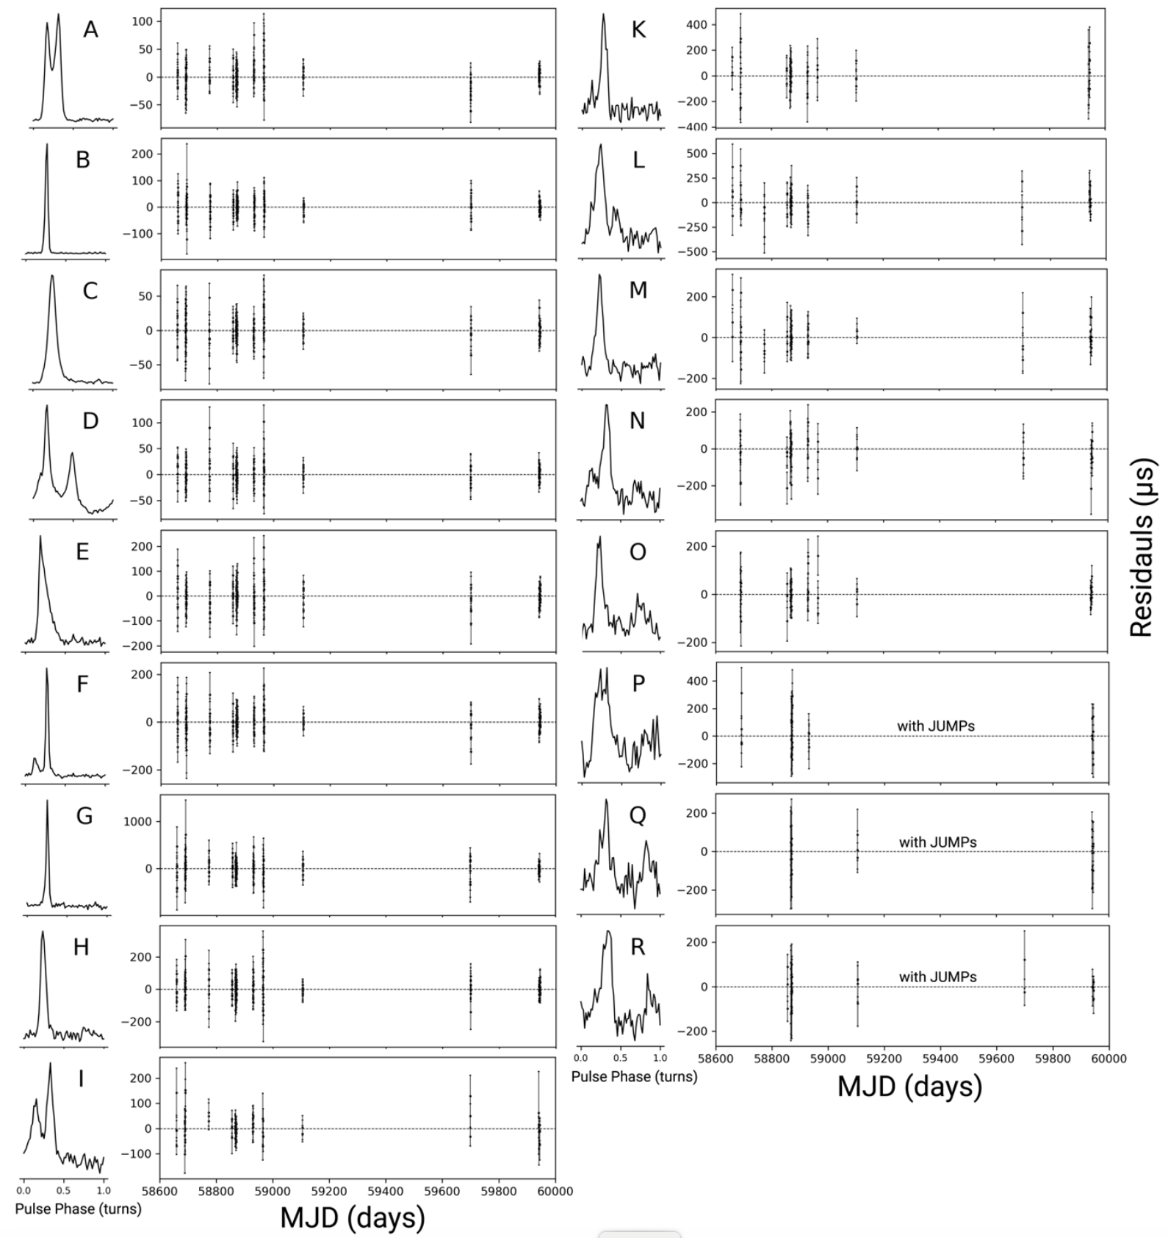
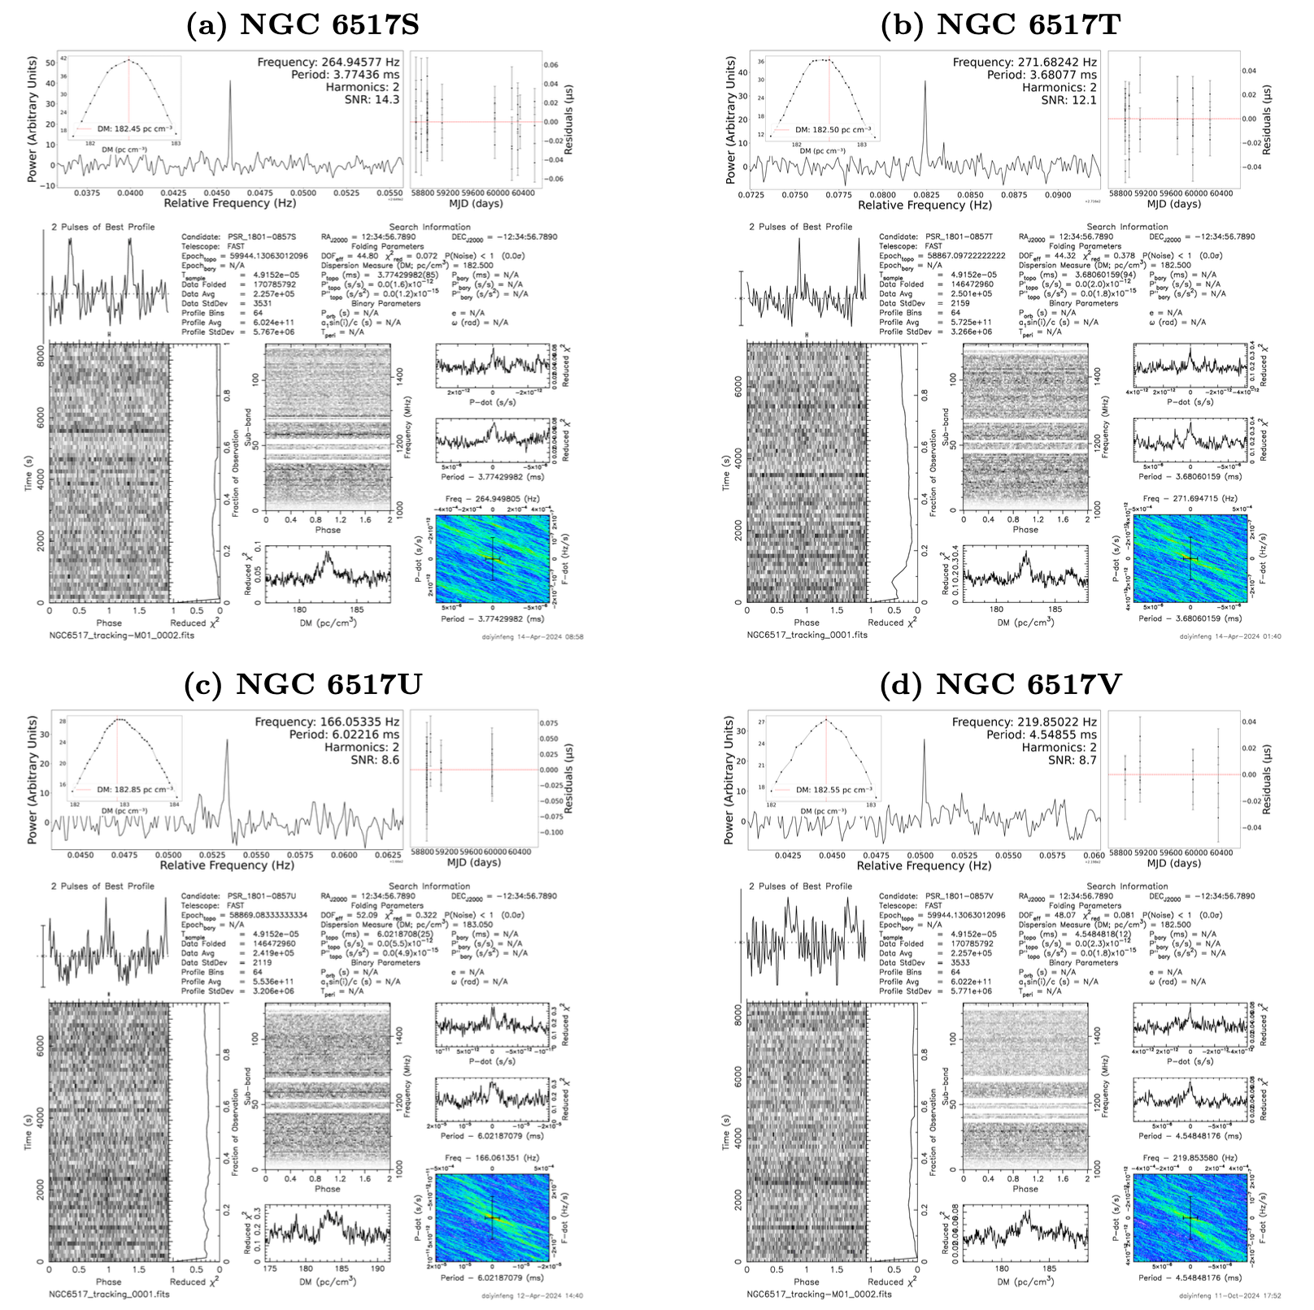
Current Pulsar Timing Progress in NGC 6517 PSRs
Yin+ 2024, A-O, no clock correction
Dai+ 2026, S-V, with JUMPs

Slide 4
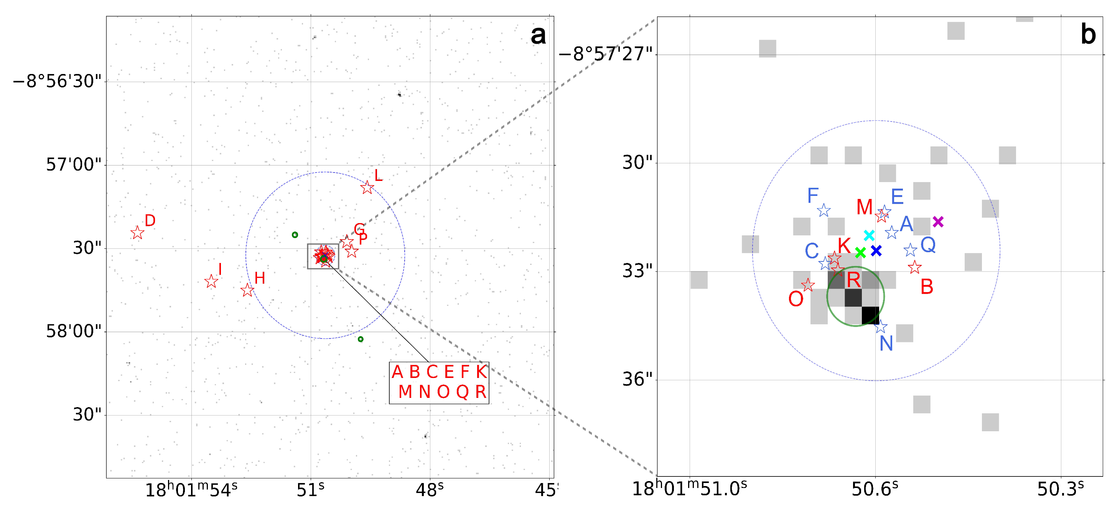
NGC 6517 PSRs Positions
Phase connected, clock corrected, A-R (17/21), S-V with JUMPs
Lian+ in prep.

Slide 5
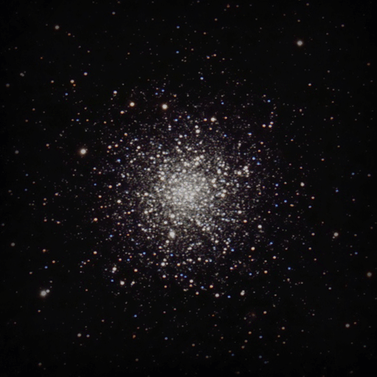
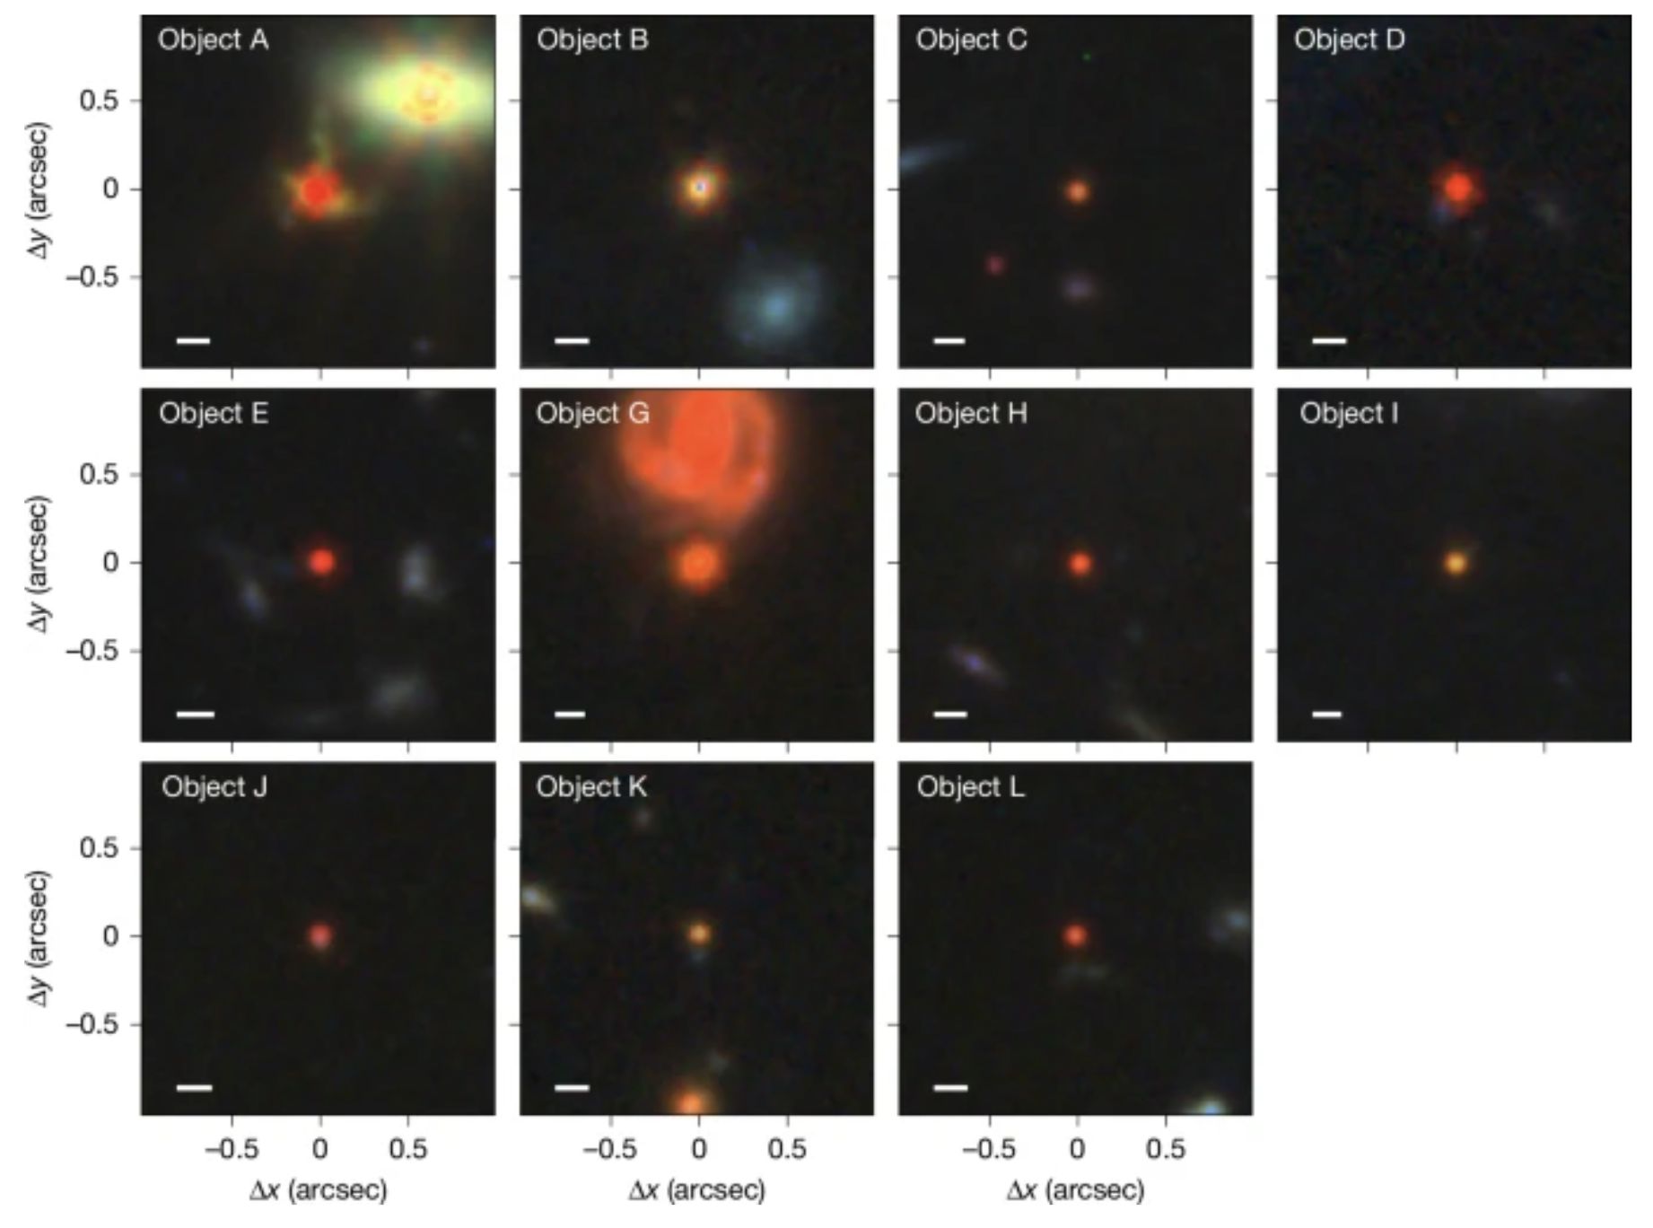
Finding Evidences of IMBH in GCs
IMBH = Intermediate Mass Black Hole
M12, from amateur astronomer Chen Zhang
If not merged along time, maybe, IMBH in galaxies and evolved to GCs?
In FAST sky, M15 (most massive) and NGC 6517 (highest core density)?
Rosakov+ 2026

Slide 6
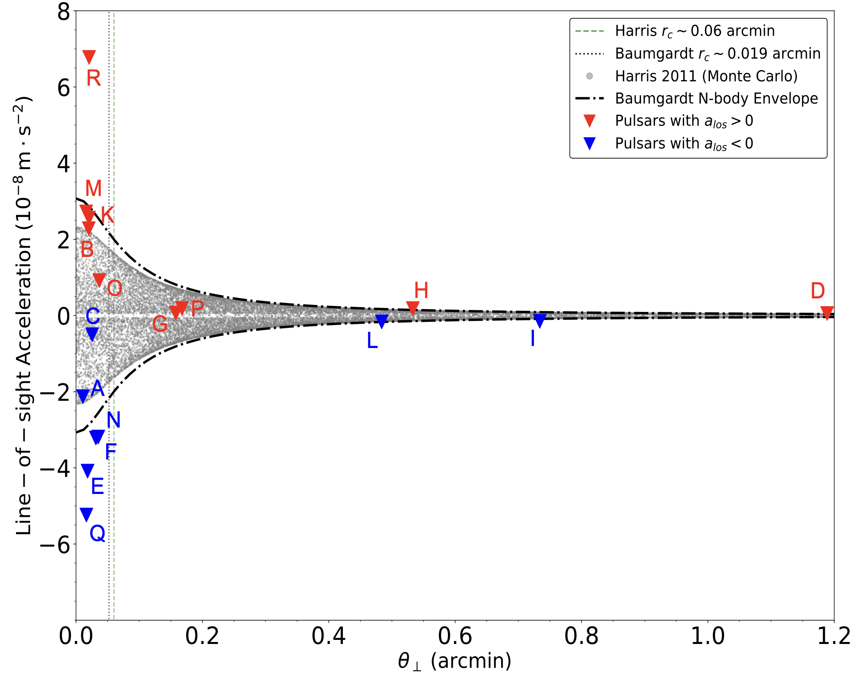
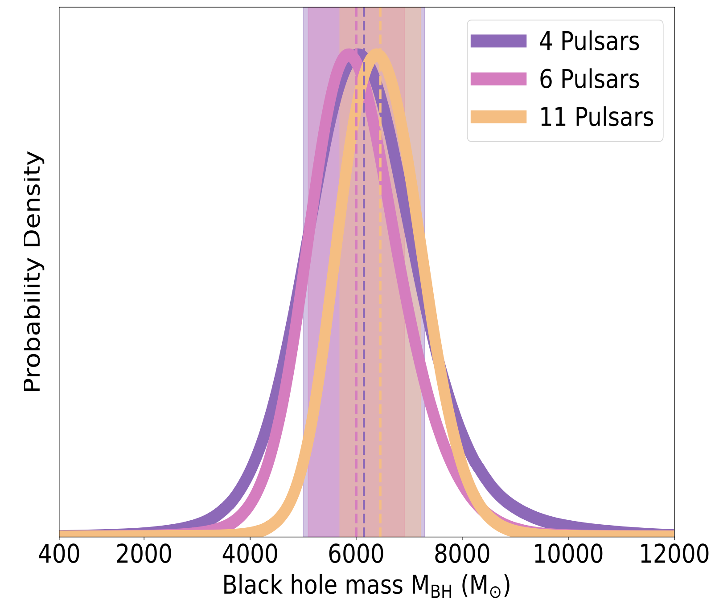
Possible IMBH and Limitations
Lian+ in prep.

Slide 7
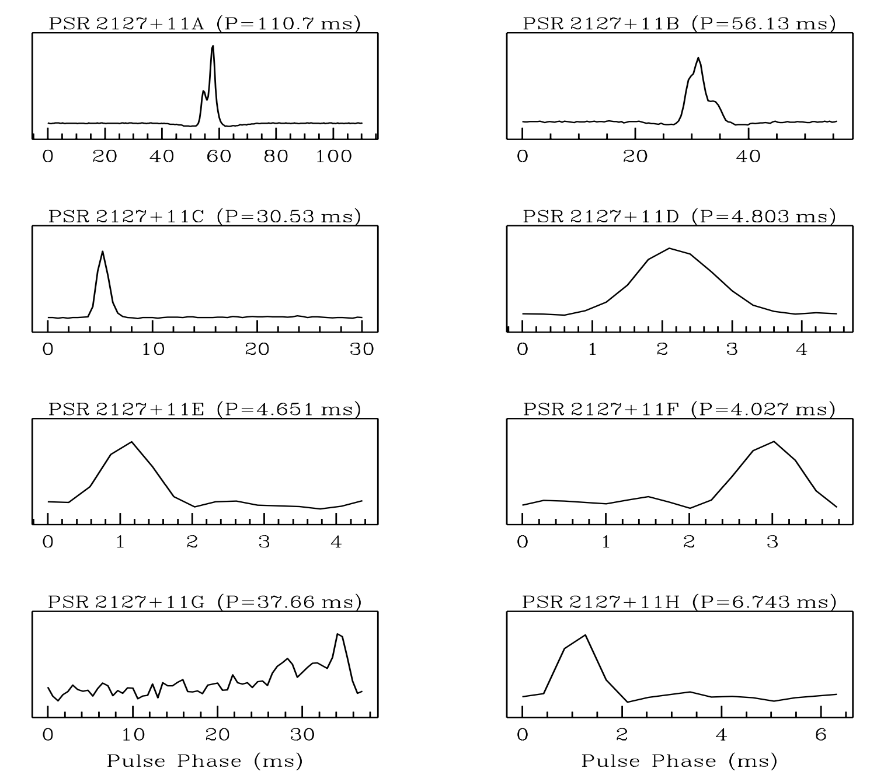
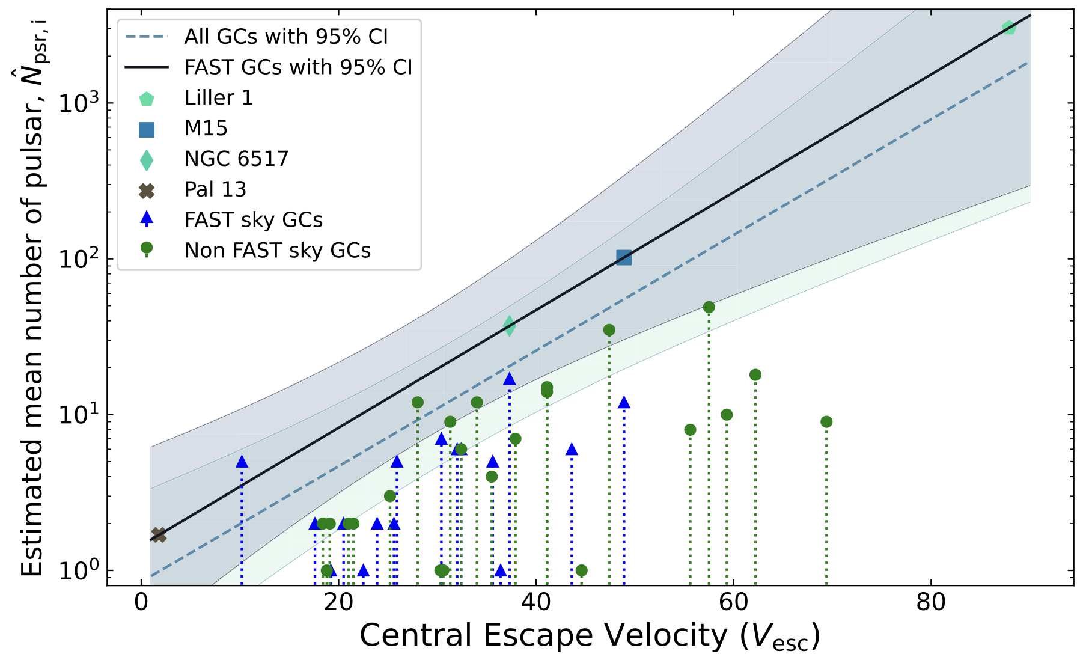
What’s in M15: More and More Pulsars
Yin+ 2024
M15 Pulsar Discoveries:
M15A, Wolszczan+ 1989
M15B/C, Anderson+ 1990
M15D/E/F/G/H, Anderson 1993
M15I, Pan+ 2021 (28 years later!)
M15J/K/L, Wu+ 2024
M15M/N/O, Dai+ 2025/2026
Anderson 1993

Slide 8
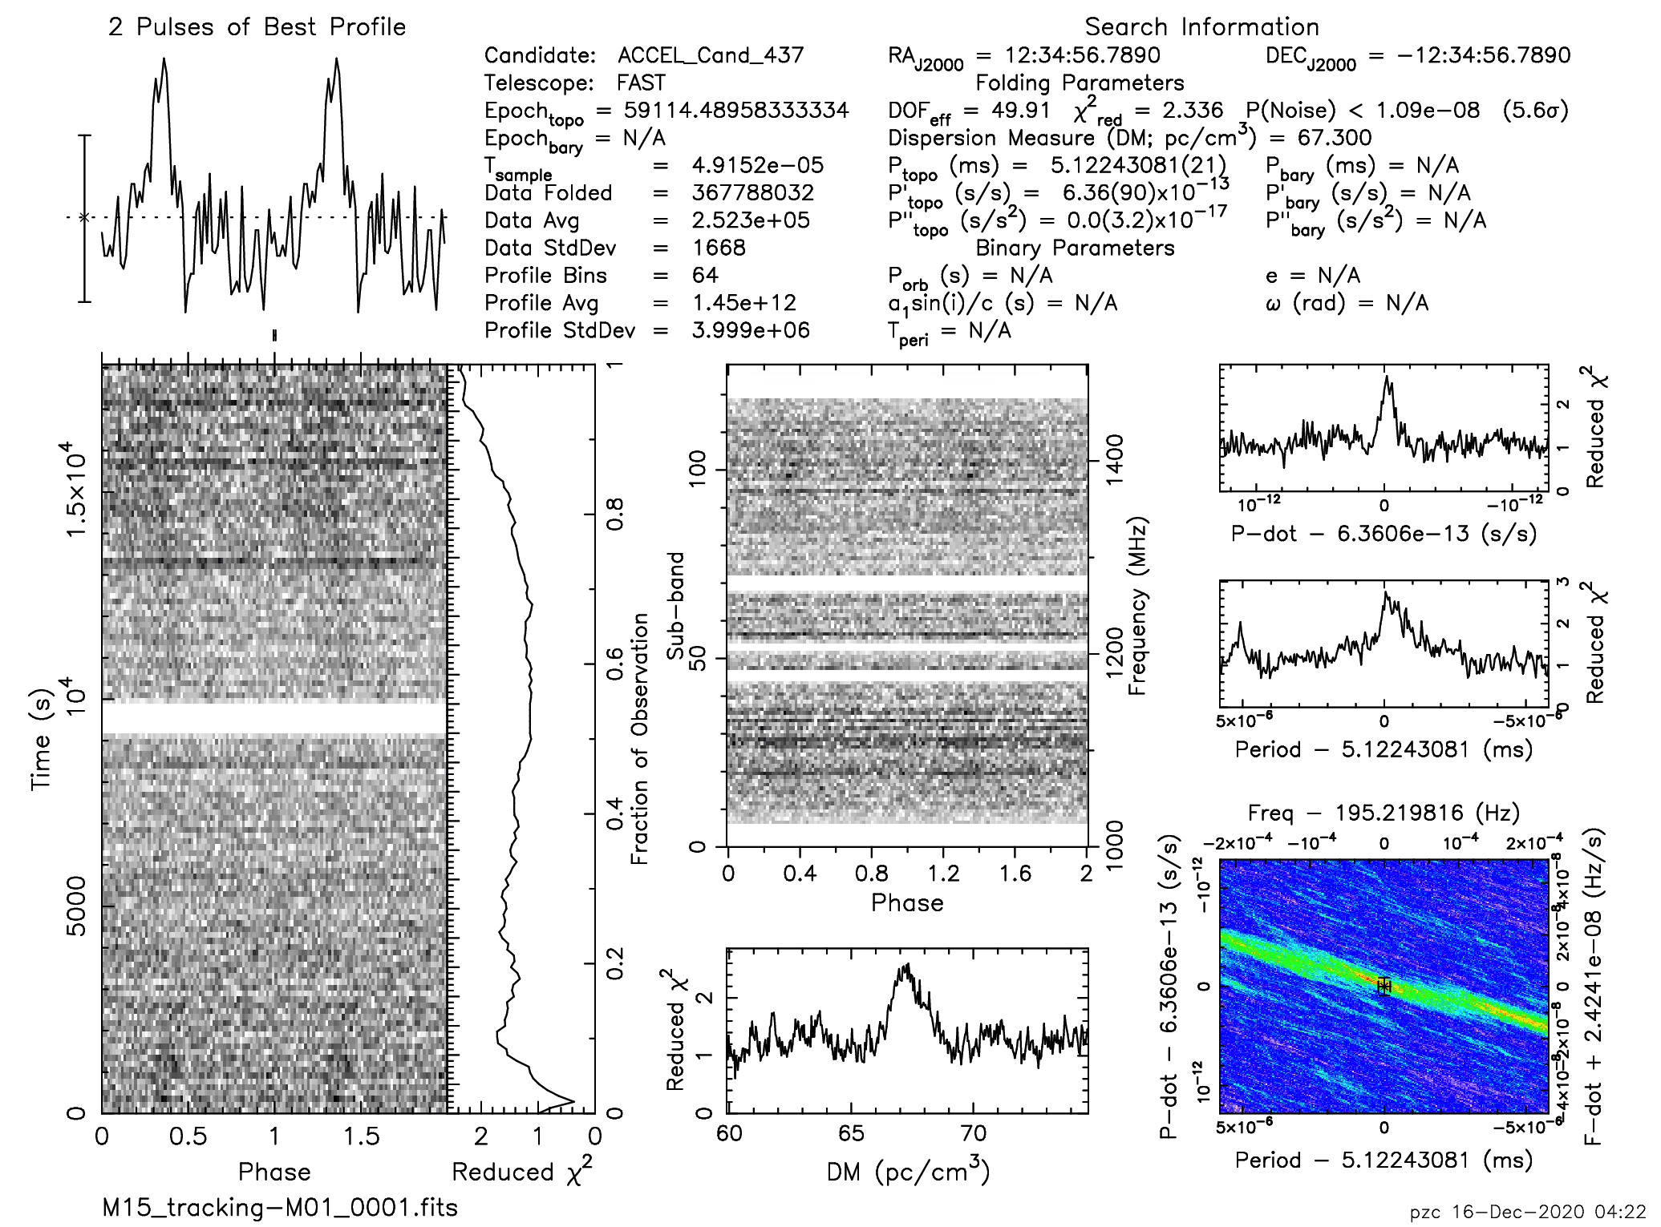
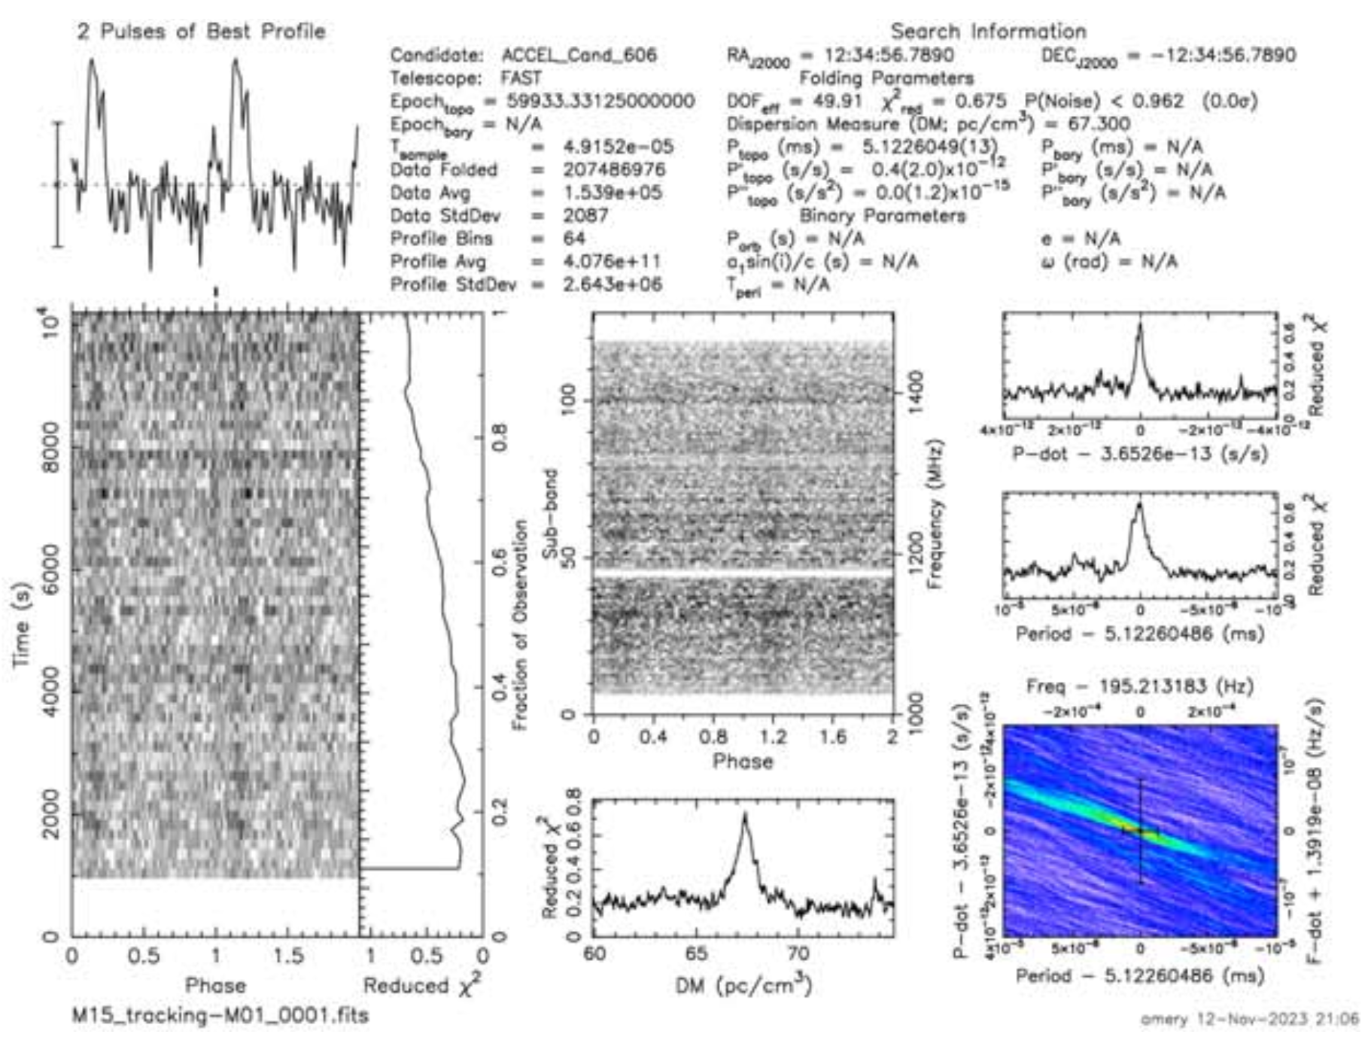
Discoveries of M15I
Wu+ 2024
Discovered by spatial modulation
Faint and confirmed in 2024
No phase connected timing
Pan+ 2021

Slide 9
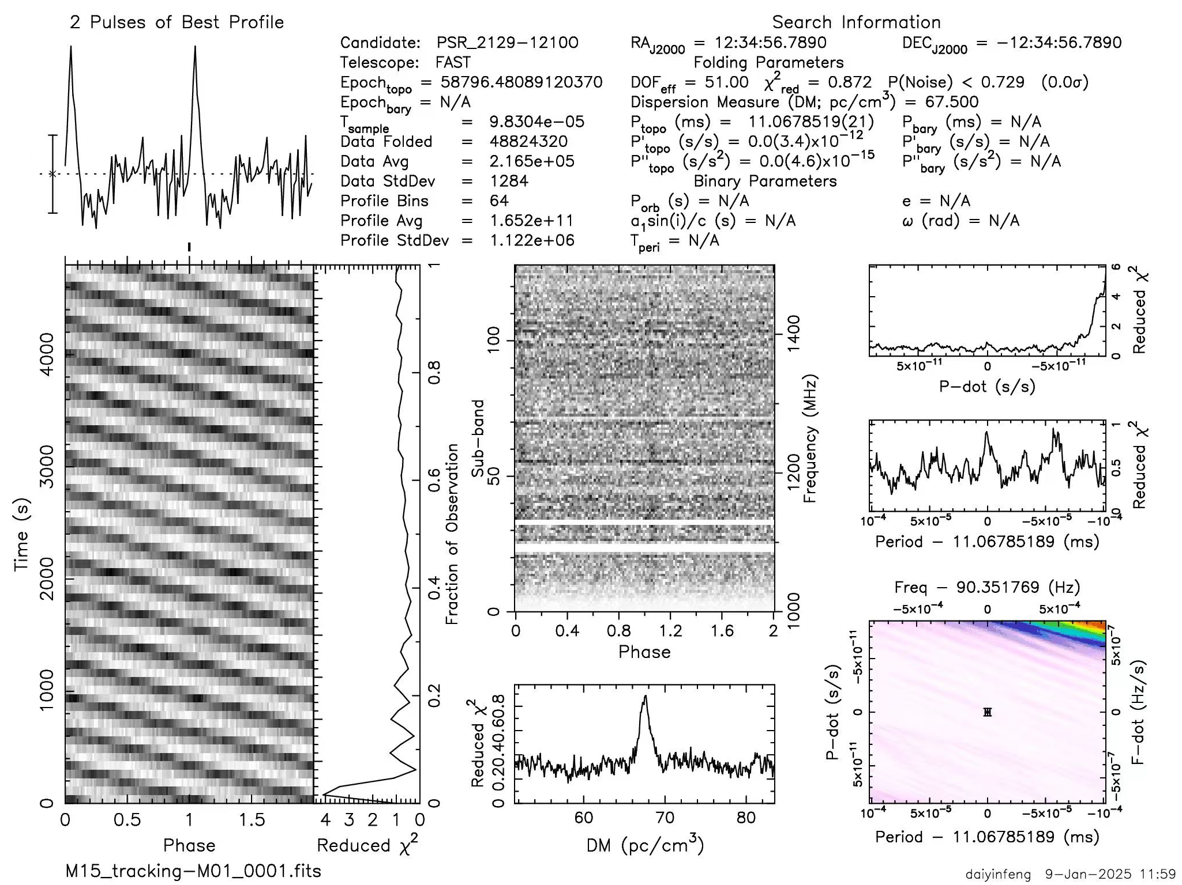
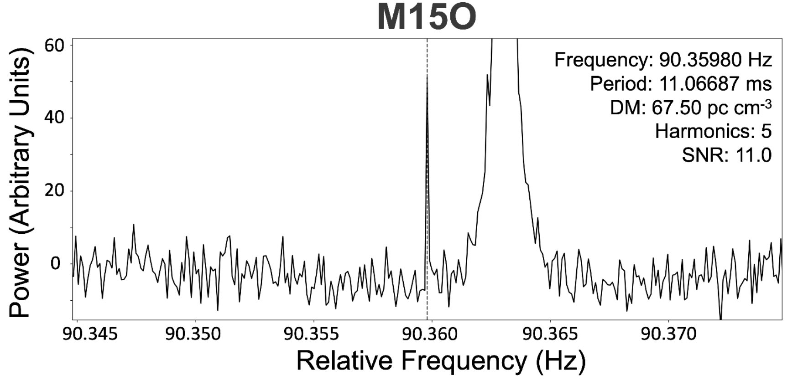
Discoveries of M15O
F1 = 1.79 X 10⁻¹⁴ Hz s⁻¹
F2 = 3.31 X 10⁻²³ Hz s⁻²
Near core (project distance)
Dai+ 2025

Slide 10
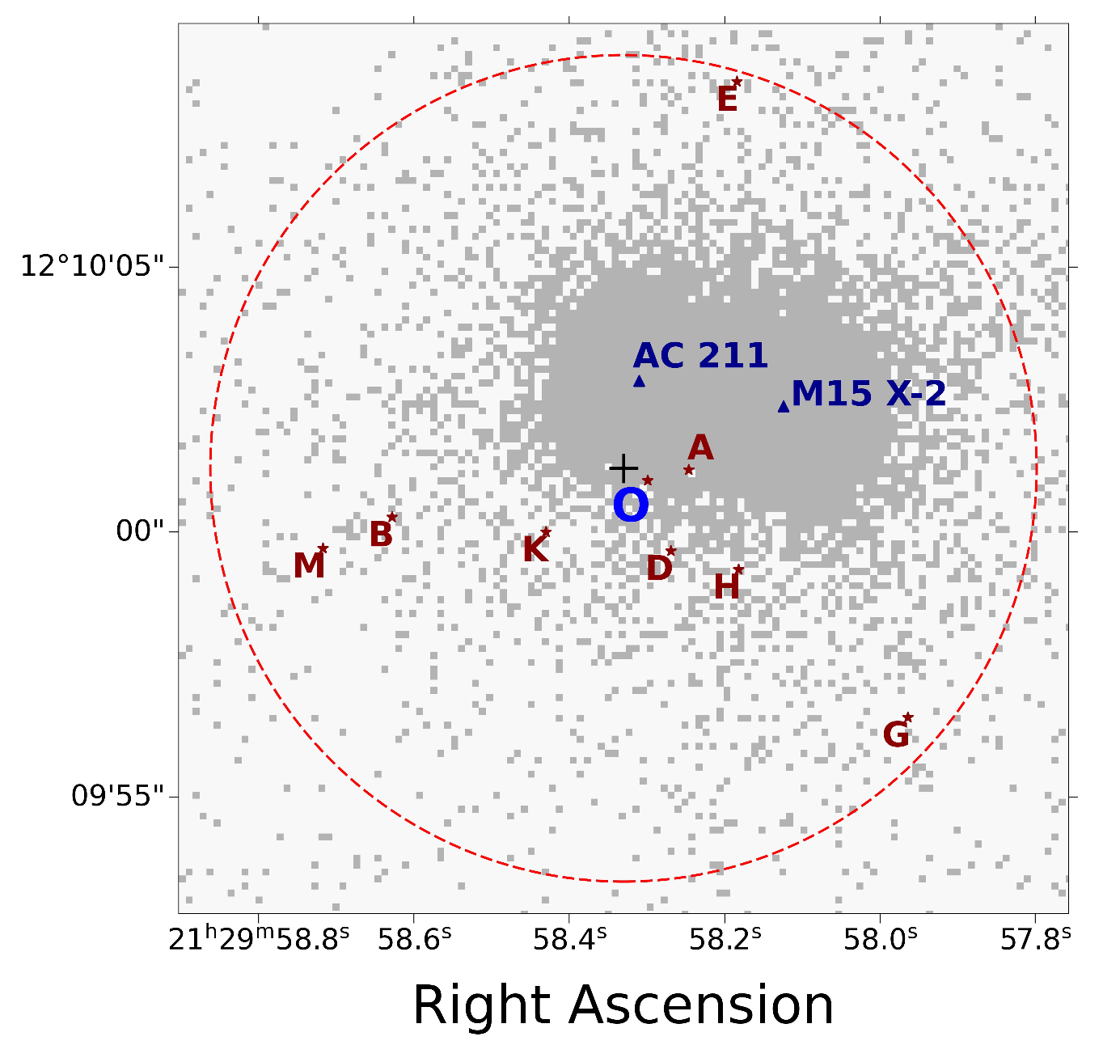
F1, F2, and maybe F3 for GC MSPs: Orbits?
A MSP should not have extraordinarily high F1 and measurable F2.
F3 for an isolated MSP???
In core-collapsing Globular Cluster M15, typical binary pulsars should not exist, especially for long orbital period binary pulsars.
How about either 1) two MSP orbiting one IMBH, or 2) two MSP-IMBH binaries in one GC???
I
Dai et al. 2025
with M15I possible position added

Slide 11
Conclusions and Forecast of My Next-year Presentation
NGC 6517: FAST GC pulsar survey discovered 17 pulsars, systematically high F1, no F2 or F3 measured, located near core region, IMBH confirmation needs space limitation.
M15: why M15I and M15O have such high F1 and even F2 and F3?
Next year: binary stacking search, e=0.985 binary, or, (if luckily enough) a triple pulsar!

Slide 12
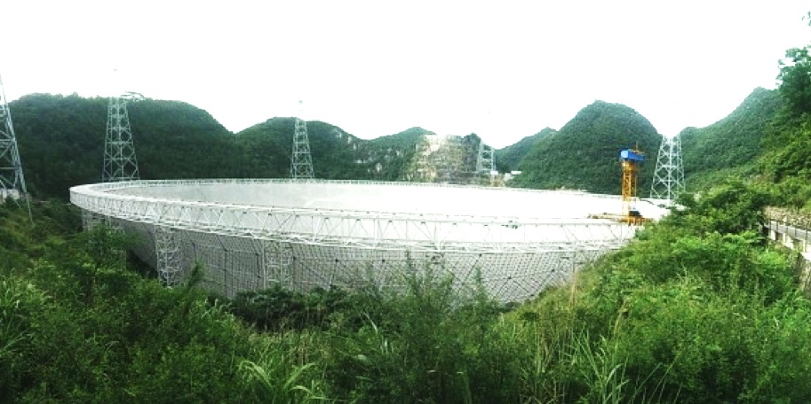
Evidence of IMBH in GCs
Thank You!
Zhichen Pan (NAOC), Yujie Lian (MPIfR)
Lei Qian (NAOC), Shuo Cao (BNU)
Yu Pan (CQUPT), Bo Peng(SWUST), etc+++
2026.7.5
Photo Credit: Zach and Shana

