Slide 1


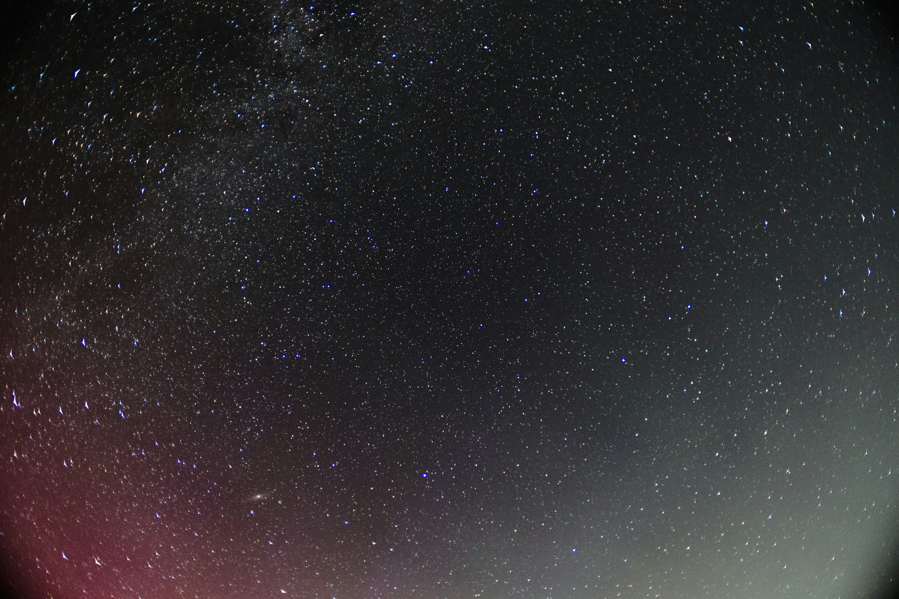
RFI identification using eigenvalue decomposition for multi-beam observations
Speaker: Juntao Bai (白俊涛)
Supervisor：Shi Dai (代实,CSIRO）、Na Wang (王娜,XAO）
5 July, 2026 · Guiyang

Slide 2
Outline
Background
Method and Results
Summary

Slide 3
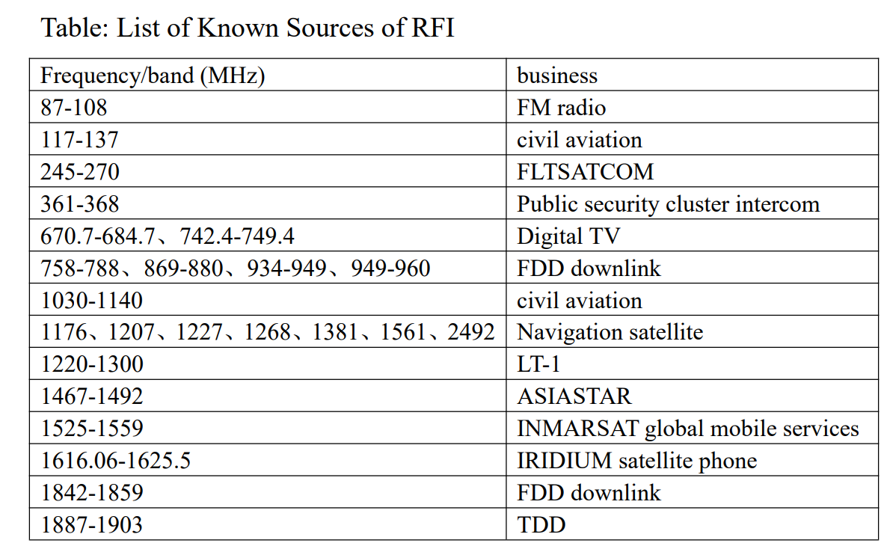
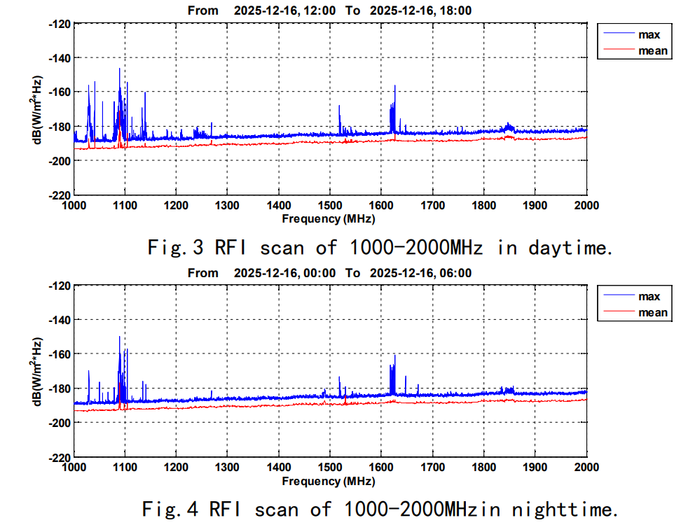
Background
Radio frequency interference (RFI)
from FAST

Slide 4
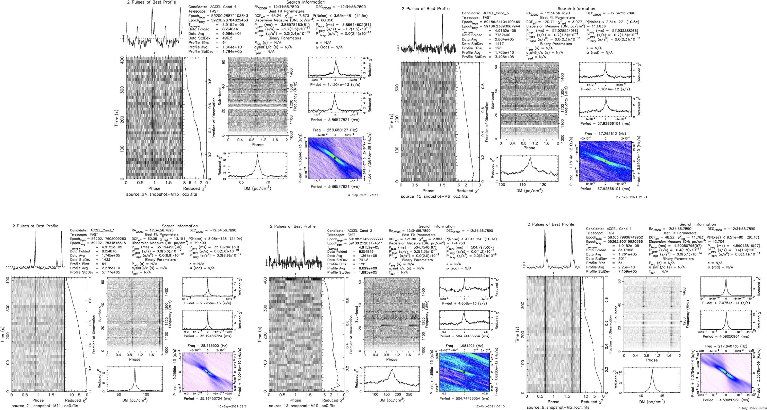
Background
Pulsar
candidates

Slide 5
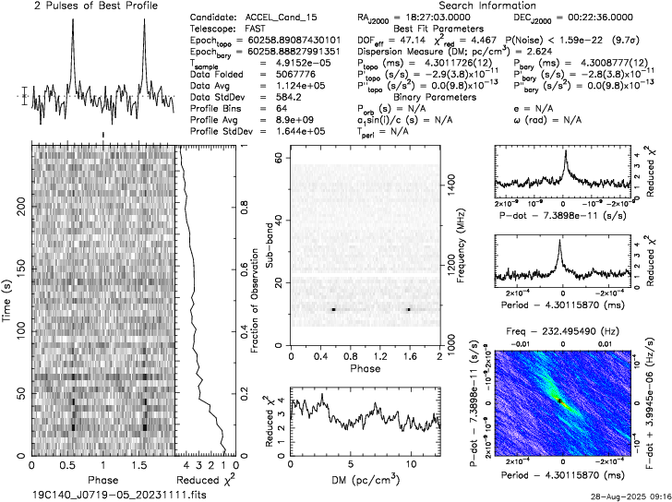
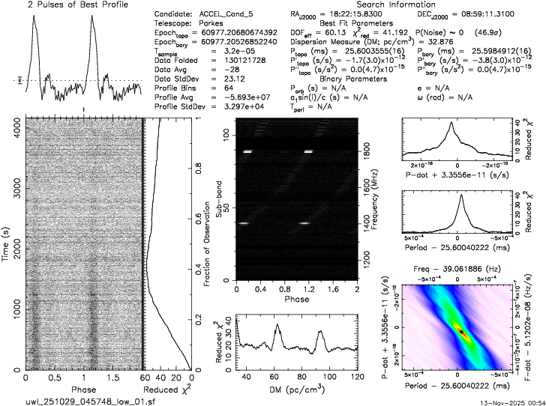
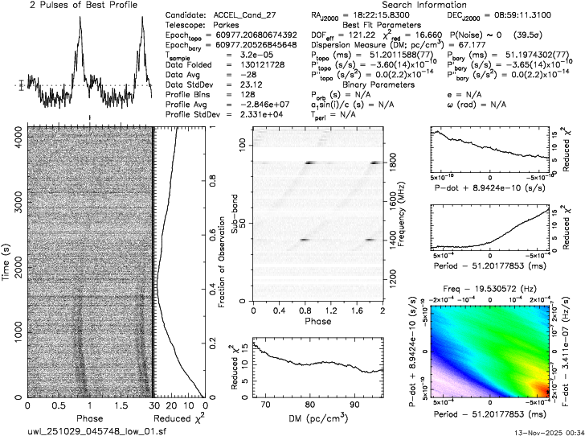
Background
Pulsar candidates (RFI)

Slide 6
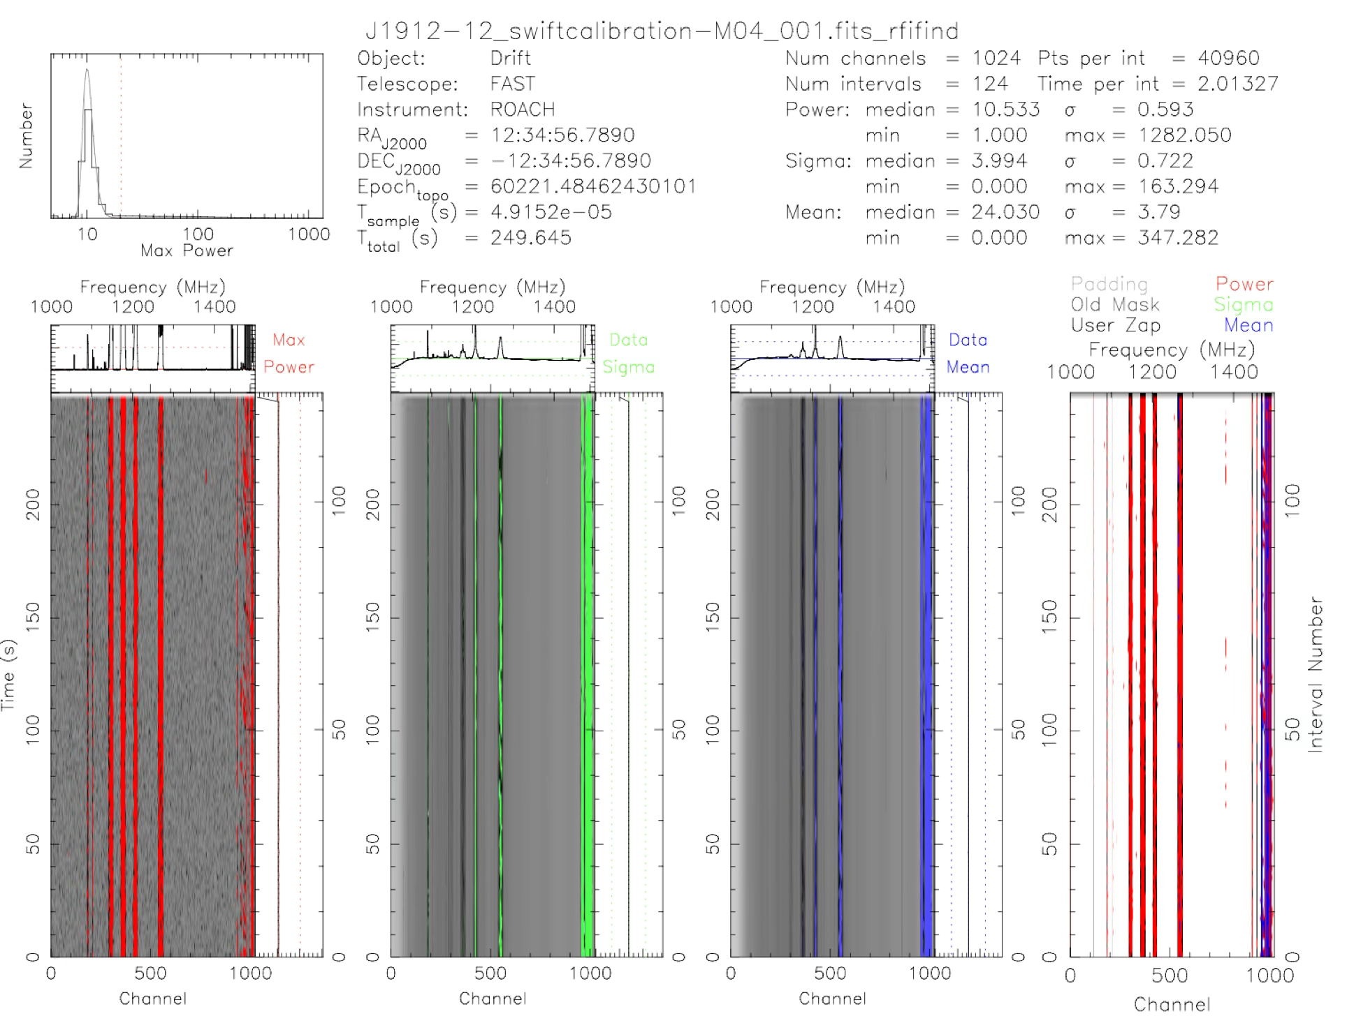
Background
RFI
identification
using
rfifind

Slide 7
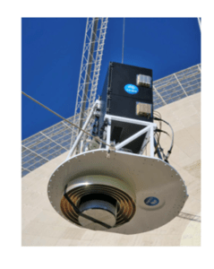
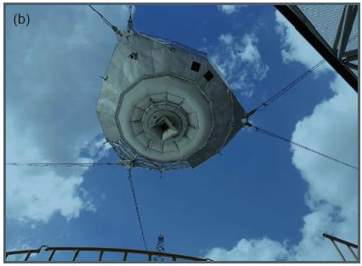
Background
Parkes
FAST
from FAST
from CSIRO

Slide 8
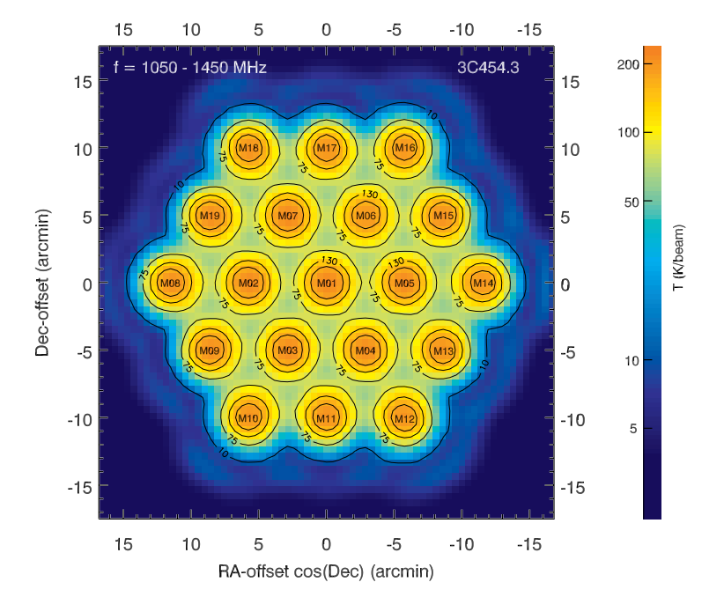
Background
FAST 19 beam
Jiang et al. 2020

Slide 9
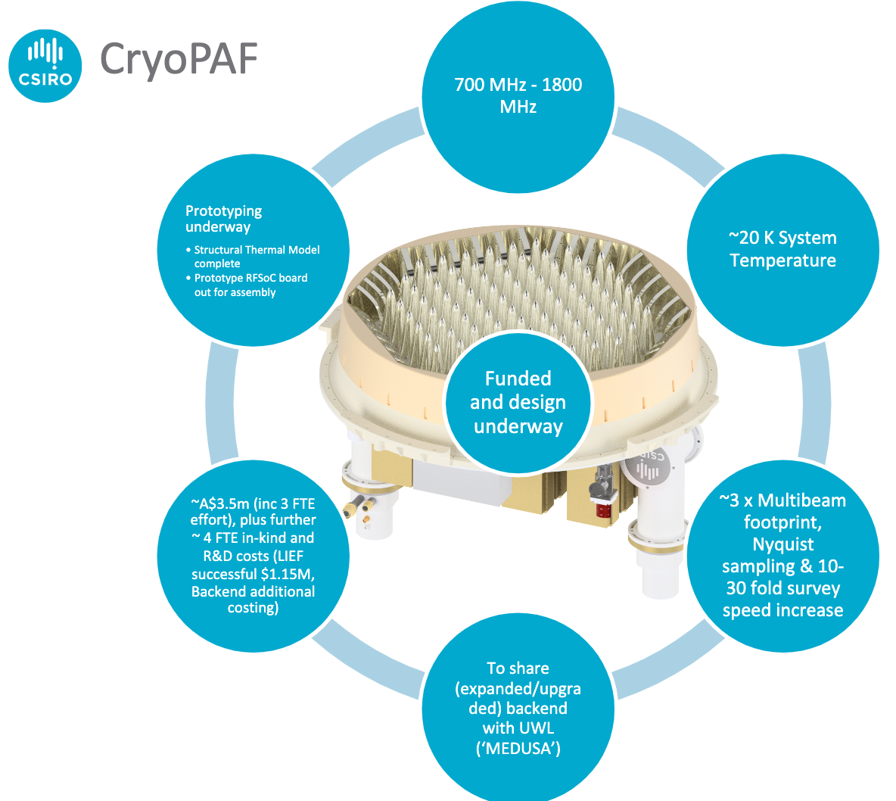
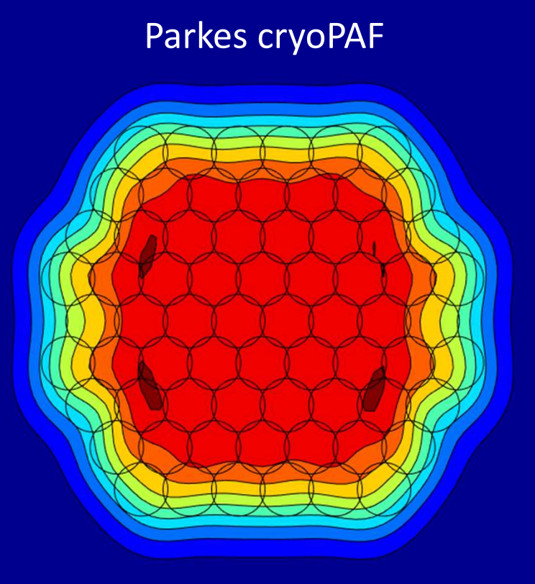
Background
Parkes PAF
from CSIRO

Slide 10
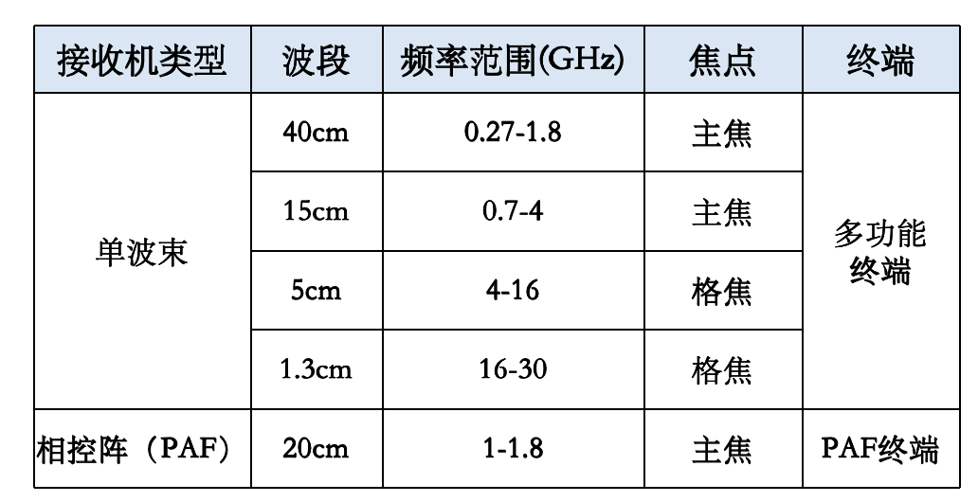
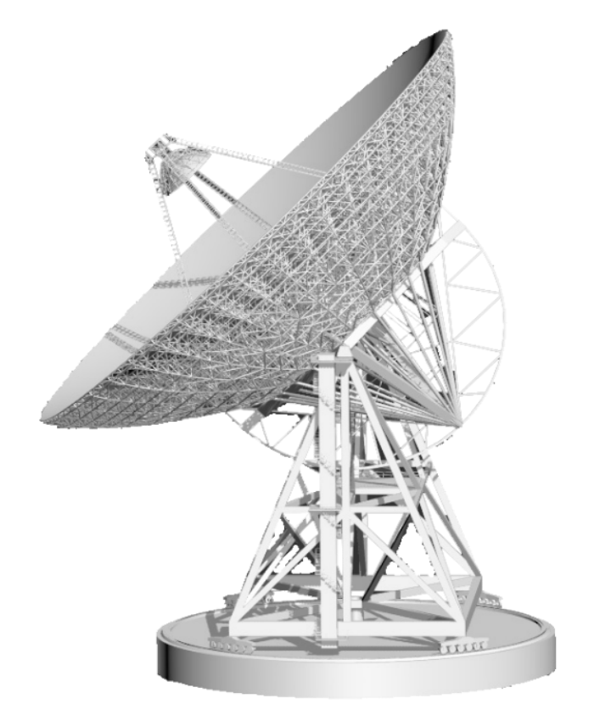
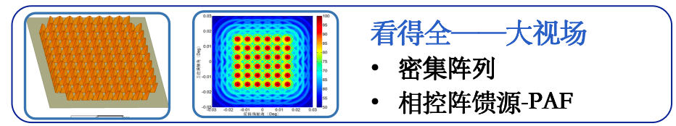
Background
QiTai radio Telescope，QTT（110米口径全向可动射电望远镜）
from XAO

Slide 11
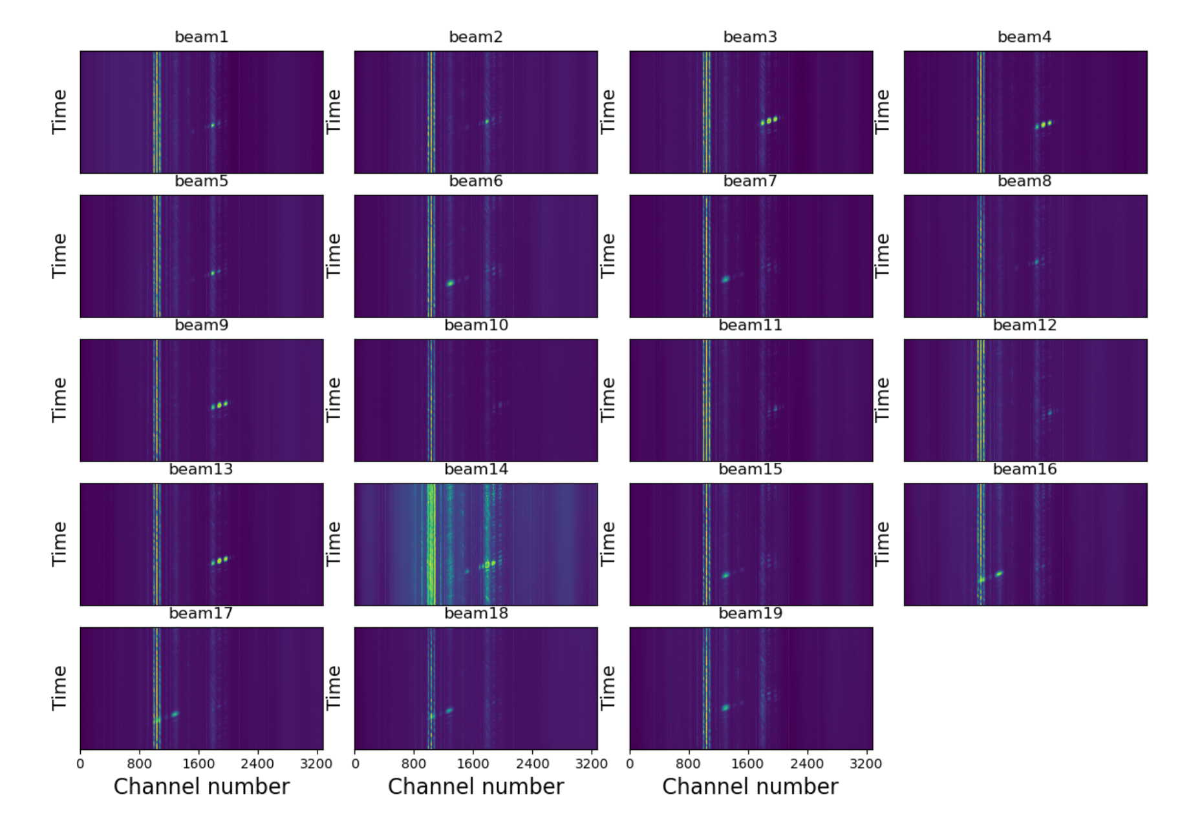
Background
FAST 19-beam test observation
RFI
highly
correlated

Slide 12
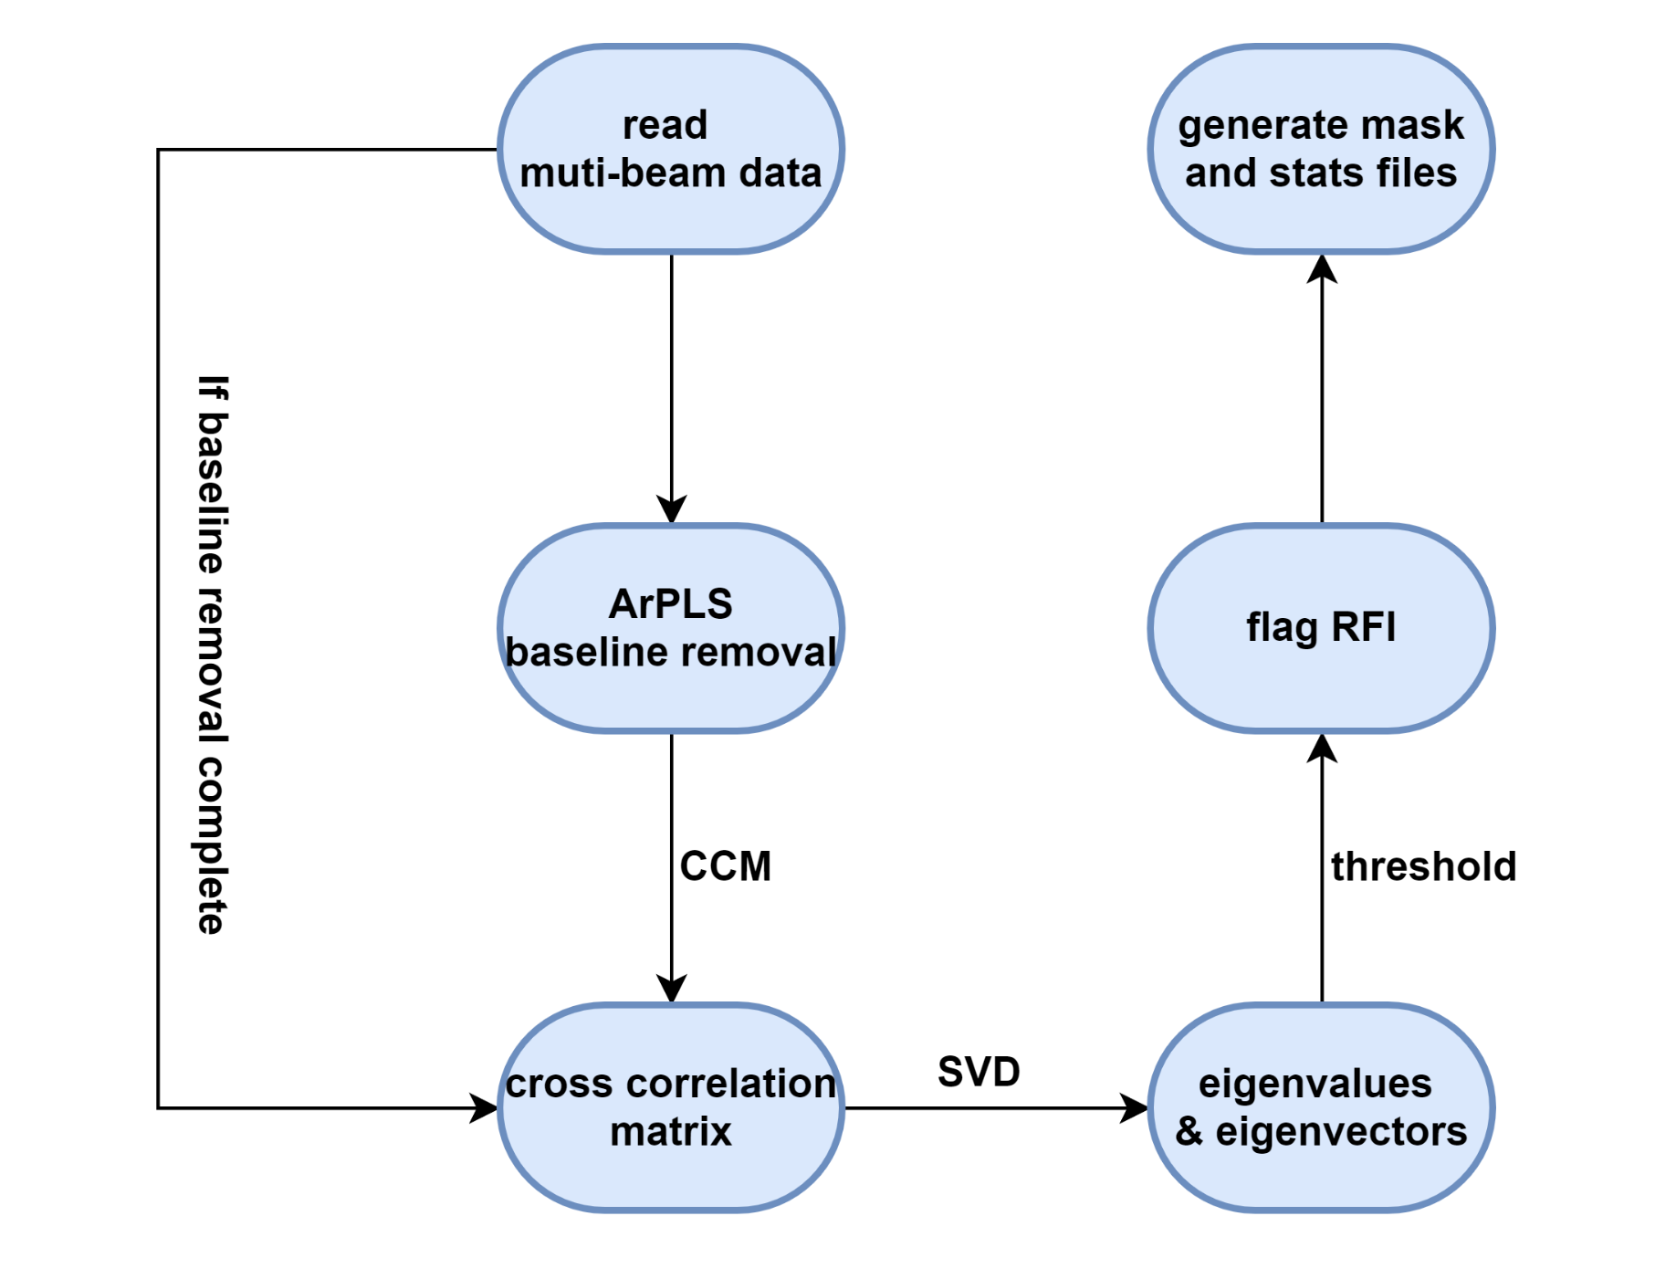

Method and Results：
mRAID (multi-beam RAdio frequency Interference Detector)
Flowchart of mRAID
EVD

Slide 13
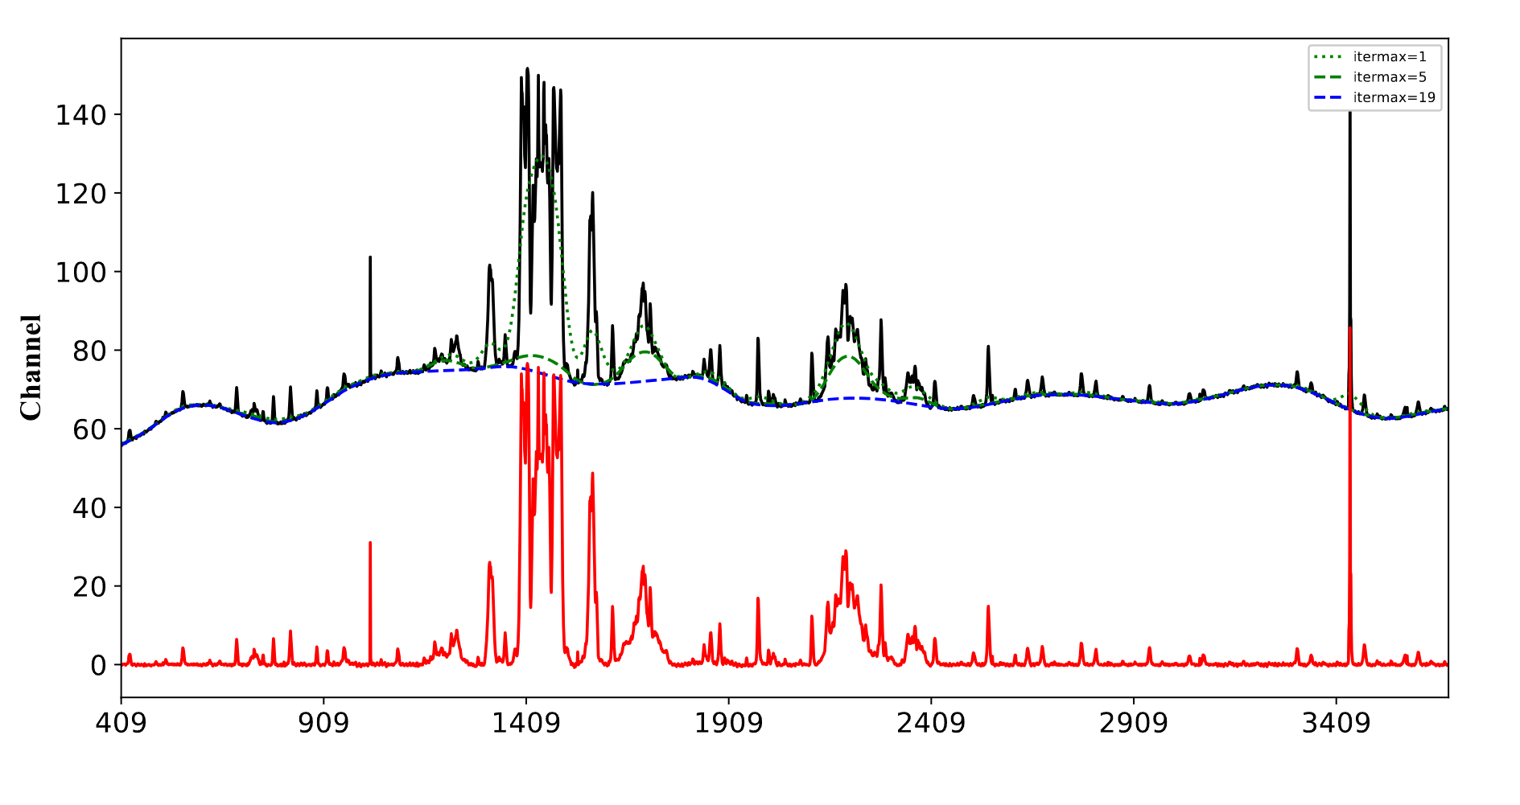
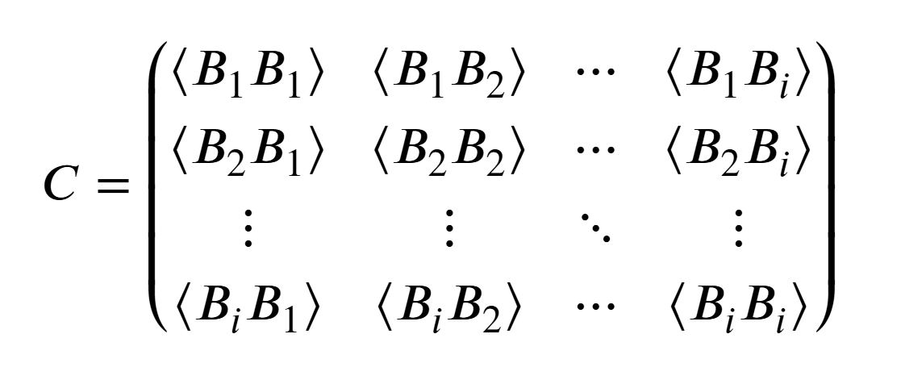
Method and Results：
Baseline removal using ArPLS (the Asymmetric Reweighted Penalized Least Squares)
the cross-correlation matrix (CCM)
Notes:
非对称加权惩罚最小二乘

Slide 14
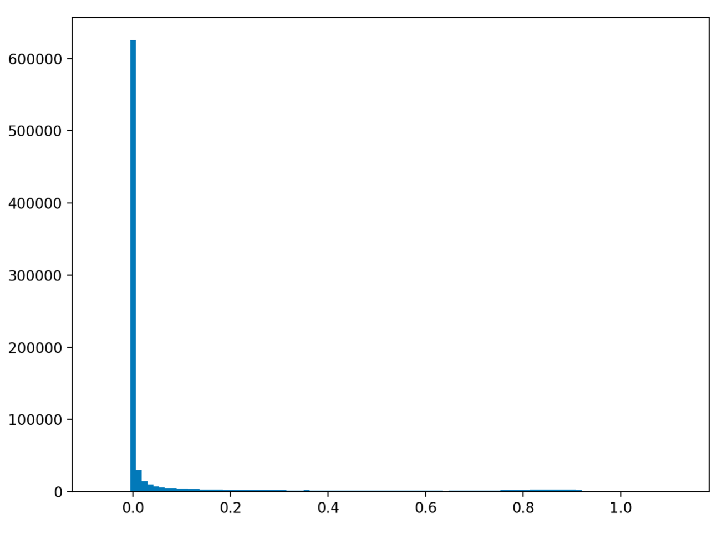
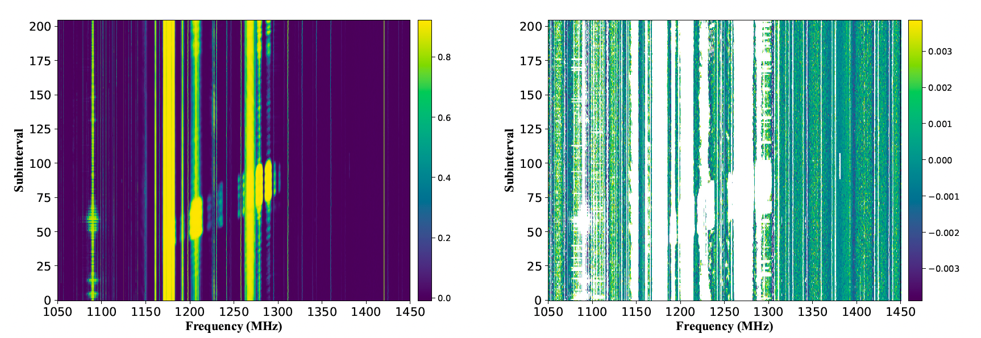
Method and Results：
The eigenvalues and its distribution

Slide 15
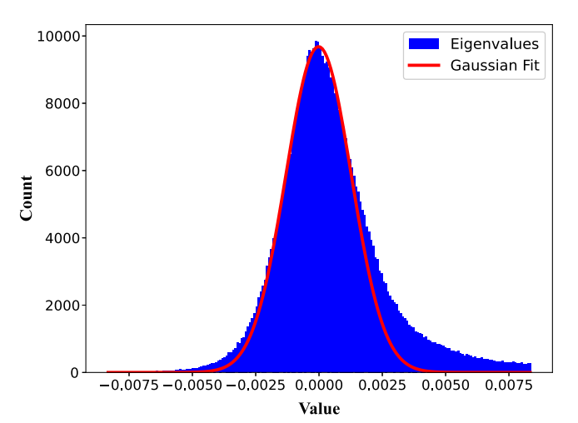
Method and Results：
The result after masking out RFI

Slide 16
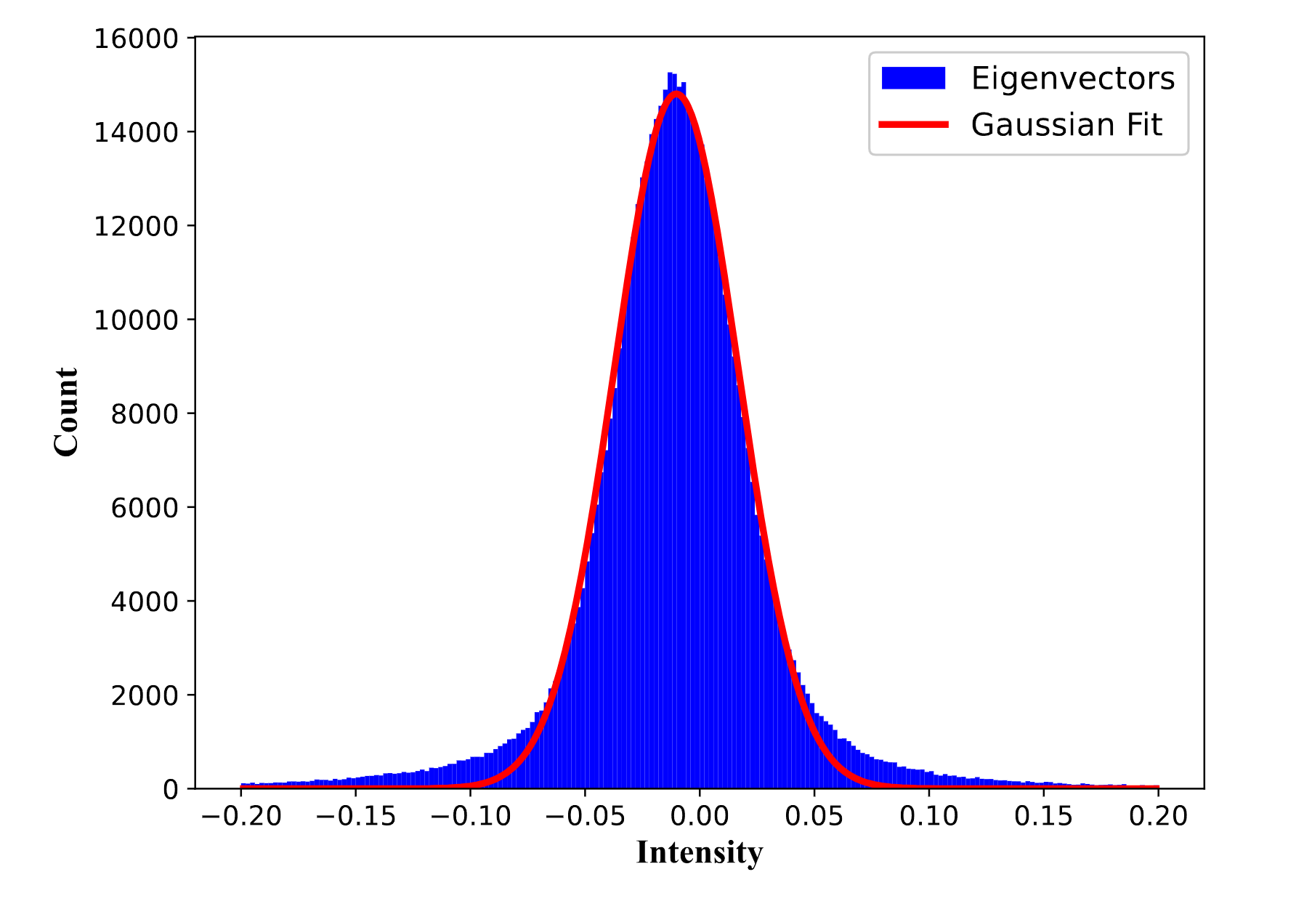
Method and Results：
Histogram of eigenvectors of non-RFI channels derived for the FAST 19-beam test observations
[0.01842425 0.0281336
0.03875579 0.03161817
0.01889884 0.01745859
0.02682648 0.02991065
0.01230798 0.01192893
0.01964607 0.02123586
0.03024516 0.03057538
0.0258399 0.02481017
0.01794422 0.01385124
0.02592183]

Slide 17
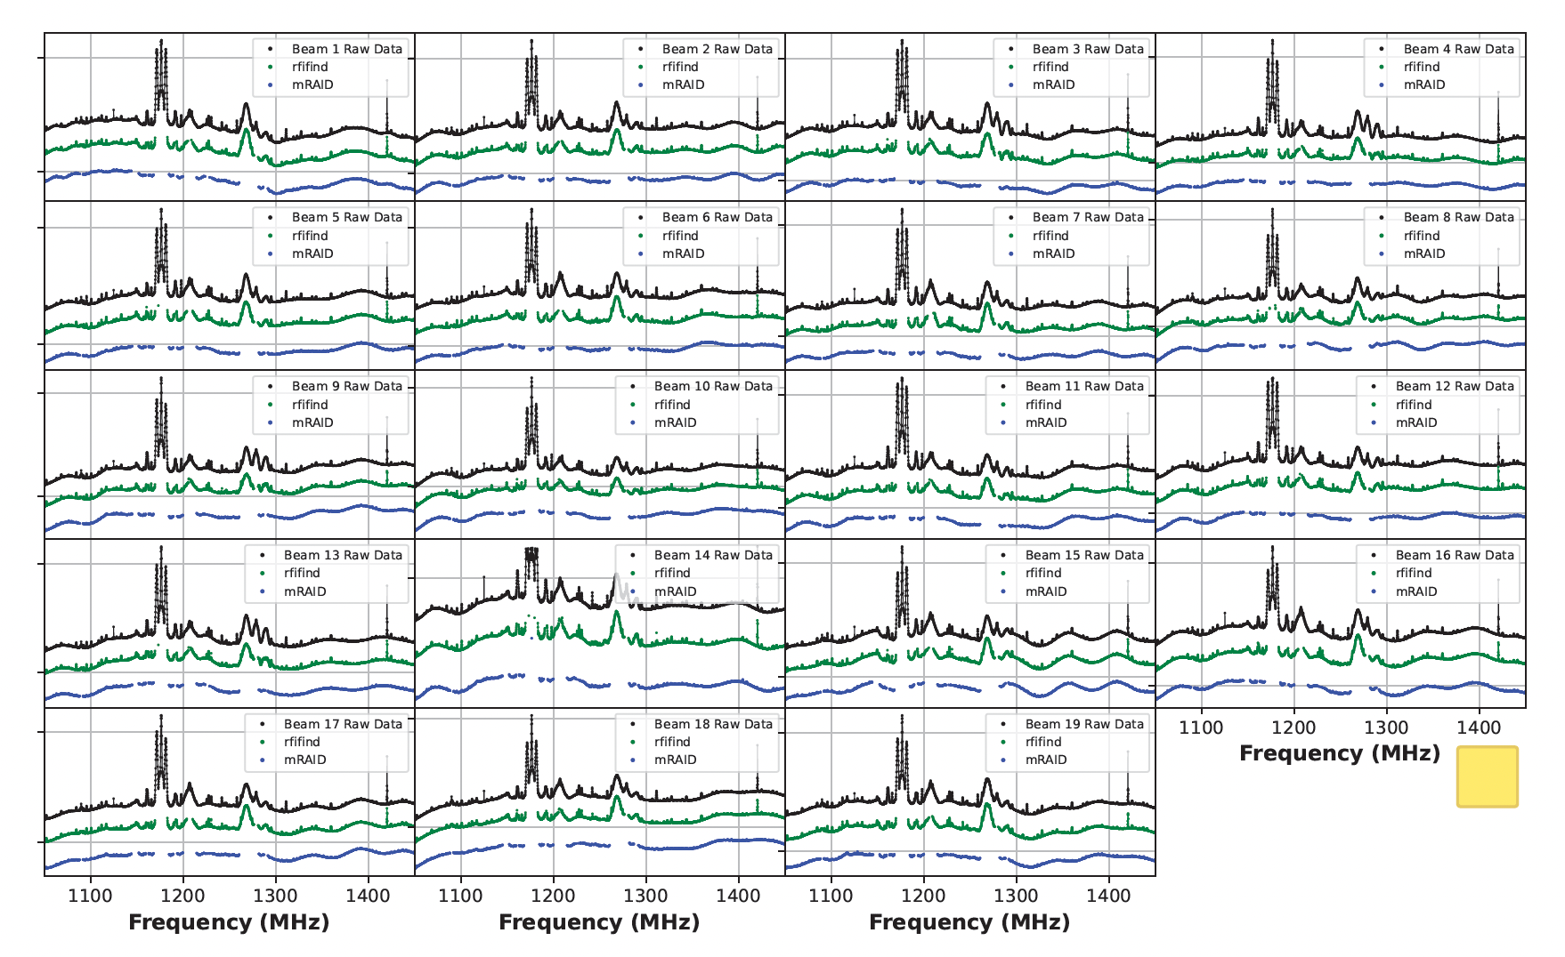
Method and Results：
Time averaged spectrum of each beam of the FAST observation

Slide 18
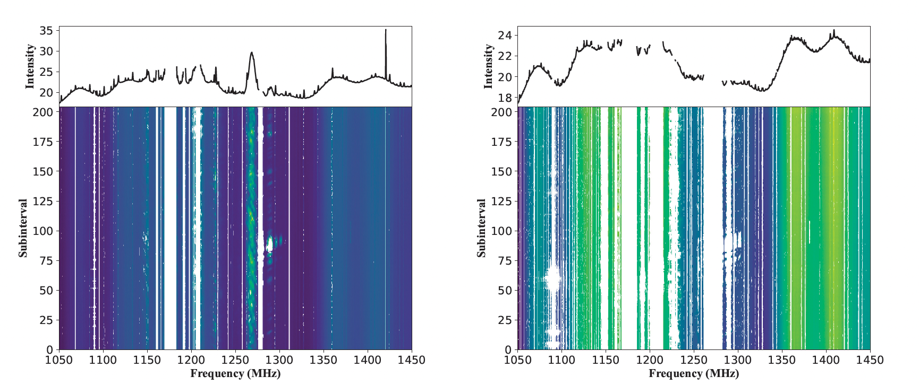
Method and Results：
RFI masked data of beam 11 of the FAST observation
rfifind
mRAID

Slide 19
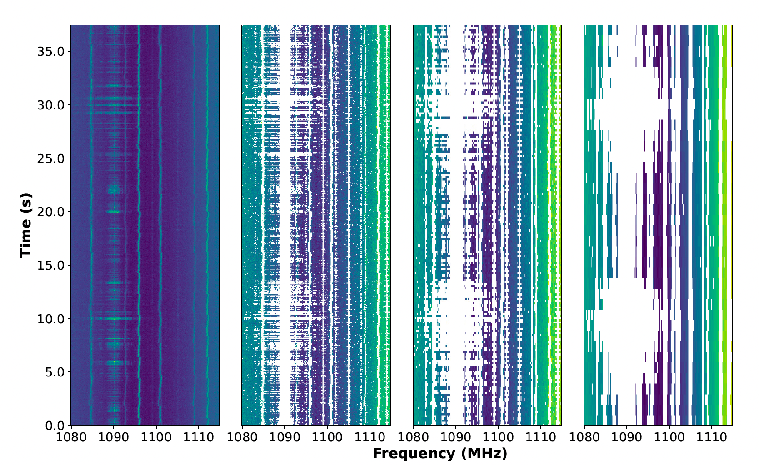
Method and Results：
RFI masking results of mRAID at different time resolutions
0.05 s 0.2 s 1.0 s

Slide 20
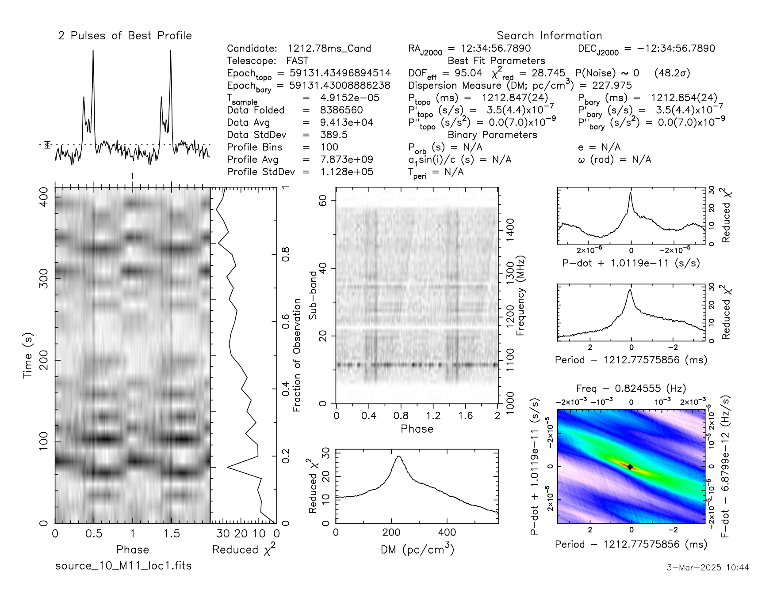
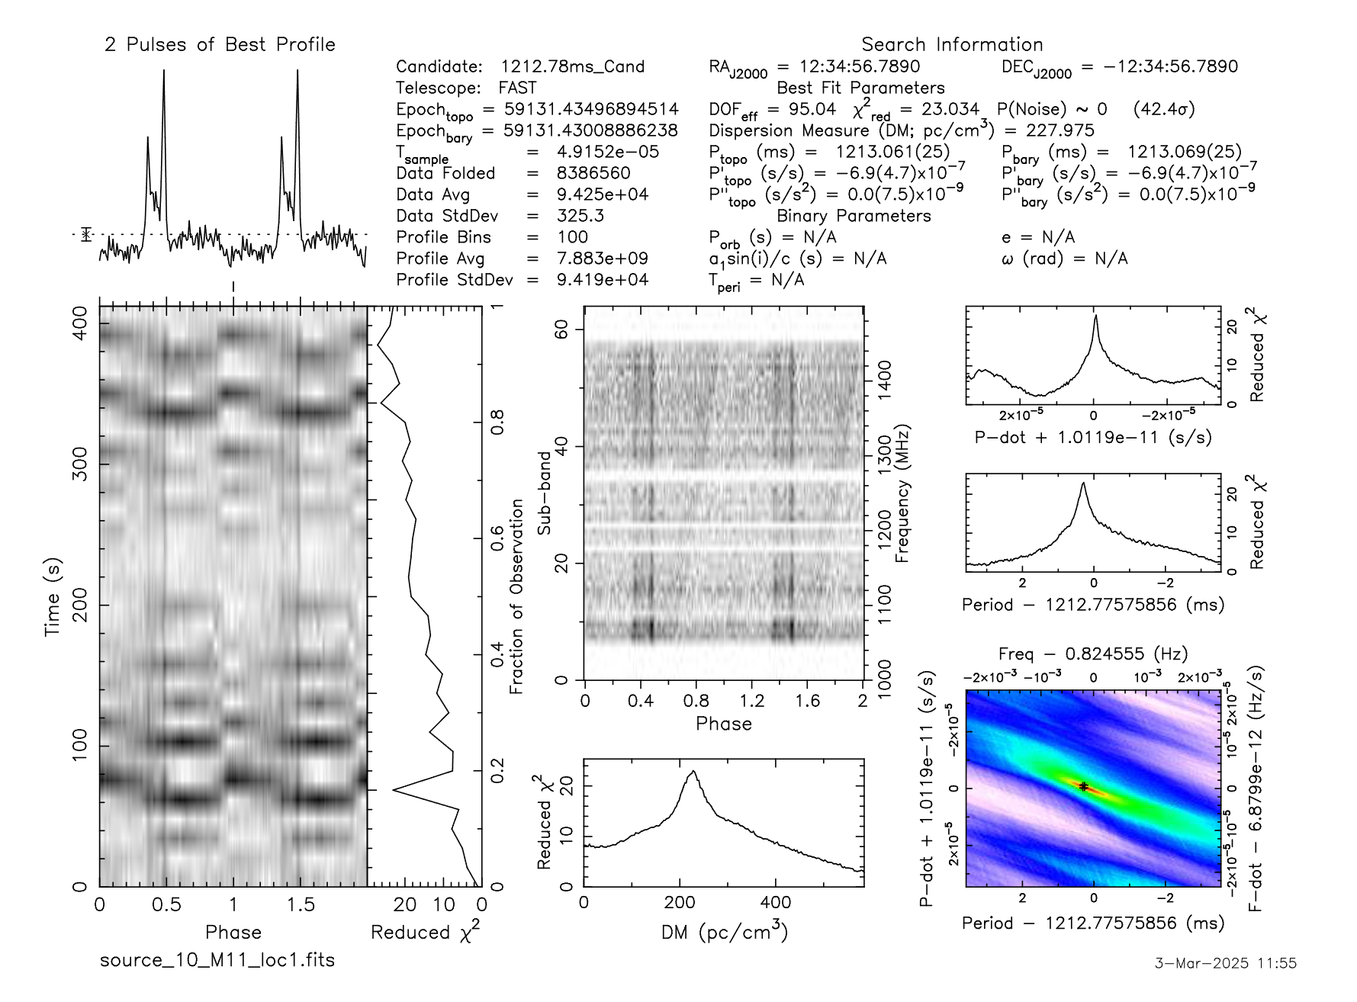
Method and Results：
Comparison of the folded pulsar results after RFI masking
rfifind
mRAID

Slide 21
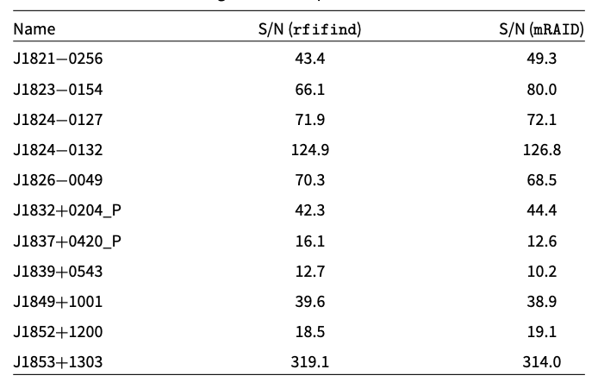
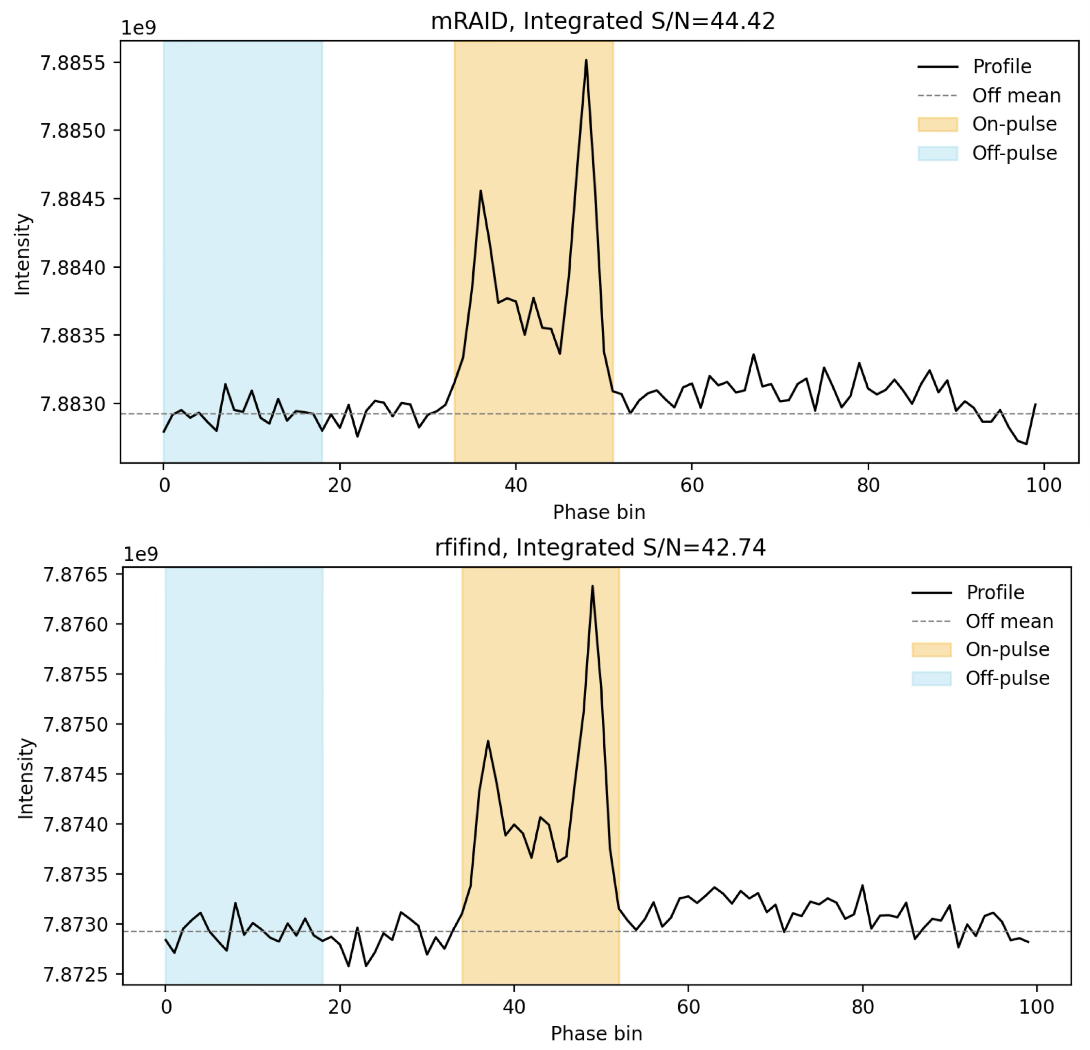
Method and Results：
Comparison of integrated S/N values for pulse profiles generated by the
rfifind and mRAID RFI-mitigation techniques

Slide 22
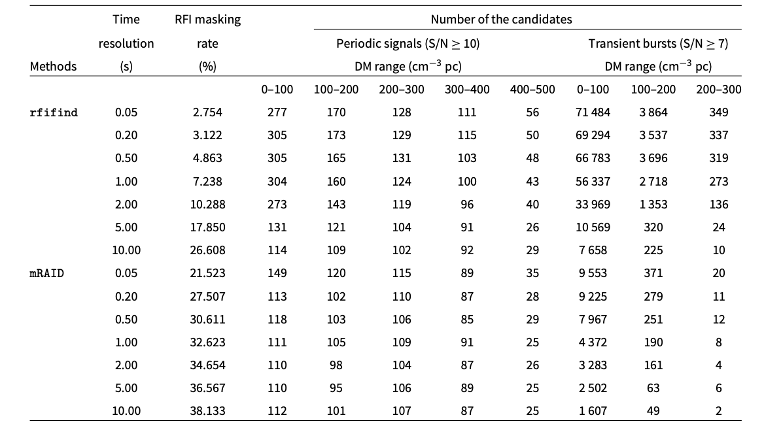
Method and Results：
The average percentage of RFI masks and the candidates number

Slide 23
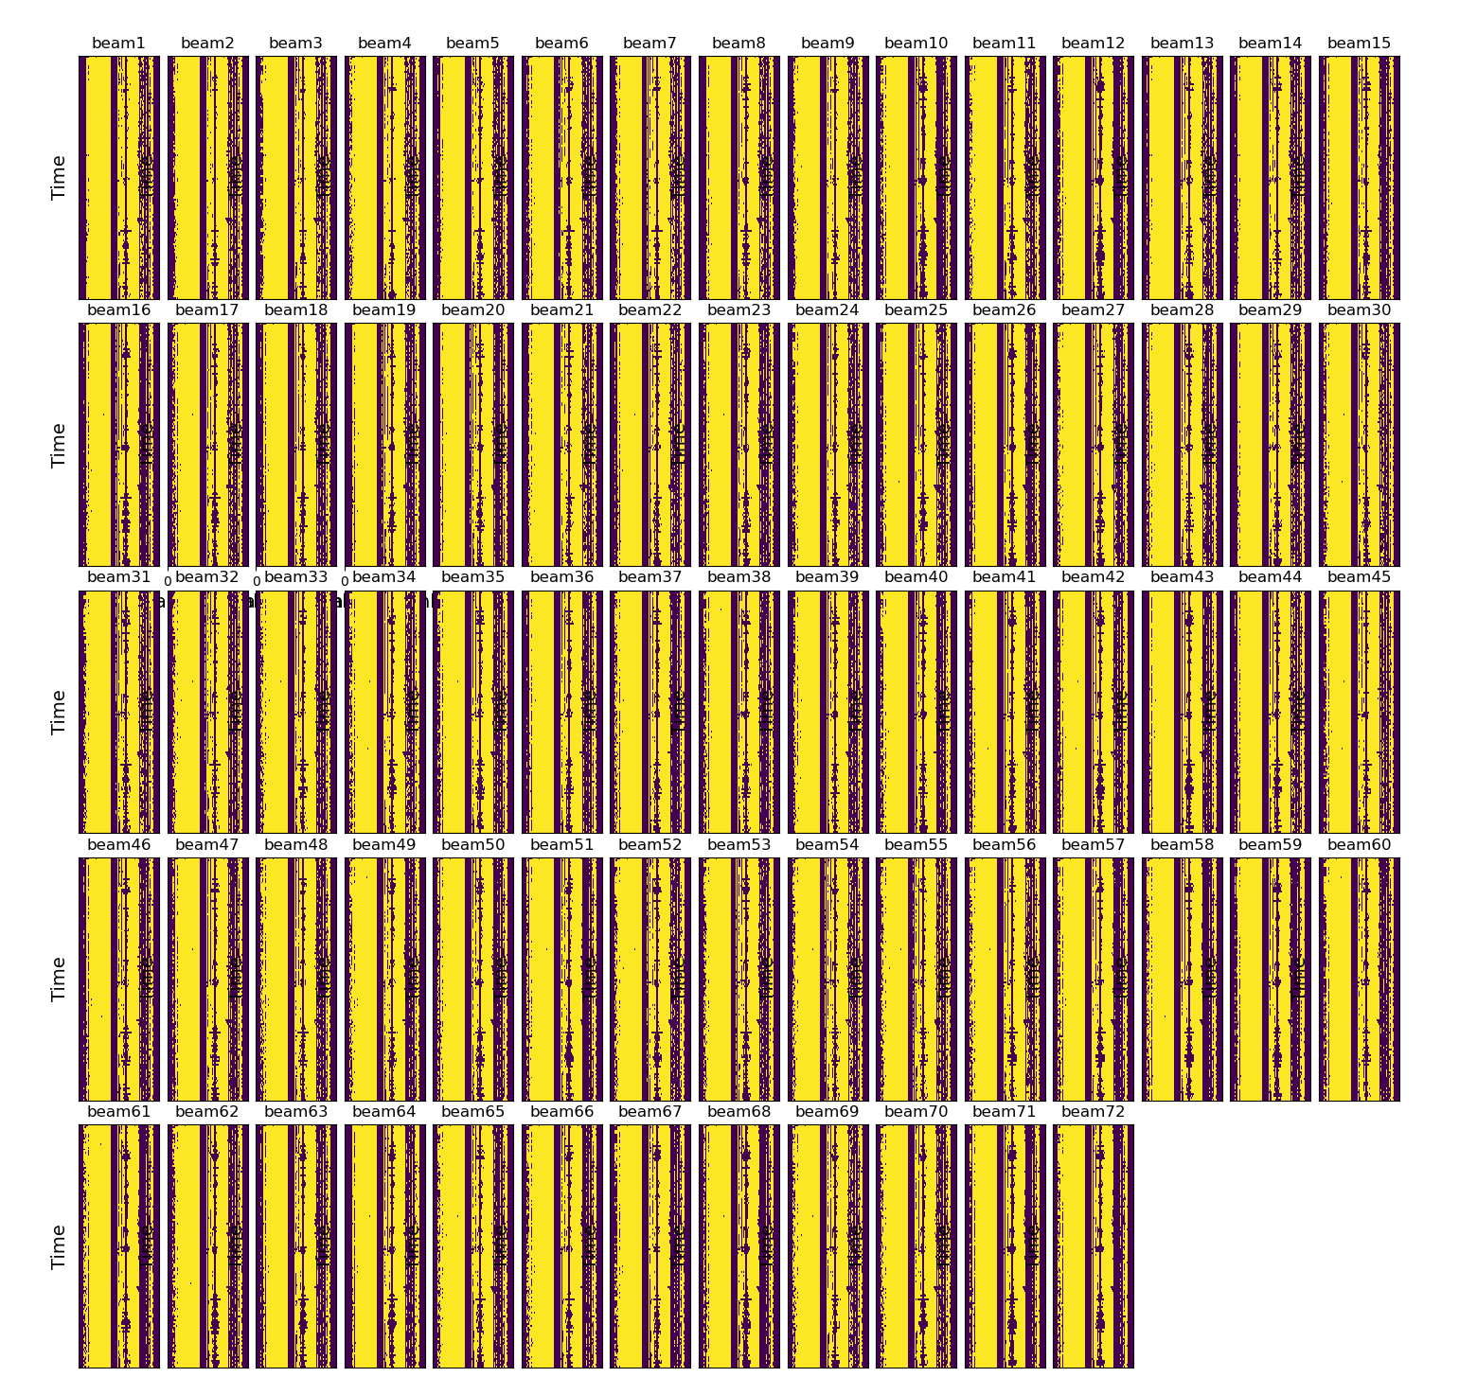
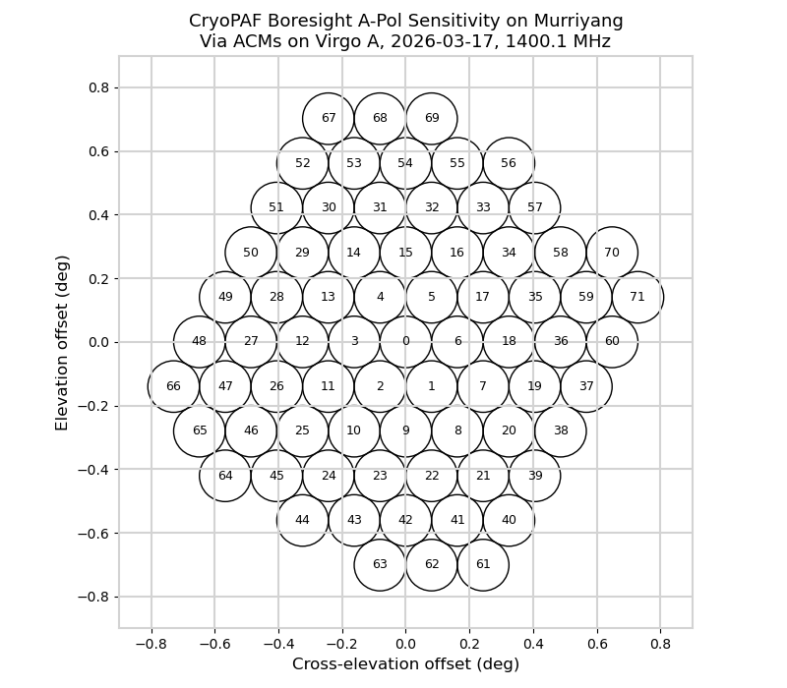
Method and Results：

Slide 24
Summary：
mRAID Summary:
Developed for multibeam (or PAF) search data
Uses eigenvalue decomposition on CCM to identify and flag RFI
Outperforms traditional threshold methods (e.g., rfifind)
Effective for short-duration and weak RFI
Supports multi-CPU parallel processing for faster analysis

Slide 25

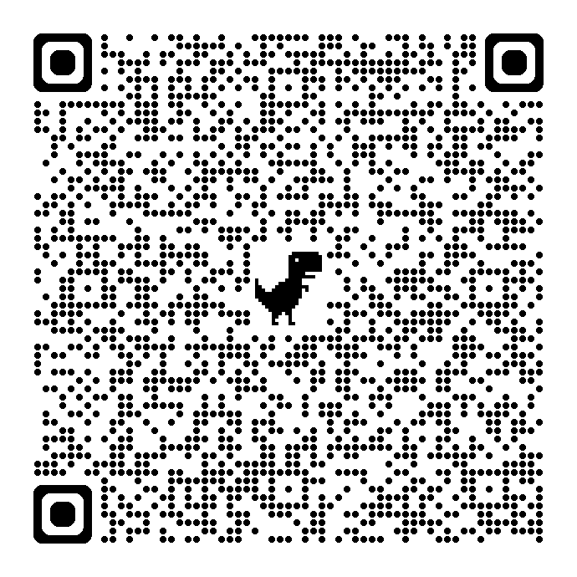
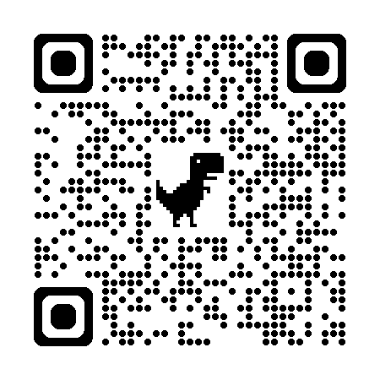
Paper and code:
Paper
Code
Thanks!

