Slide 1
    FAST-Effelsberg simultaneous observation of pulsar scintillation screen
Xun Shi 石洵
in collaboration with
Tim Sprenger, Olaf Wucknitz(MPIfR, Bonn), Robert Main(McGill)
Sprenger, Shi, Wucknitz & Main, A&A, 709, A57 (2026). arXiv:2605.15004
https://www.mpifr-bonn.mpg.de/pressreleases/2026/twinkling-pulsar-reveals-invisible-structures-in-space

Slide 2
    How 1+1>2
Xun Shi 石洵
in collaboration with
Tim Sprenger, Olaf Wucknitz(MPIfR, Bonn), Robert Main(McGill)
Sprenger, Shi, Wucknitz & Main, A&A, 709, A57 (2026). arXiv:2605.15004
https://www.mpifr-bonn.mpg.de/pressreleases/2026/twinkling-pulsar-reveals-invisible-structures-in-space

Slide 3
    Why study pulsar scintillation
    Emission mechanism, EoS, gravity tests are physics, scintillation is stamp collecting??
    ISM:
    phenomena are messy,
    physical mechanism is known,
    theory is descriptive,
    measurement has no precision

Slide 4
    Why study pulsar scintillation
    Emission mechanism, EoS, gravity tests are physics, scintillation is stamp collecting??
    ISM:
?
    Small-scale IISM as revealed by scintillation:
    phenomena are messy,
    physical mechanism is known,
    theory is descriptive,
    measurement has no precision
    phenomena are complex, but structured
    physical mechanism is unknown, possibly new
    theory is fun (plasma/MHD, holography, lensing,…)
    measurement can be very precise

Slide 5
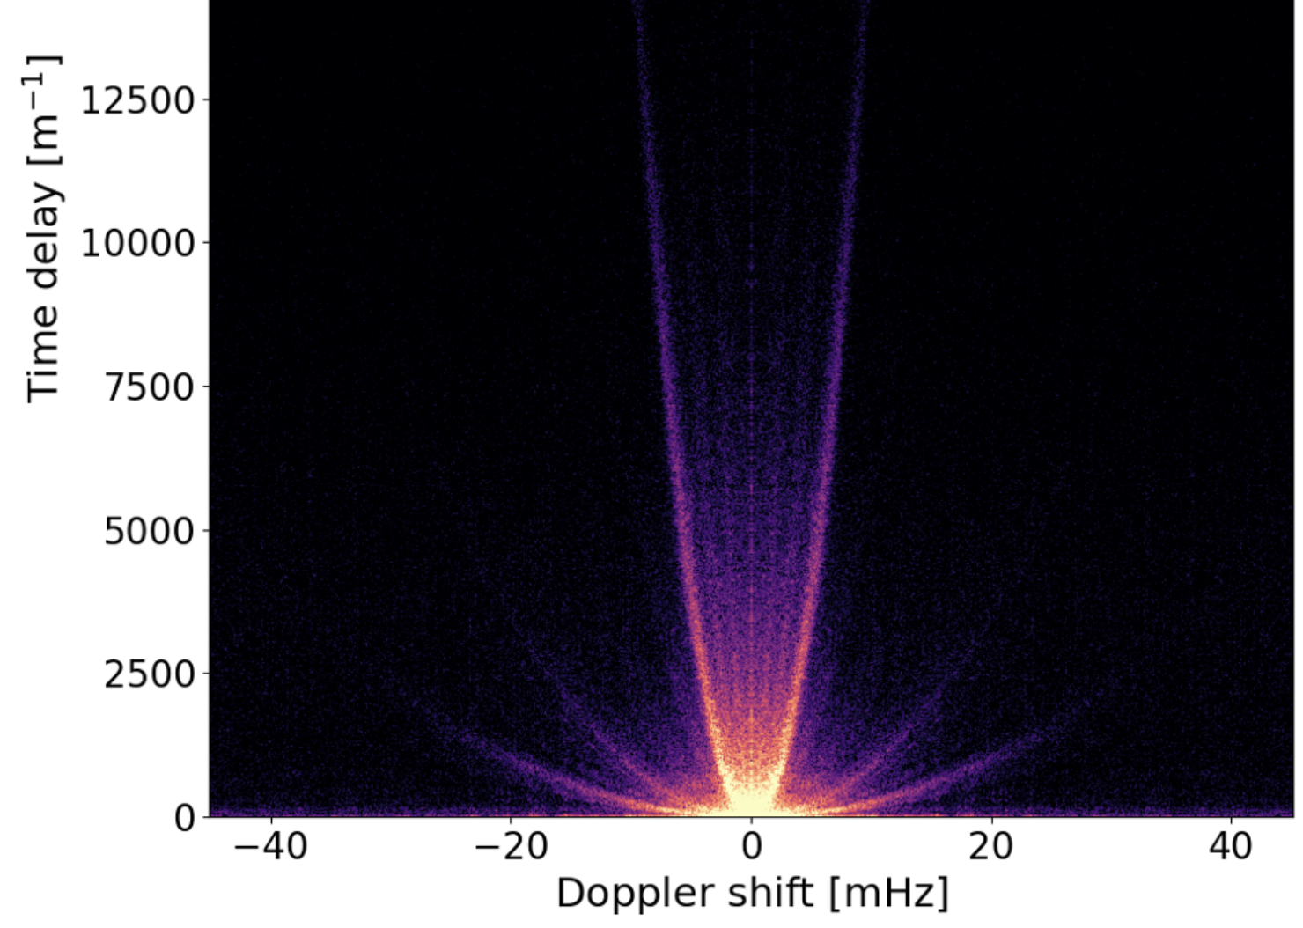
    Why study pulsar scintillation
ISM harbours unexplored physics.
We don’t yet understand the physical origin of scintillation arcs. They have intriguing properties.
B1237+25 (J1239+2453)
Many discrete scattering screens
Huang+26, ApJ, 997, 131

Slide 6
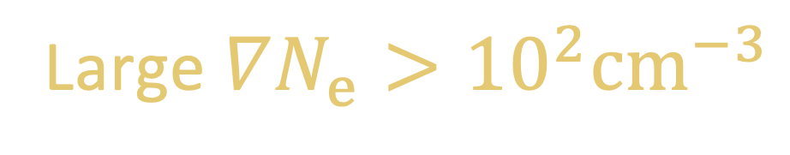

    Why study pulsar scintillation
ISM harbours unexplored physics.
We don’t yet understand the physical origin of scintillation arcs. They have intriguing properties.
B1237+25 (J1239+2453)
Many discrete scattering screens
Large $∇N_{e}>{10}^{2}{cm}^{−3}$
($≫$ density of ionized ISM)
to deflect light across ~mas angle
Huang+26, ApJ, 997, 131

Slide 7
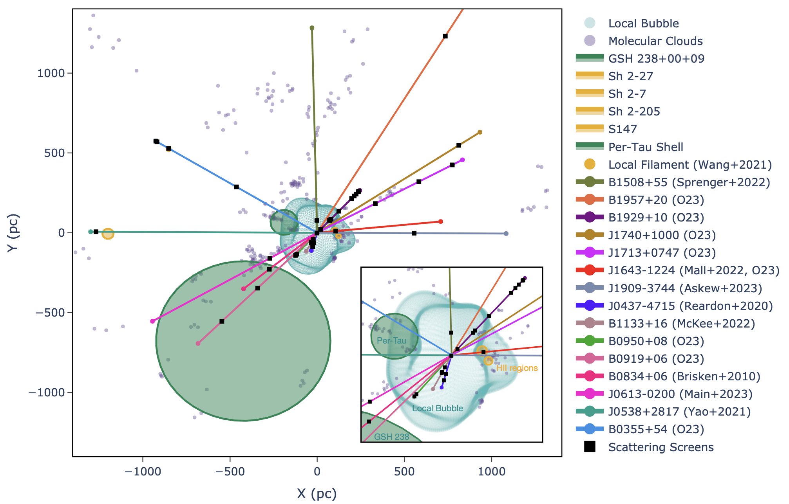
    Why study pulsar scintillation
ISM harbours unexplored physics.
We don’t yet understand the physical origin of scintillation arcs. They have intriguing properties.
B1237+25 (J1239+2453)
Many discrete scattering screens
Large $∇N_{e}>{10}^{2}{cm}^{−3}$
($≫$ density of ionized ISM)
Ocker+23, MNRAS, 527, 7568
to deflect light across ~mas angle
Scattering screens are common and everywhere (even at ~10 kpc above the Galactic plane! See Qiuyi He’s talk; 21 screens in the Local Bubble along 1 l.o.s.! Reardon+25), but in most cases they don’t match to known ISM structures
Huang+26, ApJ, 997, 131
— We rely on scintillation to know more about them.

Slide 8
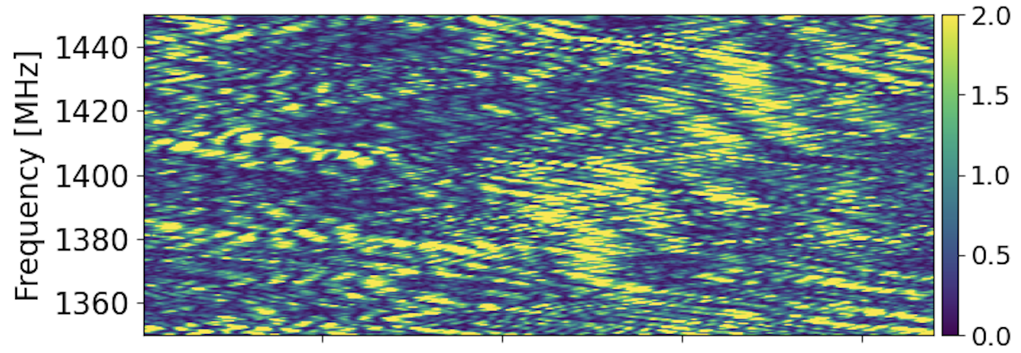
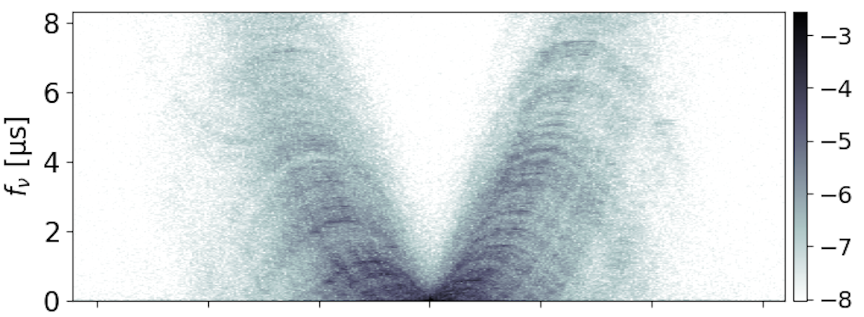
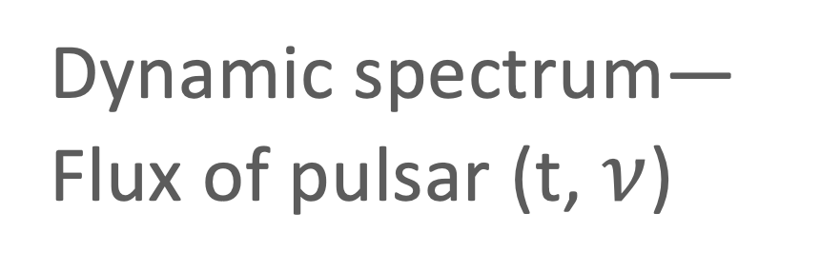
    Pulsar Scintillation observation with 1 dish
Dynamic spectrum—
Flux of pulsar (t, $ν$)
Secondary spectrum—
Log_Flux (doppler, delay)

Slide 9



Phase information in pulsar scintillation
The dynamic spectrum we measure is an interference pattern of the scattered images
$$ν$$
t
Simultaneous dynamic spectra taken by two telescopes (“1+1”) can measure differential phases from the slight shifts of the interference patterns.
Idea: Simard+19a,b; Experiment with GMRT(15 * 45m) + ARO(46m): Marthi+11

Slide 10
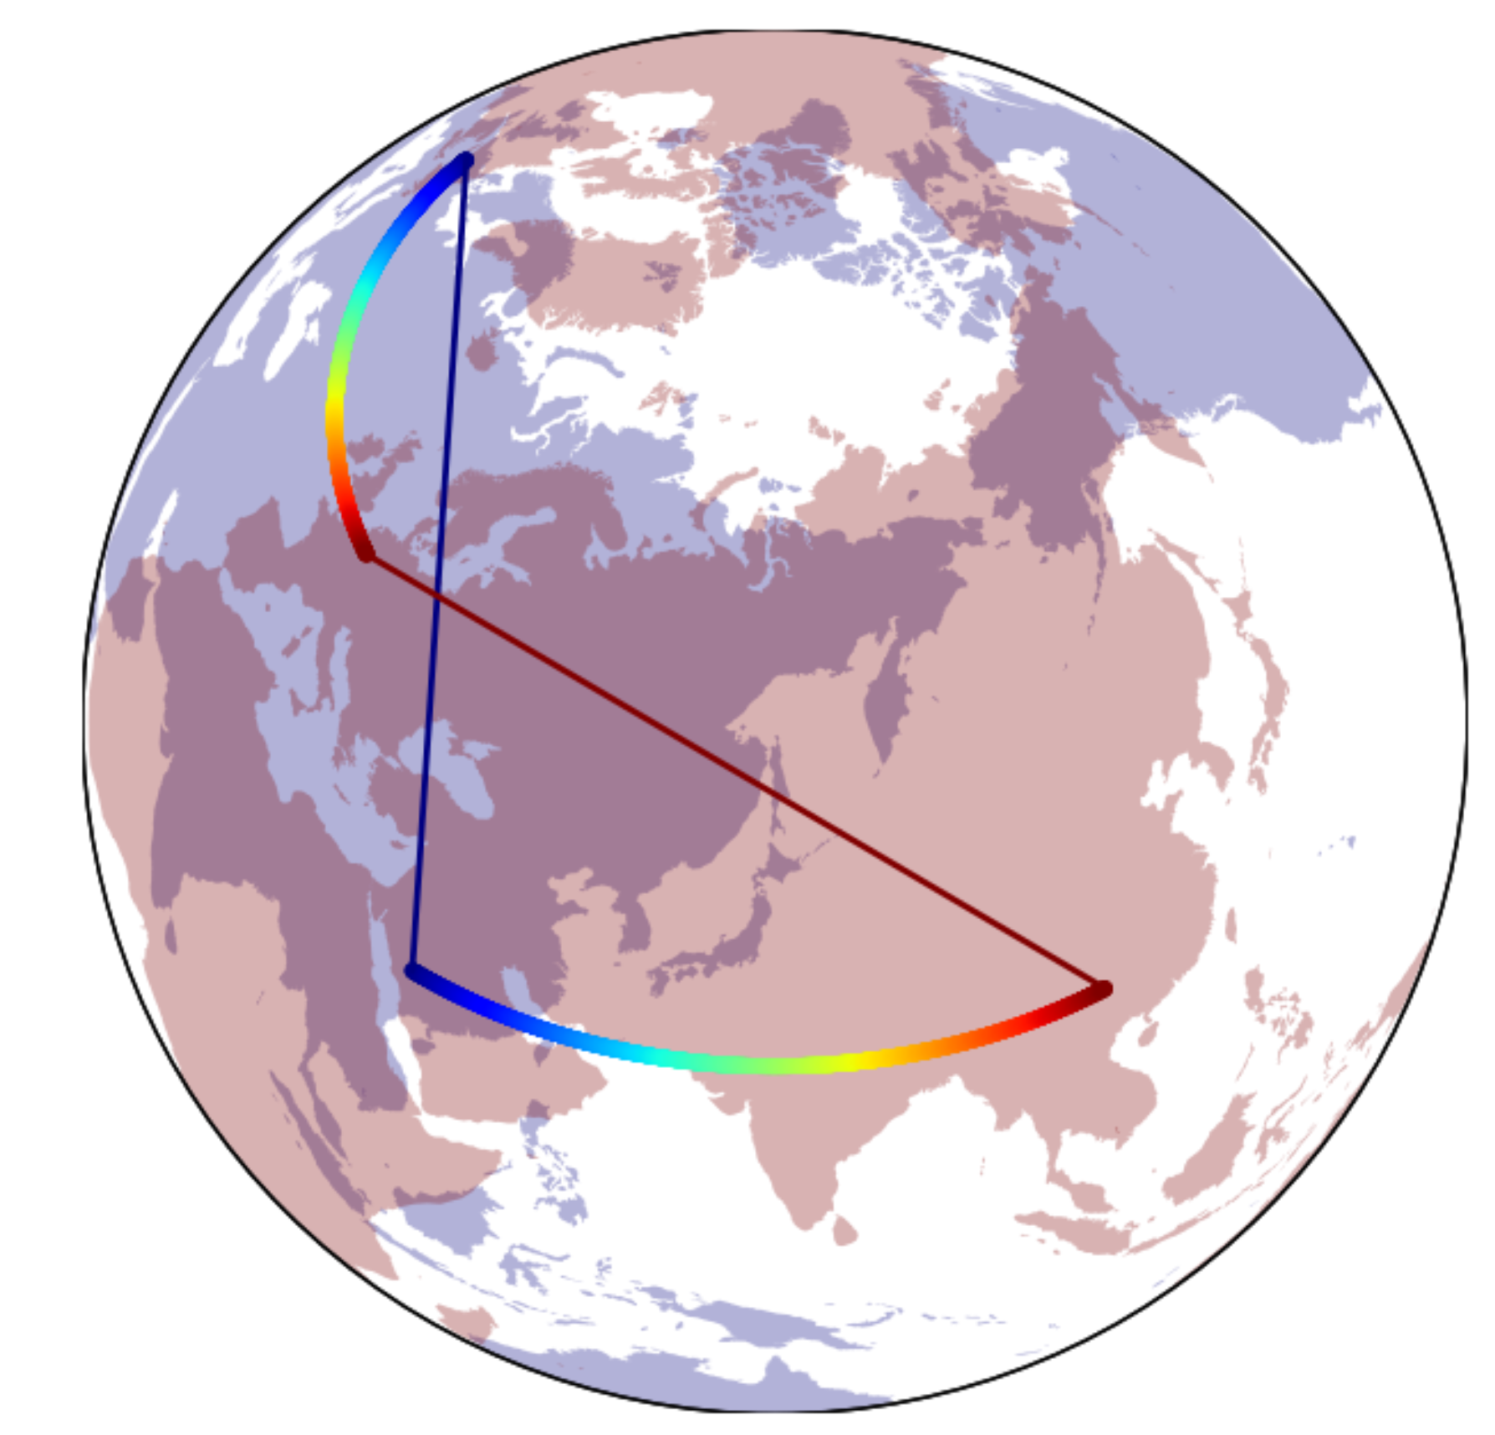
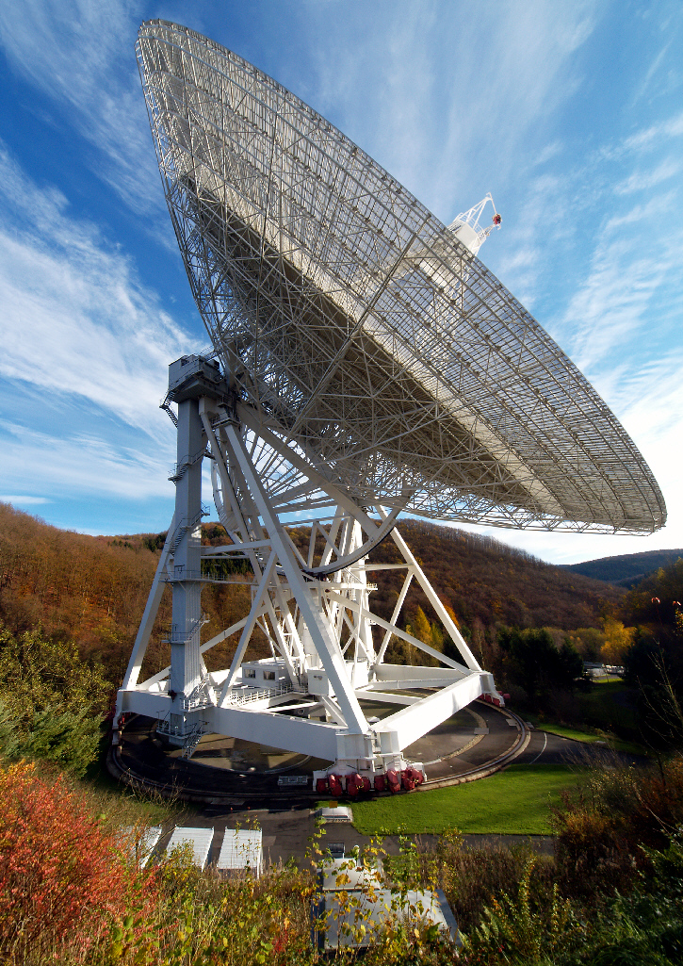
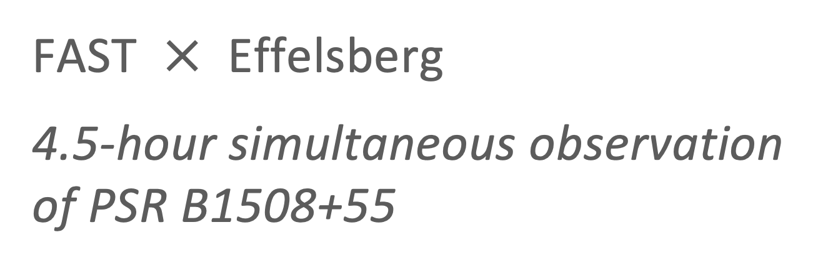
FAST $×$ Effelsberg
4.5-hour simultaneous observation of PSR B1508+55
Effelsberg 100-m Radio Telescope
Five-hundred-meter Aperture Spherical radio Telescope

Slide 11
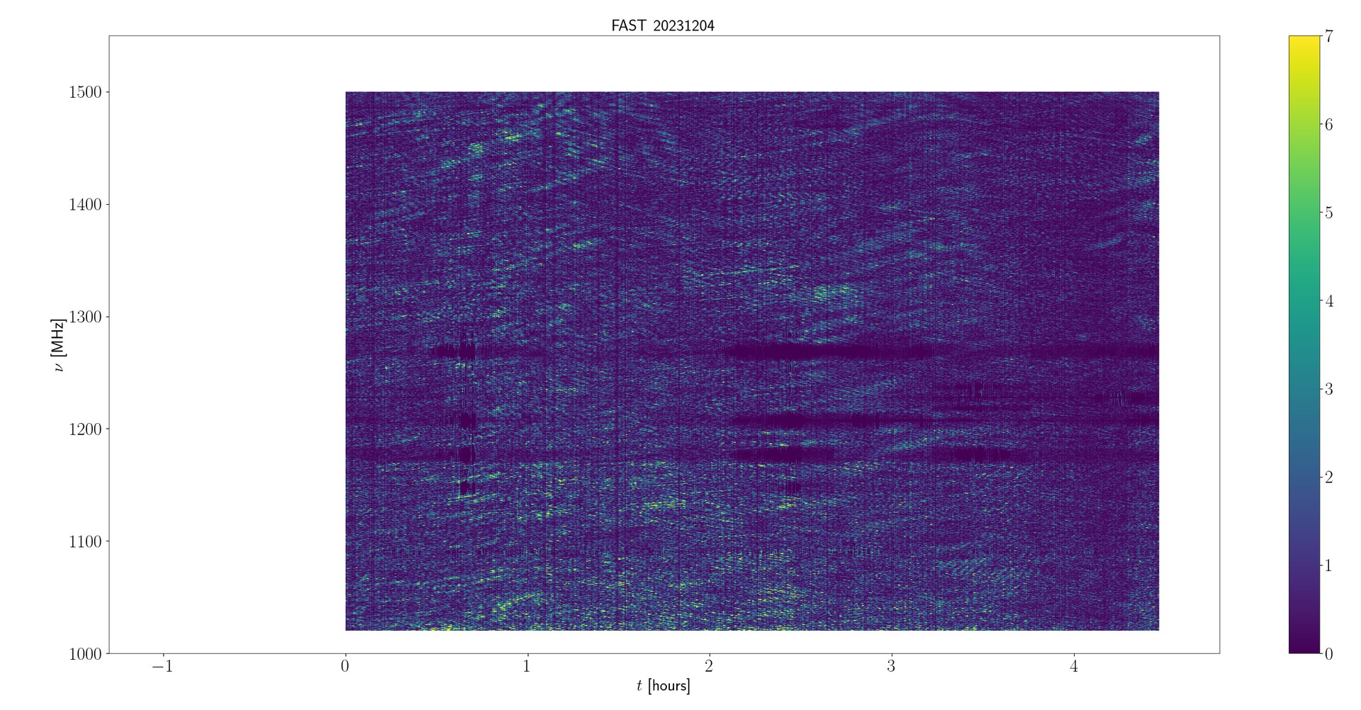
Dynamic spectrum from FAST

Slide 12
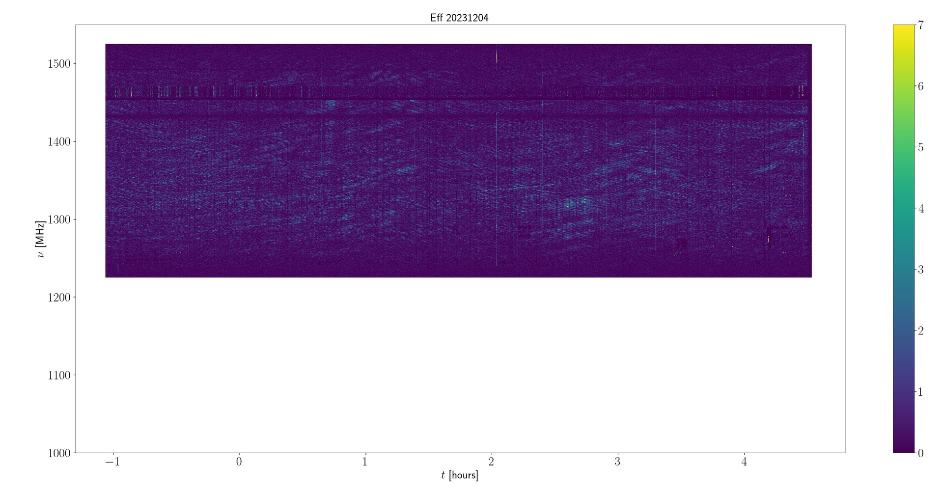
Dynamic spectrum from Effelsberg

Slide 13

FAST $×$ Effelsberg
Slight time-varying shifts in interference patterns due to
different telescope locations
(while intrinsic variations of the pulsar should not shift — distinguish between the two)
* may be of interest to people studying pulse properties

Slide 14
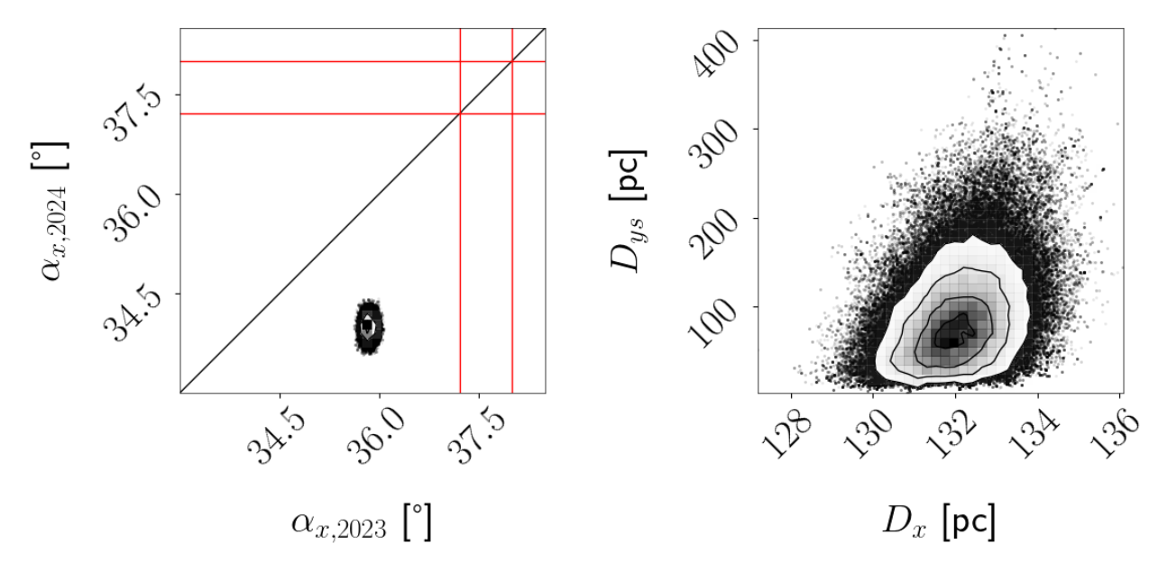
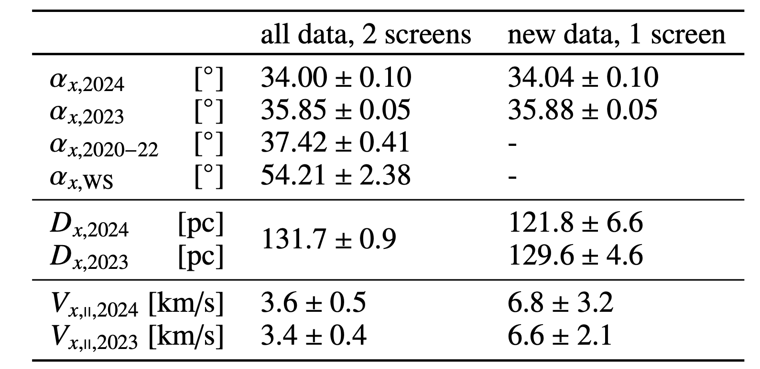

Time shift $→$ scintillation screen parameters
Precise screen parameters with only one simultaneous observation!
Image orientation
Screen distances
Without 1+1, it would require multiple observations to derive these parameters (e.g. Sprenger+22, Huang+25)

Slide 15
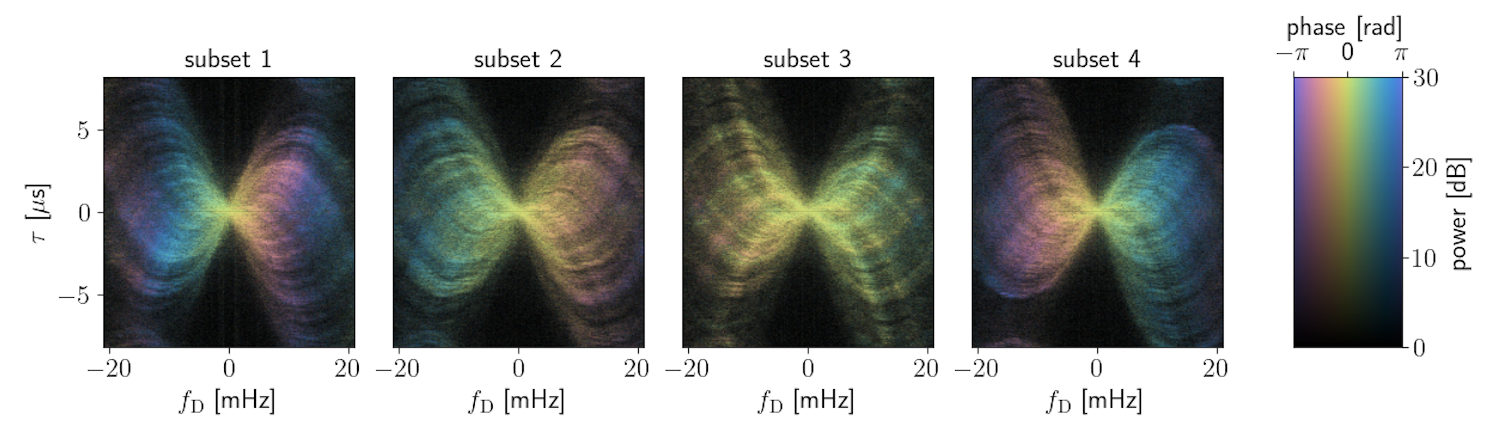
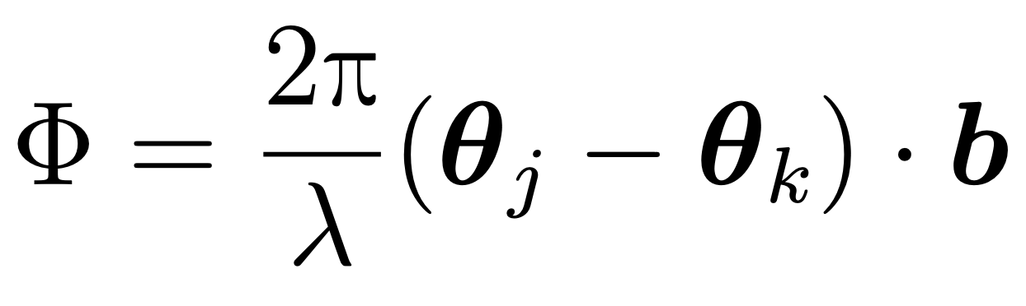

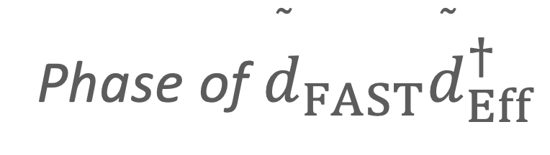
    1+1$→$Phase information!
Phase of ${\overset{˜}{d}}_{FAST}{\overset{˜}{d}}_{Eff}^{†}$
Measuring $Φ$ at rotating baseline b $→$ 2D image location $θ$

Slide 16
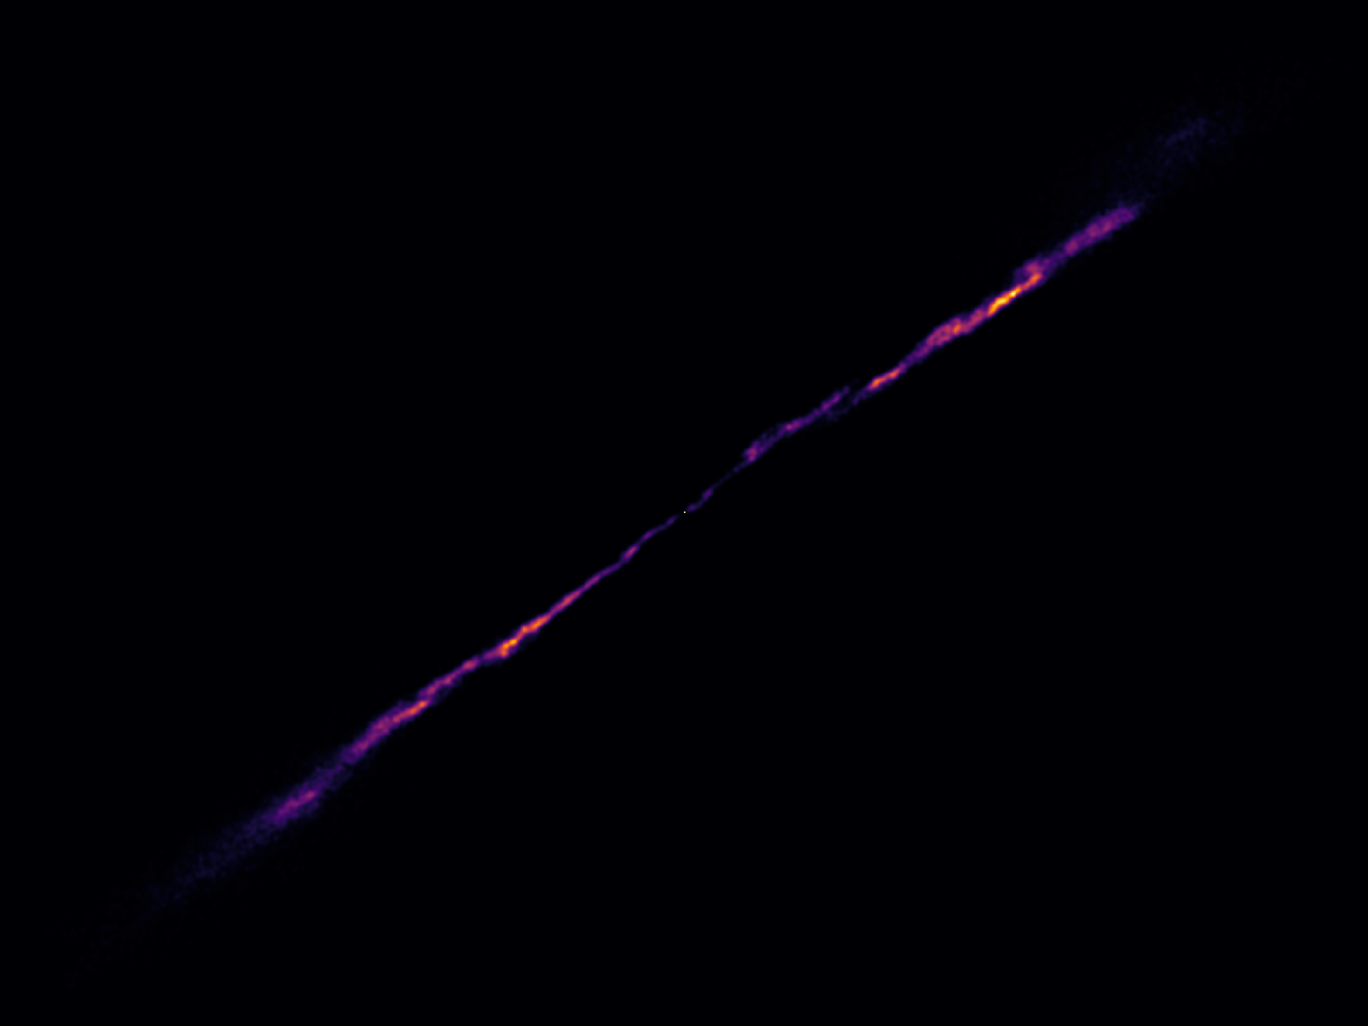

Scattered image of PSR B1508+55 reconstructed with FAST-Effelsberg simultaneous observation
Highly-anisotropic
Slight deviations from a linear image
Scattered light is much fainter than the pulsar

Slide 17
1 mas
Super-high resolution comes from scintillation not telescope baseline
Scatter screen ~ interstellar interferometer
Best reconstructed pulsar scattered image ever (more details than reconstructions with Brisken et al. 2010 VLBI data)

Slide 18
1 AU at scattering screen distance
What physical nature must the screen have to create such an image?
It’s hard to see the screen in other types of ISM observations
Scattering screens are common — some unknown plasma processes on small (but Maaacroscopic compared to lab) scales?

Slide 19
    A simple form of 1+1 (compared to VLBI)
Simultaneous scintillation flux observation
2-3 Large telescopes
Intensity measurements only
No need for baseband data
Simple data processing
Wide-band
Phase information!

Slide 20
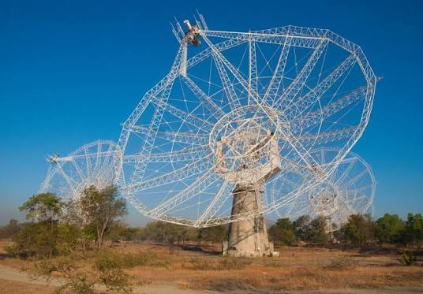
    More simultaneous observations planned
FAST
Effelsberg
GMRT

Slide 21
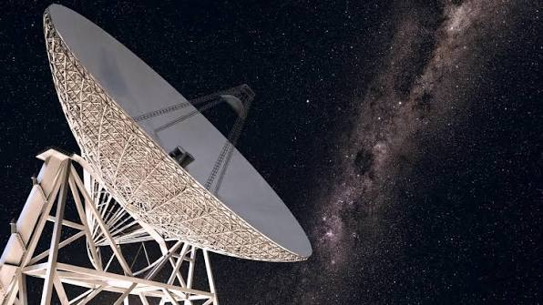
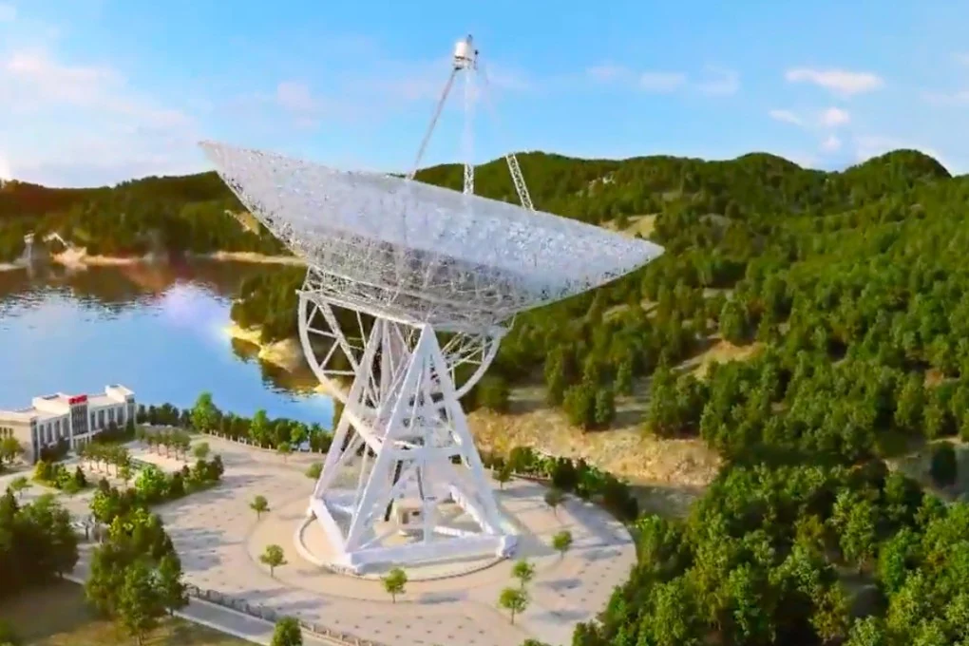
    More simultaneous observations planned
QTT?
FAST
Effelsberg
GMRT
JRT?

Slide 22
    More simultaneous observations planned
QTT?
FAST
Effelsberg
GMRT
JRT?
Simultaneous flux observations still at an early stage of development -
Hope 1+1 can bring us a new view of the IISM.

