Slide 1

On the survival of strong nuggets in the early Universe
Haoyang Qi
qhy021@pku.edu.cn
Supervisor: Renxin Xu
H.-Y. Qi, W.-L. Yuan, Y.-D. Luo, C. Chen, S. Pi, and R.-X. Xu, arXiv: 2603.16686
FAST/Future Pulsar Symposium 15
Guizhou Normal University, Jinyang Hotel, Guiyang, 2026.07.03

Slide 2
Motivations
Self bound strong matter could form stable small nuggets
Strangeon matter could be more stable than quark matter at low density and temperature
Strangeon nuggets evaporate slowly and can survive as a kind of cold dark matter

Slide 3
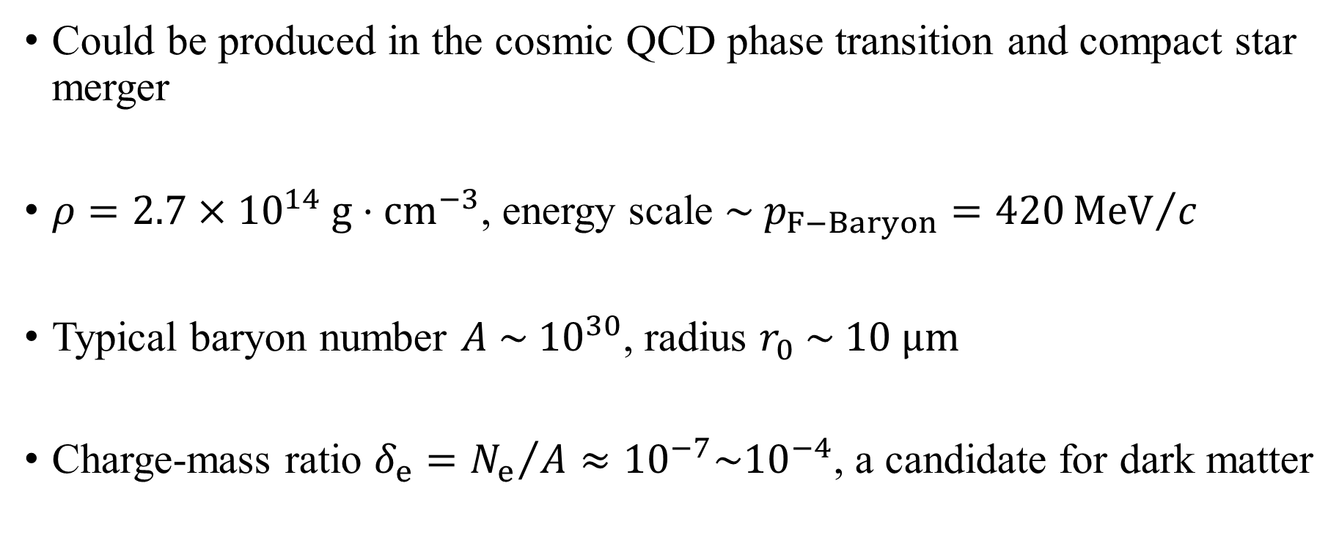
Strong nugget
Could be produced in the cosmic QCD phase transition and compact star merger
$ρ=2.7×{10}^{14} g⋅{cm}^{−3}$, energy scale $\sim p_{F−Baryon}=420{MeV}/c$
Typical baryon number $A \sim {10}^{30}$, radius $r_{0} \sim 10 μm$
Charge-mass ratio $δ_{e}={N_{e}}/A≈{10}^{−7}\sim {10}^{−4}$, a candidate for dark matter

Slide 4
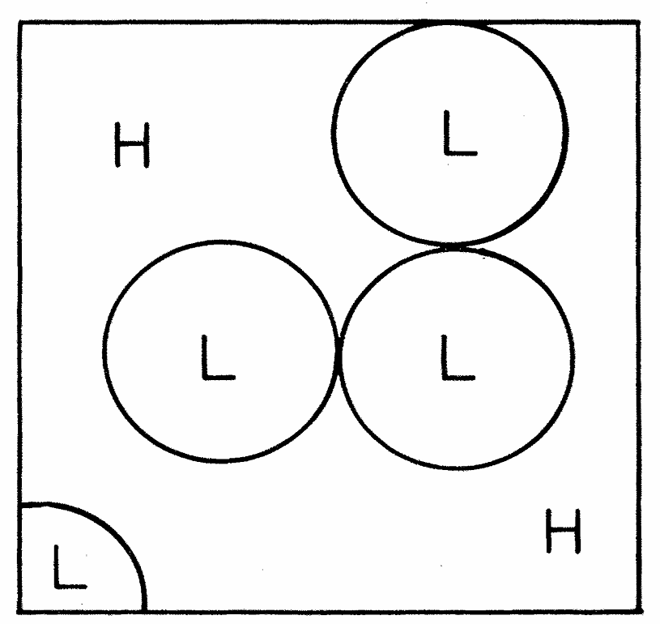
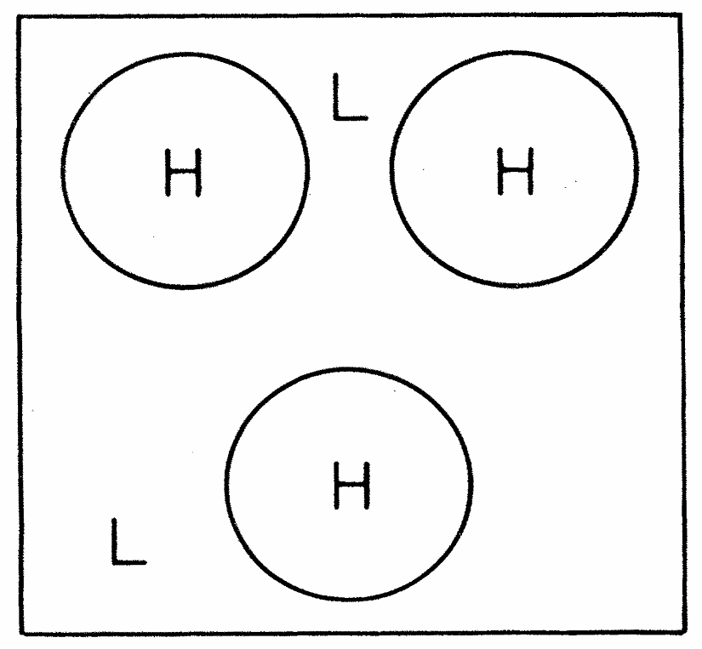
Formation: cosmic QCD phase transition
First order PT, the high-temperature phase is separated and contracts into strong nuggets
Witten 1984. H: high-$T$ QGP phase, L: low-$T$ hadron phase

Slide 5
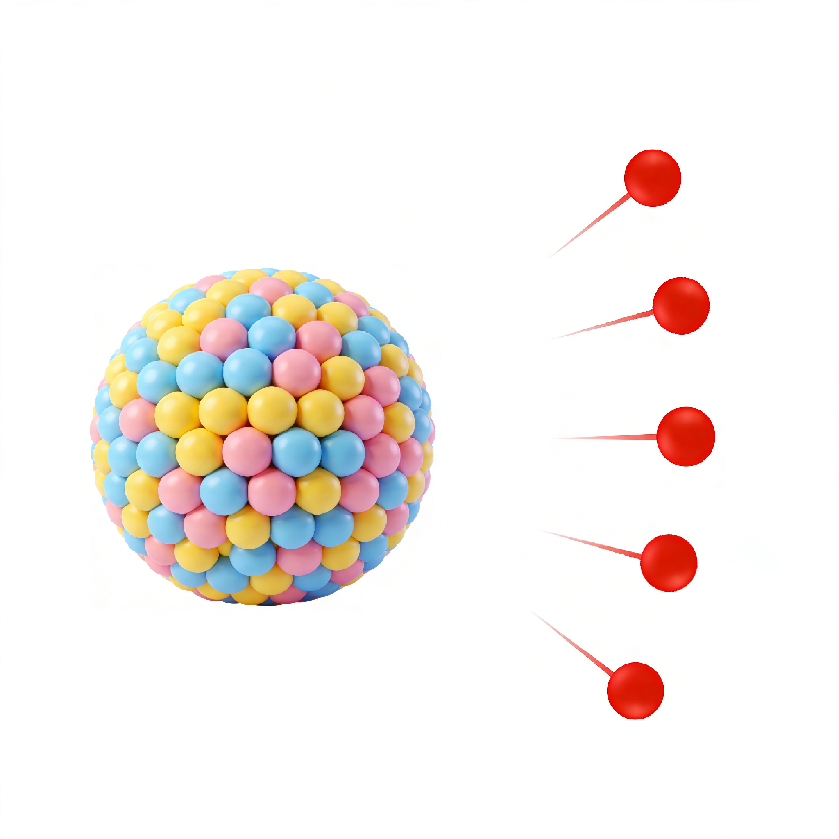
Formation: cosmic QCD phase transition
First order PT, the high-temperature phase is separated and contracts into strong nuggets
Nucleon evaporation from quark nuggets
Strange quark nugget

Slide 6
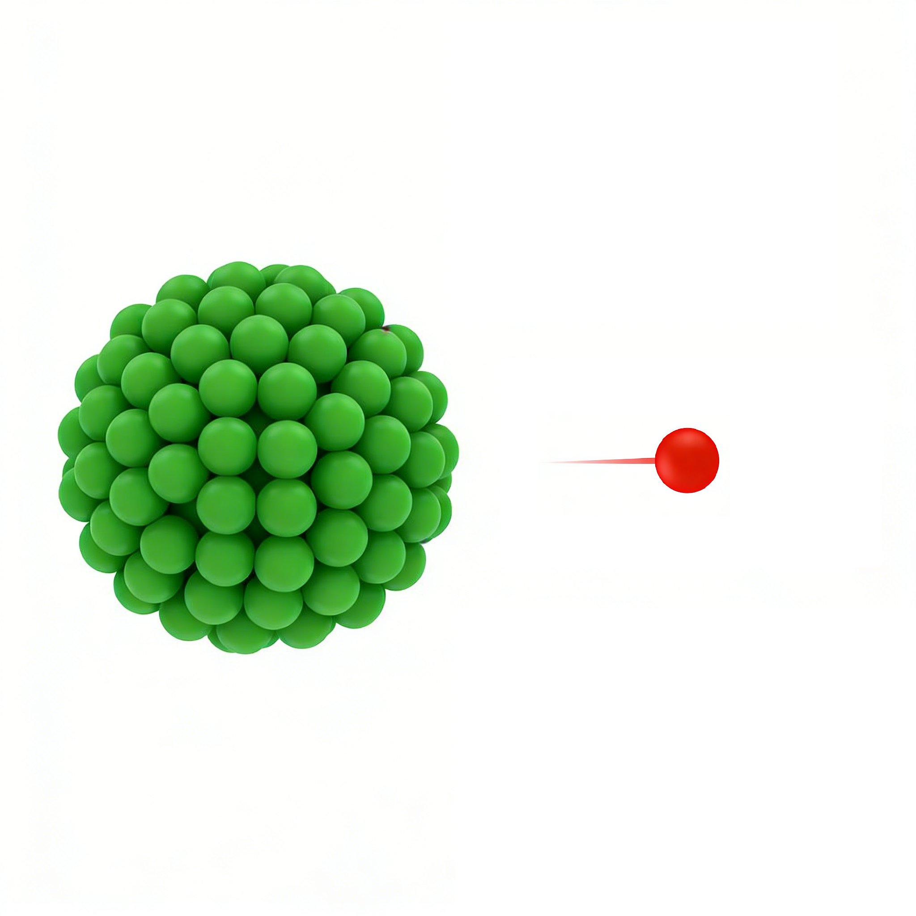
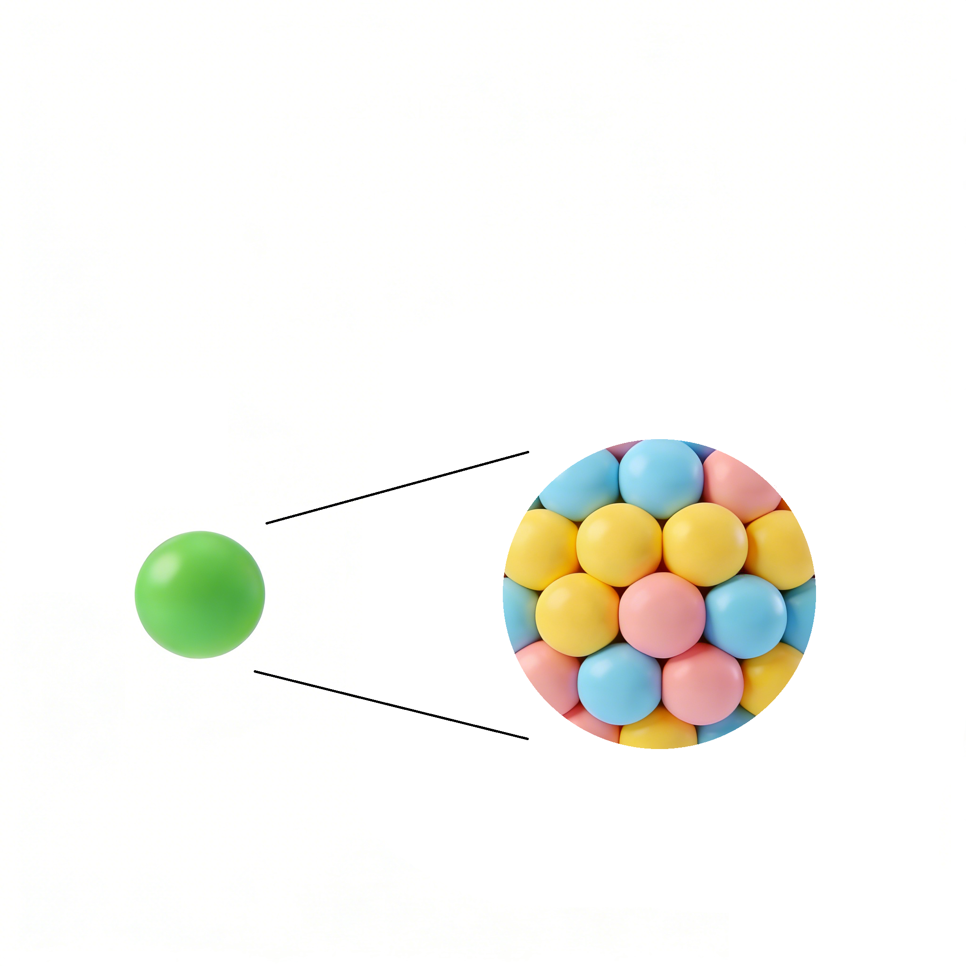
Formation: cosmic QCD phase transition
First order PT, the high-temperature phase is separated and contracts into strong nuggets
Nucleon evaporation from quark nuggets
Quarks confine to clusters called strangeons and slow down the evaporation
Strange quark nugget
Strangeon nugget

Slide 7
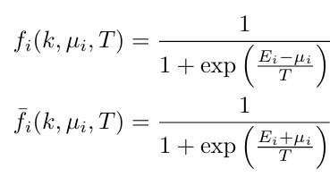
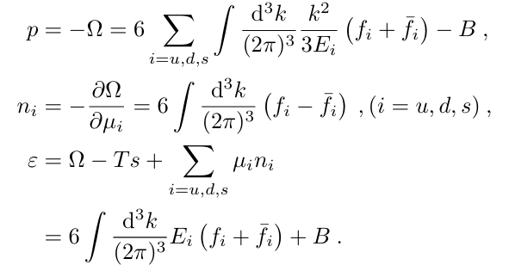


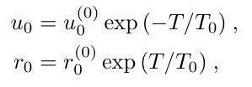
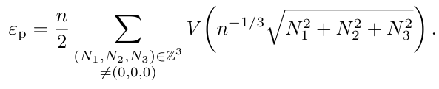





Finite temperature EoS models
Quark matter: MIT bag model (Chodos et al., 1974)
Strangeon matter: temperature-dependent double-Yukawa potential
,
,
,
,
,
,
,
,

Slide 8
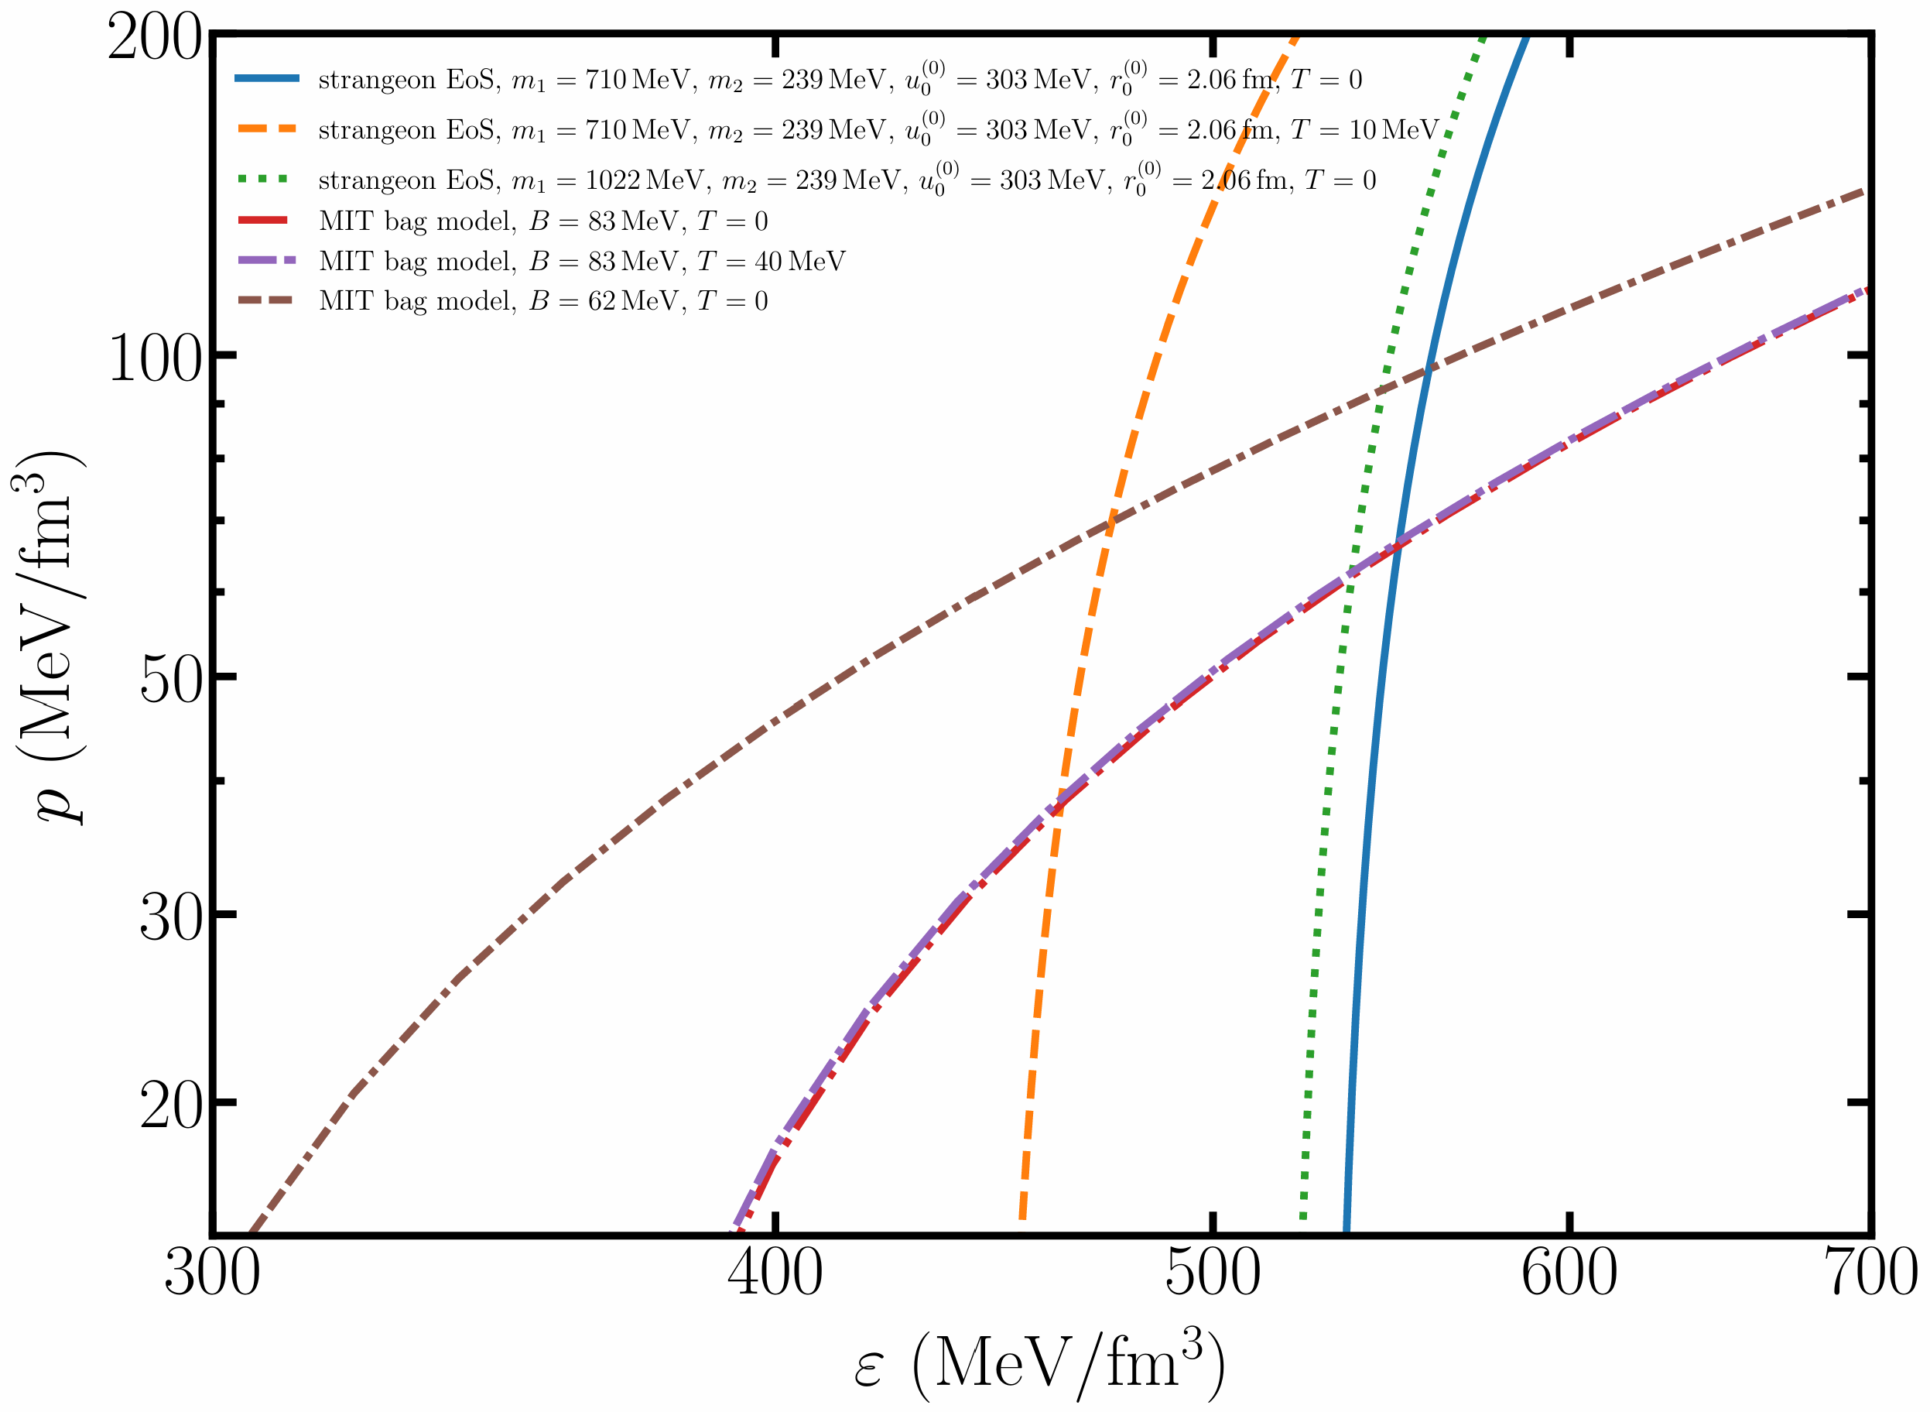

EoS $p$ - $ε$ plots
Quark matter: MIT bag model
Strangeon matter: temperature-dependent double-Yukawa potential

Slide 9
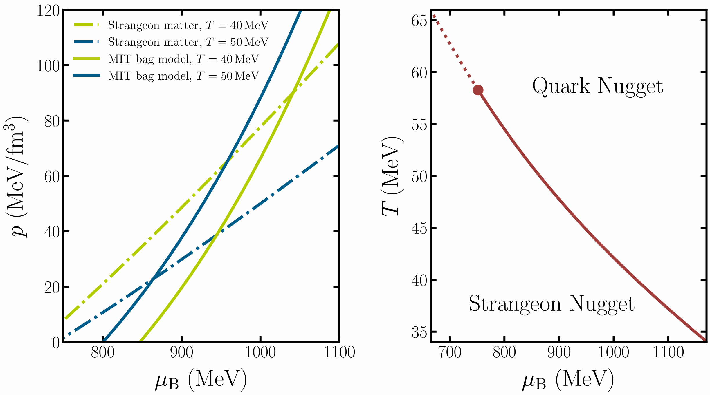
Quark-strangeon phase transition
Qi, Yuan, Luo, Chen, Pi, and Xu 2603.16686

Slide 10

Survival: evaporation process
Low baryon density and high temperature in the early Universe
Method in Alcock and Farhi 1985 to calculate the evaporation of strange quark nuggets and strangeon nuggets
Neutrino heating
Thermal evaporation
Reabsorption
Evap. cross section

Slide 11
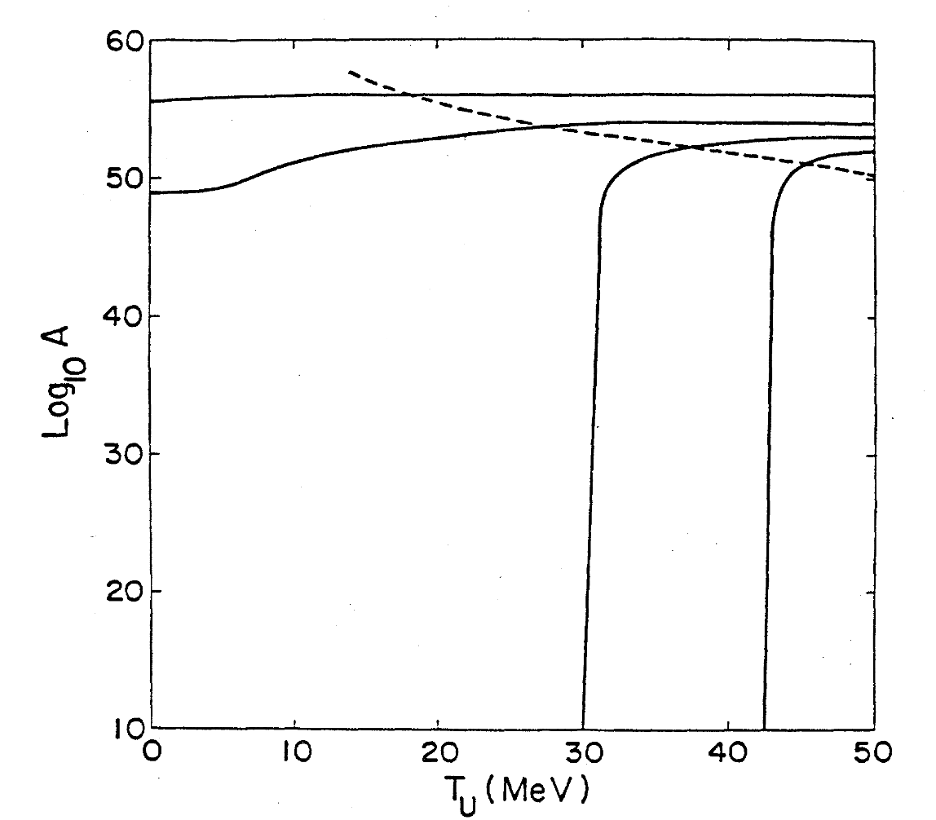
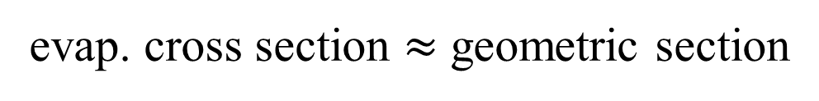

Survival: evaporation process
$$f_{n}=f_{p} \sim 1$$
strong interaction evaporation
evap. cross section $≈$ geometric section
Alcock and Farhi 1985

Slide 12
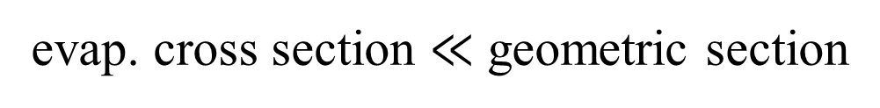

Survival: evaporation process
Quark-strangeon
phase transition temperature
$$f_{n}=f_{p}< {10}^{−13}$$
weak interaction evaporation
evap. cross section $≪$ geometric section
Alcock and Farhi 1985

Slide 13
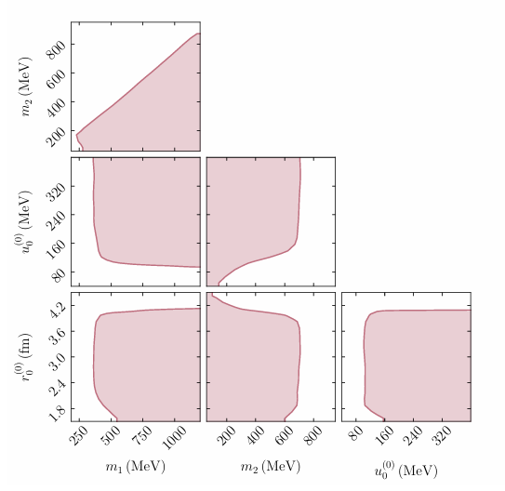
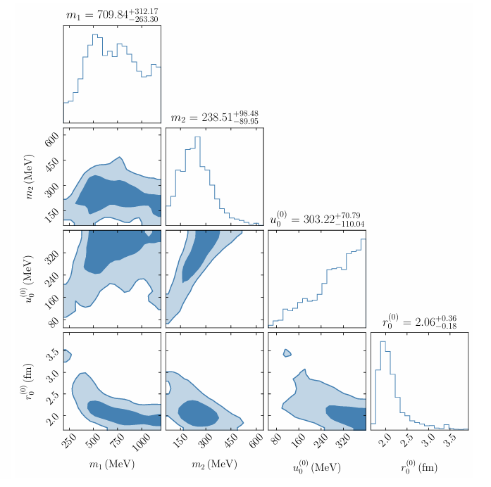
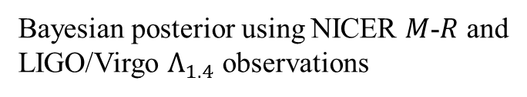
Survival: evaporation process
Allowed parameter space by DM-baryon ratio
Bayesian posterior using NICER $M$-$R$ and
LIGO/Virgo $Λ_{1.4}$ observations
Qi, Yuan, Luo, Chen, Pi, and Xu 2603.16686

Slide 14
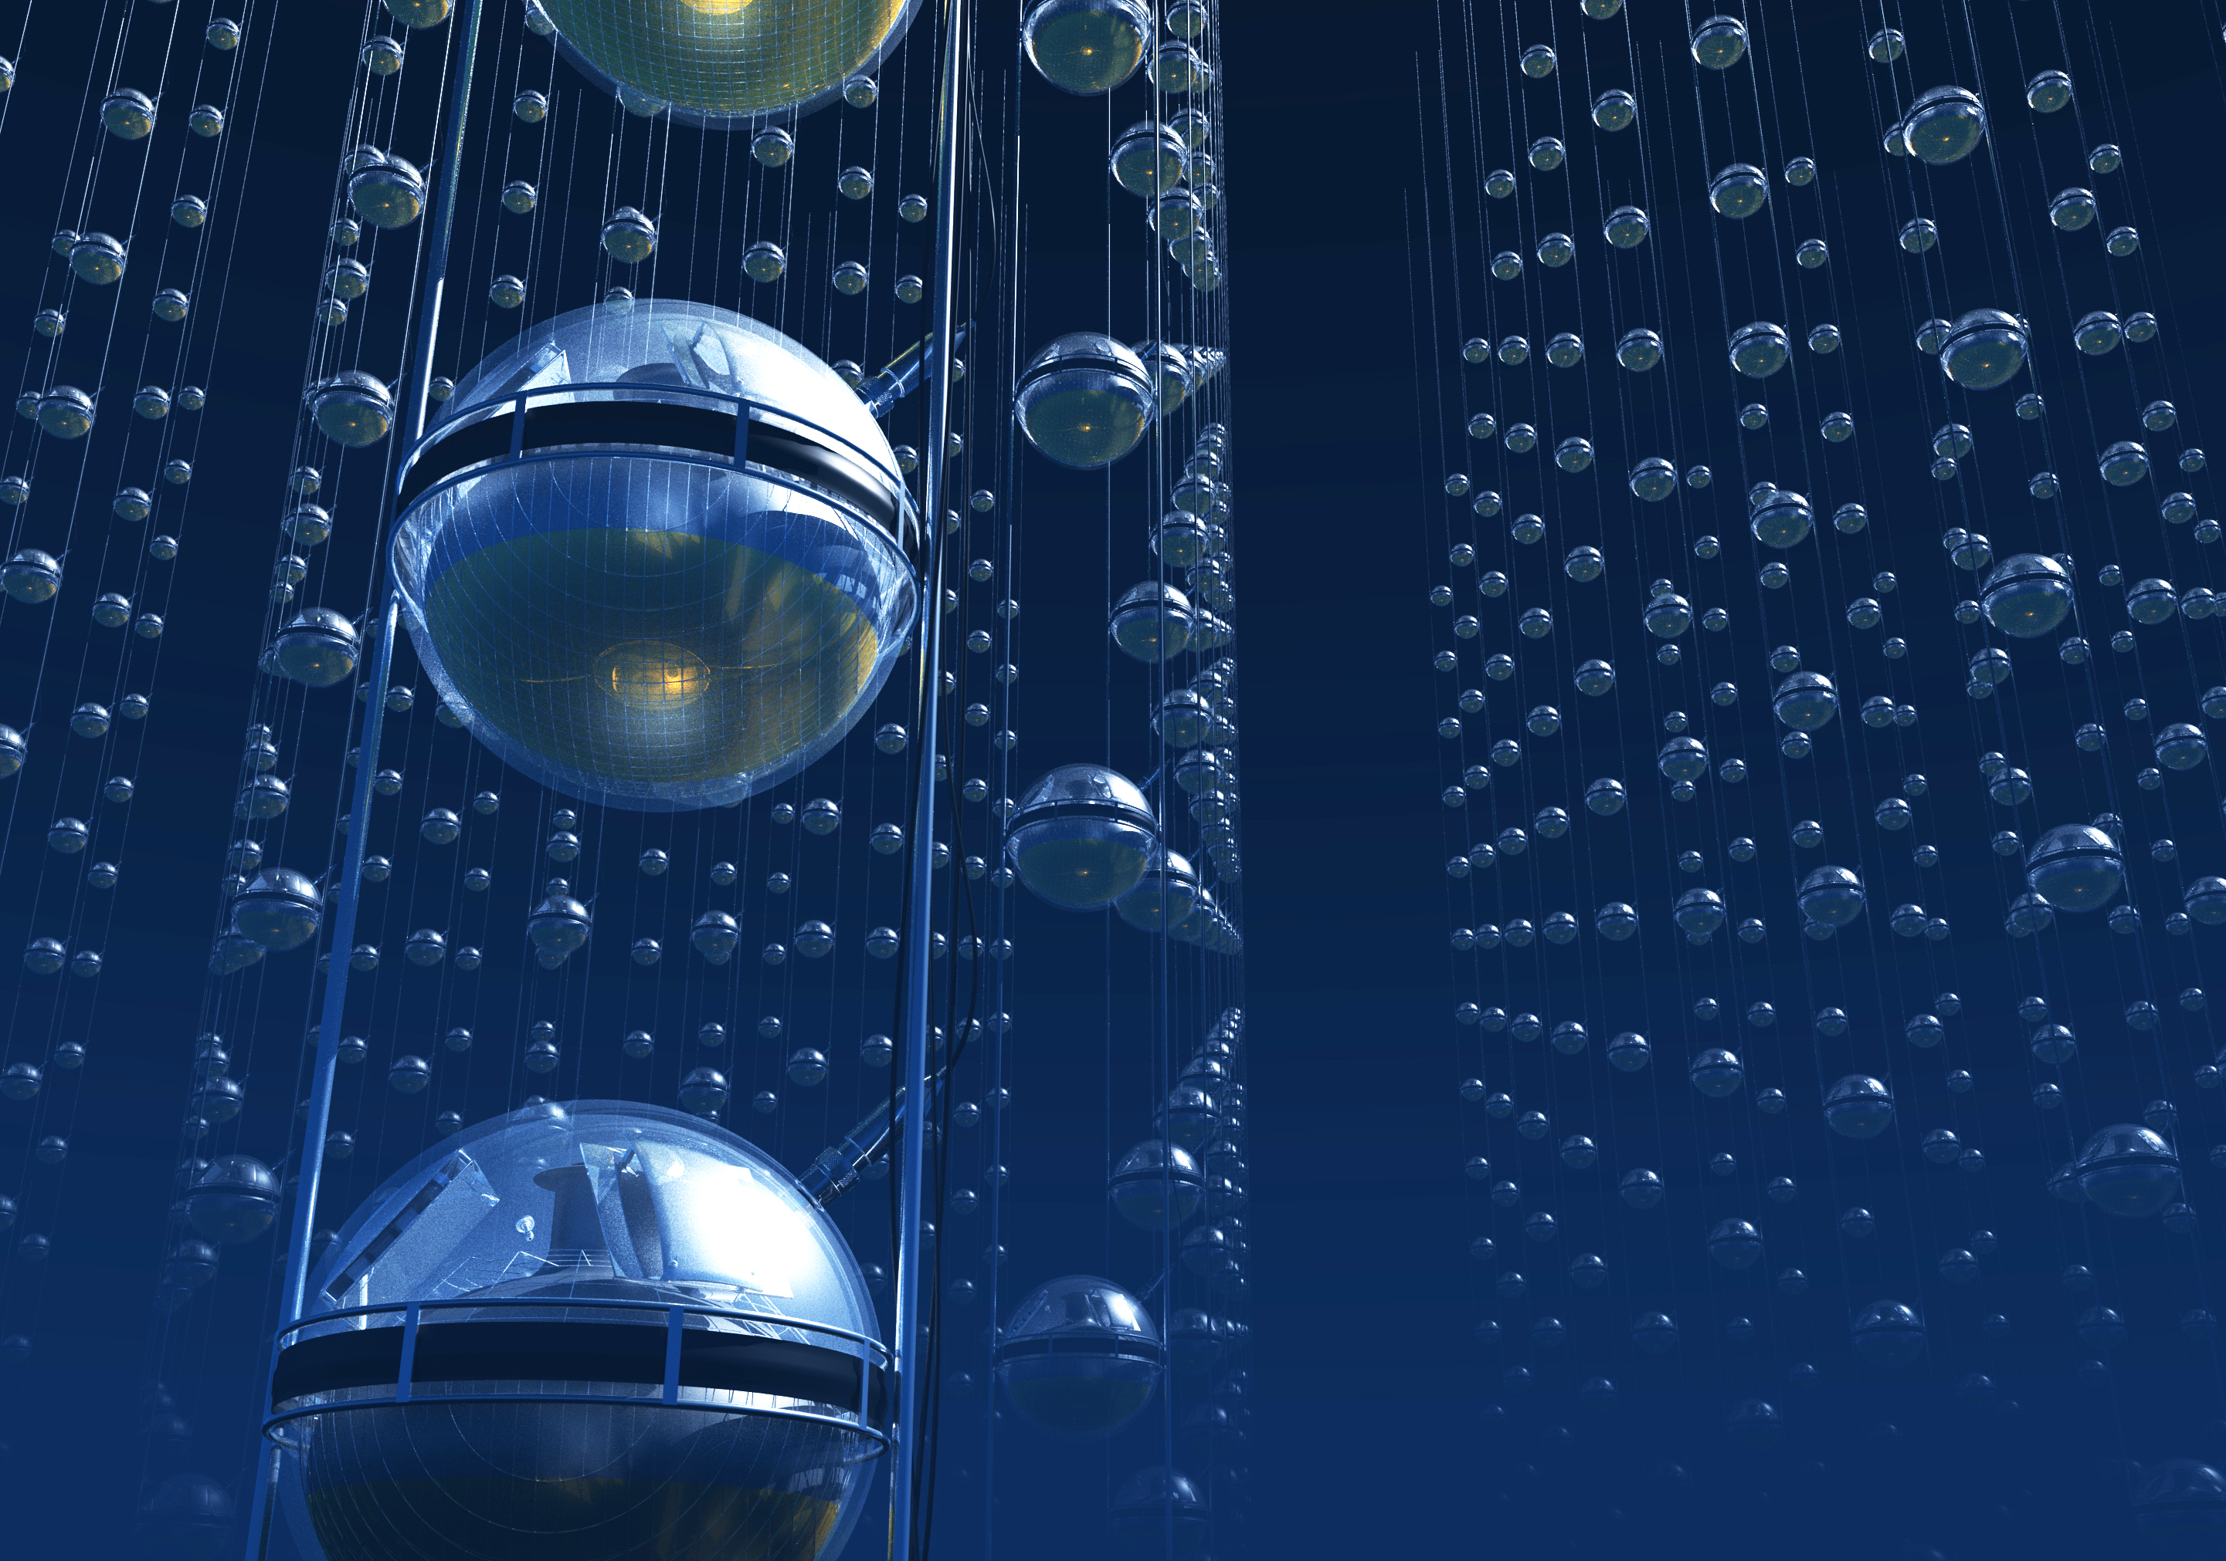
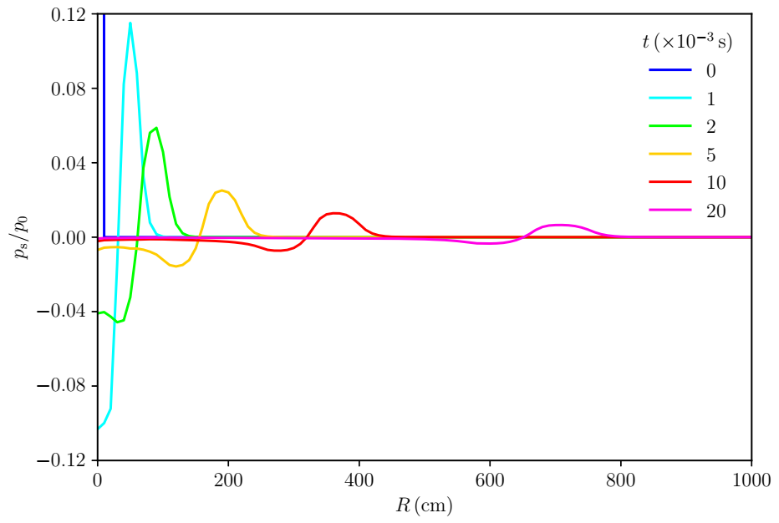




Detection: acoustic array
$$c_{s}$$
$$R$$
SN trajectory
$$x$$
Mach shockwave
$$c_{s}$$
~70 dB at 30 km
http://hunt.ihep.ac.cn/
Qi and Xu 2503.20597

Slide 15
Summary
Strange quark nuggets can stop evaporation by transforming to strangeon nuggets and survive as ultra-heavy dark matter and can be detected using an acoustic array.
In the future, the gravitational wave spectrum associated with the phase transitions can be calculated.
Thanks!

