Slide 1


The recent progresses of normal pulsars and magnetars
Mingyu Ge
Collaborators: Wentao Ye, Hanlong Peng, Xianao Wang, Yujia Zheng, Shiqi Zhou, Jianing Hu, Shanshan Weng, Xianghua Li
2026.07@GuiYang

Slide 2
Outline
Introduction
Progresses in normal pulsars
Progresses in magnetars
Summary

Slide 3
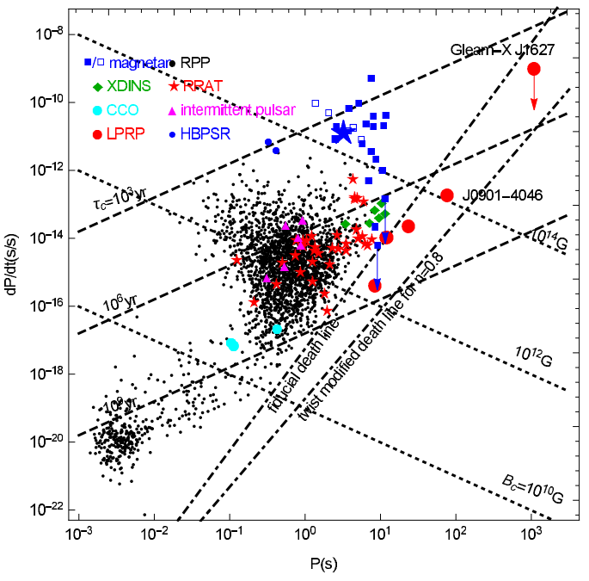
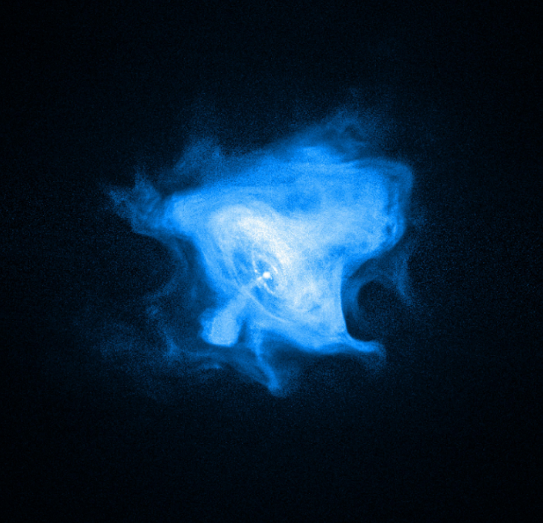
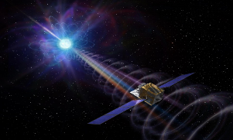
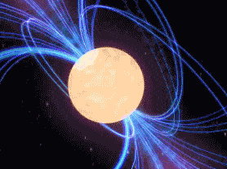
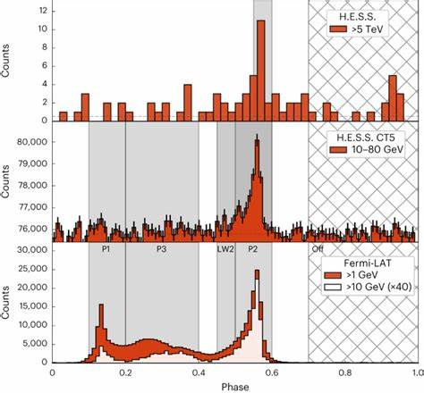
Introduction
PWN
Magnetar
Magnetar & FRB
γ-ray
HESS 2023
Tong H. et al. 2022
R: ~12km
B: ~10⁸⁻¹⁵G
ρ: ~10¹⁴⁻¹⁵gcm⁻³
Notes:
There are two basic questions: (1) where are the pulsation come from ? (2) What is inner composition of NS?
This the P-Pdot diagram in. There are several types of pulsars, most of them are rotation powered objects.. MSP and magnetars. Magnetars are very special, which show strong activities in time such Giant flare, intermediate flare and short bursts. Some of them are correlated with FRB or RB. For accreting pulsars including the ULX pulsars are not belong to this PPDot g, however, it special stage for the pulsar evolution , such as the formation of MSP.
Pulsar types

Slide 4
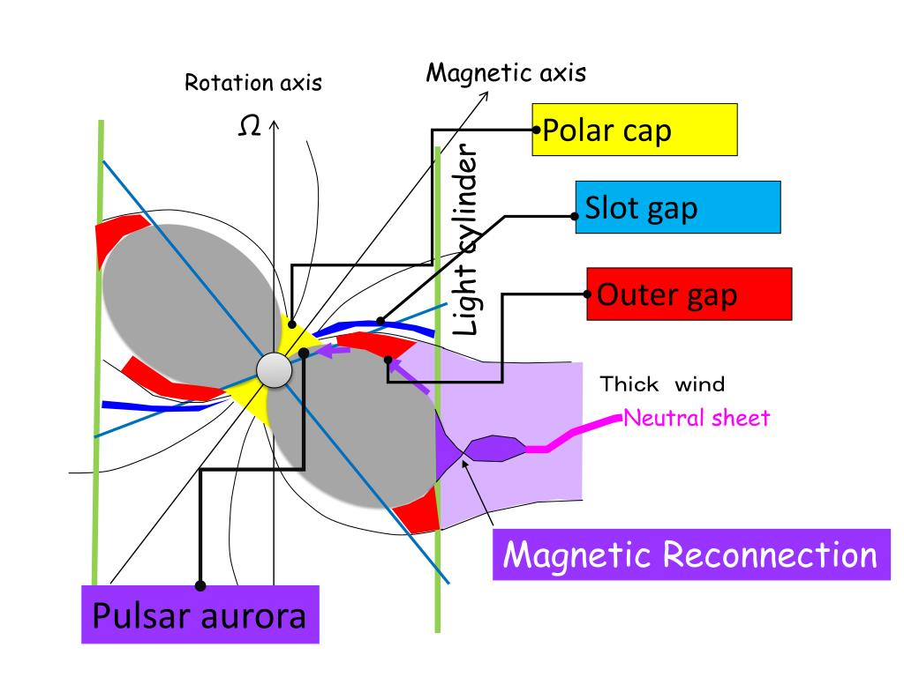
Introduction
Tong H. et al. 2022
Notes:
There are two basic questions: (1) where are the pulsation come from ? (2) What is inner composition of NS?
This the P-Pdot diagram in. There are several types of pulsars, most of them are rotation powered objects.. MSP and magnetars. Magnetars are very special, which show strong activities in time such Giant flare, intermediate flare and short bursts. Some of them are correlated with FRB or RB. For accreting pulsars including the ULX pulsars are not belong to this PPDot g, however, it special stage for the pulsar evolution , such as the formation of MSP.
Pulsar types

Slide 5
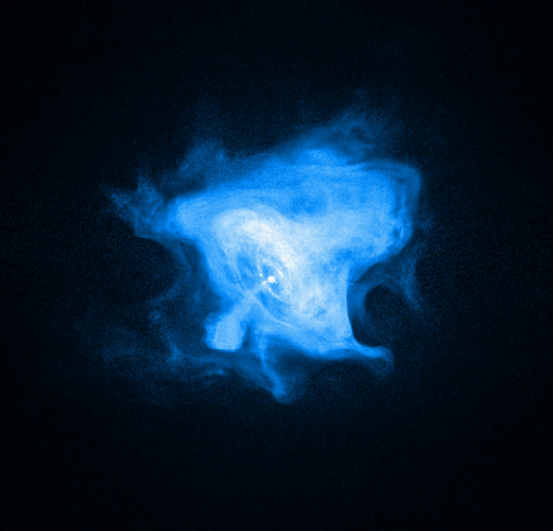
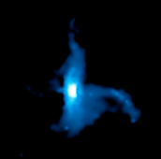
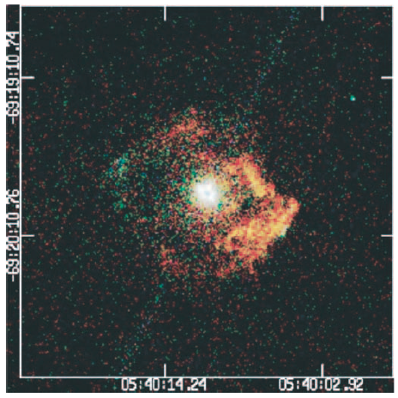
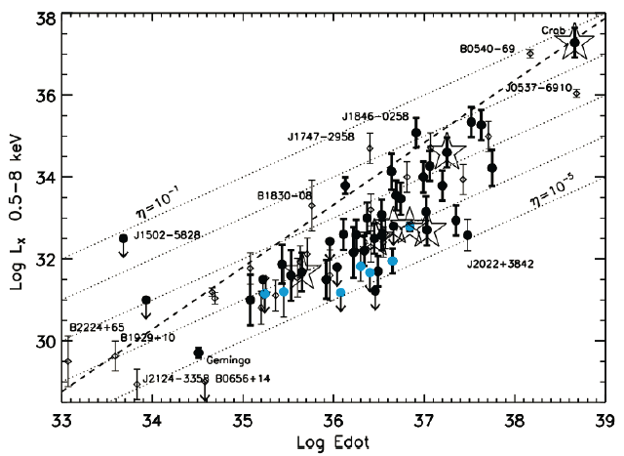
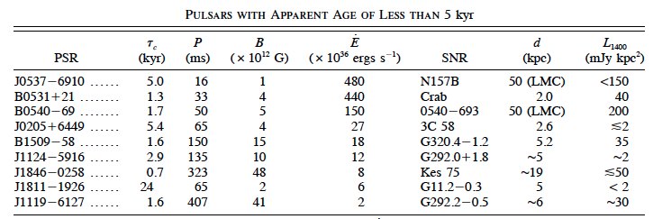
Introduction - Normal pulsar
Crab
J0205+6449
B0540-69
Kargaltsev et al. 2015
Notes:
Here, I want to show the X-ray telescopes in China, which could be used to study the features of pulsars. Insight-HXMT launched in 2017, covering 1-250keV. GECAM lauched in 2020 for mornitoring transients, such as GRB. EP and SVOM launched in this years.

Slide 6

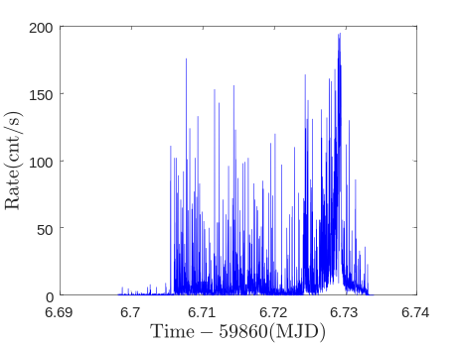
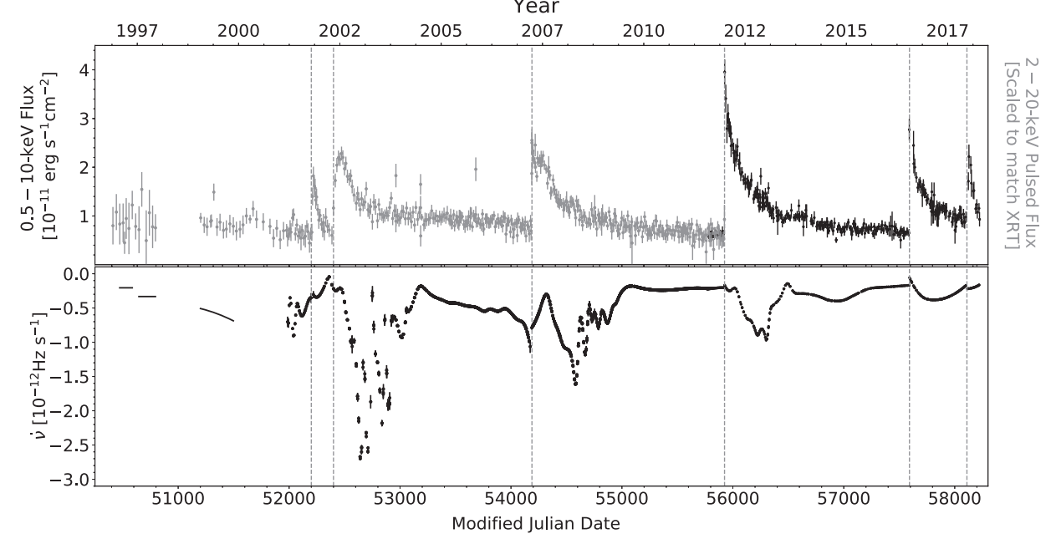
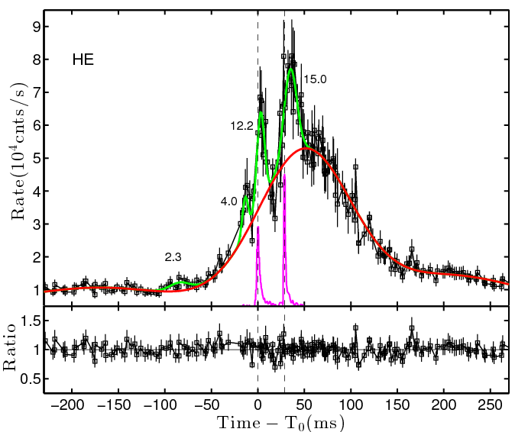
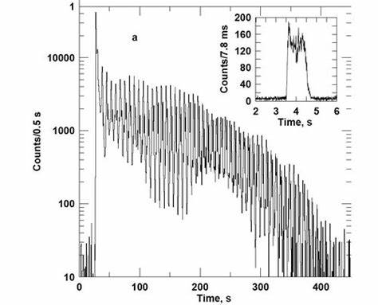
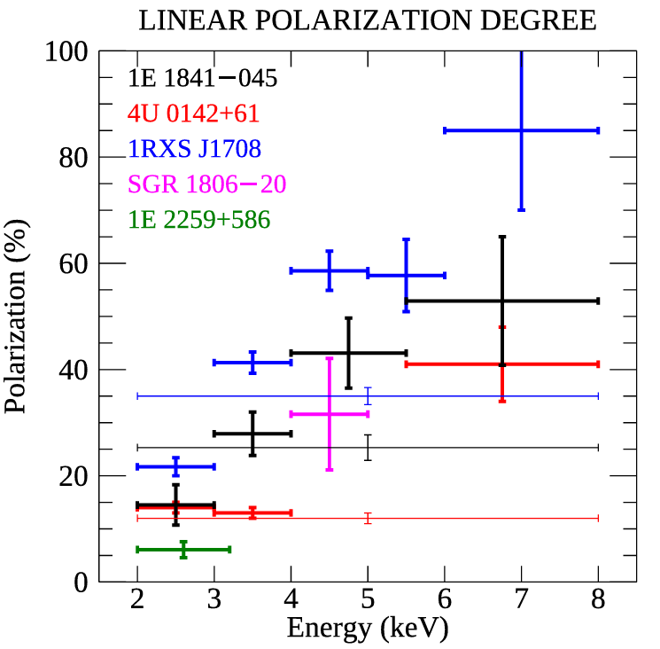
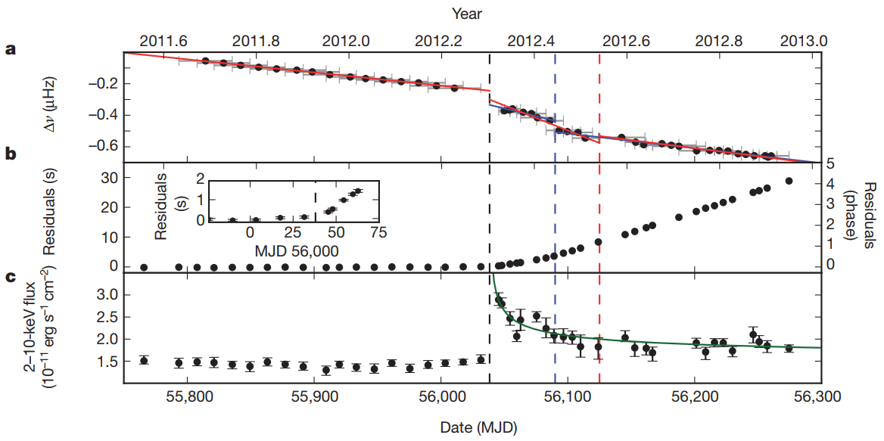
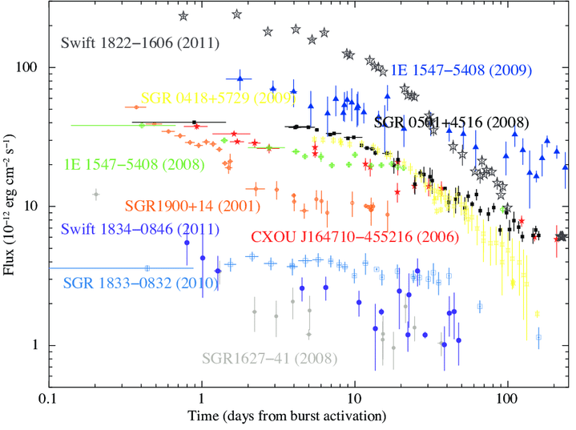
Introduction - Magnetar
SGR J1935+2154
1E 1048.1-5937
FRB 200428
1E 2259+586
磁星星表：www.physics.mcgill.ca
Li et al. 2020, Li et al. 2023, Ge et al. 2023, Archibald et al. 2013, 2020, Rigoselli et al. 2025

Slide 7
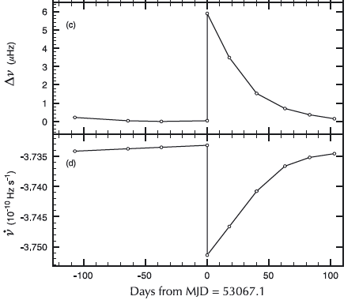
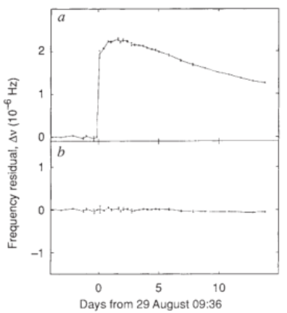
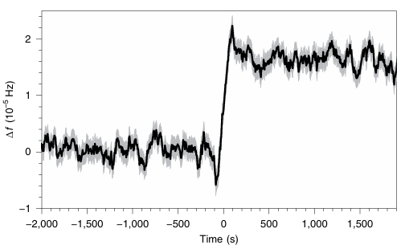
Introduction - Glitch
Vela
Crab
1E 2259+586
Anti-glitch in magnetar
Lyne et al. 1992
Archibald et al. 2013
Dodson et al. 2002
Ashton et al. 2019
Delayed spin-up component
In normal pulsar?
Notes:
Glitches are abnormal events in the timing behavior, especially in normal and magnetars. Until now, many glitches have been detected. Most of them quick rise in several seconds and experience with one or several exponential decay components. In crab pulsar, there is special one called delayed spin-up component with time scale of 1 day. Another type is anti-glicth or spin-down glitch, which happened in a magnetar. Does it possible happen in normal or even I young pulsar?

Slide 8
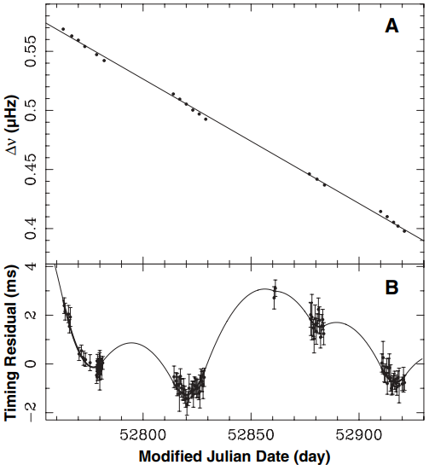
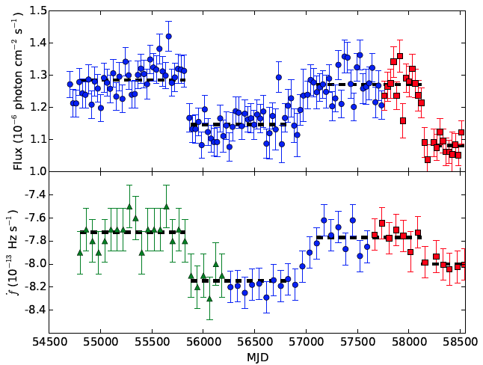
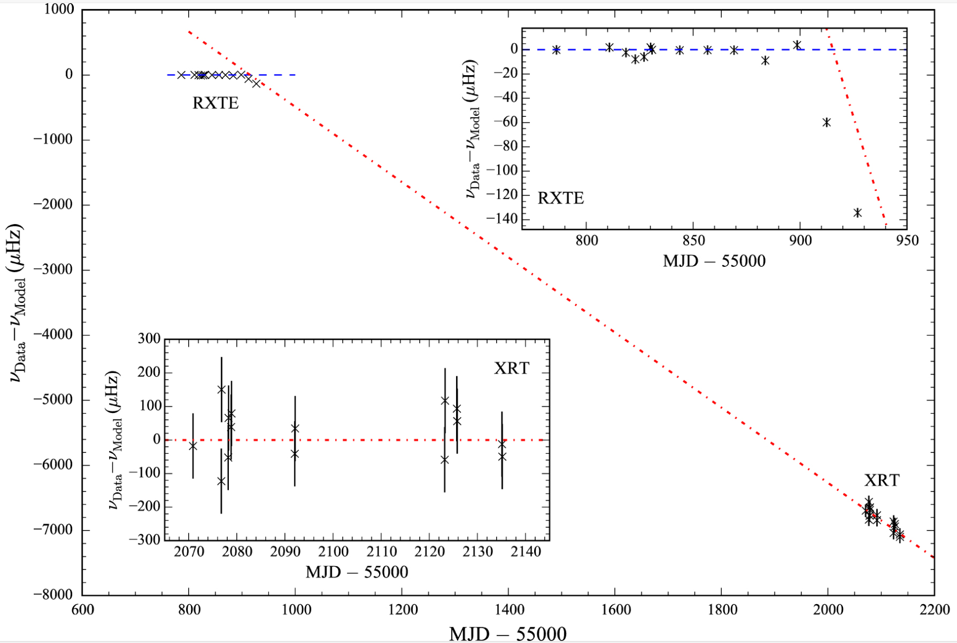
Introduction - State transition
X-ray or γ-ray
PSR B1931+24
PSR J2021+4026
PSR B0540-69
Kramer et al. 2006
Takata et al. 2020
Marshall et al. 2020
τ_{c}~10⁵-10⁶ yr
L_{sd} of young pulsar increases 38%
Notes:
Pulsars show many faces, one of them is the state transition. This is the first pulsar show switch on and off phenomenon, the change time is very quick.
Lyne also reports many radio pulsar the similar variations. This pulsar the first gamma-ray pulsar show flux variations. This is the first young show similar show similar behavior.

Slide 9
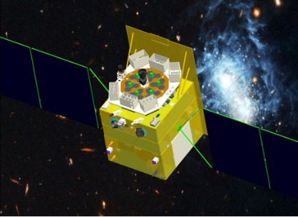
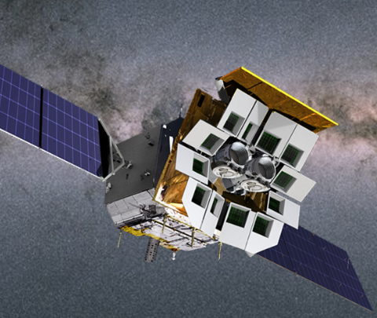
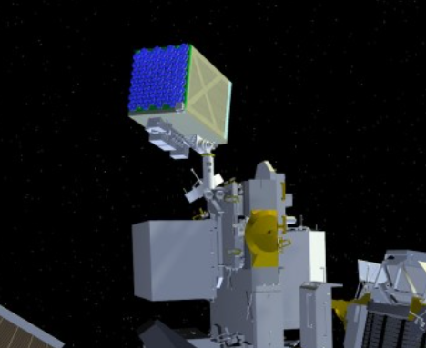
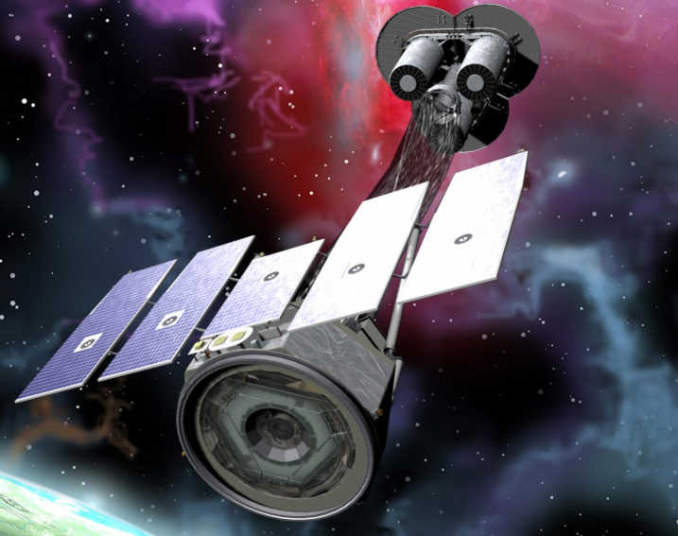
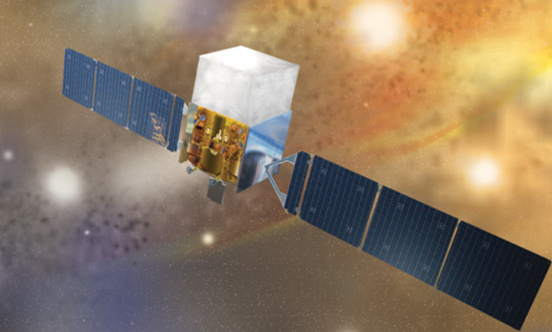
Introduction
Insight-HXMT
NICER
Einstein Probe
IXPE
Fermi-LAT
HXMT
Einstein Probe, 天关
NICER
IXPE
Fermi
Notes:
Here, I want to show the X-ray telescopes in China, which could be used to study the features of pulsars. Insight-HXMT launched in 2017, covering 1-250keV. GECAM lauched in 2020 for monitoring transients, such as GRB. EP and SVOM launched in this years.

Slide 10
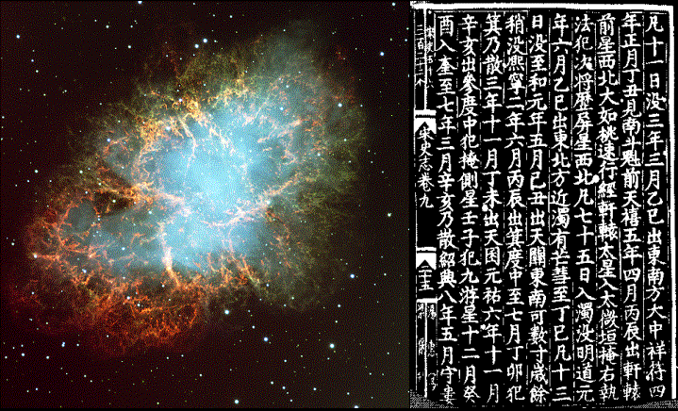
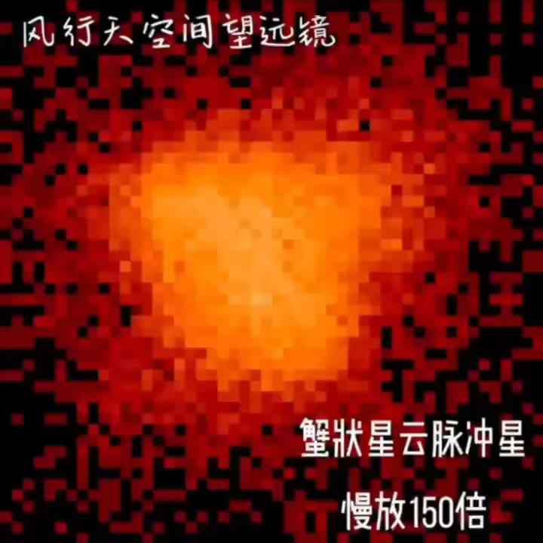
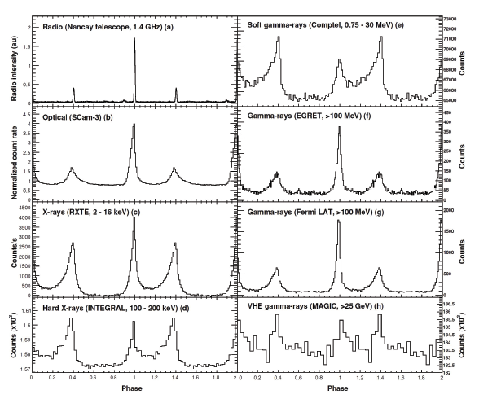
Progresses in normal pulsars
Crab pulsar: from radio to gamma
天关客星
EP-FXT team
Abdo et al. 2010
Notes:
Crab pulse is famous star in each wavelength, which is born in SN1054 recorded by China ancient scientist. This anamination is form EP-FXT team, which real time records from the imaging X_ray telescope.

Slide 11
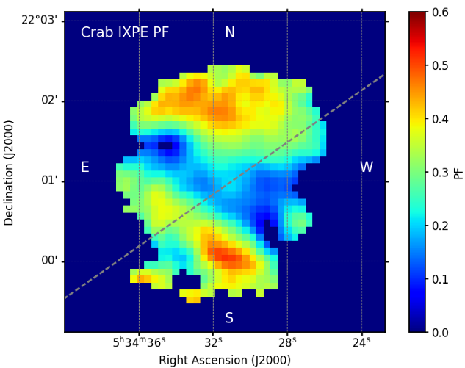
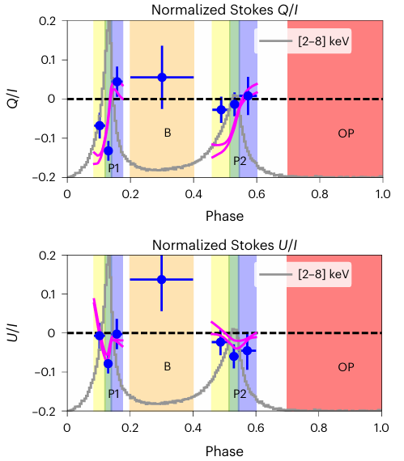
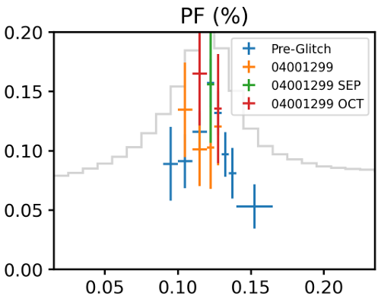
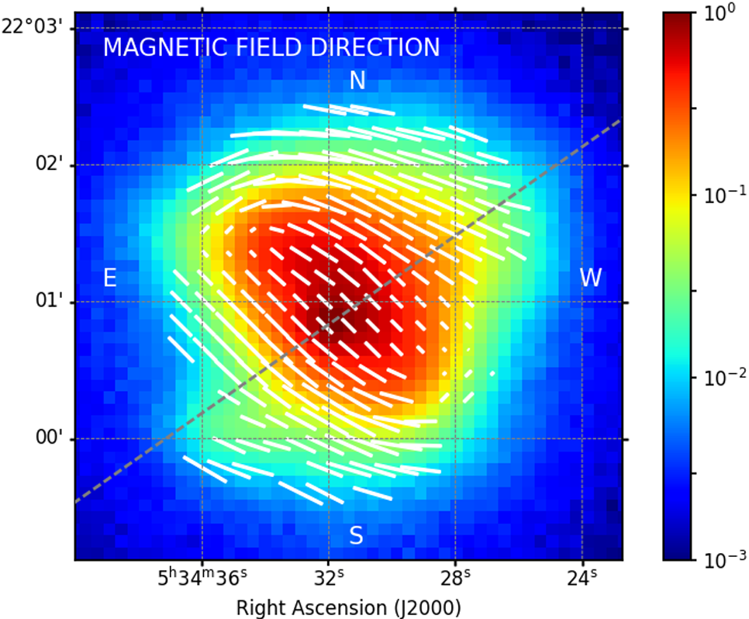
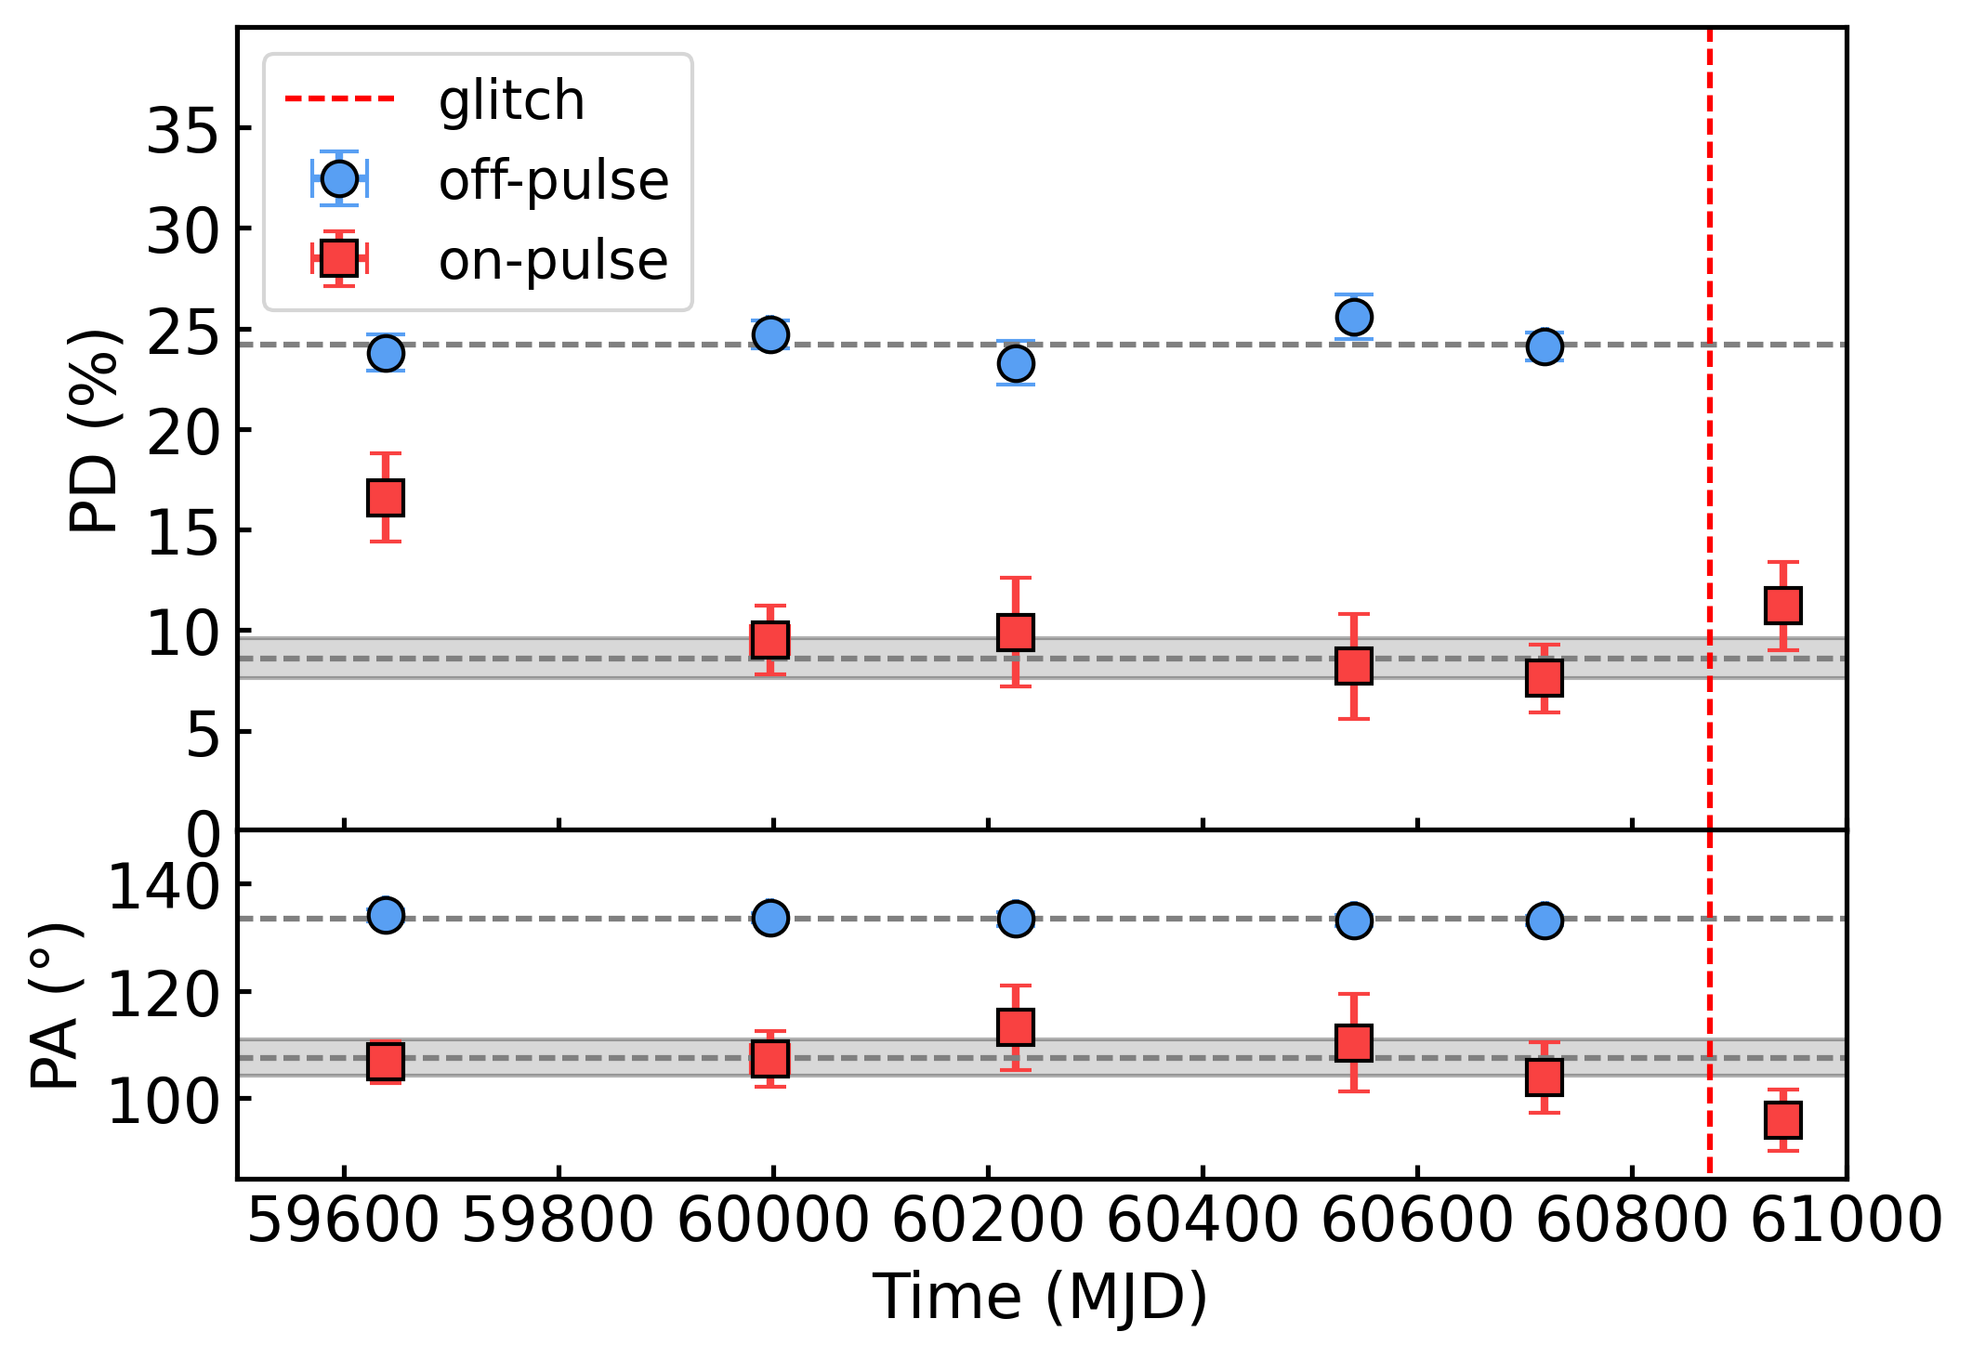
Progresses in normal pulsars
Crab pulsar: X-ray polarization
Bucciantini et al. 2023
Deng et al. 2025, Soffitta et al. 2026
Notes:
Crab pulsar is first pulsar showing steady evolution in radio and X-ray pulsations. It indicates the magnetic axis might move toward to the equator.

Slide 12
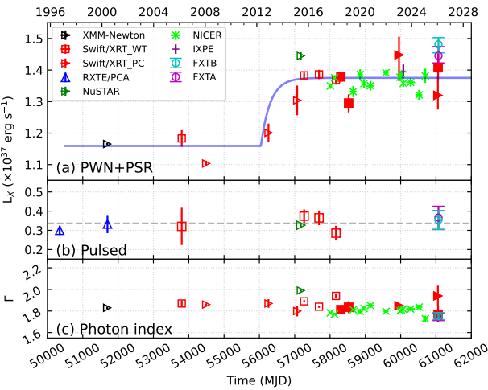
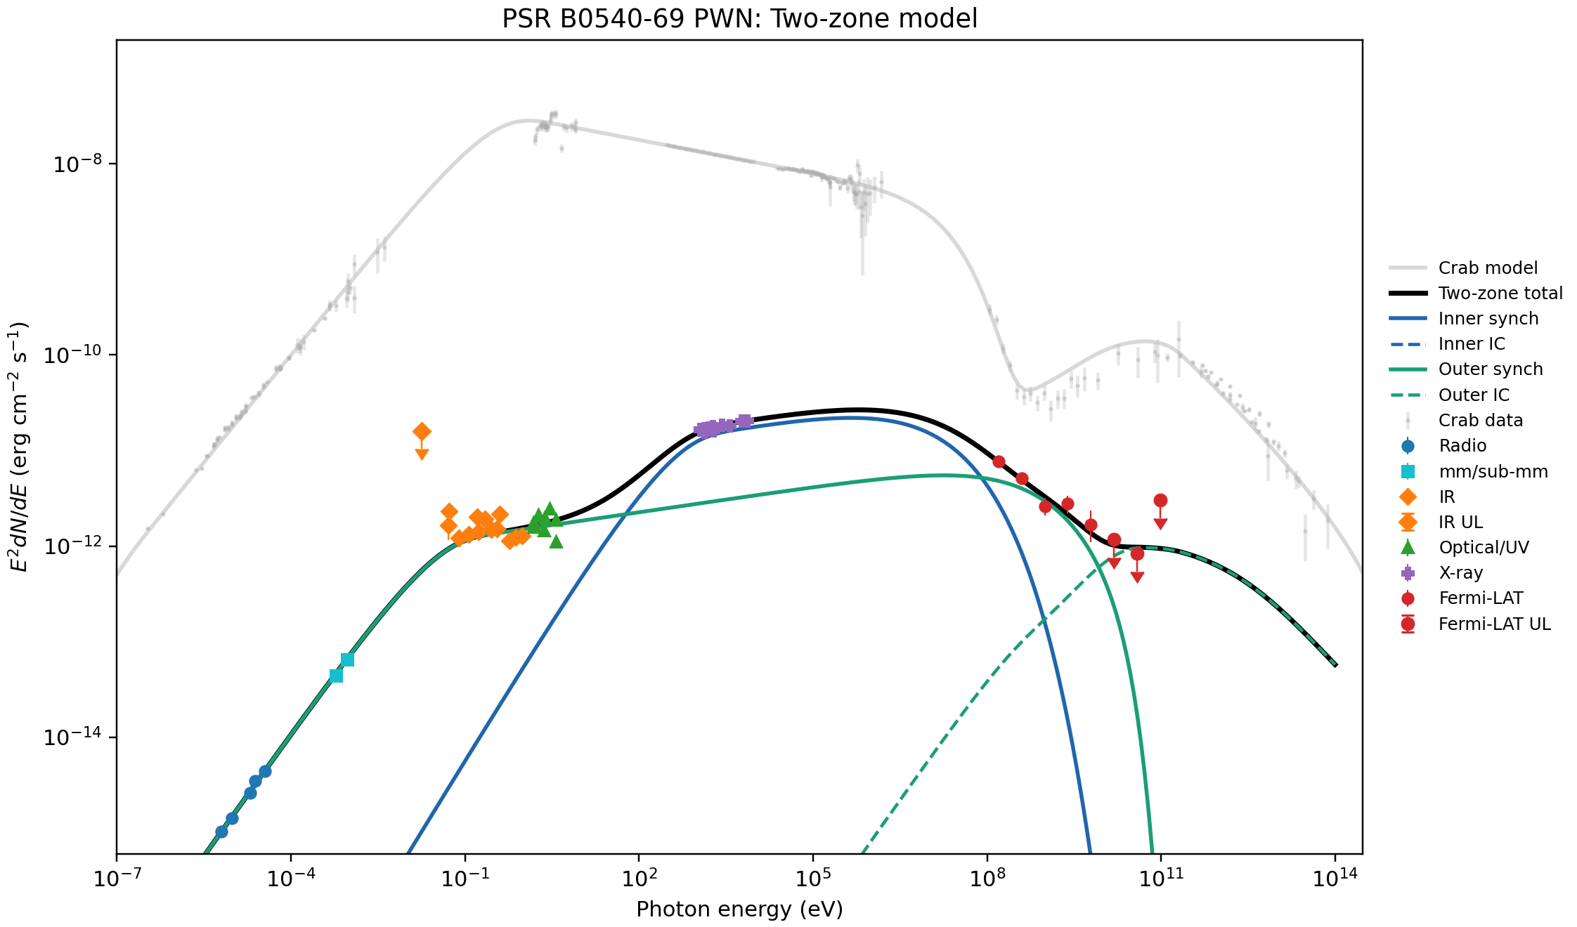
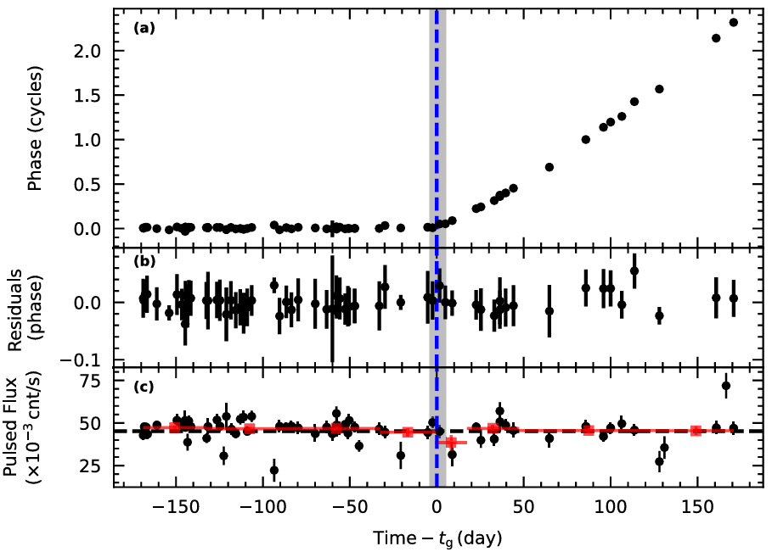
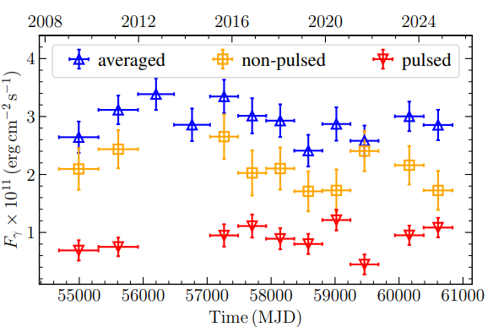
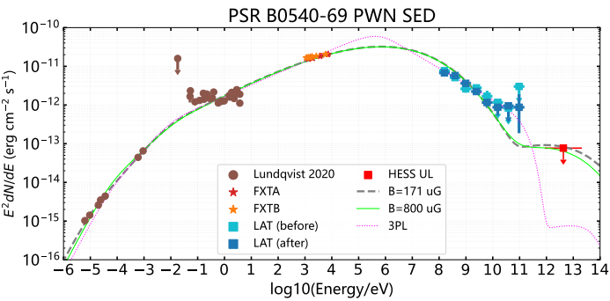
Progresses in normal pulsars
PSR B0540-69
    Spin-down glitch
    Synchrotron spectrum?
Crab PWN
Ge et al. 2019, Tuo et al. 2024, Zhang et al. prepared
Notes:
PSR B0540-69 is young pulsar located in LMC and also energetic pulsar. At the end of 2011, state transition happened, the spin-down luminosity increases 38%. However, the pulsed X-ray flux does not change. Where is the enhancement of spin-down energy? The converted to more particles and injected to PWN. We could see the gradually increasing with time. The time scale is 143 days, means the magnetic field is about 0.8mG.

Slide 13
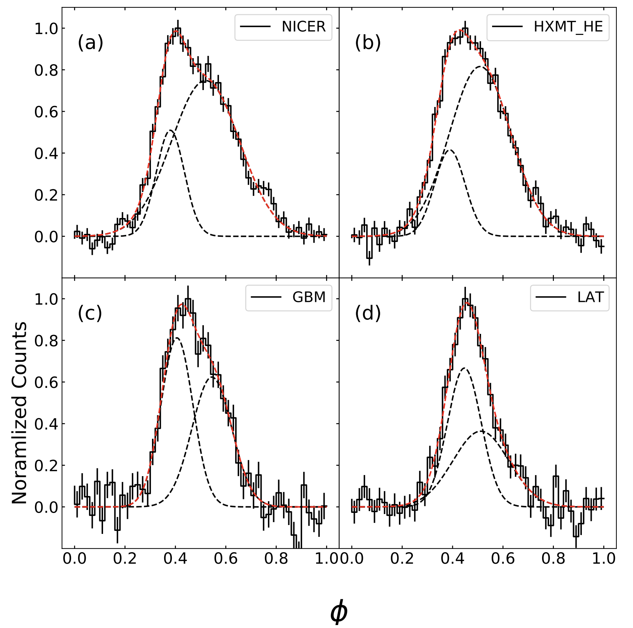
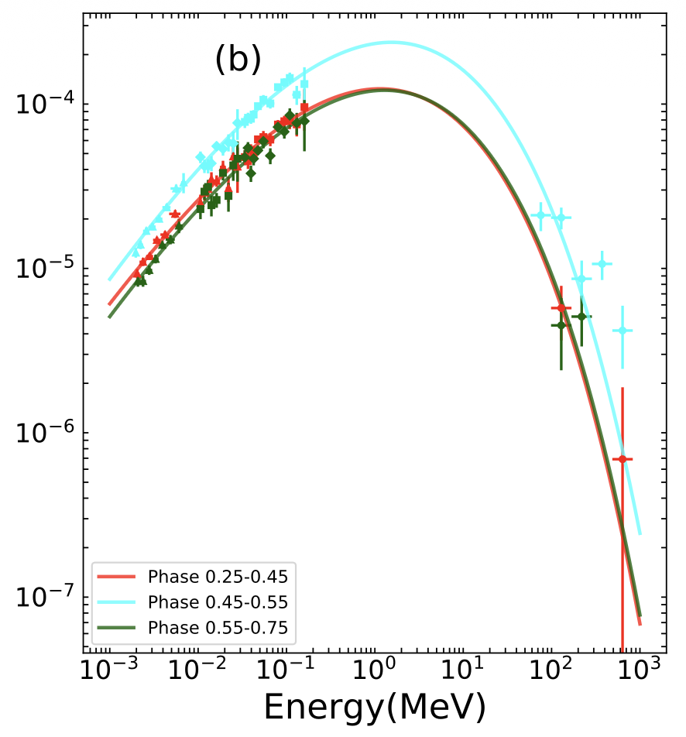
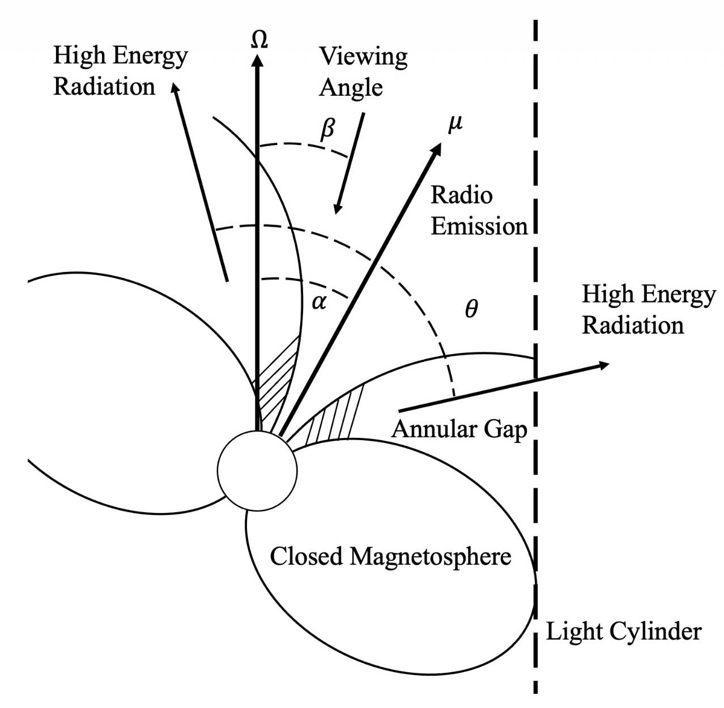
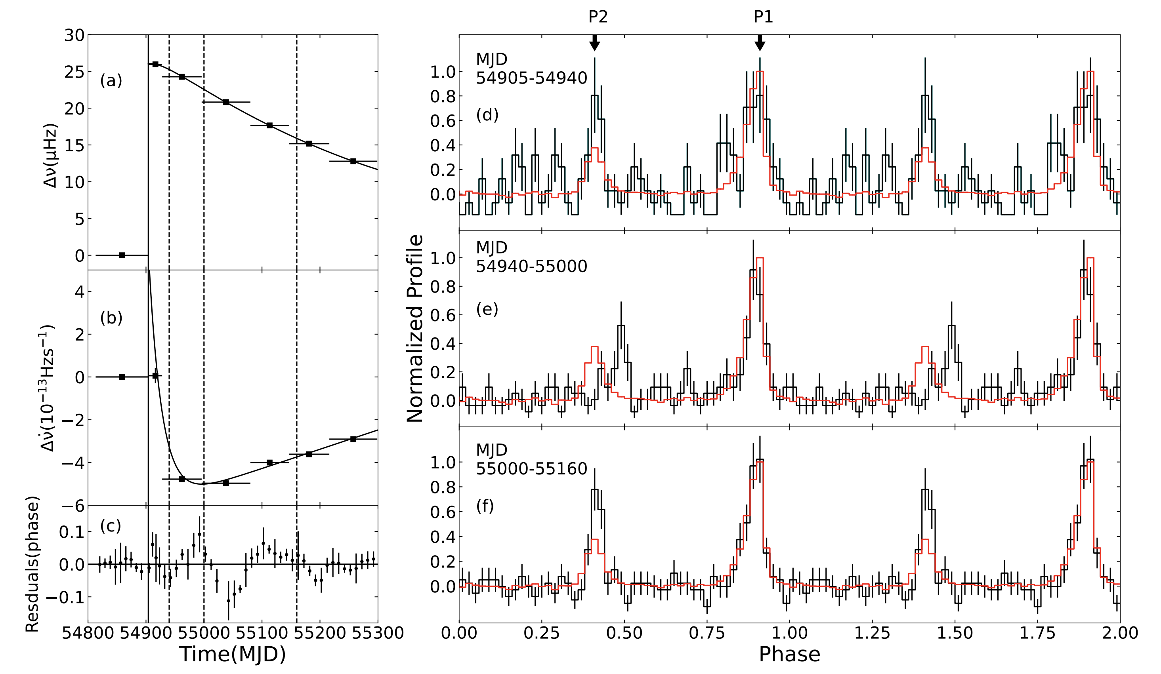
Progresses in normal pulsars
PSR B1509-58
Broadband spectrum: peak luminosity at Emax ≈ 2.1 MeV
Annular gap model: emission angle moves away from B-axis at higher energies
PSR J0205+6449
MJD 54940–55000: P2/P1 peak separation decreases (>5σ)
MJD 55000–55160: amplitude ratio P2/P1 increases (~3σ)
Profile reverts to normal state afterward
Ye W.T. et al. 2025, 2026
13
Notes:
PSR B0540-69 is young pulsar located in LMC and also energetic pulsar. At the end of 2011, state transition happened, the spin-down luminosity increases 38%. However, the pulsed X-ray flux does not change. Where is the enhancement of spin-down energy? The converted to more particles and injected to PWN. We could see the gradually increasing with time. The time scale is 143 days, means the magnetic field is about 0.8mG.

Slide 14
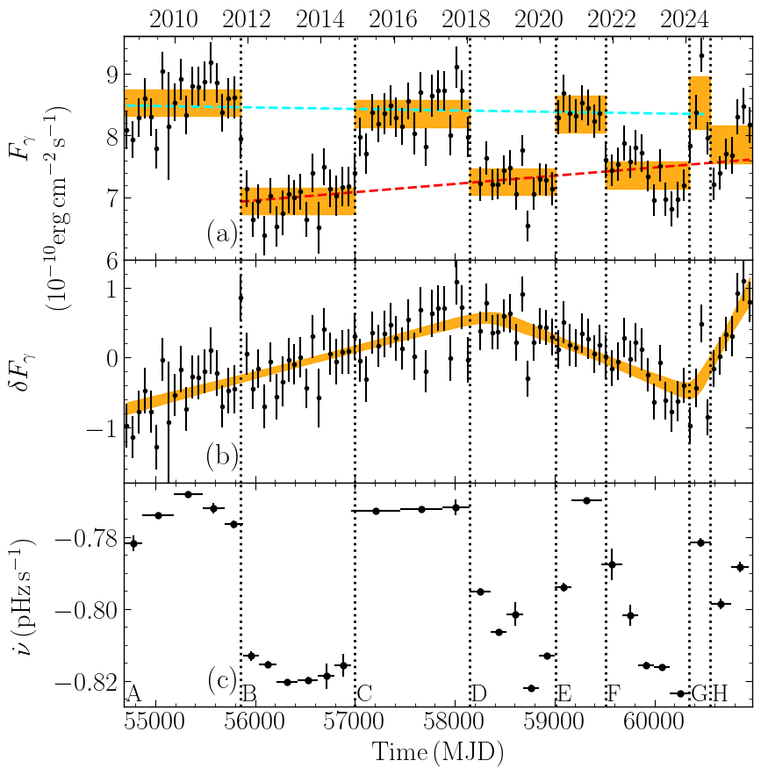
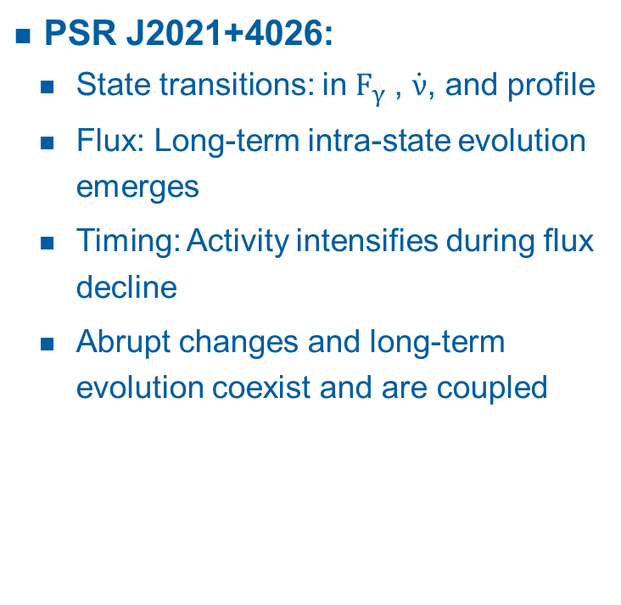

Progresses in normal pulsars
PSR J2021+4026:
State transitions: in $F_{γ}$, $\dot{ν}$, and profile
Flux: Long‑term intra‑state evolution emerges
Timing: Activity intensifies during flux decline
Abrupt changes and long‑term evolution coexist and are coupled
Original: Oscillation?
New Data
New Rise !
0
$$Δ_{F_{γ}}$$
14
Liu et al. 2026
Notes:
PSR B0540-69 is young pulsar located in LMC and also energetic pulsar. At the end of 2011, state transition happened, the spin-down luminosity increases 38%. However, the pulsed X-ray flux does not change. Where is the enhancement of spin-down energy? The converted to more particles and injected to PWN. We could see the gradually increasing with time. The time scale is 143 days, means the magnetic field is about 0.8mG.

Slide 15
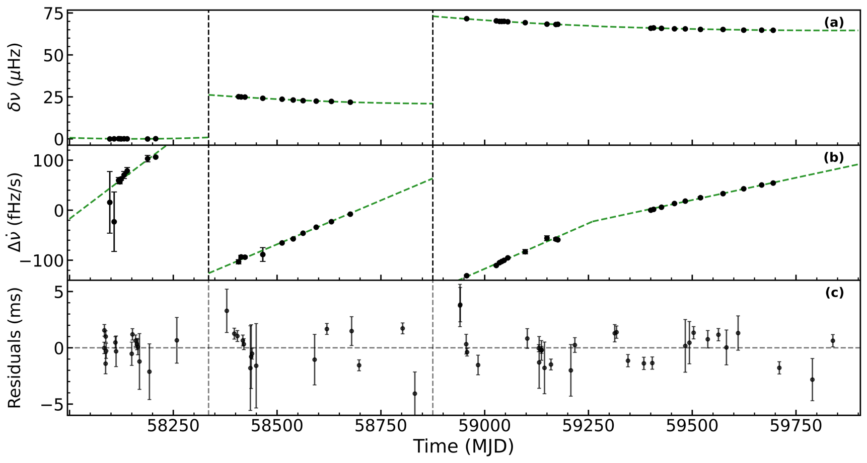
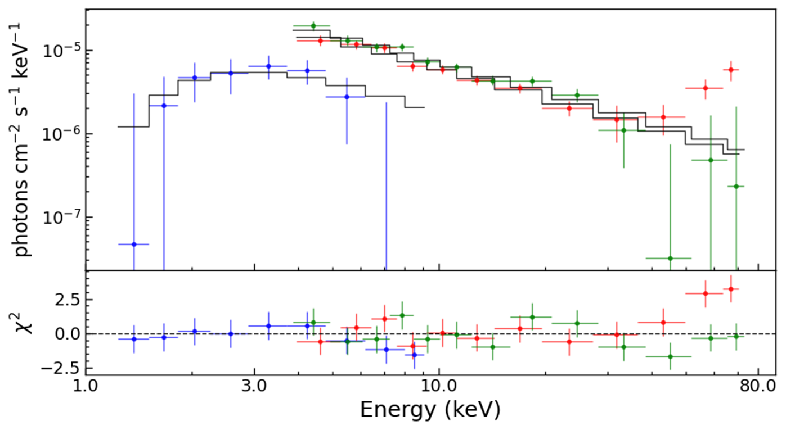



Progresses in normal pulsars
PSR J2022+3842
Two large glitches
A_{g} ~ 7 $×$ ${10}^{−7}{yr}^{−1}$
PSR J1838-0655
Glitch: 2.9$×$ ${10}^{−6}Hz$
Phase-resolved spectra
$$2.535(2)×{10}^{−5}Hz$$
$$5.2078(6)×{10}^{−5}Hz$$
Wang X.A. et al. 2025, Hu J.N. et al. 2026
15
Notes:
PSR B0540-69 is young pulsar located in LMC and also energetic pulsar. At the end of 2011, state transition happened, the spin-down luminosity increases 38%. However, the pulsed X-ray flux does not change. Where is the enhancement of spin-down energy? The converted to more particles and injected to PWN. We could see the gradually increasing with time. The time scale is 143 days, means the magnetic field is about 0.8mG.

Slide 16






Progresses in magnetars
EP+NICER
No. | Name | R.A. | Decl. | Unabs Fx (1E-12) | Photon index
1 | SGR 1935+2154 | 293.7317 | 21.8966 | 2.1 | 1.8
2 | 4U 0142+61 | 26.5934 | 61.7509 | 67.9 | 3.88
3 | 1RXS J170849.0-400910 | 257.1953 | -40.1479 | 24.3 | 2.79
4 | 1E 1841−045 | 280.3306 | -4.9364 | 21.3 | 1.9
5 | 1E 2259+586 | 345.2846 | 58.879 | 14.1 | 3.75
6 | 1E 1048.1-5937 | 162.5298 | -59.8893 | 5.1 | 3.14
7 | XTE J1810−197 | 272.462862 | -18.268908 | 0.029 | -
8 | 1E 1547.0-5408 | 237.725 | -54.3066 | 17 | 0.4
9 | SGR 0501+4516 | 75.2782 | 45.2761 | 1.7 | 3.84
10 | SGR 1900+14 | 286.8097 | 9.3223 | 4.8 | 1.9
Zheng et al. 2026

Slide 17




Progresses in magnetars
SGR J1935+2154
  X-ray burst in 2020
  FRB 200428
G57.2+0.8
Zhou P. et al. 2020
From Insight-HXMT
Li et al. 2020
Li et al., 2023, Ge et al., 2023
Notes:
SGR J1935+2154 is the first magnetar connection with FRB 200428, which proves it origin of FRB.

Slide 18




Progresses in magnetars
SGR J1935+2154
  X-ray burst in 2022
Hu et al. 2024
Fu et al. 2025

Slide 19





Progresses in magnetars
1E 2259+586
4U 0142+61
1RXS J1708
1E 1841-045
8 New Timing Events:
2 Anti-glitches
5 Glitches
1 State Transition
Peng et al. 2026
Notes:
The characertis age is young, call young pulsar, which are the central enegines of pulsar wind nebula. The connection between them are from the image, correlation between lumninostity and spin-down lumninostity. Is it possible for find more direct evidence to study the nature between PWN and central.

Slide 20




Progresses in magnetars
1E 2259+586
  Spin-down glitch
  X-ray enhancement
  No bursts detected
  Pulse profile variation
  No polarization variation
NICER: ~106%
EP: ~60%
IXPE:~13%
Peng et al. prepared
Notes:
The characertis age is young, call young pulsar, which are the central enegines of pulsar wind nebula. The connection between them are from the image, correlation between lumninostity and spin-down lumninostity. Is it possible for find more direct evidence to study the nature between PWN and central.

Slide 21



Progresses in magnetars
4U 0142+61
1RXS J170849.0-400910
1E 1841-045
Chen et al. 2025
No variations in short time scale
Notes:
The characertis age is young, call young pulsar, which are the central enegines of pulsar wind nebula. The connection between them are from the image, correlation between lumninostity and spin-down lumninostity. Is it possible for find more direct evidence to study the nature between PWN and central.

Slide 22

Spin-down glitch sample
Magnetars：12+3
  Activity
  Quiet
Normal pulsars：4+1+1
  Quiet
Amplitude：1E-8~1E-4
PSR J1119-6127
SGR J1900+14
PSR J1846-0258
SGR J1935+2154
1E 1841-045
4U 0142+61
1E 2259+586
PSRs B0540-69 & J1522-5735 & J1835-1106
Ge et al. 2023

Slide 23

Summary
Normal pulsars:
  Crab pulsar: X-ray polarization does not change pre and post glitch
  PSR B0540-69: PWN evolution, SED, spin-down glitch
  PSR J0205+6449: γ-ray pulse variation
  PSR J2021+4026: Long‑term intra‑state evolution
Magnetars:
  SGR J1935+2154: Oscillation and time delay of X-ray burst associated to FRB 200428
  Spin evolution of 4 magnetars
  1E 2259+586: flux enhancement after large spin-down glitch
eXTP: enhanced X-ray Timing and Polarimetry
Timing × Spectroscopy × Polarimetry
Thank you!

Slide 24



Spin-down glitch
PSR B0540-69
PSR J1522-5735
PSR J1835-1106
Tuo Y.L. et al. 2024
Zhou S.Q. et al. 2024
Wang M.Y. et al. 2025

