Slide 1




第十五届全国脉冲星研讨会
FAST/Future Pulsar Symposium15
Gamma-Ray Bursts: Evidence for a Common Origin of X-Ray Plateaus with Diverse Temporal Decay Index
汇报人：董小飞
指导教师：黄永锋 教授
合作者：邓晨，邹泽城，耿金军，胡宸然，吾热卡西·艾麦提，李秀娟，李亮
贵州 贵阳 2026. 7. 3

Slide 2
CONTENT
1
研究背景
2
数据筛选
3
统计结果
4
总结展望

Slide 3


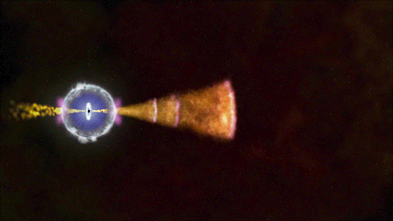
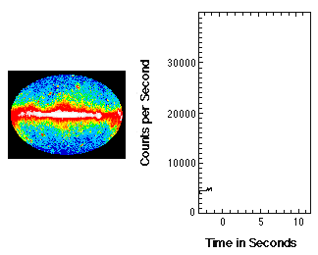
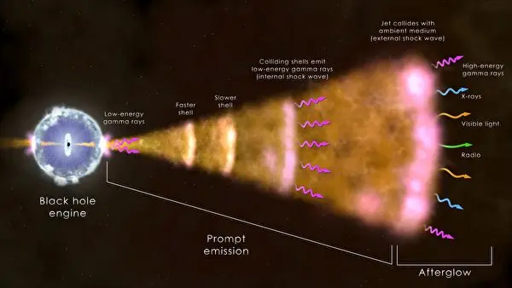
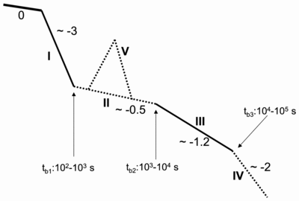
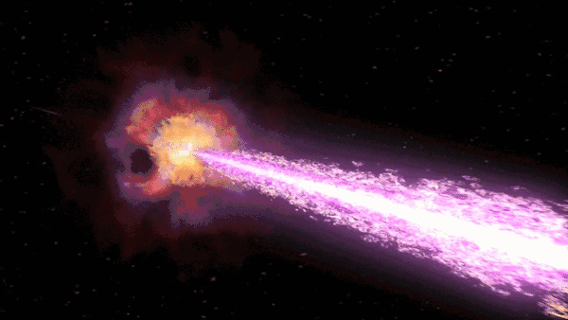
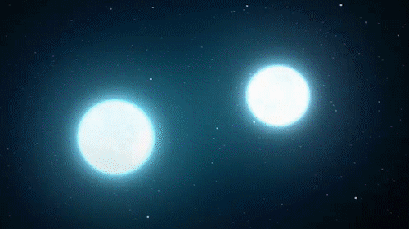
1 研究背景
Zhang et al. 2006
Phase I | initial steep decay phase
Phase II | shallow decay / plateau phase
Phase III | normal decay phase
Phase IV | Post/jet-break phase
Phase V | X-ray flares
内激波、磁重联或光球辐射
与周围星际介质或星风环境相互作用

Slide 4
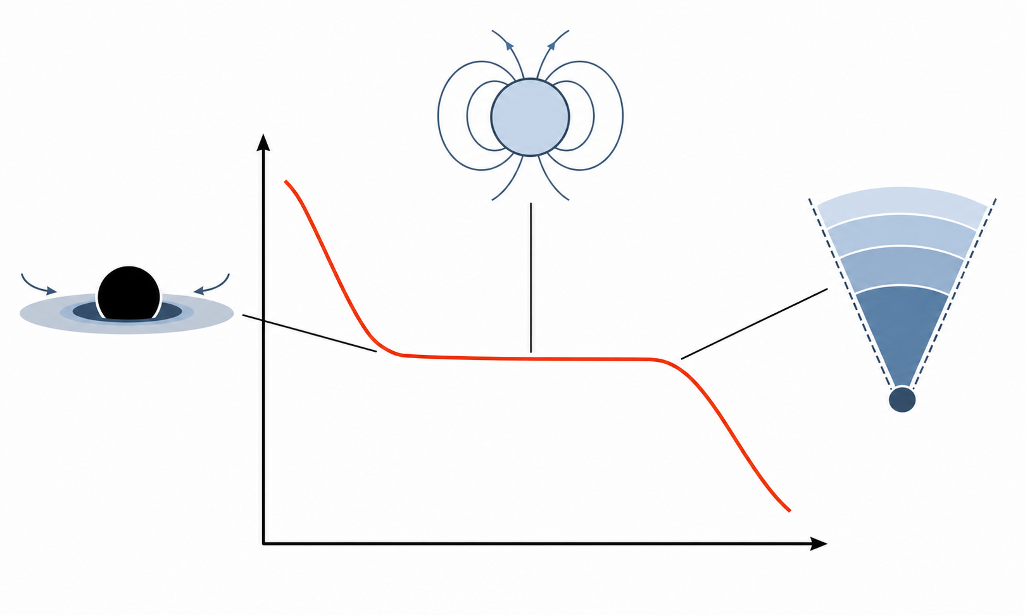
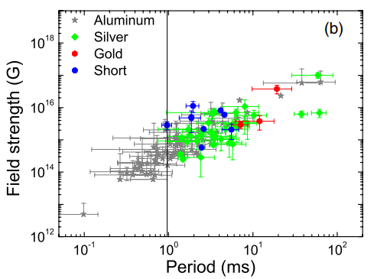
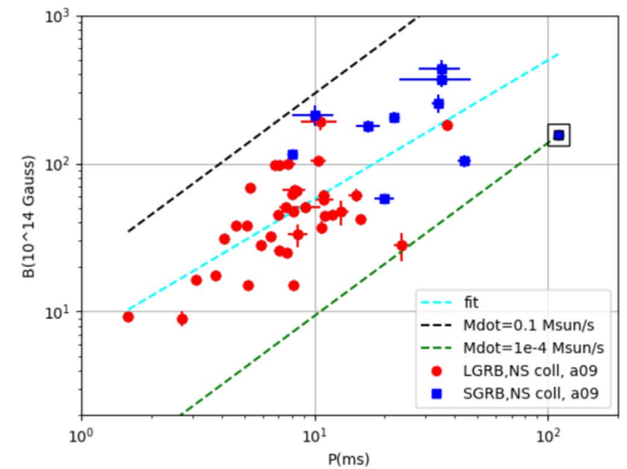
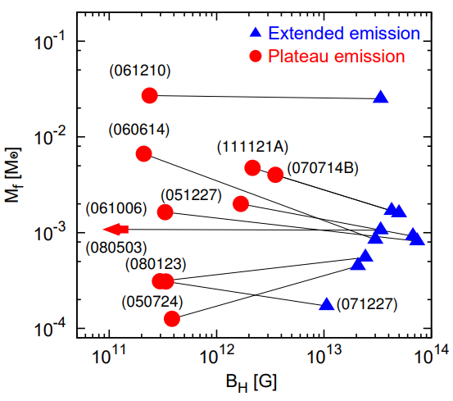
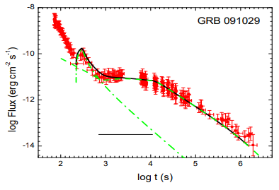
1 研究背景
Lü et al. 2014
Stratta et al. 2018
磁星自转能注入
  (Dai & Lu, 1998 ; Zhang & Mészáros, 2001)
黑洞回落吸积 (Kumar et al. 2008)
refreshed shock (Rees & Mészáros 1998)
结构化喷流 (Oganesyan et al. 2019)
late prompt emission (Ghisellini et al. 2007)
……
Kisaka & Ioka. 2015
Yu et al. 2015

Slide 5
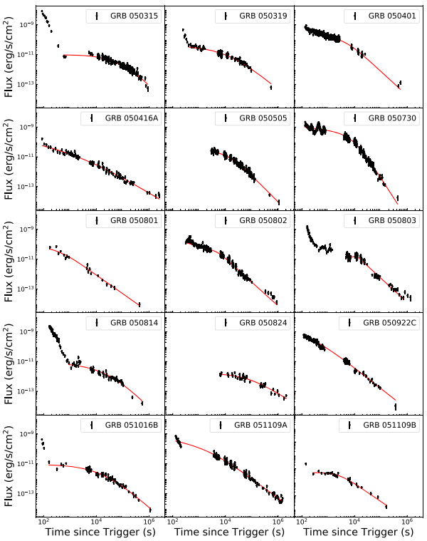
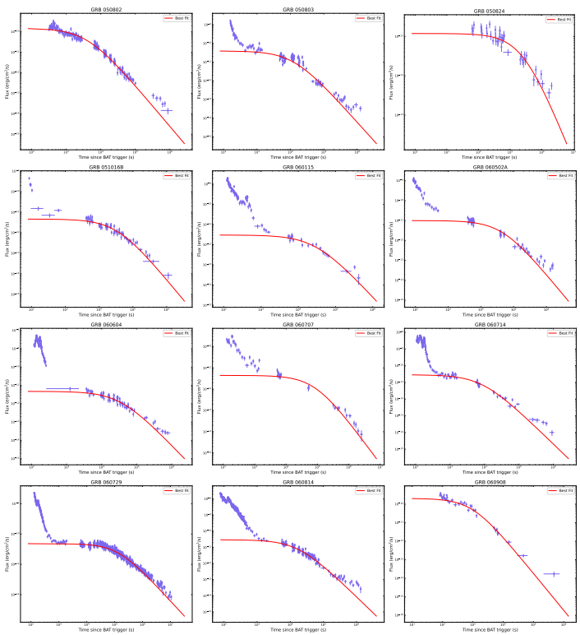
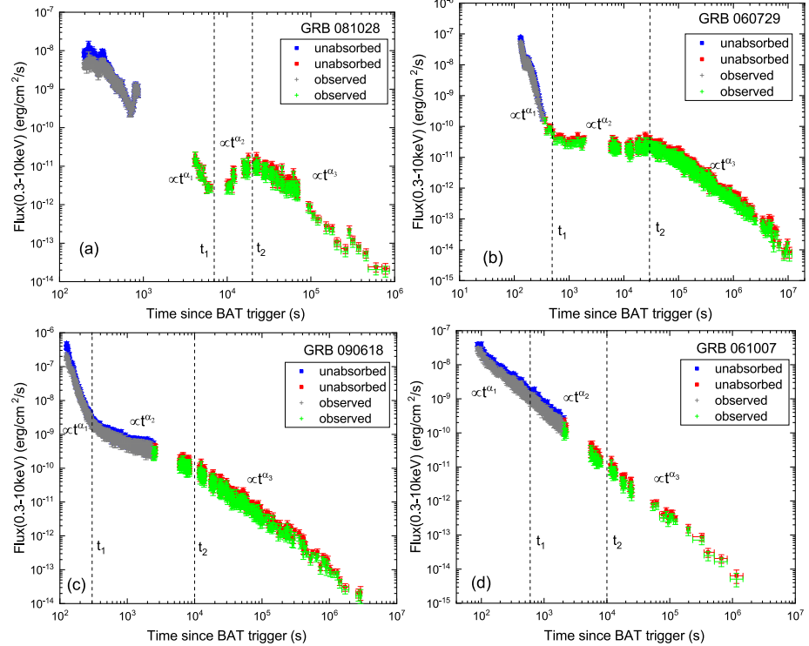
1 研究背景
Tang et al. 2019
Zhou et al. 2026
Different morphology
?
Different population
Du et al. 2024

Slide 6
1 研究背景
Large Sample
Distinguish morphology
Comparative analysis

Slide 7

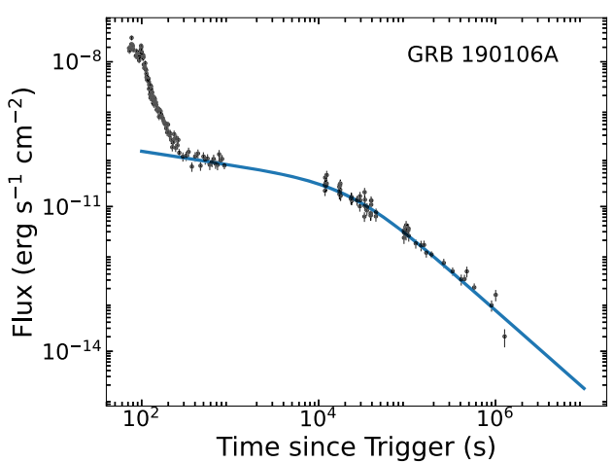

2 数据筛选
Swift / X-Ray Telescope (XRT)
2005 March -- 2025 August
174 GRBs :
C.-H. Tang et al. (2019)
36 GRBs:
C. Deng et al. (2023)
17 GRBs:
Our analysis
Data
Long GRBs
with redshift
abundant data points
strict plateau standard: alpha1∈(−0.5,+0.5)
185 LGRB with X-Ray Plateau

Slide 8
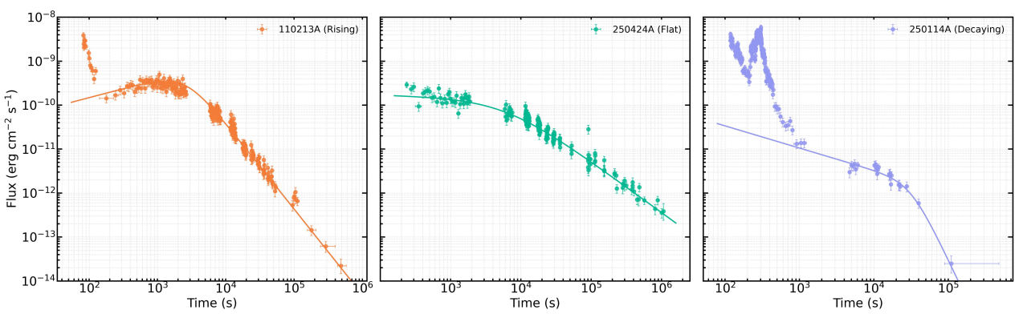
2 数据筛选
rising
flat
decaying
α1
+0.5
-0.5
-0.1
+0.1
rising
flat
decaying

Slide 9
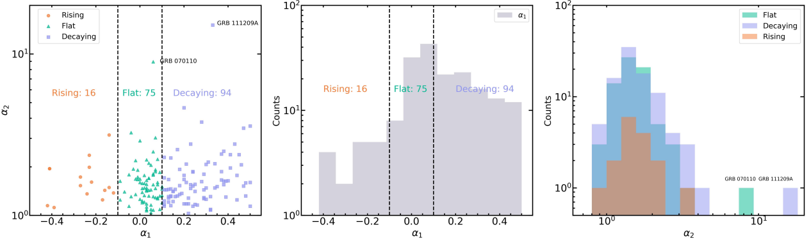



3 统计结果
generally independent of each other
peaking at
GRB 070110 (α2 ≈ 8.95)
GRB 111209A (α2 ≈ 15.11)
E.-W. Liang et al. (2007; 1.11 ± 0.39) C.-H. Tang et al. (2019; 1.4 ± 0.3)

Slide 10
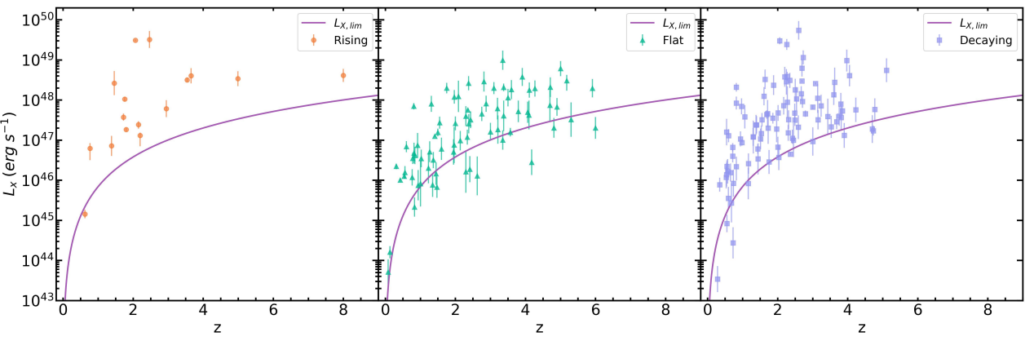

3 统计结果
L_{X,lim} taken from Khatiya et al. 2025
Luminosity functions
The Lynden-Bell’s C− method
Redshift distributions
Non-parametric reconstruction
Truncation / selection effects
Event rates

Slide 11

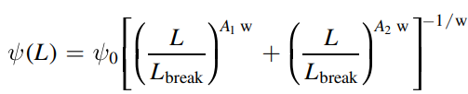
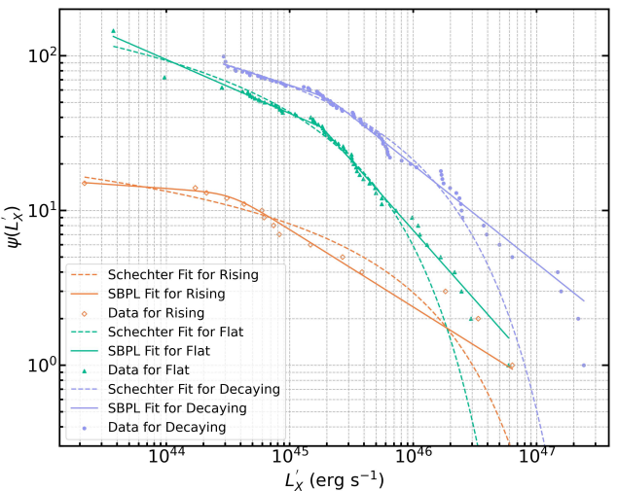
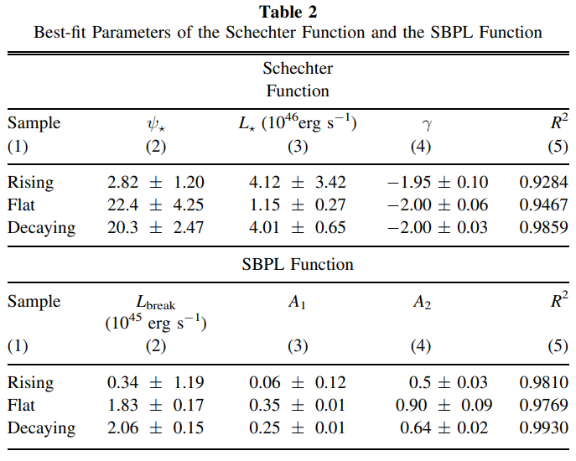
3 统计结果
Luminosity functions

Slide 12
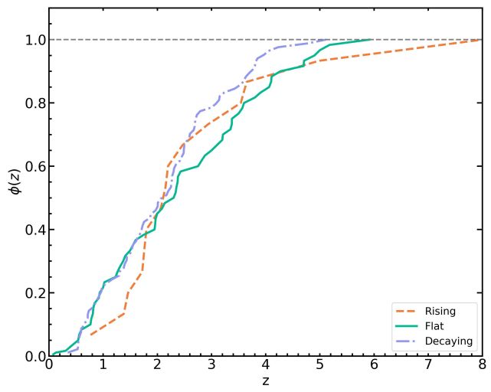
3 统计结果
Redshift distributions
Rising outlier is GRB 090423 (z ≈ 8)

Slide 13

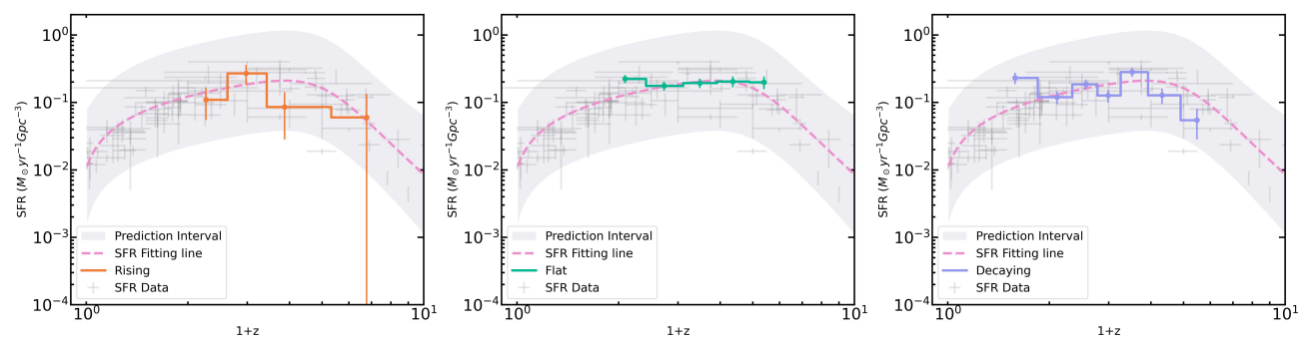
3 统计结果
Event rates
no statistically significant differences

Slide 14
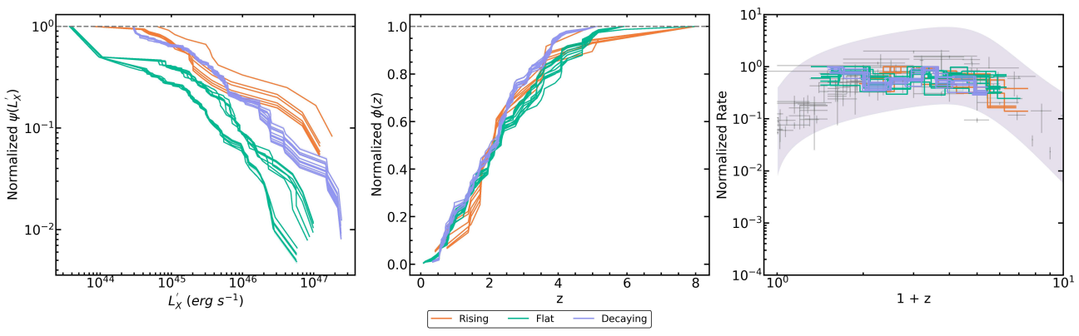
3 统计结果
rising
flat
decaying
-0.5
+0.5
-0.1
+0.1
selection bias ?
insensitive to the adopted classification boundaries of α1
10,000 Monte Carlo simulations for the slope criteria
Index standard vary from ±0.05~±0.15

Slide 15
4 总结展望
Dong et al. 2026, ApJ, 1003, 227
Large Sample：185
rising, flat, and decaying
luminosity function
redshift distribution
event rate
statistically similar properties
Thanks！
a unified population

Slide 16
Back UP!

Slide 17
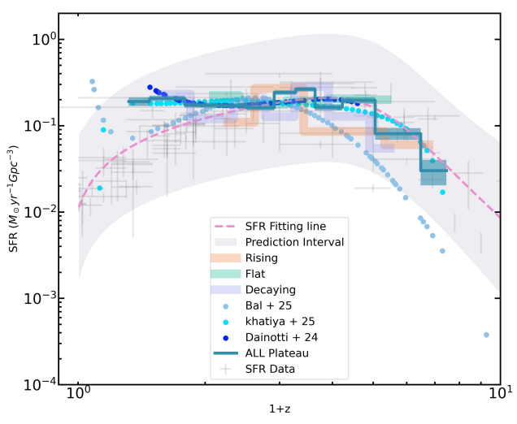
3 统计结果
Event rates derived from the full sample of 185 X-ray plateau GRBs
broadly follow the SFR
regardless of whether the sample is
defined by optical or X-ray plateaus
or whether a plateau-slope division is applied

Slide 18

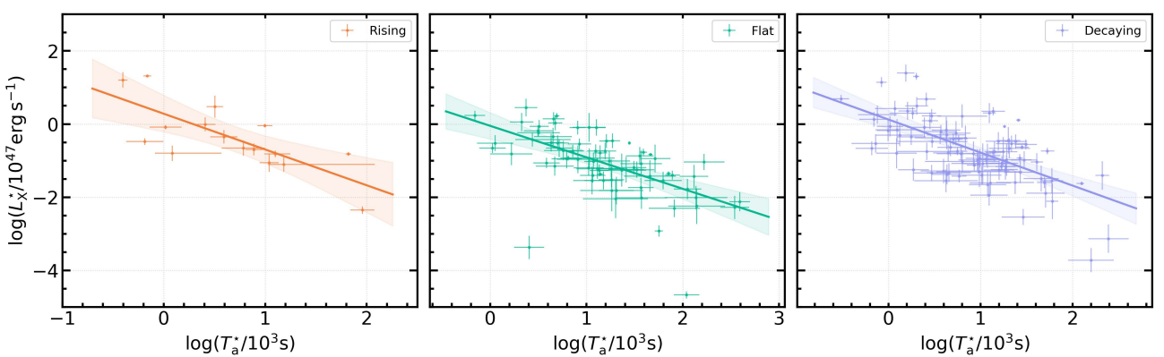



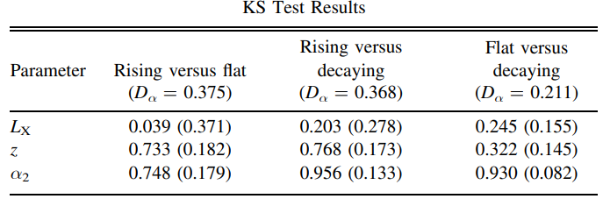
3 统计结果

