Slide 1
Semi-analytic models for thermal X-ray pulse profile modeling
PKU Tong Zhao
Supervisor: Renxin Xu

Slide 2
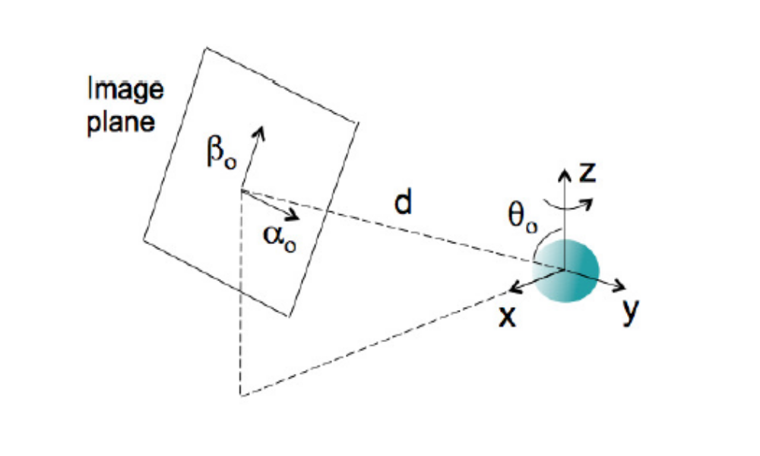
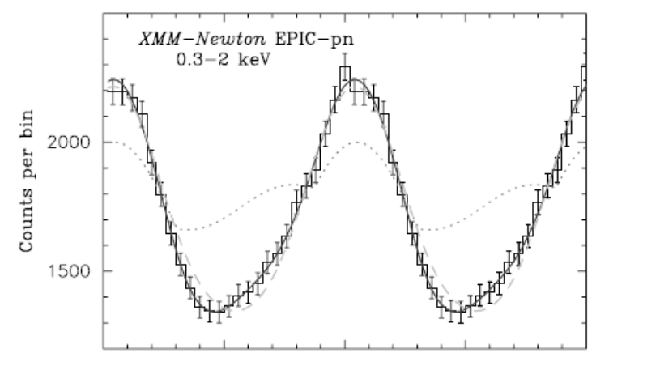
Frame work of the model
Emission:
Hot spot position and shape
Angular dependence of
the emission:
beaming function
atmosphere model
Propagation:
Ray tracing
or Analytic model
staller extinction
Instrument response
Effective area
Response matrix
background
Notes:
产生机制，光变曲线机制 分成几个部分 ray tracing 观测可能的问题

Slide 3
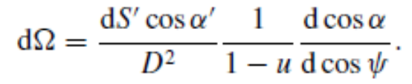
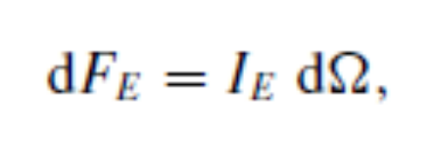
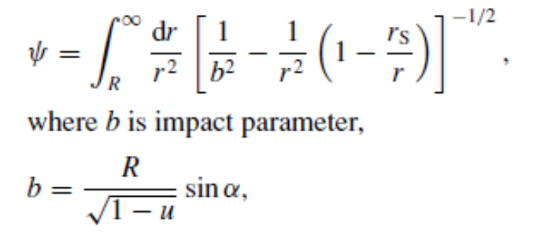
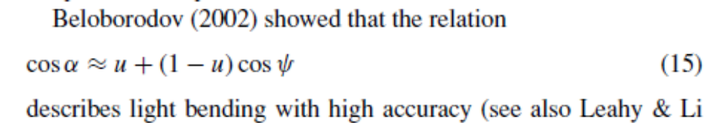

Analytic models for thermal X-ray pulse-profile modeling
Approximations
The beaming function depends on the atmosphere model of the neutron star and is not analytic
Notes:
基本物理思想 三个近似：点源, beaming function, light bending

Slide 4
Analytic models for thermal X-ray pulse-profile modeling
Merits | Demerits
Computationally more effective | Valid under the Schwartzchild+Doppler approximation
Can be used to study the degeneracy and understand the fit result
Notes:
接下面分享我最近做的三件事

Slide 5
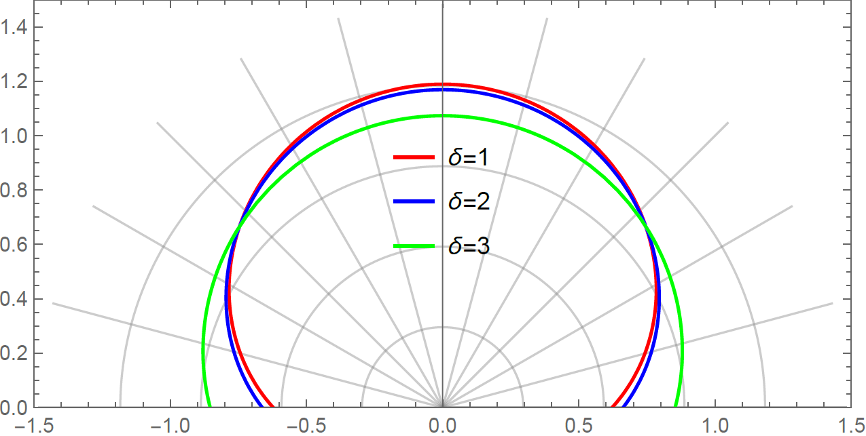
1. The assumed beaming can result in large systematic errors
The beaming function depends on the energy distribution of charged particles in the return curren.
NICER assumes the deep-heating atmosphere (δ=1)
Notes:
回流离子束的能量

Slide 6
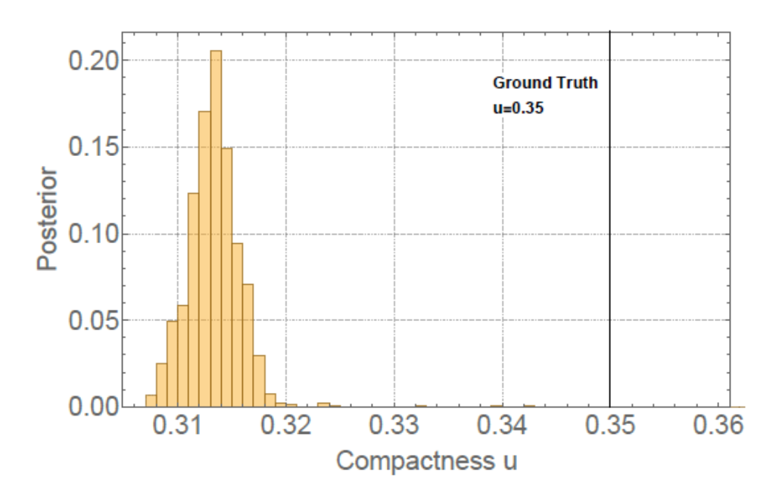
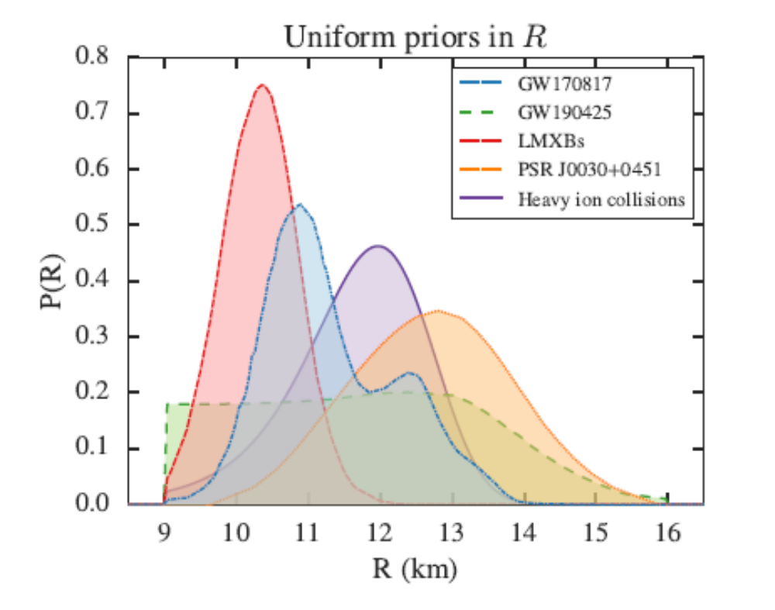
1. The assumed beaming can result in large systematic errors
（~M/R）
Feryal Ozel et al. 2016
Zhao et al. 2025

Slide 7
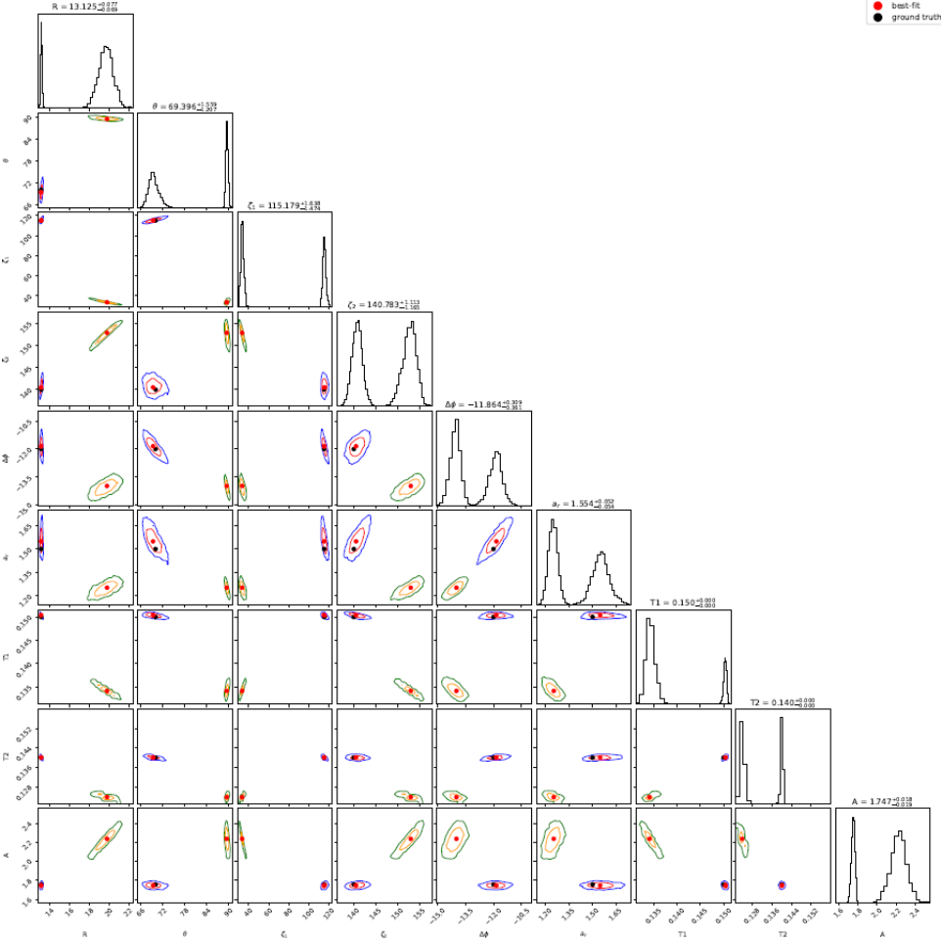
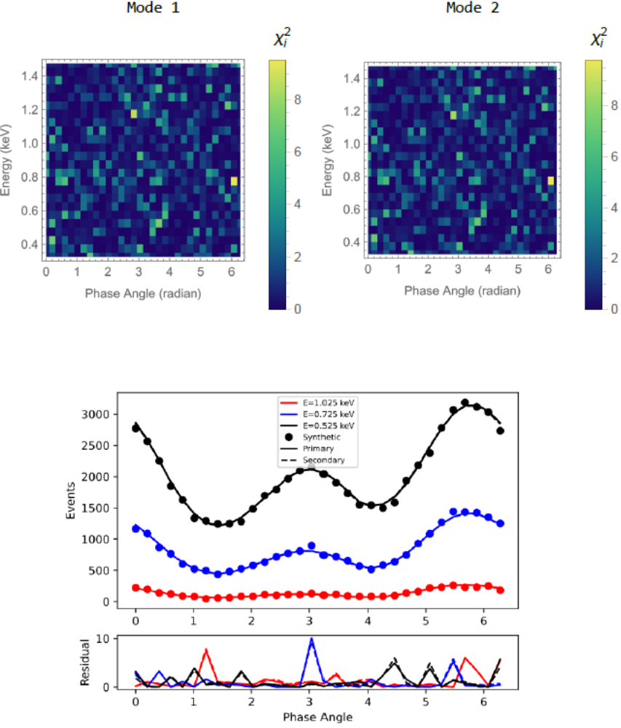
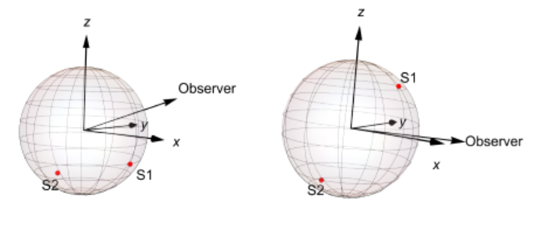
2. An intrinsic degeneracy in the simplified two-spot model
Two spot configurations correspond to the same flux at any photon energy and neutron star phase.
Notes:
对目前NICER的观测无效

Slide 8
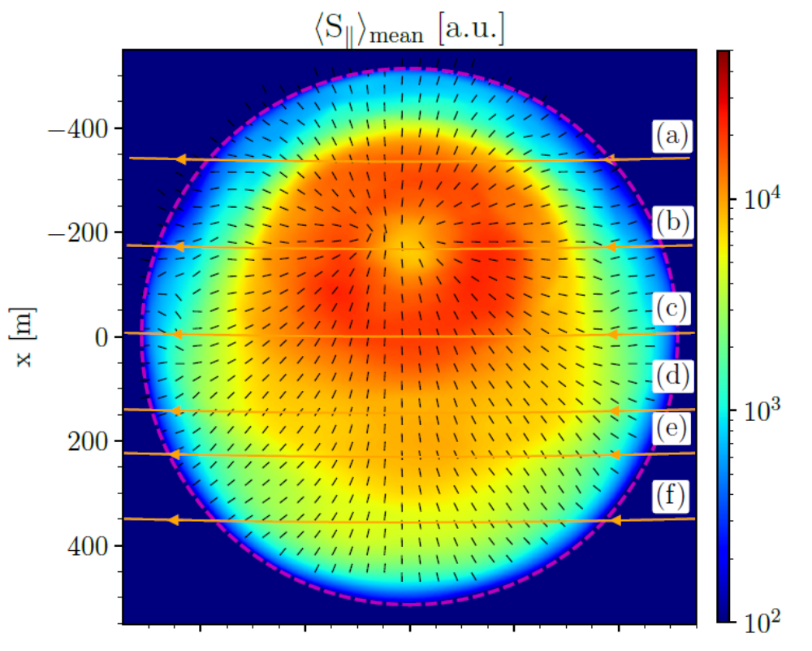
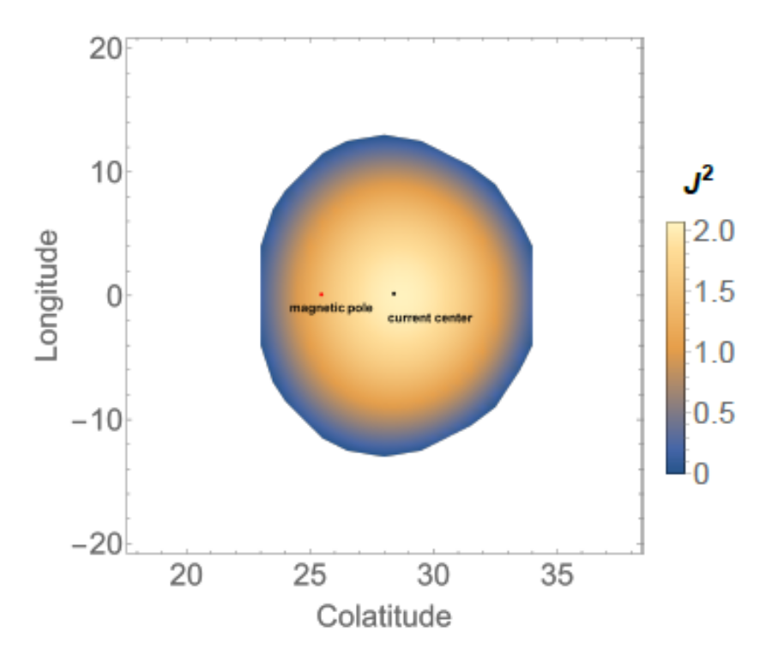
3. locate the polarization orientation focus by a multi-messengar comparison
Is the RVM meauring the inclination of the magnetic axis or just the plasma current center?
For the RVM model the uncertainty is about 0.1 degree
While for thermal X-ray model, this uncertainty can also be reduced to 0.1 degree in the most ideal situation with the eXTP instrument response. ( exposure time: 10^6 seconds)
RVM
polarization center
For normal pulsars, this deviation is about 1 degree.
For millisecond pulsars, this deviation is about several degrees.
200 Hz
real magnetic field center
Jan Benacek et al. 2026

