Slide 1
Modelling Bimodal Waiting-Time Distributions within a Slowly Rotating Magnetar Framework
Speaker: Jingwen Chen (Guangzhou University)
Supervisor: Rui Luo (Guangzhou University)
Collaborators: Shiqian Zhao(GZHU), Chengwei Liang(GZHU), Jiarui Niu (NAOC),Weiyang Wang(UCAS）
July 2026

Slide 2
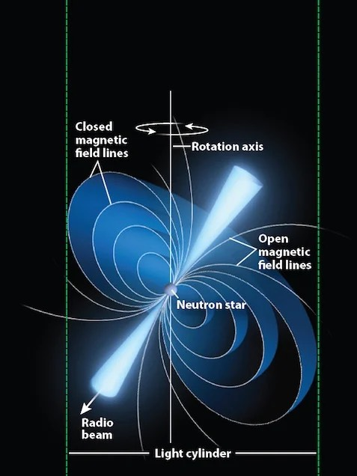
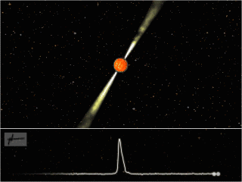
Pulsar emission
The lighthouse model

Slide 3
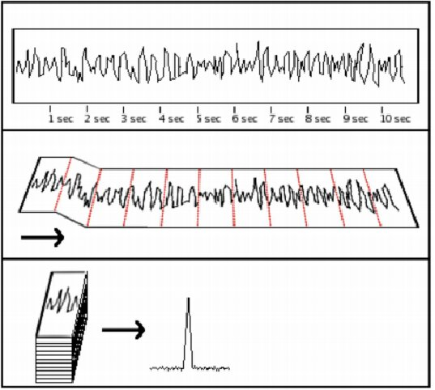
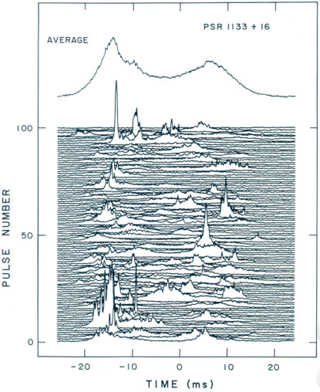
Pulsar Integrated Profile
Constant and mostly stable with enough integration time.

Slide 4
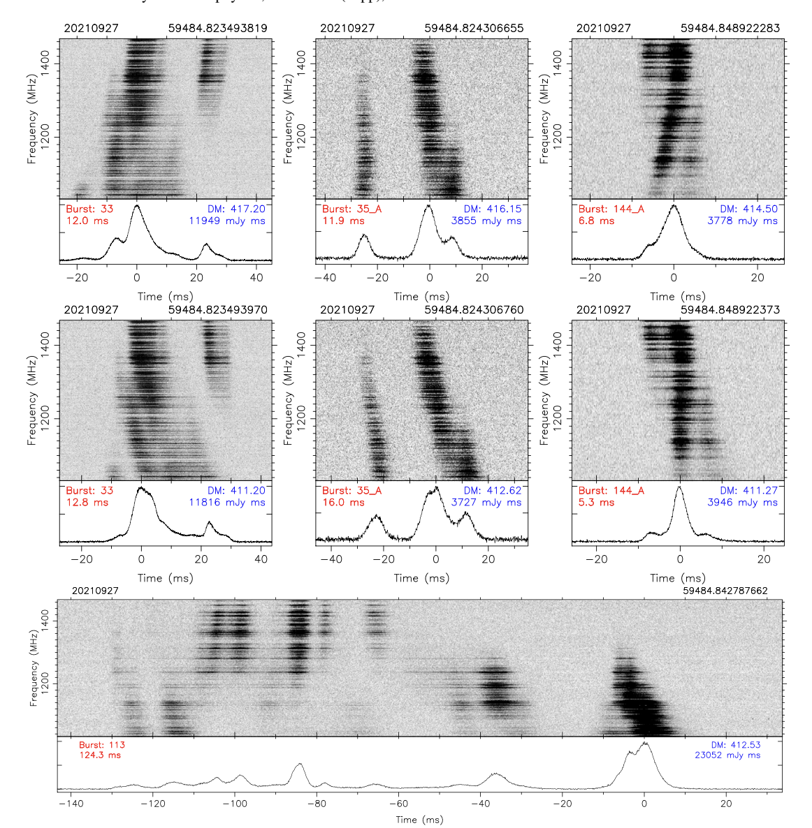
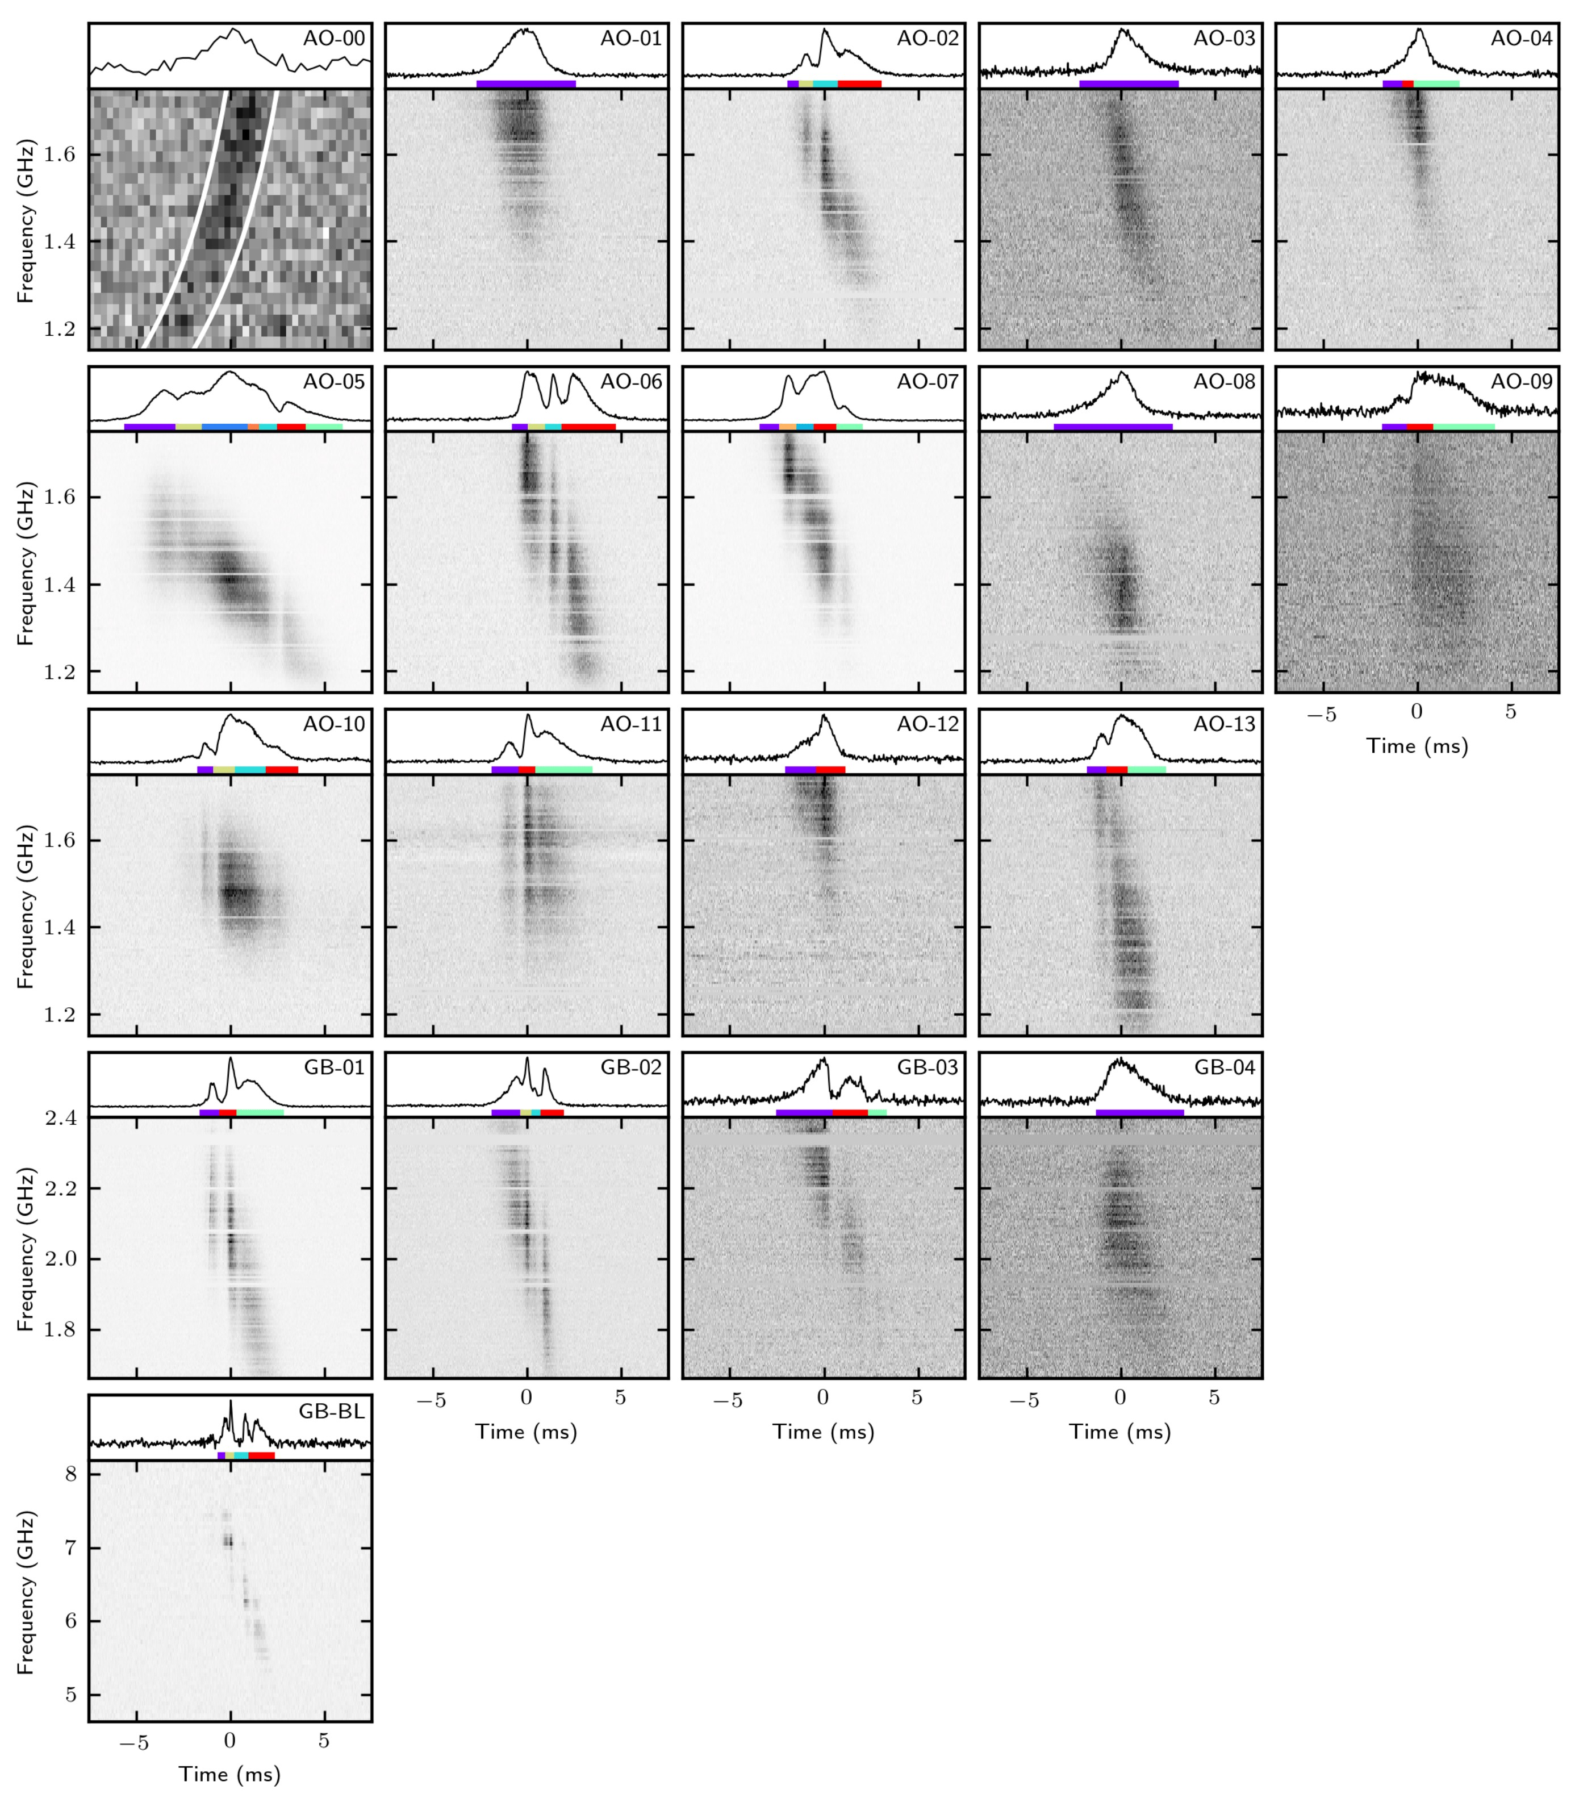
What about Fast Radio Bursts?
No spin period found (particularly for repeating FRBs)
Zhou et al. 2022
Hessels et al. 2019

Slide 5
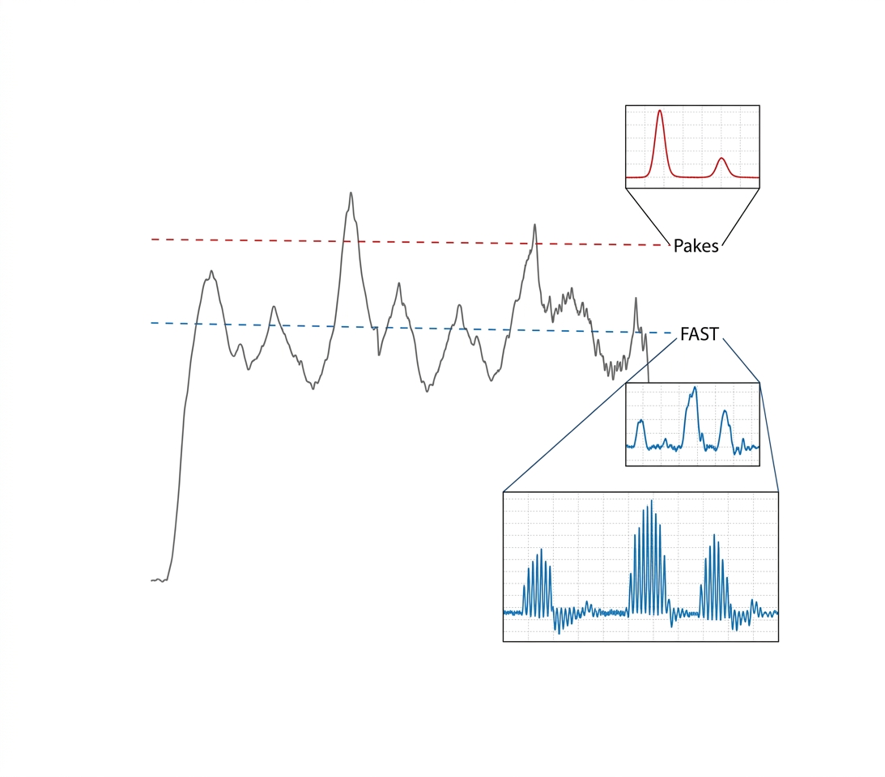

A new idea about FRB emission
“A tip of the iceberg”: What we observe are hyper flares or sub-giant pulses residing in a giant beam of spinning compact star.
If repeating FRBs originate from a slowly rotating magnetar, the emission geometry defines the active window, while stochastic bursts within the window determine the observed waiting-time distribution.

Slide 6
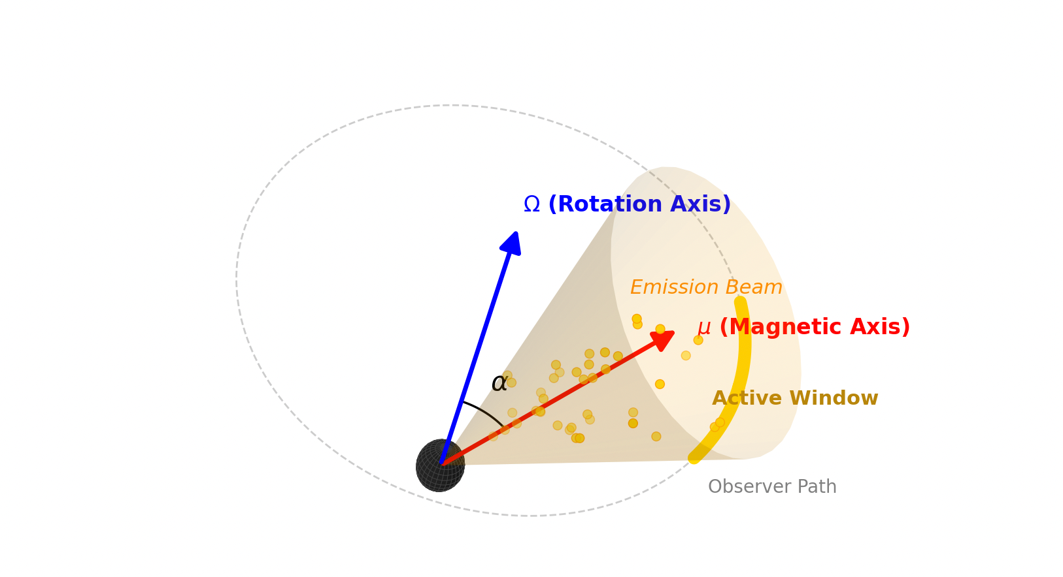
Modelling Framework
• Slowly rotating magnetar
• Wide emission beam
• Phase-limited active window
• Stochastic burst generation within the active window
Geometric configuration
Observer's line of sight

Slide 7
（s）
Simulation Method: Monte Carlo generation of burst arrival times (TOAs)
Key Parameters
Rotation period
Duty cycle
Burst rate
Random jitter
Weibull k

Slide 8
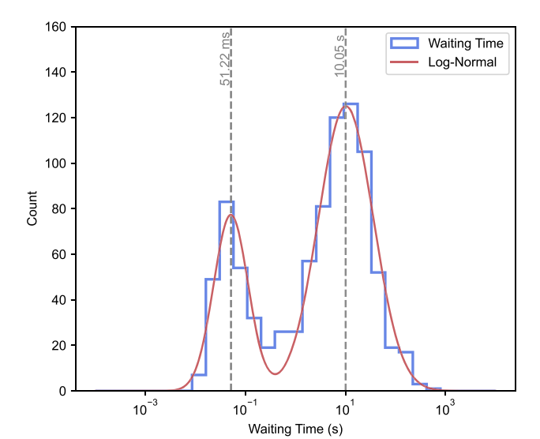
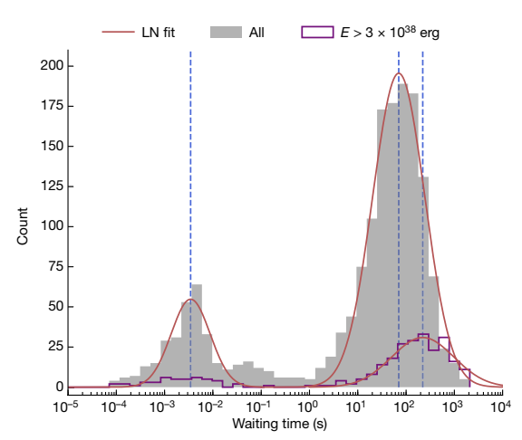
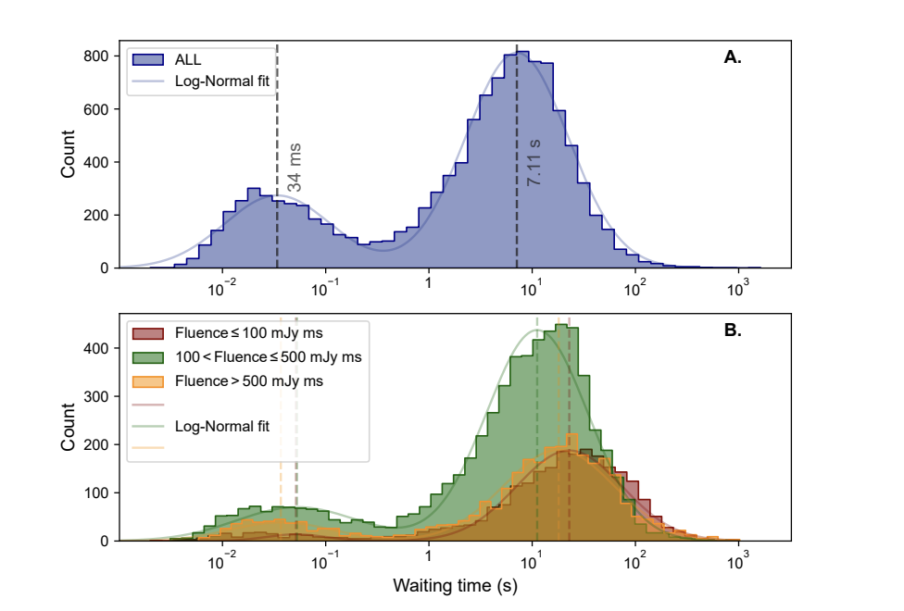
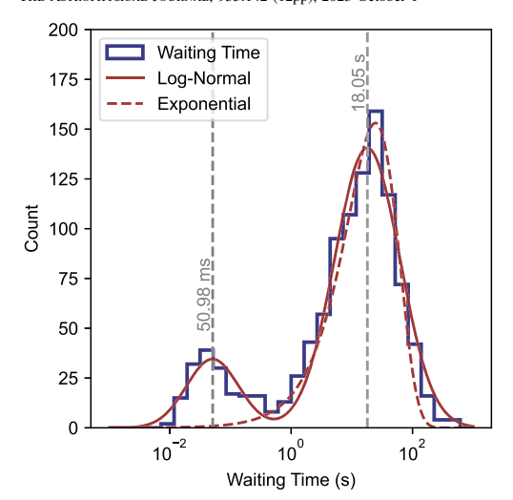
Comparison with Observations
Similar bimodal WTDs are observed in several repeating FRBs.
The simulations reproduce both the short- and long-timescale components.
This suggests that geometric modulation combined with stochastic burst emission can naturally produce bimodal WTDs.
Comparison is qualitative; quantitative fitting is left for future work.
FRB 20201124A
Yong-Kun Zhang et al. 2022
FRB 20220912A
Yong-Kun Zhang et al. 2023
FRB 121102
D. Li et al. 2021
FRB 20240114A
J.S. Zhang et al. 2025

Slide 9
Bimodal WTD
Bimodal WTD appears naturally.
Short peak：Bursts within one active window
Long peak：Bursts between rotation cycles
Bimodality arises naturally from
geometric modulation +stochastic burst emission.

Slide 10
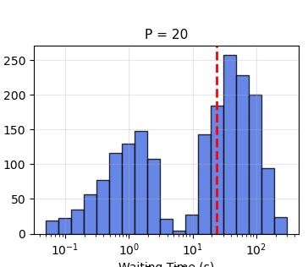
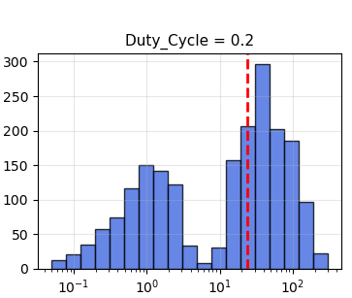
Effect of Geometry
Increasing Duty Cycle mainly changes the relative peak strength.
•Increasing P shifts the long-timescale peak to larger waiting times.
•The short-timescale peak is nearly unchanged.

Slide 11
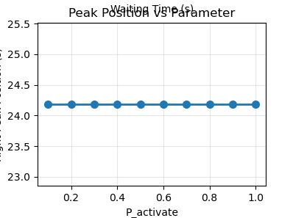
Effect of Burst Activity
Increasing burst activity enhances the prominence of the peaks.
Characteristic waiting times remain unchanged.

Slide 12
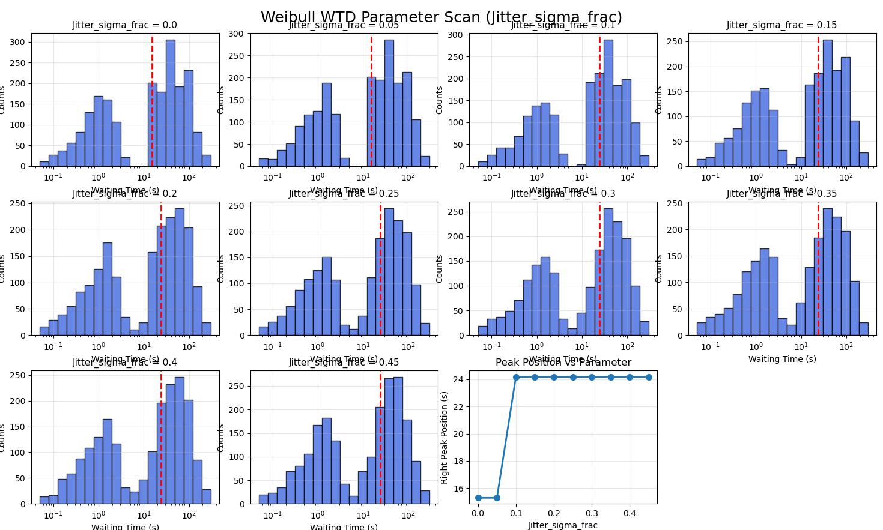
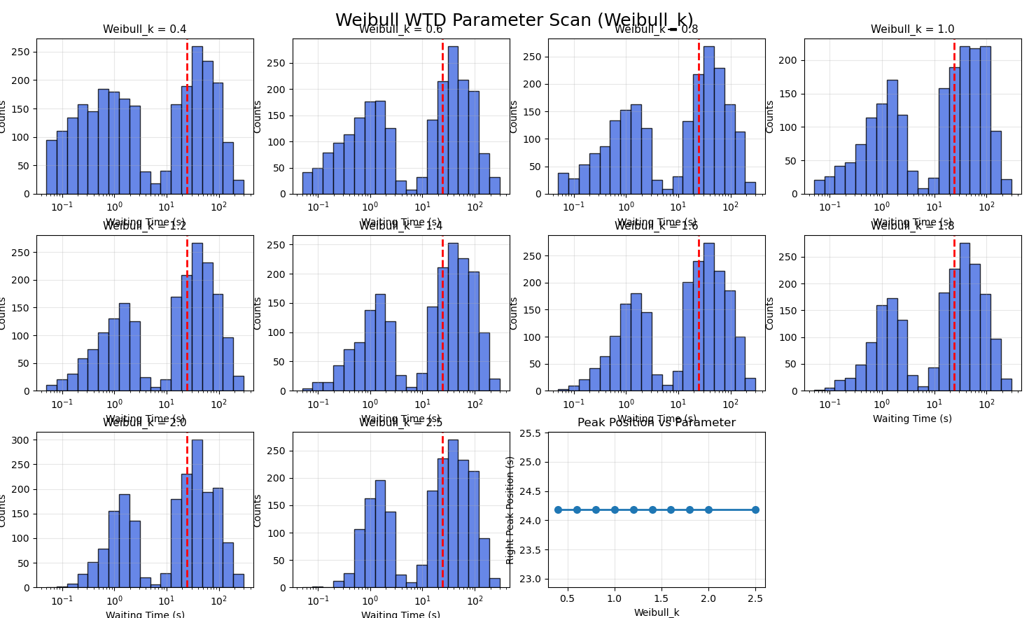
Effect of Intrinsic Randomness
Jitter broadens the waiting-time distribution.
Weibull_k modifies burst clustering.
Neither changes the long-timescale peak.

Slide 13
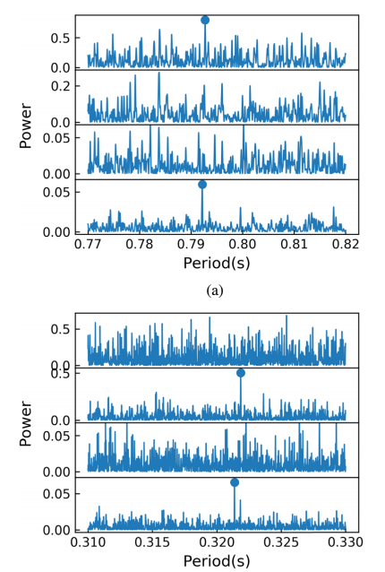
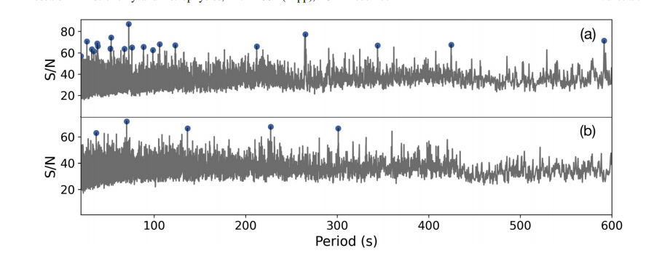
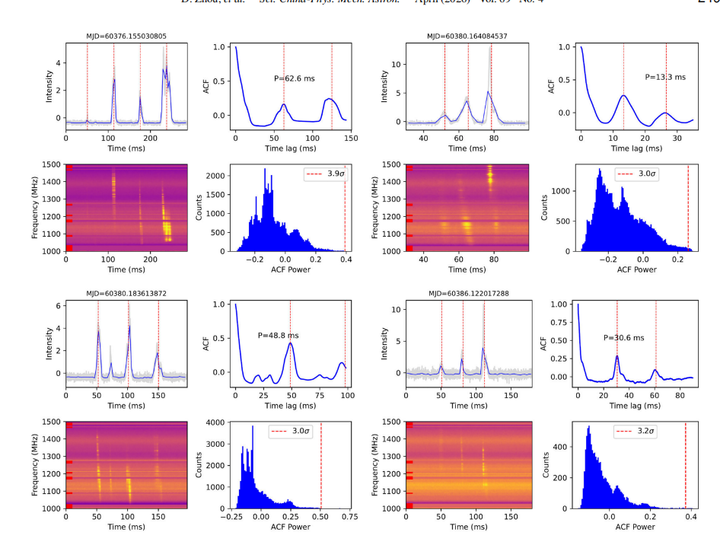
No spin period confirmed yet (particularly for repeating FRBs）
Non-detection of spin period
(996 events, FRB 20201124A, Niu et al. 2022)
Detection of ~143-day periodicity
(11553 events, FRB 20240114A, Zhou et al. 2026)

Slide 14
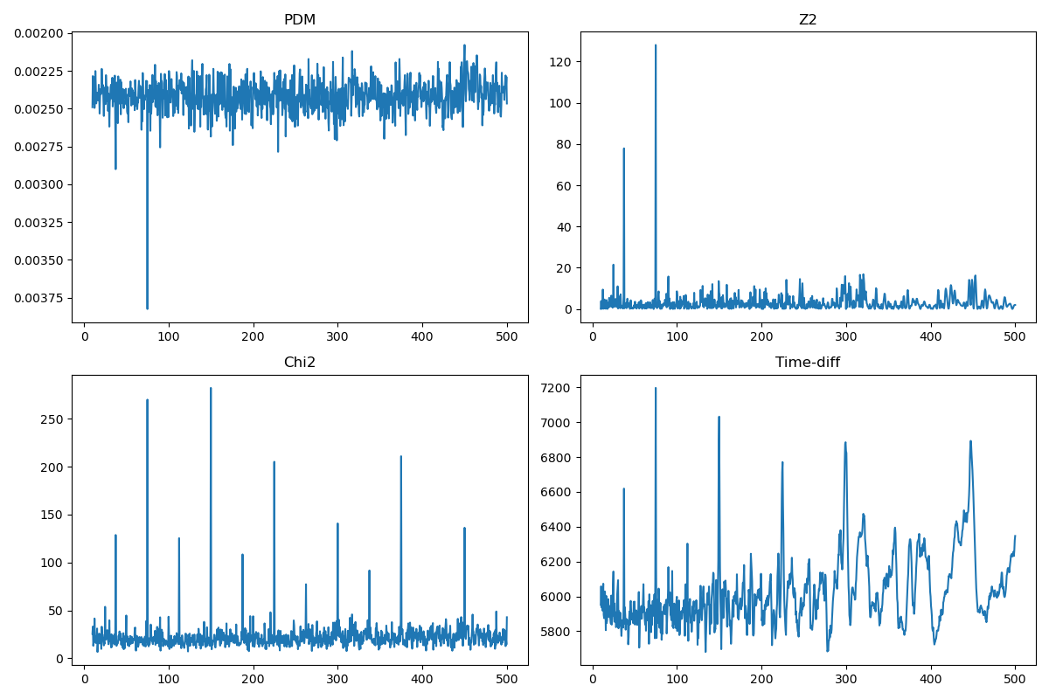
Why Is the Spin Period Difficult to Recover?
Possible Reasons：
  Low duty cycle
  Sparse burst activity
  Limited observing time
No unique periodicity is detected.

Slide 15
Discussion
Physical Interpretation
  Short waiting times originate from bursts within the same active window.
  Long waiting times correspond to bursts separated by different rotation cycles.
  Bimodality naturally arises from geometric modulation and stochastic burst emission.
  Our interpretation complements the starquake-based ETAS model proposed by Luo et al. (2025), providing an alternative explanation for the bimodal waiting-time distribution.
Why Is the Spin Period Hidden?
  Low duty cycle leaves many empty rotation cycles.
  Limited burst statistics weaken periodic signatures.
  Finite observing time further reduces period detectability.
Current Limitations
  Only burst timing is considered.
  Quantitative fitting and polarization modelling are left for future work.

Slide 16
Summary
Main Conclusions
  A slowly rotating magnetar naturally reproduces a bimodal waiting-time distribution.
  The long-timescale peak traces the rotation period, while the short-timescale peak reflects stochastic bursts within the active window.
  The intrinsic spin period may remain undetectable under realistic observing conditions.
Future Work
  Systematic parameter-space exploration.
  Quantitative comparison with repeating FRBs.
  Incorporate polarization and spectral evolution.

