Slide 1
Are there any strong assumptions in some pulsar radiation models？
汇报人：白俊涛
导 师：支启军 教授
合作者：乔国俊 教授，杜源杰 研究员，
卢吉光 博士，尚伦华 博士
F P S 8 6 月 27 日

Slide 2
Background
The slot gap model
Outline
The annular gap model
Summary

Slide 3
1
Background

Slide 4
Radio
Narrow
Observations
Gamma-ray
Wide
Polar gap
Theories
slot gap
outer gap
Annular gap

Slide 5
Strong assumptions in some pulsar radiation models
· Does the pulsar magnetosphere fully charge separated?
· The particle density flow out from the star surface equal or nearly equal to the local GJ charge density there?
Notes:
脉冲星磁层是否完全分开充电?
从恒星表面流出的粒子密度是否等于或几乎等于那里的局部GJ电荷密度?

Slide 6
2
The slot gap model

Slide 7
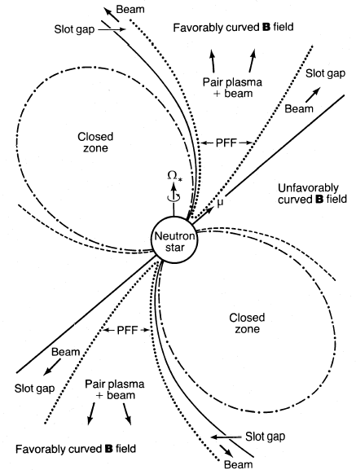
Free flow: The slot gap model
There is a steady current flowing from the surface of the neutron star;
2. The charge density flowing from the surface of the neutron star is equal to the static GJ charge density on the surface of the neutron star;
3. To neutralize the neutron star, suppose that the current flowing from the neutron star travels back to the neutron star in some way.
Favorable
region
Arons,J. 1983, ApJ
Notes:
PFF: Pair formation front “电子对产生前沿”

Slide 8
A revised slot gap model
Theorie ：$ρ=ρ_{gj} → ρ_{b}\left(rl\right)=ρ_{gj}\left(rl\right)$ Favorable and unfavorable magnetic fields are interchanged
Observation : The radiation region does not correspond to observations

Slide 9
3
The annular gap model

Slide 10
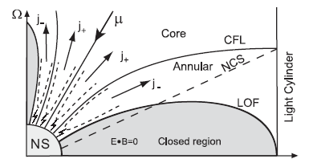
The annular gap model
The region of particle acceleration and radiation lies between CFL and LOF, extending from the surface of the pulsar to the cylindrical radius of the speed of light.
Qiao, Lee, Zhang, Wang, Xu, 2007,ChJAA
Notes:
粒子加速及辐射区域位于临界磁力线和最外开放磁力线之间，从脉冲星表面一直延伸到光速圆柱半径附近。

Slide 11
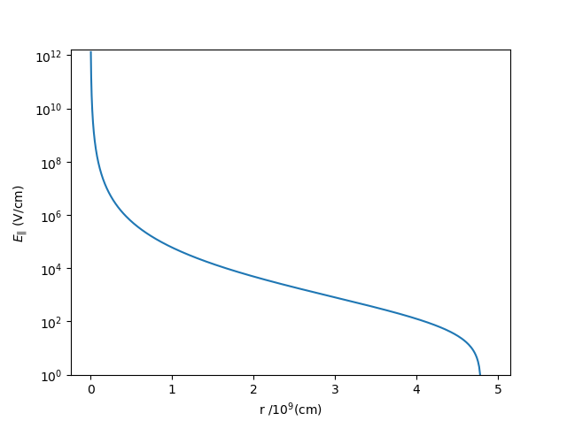
The annular gap model in the free flow situation
(1). Instead of the assumption of fully charge separated magnetosphere, it is assumed that the charge in the pulsar magnetosphere is nearly neutral, at least partly neutral;
(2). Instead of the assumption of $ρ_{b}\left(R\right)=ρ_{gj}(R)$, it assumes that near light cylinder $ρ_{b}\left(rl\right)=ρ_{gj}(rl)$;
(3). The parallel electric field near the light cylinder is zero.

Slide 12
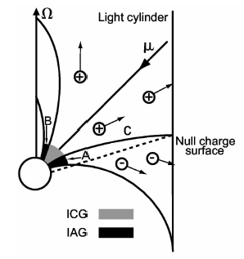
Qiao, et al., 2007,ChJAA
Qiao, et al., 2004a, APJ
The annular gap and core gap are formed when the surface binding energy of the neutron star is small
IAG, ICG, and NCS of an oblique rotator. If the center star is a strange star, both the IAG and the ICG can work.
Notes:
左：在夸克星的情况下形成的核间隙和环间隙
右：在中子星表面束缚能小的情况下形成核间隙和环间隙

Slide 13
Observation and verification of annular gap model
Gamma ray and radio pulse profile can be well fitted, which can be used for observation and inspection of radiation position and radiation mechanism. (Du , et al. , 2010, 2011, 2012, 2013)
(2) To understand the bi-drifting phenomenon.（Qiao, et al. 2004b）
(3) Gamma-ray millisecond pulsar radio and gamma-ray radiation (gamma-ray and radio radiation beams are very wide, radiating areas near zero charge surfaces). (Ravi, et al., 2010)
(4) The radiation region is defined by the geometric configuration.（Wang, et al., 2006）

Slide 14
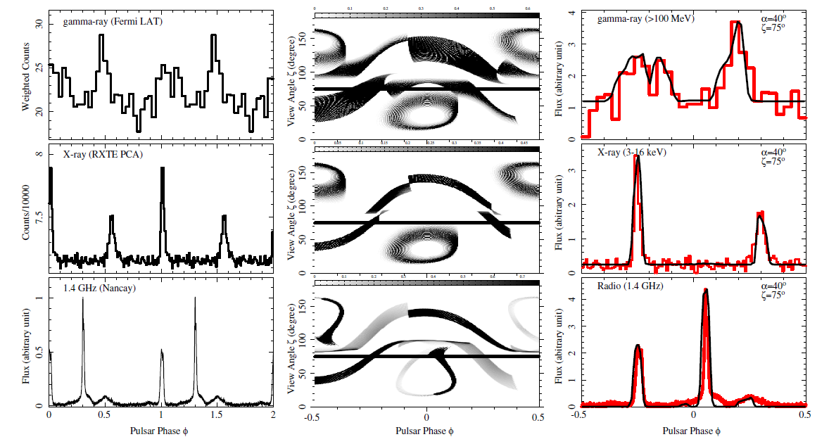
Observation and verification of annular gap model
Du, et al., 2015
The multi-wavelength (radio, X-ray, and γ -ray) pulse profiles
of PSR B1821−24 can be explained by the annular gap model

Slide 15
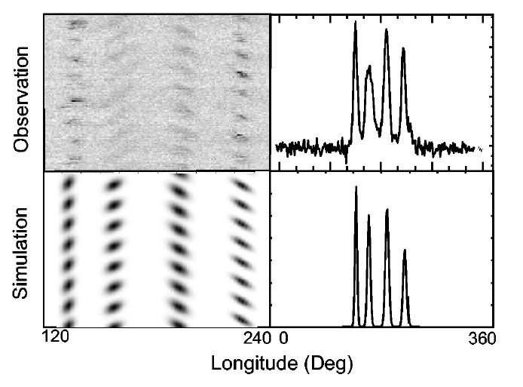
Observation and verification of annular gap model
Observed subpulse drifting patterns and pulse profiles as compared with our simulations.
Qiao, et al., 2004b

Slide 16
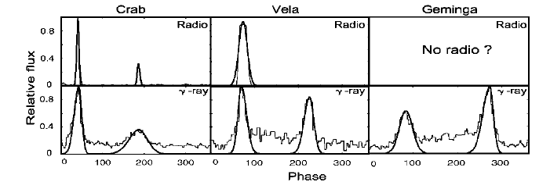
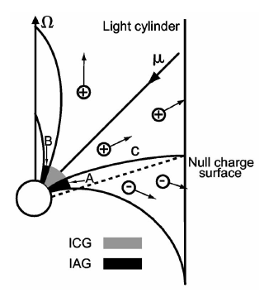
Observation and verification of annular gap model
The radio and gamma-ray can be understood by annular gap.
Qiao,et al., 2004a, ApJL

Slide 17
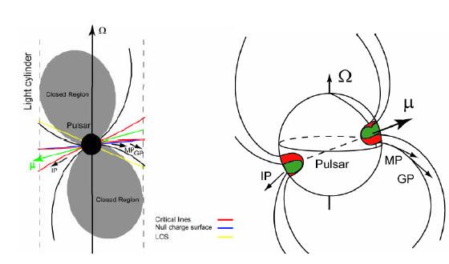
Observation and verification of annular gap model
Wang et al.2006
The observations show that the radiation position locates in the annular region.

Slide 18
4
Summary

Slide 19
1. In the slot gap model, owing to $cosζ_{anti}=−cosζ_{parll} and ρ_{gj,anti}=−ρ_{gj,parll}$. So all results are the same when anti-parallel is considered.
2. In the slot gap model, with more natural assumption: particles lost near the light cylinder is equal to the local GJ charge density, $ρ_{b}\left(rl\right)=ρ_{gj}\left(rl\right) ,$then the “unfavorable” region in the slot gap model becomes a “favorable” one.
3. The annular gap can form in neutron stars and quark stars.
4. The annular gap model in the free flow can fit observations well.
5. Acceleration is more efficient near the surface of a neutron star, whether in the annular gap or core gap.
6. As long as there is sufficient unipolar induced potential, the acceleration in the annular gap is more effective.

Slide 20
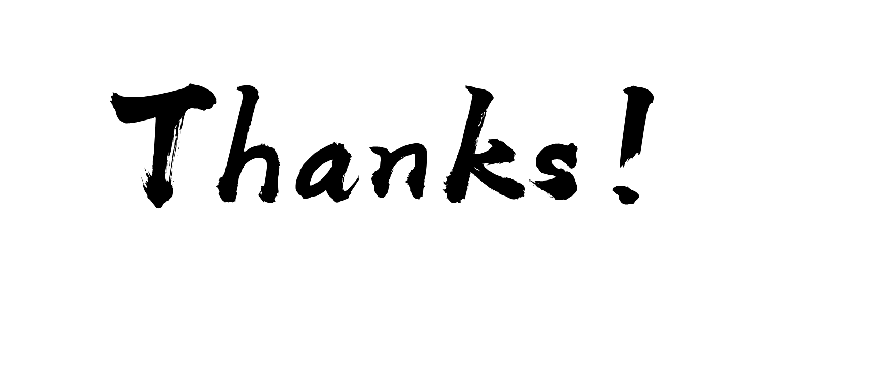

Slide 21
