Slide 1
What can PSR J1640-4631 tell us about the internal physics of this neutron star?
程 泉
武汉大学物理学院
合作者: 张双南，郑小平 ，范锡龙
2019.6.27 西安

Slide 2
Outline:
I. Introduction
1. NS magnetic fields and magnetic deformation
2. Tilt angle evolution
II. Constraining the interior physics
1. Braking index-PSR J1640
2. Our model
3. Results
III. Conclusion

Slide 3
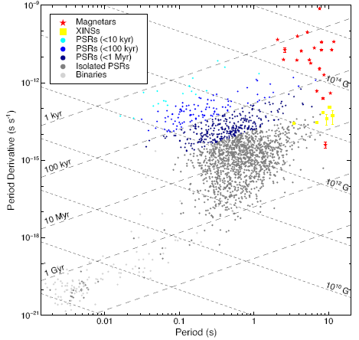
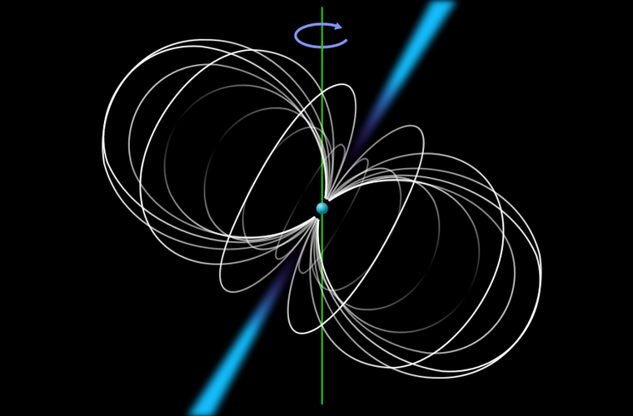
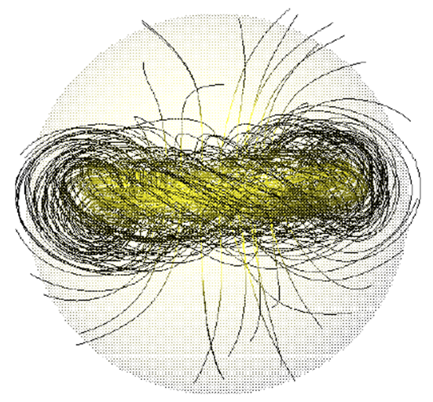
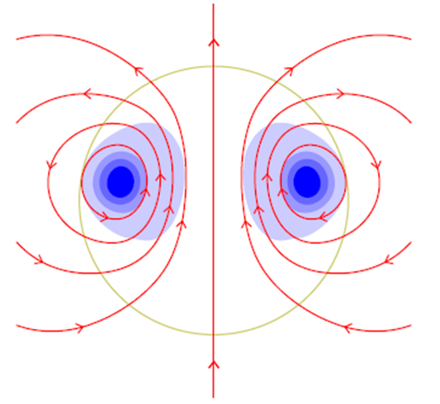
1. NS magnetic fields and magnetic deformation
1) Neutron Star Magnetic fields
Exterior magnetic field: dipole magnetic field+multipole magnetic field?
Interior magnetic field: poloidal-toroidal (toroidal-dominated?)
Olausen & Kaspi, 2014, ApJS
(Braithwaite & Spruit, 2004, Nature)

Slide 4
2) Magnetic deformation:
i) EOS ii) the magnetic configuration (GR+superconducting+multipole field) iii) the magnetic energy
a) poloidal
b) toroidal
c) poloidal-toroidal twisted torus
d) superconducting
Bonazzola & Gourgoulhon, 1996, A&A
Cutler, 2002, PRD
Mastrano et al., 2011, MNRAS
Mastrano & Melatos, 2012, MNRAS

Slide 5
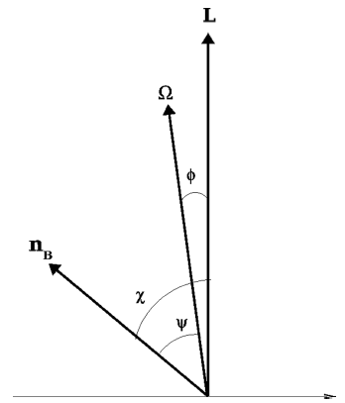
2. Tilt angle evolution
The first stage
BV: damping freebody precession, χ increase
GRR: aftermath of GW emission, χ decrease
The second stage
Crust and neutron superfluid have formed, Viscosity: core-crust coupling
Consequence: $χ=π/2, if toroidal−dominated$
Timescale：$τ_{cc}=ξP/ε_{B}$
e-vortex scattering: $ξ\sim {10}^{2}−{10}^{4}$
elastic dissipation: $ξ\sim {10}^{5}$
(Dall’Osso et al. 2009, MNRAS)
Very uncertain!

Slide 6
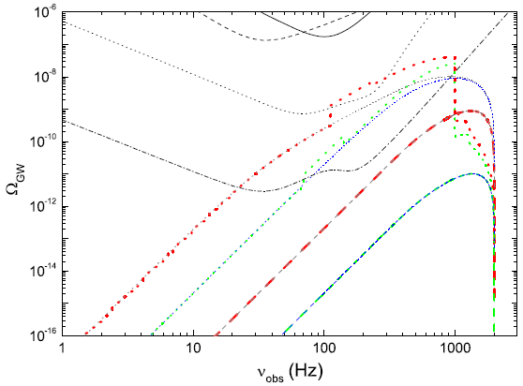
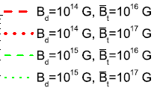
Stochastic GW background from magnetars
With the tilt angle evolutions involved, the SGWB from newly born magnetars could be changed if magnetars have B_t=10^17 G.
(1) four parts in the spectra
(2) high frequency suppressed
a few hundred to 1000 Hz enhanced
(Cheng et al. 2015, MNRAS)

Slide 7
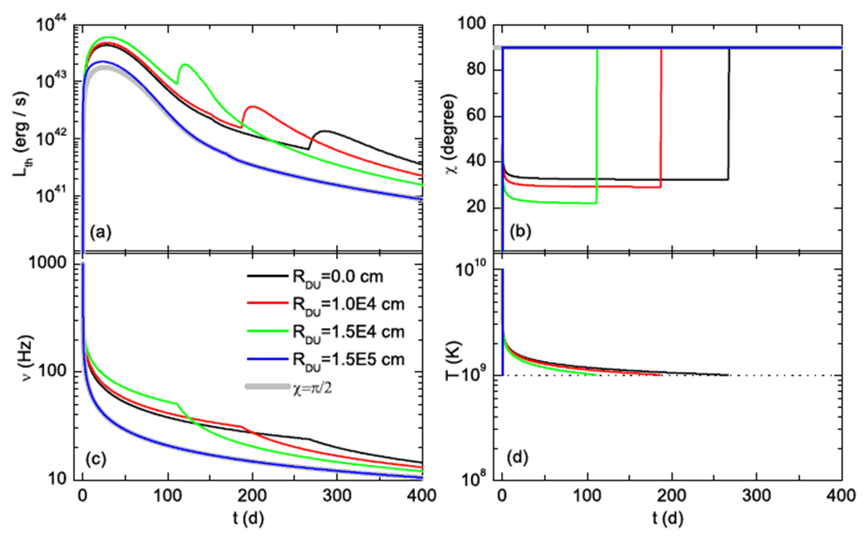
Magnetar-powered SLSNe
(Cheng et al. 2018, PRD)

Slide 8
II. Constraining the interior physics
1. Braking index—PSR J1640
young pulsars with measured braking indices
Models proposed: (1) MDR in plasma magnetosphere (Eksi et al. 2016, ApJ)
(2) MDR+wind (Tong & Kou, 2017, ApJ)
(3) MDR+GWE (de Araujo et al. 2016, JCAP)
(4) MDR+field decay (Gao et al. 2017, ApJ)

Slide 9
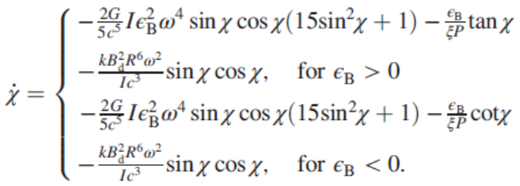
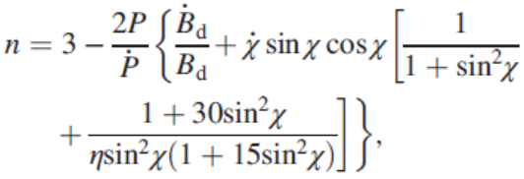
2. Our model
spin evolution (MDR+GWE) with dipole field decay involved
tilt angle evolution (GWE reaction + damping of precession)
thus we have
To be constrained
Related to field decay

Slide 10
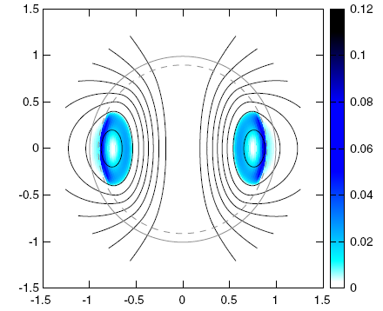
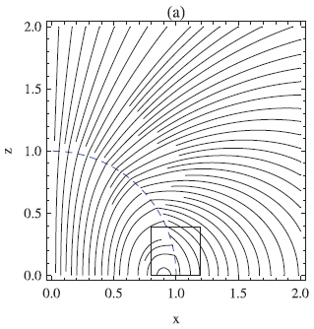
Interior magnetic configuration and NS ellipticity
proton superconductivity in the core
poloidal-dominated toroidal-dominated
(Lander 2013, PRL) (Akgun & Wasserman 2008, MNRAS)

Slide 11
The theory of magnetic field decay
the exponential form the nonlinear form
Hall drift dominate the field decay process
Ohmic dissipation dominate, possible time scales are
from thermal observations
from theoretical calculations
(core flux tube drift and crustal Ohmic dissipation)
(Cumming et al. 2004; Pons et al. 2007; Dall’Osso et al. 2012)

Slide 12
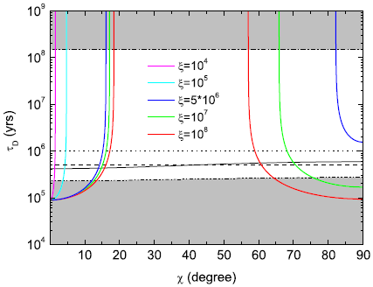
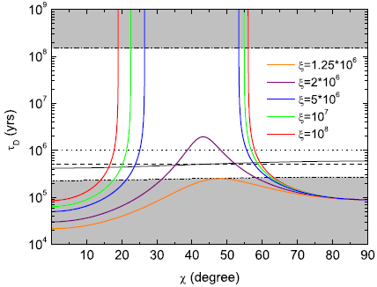
3. Our results
i) ξ would be larger than previous estimates unless a tiny angle$χ≲5°$ is observed
ii) future observation of χ using eXTP may constrain the internal magnetic field configuration
Implications of large of χ: i) weak interactions in the NS interior;
ii) weak GWEs of newborn magnetars.
Cheng et al. 2019, PRD
poloidal-dominated toroidal-dominated

Slide 13
III. Conclusion
1) ξ would be larger than previous estimates unless a tiny angle$χ≲5°$ is observed.
2) Future observation of χ using eXTP may constrain the internal magnetic field configuration.

Slide 14
Thanks!

