Slide 1
To constrain EOS of neutron star with gamma-ray bursts
Shuang Du （杜双）
SYSU and PKU
Collaborator: Pro. Ren-Xin Xu
2019.6.27 FPS8 Xi’an

Slide 2
Content
What are gamma-ray bursts (GRBs)?
• observation
• theory
How to constrain the equation of state (EOS) of neutron stars (NSs) through GRB physics.

Slide 3
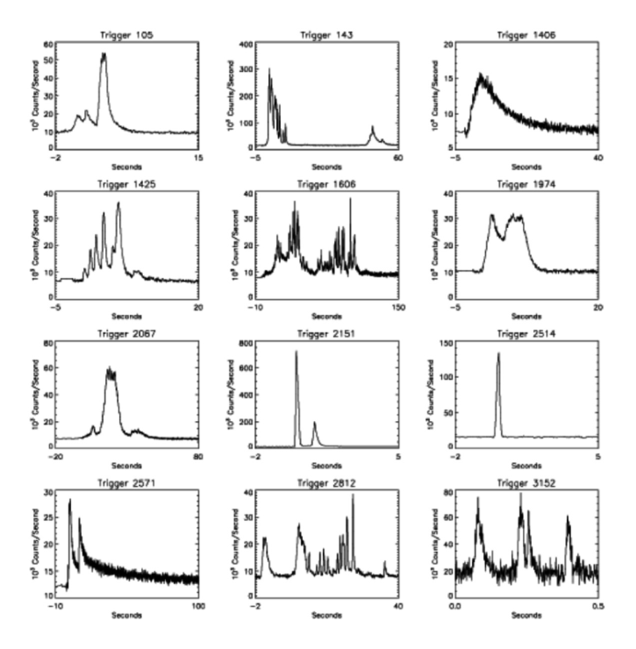
Prompt emissions of GRBs (gamma-ray band)
Fishman G. J., Meegan C. A., 1995;
Kumar P., Zhang B., 2015

Slide 4
Two types
Kouveliotou C., et al., 1993, Astrophys. J., 413, L101

Slide 5
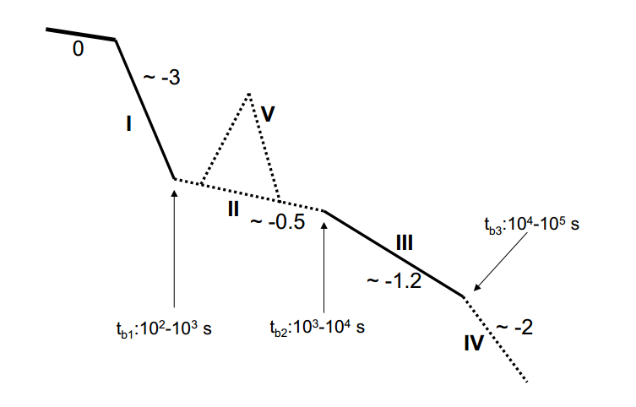
GRB afterglows (X-ray band, 0.3-10 keV)
Zhang B., 2006, Astrophys. J., 642, 354

Slide 6
The general picture of GRBs
t
merger SGRB/kilonova
disk
GRB
collapse LGRB/supernova
jet
central engine

Slide 7
As you can imagine, different central engines will lead to different phenomena. It is true that the type of central engine can be determined by the observational characteristics of X-ray afterglow.

Slide 8
Standard afterglow (without energy injection)
Evans et al., 2009

Slide 9
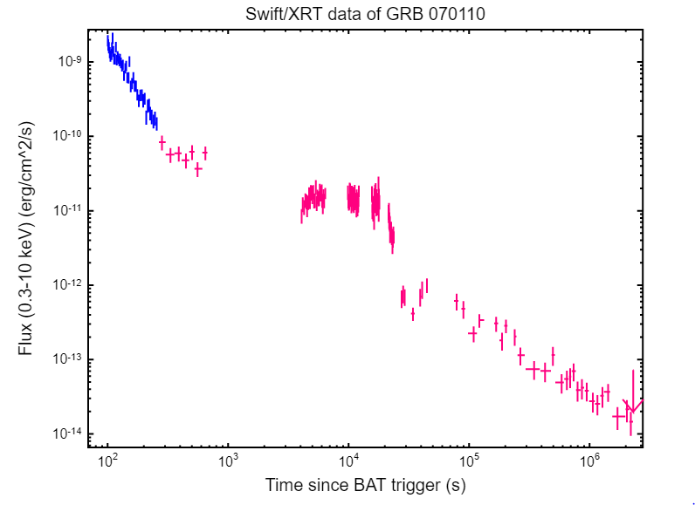
Energy injection
Evans et al., 2009

Slide 10
Evidence of magnetars in GRBs
Xue et al., 2019

Slide 11
The spin down of NSs
magnetic dipole radiation dominating
gravitational radiation dominating
Lasky & Glampedakis 2016

Slide 12
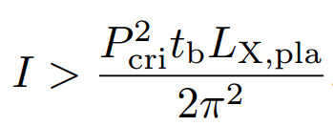
Two conditions
To power the x-ray plateau, there are
the spin-down luminosity L_{sd} mush be larger than the luminosity of the X-ray plateau L_{X,pla ;}
the initial total rotational energy E_{k,0} of the magnetar should be high enough to power the whole X-ray plateau .

Slide 13
Determing B_{eff,max}
1. The observed nascent magnetars in soft gamma repeaters (SGRs) and anomalous X-ray pulsars (AXPs) is minisecond pulsars just like that of in GRBs.
2. The decay of magnetic torque of the magnetar in SGRs and AXPs is consistent with the galactic pulsars.
we take the upper limit of B_{eff} as B_{eff,max} = 10¹⁵ Gs and B_{eff,max} = 2.5 × 10¹⁵ Gs empirically.

Slide 14
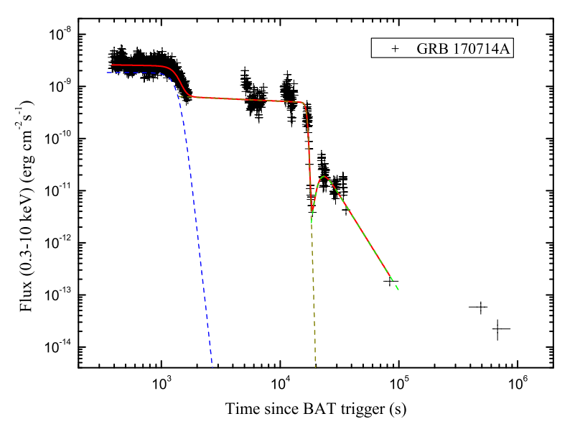
Two case studies
GRB 080607
Hou et al., 2018
Du, Xu, arXiv:1905.01655

Slide 15
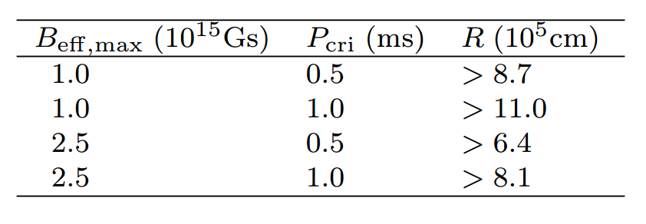

Slide 16
Discussion
The constraint is weak due to the narrow energy band 0.3-10keV
For more compact constraint: (a) widening the observational energy band ; (b) searching for some extreme samples with long-duration and bright X-ray plateaus.
To improve the method, one may consider the angular distribution of the spin-down winds and the relativistic modification on the rotational energy of NSs.
Thanks

Slide 17
Angular distribution

