Slide 1
Role of Fan Beam Model in Population Statistics
of Isolated Pulsars
Wenjun Huang
（黄文俊）
Supervisor: 王洪光教授
Guangzhou University
2019/06/27

Slide 2
Outline
Motivation
Methods
Simulation and Results
Conclusion

Slide 3
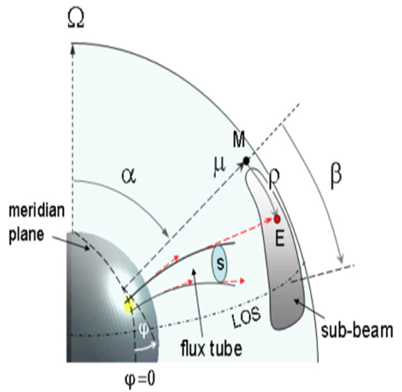
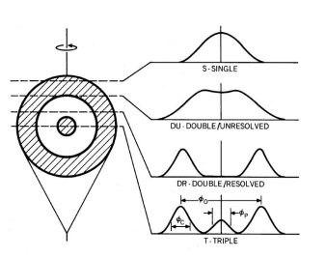
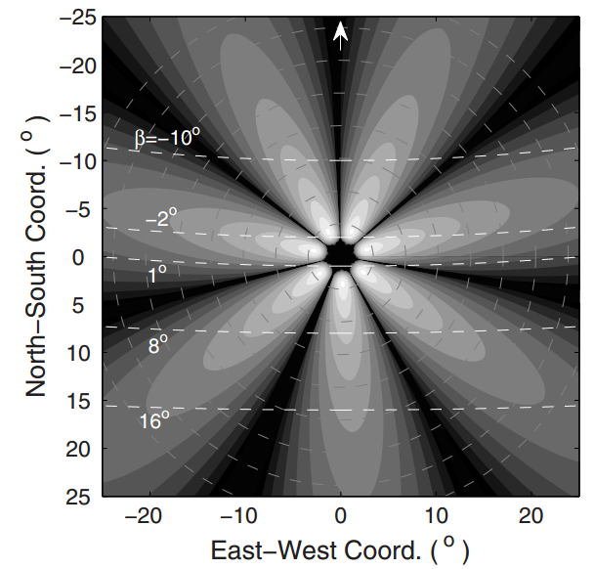
Motivation
Why study pulsar population?
Understand the underlying distribution of pulsars
Make predictions for future survey yields, e.g. FAST
Width model: conal beam or fan beam ?
Luminosity model:
radial limb-darkening intensity distribution ?
or
Motivation:
Using fan beam model in pulsar population
(Wang et al. 2014)
conal beam
Fan beam

Slide 4
Outline
Motivation
Methods
Simulation and Results
Conclusion

Slide 5
Population methods
Snapshot: empirical distribution functions (P, L,R,z …)
Evolution: time-dependent evolution model (P,Pdot,B…)
Open source package: PsrPopPy
https://github.com/samb8s/PsrPopPy
(Lorimer et al. 2016)
(Faucher-Giguere & Kaspi 2006)
(Bates et al. 2014)
MC simulation procedure:
the code continually generates new synthetic pulsars whose parameters are drawn from the user-specified distributions;
each pulsar is run through each of the simulated surveys (PMSURV, SWINB1 and SWINB2) in turn ;
if the pulsar is detected (S/N>9) and beaming towards Earth (or lie above the death-line) in any of the surveys, a counter is incremented and a new pulsar generated;
if the pulsar is not detected, it remains in the model, but the counter is not incremented;
when the counter reaches n=1214 pulsars (P > 30 ms, 0<Pdot< 10^{−12} and not in binary system detected by these surveys) , the loop terminates.
Notes:
PMSURV: gl=[-100,50],gb=[-5,5]
SWINB1: gl=[-100,50],|gb|=[5,15]
SWINB1: gl=[-100,50],|gb|=[15,30]

Slide 6
Outline
Motivation
Methods
Simulation and Results
Conclusion

Slide 7
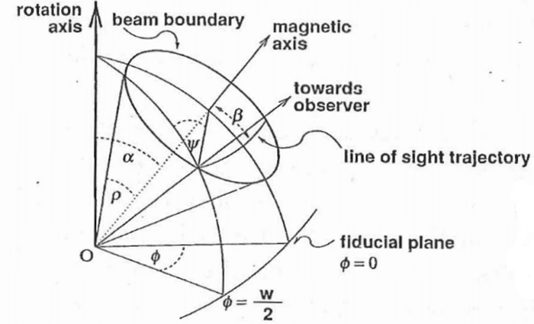
Snapshot Model
Snapshot model A
(Smits et al. 2009)
Snapshot model B
(replace with fan beam width model)
(Wang et al. 2014)
(Kramer et al. 1998)

Slide 8
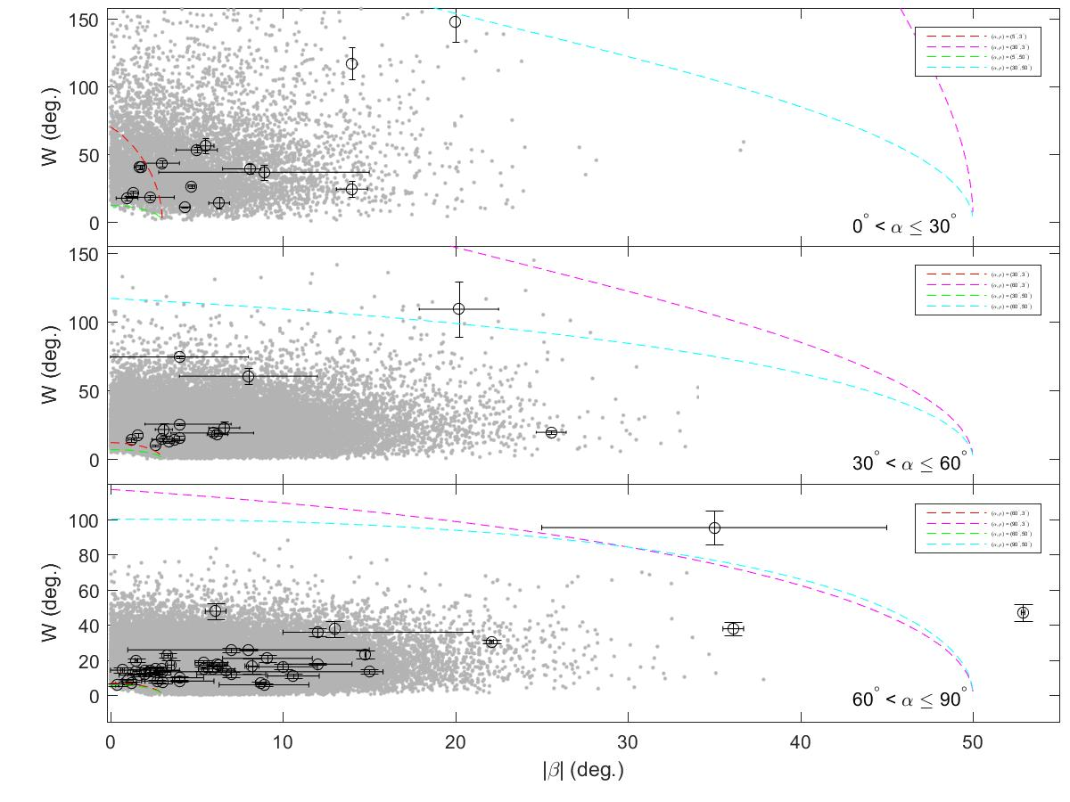
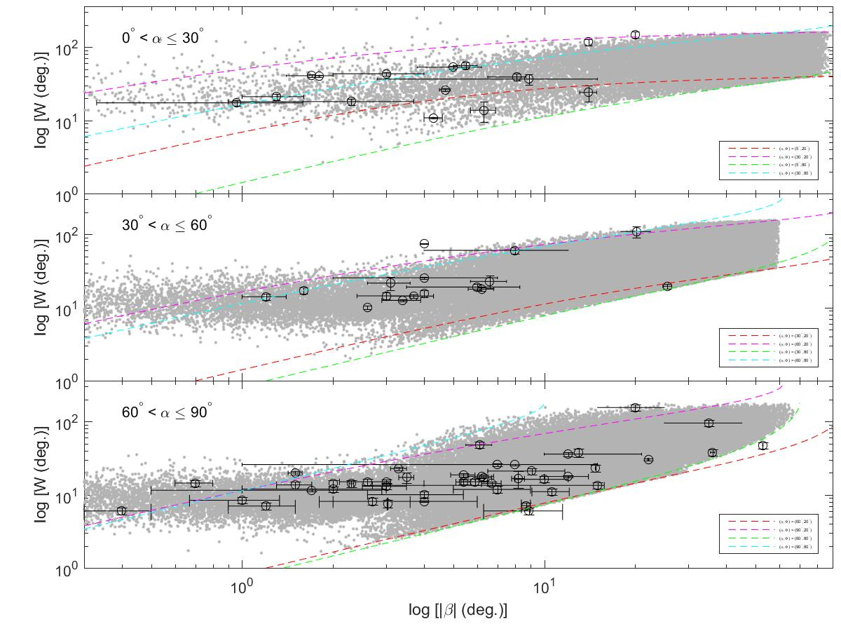
Result
W − |β| Relationship
Snapshot model A
Snapshot model B
Better !

Slide 9
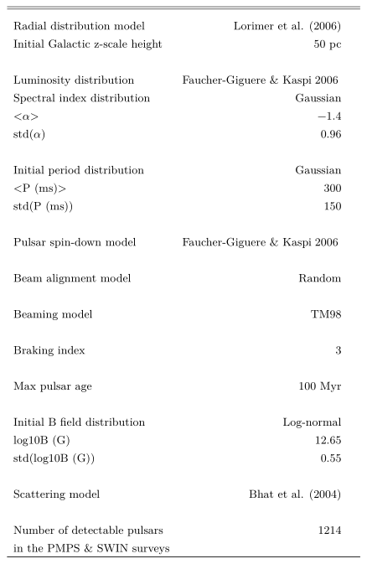
Evolution Model
Evolution model A: “optimal” model found by literatures
(Faucher-Giguere & Kaspi 2006);
(Ridley & Lorimer 2010);
(Bates et al. 2014)...
spin-down model
luminosity model
(Faucher-Giguere & Kaspi 2006)
width model
(Smits et al. 2009)

Slide 10
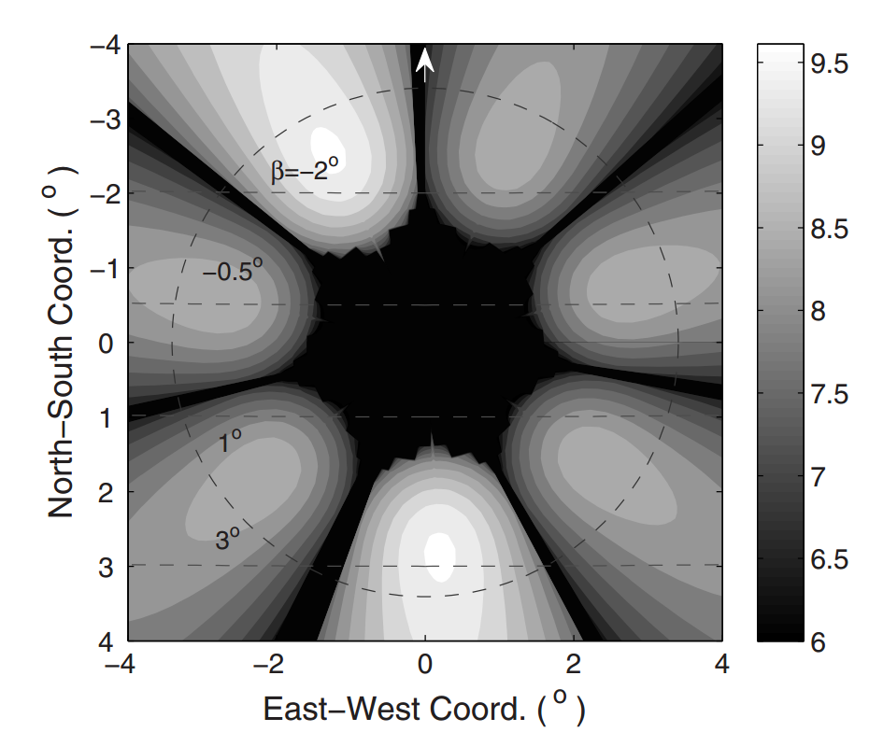
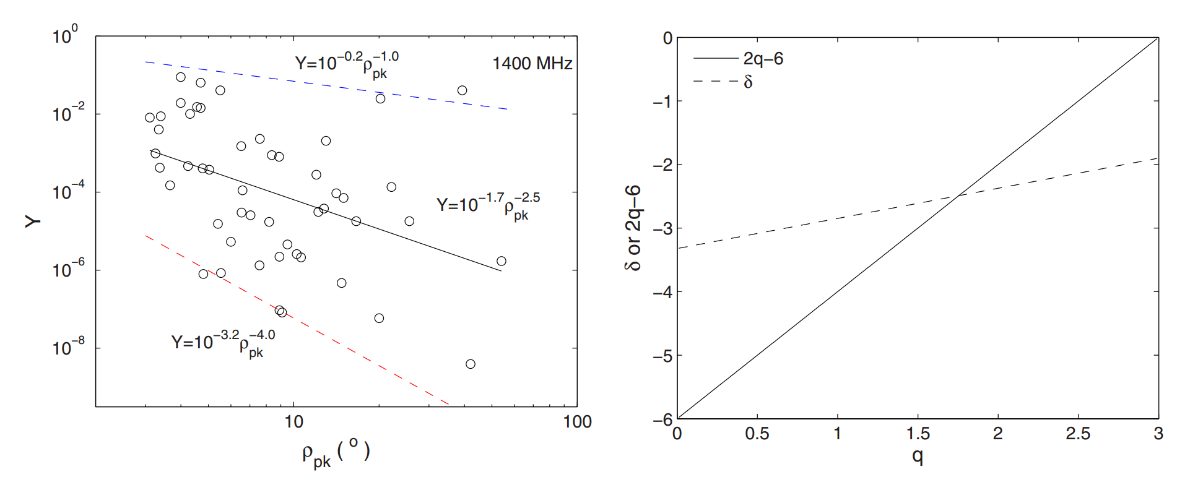
Evolution Model
Fan beam luminosity
Evolution model B: replace with fan beam width model and luminosity model
Intensity–Radius Relationship:
q = 1.75 ?
q in [0 , 4]
(Wang et al. 2014)

Slide 11
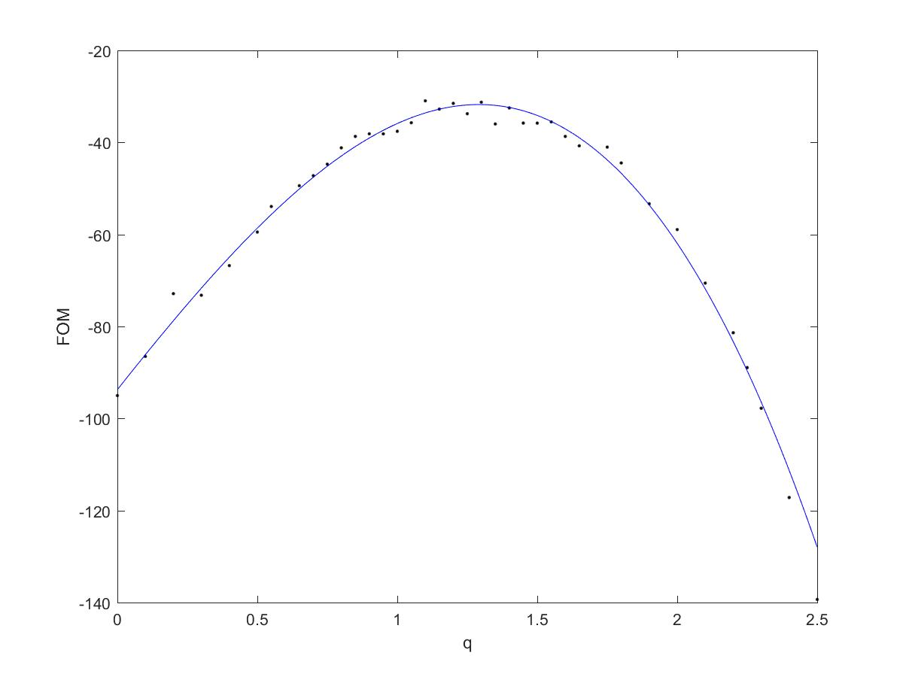
Evolution Model
Method for comparison
define a figure of merit for each simulation
(Ridley & Lorimer 2010)
Note that Q means KS probability of simulated sample and observed sample, which are detected by PMSURV, SWINB1 and SWINB2 .
q = 1.30

Slide 12
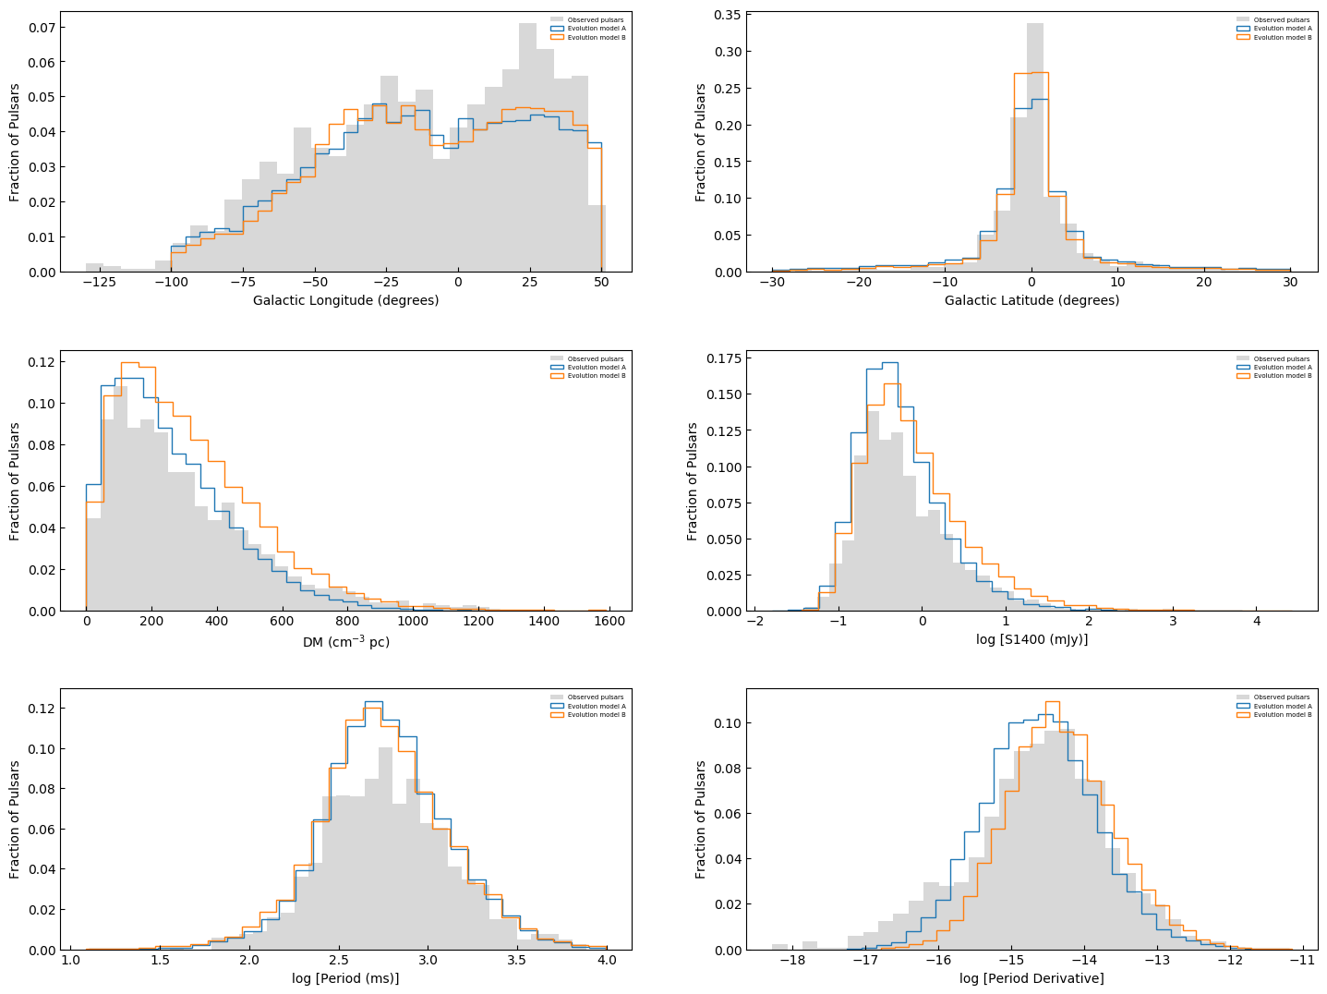
Results
Gray region: Observation
Blue line: Evolution model A
Orange line: Evolution model B (q=1.30)
Gl
Gb
DM
F1400
P
Pdot

Slide 13
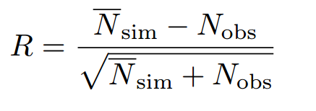
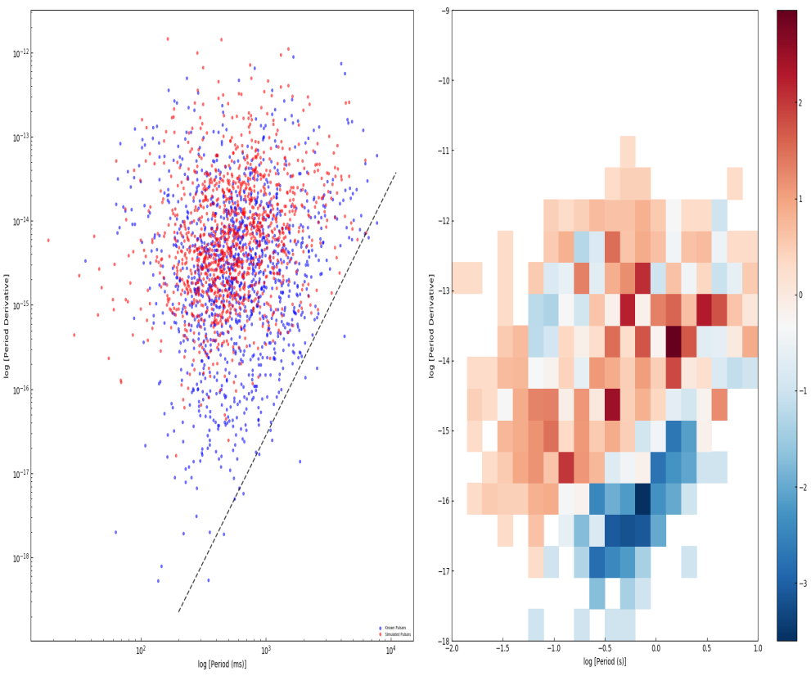
Results
P-Pdot diagram
define the significance of the difference in the pairs of simulated pulsars and observation pulsars in each 2-D bin
(Johnston & Karastergiou. 2017)
Red dots: simulated pulsars
Blue dots: observed pulsars
Red 2-D bins: N_sim > N_obs
Blue 2-D bins: N_obs > N_sim
Evolution model B

Slide 14
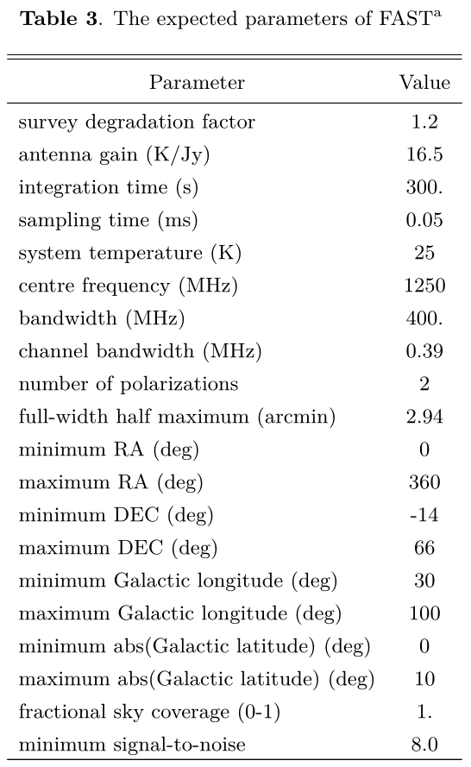
Prediction for FAST survey

Slide 15
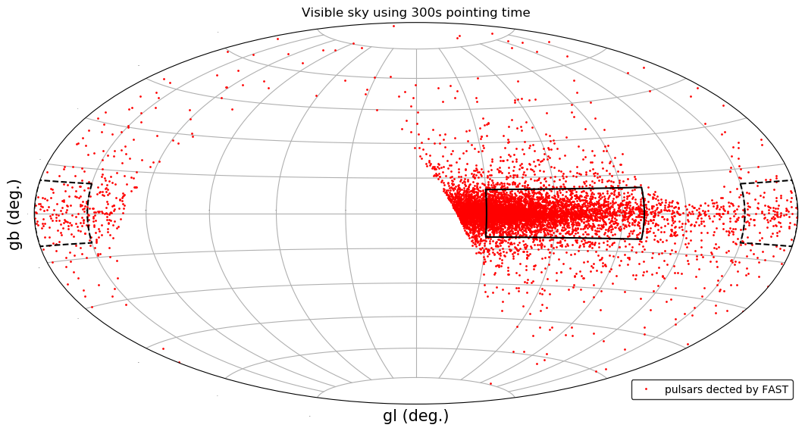
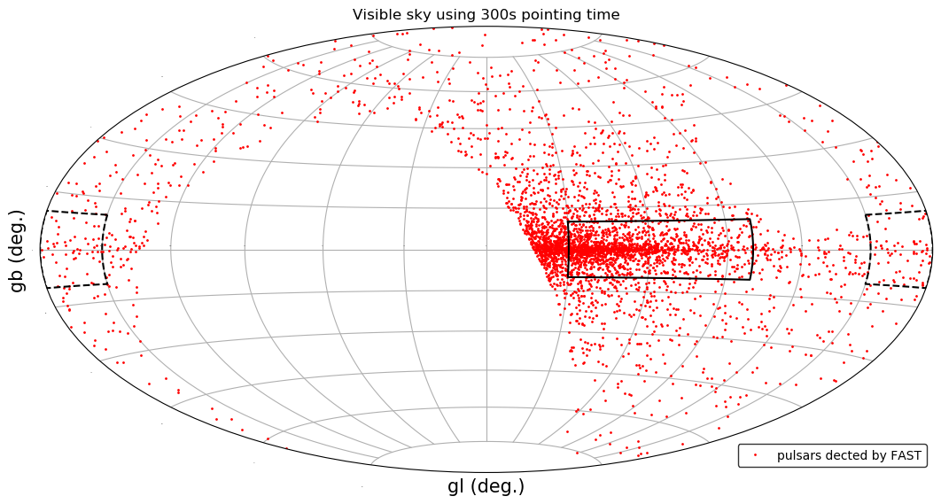
Results
Visible sky using 300s pointing time
OGP
IGP
Snapshot model B
Evolution model B
Inner Galactic plane: (30<gl<100; |gb|<10)
Outer Galactic plane: (150<gl<210; |gb|<10)
 | SA | SB | EA | EB
IGP | 3536 | 4057 | 2322 | 1472
OGP | 185 | 229 | 219 | 111
Notes:
radio loud pulsars and beamed toward us
SA:123082
SB:178603
EA:106922
EB:211542

Slide 16
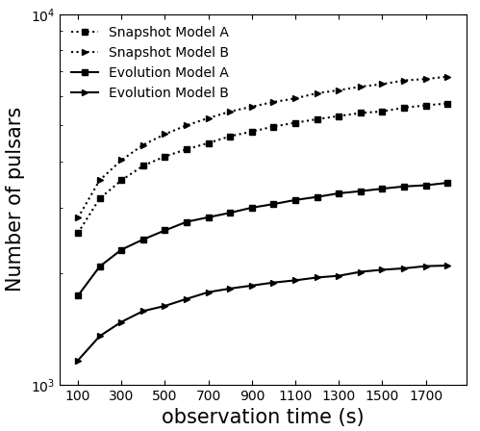
Results
Inner Galactic plane: (30<gl<100; |gb|<10)
6700
Snapshot model B
(+ fan beam model)
5700
3500
Evolution model B
(+ fan beam model)
1800

Slide 17
Outline
Motivation
Methods
Simulation and Results
Conclusion

Slide 18
Conclusion
Using the fan beam width and luminosity model in pulsar population
W − |β| relationship can be well reproduced by fan beam width model.
compared with the known pulsar population, the q value in fan beam luminosity relationship may be 1.30 rather than 1.75 .
predict the numbers of normal pulsars detected by FAST with 300s pointing time:
inner Galactic plane~1500
outer Galactic plane~ 120

Slide 19
Thank you！

