Slide 1
Merging strangeon stars, kilonova, and r-process
Xiaoyu Lai 来小禹
Hubei University of Education 湖北第二师范学院
2019/06/27
FPS8
2019/06/26-2019/06/28

Slide 2
Outline
Strangeon stars
Merging strangeon stars
Summary

Slide 3
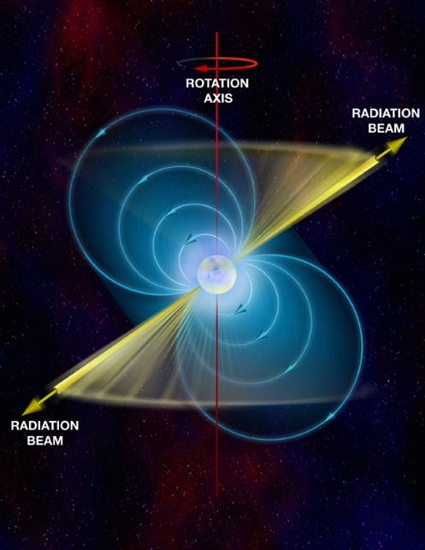
u
d
crust
d
u
d
u
d
d
?
d
Landau的巨大原子核＋壳层
中子星
neutron stars
u
d
脉冲星的本质？
d
u
d
u
夸克星
quark stars
d
s
s
s
u
Witten猜想：
三味(u+d+s)夸克物质可能
比两味(u+d)物质更稳定
s
d
d
u
s
d
s
u
d
u
巨大的强子
u
u
s
d
s
奇子星
strangeon stars
d
u
u
非微扰QCD效应
→ 三味夸克禁闭在奇子中
u
u
s
s
d
d
s
d
d
s
s
d
u
s
d
u
巨大的奇异原子核

Slide 4
proton
strangeon
u
u
u
u
d
neutron
s
d
s
d
u
u
d
d
u
u
s
u
u
s
d
d
s
d
d
d
d
s
s
d
u
u
u
s
d
d
u
~ 4 fm
~ 20 km
Nucleons in microscopic nucleus
2-flavored
Chromo-singlets
Interact via meson-exchange
Strangeons in gigantic nucleus
3-flavored
Chromo-singlets
Interact via meson-exchange

Slide 5
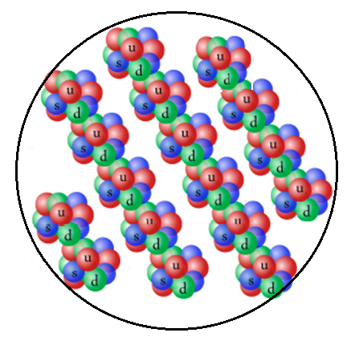

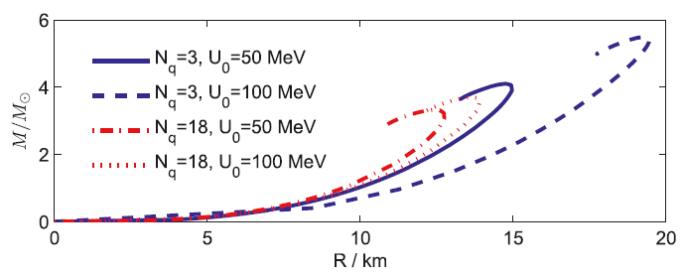
Strangeon stars
strangeon
(quark-cluster)
“strangeon” = strange nucleon
Stiff EOS → High maximum mass
V (r)
r
N_{q} = ?
(3, 6, 9, 12, 15, 18, …)
Lai & Xu, 2009

Slide 6
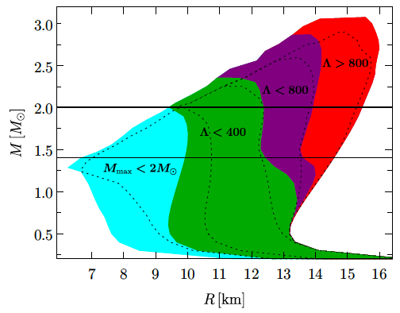
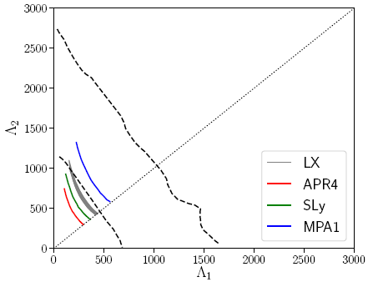
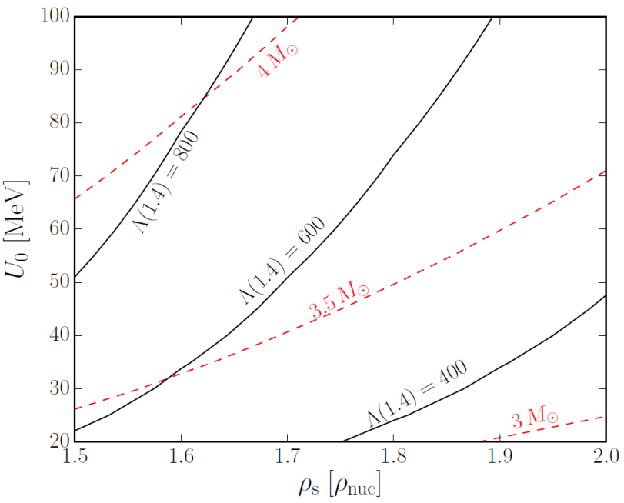
Strangeon star model passes dynamical test of Λ
Annala et al. 2018
Most of the EOS parameters satisfy the constraint of GW170817
High-mass strangeon stars could still pass the test of GWs
Lai et al. 2018a
Lai, Zhou & Xu 2019
50% and 90% confidence contours
by Abbott et al. 2017

Slide 7
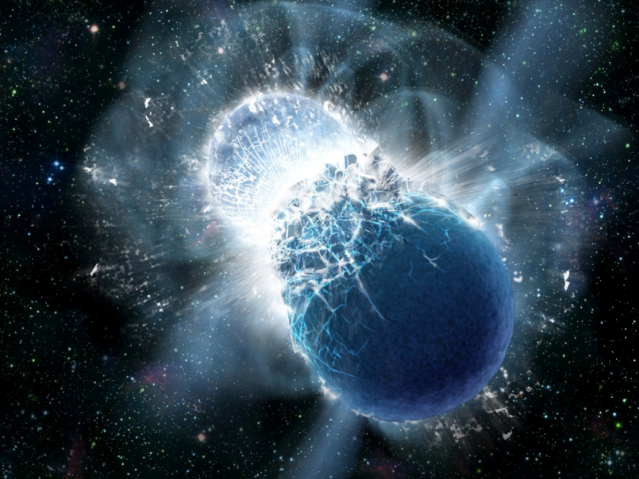
Merging binary neutron stars
Nucleosynthesis
kilonova event
ejecta

Slide 8
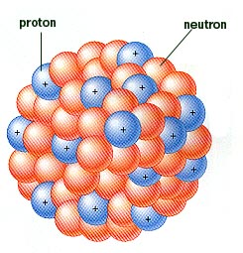
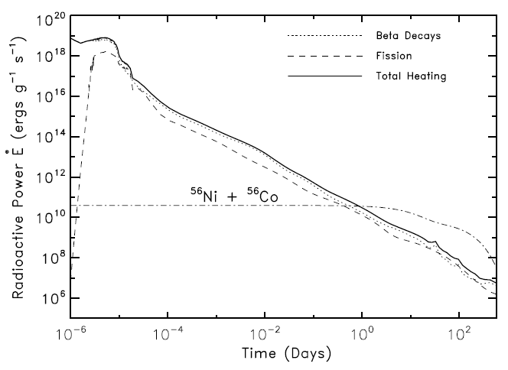
Conventional scenario of kilonova
n
n
n
r-process
Radioactive decay
n
n
n
n
n
( < 1 second )
Fission
n
n
Radioactive heating:
power EM emission
Elements heavier than Fe
High opacity ?
Metzger et al. 2010

Slide 9
R-process
(Z, N)+n → (Z, N+1) → (Z+1, N)
Rate of n-capture > Rate of beta decay
A ~ 220 (fission)
Z
N

Slide 10

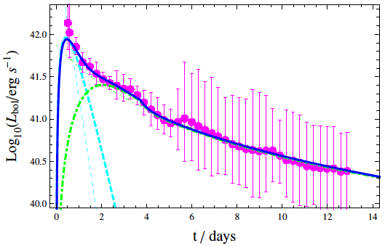
Merging strangeon stars
Nucleosynthesis ?
“kilonova” event ?
Strangeon nuggets
Lai et al. 2018

Slide 11

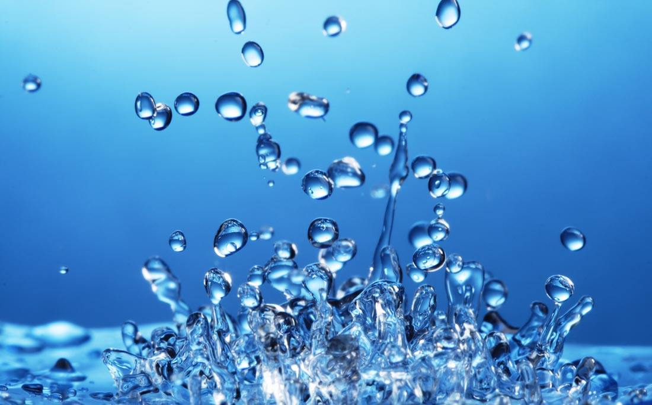

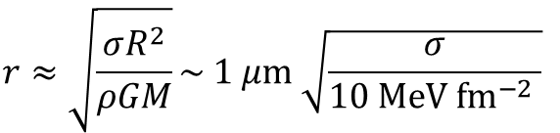



Estimate the maximum size of strangeon nuggets

Slide 12

Estimate the minimum size of strangeon nuggets
Weber number:
The baryon number range of initially ejected strangeon nuggets
Stable or unstable under 3 flavors → 2 flavors ?

Slide 13
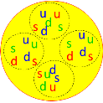
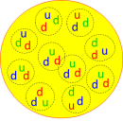
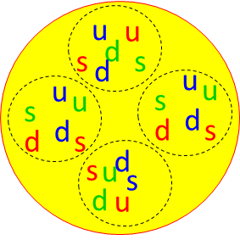

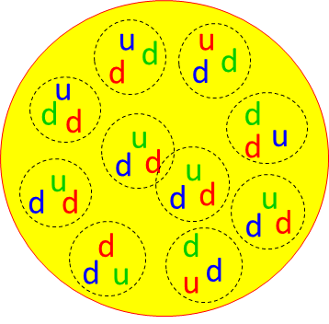


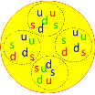



Merging strangeon stars: nucleosynthesis
Decay
3 flavors → 2 flavors
Strangeon nuggets
(unstable)
Neutron-rich nuggets
Fragment
“Standard kilonova”
Neutron-rich nuclei
( r-process nuclei without r-process )

Slide 14
Comparison: energy and timescale
Strangeon nuggets
Neutron-rich nuggets
Neutron-rich nuclei
Fragment into neutron-rich nuclei
3 flavors → 2 flavors
E/A ~ 200 MeV
E/A ~ 1 MeV
Neutron-rich ejecta
Neutron-rich nuclei
n
n
n
r-process
n
n
n
n
n
n
n
E/A ~ 10 MeV
t < 1 s

Slide 15
Summary
If pulsar-like compact stars are strangeon stars
Global structure of pulsars
The Gravitational wave signals of merger
The “kilonova” event ?
Production of r-process nuclei without r-process ?

