Slide 1
Drifting sub-pulses of radio pulsar: evidence for self-bound surface?
Jiguang Lu
National Astronomical Observatories, Chinese Academy of Sciences
Jun 27, 2019

Slide 2
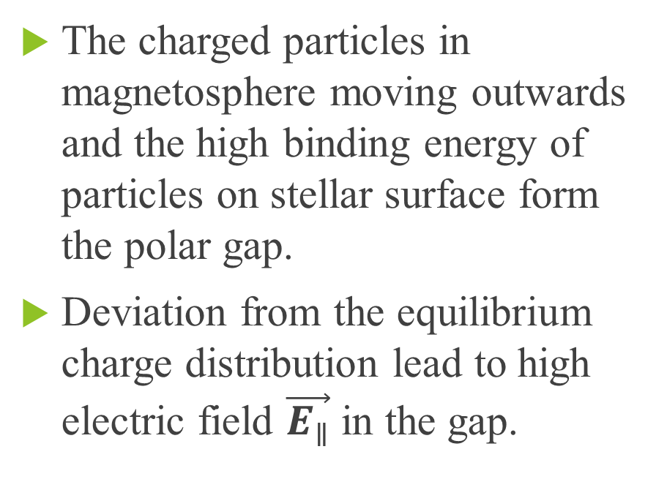
Polar gap model for radio radiation from pulsar
The charged particles in magnetosphere moving outwards and the high binding energy of particles on stellar surface form the polar gap.
Deviation from the equilibrium charge distribution lead to high electric field $\vec{E_{∥}}$ in the gap.
Ruderman & Sutherland (1975)

Slide 3
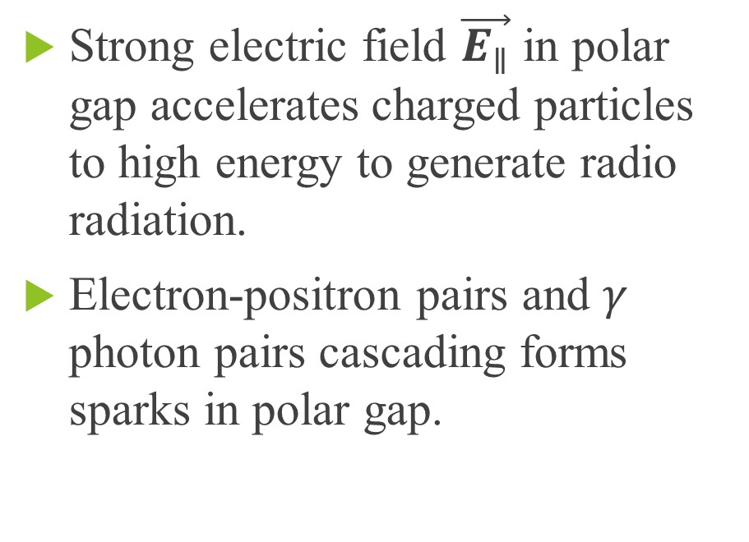
Polar gap model for radio radiation from pulsar
Strong electric field $\vec{E_{∥}}$ in polar gap accelerates charged particles to high energy to generate radio radiation.
Electron-positron pairs and $γ$ photon pairs cascading forms sparks in polar gap.
Ruderman & Sutherland (1975)

Slide 4
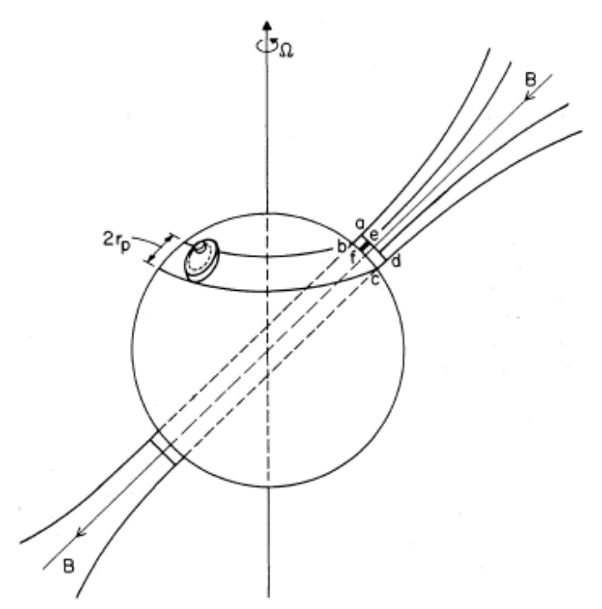
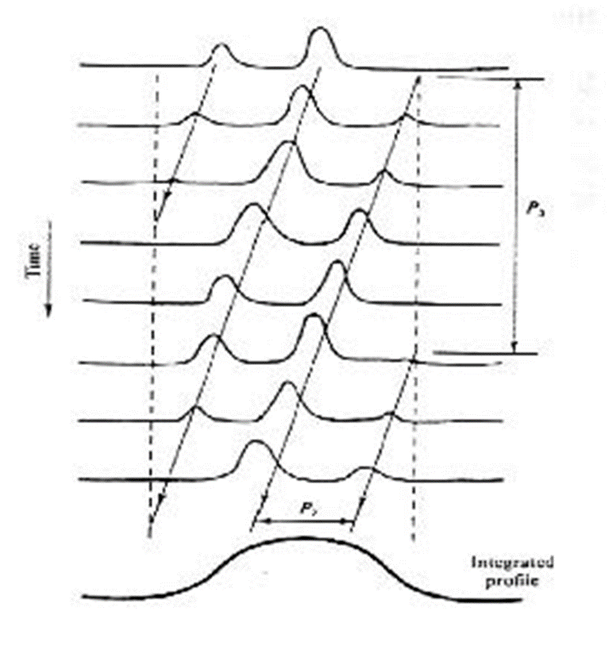
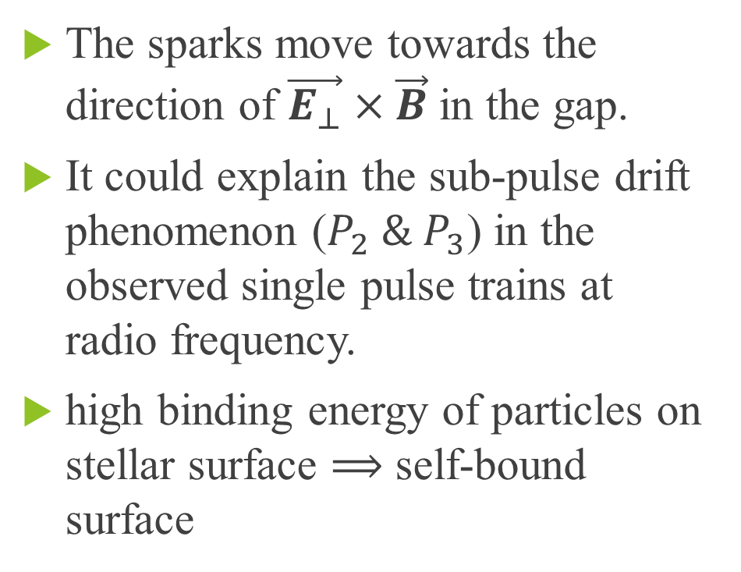
Sub-pulse drift in polar gap model
The sparks move towards the direction of $\vec{E_{⊥}}×\vec{B}$ in the gap.
It could explain the sub-pulse drift phenomenon ($P_{2} \& P_{3}$) in the observed single pulse trains at radio frequency.
high binding energy of particles on stellar surface $⟹$ self-bound surface
Ruderman & Sutherland (1975)

Slide 5
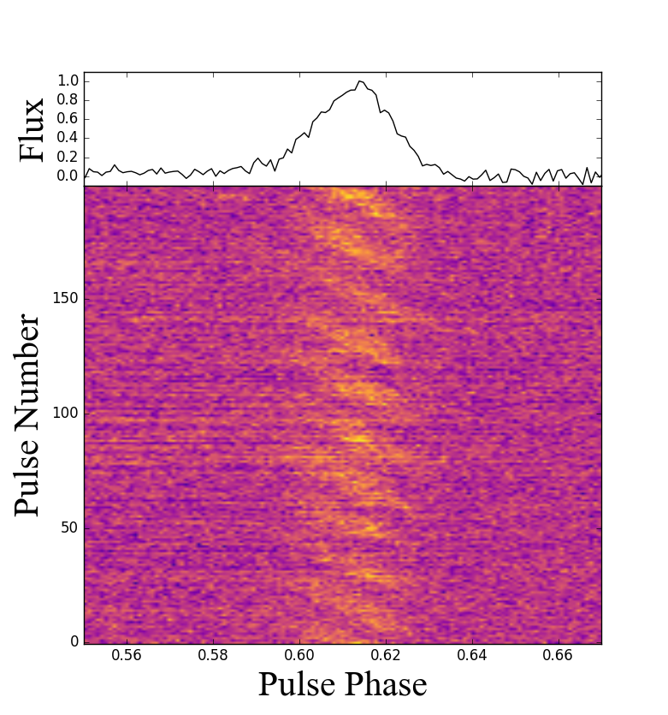
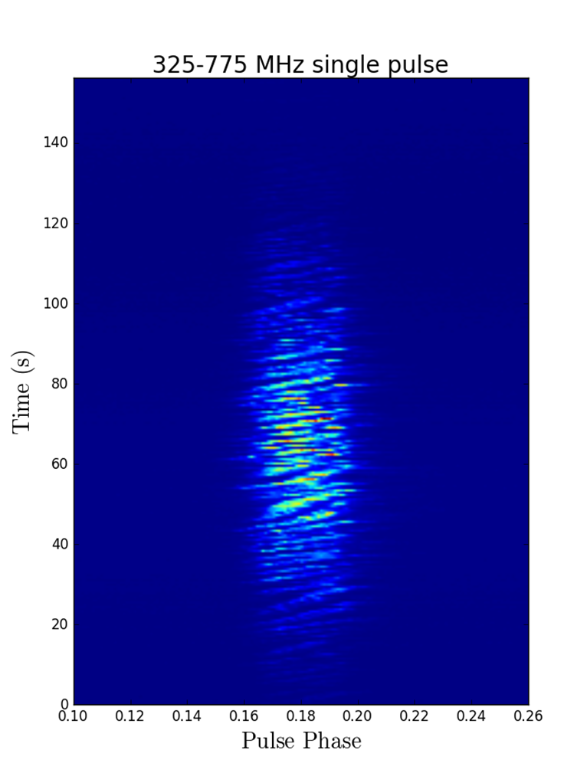
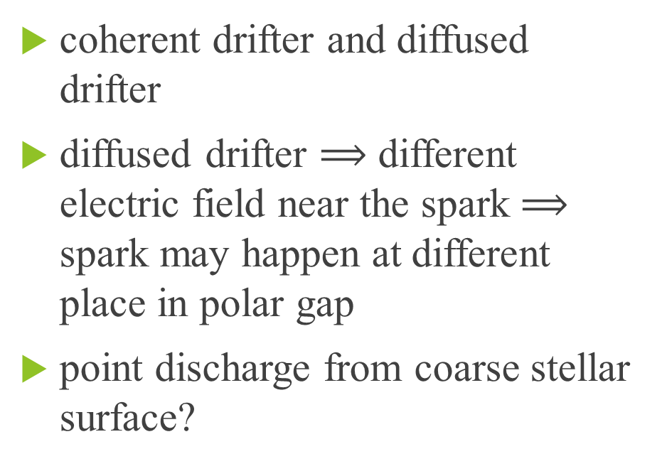
Other properties of drifting sub-pulse
coherent drifter and diffused drifter
diffused drifter ⟹ different electric field near the spark $⟹$ spark may happen at different place in polar gap
point discharge from coarse stellar surface?

Slide 6
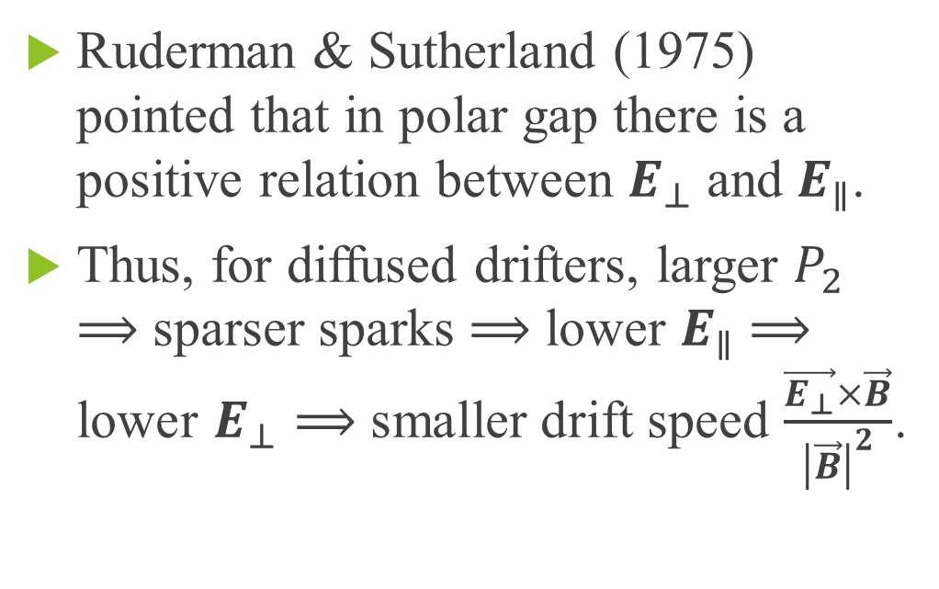
Physical prediction
Ruderman & Sutherland (1975) pointed that in polar gap there is a positive relation between $E_{⊥}$ and $E_{∥}$.
Thus, for diffused drifters, larger $P_{2}$ ⟹ sparser sparks ⟹ lower $E_{∥}$ ⟹ lower $E_{⊥}$ ⟹ smaller drift speed $\frac{\vec{E_{⊥}}×\vec{B}}{{\left|\vec{B}\right|}^{2}}$.

Slide 7
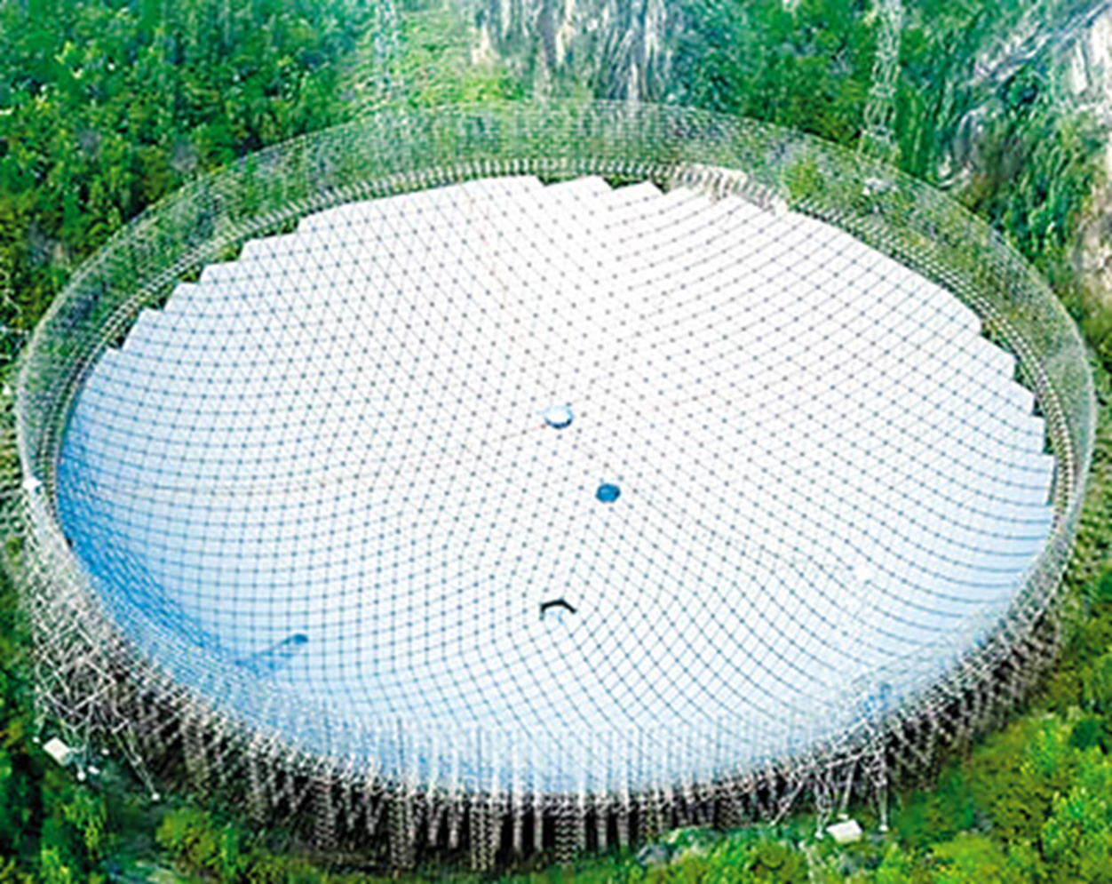
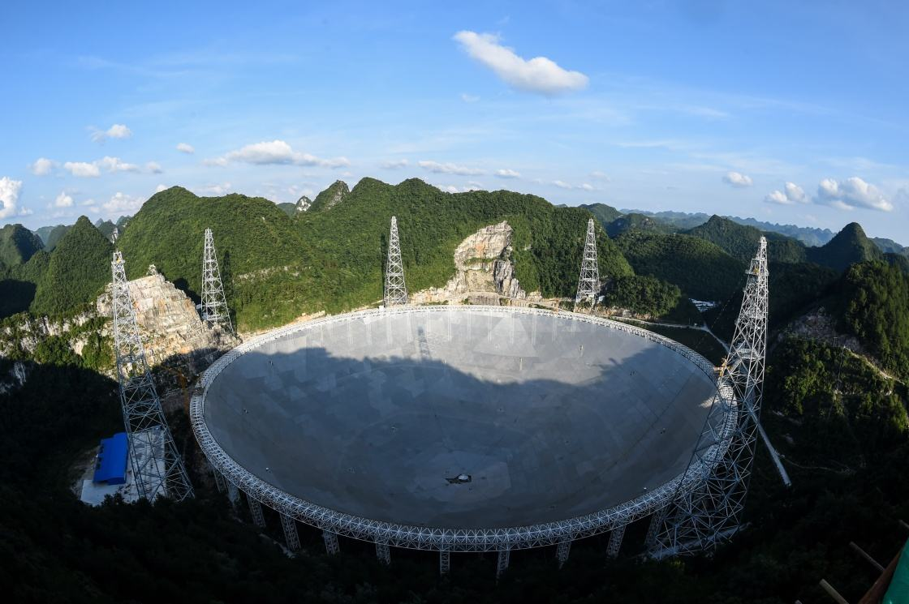
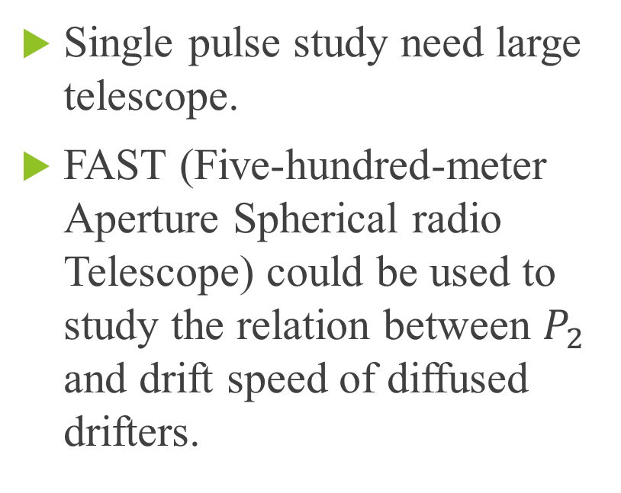
Sub-pulse drift study with FAST
Single pulse study need large telescope.
FAST (Five-hundred-meter Aperture Spherical radio Telescope) could be used to study the relation between $P_{2}$ and drift speed of diffused drifters.

Slide 8
Drifting sub-pulse: drift rate
diffused drifter PSR B2016+28
Drift rate fluctuates with time.

Slide 9
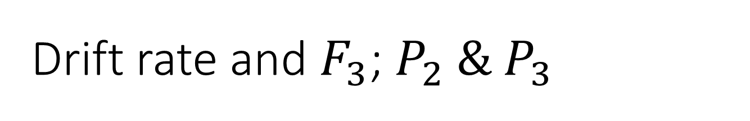
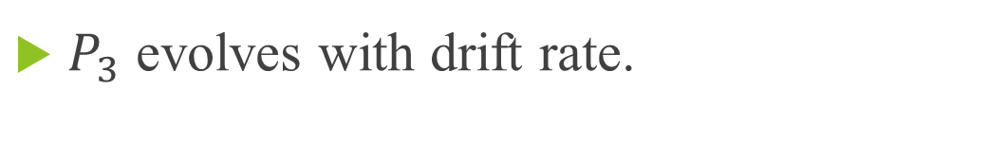
Drift rate and $F_{3}$; $P_{2} \& P_{3}$
$P_{3}$ evolves with drift rate.

Slide 10
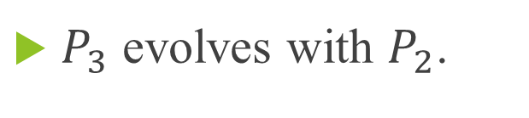
Harmonic analysis for drifting sub-pulse
$P_{3}$ evolves with $P_{2}$.

Slide 11

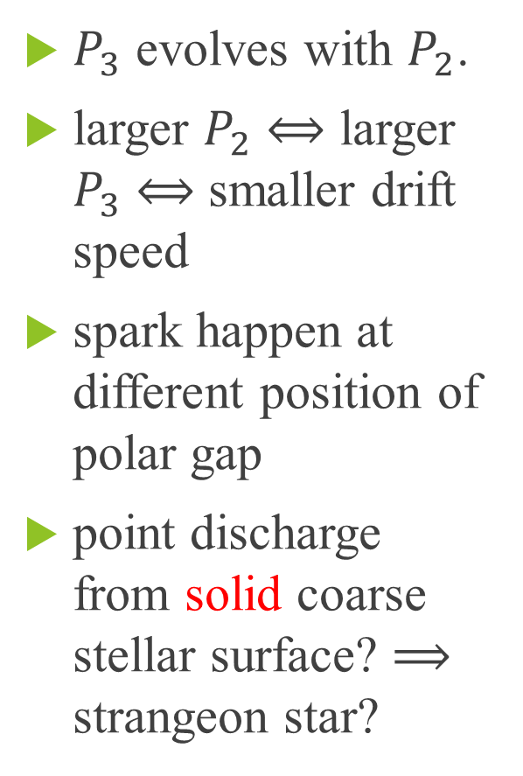
Relation between $P_{2} \& P_{3}$
$P_{3}$ evolves with $P_{2}$.
larger $P_{2}$ $⟺$ larger $P_{3}$ $⟺$ smaller drift speed
spark happen at different position of polar gap
point discharge from solid coarse stellar surface? ⟹ strangeon star?

Slide 12
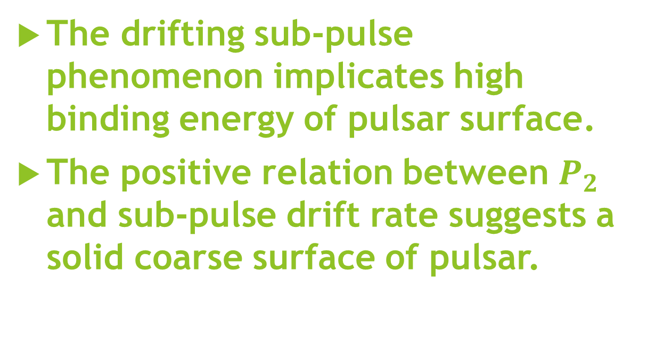
SUMMARY
The drifting sub-pulse phenomenon implicates high binding energy of pulsar surface.
The positive relation between $P_{2}$ and sub-pulse drift rate suggests a solid coarse surface of pulsar.
Thanks!

