Slide 1


Correct atomic time-scale maintained at NTSC by pulsar time-scale
Minglei Tong(童明雷)
NTSC(中科院国家授时中心)

Slide 2
Outline
Time scales
Pulsar time-scale (PT)
Correct AT at NTSC by PT
Summary

Slide 3
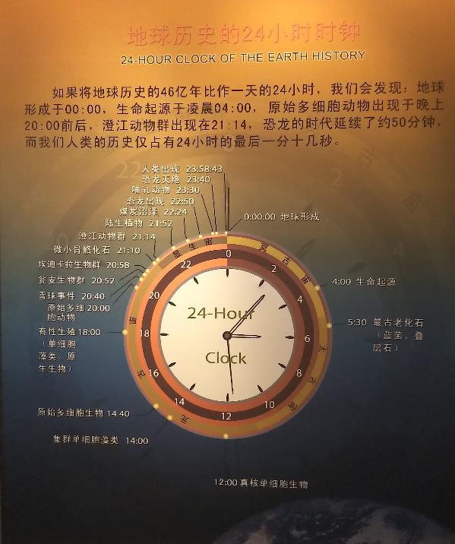

Slide 4
时空计量基准
秒长与国际单位制基本物理量的现状
基本量 | 单位 | 现行定义 | 不确定度 | 可能修订的新定义
时间 | s | Cs 超精细分裂 | 10⁻¹⁶
长度 | m | 光速 | 10⁻¹²
质量 | kg | 原器质量 | 10⁻⁸ | Planck 常数 (h) 或 Avogadro常数 (NA)
电流 | A | I=V/Ω | 10⁻⁹ | 电子电荷 (e)
热力学温度 | K | 水三相点温度 | 10⁻⁵ | Boltzmann常数 (k_{B})
发光强度 | ca | 特殊光源的发光效率 | 10⁻⁴
物质量 | mol | 碳的Mole质量 |  | Avogadro常数 (NA)
SI秒定义(1967): ¹³³Cs超精细能级间跃迁辐射9,192,631,770周的时间。
米定义(1983)：光在真空中1/299792458s时间内所传播的距离。

Slide 5
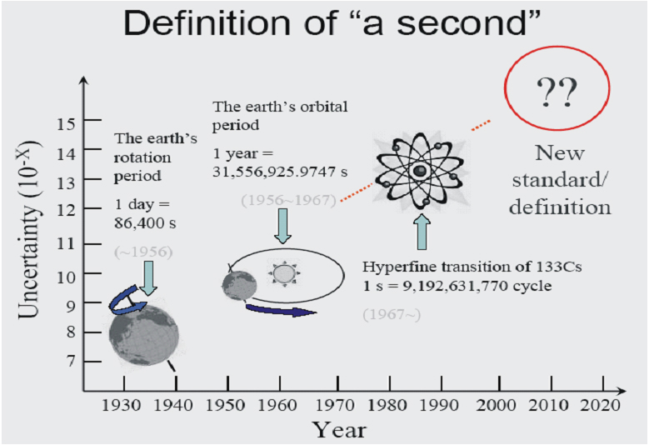
秒长与国际单位制基本物理量的现状
基本量 | 单位 | 现行定义 | 不确定度 | 可能修订的新定义
时间 | s | Cs 超精细分裂 | 10⁻¹⁵
长度 | m | 光速 | 10⁻¹²
质量 | kg | 原器质量 | 10⁻⁸ | Planck 常数 (h) 或 Avogadro常数 (NA)
电流 | A | I=V/Ω (JJV + QHR) | 10⁻⁹ | 电子电荷 (e)
热力学温度 | K | 水三相点温度 | 10⁻⁵ | Boltzmann常数 (k_{B})
发光强度 | ca | 特殊光源的发光效率 | 10⁻⁴
物质量 | mol | 碳的Mole质量 |  | Avogadro常数 (NA)
秒定义 (1967): ¹³³Cs超精细能级间跃迁辐射9,192,631,770周的时间。
米定义(1983)：光在真空中1/299792458s时间内所传播的距离。

Slide 6
Time-scales
Proper time (local quantity):The time recorded by the standard clock carried by an observer in his own would line.
e.g. Atomic time: Maintained by atomic clocks;
Pulsar time: Described by local stable pulsars ignoring their self-gravity.
Properties of proper time:
Independent on the choices of coordinate system
A local quantity and can be measured directly
Unable to synchronize with each other directly unless using coordinate time as a medium.
Coordinate time (global quantity): The time derived from proper time
TAI：International Atomic Time （国际原子时）
TT: Terrestrial Time （地球时）
TCG：Geocentric coordinate time （地心坐标时）
TCB：Barycentric coordinate time（太阳系质心坐标时）

Slide 7
Different time scales

Slide 8
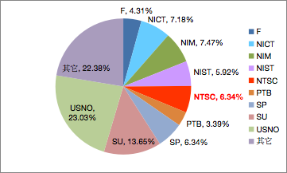
TAI、UTC、TA(k)与UTC(k)
1. TAI
76 time laboratories
500+ atomic clocks
16 primary standard clocks
2. UTC
UT goes slower and slower
The difference between UT and TAI is bigger an bigger
January 1972，UTC was defined
3. TA(k)与UTC(k)
15 labs have their own TA(k)
UTC(k) is the standard time of a
country kept by her time laboratory
In China, UTC(NTSC) is Beijing Time
Weights of the time laboratories in 2018
NTSC：29 5071A Cs + 9 HM(USA) + 1 HM (SHAO)

Slide 9
Outline
Time scales
Pulsar time-scale (PT)
Correct AT at NTSC by PT
Summary

Slide 10
Pulsar timing model
Phase model：
Timing model：
Residuals: intrinsic timing noise,GWs,DM effects, solar system ephemeris errors
Noises in the time comparison of TT and PT：

Slide 11
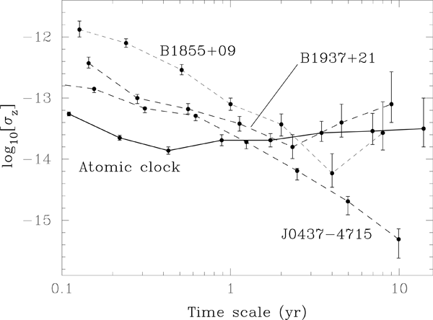
Pulsar time-scale
Spin parameters
Astrometric parameters
→ Predict the TOAs at SSB
Properties of PT：
Independent of AT but relying on AT for the measurement of TOAs
High stability at long-term time scale (more than one year)
Long-term timing data needed
Pulsars are natual, safe and long lived

Slide 12
Stability comparison between AT and PT
PSR J0437-4715
PPTA data
IPTA data

Slide 13
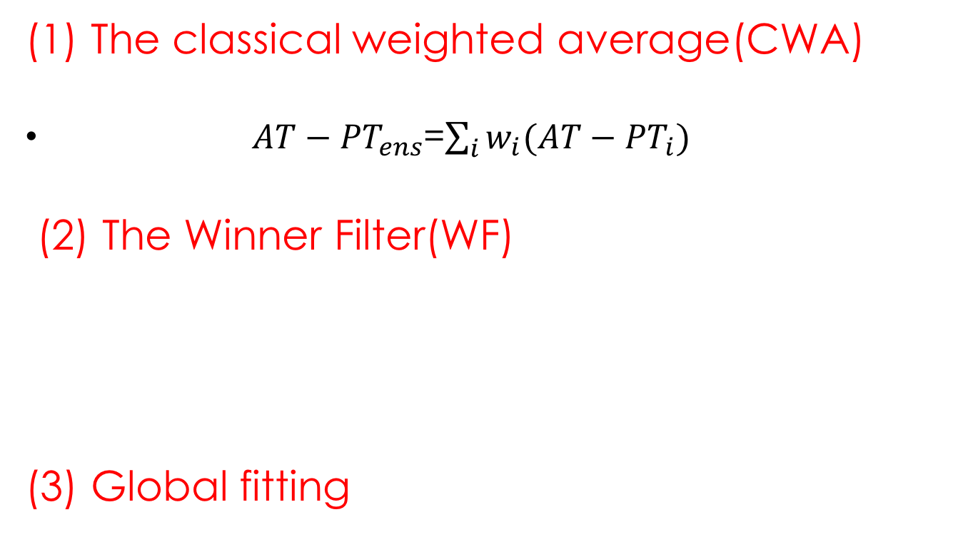
Ensemble pulsar time scale
(1) The classical weighted average(CWA)
$AT−{PT}_{ens}$=$\sum_{i}{w_{i}(AT−{PT}_{i})}$
(2) The Winner Filter(WF)
(3) Global fitting

Slide 14
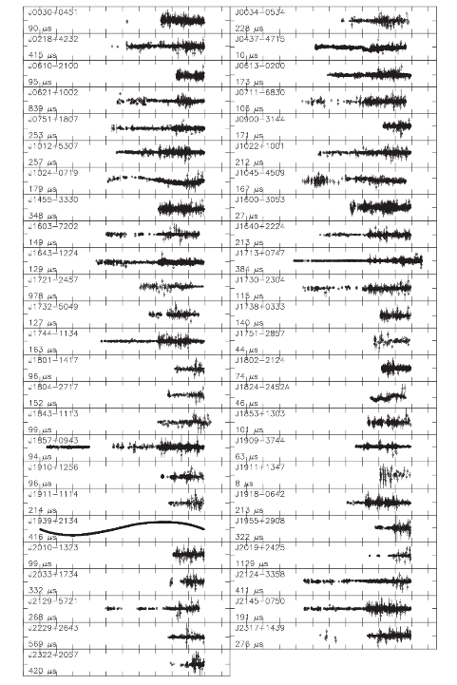
Observable data (IPTA)
49MSPs
14 (Solitary)
35 (binary)
26 (more than a decade of data)
Verbiest et al. MNRAS, 2016, 458:1267

Slide 15
Time reference: TT(BIPM2013)
16 pulsars from IPTA
Time duration: 15yr (data span of J0437)
M L Tong, G Hobbs, K J Lee et al. in prep.
2.88E-17

Slide 16
Outline
Time scales
Pulsar time-scale (PT)
Correct AT at NTSC by PT
Summary

Slide 17
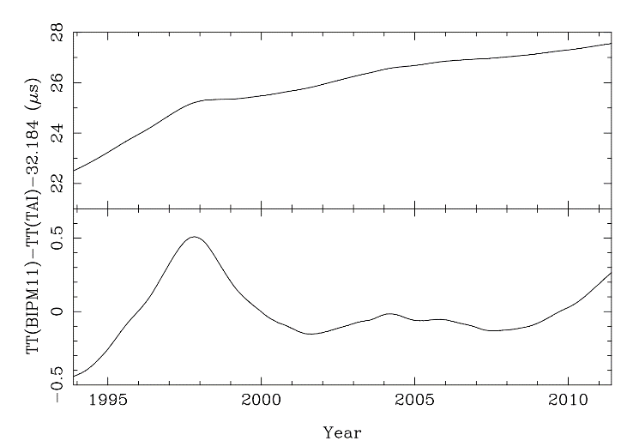
TAI与TT(BIPM)的关系

Slide 18
Global fitting the clock differences
PPTA data:
Hobbs et al., MNRAS, 427, 2780 （2012）

Slide 19
Detect the fluctuations of TAI referred to TT(BIPM) by Wiener filtering method
TT(TAI)
J0437-4715 & J0613-0200
Time reference: TT(TAI)
M L Tong, G Hobbs, K J Lee et al. in prep.

Slide 20
Detect the fluctuations of TAI referred to TT(BIPM) by Wiener filtering method
J0437-4715 & J1713+0747
J0437-4715 & J1012+5307

Slide 21
TAI、UTC、TA(k)与UTC(k)关系

Slide 22
Predict the next one year using the constructed pulsar time-scale
16 IPTA pulsars

Slide 23
Correct TA(NTSC) by PT
EPT realized by the combination of J0437 and J1909
Slope of TA(NTSC)-PT(wf)=-0.005007（微秒／天）
Slope of TA(NTSC)-PT (CWA:RMS) =-0.005476
Slope of TA(NTSC)-TAI=-0.004849
Slope of TA(NTSC)-TT(BIPM13)= -0.00538

Slide 24
Summary
Pulsar time-scale has a high long-term stability
The high stability of EPT make it can detect the fluctuations of TAI (or TA(k)) relative to TT
It is possible to use pulsar time-scale to correct the local atomic time-scale at NTSC
Data from HRT will be used in the following work

Slide 25
Thanks for your listening!

