Slide 1
The Tidal Dissipation in Millisecond Pulsar Binary
Reporter: Wang di
Supervisor: Gong Biping
华中科技大学物理学院
粒子与天体物理所
HUST

Slide 2
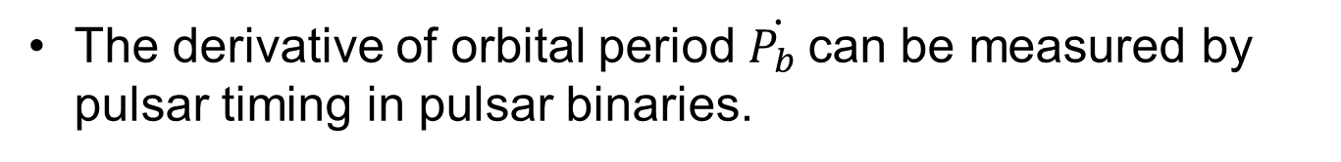
Motivation
The derivative of orbital period $\dot{P_{b} }$can be measured by pulsar timing in pulsar binaries.
Normal explanation:
Shklovskii effect (Transverse Motion)
Acceleration on the line of sight
GW radiation
Is there other effect?
1

Slide 3
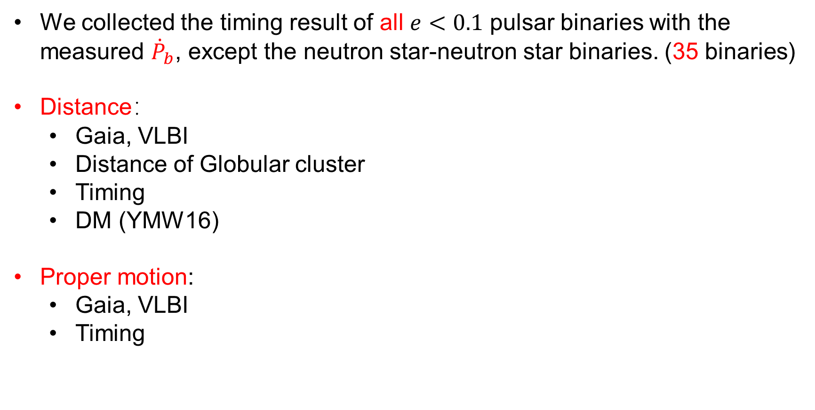
Data Collection
We collected the timing result of all $e<0.1$ pulsar binaries with the measured ${\dot{P}}_{b}$, except the neutron star-neutron star binaries. (35 binaries)
Distance：
  Gaia, VLBI
  Distance of Globular cluster
  Timing
  DM (YMW16)
Proper motion:
  Gaia, VLBI
  Timing

Slide 4
Acceleration Estimation
3D Position
  Coordinate measured by pulsar timing
  Distance
Potential Model
  Galactic potential model by McMillan. (McMillan 2016)
  Globular cluster potential model by Freire. (Freire et al. 2005) , The parameter of GC is given by Baumgardt. (Baumgardt et al. 2018)

Slide 5

The are some positive intrinsic${\dot{P}}_{b}^{Int}$, can’t be explained by GW radiation.

Slide 6
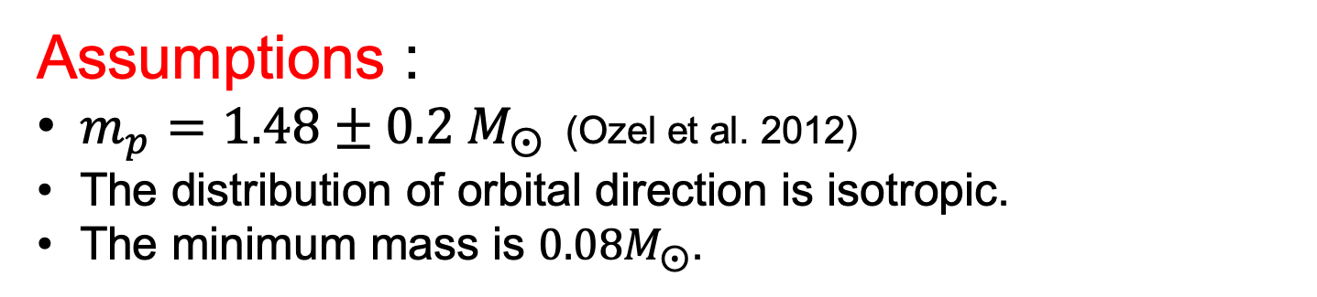
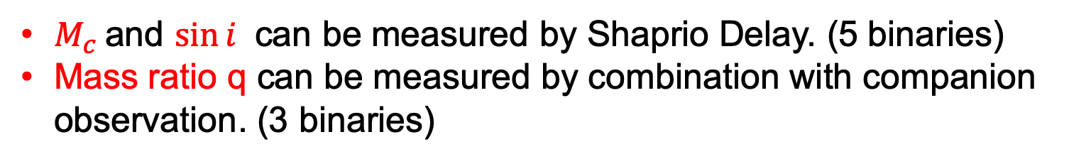
Mass Estimation
Mass function:
$M_{c}$and $\sin{i}$ can be measured by Shaprio Delay. (5 binaries)
Mass ratio q can be measured by combination with companion observation. (3 binaries)
Assumptions :
$m_{p}=1.48±0.2 M_{⨀}$ (Ozel et al. 2012)
The distribution of orbital direction is isotropic.
The minimum mass is $0.08M_{⨀}$.

Slide 7

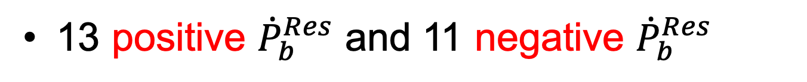
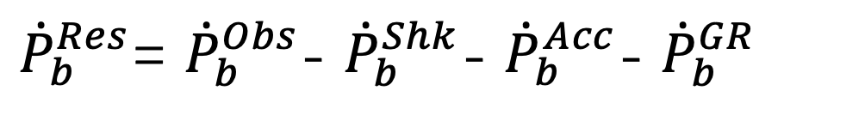
${\dot{P}}_{b}^{Res}$= ${\dot{P}}_{b}^{Obs}$- ${\dot{P}}_{b}^{Shk}$- ${\dot{P}}_{b}^{Acc}$- ${\dot{P}}_{b}^{GR}$
25 Binaries have ${\dot{P}}_{b}^{Res}$ above 1 𝜎 confidence level.
13 positive ${\dot{P}}_{b}^{Res}$ and 11 negative ${\dot{P}}_{b}^{Res}$
Tidal dissipation can produce distribution of half positive and half negative ${\dot{P}}_{b}^{Res}$

Slide 8

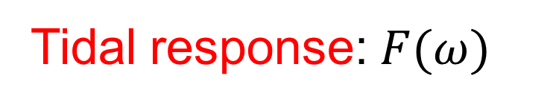




Tidal Dissipation
$$ω$$
Classical figure:
$$R_{c}$$
$$m_{p}$$
$$θ$$
Lag angle
$$m_{c}$$
Fuller’s formula:
Tidal torque:
Tidal response:$F(ω)$

Slide 9
Radius Estimation
For White Dwarf (Andronov & Yavorskij 1990)
For Main-sequence star (Demircan & Kahraman 1991)

Slide 10
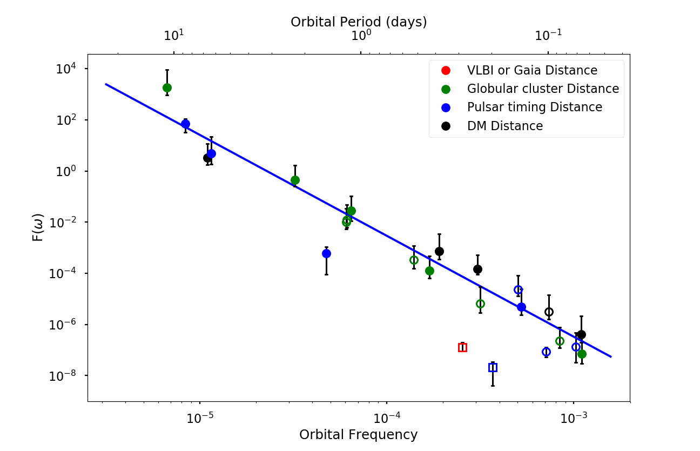
For WD binaries

Slide 11
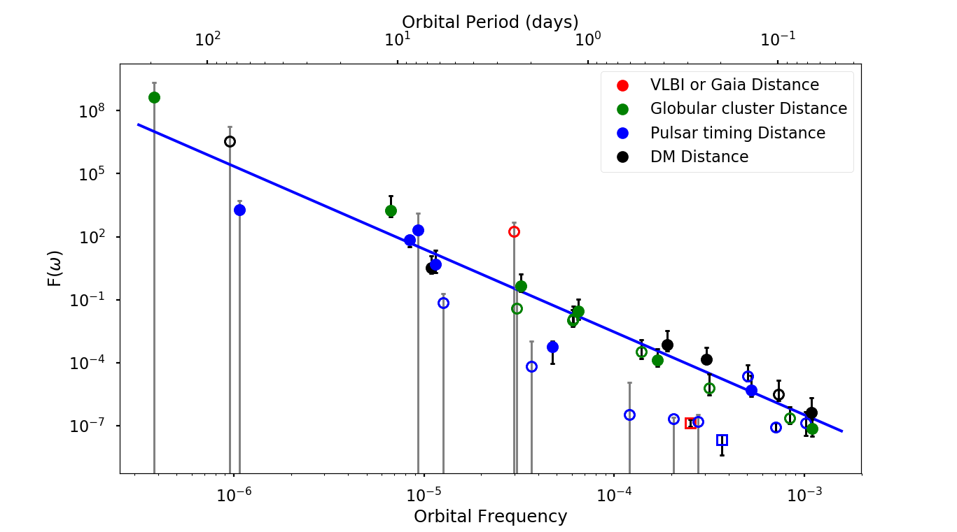

Slide 12
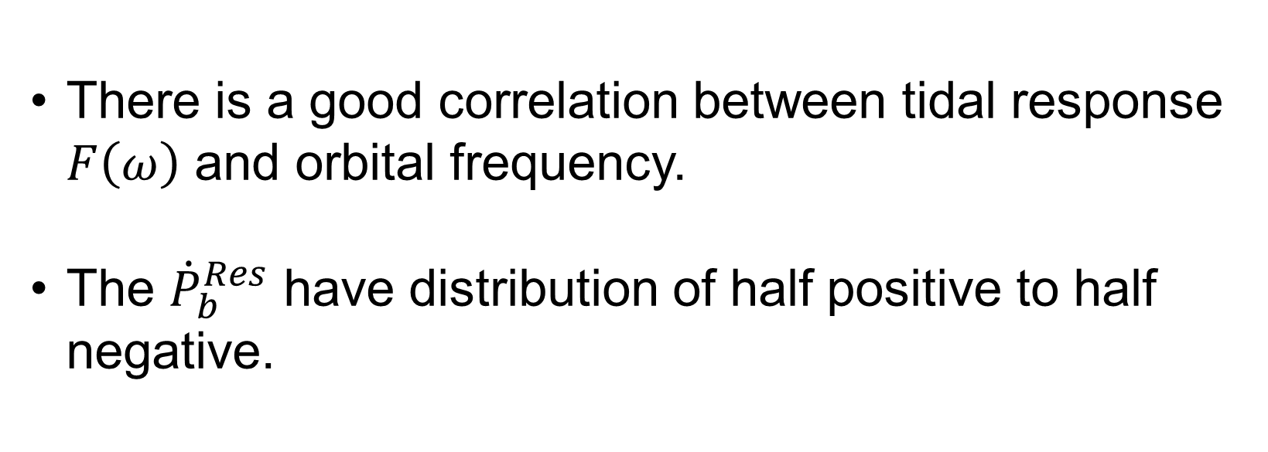
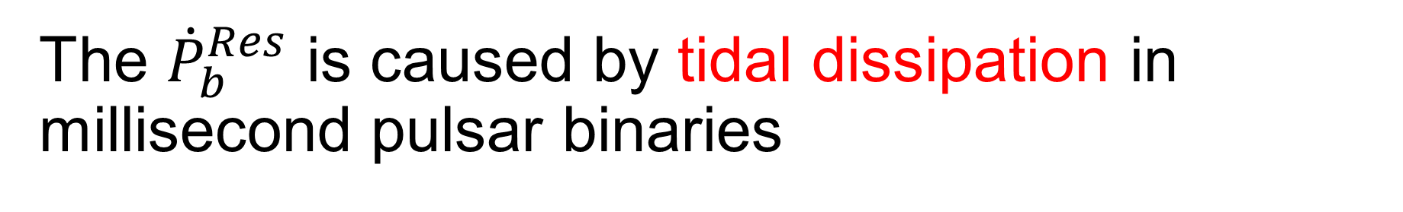
The ${\dot{P}}_{b}^{Res}$ is caused by tidal dissipation in millisecond pulsar binaries
There is a good correlation between tidal response $F\left(ω\right)$ and orbital frequency.
The ${\dot{P}}_{b}^{Res}$ have distribution of half positive to half negative.

Slide 13
Comparison with GW Radiation
The orbit is affected by both tidal dissipation and gravitational wave radiation
For WD-MSP binaries, the critical orbital period is about $0.07 day$
While $P_{b}=1 day,$ ${\dot{P}}_{b}∼{10}^{−12}$

Slide 14
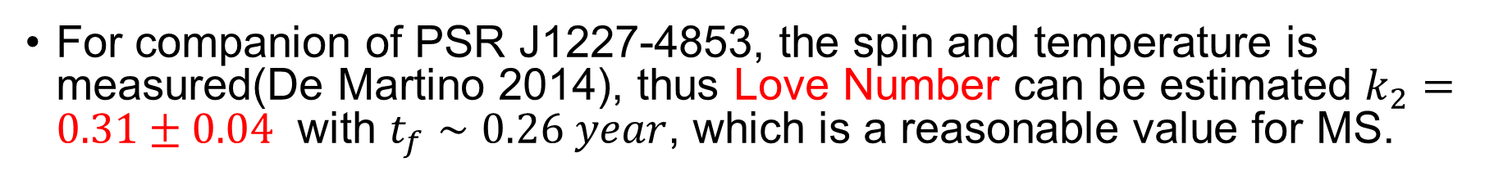
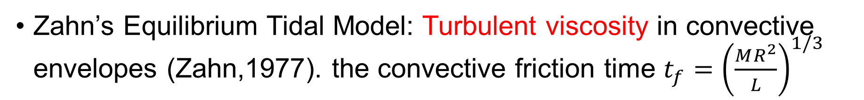
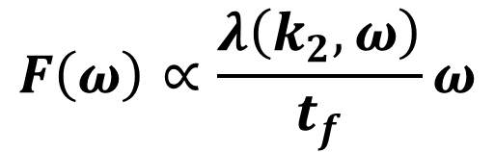
As a probe of the interior of star
Zahn’s Equilibrium Tidal Model: Turbulent viscosity in convective envelopes (Zahn,1977). the convective friction time $t_{f}={\left(\frac{MR^{2}}{L}\right)}^{1/3}$
$$F\left(ω\right)∝\frac{λ\left(k_{2},ω\right)}{t_{f}}ω$$
For companion of PSR J1227-4853, the spin and temperature is measured(De Martino 2014), thus Love Number can be estimated $k_{2}=0.31±0.04$ with $t_{f}∼0.26 year$, which is a reasonable value for MS.

Slide 15
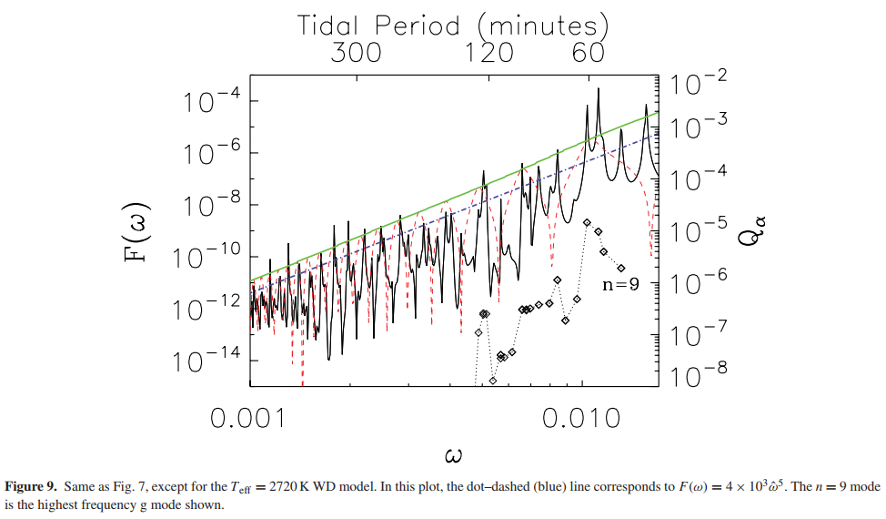
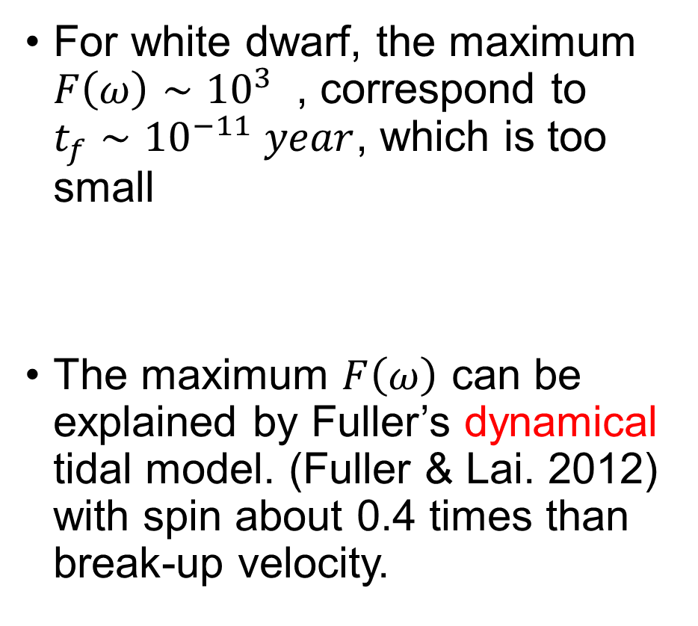

Tidal Model for white dwarf
For white dwarf, the maximum $F\left(ω\right)∼{10}^{3}$ , correspond to $t_{f}∼{10}^{−11} year$, which is too small
The maximum $F\left(ω\right)$ can be explained by Fuller’s dynamical tidal model. (Fuller & Lai. 2012) with spin about 0.4 times than break-up velocity.
$$F\left(ω\right)∝ω^{5}$$
(Fuller & Lai 2012)

Slide 16
General Tidal Model
In almost all tidal model
Our result implies
There is a correlation between tidal frequency and orbital frequency.
We guess it’s coming from recycled stage of MSP binaries

Slide 17
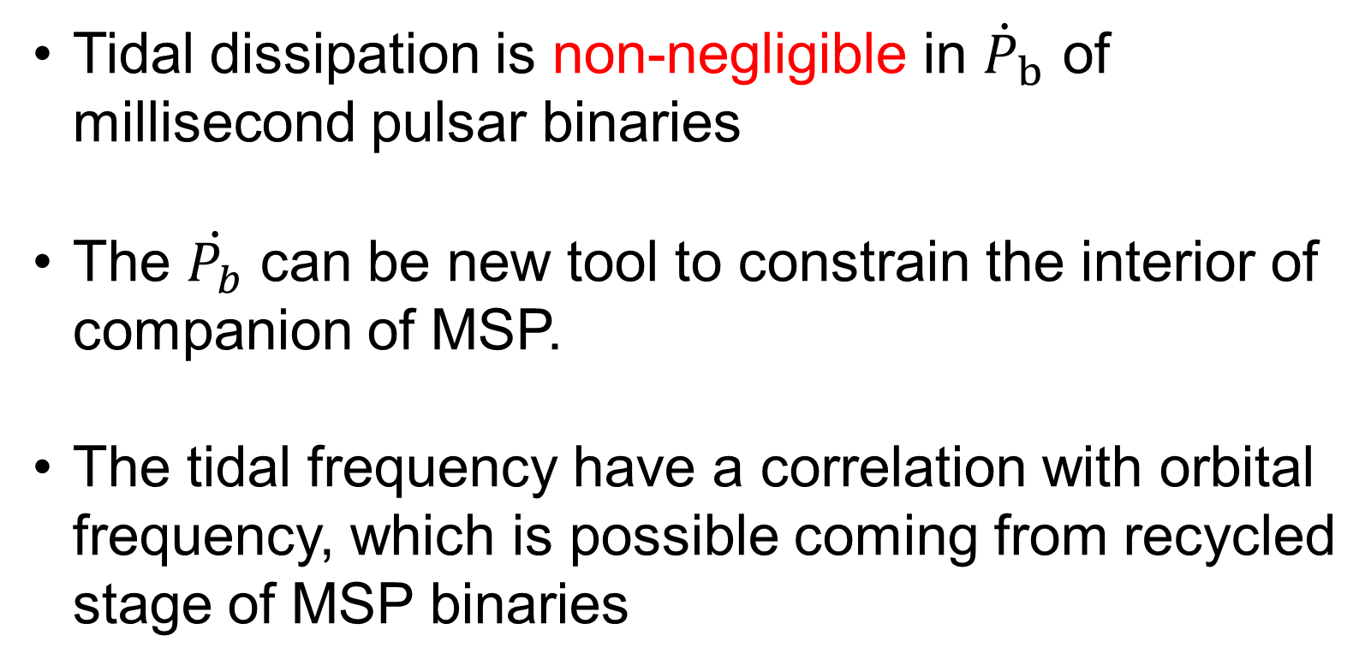
Summary
Thanks !
Tidal dissipation is non-negligible in ${\dot{P}}_{b}$ of millisecond pulsar binaries
The $\dot{P_{b}}$ can be new tool to constrain the interior of companion of MSP.
The tidal frequency have a correlation with orbital frequency, which is possible coming from recycled stage of MSP binaries

