Slide 1
RADIO OBSERVATIONS OF PULSARS J1841-0500, J1832+0029, J1634-5107 and J1938+2213
王双强， 王晶波，王娜, G. Hobbs, S. Dai,
M. Kerr, R. Shannon, V. Ravi, R. Hollow
中国科学院新疆天文台
2019年6月26日

Slide 2
Outline
Background
Radio observations and results
Intermittent pulsar J1841-0500
Intermittent pulsar J1832+0029
Nulling pulsar J1634-5107
Bursting pulsar J1938+2213
Summery

Slide 3
Pulsar
Pulsar is formed during the core collapse supernova explosion of the massive star.
Wide-waveband emission: radio, optical, infrared, X-ray, gamma ray.
Most of them have radio emissions.
The radio emissions are from their polar gaps

Slide 4
Nulling
In 1970, pulsar nulling was first noted by Backer (1970).
Nulling: the pulse appears to cease suddenly on timescales of several pulse periods to many hours, even days, and then switch back on again.
Wang et. al 2007

Slide 5
The intermittent pulsar
Show normal pulsar emission properties for a period of time (ON phase) and then switch OFF and back ON again, with cycle times measured in days or even years. (Lyne et. al 2017)
It gives quantitative information on the strengths of the magnetospheric electric currents that generate the pulsar’s pulsed radiation. (E. P. J. van den Heuvel 2006)
First discovery: Kramer et. al in 2006, 76-m Lovell Telescope (Kramer et. al 2006)
Five are known: B1931+24, J1841−0500, J1832+0029, J1910+0517, J1929+1357. (Lyne et. al 2017)
Kramer et. al 2006

Slide 6
Mode changing
Mode changing: the average pulse profile of pulsars abruptly change between two or more states from time to time
Nulling can be thought to be an extreme case of mode changing
both nulling and mode changing have been studied in more than 200 pulsars.
PSR B0826-34 (Esamdin et. al 2012)

Slide 7
The bursting pulsar
The bursting pulsar: the emission increases sharply in the observation, then it tends to drop off from pulse to pulse dramatically.
They bear some similar to the nulling pulsars, which may indicate that nulling result from telescope’s sensitively.
These emission behaviors are only seen in a few pulsars: J1752+2359 (Lewandowski et al. 2004), J1938+2213 (Lorimer et al. 2013) and B0611+22 (Seymour et al. 2014).

Slide 8
The pulsars
J1841−0500: the second intermittent pulsar, approximately on for 400 d and then off for 580 d, Green Bank Telescope (Camilo et. al 2012).
J1832+0029: the third intermittent pulsar, approximately on for 600 d and then off for 800 d, Parkes 64 m and Lovell 76 m radio telescopes (Lorimer et. al 2012).
J1634−5107: a quasi-periodical nulling pulsar, the time scales of the “on” and “off” phases are about 1 and 9 days, respectively, (O’Brien et al. 2006 ).
J1938+2213: unusual emission properties (the bursting emission), Arecibo telescope, (Lorimer et. al 2013)

Slide 9
PSR J1841-0500
Parkes radio telescope.
From 2011 September 02 (MJD 55806) to 2018 April 02 (MJD 58210), total 73 observations,
53 search modes and 20 fold modes

Slide 10
Timing
After May 2014,
almost 4 yrs

Slide 11
Single pulse
P3~18 pulse periods.
a quasi-periodic fluctuation

Slide 12
PSR J1832+0029
Parkes radio telescope.
From 2005 April 28 (MJD 534888) to 2018 April 02 (MJD 58210)
totally 131 individual detections (65 search modes and 66 fold modes)

Slide 13
Timing

Slide 14
Detected
The emission is not stable.
In the same observational frequencies and integral time, the pulsar was not always be detected.
In simultaneous observations, it may only be detected in one frequency.
More sensitive telescopes are needed, such as: FAST, QTT.

Slide 15
Flux
$α$=-0.84±0.48
The mean flux densities at 0.7 (square), 1.4 (circle) and 3.1(triangle) GHz are 0.21 ± 0.15, 0.25 ± 0.16 and 0.06 ± 0.04 mJy.

Slide 16
Weak emission
During the second off phase as noted by Lorimer et al. 2012 (MJD 55293-56128), the pulsar was detected.
Not absolutely shut down!

Slide 17
Single pulse search
we carried out the single pulse search campaign at the observations which there is no obvious accumulated pulse profile and found that there may exist sporadic emission.

Slide 18
PSR J1634-5107
Parkes radio telescope.
From 2005 August 24 (MJD 53606) to 2018 April 02 (MJD 58210)
totally 339 individual detections (165 search modes and 183 fold modes)

Slide 19
Results
Nulling fraction (NF) :
82 ± 9 per cent at 0.7 GHz
70 ± 6 per cent at 1.4 GHz.
The similar forms of these two curves suggest that the fraction of observations when the pulsar is active is unchanging.
DET
OBS

Slide 20
FLUX
Squares- 1.4 GHz and circles - 0.7 GHz
1.4 GHz : 0.51 mJy
0.7 GHz : 0.37 mJy

Slide 21
Bursting emission
RRAT-like emission.
The burst rate is about 3.6% with the 1-5 pulse periods duration time. most bursts (larger than 99%) last 1 pulse period.
A nearby RRAT, like PSR B0656+14?

Slide 22
PSR J1938+2213
Three observational frequencies, the observations at 732 and 3094 MHz
are simultaneous.

Slide 23
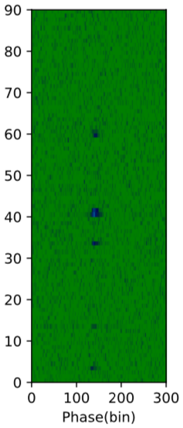
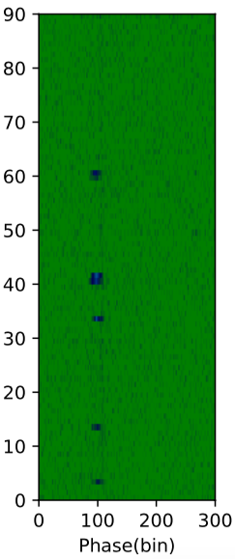
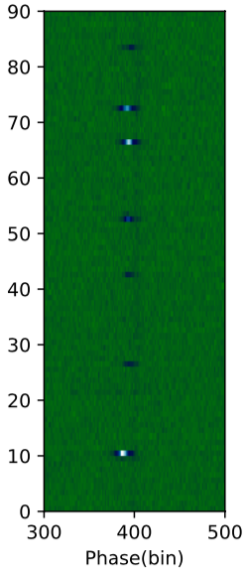
Flux
The flux density in bursting state is dozens of times that of normal state.
Mean flux densities: 732MHz: 2.08mJy, 1369 MHz: 1.11mJy, 3094MHz: 0.58 mJy
Simultaneous
.

Slide 24
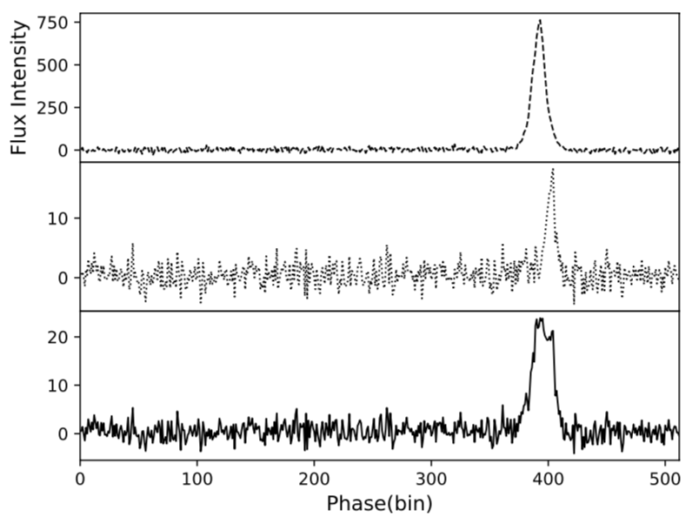
Profiles
3.4 degrees at 732 MHz
6.1 degrees at 3094 MHZ
7.1 degrees at 1369 MHz

Slide 25
The burst rate
1.1 percent at 1.4 GHz
Last for 1-38 pulse periods.

Slide 26
Switch patterns

Slide 27
Polarization
The fractional linear polarization in bursting state is higher that that in normal state.
The circular polarization is low in both states.

Slide 28
Summary
J1841-0500
The cycle time of the on/off phase is not quasi-periodic.
In on phase, it has a have a quasi- periodic fluctuation with the modulated period in the range of 18 − 33 pulse periods.
J1832+0029
The emission is not stable, more sensitive telescopes are needed.
We found weak emission during off states.
J1634-5107
We detect pulse emission at 0.7 GHz for the first time and obtained new nulling fraction at 0.7 GHz and 1.4 GHz, respectively.
We observe burst emission in on state with the 1-5 pulse periods duration time.
J1938+2213
It is observed simultaneously at the first time.
We analyze the phase offsets, the burst duration time, the switch patterns and the polarization at different frequencies.

Slide 29
References
Kramer, M., Lyne, A. G., O’Brien, J. T., Jordan, C. A., & Lorimer, D. R. 2006, Science, 312, 549
O’Brien, J. T., Kramer, M., Lyne, A. G., Lorimer, D. R., & Jordan, C. A. 2006, Chinese Journal of Astronomy and Astrophysics Supplement, 6, 4
Wang, N., Manchester, R. N., & Johnston, S. 2007, MNRAS, 377, 1383
O’Brien, J. T., 2010, PhD thesis, The University of Manchester
Camilo, F., Ransom, S. M., Chatterjee, S., Johnston, S., & Demorest, P. 2012, ApJ, 746, 63
Lorimer, D. R., Lyne, A. G., McLaughlin, M. A., et al. 2012, ApJ, 758, 141
Young, N. J., Weltevrede, P., Stappers, B. W., Lyne, A. G., & Kramer, M. 2015, MNRAS, 449, 1495
Lyne, A. G., Stappers, B. W., Freire, P. C. C., et al. 2017, ApJ, 834, 72

Slide 30
Thanks

