Slide 1
The backend for real-time monitoring of FRB at Tianma RT
Wu Yajun, Yan Zhen, Liu Qinghui, Zhu Renjie, Guo Shaoguang, Gang Jiangying, Xu Zhijun, Li Jiyun
FPS 8, Xi’an, 2019/06/26

Slide 2
Contents
Fast Radio Burst and Observations
Tianma Radio Telescope
The FRB Backend
  Hardware
  Pipeline in FPGA and CPU/GPU
  The control and communication
Test Observation
Conclusion and next step

Slide 3
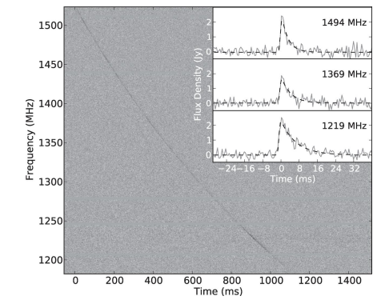
Fast Radio Burst
Short Bright radio pulses;
High Dispersion Measure(DM)
Observe:
  Origin;
  Frequency range
  Repeating
  Polarisation
  …
FRB110220 Thornton(2013)

Slide 4
Observations of FRB
Telescope | FRBs | Frequency(MHz)
UTMOST | 10 | 835
Parkes | 29 | 1352
CHIME | 14 | 600
ASKAP | 25 | 1300
Pushchino | 3 | 111
Arecibo | 2 | 1375
GBT | 1 | 800
From frbcat
FRB121102: Arecibo(1375MHz), GBT(6407MHz)
FRB180814.J0422+73: CHIME

Slide 5
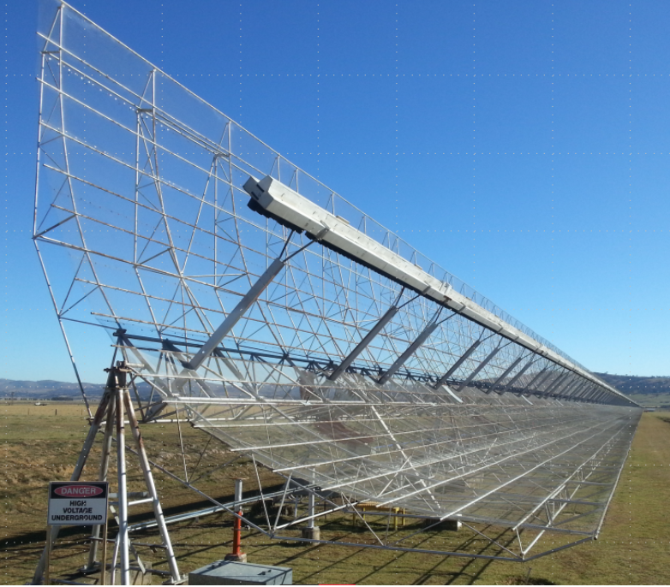
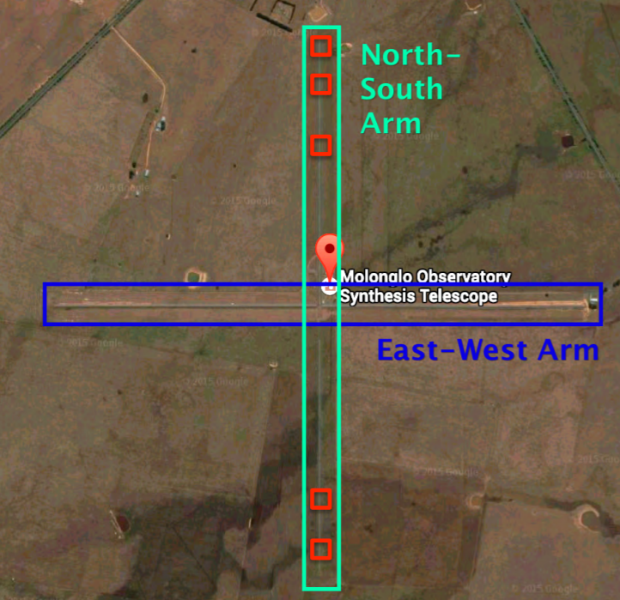
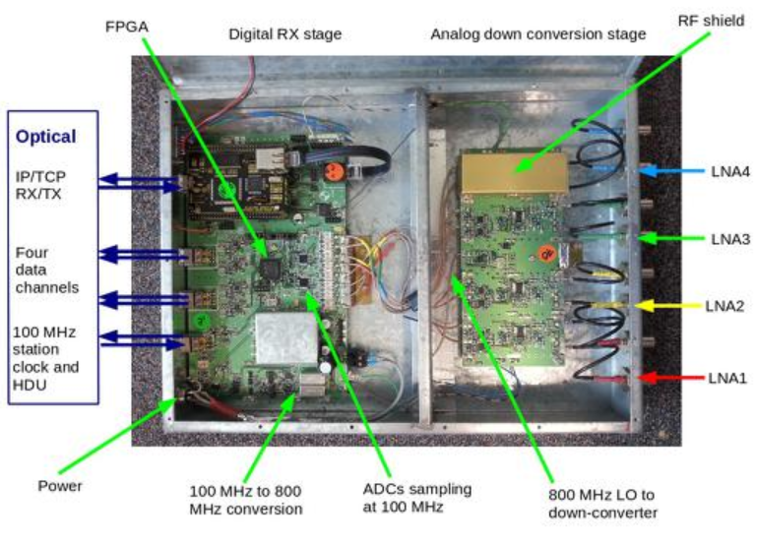
The telescope for FRB: UTMOST
352 antennas;
Arcsecond-level FRB localisation

Slide 6
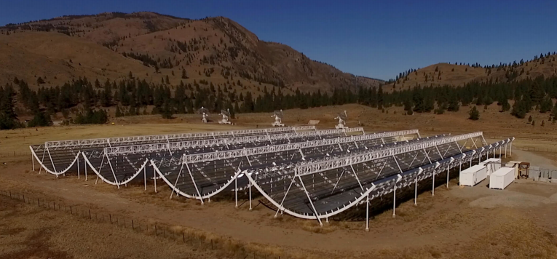
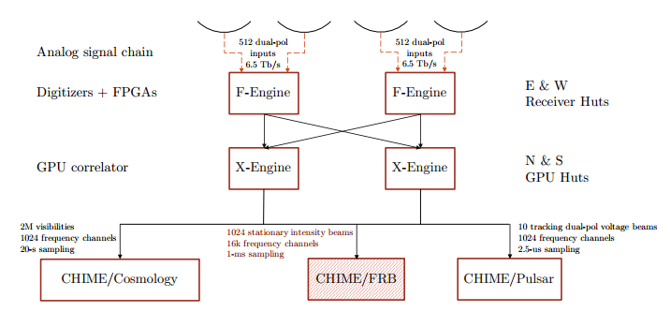
The telescope for FRB: CHIME

Slide 7
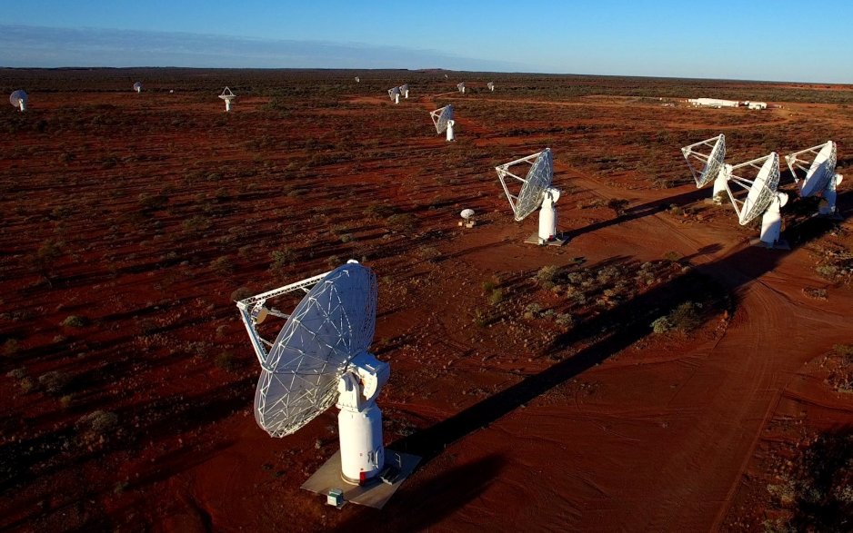
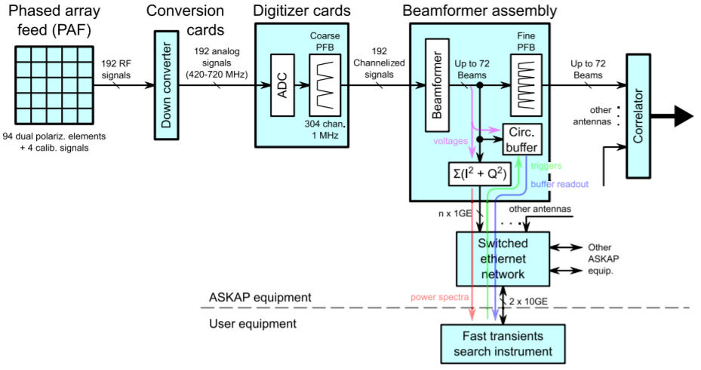
The telescope for FRB: ASKAP

Slide 8
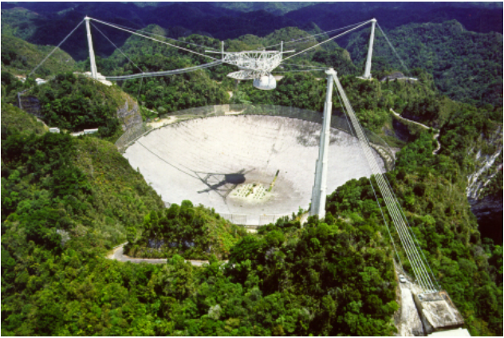
The telescope for FRB: Arecibo
Arecibo L-band Feed Array
SETIBURST back-end
ARTEMIS automated, real-time pulse detection;

Slide 9
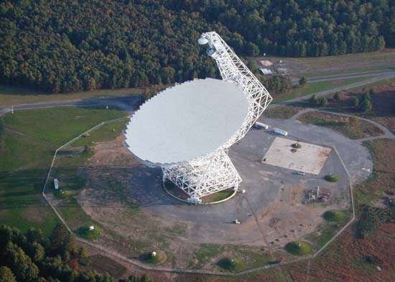
The telescope for FRB: GBT
GreenBurst: 960-1920 MHz, single pixel;
obtain data all time
The Roach II and GPU for data pipeline;

Slide 10
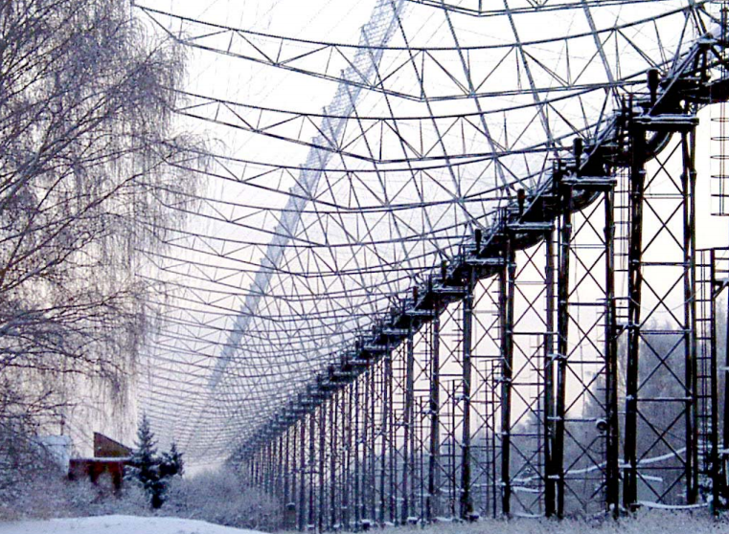
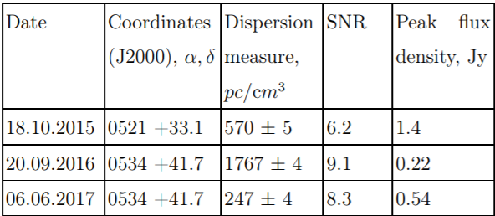
The telescope for FRB: Pushchino
Frequency: 111 MHz; BW 2.5 MHz
50 squaredegree

Slide 11
Tianma Radio Telescope: Signal link
Specification:
frequency: 1-50 GHz, 8 band;
Pulsar; Spectroscope; Continuum; VLBI；

Slide 12
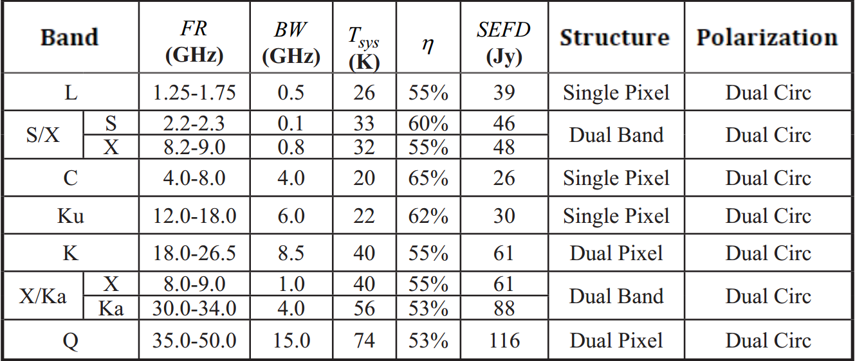
Tianma Radio Telescope: Performance

Slide 13
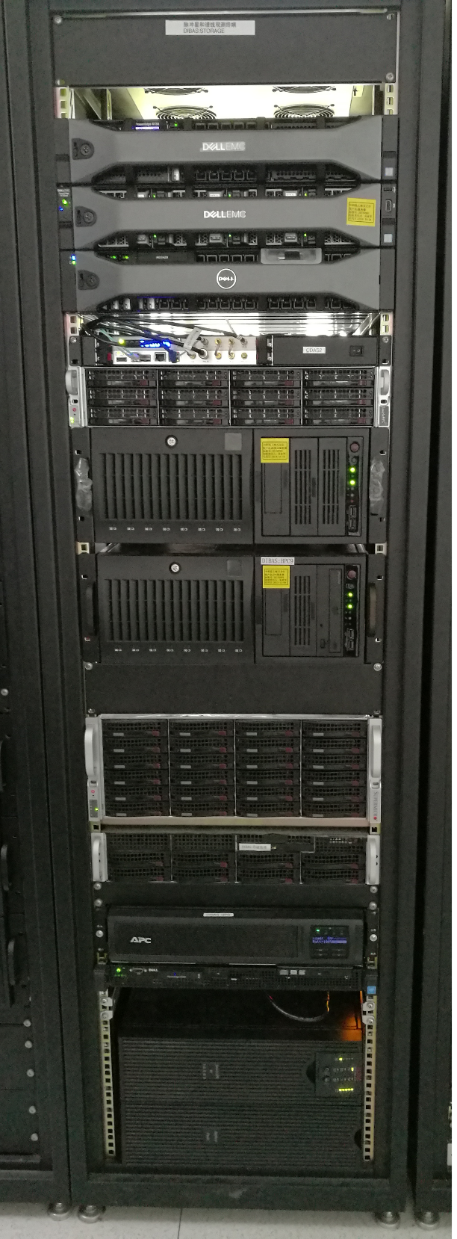
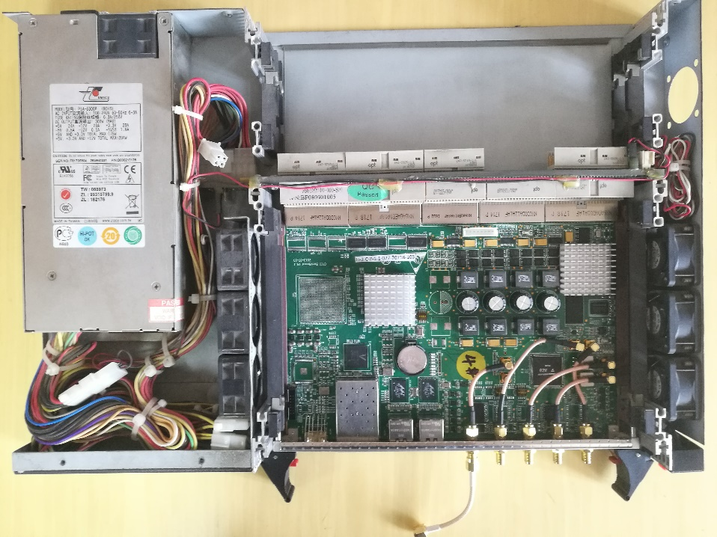
The FRB Backend: hardware
采用主流ADC+FPGA+GPU的数字化终端结构
Dual Channel 1Gsps ADC, 8-bit;
Xilinx K7480t FPGA
10Gb Ethernet for data
H-maser for timing
Intel® Xeon® Processor E5 2.2GHz 28 core;
128G DDR Ram
GeForce GT 1030 GPU
40 TB storage
GPU Storage Server

Slide 14
The Backend: Pipeline
Real-time pipeline:
FFT: 1024 Channels
Clean RFI: clean frequency range
De-dispersion: GPU
Detect: the statistic for the DM-time series
FPGA
CPU/GPU

Slide 15
The Backend: 24 hours monitoring
The information required for pipeline
  Telescope: AZ/EL, transformed to RAJ/DEC, filterbank;
  Receiver: clean frequency range;
  Up Down Converter: frequency range, De-dispersion;
Program of communications with control
  Receiver or frequency changes, the pipeline re-initiation;
  Information refresh every second;

Slide 16
The Backend specifications
Two polarizations: stokes I detection and output; I/Q/U/V output possible;
Bandwidth: max 512 MHz;
Channels: 1024, 0.5 MHz/channel;
Time resolution: 200 us;
Data rate: 5MB/s for I; 20 MB for I/Q/U/V; depends on computer;
DM count: 400, DM(0-2000);
Output: filterbank for data; ps file for result;

Slide 17
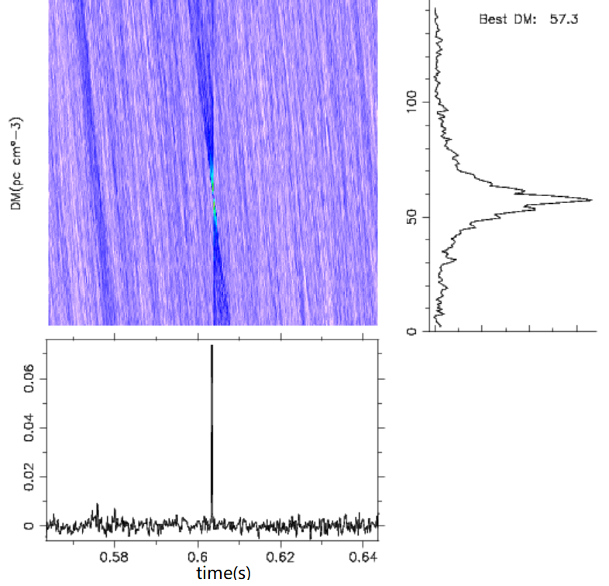
Test Observation: post pipeline
Giant Pulse of B0531+21
Record the data, then pipeline
S band, clean at 2180-2280 MHz

Slide 18
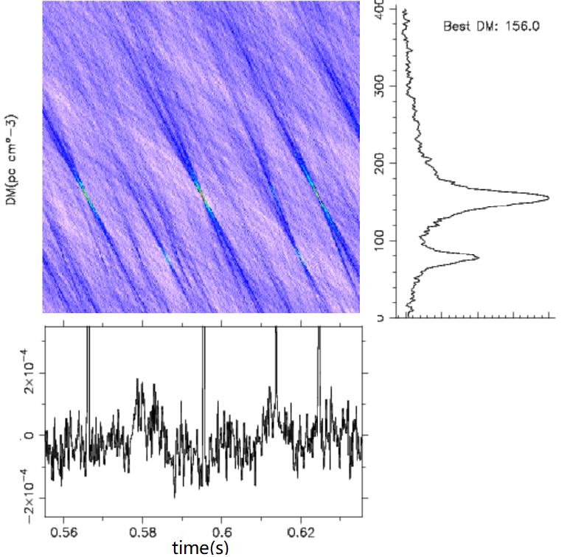
Test Observation: real time
Real time pipeline
Full S band, 2100-2400 MHz
RFI leads to false detection

Slide 19
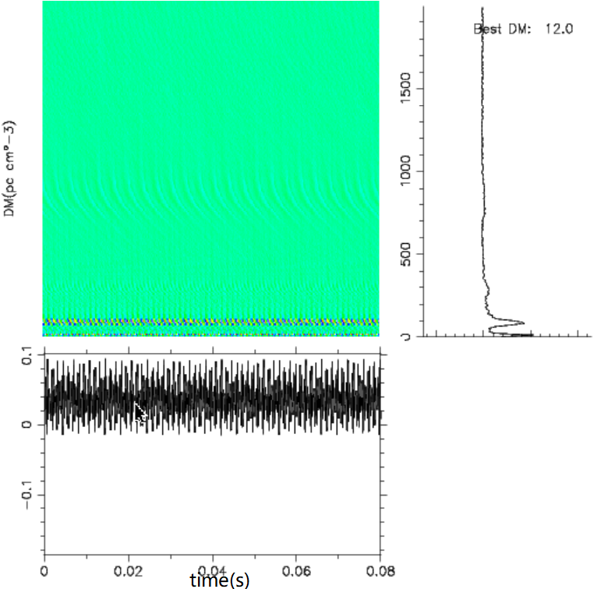
Test Observation: real time
Real time pipeline
C band: 4590-4950MHz(clean band)
No detection for serval days
The performance of C bad is very good

Slide 20
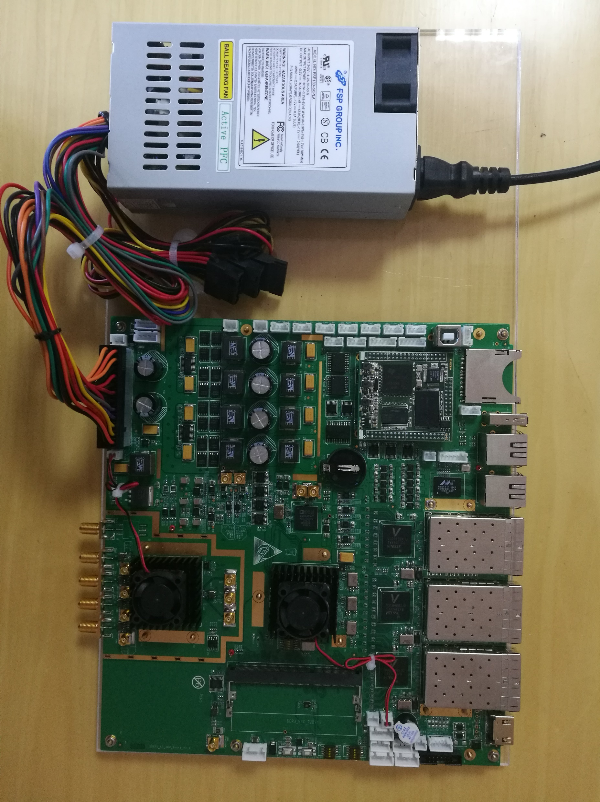
New hardware: upgrade in plan
One channel 5 Gsps ADC or Dual Channel 2Gsps ADC, 10-bit;
Xilinx K7480t FPGA for signal processing
6 X 10Gb Ethernet for data transmission
Arm/Linux for control;
16 GB DDR3 for burst data storage;
Keep working to upgrade the FRB backend

Slide 21
Conclusion and next step
The real time FRB backend is automated working at Tianma radio telescope, with basic RFI mitigation;
  Max 500 MHz, 200 us, 1024 channels;
Way of detection should be upgraded: detection rate; accurate DM;
RFI detection and mitigation;
2GHz bandwidth, for S/C/X band;
The time resolution(200 us to 20 us) and frequency resolution(1024 channels to 8192 channels);
Incoherent de-dispersion to coherent de-dispersion, prepare for Low frequency observation.

Slide 22
Thanks for Attentions!
Welcome for advices and Comments!

