Slide 1
Merging strangeon stars:
the ejecta and light curves
Xiaoyu Lai 来小禹
Department of Physics and Astronomy, HUE
Collaborators: Chengjun Xia (NIT, ZJU), Renxin Xu (PKU)
FPS9@xmu
2020/08/28-2020/08/30

Slide 2
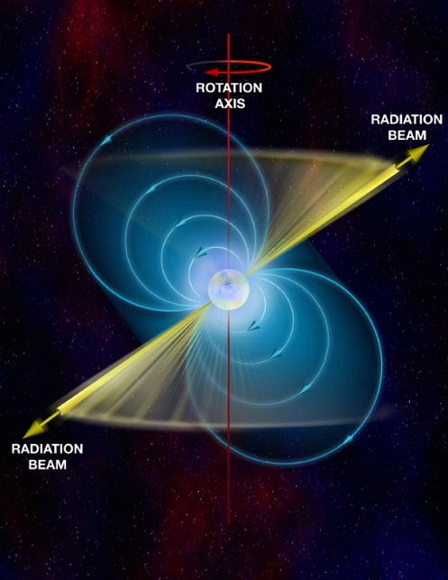
u
d
crust
d
u
d
u
d
d
?
d
Landau的巨大原子核＋壳层
中子星
neutron stars
u
d
脉冲星的本质？
d
u
d
u
夸克星
quark stars
d
s
s
s
u
Witten猜想：
三味(u+d+s)夸克物质可能
比两味(u+d)物质更稳定
s
d
d
u
s
d
s
u
d
u
巨大的强子
u
u
s
d
s
奇子星
strangeon stars
d
u
非微扰QCD效应
→ 三味夸克禁闭在奇子中
u
s
u
s
u
d
d
d
d
s
s
s
d
u
s
d
u
巨大的奇异原子核

Slide 3
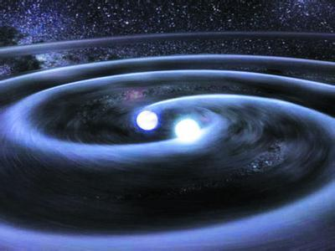
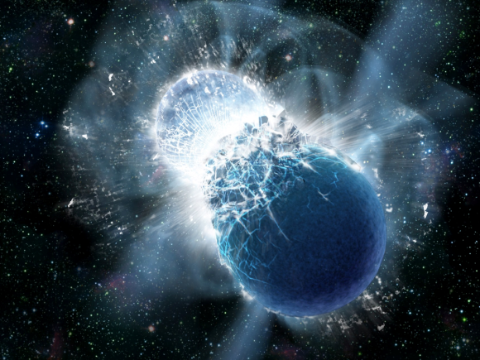
Merging binary stars
Tidal deformability from GW detection
  A clean dynamical test for EoS
EM counterpart: kilonova （千新星）
  Indirect (?) test for EoS

Slide 4
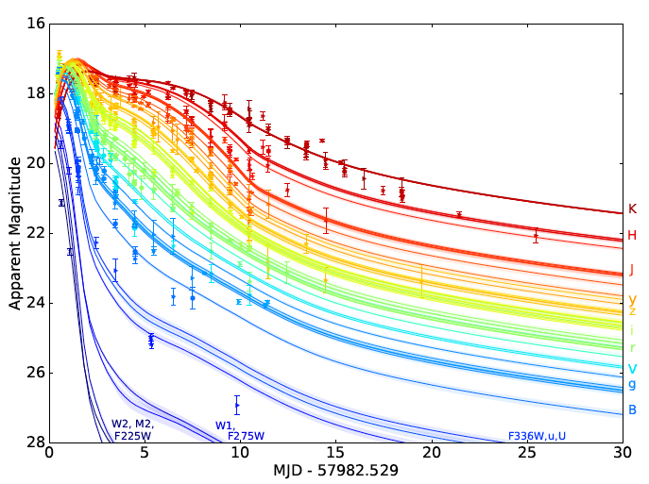
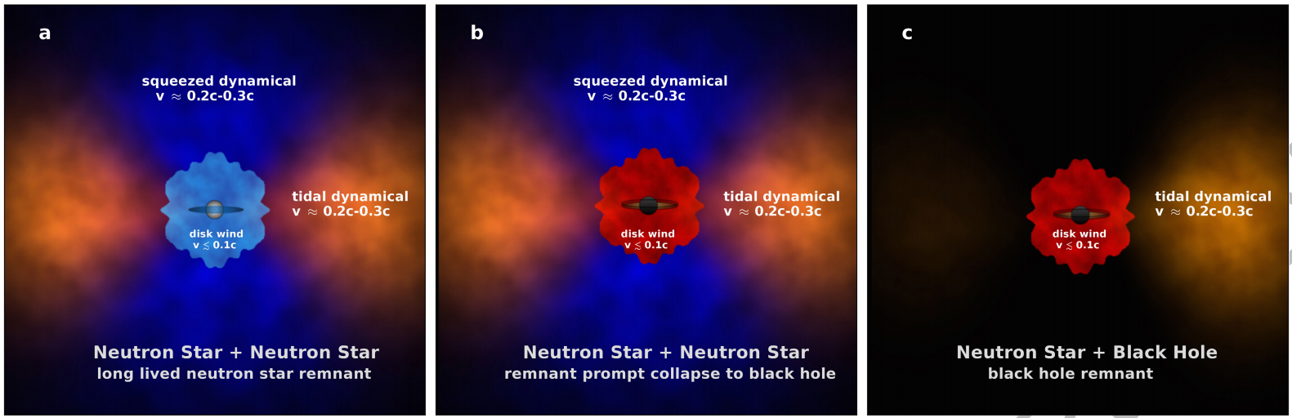
Kilonova
AT2017GFO
Gao et al. 2013
Villar et al. 2017
Kasen et al. 2017

Slide 5
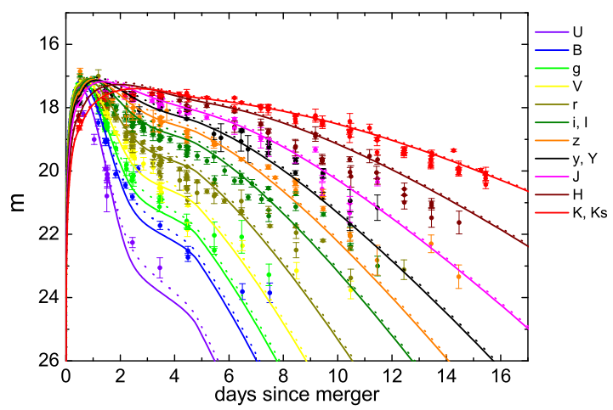

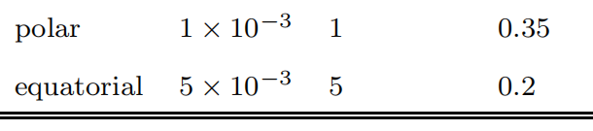
A long-lived NS powered AT2017GFO ?
Li, Liu, Yu and Zhang, 2018, ApJL, 861, L12

Slide 6
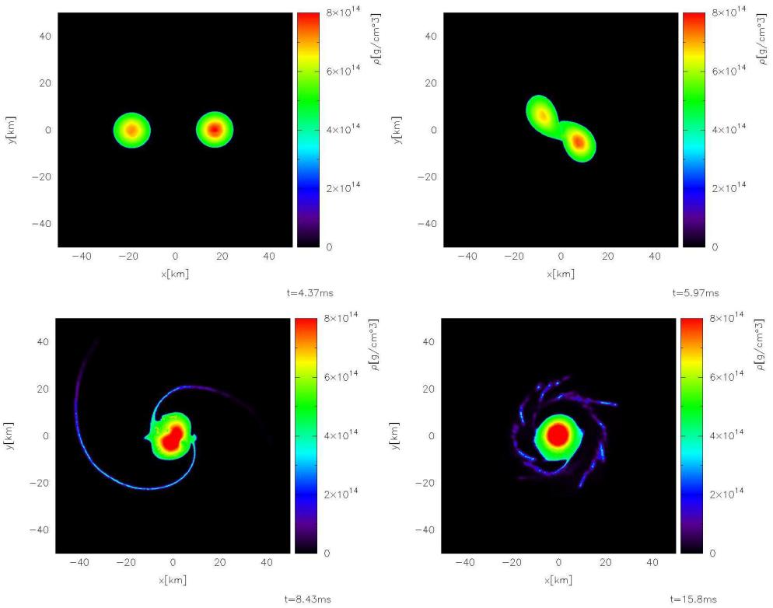
Binary Quark Stars: 1.2 M_{ʘ} + 1.35 M_{ʘ}
M_{ejecta} ≈ 0.004 M_{ʘ}
M_{torus} ≈ 0.08 M_{ʘ}
Bauswein, Oechslin, and Janka, 2010, PRD, 81, 024012

Slide 7
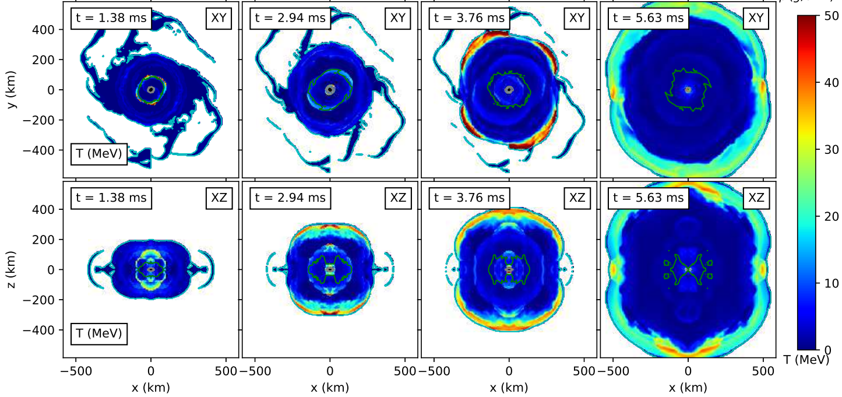
Shocks (generated by the oscillations of the remnant) can heat the ejacta of BNS:
De Pietri, Drago, Feo, et al., 2019, ApJ., 881, 122

Slide 8
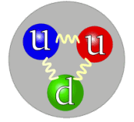
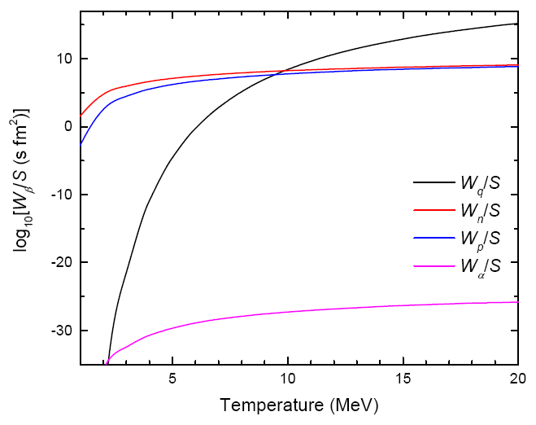

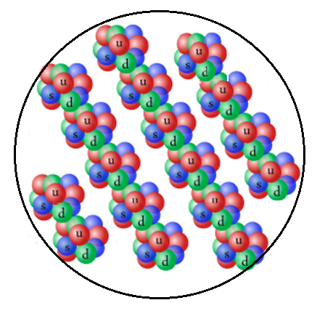
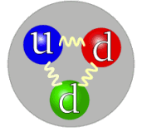
Evaporation of strangeon nuggets
At T ~ 20 MeV, the nuggets with A₀ < 10³⁶ would totally evaporate into strangeons within ~ 1 ms
At T ~ 5 MeV, the nuggets with A₀ < 10²⁵ would totally evaporate into neutrons within ~ 10 ms

Slide 9
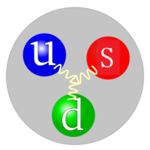
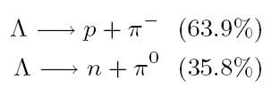
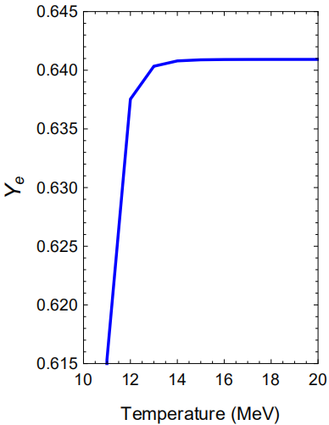
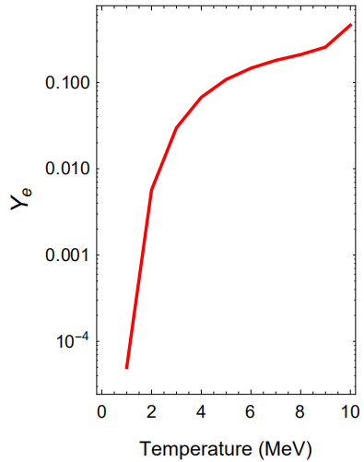
Decay of strangeons
Λ particles
丰质子

Slide 10
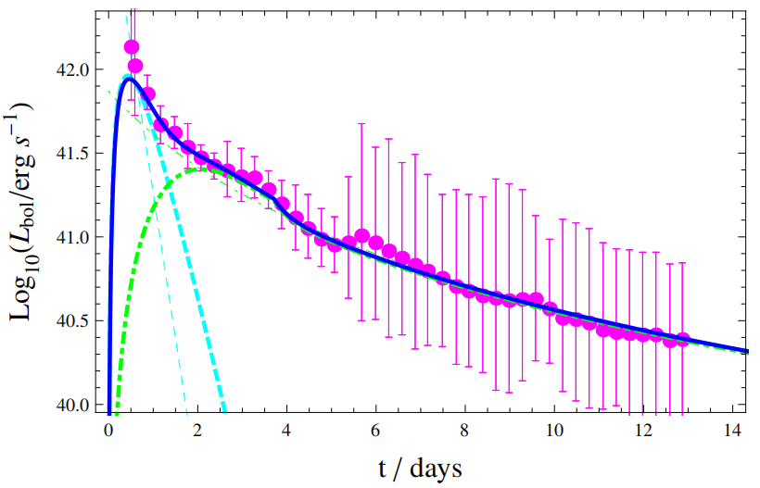
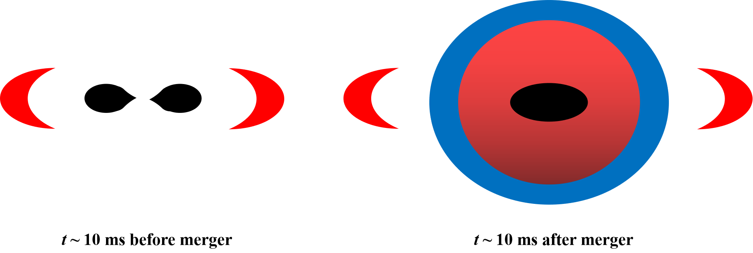
Strangeon kilonova
Lai, Yu, Zhou, Li and Xu,
2018, RAA, 18, 024
Ejecta from tidal disruptions
  Low Y_{e}
Ejecta from shock heating
  High Y_{e}

Slide 11
Conclusions
Merging double strangeon stars could reproduce both the red and blue components of kilonova
Discussions
How to distinguish NS-NS and SS-SS mergers?
The effect of the long-lived remnant ?
The survived strangeon nuggets would perform like ultra high energy cosmic rays ?

