Slide 1
Pulsar Coherent De-dispersion Technology
Li,hao
National Time Service Center(国家授时中心)
University of Chinese Academy of Science
Collaborators:Luo,jintao；Pan,zhichen
Aug.29,2020
Notes:
亮亮图文旗舰店https://liangliangtuwen.tmall.com

Slide 2
Outline
Background
Research on Related Technologies of
Coherent De-dispersion
Summary

Slide 3
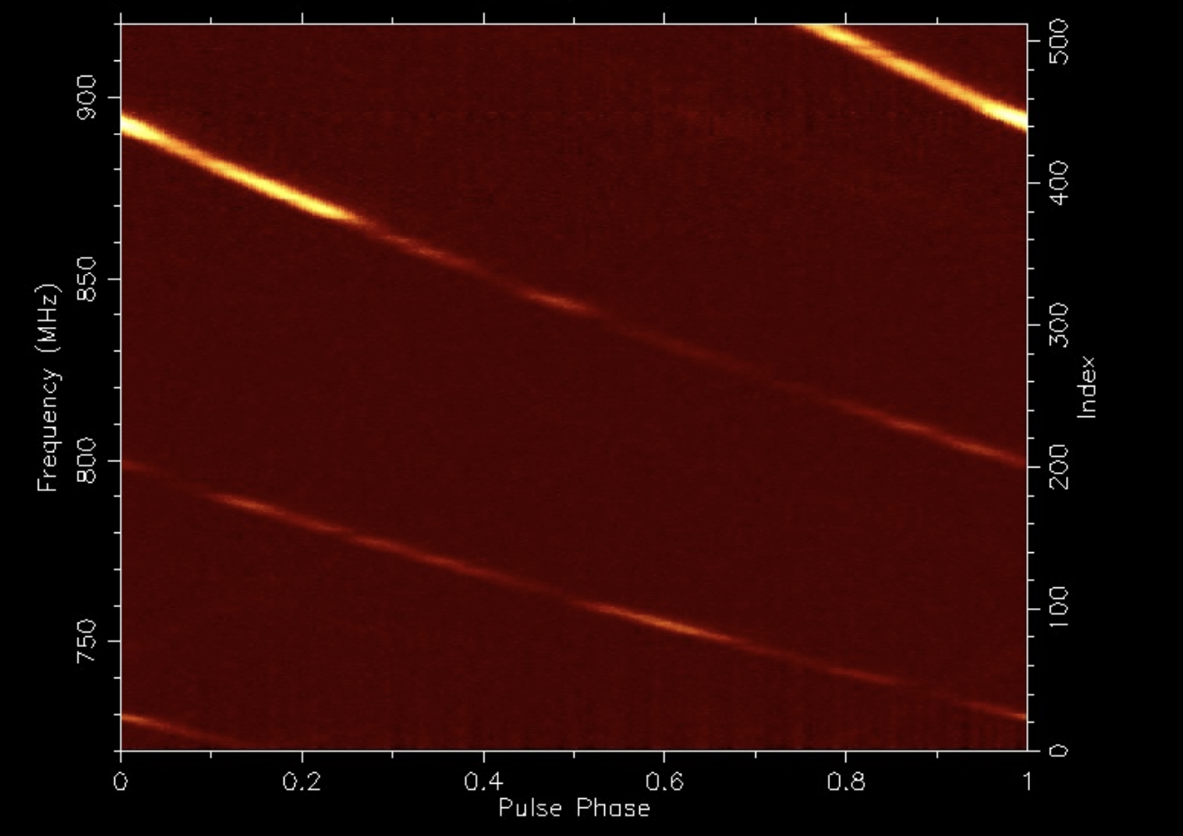
Pulsar signal characteristics
Short and stable pulse period
1ms-10s
Millisecond pulsar period change rate:（10⁻¹⁹ -10⁻²¹ )
Weak signal strength，wide signal bandwidth
Most pulsars S1400 is at the mJy level
Radio signal covers approximately 10MHz-100GHz
Interstellar medium influence
Dispersion-pulse profile broadening
Flicker effect-pulse intensity change
Scattering-pulse delay, broadening

Slide 4
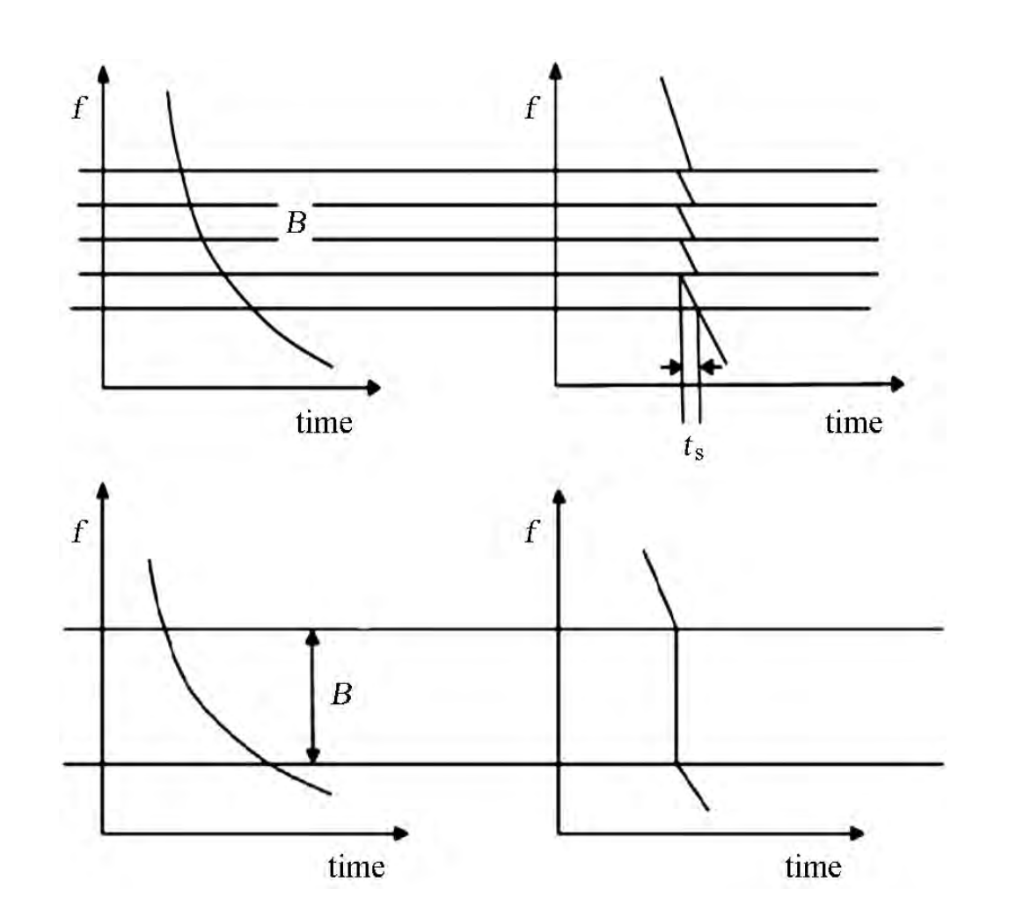
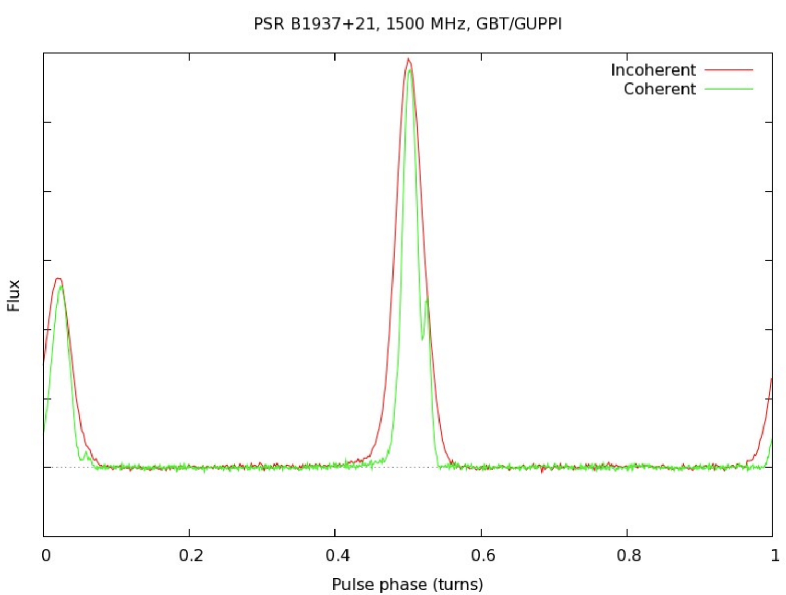
STAIRS I H et al.2000
Schematic diagram of incoherent de-dispersion and coherent de-dispersion．
Paul Demorest et al.2010

Slide 5
De-dispersion effect is more thorough
Algorithm is simple
Keep the original data phase difference, time resolution
Use subsequent identification to eliminate interference
Carry out research on the radiation characteristics of ultra-high time resolution pulsars
Large amount of calculation (floating point operations)
Long data processing cycle
High-speed, massive data receiving and processing
More powerful data processor server/cluster
De-dispersion algorithm operating efficiency

Slide 6
Terminal |  |  | DSP | 消色散 | Terminal |  |  |  | DSP | 消色散
XAO 26m | VLBI |  | AFB+MK5A+CPU | 相干 | GBT | VEGAS |  |  | ROACH2+GPU | 相干
 |  |  |  |  | Parkes
 |  |  |  |  |  | DFB
 |  |  |  |  |  |  |  |  | FPGA+DSP
 | PDFB |  | ROACH2+GPU | 非相干 |  |  |  |  |  | 非相干
YNAO 40m | DIBAS |  | ROACH2+GPU | 非相干/相干 |  | CASPSR |  |  | IBOB+GPU +DSPSR +PSRDADA | 相干
 |  |  |  |  |  | BPSR |  |  | ROACH+GPU +DSPSR +PSRDADA
 | VLBI |  | DBBC+MARK5B +GPU | 相干
Tianma |  | DIBAS | ROACH2+GPU | 非相干/相干 | Effelsberg |  |  | PSRIX | ROACH+GPU | 相干
NTSC |  | HRT | ROACH2+GPU | 非相干/相干 | Arecibo |  | PUPPI |  | FPGA+CPU | 非相干/相干
NAOC | VLBI |  | FPGA+GPU | 相干
 | FAST |  | ROACH2+GPU | 非相干
关键词
关键词
关键词
关键词

Slide 7
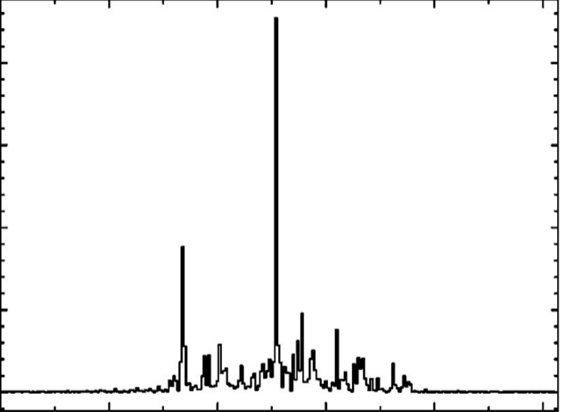
Data processing steps
60%
Li Jiagong el al.2014

Slide 8
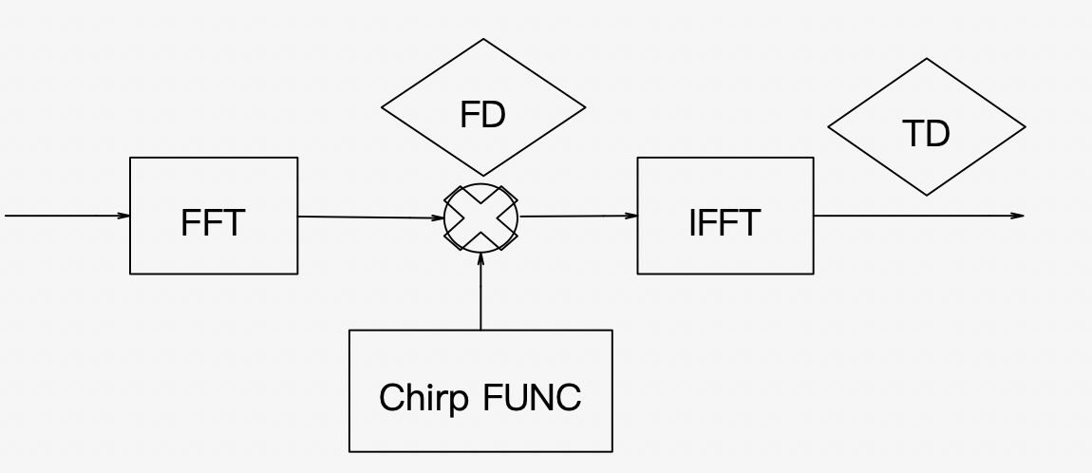
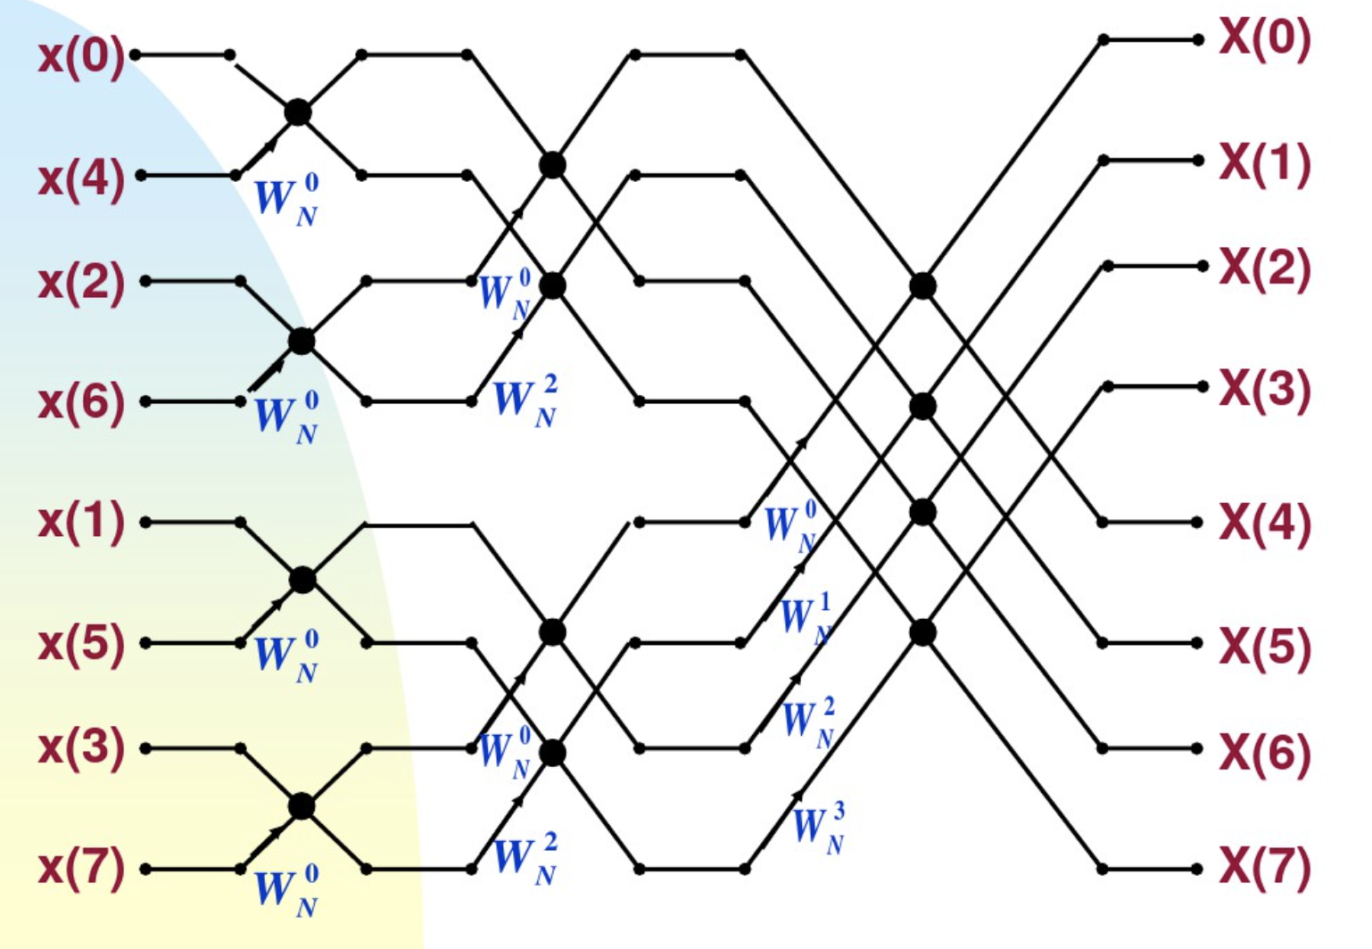
Principle of coherent de-dispersion algorithm
N-point FFT requires $（\frac{N}{2}\log_{2}{N}$）
complex multiplication

Slide 9
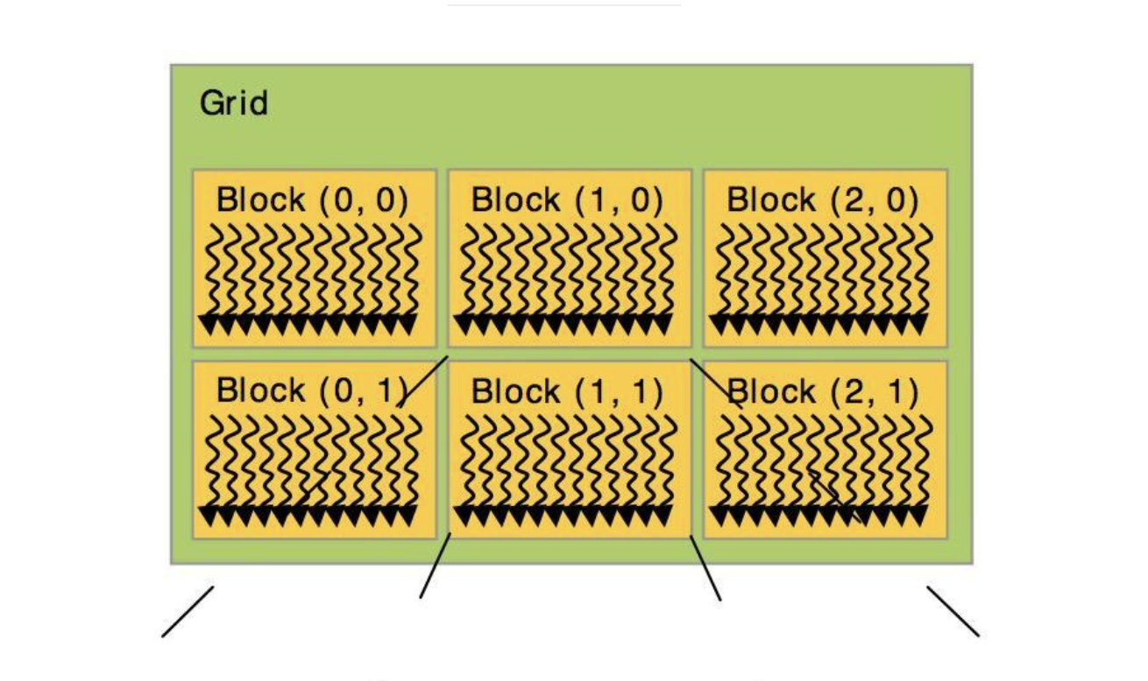
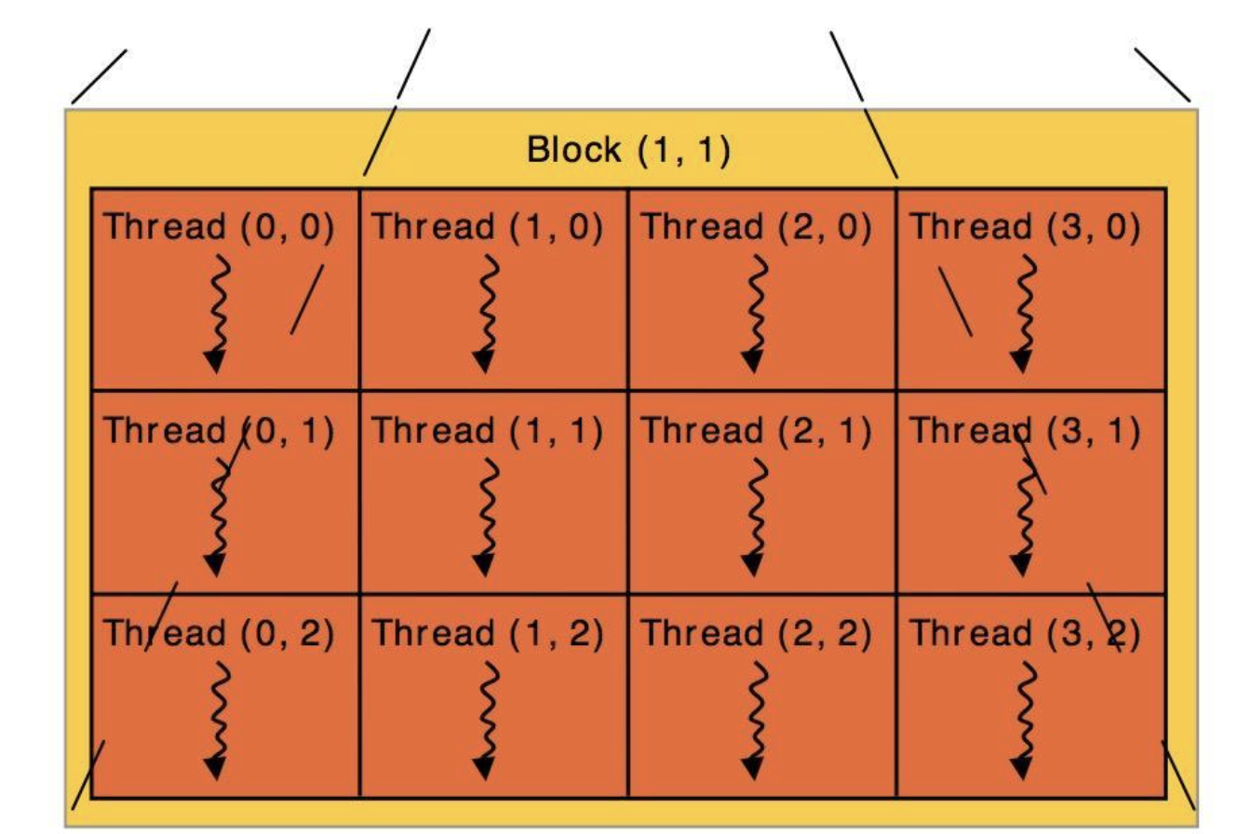
GPU+CUDA
CUDA is a general-purpose parallel computing platform and programming model launched by NVIDIA
CUDA provides a direct access interface for hardware, and adopts a new computing architecture to use the hardware resources provided by GPU
CUDA uses an extension of the standard C language as a programming language, providing a large number of high-performance computing instructions

Slide 10
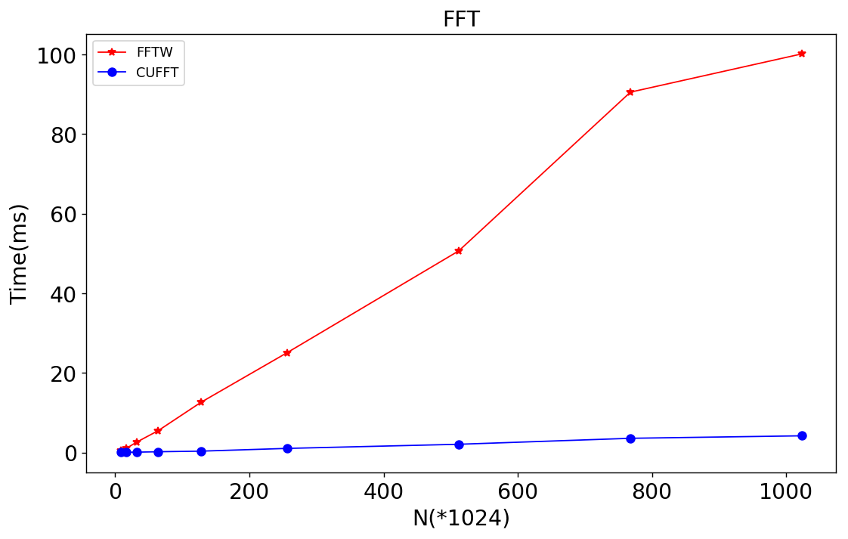
CUFFT and FFTW
Test environment
Device | Unit type
CPU | Inter(R) Xeon(R) W- 2123 CPU @ 3.60GHz
Total Memory | 64GB
GPU | GeForce GTX 1080
Global Memory | 8119MB
Cores（SM） | 2560
Max threads/block | 1024
Max threads/core | 2048
FFTW | fftw-3.3.8
CUDA | Driver/Runtime version 10.1/10.1

Slide 11
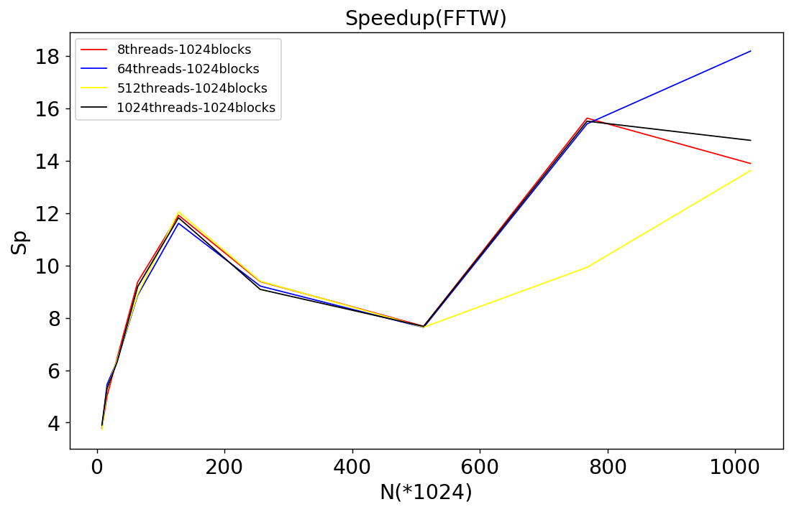
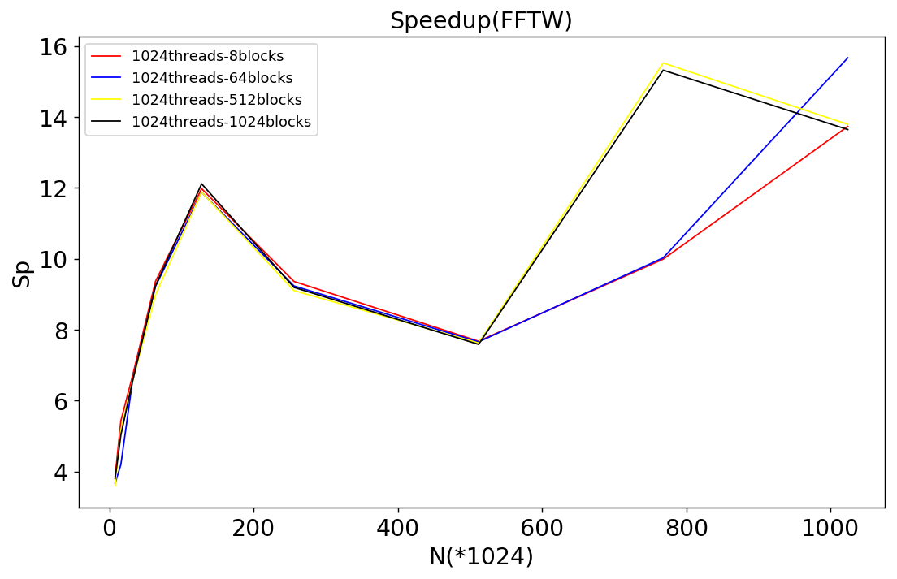

Slide 12
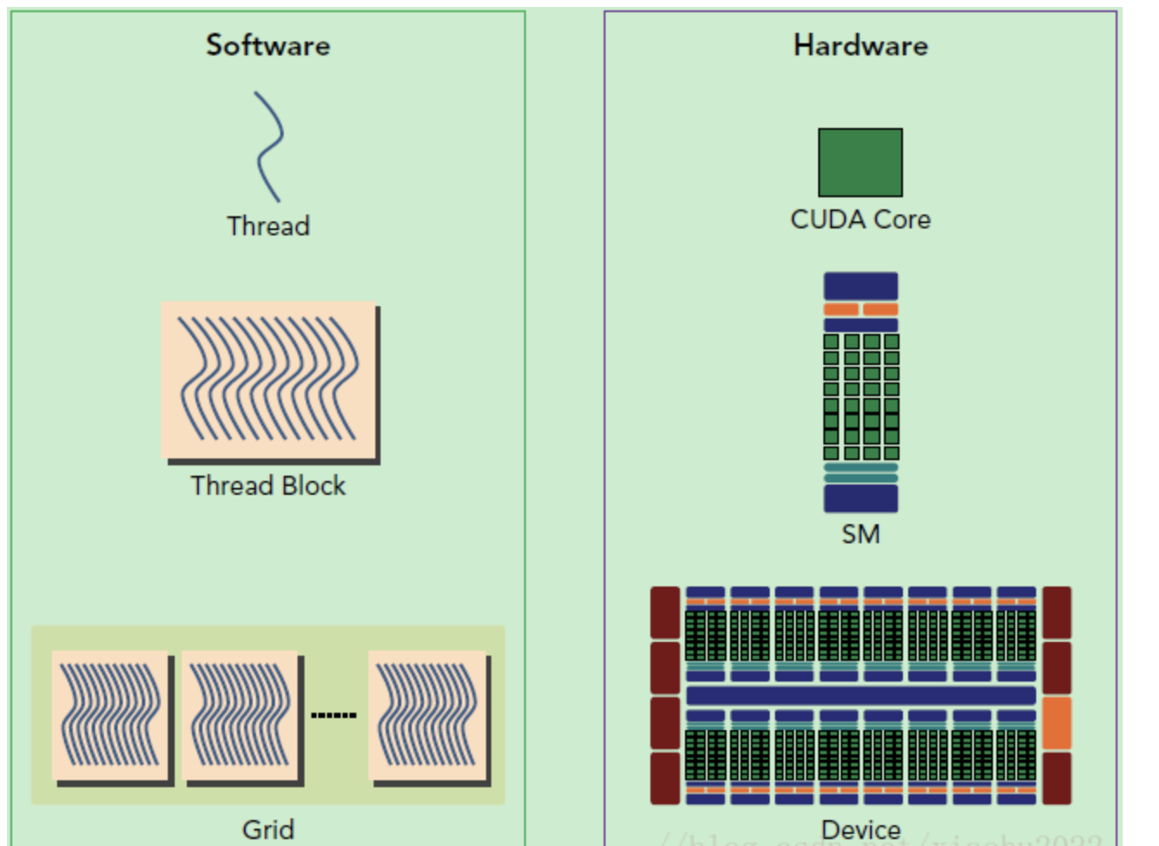
Result
Speedup ratios > 1
The overall trend is positively correlated, the larger the N, the GPU parallel computing power can also be reflected
About the fluctuation of the speedup：
GPU physical layer execution module Streaming Multiprocessor (SM)
The basic execution unit of SM is wraps, which contains 32 threads
SM must allocate shared memory for each thread block, but also allocate independent registers for each thread in the warp.
The configuration of SM affects the number of concurrent thread blocks and warps supported by it. The configuration of grid and block is different, the performance will be different

Slide 13
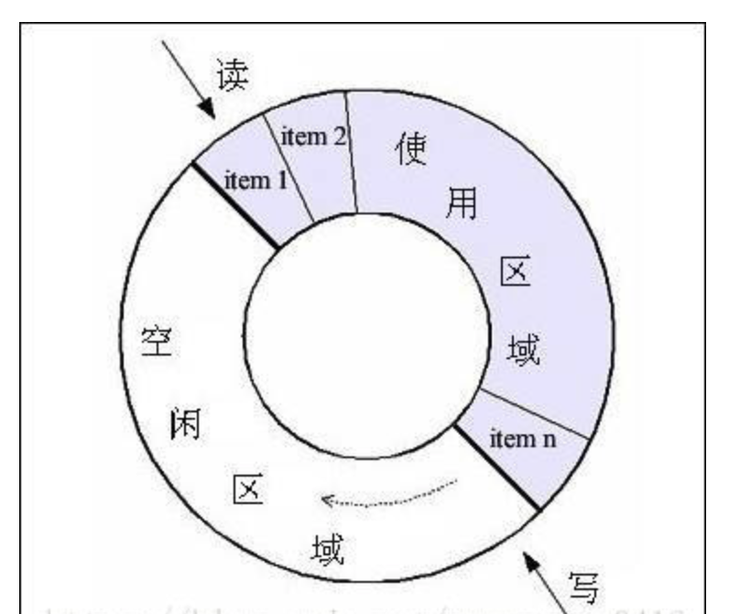
Psrdada
Open Source software project to support the development of data acquisition and distributed analysis systems.
Primarily in the implementation of baseband recording and processing instrumentation for pulsar astronomy.
PSRDADA is a flexible and well-managed ring buffer with a variety of applications for piping data from device to ring buffer and from ring buffer to device

Slide 14
Psrdada Pipeline
PSRDADA

Slide 15
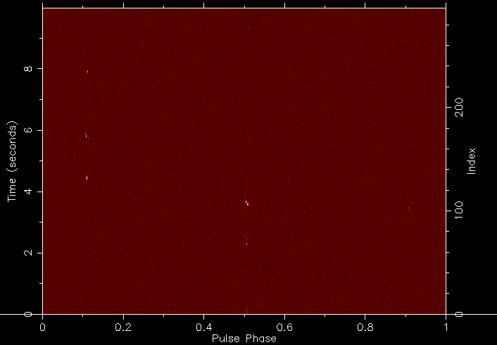
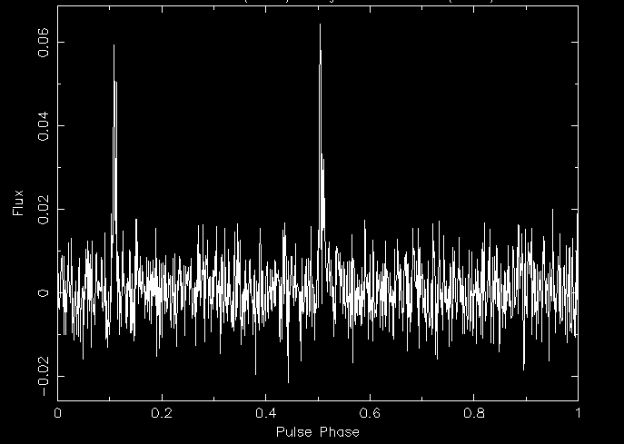
Psrdada pipeline result
20s (20GB) baseband data coherent de-dispersion processing result

Slide 16
Summary
Coherent achromatic dispersion is the most direct and thorough elimination technique for the dispersion effect of the interstellar medium
Realize the process of coherent de-dispersion
Research on FFT, the core algorithm of coherent achromatic dispersion, and use GPU parallel computing for comparison. The maximum speedup is about 18
Our further work in the future:
Parallel optimization of de-dispersion and folding process in Dspsr
Real-time ultra-wideband coherent dedispersive pulsar data processing
Seek technological breakthroughs in high-speed digital signal processing, massive data processing and analysis

Slide 17
Thanks ！
Notes:
亮亮图文旗舰店https://liangliangtuwen.tmall.com

