Slide 1
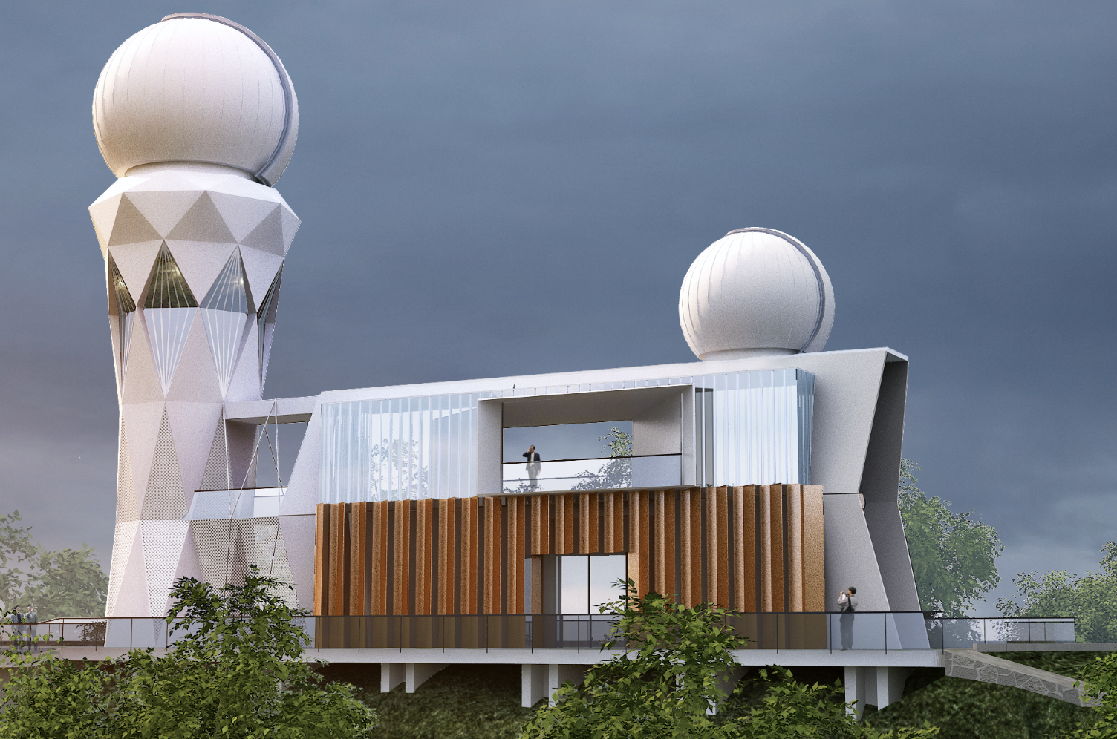
Coalescing Binary Neutron Star Systems under a Three-Dimension Gravitational-Wave Detector
Liu Mengxu
Supervisor: Gong biping

Slide 2
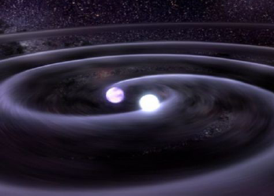
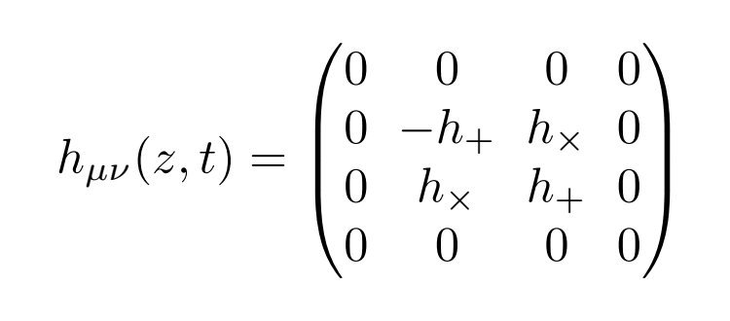
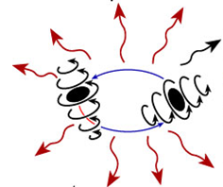
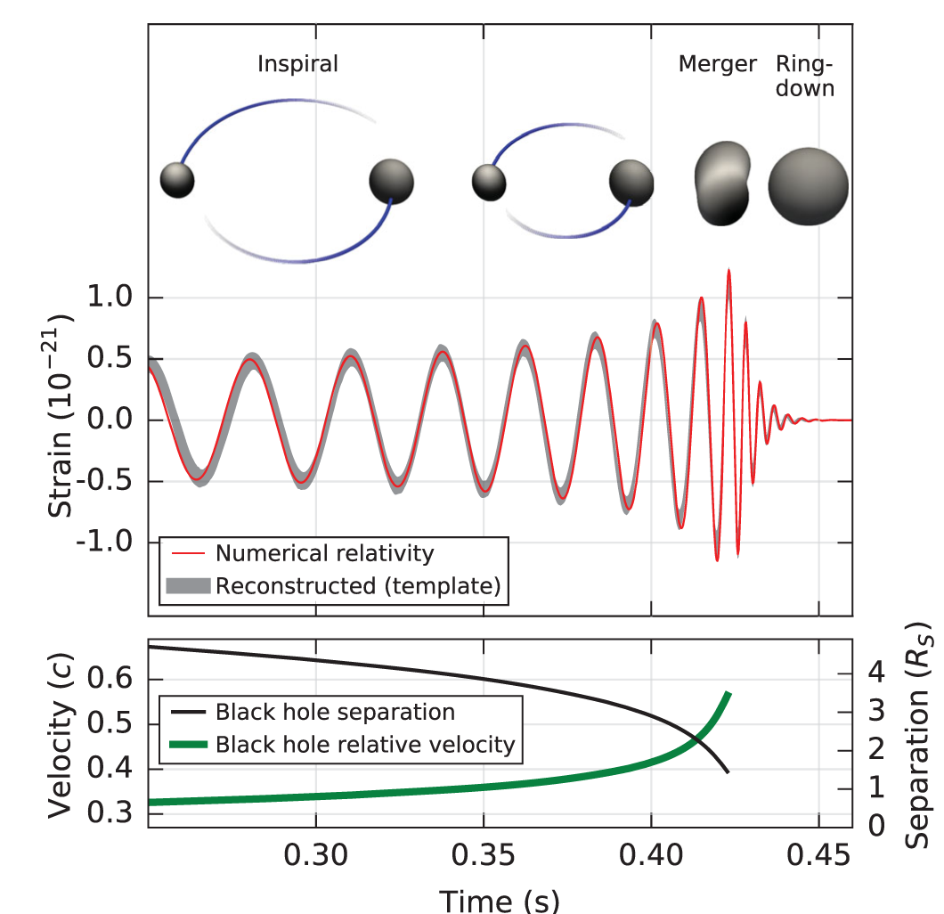
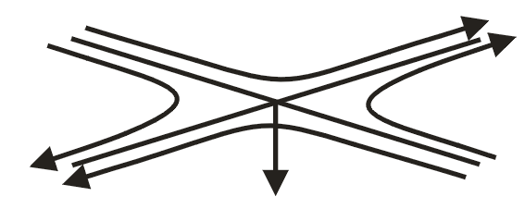
Introduction to GW
$$M_{1}=36 M_{⨀};$$
$$M_{2}=29 M_{⨀};$$
$D_{L}=410 Mpc$
GW150914
(B. P. Abbott et al. Phys. Rev. Lett. 116, 061102)

Slide 3
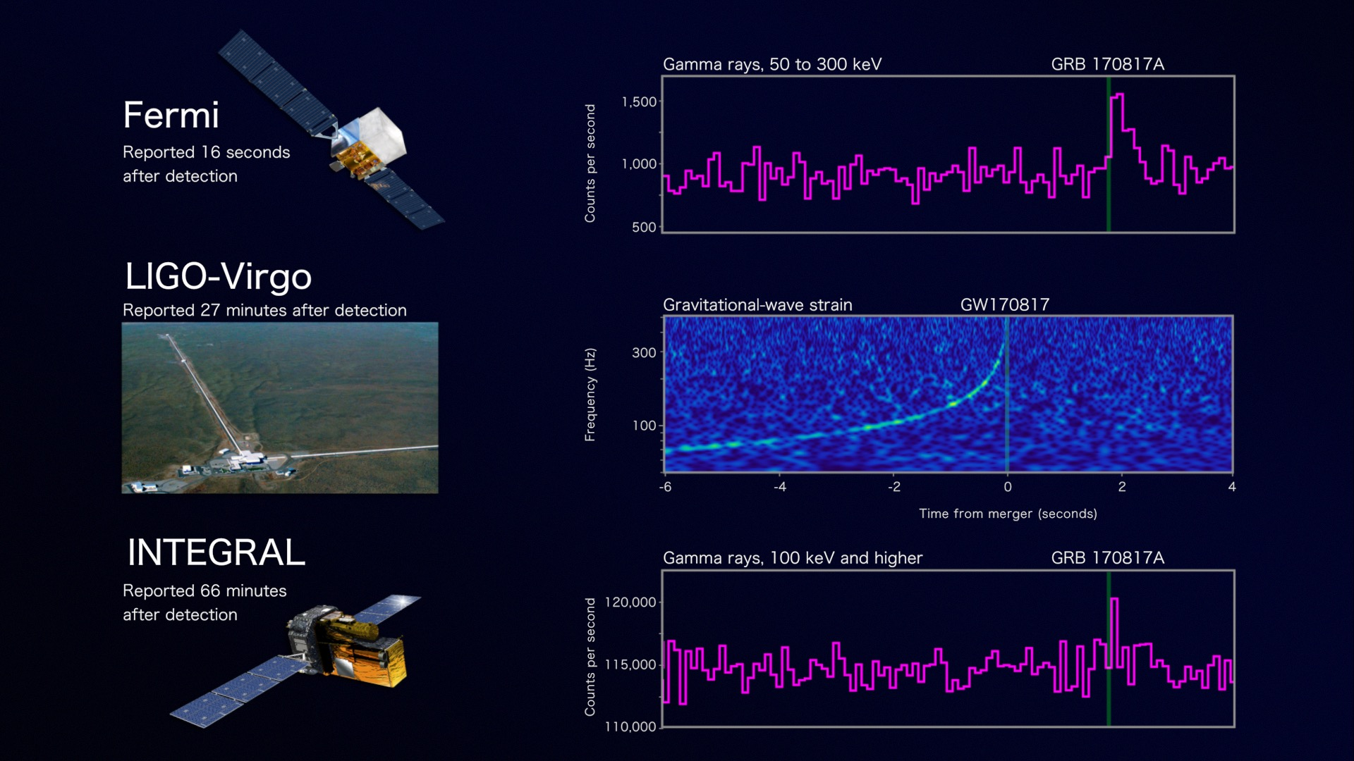
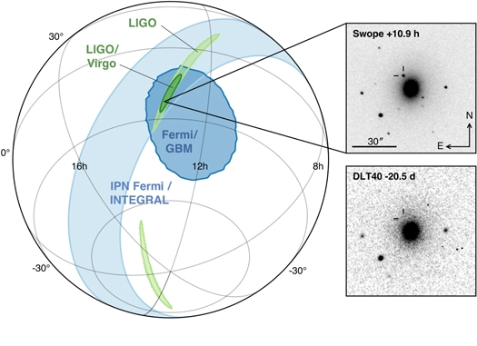
Unlocking Multi-Messenger Astronomy: GW170817
Credit: NASA's Goddard Space Flight Center, Caltech/MIT/LIGO Lab and ESA
$$M_{1},M_{2}\sim 1.17−1.6 M_{⨀};$$
$D_{L}=40 Mpc$.
Figure 1 from Multi-messenger Observations of a Binary Neutron Star Merger
B. P. Abbott et al. 2017 ApJL 848 L12 doi:10.3847/2041-8213/aa91c9
Credit: NASA's Goddard Space Flight Center, Caltech/MIT/LIGO Lab and ESA

Slide 4
The Science Enabled by Joint GW/EM observations
Improving Parameter Extraction of GW Events
A New Precision Cosmology Tool
What is the Nature of Short-Hard Gamma-Ray Bursts?

Slide 5
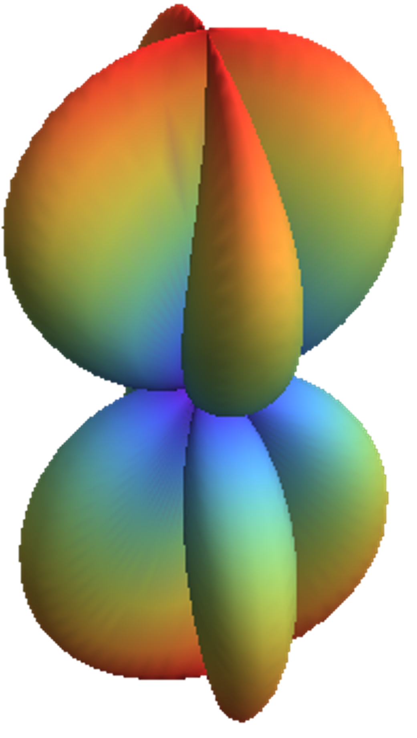
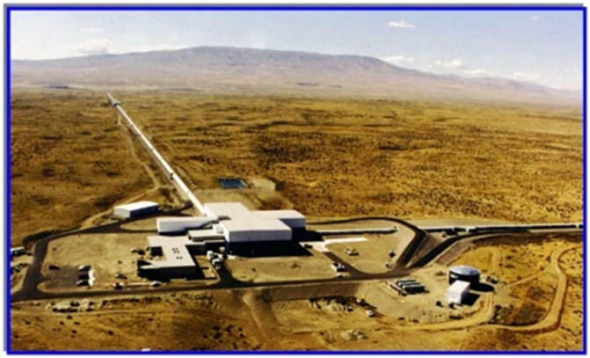
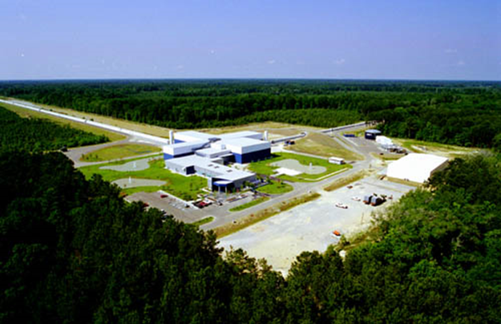
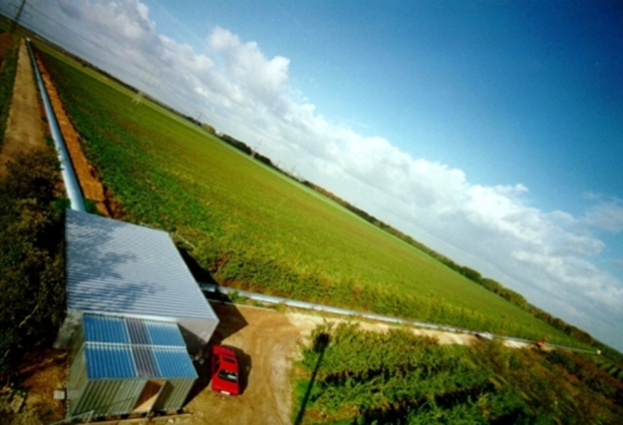
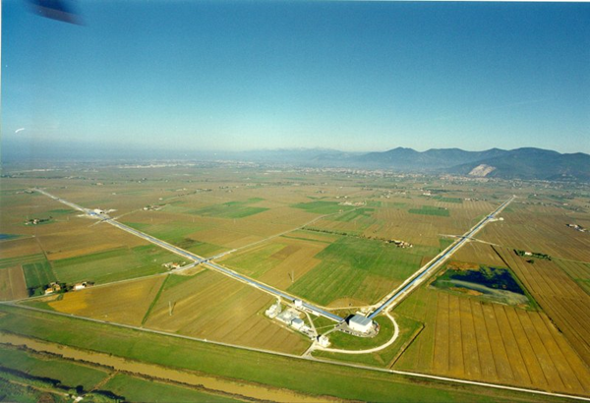
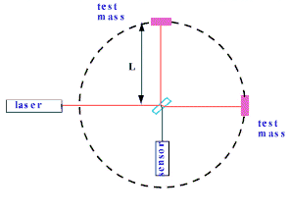
GW detectors
LIGO Hanford Observatory, WA
LIGO Livingston Observatory, LA
GEO, 600 m arms, near Hannover
Virgo, 3 km arms, near Pisa

Slide 6
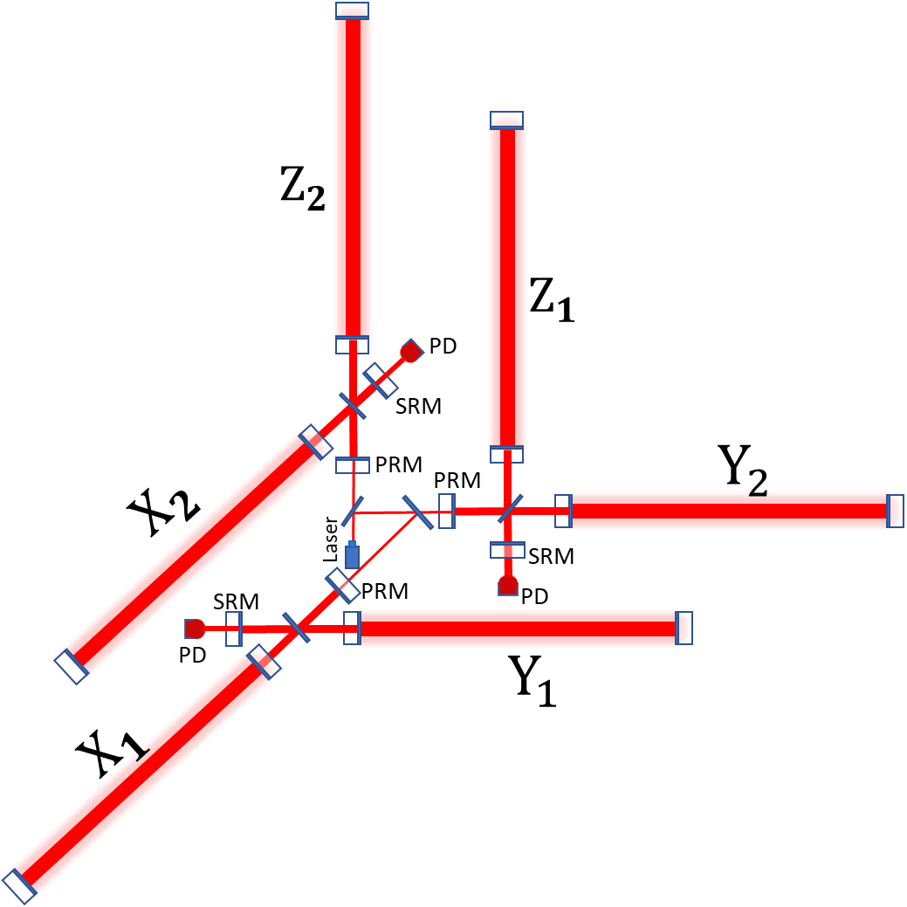
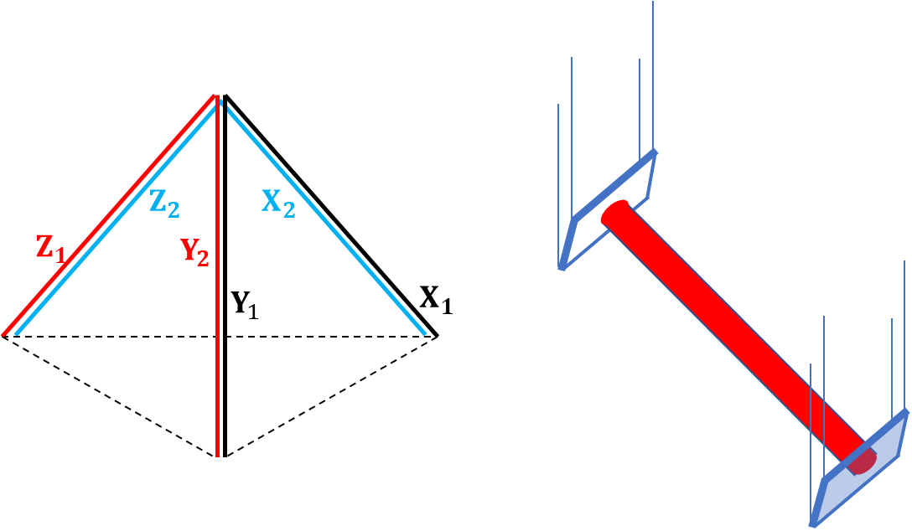
Design for 3D GW Detector

Slide 7
Benefits
1. More spherically symmetric antenna pattern
X-Y
X-Z
Y-Z
Total

Slide 8
Benefits
2. Eliminating false alarms
$$s_{X−Y}=h_{X−Y}+n_{X−Y}$$
Null-stream
$$s_{Y−Z}=h_{Y−Z}+n_{Y−Z}$$
$$s_{Y−Z}+s_{X−Z}−s_{X−Y}=n_{Y−Z}+n_{X−Z}−n_{X−Y}$$
$$s_{X−Z}=h_{X−Z}+n_{X−Z}$$
All noises
$${h_{X−Y}=h}_{Y−Z}+h_{X−Z}$$

Slide 9
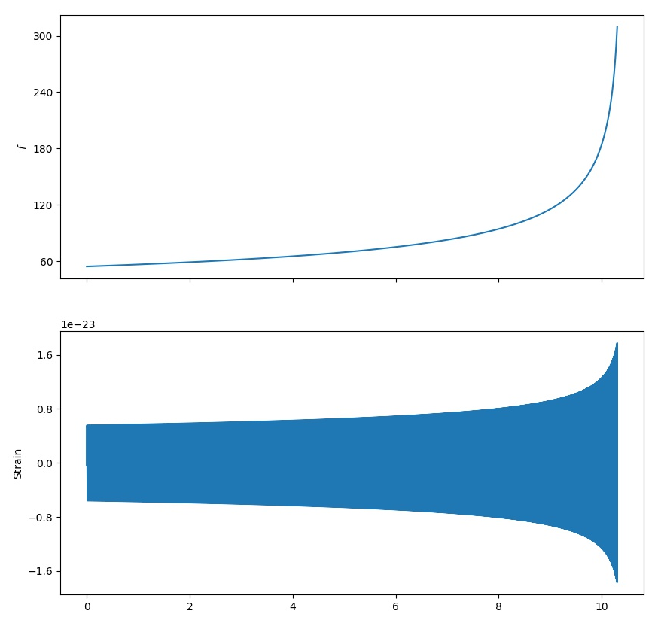
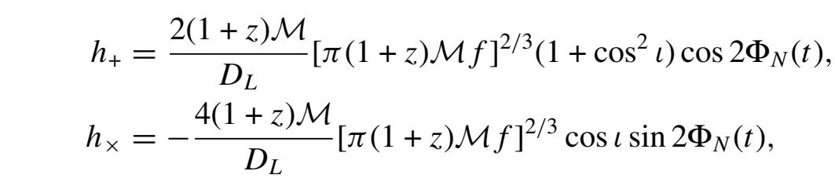
Benefits
3. stronger constraints on parameters of GW sources

Slide 10
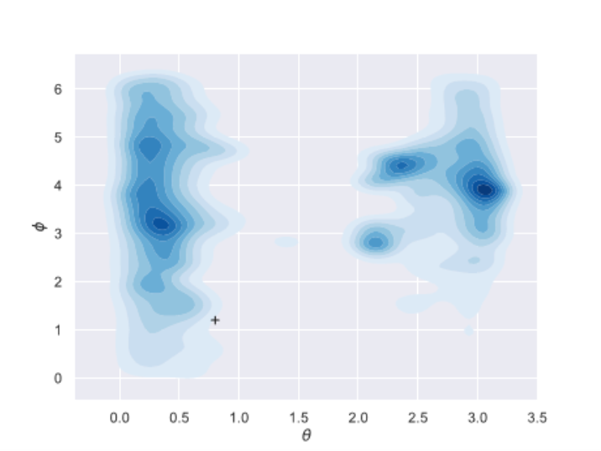
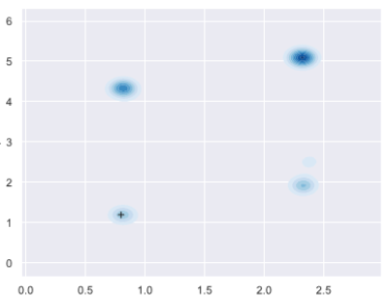
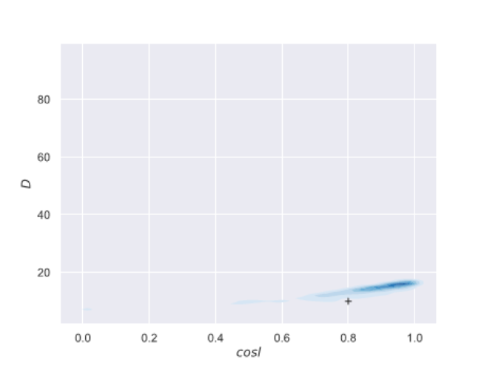
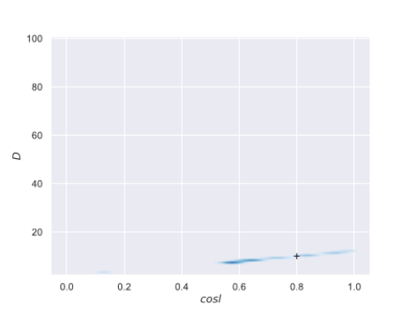
Benefits
3. stronger constraints on parameters of GW sources
$$φ$$
$$φ$$
$$θ$$
$$θ$$
$$D_{L}$$
$$D_{L}$$
$$\cos{ι}$$
$$\cos{ι}$$

Slide 11
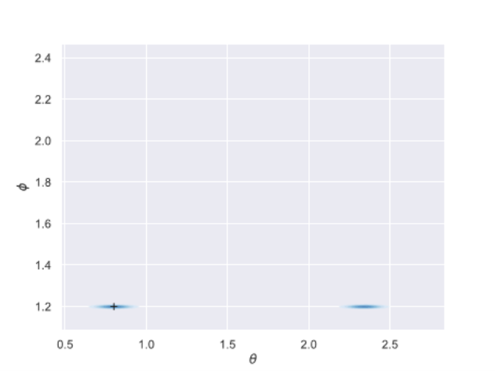
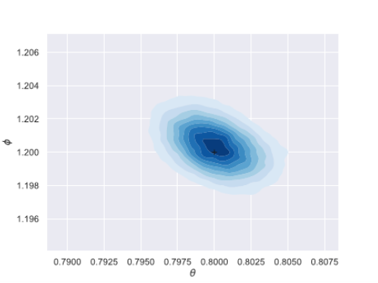
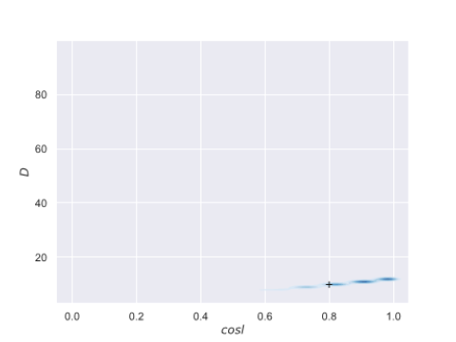
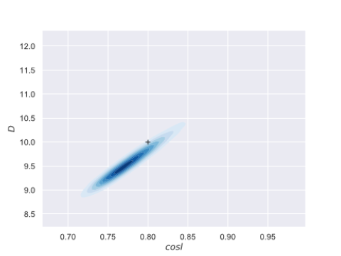
Benefits
3. stronger constraints on parameters of GW sources
$$φ$$
$$φ$$
$$θ$$
$$θ$$
$$D_{L}$$
$$D_{L}$$
$$\cos{ι}$$
$$\cos{ι}$$

Slide 12
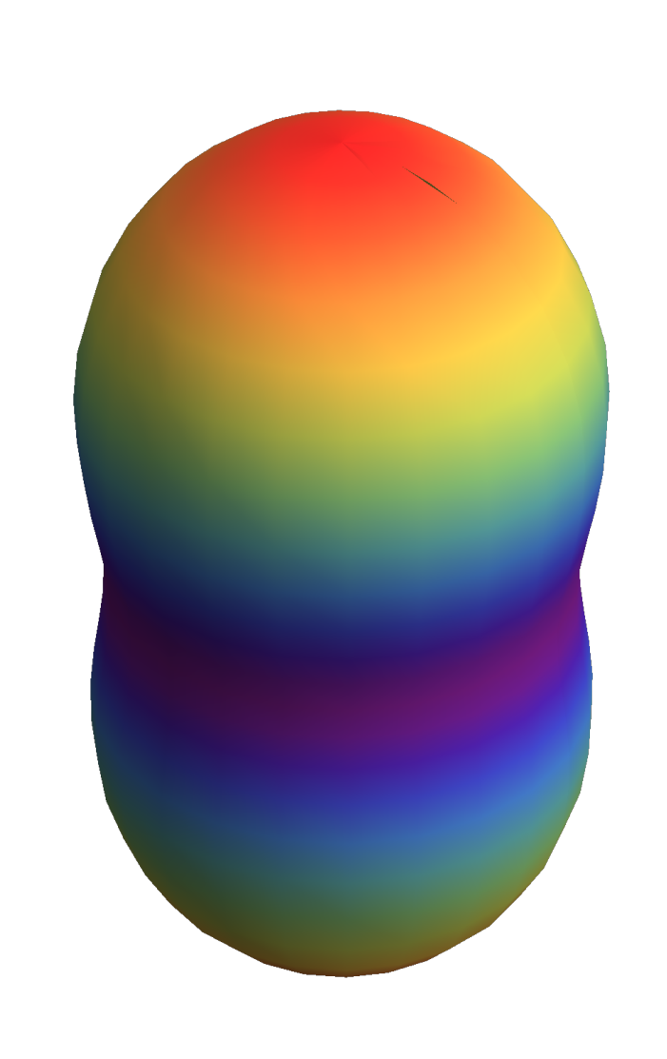
3D detector VS ET

Slide 13
Outlook
If such a 3-D detector can be realized with kilometer scale,
More GW events can be caught due to the wider field of view.
Most false alarm events can be distinguished.
New GW sources like spinning neutron stars and collapse supernovae can be detected.
Equation of state of neutron stars can be constrained.
Parameters of GW sources can be further constrained by joint detection with other detectors.

