Slide 1
Repeating FRB from the pulsar-asteroid belt collision: frequency drifting and polarization
Zenan Liu (刘泽南)
School of Astronomy and Space Science, Nanjing University
Liu et al. 2020, submitted to ApJ
Collaborators: Wei-Yang Wang, Yuan-Pei Yang, Zi-Gao Dai
August 28-30, 2020, Xiamen University
Stellar Structure and Evolution presentation

Slide 2
Outline
FRB observational properties
Pulsar-asteroid belt collision model
Time-frequency drifting and linear polarization
Summary

Slide 3
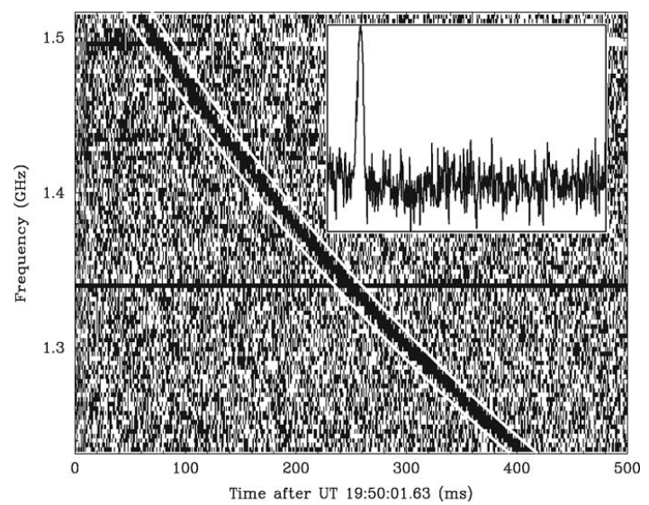
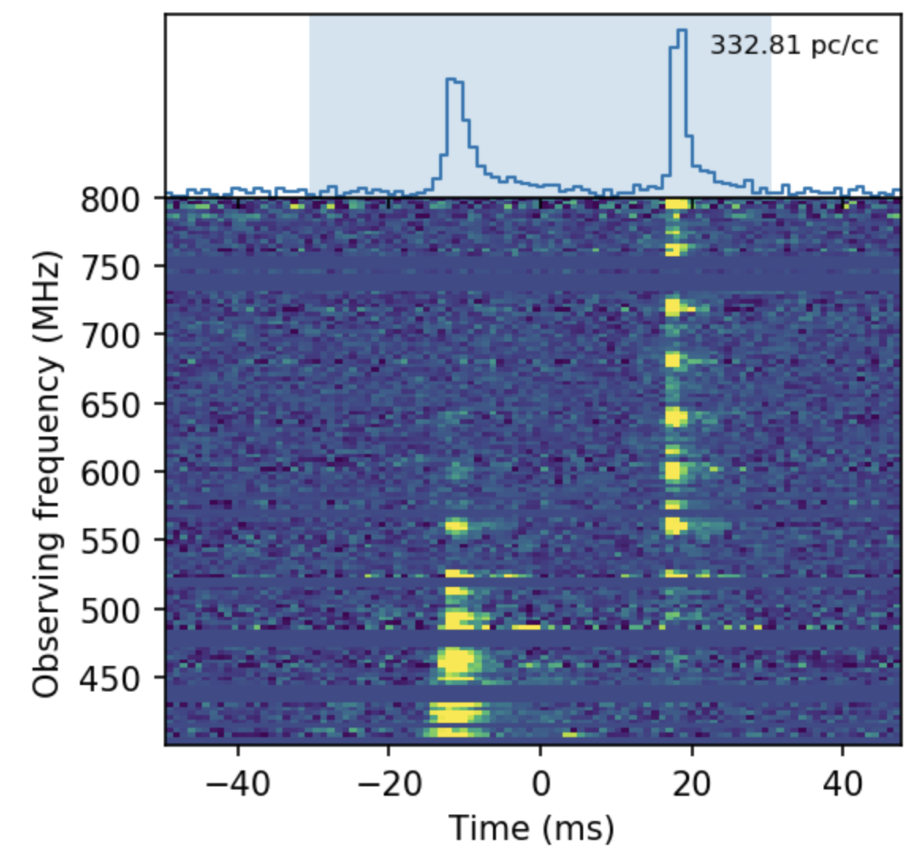
FRB observational properties
Event rate density: ~ 3.5×10⁴ Gpc⁻³ yr⁻¹ above 10⁴² erg/s
Duration: milli-seconds
Observed frequency: ~ 300 MHz to ~ 8 GHz
Brightness Temperature: ~ 10³⁷ K → Coherent radiation mechanism
Isotropic energy and peak luminosity: 10³⁵ - 10⁴³ erg and 10³⁸ - 10⁴⁶ erg/s
Periodicity: ~ 16-day period of FRB180916.J0158+65 and ~ 161-day period of FRB121102 (Amiri et al. 2020, Cruces et al. 2020)
FRB 200428 associated with an X-ray burst (XRB) from the Galactic magnetar SGR 1935+2154 (Andersen et al. 2020, Bochenek et al. 2020)
Luo, et al. 2020
Lorimer et al. 2007 (FRB 010724)

Slide 4
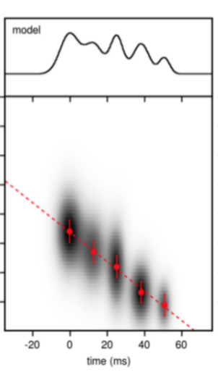
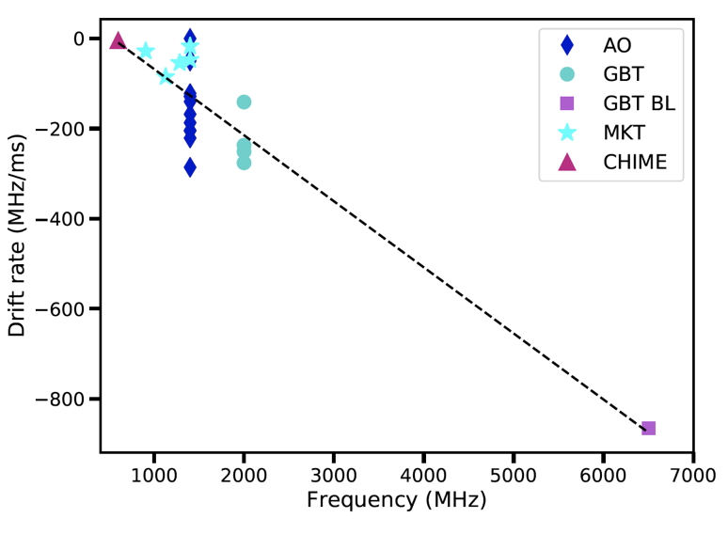
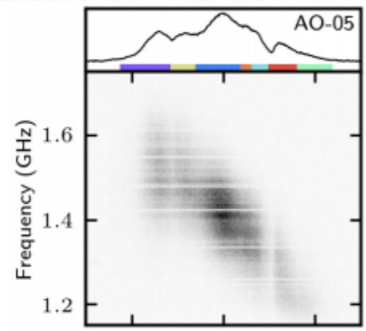
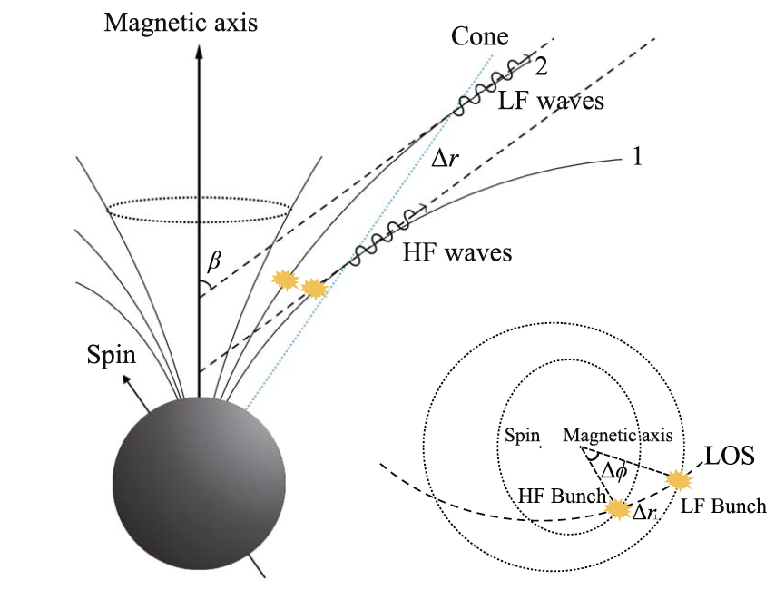
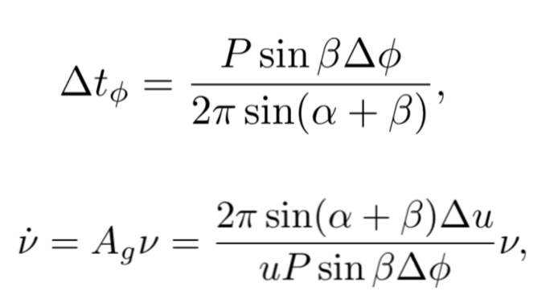
Time - Frequency pattern
FRB 121102
FRB 121102(Hessels et al. 2019, ApJ, 876, L23)
FRB 180814.J0422+73(Amiri et al. 2019, Nature,566, 235)
Caleb et al. 2020, MNRAS, 496, 4565
Repeaters ✅
Non-Repeaters ❌
• Drift rate (~ 200MHz/ms for FRB 121102) increases with increasing frequency.
Wang et al. 2019, ApJ, 876, L15
has a lot of uncertainty due to the drifting rate only observed in the 400-800 MHz and 6.5 GHz, respectively, mainly dominating the linear trend. On the other hand, the linear fitting curve does not cross the original point of the coordinate axis. In addition, the drifting rate detected in the central frequency of 1.4 GHz deviates with a Gauss distribution.

Slide 5
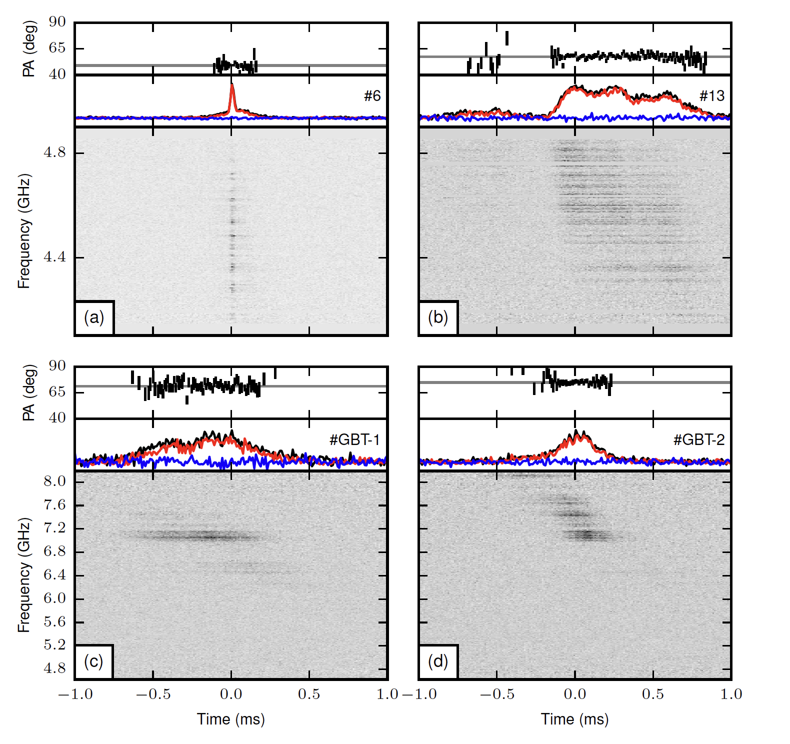
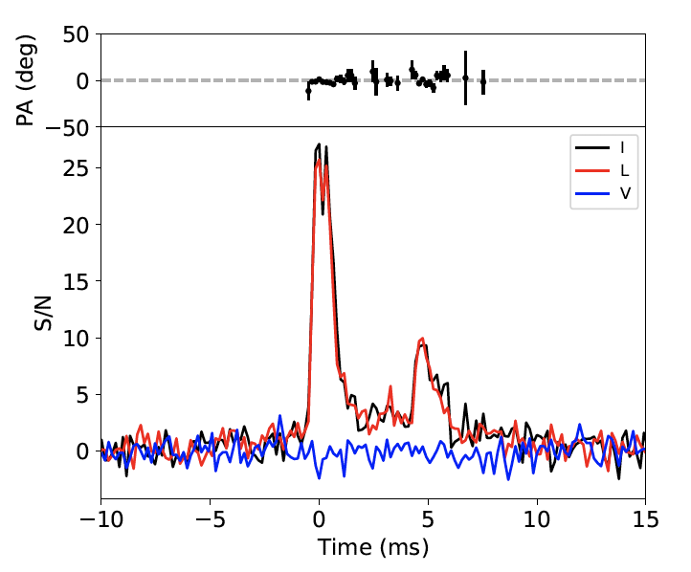
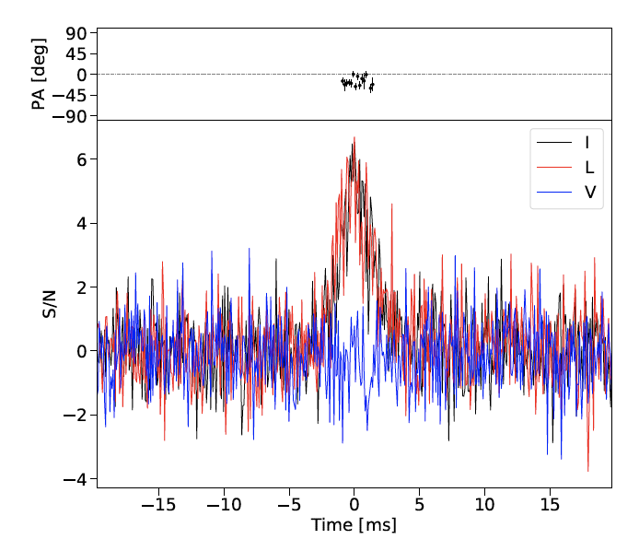
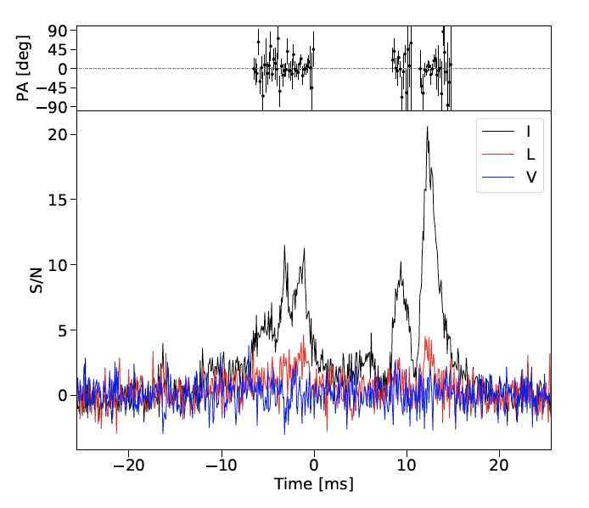
Linear Polarization
• ~100% linear polarization for repeating FRBs.
• Constant polarization angle in each burst (e.g. FRB 121102)
FRB 121102
FRB 180916
FRB 190604
Fonseca, et al. 2020
Michilli, et al. 2018
CHIME/FRB Collaboration, 2019
FRB 190303
Linear polarization constrained with ≥ 20%
Fonseca, et al. 2020

Slide 6
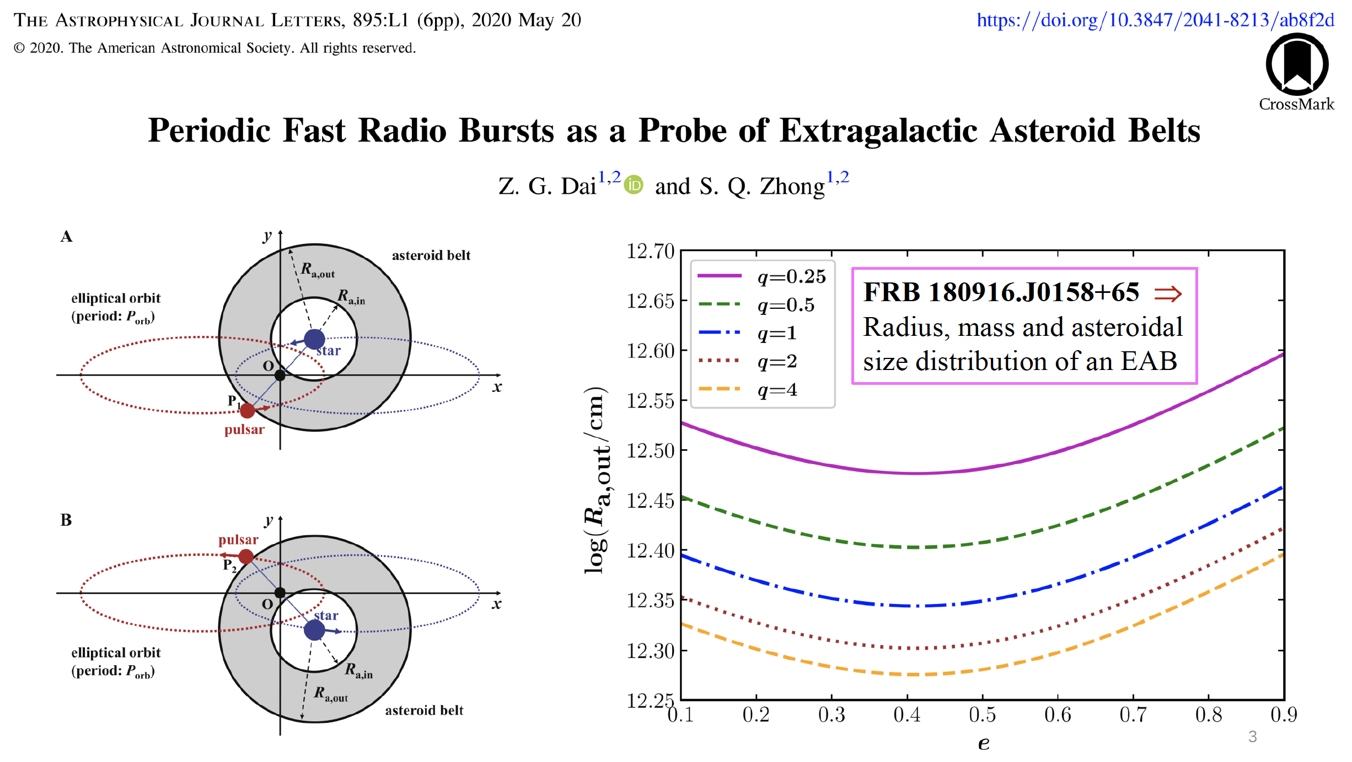
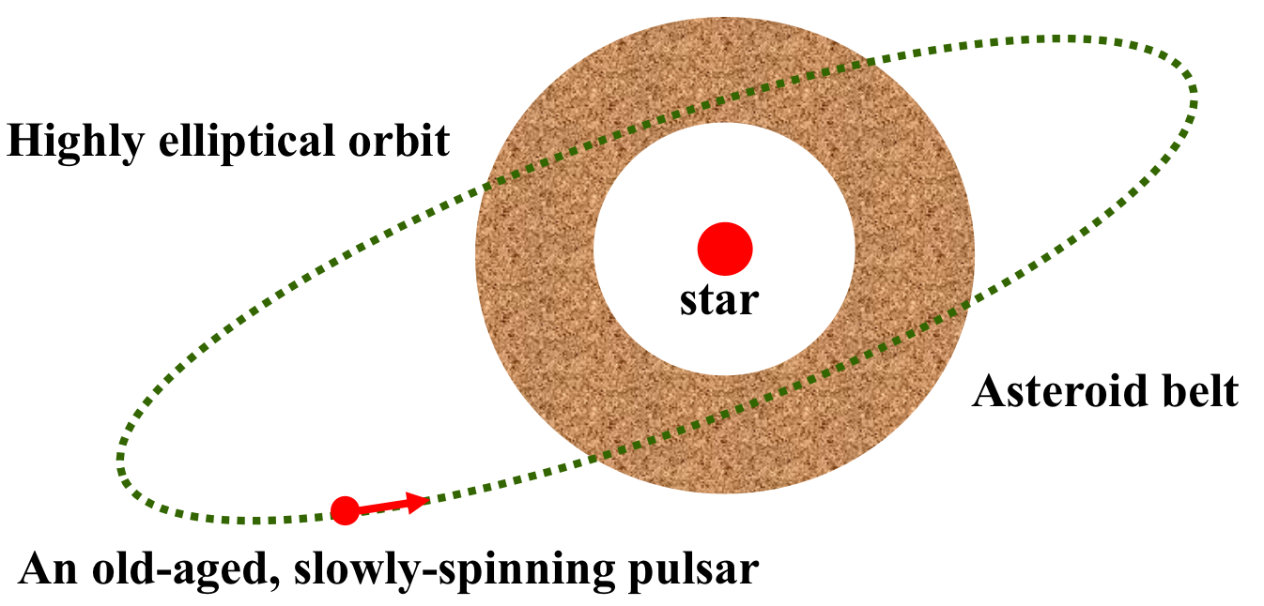
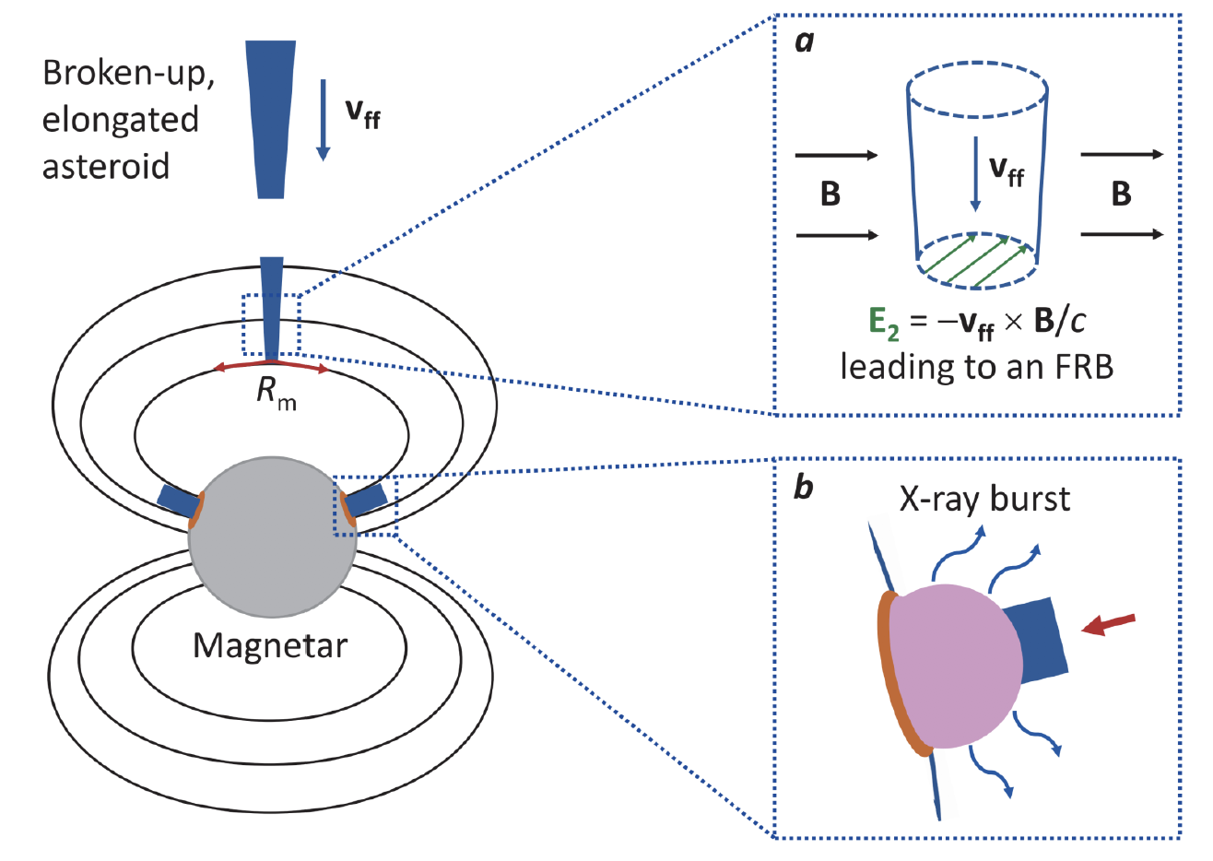
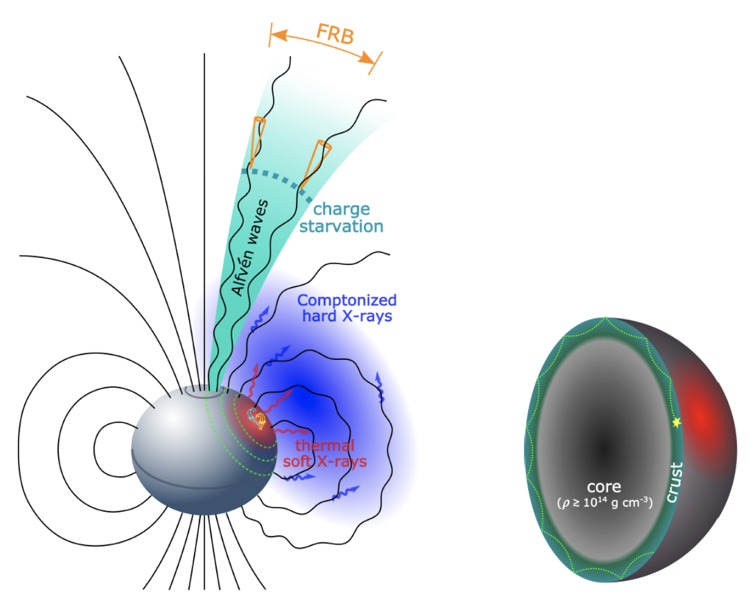
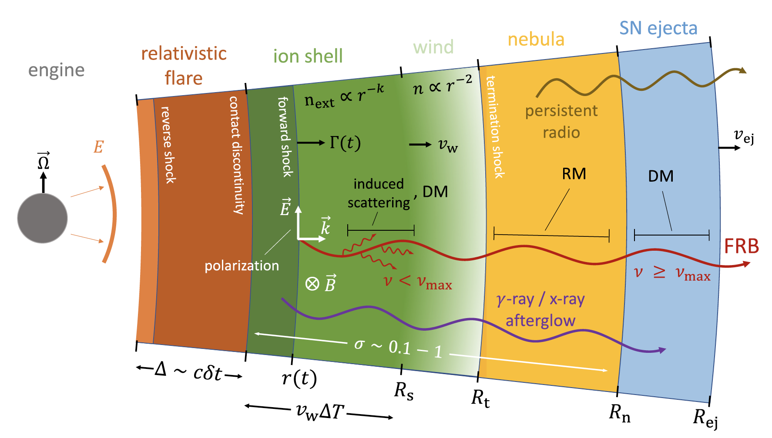
Some FRB models
Dai et al.2016, ApJ, 829, 27
Dai 2020, ApJL, 897, L40
close-in model
far-away model
Lu et al. 2020
Metzger et al. 2019

Slide 7
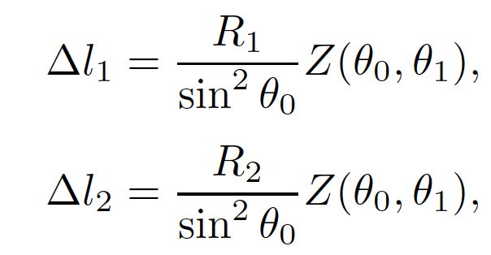
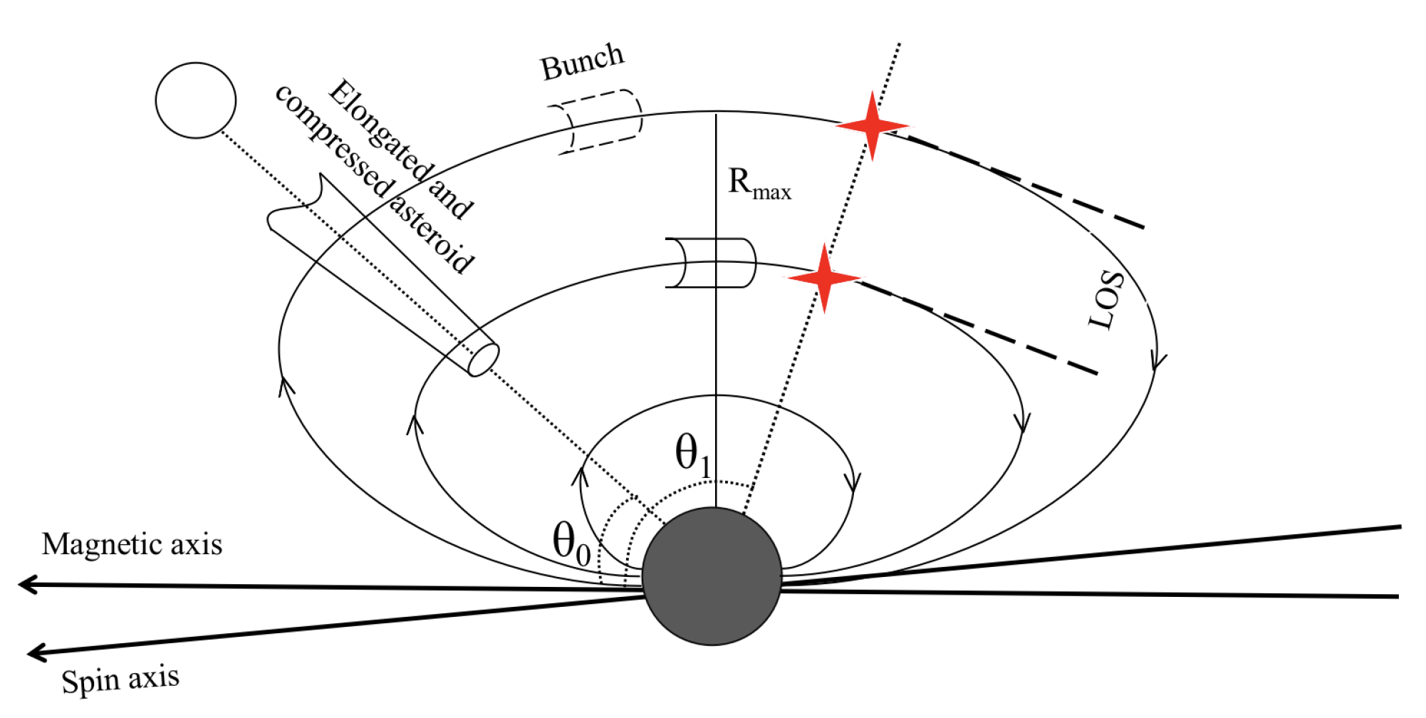
Pulsar-asteroid belt collision model
The distance along the magnetic lines
Liu et al. 2020, submitted to ApJ

Slide 8
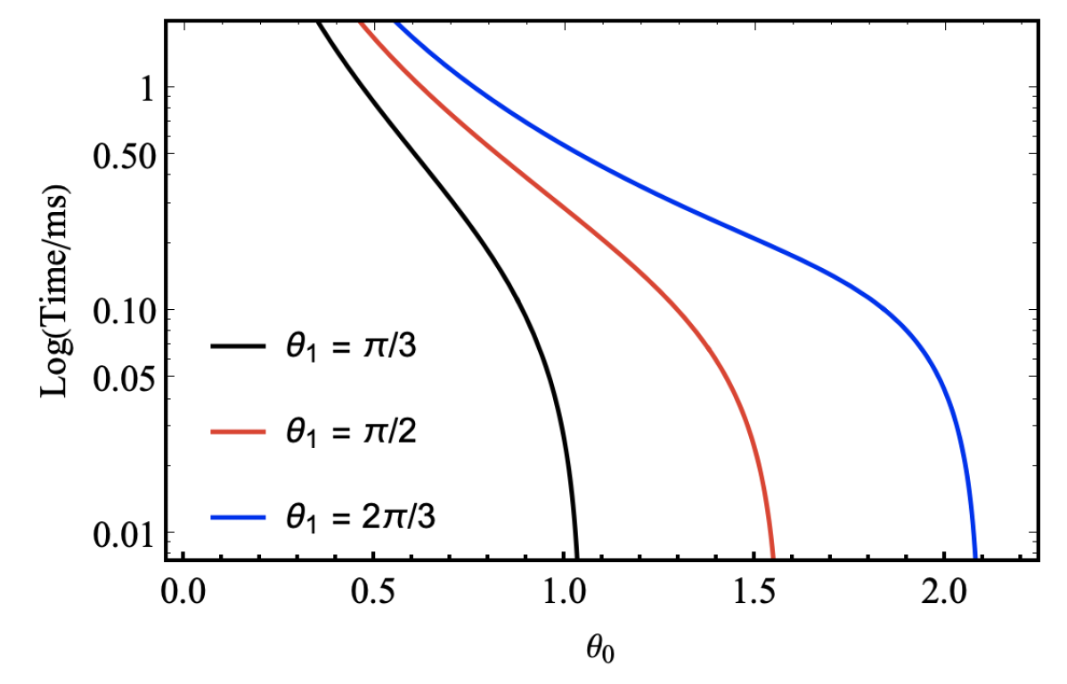
Time-frequency drifting
The delay of the high frequency bunches relative to the low frequency
The polar angle
The initial distance between the high and low frequency bunches are the length of the asteroid 10⁷ cm.
Liu et al. 2020, submitted to ApJ
If the distance between the bunches of high and low
frequency from the surface of the asteroid is too close,
no matter what angle the asteroid falls down, there is
no delay effect in the direction of the LOS. There is al-
ways a low limit of the incident angle for the time delay
of millisecond order between high and low frequencies
to be observed in a given LOS.

Slide 9
Time-frequency drifting
The rapid cooling of emitting particles and therefore requires the parallel electric field
Kumar et al. 2017
A asteroid travels through the magnetic field lines longitudinally, causing the induced electric field
The drifting rate is given by (the Lorentz factor evolves with R)

Slide 10
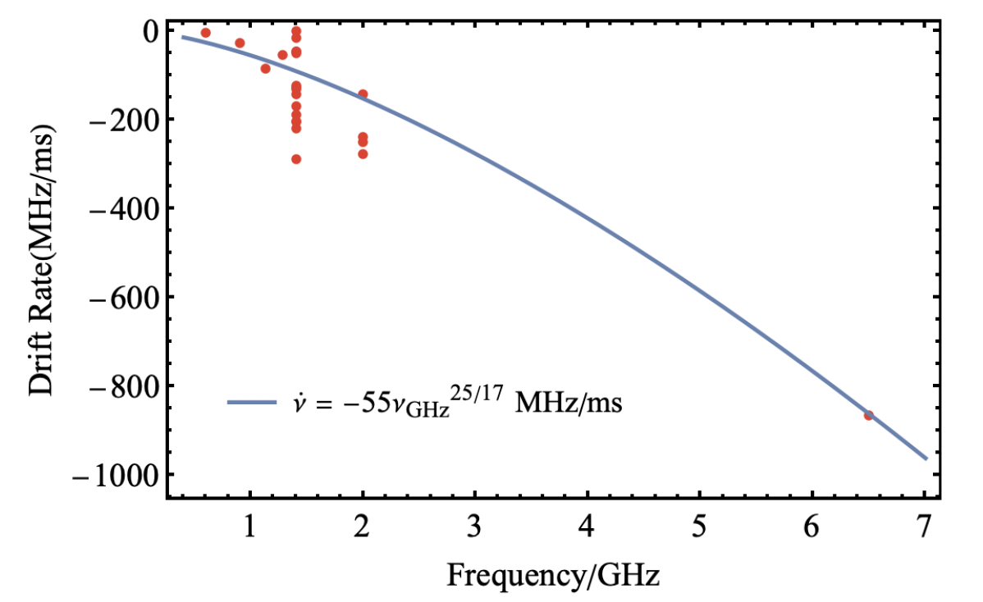
Time-frequency drifting
The fitted parameter Ne ~10²⁷ matches the electron numbers by Dai et al. (2016), which indicates that our model is self-consistent.
Liu et al. 2020, submitted to ApJ
The drifting rate at a higher frequency is larger than that at a lower frequency. Sub-pulses at the same central frequency may have uctuated the drifting rate. The uctuation of the drifting rate may be related to the uctuation of the emitting electron Lorentz factor and the angle of the asteroidal falling due to a random-falling asteroid.

Slide 11
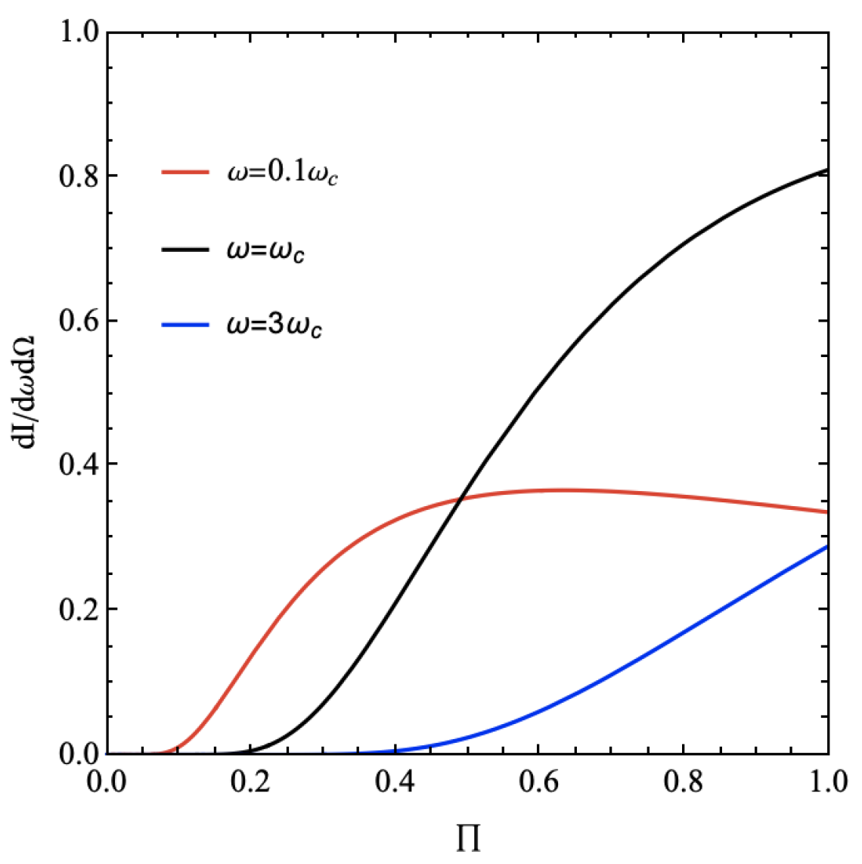
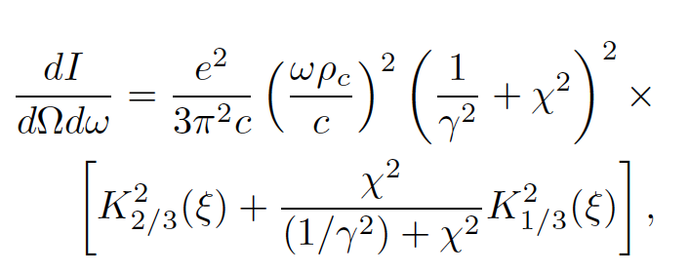
Linear Polarization
FRB 190303: Linear polarization constrained with ≥ 20%. (Fonseca, et al. 2020)
The energy per unit frequency interval per unit solid angle is given by
Jackson 1975
The degree of linear polarization is given by
γ = 200 and χ changes from 0 to 10/γ
Liu et al. 2020, submitted to ApJ

Slide 12
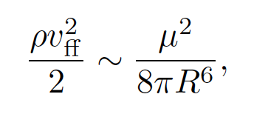
The balanced point position can be given by
(Dai et al. 2016, ApJ , 829)
Alfvén radius
The asteroidal radius distribution
(Ivezić et al. 2001, Davis et al. 2002)
The asteroidal mass distribution (assuming the initial density is constant)
The gravitational energy release rate

Slide 13
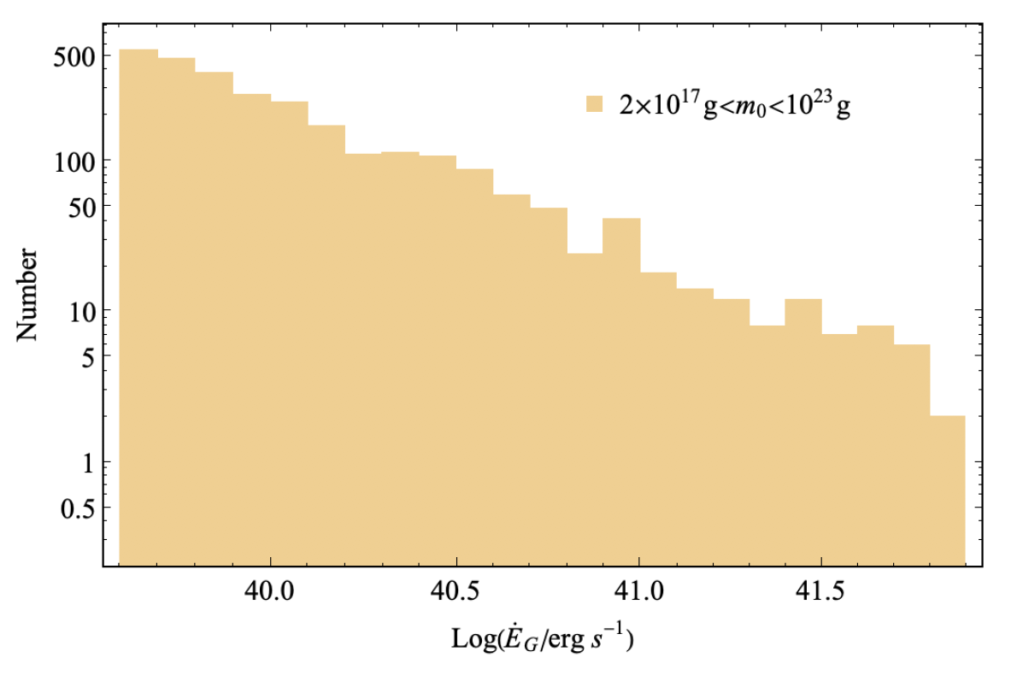
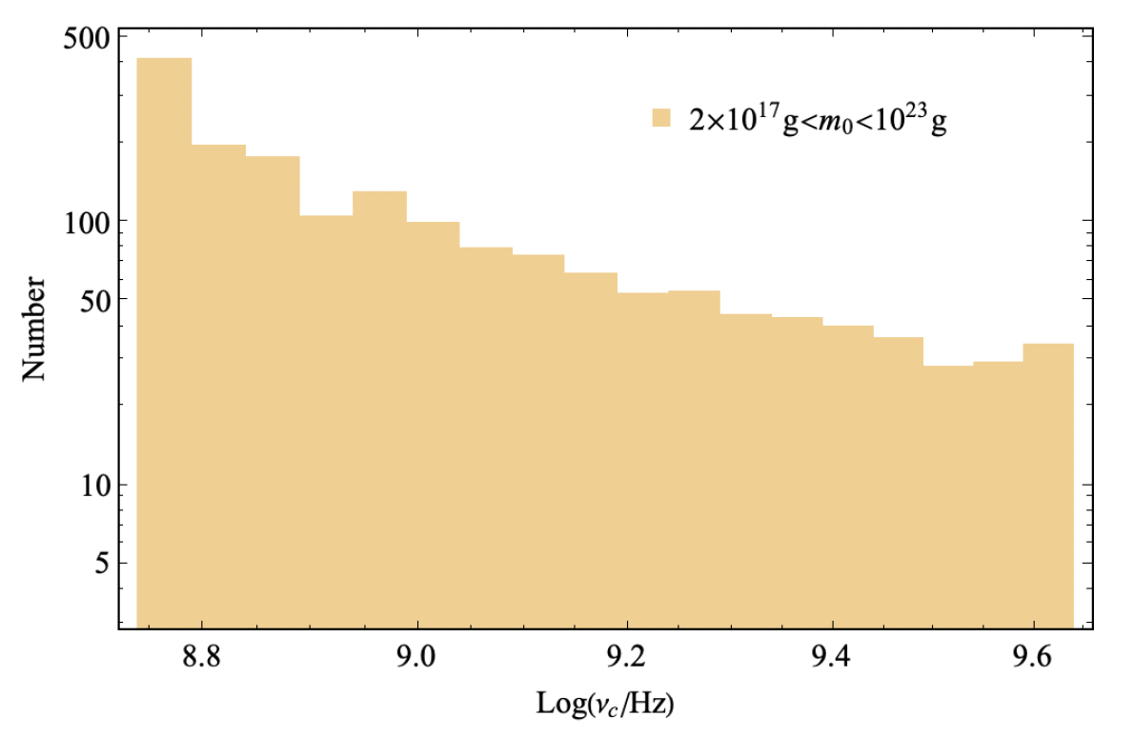
The observed minimum luminosity of the extragalactic FRBs ~ 10³⁹ erg/s → the low limit : m_{min} ≃ 5.4×10¹⁶ g and r_{0,min} ≃ 1.8×10⁵ cm
Random distribution: sin θ₀ (from 0 to 1) and sin χ (from 0 to sin (10/ γ ))
A heavier asteroid would cause a stronger gravitational energy release rate.
Incident radius ↑, balanced point position ↓,
curvature radius ↓, observed frequency ↑.
Liu et al. 2020, submitted to ApJ
Owing to the mass difference of the incident asteroids, broad frequency band FRBs would be observed.

Slide 14
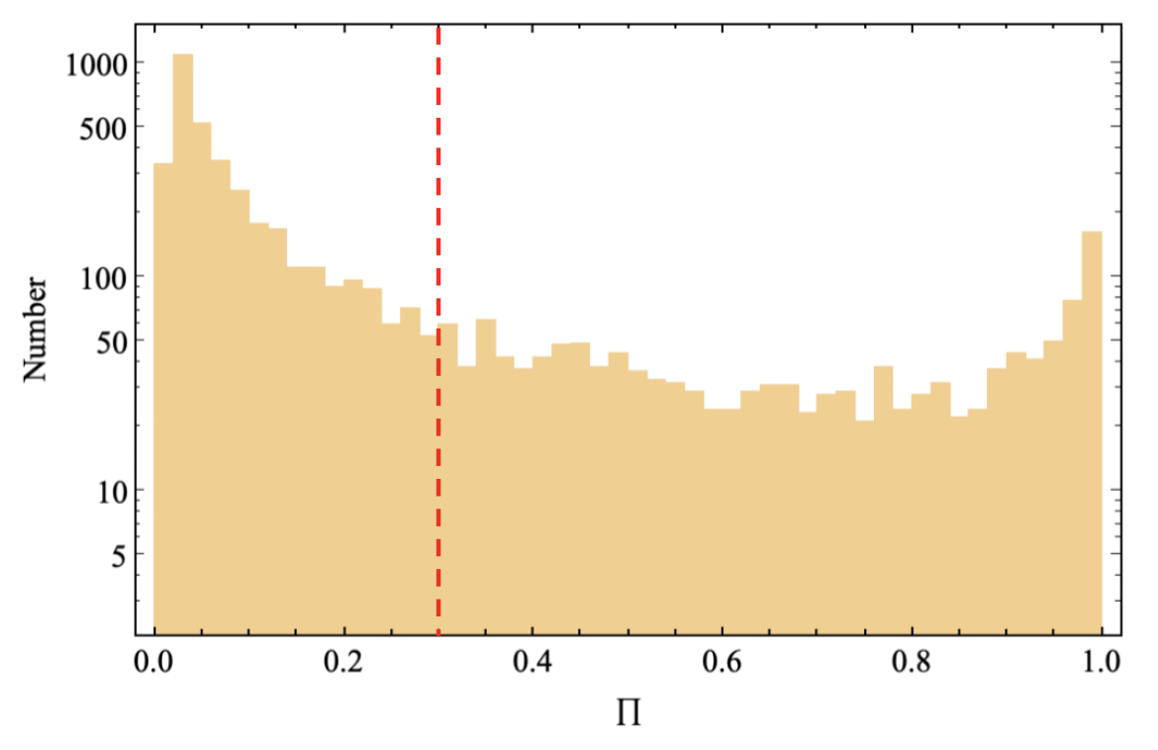
Linear Polarization
The LOS is random, one has χ >> 1/γ , which makes the polarization become low.
For a single point source, Π decreases with χ , Π is maximum at χ = 0.
A smaller emission angle would cause a higher linear polarization distribution due to the beaming effect.
Liu et al. 2020, submitted to ApJ

Slide 15
Summary
• Following the model of Dai et al. (2016) who proposed that repeating FRBs may originate from a slowly rotating and old-aged pulsar colliding with an asteroid belt around a stellar-mass object, we focus on the prediction of time–frequency drifting and polarization.
• The frequency drifting is mainly caused by the geometric structure of a pulsar magnetosphere, and the drifting rate–frequency index is found to be 25/17.
• Considering the typical differential mass distribution of incident asteroids, we find that an asteroid with mass m ≳ 10¹⁷ g colliding with the pulsar would contribute abundant gravitational energy, which powers an FRB. A broad frequency band of the FRBs would be expected, due to the mass difference of the incident asteroids.
• We simulate the linear polarization distribution for the repeating FRBs, and constrain the linear polarization with ≳ 30% for the FRBs with flux of an order of magnitude lower than the maximum flux.

Slide 16
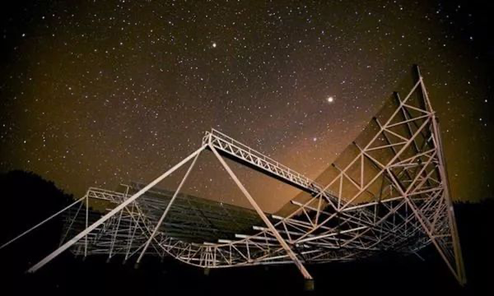
Thanks for your listening!

