Slide 1

Polarization and Radiation Geometry of PSR B1937+21
Jiguang Lu (卢吉光) NAOC, FAST
Aug 29, 2020

Slide 2
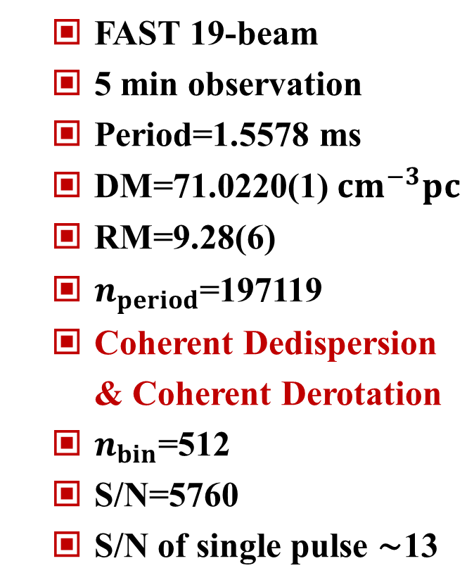
Observation
  FAST 19-beam
  5 min observation
  Period=1.5578 ms
  DM=71.0220(1)$cm^{−3}pc$
  RM=9.28(6)
  $n_{period}$=197119
  Coherent Dedispersion & Coherent Derotation
  $n_{bin}$=512
  S/N=5760
  S/N of single pulse ∼13

Slide 3
RVM Fitting
  I, IV: weak radiation regions
  II, V: peak regions
  III, VI: off-pulse regions
  With the high sensitivity of FAST, the polarization position angle (PPA) curve in the weak radiation regions can be well fitted by the RVM equation.

Slide 4
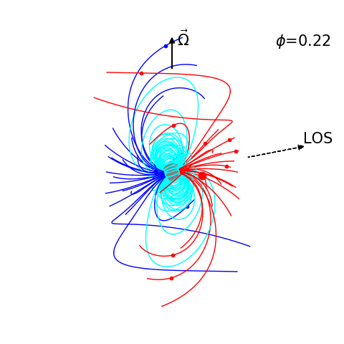
Rotation and Radiation
  With a dipole magnetic field, the field lines and corotating speed of particles are obtained.
  With considering the aberration and retardation effects, the radiation points and radiation phase are calculated.

Slide 5
Radiation Phase and Polarization
  The PPA curve of PSR B1937+21 can be explained in the framework of a rotating dipole field.
  Each of the two peaks may have two origins, and this can lead to the variations on PPA curves.

Slide 6
Radiation Altitude
  Both of the two peaks come from high altitude regions (may be out of the light cylinder), and the corotating speed at the radiation points are high.

Slide 7
Summary
  The multipolar field model can indeed be used to explain some confusing phenomena, but sometimes it need not necessarily be introduced. With “the Occam’s Razor” in mind, the necessity of invoking a multipolar field should be considered carefully.
Thanks!

