Slide 1
Pulsar glitch activity in a strangeon star model and parameter constraint
Weihua Wang,
合作者：徐仁新，来小禹，周恩平，卢吉光，郑小平
wang-wh@pku.edu.cn
2020.08.29@Xiamen University

Slide 2
Outline
1.Motivation
2.Glitch activity in the starquake model of solid quark stars
3.Improved starquake model
4.Summary

Slide 3
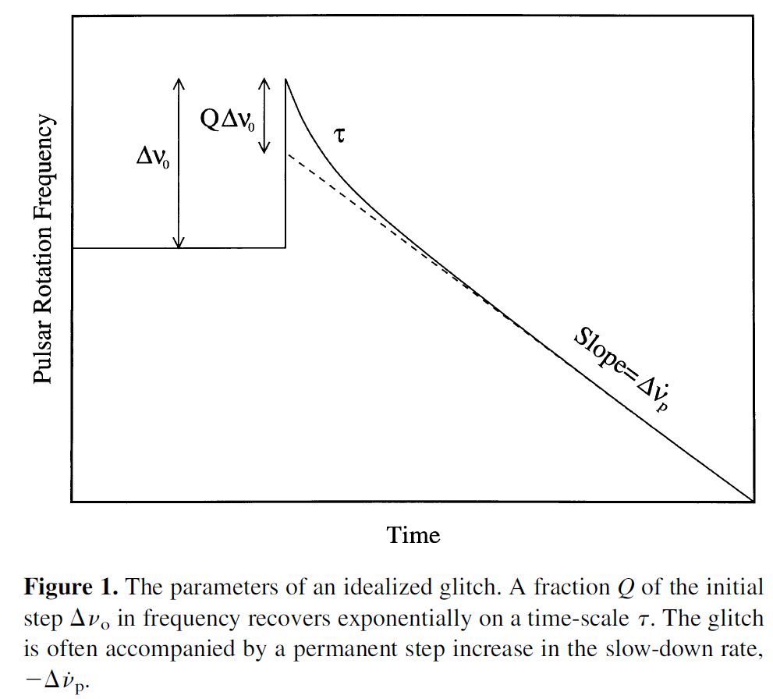
1.Motivation
Observational quantities:
①
②
Fitting parameters:
①
② (recovery coefficient)

Slide 4
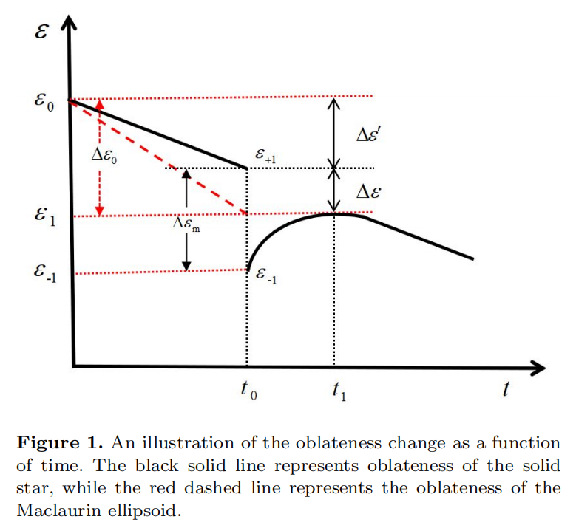
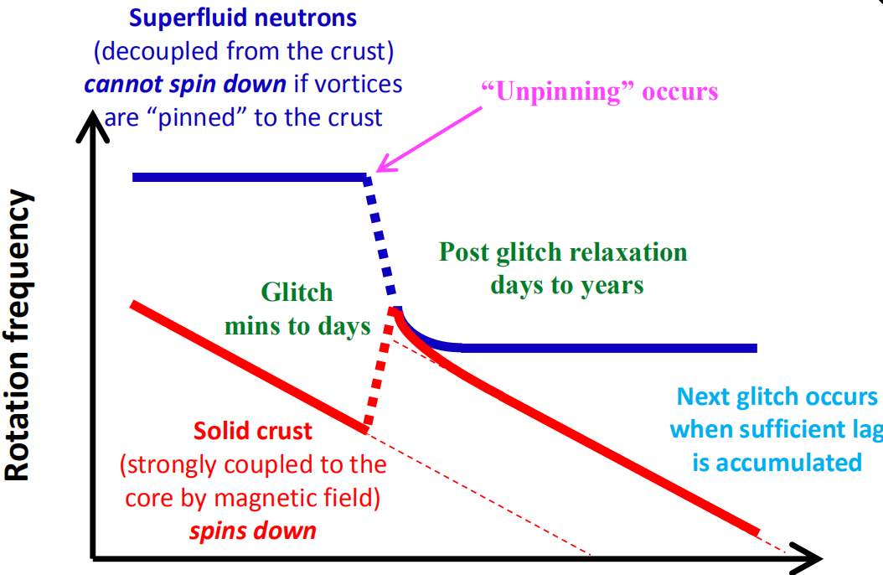
Vortex model
Starquake model

Slide 5
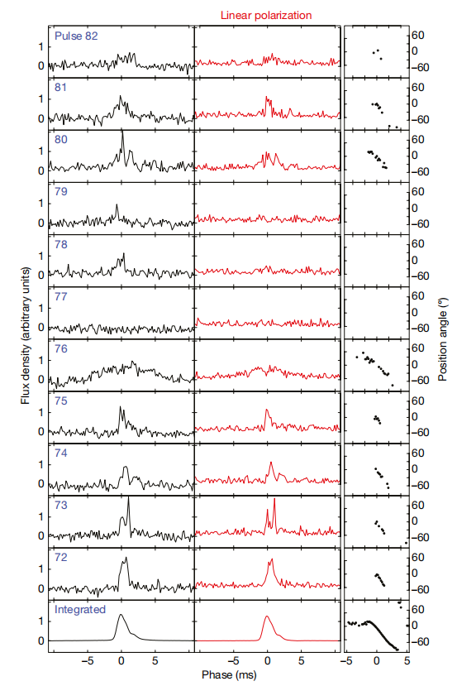
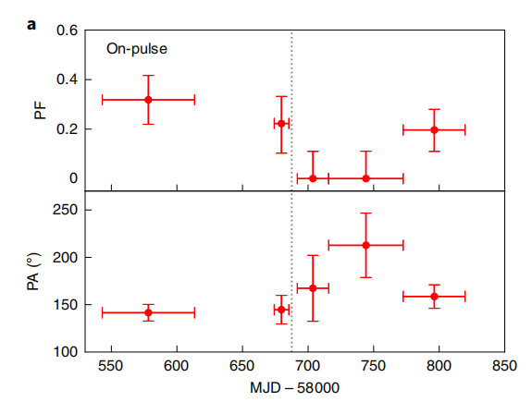
The vortex model is widely accepted mainly due to three aspects in spite of the nature of pulsars:
1.Its success in explaining the post-glitch recovery. Baiko 2018
2.No radiative and/or pulse profile changes accompanied by glitches, previously, internal origin.
3.The statistical glitch activity parameter.
The Vela pulsar, radio, Nature 2018
The Crab pulsar, soft X-ray 3.0-4.5 kev, Nature Astronomy 2020, H. Feng(冯骅), one sigma.

Slide 6
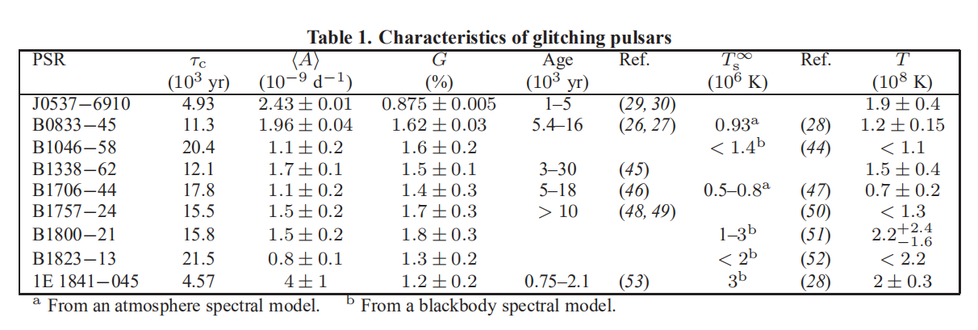
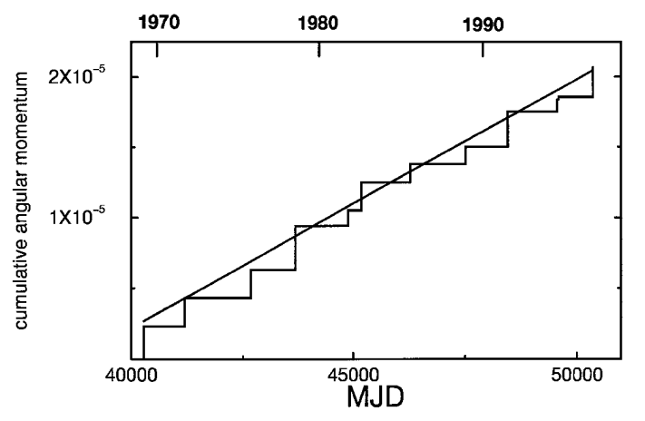
Lower limit of the fraction of superfluid reservoir that transfers angular momentum to the crust.
Ho 2015

Slide 7
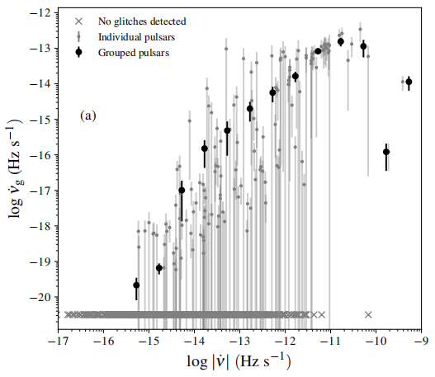
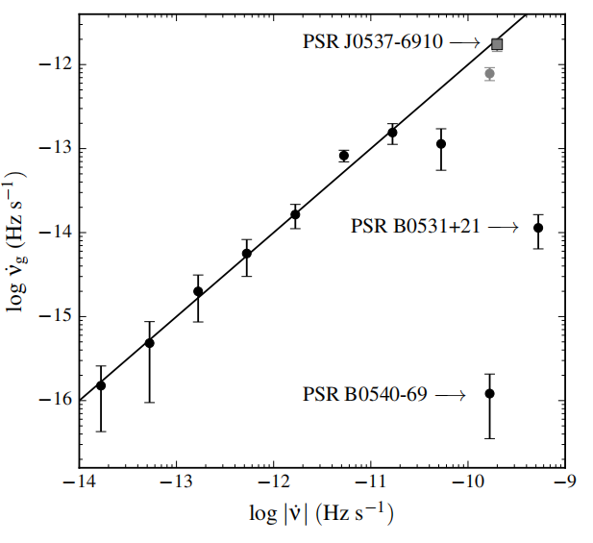
Fuentes et al. 2017

Slide 8
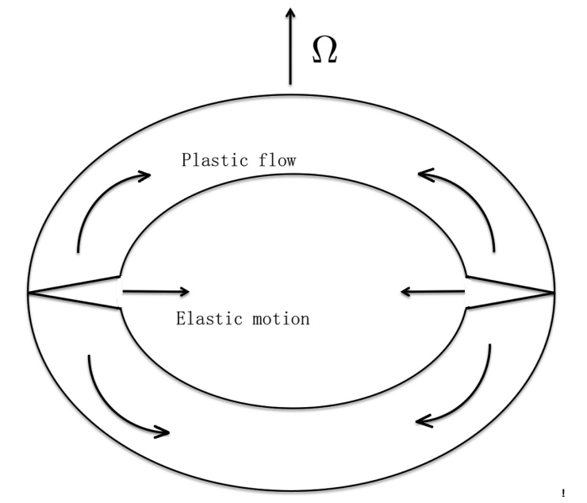
2. Pulsar glitch activity parameter in the starquake model
plastic flow
plastic flow

Slide 9
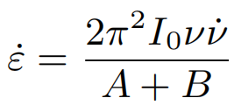

Slide 10
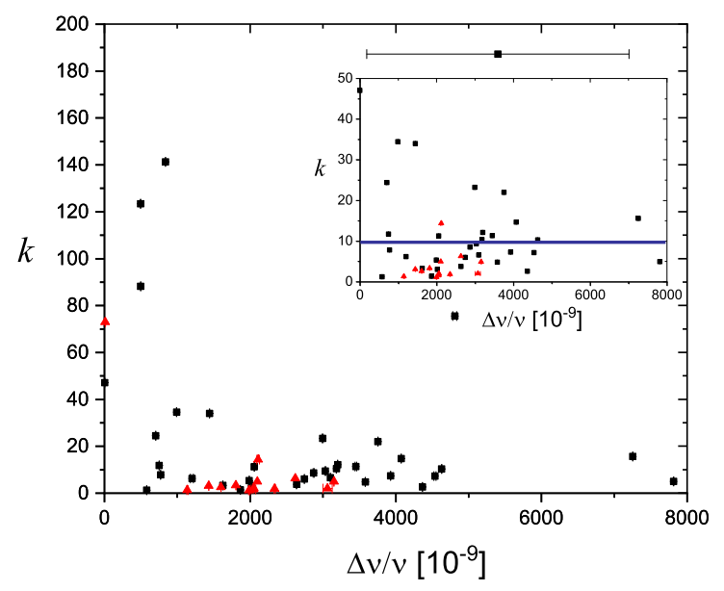
557 glitches detected in 190 pulsars, among them, 82 glitches have measured recovery coefficient Q.
(https://www.atnf.csiro.au/people/pulsar/psrcat/glitchTbl.html)

Slide 11
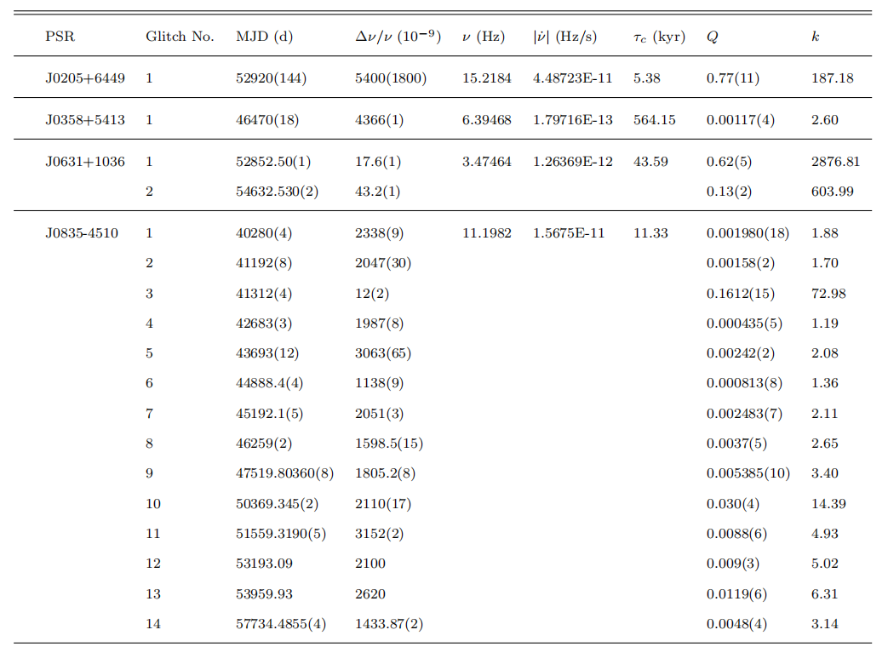
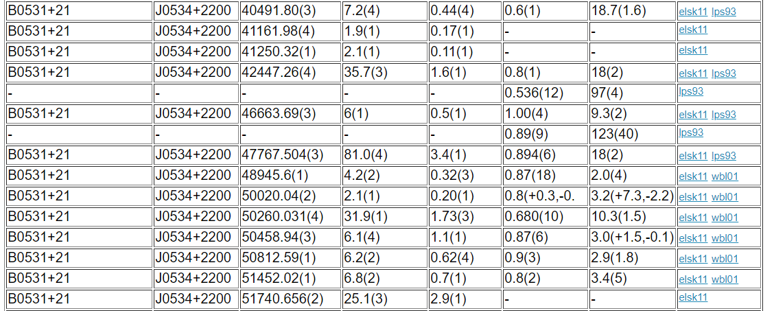
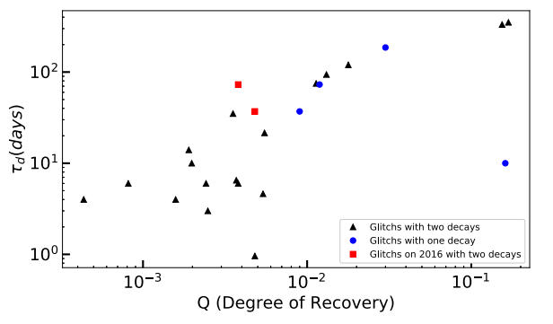
3. Improved starquake model
Xu et al. 2019
Wang et al. 2020

Slide 12
Simple estimations:

Slide 13
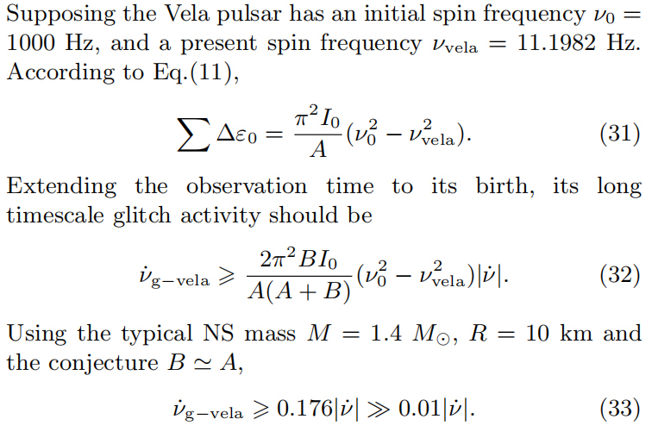
Simple estimations:

Slide 14
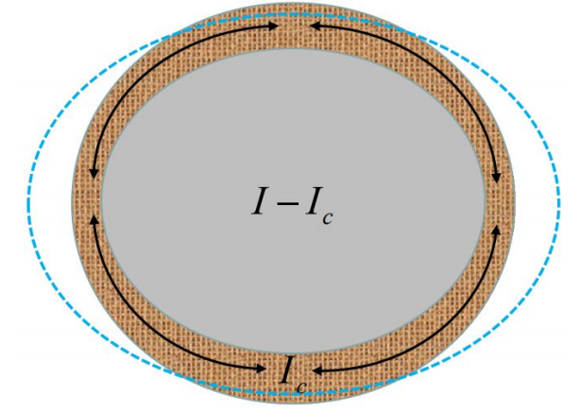
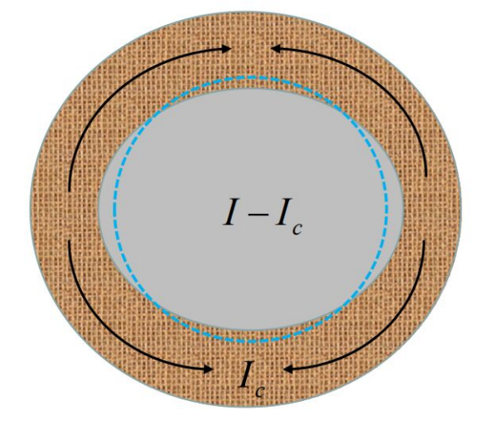
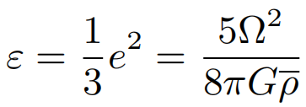
To understand the behaviors of Crab and Vela pulsar glitches in a unified two-layered starquake model.
:sink
:sink+spread
The Crab pulsar: dominated.
The Vela pulsar: dominated.

Slide 15
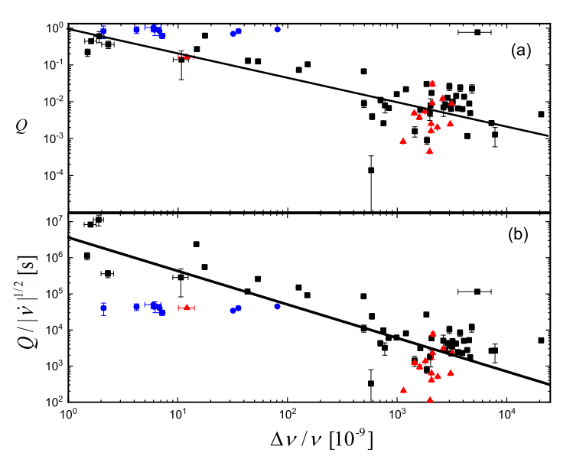
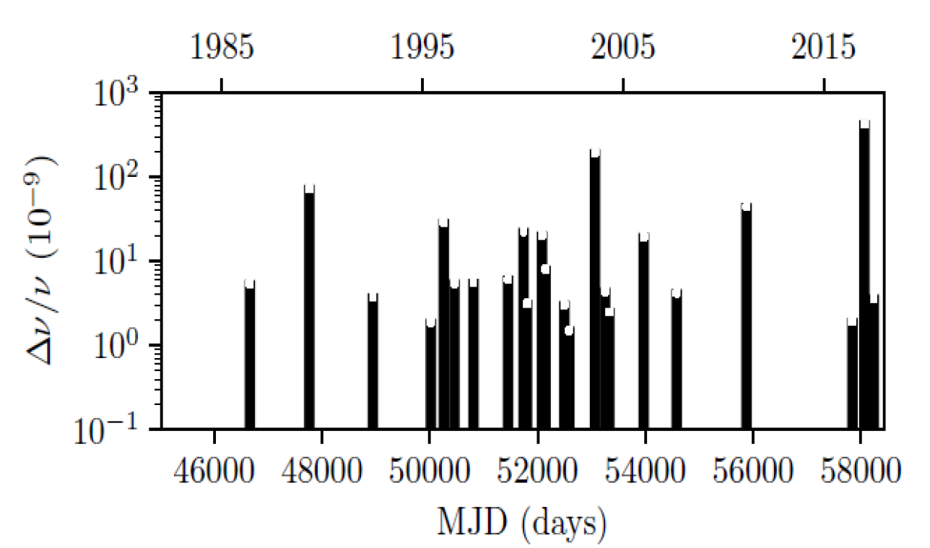

Slide 16
Energy release during starquake induced glitch:

Slide 17
4.Summary
① To explain the glitch activity parameter, the shear modulus of any kind of solid quark star should be on the order 10^34 erg/cm^3. This result is weakly dependent on the specific starquake model.
② To consistently explain the statistical glitch behaviors of all pulsars (glitch size, recovery coefficient), the density between the outer and inner layers differs by a factor of about 3.
③ If the recovery coefficient of glitches in very young pulsars (e.g., PSR B0540-69, PSR J0537-6910 , and the Crab pulsar) turns out to be comparable with that in the Vela pulsar, it will greatly challenge this model directly.

