Slide 1
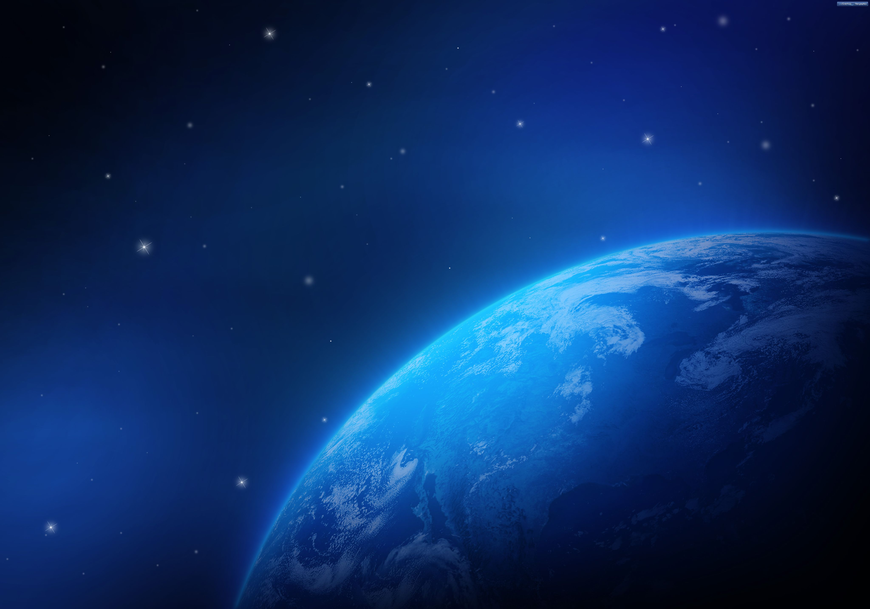

On the magnetospheric ogirion of the repeating Fast Radio Burst
Speaker：Weiyang Wang（王维扬）
NAOC
Collaboration: Renxin Xu & Xuelei Chen
2020.8
Wang et al. 2020, ApJ, 889, 109

Slide 2
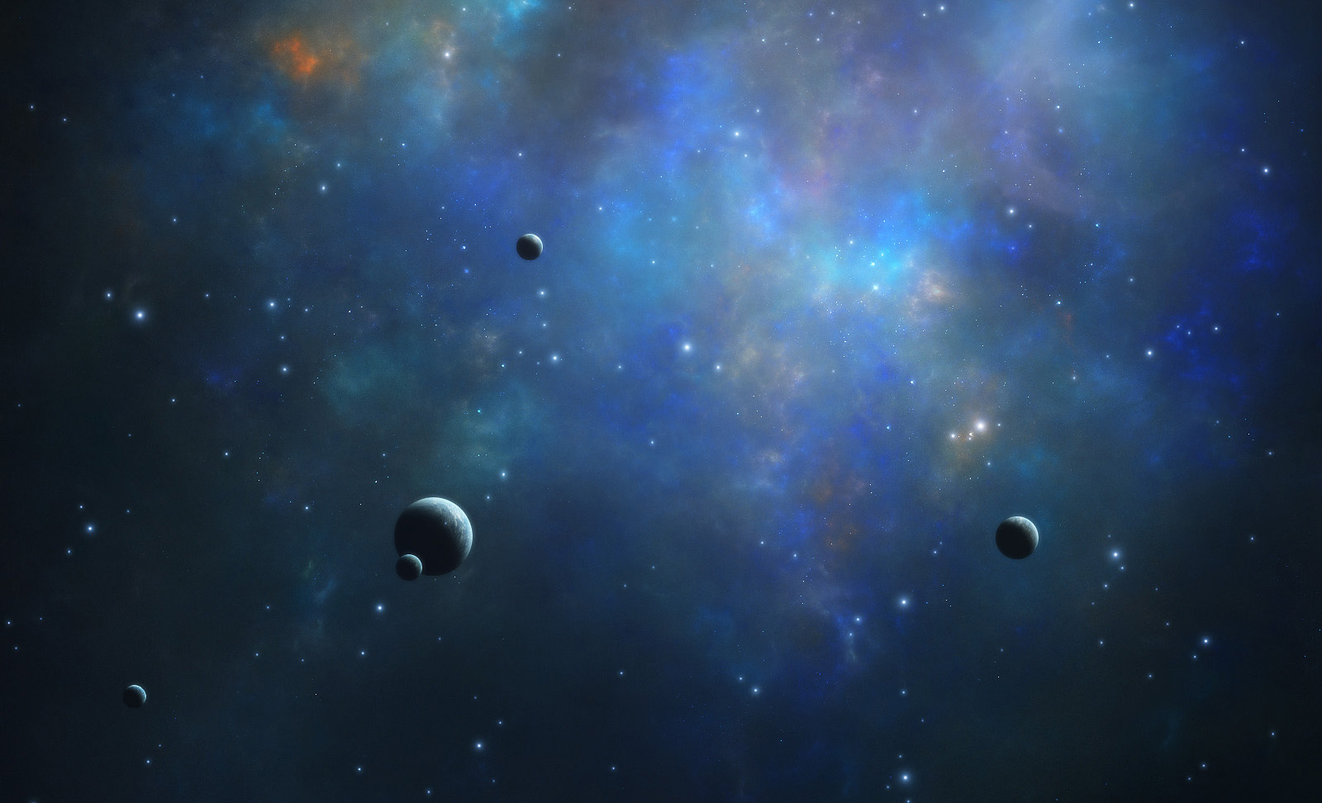


OUTLINES
Background
Model
Application
Conclusion

Slide 3
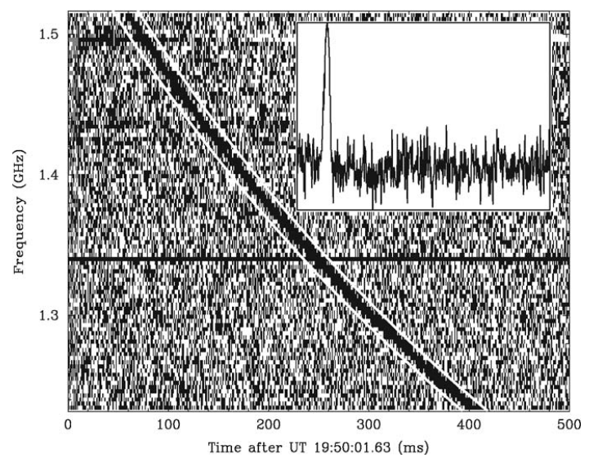

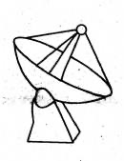
Fast Radio Burst
Roughly 100 FRBs
More than 20 repeaters
9 were localized their galaxies
The Lorimer burst (FRB 010724)
Short duration (0.01 — 50 ms)
High Dispersion Measure (DM, 100-2600 pc cm^-3)
http://frbcat.org

Slide 4
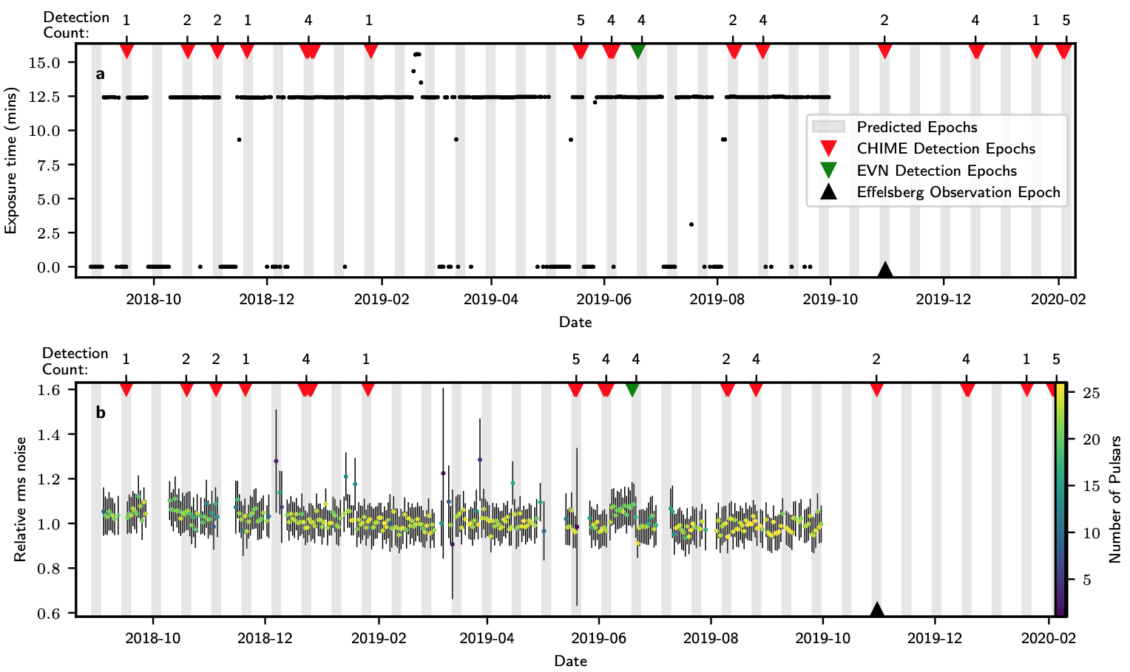
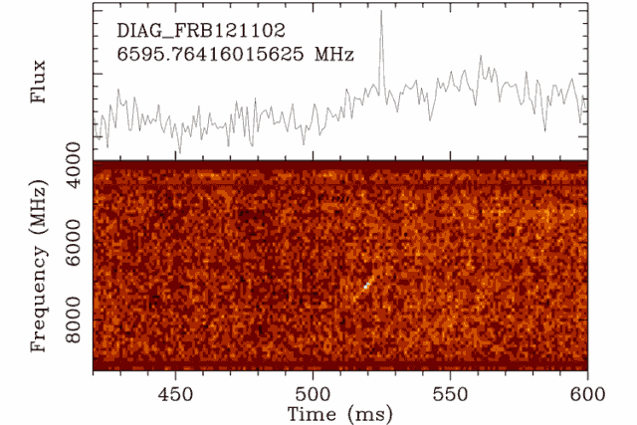
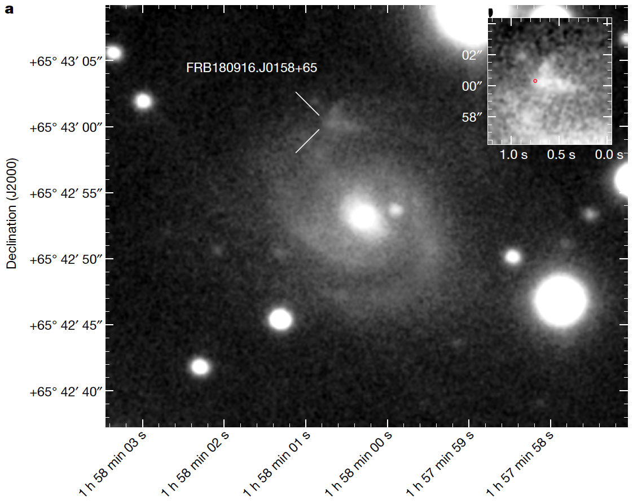
Repeaters
FRB 180916.J0158+65
FRB 121102
Spitler et al. 2016; Marcote et al. 2017, 2020; CHIME/FRB Collaboration et al. 2020

Slide 5
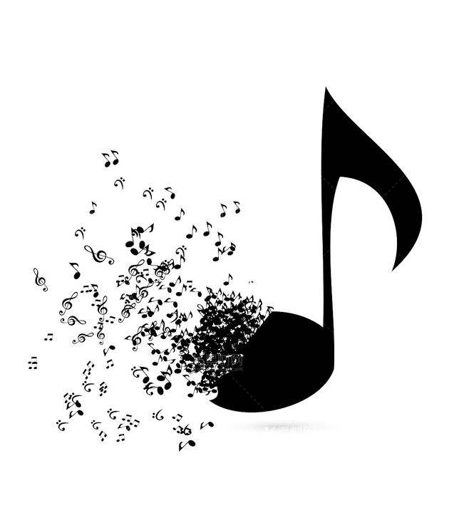
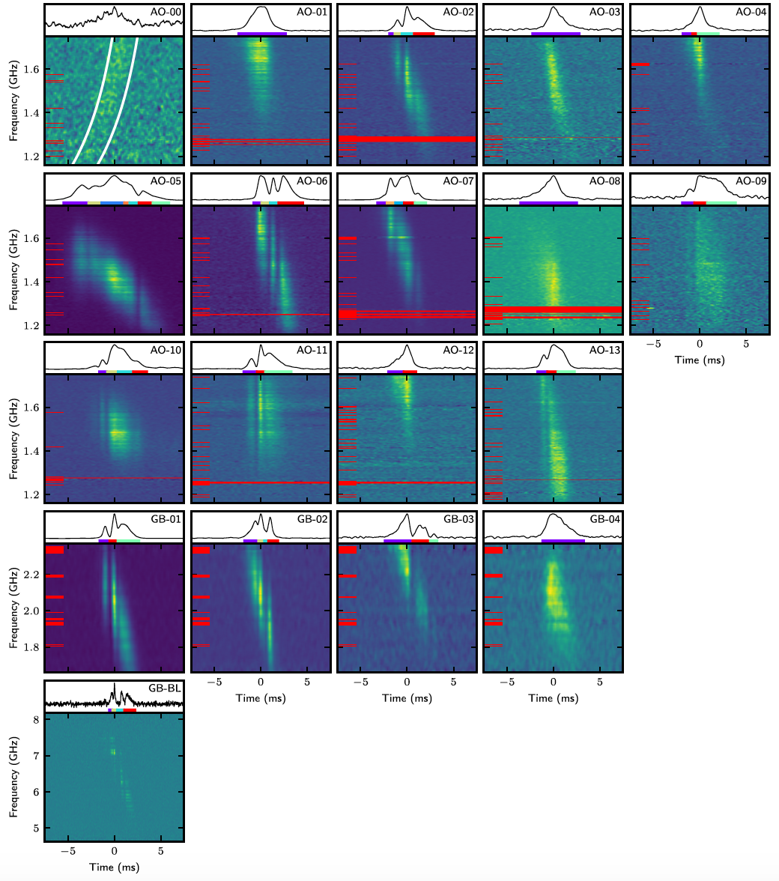
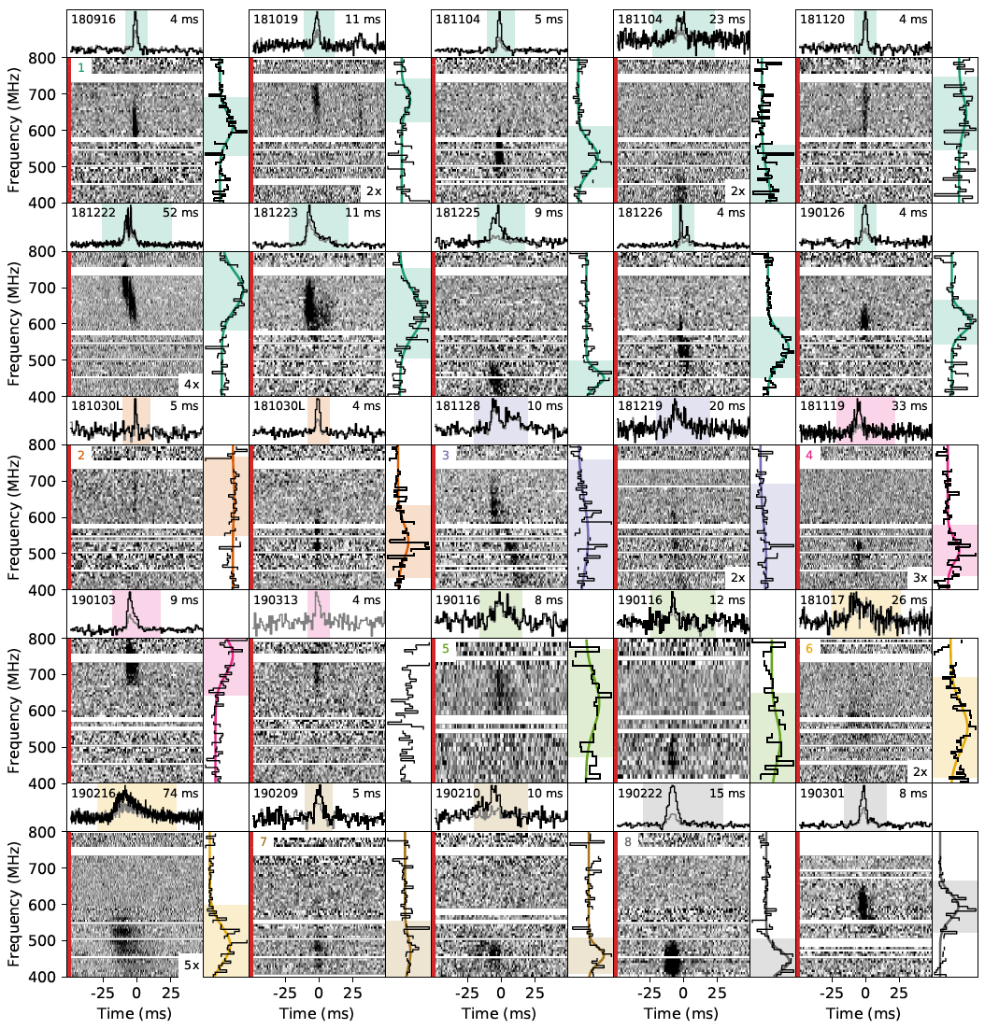
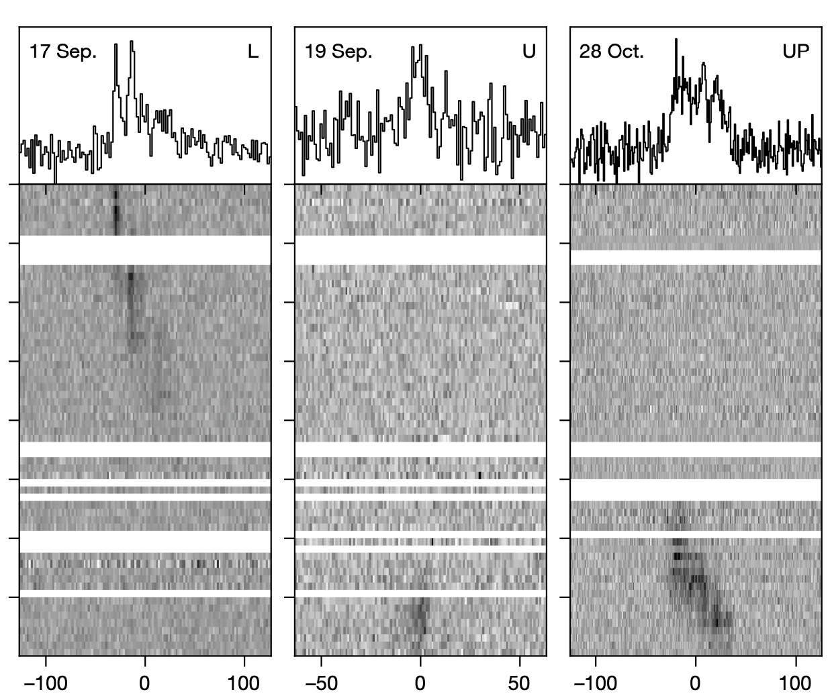
The music of FRB: Drifting structure
FRB 121102
FRB 180916.J0158+65
FRB 180814.J0422+73
Hessels et al. 2019; CHIME/FRB Collaboration, et al. 2019 a,b
Notes:
Only downward drift…
The propagation effect is challenged by why such structures are favored in repeaters.

Slide 6
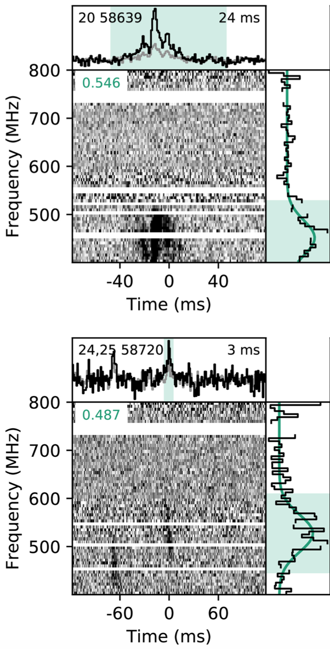
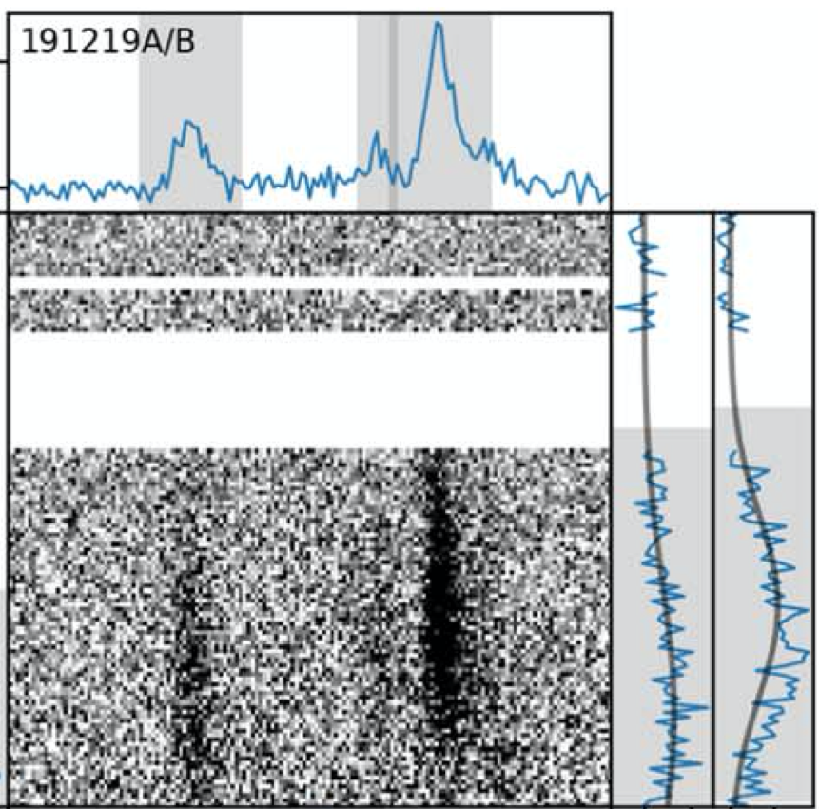
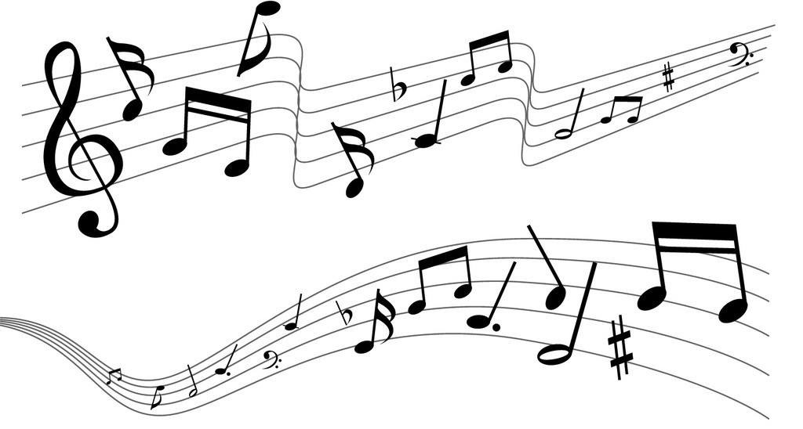
Upward-drifting pattern
FRB 180916.J0158+65
Most are downward-drifting
Such structures have not been reported in Non-repeating FRBs.
CHIME/FRB Collaboration, et al. 2019
Notes:
Only downward drift…
The propagation effect is challenged by why such structures are favored in repeaters.

Slide 7
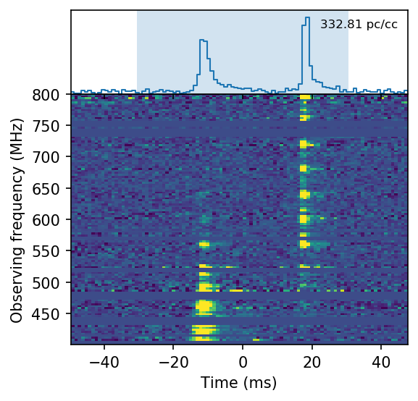
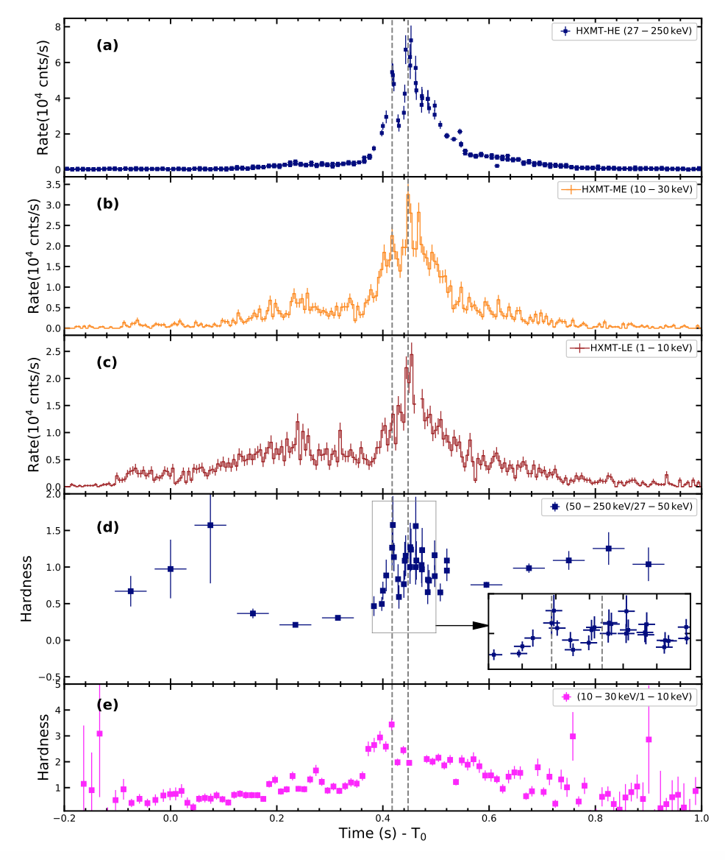
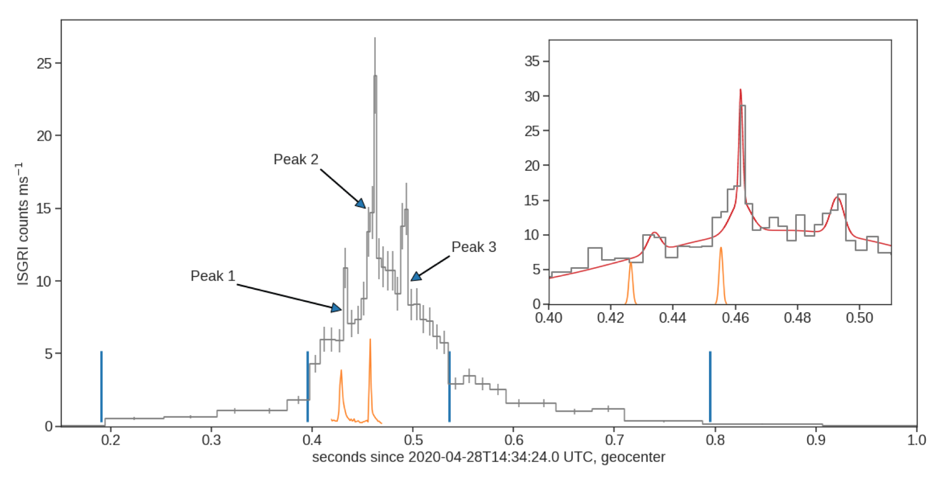
Galactic FRB-like burst
Bursts from SGR 1935+2154
CHIME/FRB Collaboration, et al. 2020;
Li et al. 2020; Mereghetti et al. 2020
Notes:
Only downward drift…
The propagation effect is challenged by why such structures are favored in repeaters.

Slide 8
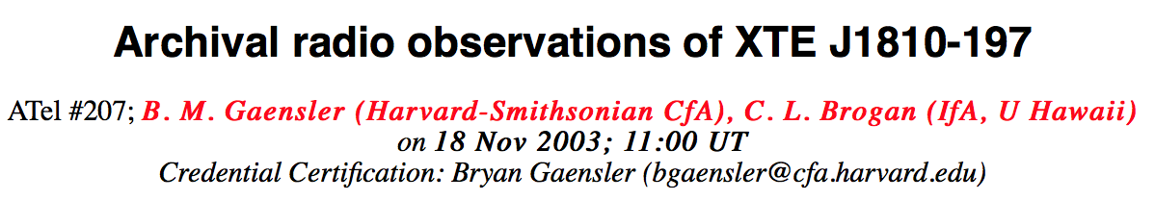
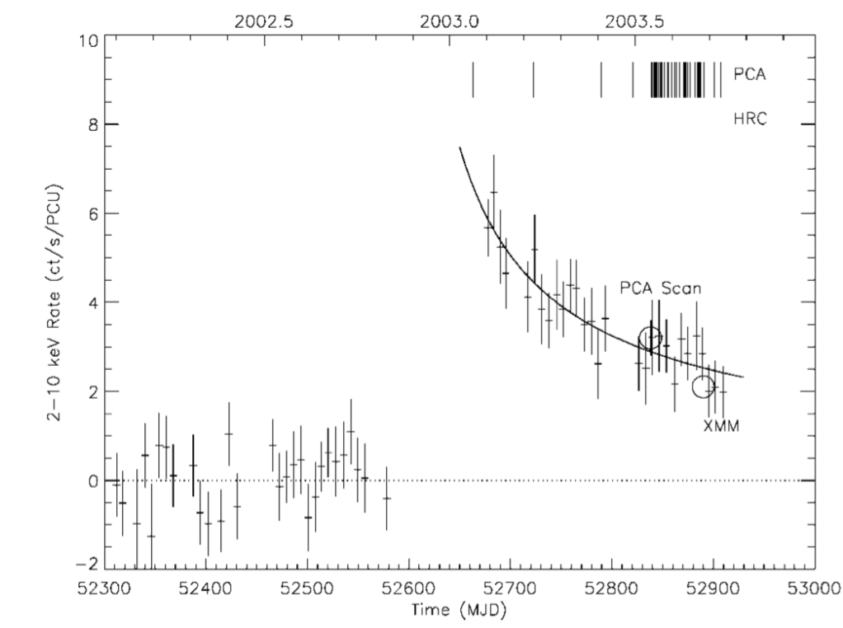
Origin of FRB
XTE J1810-197
A sudden trigger!
Bright: Coherent emission
Different arrival time: Geometric effect
Ibrahim et al. 2004

Slide 9
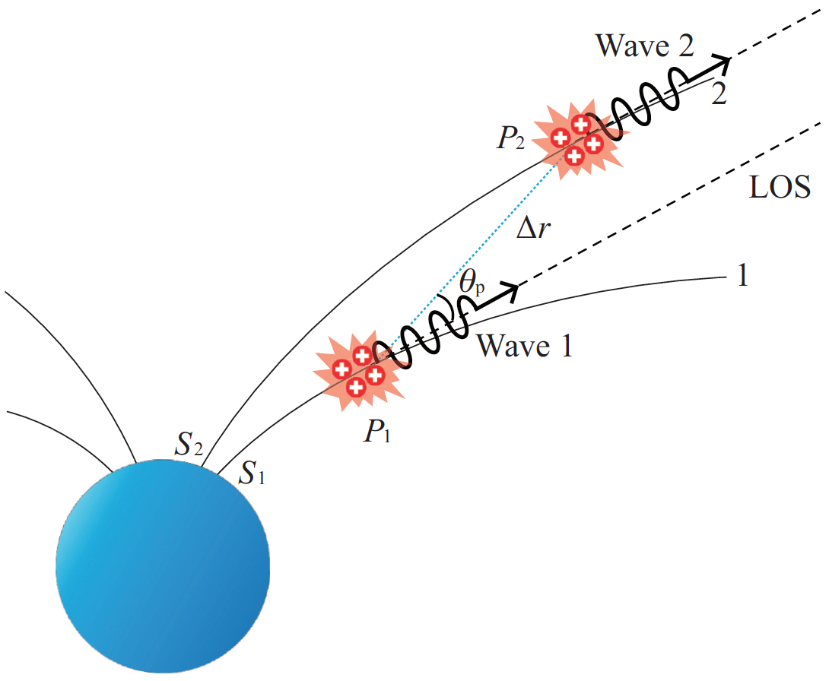
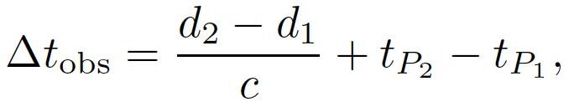

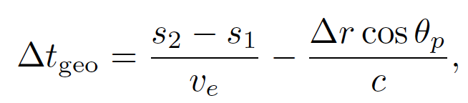


CCE in pulsar-like model
Acceleration of bunches
A general model
$$ν=3cγ^{3}/(4πρ)$$
Geometry
If 𝜸 is a constant, 𝞶₁ > 𝞶₂.
The observed interval time
Interval time of bunch generation
Geometric term
For a dipolar configuration, $∆t_{geo}>0$ .
Notes:
As long as the sparks or bunches of charged particles are produced abruptly from the inner magnetosphere of a neutron star, and stream outwards along the open field lines, a spark observed at an earlier time was always emitted in a more curved part of field line, hence at a higher frequency than one observed later, which had traveled to a less curved part of the field line, hence emitting at a lower frequency.
That is a geometric effect.

Slide 10
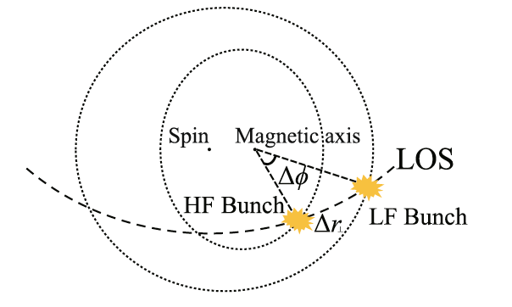
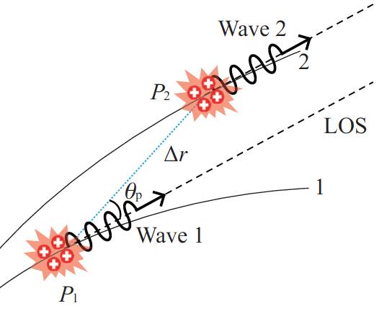


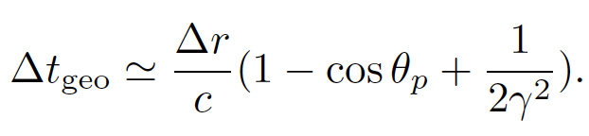
Simultaneity
Wang et al. 2019
Wang et al. 2020
Slow rotating pulsar
𝞶
“Frequency-radius mapping“
t

Slide 11
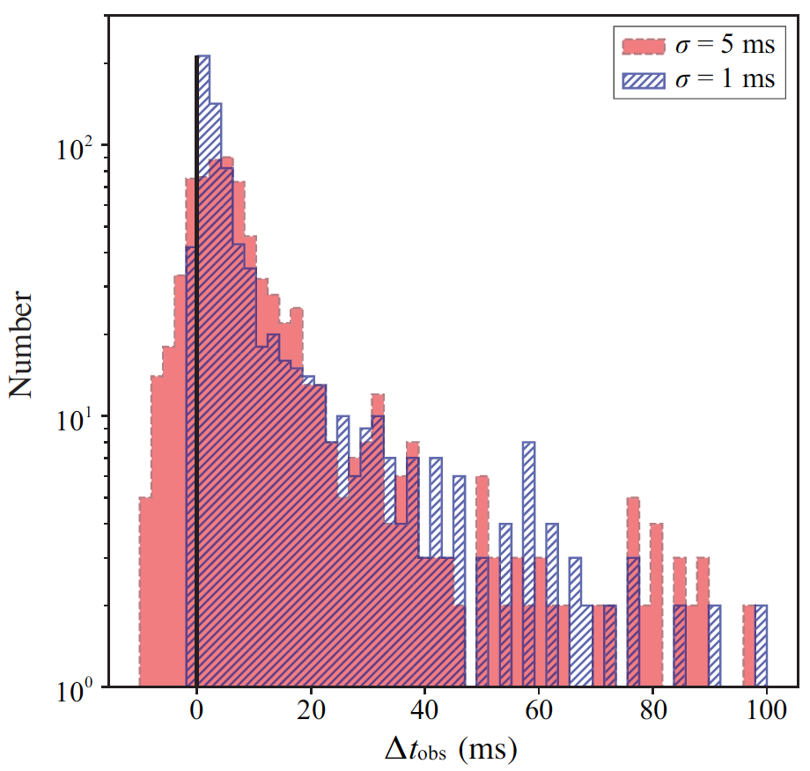
Upward and Downward
$t_{20}−t_{10}$ obeys a Gaussian distribution
Most have downward- drifting sub-pulses, but there are also upward- drifting events.
Long-duration trigger mechanism is more likely to generate upward-drifting events.

Slide 12
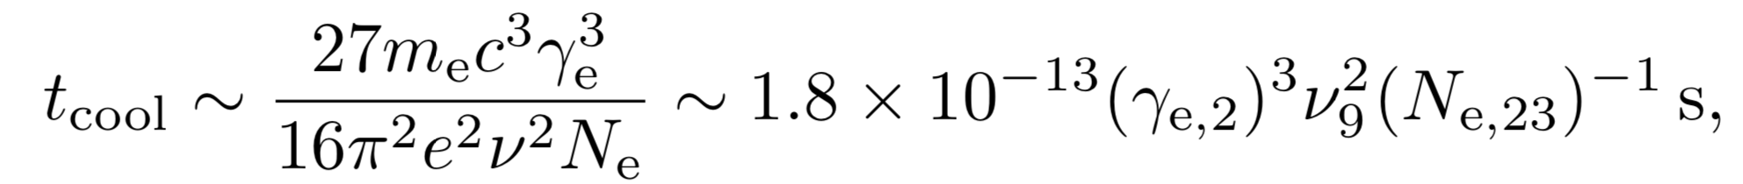
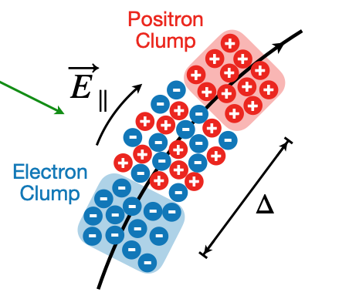
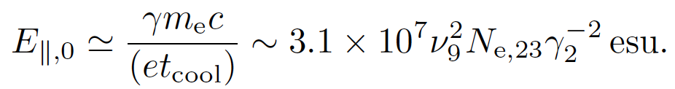
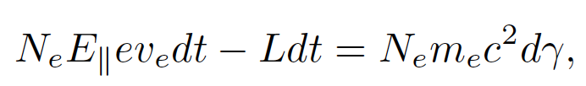
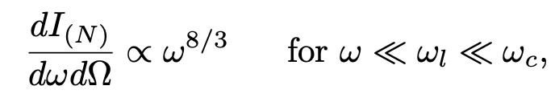
Accelaration and cooling
Fast cooling
much smaller than FRB duration
The required electric filed (constant 𝜸) is
The accelearation of bunches:
Charge sepration leads to a narriow spectrum:
Wang et al. 2019; Yang et al. 2020
Notes:
For typical FRB parameters, both models involve rapid cooling of the emitting particles.
Therefore, to sustain a constant Lorentz constant within the FRB duration, one requires that there exists an E_parallel to the B-field that can accelerate electrons.

Slide 13
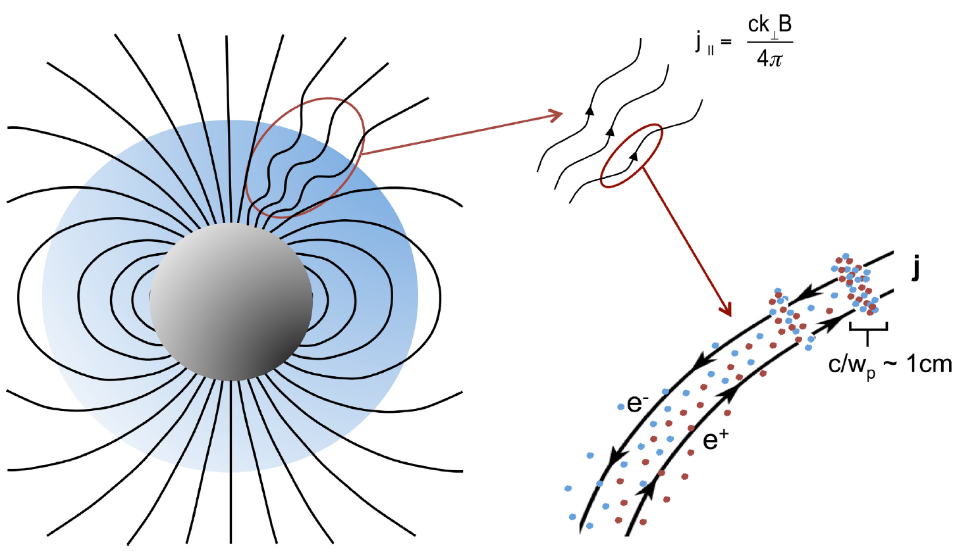


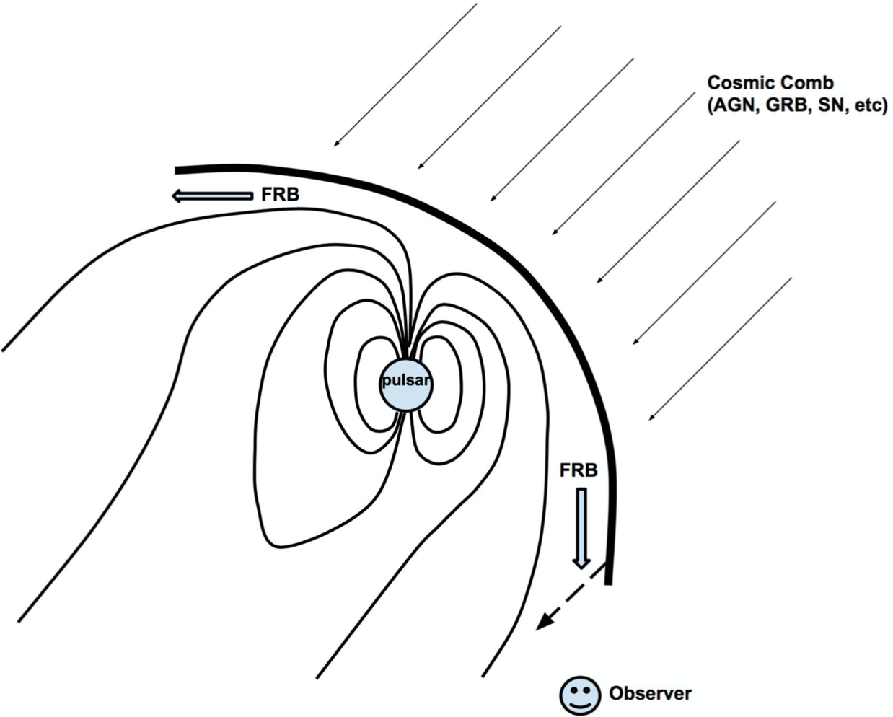
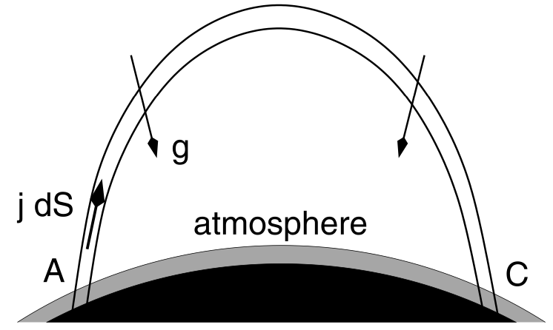
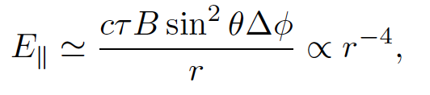
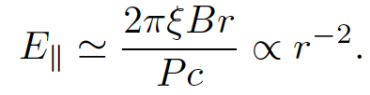
Scenarios of E||
Alvén wave in the charge starvation region
A self-induced field in the twist-current-carrying bundle
Cosmic Comb
Beloborodov & Thompson 2007; Zhang et al. 2017; Kumar & Bošnjak 2020

Slide 14
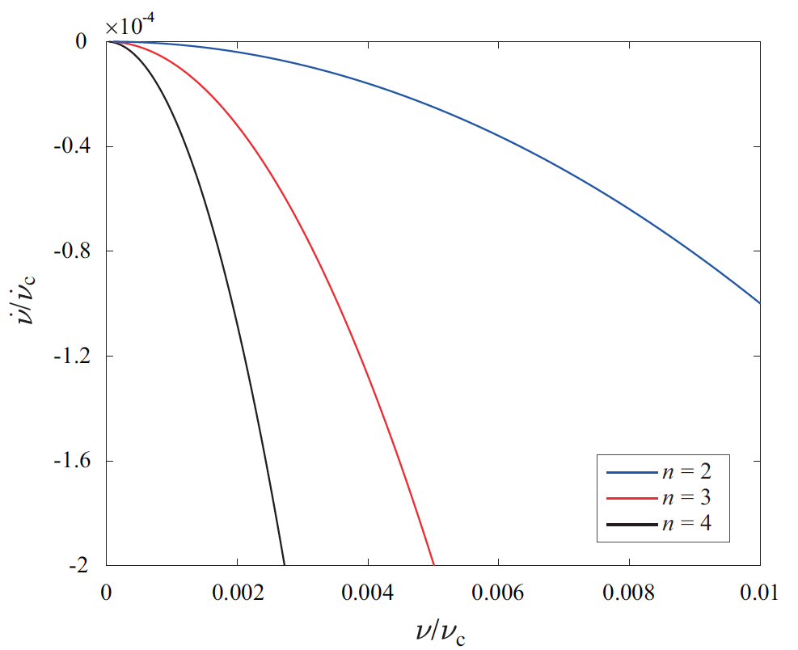
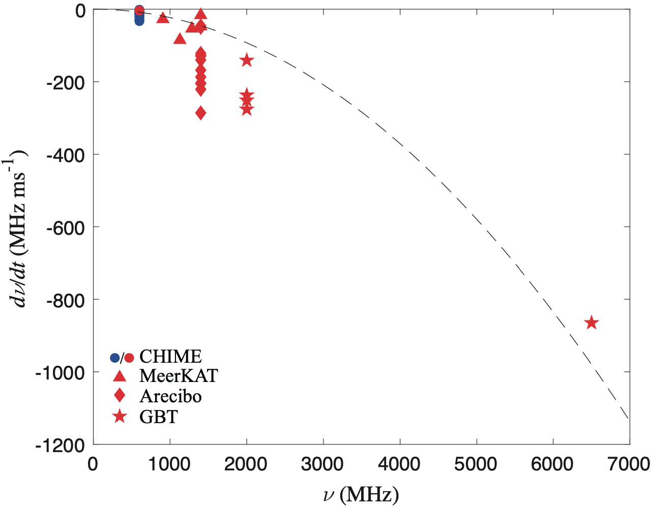
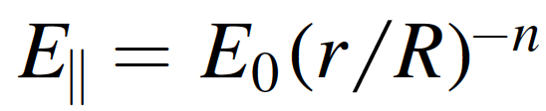
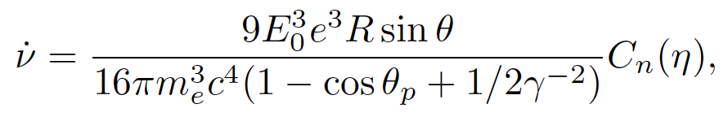
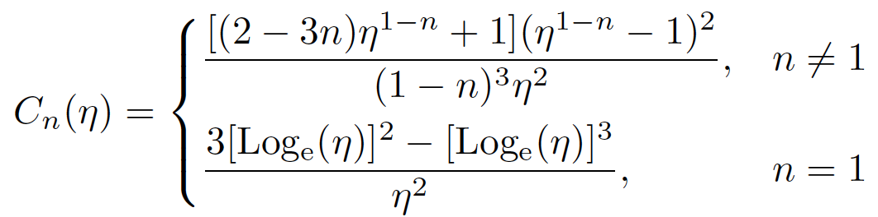

Drifting Structures
Generally,
For constant 𝜸, $dν/dt∝−$𝞶².
FRB 121102 have a rapidly decreasing E||.
n < 1: upwards and downwards.
n > 1: downwards.

Slide 15
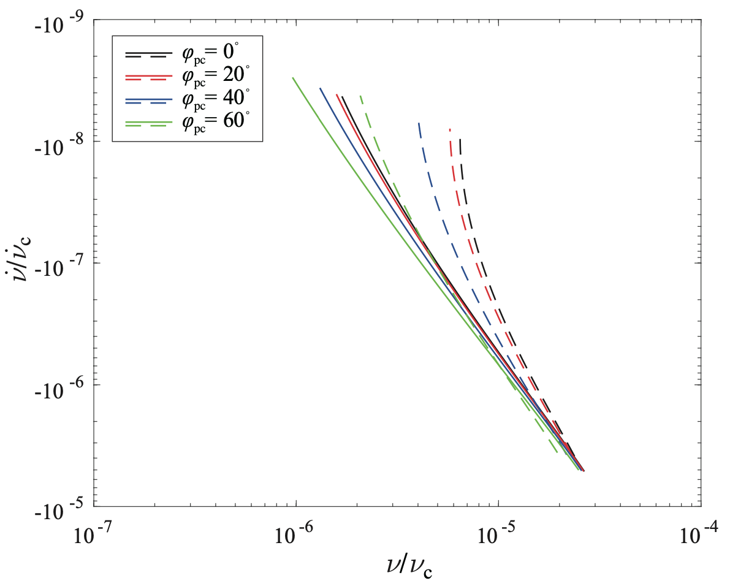
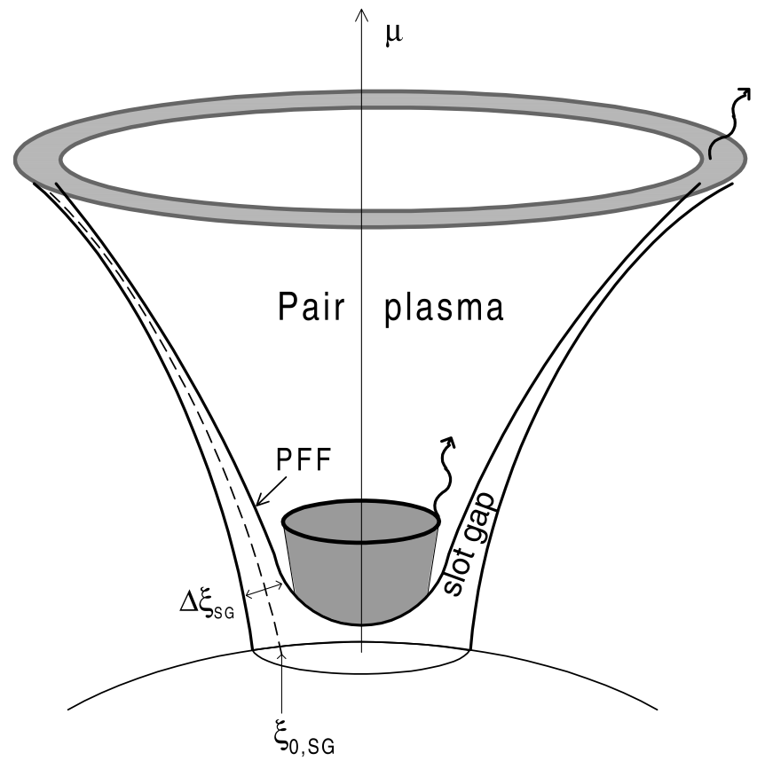
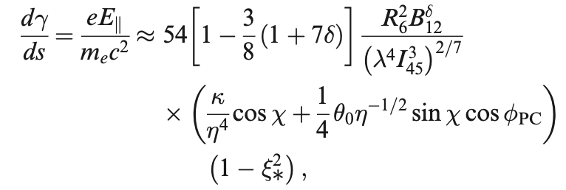
E|| in the slot gap
Muslimov & Harding 2003
Central frequency 𝞶
Drift rate d𝞶/dt

Slide 16
Summary
For an NS with sudden, sporadic and violent triggered sparking, such structure of sub-pulses is a natural consequence of coherent curvature radiation.
Our model model predicts that most FRBs would have downward-drifting sub-pulses, but there are also upward- drifting events, and one would more likely to observe these from FRBs with long duration.
E|| proposed in most FRB models are related to the trigger mechanis, which can be revealed by observation of the time–frequency structure.

Slide 17
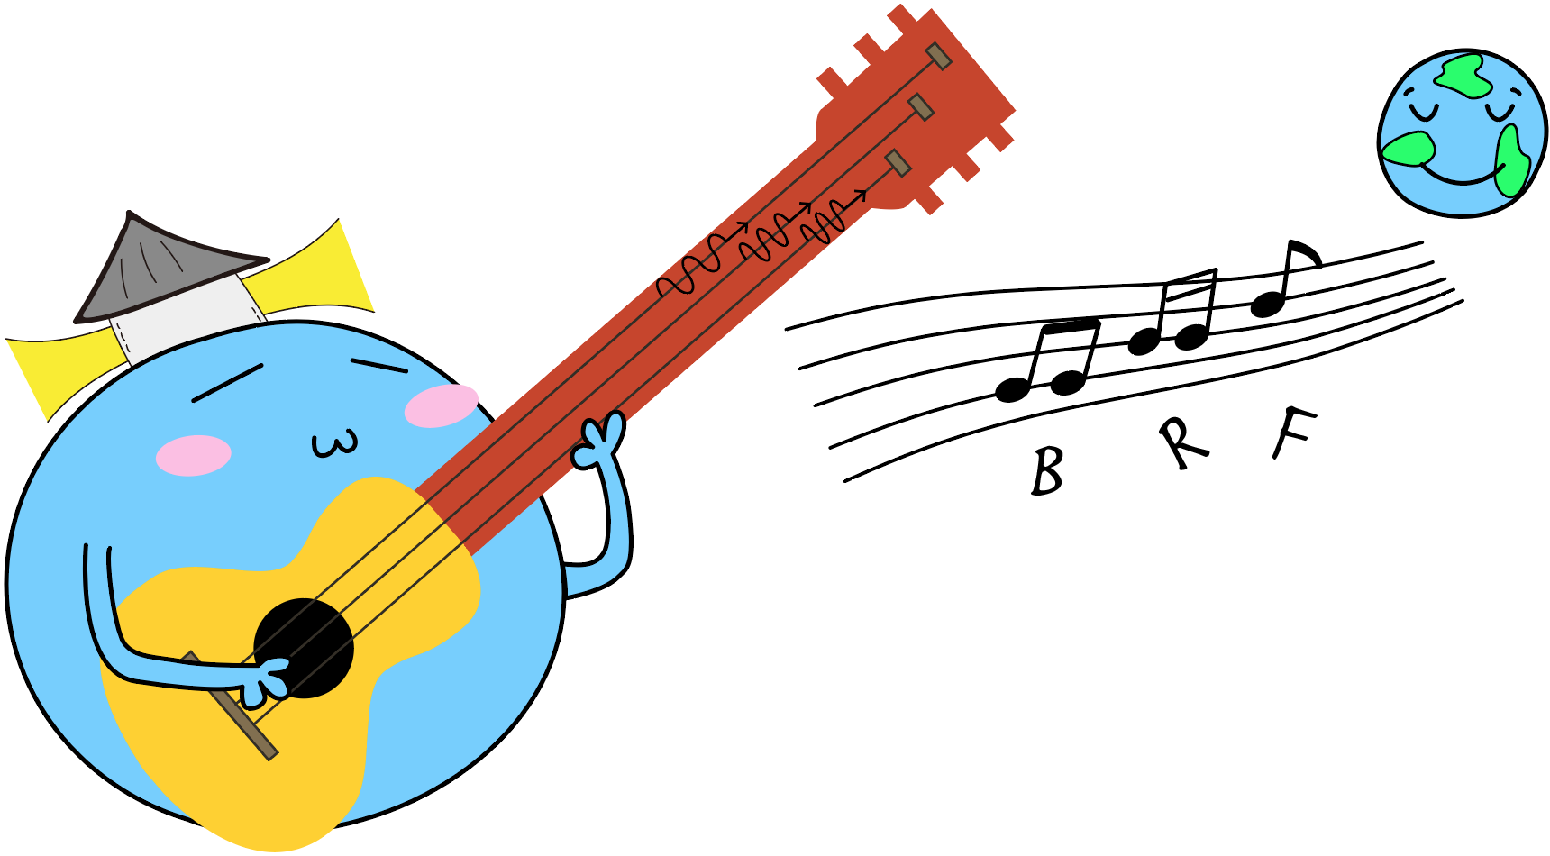
Let us enjoy the music of FRB!
Thanks！

