Slide 1
Supercritically charged objects and electron-positron pair creation
Phys. Rev. D 101,103031 (2020)
Xia, Cheng-Jun (夏铖君)
Zhejiang University Ningbo Institute of Technology
Japan Atomic Energy Agency
Collaborators:
She-Sheng Xue, Ren-Xin Xu, and Shan-Gui Zhou

Slide 2
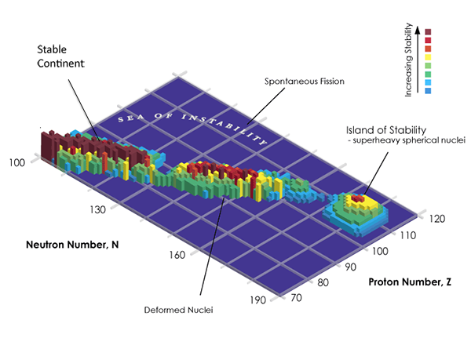
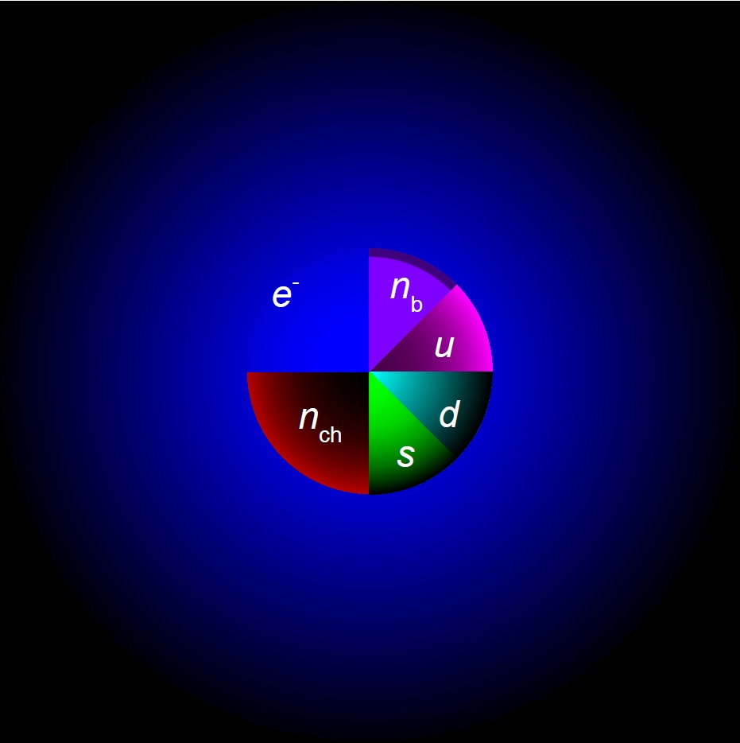
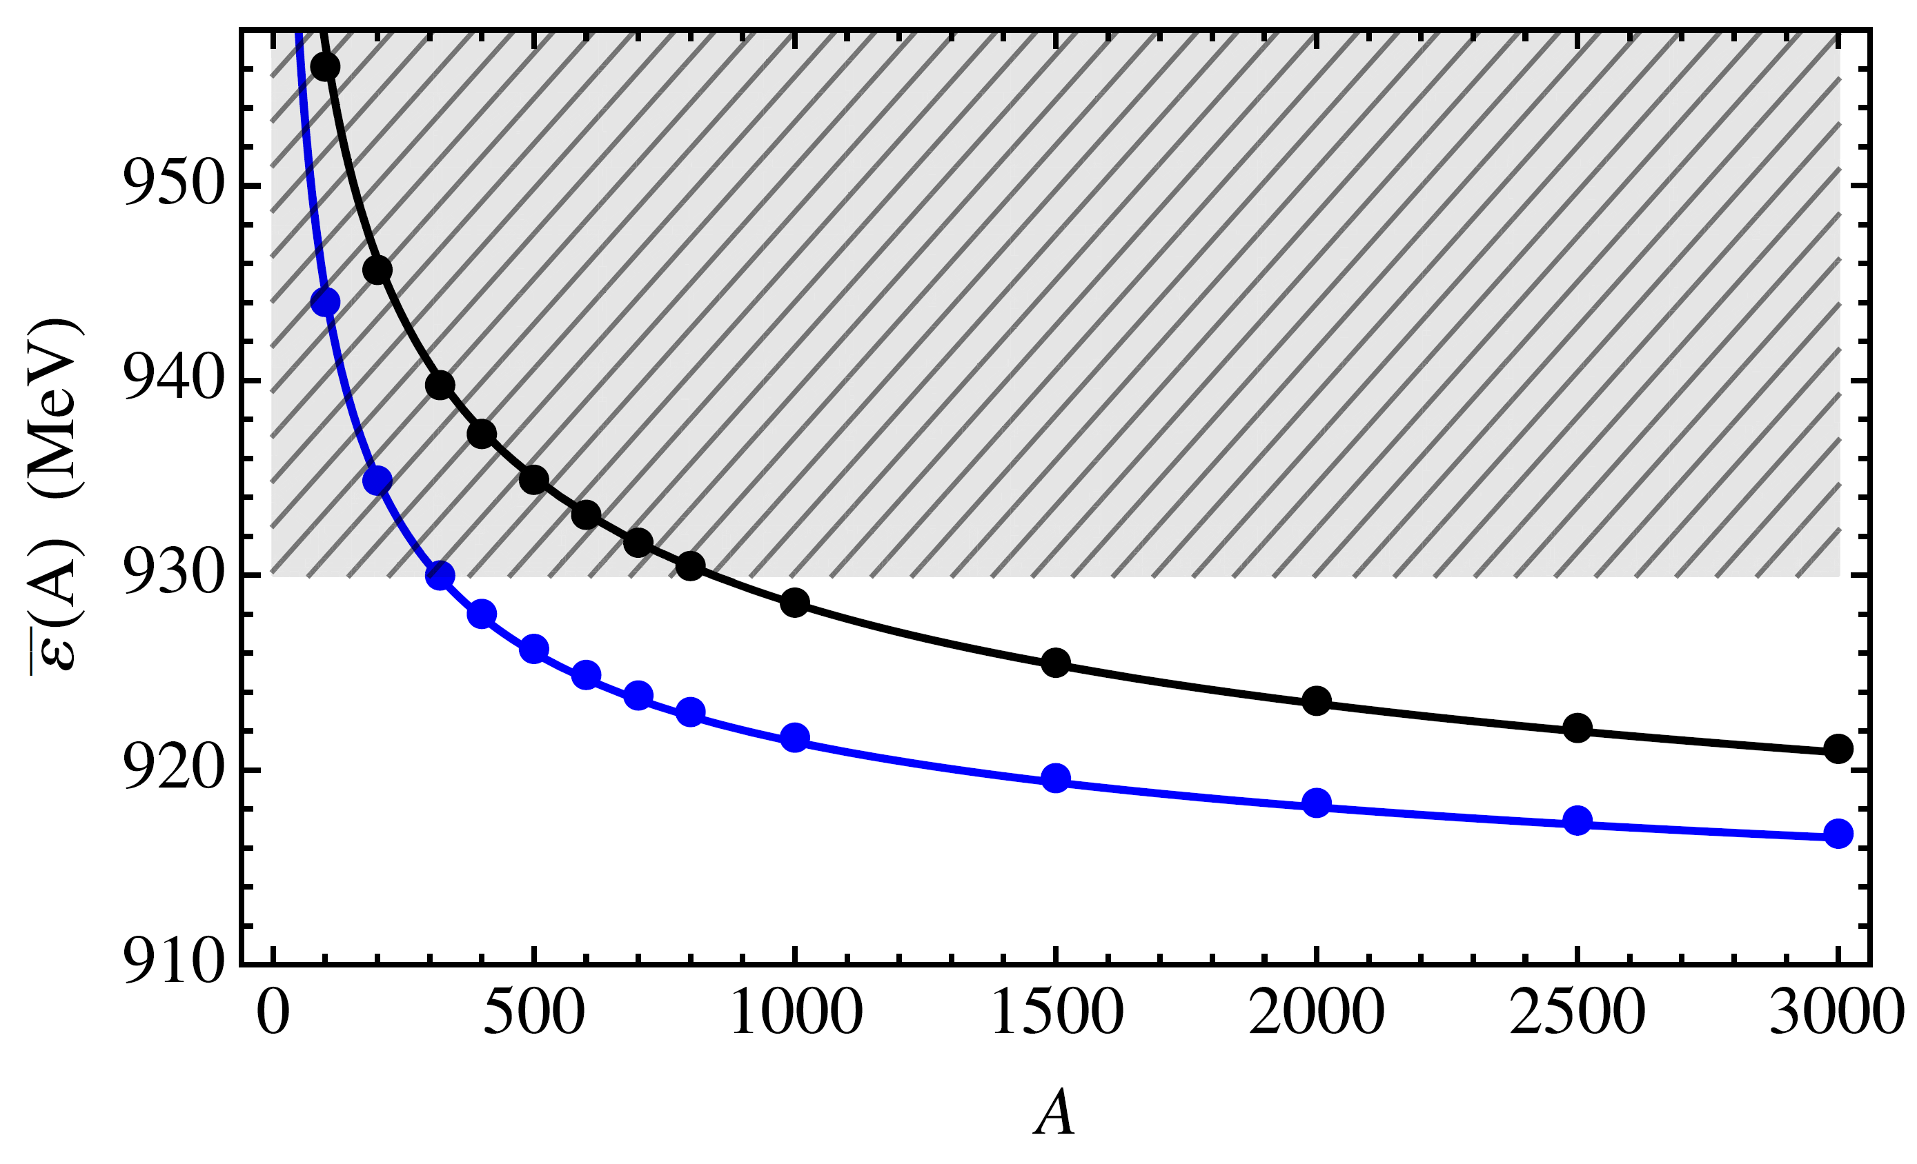
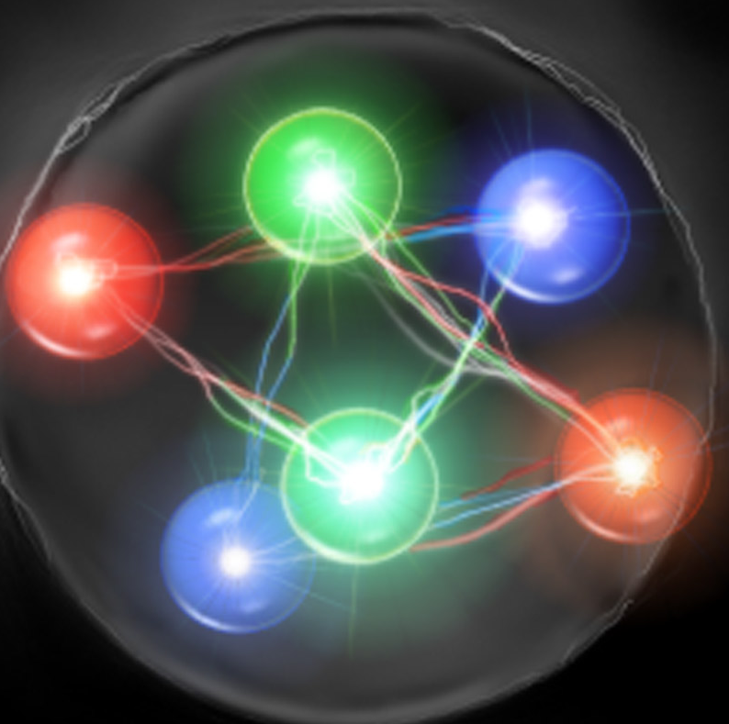
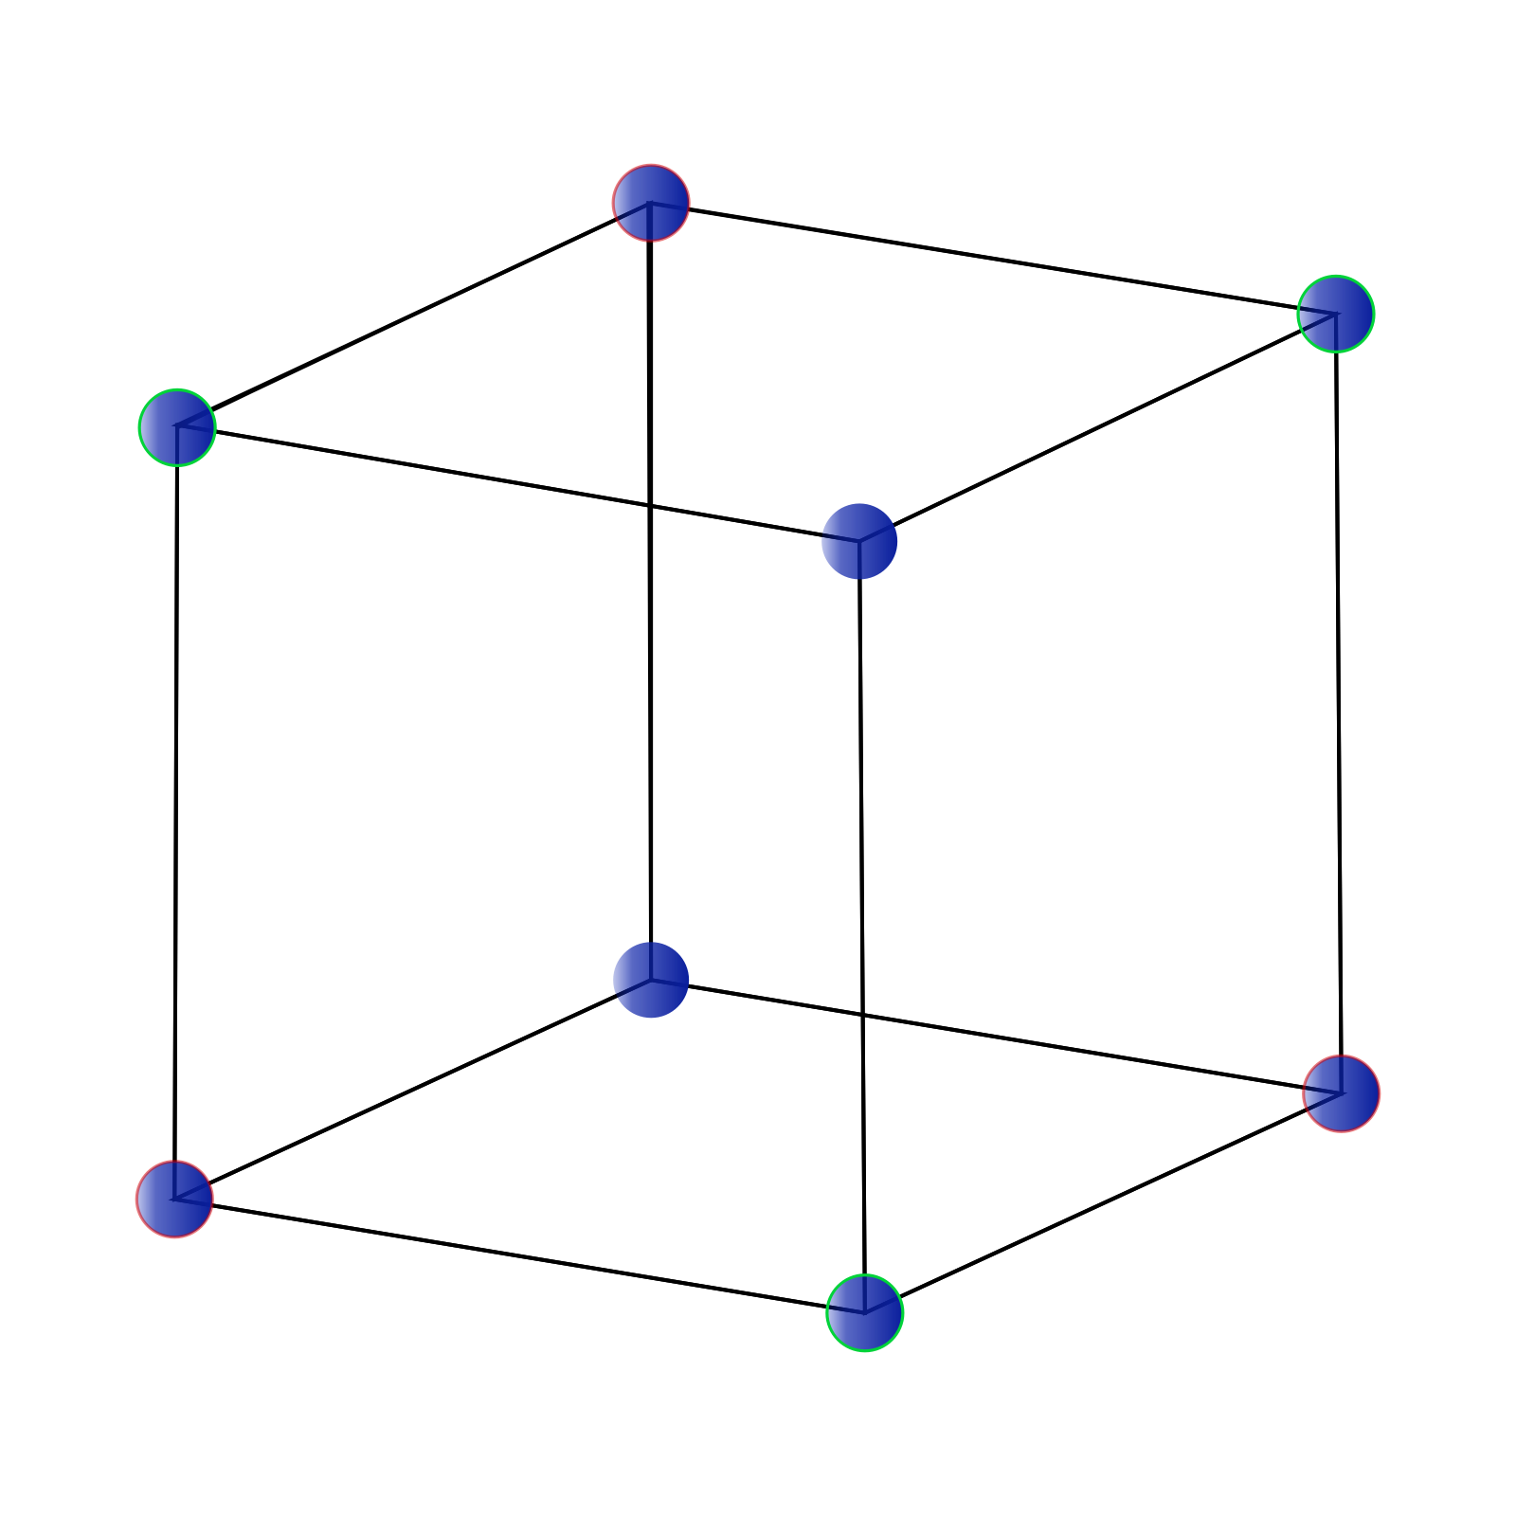
Possible candidates
Superheavy elements with Z≤118 have been synthesized.
Strangelets
Credit: D. Petricic
A_{q}= 2, 3, 4...
Holdom_Ren_Zhang2018_PRL120-222001
Strangeon nuggets:
Prof. Xu's talk
udQM nuggets
Taken from wikipedia

Slide 3
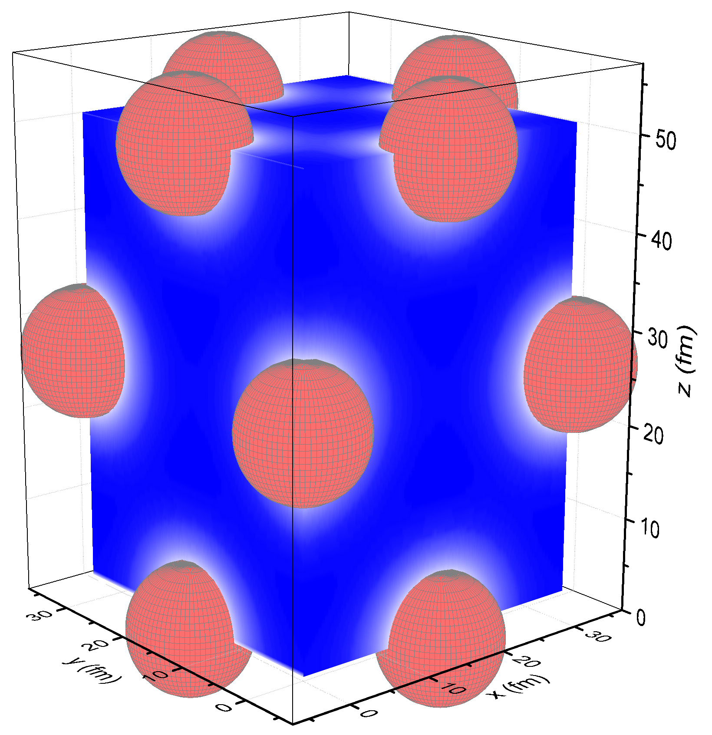
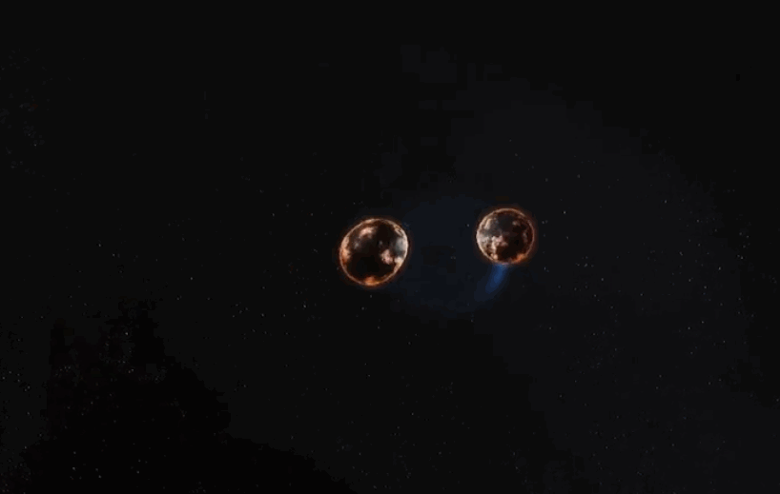
Creation of heavy objects
Gravitational waves: GW170817
Short gamma ray burst: GRB170817A
Transient counterpart: AT2017gfo
Adamian et al.2018_NPA970-22
© 1996-2020 SINA Corporation
Shen et al.2020_ApJ891-148

Slide 4
511 keV line
Possible ionization mechanism:
thermal ionization
Lorentz ionization
collision with other objects
Goldreich-Julian effect of electric charge separation
e⁺
e⁻
2γ
Prantzos et al.2011_RMP83-1001:
Intensity: Total rate of positron annihilation L_{e+} ≥ 2×10⁴³ s⁻¹
Morphology: Bulge-to-disk ratio 1.4
Spectroscopy: positronium fraction 97%+2%
Supercritically charged objects
e⁺+e⁻ -> 2γ (511 keV)
Tracers of binary neutron star mergers: Fuller_Kusenko_Radice_Takhistov2019_PRL122-121101

Slide 5
3.5, 8.7, 9.4, and 10.1 keV emission lines
Han_Ruffini_Xue2010_PLB691-99
Bulbul et al.2014_ApJ789-13

Slide 6
Strong matter and finite-sized objects
Expanding the energy per baryon to the second-order
E_{DM} + E_{e}
Minimizing the mass:

Slide 7
Energy per baryon

Slide 8
Charge properties
The JWKB approximation:

Slide 9
Decay rates
1 MeV = 1.52×10²¹ s⁻¹

Slide 10
Isotropic energy release
GRB170817A: (3.1 ± 0.7)×10⁴⁶ erg

Slide 11

Summary
Based on the Thomas-Fermi approximation, we study stability and e⁺e⁻ pair creation of supercritically charged superheavy nuclei, udQM nuggets, strangelets, and strangeon nuggets. We find
a universal relation ;
the e⁺e⁻ pair production rate estimated with JWKB approximation;
most positrons are emitted at t <10⁻¹⁵ s, while a long lasting positron emission can be observed for large objects with R>10³ fm.
the production e⁺e⁻ pairs may be partially responsible for the short γ-ray burst, the 511 keV continuum emission, the narrow faint emission lines in x-ray spectra from galaxies and galaxy clusters.
Thank you!!!

