Slide 1
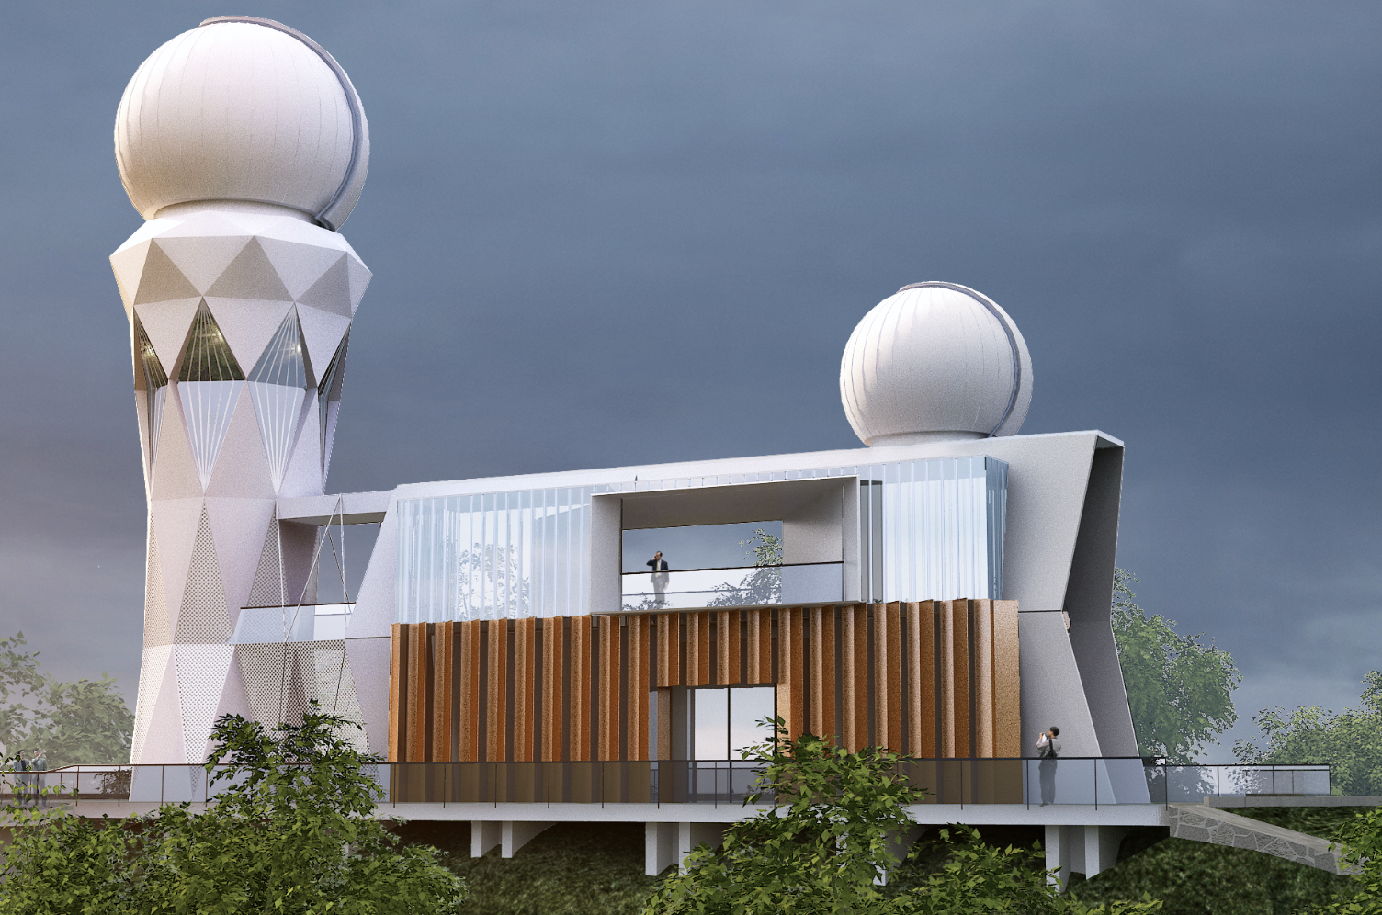
Soft gamma-ray emissions from the polar cap cascade region
Yiyuan Zhu
Collaborator: Jumpei Takata

Slide 2
Outline
Background and Motivation
Model
Result
Conclusion

Slide 3
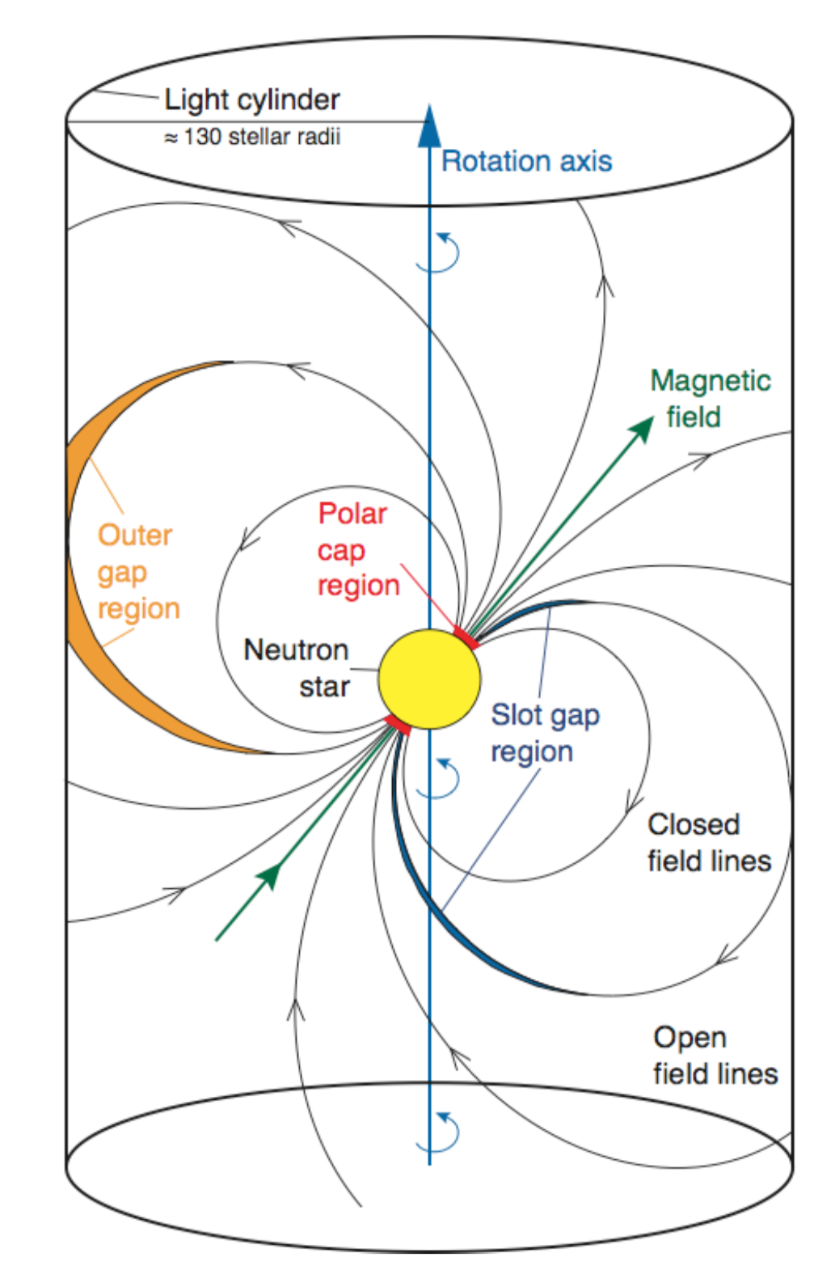
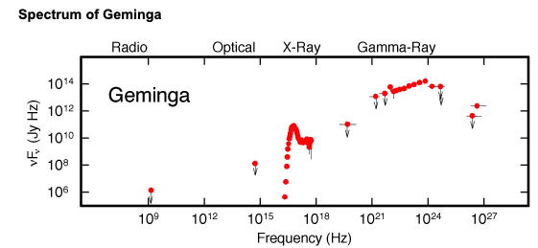
Background and Motivation
Polar cap cascade is the fundamental physical process of the pulsar
No high-energy feature from the polar cap cascade region has been confirmed.
Origin of Non-thermal X-Ray is under debate.
Could it come from the polar cap region?
?
(Credit: D.J. Thompson (NASA/GSFC))
(Aliu et al. 2008+)
Notes:
1. 基础过程: 射电, 星风粒子
2. 对高能辐射, 目前还没有来自polar cap的证据, 例如geminga的X-ray的来源. GeV的来源一般认为来自light cylinder 附近的outer gap, 但 X-ray 的非热辐射很难用outergap解释.
因此我们考虑这种辐射来自于polarcap的可能性,
MeV 脉冲星很可能就是辐射来自于polarcap区域的证据

Slide 4
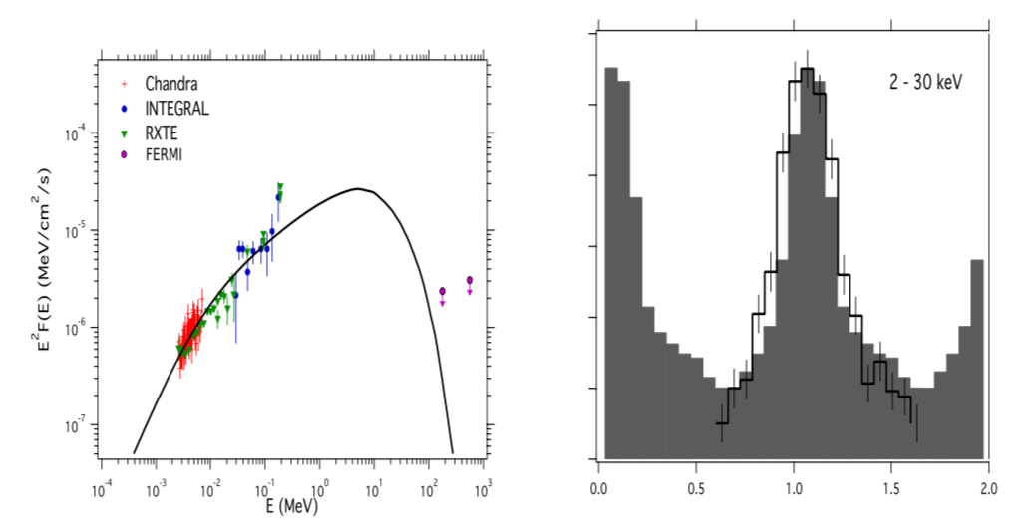
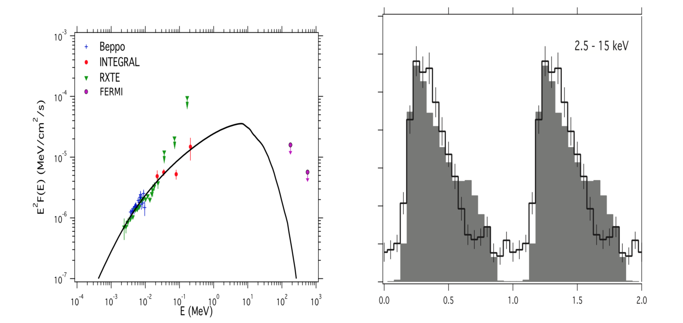
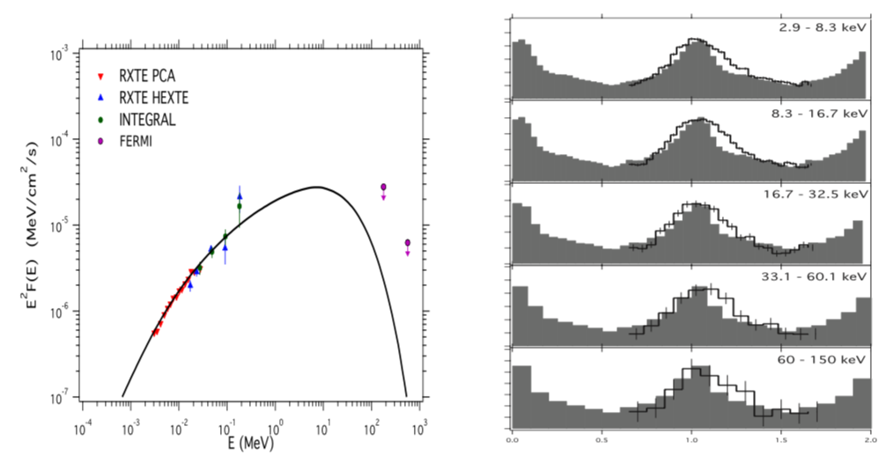
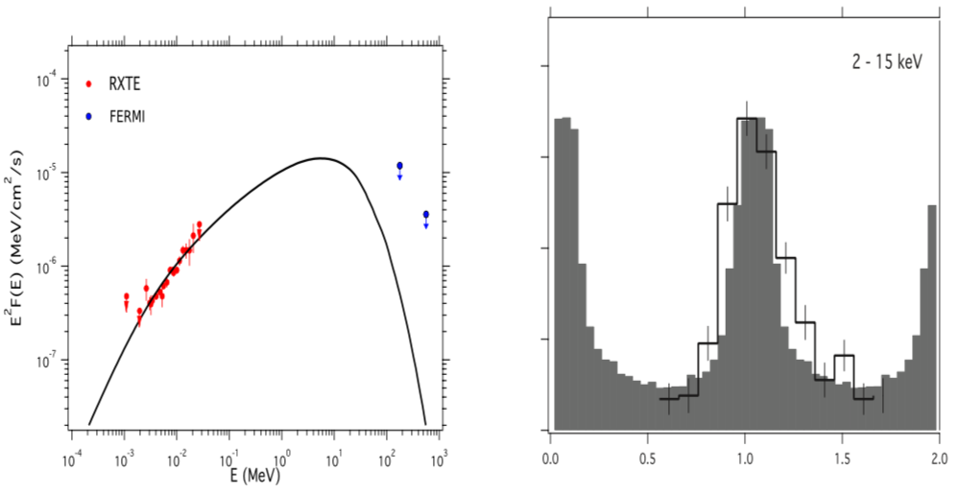
Spectrum and Pulse profile of the MeV pulsars
(Wang et al. 2018)
PSR J1617-5055
PSR J1811-1925
PSR J1846-0258
PSR J1930+1852
MeV pulsars may be the evidence of the emission from the polar cap cascade !
Notes:
Mev 脉冲星是GeVquiet的软伽马ray脉冲星, 目前有6个这样的脉冲星被发现.
他们的观测数据点一般在1kev-1mev之间, turn over 在 10Mev cutoff 在0.1GeV量级

Slide 5
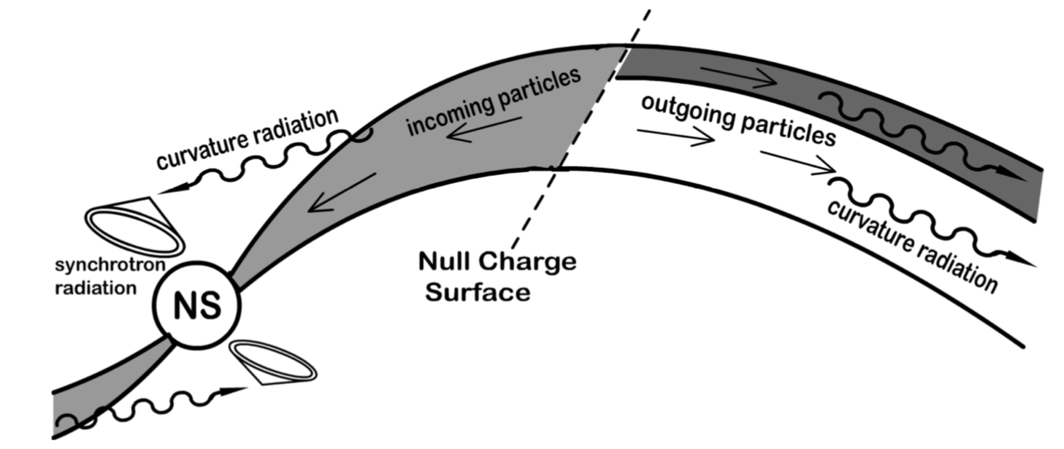
Previous model
(Wang et al. 2018)
Previous work by Wang et al.(2018) suggested that GeV quiet soft gamma-ray is because of the peculiar geometry (Outer gap model).
We discuss the possibility that the emission comes from the polar cap cascade region.
(Aliu et al. 2008+)
Notes:
之前的模型认为这样的MeV辐射来自于outergap区域 inward的高能粒子激发的cascade过程产生了 软gammaray 辐射 加上几何模型, 认为 磁倾角和观测倾角都很小的时候观测到软伽马ray.
我们想研究 这样的软伽马ray辐射 有没有可能来自于polar cap的cascade区域.

Slide 6
Purpose
Simulate the polar cap cascade
Study the high-energy emission from the cascade region
Application to the MeV pulsars.
Notes:
因此我们对这个过程进行了模拟 然后我们研究这个cascade区域发出的高能辐射 最后我们把结果应用到MeV pulsar上, 与观测的光谱进行对照

Slide 7
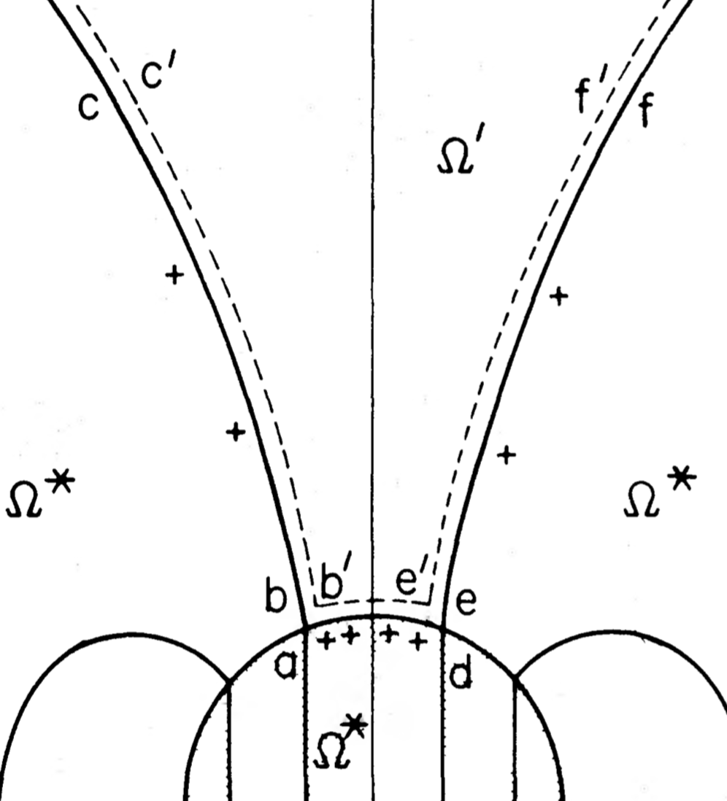
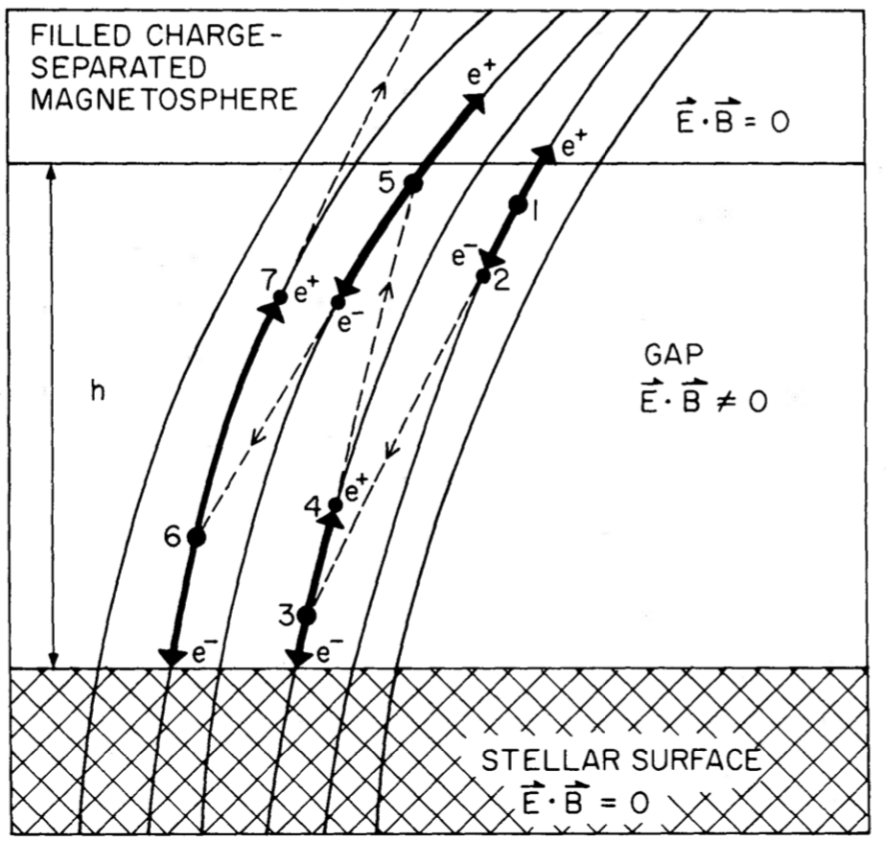
Polar cap accelerator
Basic idea of the polar cap acceleration:
Potential drop
Lorentz factor of the primary particle
Size of the polar cap accelerator
Pulsar dipole magnetic field
（Ruderman et al. 1975 +）
Notes:
介绍一下polarcap的加速区模型, 由于脉冲星的高速旋转, 在极冠区形成一个电压为10^12V的加速区, 这个区域的高度约为 10^3 cm

Slide 8
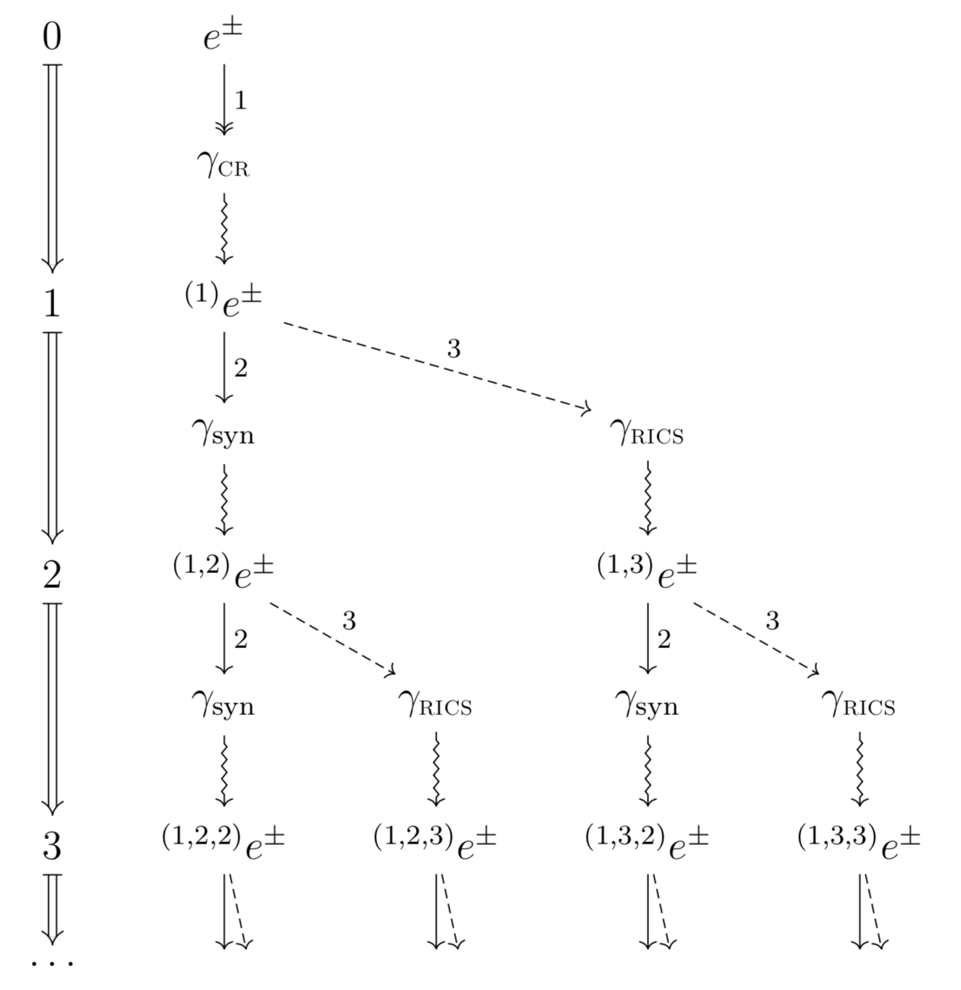
Cascade process in pulsar polar cap
Our calculation is based on Timokhin et al. (2018).
The difference is that we also calculate the spectrum.
The photons that escape from the cascade region make up the spectrum we observe.
（Timokhin et al. 2018）
Notes:
The primary particle emits curvature-radiation(CR) photons.
CR photons are absorbed by the strong magnetic field line and create pairs.
The pairs emit synchrotron and RICS photons.
The photons absorbed by the magnetic field again, and create another generation of pairs,
...
这样 一个初始粒子就可以产生很多个正负电子对, 这样的过程就叫做cascade过程

Slide 9
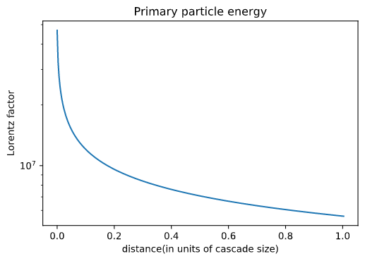
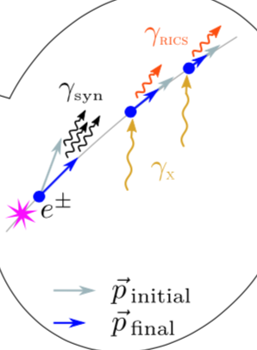
Emission processes
Initial primary particle energy
(in units of m_{e}c²)
-- Curvature radiation
About half of the energy would be transferred into CR photons.
Emission from the pairs
-- Synchrotron radiation
-- Reasonant inverse-Compton scattering(RICS) with the thermal photons from the surface.
Notes:
这里考虑到的辐射机制有3种, CR syn RICS. 初始粒子只发出曲率辐射, 在经过整个cascade区域后, 大约辐射出了一半的能量作为CR光子. 从几x10^7 -几x10^6 洛伦兹因子.
曲率辐射光子被磁场线吸收后产生的正负电子对 只辐射syn RICS,
同步辐射光子的能量来自 垂直磁场线的动能 垂直分量消耗完毕后 粒子与(来自中星表面的热光子)软x射线光子发生 rics , 消耗掉平行B方向的能量.

Slide 10
Assumptions
Size of the cascade region. s_{cascde} = 2R_{NS}
Constant magnetic field
Constant curvature radius of the magnetic field
Polar cap injects the particles with an Goldreich-Julian rate.
Notes:
我们的模拟有几个假设

Slide 11
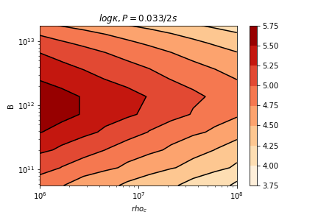
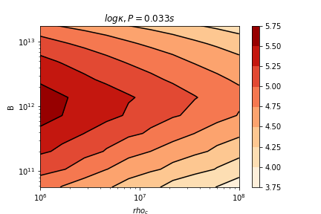
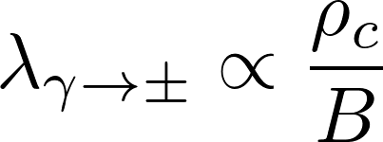
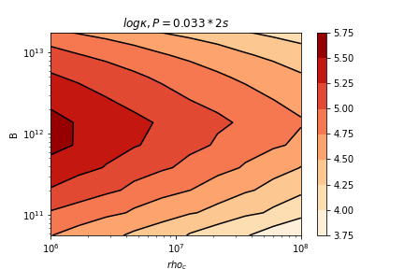
Multiplicity
Multiplicity is the number of particles created by one priamry particle.
At B~10¹² G it reaches the maximum.
When magnetic field > 10¹²G, the mean free path decrease, then the perpendicular momentum decrease.
Multiplicity ~10⁵-10⁶ for typical parameters of the pulsars.
Notes:
这是模拟得到的multi的结果, multi是... 我们在不同的磁场线曲率半径10^6-8cm 和不同磁场强度 10^11-13 G 的范围下模拟得到 muilti

Slide 12
Luminosity of escaping photons
The maximum locates at B~10¹²G,
because synchrotron radiation power decrease with B and N_{GJ} increase with B.

Slide 13
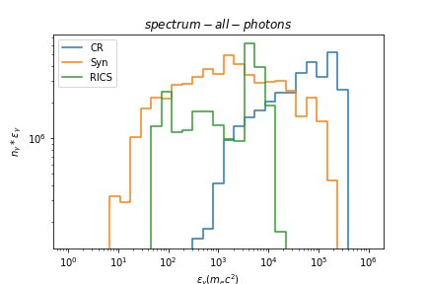
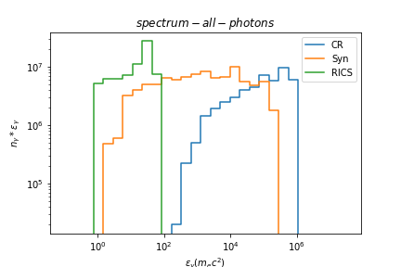
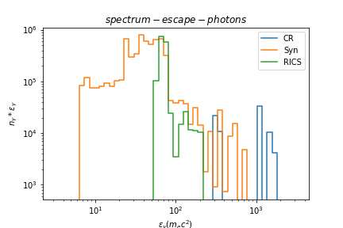
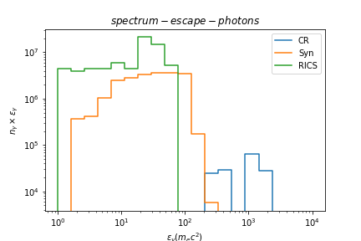
Spectrum
B=10¹³G
B=10¹²G
Notes:
过程中产生的所有光子, 逃逸出来的光子.
逃逸的光子成分主要是同步辐射和逆康普顿散射.
B-12, 产生的逆康普顿光子几户全部逃逸出来了, 没有贡献multiplicity
B-13, RICS被吸收 说明磁场较大时逆康普顿散射贡献的multi较多

Slide 14
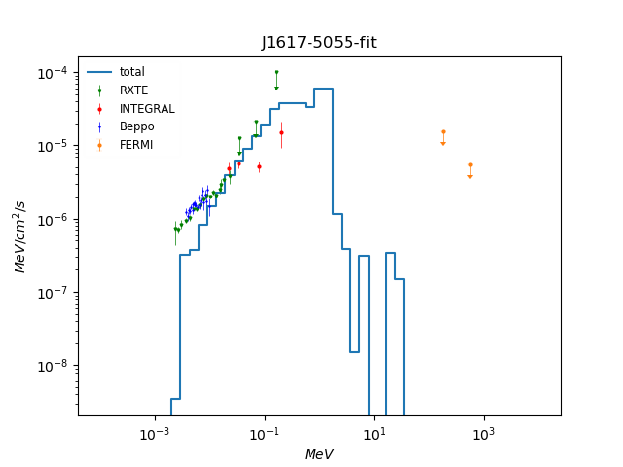
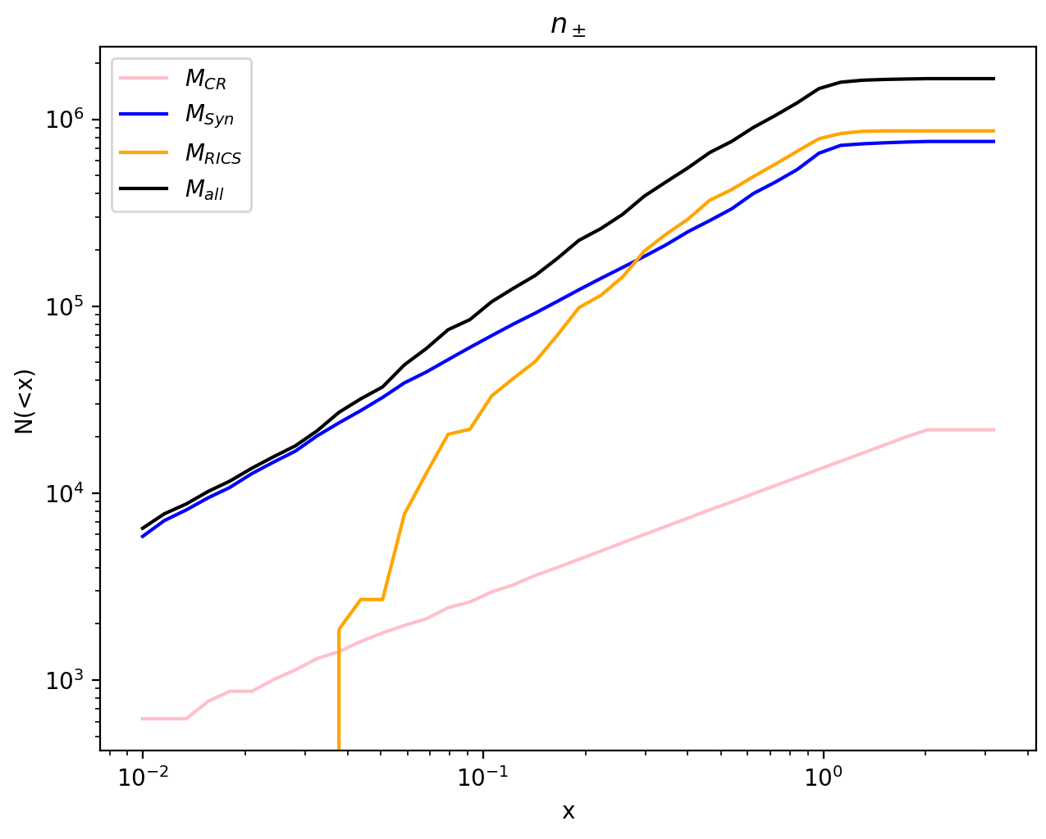
Compare with the observation of SGR PSR J1617-5055
multiplicity: 1648899
J1617-5055: P=69ms
B~3.1x10¹²G
Our simulation could explain the emission of J1617-5055 at 1keV~1MeV.
Parameters with s_{cascade}=2R_{NS} and ρ_{c}=10⁶cm provides a good fit to the observation.

Slide 15
Conclusion
Our work suggests that the soft gamma-ray emissions could come from the cascade process in the pulsar polar cap region.
The multiplicity could reach its maximum when B~10¹²G. And it's higher with lower curvature radius and shorter spinning period.
The maximum of luminosity locates at B~10¹²G. And it's higher with shorter period and higher curvature radius.
RICS contributes more to multiplicity in higher magnetic field.

Slide 16
Future plan
Extend the model
Extending the cascade simulation for magnetic field > 10¹³ G where Photon splitting becomes important.
Apply the 3D polar cap accelerator model to our simualtion.
Confirm the model
- Study the emission geometry and compare it with the pulse profile.

