Slide 1


Structure and stress interaction between planetary interior layers
⎯⎯⎯ A case study on Tibet Plateau
Yan Hu, Jian Zhang, Yunguo Chen
School of Earth and Space Sciences, University of Science and Technology of China
2023-05-22 FAST

Slide 2
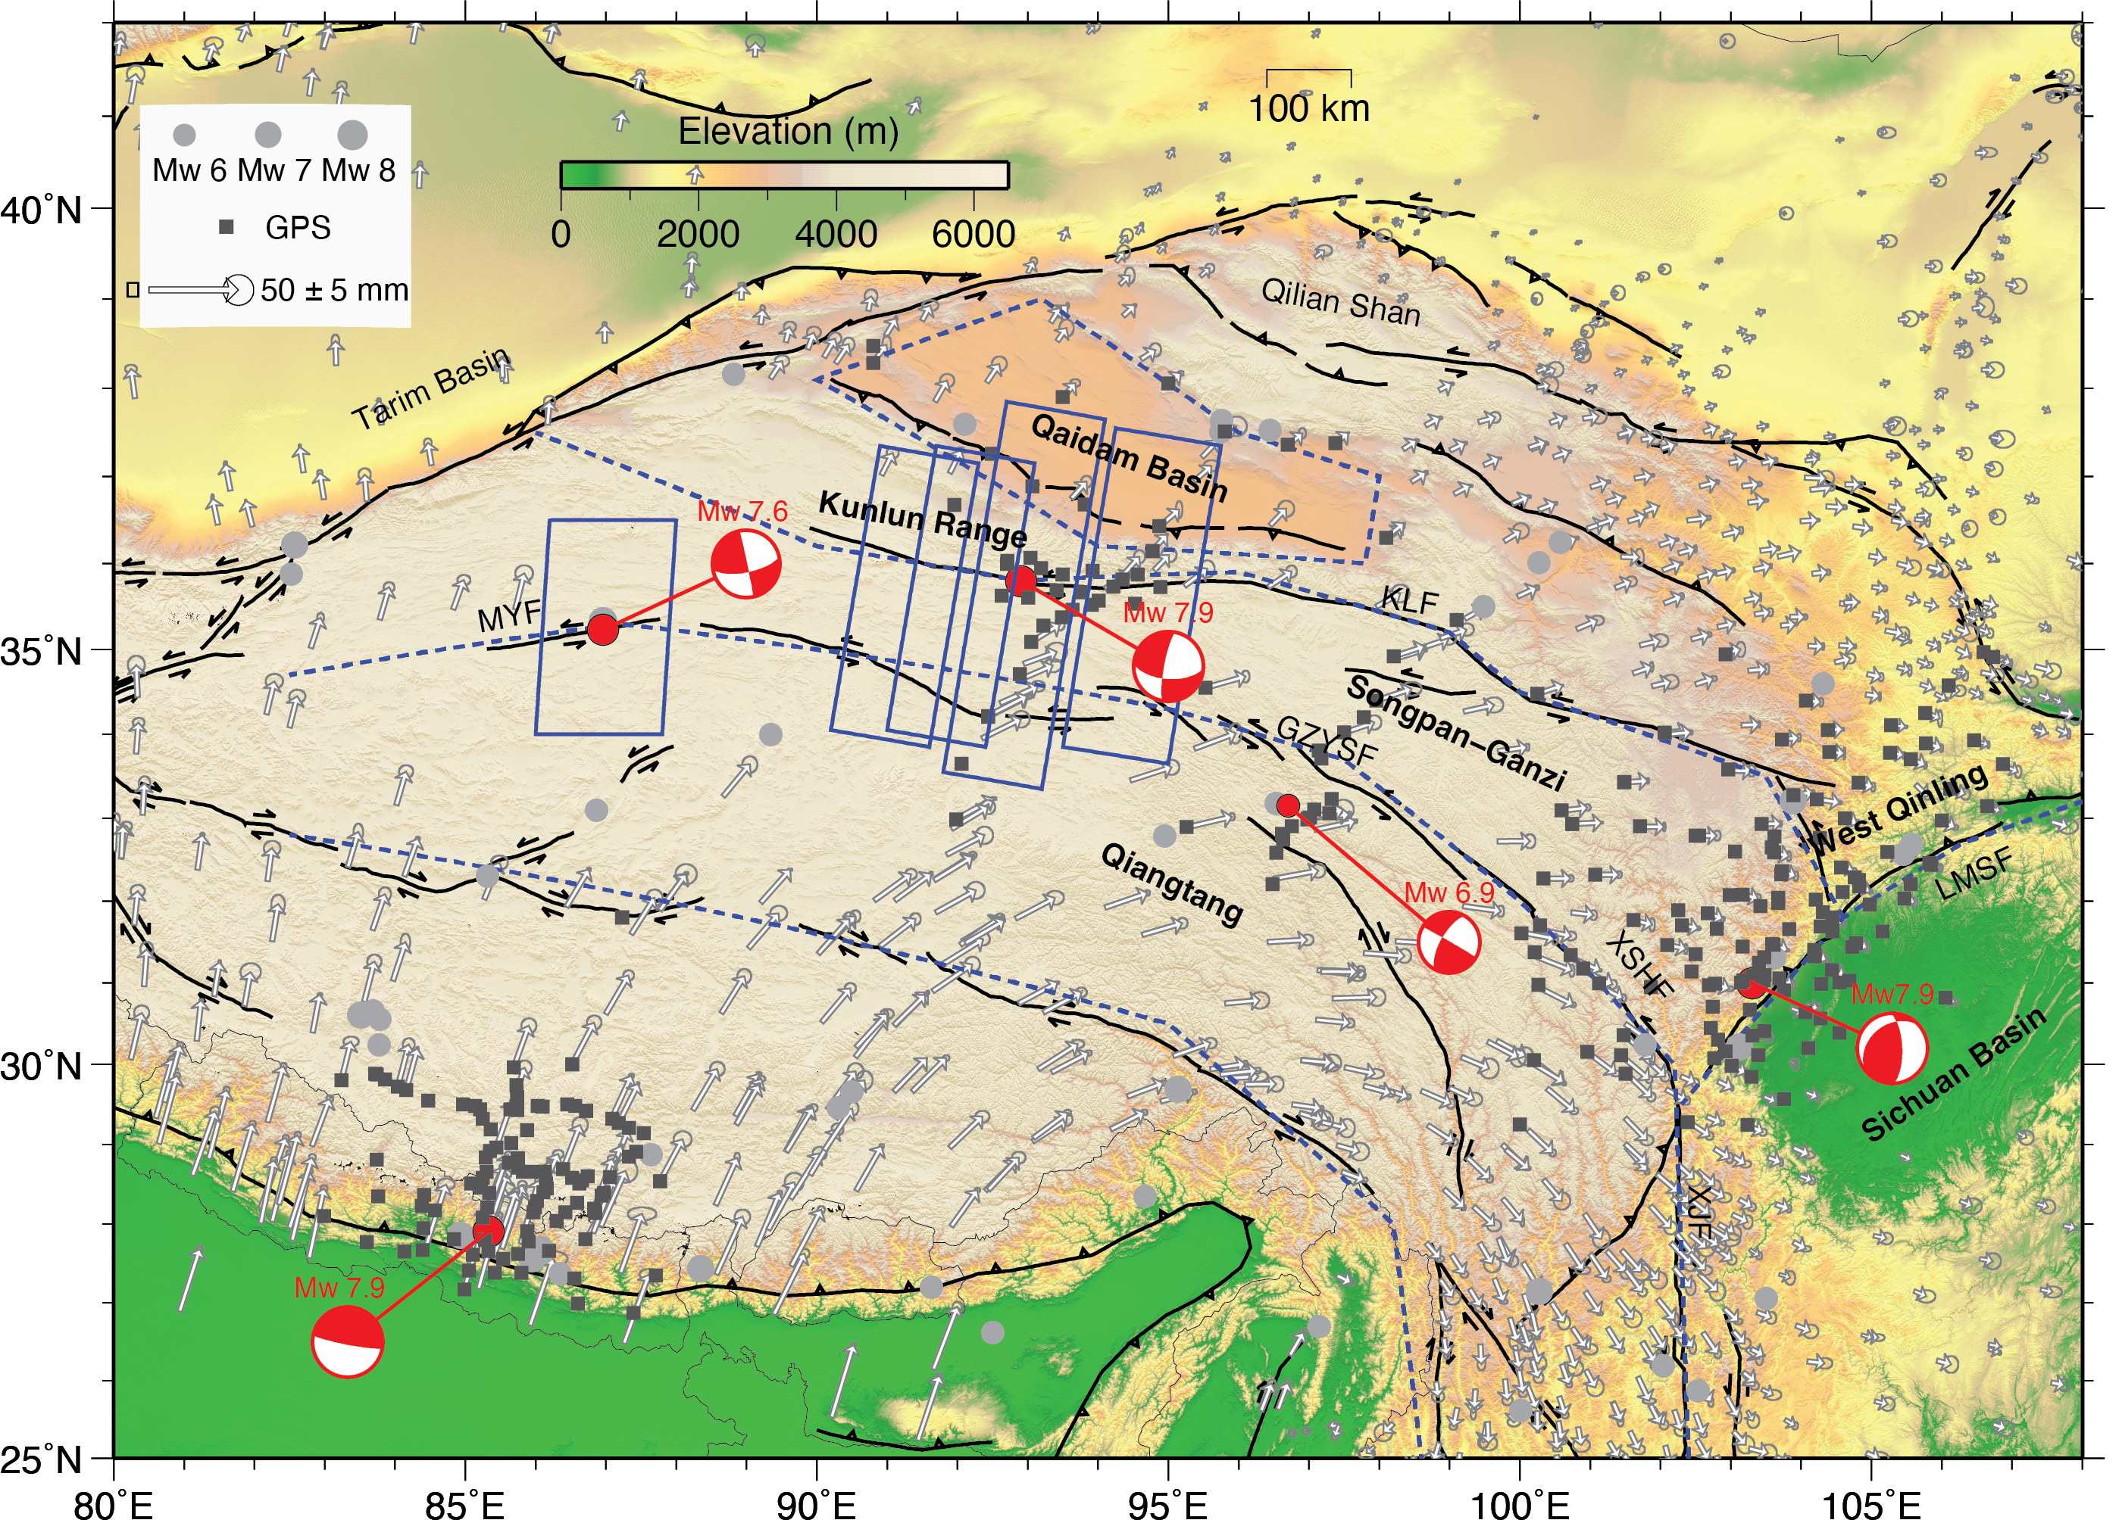
Tibet Plateau
One of the most active deforming regions in the world with several Mw7+ earthquakes in the past a few decades
Abundant geodetic observations in this region
Rheological structure and lithospheric stress evolution not well known
Notes:
Leaving empty. I can fill this part if necessary.

Slide 3
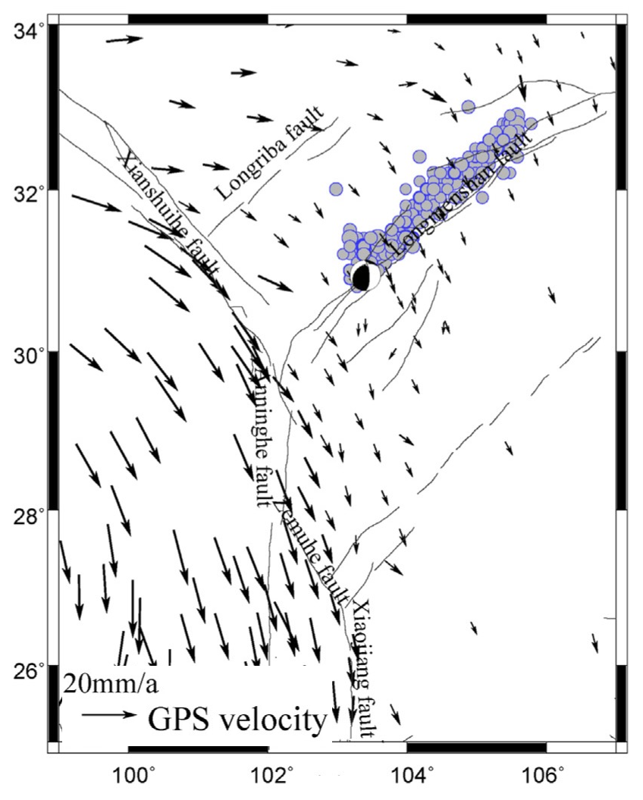
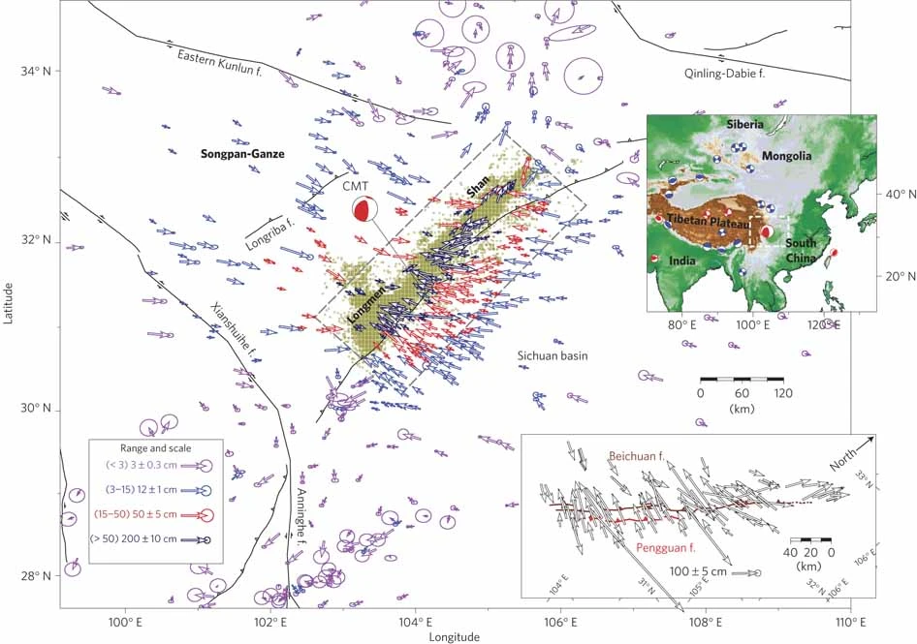
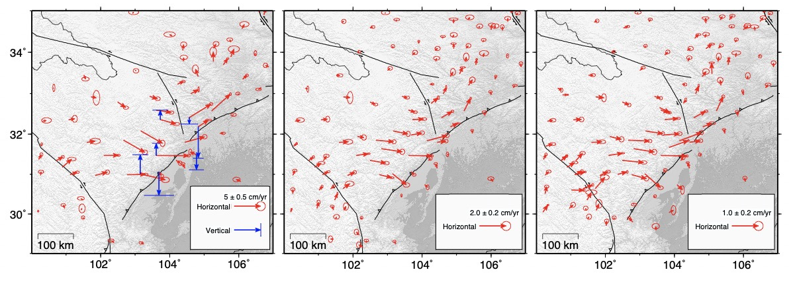
Deformation Before, During and After 2008 Mw7.8 Wenchuan Earthquake
(Wang et al., 2001)
(Wu et al., 2005)
0 – 1 yr
2 – 4 yrs
5 – 10 yrs
(Chen, 2022)
(From Wang et al., 2011, N.Geo.)

Slide 4
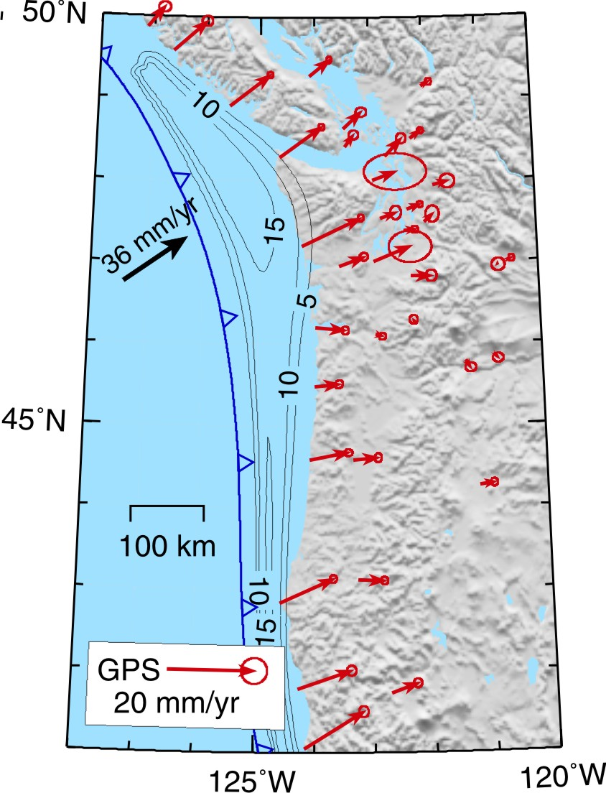
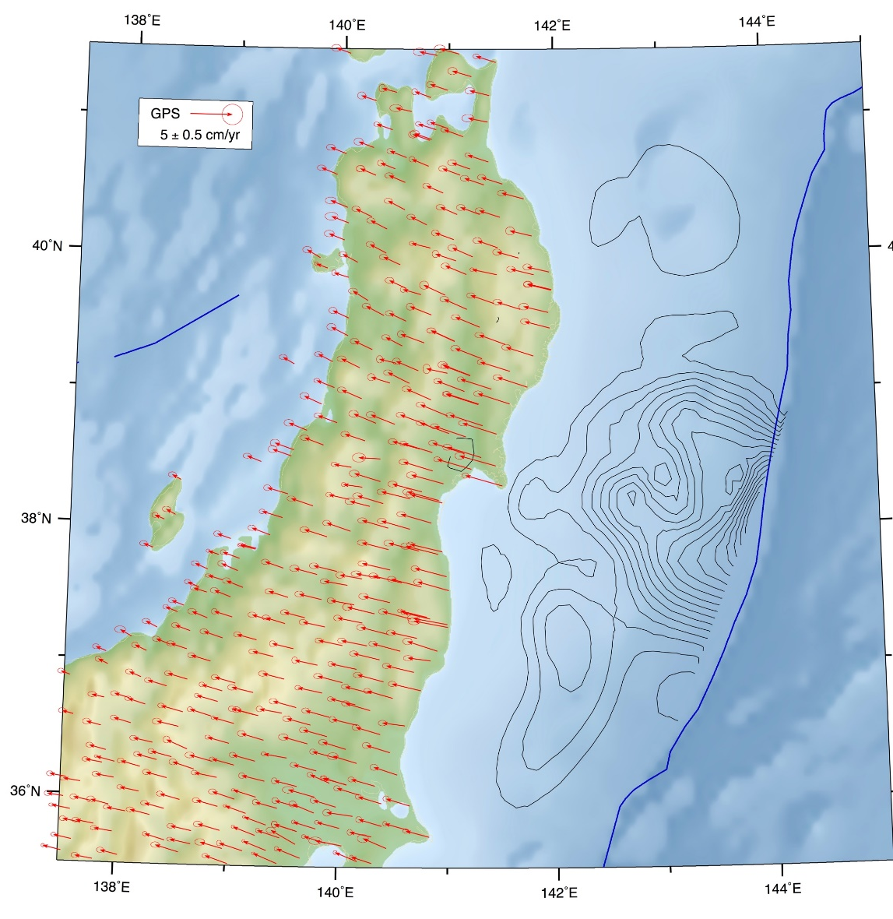
Interseismic Deformation
1700 Mw9.0 Cascadia
NE Japan (869 Mw8.3 Jogan?)
8 cm/yr
(coseismic slip contours from Iinuma et al., 2012)
~10⁰ cm/yr
(Wang et al., 2012)

Slide 5
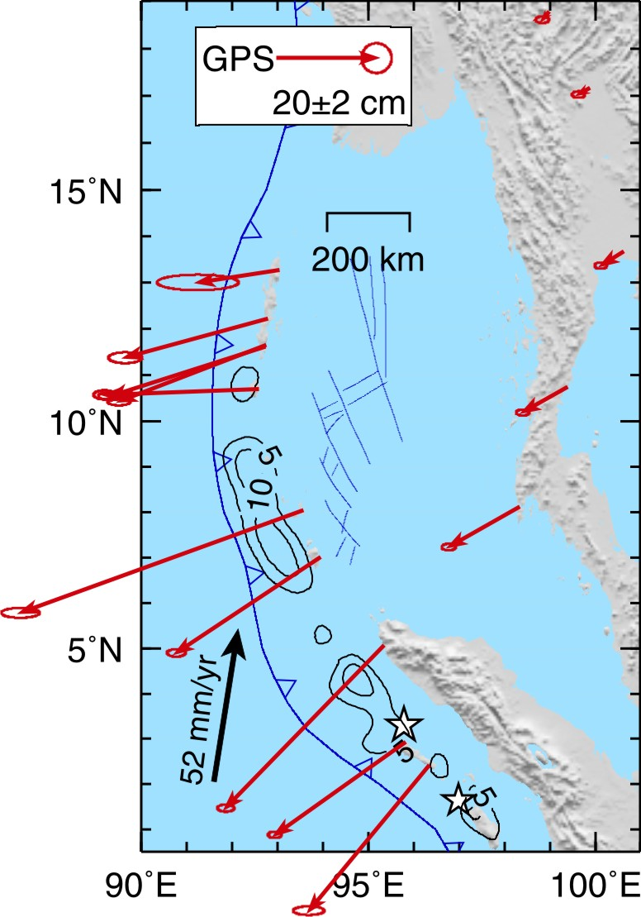
Short-term Postseismic Deformation
2004 Mw9.2 Sumatra
2011 Mw9.0 Tohoku
~10¹ cm/yr
(From Hu et al., 2012)

Slide 6
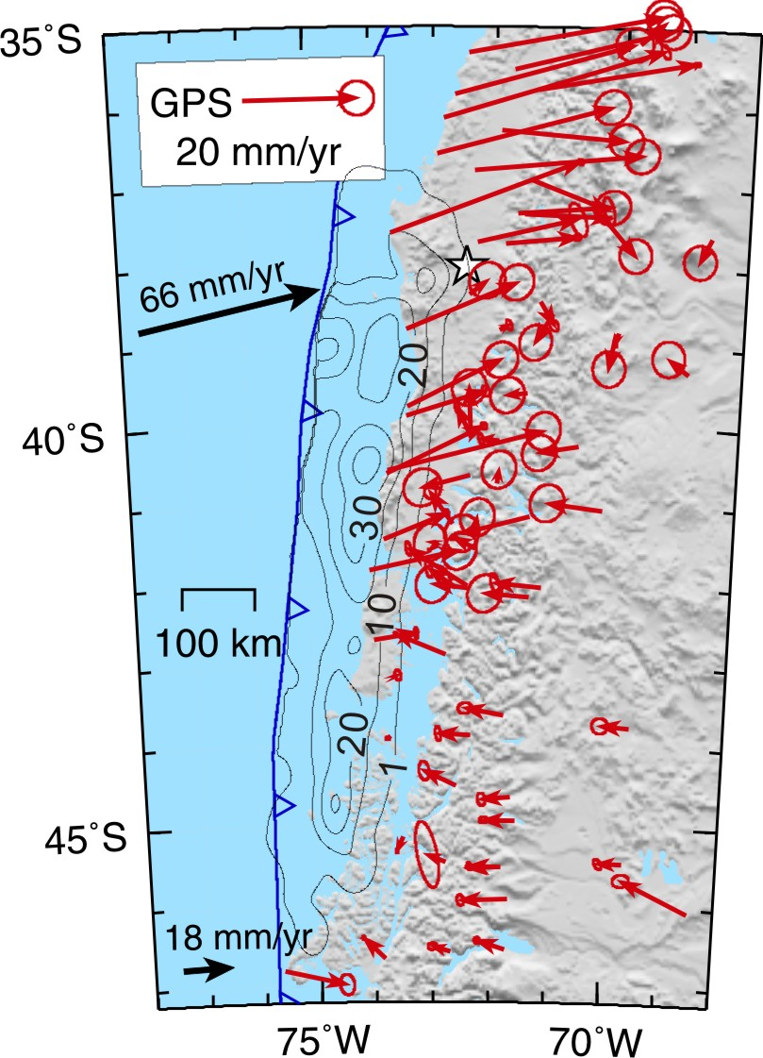
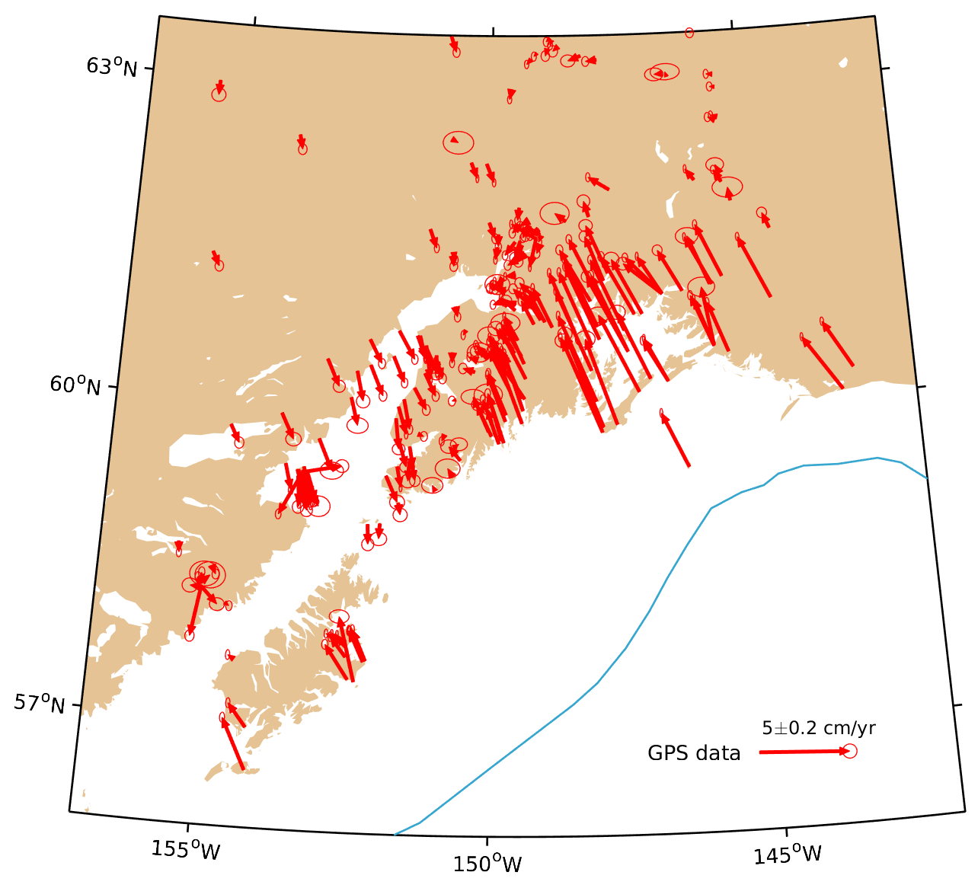
Decadal Postseismic Deformation
1960 Mw9.5 Chile
1964 Mw9.2 Alaska
50mm/yr
55mm/yr
(Freymueller, 2008; Huang et al., 2020)
~10⁰ cm/yr
(Klotz et al., 2001; Wang et al., 2007; Moreno et al., 2009)

Slide 7
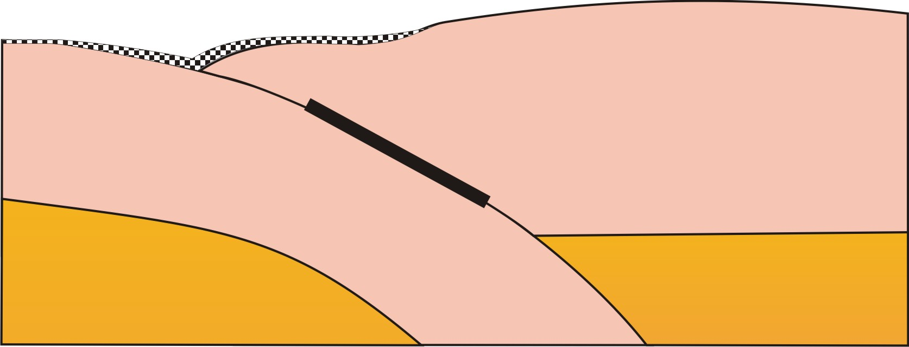
Postseismic Deformation Processes
3
2
1
1
3
Locking
1
2
Afterslip
2
Stress relaxation
Stress relaxation
(Wang, Hu, He, 2012)

Slide 8
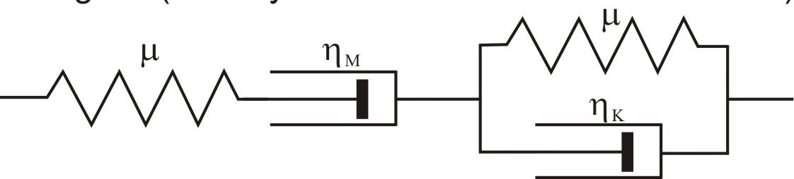
Burgers Rheology
Earthquake Cycle Stress Evolution
τ
Aseismic
Seismogenic zone
Aseismic
Steady-state Maxwell
Transient Kelvin
Before
Trench
Spring
Dashpot
Depth
τ
During
Under constant stress
ε
Depth
ε₀
τ
After
0
t
η_{K}
η_{M}
Depth

Slide 9
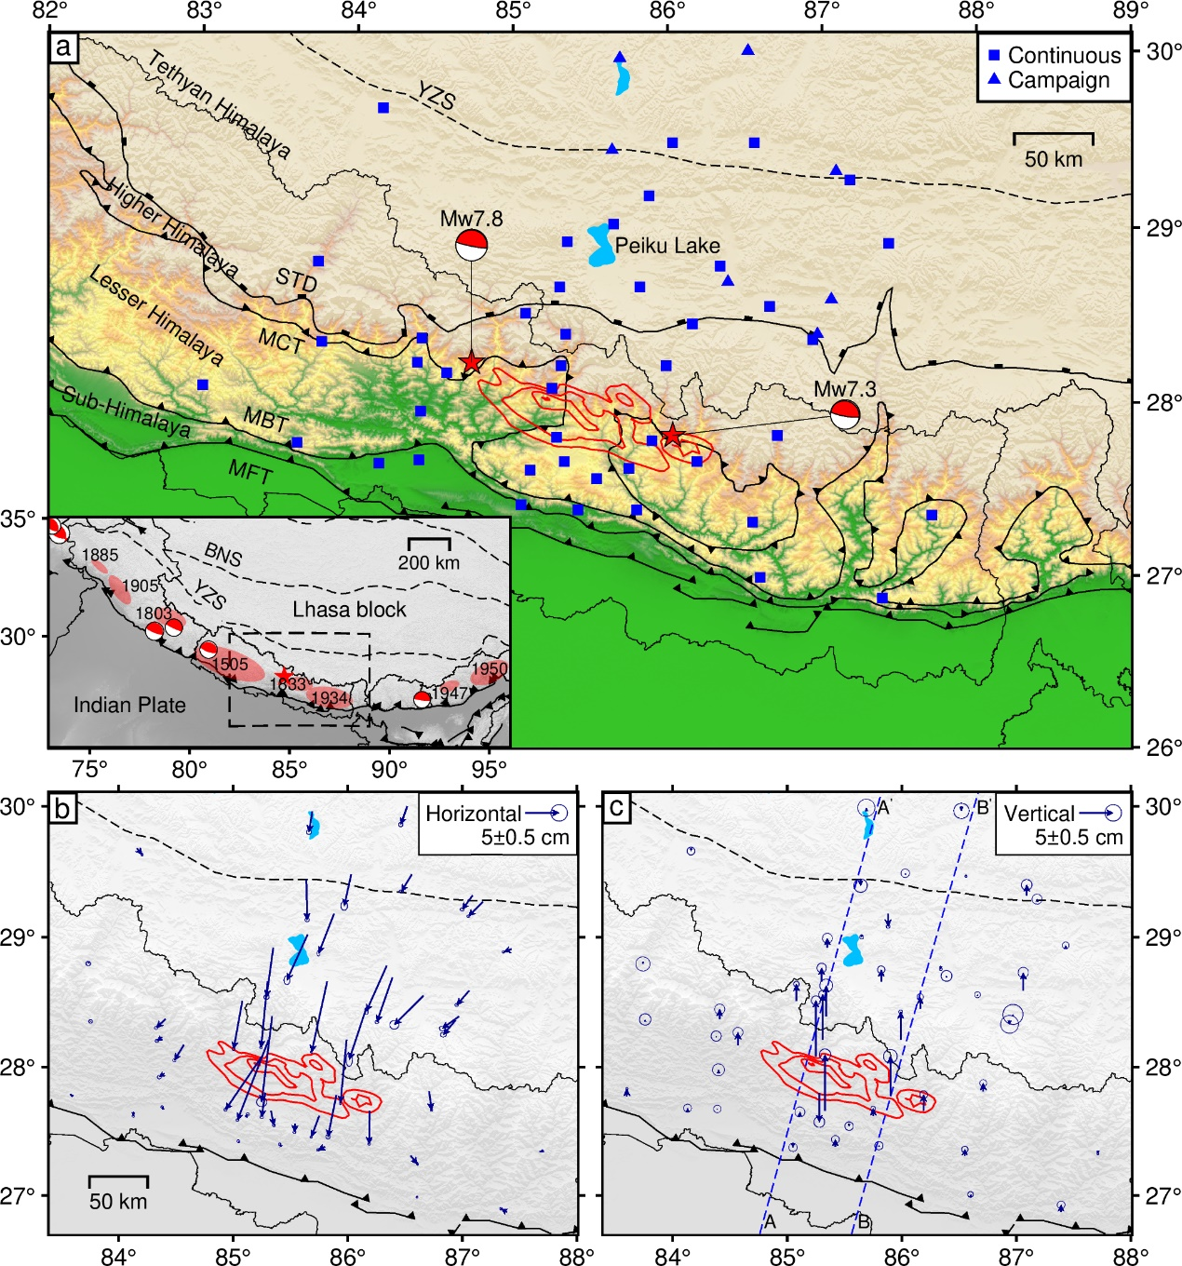
2015 Mw7.8 Nepal Earthquake
This earthquake ruptured the deformation front.
Postseismice surface deformation within 5 years after the earthquake is 10¹ cm north of the rupture area and no more than 10⁰ cm south of the rupture area.
Fairly well spatial coverage of the geodetic stations may help constrain the lateral rheological heterogeneities.

Slide 10
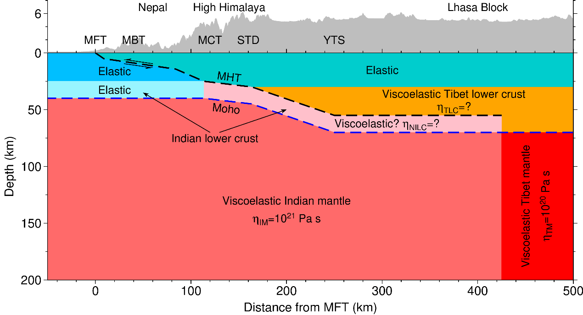
Finite Element Model
Notes:
Xu: 中南大学的许文斌老师

Slide 11
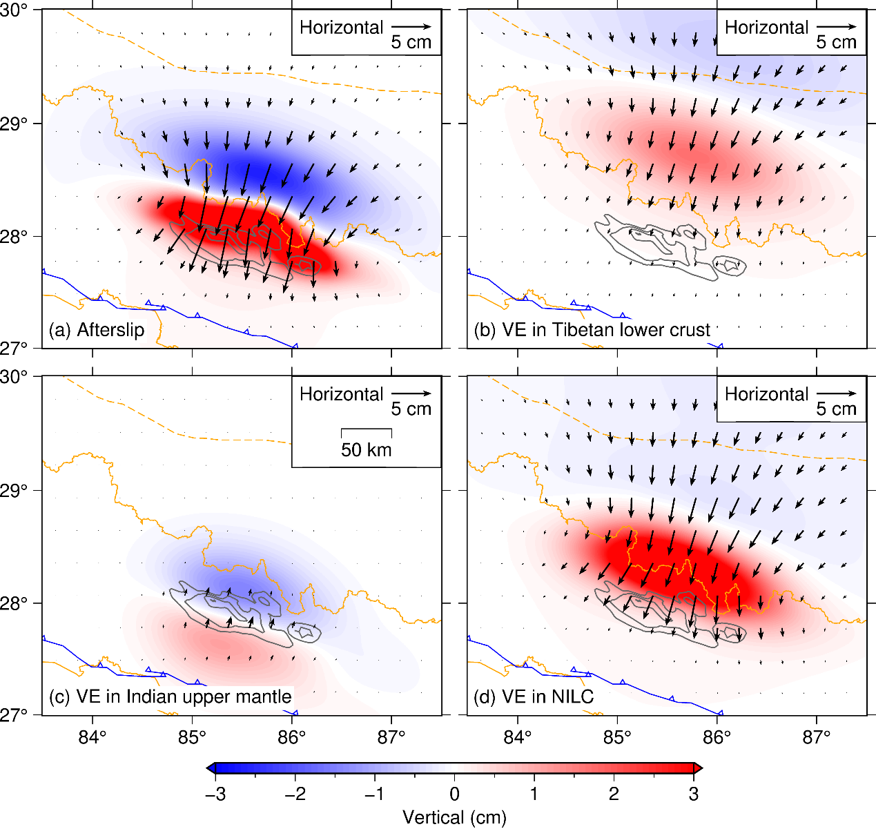
Sensitivity Tests of Rheological Units
Assume viscoelastic relaxation only in one rheological unit while other units are fixed to be elastic.
Surface deformation is controlled mainly by the afterslip, viscoelastic relaxation in the Tibetan and Indian lower crust.

Slide 12
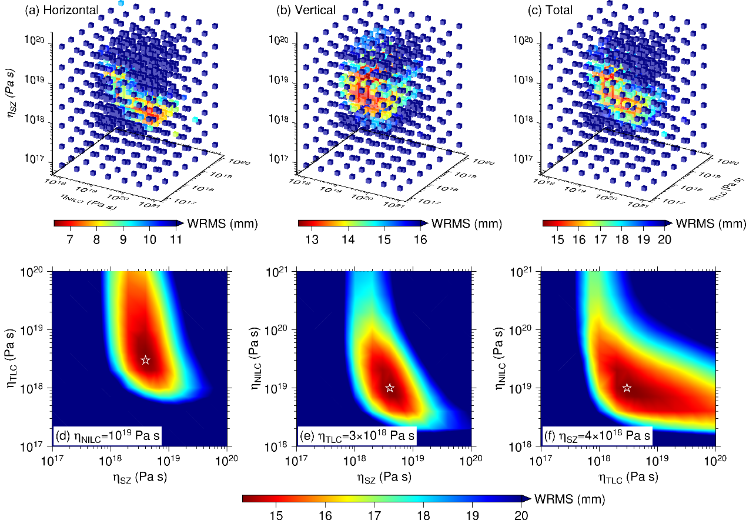
Grid Search on Best-fit Model
Best-fit Model:
Shear zone: η_{SZ} = 4×10¹⁸ Pa s
Tibetan lower crust: η_{TLC} = 3×10¹⁸ Pa s
Indian lower crust: η_{NILC} = 10¹⁹ Pa s

Slide 13
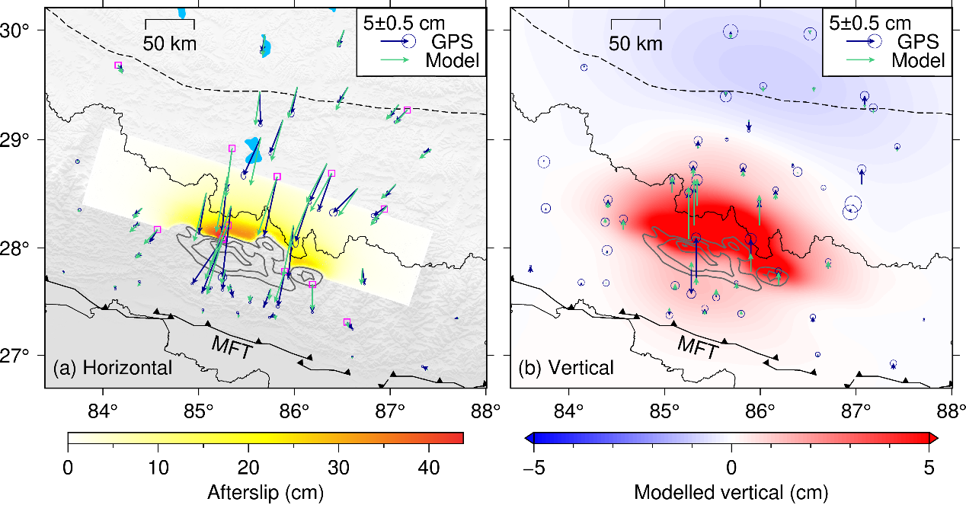
Comparison of GPS Observations With Model Predictions
Notes:
Note: vertical deformation is not considered in grid search

Slide 14
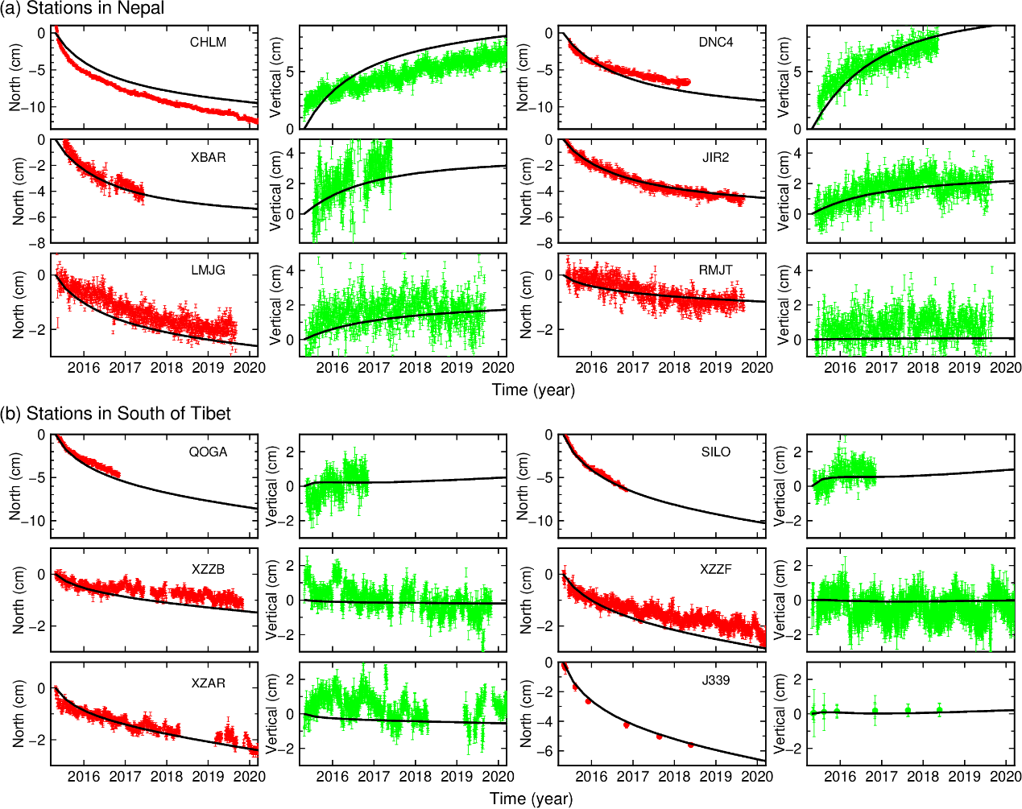

Slide 15
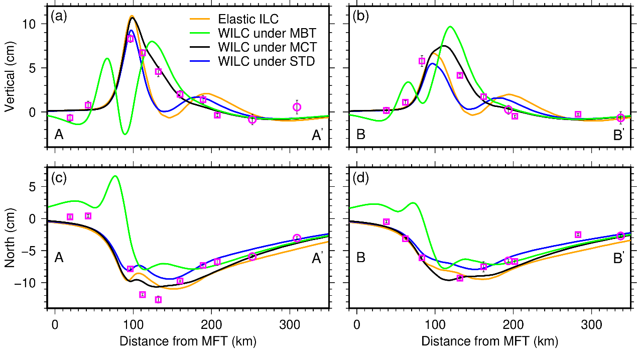
Location of the Transition from Elastic to Viscoelastic property in the Indian Lower Crust

Slide 16
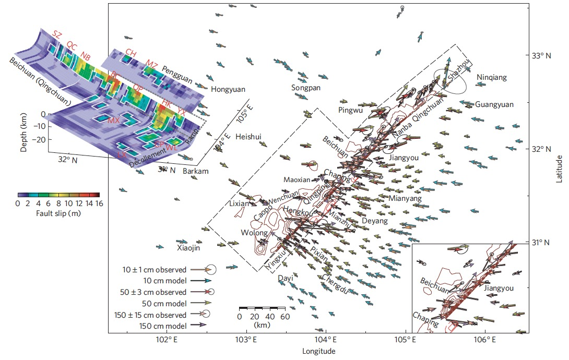
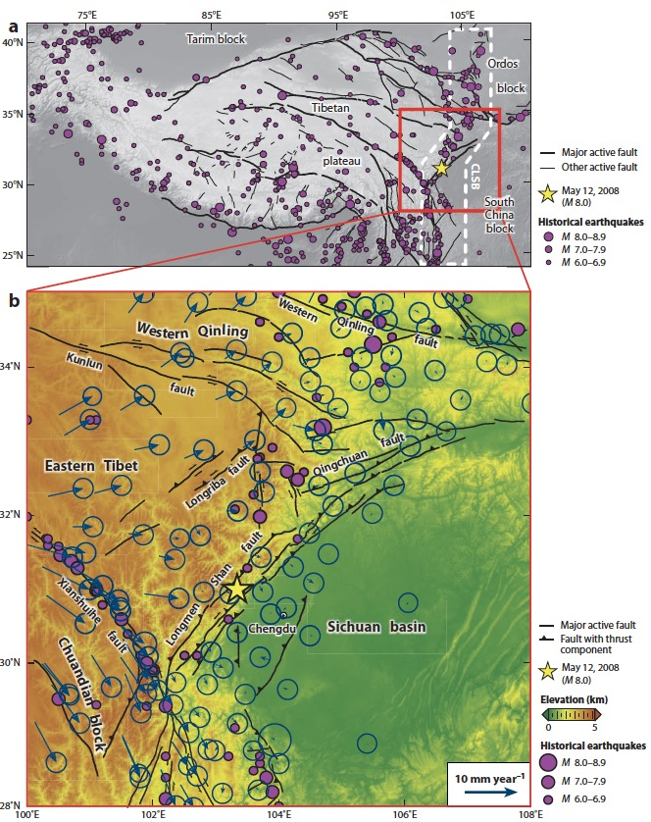
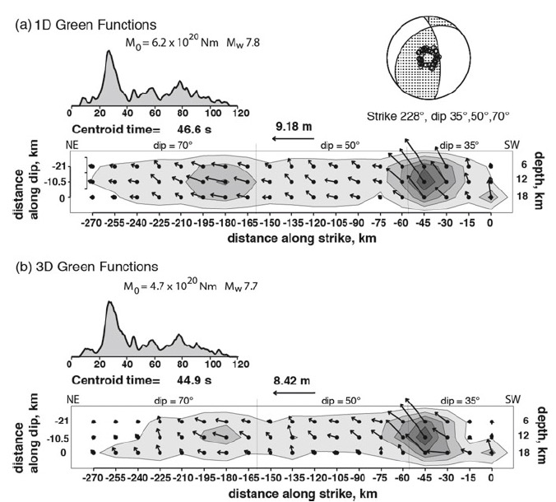
Southeastern Tibet
(Wang et al., 2011)
(Zhang et al., 2010; Wang et al., 2021)
(Lay, 2019)

Slide 17
Coseismic Coulomb Stress due to the 2008 Wenchuan Earthquake
(Liu et al., 2021)

Slide 18
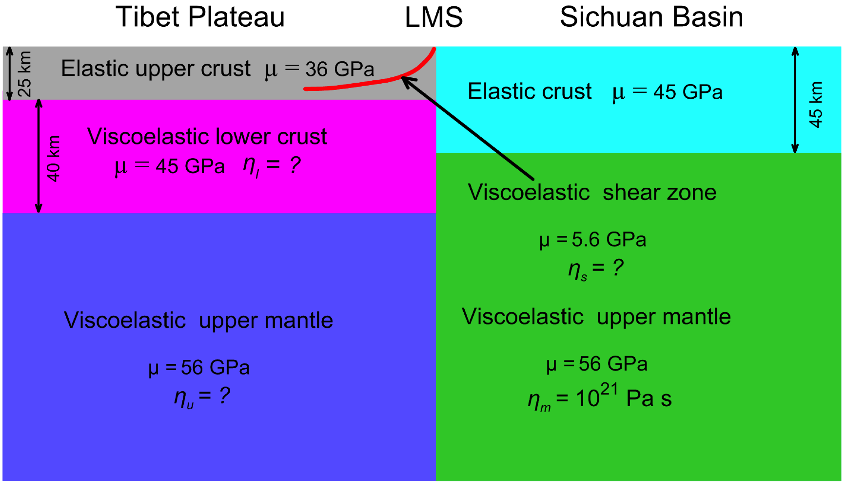
Finite Element Model
Viscoelastic relaxation is represented by Burgers rheology. Afterslip is simulated by 2-km weak shear zone. μ is the shear modulus. η_{l}, η_{u}, η_{m} and η_{s} is the viscosity of the lower crust, Tibetan upper mantle, Sichuan basin upper mantle and shear zone, respectively.

Slide 19
Individual Contribution of Rheological Units to Surface Deformation
√ Afterslip
√ Lower crust
⨉
⨉
√ Upper mantle

Slide 20
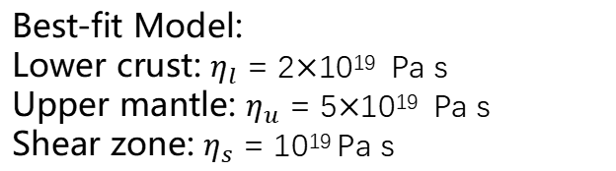
Best-fit Model:
Lower crust: $η_{l}$ = 2$×$10¹⁹ Pa s
Upper mantle: $η_{u}$ = 5$×$10¹⁹ Pa s
Shear zone: $η_{s}$ = 10¹⁹ Pa s

Slide 21
Comparison of GPS Observations With Model Predictions
0 – 1 year
2 – 4 years
5 – 10 years

Slide 22
Postseismic Stress Distribution and Evolution

Slide 23
Conclusions
Both afterslip and viscoelastic relaxation must be at play and together control the postseismic deformation of large earthquakes.
The viscosity of the Tibetan lower crust increases from 3×10¹⁸ Pas in the south to 2×10¹⁹ Pa s in the southeast. The viscosity in the shear zone is at an order of 10¹⁸ – 10¹⁹ Pa s.
Afterslip takes place mostly in the vicinities of the rupture area and decays rapidly with time.
Notes:
Leaving empty. I can fill this part if necessary.

Slide 24
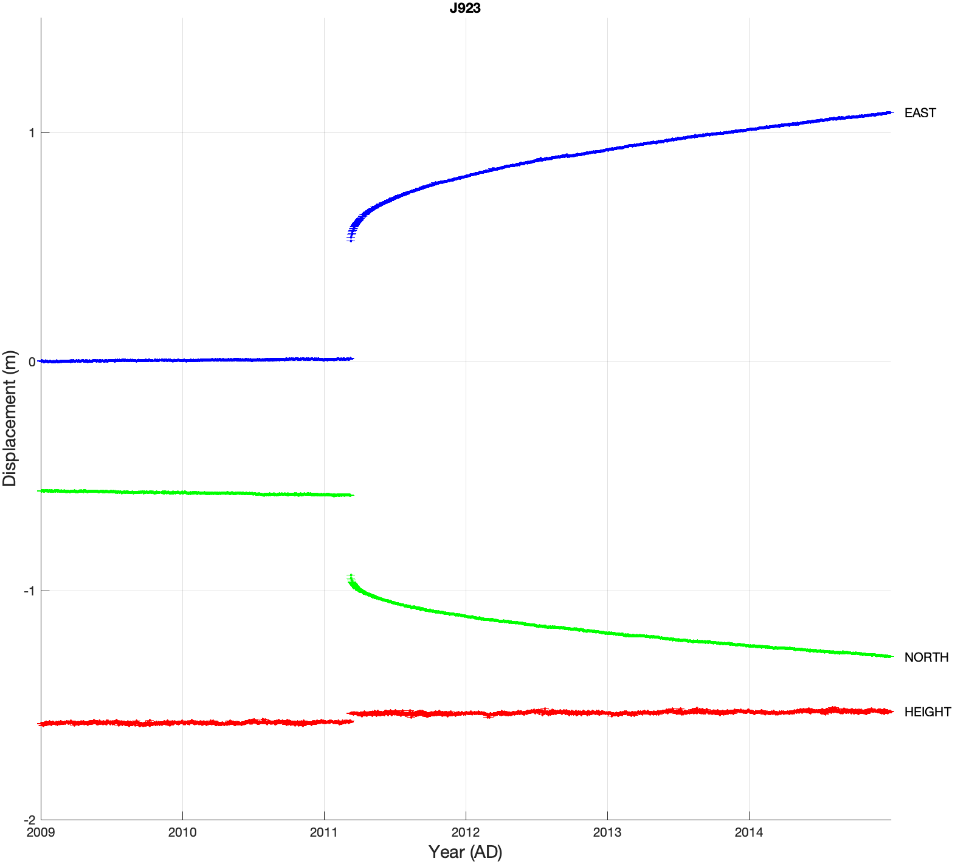
Earthquake
Notes:
Leaving empty. I can fill this part if necessary.

Slide 25
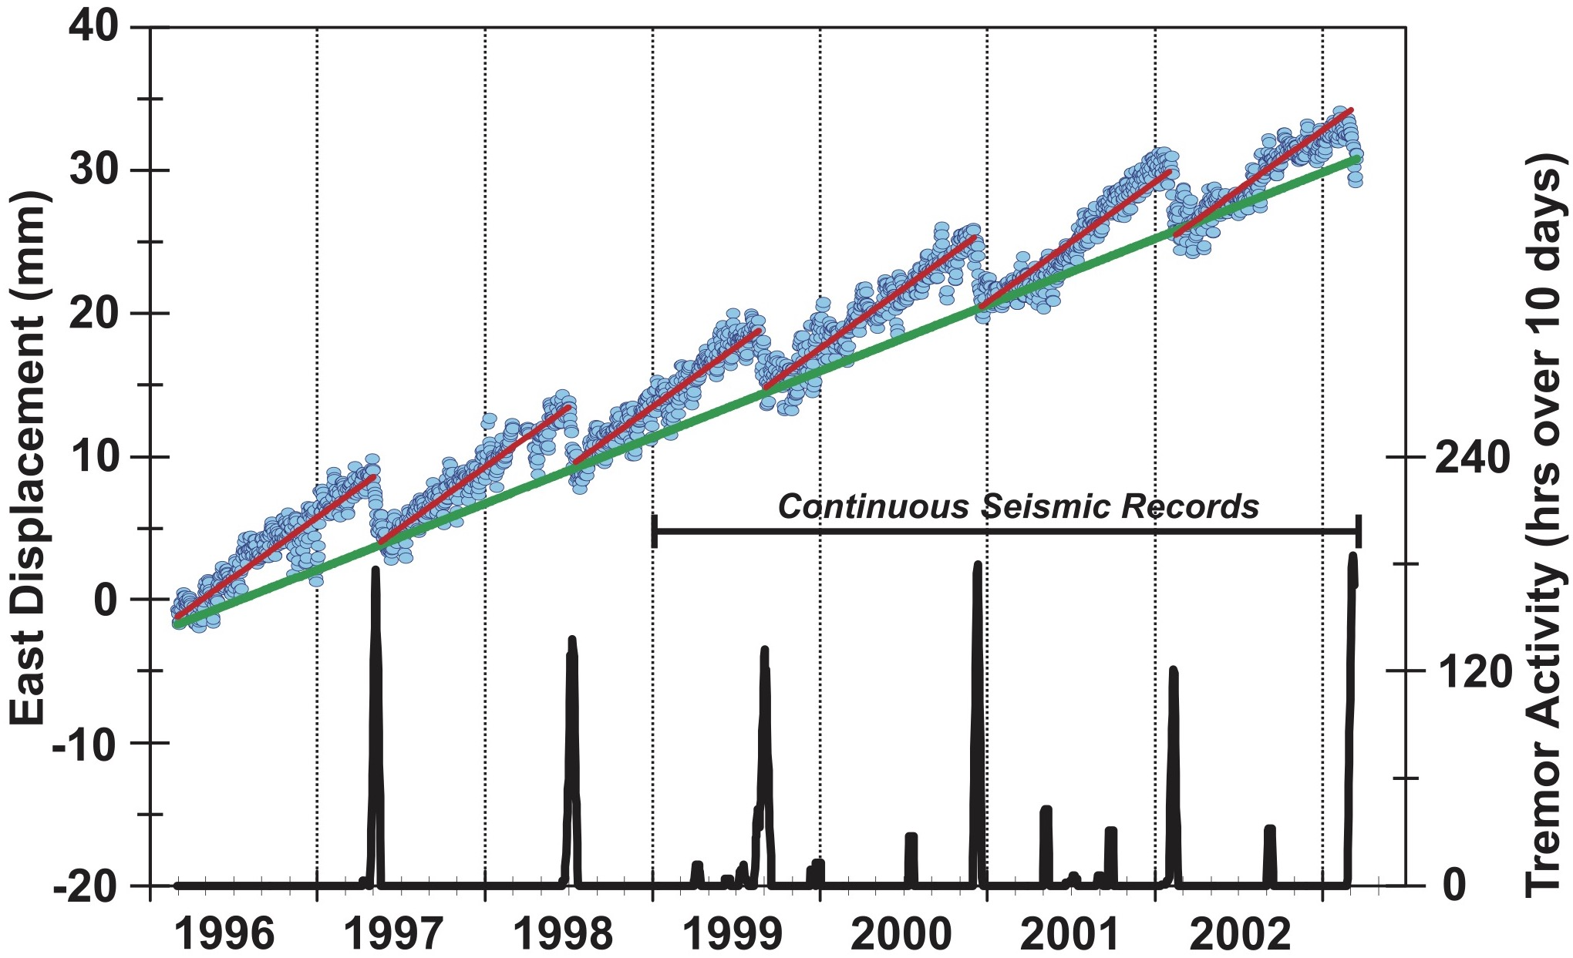
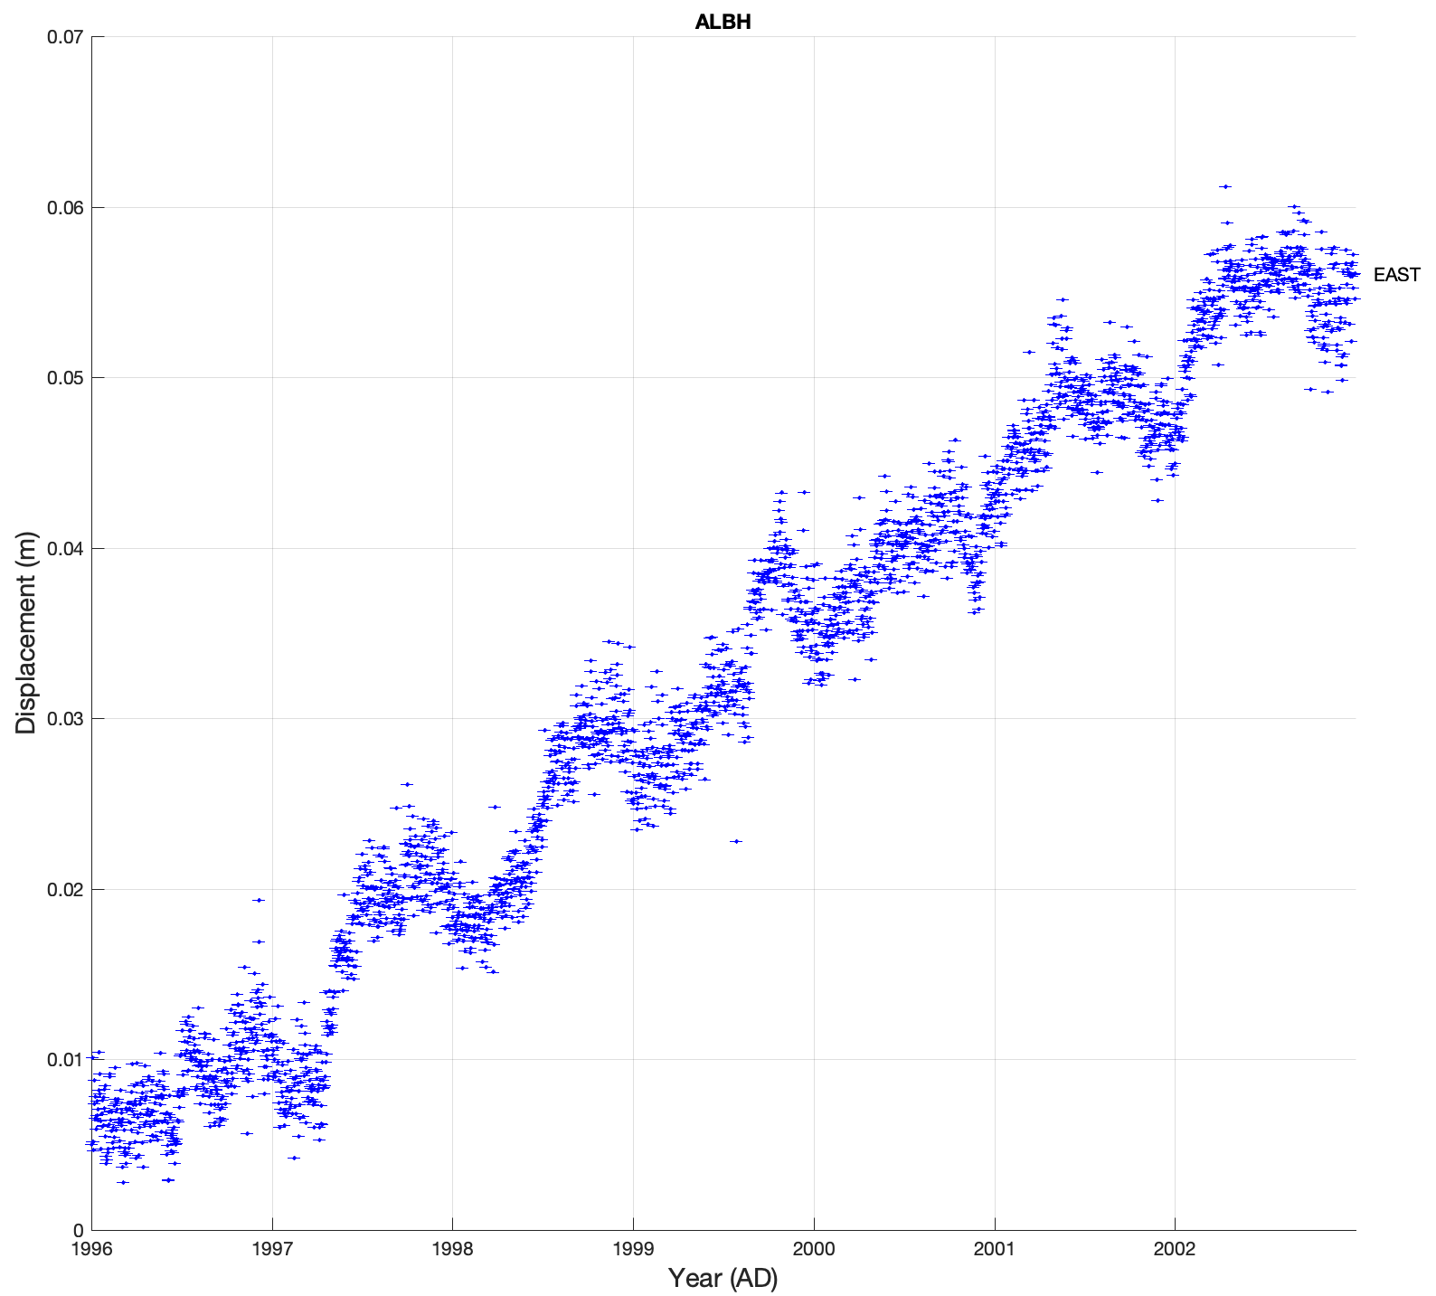
1700 Mw9.0 Cascadia
(Rogers and Dragert, 2003)
(Wang et al., 2012)
Lasts 10-20 days every 13-16 months
Notes:
Leaving empty. I can fill this part if necessary.

Slide 26
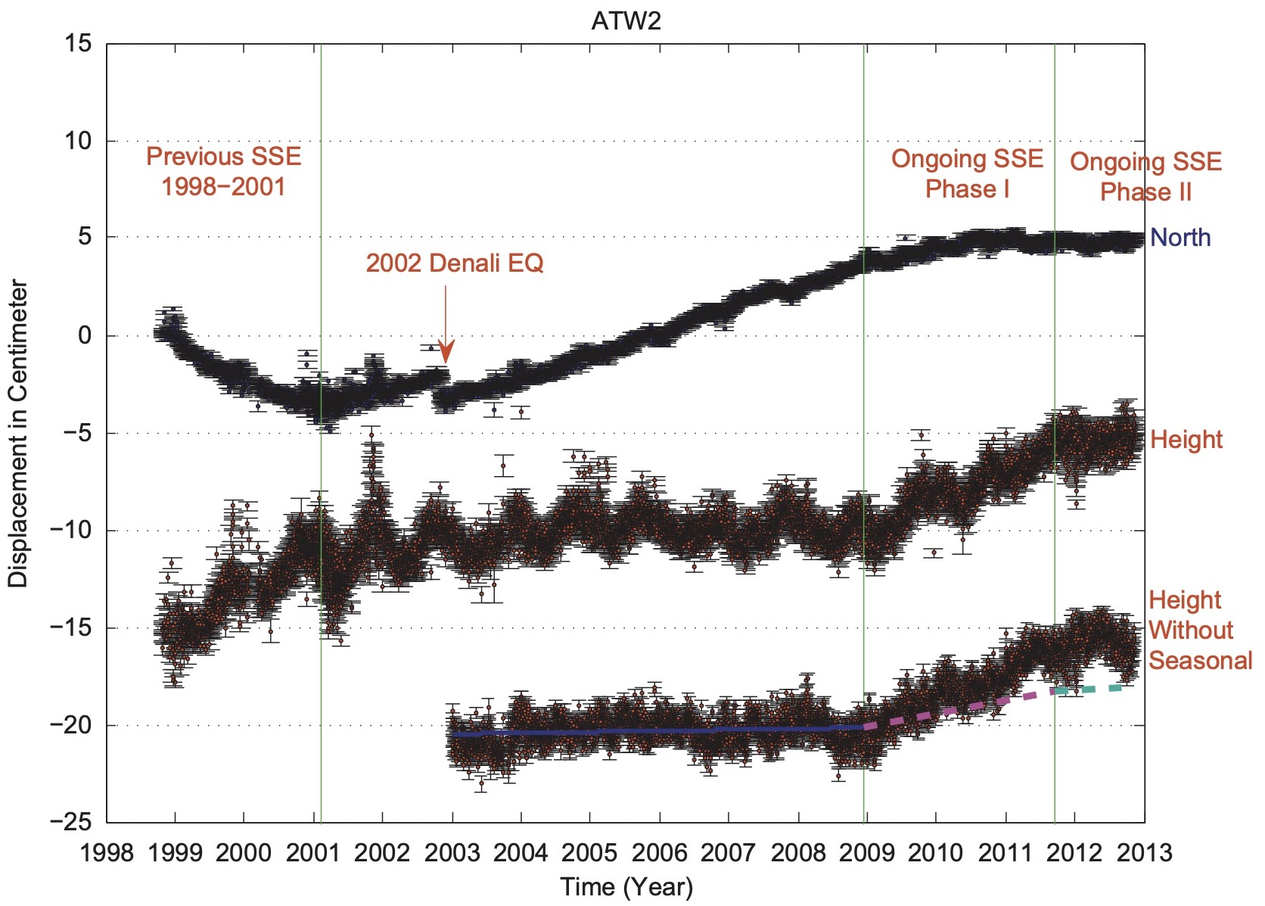
1964 Mw9.2 Alaska
50mm/yr
55mm/yr
(Freymueller, 2008; Huang et al., 2020)
(Fu and Freymueller, 2013)
Notes:
Leaving empty. I can fill this part if necessary.

Slide 27
Thanks for Your Attention!
Notes:
Leaving empty. I can fill this part if necessary.

