Slide 1
Pulsar glitch activity in a strangeon star model
汪卫华(Weihua Wang), 温州大学(WZU)
2023.05.21 中国--贵州--光年之外酒店

Slide 2
Outline
1.Background
2.Glitch activity in the starquake model of solid quark stars
3.Improved starquake model
4.Summary

Slide 3
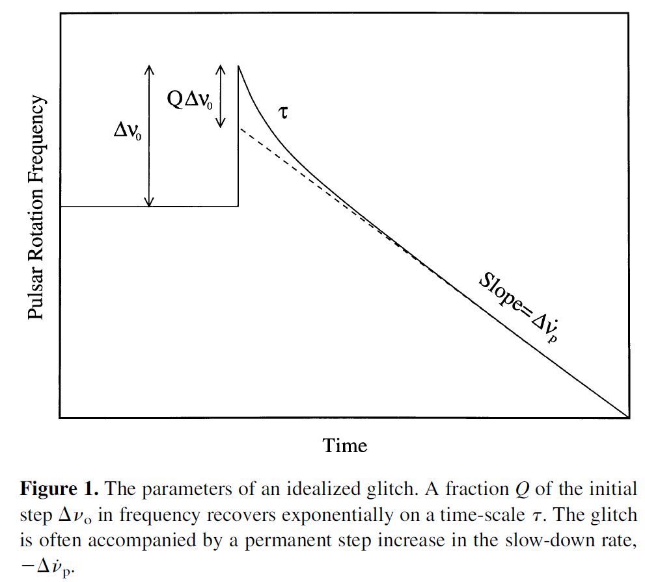
1.Background
恢复系数 recovery coefficient

Slide 4
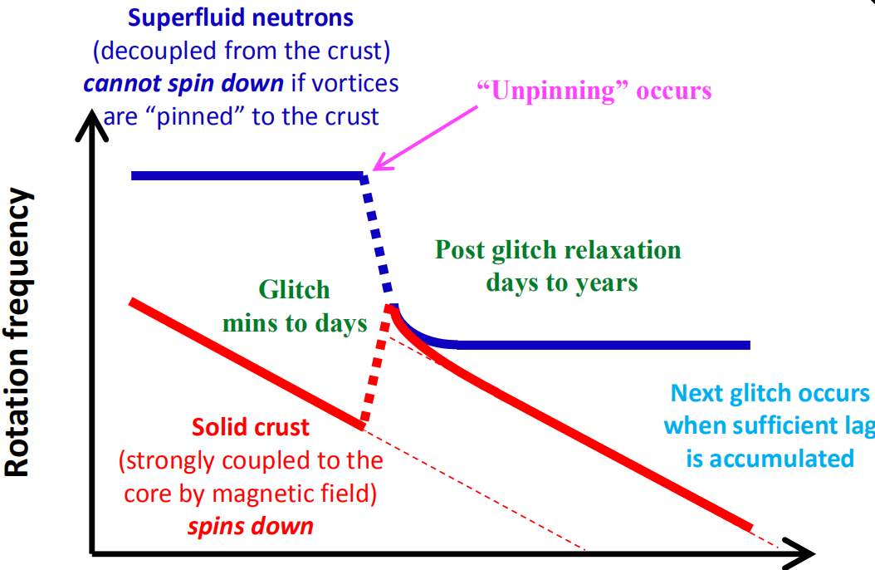
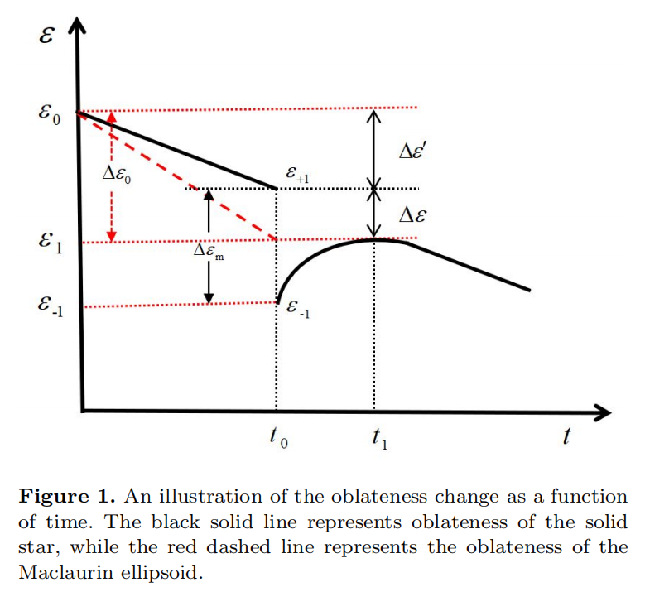
Vortex model
Starquake model

Slide 5
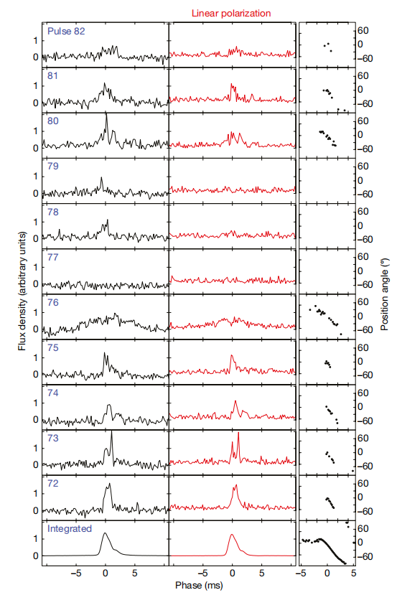
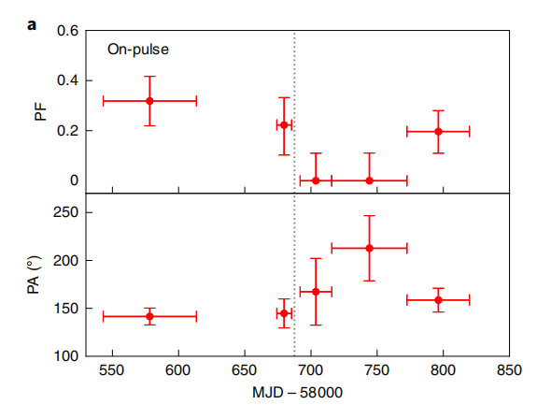
The Vela pulsar, radio, Nature 2018
The Crab pulsar, soft X-ray 3.0-4.5 kev, Nature Astronomy 2020, H. Feng.

Slide 6
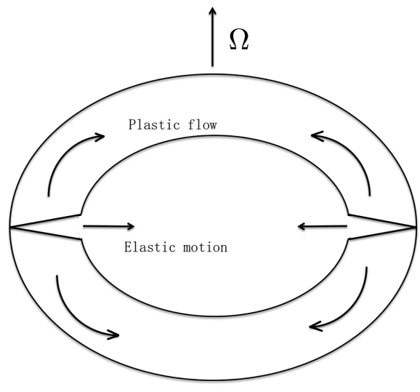
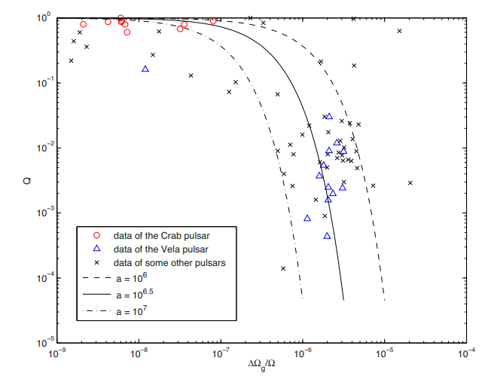
Lai et al. 2018 MNRAS

Slide 7
Lu et al. 2023 MNRAS

Slide 8
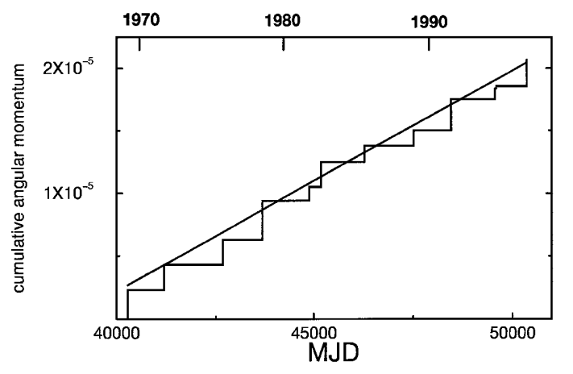
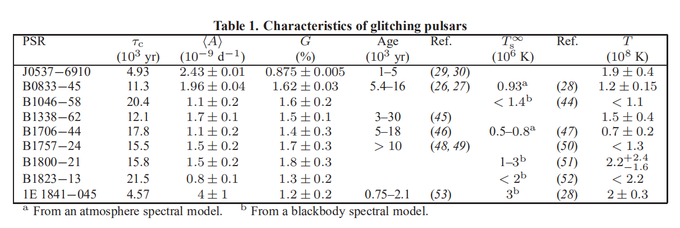
Ho 2015

Slide 9
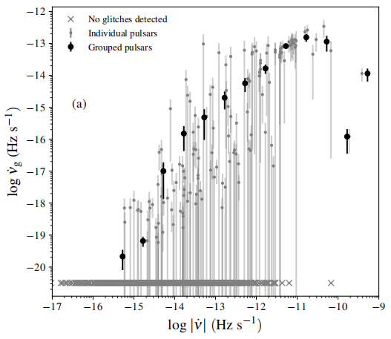
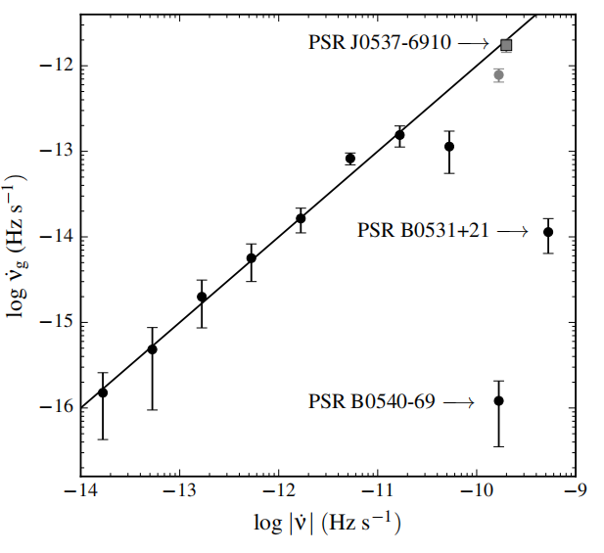
Fuentes et al. 2017

Slide 10
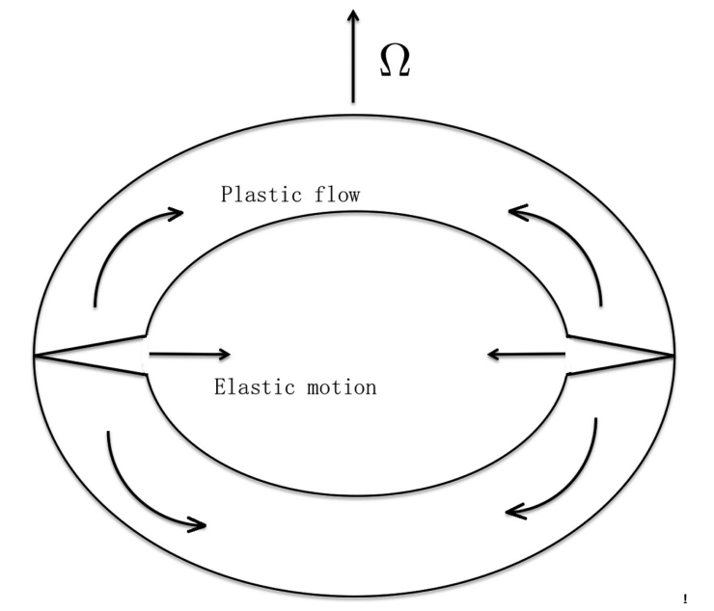
2. Pulsar glitch activity parameter in the starquake model
plastic flow
plastic flow

Slide 11
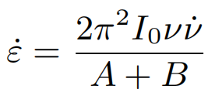

Slide 12
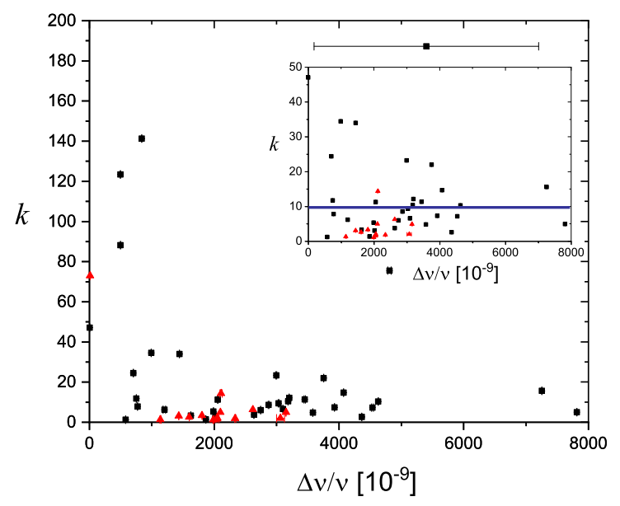
557 glitches detected in 190 pulsars, among them, 82 glitches have measured recovery coefficient Q.
(https://www.atnf.csiro.au/people/pulsar/psrcat/glitchTbl.html)
Wang et al. 2021 MNRAS

Slide 13
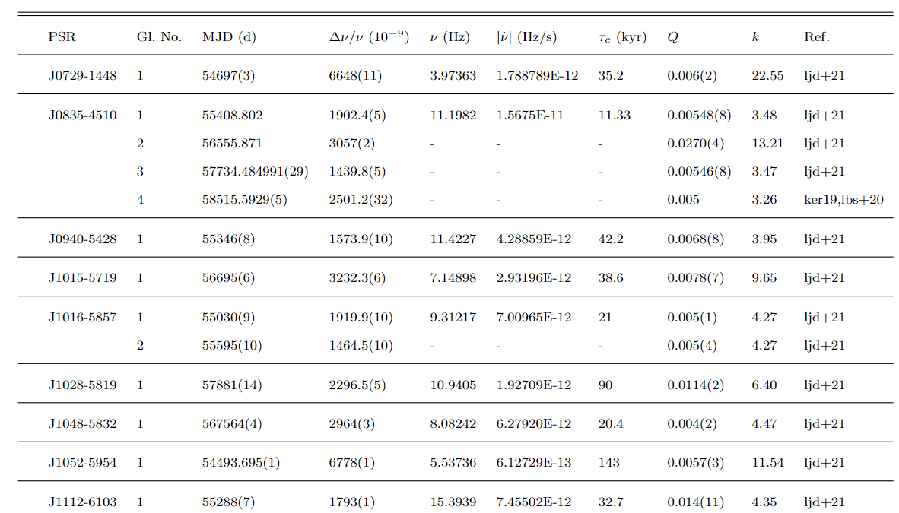
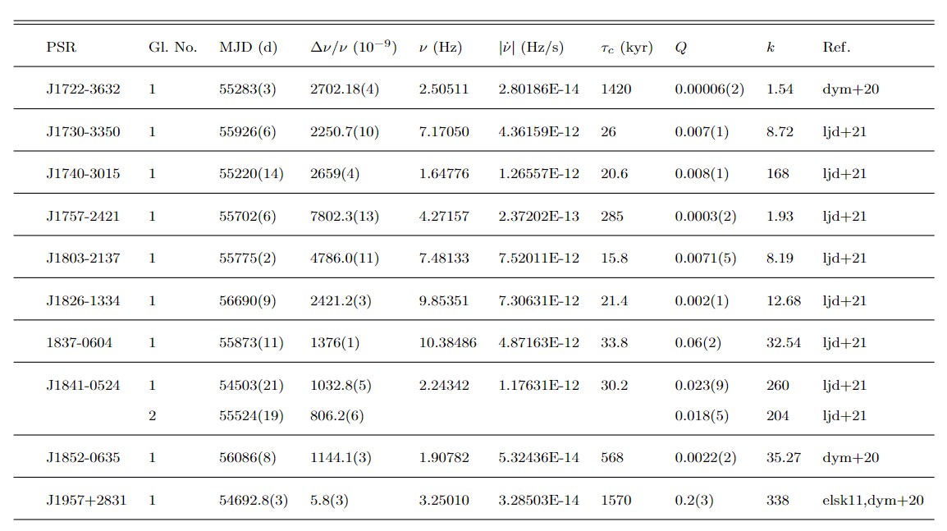
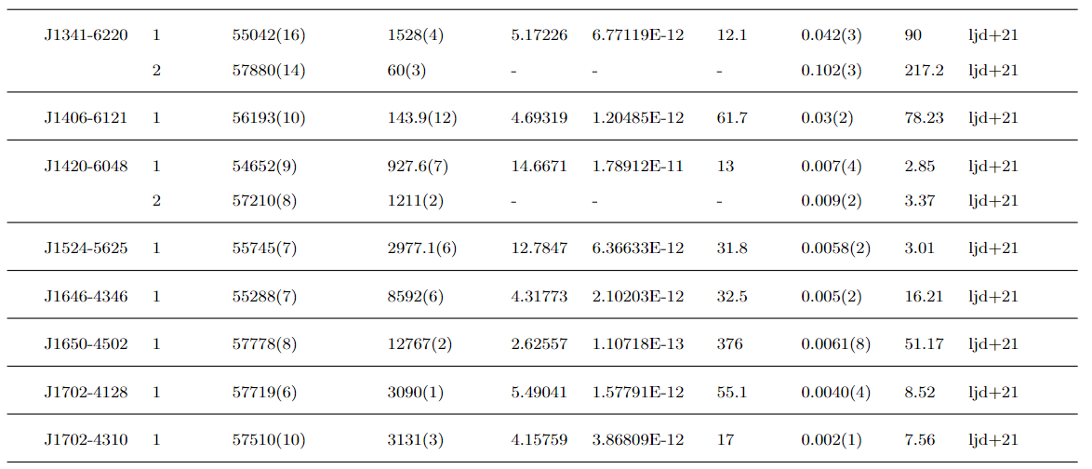
Lower 2021

Slide 14
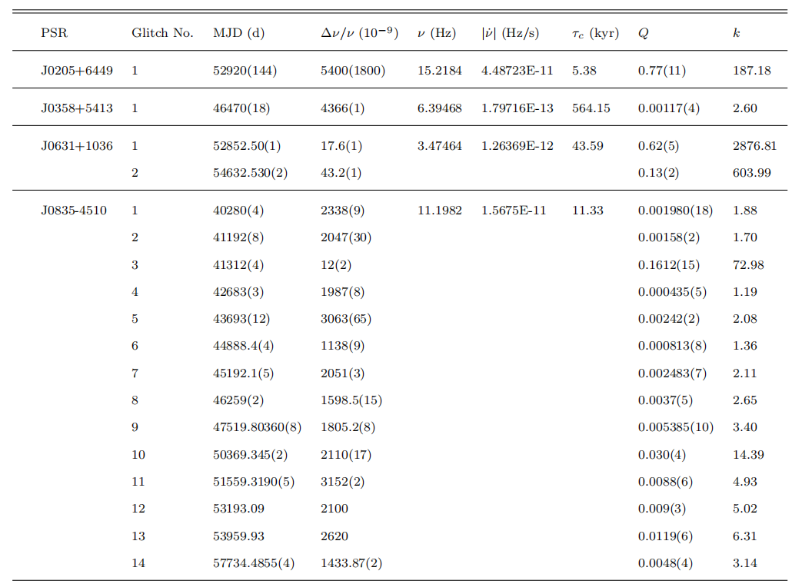
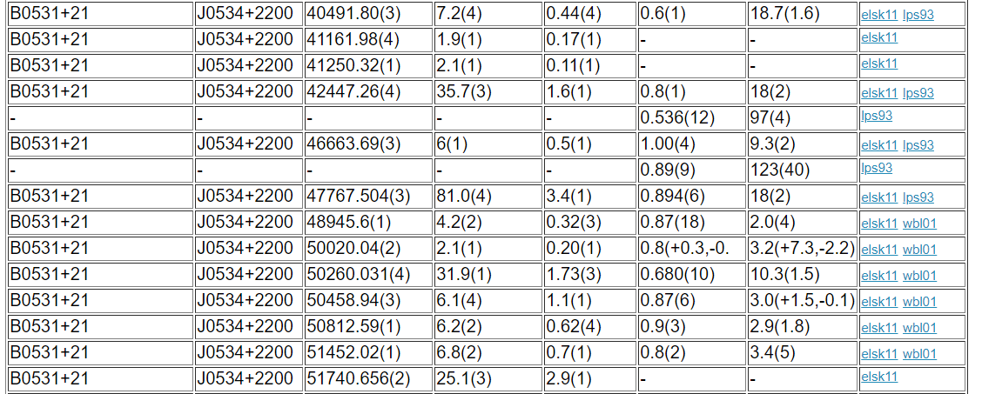
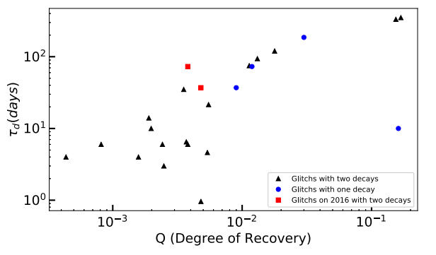
3. Improved starquake model
Xu et al. 2019
Wang et al. 2020

Slide 15
Simple estimations:

Slide 16
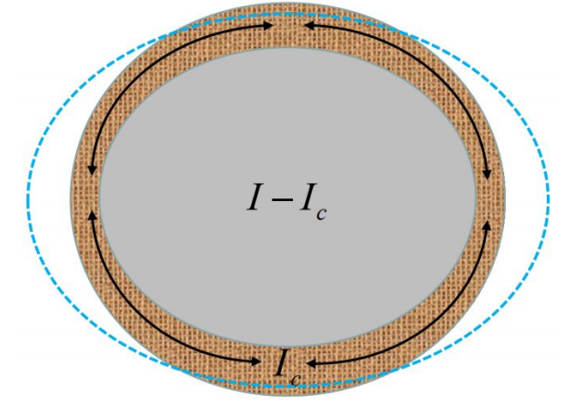
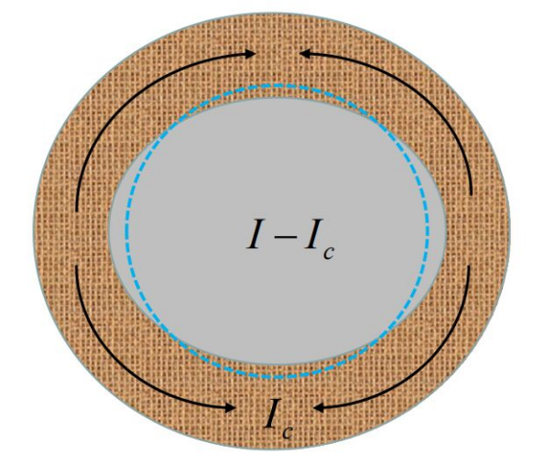
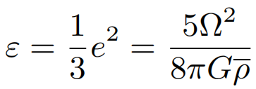
To understand the behaviors of Crab and Vela pulsar glitches in a unified two-layered starquake model.
:sink
:sink+spread
The Crab pulsar: dominated.
The Vela pulsar: dominated.

Slide 17
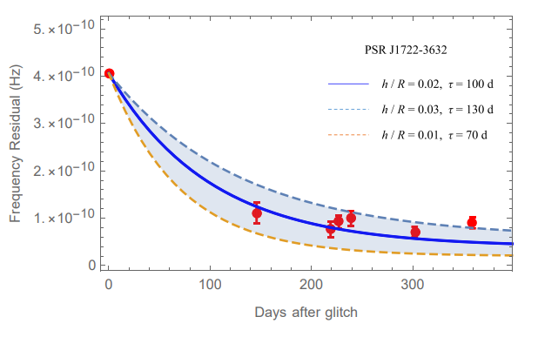
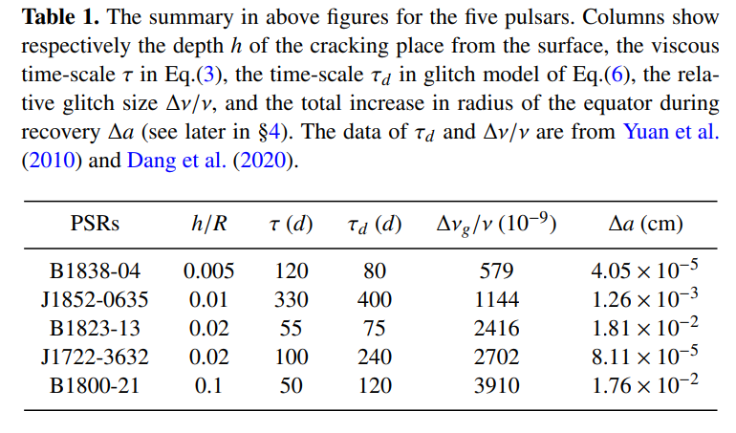
Lai et al. 2023 MNRAS submitted

Slide 18
4.Summary
To explain the glitch activity parameter, the shear modulus of any kind of solid quark star should be on the order 10^34 erg/cm^3. This result is weakly dependent on the specific starquake model.
Main aspects of starquake model:
glitch size √
recovery coefficient √
glitch activity √
slow glitch √
starquake and FRB √
glitch and GW?
absence of glitch associated radiative changes in Vela-like pulsars?
glitch and delayed spin-up glitch?

