Slide 1
Elastic properties of neutron star matter and crustal torsional oscillations
Quakes: from the Earth to Stars
PRC 103 (2021) 055812
PRD 106 (2022) 063020
PLB 839 (2023) 137769
Xia, Cheng-Jun (夏铖君)
Center for Gravitation and Cosmology,
Yangzhou University
Collaborators: T. Maruyama, N. Yasutake, T. Tatsumi, and Y.-X. Zhang

Slide 2
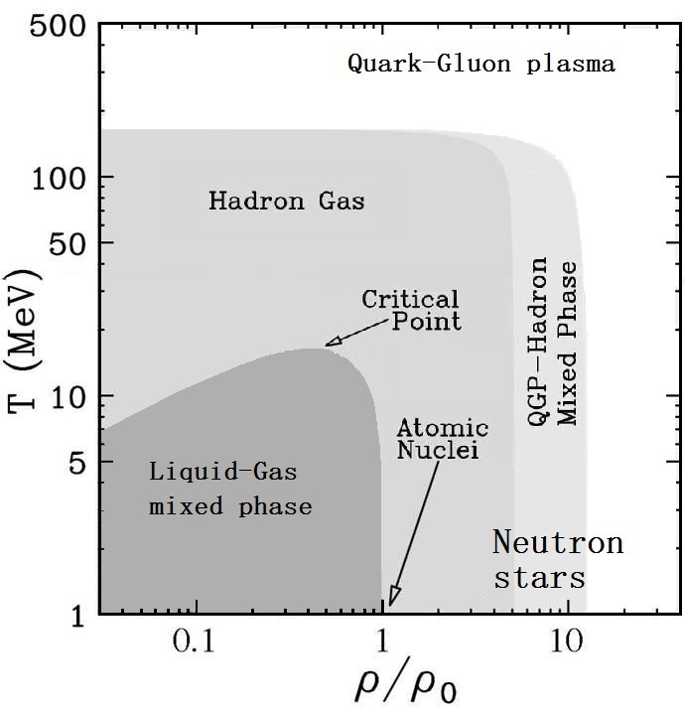
Nuclear matter phase diagram

Slide 3

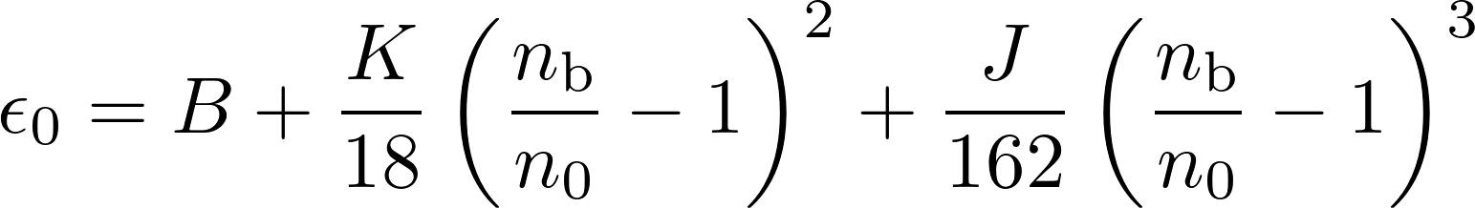
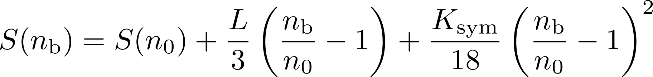


Constraints on nuclear matter properties
The binding energy per nucleon can be expanded as
Zhang et al.2020_PRC101-034303:
K = 250.23±20.16 MeV,
S = 31.35±2.08 MeV
L = 59.57±10.06 MeV
Lattimer_Steiner2014_EPJA50-40
with
Essick et al.2021_PRL127-192701:
S = 33.0^{+2.0}_{−1.8} MeV
L = 53⁺¹⁴₋₁₅ MeV
Farine et al.1997_NPA615-135:
J = −700±500 MeV Xie_Li2021_JPG48-025110:
J = −390⁺⁶⁰₋₇₀ MeV
Shlomo et al.2006_EPJA30-23:
Notes:
尽管核物质的具体结构和性质对中子星的性质及演化过程至关重要，但是当前我们对核物质性质的了解仅限于原子核所能涵盖的密度和不对称度附近。
from fits of generalized Skyrme force to breathing-mode nergies
empirical pressures in relativistic heavy-ion collisions K = 240±20 MeV
-180+100-110

Slide 4
Compact star structures
~10¹⁵g/cm³
Cross section of a neutron star
Cross section of a cooling white dwarf star
~10⁶g/cm³
Caplan_Horowitz2017_RMP89-041002
Notes:
Coulomb parameter Γ describe the ratio of a typical Coulomb energy to the thermal energy
(1) 中子星大气是一层薄薄的等离子体，主要成分是氢和氦，对于无吸积的冷暗中子星，该层厚度大约为几毫米到十厘米不等。大气层虽然很薄，但却影响热辐射的光谱。
(2) 中子星海洋是覆盖在固体外壳层上的一层液体，主要成分是由离子和自由电子组成的等离子体。
(3) 外壳层被定义为从大气层底部到中子滴密度的固态区域，厚度约为几百米
(4) 内壳层由富中子化原子核、自由中子、电子和少量质子组成，主要由非相对论性自由中子和相对论性简并电子提供压强，它从中子滴密度一直延展到0.5倍核饱和密度附近。

Slide 5
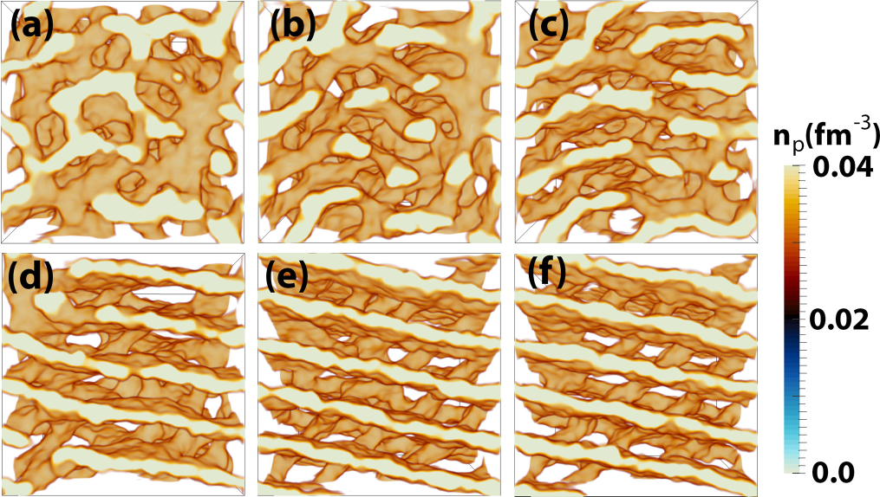
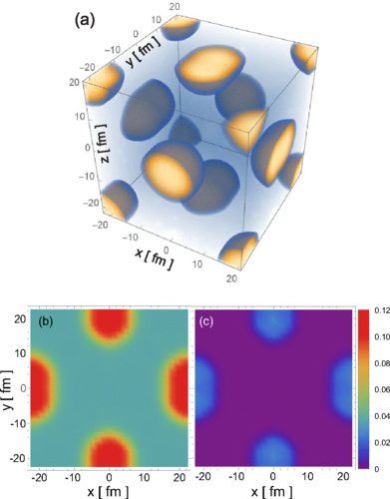
Nuclear shapes and lattice types
Okamoto_Maruyama_Yabana_Tatsumi2012_PLB713-284
Schuetrumpf_Martnez-Pinedo_Afibuzzaman_ Aktulga2019_PRC100-045806
Berry_Caplan_Horowitz_Huber_Schneider2016_PRC94-055801
Kashiwaba_Nakatsukasa2020_PRC101-045804
Oyamatsu1993_NPA561-431
Schneider_Berry_Briggs_Caplan_Horowitz2014_PRC90-055805
Notes:
the gyroid and double-diamond morphologies, P-surface configurations, nuclear waffles, Parking-garage structures
1. 中子星结构，如半径，潮汐形变等；
2. Neutrino opacity, Thermal conductivity, electric conductivity 中微子不透明度（热导率：低质量x双星系、电导率：磁星磁场演化）
3. the strength of nuclear pasta in neutron stars (such as the the breaking (yield) strain) determines Maximum degree of deformation for the crust, i.e.,
the height of Mountains which determines the gravitational wave strain from a rotating NS
4. pulsar glitch: The interplay of nuclear pasta with the superfluid vortexes was essential to explain pulsar glitches in votex creep model, starquake model
5. Quasi periodic oscillations (QPOs) observed after Giant flares of manetars are usually interpreted as
Crustal Torsional Oscillations (Starquake), where the elastic and superfluid properties of nuclear pasta play essential roles
在硬X射线和软γ射线中，探测到来自磁星的超高能巨型耀斑

Slide 6
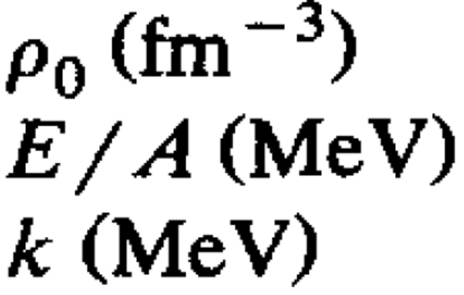
Lagrangian density
The Lagrangian density of the RMF model is
Zhang et al.2020_PRC101-034303:
K = 250.23±20.16 MeV,
S = 31.35±2.08 MeV
L = 59.57±10.06 MeV
Essick et al.2021_PRL127-192701:
S = 33.0^{+2.0}_{−1.8} MeV
L = 53⁺¹⁴₋₁₅ MeV
The adopted parameter set for RMF theory:
[Set 0: Maruyama_Tatsumi_Voskresensky_Tanigawa_Chiba2005_PRC72-015802]
Saturation density:
Binding energy:
Incompressibility:
0.153
-16.3
240
Set 0: E_{sym} = 32.46 MeV, L = 89.39 MeV
Set 1: E_{sym} = 31.85 MeV, L = 41.34 MeV

Slide 7
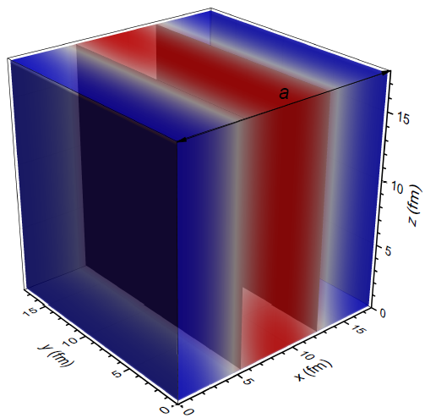

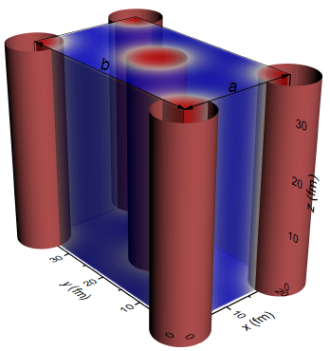
Numerical recipe
The boson
The boson
Droplet/Bubbles in BCC and FCC lattices
Slabs
n_{b}
The boson
Rods/Tubes in simple and honeycomb configurations
The boson fields and density profiles are solved iteratively inside a 3D periodic unit cell with discretized space coordinate, i.e.,
Assume initial density distributions of fermions at given total particle numbers;
Solve the boson field equations via fast cosine transformations (reflection symmetry) ;
Prepare the density distributions of fermions with the imaginary time step method [Levit1984_PLB139-147];
Go to step 2 until convergence is reached.

Slide 8
Convergency and effect of finite cell size
∆E/A < 0.001 keV
∆E/A ≈ 1.5 keV, 0.03 keV, and 0.0006 keV
for dx = dy = dz = 0.96 fm, 0.48 fm, and 0.24 fm

Slide 9
Energy per baryon
Set 0: L = 89.39 MeV

Slide 10
Energy per baryon
Set 1: L = 41.34 MeV

Slide 11
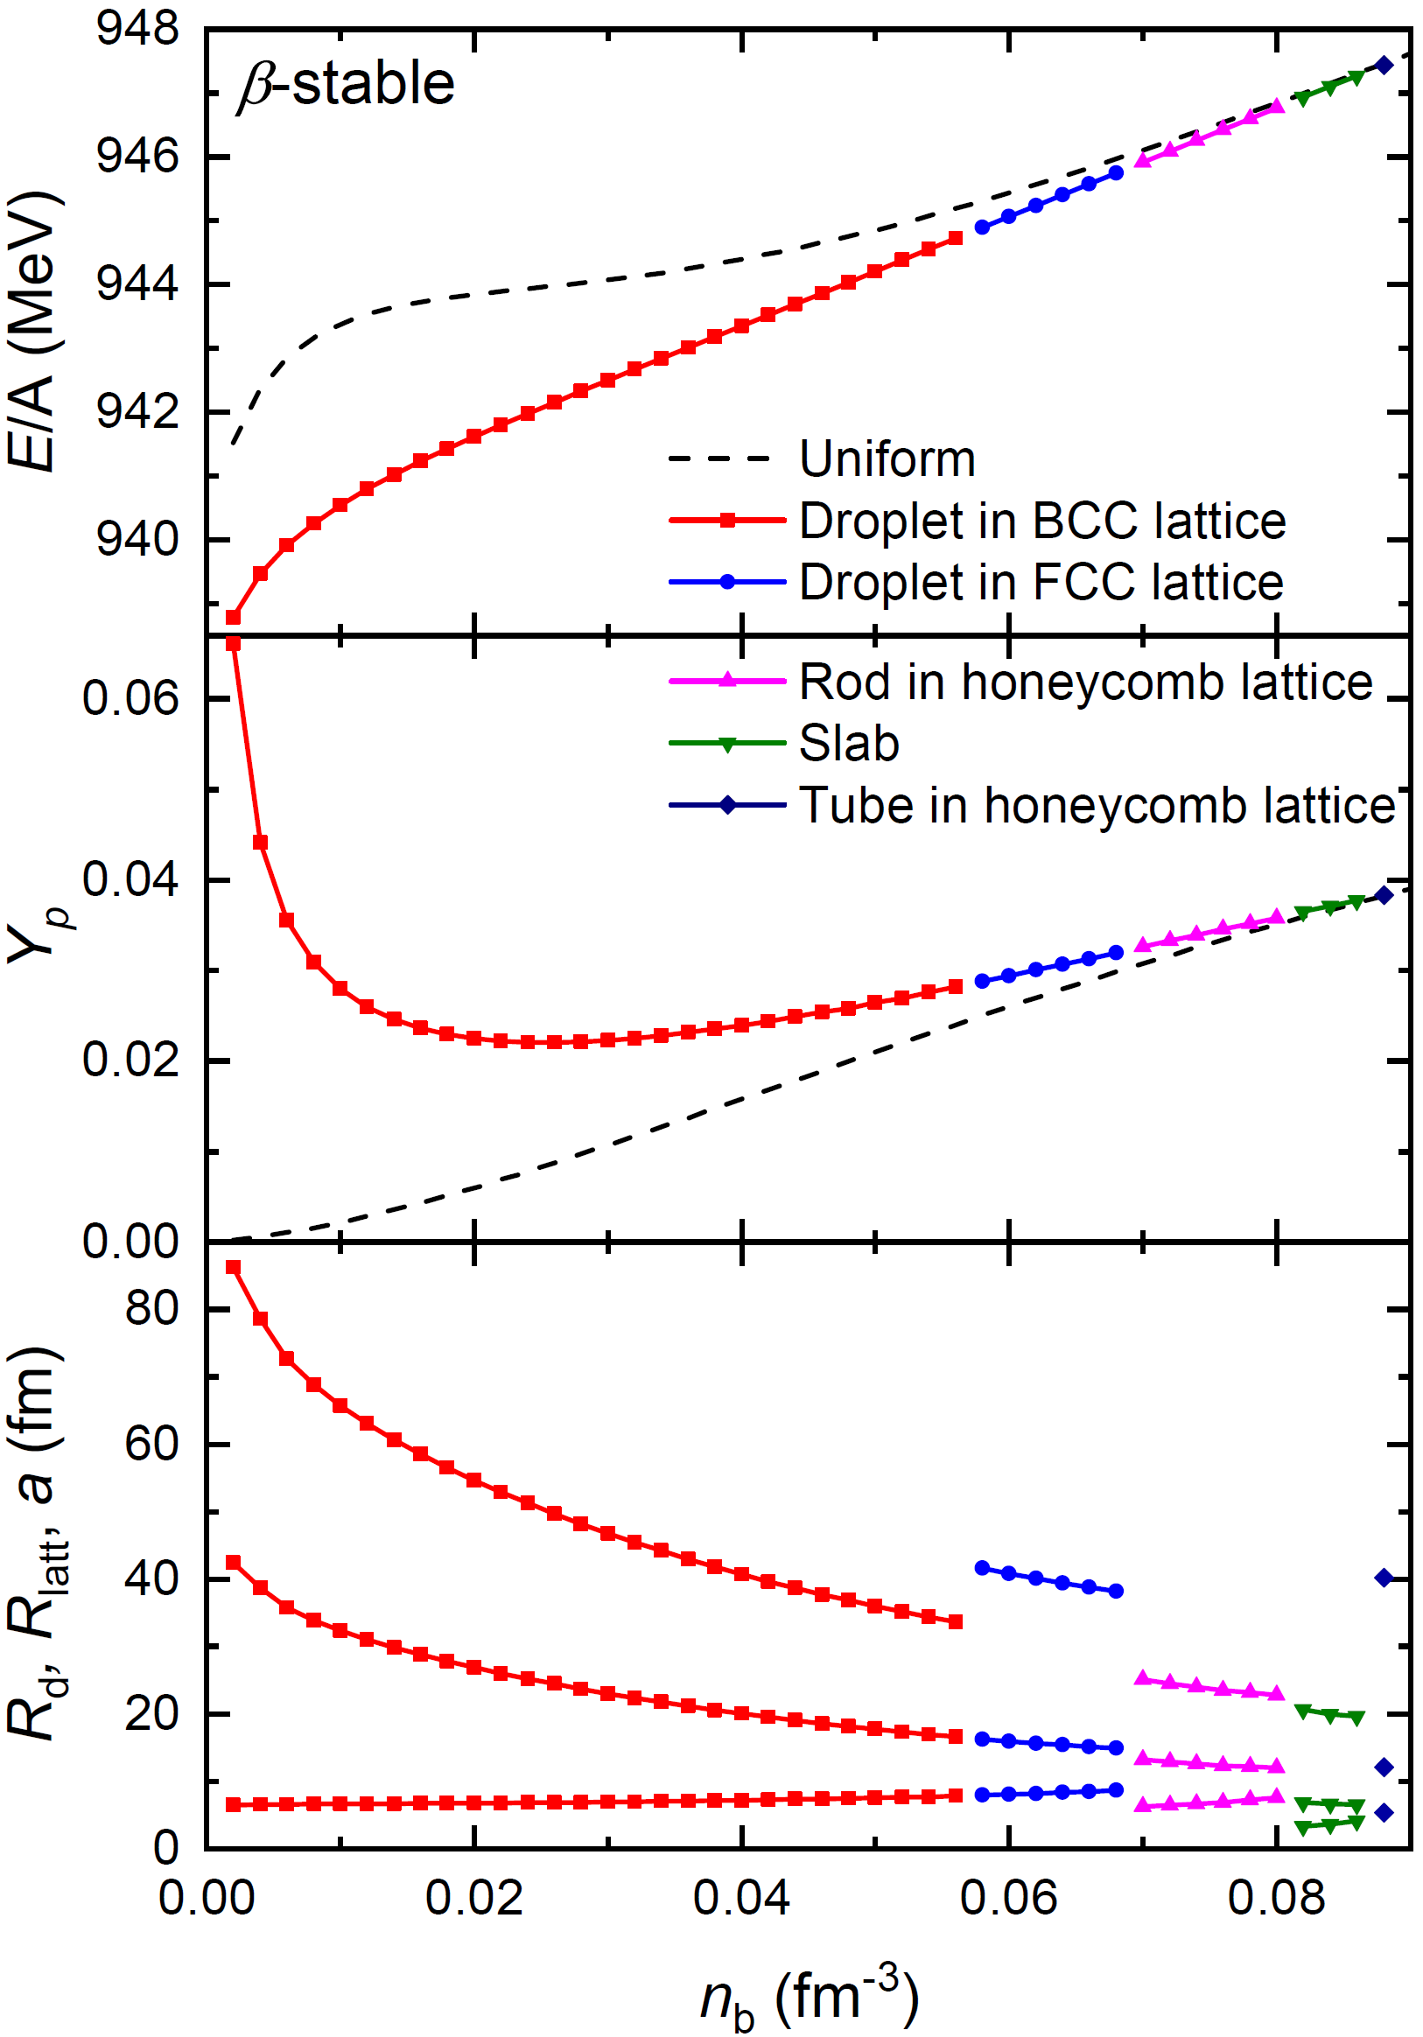
Nuclear matter in β-equilibrium
Set 0: L = 89.39 MeV
Set 1: L = 41.34 MeV

Slide 12
Neutron stars

Slide 13
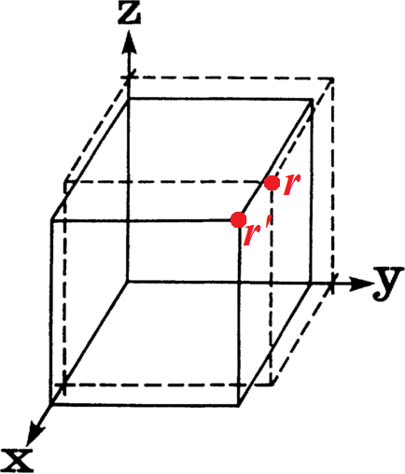
Elastic theory
The displacement gradient u_{ij} moving a droplet at position r to r'
Single crystal:
The variation of energy density due to deformation
Droplet/bubble phases with cubic symmetry (BCC and FCC lattices):
c₁₁ = c₂₂ = c₃₃, c₁₂ = c₂₁ = c₁₃ = c₃₁ = c₂₃ = c₃₂, c₄₄ = c₅₅ = c₆₆;
Rods/tubes that are aligned with the z-axis, the nonzero terms:
c₁₁ (= c₂₂), c₁₂, and c₄₄ (= c₁₁/2 - c₁₂/2 for honeycomb configuration);
Slabs perpendicular to the x-axis, only c₁₁ persists.

Slide 14

Elastic theory
Coulomb crystal:
Assuming a BCC crystal of point nuclei embedded in a uniform electron background, a Monte Carlo simulation predicts [Ogata_Ichimaru1990_PRA42-4867]
Incompressible liquid-drop model [Pethick_Potekhin1998_PLB427-7]:

Slide 15
Elastic properties
PLB 839 (2023) 137769

Slide 16
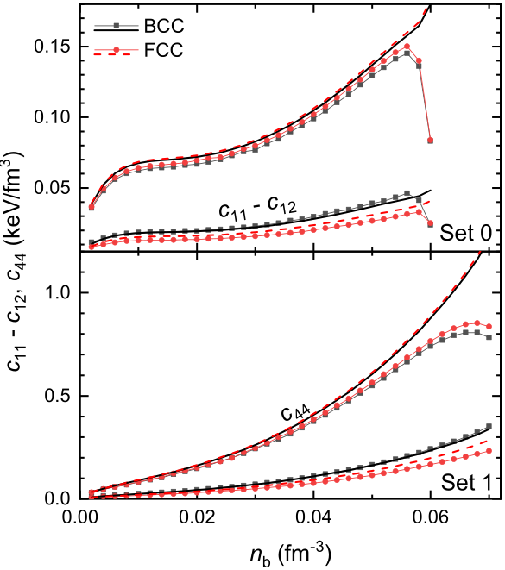
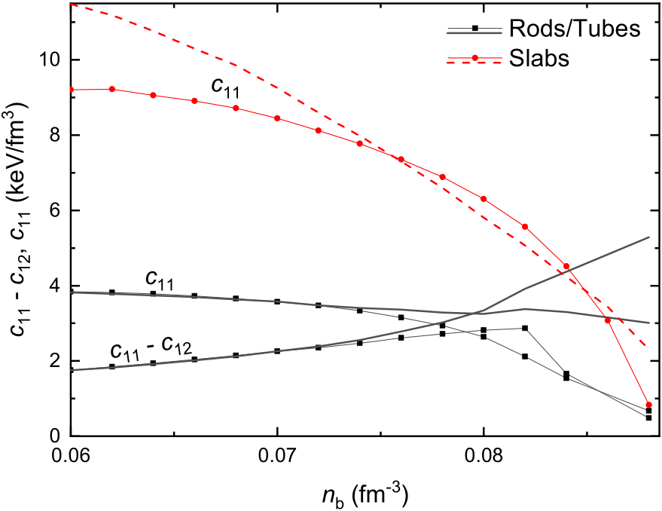
Elastic constants
PLB 839 (2023) 137769
L = 89.39 MeV
L = 41.34 MeV
Notes:
Assuming a crystal of point nuclei embedded in a uniform electron background, a Monte Carlo simulation predicts [Ogata_Ichimaru1990_PRA42-4867]
Single crystal:

Slide 17
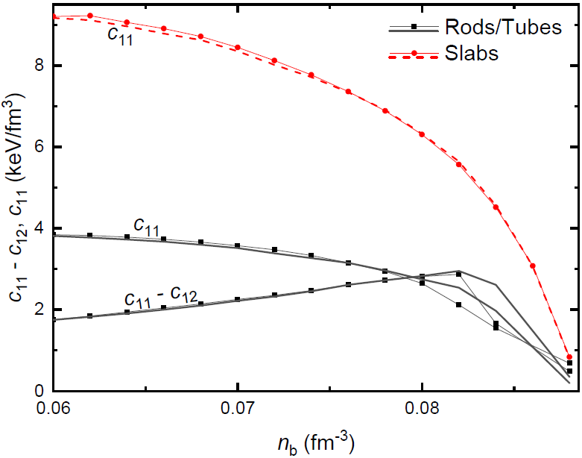
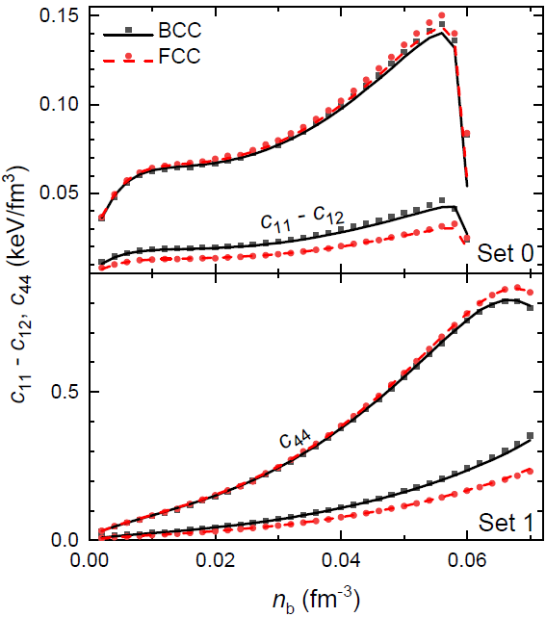
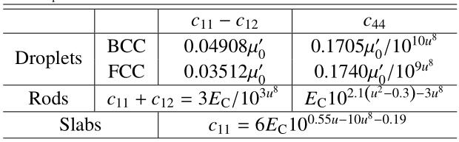
Elastic constants
L = 89.39 MeV
L = 41.34 MeV
µ₀’ ≡
Notes:
Assuming a crystal of point nuclei embedded in a uniform electron background, a Monte Carlo simulation predicts [Ogata_Ichimaru1990_PRA42-4867]
Single crystal:

Slide 18
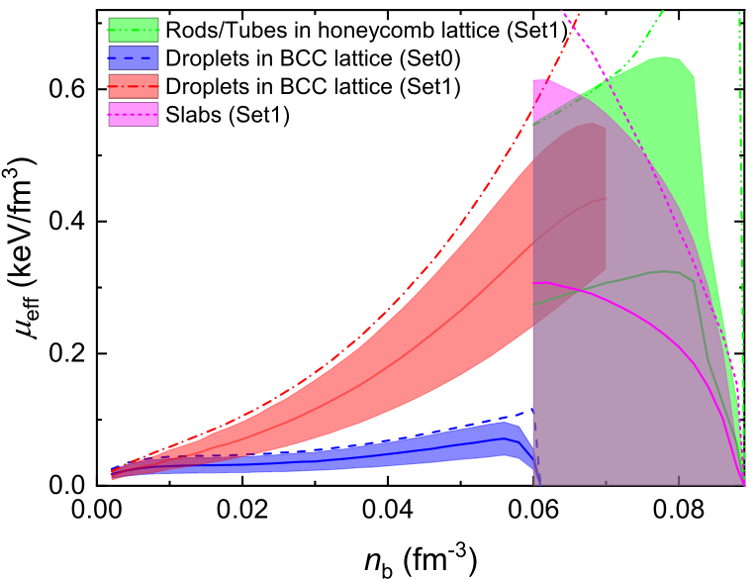
Effective shear modules
Horowitz_Kadau2009_PRL102-191102
Polycrystal:
Effective bulk module K
and shear module μ_{eff}.
Voigt theory:
Reuss theory:
for BCC and FCC lattices
Arithmetical Hill method:
Notes:
Polycrystal: Voigt theory & Reuss theory
Based on the extent of anisotropy in polycrystallines, the elastic properties vary within the bounds predicted by the Voigt and Reuss theories.
the Voigt theory estimates the effective shear module by averaging over all possible lattice orientations for the stress in a given strain.
while the Reuss theory estimates the effective shear module by averaging the strain at a given stress

Slide 19
Giant flares [arXiv1803.05716]
The 2004 December 27 giant flare of SGR 1806–20 as observed by RHESSI (from Hurley et al. 2005). Panel a shows the 20–100-keV light curve. The (saturated) spike is at ~30 s and the inset shows the profile of a bright burst the preceded the flash by ~2 minutes. The modulation at
the spin period of SGR 1806–20 (7.5 s) is apparent. Panel b shows the temporal evolution of the spectral temperature.
Quasi periodic oscillations (QPOs) at about 18, 30, 93, 150, 625 and 1840 Hz [Israel et al., 2005; Watts
and Strohmayer, 2006].
Crustal Torsional Oscillations (Starquake)

Slide 20
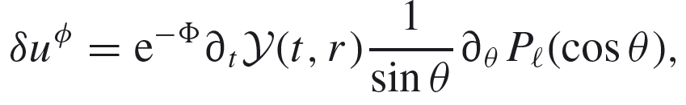

Crustal torsional oscillations
ɸ-component of the perturbed four-velocity of fluid:
The angular displacement of the stellar matter:
The perturbation equation:
$$v_{s}=\sqrt{\frac{μ}{E+P}}$$
Shear velocity:
Sotani_Nakazato_Iida_Oyamatsu2012_PRL108-201101

Slide 21
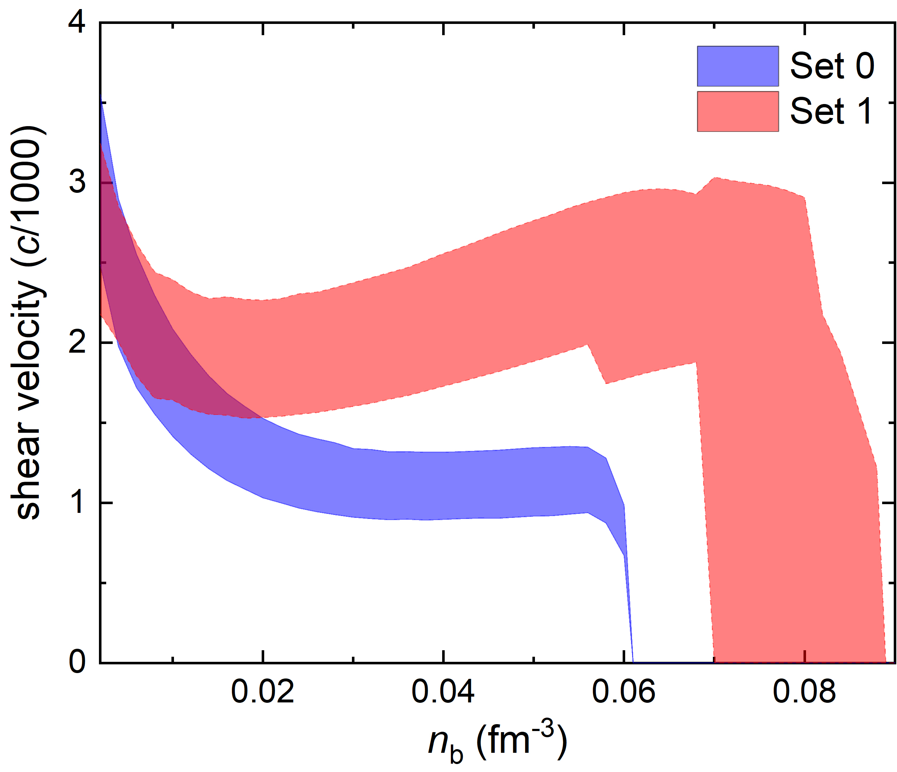
Shear velocity

Slide 22
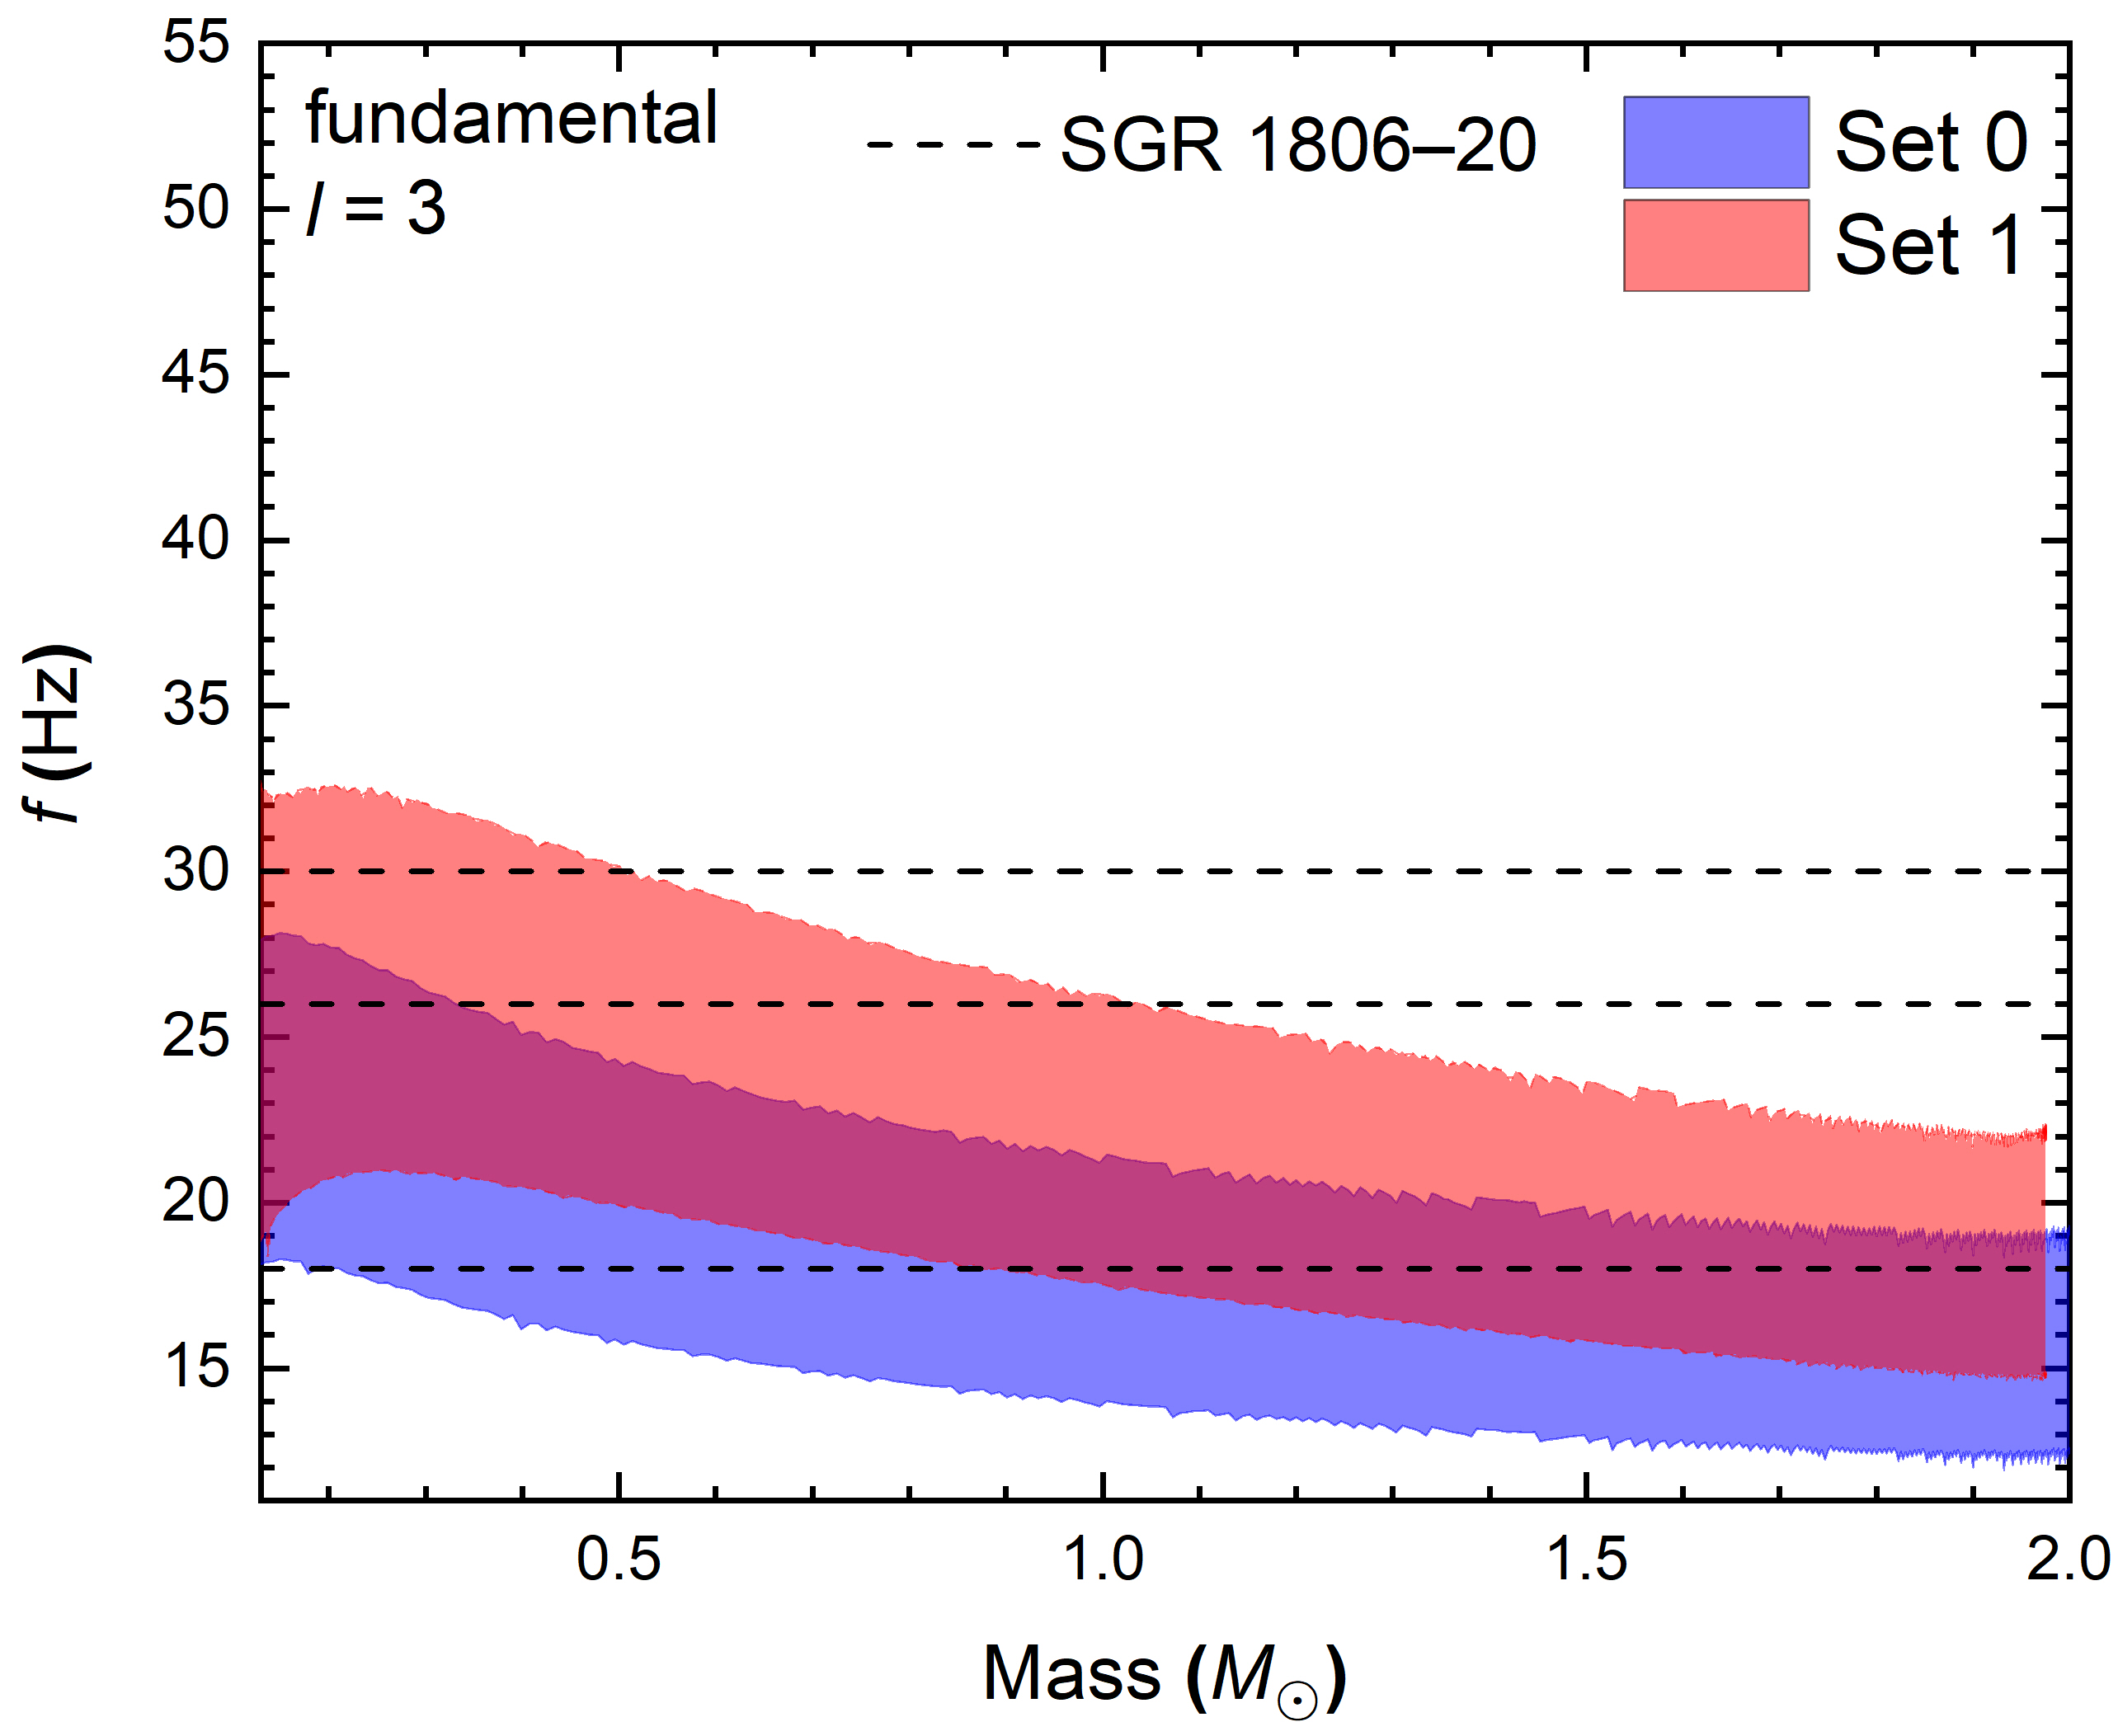
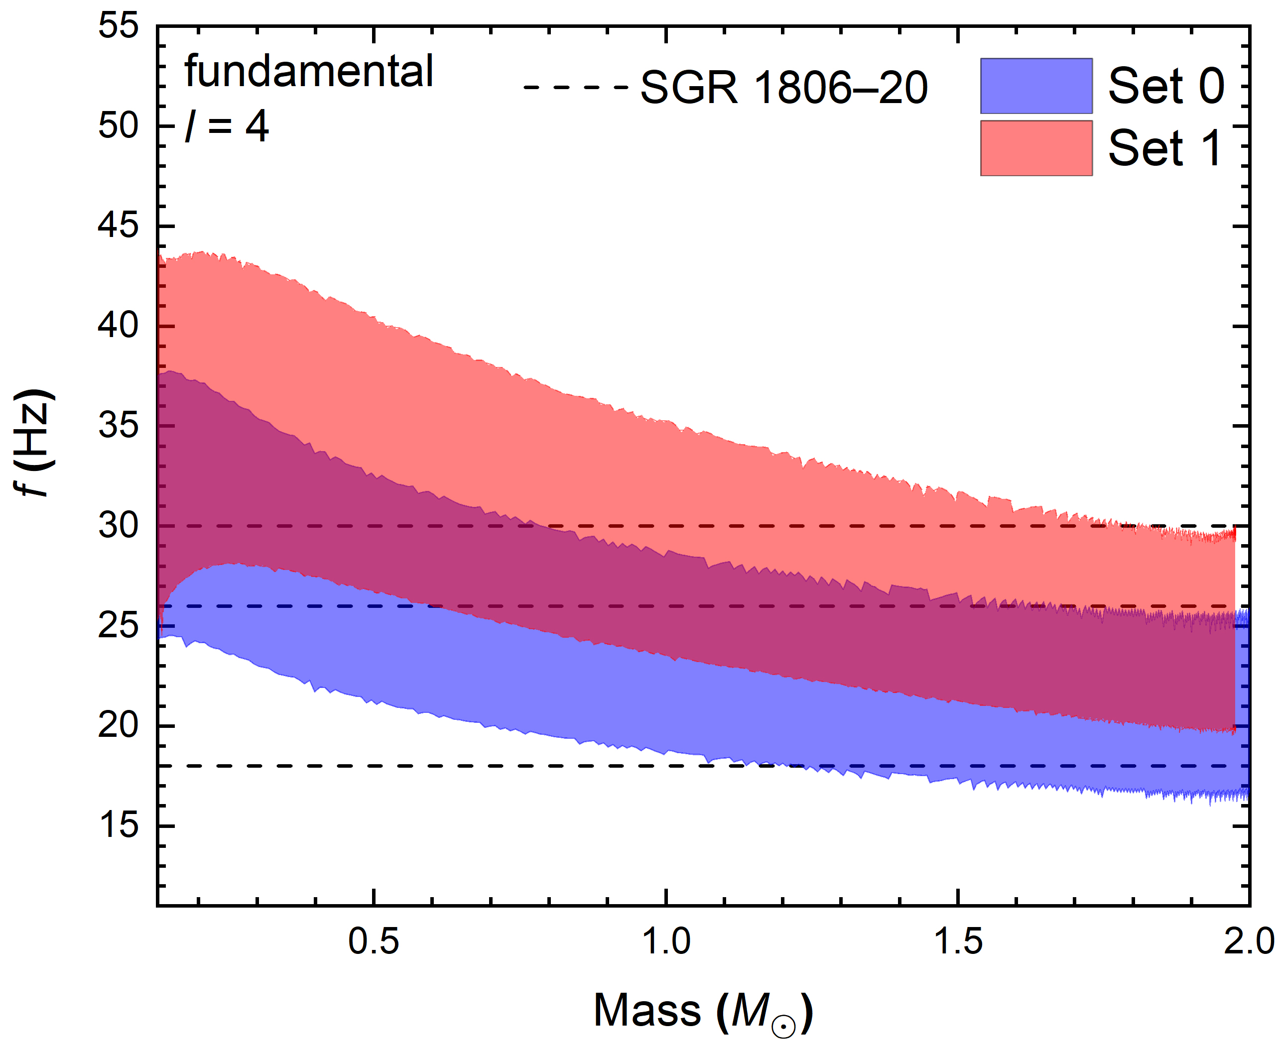
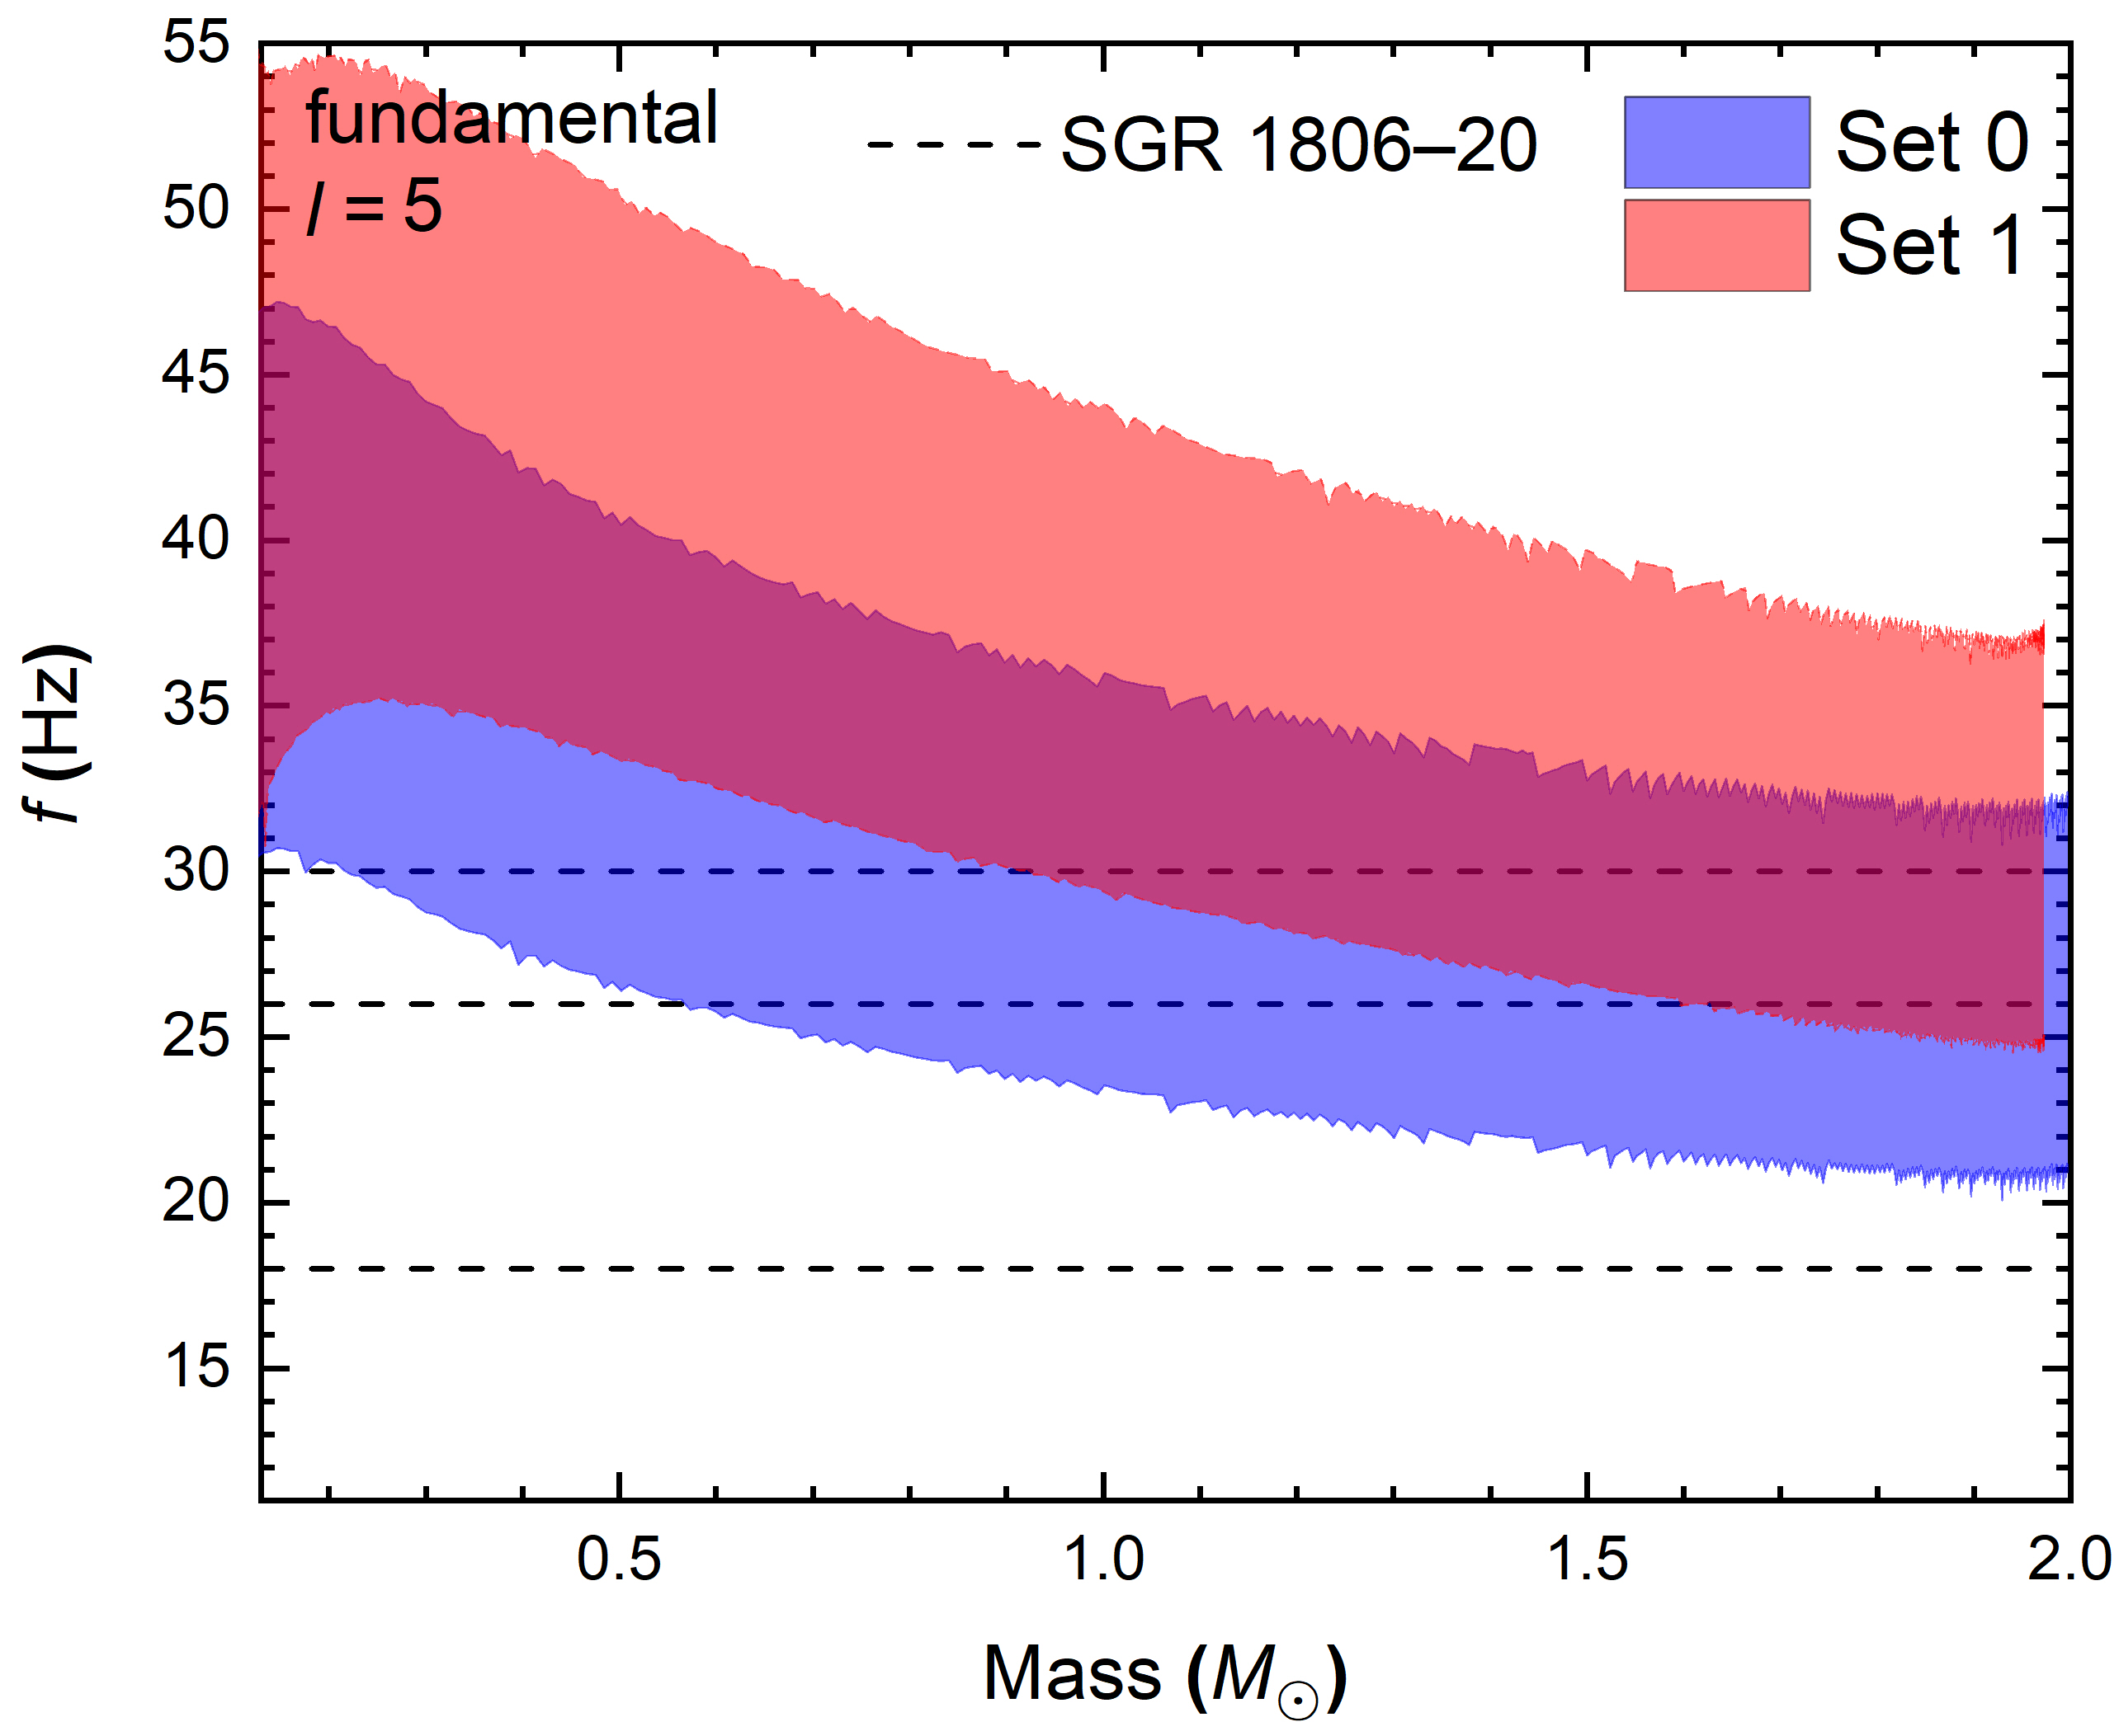
Crustal torsional oscillations
Preliminary

Slide 23
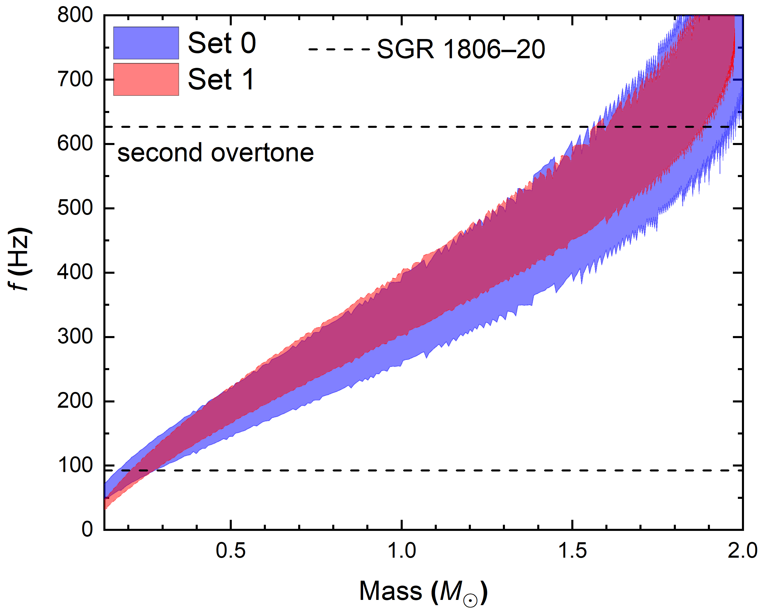
Crustal torsional oscillations
Preliminary

Slide 24
Summary
We have investigated the structures and elastic properties of low density nuclear matter in a fully three-dimensional geometry.
The effect of finite cell size is treated carefully by searching for the optimum cell size.
The EOSs of nuclear pastas are insensitive to the lattice structures (size, volume, A, and Z), where the difference of energy per baryon is small.
The elastic properties deviates from that of Coulomb crystals at large densities, while those predicted by the incompressible liquid-drop model agree with our calculation quanlitatively but not quantitatively.
A smaller slope of symmetry energy predicts larger onset densities for core-crust transition and non-spherical nuclei, elestic constants, and frequencies of fundamental torsional shear modes.
Thank you!!!

Slide 25




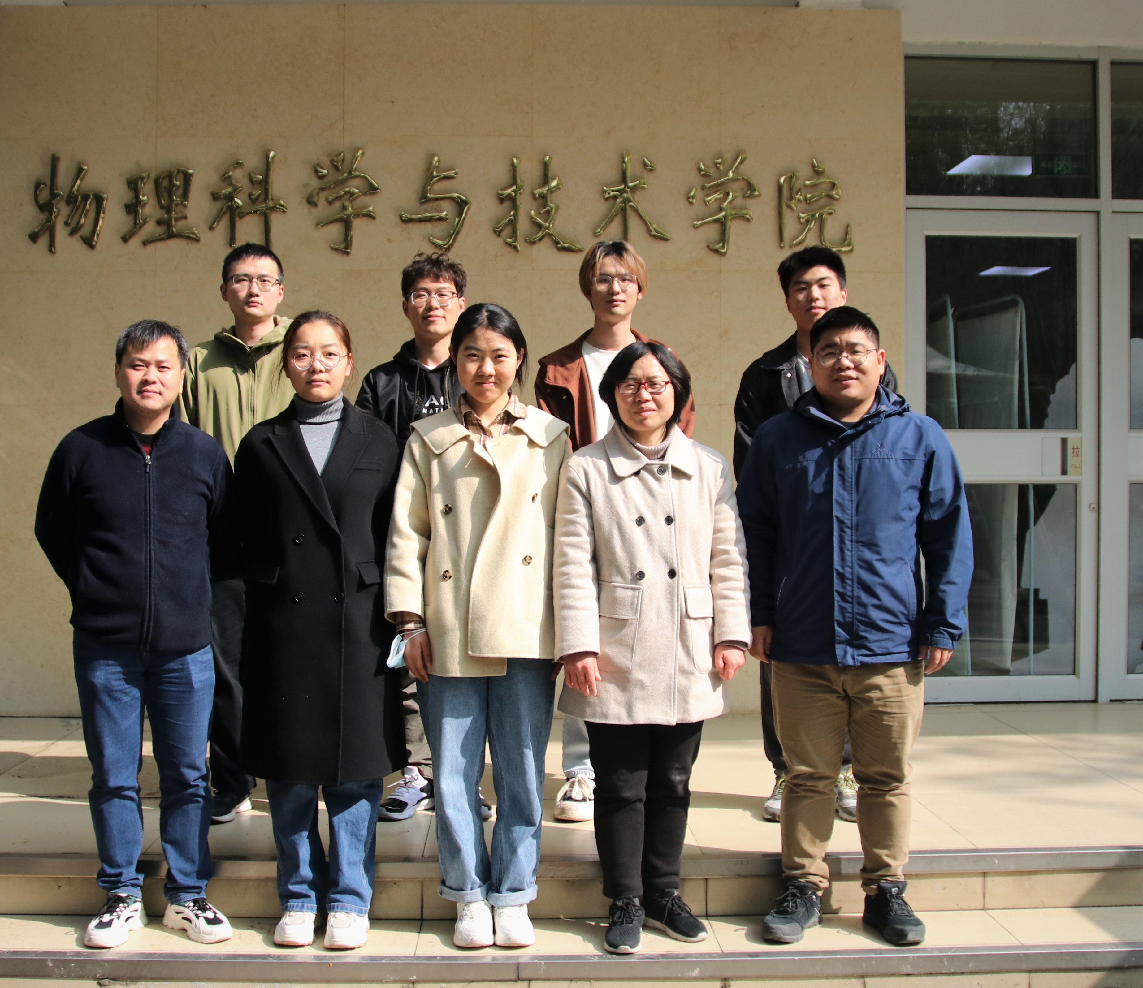
欢迎大家来扬州！

