Slide 1


Does Stress Drop Positively or Negatively Correlate With Rupture Speed?
Shiqing Xu
SUSTech, Shenzhen

Slide 2
Some background

Slide 3
Newtonian mechanics
Describe the motion of particles
Ignore relativity effect
Due to the inertia, one cannot have instantaneous change in velocity

Slide 4
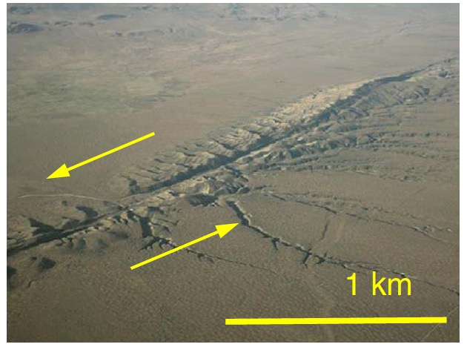
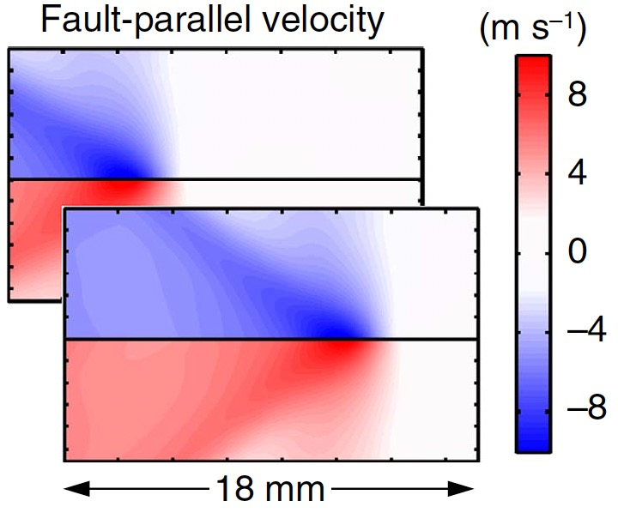
Rupture propagation
Focus on the motion of the rupture front
Particles still vibrate near their equilibrium positions
Newtonian mechanics (PDE) applies
Fault
Boundary condition applies
Fault
Rubino et al. (2017)

Slide 5

Fracture mechanics
Supply
Consumption
Thickness $→$ zero
Massless, no inertia at the rupture front
Dynamic energy release rate
Universal function
Static energy release rate
Fracture energy
Rupture speed
Stress drop

Slide 6
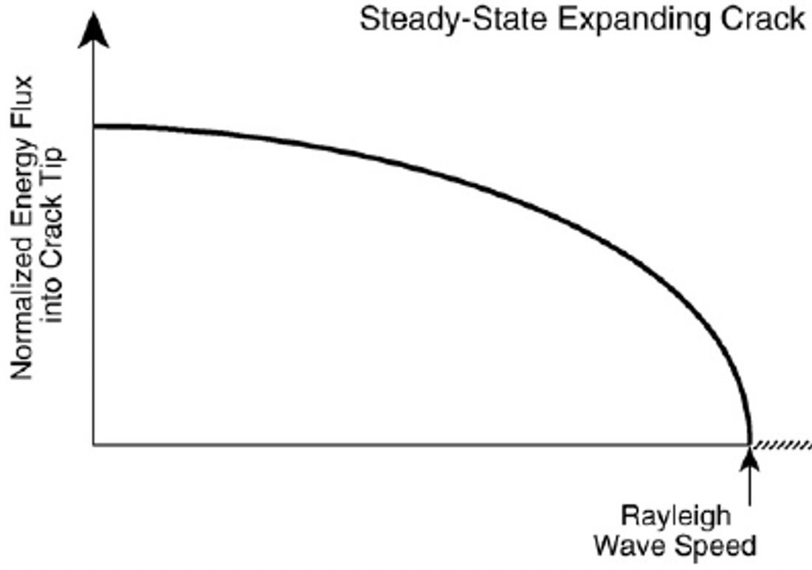
Fracture mechanics
Supply
Consumption
Thickness $→$ zero
Massless, no inertia at the rupture front
Dynamic energy release rate
Universal function
Static energy release rate
Fracture energy
Rupture speed
Stress drop

Slide 7
Contrasting results

Slide 8
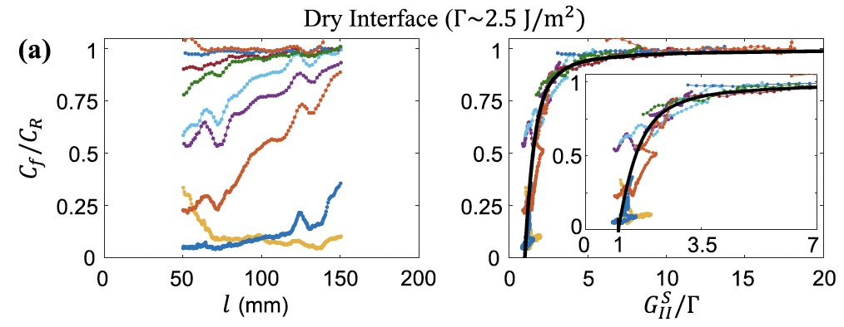
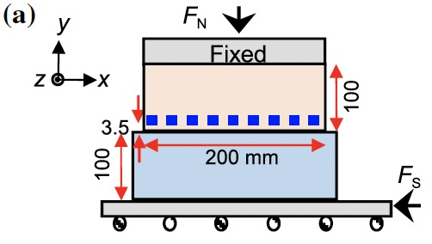
Correlation between Δτ and V_{r}
Svetlizky et al. (2017)
Increasing functional of stress drop
Overall positive correlation between and

Slide 9
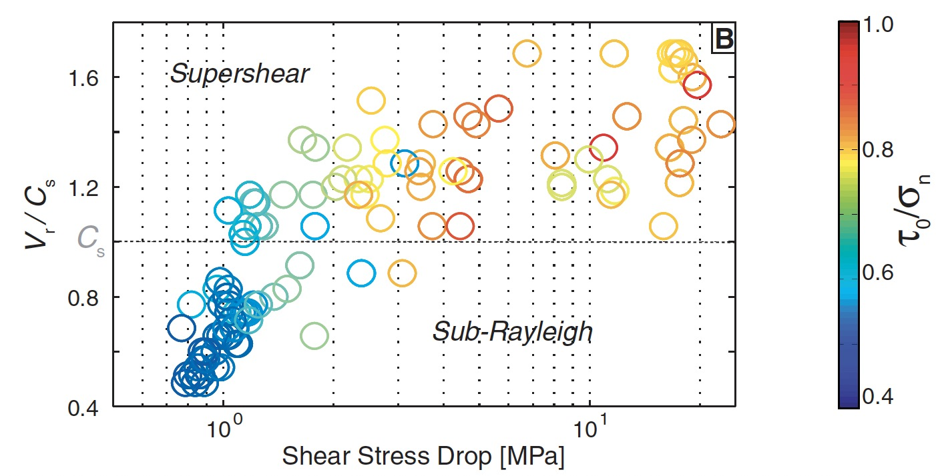
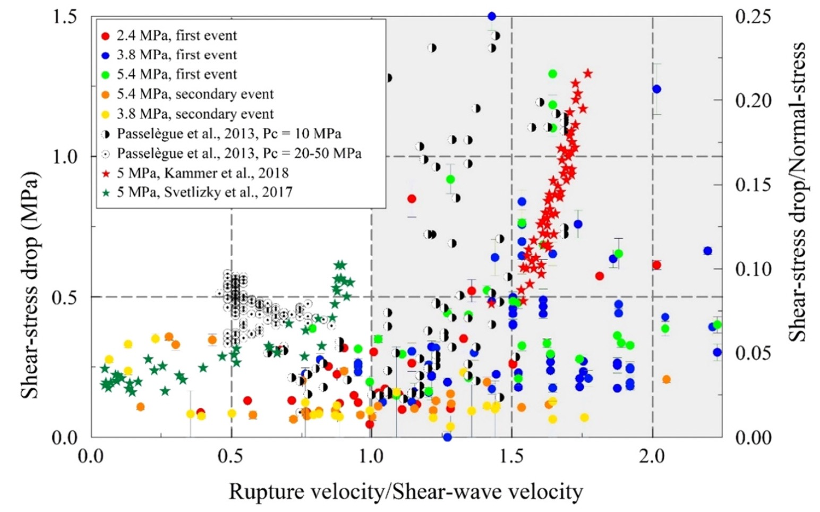
Correlation between Δτ and V_{r}
Passelegue et al. (2013)
Chen et al. (2021)
Overall positive correlation between and

Slide 10
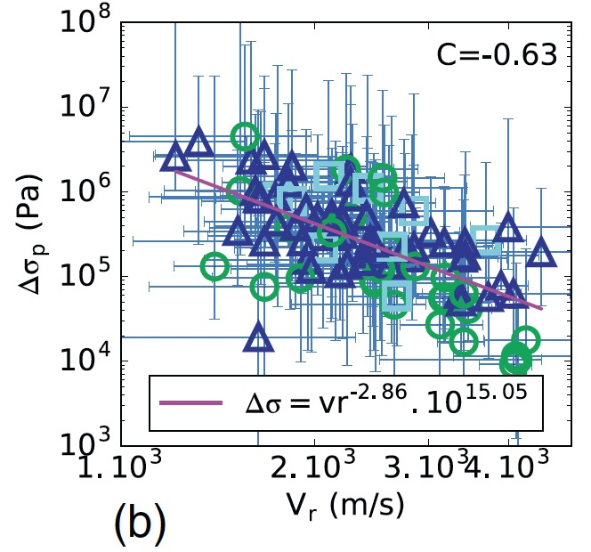
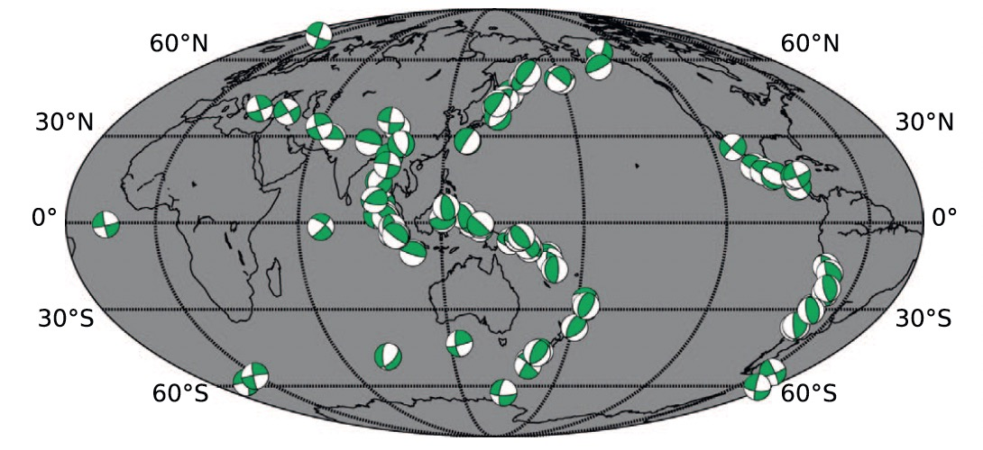
Correlation between Δτ and V_{r}
Chounet et al. (2018)
Overall negative correlation between and

Slide 11
Correlation between Δτ and V_{r}
Natural earthquakes
Positive or negative correlation, that is the problem
Laboratory earthquakes
Context-based solution
Physics-based solution

Slide 12
Context-based solution

Slide 13
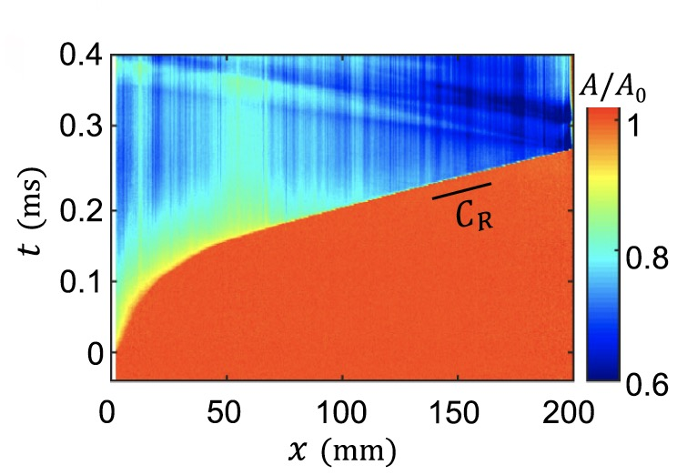
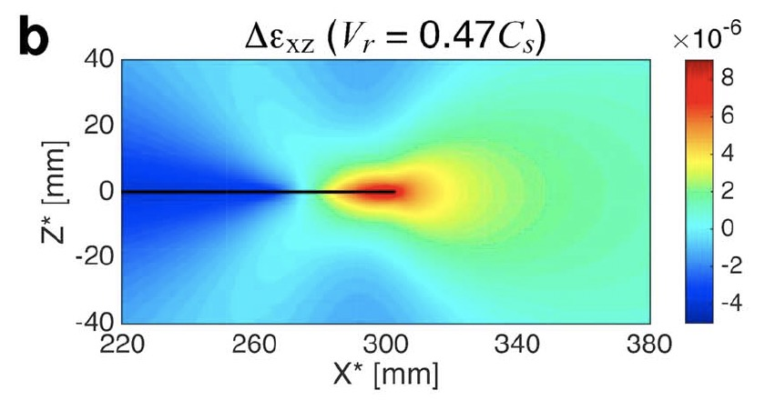
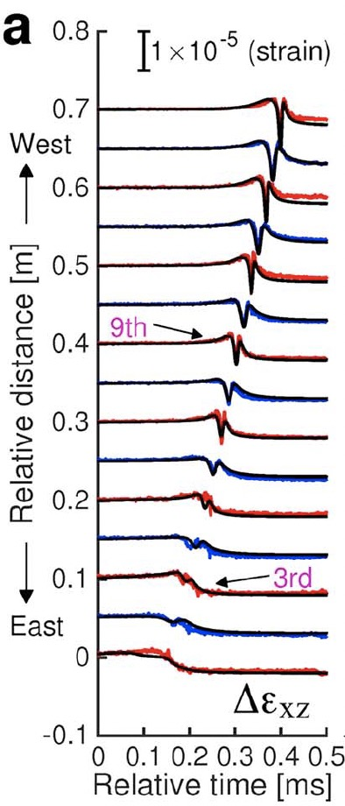
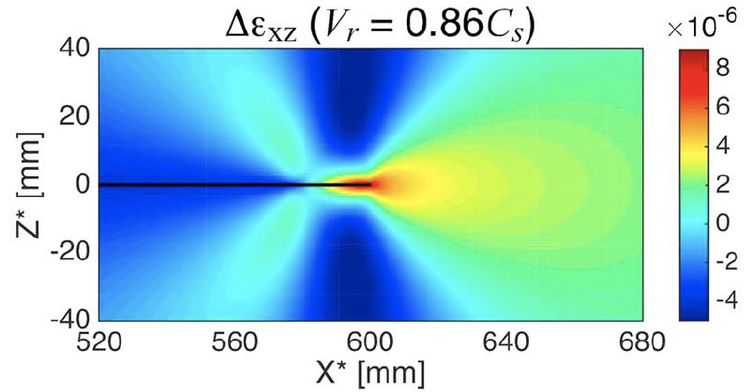
Estimation of V_{r} for lab quakes
Space-time migration
(multiple locations)
Waveform pattern
(single location)
Combined
Svetlizky et al. (2017)
Xu et al. (2019a)

Slide 14
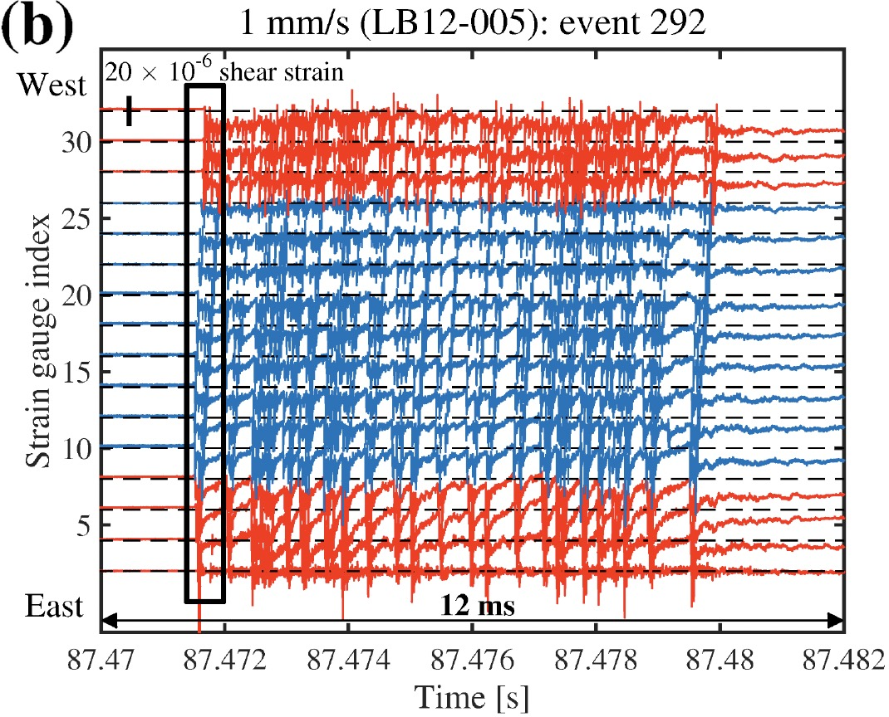
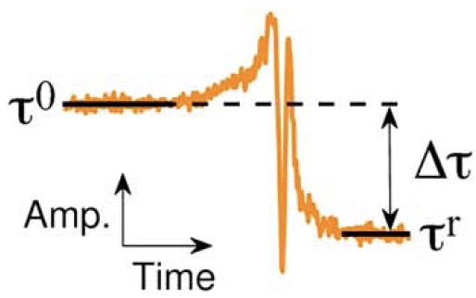
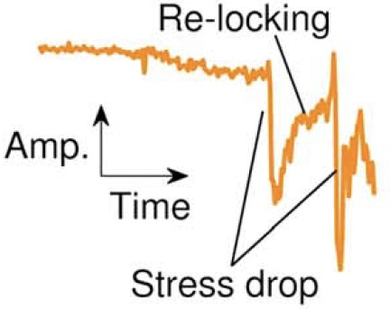


Estimation of Δτ for lab quakes
Only for one rupture front
Multiple ruptures
Xu et al. (2019a and b)

Slide 15
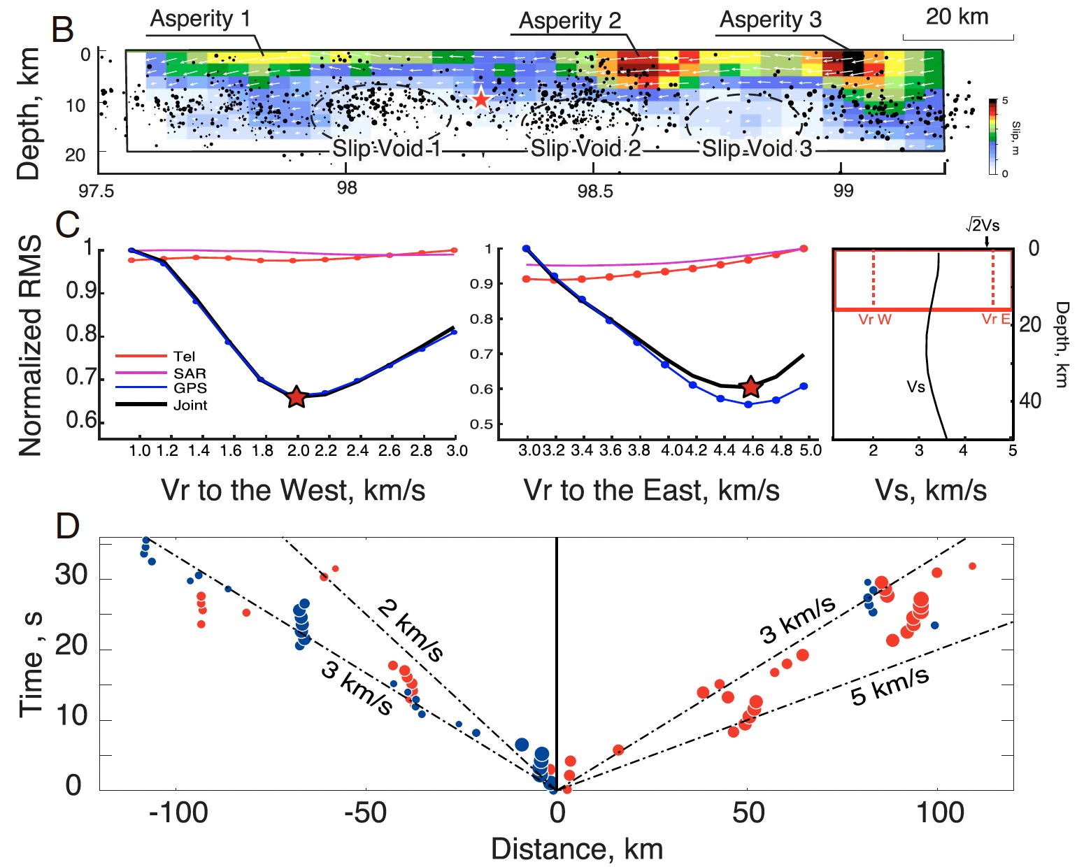
Estimation of V_{r} for large natural quakes
Discretize fault into patches
Assume a kinematic rupture process (under adjustable V_{r}) => synthetic waveforms
Find V_{r} by minimizing the misfit between synthetic and observed waveforms
Yue et al. (2022)

Slide 16
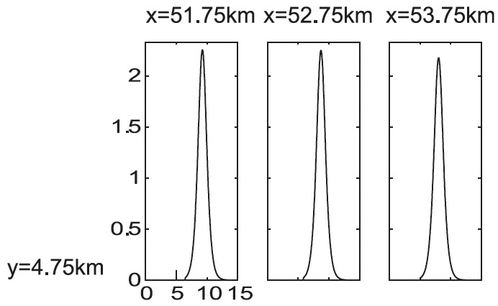
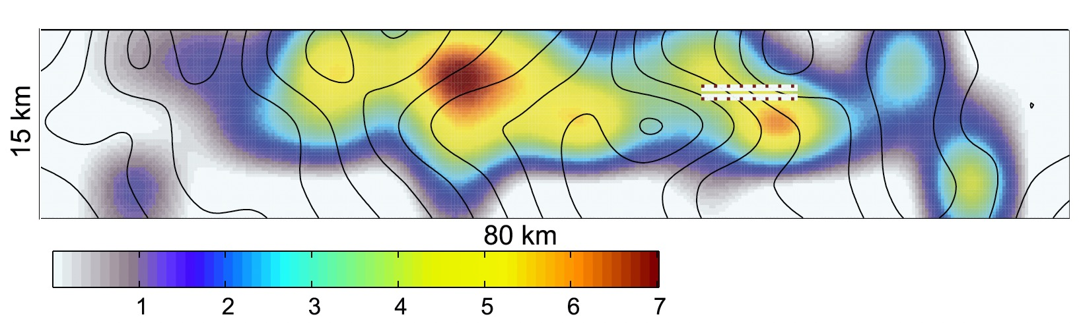
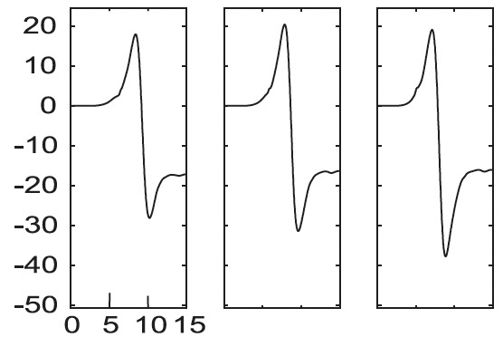
Estimation of Δτ for large natural quakes
Constitutive
relation on
the fault
Slip rate
Inverted slip distribution
Shear stress
Tinti et al. (2005)

Slide 17
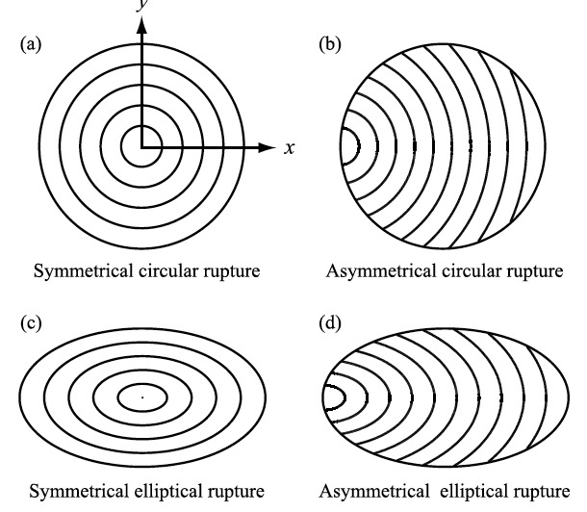
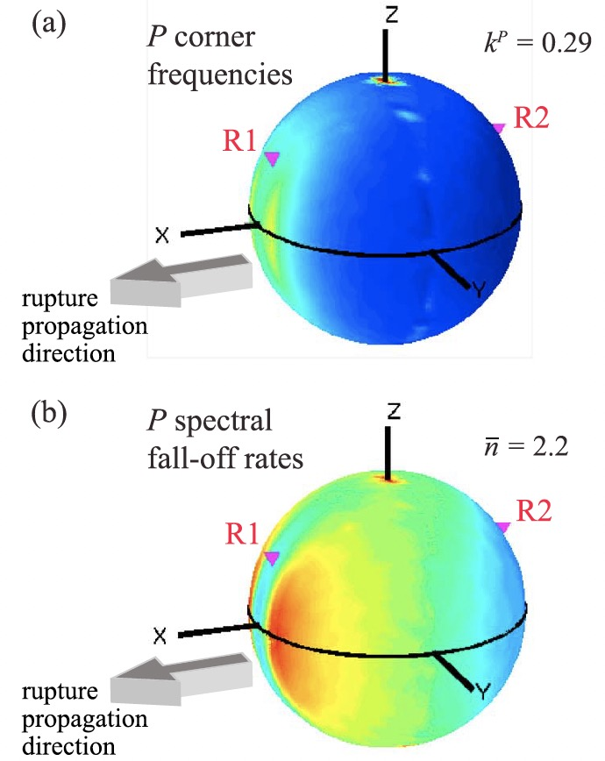
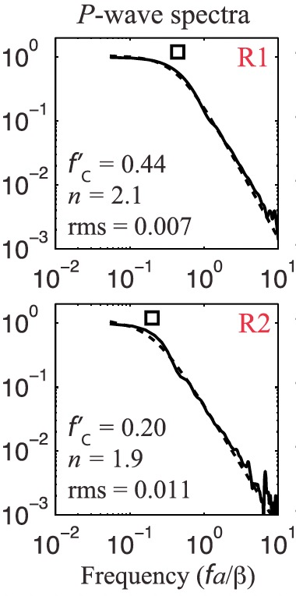
Estimations of V_{r} and Δτ for small natural quakes
Simple models
Directivity effect
V_{r} is either assumed or inferred from the corner frequency and directivity (Doppler) effect
Kaneko and Shearer (2015)

Slide 18
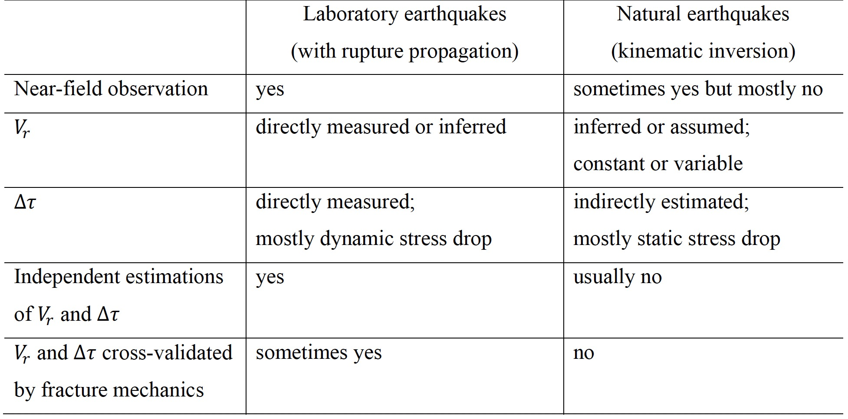
Different contexts for discussing V_{r} and Δτ

Slide 19
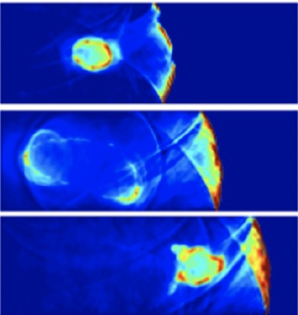
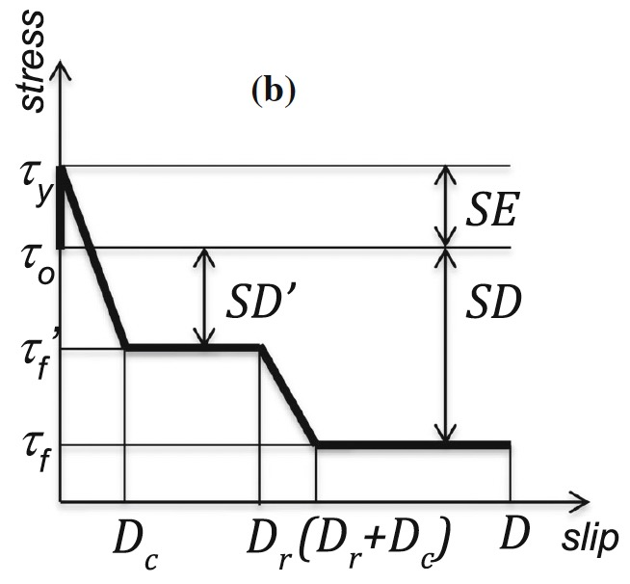
Different contexts for discussing V_{r} and Δτ
(1)
(2)
Static stress drop
Only for one rupture front
(1)
(2)
Multi-stage weakening + healing

Slide 20
Physics-based solution

Slide 21
Positive correlation between Δτ and V_{r}
Energy supply
Energy consumption
Assuming it is fixed
Decrease in

Slide 22
Negative correlation between Δτ and V_{r}
Energy supply
Energy consumption
Assuming it is reduced
Decrease in

Slide 23
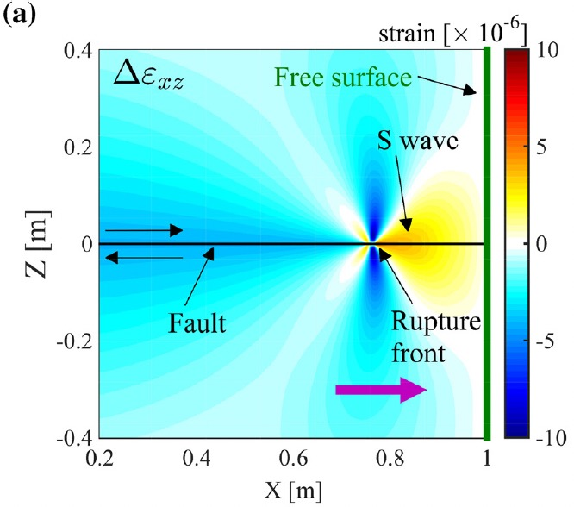
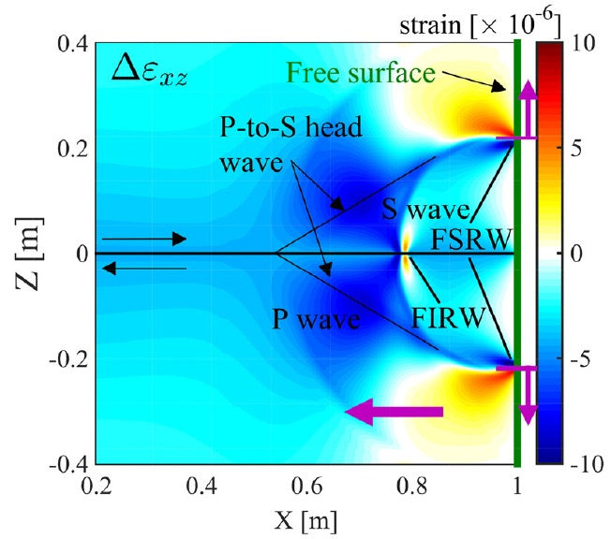
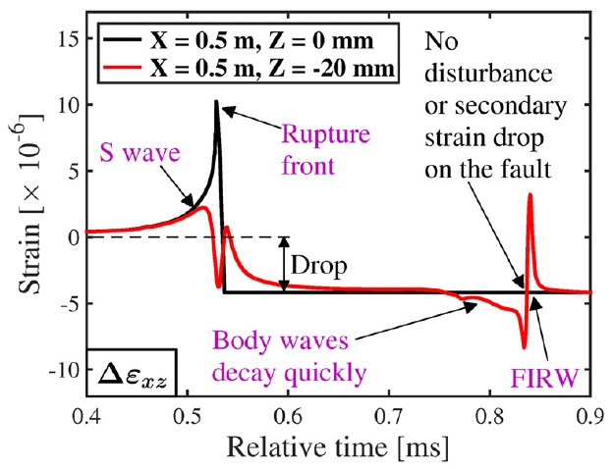
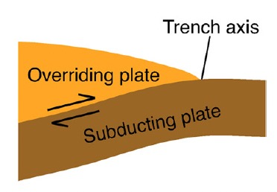
Negative correlation between Δτ and V_{r}
Primary rupture
Secondary rupture
Xu et al. (2019b)

Slide 24
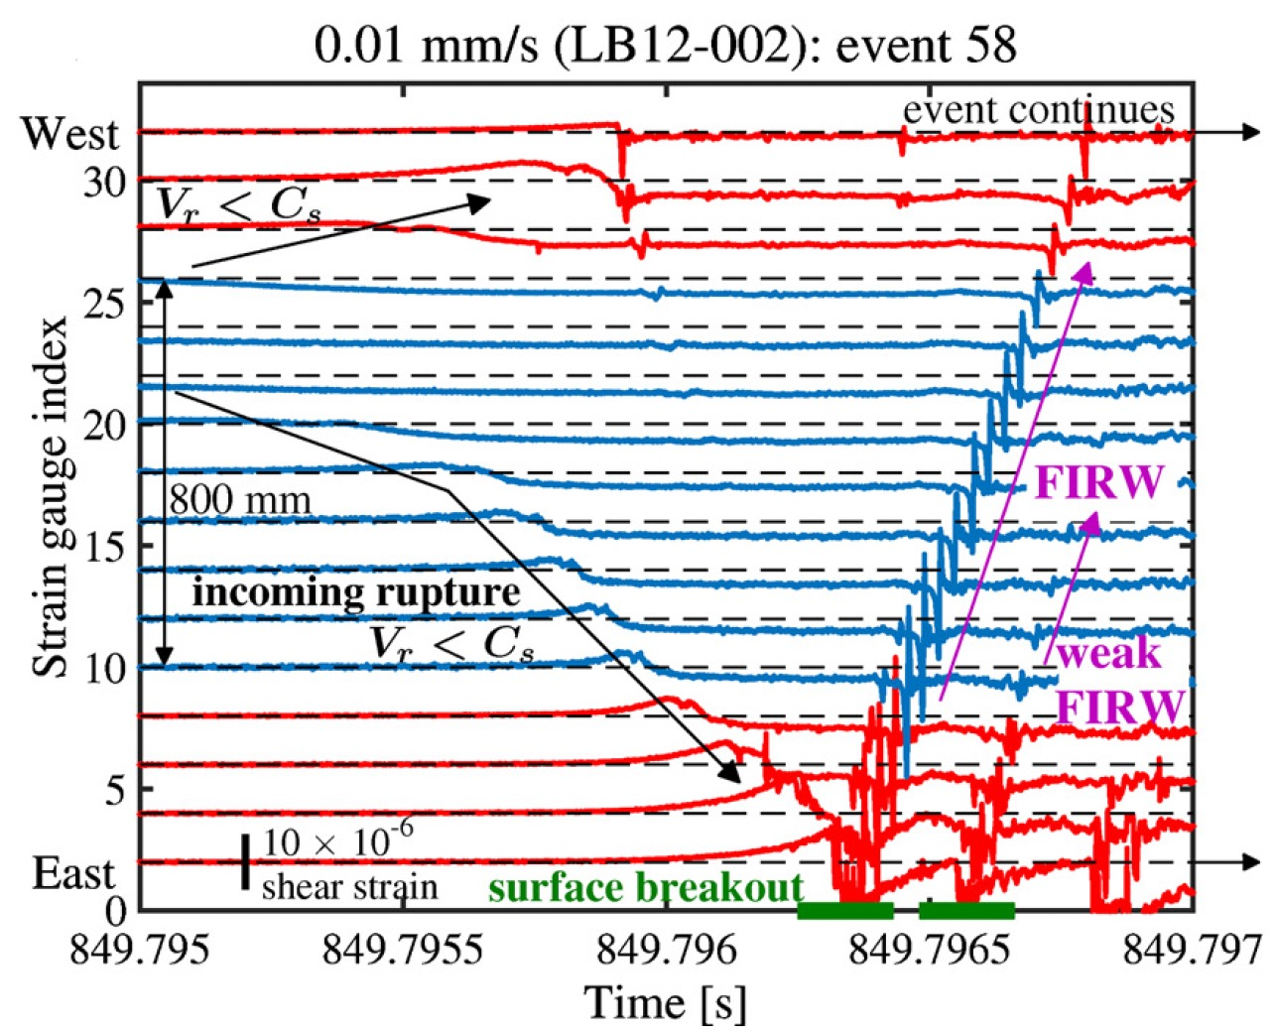
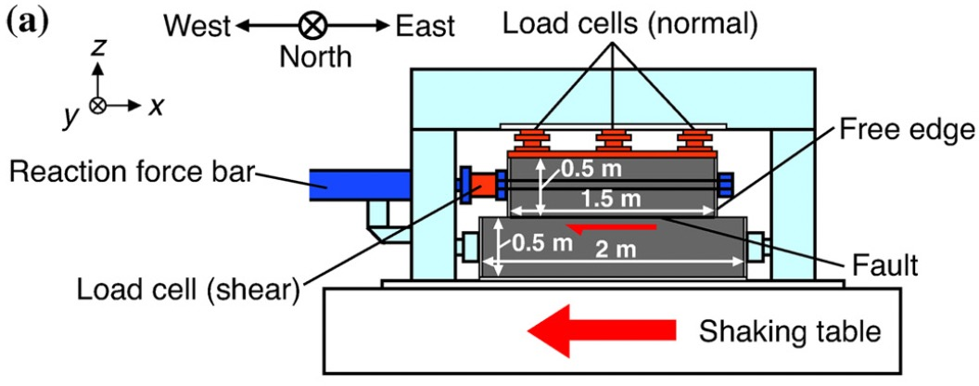
Negative correlation between Δτ and V_{r}
Secondary rupture
Faster rupture speed
Smaller (or even zero) stress drop
Primary rupture
Xu et al. (2019b)

Slide 25
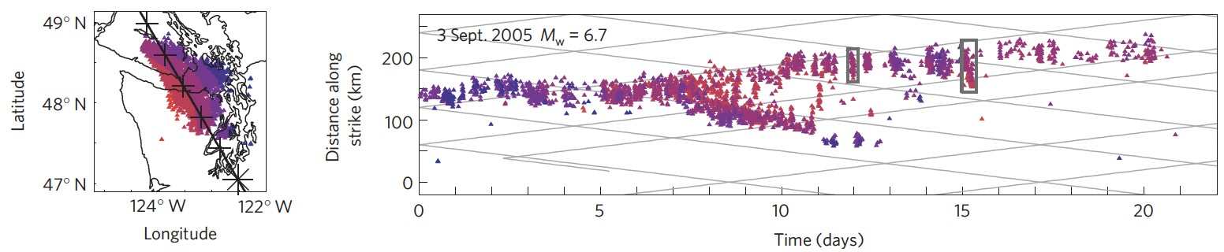
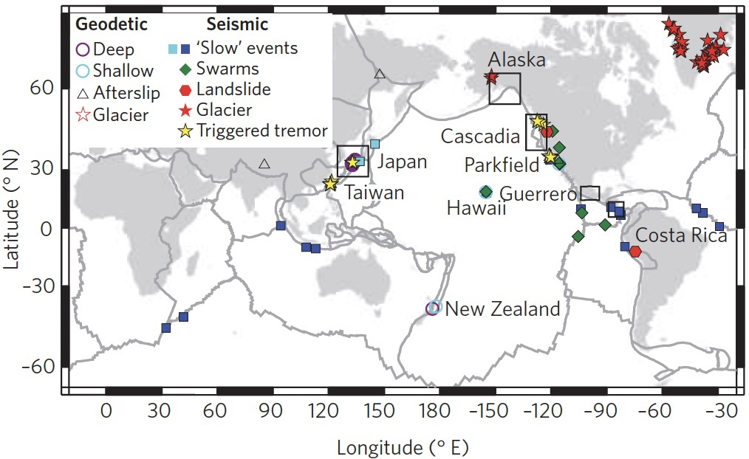
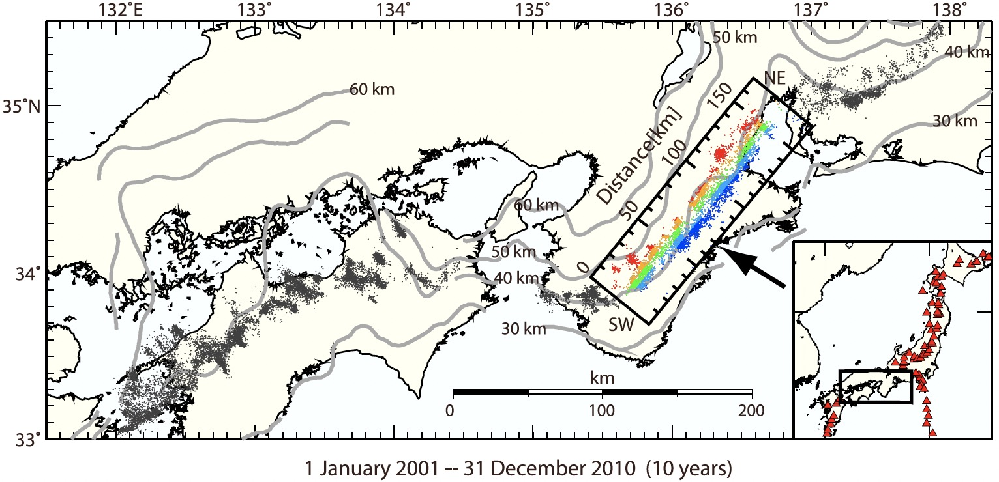
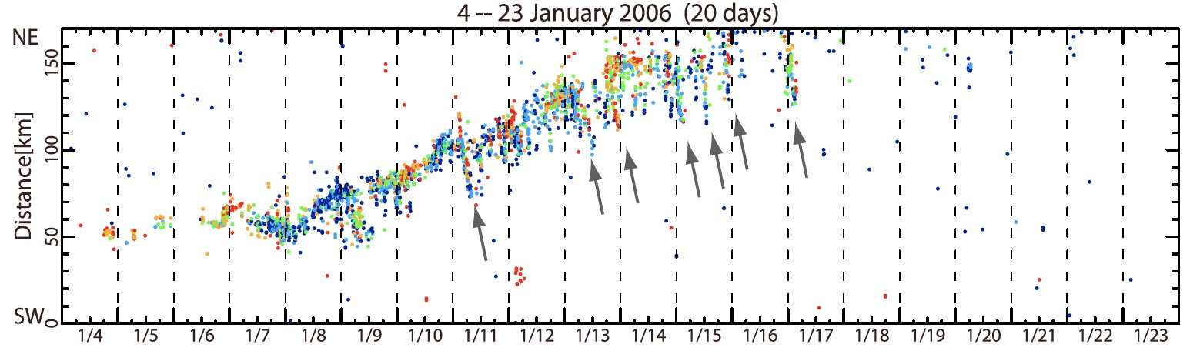
Negative correlation between Δτ and V_{r}
Primary rupture
Secondary
rupture
Houston et al. (2011)
Primary rupture
Peng and Gomberg (2010)
Secondary
rupture
Obara et al. (2012)

Slide 26
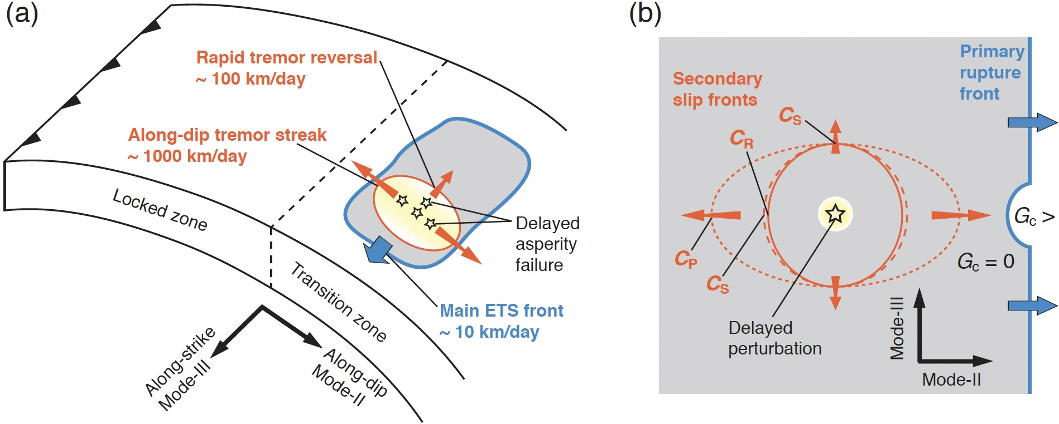
Negative correlation between Δτ and V_{r}
Secondary rupture fronts can show diverse propagation directions and speeds
Xu (2023), submitted to JGR-SE

Slide 27
Conclusions
Different contexts for discussing rupture speed, stress drop, and their correlations
Importance of both energy supply and consumption
Fixing energy consumption while increasing supply => a positive correlation between stress drop and rupture speed
Reducing energy consumption => a negative correlation

