Slide 1

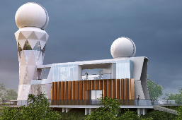
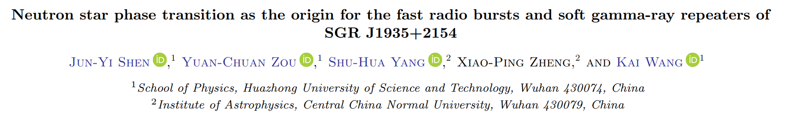
中子星相变的FRB能源机制
Yuan-Chuan Zou（邹远川）
华中科技大学天文学系
合作者: 沈君义, 杨叔华, 郑小平, 王凯
@Quakes: From the Earth to Stars 2023.5.22

Slide 2
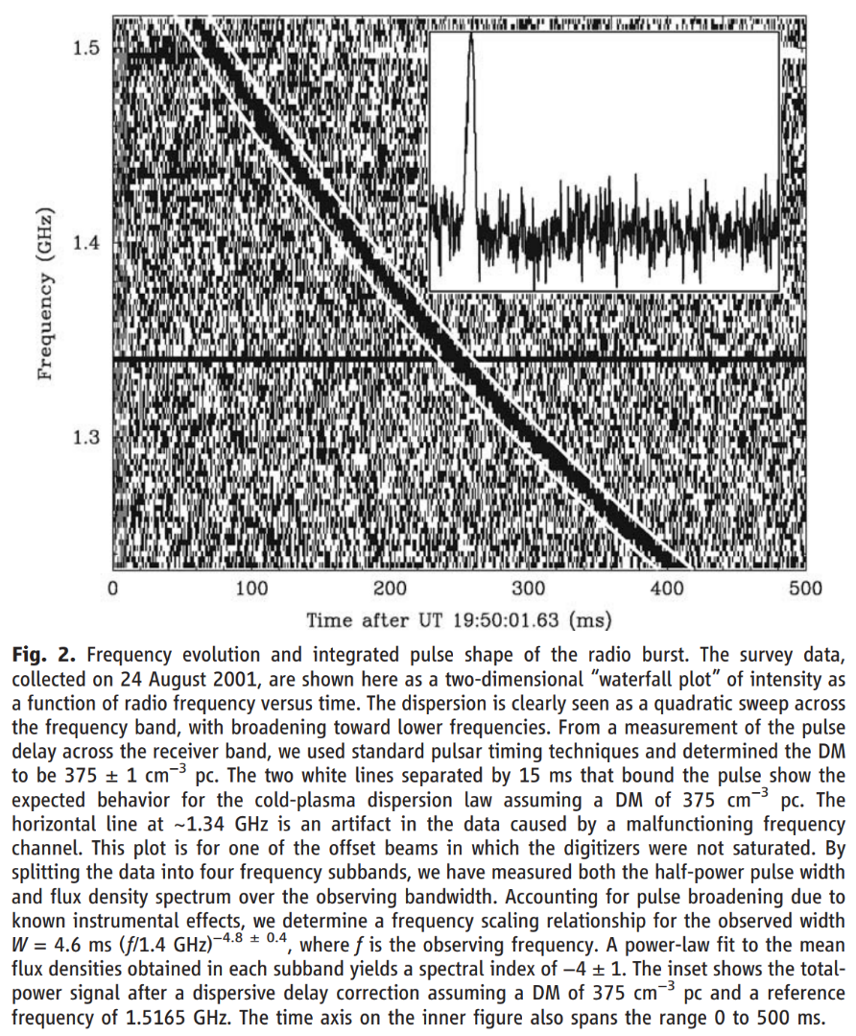
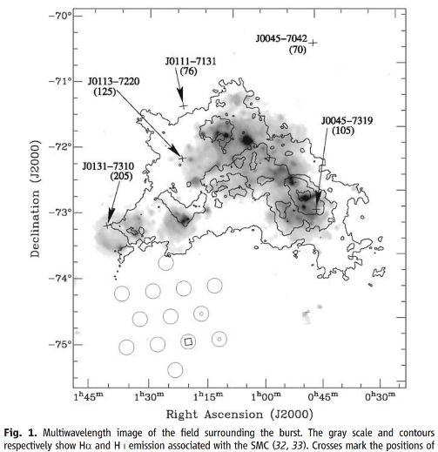
2007
Lorimer Burst FRB 010824
D. R. Lorimer; M. Bailes; M. A. McLaughlin; D. J. Narkevic; et al. (27 September 2007). "A Bright Millisecond Radio Burst of Extragalactic Origin". Science. 318 (5851): 777–780. arXiv:0709.4301

Slide 3
Key Features of FRBs (fast radio burst):
Duration: ~0.1—10ms
Energy: ~10³⁶⁻⁴⁰ ergs
Band: ~100MHz—1GHz
Spectrum: α ∼ −10 to +14 (Spitler 2016, with caution)
Polarization: highly linear
Event rate: ~10⁴ events/day
Sub-classes: single, repeated…
Environment: highly magnetized (RM)
Lack of: other band counterpart, long lasting signal

Slide 4
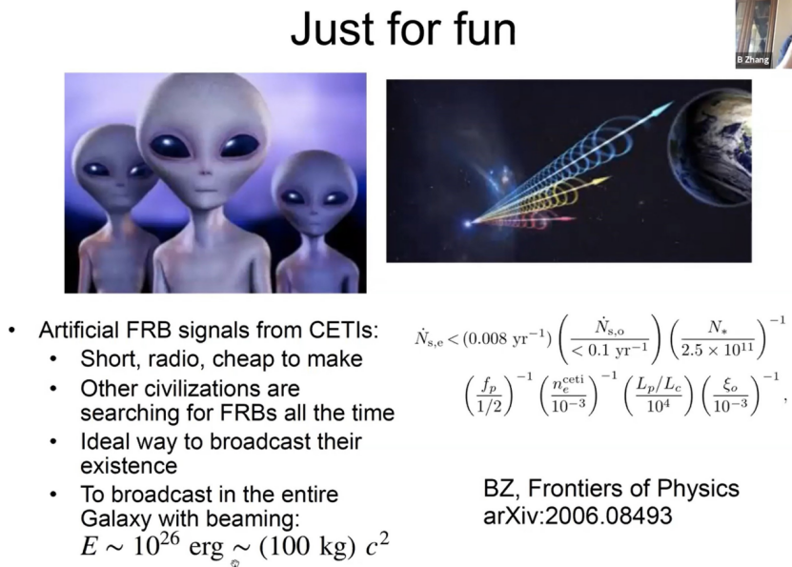
一些模型
张冰教授对FRB来自外星人的可能性以及我们是否应该发射FRB和外星人通讯，进行了一本正经地讨论，论文发表在正经杂志由中国高等教育出版社与德国施普林格科学+商业媒体联合出版的同行评审英文学术期刊Frontier of Physics上。

Slide 5
Energy source models related to NSs
Magnetar giant flares (Popov & Postnov 2007; Kulkarni et al. 2014)
Giant pulses from young pulsars (Connor et al. 2015; Cordes & Wasserman 2016; Pen & Connor 2015)
Giant-glitch-induced events in young magnetars (Lieu 2017)
Pulsar lightning (release of stored electrostatic energy, Katz 2017)
  Planetary companions around pulsars (Mottez & Zarka 2014)
  Collapse of supra-massive NSs into black holes (Falcke & Rezzolla 2014; Zhang 2014; Ravi & Lasky 2014)
  Neutron star-white dwarf binaries (Gu et al. 2016)
  Binary neutron star mergers (Totani 2013; Wang et al. 2016)
  Pulsar-asteroid collisions (Geng & Huang 2015; Dai et al. 2016)
From Zigao Dai’s PPT 2017 FRB_SVOM

Slide 6
Other energy source models
Cosmic string collisions (Cai et al. 2012)
Flaring stars (Loeb et al. 2014)
Binary white dwarf mergers (Kashiyama et al. 2013)
Black hole-neutron star mergers (Mingarelli et al. 2015)
Evaporation of primordial black holes (Barrau et al. 2014)
Charged black hole mergers (Zhang 2016; Liu et al. 2016; Punsly & Bini 2016)
Light sails of extragalactic civilizations (Lingam & Loeb 2017)
Collisions between relativistic field structures (Thompson 2017)
Pulsar’s magnetosphere combed by a plasma stream (Zhang 2017)
From Zigao Dai’s PPT 2017 FRB_SVOM

Slide 7
微波炉？ | 来自太阳系？ | 来自外星人？ | 宇宙学起源？ | 高DM是因为IGM？
✘ | ✘ | ██ | ✔ | ✔
时标？ | 流量 | 能量 | 有宿主星系？ | 在恒星形成区？
~ms | ~1 Jy ms | 10³⁹-10⁴¹ erg | ✔ | ██
重复？ | 有周期？ | 有脉冲星？ | 有X射线？ | 有余辉？
✔ | ✔ | ██ | ██ | ██
分类？ | 相干辐射？ | 来自黑洞？ | 来自中子星？ | 其它来源？
✔ | ✔ | Maybe | Probably | 不排除
微波炉？ | 来自太阳系？ | 来自外星人？ | 宇宙学起源？ | 高DM是因为IGM？
✘ | ✘ | ██ | ✔ | ✔
时标？ | 流量 | 能量 | 有宿主星系？ | 在恒星形成区？
~ms | ~1 Jy ms | 10³⁹-10⁴¹ erg | ✔ | ██
重复？ | 有周期？ | 有脉冲星？ | 有X射线？ | 有余辉？
✔ | ██ | ██ | ██ | ██
分类？ | 相干辐射？ | 来自黑洞？ | 来自中子星？ | 其它来源？
✔ | ✔ | ██ | ██ | ██

Slide 8
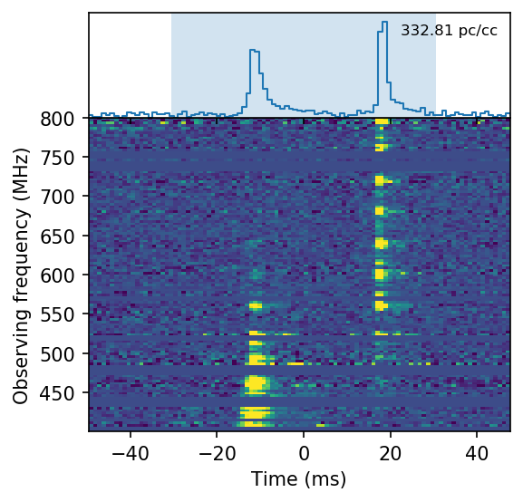

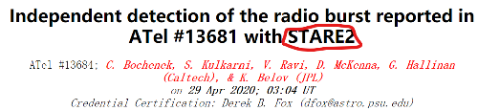
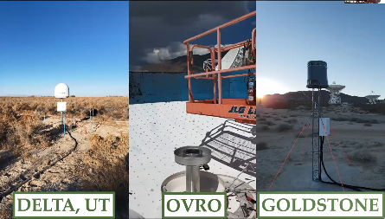
2020
银河系、磁星、脉冲星 FRB200428
DM 333.2 +/- 0.8 pc cm⁻³，
流量：>1.5 MJy ms
astronomerstelegram.org/?read=13681
Scholz et al., Nature, Vol. 587, p.54, 4 Nov 2020
arXiv:2005.10324 CHIME/FRB
C. D. Bochenek et al.,Nature, Vol. 587, p. 59, 4, Nov 2020, arXiv:2005.10828, STARE2

Slide 9
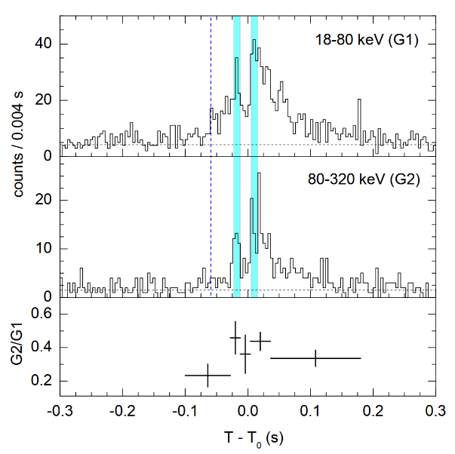
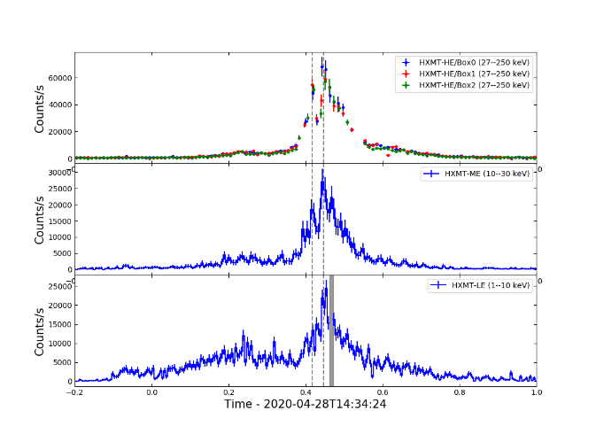
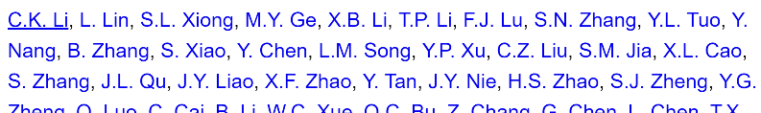
Konus-Wind
A peculiar hard X-ray counterpart of a Galactic fast radio burst
A. Ridnaia, et al. 2021, Nature Astronomy, 5, 372–377, arXiv:2005.11178
Identification of a non-thermal X-ray burst with the Galactic magnetar SGR 1935+2154 and a fast radio burst with Insight-HXMT
慧眼 HXMT
C.K. Li, L. Lin, et al.,2021, Nature Astronomy, 5, 378–384, arXiv:2005.11178

Slide 10
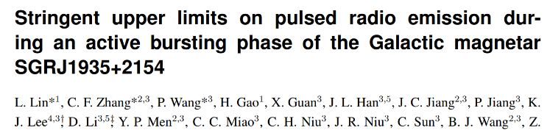
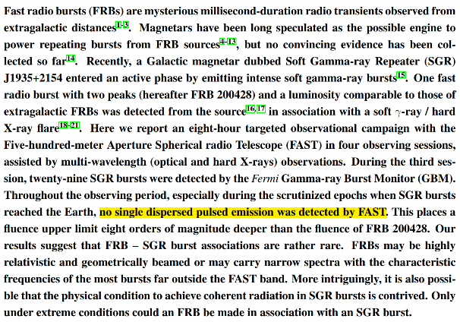

L. Lin et al.,Nature, Vol. 587, p. 63, 4, Nov 2020

Slide 11
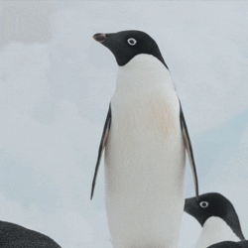


Slide 12
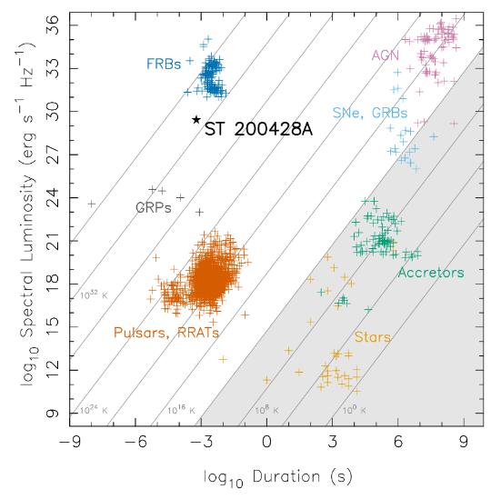
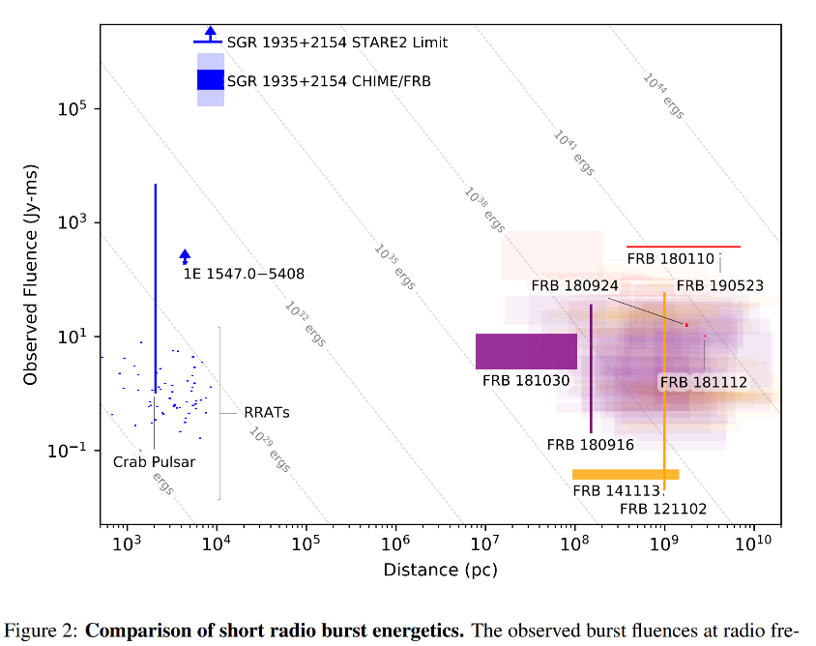
和其它射电源对比
Scholz et al., Nature, Vol. 587, p.54, 4 Nov 2020
arXiv:2005.10324 CHIME/FRB
C. D. Bochenek et al.,Nature, Vol. 587, p. 59, 4, Nov 2020, arXiv:2005.10828, STARE2

Slide 13
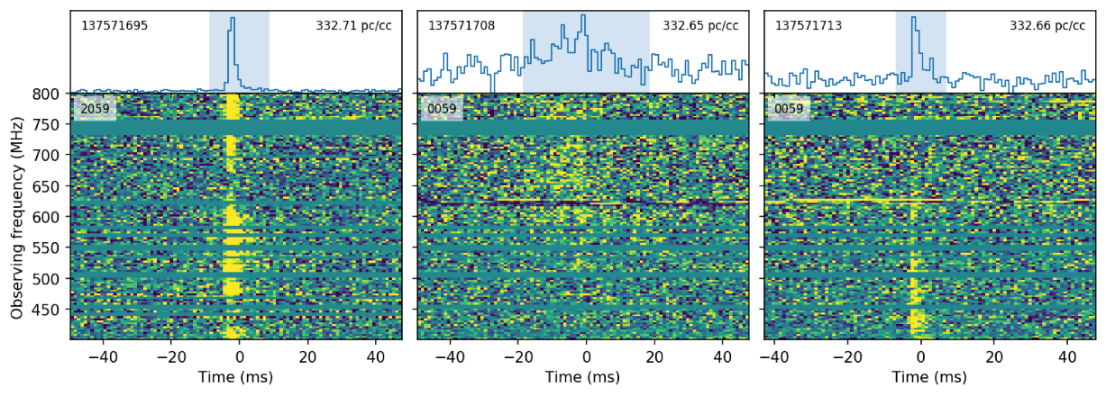
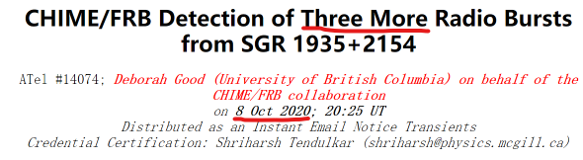
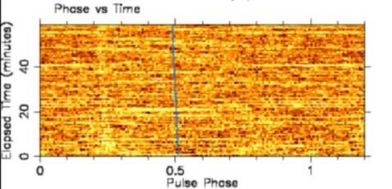
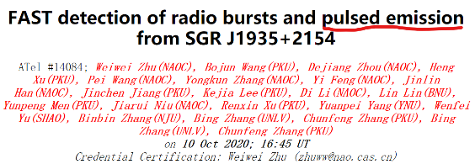

Slide 14
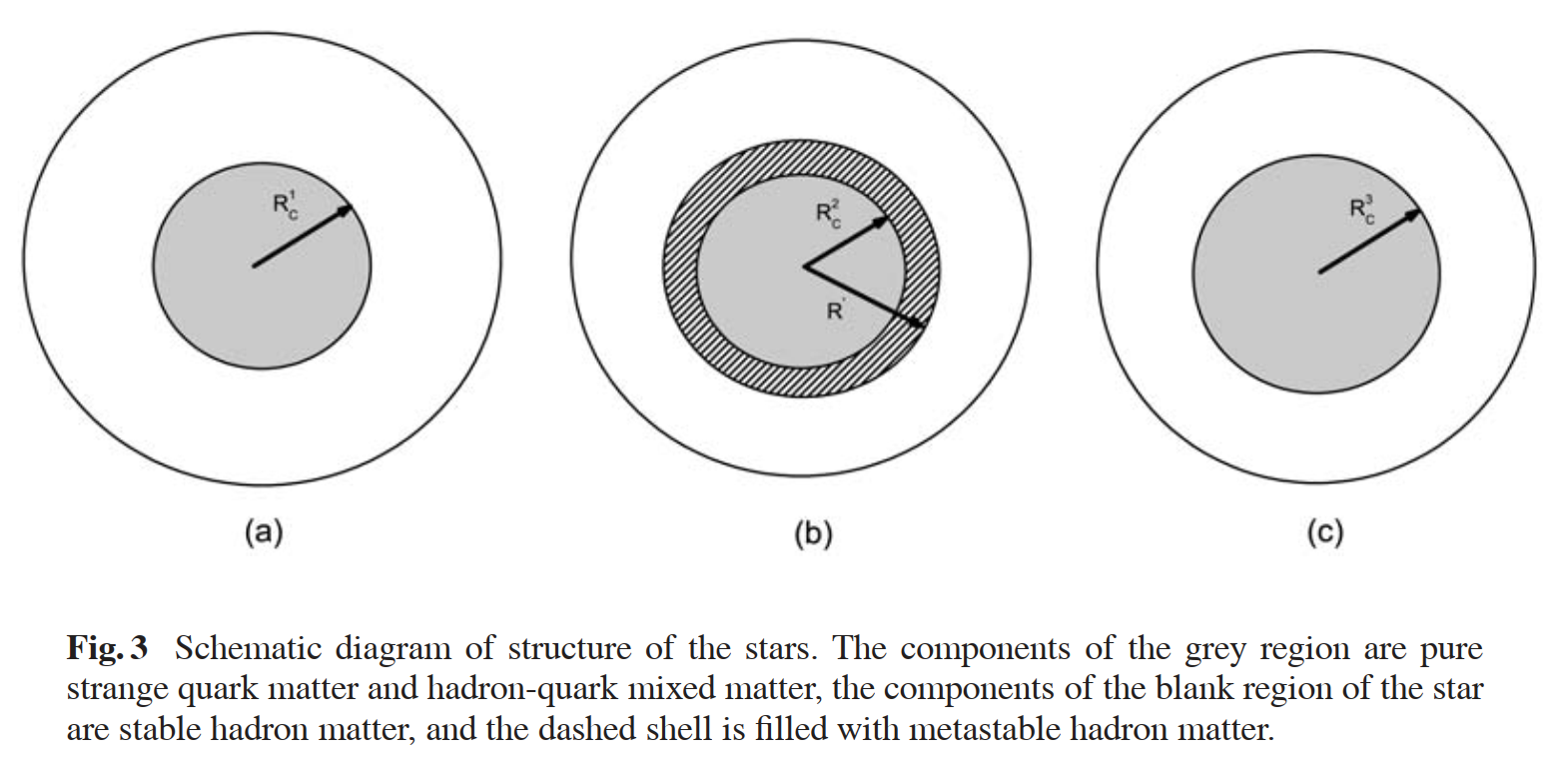
First-order phase transitions in rotating hybrid stars and pulsar Glitches Xiao, F., Pi, C.-M., Yang, S.-H., Zhou, A.-Z., & Zheng, X.-P. 2011, RAA, 11, 679

Slide 15
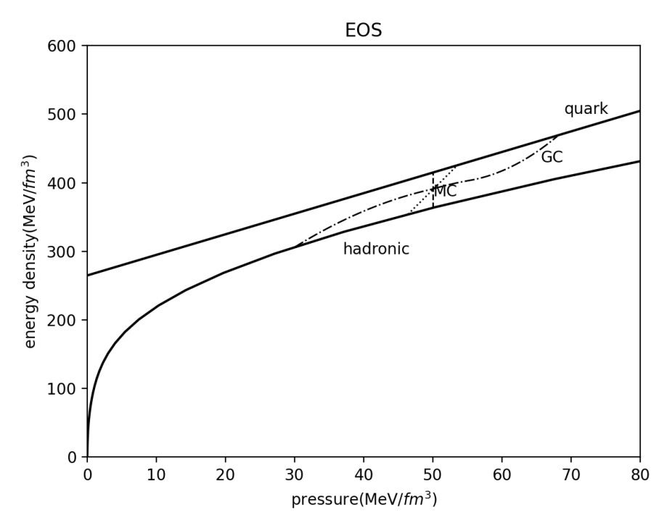
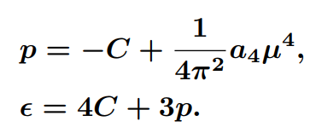
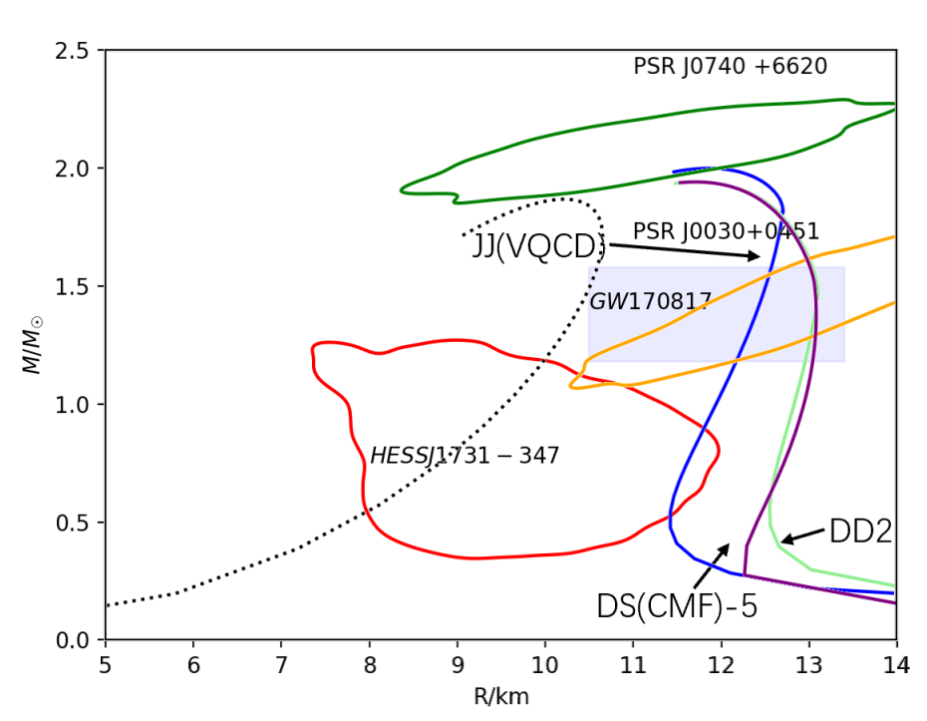
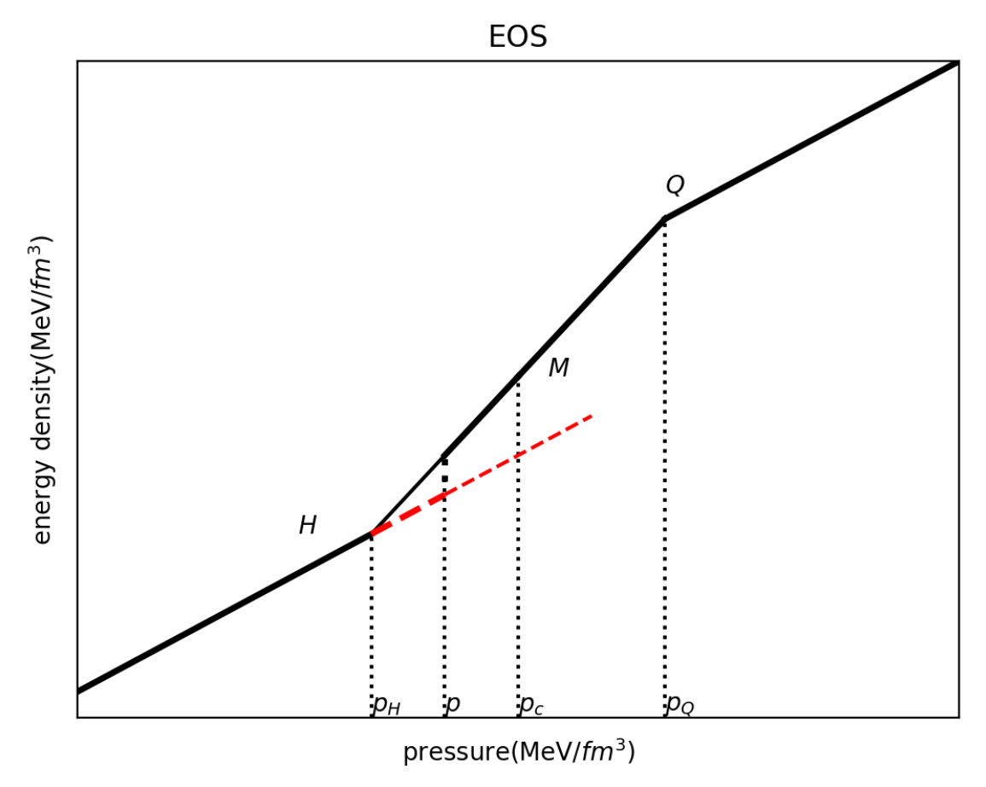
Shen, Zou, Yang, Zheng, & Wang 2023, arXiv: 2304.10871
Quark phase:
MIT bag
Hadron phase:

Slide 16
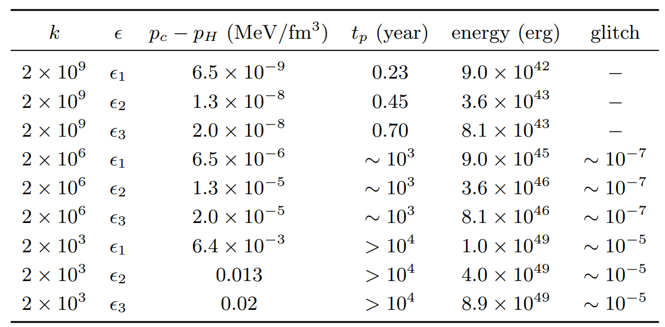
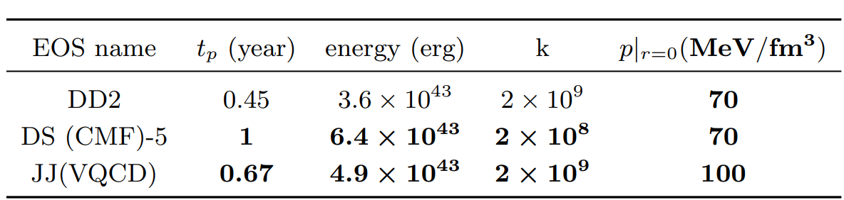
arXiv: 2304.10871
ApJ submitted

Slide 17
谢谢！

