Slide 1
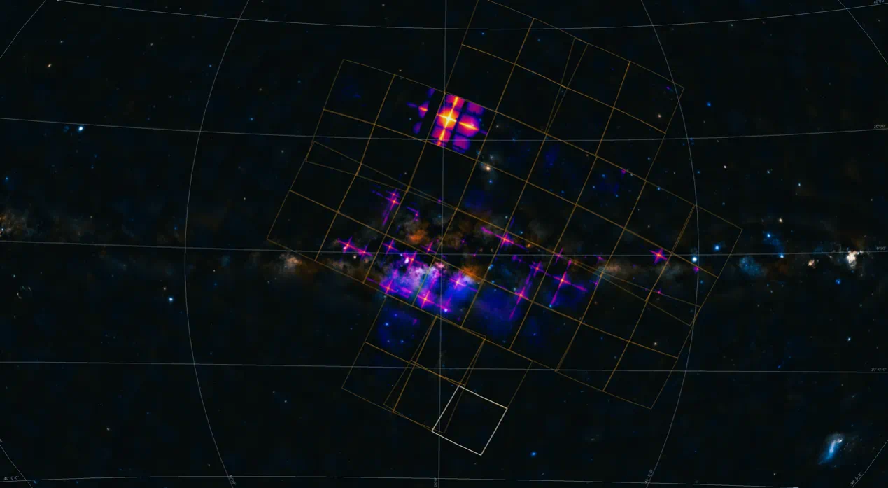
X-ray studies of neutron stars and the equation of state
EP satellite Apr2024
LI Ang 李昂
liang@xmu.edu.cn
with
Zhiqiang Miao (TDLee), Liqiang Qi, Juan Zhang, Mingyu Ge (IHEP)
Based on arXiv:2402.02799
Dialog at the Dream Field (DDF2024): Supranuclear Matter
关于致密物态的桃源对话 Guizhou, China, May 10-15, 2024

Slide 2
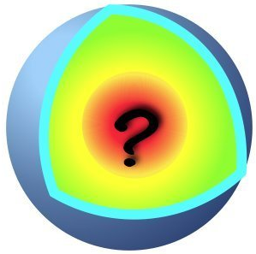
Outline
Introduction on neutron star EOS and the observation
Thermal x-ray studies of (nonaccreting) NSs and the EOS
What we learn so far
equation of state (EOS)
mainly p(𝜺)

Slide 3
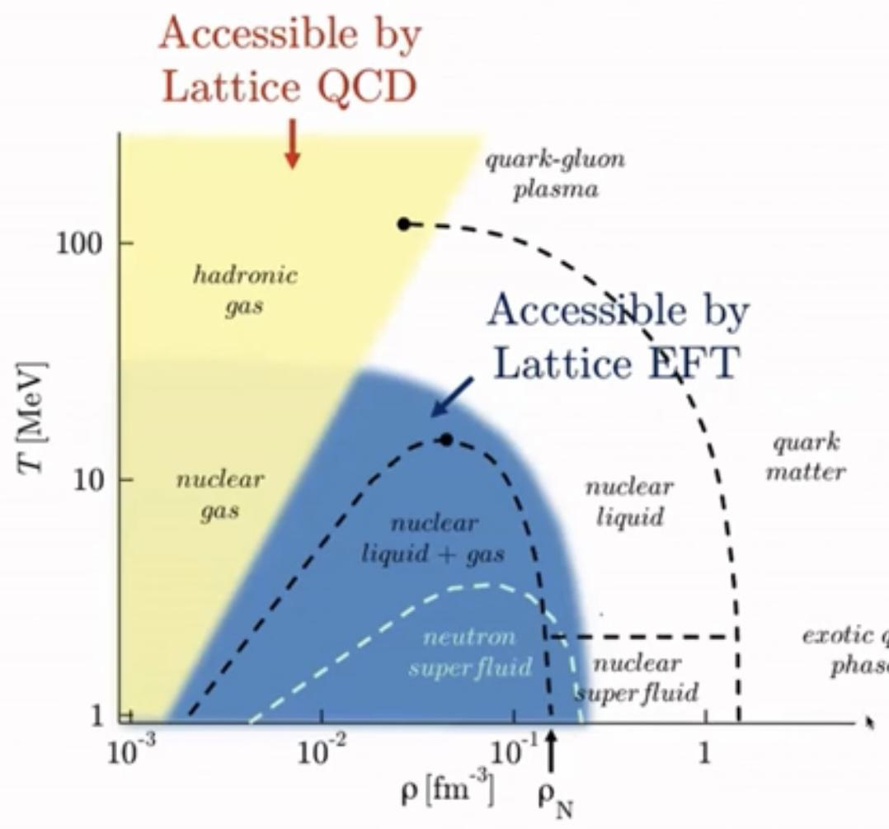
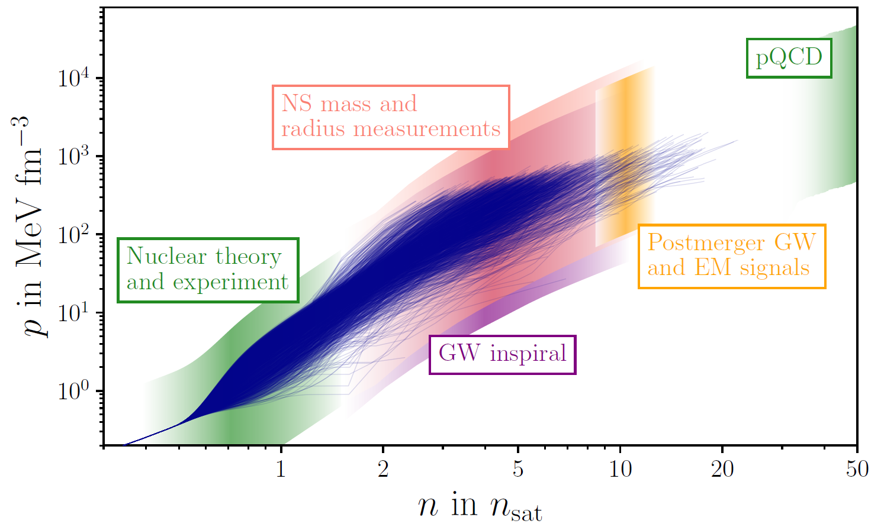
Challenge: QCD at finite baryon chemical potential NOT well understood
NS EOS dominated by strong coupling in non-perturbative regime: Not computable;
General constraints: Causality (sound speed should not exceed the speed of light), Thermodynamic stability (energy density 𝜺 to be positive definite and monotonically increasing function of pressure p);
Laboratory constraints: Nuclear binding energies, Neutron skin thickness, Dipole polarizabilities, Giant dipole resonances,...;
Astrophysical constraints: Massive PSRs, Radii (from NICER), Tidal Deformabilities (from LIGO/Virgo), Spins, Moment of inertia, ...
Not computable
Computable
~1-10 𝜌₀
Best time:
Multiwavelength & Multimessenger Era!
Notes:
If we take a typical mass of 1.4 solar mass and a typical radius of 10 kilometer,
the average density of the star is 2-3 times of nuclear normal density,
corresponding the energy sclale of several hundreds MeV脉浮，
So in order to calcualte the NS EOS, we have to deal with the strong coupling in non-perturbative regime.
One can not solve it at the moment in mathematics, so the first-principle theoretical calculations of EOS are unfortunately impossible.

Slide 4
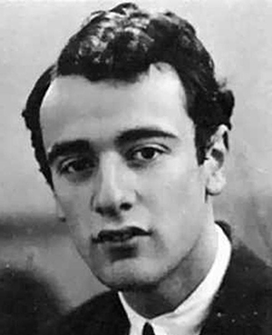
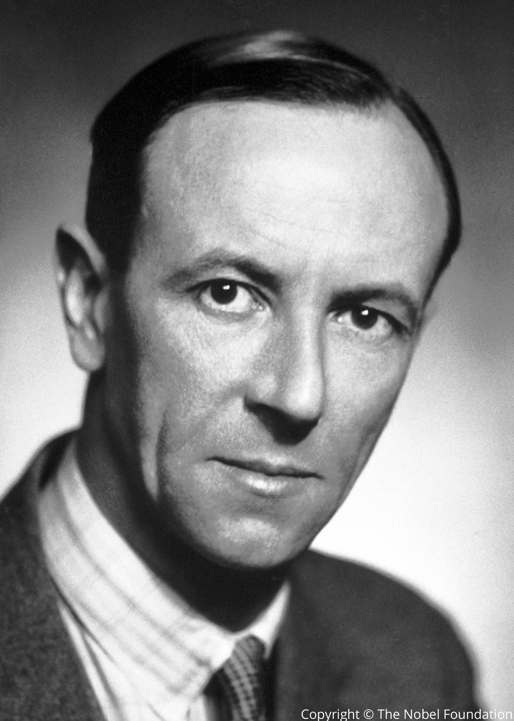
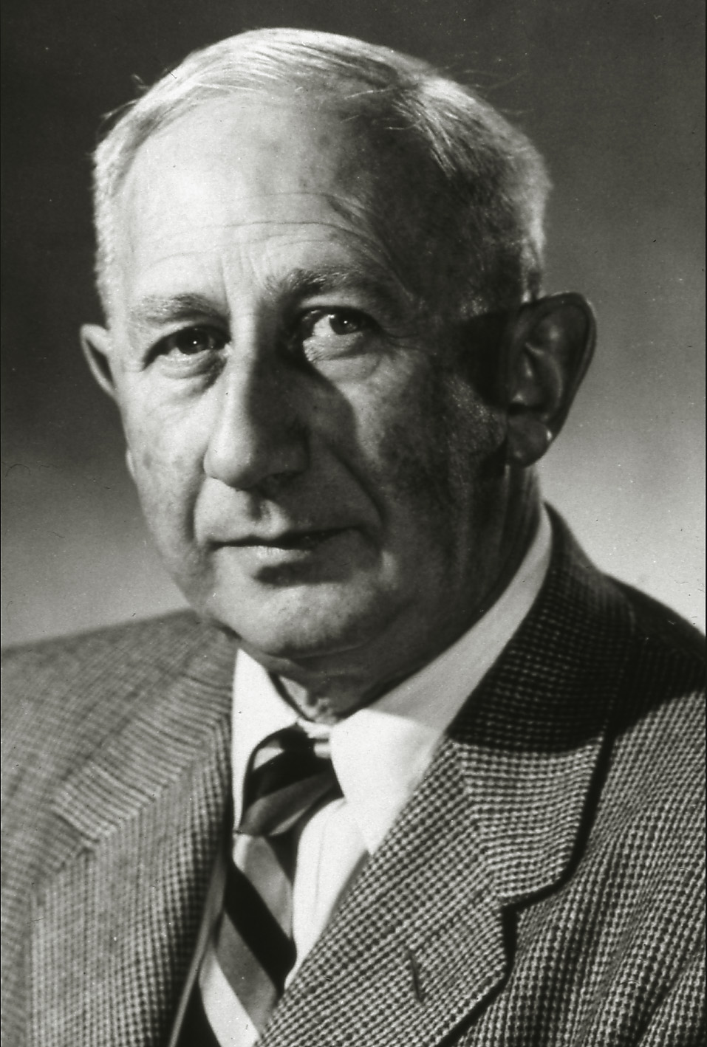
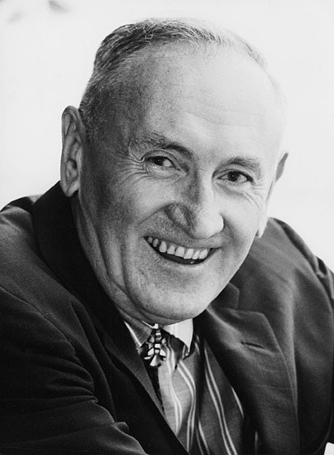
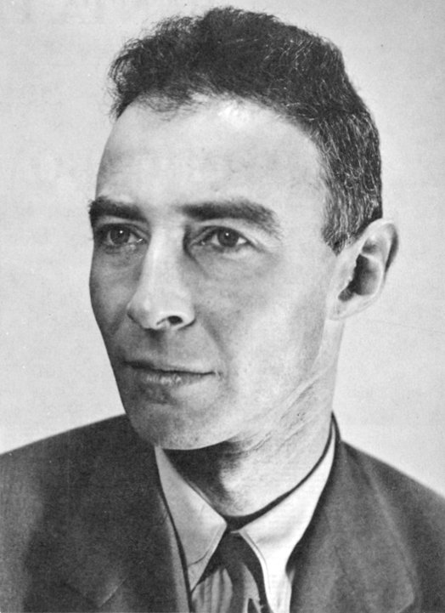
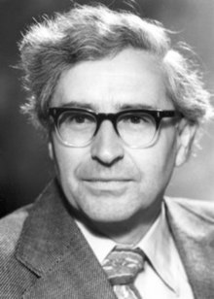
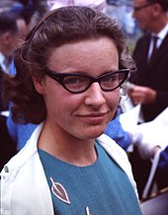
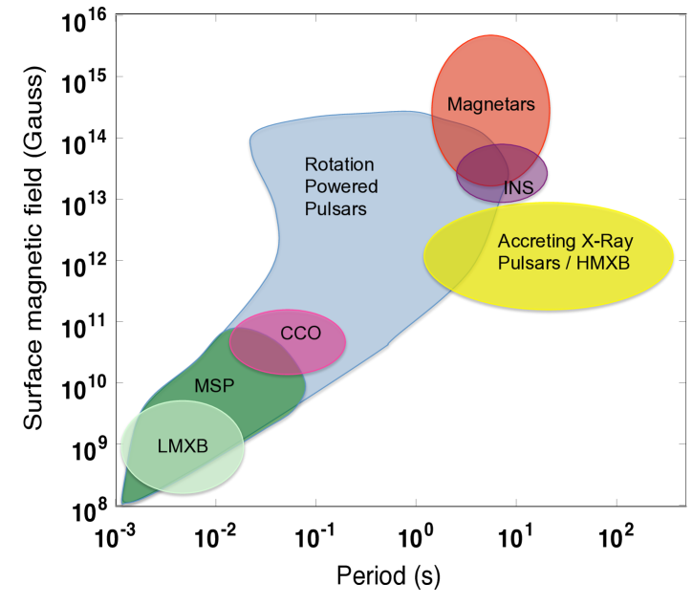
Neutron star physical conditions and observations
Lev Landau
James Chadwick
Walter Baade
Fritz Zwicky
Antony Hewish
1932-
J. Robert Oppenheimer
Dame Jocelyn Bell Burnell
1967
Nobel prize 1974
Fundamental Physics Breakthrough Prize 2018
“the density of matter becomes so great that atomic nuclei come in close contact, forming one gigantic nucleus.”
Rapid spin （P~10⁻³-10^{1.5}s);
Hot surface (T~10⁵⁻⁶ K);
Strong B field (B~10⁸⁻¹⁵)T;
Strong E field (ΔU~10¹²⁻¹⁷V)
fast rotation + strong B field -> strong E field;
acceleration of charged particles -> radiation;
energetic radiation -> pair production
pulsations in radio and X-ray;
X-ray bursts;
giant flares in magnetars;
superbursts and thermal relaxation in accreting NSs.
(this talk)
Harding 2013
Notes:
Things not covered in this talk
Neutron stars exhibit a wide range of X-ray emissions,
These include common phenomena such as pulsations in radio and X-ray, and X-ray bursts observed daily,
less frequent phenomena such as giant flares in magnetars, superbursts and thermal relaxation in accreting neutron
stars that recur on the timescale of few years,
Although the basic paradigm exists for each of these phenomena, a quantitative understanding is only now beginning to emerge
The technique is the most promising in providing accurate and precise constraints on R
in the coming years!

Slide 5
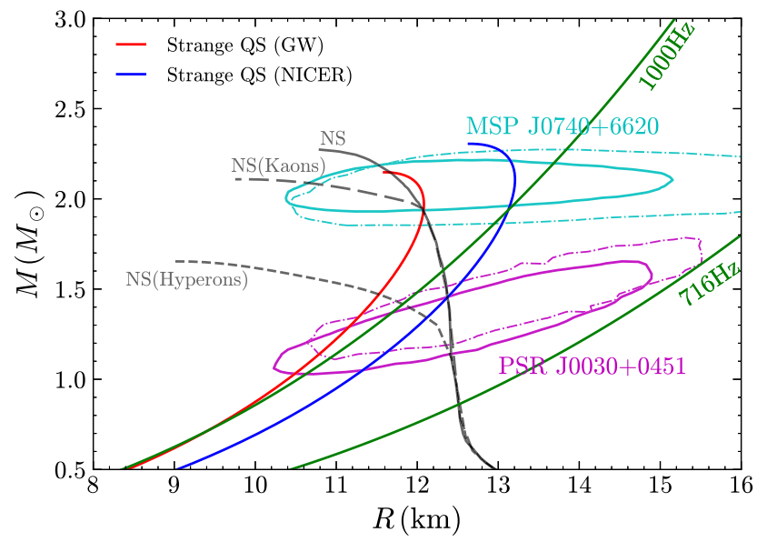
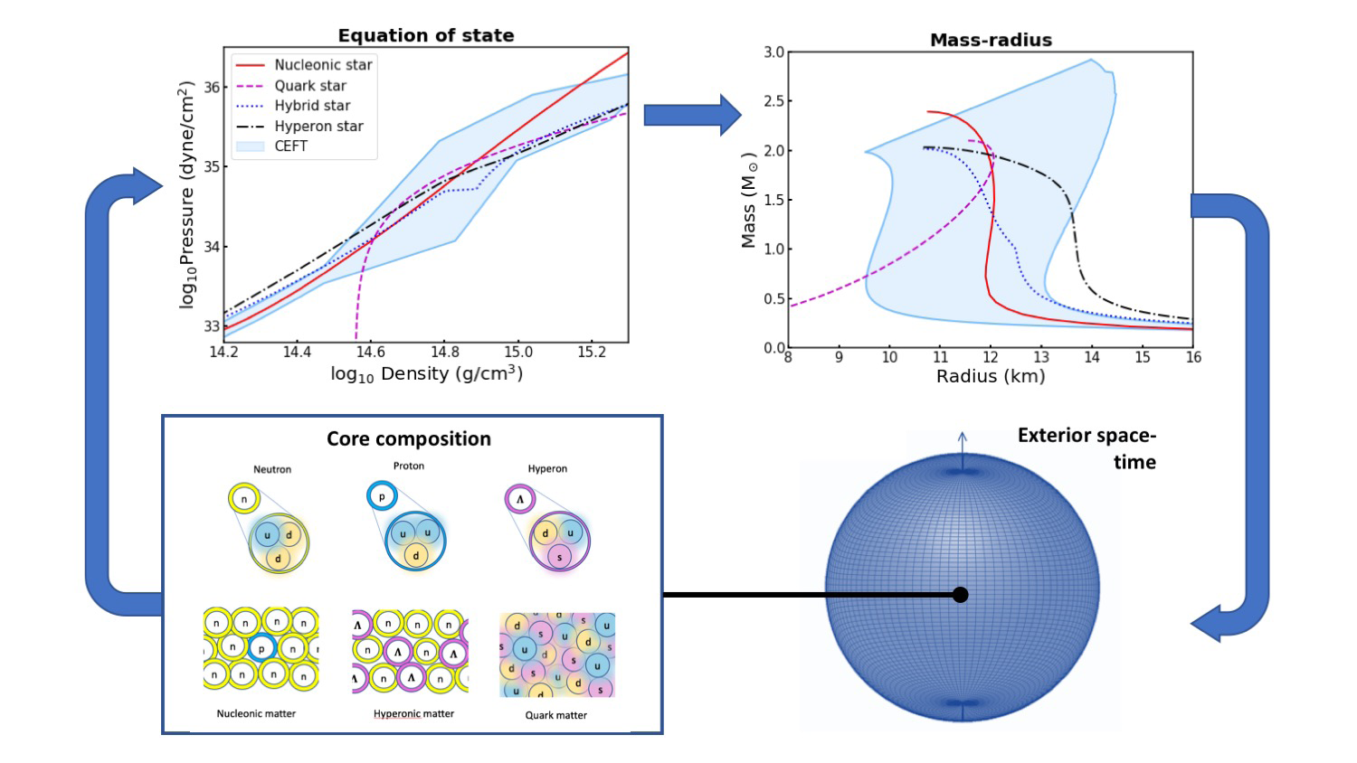
New frontier: (How) can we distinguish different EOSs?
see also 2401.02604 for a similar conclusion for upcoming 3rd generation GW observatories.
need <~1km accuracy
R measurement
“R measuring: one of primary goal of next generation of x-ray timing instruments.”
Li Ang, EPJ Web Conf. 2022
NIC-XVI Proceeding
Dense matter with eXTP
white paper 2019
第16届国际核天体物理大会

Slide 6
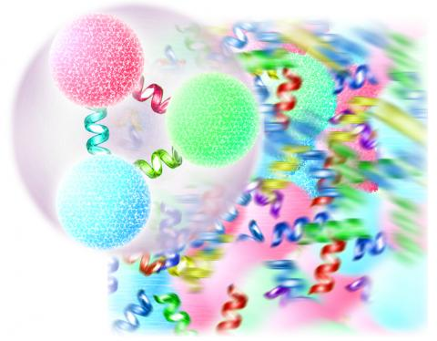
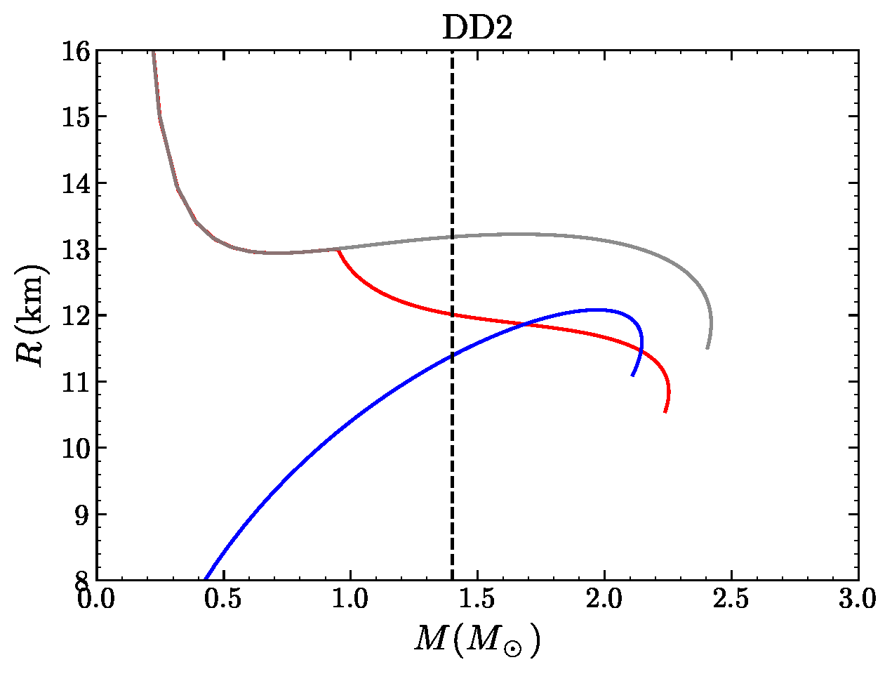
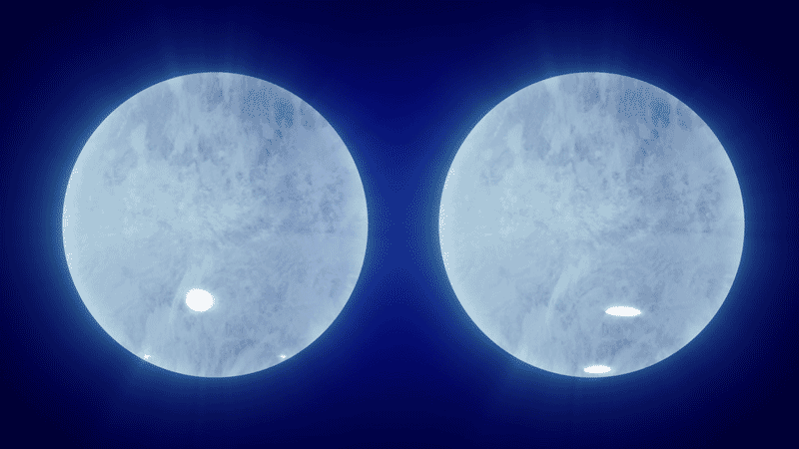
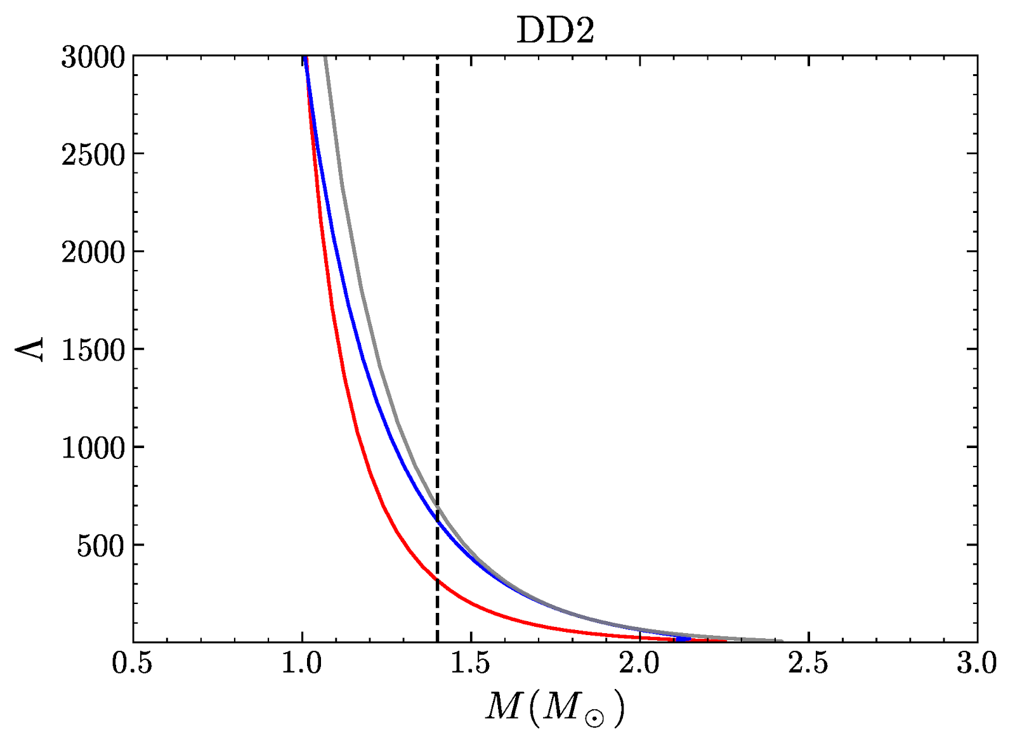
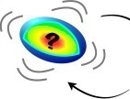
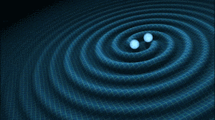
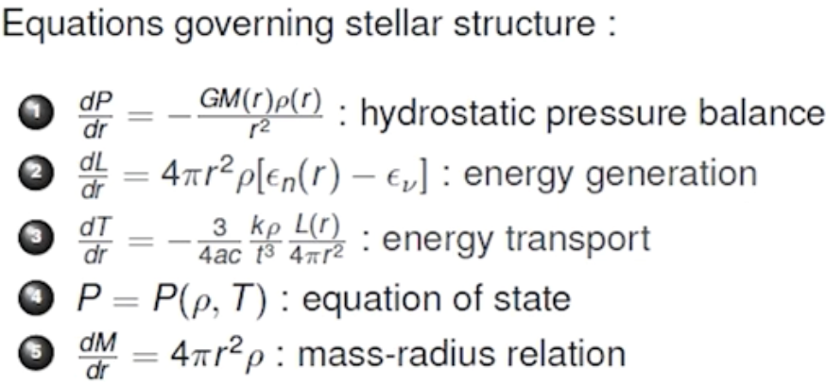
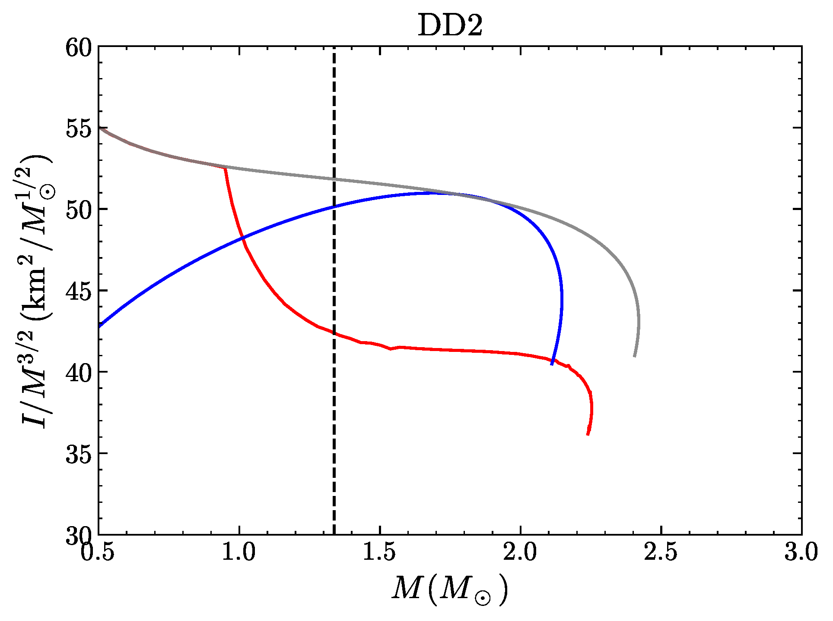
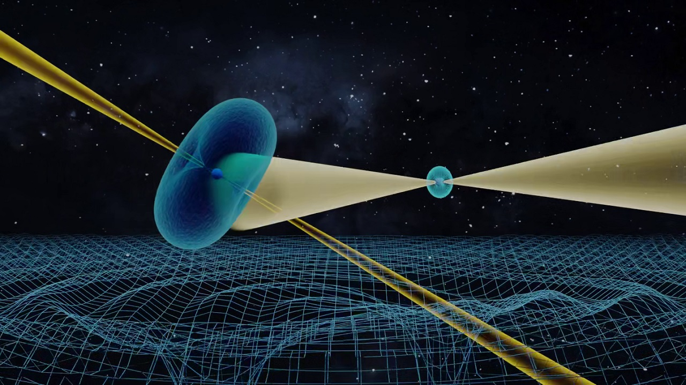
Macroscopic global properties of NSs have an intrinsic correlation with microphysical EOS
Microhysics
mass & radius
neutron star
@NICER, … STROBE-X, eXTP;
Hydrostatic equlibrium
quark star
hybrid star
PSR J0030+0415
PSR J0740+6620
EOS
mainly p(𝜺)
(GR version) TOV eq.
Connect consistently nuclear physics and GW+EM observations and perform joint analysis!
tidal deformability
Perturbed hydrostatic equlibrium
@LIGO/Virgo/KAGRA, ... CE, ET;
GW170817
GW190425
(Newtonian version)
moment of inertia
@平方公里陣列射電望遠鏡(SKA)
PSR J0737-3039
(Matter is degenerate, E_{F} <<KT: Role of T is insignificant.)
Notes:
In the case of eos study for NSs, we actually are very lucky to be in this era of multi-messenger GW ear,
So a feasibalbe way is to
we are make use of the one-to-one correspondence of
nowadays
the mass–radius measurements of two X-ray pulsars with 10% accuracy
robust
I list here the typical results of different types of compact stars, neutron stars, hybrid stars, quark stars,
High-accumcy data have the potential to distinguish different EOS models, and tell us the true nature of compact objects, and the phase state of dense QCD matter.
Tolman-Oppenheimer-Volkoff equation.
The NICER (Neutron star Interior Composition Explorer) collaboration has reported two simultaneous mass–radius measurements of X-ray pulsars (PSR J0030 +0451 and PSR J0740+6620) based
the mass–radius measurements of X-ray pulsars
Especially, there are accurate observations coming from the currently operating satellites (e.g., Neutron star Interior Composition Explorer, in short NICER). X-ray spectrum
The gravitational-wave events dectected in the laser interferometers (e.g., AdvLIGO, and Virgo) have opened a window of opportunity for studying the physics of dense matter, since some NS observables (like the tidal deformability) can be obtained by wave-form analysis.
Neutron stars exhibit a wide range of phenomena producing unique photon, neutrino and gravitational wave signals.
而这些 观测量 一一对应
将来还会有 基于下一代设备对这些量的更多高置信度数据
以及比如moi其他观测量的精确测量
比如中国参与的ska

Slide 7
https://indico.impcas.ac.cn/event/54/
March 1, 2024: Start of registration
March 1, 2024: Abstract submission open
June 30, 2024: Abstract submission closed
Notes:
Jinping Underground Nuclear Astrophysics experimental facility，JUNA

Slide 8
https://indico.yukawa.kyoto-u.ac.jp/event/30/

Slide 9
Outline
Introduction on neutron star EOS and the observation
Thermal x-ray studies of (nonaccreting) NSs and the EOS
What we learn so far
(Biased selected results; Highlighing work done by our group)

Slide 10
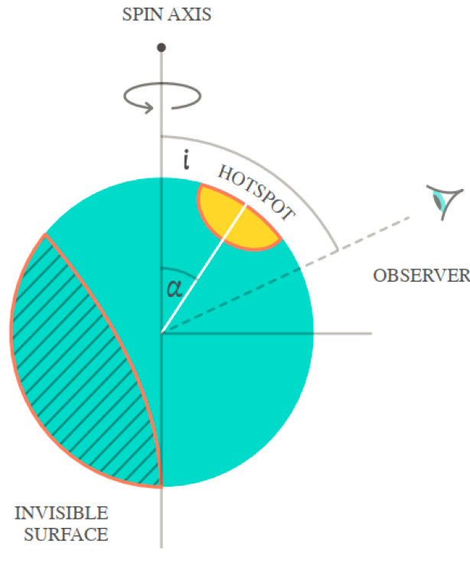
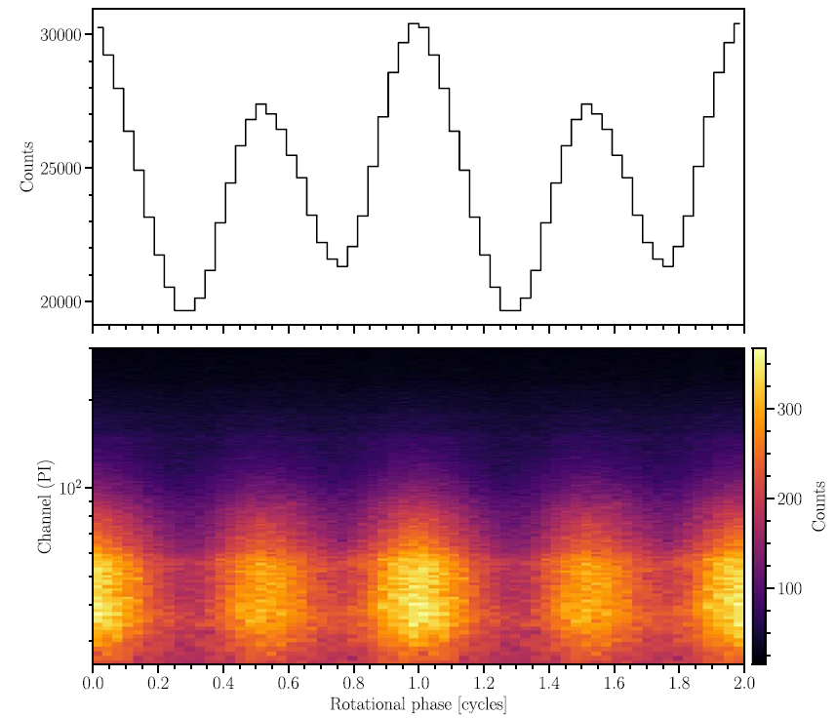
Pulsed thermal emission caused by hot spots on a rotating NS can help measure M/R
Predict the emission received by a distant observer, assuming that it is due to one (or multiple) hot spot(s) on the stellar surface rotating rigidly with star;
Stellar M controls the level of light bending;
Stellar R causes an asymmetry in pulse profile due to rotation:
Primary assumption made concerns the propagation of photons in the atmosphere, which is typically assumed to be non-magnetized and composed of fully ionized hydrogen (or helium): Justified for MSPs;
The asymmetry the pulse profile becomes more pronounced for fast rotators;
Successfully applied to e.g., J0030+0451, J0740+6620.
P <30ms
Age > 10⁸yr
Weakest B fields in NS population
The technique is the most promising in providing accurate and precise constraints on R
in the coming years!
Ascenzi, Graber & Rea, 2401.14930
Notes:
Currently the most promising way of
There are some assumptions, but mainly
Which is kind of safe for MSPs,
In one hand, low B;
on the other hand, rotation
I will later on show your some results on EOS based on the analysis of these two nicer sources

Slide 11
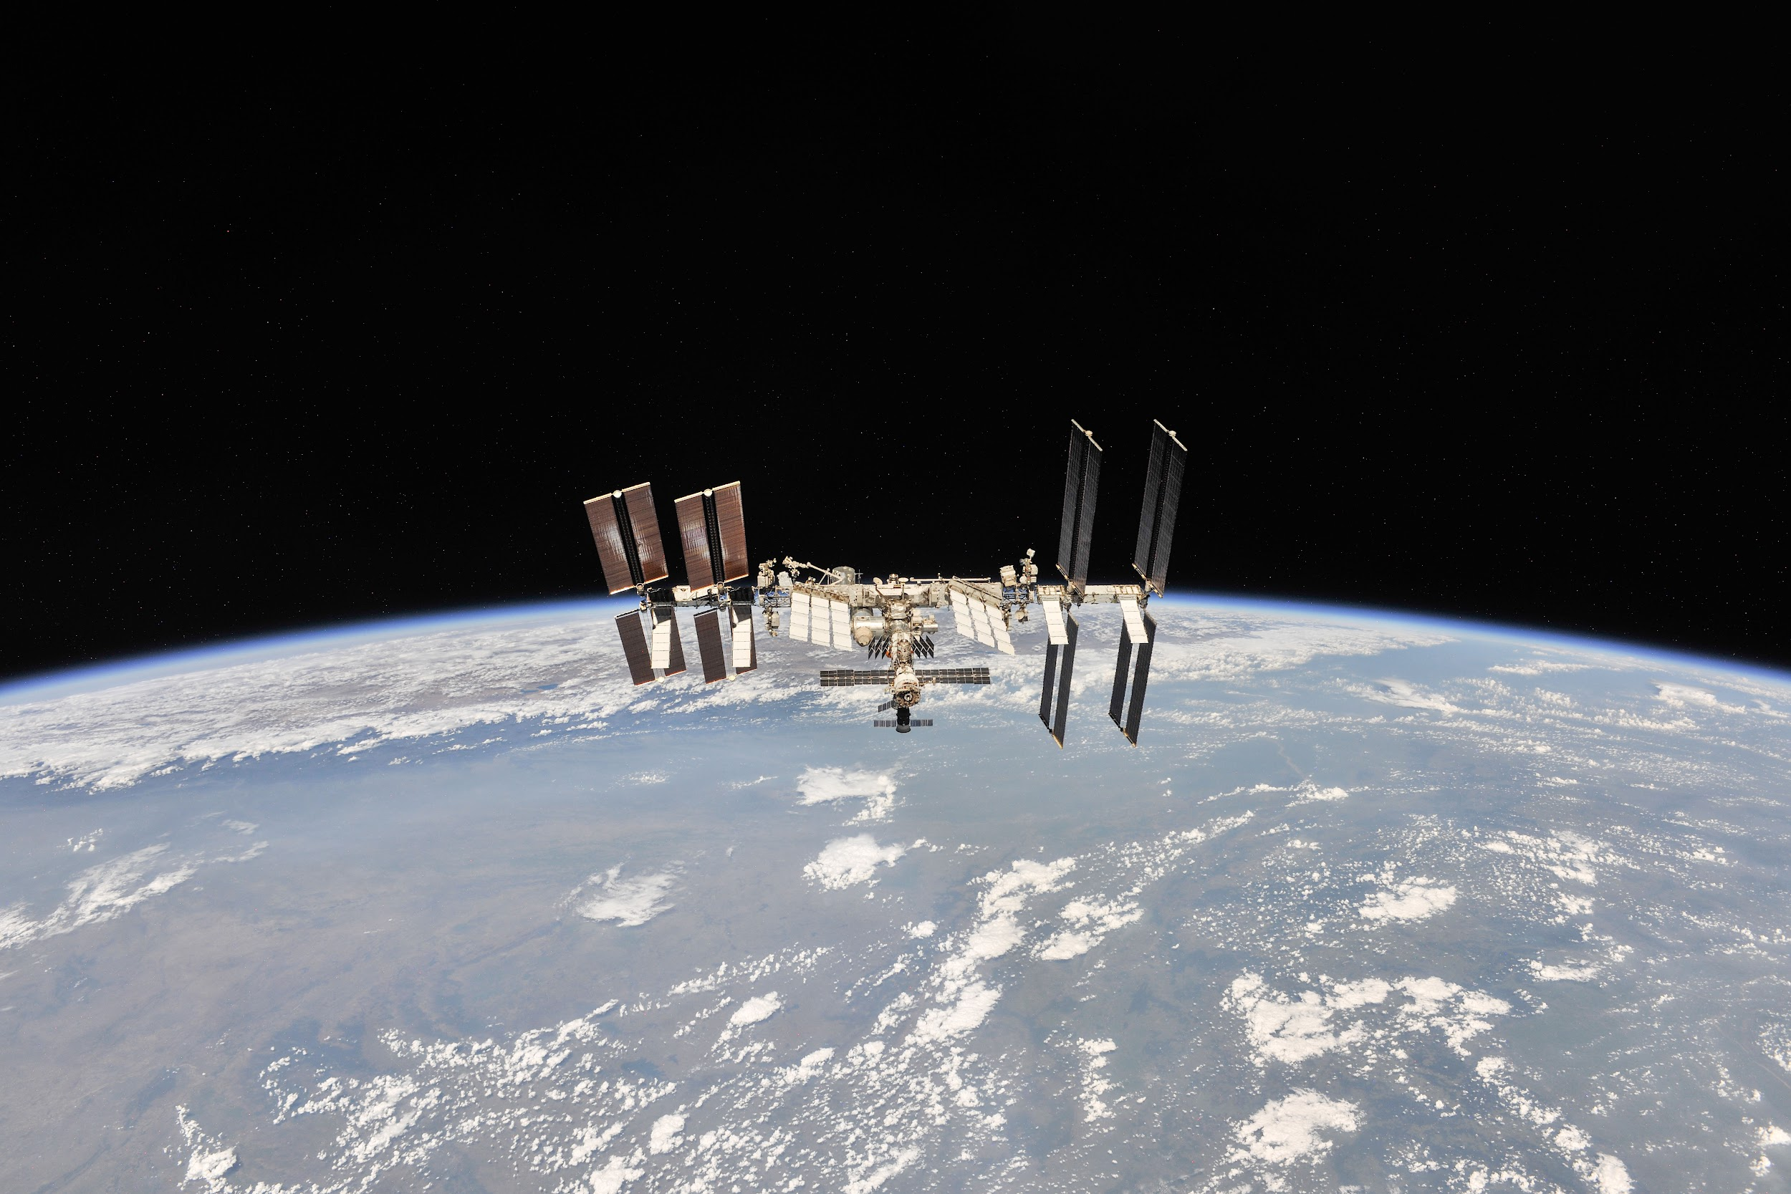
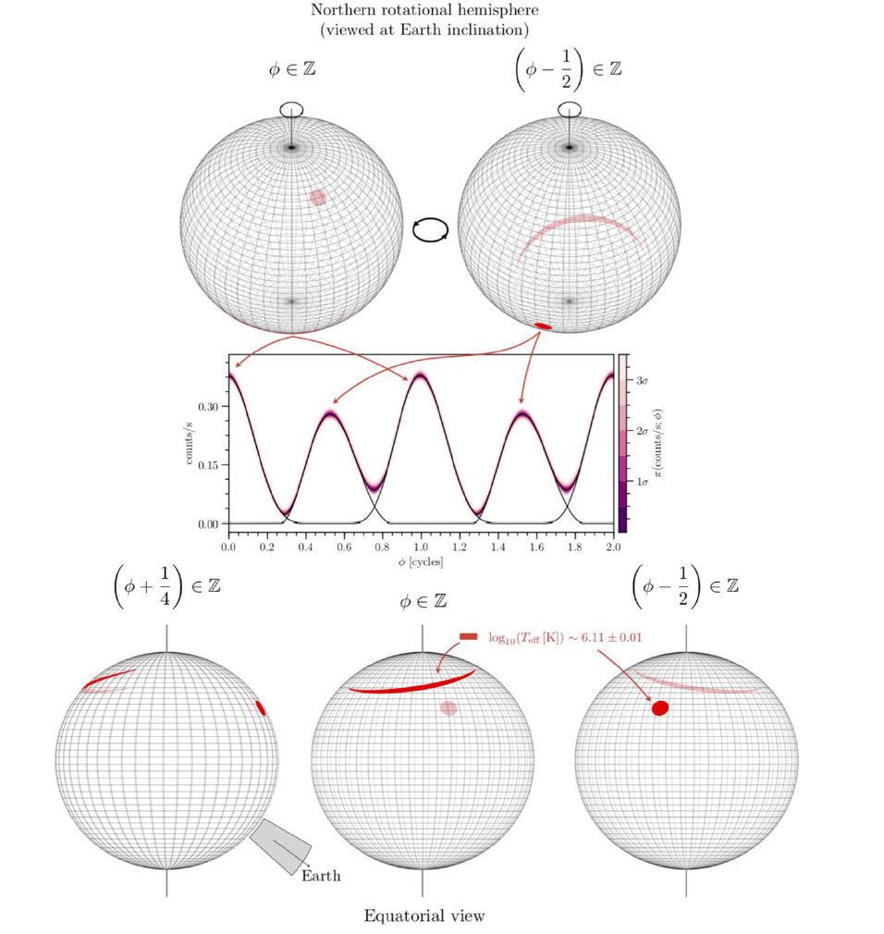
NICER view of PSR J0030+0451: MSP parameter estimation
Riley et al. 2019
Follow the propagation of light from the NS surface to the observer through the curved spacetime around the star ->
“Pulse profile modeling”
Main difficulty lies in the degeneracy between MANY parameters it employs: (in addition to M, R)
source D; H column density, parameters needed to describe the surface T map, angles encoding the orientation of this map with respect to the rotational axis and the observer’s LOS;
Significant uncertainties in M,R estimate may be from low counts in the detected lightcurve or noisy data can lead to degeneracies between the model parameters or multi-modal posteriors:
X-ray telescopes with large effective area, high energy resolution, and high time resolution in the soft X-ray band, as well as adequate imaging capability to discriminate the background:
NICER (2017), EP-FXT (2024), eXTP(~2025), ATHENA(~2030), STROBE-X(~2030).
Notes:
The technique involved in such kind of measurement is
Has said it is a straightforward way to deduce R, but in reality, there are many complications
Naturely, to avoid the possible degeneracy caused by
We needy
And the NICER proved to be the first step to achieve both
In the coming years, more pricise and more accurate data will be accumulating, and Chinese astronomers play an increasingly important role in this field of time-domain astrophysics

Slide 12
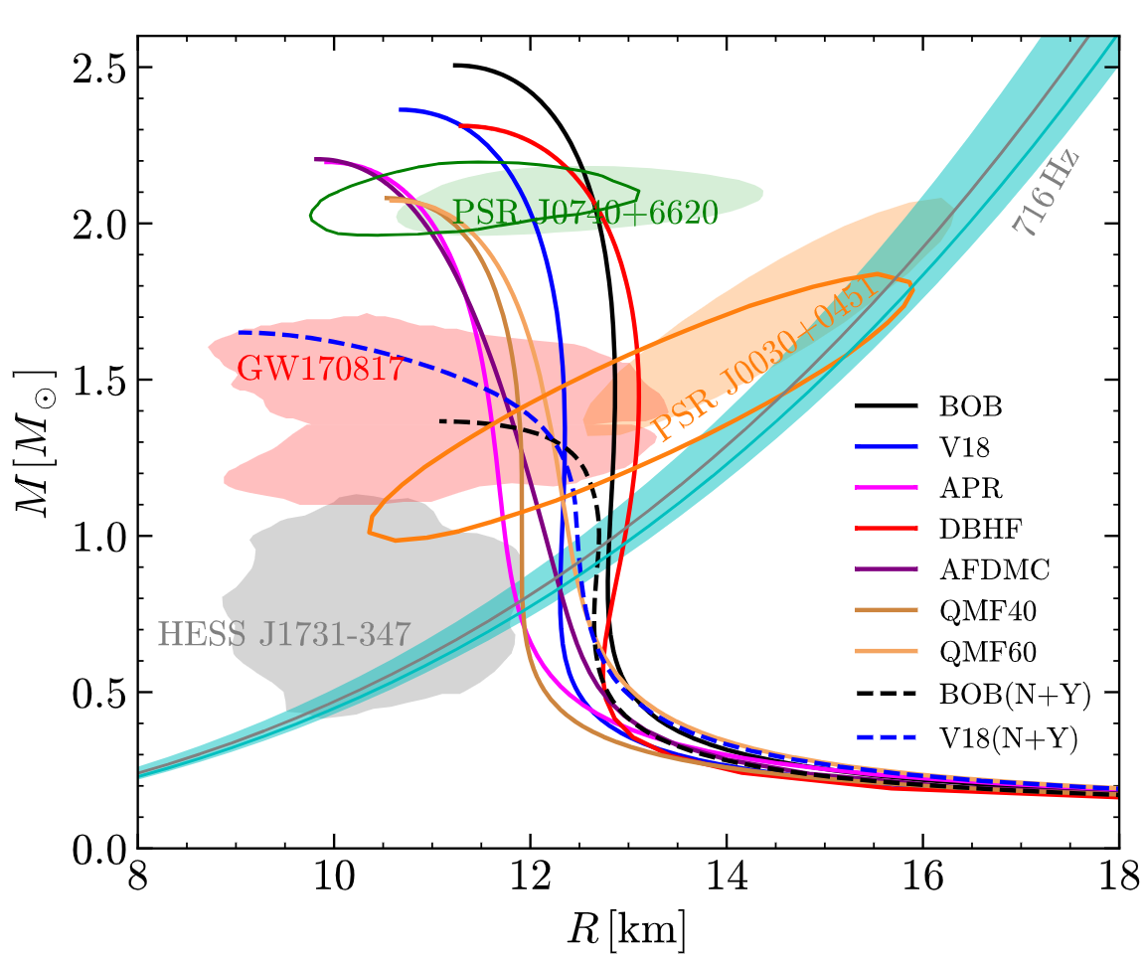
NICER view of PSR J0030+0451: MSP parameter estimation
Riley et al. 2019
Follow the propagation of light from the NS surface to the observer through the curved spacetime around the star;
XMM-Newton data can provide (indirect) NICER background constraint:
The introduction of the XMM-Newton data (EPIC MOS1 and MOS2) led to a reduction in background estimates from NICER-only data, resulting in higher compactness value:
Main difficulty lies in the degeneracy between MANY parameters it employs: (in addition to M, R)
source D; H column density, parameters needed to describe the surface T map, angles encoding the orientation of this map with respect to the rotational axis and the observer’s LOS;
+XMM data
Significant uncertainties in M,R estimate may be from low counts in the detected lightcurve or noisy data can lead to degeneracies between the model parameters or multi-modal posteriors:
X-ray telescopes with large effective area, high energy resolution, and high time resolution in the soft X-ray band, as well as adequate imaging capability to discriminate the background:
NICER (2017), EP-FXT (2024), eXTP(~2025), ATHENA(~2030), STROBE-X(~2030).
Notes:
Especially we theoreist should realize the ever-changing of the observational data, just recently, the nicer refined the analysis of their two sources, through the culaberation of other X-ray
Green band: Minimum spin period from latest pulsar surveys

Slide 13
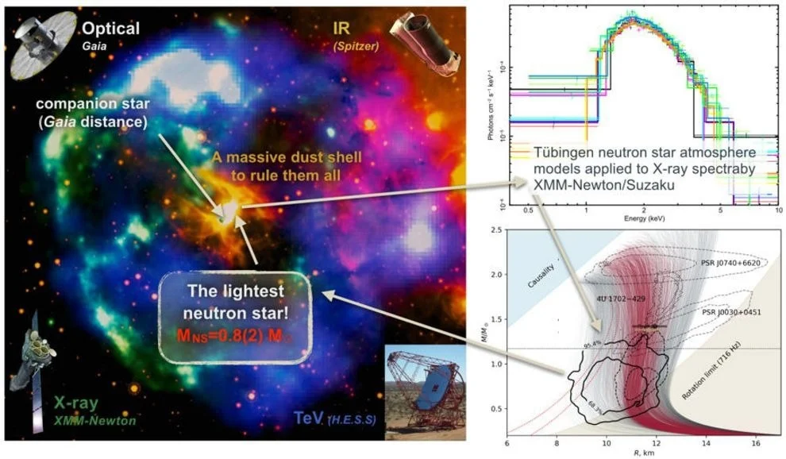
Simplicity of CCO energy spectra position them as excellent sources for studying the EOS
(Doroshenko et al. 2022)
CCOs: Radio-quiet isolated NSs emitting steady thermal x-ray; Low dipolar B fields (10¹⁰-10¹¹ T); Being discovered due to their locations at the centers of luminous shell-like SN remnants->
Energy spectra can be well-fitted with thermal emissions, even in the case of the three pulsed CCOs which exhibit non-uniform surface T;
Data from XMM-Newton + Suzaku + Gaia (reliable D estimation): Estimating the CCO’s distance based on that of the optical star in the same shell in SN remnant HESS J1731-347, available from Gaia parallax measurements.
Summary of R measurement:
somewhat/strongly model-dependent
Note: the systematics and physical assumptions behind the HESS J1731 measurements are HUGE.
√
√
Notes:
apart from the light-curve modelling,

Slide 14
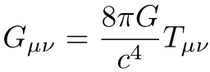
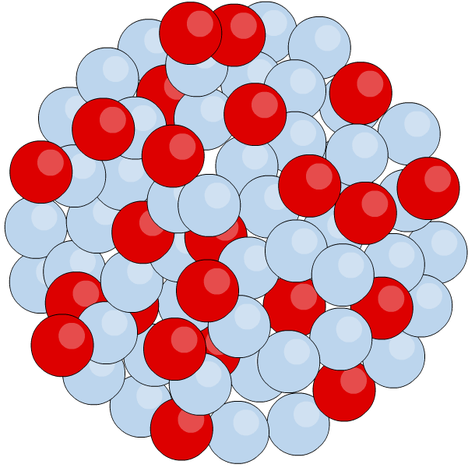
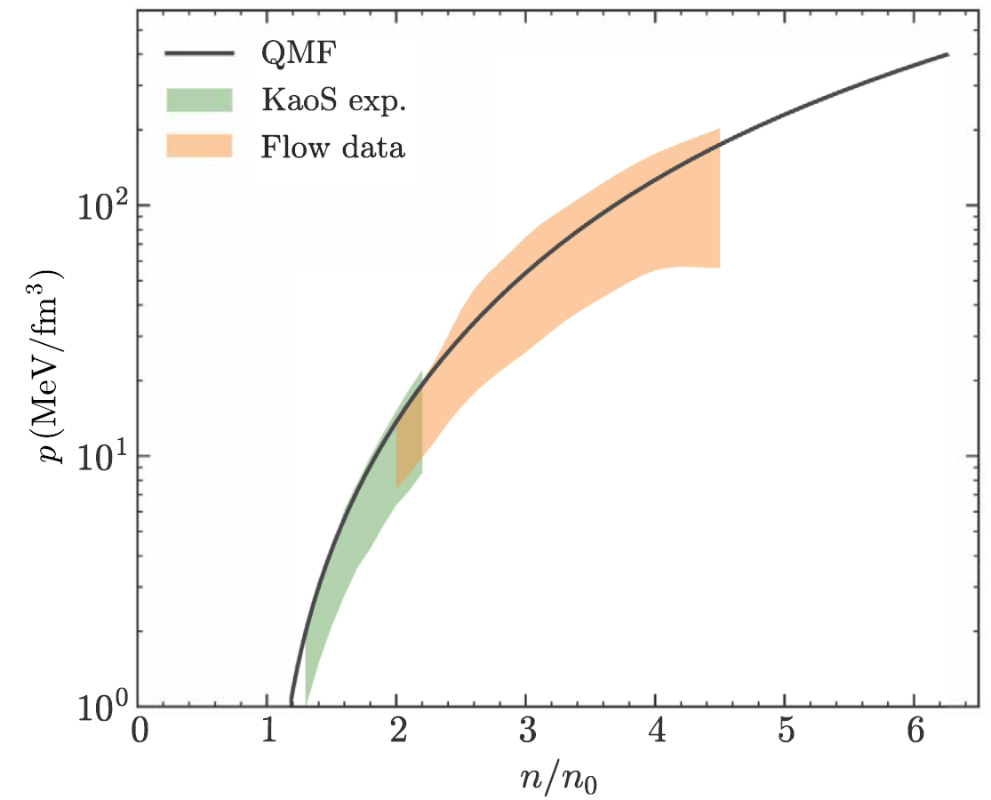
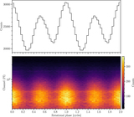
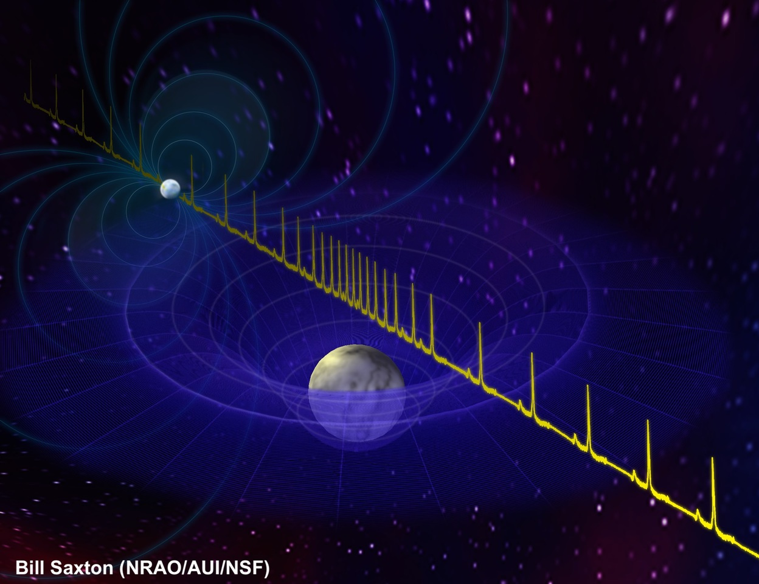
Neutron star EOS: Roadmap
3. EOS inference from NS obs.
(GW, photons, neutrinos)
1. Model for interaction 2. EOS prior
pasting test
between particles
Physics on the EOS, the composition and the underlying strong interaction
Notes:
This the runtine for modelling a EOS, first, then, if,.
For example, in the language of quantum field theory,
the NN interaction is describled by meson-exchange,
the meson coupling paramters are fitted to reproduce the nuclear matter properties around nuclear normal density or nuclear saturation density rho_0,
Currently, other nuclear matter properties are relatively well-determined, except the nuclear symmetry energy,
It represents EOS contribution from isospin-asymmetry part,
And the uncertain nuclear symmetry energy around 𝜌0 dominates EOS ambiguity and stiffness in the case without strangeness.

Slide 15
Black box = EOS microphysics
Procedure used until now
Piecewise polytrope EOS: Logarithm of the adiabatic index (𝜞) of the EOSs are treated as polynomial: Little to no microphysics;
Better procedure
More physics at the EOS modelling stage;
Support quantitative studies of the EoS at different density regimes;
With prior explicitly considering phase transition;
Allow for straightforward extensions to higher-dimensional models, accommodating the inclusion of additional particles within NSs, even dark matter;
Can discuss the composition of matter and the underlying strong interaction;
Facilitate a connection with the ongoing research efforts in the field of relativistic HIC.
NUCL ASTRO
Notes:
but the analysis of tidal deformality use only polytrope eos
and if later the phase transition is included in the prior, one expects the star properties would be less constrained.
There are already several papers discuss the tidal deformability with strangeness phase transition, including ours.

Slide 16
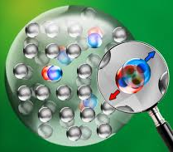
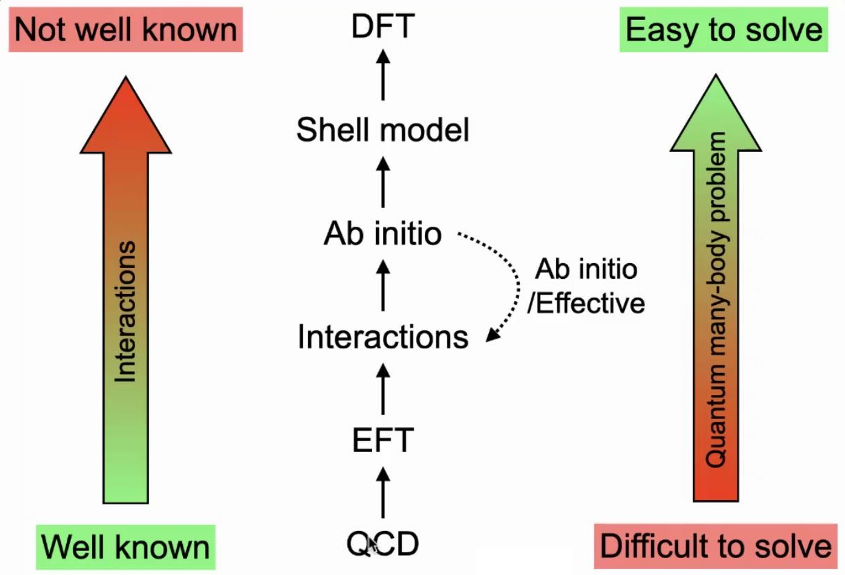
Context: the many-body problem
A ~ 10⁵⁷
Summary of available methods:
micro
Green’s Function Monte Carlo
Chiral Perturbation Theory (𝟀PT)
Variational Many-Body (VMB)
Nambu-Jona-Lasinio (NJL)
Dyson–Schwinger (DS) equations
(Dirac-) Brueckner-Hartree-Fock (BHF)
…
(Beyond) relativistic mean-field (RMF)
Skyrme energy density functional
...
pheno
Particle interactions are inadequate
Theories of multi-body problem are still incomplete
Notes:
While establishing a direct connection between QCD and NS EoS remains challenging, a pragmatic approach is necessary to translate NS observations into EOS microphysics.

Slide 17
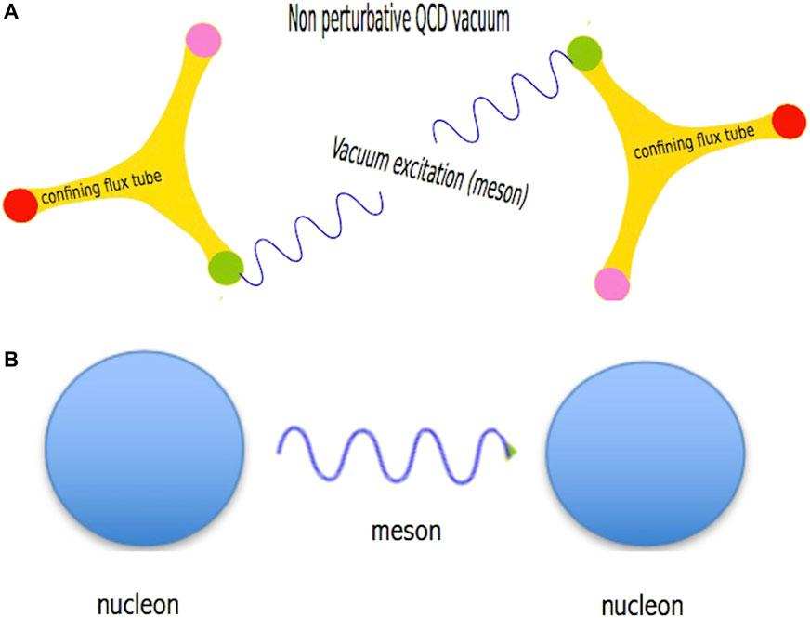
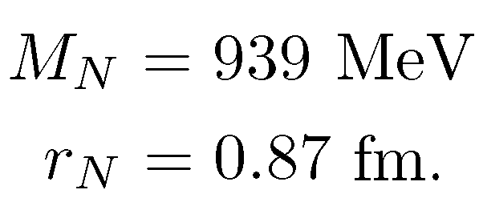
Prepare priors for a set of EOS parameters
Step 1: Dirac equation for the quark inside nucleon;
Step 2: Effective Lagrangian for nucleon many-body system (N + σ,ω,ρ):
Parameter fixing
Parameter
fixing
Notes:
QMF stands for quark mean field
We newly constructed a set of EOS only different in the L parameter, and in the same time agree all laboratory nuclear experiments.

Slide 18
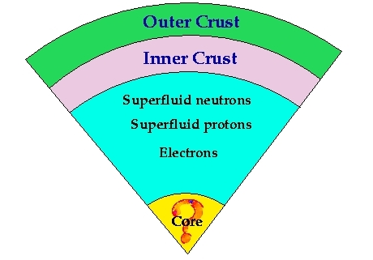
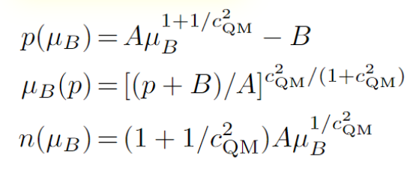
Span uncertainty in EOS at supranuclear density
(n_{trans}, 𝚫Ɛ, c_{QM})
Esym0, L₀,...
Unified EOS
nonuniform nuclear matter
Esym(n)
Assuming
considerable hadron-quark interface tension
uniform nuclear matter
(E/A, K₀,...n₀)
quark matter
full parameter space rom 1/sqrt(3) (the conformal limit in perturbative QCD matter) to 1 (the causal limit)
Notes:
considerable hadron-quark interface tension

Slide 19
Span uncertainty in EOS at supranuclear density
(n_{trans}, 𝚫Ɛ, c_{QM})
~1-10 𝜌₀
Esym0, L₀,...
𝟀PT
😍
Esym(n)
(E/A, K₀,...n₀)
full parameter space rom 1/sqrt(3) (the conformal limit in perturbative QCD matter) to 1 (the causal limit)

Slide 20
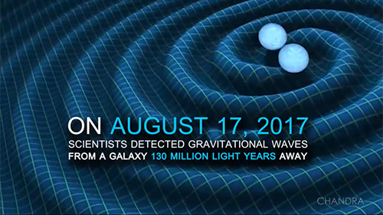
Perform Bayesian inference to find the golden EOS!
Likelihood
Inspiral
waveform depending on 17(4) parameters
Kernel density estimation
Data:
GW event of GW170817(+GW190425) & kilonova light curve of AT2017gfo,
NICER⁢⁢⨉XMM-Newton’s measurement of mass and radius of 2 PSRs,
(Mocked) SKA’s moment of inertia measurement on PSR J0737-3039,
Neutron-skin from PREX-II, CREX and the ab initio predictions on ²⁰⁸Pb, ⁴⁸Ca;
Software:
Bilby (Ashton et al. 2019, version 0.5.5, https://git.ligo.org/lscsoft/bilby/),
PyMultiNest (Buchner 2016, version 2.6, https://github. com/JohannesBuchner/PyMultiNest),
Toast (Hernandez Vivanco et al. 2020, https://git.ligo.org/francisco.hernandez/toast),
Corner (Foreman-Mackey 2016, https://github.com/dfm/corner.py)

Slide 21
Constraint on the pressure at densities ∼1-3n₀ effectively tightened
P2n0
(N³LO)
w.o. XMM-Newton data
Plus HESS data: Enlargement of the EOS parameter space.

Slide 22
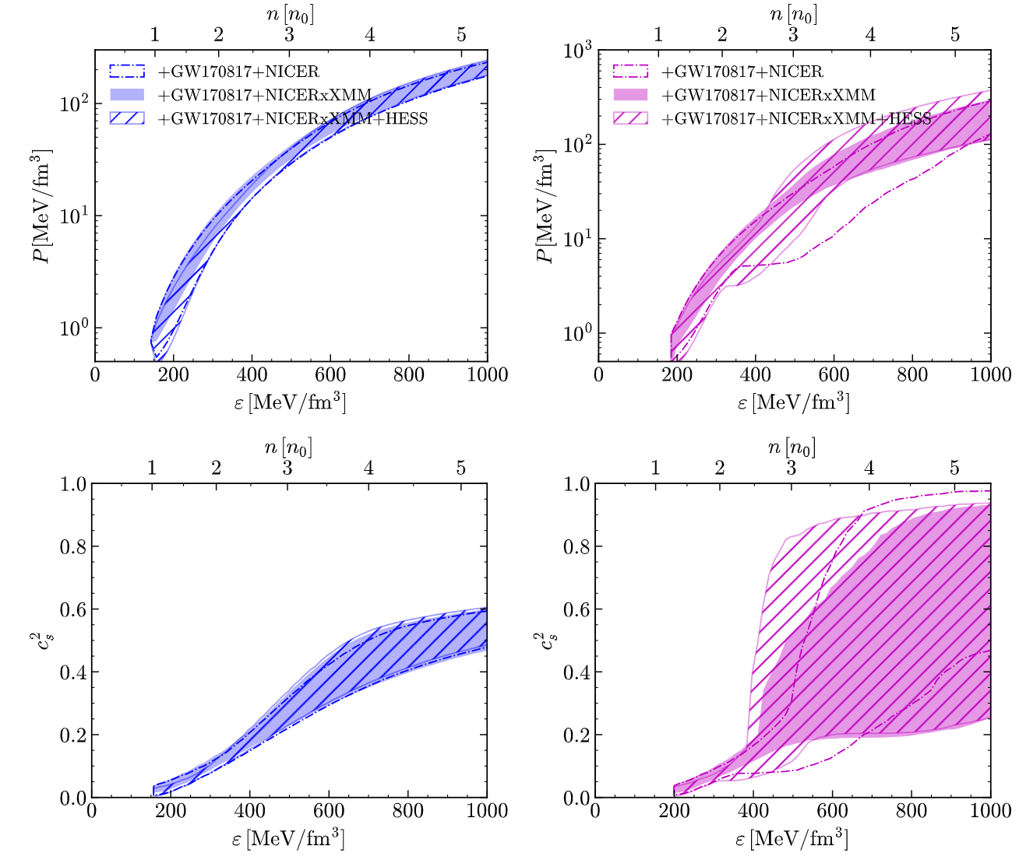
Neutron stars vs. Hybrid stars
1σ credible intervals of HSs are much larger than those of pure NSs;
Similar results for R_{1.4} (~12 km) are found for both pure NSs and HSs;
Refined constraints expected on uncertain nuclear matter properties like L₀…
Notes:
The updated radius measurements, incorporating XMM-Newton data, enhance the precision of the EoS inference by tightening the constraint on the pressure at densities around ∼1-2n₀ (∼1-5 n₀) for NSs (HSs);

Slide 23
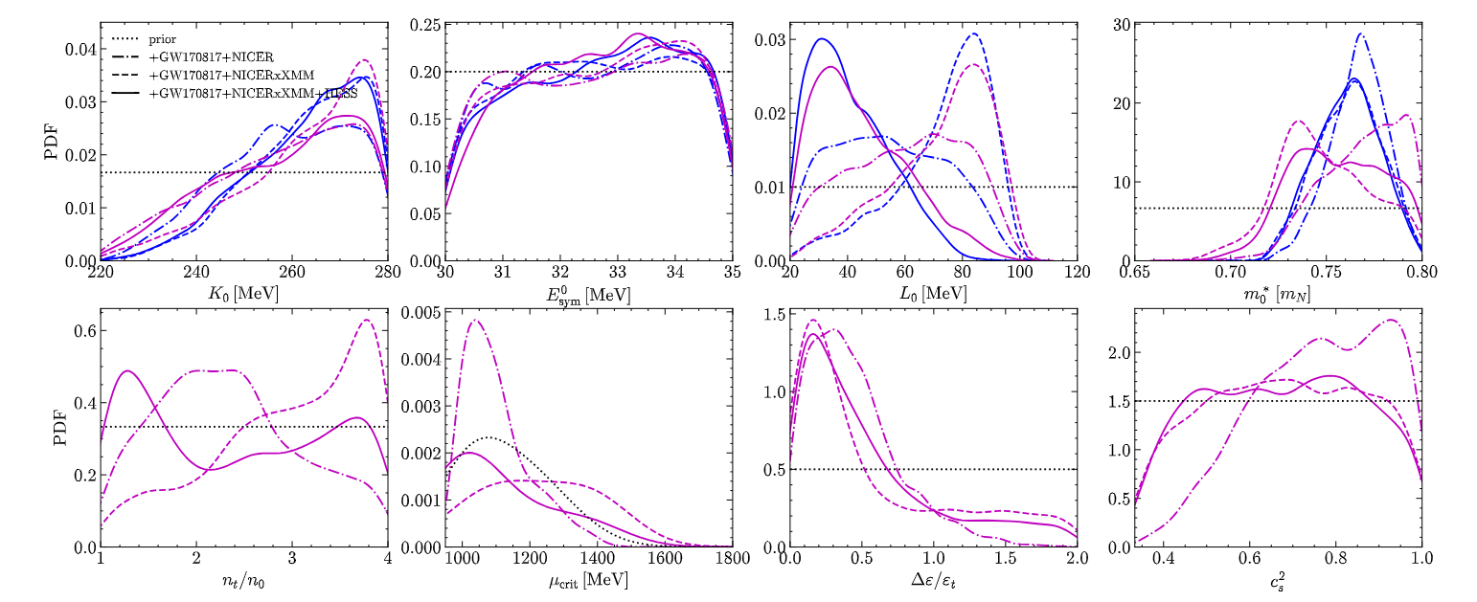
Results on nuclear matter parameters and the phase transition:
GW + X-ray (NICER⨉XMM+ HESS)
K0 is more sensitive to XMM-Newton data
L0 is more sensitive to both XMM-Newton and HESS data
L₀~40 MeV
K₀, Esym0, L₀,...
n_{trans}, 𝚫Ɛ, c_{QM},...
consistent predictions;
Not well determined so far !
Notes:
Consistent predictions are obtained for the saturation properties K0,E0sym, and m∗0 for the cases with or without strangeness phase transition;
Accounting for the possibility of a phase transition, the resulting L0 is around 41.7 MeV.

Slide 24
What we learn so far
Produce self-consistent framework for EOS modeling
Check if constraints from all available constrains are fulfilled
Demonstrate the consistency between laboratory and astrophysical nuclear matter in neutron stars by considering low-density nuclear physics constraints (from ²⁰⁸Pb neutron-skin thickness) and high-density astrophysical constraints (from neutron star global properties).
Prepare priors for a set of EOS parameters, also incorporating phase transitions
Statistically establish the effective stiffness of neutron star EOS
General requirements adopted (e.g., causality) indicate the EOS is moderately stiff, with sound speed squared peaked at ~0.8c_{s}² in NS matter, not subject to the type of phase transitions.
Examine whether current data favour strong 1st-order phase transition inside NS cores
Current data compatible with both possibilities; Evidence of a phase transition strengthened for stiff hadronic EOSs (like DD2).
Confront single Λ-hypernuclei data with the neutron star observational data
With relaxation of the commonly-assumed SU(3) symmetry, the data of single Λ hypernuclei ensures a large enough scalar hyperon coupling to match the large vector hyperon coupling: No hyperon puzzle?!
Suggest possibility to distinguish neutron stars with quark stars from simultaneous measurement of the stellar radius and the moment of inertia
If the MOI is measured large for PSR J0737-3039 A, 𝐼_{𝐴}≳1.4×10⁴⁵g cm², it is most likely a quark star rather than a neutron star with or without a quark core, provided that the accuracy of the radius measurement is at least∼1 km.
Comprehensive analysis of multi-messenger, multi-wavelength data ongoing to probe the EOS at different density regimes…

Slide 25
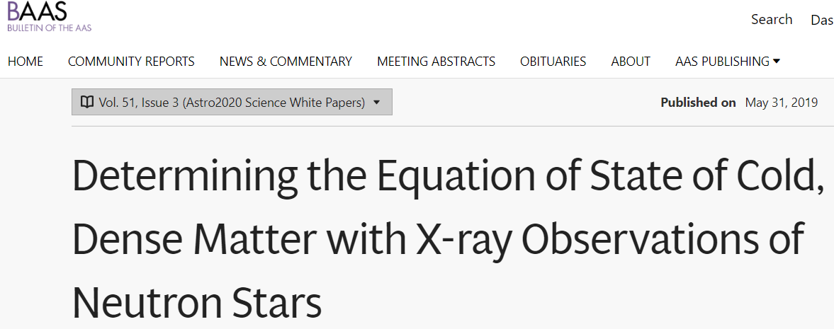
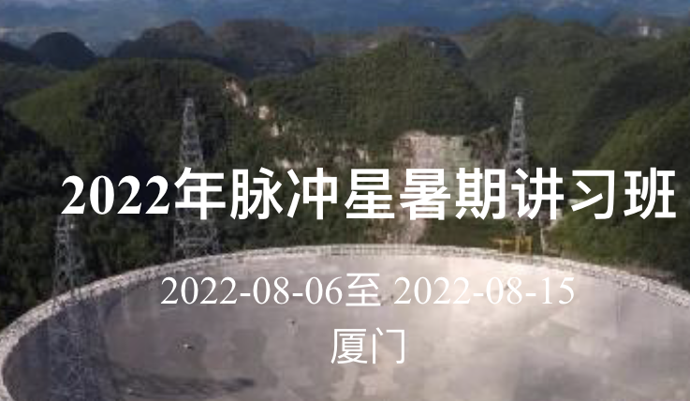
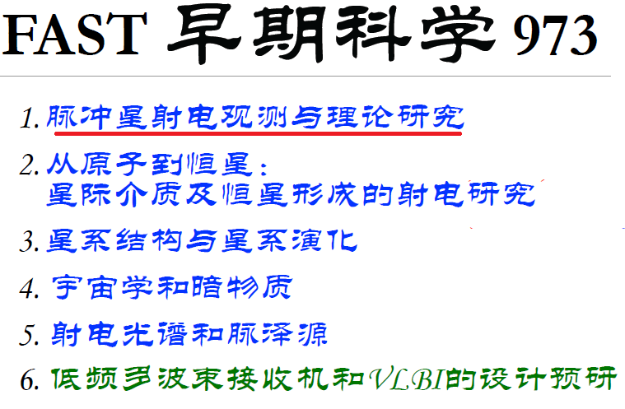
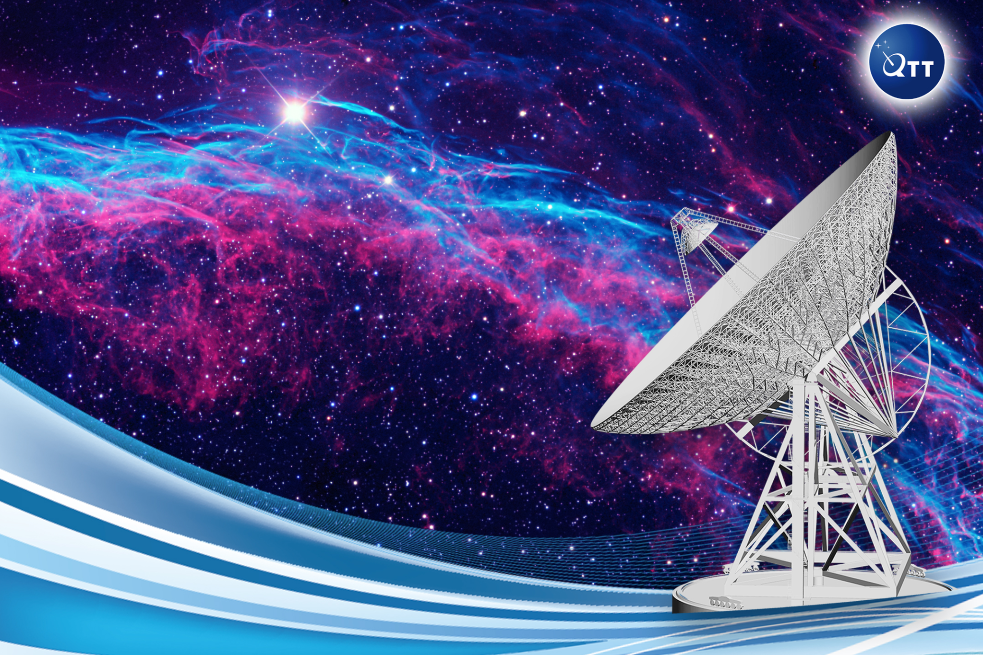
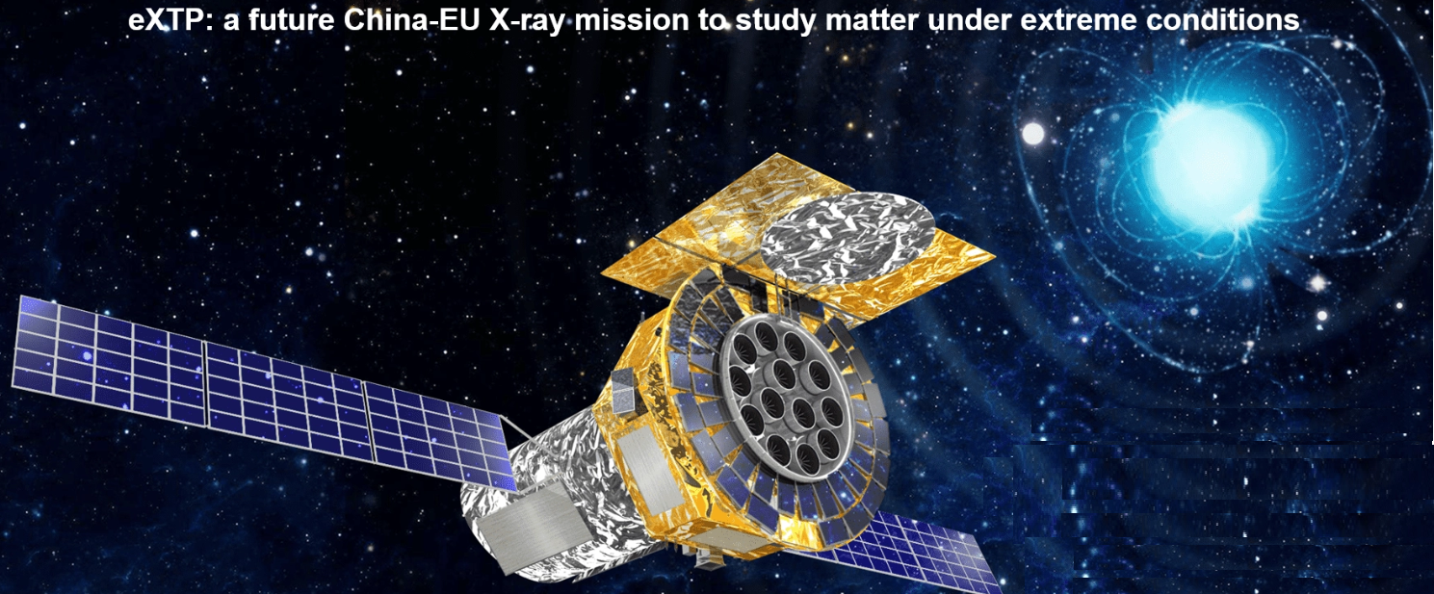
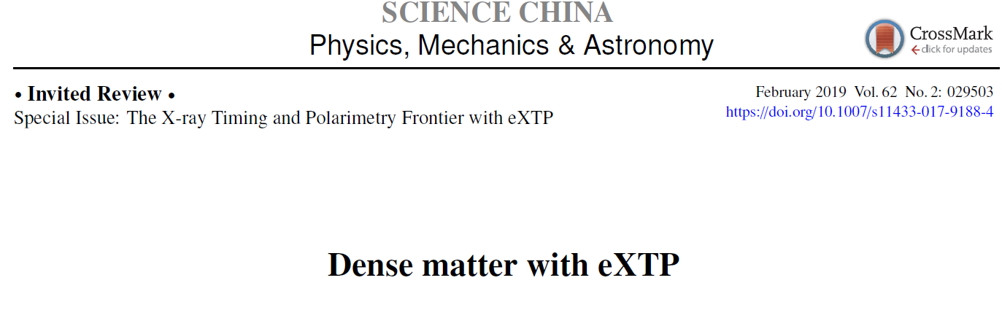
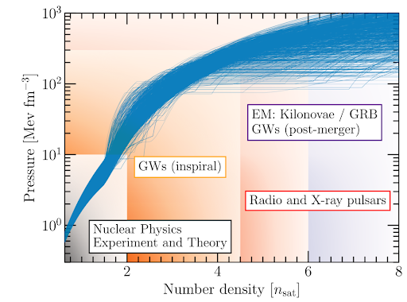
Multiwavelength & Multimessenger Era!
https://baas.aas.org/astro2020-science
https://fast.bao.ac.cn/
面向2022-2032的天文和天体物理十年规划Astro2020
世界最大的110米口径全可动射电望远镜
强流重离子加速器装置(HIAF), FRIB, RHIC, FAIR, NICA, RIKEN, ROAN, …
https://www.isdc.unige.ch/extp/
增强型X射线时变与偏振空间天文台卫星
~5-10⨉NICER
https://www.skatelescope.org/
平方公里射电阵
Thank you!
Notes:
Open the black box: To quantitatively determine neutron star EOS from connecting consistently nuclear physics and astronomy

Slide 26
RMF EOSs with 7 types of variation of the RMF effective interactions
NN potential general scheme
EOS reproducing nuclear saturation with varying stiffness
Original linear Walecka model,
Nonlinear Walecka model with 𝜎 self-interacting mesons
Nonlinear Walecka model with 𝜎, 𝜔 self-interacting mesons,
Nonlinear Walecka model with 𝜎, 𝜔 self-interacting mesons and possible mesonic cross terms,
Models in which the parameters that couple the baryons with the mesons are density-dependent,
Point-coupling models without exchanging mesons,
Models with the inclusion of 𝛿 mesons, i.e., a₀(980).
M_{max}(NS)≥2.3M⨀
Including hyperons
Dashed: w.o. Y
Solid: with Y
Notes:
before I show you the results
accounting for higher-order many-body effects
either by including nonlinear
or density dependence
we chose especially the stiff ones because
keeping consistency
with a span of

Slide 27
pQCD may impact dense matter at NS densities
even though pQCD itself is valid only at much larger densities
NSs never explore densities close to n_{pQCD}(~40n₀), they might explore chemical potentials close to μ_{pQCD}(>~2GeV);
Astrophysical NS observations favors fast rise of the chemical potential with the number density, he chemical potential may become too large to be connected to the pQCD limit;
If the number density is too low, the asymptotic pQCD limit cannot be reached in a thermodynamically consistent manner, such EoS are ruled out.
Constraints from pQCD are very sensitive to model assumptions: The density where pQCD integrals are connected plays an important role for making claims about the constraining power of pQCD.
Different renormalization scale
Fixed μ_{pQCD}
Somasundaram ,Tews & Margueron
2023 Phys. Rev. C (letter)

Slide 28
Brief summary of news from the data
核结构finite nuclei (especially neutron-rich, superheavy);
核反应collective flow/transport/meson production in HIC;
neutron star binary:
GW+短伽玛暴SGRB+千新星kilonova
PSR J0030+0451
PSR J0740+6620 (Cromartie et al. 2019)
NUCL ASTRO
(Riley et al. 2019)
(Miller et al. 2019)
(currently most massive neutron star)
GW170817 (the ‘golden’ event)
PSR J0737-3039
(Riley et al. 2021)
(Miller et al. 2021)
upcoming ~10% accuracy moment of inertia measurement
Notes:
Naturely arise
那么它们是不是可以在一个eos描述框架下兼容
If consistent can go ahead

Slide 29
Why is understanding the EOS important for nuclear/astrophysicists?
类型
one or two-family compact stars
质量半径关系
mass-radius relation
低质量间隙mass gap between NS and BH
脉冲星
glitch crisis
LMXB
双中子星并合binary evolution and the remnants
产生和演化
supernova and
star formation
equation of state (EOS)
mainly p(𝜺)
极限质量
the maximum mass
伽马射线暴SGRB central engine and kilonova
QCD
strangness phase transition
核对称能
symmetry energy
超子危机
hyperon interaction
hypernuclei
incompressibility
Notes:
Why we all care about the NS EOS?
becaure not only they are related to the birth and the evolution of NSs as well as the remnants. but also crucial to our understanding of the central engine of short GRBs, and the associated kilonova emission.
They are also crucial to many puzzles like the mass gap,.. and the glitch crisis.
Unfortunately, the extract EOS remains very uncertain due to the complication of the nonperturbtive QCD,
and difficult to pin down.

