Slide 1
IXPE Detection of Polarized X-rays from Magnetars & QED Vacuum Resonance
Dong Lai
Cornell University
and
T.D.Lee Institute (Shanghai)
Ref: Lai 2023 PNAS + etc
Dialogue at the Dream Field (DDF), Guizhou, May 11, 2024

Slide 2
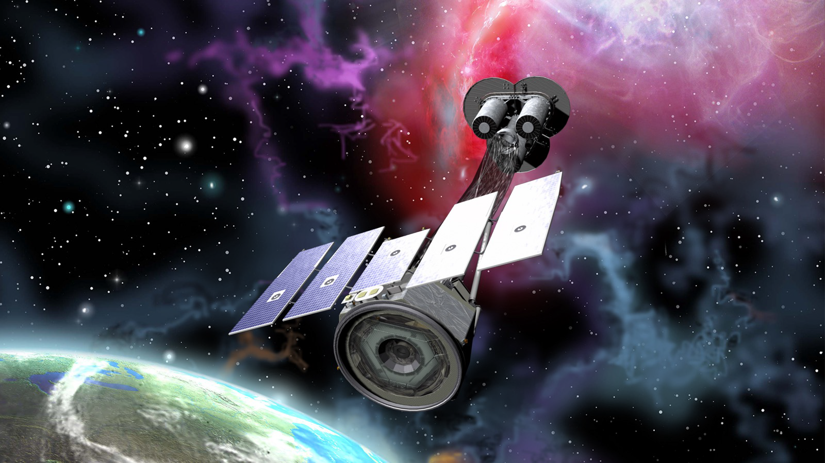
IXPE (Imaging X-ray Polarimetry Explorer):
SMEX-14, launched 12/2021
2-8 keV x-ray polarization
energy resolution 0.6 keV at 2 keV
imaging 30”

Slide 3
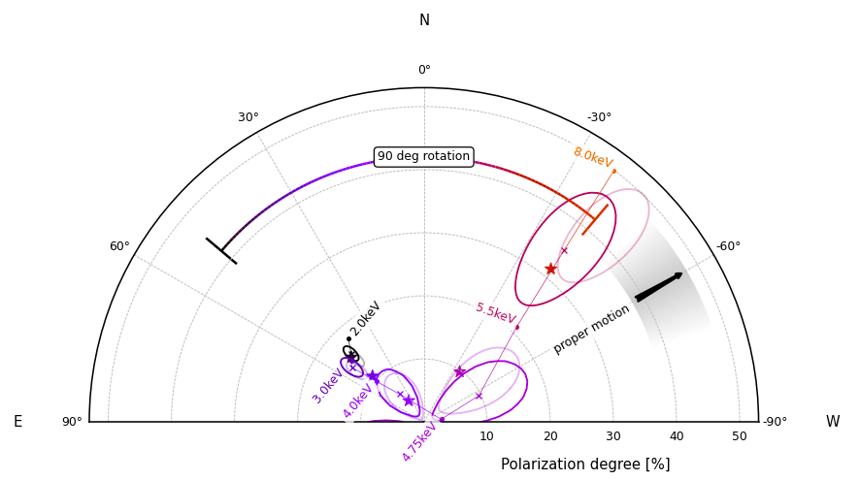
Taverna et al. 2022, Science, “Polarized X-rays from a magnetar”
AXP 4U 0142: in quiescence: P=8.7s; P, Pdot => B_{d}~10¹⁴G
T_{s} = 5 MK (+ PL or another BB)
IXPE found: Linear polarization degree =
angle: 90-degree change at 4-5 keV

Slide 4
Taverna et al. 2022, Science, “Polarized X-rays from a magnetar”
AXP 4U 0142: in quiescence: P=8.7s; P, Pdot => B_{d}~10¹⁴G
T_{s} = 5 MK (+ PL or another BB)
IXPE found: Linear polarization degree =
angle: 90-degree change at 4-5 keV
Taverna et al suggested: condensed surface of NS
Van Adelsberg, DL et al 2005
Medin & DL 2006
Not clear B is high enough and T low enough

Slide 5
Taverna et al. 2022, Science, “Polarized X-rays from a magnetar”
AXP 4U 0142: in quiescence: P=8.7s; P, Pdot => B_{d}~10¹⁴G
T_{s} = 5 MK (+ PL or another BB)
IXPE found: Linear polarization degree =
angle: 90-degree change at 4-5 keV
This talk:
A more natural explanation: QED vacuum resonance

Slide 6
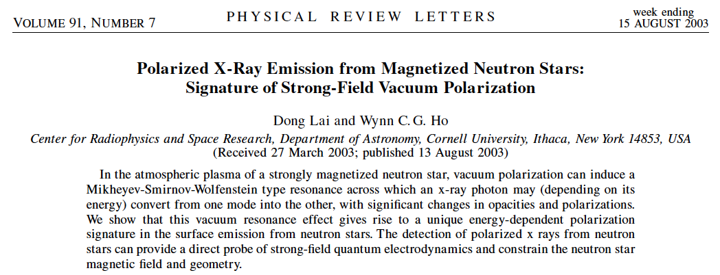
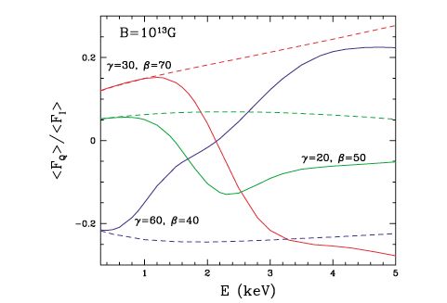
Predicted 90-degree polarization changes at ~2 keV for B< 7x10¹³G (for H atmosphere)

Slide 7
Neutron star atmosphere:
magnetized (partially ionized) plasma
Scale height:
Density: 0.1 – 100 g/cm³

Slide 8


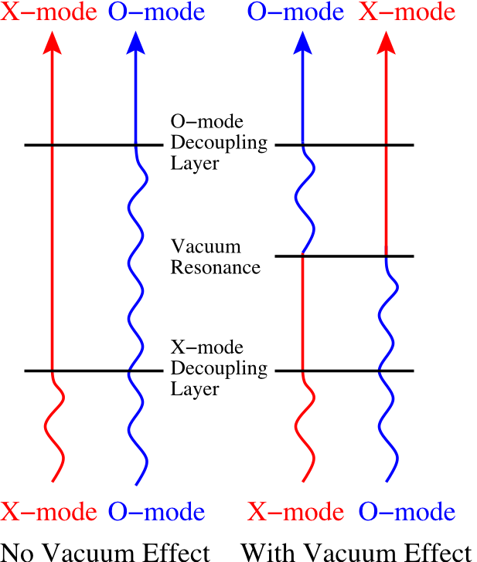
Photon Polarization Modes in a Magnetized Plasma
Dielectric tensor: ε = I + ∆ε ^{(plasma)}
For photon energy ω << ω_{ce} =1160 B₁₄ keV
Ordinary Mode (O-mode):
E nearly in the k-B plane:
k
B
Extraordinary Mode (X-mode):
E nearly ⊥ k-B plane:
The two modes have different opacities (scattering, absorption):
κ _{(O-mode)} ~ κ _{(B=0)}
κ_{(X-mode)} ~ κ _{(B=0)} (ω ⁄ω_{ce} )²
X-mode photons are the main carrier of X-ray flux
(Two photospheres)

Slide 9


QED Effect: Vacuum Polarization in Strong B
e⁺
photon
photon
Heisenberg & Euler,
Weisskopf, Schwinger,
Adler…
e⁻
Dielectric tensor: ε = I + ∆ε ^{(vac)}
∆ε ^{(vac)} ~ 10⁻⁴ (B/B_{Q})² , with B_{Q} = 4.4×10¹³G
Two photon modes in magnetized vacuum:
Ordinary mode (//)
Extraordinary mode (⊥)

Slide 10
QED Effect in NS Atmosphere
Dielectric tensor of magnetized plasma including vacuum polarization
ε = I + ∆ε ^{(plasma)} + ∆ε ^{(vac)}
where ∆ε ^{(vac)} ~ 10⁻⁴ (B/B_{Q})² , with B_{Q} = 4.4×10¹³G
Vacuum resonance:
∆ε ^{(plasma)} + ∆ε ^{(vac)} ~ 0
depends on −(ω_{p}/ω)² ∝ ρ/E²
ρ_{V} = 1.0 Y_{e}⁻¹B₁₄² (E/1 keV)² g cm⁻³

Slide 11
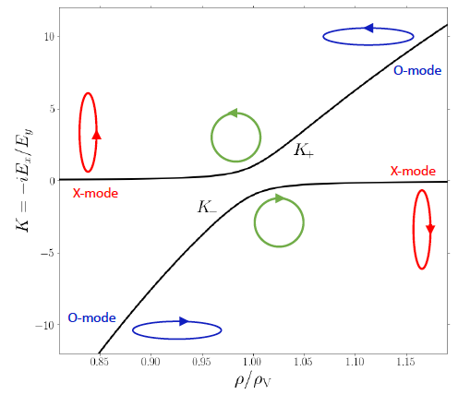
Polarization of photon modes: Plasma + QED vacuum
k
B
B=10¹⁴ G, E=5 keV, θ_{kB}=30º

Slide 12
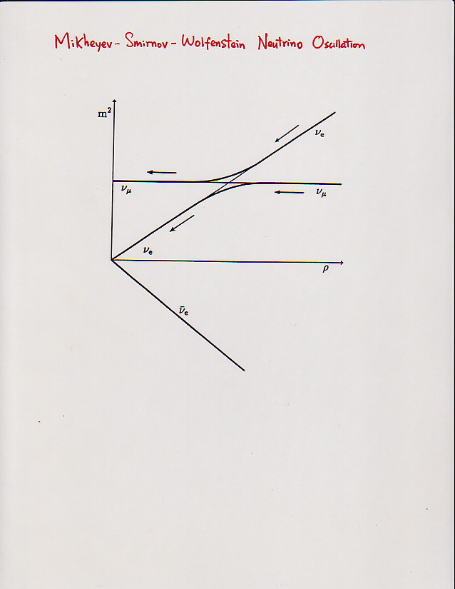
Mikheyev-Smirnov-Wolfenstein (MSW)
Neutrino Oscillation
Notes:
In the solar neutrino case, there are also two neutrino modes, these two curves resepnet theire effective mass-energy.

Slide 13
Polarization of photon modes: Plasma + QED vacuum
k
B
B=10¹⁴ G, E=5 keV, θ_{kB}=30º

Slide 14
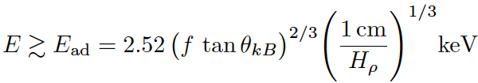


Adiabatic Condition:
⏐n₁ − n₂⏐ > ( ⋅⋅⋅ ) ⏐dρ/ds⏐
~
Photons with E > E_{ad}, mode conversion
Photons with E < E_{ad}, no mode conversion
In general, nonadiabatic “jump” probability

Slide 15
Recall
-- X-mode and O-mode have different photospheres
-- Vacuum resonance
ρ_{V} = 1.0 Y_{e}⁻¹B₁₄² (E/1 keV)² g cm⁻³

Slide 16
For B < B_{OV}=8×10¹³ (…) T₆^{-1/8} E₁^{-1/4} G:
Vacuum resonance lies outside both photospheres
Vacuum resonance
O-mode photosphere
X-mode photosphere

Slide 17
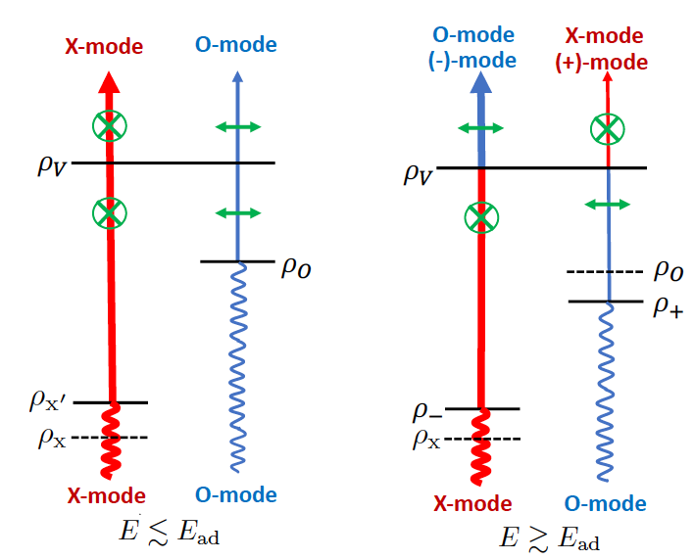
For B < B_{OV}=8×10¹³ (…) T₆^{-1/8} E₁^{-1/4} G:
Vacuum resonance lies outside both photospheres
Plane of linear polarization at < E_{ad} is perpendicular to that at > E_{ad}.

Slide 18
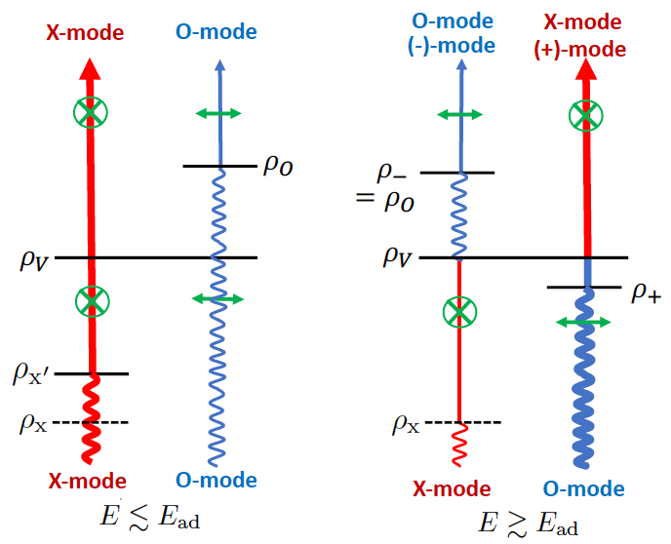
For B > B_{OV}=8×10¹³ (…) T₆^{-1/8} E₁^{-1/4} G:
Vacuum resonance lies between the two photospheres
Plane of linear polarization at different E coincide

Slide 19
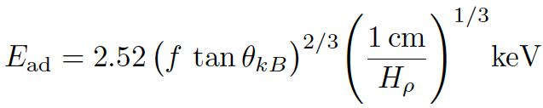
Recap:
To produce 90-degree polarization change (across E) requires
Transition energy

Slide 20
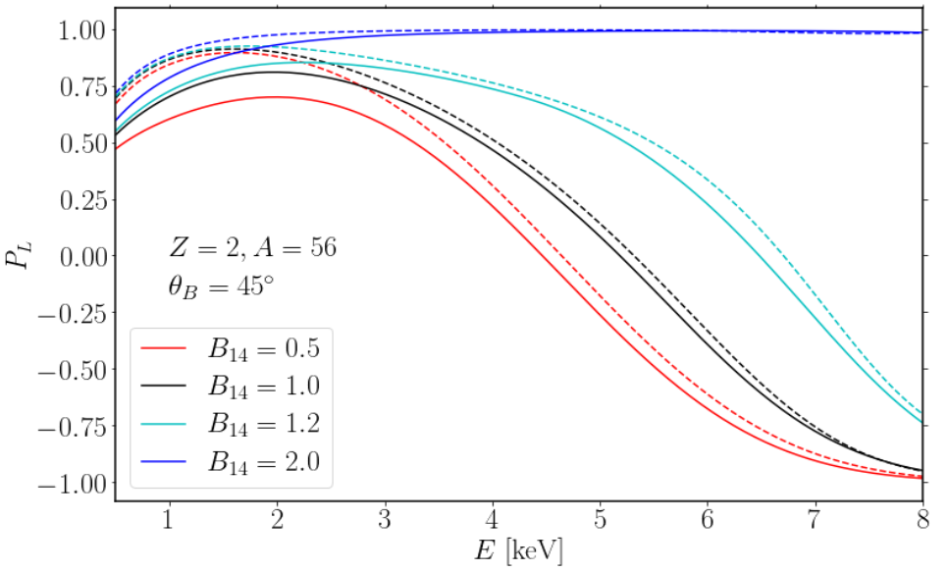
Heavy-element (partially ionized) atmosphere

Slide 21
Recap/Implications
-- The observed 90⁰ X-ray polarization change
at 4-5 keV from 4U 0142 can be “naturally”
explained by mode conversion associated
with vacuum resonance
-- Low-E emission dominated by X-mode
High-E emission dominated by O-mode
In this interpretation:
the phase-averaged low-E polarization is perpendicular
to spin axis projection in sky
➔ Spin-kick alignment
-- Requires heavy-element atmosphere
-- Surface B field should be comparable or (preferably) less (by a factor of 2) than dipole
field inferred from P, Pdot.
e.g. the puzzle of very slow “pulsars”: 76 s pulsar (Celeb+2022)
18 min periodic radio transient (Hurley-Walker+2022)
6.67 hr CCO in SNR RCW 103

Slide 22
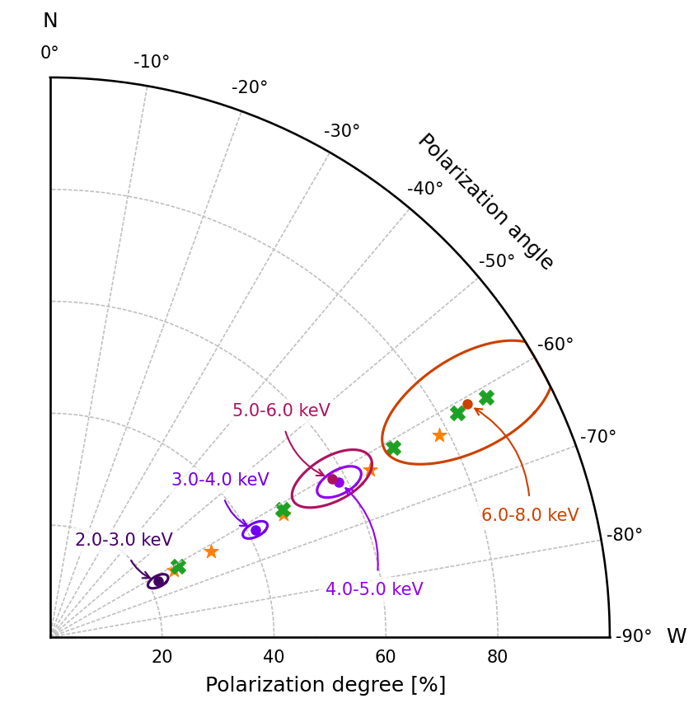
IXPE detection of magnetar 1RXS J1708
Zane et al. 2023
Linear polarization degree:
ranges from 20% at 2-3 keV
to 80% at 6-8 keV
Polarization angle:
independent of photon energy
For this magnetar:
P, Pdot ➔ B_{d}=5x10¹⁴G

Slide 23
For B > B_{OV}=8×10¹³ (…) T₆^{-1/8} E₁^{-1/4} G:
Vacuum resonance lies between the two photospheres
Plane of linear polarization at different E coincide

Slide 24
Summary
-- Physics: A photon traveling in NS atmosphere can
undergo mode conversion at “vacuum resonance”
if E a few keV (adiabatic condition)
-- For B , resonance occurs at low density
➔ Linear polarization angle changes at E ~ a few keV,
as seen in 4U 0142
-- For B , resonance occurs at high density
➔ Linear polarization angle independent of energy
as seen in 1RXS J1708
Caveats: Non-thermal ”contamination” at high energy?
What do we learn from soft x-ray polarization of magnetic NSs?
-- Surface environment of the NS: B field (not just dipole field), composition
-- Geometry: Magnetic field, spin, line-of-sight (e.g. spin-kick)
Future mission eXTP…

Slide 26
Propagation of Polarization from NS Surface to Observer
Through Magnetized Vacuum
polarization limiting radius >> R
Polarization states of photons from
different patches of the star are
aligned at large r, and (largely)
do not cancel --- Thanks to QED!

Slide 27
Propagation of Polarization from NS Surface to Observer
Through Magnetized Vacuum
Polarization states of photons from
most region of the NS surface are
aligned at large r, and do not cancel
--- Thanks to QED!
===>
Observed polarization direction
depends only on the dipole
component of the field, regardless
of surface field structure.
(Recall: Intensity light curves
depend on surface field structure)
Notes:
Now let’s consider the propagation of the radiation from the surface to the observer in this magnetized vacuum.
Let’s say we have radiation from a given patch on the star, and it is dominated by X-mode (perp. To the local B).
Now imagine yourself sit on that photon and ride with that photon along the geodesics.
Then you are going to see a changing B field (both magntide and direction). You ask youself how is the
Polarization state going evolve?
Well, if the variation of B is sufficiently slow, you are going to evolve adiabatically, I.e., you will always
Be in the X-mode, I.e., you will be perp. To the local B field. So a the B changes, the plane of polarization will
Change with it. This will continue until you reach the point where the adiabtic condition is no longer
Valid (bewcause the B field is too small). At that point the polarizatoin will be frozen and that will be
The observed polarization. The point is that the polarizatob limiting radius is much large than R…

Slide 28
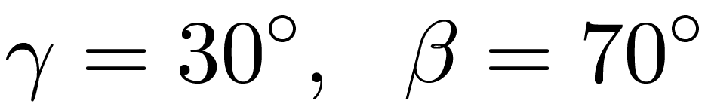
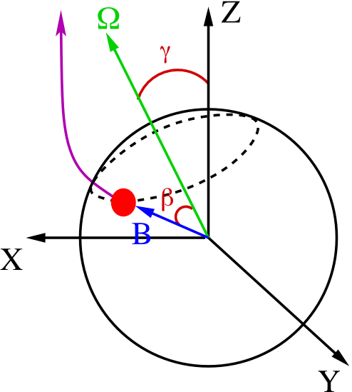
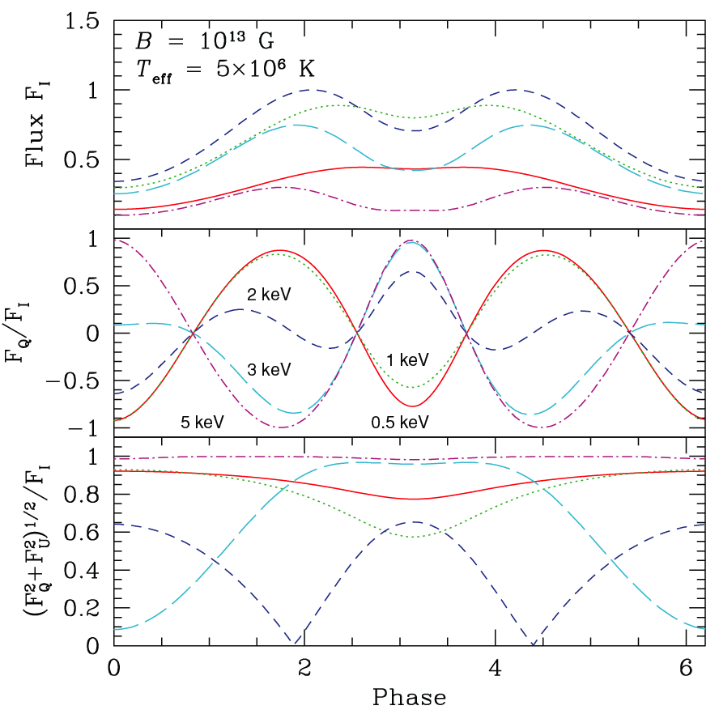
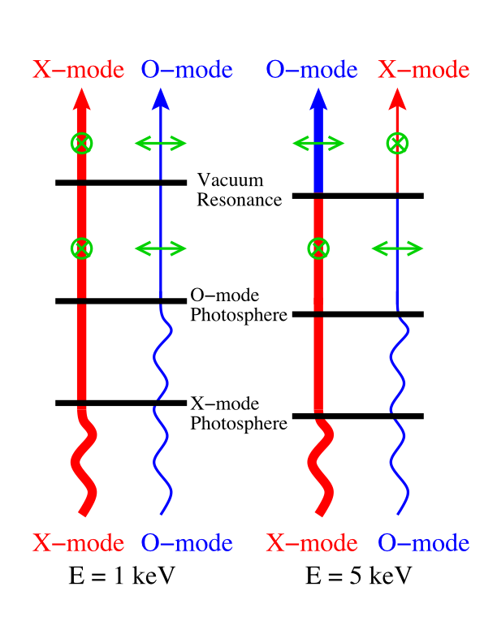
B=10¹³G
Van Adelsberg & DL 2006 (also DL & Ho 2003)
Plane of linear polarization at <1 keV is perpendicular to that at >4 keV.

Slide 29
After phase-averaging:

Slide 30
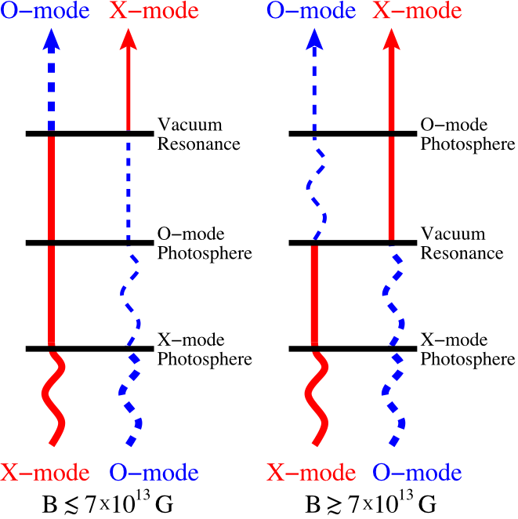
Recapitulation: Effect of Vacuum Resonance on Surface Emission
For B<7×10¹³G (ρ_{vac} < ρ_{o-mode} < ρ_{x-mode})
Negligible effect on spectrum
(spectral line possible: already observed?)
Dramatic effect on X-ray polarization signals
(plane of linear polarization depends E)
--- A “clean” QED signature
For B>7×10¹³ G (ρ_{o-mode} < ρ_{vac} < ρ_{x-mode})
Dramatic effect on spectrum
(suppress absorption lines, soften hard
tails: observations of magnetars)
Polarization signals affected by QED:
plane of linear polarization coincides for
different E

